Slide 1
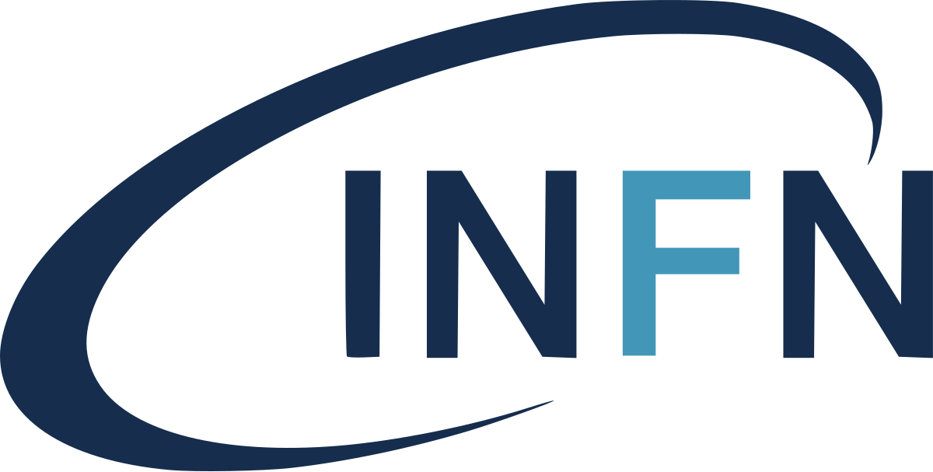
Facilitating the distribution of software by using CernVM File System and S3 bucket
Giada Malatesta giada.malatesta@cnaf.infn.it
Francesca Del Corso francesca.delcorso@pg.infn.it
Alessandro Costantini alessandro.costantini@cnaf.infn.it
Daniele Spiga Daniele.Spiga@pg.infn.it
Massimo Sgaravatto massimo.sgaravatto@pd.infn.it
Sergio Traldi sergio.traldi@pd.infn.it
Taipei, 28/03/2024
International Symposium on Grids and Cloud

Slide 2
Outline
Context
The INFN DataCloud project
Software Management Service
The software distribution challenge
The Software Management @DataCloud solution
Workflow overview
Adopted technologies
Implementation and user perspectives
Conclusions
Summary

Slide 3
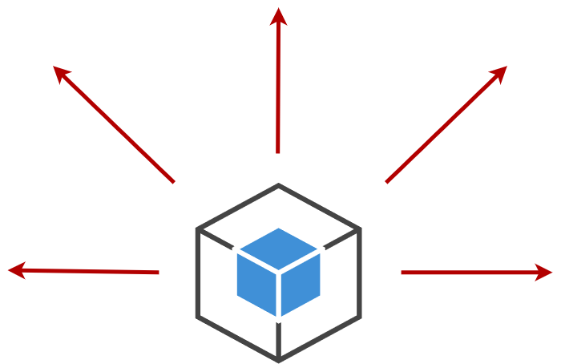
Context

Slide 4
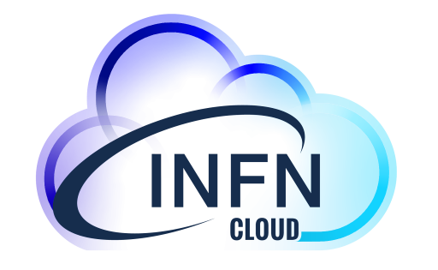
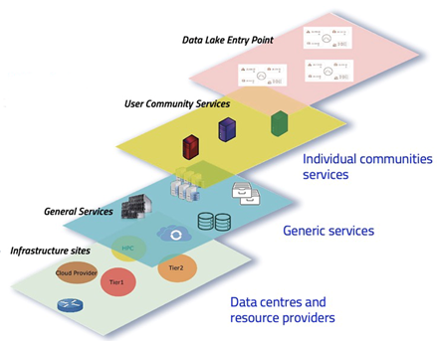
The INFN DataCloud project
The DataCloud Project manages all core activities related to computing@INFN and its projects
Development, implementation & management of the INFN Datalake architecture
Development of ISO-Certified solutions mainly for clinical and omics data management
Support to users and to the management and operation of all INFN sites (both Grid and Cloud paradigms)
Development of new services
Focus on Integration of resources, methods, people, solutions.
Modular architecture based on service composition.
The INFN foundation of all the NRRP computing-related initiatives.

Slide 5
Software distribution challenge

Slide 6
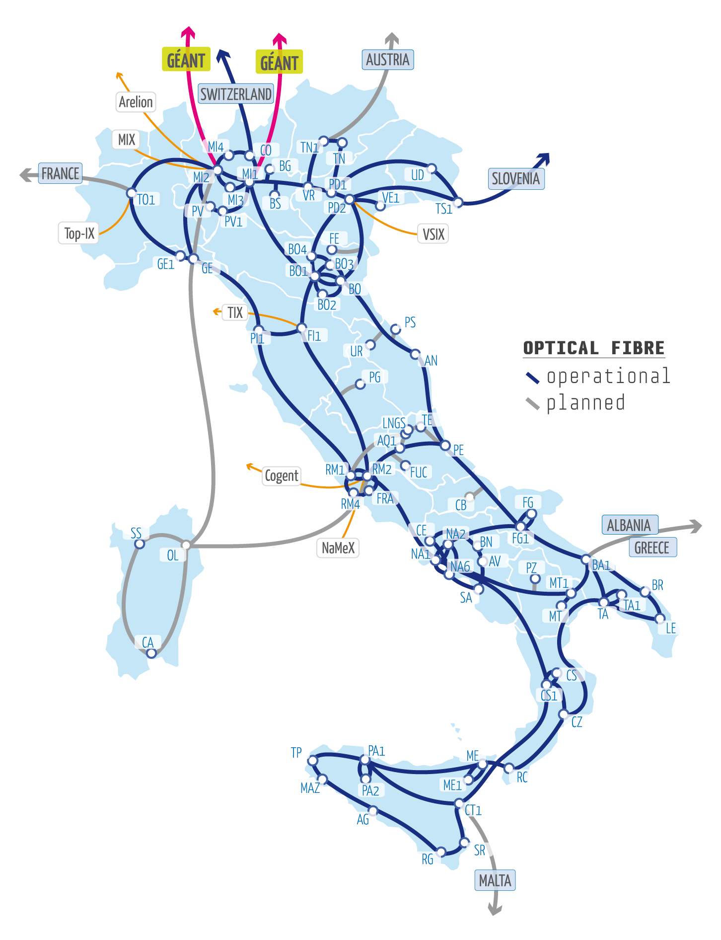
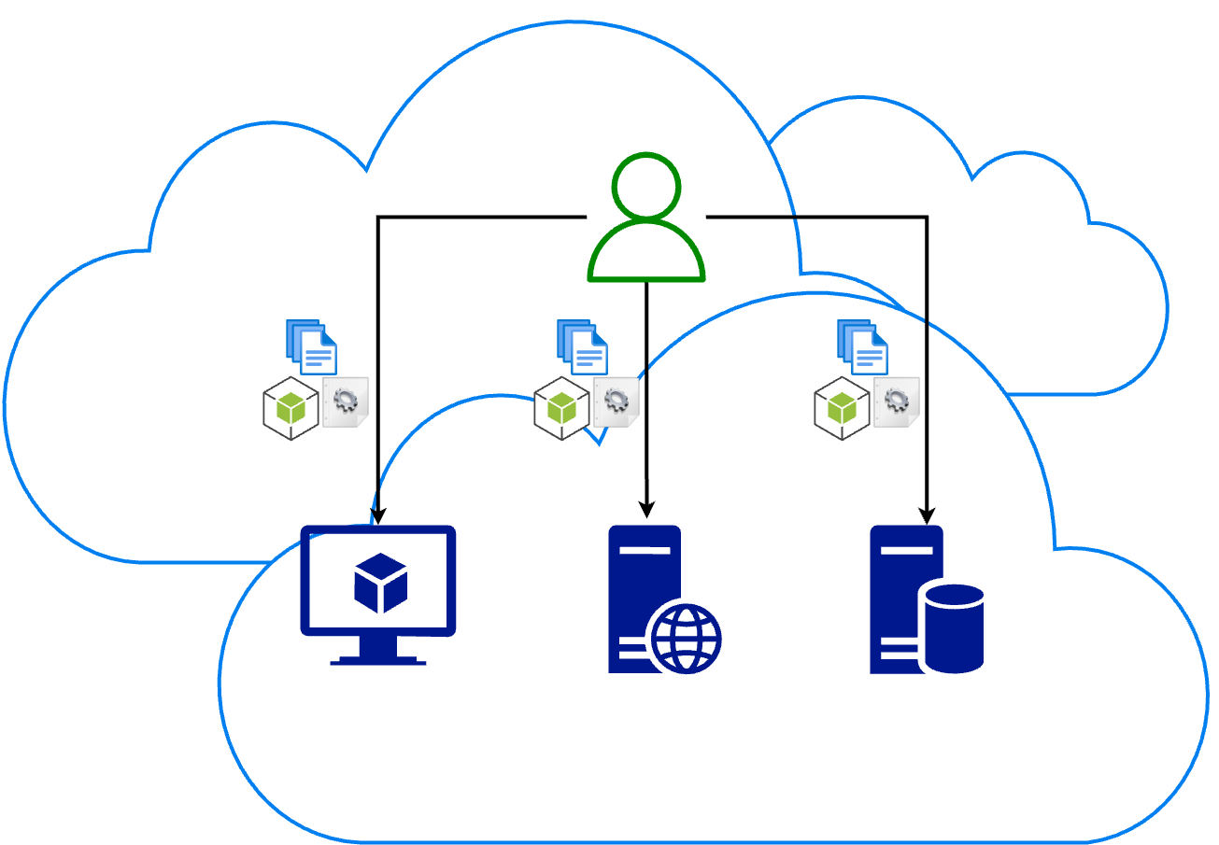
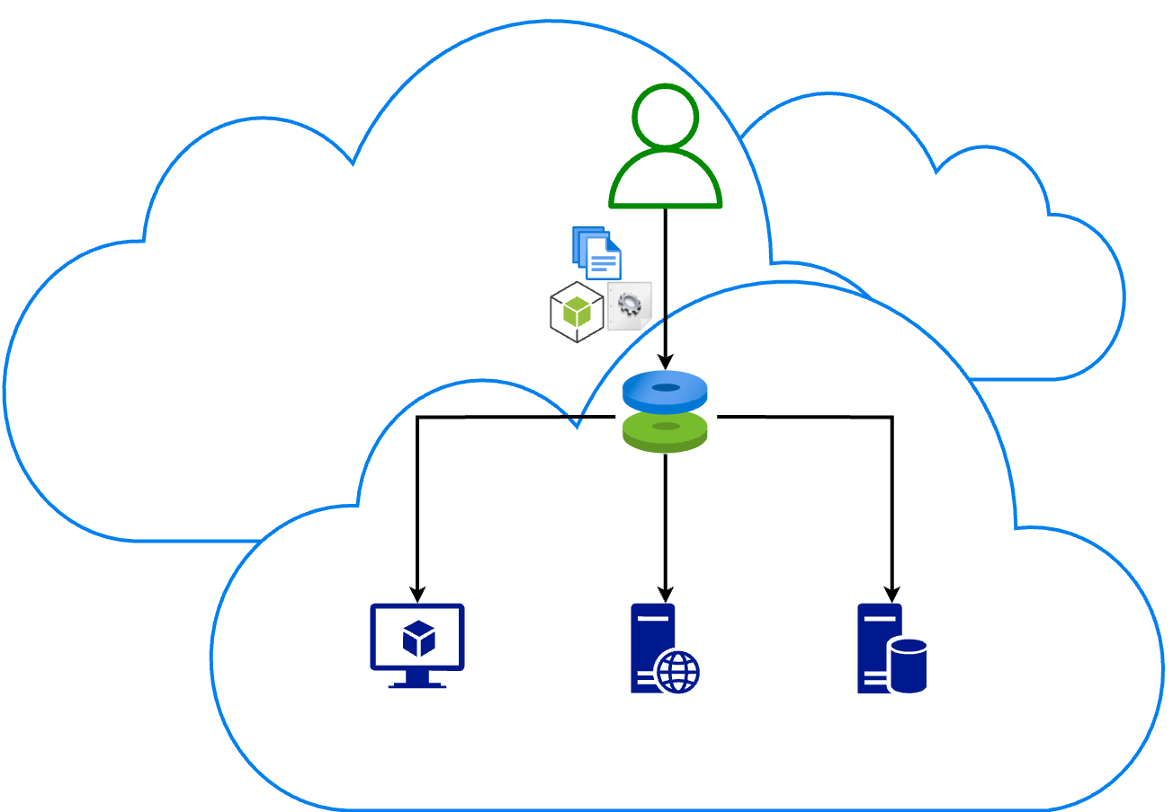
User software distribution: the challenge
In a distributed and heterogeneous environment the sharing of software, libraries and configurations in an effective, user-friendly and transparent way can be challenging.
There are already low-level solutions that address this challenge.
Our aim is to further simplify the adoption of a well established technologies such as Cern-VM File System (CVMFS) in a highly multidisciplinary environments.

Slide 7
Software Management solution

Slide 8
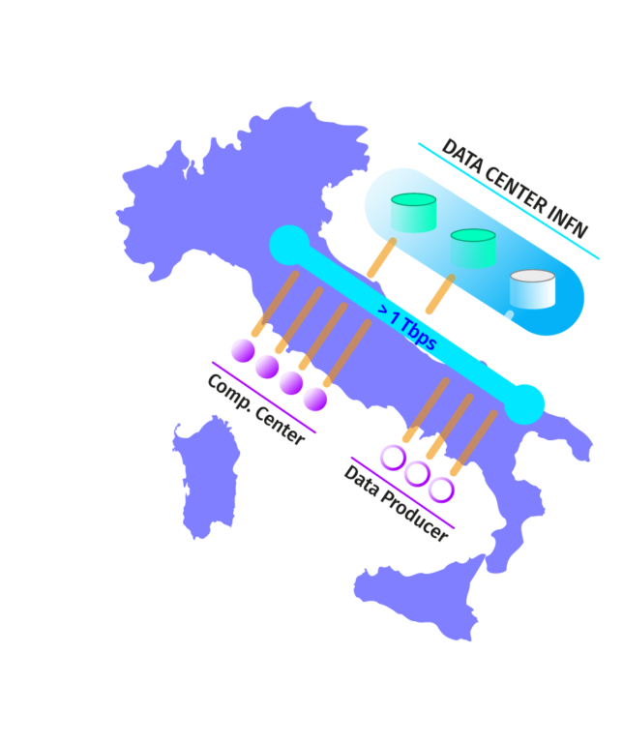
Software Management @DataCloud: the strategy
In order to cope with the challenge in a Cloud infrastructure, such as our DataCloud, we implemented a Software Management service.
We build on top of a well established technology known as CernVM File System (CVMFS).
Abstraction: what the project adds, is to avoid to know any technical details about CVMFS mechanisms providing abstractions in order to let the user accessing the repository in a simple and completely transparent way.
Automation: in other words we enable the possibility to copy software, libraries and related dependencies, small files, configuration files etc in S3 cloud storage and that's it.

Slide 9
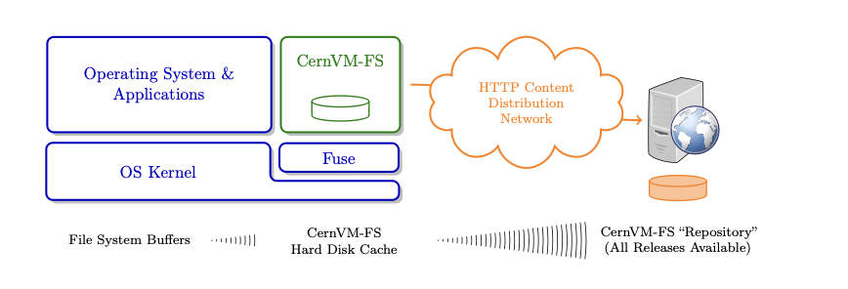
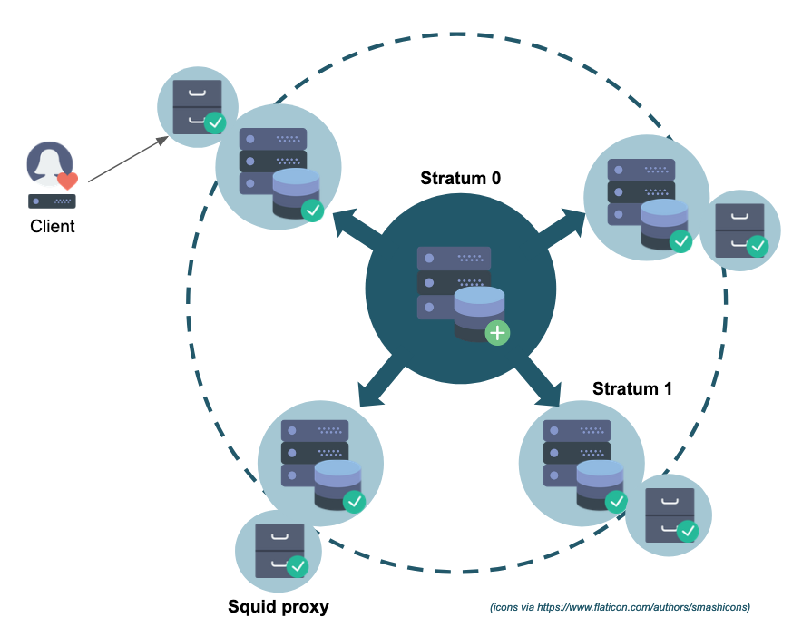
It’s an open-source, usable and customizable software distribution service.
It’s a network file system implemented as a POSIX read-only file system.
Files and directories are hosted on standard web servers and mounted in the universal namespace /cvmfs.
It uses standard HTTP transport, avoiding most of the firewall issues.
It is a read-only files system for those who access it, only the admin is able to modify its content.

Slide 10
Workflow overview

Slide 11
Workflow overview
The user requests a CVMFS repository (personal or group) via the INFN Cloud dashboard.
The request is send to RabbitMQ and is elaborated in order to create the repository.
Once created, the relative keys are published in a Vault system.
The user accesses the S3 object storage space and creates a bucket (personal or group).
He uploads what he want to distribute in a specific area of the bucket named cvmfs.
The S3 bucket service system sends a message to RabbitMQ so that the system get notified and can synchronize the content of the correspondent CVMFS repository.
At this point, the user can access the CVMFS client in read mode to the distributed software.
The user can populate his repository by installing a CVMFS publisher by using his repository keys.

Slide 12
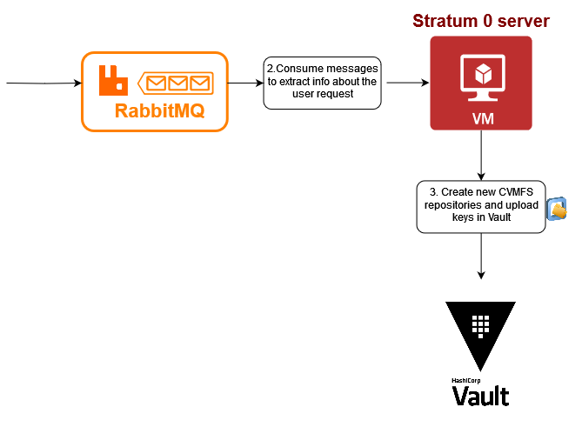
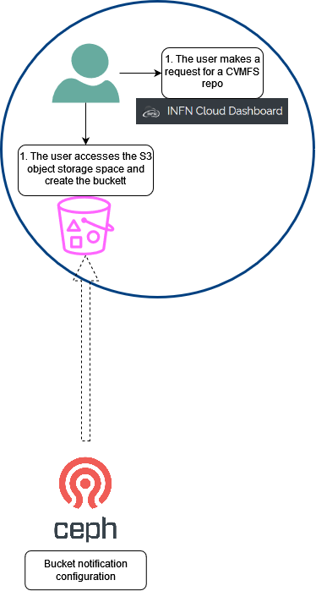
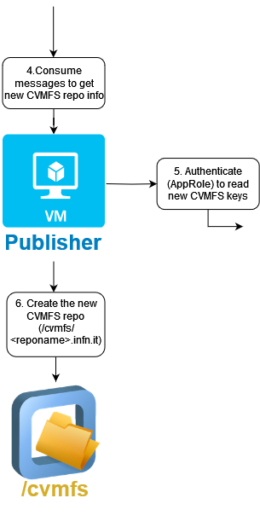
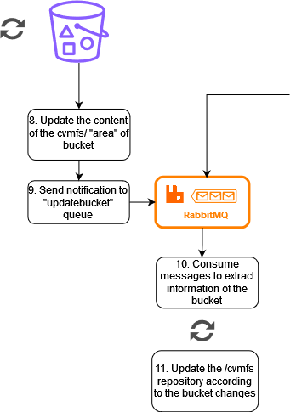
Workflow overview

Slide 13
Adopted technologies

Slide 14
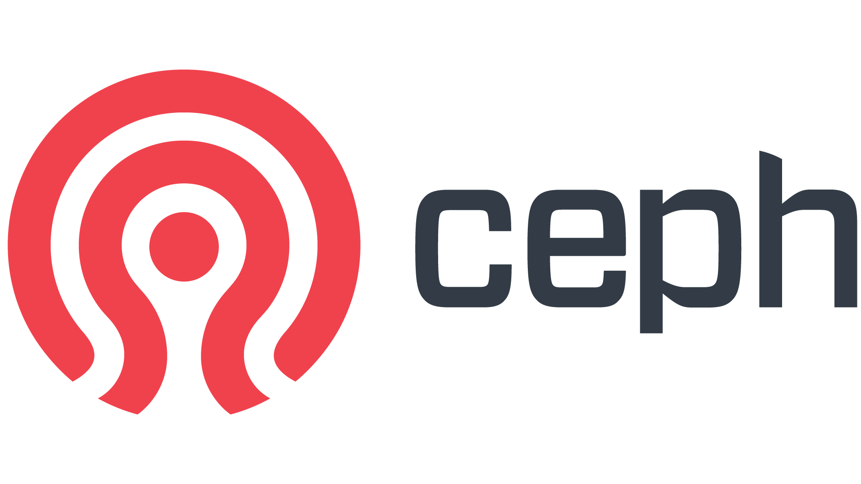
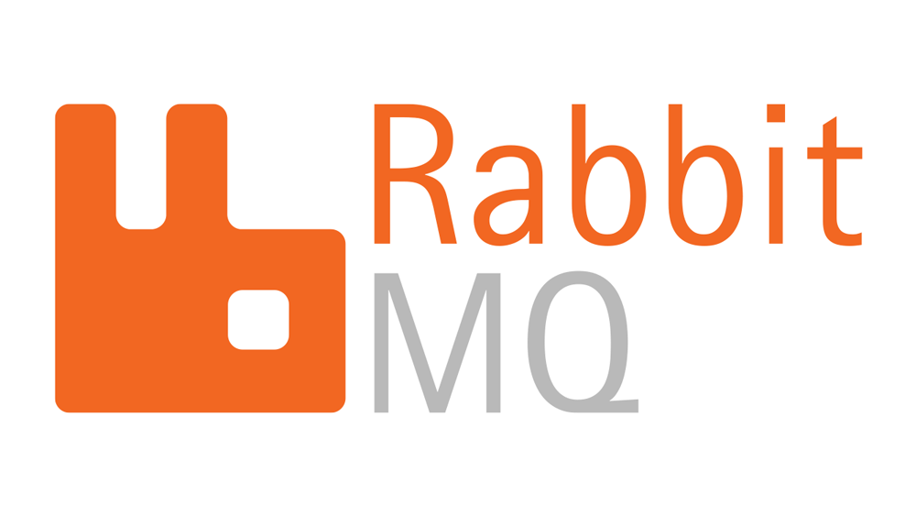
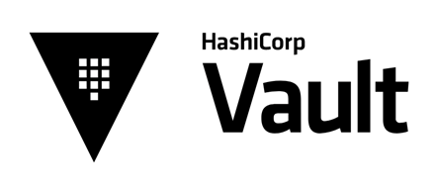
Adopted technologies
The CernVM File System provides a scalable, reliable and low-maintenance software distribution service. CernVM-FS is implemented as a POSIX read-only file system in user space (a FUSE module). Files and directories are hosted on standard web servers and mounted in the universal namespace /cvmfs.
Ceph is an open-source, distributed storage system.
Vault provides organizations with identity-based security to automatically authenticate and authorize access to secrets and other sensitive data.
RabbitMQ provides an open-source, reliable, scalable platform for message delivery, through features like message acknowledgements, persistence, routing.

Slide 15
Implementation and user perspectives

Slide 16
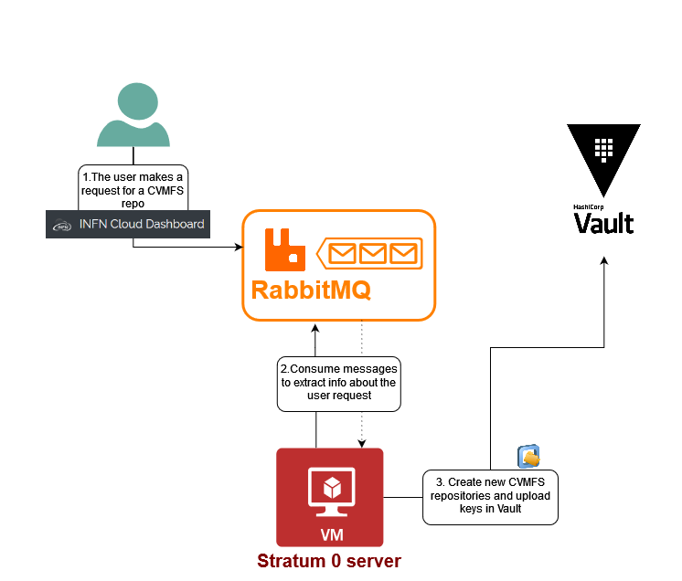
CVMFS stratum 0 - Vault - RabbitMQ interaction
This interaction allows the CVMFS stratum 0 server to get notified when a user requests a personal/group CVMFS repository.
It takes this information from a RabbitMQ queue.
With this information, it creates the CVMFS repository and the relative keys.
CVMFS stratum 0 server authenticates to Vault and copies the secrets in a specific path of the service.

Slide 17
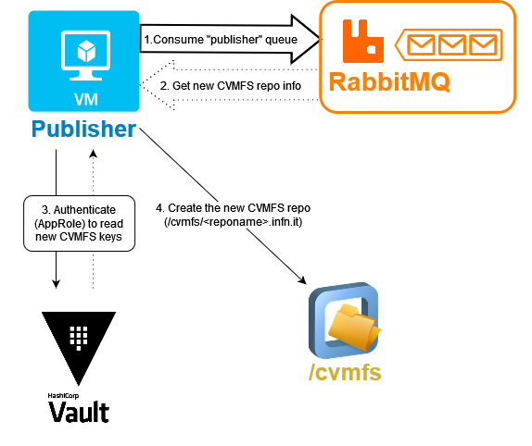
CVMFS publisher - Vault - RabbitMQ interaction
This interaction allows the Publisher to understand if a user have requested a new CVMFS repositories.
It takes this information from a RabbitMQ queue.
The information is sent to the queue when the stratum 0 server creates the CVMFS repository and the keys.
Using the given information, the publisher authenticates to Vault and takes the keys needed to write in the repository via gateway.

Slide 18
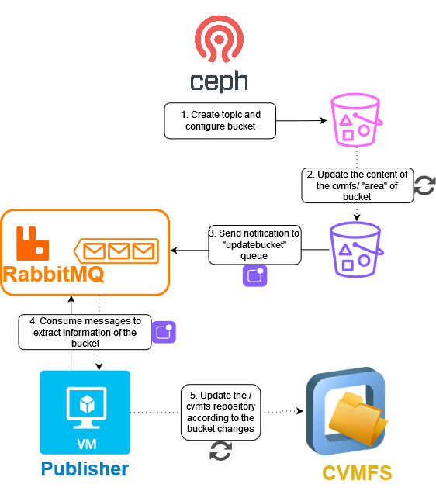
CVMFS publisher - Ceph - RabbitMQ interaction
This interaction allows the Publisher to get information about changes in the cvmfs/ “area” of the buckets and therefore to synchronize the content of the CVMFS repository.
Notification messages are sent to a RabbitMQ queue with informations about bucket owner, object key and event type.
Using those informations, the publisher distribute the software in the correct CVMFS repository.

Slide 19
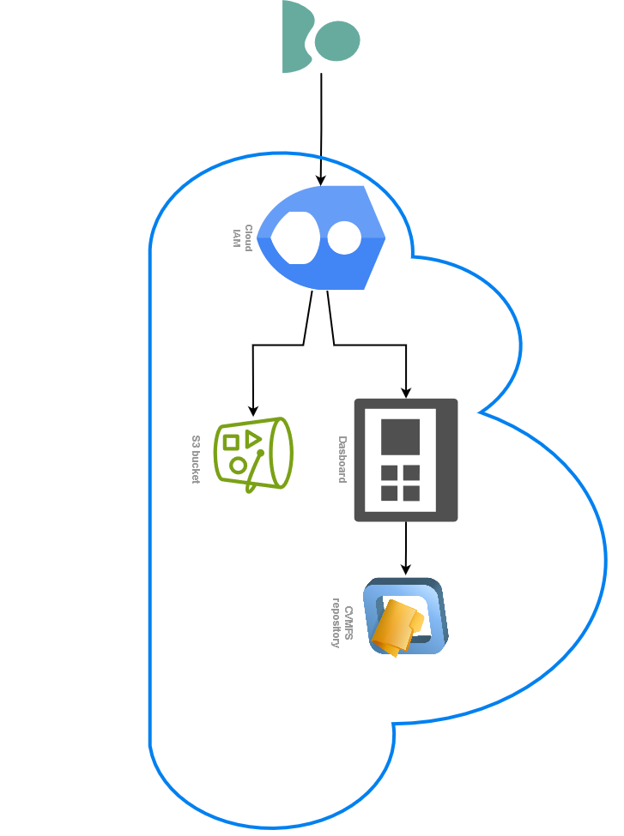
User perspectives
The user doesn’t need to know CVMFS.
The user needs a token and an S3 DataCloud account.
The user must be authenticated through JWT based auth N/Z (based on IAM) to access the Cloud Dashboard.
The user can request a personal CVMFS repository via dashboard with one click.
Access to the CVMFS repository keys: they can be easily
downloaded from the dashboard to configure the CVMFS client
to access the repo in read-only mode.
The user must have access to the
backbone S3 object storage to upload
software and files.

Slide 20
Summary

Slide 21
Conclusions
Both abstraction and automation of the underlying CVMFS system are successfully provided by the presented Software Management service.
The service is an open-source service here applied to a Cloud infrastructure and integrated in Datacloud, but the deployment can be easily replicated anywhere.
The architecture is based on standards except the daemons that are lightweight and stateless.
Because of the intrinsic flexibility of the application and of the related services and technologies adopted, it is suitable to be adopted by multidisciplinary communities.

Slide 22
Thank You!

