Slide 1
Remote S3 Storage Access Using CEPH Rados Gateway
Ahmad Alkhansa (ahmad.alkhansa@cnaf.infn.it)​
Diego Ciangottini (ciangottini@pg.infn.it)​
Alessandro Costantini (alessandro.costantini@cnaf.infn.it)​​
Jacopo Gasparetto (jacopo.gasparetto@cnaf.infn.it)
​Giada Malatesta (giada.malatesta@cnaf.infn.it)​
Diego Michelotto (diego.michelotto@cnaf.infn.it)​
Massimo Sgaravatto (massimo.sgaravatto@pd.infn.it)​
Daniele Spiga (daniele.spiga@pg.infn.it)​
Stefano Stalio (stefano.stalio@lngs.infn.it)
​
Taipei, 28-03-2024
International Symposium on Grids and Cloud

Slide 2
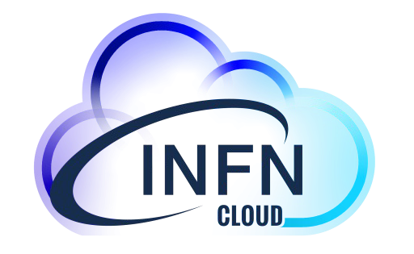
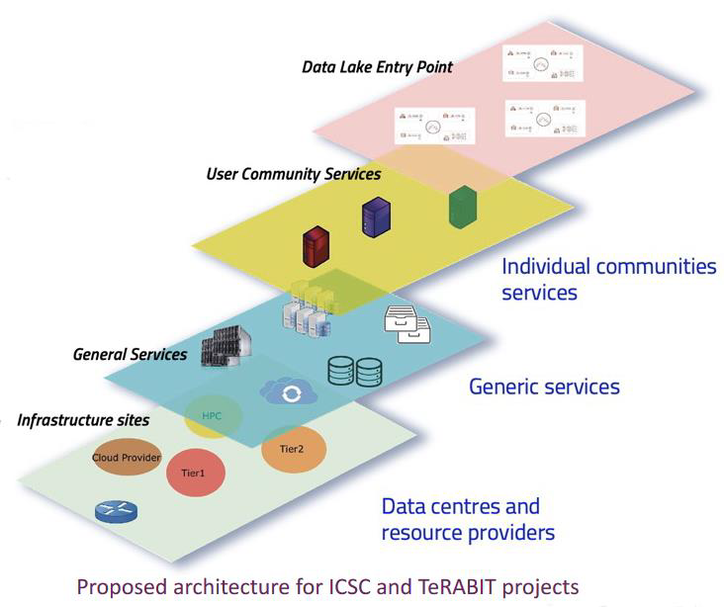
INFN Cloud
To support and evolve use cases that could not easily exploit the Grid paradigm, for many years several INFN sites have been investing in Cloud computing infrastructures
heterogeneous in hardware, software and cloud middleware
To optimize the use of available resources and expertise, INFN decided to implement a national Cloud infrastructure for research
as a federation of existing distributed infrastructures extending them if necessary in a transparent way to private and commercial providers
as a “user-centric” infrastructure making available to the final users a dynamic set of services tailored on specific use cases
leveraging the outcomes of several national and European cloud projects where INFN actively participated
INFN Cloud was officially made available to users in March 2021

Slide 3
TeRABIT in a nutshell
Create a distributed, hyperconnected, hybrid Cloud-HPC environment that offers services prepared
to meet the various research needs.
The environment will be created by federating, integrating and updating the
GARR-X, PRACE-Italia and HPC-BD-AI research infrastructures.
Three main objectives:
Enable widespread data transfer, up to Terabits per second, and services on a national scale, with particular attention to southern and island regions, connected to Europe
Innovate the central HPC node of PRACE-Italia while maintaining the Tier-1 level.
Innovate the set of HPC services offered to researchers, beyond centralized calculation model
https://www.terabit-project.it/

Slide 4
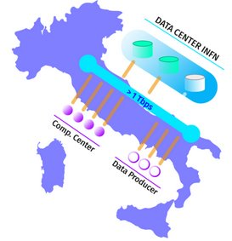
INFN Cloud
Infrastructure Architecture
A backbone that consists of two main INFN computing sites.
The sites are connected by high speed network.
Multiple external Cloud infrastructures.
Services
Federated Access to IaaS, PaaS and SaaS
Virtualized computational resources.
Object Storage as a Service.

Slide 5
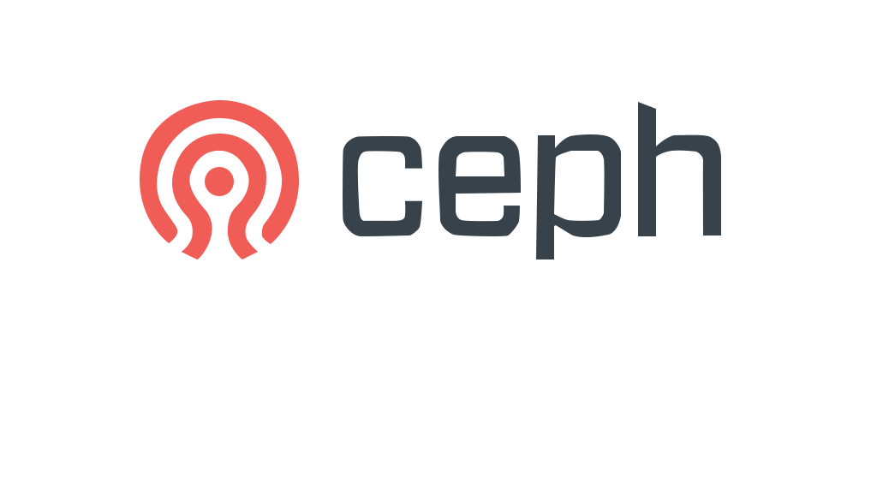
Ceph
Ceph Storage Cluster
RADOS object store that is able to reach hyper-scale.
Replicated RADOS objects are stored and managed by Ceph OSDs.
High Availability provided by Ceph Monitors that store a master copy of the cluster map.
Ceph OSDs and Clients participate in the computation of the objects localization by using CRUSH algorithm, achieving Decentralization.
App
Host/VM
Kernel Client
Clients
RADOS Object Gateway
RADOS Block Device
Ceph File System
Interfaces
LIBRADOS
Monitor
Metadata Server
Object Storage Daemon
Object Storage Daemon
Object Storage Daemon
Monitor
Metadata Server
Storage Cluster
Monitor
Manager
Object Storage Daemon
Object Storage Daemon
Object Storage Daemon
Monitor
Manager

Slide 6
Ceph
Interfaces as Abstraction
Posix-Compliant CephFS distributed file system for CephFS Kernel Clients.
Rados Block Device (RBD) with virtualization in consideration for RBD Kernel Clients with QEMU/KVM drivers.
Rados Gateway that provides Swift/S3 compatible API for Object storage.
LIBRADOS C++ library that allows direct access to RADOS.
App
Host/VM
Kernel Client
Clients
RADOS Object Gateway
RADOS Block Device
Ceph File System
Interfaces
LIBRADOS
Monitor
Metadata Server
Object Storage Daemon
Object Storage Daemon
Object Storage Daemon
Monitor
Metadata Server
Storage Cluster
Monitor
Manager
Object Storage Daemon
Object Storage Daemon
Object Storage Daemon
Monitor
Manager

Slide 7
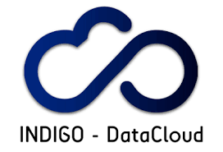
Rados gateway
1.1 STS Request with Access token
1.3 STS Response with temporary credentials
HTTP server interacts with Storage Cluster using LIBRADOS.
Implements a large subset of S3 RESTful API.
Security Token Service (STS) allowing access using INDIGO IAM as OIDC provider.
Integration with Open Policy Agent (OPA) for fine-grained Authorization.
High availability through Mulitsite Configuration
2.1 S3 Client request
2.4 S3 RGW Response
S3-compatible API
Rados Gateway
1.2 Validate Identity
STS Engine
2.2 Authorize
INDIGO IAM
LIBRADOS
2.3 Perform operation
RADOS

Slide 8
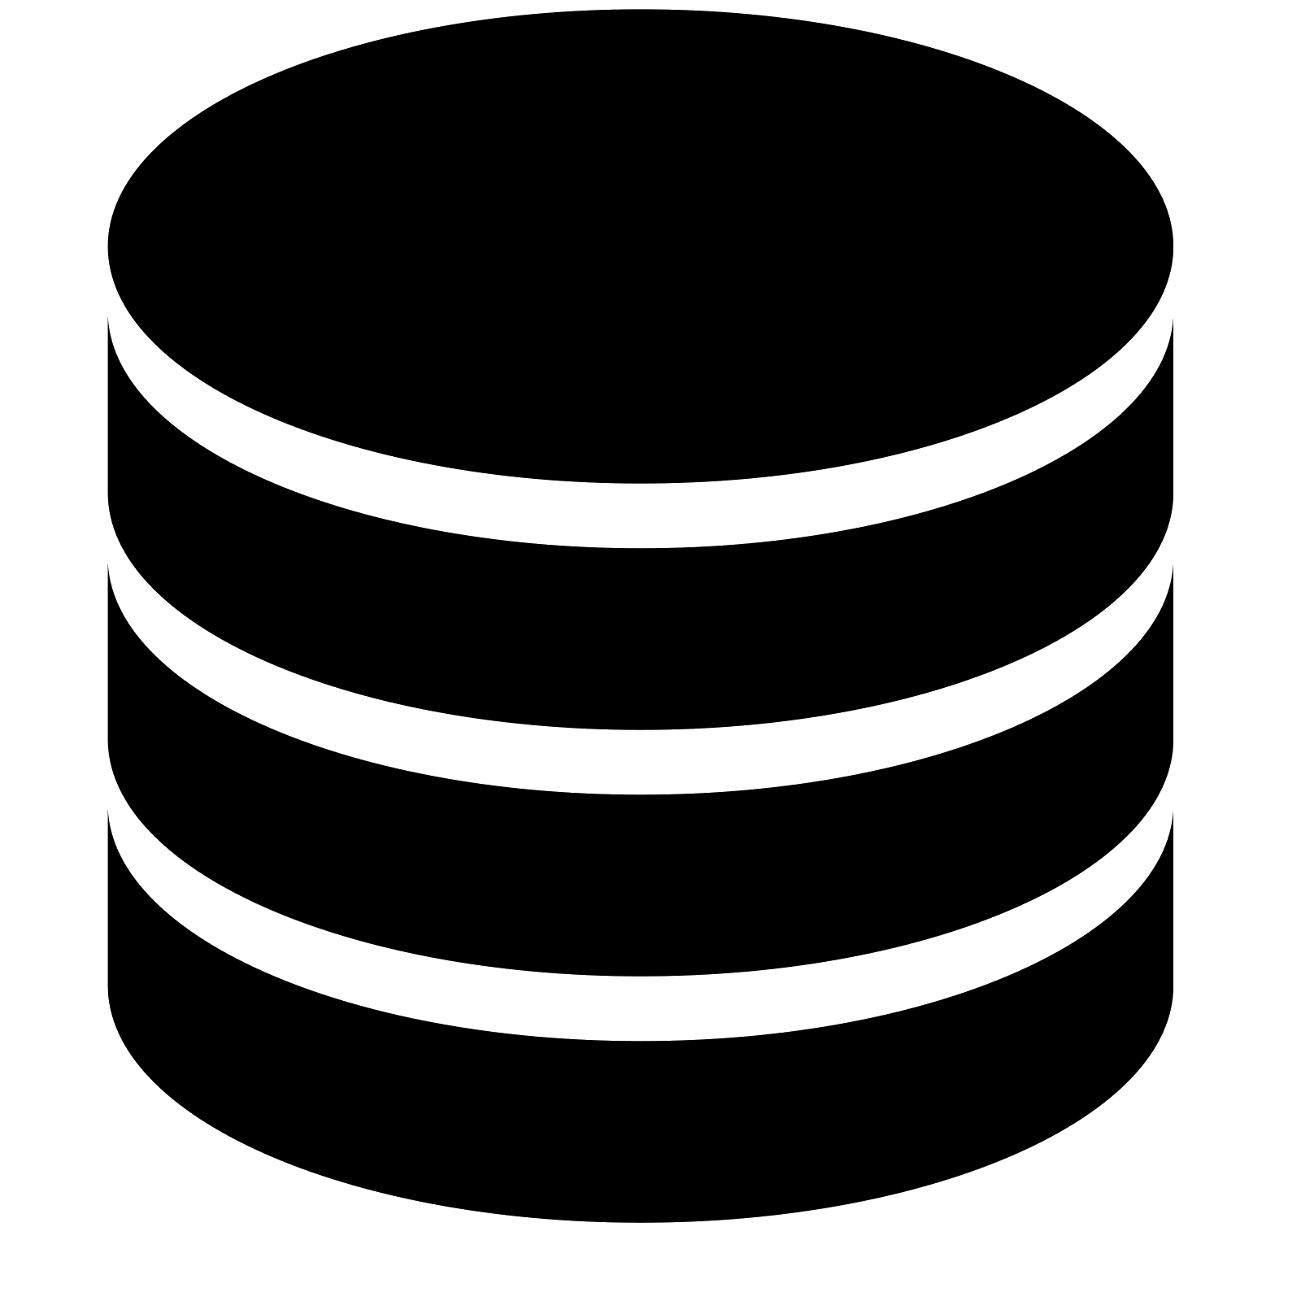
Open Policy Agent
Policy Engine
Scalable and Lightweight.
Applies Policy Decoupling that offloads decision making from the software.
Receives and Produces documents that contribute to the authorization process.
Different models for dynamic policy and data management.
Synchronous Push Data API
Asynchronous
Pull Bundles
Synchronous
Pull Functions
Asynchronous
Push Data API
Data source

Slide 9
Open Policy Agent
RGW
Integration with Rados Gateway
Rados Gateway authorization request contains user’s uuid and the S3 operation.
Open Policy Agent requires additional information such as groups and username in its decision making.
Gitlab repository that contains OPA policies managed by administrators.
Gitlab CI/CD Pipline periodically provide policies and users’ information.
query
response
Policies + IAM information
Gitlab
Scheduled CI/CD Pipeline
Groups, uuid and usernames
SCIM
INDIGO IAM

Slide 10
Open Policy Agent
RGW
SCIM API response with users’ info
Integration with Rados Gateway
Gitlab CI/CD pipeline:
Collects Users’ information from INDIGO IAM SCIM API.
Generates OPA bundle from the collected data and the stored policy files within the repository.
Create an OCI container from the bundle and push it the registry.
OPA service Polls Gitlab’s Container registry for new bundle.
Scheduled CI/CD Pipeline
Job Artifact API
Build Stage:
- Collect User Info from SCIM API.
- Build OPA Bundle.
- Store bundle as job artifact.
SCIM
INDIGO IAM
POST request with input (S3 operation + user’s ID)
users’ info request
Response with Policy query result
Test Stage:
- Test OPA bundle using testing policies.
Deploy Stage:
- Store bundle within an OCI container.
- Push image to Baltig’s Container registry.
Data API
Download bundle from the latest successful pipeline
authz.rego
admins.rego
Users Info Data
OPA Bundle
Container Registry
users.rego
<policy package>
OPA Polling for new bundle
Gitlab

Slide 11
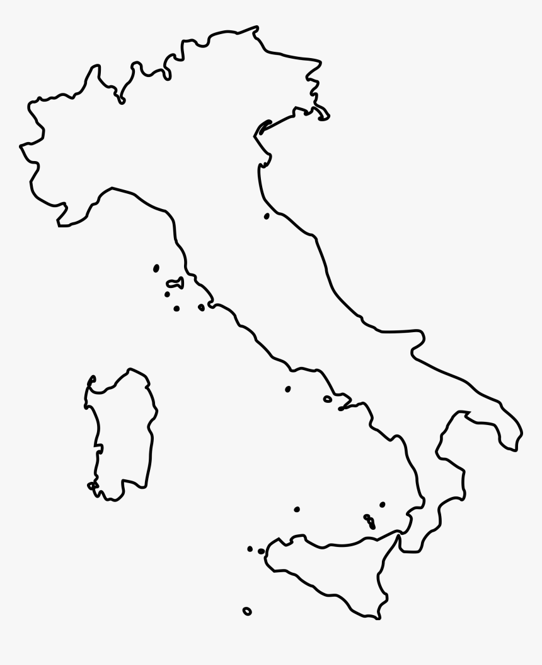
Backbone Multisite Configuration
Single Realm with a unique Zonegroup.
2 Zones with independent Ceph Storage Clusters.
3 instances of RADOS Gateway run in high availability within each zone.
Every Zone connects to a dedicated OPA deployment through a private network.
The zones have Active-Passive Configuration.
600 KMs apart with 9 ms latency and 10Gb/s of bandwidth.
M. Zone
CNAF
10Gb/s
S. Zone
Bari

Slide 12
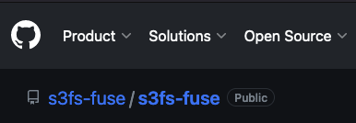
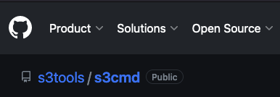
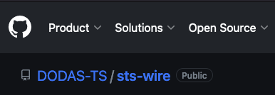
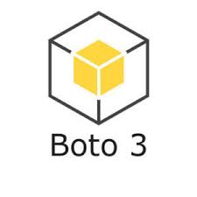
Rados Gateway Clients
Posix-like Mount of S3 Buckets
sts-wire is a wrapper around rclone. It allows continuous refresh of IAM Access tokens.
S3fs-fuse uses FUSE (Filesystem in Userspace) to mount S3 Buckets with large subset of POSIX.
Command Line Tools
S3cmd is a client written in Python that allows S3 bucket management and data synchronization with the local directory.
S5cmd is a GO tool that focuses on performance.
Software Development Kit (SDK)
Boto3 is developed by Amazon for Python that provides object-oriented API.
S3-compatible API
Rados Gateway
STS Engine
LIBRADOS

Slide 13
Rados Gateway Clients
S3 WebUI
Web App
Based on React and FastAPI.​
OIDC protocol with IAM to generate Json Web Token (JWT).​
Uses IAM Access Token to perform STS with RGW.​
S3 operations using AWS SDK library.​
1. OIDC protocol to generate JWT
2.1 STS Request with Access token
2.3 STS Response with temporary credentials
3.1 S3 Client request
3.2 S3 RGW Response
S3-compatible API
Rados Gateway
2.2 Validate Identity
STS Engine
INDIGO IAM
LIBRADOS

Slide 14
Conclusion
INFN Cloud has a geographically distributed infrastructure.
Ceph is a decentralized Object storage solution that offers multiple interfaces.
Rados Gateway
Provides S3 compatible API.
Integrated with OIDC providers using the Security Token Service Engine.
Allows fine grained authorization with Open Policy Agent.
Ensures High availability through a multi-site configuration.
OPA is a lightweight and scalable policy engine with a flexible synchronization model.
DevOps tools are advantageous for dynamic OPA bundle updates.
Several RGW open-source clients exist with different approach of data management.
S3 Web App is a Graphical User Interface for the Object Storage Service.
INDIGO IAM

Slide 15
Thank you
ahmad.alkhansa@cnaf.infn.it

