Slide 1



Blockchain-Enabled Secure Management of Scientific Data in Permissioned Networks: a Metadata-Centric Approach
​
Domingo Ranieri, Alessandro Costantini, Barbara Martelli
ISGC 2024, Taipei, 28 March 2024
ICSC Italian Research Center on High-Performance Computing, Big Data and Quantum Computing
Missione 4 • Istruzione e Ricerca
Notes:
Cover

Slide 2
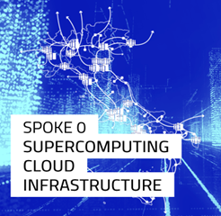

ICSC Italian Research Center on High-Performance Computing, Big Data and Quantum Computing
1
The Center conducts R&D, nationally and internationally, for innovation in
high-performance computing, simulations, and big data analytics.
FUNDAMENTAL RESEARCH
& SPACE ECONOMY
FUTURE HPC
& BIG DATA
2
3
4
ASTROPHYSICS & COSMOS OBSERVATIONS
EARTH
& CLIMATE
5
6
ENVIRONMENT
& NATURAL DISASTERS
MULTISCALE MODELING
& ENGINEERING APPLICATIONS
7
8
IN-SILICO MEDICINE
& OMICS DATA
MATERIALS &
MOLECULAR SCIENCES
9
DIGITAL SOCIETY
& SMART CITIES
QUANTUM COMPUTING
10
1
ICSC Italian Research Center on High-Performance Computing, Big Data and Quantum Computing
Missione 4 • Istruzione e Ricerca

Slide 3
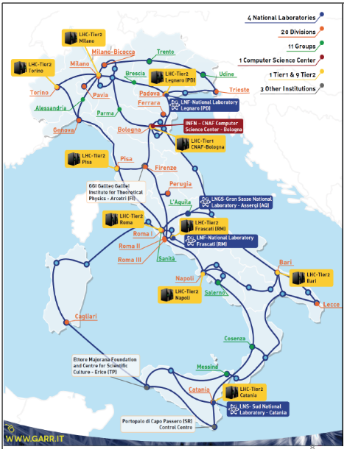
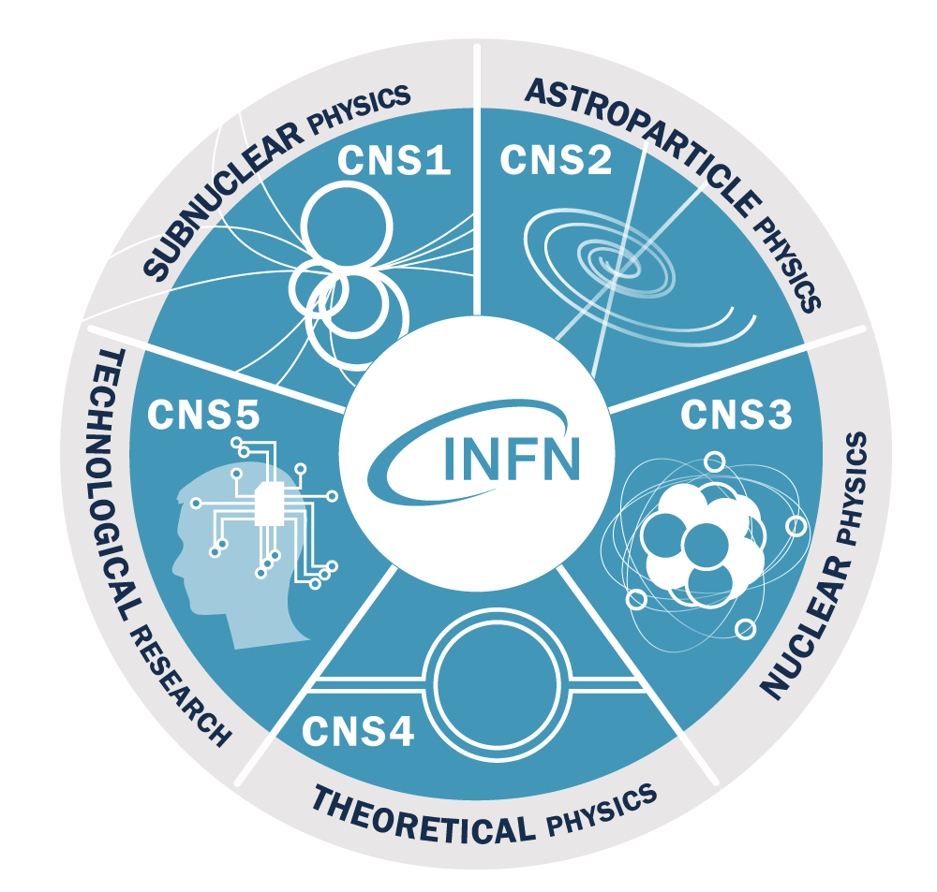
Italian Institute for Nuclear Physics (INFN)
Research areas:
5 lines of research
With computing as a transversal needs
Facilities:
4 national laboratories
20 divisions
6 associated groups
3 national centers and schools
1 international consortia
Strong participation on national and international projects and collaborations
2
ICSC Italian Research Center on High-Performance Computing, Big Data and Quantum Computing
Missione 4 • Istruzione e Ricerca

Slide 4



Project overview
Our solution is developed as part of an Innovation Grant ICSC with partners Leonardo ThalesAlenia, INAF and INFN
With the increasing volume and complexity of space-related information, ensuring the integrity, security, and accountability of data becomes critical.
Our solution
  A blockchain-based data management system ensuring integrity and reliability of data.
  Using a combination of on-chain and off-chain data storage mechanisms
  To secure data and facilitate traceability and reproducibility of workflows.
3
ICSC Italian Research Center on High-Performance Computing, Big Data and Quantum Computing
Missione 4 • Istruzione e Ricerca

Slide 5
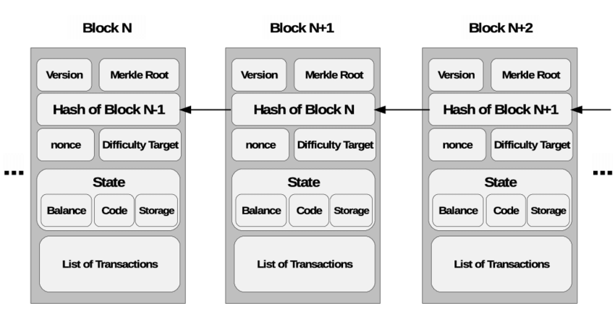
Blockchain Technology
Blockchain's cryptographic techniques ensure data integrity and
protection against unauthorized tampering.
Smart contracts automate and enforce business logic, reducing the risk of errors or disputes.
4
ICSC Italian Research Center on High-Performance Computing, Big Data and Quantum Computing
Missione 4 • Istruzione e Ricerca

Slide 6

Hyperledger Fabric
Hyperledger Fabric (HF) is an enterprise-grade permissioned distributed ledger platform.
HF boasts a range of features:
  facilitates smart contract development in multiple programming languages, including Go, JavaScript and Java
    offers REST APIs for seamless communication with off-chain services
    modular architecture enables the possibility to implement and tune specific requirements
5
ICSC Italian Research Center on High-Performance Computing, Big Data and Quantum Computing
Missione 4 • Istruzione e Ricerca

Slide 7

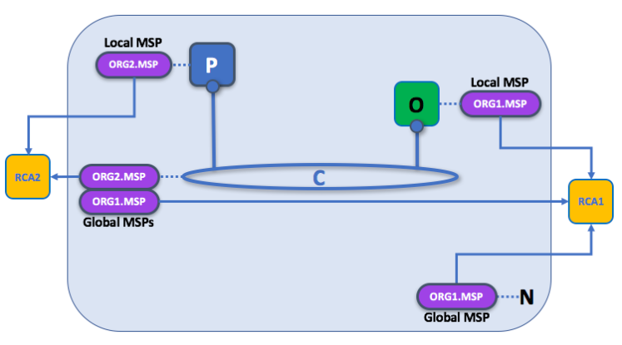
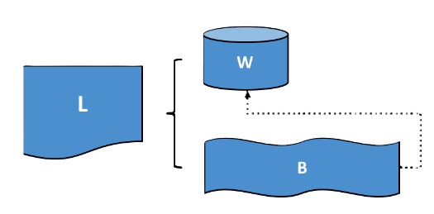
Data Management Architecture
Authentication and Authorization managed by INDIGO-IAM service
Json Web Token (JWT) to be used among microservices
Client saves data in a storage system (which could be of any type).
Then it send metadata and operation information to the blockchain service via APIs call.
Smart contract create an object with specific attribute.
can be used to interact with the objects created.
client
6
ICSC Italian Research Center on High-Performance Computing, Big Data and Quantum Computing
Missione 4 • Istruzione e Ricerca

Slide 8
Off-Chain Data: Raw and Processed Data
Raw Data
Processed Data
Raw data represents the initial, unprocessed form of data collected or generated.
Examples include experimental measurements, sensor readings, or unprocessed files.
Raw data may undergo versioning to track changes over time.
Processed data results from the transformation or analysis of raw data using algorithms, computational methods, or human intervention.
Processed data is typically more structured
Examples are summary statistics, machine learning model outputs, or aggregated datasets.
Data saved on blockchain are not deletable
7
ICSC Italian Research Center on High-Performance Computing, Big Data and Quantum Computing
Missione 4 • Istruzione e Ricerca

Slide 9
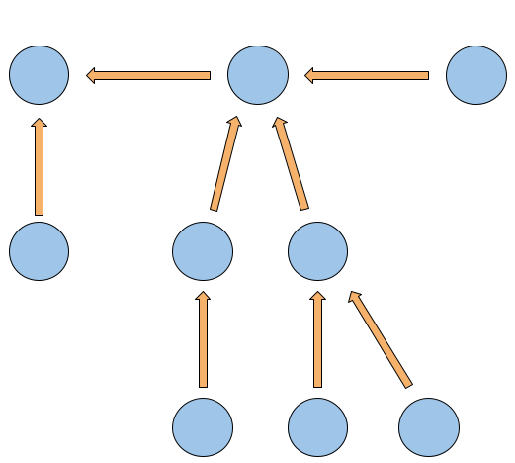
Information saved on-chain
In blockchain are saved:
the metadata of data stored off-chain
information about operation performed
Using metadata is possible
to check validity of data
reconstruct the workflow for processed data.
Recording operation information transparent traceability of data modifications is enabled
facilitating analysis and auditing.
versioning
processing
8
ICSC Italian Research Center on High-Performance Computing, Big Data and Quantum Computing
Missione 4 • Istruzione e Ricerca

Slide 10
Example of use
A set of measurement from sensors are taken by Thales satellites every day for a month and collected in a dataset (sensorsMeasureJan24.csv)
Raw dataset is locally stored,
Metadata goes to the blockchain
{
"dataHash":"5c23dd087...068789ded69d",
"datasetName":"sensorsMeasureJan24.csv",
"creationTimestamp":"1706659200",
"owner":"Thales",
"type":"raw",
"fromHash":"null",
"algorithmUsed":"null",
"version":0,
}
9
ICSC Italian Research Center on High-Performance Computing, Big Data and Quantum Computing
Missione 4 • Istruzione e Ricerca

Slide 11

Example of use
Raw data are used (e.g. by a University Research Group) and processed by using a proprietary algorithm or a procedure
A new dataset is produced and stored (studyExperiment0124.csv).
New metadata are sent to the blockchain
{
"dataHash":"91d01e2bf...04f62fcf2503",
"datasetName":"studyExperiment0124.csv",
"creationTimestamp":"1708387200",
"owner":"URG",
"type":"processed",
"fromDataset":"5c23dd087...068789ded69d",
"algorithmUsed":"676e838652...08c06f80f921",
"version":"null",
}
processing
10
ICSC Italian Research Center on High-Performance Computing, Big Data and Quantum Computing
Missione 4 • Istruzione e Ricerca

Slide 12
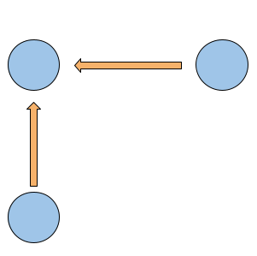
Example of use
Any new dataset coming from the previous can be considered as an update and properly versioned
versioning
{
"dataHash":"b5cf2812d...8b20dba230b5",
"datasetName":"sensorMeasureFeb24.csv",
"creationTimestamp":"1709164800",
"owner":"Thales",
"type":"raw",
"fromHash":"5c23dd087...068789ded69d",
"algorithmUsed":"null",
"version":1,
}
processing
11
ICSC Italian Research Center on High-Performance Computing, Big Data and Quantum Computing
Missione 4 • Istruzione e Ricerca

Slide 13
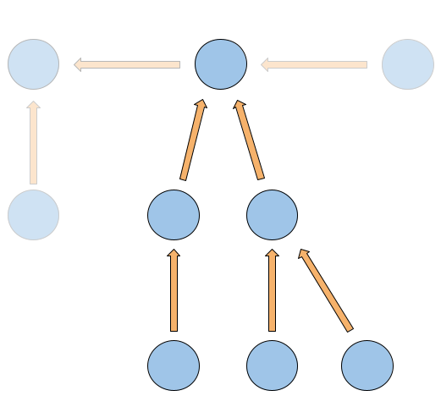
Example of use
Global view of processing and versioning
versioning
processing
12
ICSC Italian Research Center on High-Performance Computing, Big Data and Quantum Computing
Missione 4 • Istruzione e Ricerca

Slide 14
Example of use
For any operation performed, peculiar information can be stored in blockchain.
Only the Metadata are saved in the BC saving storage and computing effort.
{
"operationID":"plsda012...lo32j7u13q3k",
"operationType":"rawDatasetUpload",
"executedBy":"Thales-UserID",
"operationTimestamp":"1706778000",
}
The operation ID is the hash of the concatenation between dataHash and the other operation details.
13
ICSC Italian Research Center on High-Performance Computing, Big Data and Quantum Computing
Missione 4 • Istruzione e Ricerca

Slide 15
Conclusion
Our project represents a new approach to data management, leveraging blockchain technology to provide
  data immutability
  operation traceability
  workflow reproducibility
Working with metadata can save storage space and computational effort, by maintaining data integrity
Future steps:
Develop a Blockchain as a Service (BaaS) on INFN Cloud infrastructure
Give the user the ability to customize the blockchain network
14
ICSC Italian Research Center on High-Performance Computing, Big Data and Quantum Computing
Missione 4 • Istruzione e Ricerca

Slide 16
Thank you
Domingo.ranieri@cnaf.infn.it

