Slide 1
The Open Infrastructure Portal for DESY and HIFIS
Tim Wetzel, Patrick Fuhrmann, Uwe Jandt, Paul Millar, Sophie Servan, Franz Rhee, Peter van der Reest, Regina Hinzmann, Noel Barth, Johannes Reppin, Christian Voss, Linus Pithan, Anton Barty, ...
ISGC in Taipei, 2024
Presenter: Patrick Fuhrmann

Slide 2
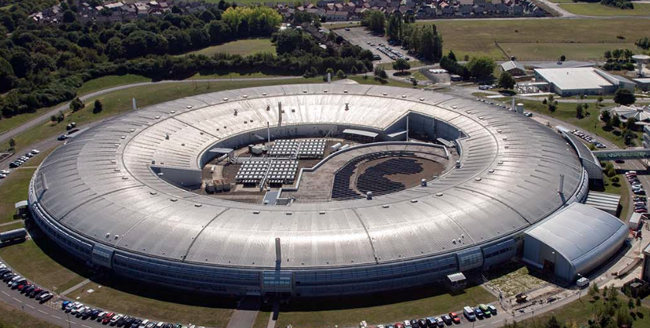
The Science (Example)
Minute
8 - 9
OXFORD UNIVERSITY PARTICLE ACCELERATOR ☺
AKA
The UK Diamond Light Source (Synchrotron)

Slide 3
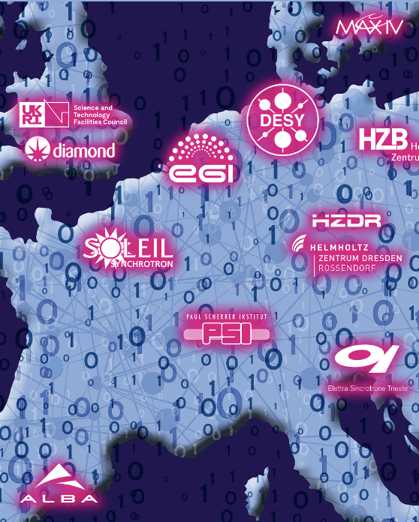
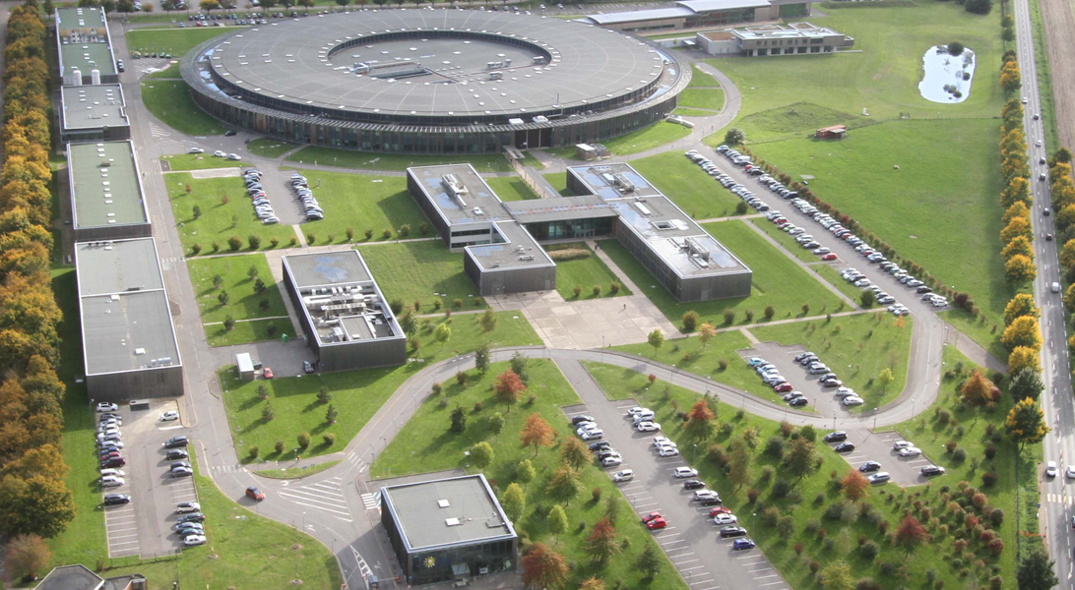
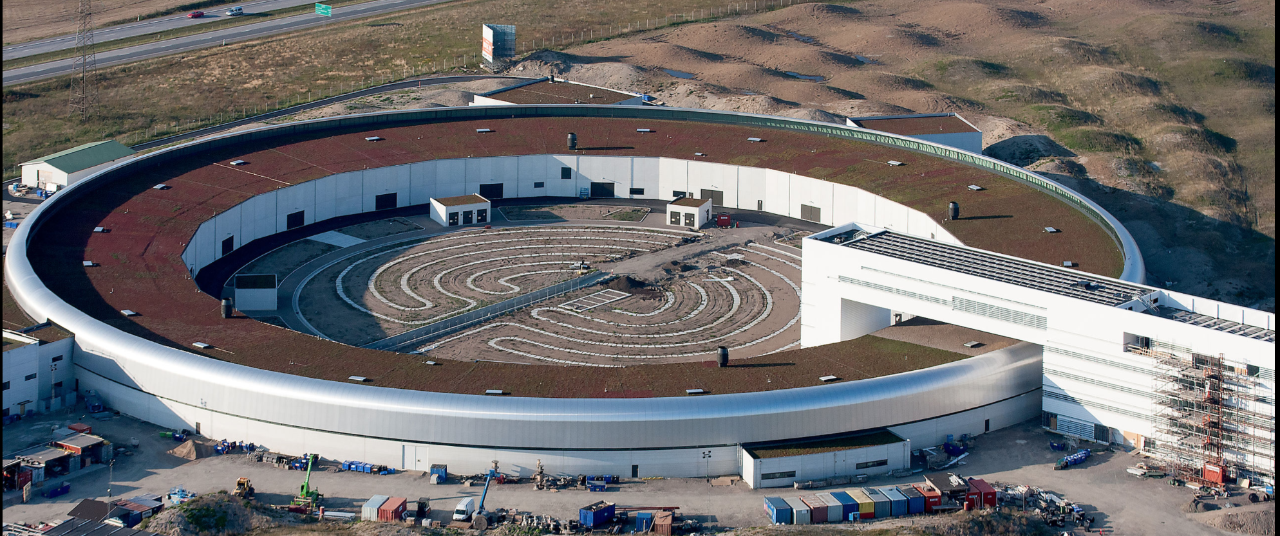
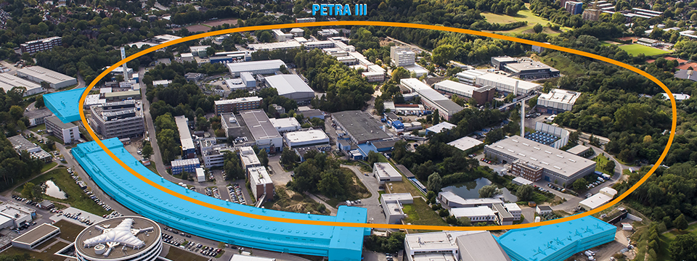
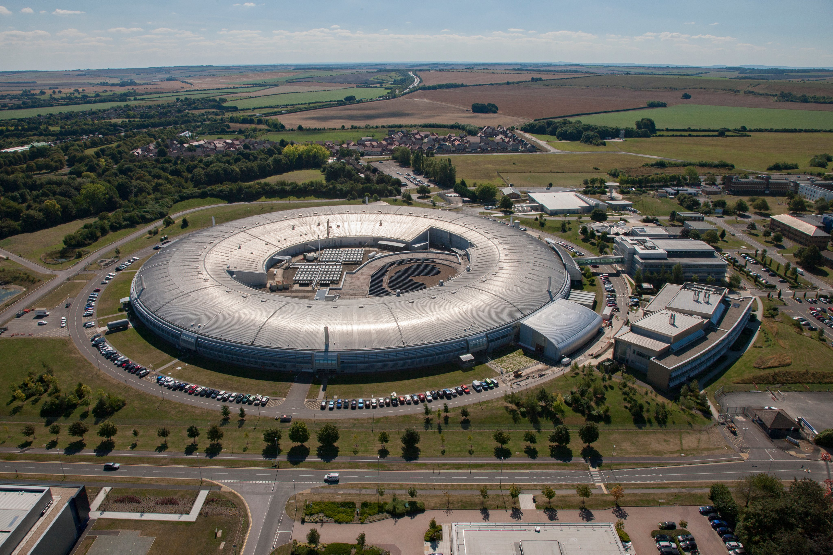
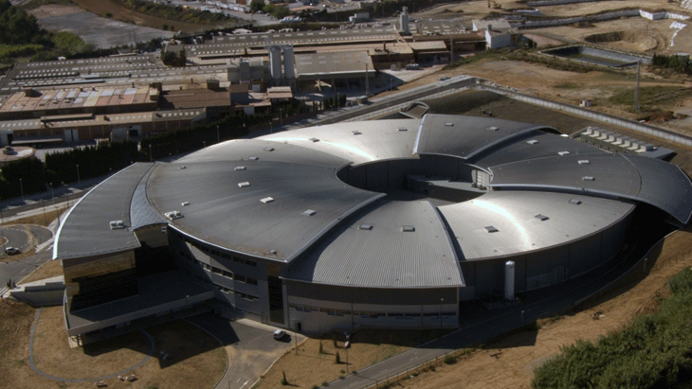
The National Light Sources in Europe
For the Chinese one see : Qingbao Hu: Design and implementation of HEPS Scientific Computing System
Soleil
MAX IV
PETRA III
Diamond
ALBA

Slide 4
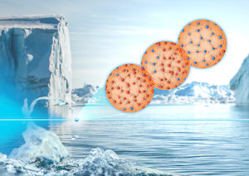
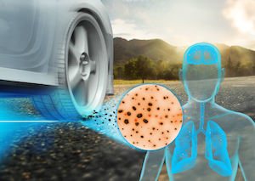
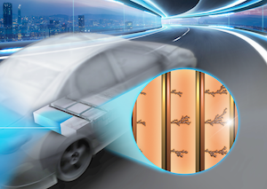
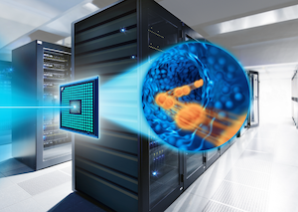
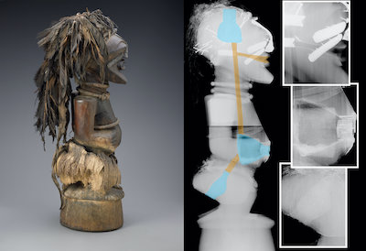
Why I’m showing this ?
Light sources are huge infrastructures, providing extremely brilliant light, used with more than 200 techniques to look deep into matter for Biology, Material Science, Cultural Heritage and what not.
In 2019 Petra III at DESY had more than 6300 visits from 3150 national and international users at 21 beamlines;
Those beam times produce an enormous amount of extremely precious data, under the governance of the PI.
But, after the ‘embargo period’ all this data becomes ‘Open Data’ (public)
Role of Water
Fine Dust
Data which wasn’t used in publications is essentially lost.
After a publication, the future of the data only depends on the PI, who will have moved on to his/her next project. The future of that data is undetermined.
No one, except the original group, understands the details of those collected datasets.
Battery
So far so good.
Superconductors
Cultural Heritage

Slide 5
Why I’m showing this ?
Light sources are huge infrastructures, providing extremely brilliant light, used with more than 200 techniques to look deep into matter for Biology, Material Science, Cultural Heritage and what not.
In 2019 Petra III at DESY had more than 6300 visits from 3150 national and international users at 21 beamlines;
Those beam times produce an enormous amount of extremely precious data, under the governance of the PI.
But, after the ‘embargo period’ all this data becomes ‘Open Data’ (public)
Role of Water
We have a similar situation in almost all sciences.
Fine Dust
BUT
Data which wasn’t used in publications is essentially lost.
After a publication, the future of the data only depends on the PI, who will have moved on to his/her next project. The future of that data is undetermined.
No one, except the original group understands the data.
Battery
Superconductors
Cultural Heritage

Slide 6
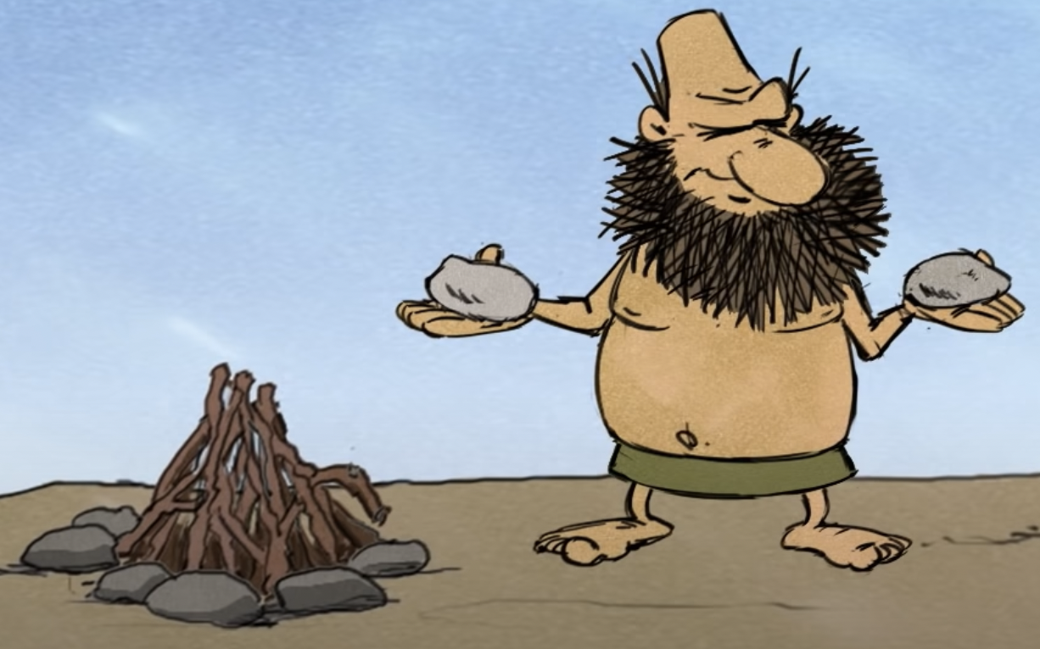
So what to do ?

Slide 7
Open versus FAIR Data
Open Data is a prerequisite for a healthy and accelerated Science.
Open Data by itself is of no value, unless it fulfills certain quality criteria.
However
Since 2014, these criteria are known as FAIR Data Principles
The FAIR Principles define a set of quality attributes with the goal of a minimum reusability of the data (later or in other sciences)
Remember: FAIR Data doesn’t need to be open.
A short summary of the FAIR principles by the Cambridge Crystallographic Data Center is
“The FAIR Data Principles set out criteria that enable the philosophy of openness to be realized in a tangible way through modern publishing practices and infrastructures that support current data science needs.”
In short: Applying the FAIR Principles makes Data, but in particular “Open Data” more valuable for the benefit of improved and accelerated Science.

Slide 8
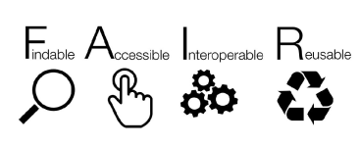
FAIR at DESY
FAIR data in a nutshell
Meta Data
Catalogue
File Formats
(Domain Scientists)
Accessable long
Term storage
Open
Infrastructure

Slide 9
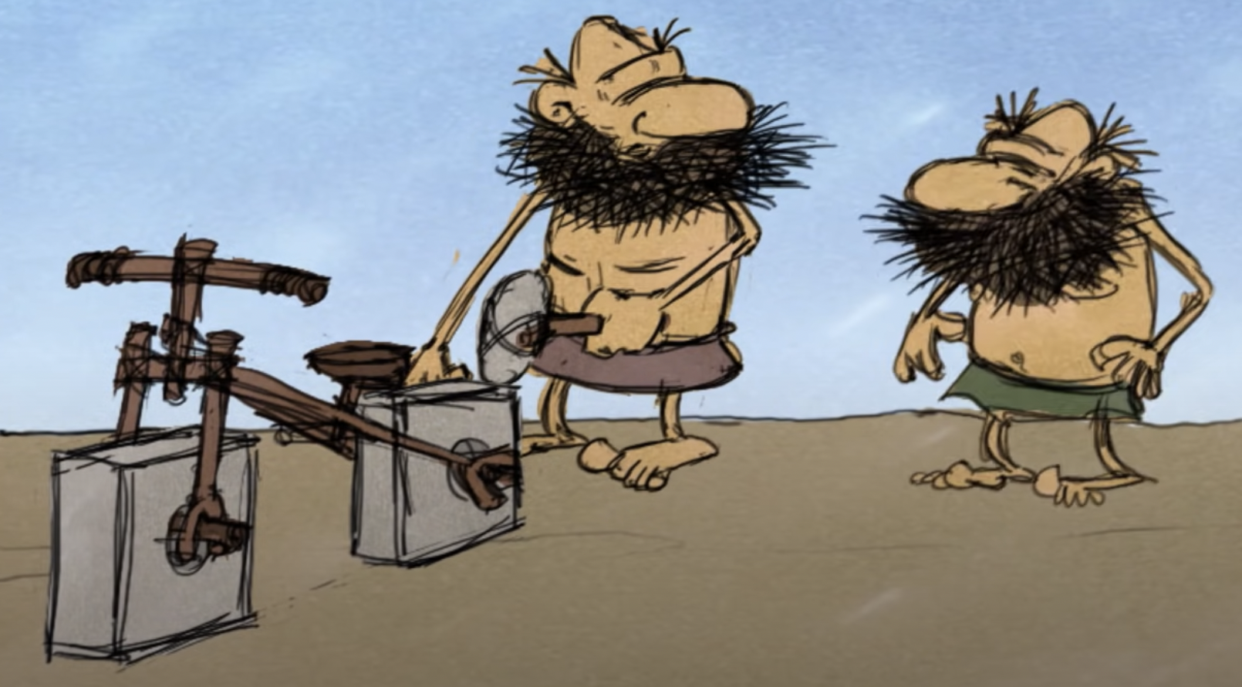
The problem with the Meta-data

Slide 10
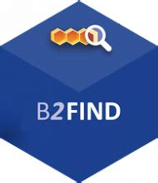
Importance of standard meta-data definitions
Meta Data Challenge:
Scientists don’t like to manually annotate data with metadata
Devices, e.g. detectors and beamline software must produce those meta data on the fly.
Heterogeneous origin of data sets from different experiments with different specific metadata need to be mapped into the same catalogue;
Metadata input and verification need to be handled properly in the publication process. Enforcing the completeness of meta data schema.
Brief categarization of Meta Data
OAI-PMH
Mandatory core metadata | Defined in prior activities and by responsible reference bodies e.g. DublinCore, DataCite v4.4
Domain-specific metadata | To be provided by the community e.g. former PaNOSC/ExPaNDS, Daphne4NFDI, Photon Science Community
(Optional) Additional metadata | Experiment/Beamline/Facility-specific metadata might be needed

Slide 11
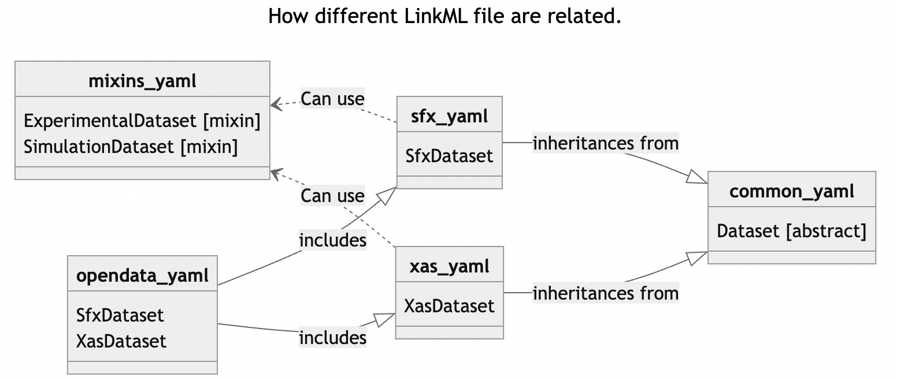
Guiding and verifying meta data usage.
Meta-data quality verification
First installment with LinkML
Metadata schema description via YAML documents setting standards that metadata has to conform to
Data description in terms of “classes” and “slots”, allowing inheritance and mix-ins for creating custom types
60+ different open-source tools to work with schemata for introspection, validation, format conversion, …
https://gitlab.desy.de/ric/opendata-metadata/
Starting with two public data use-cases
XAS & SFX
Integration into Gitlab CI/CD pipeline for linting,
generating documentation and JSON-Schema
If you are interested in details:
Talk to Tim and Paul
Assuming you find someone in the science community to define their meta-data.

Slide 12
Let’s have a look at a simplied Beamline Data Management
Very simplified

Slide 13
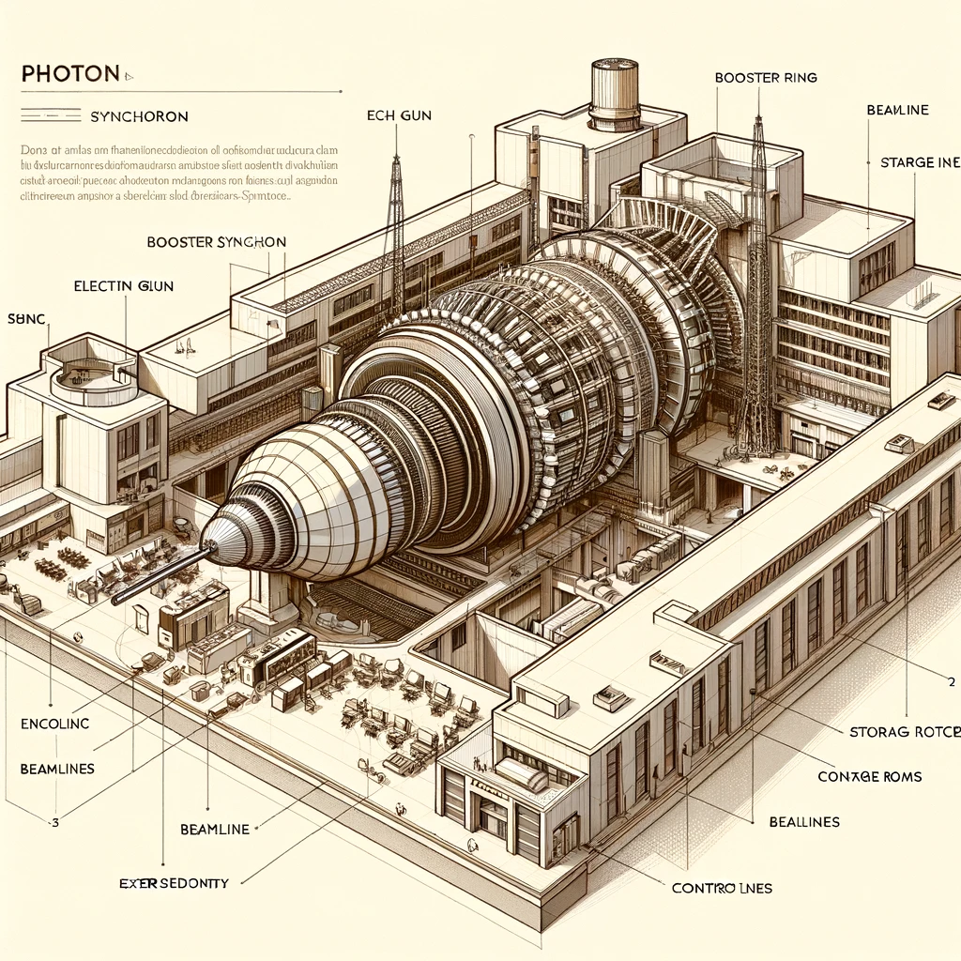
DESY Photon Science Setup
The three pillars of a beam line infrastructure
Synchrotron
Persistent
Storage
Meta Data
Catalogues
Computing
DESY
HPC
System
Embargo’ed
Data
Data
Taking
Access Controlled internal Catalogue
Synchrotron owned
Storage Spaces
Protected Network
This is how chatGTP thinks a synchrotron would look like.
Image adapted from Anton Barty’s slide

Slide 14
DESY Photon Open Science
OAI-PMH
The High Level View
DOI minting
Data Exploitation
OPEN
DATA
Helmholtz AAI
Public Helmholtz
Spaces
Open Catalogue
We try to use standard protocols only to allow components to be replaced by components with similar functionality.
Out of
Embargo
DESY
HPC
System
Embargo’ed
Data
Synchrotron owned
Storage Spaces
Access Controlled internal Catalogue
Protected Network
Image adapted from Anton Barty’s slide

Slide 15
Envisioned data ingestion process
1
2
3
Publishing Process
Open Data
Upload to staging space
Meta Data can still be extended/modified.
Meta Data
Enrichment
Additional
Manual
Meta Data
Data Quality verification
Persistent Space (Frozen)
Meta Data Extraction
Data is immutable and no longer removable
Optional DOI minting

Slide 16
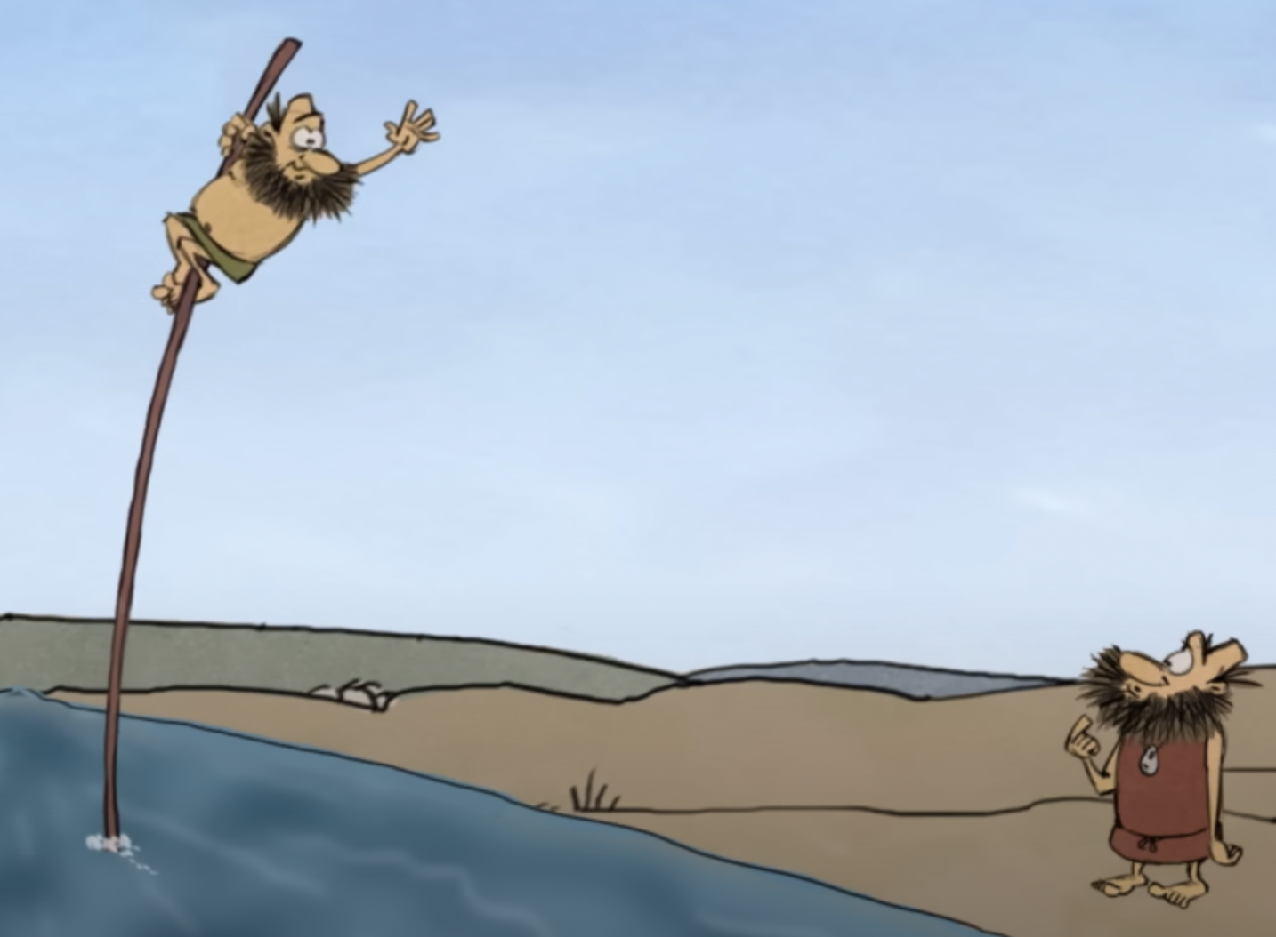
How does this all look like ?
From high above

Slide 17
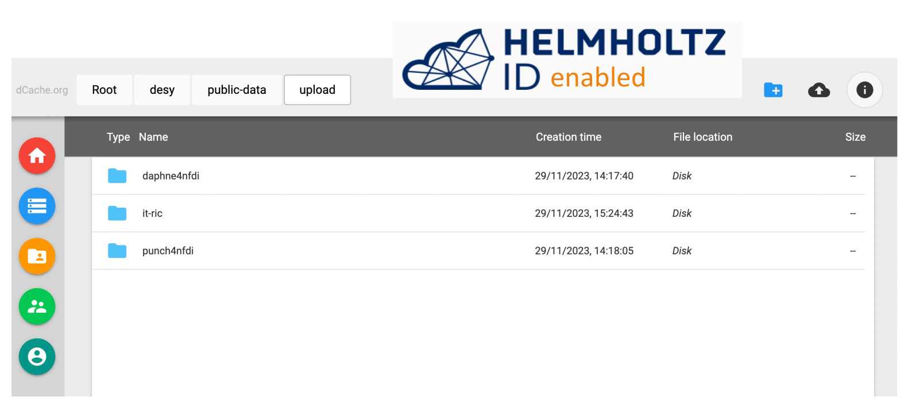
Hifis-storage.desy.de
The ”drop-box” and final storage space for Open Data

Slide 18
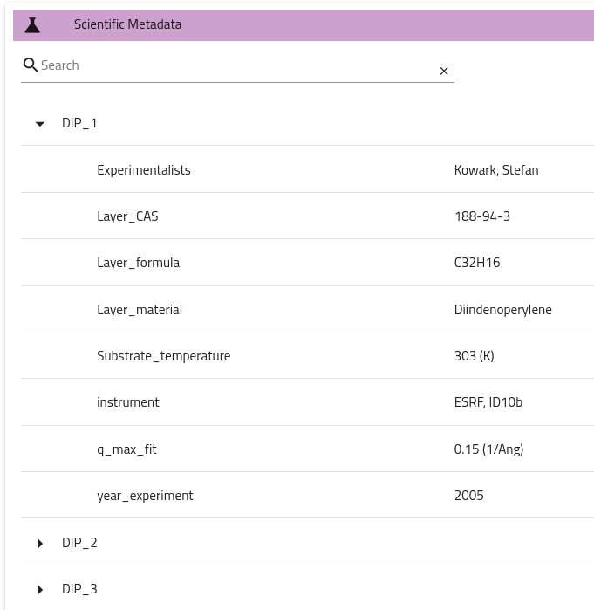
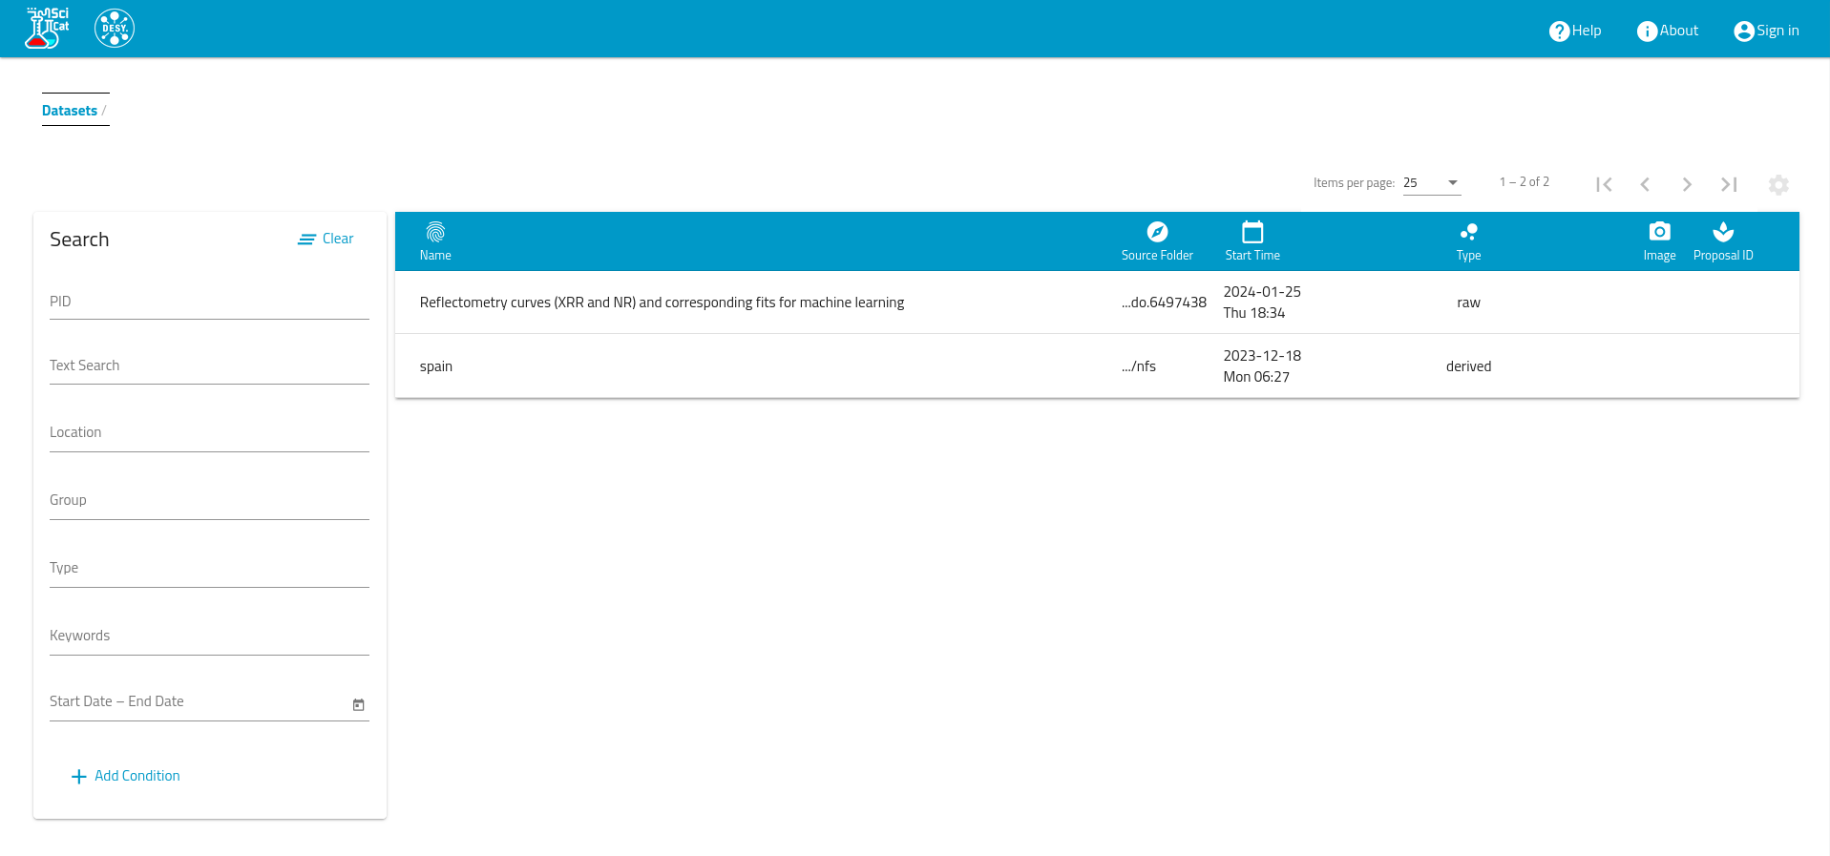
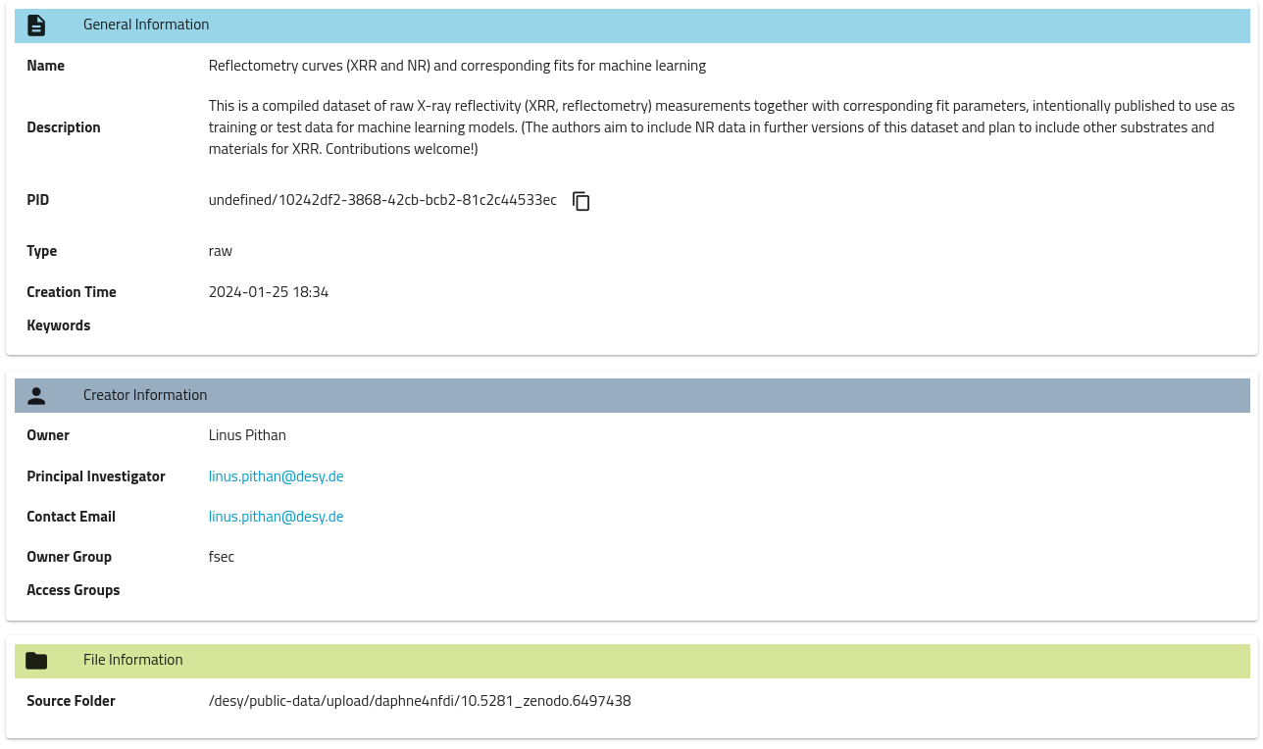
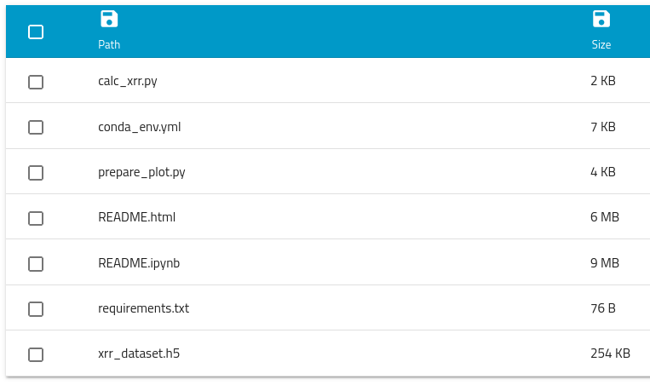
public-data.desy.de
The meta data catalogue

Slide 19
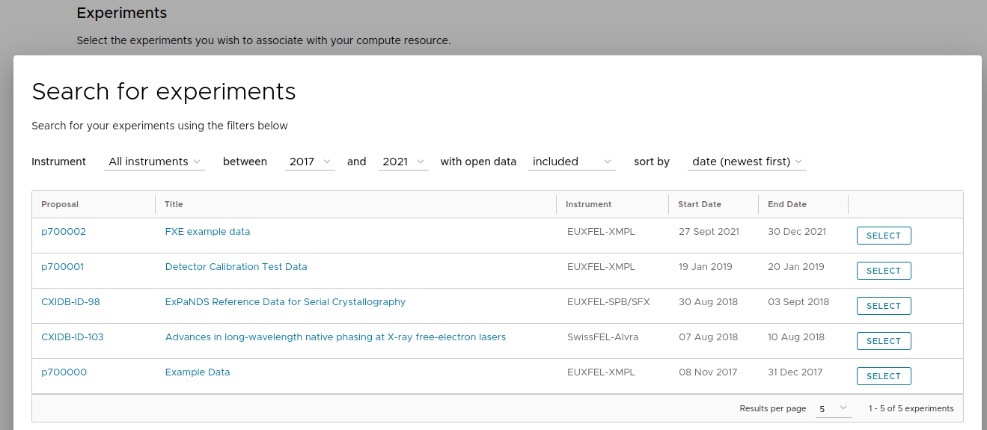
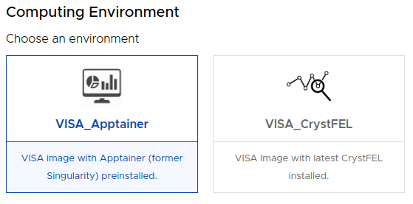
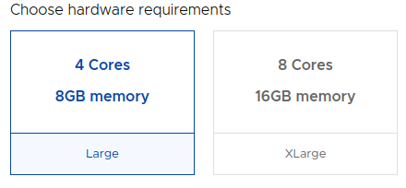
Visa.desy.de
Select a dataset to be accessible within a virtual machine
The current VISA database is populated with example datasets.
Real Open Data will be integrated later in 2024 via automated data exports from public-data.desy.de

Slide 20
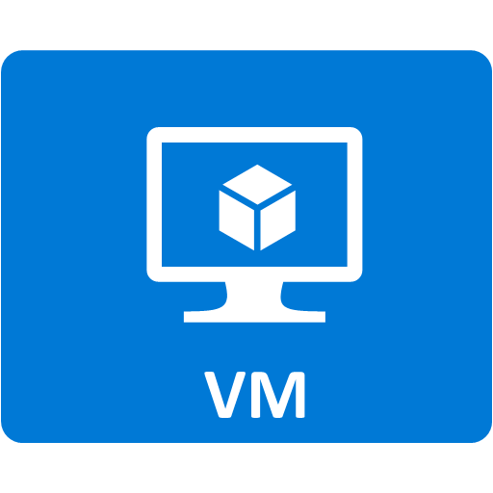
Visa.desy.de
Architecture Overview (Data Analysis Platform)
Sources
Git repositories
Helm Charts
Sealed Secrets
NFS
Data
Targets
Clusters
Namespaces
VISA-Jupyter-Proxy
VISA Frontend
Nginx Ingress
VISA-API-Service
VISA-DB
VISA Frontend
VISA Frontend
OIDC, X.509
VISA-Web-Service
Serve Frontend App
ETL
Cronjob
VISA-Account-Service
Meta Data Catalogue
Keycloak

Slide 21
Visa.desy.de
Analysis software provisioning via Apptainer images
Software in Apptainer images
Many applications already available as Apptainer image from HPC workflows
Built from .def file in CI/CD pipeline
Image publicly available in Gitlab registry
Pulled on application startup
Application menu entries defined separately in git repository
Seamless integration into the OS applications
Menu entries updated from menu config by cronjob pulls the repository regularly
Seamless updates to the menu by admins
Image
definition
CI/CD
apptainer pull
Container
Registry
Application
Menu config
git pull

Slide 22
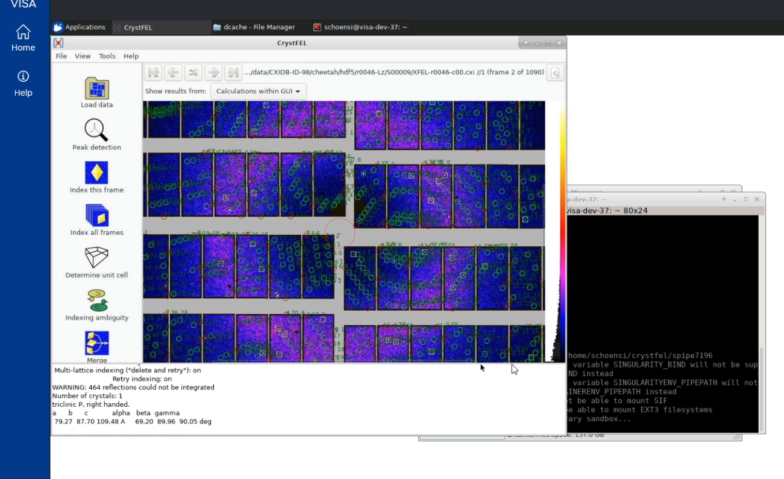
Visa.desy.de
Example: Work via remote desktop connection with graphical interfaces
Using CrystFEL Docker Images to run Singularity Container and work with Crystfel 10 Graphical Interface.
CrystFEL is a suite of programs for processing diffraction data acquired "serially" in a "snapshot" manner, such as when using the technique of Serial Femtosecond Crystallography (SFX) with a free-electron laser source. CrystFEL comprises programs for indexing and integrating diffraction patterns, scaling and merging intensities, simulating patterns, calculating figures of merit for the data and visualising the results.

Slide 23
Thank you

Slide 24
Fuhrmann Patrick, Wetzel Tim
DESY IT
Patrick.Fuhrmann@desy.de, Tim.Wetzel@desy.de

