Slide 1
Leveraging Cloud-based OpenAI’s LLMs to Create Learning-as-a-Service (LaaS) Solutions for Culturally Rich Conversational AI: A Study Using the Legacy of Slavery Dataset
Rajesh Kumar Gnanasekaran
ISGC2024, Taipei, March 26, 2024

Slide 2
Introduction
Need for increased support to learn/teach programming and to use Computational Thinking practices in the Archives and Library Sciences field
Need for enabling wide access to the culturally rich datasets that are digitally archived or born digital
Need for an open source set of solutions with unlimited free access anywhere to enable the learning and understanding of the concepts for interested individuals.

Slide 3
Overall Objective
Through multiple projects, create Learning-as-a-Service (LaaS) solutions
Artifacts to facilitate access to large amount of training information
Cloud Hosted
Easy on-the-go access
Teach latest and advanced topics to Digital Archives and Library Sciences students and researchers in a simple way

Slide 4
Project Objective
For this project, the three important goals are to
Create unique LaaS solutions in the form of cloud-hosted, coherent and modularized digital notebooks that could be publicly accessed.
Serve as self-teaching material for interested individuals on advanced computational thinking topics in a simple manner
Use culturally rich dataset collections as case studies in these LaaS solutions. Adds a third benefit by enabling access to these datasets for research and analysis by the budding students and researchers.

Slide 5
Research Methodology & Questions
An exploratory case-study methodology
Research Questions:
(RQ1) What are the potential benefits and challenges associated with utilizing Large Language Models, such as OpenAI’s GPT models, to develop a tailored chatbot capable of exploring data from high cultural context datasets and unveiling previously undiscovered relationships and patterns within this data?
(RQ2) How can we compare GPT models with traditional, non-AI exploratory data analysis models?

Slide 6
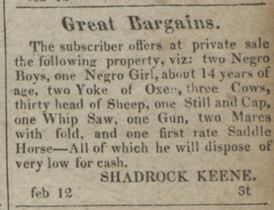
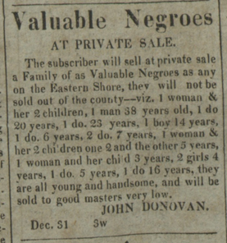
Domestic Traffic Ads Dataset

Slide 7
Learning Objective
Learn/Teach how to use Python as a programming language to create advanced AI technology solutions such as chatbots and to perform data science on culturally rich datasets.
Step-by-step walkthrough on how to create an Artificial Intelligence (AI) powered Conversational chatbot that will use the DTA dataset as its source to answer two types of questions by the end users.
Queries about a particular event, place, enslaved individual or slave owner’s details
Perform aggregate data analysis on the DTA dataset by asking the chatbot a set of natural language questions without knowing the intricate details.

Slide 8
Cloud-based digital notebooks
Jupyter Books¹
Evolution of Jupyter Notebooks
Structure and Organize content
Write narrative content
Write executable content
Build and Publish digital books online for free through GitHub Pages
1 - https://jupyterbook.org/en/stable/start/overview.html

Slide 9
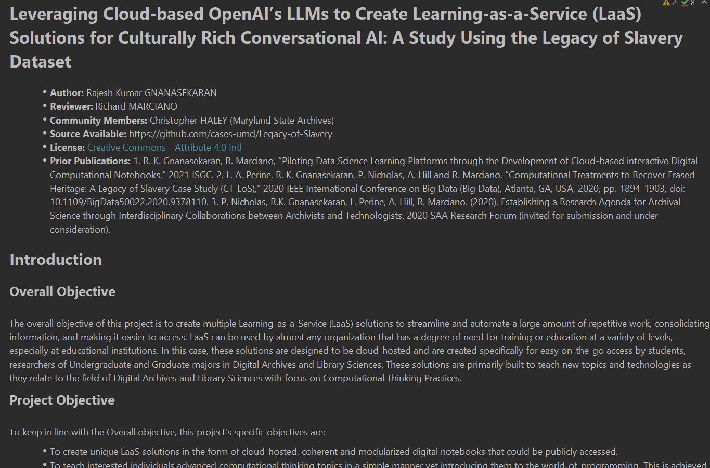

Slide 10
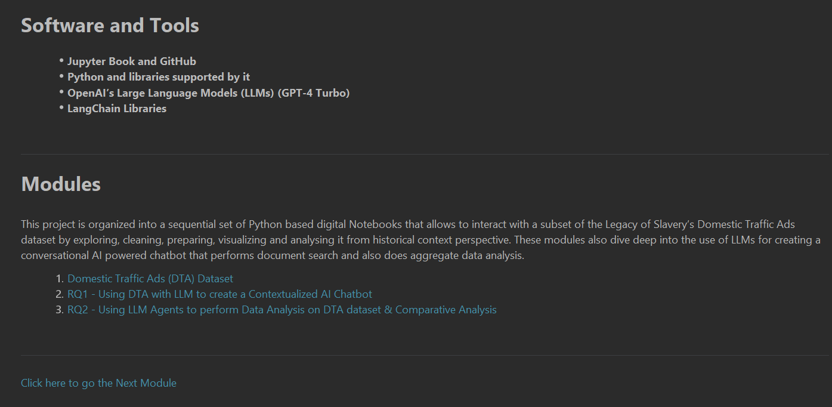

Slide 11
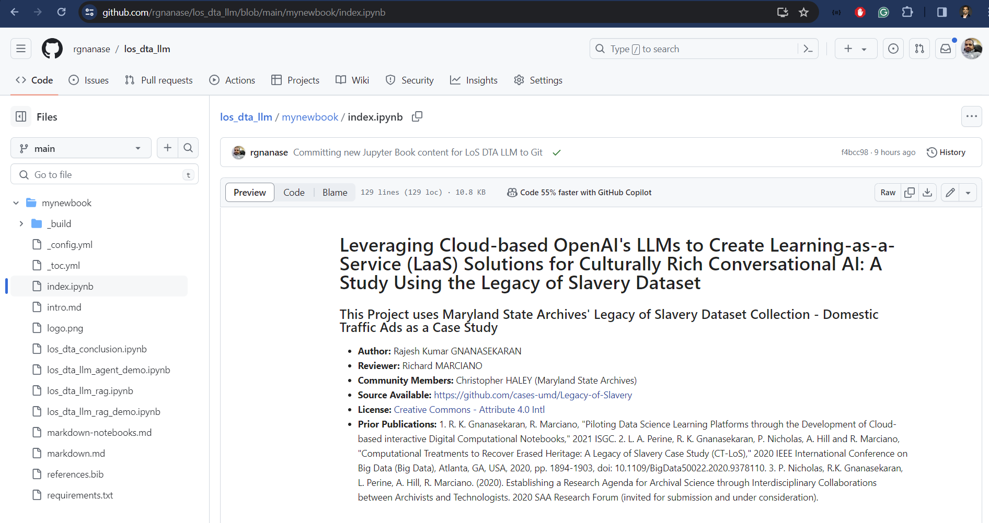

Slide 12
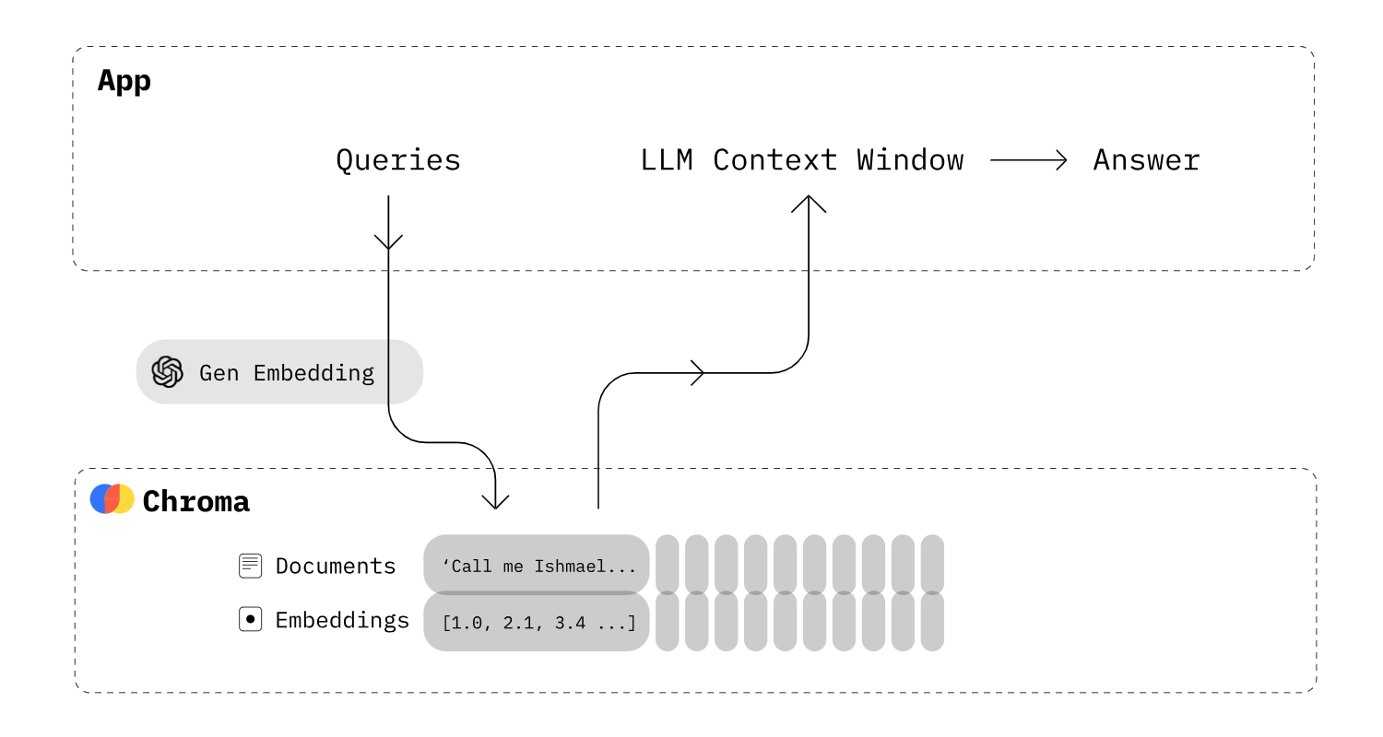
RQ1 - Using DTA with LLM to create a Contextualized AI Chatbot
Retrieval Augmented Generation
Source - https://heidloff.net/article/retrieval-augmented-generation-chroma-langchain/

Slide 13
RQ2 - Using LLM Agents to perform Data Analysis on DTA dataset & Comparative Analysis
The CSV Agent is a LangChain agent that reads data from a CSV file, and then performs different types of operations on the data. Behind the scene, the CSV Agent calls another agent — the Pandas DataFrame Agent,
which in turn calls the Python Agent, which generates LLM generated Python code.²
2 - Using LangChain CSV Agent for Performing Analytical Tasks

Slide 14
RQ2 - Using LLM Agents to perform Data Analysis on DTA dataset & Comparative Analysis

Slide 15
ISGC 2024 - LLM Chatbot vs Tableau Comparative Data Analysis - Test Results

Slide 16
Discussion & Limitations
LLM based chatbots can understand natural language statements to automatically choose the columns needed for aggregate data analysis.
They seem to be able to perform some of the level of data analysis in par with the non-AI tools like Tableau, worse on some metrics and better on some.
These models yet need to understand the context of the DTA collection and be further trained.

Slide 17
Future Work
RQ3 - How can we incorporate socio-technical considerations to promote trustworthiness and mitigate potential bias arising from the use of GPT models with library and archival collections?
Involve community users and receive feedback from them through regular workshops
Implement feedback receiving mechanisms from the chatbot to request and receive feedback
Implement solutions and guardrails in place to avoid issues related to ethical violations.

Slide 18
Questions?

