Slide 1
AI Platform for INFN Scientific Use Cases
INFN
National Institute for Nuclear Physics
Italy
Mauro Gattari (LNF)
DSI/DataCloud - mgattari@infn.it
Luca Giommi (CNAF)
DataCloud (Terabit) - giommi@infn.it
Marica Antonacci (BA)
DataCloud (FAIRS6, ICSCS0) - antonacci@infn.it
Gioacchino Vino (BA)
DataCloud - vino@infn.it
ISGC 03/2024

Slide 2
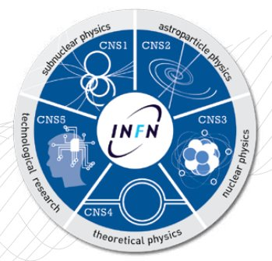
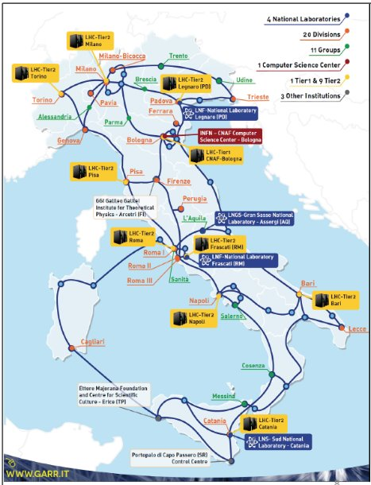
INFN National Institute for Nuclear Physics
5 lines of research
Facilities:
4 national laboratories
20 divisions
6 associated groups
3 national centers and schools
1 international consortia
Strong participation on national and international projects and collaborations
Across the diverse research domains, the demand for Machine Learning solutions has increased consistently.
Common need: accelerate ML adoption through an application-agnostic Machine Learning as a Service solution
AI Platform design driven by a bottom-up approach: from use cases to general purpose

Slide 3
Agenda
What's Next
AI Platform for Scientific Use Cases - Intro
Inference - Use Cases: NLP, HEP
Distributed Training

Slide 4
AI Platform Application/Experiment agnostic
Train/fine-tune machine learning models at scale
Host/share datasets and trained models in the cloud
Serve models to make inference from new data
Manage models and versions through a public INFN catalog
Provide a Web Application with a proper UI/UX that hides to end-users the complexity of the platform
Provide SDKs, CLIs, Tools to accelerate integration with the platform
AI Platform
providing
Services in the Cloud

Slide 5
AI Platform Components - Technologies
Physical/Virtual resources | CPUs, GPUs, RAM, Storage, Networking | INFN Cloud
Container Orchestrator | Automate deployment, scaling, and management of workloads on physical/virtual nodes | Kubernetes
Event Source | Decouple task submissions from their execution | Kafka
Inference | Models serving, horizontal scaling, batching, deployment strategies, inference pipelines | KServe, Knative
Train | Run distributed training jobs. Hyperparameters tuning. Resources quota (multi-tenancy). | Kubeflow Training Operator, MPI Jobs, Horovod, Katib Kueue
Infrastructure | Resources provisioning. Cluster Scaling | Kubernetes AutoScaler INFN Cloud Orchestrator/IM
NoSQL DB | Track jobs status. Public models catalog. | MongoDB
Object/Block Storage | Host data and models | S3/MinIO, Longhorn
on top of
INFN Cloud
Dedicated, geographically distributed infrastructure which offers composable, scalable, and open-source solutions to enhance
resource sharing and accessibility for INFN users, encompassing a wide range of resources, including GPUs and storage.

Slide 6
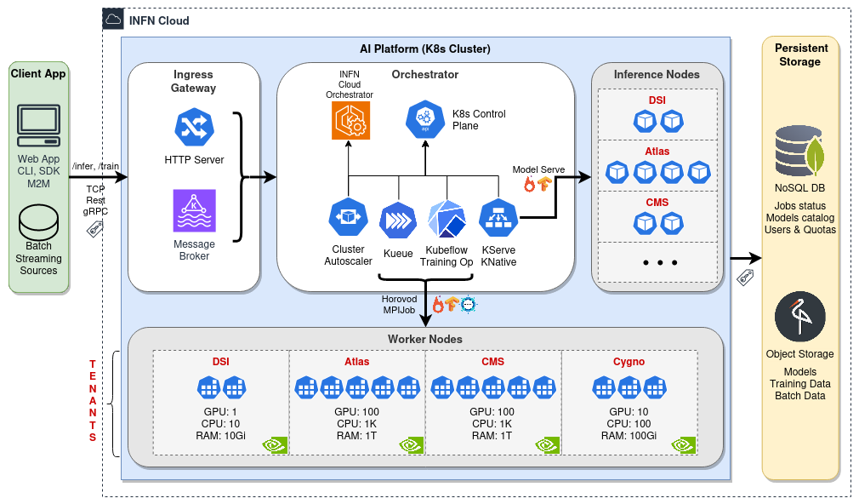
AI Platform High-Level Architecture

Slide 7
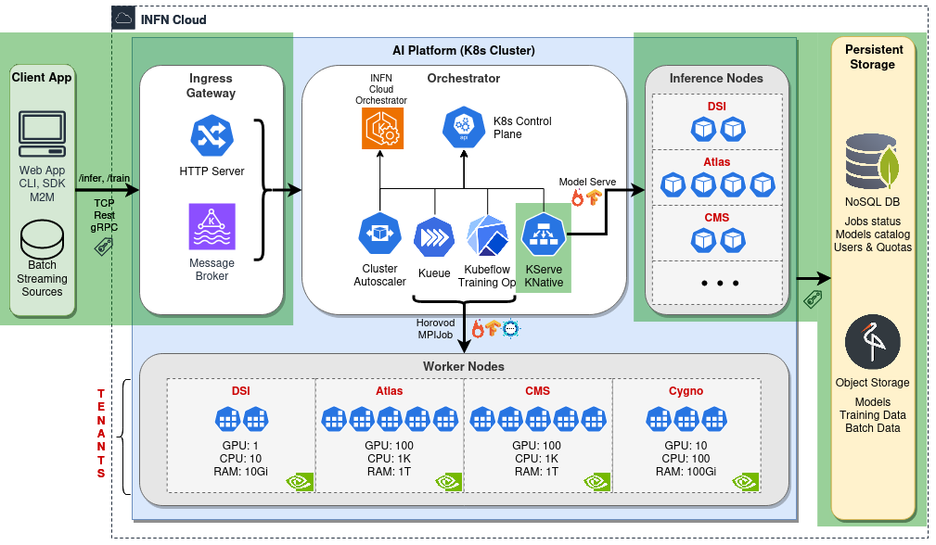
Inference High-Level Architecture

Slide 8
Use Case NLP: AI Assistant Retrieval Augmented Generation
AI assistants can be used to solve a variety of tasks:
searching for relevant information
data exploration and analysis
content creation, tasks automation (e.g., tickets), etc.
If AI assistants are to play a more useful role in everyday life, they need to be able not just to access vast quantities of information but, more importantly, to access the correct information. AI at Meta
RAG is a popular technique for injecting knowledge into an LLM:
highly effective at integrating LLMs with external up-to-date data sources;
help solve LLMs poor ability to retrieve and manipulate the knowledge that they possess:
hallucination (generate false information);
knowledge cutoffs (a pre-trained model knows nothing after its pre-training date);
poor understanding of specialized domains;
save time/costs for LLM fine-tuning over proprietary data.

Slide 9
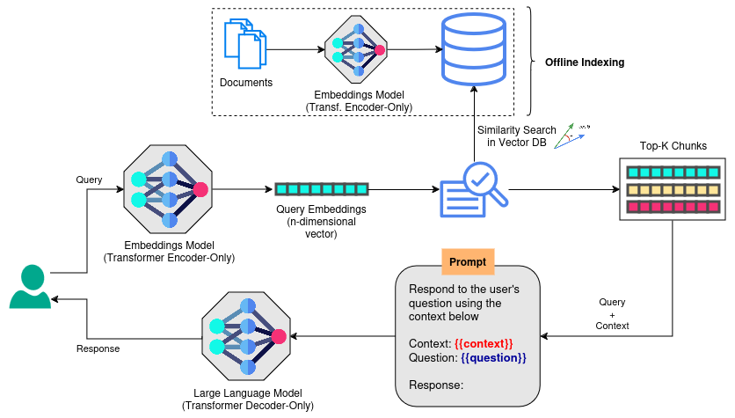
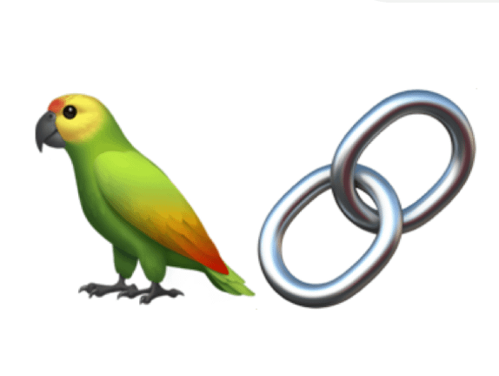
AI Assistant RAG Pipeline
RAG in a nutshell:
takes an input question and retrieves relevant documents from an external database;
passes those chunks as a context in a prompt to help an LLM generate an augmented answer.
Technologies:
LangChain
ChromaDB
HuggingFace
Transformers
Accelerate
KServe

Slide 10
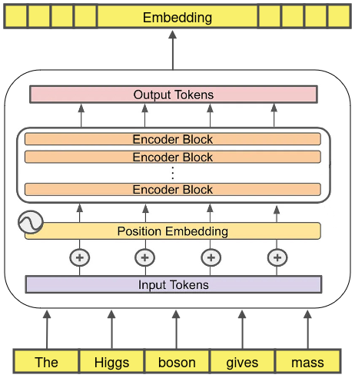
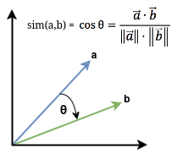
Embeddings Model Transformer Encoder-Only
Transformer
Encoder-Only
Transforms an input text into a mathematical object named embedding
An embedding is a n-dimensional dense vector that mathematically represents the semantics meaning of the input text
If properly trained, close vectors in the n-dimension space corresponds to semantically similar texts
Example:
intfloat/multilingual-e5-large-instruct
559M parameters
good Italian support
Input Text
Close vectors
~ Similar texts

Slide 11
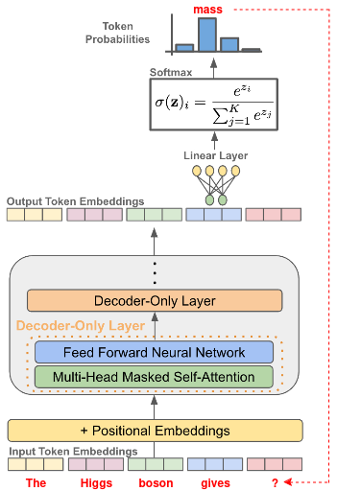
Large Language Model Transformer Decoder-Only
Predict probability distribution over next token based on the previous tokens
Generate sequence of tokens autoregressively
Example:
mistralai/Mixtral-8x7B-Instruct-v0.1
46.7B parameters
~24GB RAM required (quantized 4 bit)
good Italian support

Slide 13
AI Platform HEP-agnostic MLaaS
ML techniques in the HEP domain are ubiquitous, successfully used in many areas, and are playing a significant role in LHC Run 3 and in the future High-Luminosity LHC upgrade.
It would be useful a service that ease the adoption of ML in HEP analysis:
existing HEP solutions are not "aaS" solutions or do not cover the whole ML pipeline;
existing commercial MLaaS solutions cover many use cases but they are not directly applicable in HEP (e.g. lack of support for native HEP data, jagged array events, etc.).
The AI Platform is being designed to offer a MLaaS solution that is HEP/Experiment-agnostic.

Slide 14
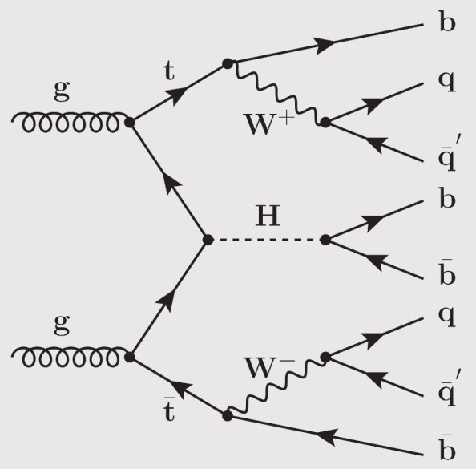
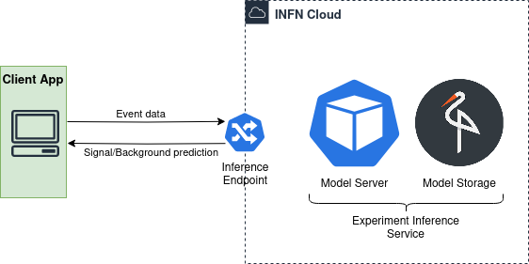
Real Case Scenario 𝑡𝑡𝐻(𝑏𝑏) analysis in the boosted, all-hadronic final states
Successfully deployed a ML model trained for signal vs background discrimination in a 𝑡𝑡𝐻 analysis in the boosted, all-hadronic final states
Inference service exposed through a INFN Cloud HTTP endpoint

Slide 15
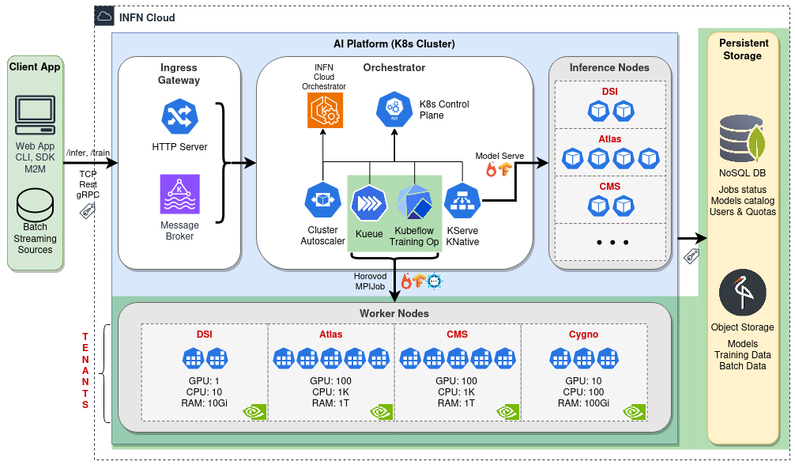
Distributed Training

Slide 16
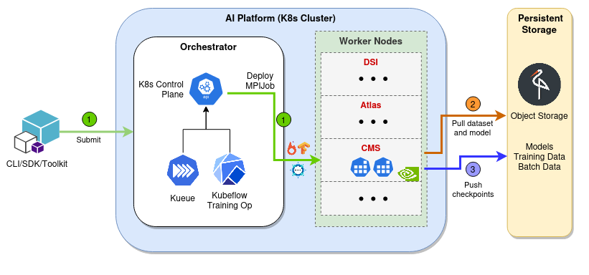
Distributed Training Workflow – Work In Progress
Submit of training jobs from user
Kubeflow Training Operator enables deployment of MPI Jobs at scale
MPI Jobs integrate with Kueue for resources sharing and quotas
Distributed Training via Horovod for inter-pod MPI communication

Slide 17
Motivation Democratizing AI
Share data, algorithms, computing resources, and knowledge
Provide tools to automate and accelerate the lifecycle of an AI project
Reduce time and cost of AI development, increase productivity
Promote collaboration and openness, foster creativity
Promote widespread adoption of AI

Slide 18
What's Next
Project Finalization
Finalize platform architecture and implementation
Promote adoption
NLP
Improve RAG pipeline with new techniques:
Chain of thoughts, Knowledge graphs, Semantic routing
HEP
Onboard more scientific use cases

Slide 19
Thank You

Slide 20
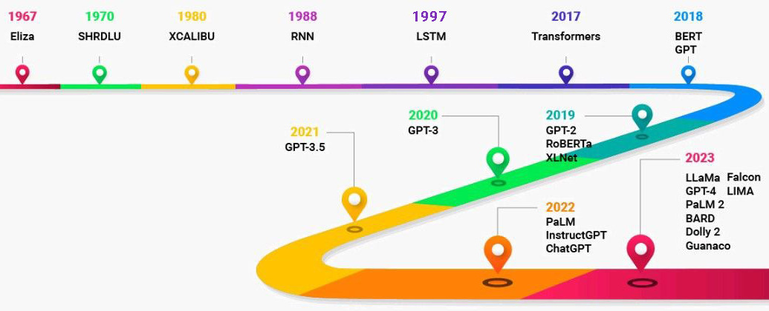
NLP/Transformers
NLP (Natural Language Processing): subfield of linguistics and computer science, primarily concerned with giving computers the ability to "understand" human language
A key event in the history of Language Models is the introduction of the Transformer architecture in 2017 (Google Brain team)
Transformer models outperformed existing solutions in solving NLP problems:
ChatGPT => Generative Pretrained Transformer

Slide 21
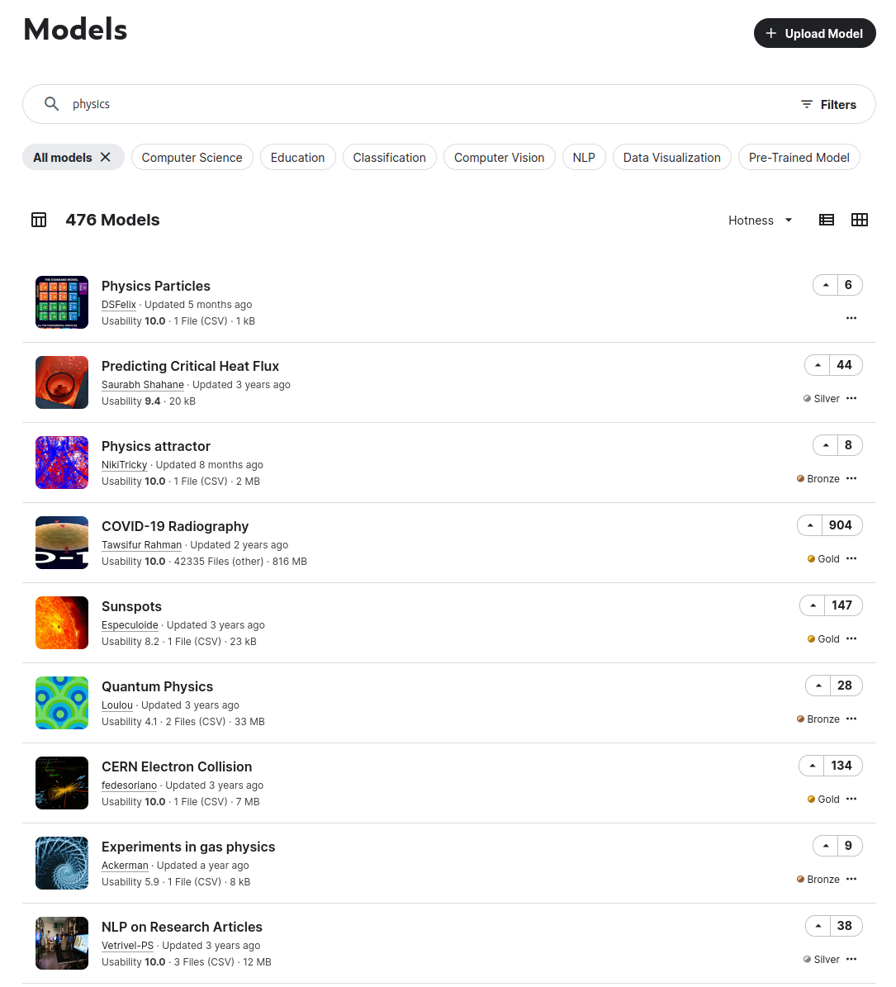
Web App
Models Catalog Page

Slide 22
RAG Pipeline Models and libraries
LLM Model:
Mixtral-8x7B-Instruct-v0.1
Embeddings Model:
multilingual-e5-large-instruct
Libraries (python):
Langchain
RAG pipeline
Faiss/Chroma
Vector database
Unstructured
Data processing workflow
Transformers, Accelerate
Pretrained Models
Multi-GPUs, Quantization
KServe
HTTP RESTful service and streaming endpoints

Slide 23
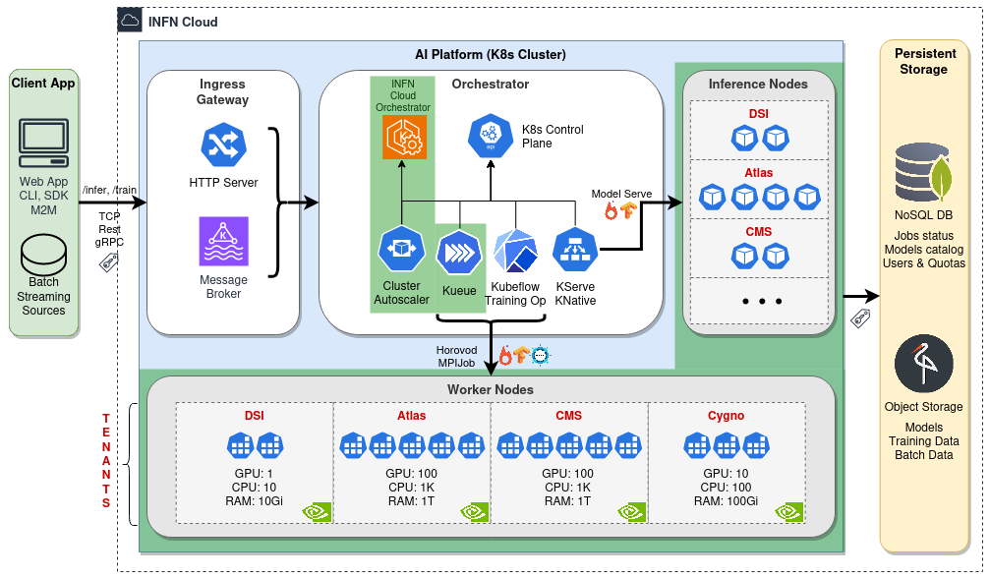
AI Platform Infrastructure Orchestrator

Slide 24
Infrastructure Orchestrator Workflow – Work In Progress
Demand of resources for Inference/Training
Horizontal autoscaling via Kubernetes Cluster Auto Scaler
Integration with INFN Orchestrator for deployment of new nodes
Kueue management of resources sharing and quotas

Slide 25
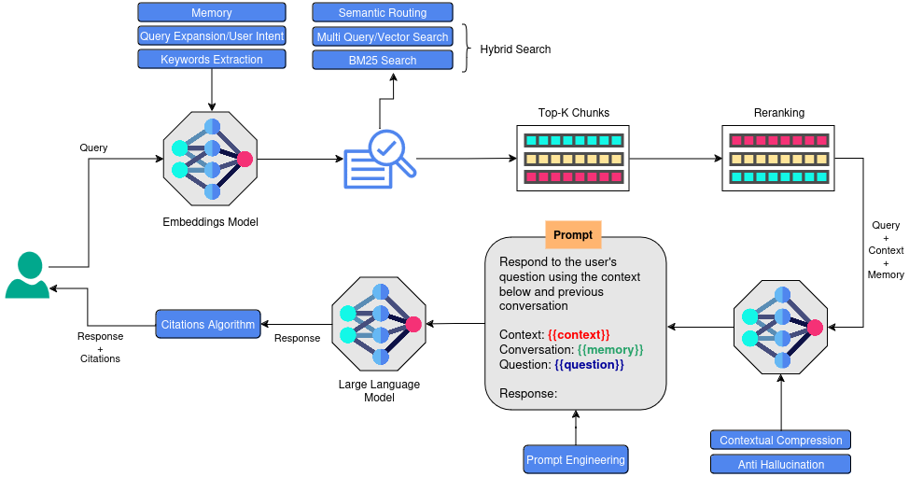
RAG Full Pipeline Work in progress

