Slide 1



The Application of Cluster-Based Distributed Computing in High Energy Physics Experiments
GUO, Chaoqi
IHEP CC , CAS
2024-02-23
Notes:
Hello everyone, I’m Chaoqi, come from IHEP, Chinese Academy of Sciences. I do this report on behalf of IHEP Computing Center. I will talk about …

Slide 2
Outline
1
Background
2
Status of Local HTC Cluster
3
dHTC design and implement at IHEP
4
key issues in cluster extending
5
Summary and Plan

Slide 3

Background and motivations
IHEP is hosting or attending in 15+ experiments around the field of high energy physics
  Most of experiments process the data at the local cluster
  Some domestic collaboration members are running small cluster
Extending the HTC local cluster is the good way to find more resources
  The data processing has run for a long time and bounded with the local cluster
  Most of users have been used to do data analysis at a local cluster
    Closer to use a personal PC and would not like to change any habit
    Access data and software in anytime and anywhere by the shared file system
  Some experiments do not have official experiment software
    User write their own data processing program in different ways

Slide 4
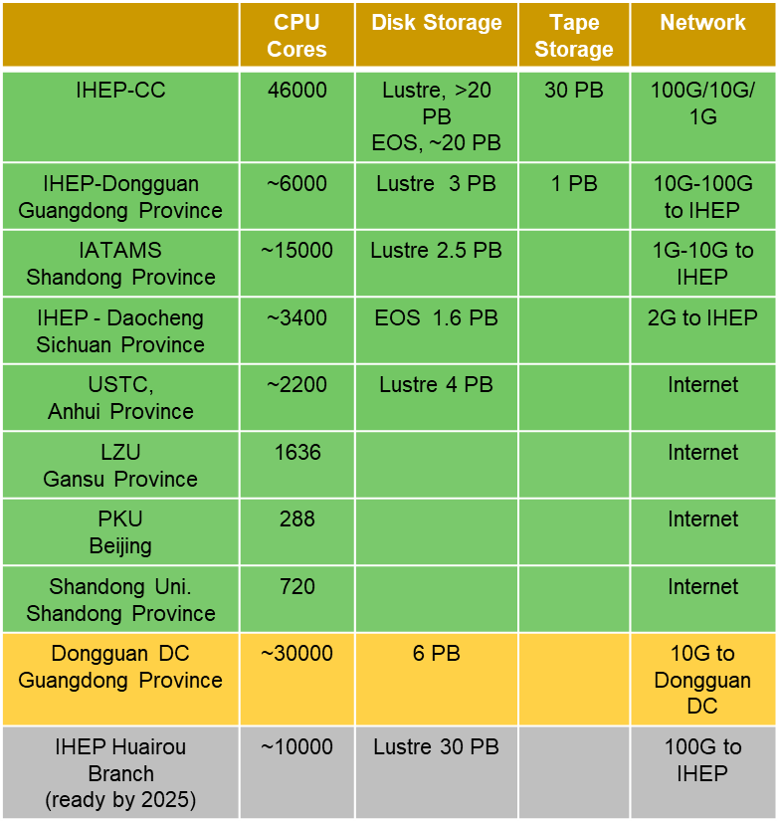
Clusters and Sites
More and more sites are built for scientific research in China
Branches of IHEP
  Long-term resources provided, regarded as part of HTC pool
  Limitation on network bandwidth and storage
Collaboration members
  Most are edge sites, not quite big
  Without a pledged storage
Cooperation institutes
  All are dynamic, opportunistic
  Nothing is pledged
Diverse requirements according to the conditions
  CPU & GPU & ARM & Cloud
  Structures of computing system are different
  Policies of job are different

Slide 5
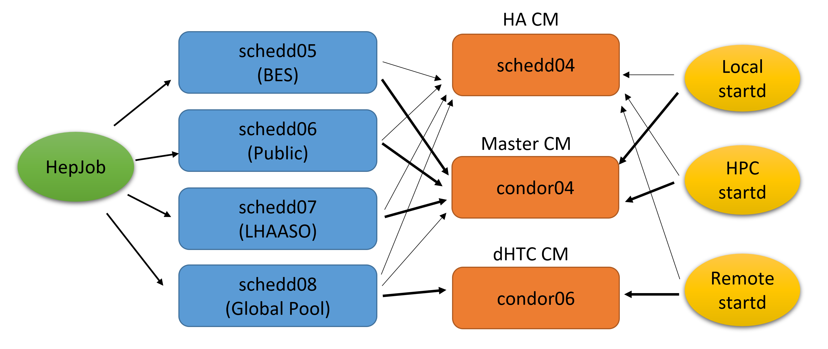
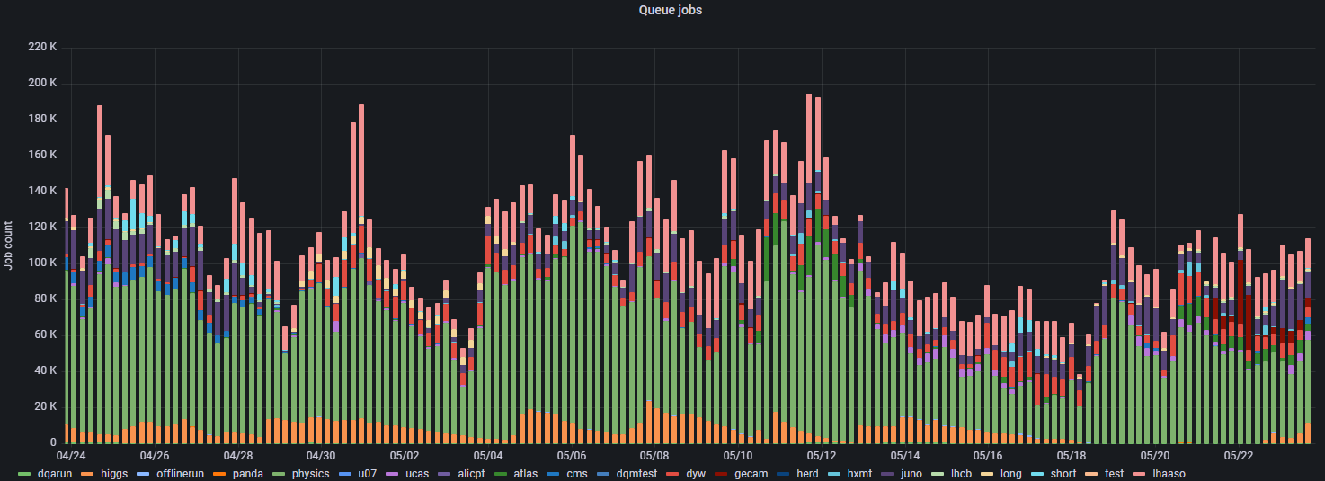
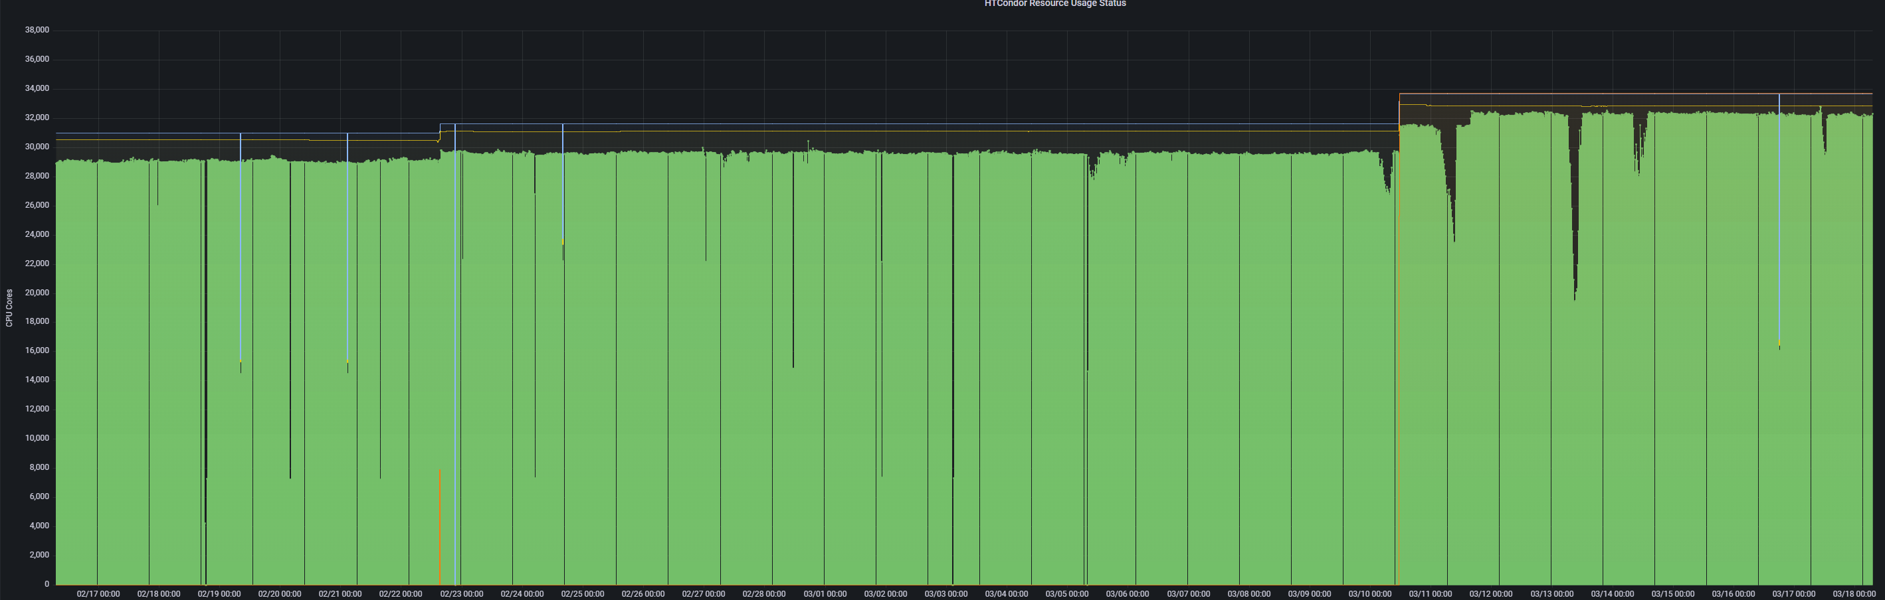
Status of IHEP Local HTC Cluster
IHEP HTCondor cluster is getting bigger
  4 Schedd: mapping by specific groups
  3 CM: Main CM & HA CM
  CPU: > 40k cores
    Most are single core slots
Finding more resources for the local cluster is becoming an urgent task
  Large amount of jobs are waiting for resources
    > 100k jobs sitting idle in the local job queue
  The HTC pool is quite busy
    > 90% resource utilization rate（> 40k CPU cores）

Slide 6
Basic Idea
The extended resources are likely added as direct worker nodes into the local cluster
The users still keep the same usage mode and interact with the computing system in a unified entrance
HTC jobs
HTC jobs
Local HPC Cluster
Local HTC Cluster
Remote Cluster
Produce Glidein Jobs
Produce Glidein Jobs
Glidein Factory

Slide 7
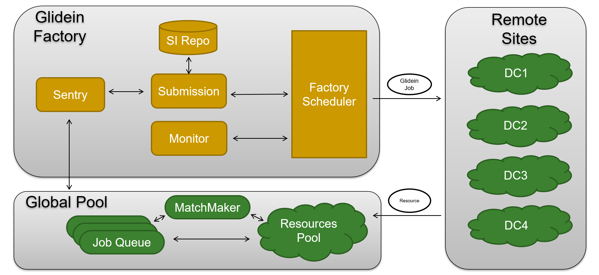
Factory Workflow
A central glidein factory can cover most sites or clusters
Glidein job will be submitted when the sentry finds new user jobs in the global job queue

Slide 8
Factory Schedule Policies
A heterogeneous policy of resource share
Static resource policy for self-owned and the pledged sites
  Resource provider report the promised number of long-term resources to the pool
  All the resources have been ready and glidein job can be submitted at anytime
Dynamic resource policy for cooperation sites and local HPC clusters
  Resource provider report a specific number of short-term resources as the workload
  Site decides when and what resource will be reported
    A client on site side to take charge of glidein submission and removal
Job policies depend on the job requirements
  All the job can run in the local HPC cluster due to the same worker node environment
  The job with small data transfer can run in the edge sites without pledged storage
  The job with large data output can run in the big site with large storage and good network

Slide 9
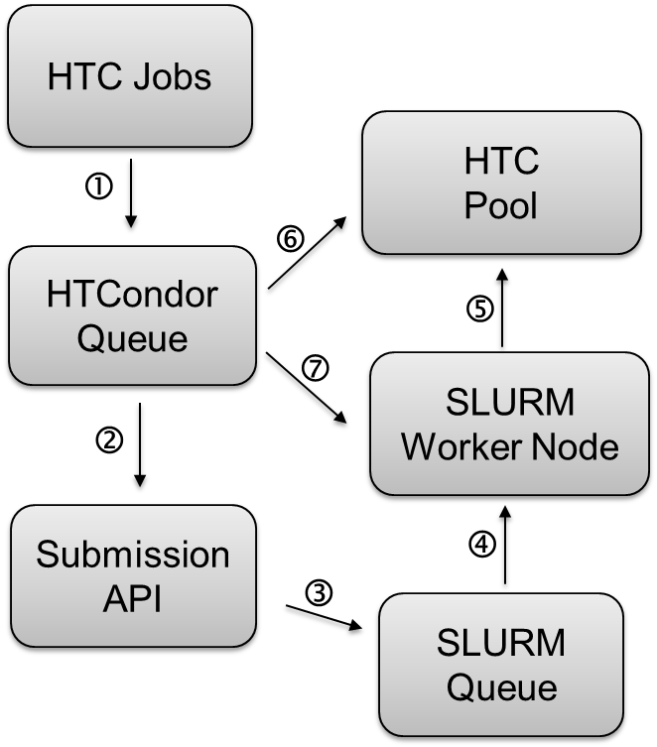
Extending to Local HPC
The system software of local HPC WN is same as that of HTC WN
  With shared file system and same user namespace
The workflow is:
  ① submit HTC jobs to HTCondor queue
  ② submission API receives the job requirements
  ③ submission API submits glidein jobs to Slurm queue
  ④ Slurm schedules glidein jobs to Slurm worker nodes
  ⑤ glidein startups startd and report to HTC pool
  ⑥ matchmaker
  ⑦ HTC jobs are sent to Slurm worker node
The policy in submission API is quite easy
  Specific idle user jobs
  Empty worker nodes in Slurm

Slide 10
Extending to Remote Cluster
The environment of the worker node is completely different from that of the local worker node
  The operating system versions are different
  The user namespaces are different
  The directory structures are different, with no identical shared file system
Key Issues
  Certification and Authentication
    Mutual authentication between services and permissions for user file transfers
  Distributed Data Access
    To be able to access the required local files remotely
  Transparent to the local cluster users
    Users would like to run job remotely without much change of the previous usage mode
  Running environment consistency

Slide 11
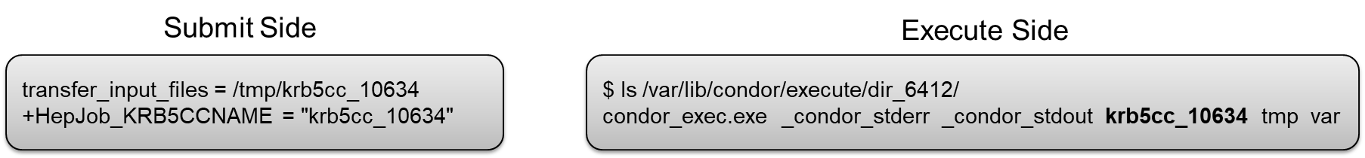
Cert & Auth with Tokens
The aim is to migrate from CLAIMTOBE to Tokens
  CLAIMTOBE is used is the local cluster for years
IDTokens for Daemon Certification
  All works are following HTCondor manual
Kerberos tokens for jobs and other services
  Tokens are treated as a regular file and transferred to remote site
  The token credential will be initialized in job wrapper
    Regular updates are performed daily to prevent permission expiration, with a maximum validity period of 7 days

Slide 12
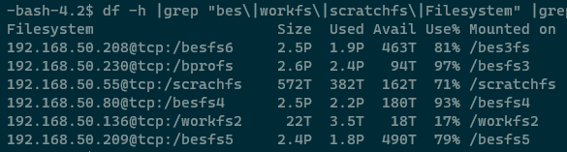
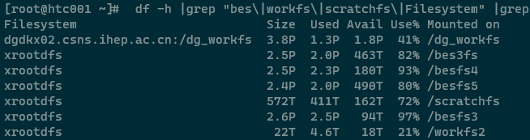
Distributed Data Access
A software Mimicfs is developed based on XRootD
  Widely used in HEP community
Remote jobs complete identity authentication through tokens
Two methods of reading and writing
  Directly read and write in a remotely mounted directory
  Access using the XRootD protocol remotely

Slide 13
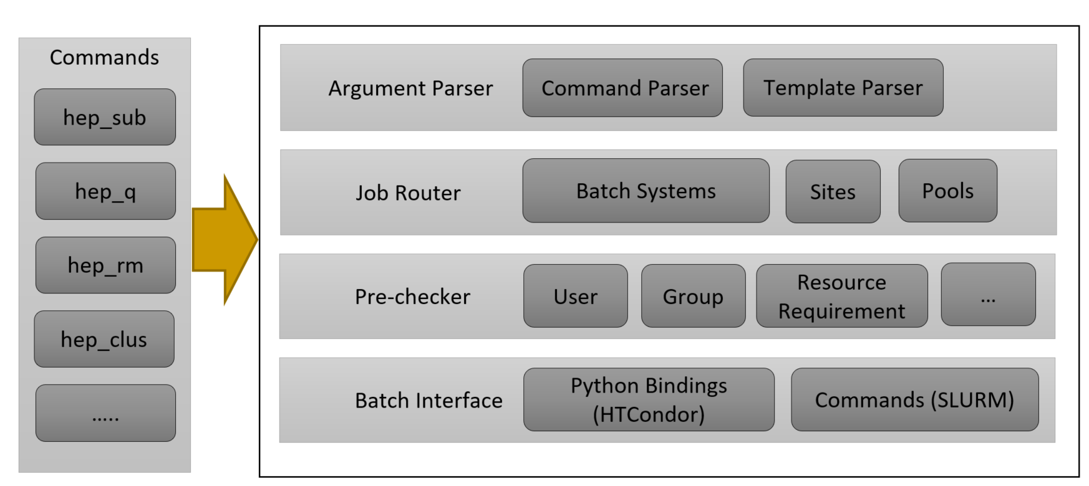
User Interfaces
User interface will fully respect the old usage mode
  No additional learning costs
  All the new functions are wrapped and added by extending the job tool – HEPJOB
Job workflow is helpful to introduce dHTC to experiments
  Re-design and implement the process of job workflow and the structure of data storage

Slide 14
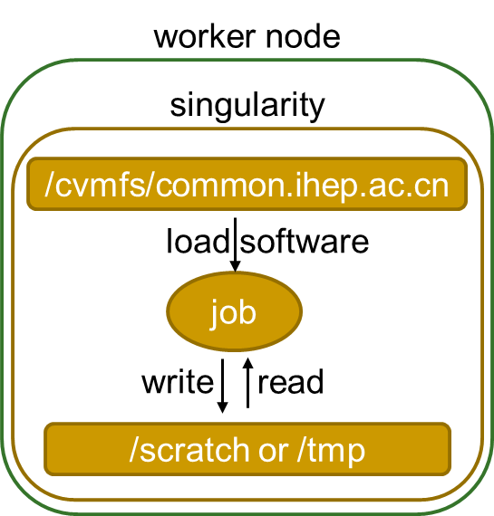
User Job Environment
Job environment in all solutions are based on singularity
Operating System
  Singularity images are published into /cvmfs/container
  Glidein job starts up singularity as the given image
Software
  Managed and served by CVMFS
  Transferred with job, as part of job input
Temporary storage
  The local scratch on the worker node
  The global storage shared in the whole distributed infrastructure

Slide 15
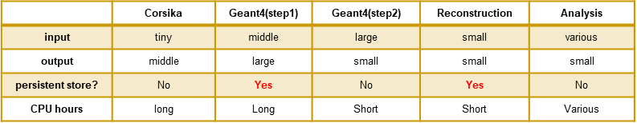
Application Cases
LHAASO simulation
  Characteristics: small input and not large output
  Job submission policy is that user decides where the job will run
    Still a simple command in HEPJOB: hep_sub job.sh –rmt
BES simulation & Reconstruction
  Characteristics: mature software framework (BOSS) ; tiny input but big output
  Job policy is that job will be transparently scheduled to anywhere by scheduler policy
    Job type and data position can be easy to judge with BOSS job option file
    The job will be selected and the data path will be remapped to the new path in the remote sites

Slide 16
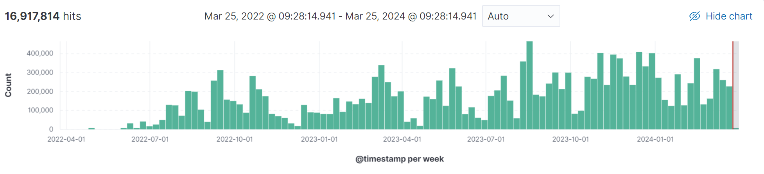
Current Status of Application
HTC jobs have been dispatched in the extended remote sites for over a year
  A total of 16,917,814 jobs have been completed, consuming approximately 89,783,563 CPU hours
Some specific jobs have been running at the Dongguan site
  LHAASO experiment: WCDA / WFCTA / KM2A / LACT simulation job
    The experimental tasks of WCDA, KM2A, and LACT are executed on x86 architecture
    The experimental tasks of WFCTA are executed on both x86 and ARM architectures
  BESIII experiment: All simulation jobs and some of the reconstruction jobs.
    Filter all the specific jobs submitted by users according to the specific attributes

Slide 17
Summary
Adding more resources by extending the local HTC cluster is the better way currently
  Experiments at IHEP have been used to processing data in the local cluster for a long time and the local HTC cluster is getting quite busy
With HTCondor glidein, we have made a basic design of dHTC at IHEP
Two parts of resources have been extended into the local HTC cluster and served in production
  The local HPC cluster and Dongguan site
Future plan
  Analyze and optimize the efficiency of distributed job remote access
Thanks!
Q&A

