Slide 1
Mining and Management of Physics Simulation Data
ISGC24 “Physics and Engineering” | 28.3.2024 Taipei, Taiwan

Slide 2


Leibniz Supercomputing Centre (LRZ)
Institute of the Bavarian Academy
of Sciences
and Humanities
IT Service Provider for Munich Universities
IT Solutions for Science
HPC
High-Performance
Computing
110,000
students
~ 270
employees
approx.
V2C
Virtual Reality
and Visualisation
262,5
Gbit/s internet
connection
30,000
employees
QC
Quantum-computing
62
years of
IT support
8,500
scientists
Big Data
Competence
Centre
4,900
WLAN
access points

Slide 3

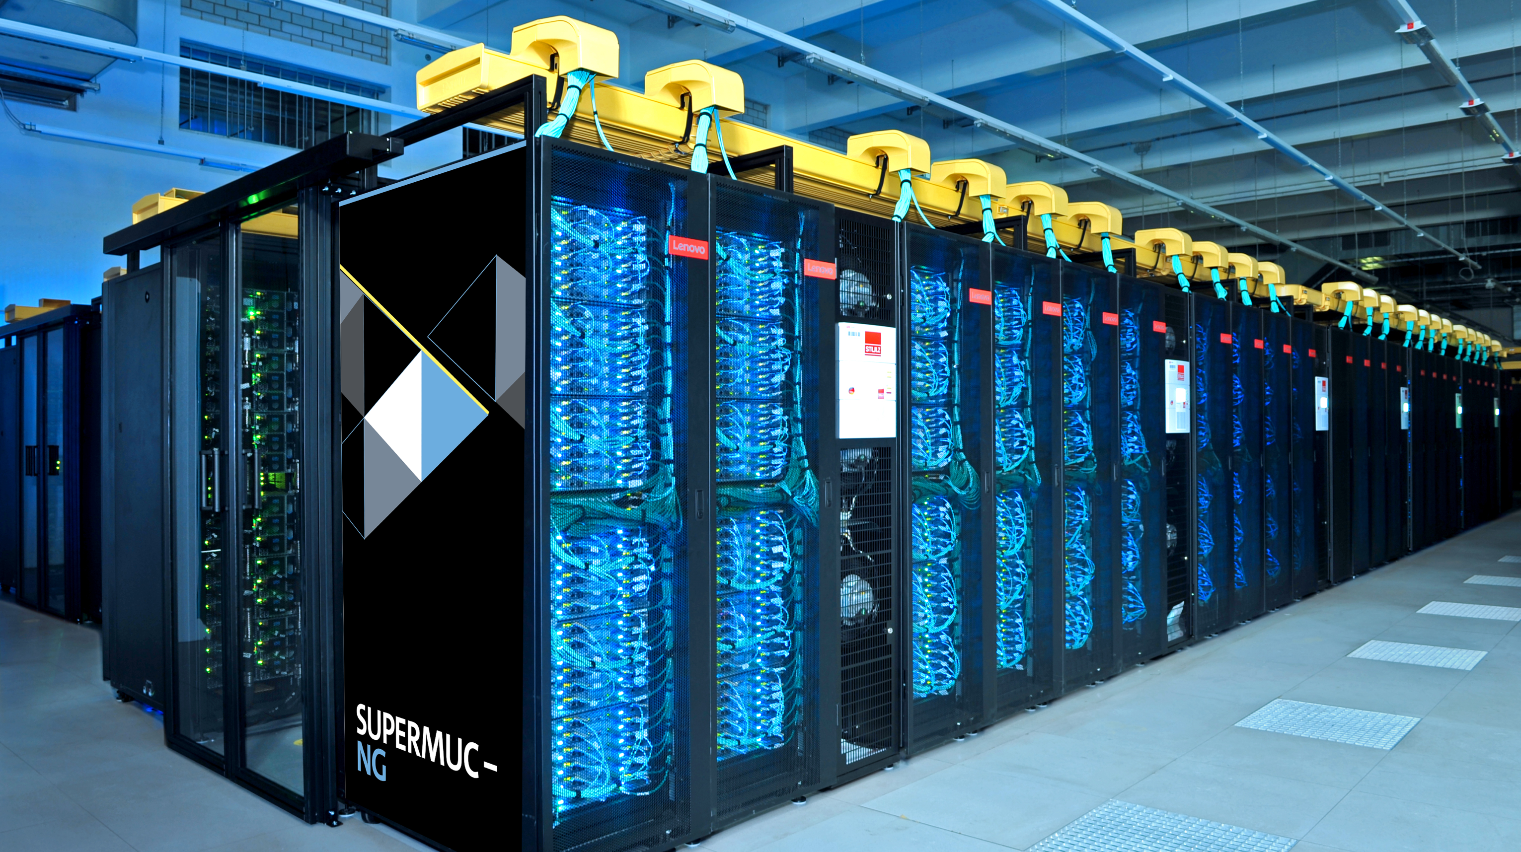

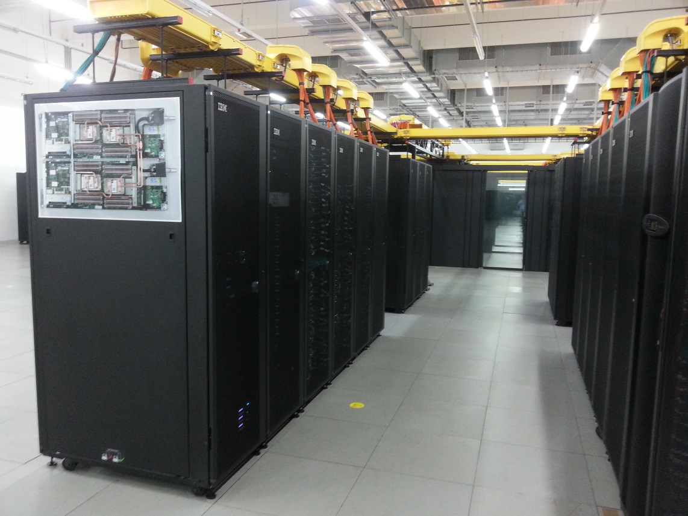
SuperMUC-NG, Compute Cloud, Linuxcluster
Infrastructure
Lenovo/Intel (2019)
311,040 cores Intel Xeon Skylake
26.9 Petaflops Peak
70 Petabyte Disk
719 Terabyte Main Memory
OpenStack (2015)
82 Intel Xeon Gold Nodes
32 GPU Nodes– 2x Nvidia Tesla
384/768 Gigabyte RAM per Node
6000 Gigabyte on Huge Node
LinuxCluster (2016)
400 Haswell nodes (CooLMUC-2)
6TB Teramem (Intel Broadwell)
150 mem HP DL580 64 KNL 7210-F Omnipath (CooLMUC-3)
1 Petaflops Peak

Slide 4
Project and Collaborators

Slide 5
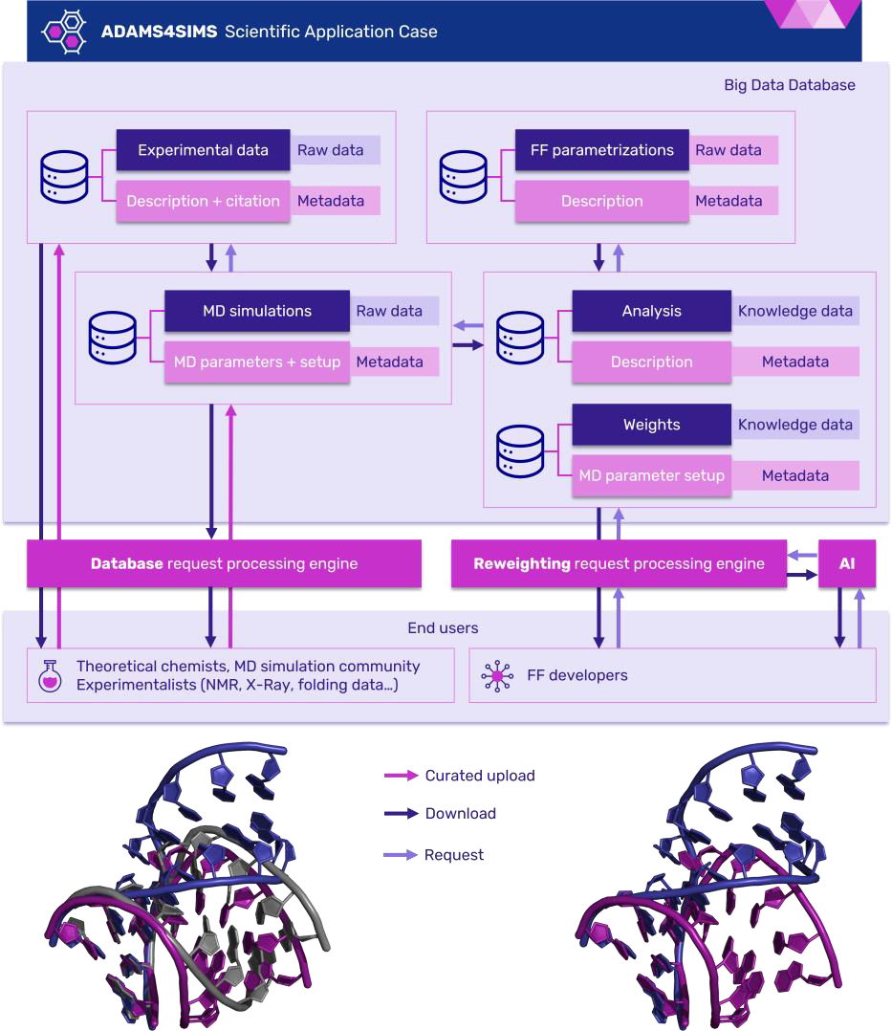
EXA4MIND Project
Project
Utilizing Databases for Data Management
Metadata for looking up the correct simulation
Where possible:
  In DB calculation via SQL queries
Aim for Cross-Platform Availability
Enable Automated workflows
Reduce manual interaction
Sketch of EXA4MIND MD database ecosystem

Slide 6



Partners
Project
Collaboration with LMU
EXA4MIND Partners
PSC - Plasma Simulation Code:
Hartmut Ruhl
Kai Germaschewski, K Bamberg, N. Moschüring
Chair for Computational and Plasma Physics
Experiments by J.Schreiber’s group (LMU):
Tobias Ostermayr, Peter Hilz
Project Lead:
Jan Martinovic, Martin Golasowski
Work-Package Partners:
Prof. Michal Otyepka
Vojtech Mlynsky
David Ciz
Radek Furmanek

Slide 7
Physics Simulations
Plasma Mean Field & Molecular Dynamics

Slide 8
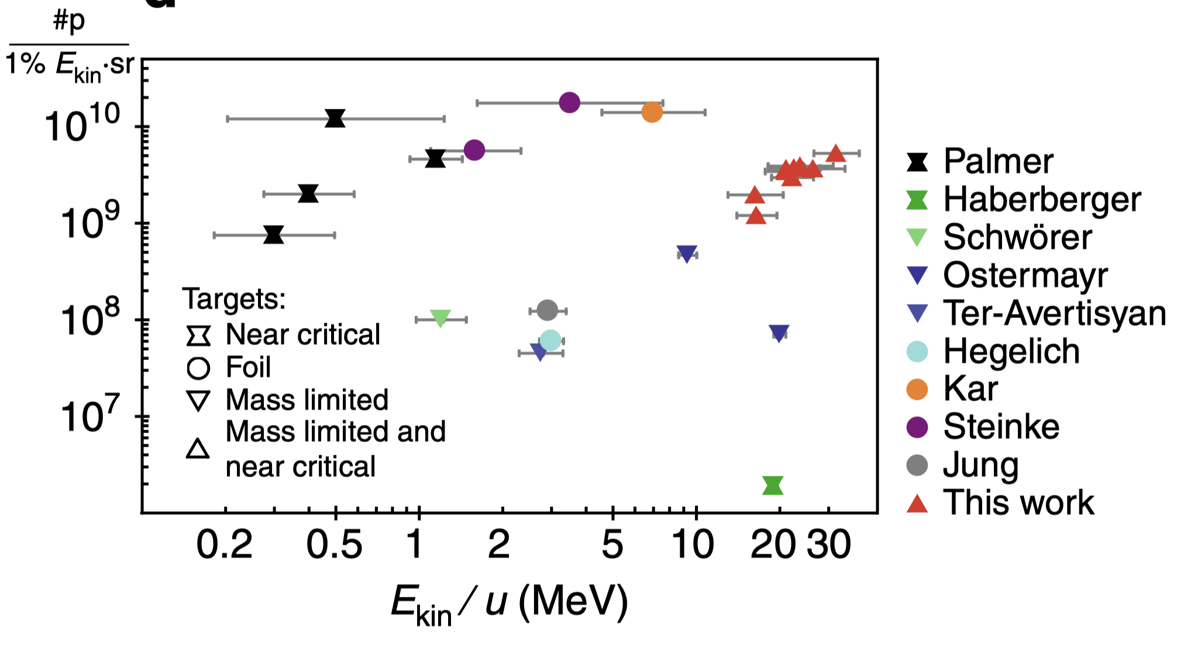
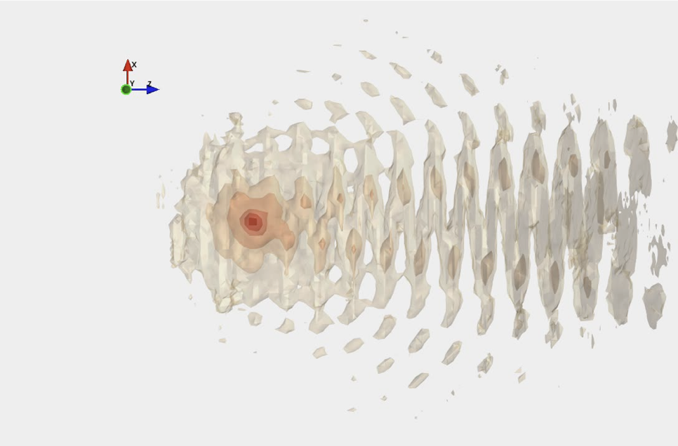
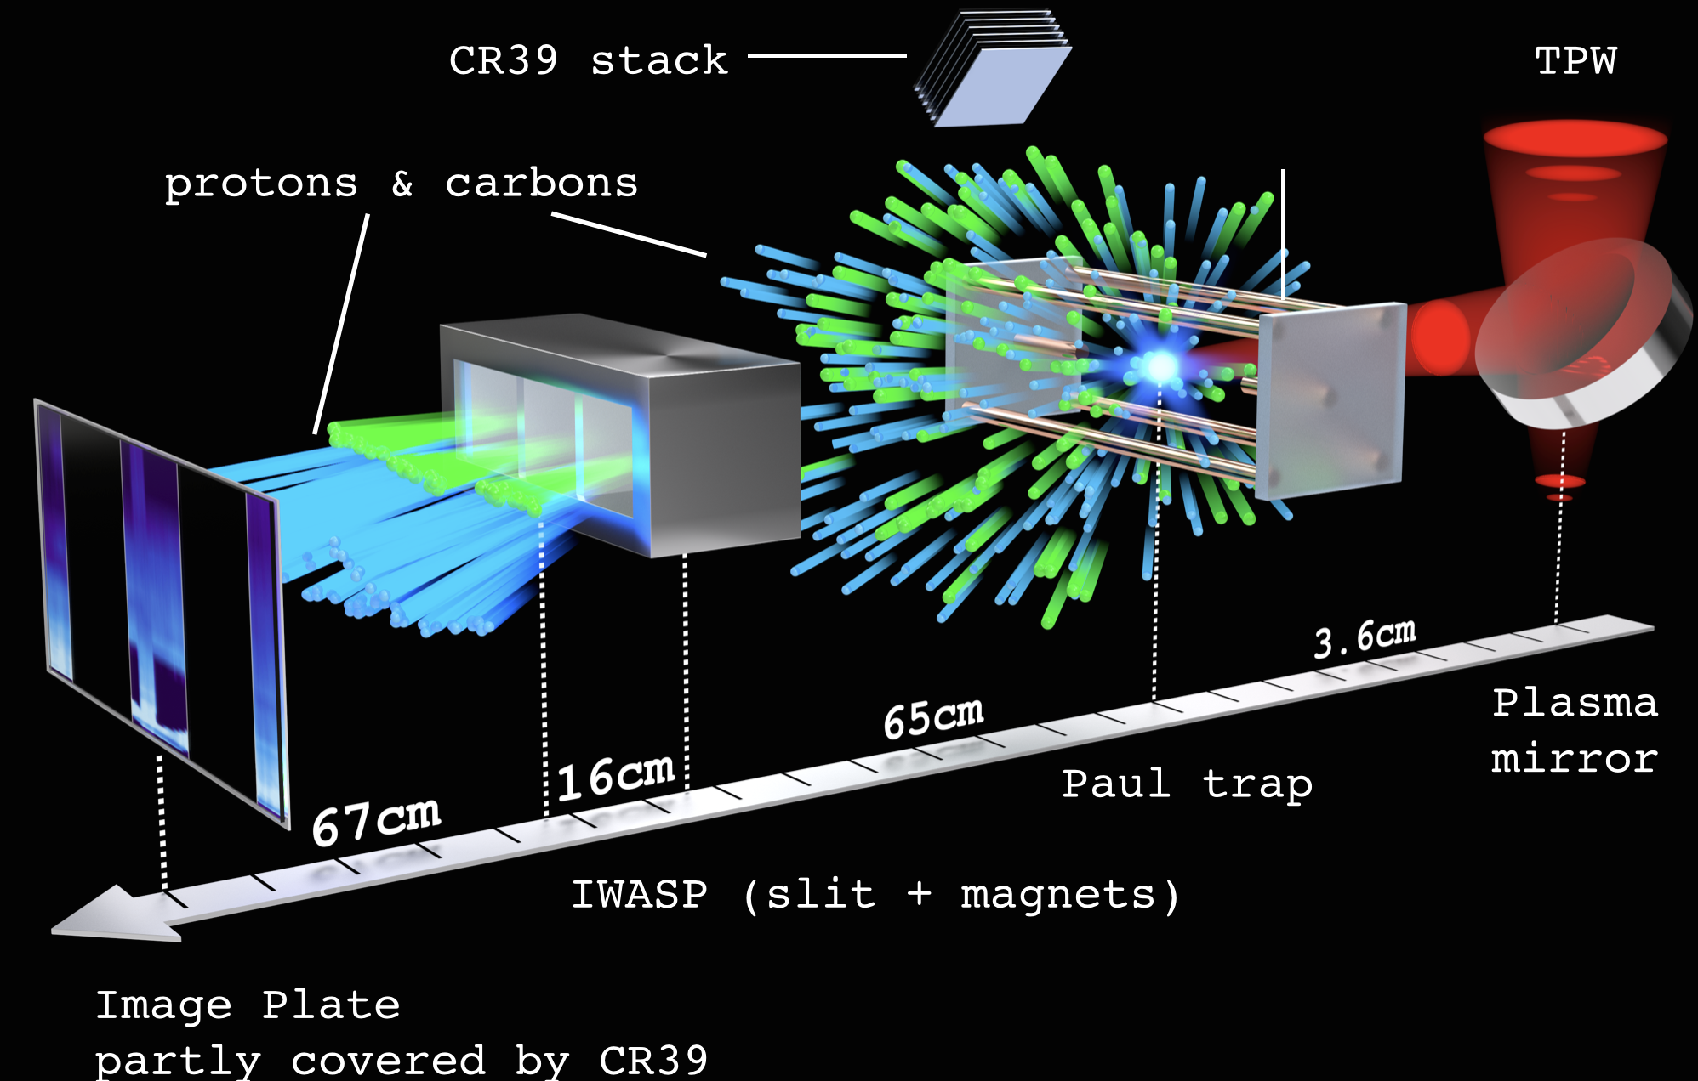
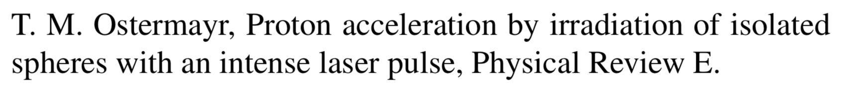
Plasma Simulation
Physics: Plasma Simulation
Plasma is Matter at very high energies
Atom hulls (partially or fully) desintegrate – free ions and electrons
Laser field introduces external force
Particles are accelerated to relativistic energies within nanoseconds
Experiments at Texas Petawatt Laser and PHELIX
Plastic Sphere (CH) is levitated in Paul trap
I=10²⁰-10²¹ W/cm², a₀=10-17 150 - 500 fs FWHM
Simulation of excited electrons
Sketch Experimental Set-Up

Slide 9
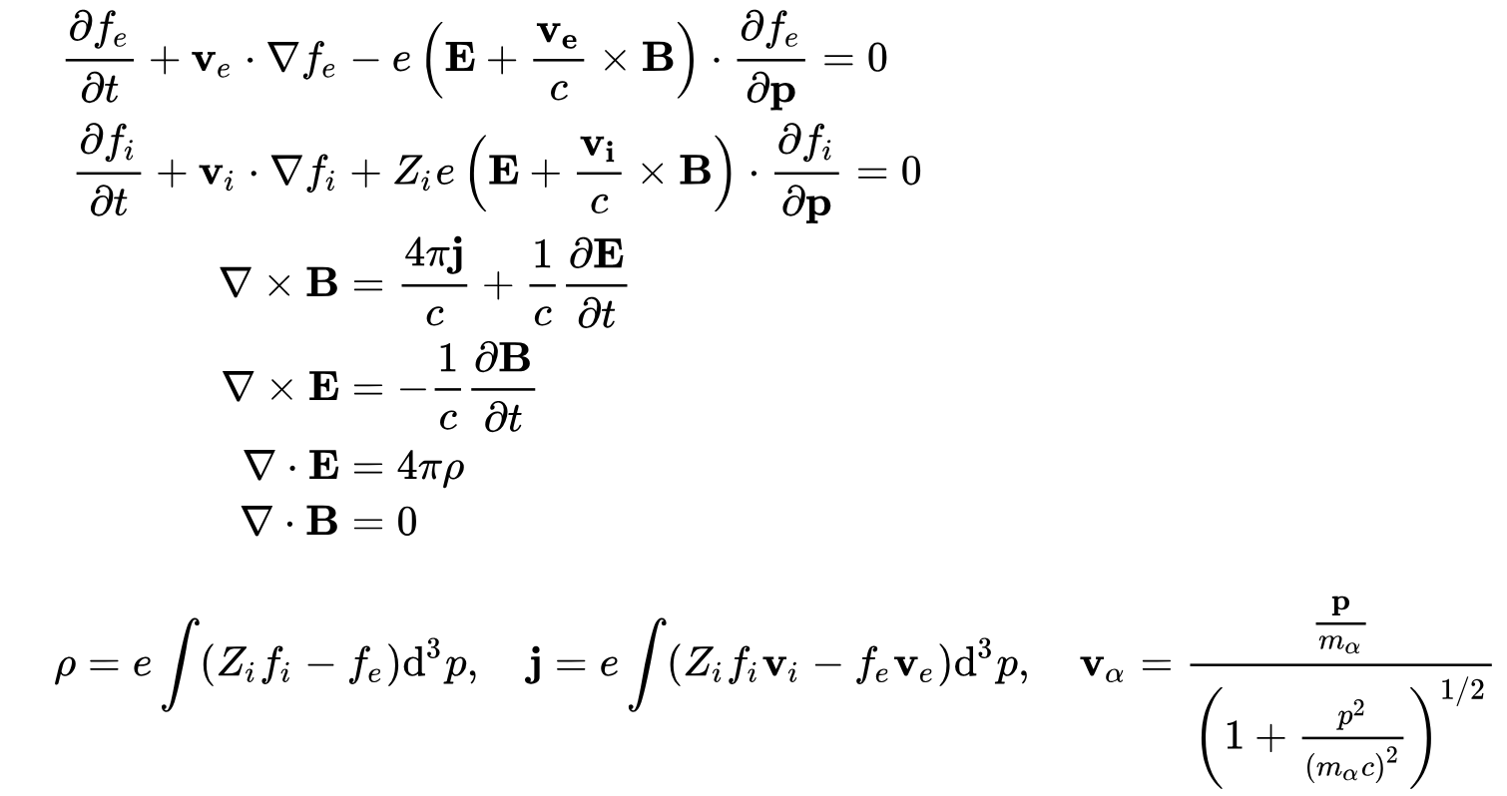
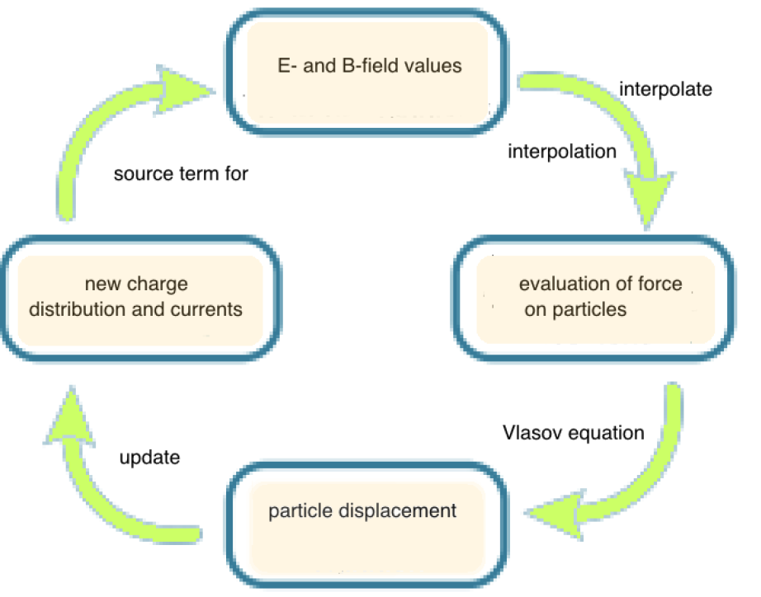
Particle in Cell Simulation
Physics: Plasma Simulation
Particle In Cell Simulation
Calculate electromagnetic fields from Maxwell Equations
Distribution function represents „quasi particles“
Up to 10¹³ quasi-particles per simulation
Electrons can reach close to lightspeed -> relativistic energies
Maxwell-Vlasov Equation

Slide 10
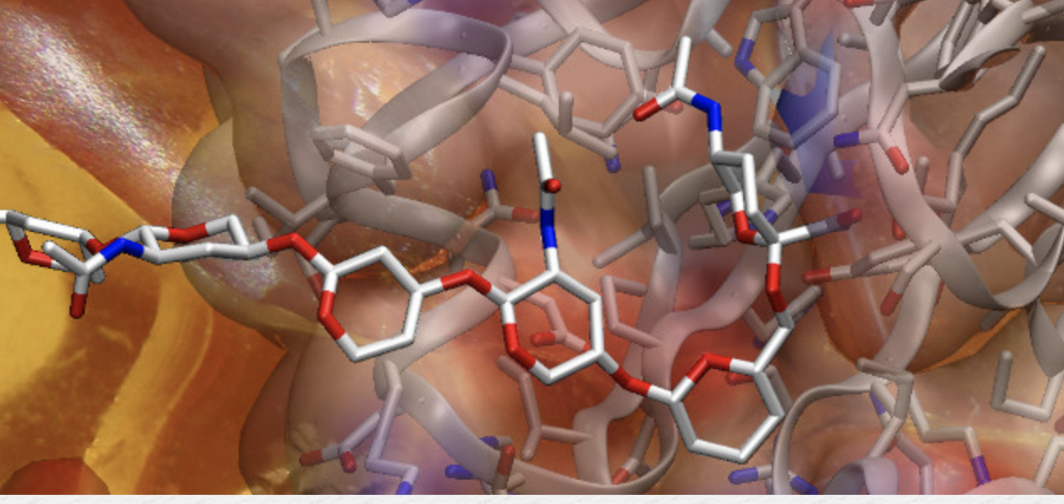
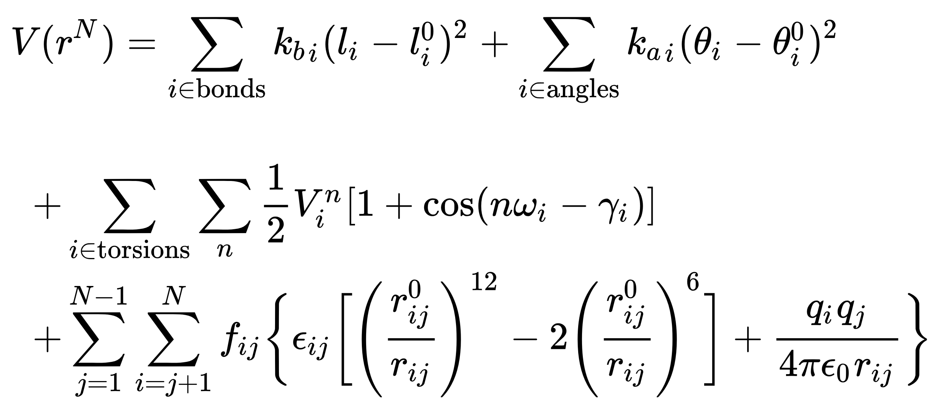
Molecular Dynamics with AMBER
Physics: Theoretical Chemistry
important applications ranging from drug discovery over structure and function relationships to protein/nucleic acid design
MD simulations support tens of thousands of scientific publications
has been supported by development of empirical force fields (FF)
capture many structural features of biologically relevant systems
researchers often face FF artifacts, related to overparameterization and overfitting of the FF parameters
Example of Molecule representation
https://ambermd.org/
)
Molecular force fields

Slide 11
Mining HPC Data

Slide 12
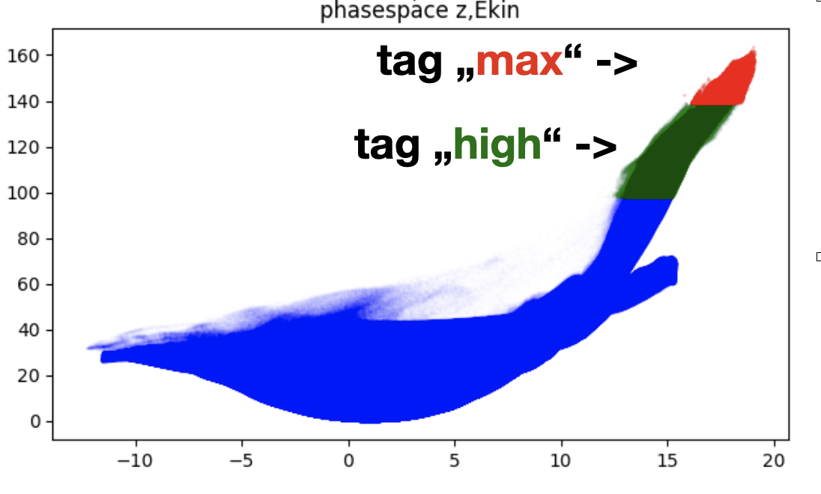
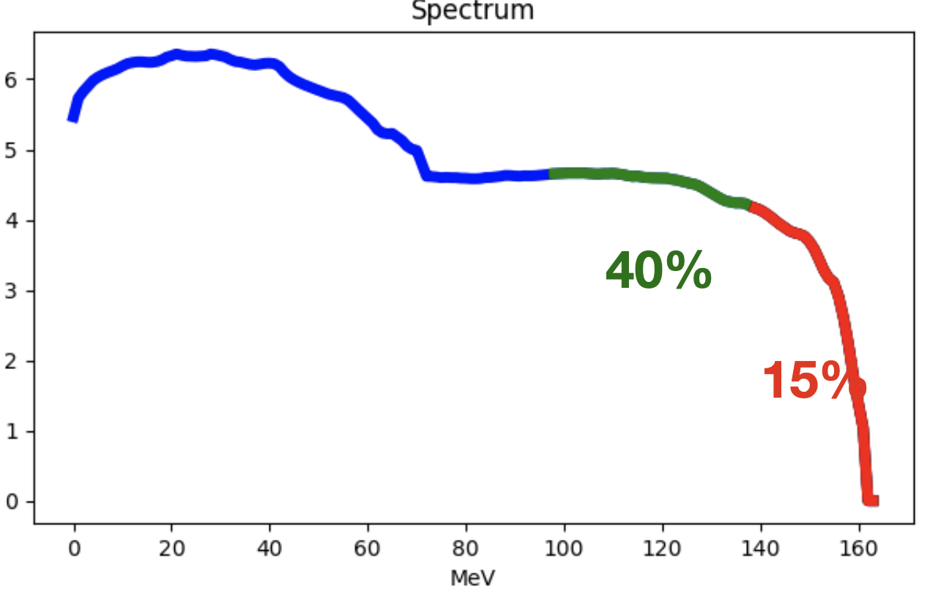
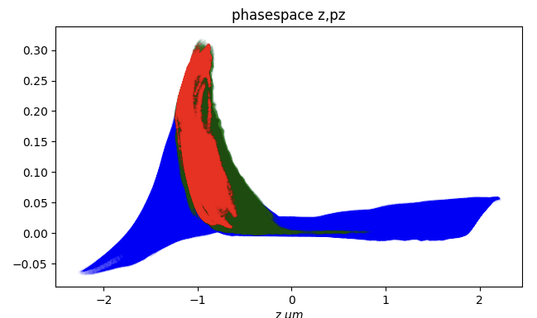
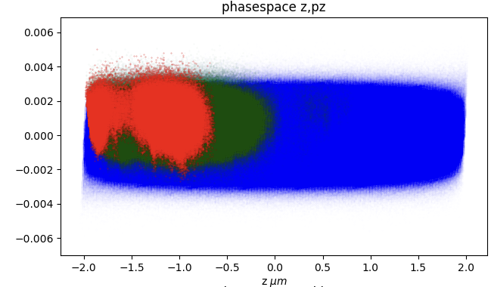
Tracking Fast quasi particles
Physics: Plasma Simulation
Interested in generation of fastest Ions + Electrons
Tracing fast protons
Plotting for intuitive understanding of dynamics
Sort by species
Evalueate UID mask
Get momentum
Calculate energies
Sort for fastest particles
List of UIDs
Load Timestep
From HDF5
Phasespace
Scatterplots
Load Timestep
Get earlier time
Plot
Visualisation
Make 2D slice
Density with histograms
Sort by list
Get fast UIDs
Python-Skripte
Postprocessing

Slide 13
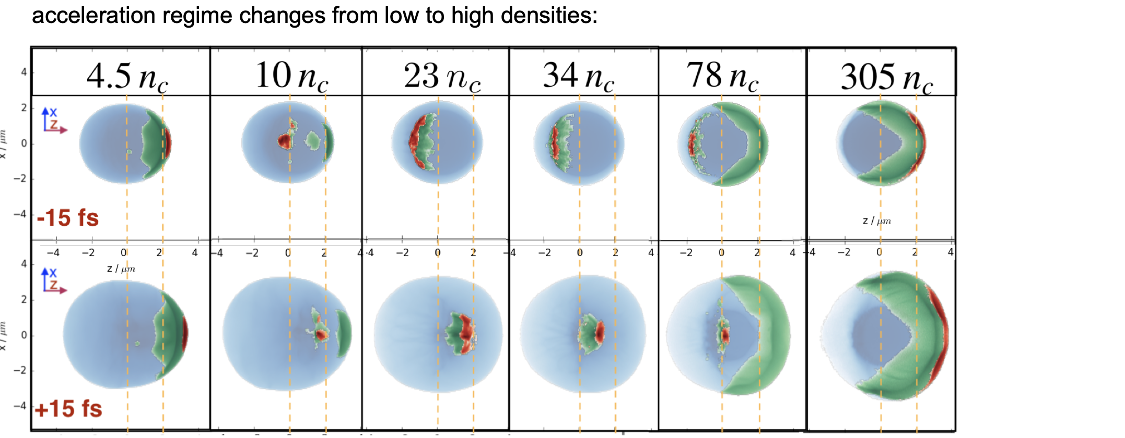
Parameter Scans
Physics: Plasma Simulation

Slide 14


Molecular Dynamics: Force Field Re-evaluation
Physics: Theoretical Chemistry
Goal: routinely optimise the FF for as many cases as possible using reweighting methods
automation of tuning, based huge database of simulations and observed parameters for benchmark molecular systems
Get data
Find correct molecule
Trajectory
Location of single atoms
Combine
Load list of relevant pairs
Calculate
Distances, dihedrals
Store
Distance, angles
Re-Calculate
Forces with new weights
Evaluate
New Force Field
Calibrate
Against Experimental data

Slide 15
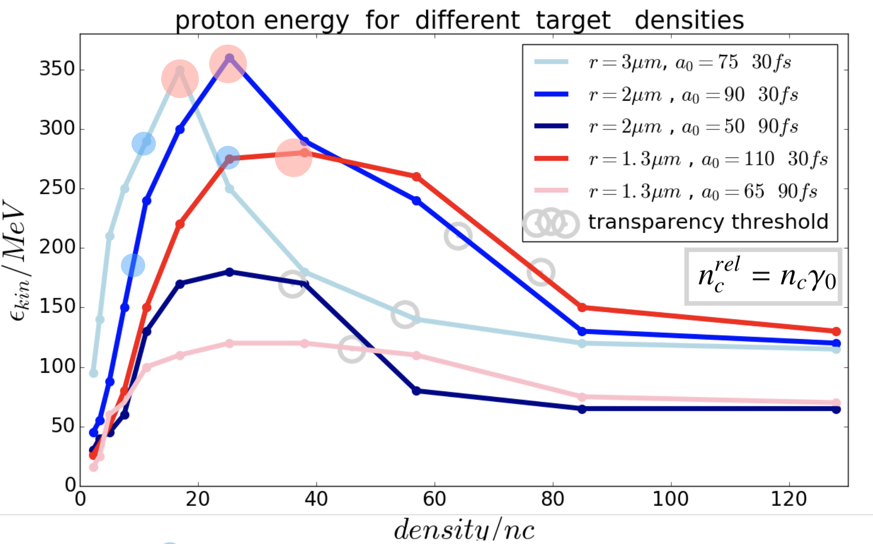
Data Mining Challenge
Further ESS Projects where LRZ’s Environmental Computing Team is involved
Plasma Simulation:
>100 runs , >50 TB particle data
7 dimensional parameter scan
  Density & target size
  Field Polarisation & Field strengths
  Pulse length & Pulse Focus
  Ion species
3D: high simulation costs
Domain size:36x36x63 µm
2304x2304x4032 grid cells
10 quasi-particles per species and cell
2-4 species
runs on 128, 256 or 512 nodes -> 3584, 7168 or 14336 ranks (1/4 - 1 island on Supermuc Phase 2)
runtime 5 h -> 17000 - 72000 cpuh per run
~10 GB field data and
0.5-20 GB particle data per timestep
Typically 10000 timesteps

Slide 16
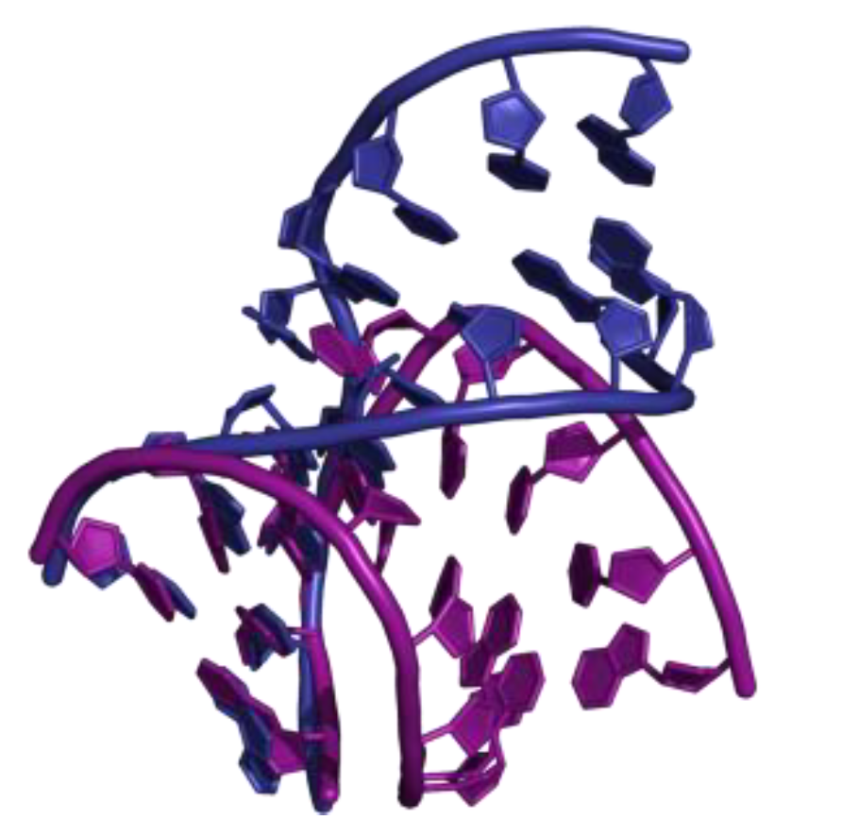
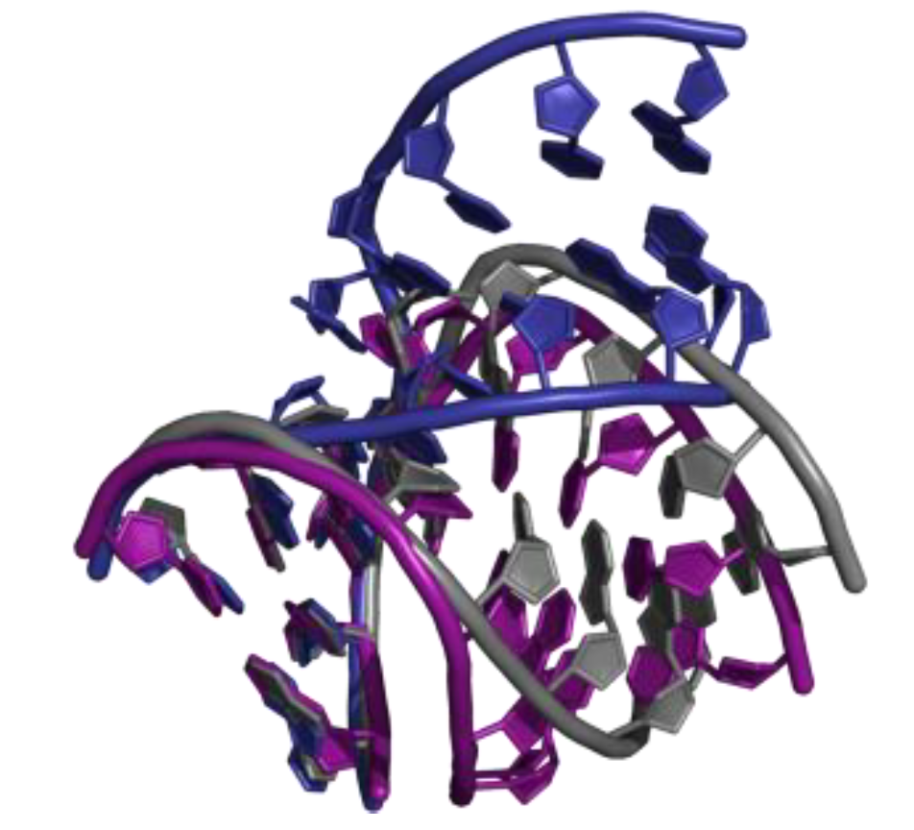
Data Mining Challenge – MD simulations
Further ESS Projects where LRZ’s Environmental Computing Team is involved
simulation output
  trajectory
  topology
  output
  Metadata
  up to 1TB for specific system
datasets from post-processing – analysis of structural parameters (up to 1 GB for each parameter)
comparison against experimental datasets: database of weights; up to 10 MB for each file
1000s of molecules investigated
DNA, RNA molecules
Typically >100 atoms in molecule
+ 10000s of H2O If simulated in water
Typically 100 000 timesteps
Organised in chunks
Temperature/Energy ist varied
Atom names and pair lists in separate files

Slide 17
Database Concepts

Slide 18
Row Data Storage
Databases for scientific Data Analysis
rows are stored as consecutive arrays on disk
they are loaded into memory as entities
Other rows are not touched, if not necessary
Iparticle ID | x | y | z
0 | 1.653 | 4.776 | -10.693
1 | 0.823 | 5.243 | 0.123
2 | -0.645 | 5.985 | 30.655
3 | -2.334 | 5.324 | 82.739
Operations that need all/many values in 1 row are fast in row based DB
Example:
  Fetch all relevant fields/metadata for an entry
EUDAT,
Data
Spaces

Slide 19
Columnar Data Storage
Databases for scientific Data Analysis
Columns are stored as consecutive arrays on disk
Columns are loaded into memory as entities
Other entries in the row are not touched
Iparticle ID |  | x |  | y |  | z
0 |  | 1.653 |  | 4.776 |  | -10.693
1 |  | 0.823 |  | 5.243 |  | 0.123
2 |  | -0.645 |  | 5.985 |  | 30.655
3 |  | -2.334 |  | 5.324 |  | 82.739
Operations that aggregate columns are fast in columnar DB
Examples:
  Sum of energies of all particles in a table
EUDAT,
Data
Spaces

Slide 20





Database Structure Type
Databases for scientific Data Analysis
Postgres + Citus
  Distributed
  columnar
MonetDB
  natively columnbased
  Developed for science
MariaDB + Columnstore
  Fork of MySQL
  Parallel loading
Clickhouse
  Realtime
  Vector processing
  Time series
OnLine Transaction Processing OLTP-focused RDBMS systems are more row-oriented
OnLine Analytical Processing OLAP-focused systems are a balance of row-oriented and column-oriented
Column based DB:
less seek time (disk access is slow!)
Compression (column is continuous and of the same type)
Increased activity in CMDB since 2004

Slide 21
Simple example query
Databases for scientific Data Analysis
MariaDB [test_db]> SELECT 0.5109993*sum(sqrt(power(x,2)+power(y,2)+power(z,2)+1)-1) AS total_energy FROM wf1_test_column WHERE z>10. AND y<5 ;
+--------------------+
| total_energy |
+--------------------+
| 35554864.167503394 |
+--------------------+
1 row in set (2.409 sec)
MariaDB [test_db]> SELECT 0.5109993*sum(sqrt(power(x,2)+power(y,2)+power(z,2)+1)-1) AS total_energy FROM wf1_test_row WHERE z>10. AND y<5 ;
+-------------------+
| total_energy |
+-------------------+
| 35554864.16750364 |
+-------------------+
1 row in set (35.870 sec)

Slide 22
Tests of MariaDB row vs column storage
Databases for scientific Data Analysis
Calculating distance/Energy between particles
  1000 entries (small)
  2GB file (large)
In one large table
Numbers in parentheses are second run, when data is partially already in
Comparing with a typical hdf5 dataset loaded with python
 | hdf5 & numpy | row DB | column DB
Distance small | 5.2 (0.2) s | 0.09 | 0.11
Energy small | 3.5(2.6) s | 0.04s | 0.06s
Distance Large | 110 (73)s | 46s | 13s
Energy Large | 89 (51) s | 247 (46) s | 15s
EUDAT,
Data
Spaces

Slide 23
Tests of Divided vs. Combined table structure
Databases for scientific Data Analysis
Tables structured either as
  one large table for all atoms
  Many tables (100-200), one per atom
Two lengths of simulation run
  119 atoms, 100000 steps
  144 atoms, 70000 seps
Cache misses cause 50% longer table to be >2 times slower
 | Combined table all | Combined table Filter for atoms | Separated table per atoms
Distance 1 atom short | 3.565 s | 1.215 s | 32 ms
Distance 1 atom long | 6.470 s | 2.602 s | 50 ms
Distance 2 atom short | 142.486 s | 1.253 s | 85 ms
Distance 2 atom long | 630.277 s | 2.717s | 124 ms
EUDAT,
Data
Spaces

Slide 24
Data Curation & Meta Data

Slide 25
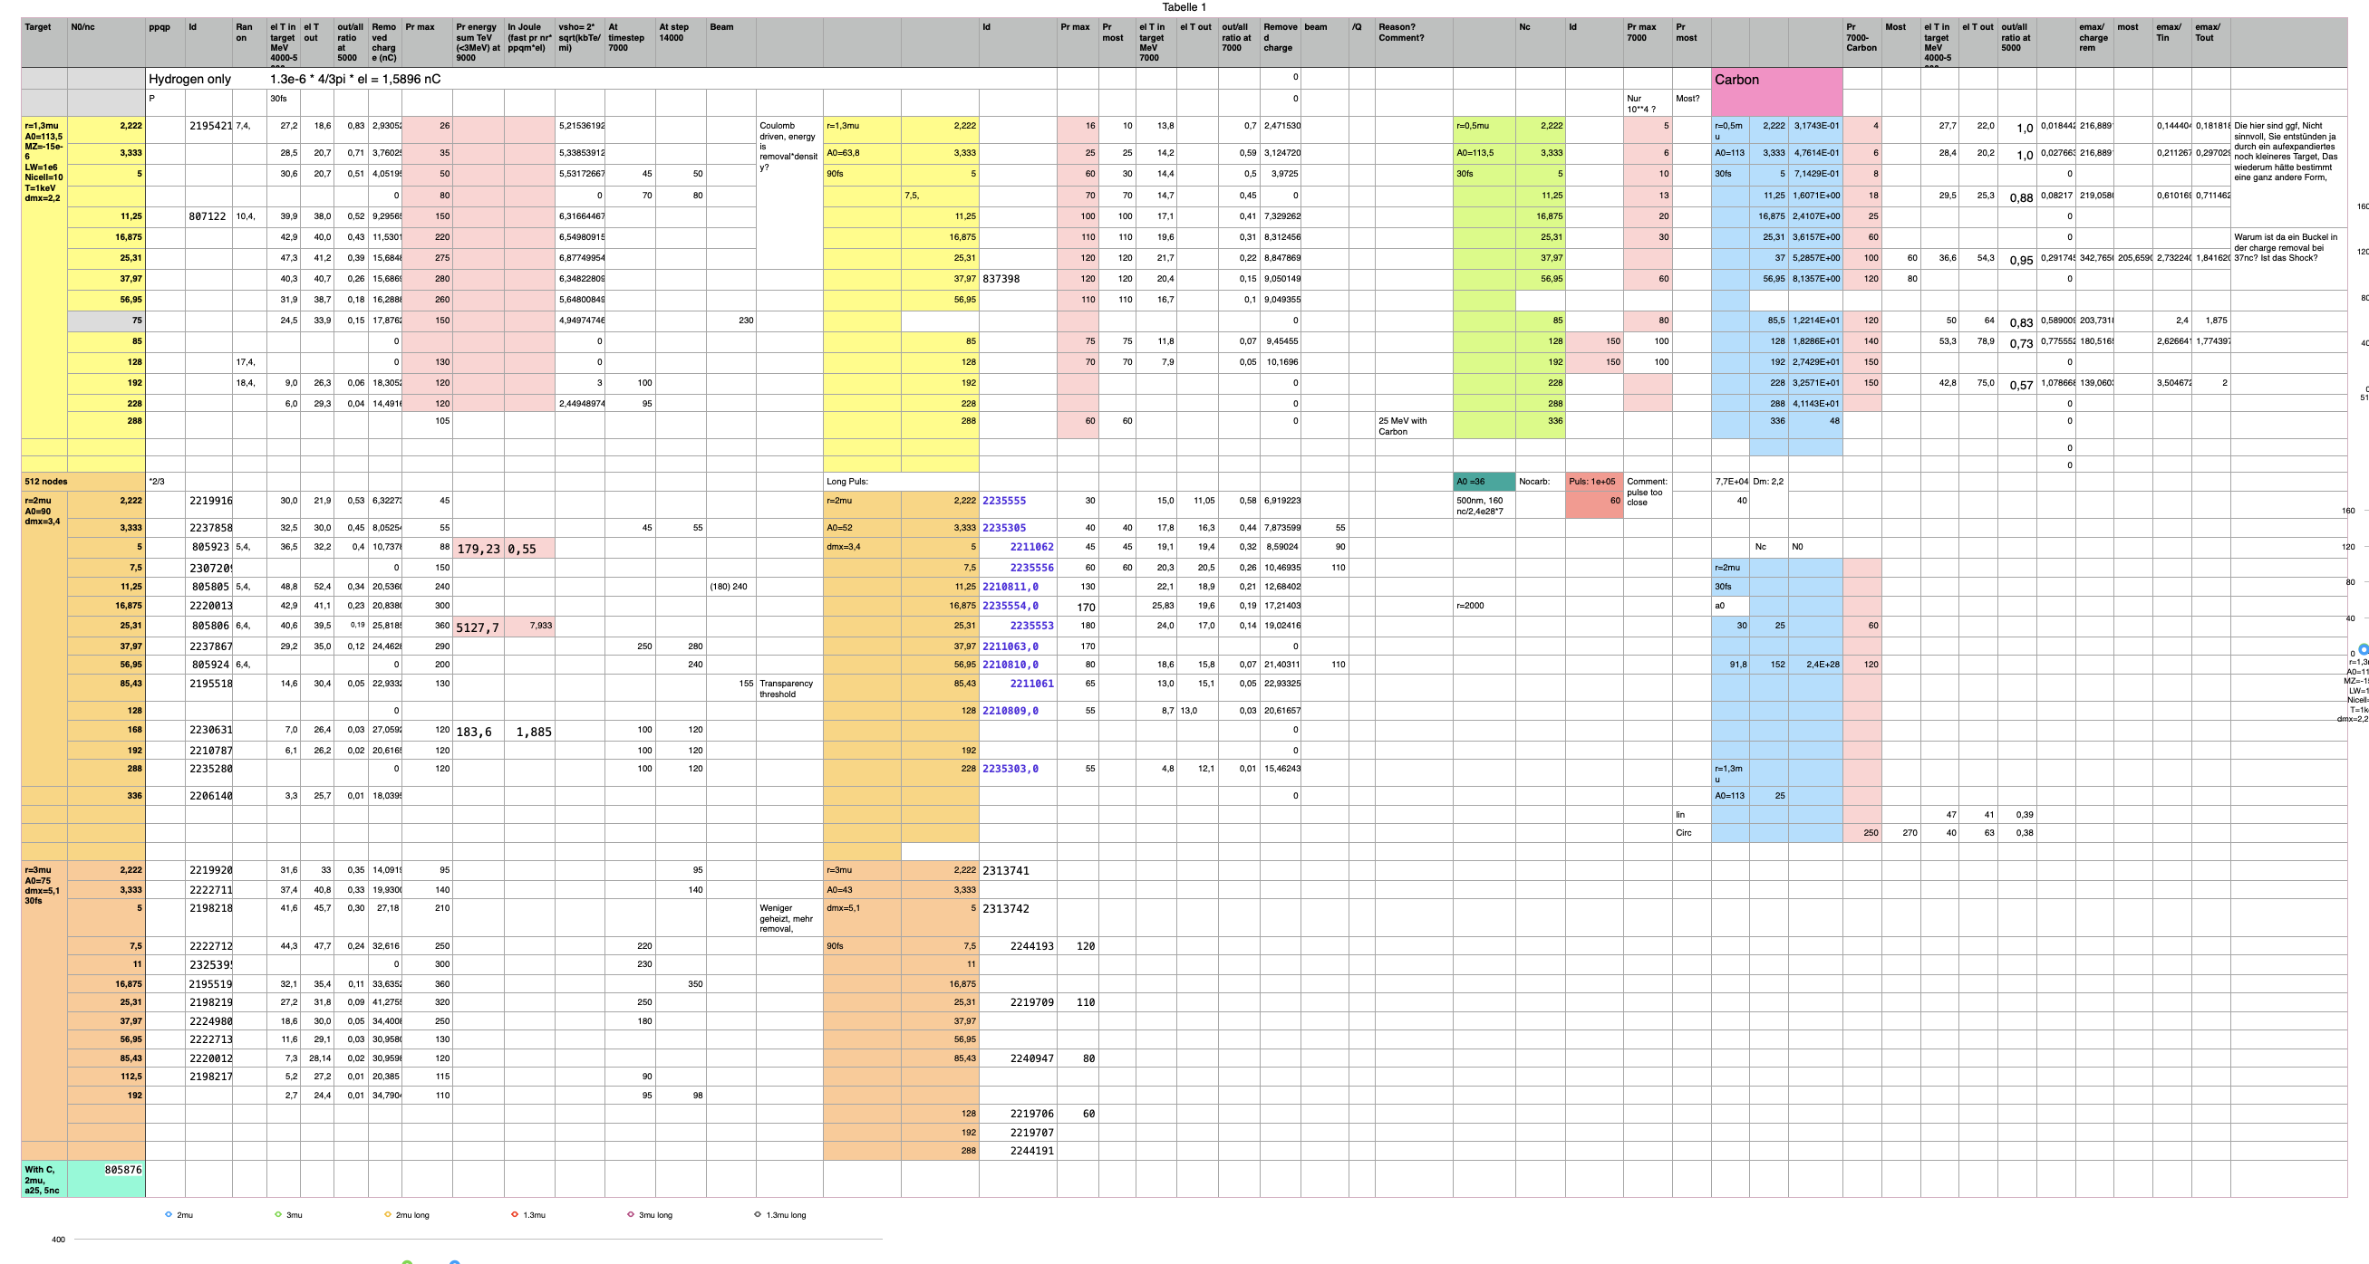
Data Management Issue - Metadata
Data Management
Keeping track of simulation parameters?
  Resolution
  Particle numbers
  Field parameters
  …
FAIR (findable, accessible, interoperable, reproducable) data?
  Author
  Date
  Code Version
  Project, Funding…
Multipage Table with Simulation Parameters for Parameter Study

Slide 26
Cross-Site Workflows & Big Data

Slide 27
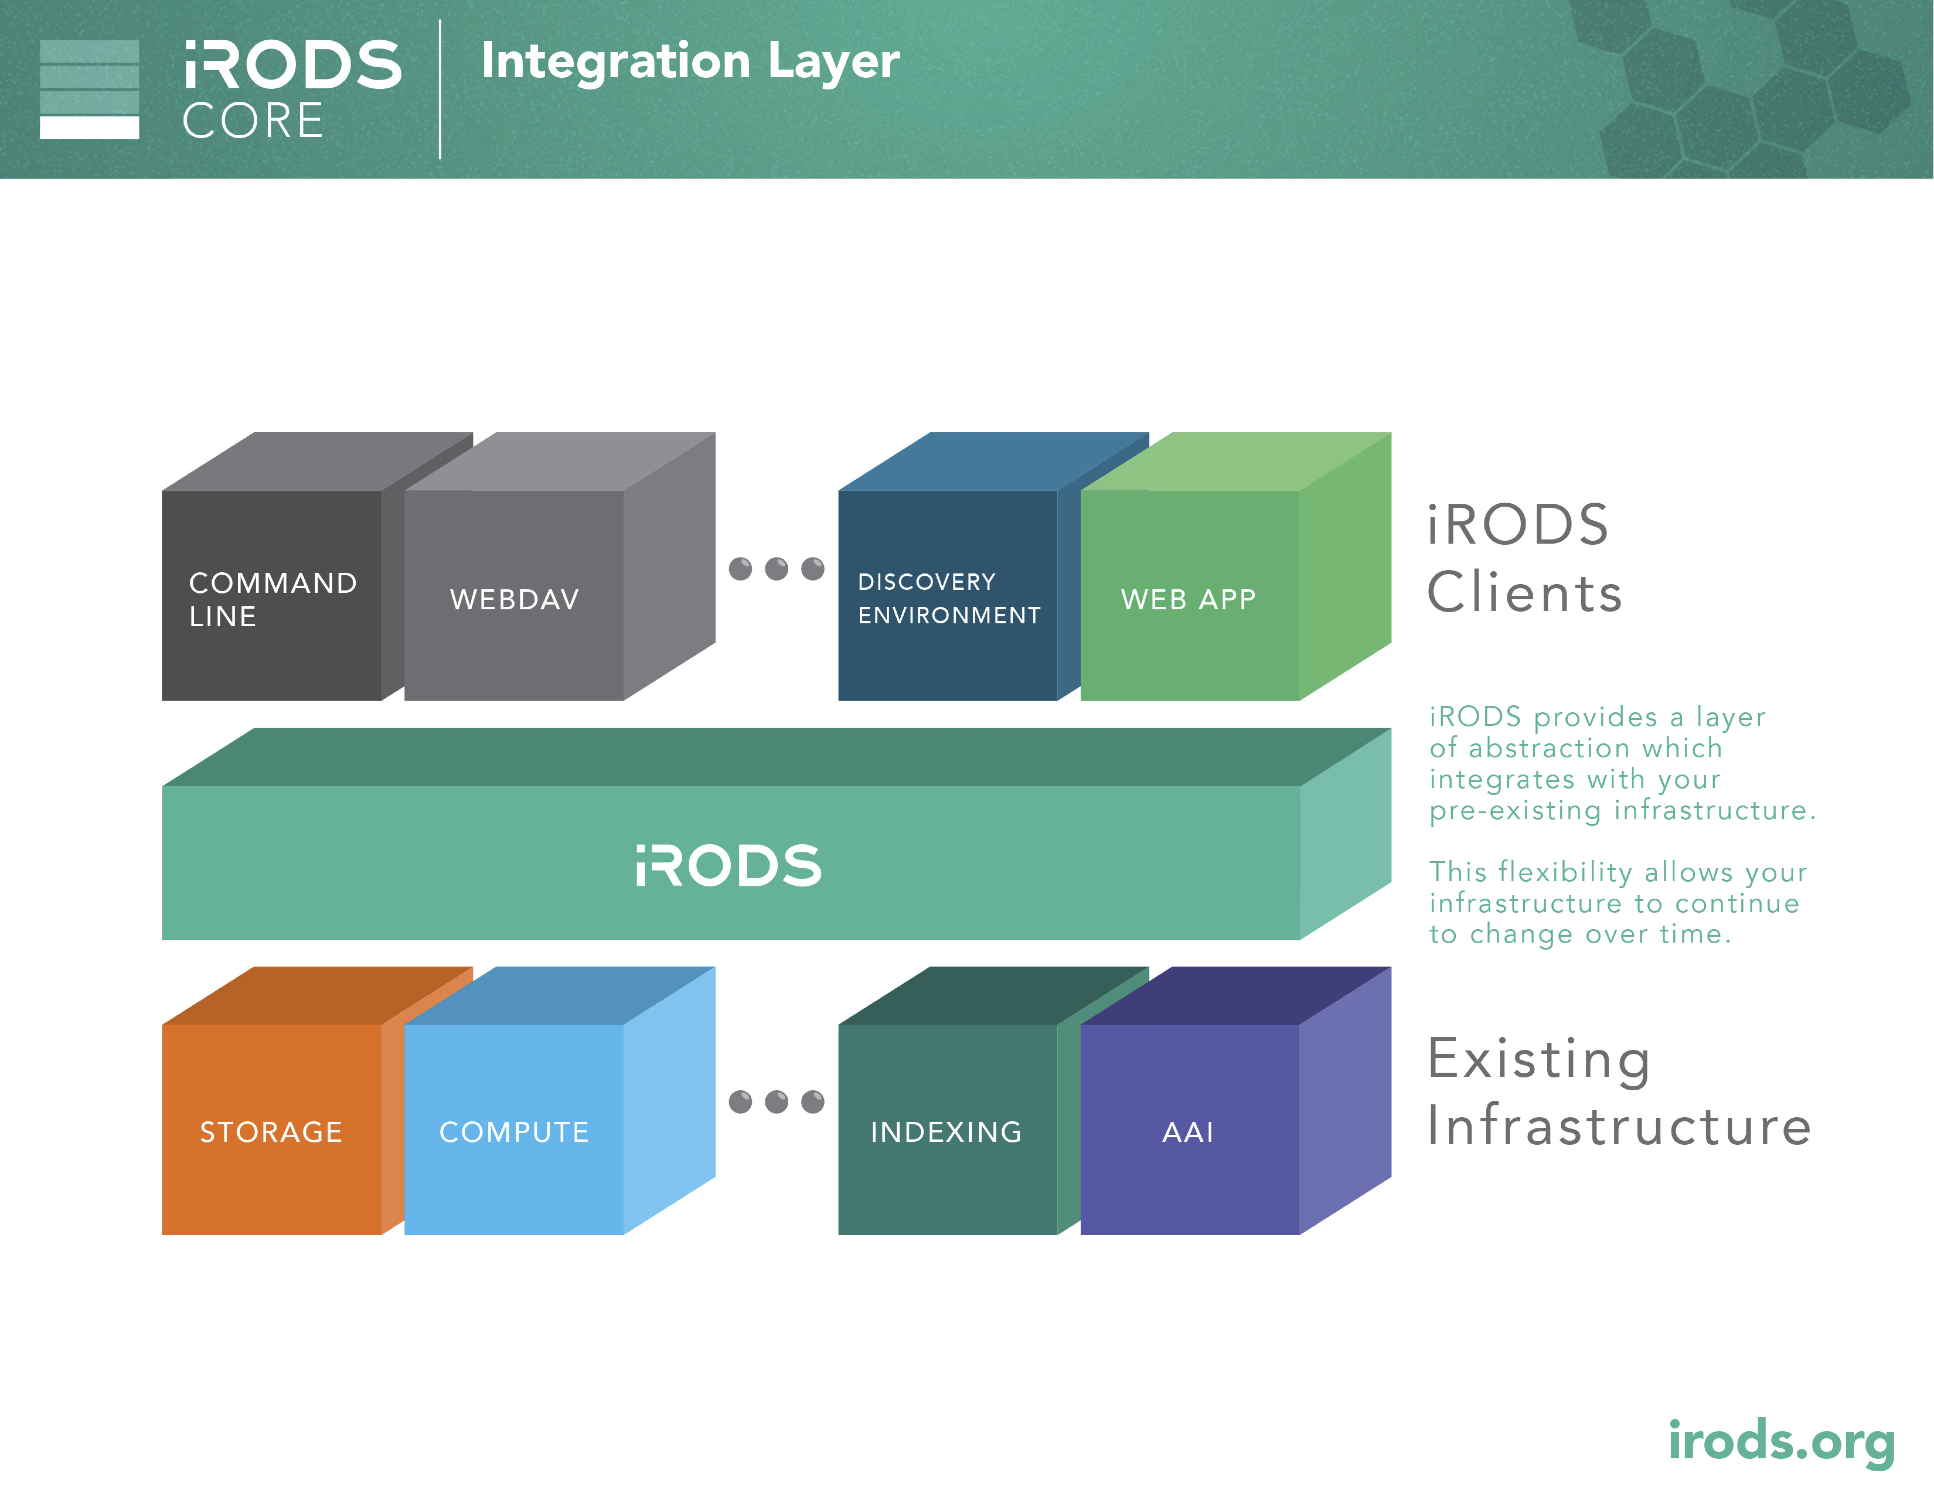
IRODS
Integration of Systems
Integrated Rule Oriented Data System
Data exchange Client
Files as Data Objects organized into Collection
Rule Engine that is an event-triggered background process
provides Secure Collaboration through three technologies:
Tickets, Permissions, and Federations
Plugins for PostgreSQL, MySQLElasticSearch…

Slide 28
Feel free to contact us.
Contacts
Exa4MindTeam:
Leads:
Mohamad Hayek (hayek@lrz.de )
Viktoria Pauw (pauw@lrz.de )
Huseyn Gurbanov (gurbanov@lrz.de )
Research Data Management Team:
rdm@lists.lrz.de
Leads:
Stephan Hachinger (hachinger@lrz.de – admin)
Johannes Munke (munke@lrz.de – tech)

