Slide 2
HEPScore and the
HEP Benchmark Suite:
Sustainable Computing in High-Energy Physics, a toolkit to support decision making
G. Menéndez Borge (CERN)
on behalf of
HEPiX Benchmarking WG
ISGC 2024
28 Mars 2024

Slide 3
Sustainable computing in HEP
Sustainable computing is the
design
development
use
disposal
of computing systems in an environmentally sustainable manner.
The usage is the stage that varies the most per field
How to minimize the energy consumption without sacrificing performance in HEP?
Notes:
What makes WLCG special is:
that the datacenters that compose it are
independent
federated
A high-speed network between sites makes the size of the data not an issue
Tier 0 & 1 have a dedicated 10 Gbit/s (or higher for T1s)
Performance studies removed due to lack of space
more info on the scale https://home.cern/science/computing/grid
de-facto recognised currency to value resources
Used for:
Site pledges
Accounting reports
Procurement procedures

Slide 4
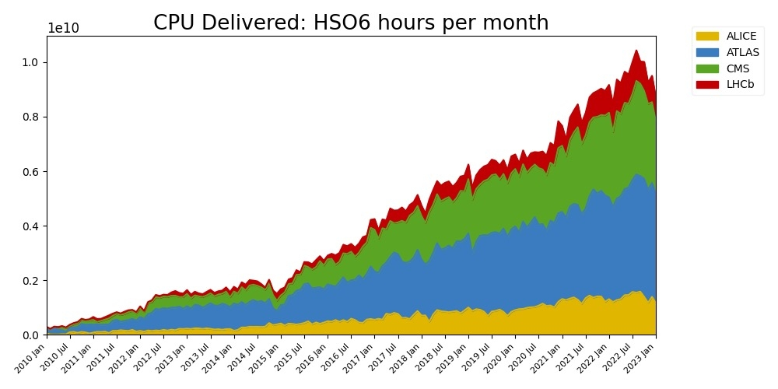
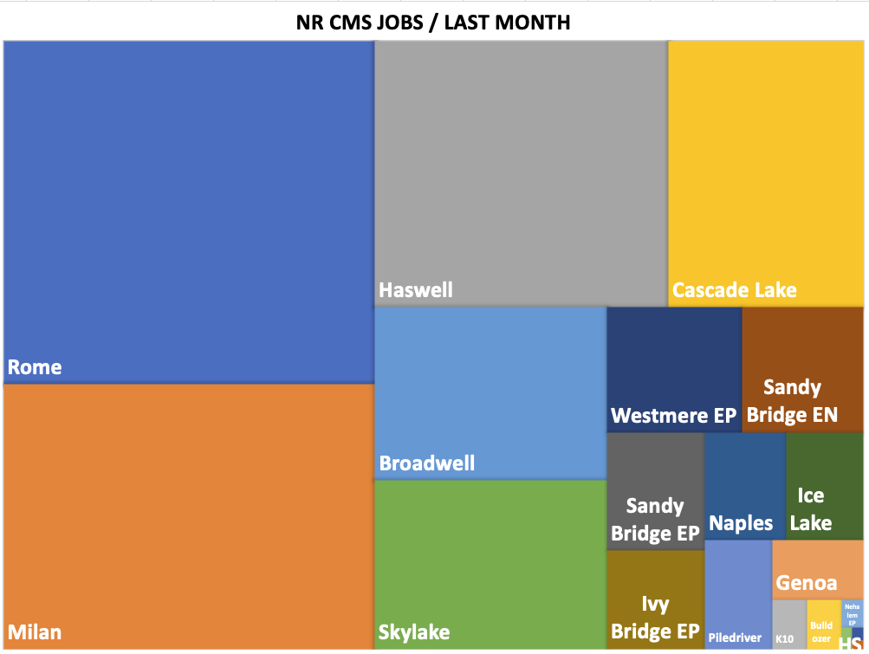
WLCG Benchmarking
Massive scale
~ 170 data centers
~1.4 million CPU cores
1.5 exabytes of storage
CPU benchmarking plays a central role in the WLCG
WLCG's resource-sharing model based on it
Core counts are normalized to their effective performance using a benchmark scale
Since 2009, based on HEP-SPEC2006 (HS06)
De facto recognized as a currency to value resources
credits A. Sciabà
Notes:
What makes WLCG special is:
that the datacenters that compose it are
independent
federated
A high-speed network between sites makes the size of the data not an issue
Tier 0 & 1 have a dedicated 10 Gbit/s (or higher for T1s)
Performance studies removed due to lack of space
more info on the scale https://home.cern/science/computing/grid
de-facto recognised currency to value resources
Used for:
Site pledges
Accounting reports
Procurement procedures

Slide 5
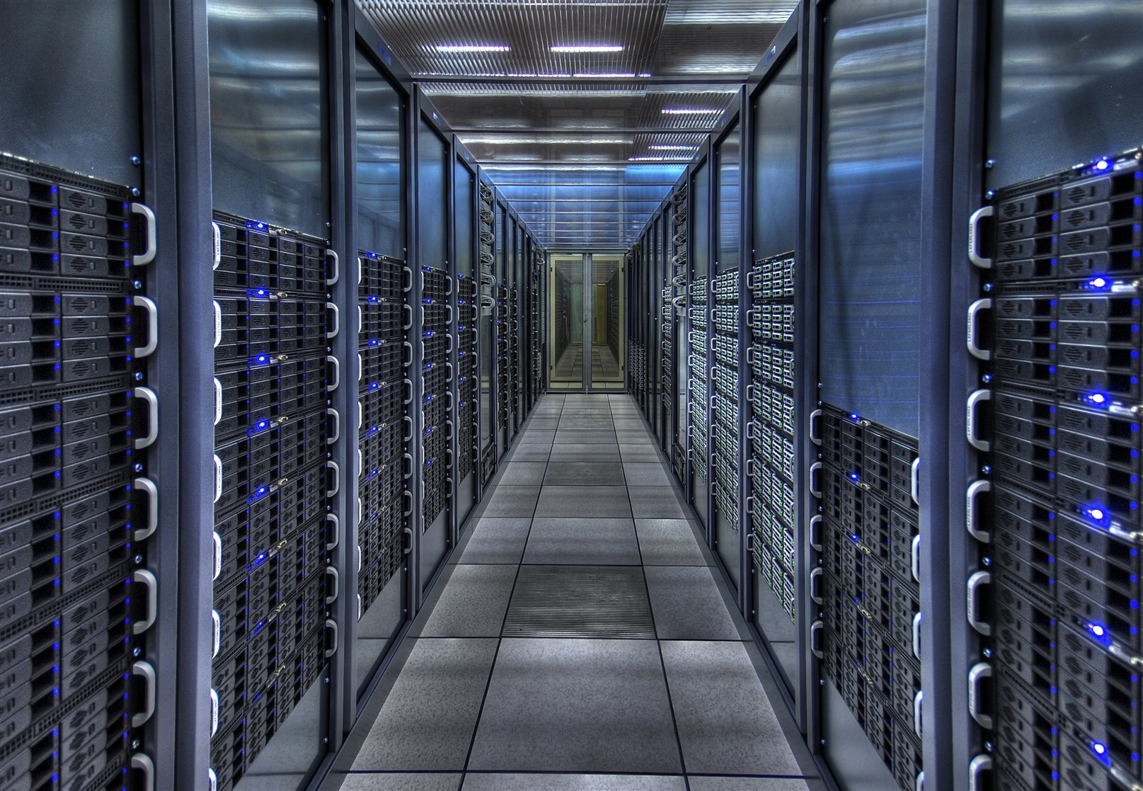
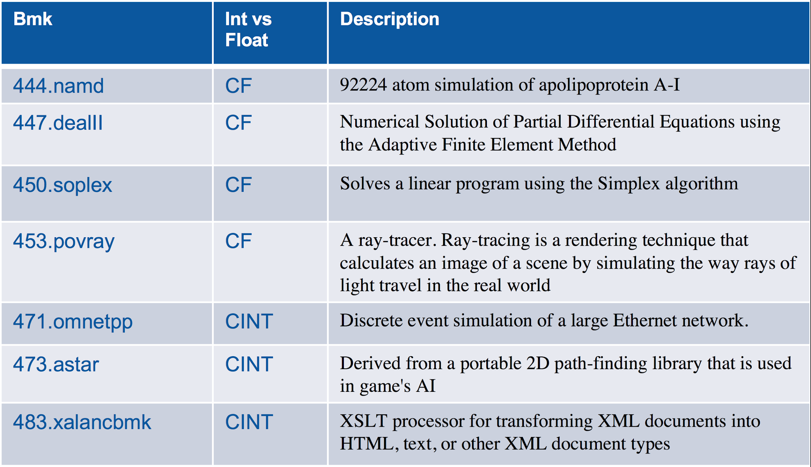
Need for evolution
HEP-SPEC06
Based on SPEC CPU® 2006
Proprietary industry standard
Not officially supported since 2018!
None of the applications is an event-based detector, simulation or reconstruction
Existing benchmarks are lacking:
Not representative enough of HEP nowadays
Not field-specific (HEP)
Desire to address more architectures, GPUs, vectorization…
Need for a new benchmark arises
Notes:
HS06 is a suite of 7 C++ applications
None of the applications is an event-based detector simulation or reconstruction
Subset of SPEC CPU® 2006 benchmark
SPEC's industry-standardized
Need for a new benchmark arises
Scale like HEP applications
Multi-threading
Vectorization
GPUs
Highlight that SPEC06 isn't supported anymore, but hepspec is
put the logo on the line that refers to spec's deprecation
HS06 doesn't reflect how our applications behave

Slide 6
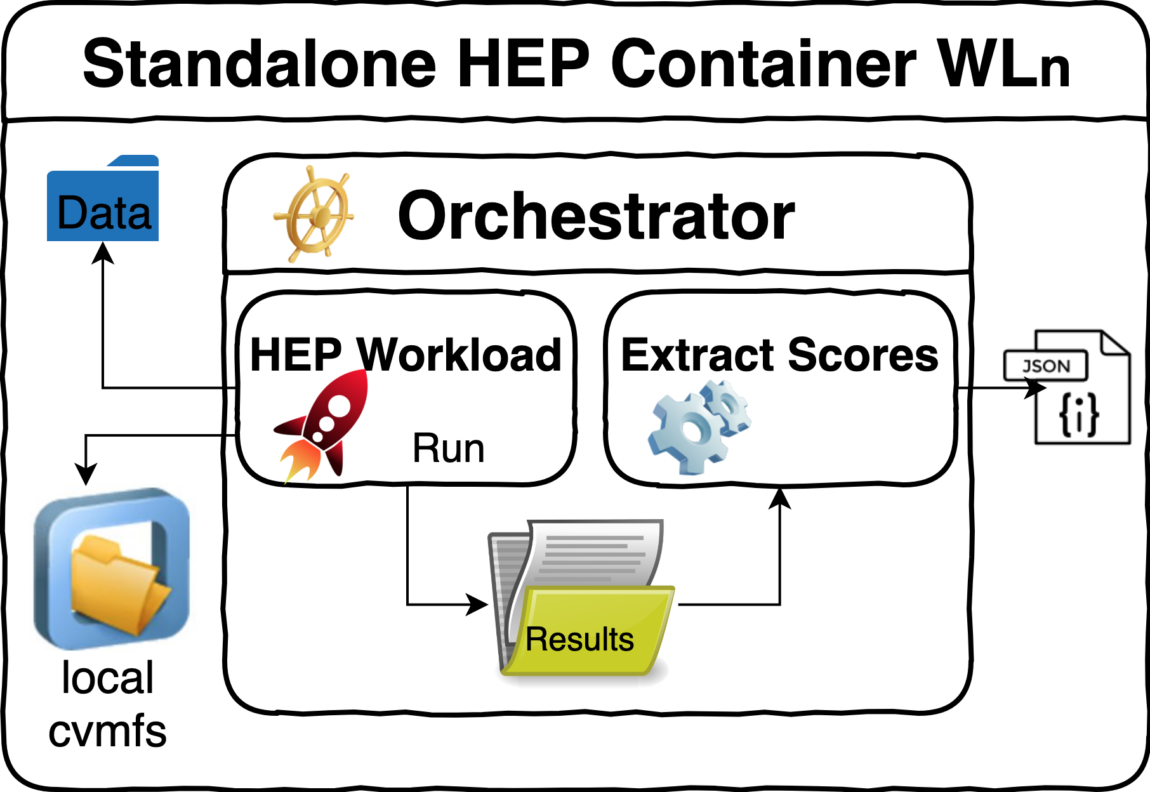
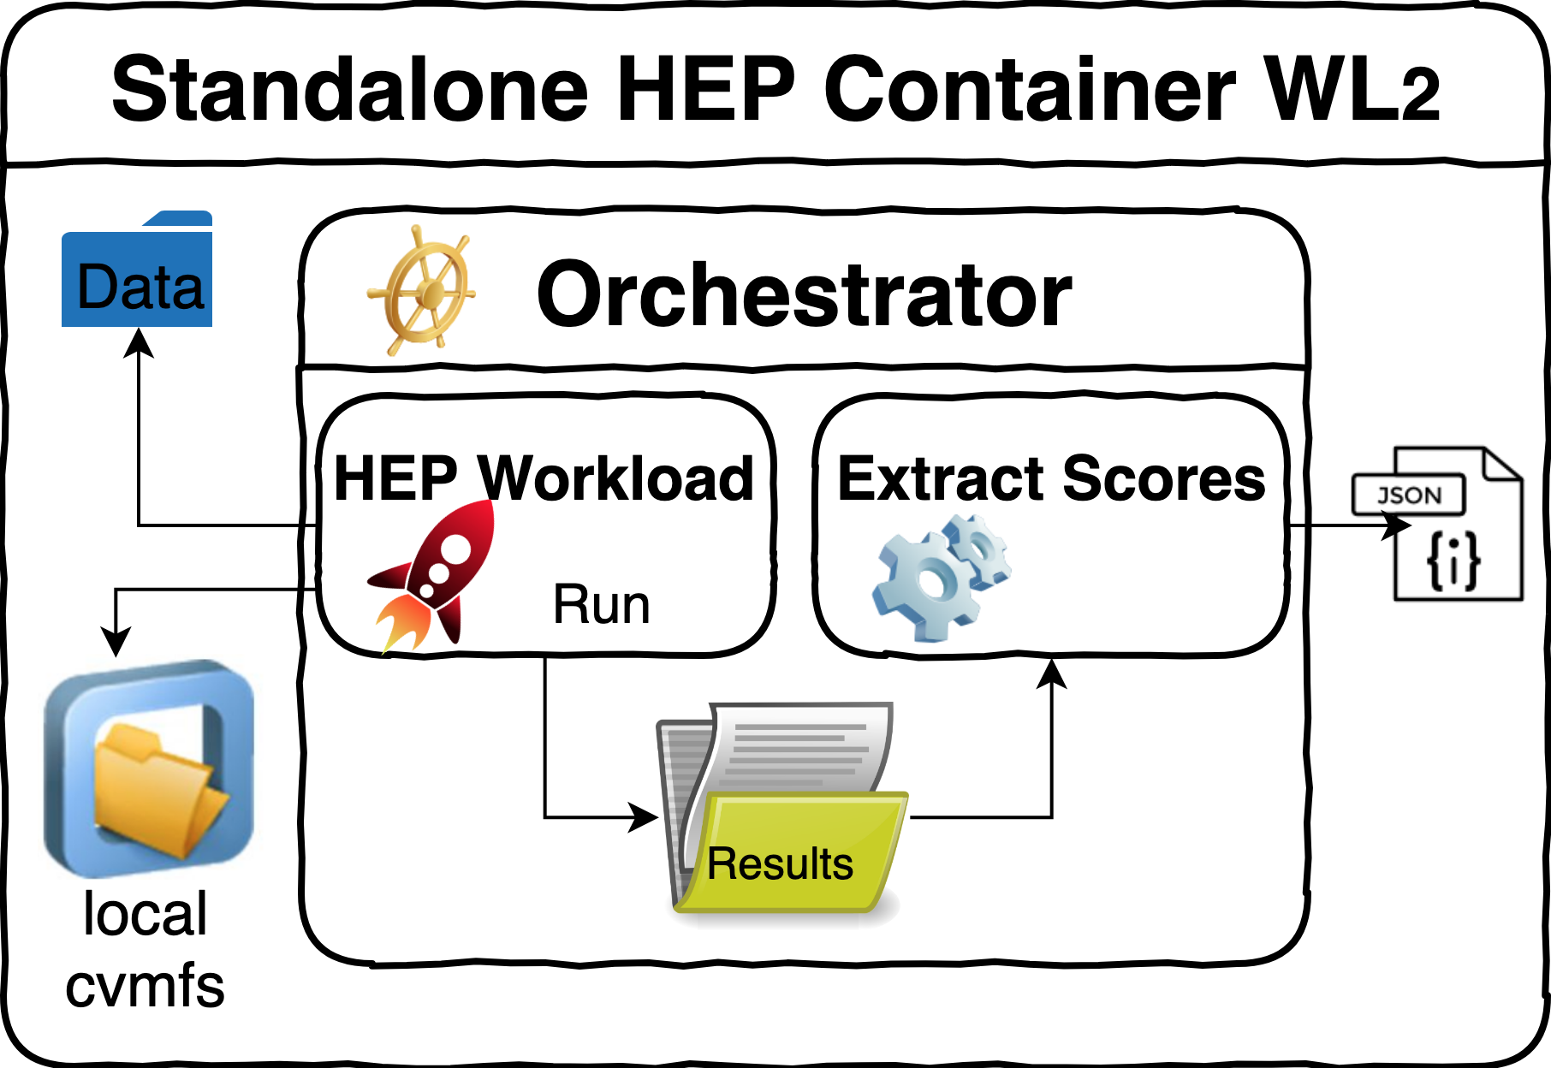
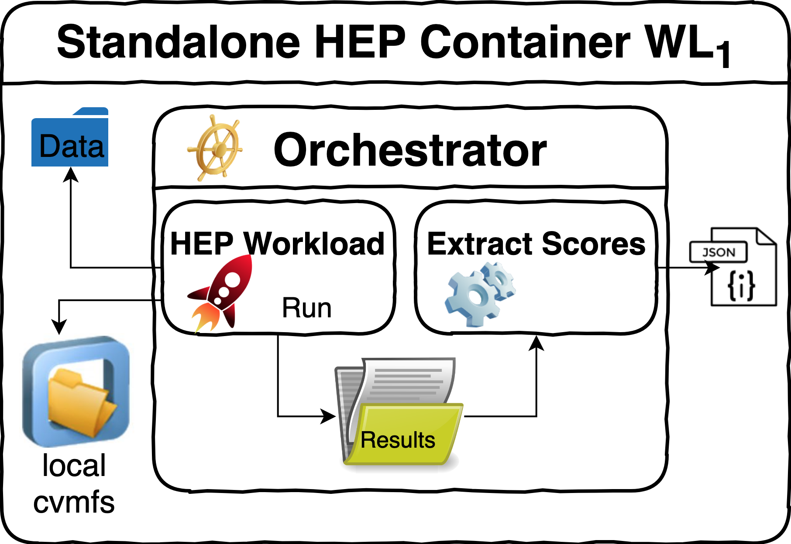
HEPScore
A new High-Energy-Physics-specific benchmarking framework
Conceived to run physics workloads [1]
Free & Open Source
Configurable
Workloads to be run
Overall score calculation
Repetitions
Retries
Container executor
New architecture support (ARM)
GPU support
Useful metadata on top of performance
HEPScore
Report
Notes:
Things you can configure from a Workload
results_file: atlas-sim_mt-ma_summary.json
ref_scores:
sim: 1
weight: 1.0
version: v2.0_aarch64
args:
threads: 4
events: 5
—-----------------------------------
DOMENICO
we have created a benchmark with the applications from the experiments
we have representatives from other computing infrastructures
you could create a WL in a container and add it to the

Slide 7
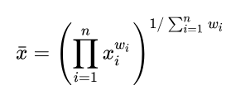
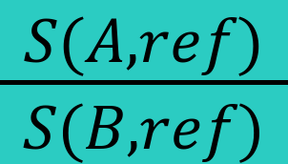
HEPScore Definition
Similar functional definition of HS06:
Set of reference workloads (WLs)
Measure of performance per WL (m_{i}): work done in unit of time
Reference server (ref)
The score S of a server (srv) is defined as the geometric mean of the speed factors x_{i}(srv,ref) = m_{i}(srv)/m_{i}(ref) respect to the reference server
 | WL₁ |  | WL₂ |  | WL_{n} |  | Score | S(A,B)
 | m₁(ref) | 1 (by def) | m₂(ref) | 1 (by def) | m_{n}(ref) | 1 (by def) | 1 (by def)
 | m₁(A) | x₁(A,ref) | m₂(A) | x₂(A,ref) | m_{n}(A) | x_{n}(A,ref) | S(A,ref)
 | m₁(B) | x₁(B,ref) | m₂(B) | x₂(B,ref) | m_{n}(B) | x_{n}(B,ref) | S(B,ref)
Ref. Srv
"File:201912 Rack-optimised servers.svg" by DataBase Center for Life Science (DBCLS) is licensed under CC BY 4.0
Srv A
Srv B

Slide 8
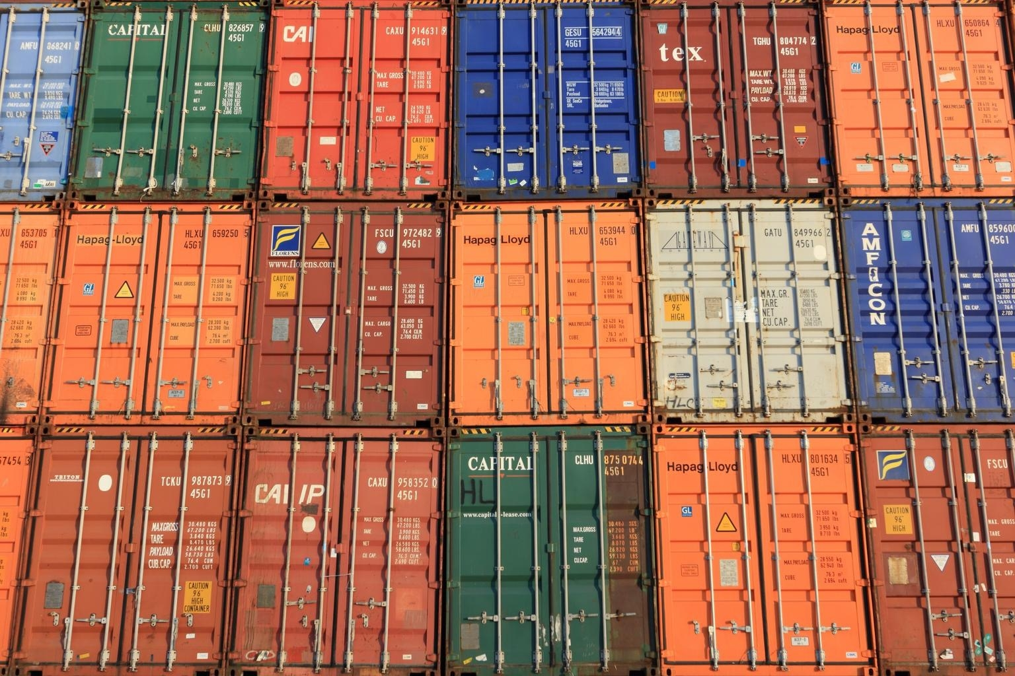
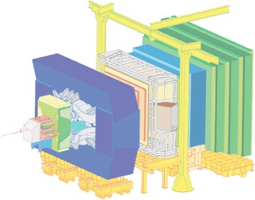
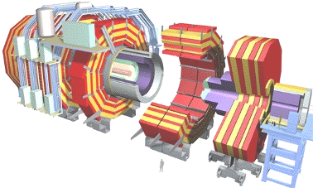
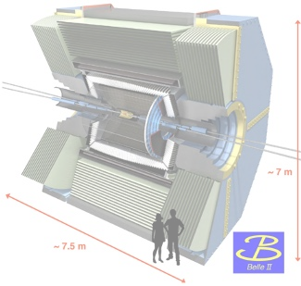
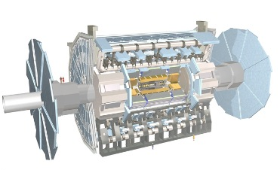
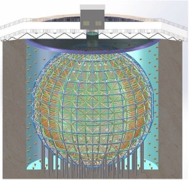
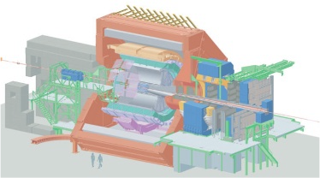
HEP Workloads
Create, maintain and execute workloads from HEP experiments
+30 workloads
7 experiments
Workload requirements:
Remote-access independent
Consistency (CLI, reporting structure, logging)
Portable
Reproducible results
Shipped in standalone containers
Support Docker & Apptainer (previously Singularity)
Any scientific field could create their own workloads!
Notes:
+30 workloads is taking into account versions, actually they are way less
containers encapsulating all and only the dependencies needed to run the benchmarks: they are self-contained
don't say benchmark instead of workload, people could get confused
—-----------------------------------
DOMENICO
you could create a WL in a container and add it to the

Slide 9
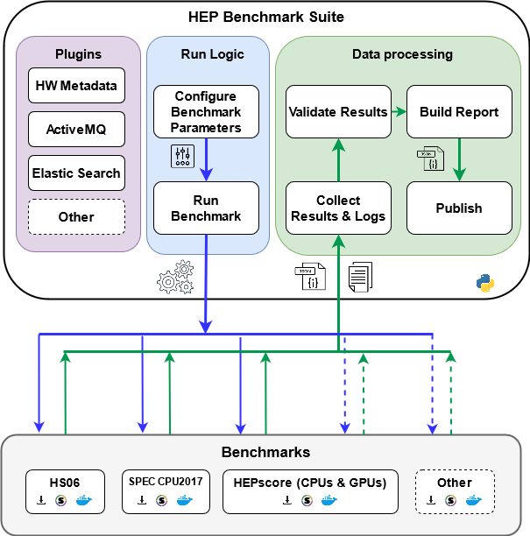
The HEP Benchmark Suite
Toolkit to orchestrate different benchmarks in one application
Built in a modular fashion
Benchmarks
Plugins
Takes care of:
Configuration
Data collection
Data validation
Optional publication to the WLCG benchmarking monitoring infrastructure
Notes:
put optional publication in one line

Slide 10
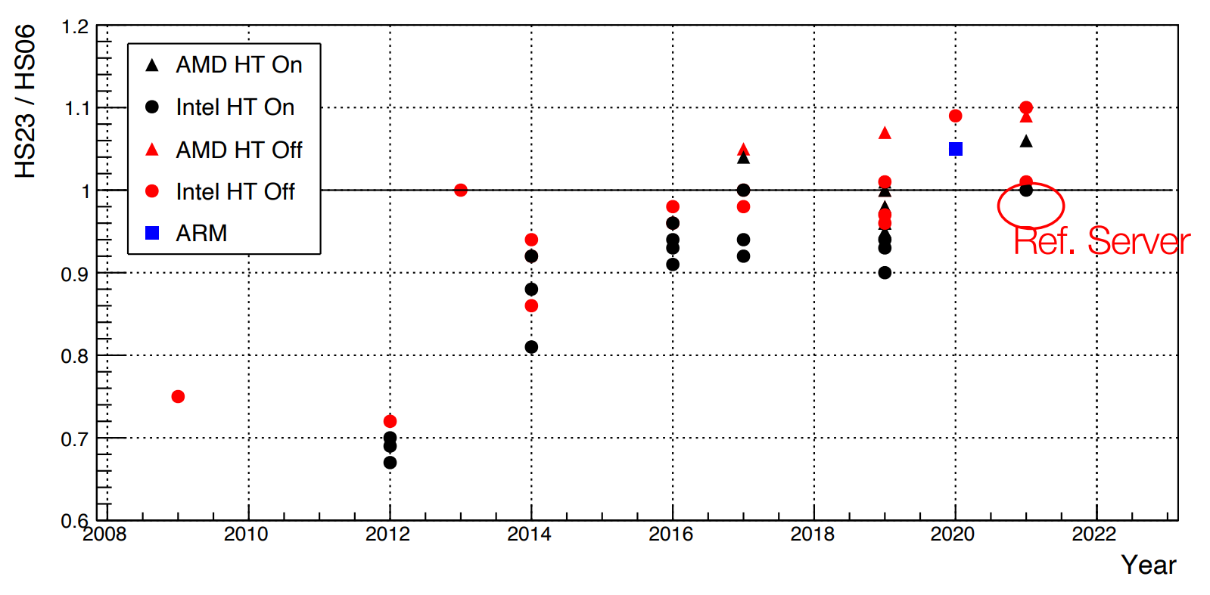
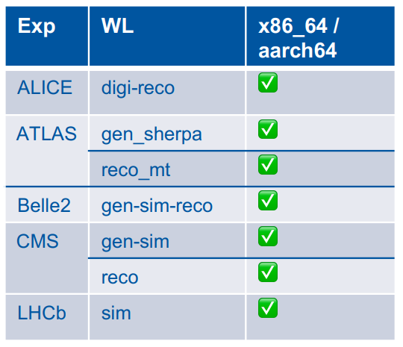
HEPScore23
Experiment | Workload | x86_64 | aarch64
ALICE | Digi Reco | ☑️ | ☑️
ATLAS | Gen Sherpa | ☑️ | ☑️
 | Reco MT | ☑️ | ☑️
Belle2 | Gen Sim Reco | ☑️ | ☑️
CMS | Gen Sim | ☑️ | ☑️
 | Reco | ☑️ | ☑️
LHCb | Sim | ☑️ | ☑️
The official HEPScore configuration
Composed by 7 Workloads from 5 experiments
More field-specific than its predecessor, HS06
Better represents HEP performance
Extended support
New architectures (ARM)
GPU ready
Free & open source
Adopted officially on April 1, 2023, by WLCG
Useful metadata on top of performance
✅ | ✔️
☑️ | ☑
✔
Notes:
HS23 is normalized to HS06 on the reference machine
to allow for smooth transition of tables and plots
Sites are encouraged to run HS23 only for new hardware
Capacity deployed before 2023 can still be reported in HS06 score
Avoid changes in pledged vs delivered resources
GPUs are not used rn bc the experiments don´t use them as of rn, but when they do, HEPScore is ready to run workloads that use GPUs
HEPScore 23 is all lhc + belle 2
Add the plot from Domenico's presentation on Wednesday!!!

Slide 11
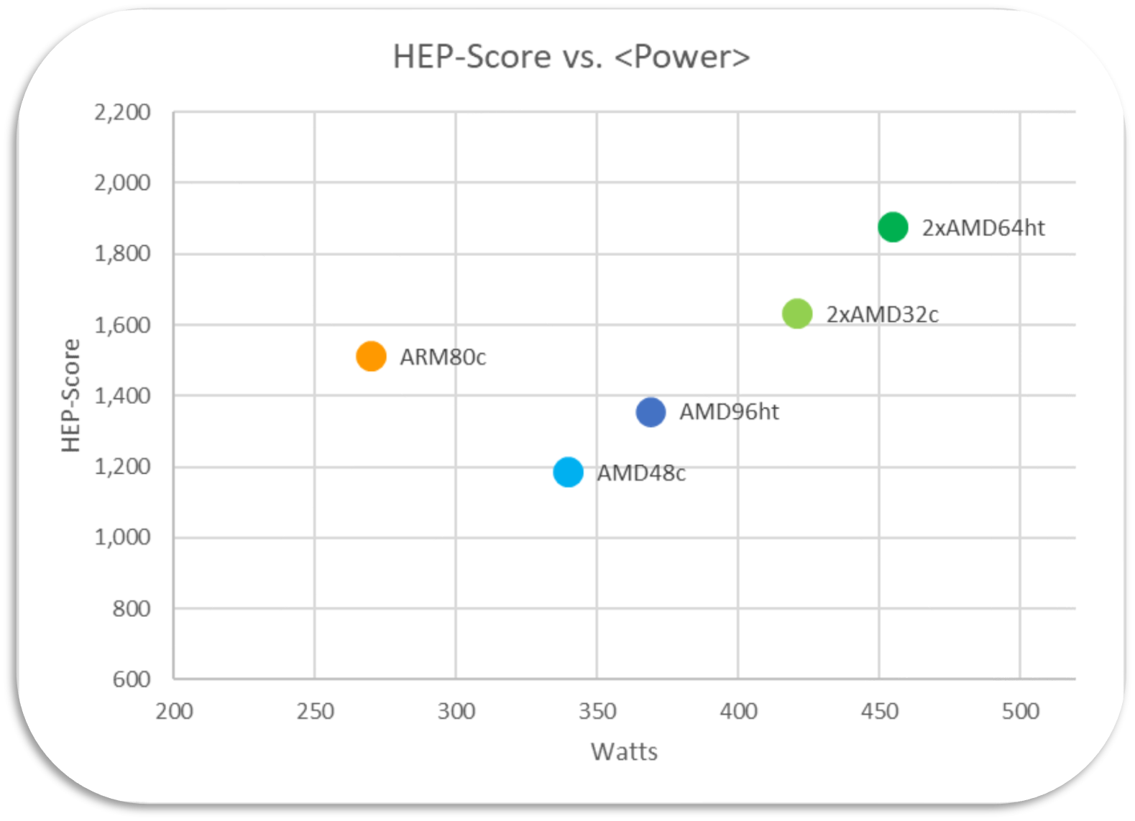
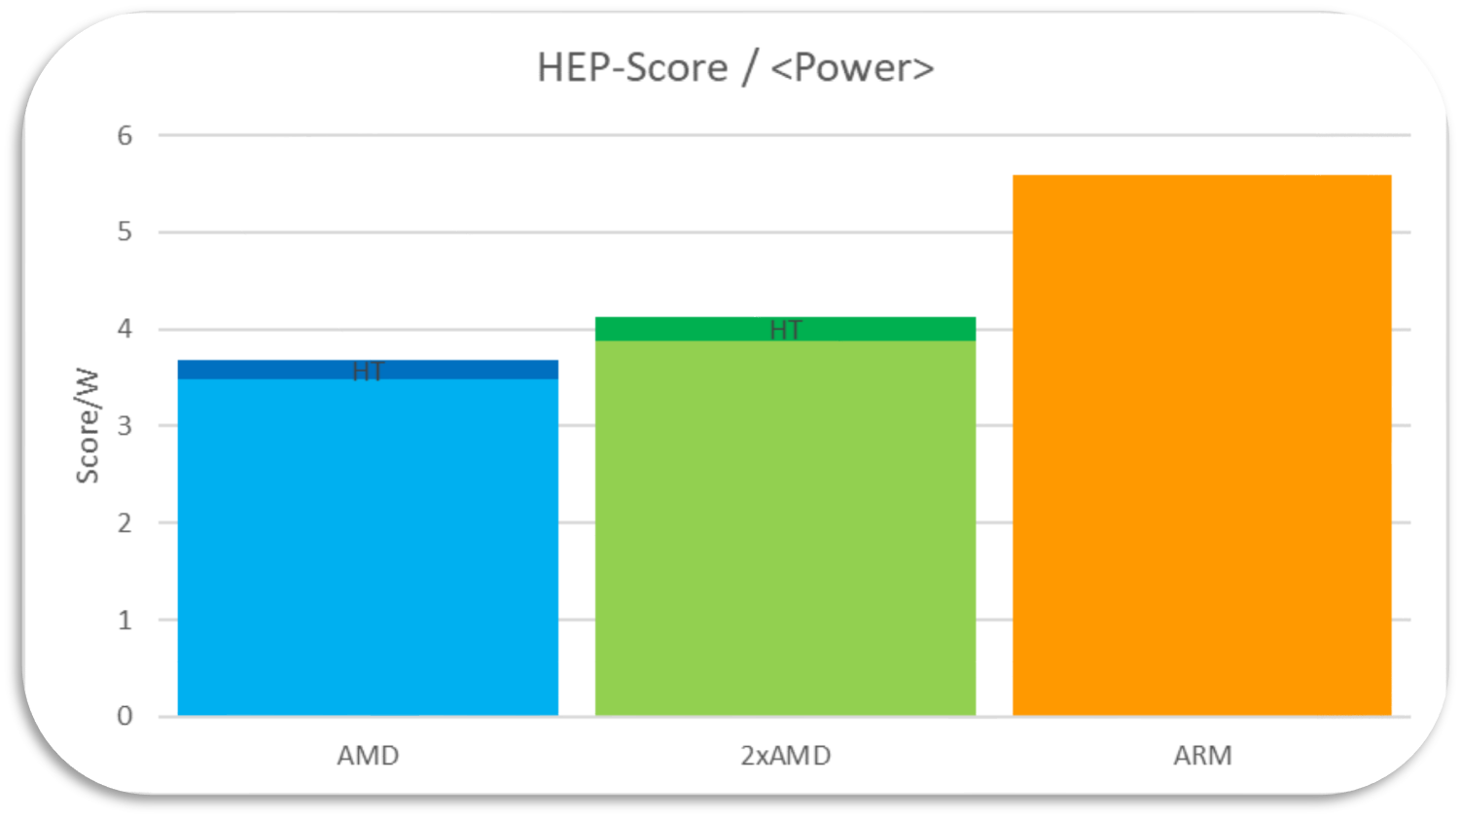
Plugins
Fine-grain plugins:
General
Hardware
Software
Time series
CPU frequency
GPU Power Consumption
General Power Consumption
Used Memory
Can be enabled independently
Allow for studies beyond pure score!
E.g. Which CPU performs better per watt?
Plots from E. Simili et al. [2]

Slide 12
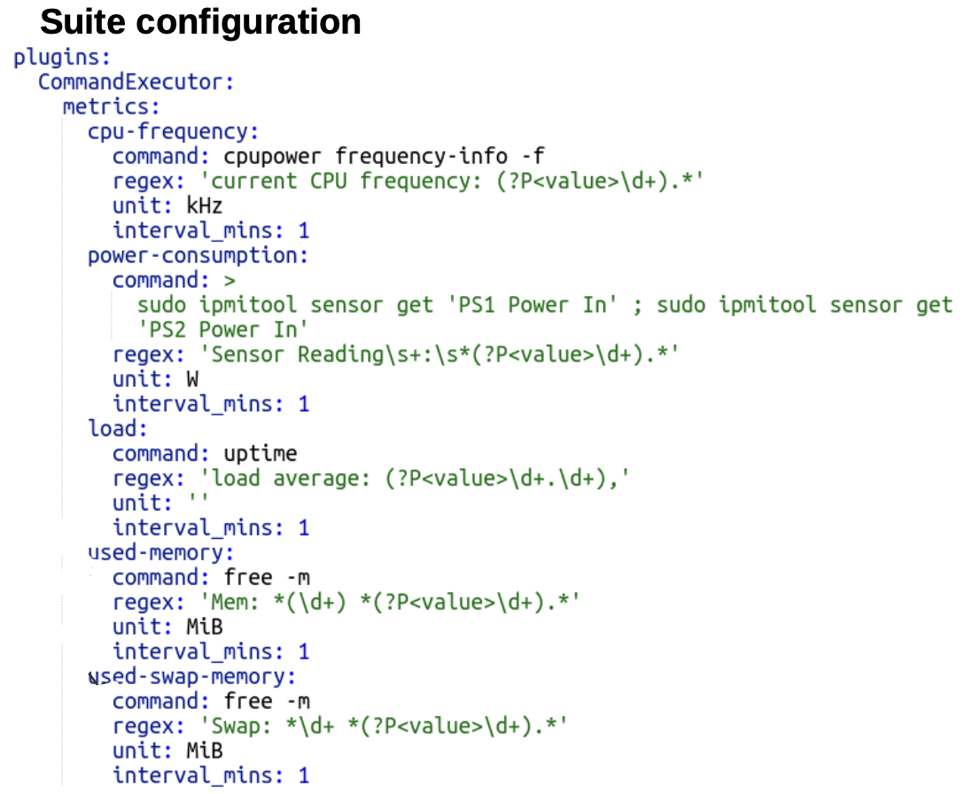
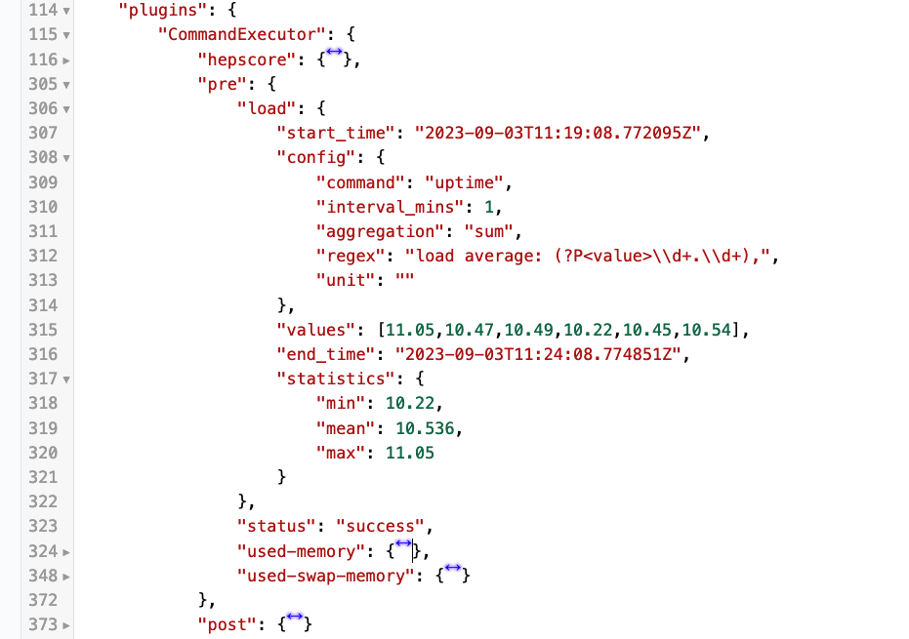
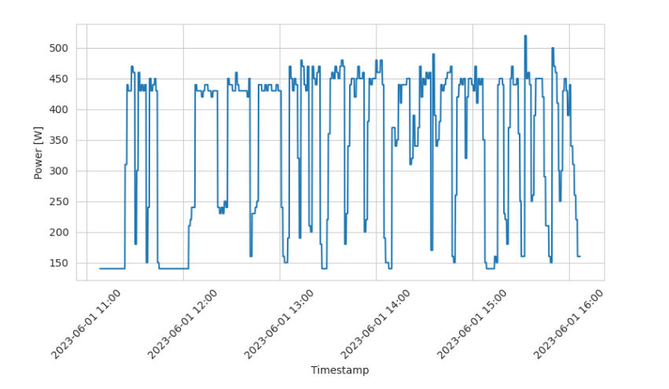
Plugins: Implementation
Example: Plugin Configuration
Suite plugins collect and report time-series metrics
Individual measurements for deep analysis
Aggregated statistics for visualization
Command-executor plugin available
Allows for new plugins just by changing config
No need to code!
Approach:
Run alongside benchmarks
Run before/after benchmark execution
Allows for comparison with the idle state
Available on versions 3.x (pre-release) of the Suite
Plugins’ Report
Retrieved time series from stored data
Notes:
Mention the in the last chart we have plotted the power consumption vs time while running a benchmark
also that the idle state before and after is to establish a base line

Slide 13
Energy vs. Performance studies
Increasing interest in environmental impact
Initiatives ongoing to measure Performance/Watt
Performance ⬄ Benchmark score
Energy consumption
The WLCG community would profit from
A common measurement approach
ipmi tools
power_now
lm_sensors
powerstat
A common data repository
From HEPiX Autumn 2023
Ofer Rind (SDCC, BNL)

Slide 14
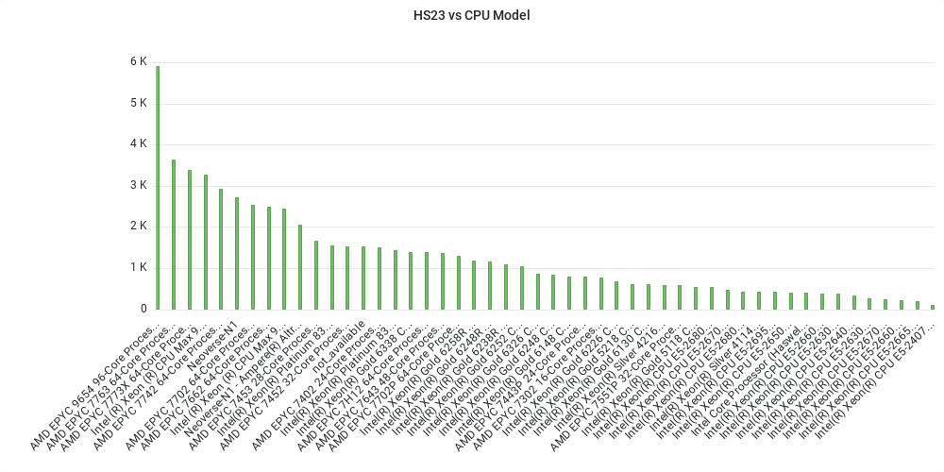
WLCG Benchmarking Infrastructure
Data is stored in 2 different DBs: Opensearch & HDFS
Backup
Diversity & compatibility
Kibana
Grafana
Spark
Over 2k machine configurations
Result comparison
Analysis
Data monitoring
Continuous data analysis
Look out for failures, outliers, statistics, …
Notes:
Data is available but not accessible publicly, only to contributors
put a dashboard instead of the logos https://monit-grafana.cern.ch/d/2DLDQt2Vz/wl-results?orgId=62&viewPanel=204&from=1677625200000&to=1685716934970
2209 machine configs
216 cpu models

Slide 15
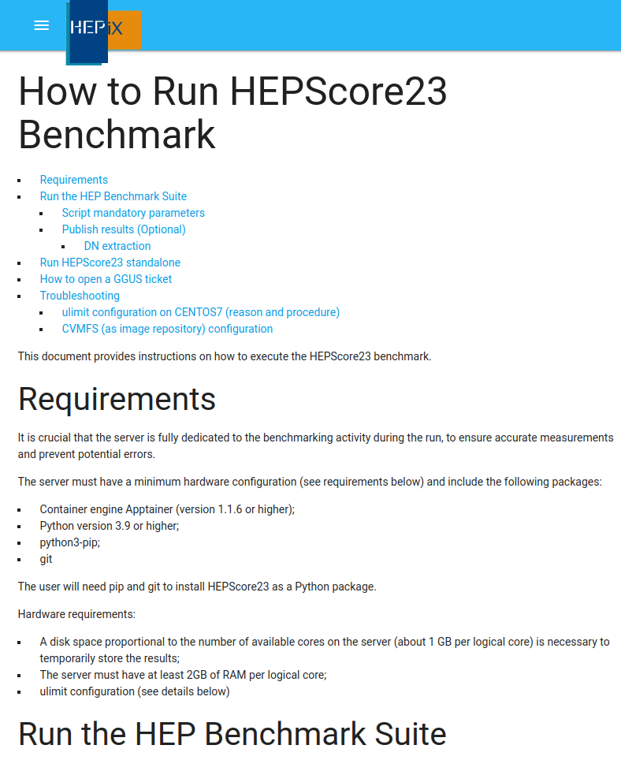
Running HEPScore
Link
Official documentation [3]
Download our script from Gitlab [4]
Grant it execution permissions
Use its options to configure it
./run_HEPscore.sh -s SITE [-p -c ./cert.pem -k ./key.pem]
./run_HEPscore.sh --help to see all options
Send results to our infrastructure
Create a GGUS ticket [5] to us
State your institution
Include the certificate subject DN to use
Notes:
Mention the documentation of hepscore is here http://w3.hepix.org/benchmarking where before we had hs06 info
cambiar las imágenes por una captura de la página

Slide 16
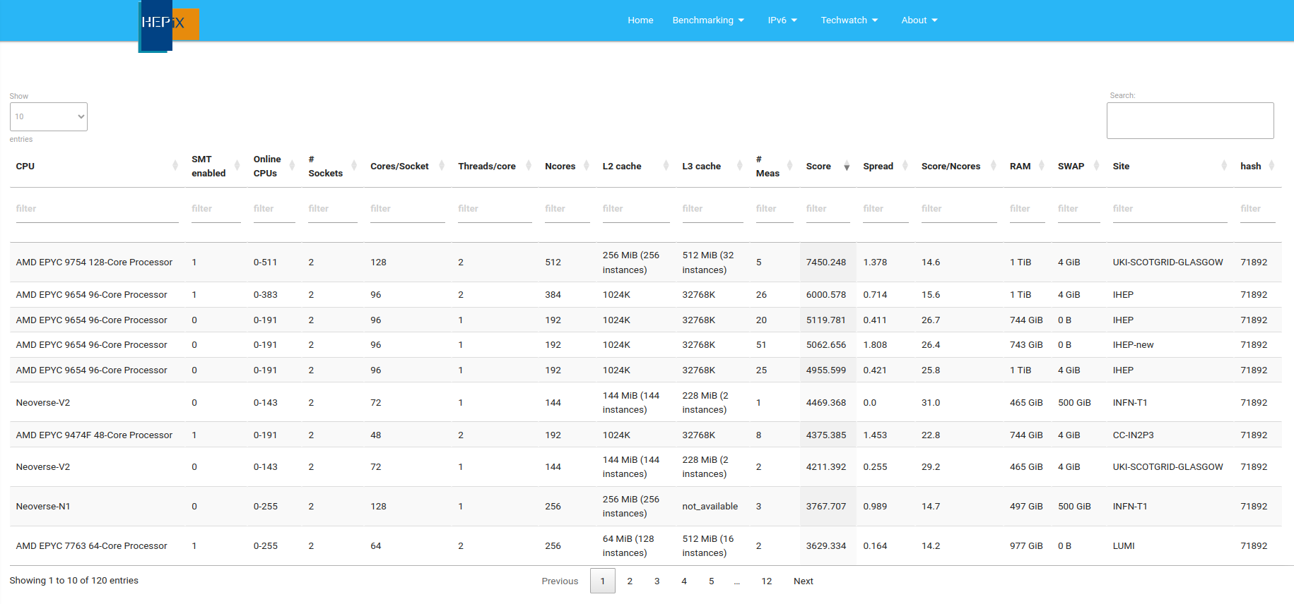
HS23 Public Scores
Link
Notes:
certified results can be found in the table
they are not real time, they undergo a validation process

Slide 17
Demo
Notes:
run hepscore23
use the script from
ES

Slide 18
In Sum
Running CPU/GPU benchmarks? Use the HEP Benchmark Suite!
Profit from its simplicity, extra features and community 📊
Its best feature, the modular benchmarking framework HEPScore
Use the available workloads or create your own 🛠️
Try it out HEPScore23! Devised for HEP applications
See how well it scales with your own application! 📈
Harness the Suite's plugins and unleash the power of metadata! 🚀
Analyze results based on energy consumption, CPU frequency, memory utilization, …
Notes:
Mention the documentation of hepscore is here http://w3.hepix.org/benchmarking where before we had hs06 info
cambiar las imágenes por una captura de la página

Slide 19
Contact & References
gmenende@cern.ch 📩
[1] HEP Workloads
https://gitlab.cern.ch/hep-benchmarks/hep-workloads
[2] Energy Efficiency in H.E.P. (ARM vs. x86 and beyond)
https://indico.jlab.org/event/459/contributions/11660/
[3] HEPScore23 Documentation
http://w3.hepix.org/benchmarking
[4] HEPScore23 example script
https://gitlab.cern.ch/hep-benchmarks/hep-benchmark-suite/-/raw/master/examples/hepscore/run_HEPscore.sh
[5] GGUS ticket submission
https://ggus.eu/?mode=ticket_submit
Notes:
Mention the documentation of hepscore is here http://w3.hepix.org/benchmarking where before we had hs06 info
cambiar las imágenes por una captura de la página

Slide 20
Q&A

