Slide 1
INFN Cloud User Support:
the link between research and IT
International Symposium on Grids & Clouds (ISGC) 2024
Alessandro Pascolini
alessandro.pascolini@cnaf.infn.it

Slide 2
Outline
State of Art
Portfolio
Guides
Training courses
Numbers
Who? And How?
Projects

Slide 3
INFN – Cloud working structure
Activities assigned to different Working-Packages
WP1
WP2
WP3
WP4
WP5
WP6
WP7
Operation & Infrastructure
User Support
& Training
Resources & Sustainability
Security & Policies
Middleware & New Services
R&D
Legal Compliance

Slide 4
Services – Current portfolio
SaaS
PaaS
IaaS
NaaS
Harbor
MinIO
Simple VM
DockerCompose, Run Docker
Elasticsearch&Kibana
Kubernetes, Spark
HTCondor Mini
IAMaaS
Jupyter with persistence
Sync&Share
Start&Stop
Hostname choice
Port managed by the user
DNSaaS

Slide 5
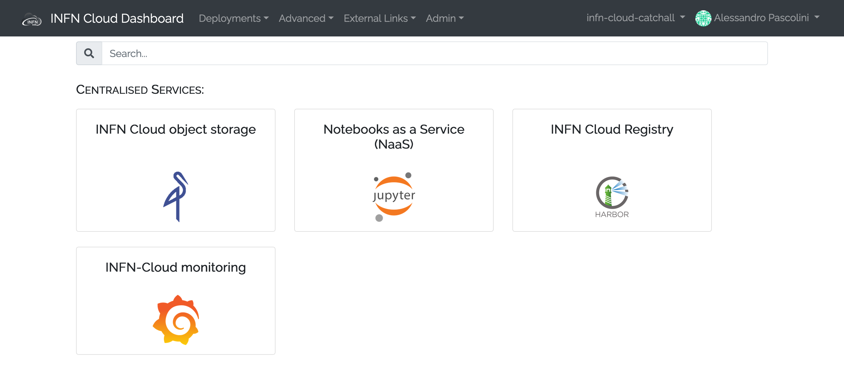
Services – Dashboard
Centralized Services
No Sys-admin
Available to all users

Slide 6
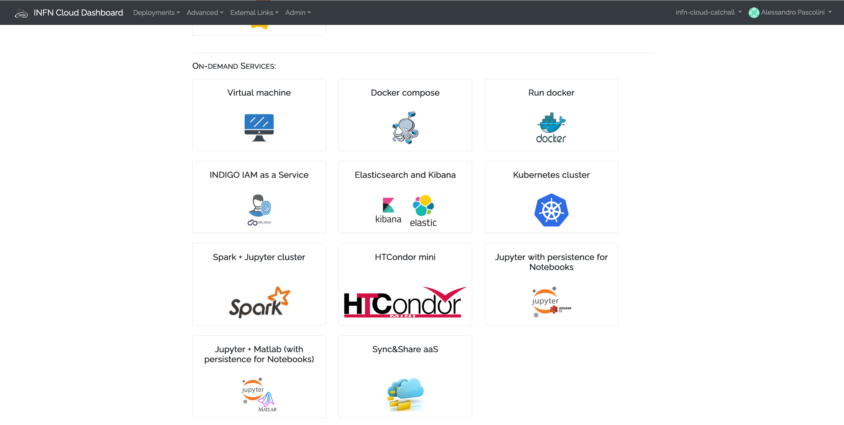
Services – Dashboard
On-Demand
Sys-Admin ONLY
WIP: deployments on private network - no sys-admin - no Floating-IP consumption

Slide 7
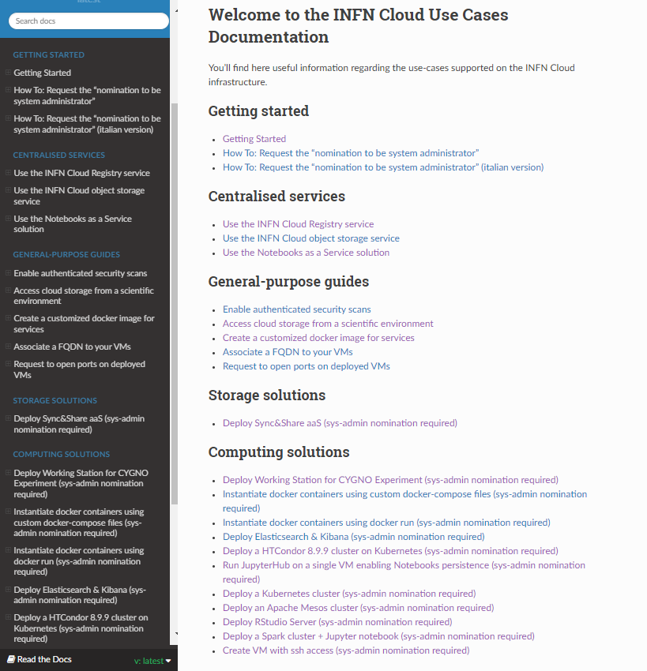
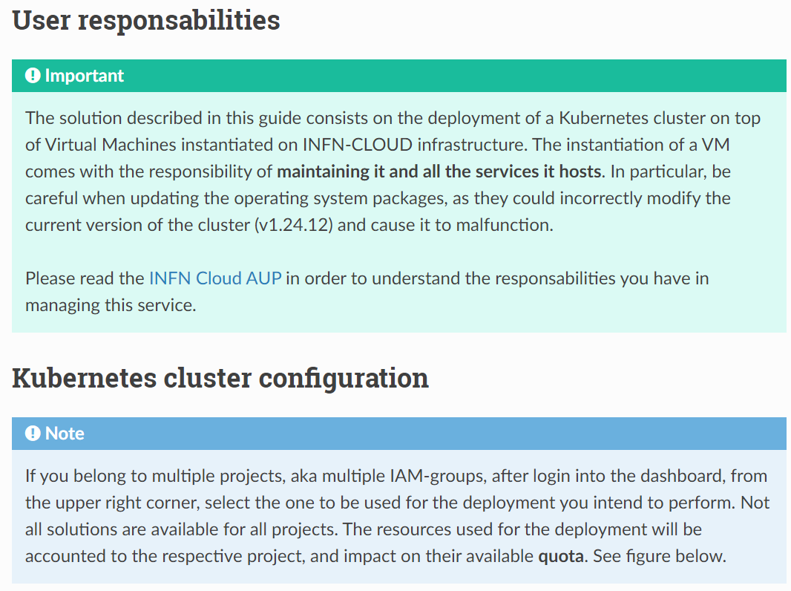
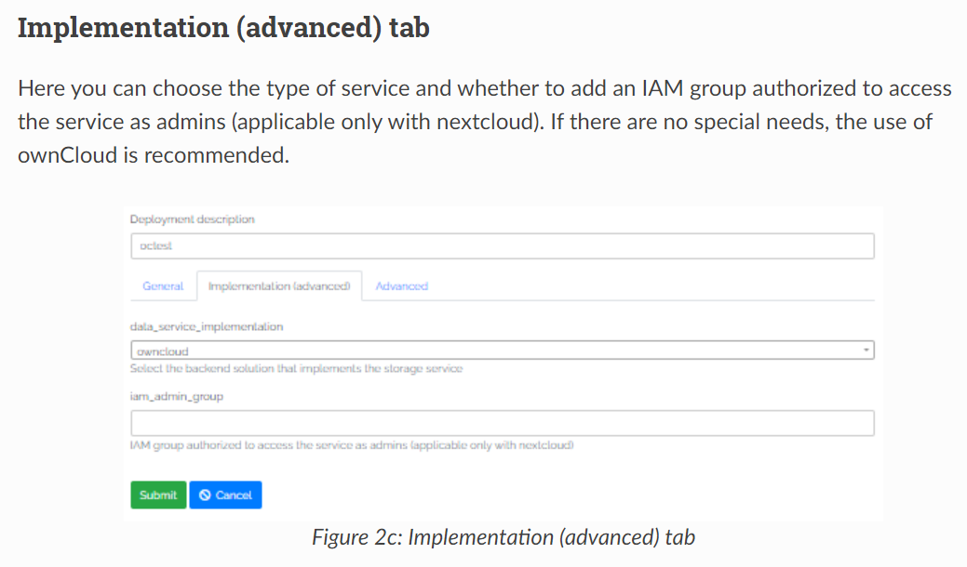
Guides – Documentation [1]
Services Catalog
List of procedures
Guides on Services deployment
[1] https://guides.cloud.infn.it/docs/users-guides/en/latest/

Slide 8
Organised/supported training events (2022/2024)
2022
ClueApp – 13-16/09
3° ML-INFN Hackaton 21-24/11
Administration of resources provided through INFN Cloud – 29/11 – 2/12
2023
User Course 29-30/05
Clue App – 31/05-1/06
4t ML-INFN Hackathon 21-23/06
Openstack & INFN Cloud 27-30/11
2024
Administration of IT resources – 6-9/02

Slide 9
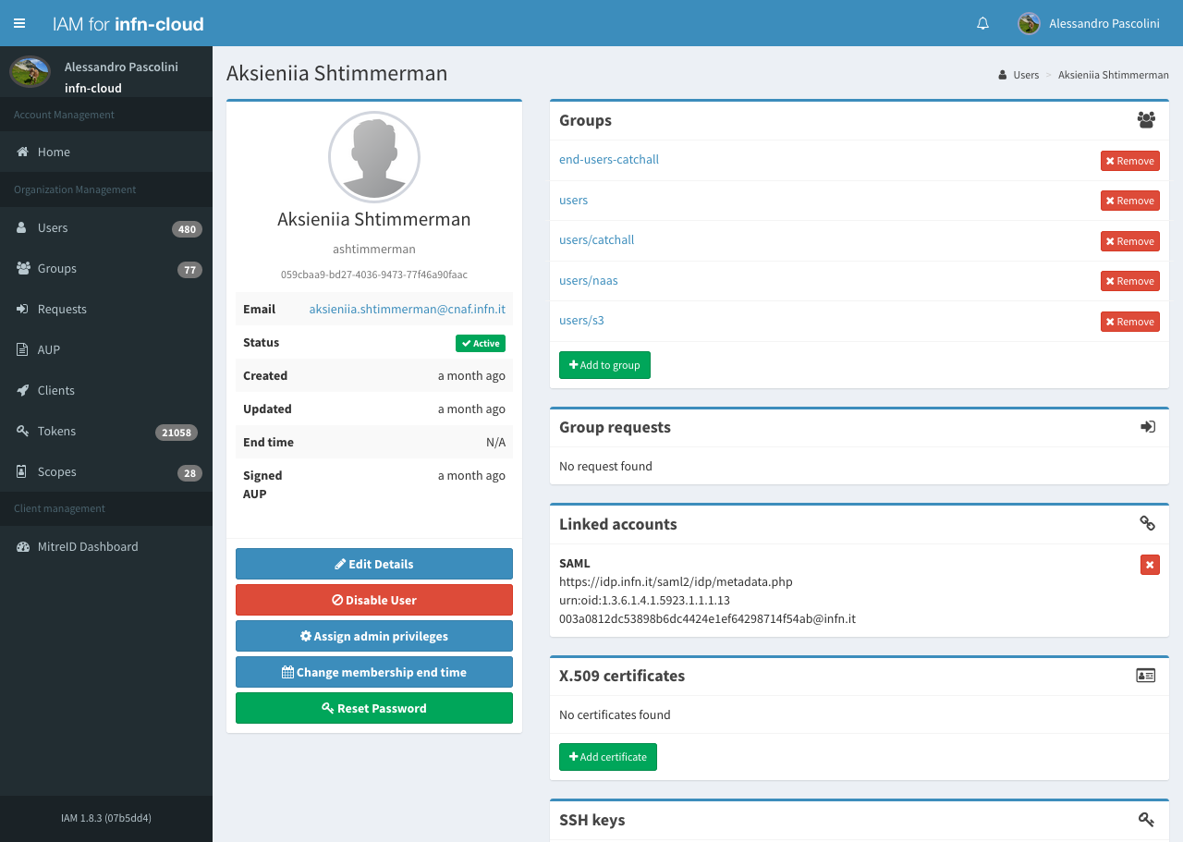
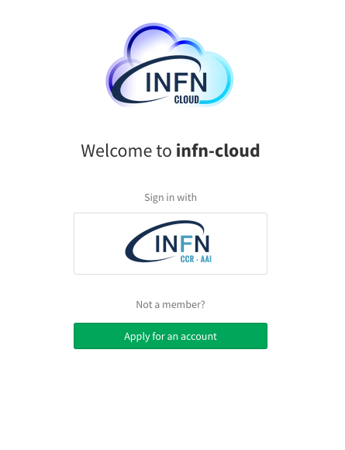
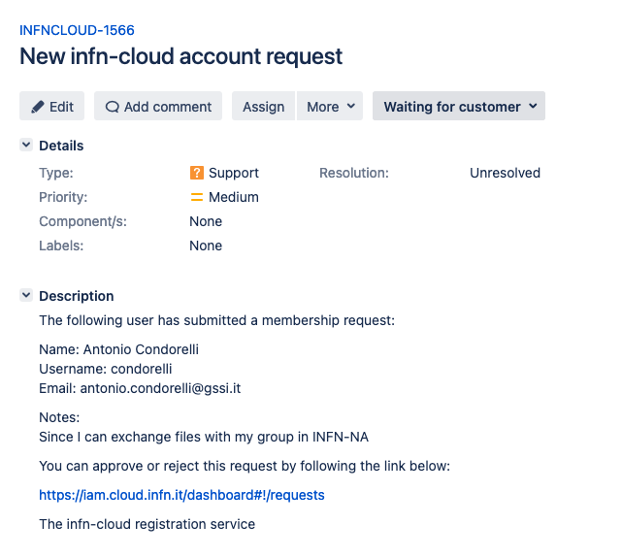
Cloud Subsctiptions
IAM-Cloud
IAM instance to perform AuthN/Z on the PaaS
Resources allocation based on IAM Groups
Access reserved only for INFN associates*
* Planning to extend access to non-INFN users

Slide 10
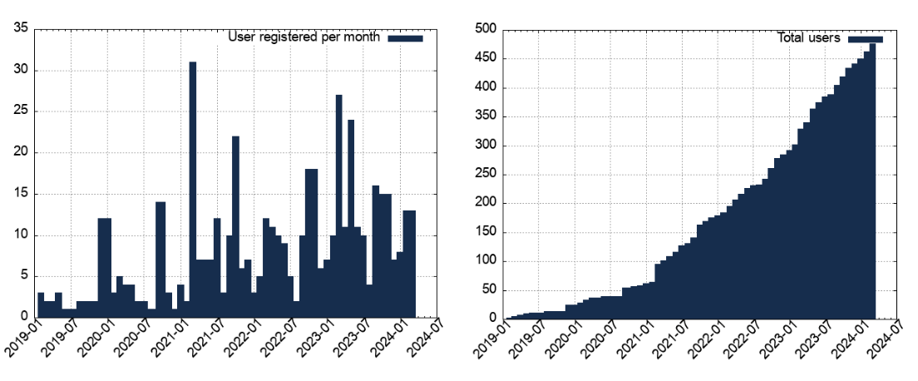
Numbers – Cloud Subsctiptions

Slide 11
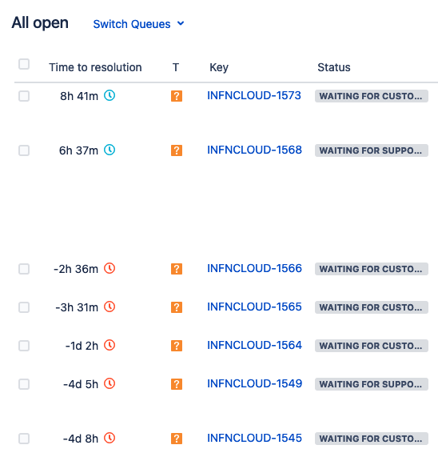
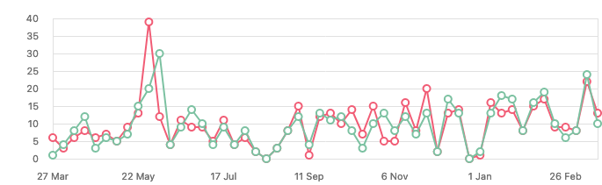
Numbers – User Support
~1600 suport tickets in over 4 years
Only 14 tickets open right now
CREATED vs RESOLVED tickets over last year

Slide 12
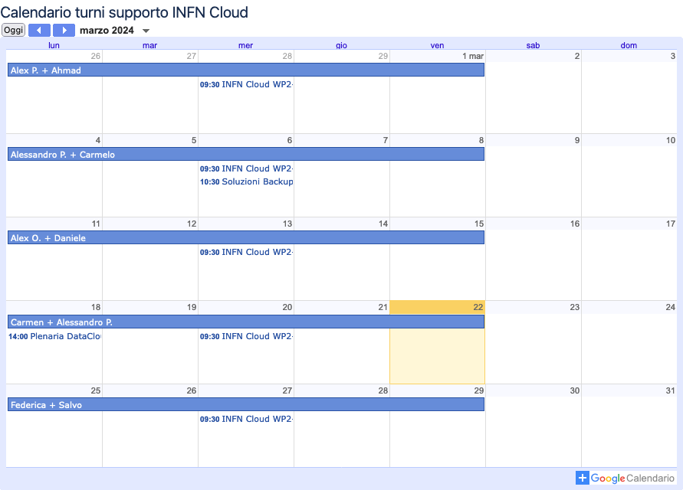
Who? How?
Support Team
Contacts via Service Desk
Announcements cloud-announce@lists.infn.it
First Level
Second Level
Ahmad Alkhansa
Federica Fanzago
Daniele Lattanzio
Alessandro Pascolini
Carmelo Pellegrino
Francesco Sinisi
Stefano Stalio
Simona Stellacci Carmen Giugliano
Alessandro Alberto Oliva
Salvatore Aurnia
Stefano Stalio
Marica Antonacci
Giacinto Donvito
Ddaniele Spiga
Barbara Martelli
Vincenzo Ciaschini
Diego Michelotto
Daniele Cesini
Luca Giovanni Carbone
Enrico Vianello
Massimo Sgaravatto
Nadina Foggetti
NEW ENTRIES!!
And many more …

Slide 13
Supported Projects
AI_INFN
AMS-02
Cygno
Darkside
ELETBIC
EUROLABS
HERD
IXPE
KM3NeT
LHCb
MUONE
NUCS
QUAX
SI
TIFPA

Slide 14
Cygno

Slide 15
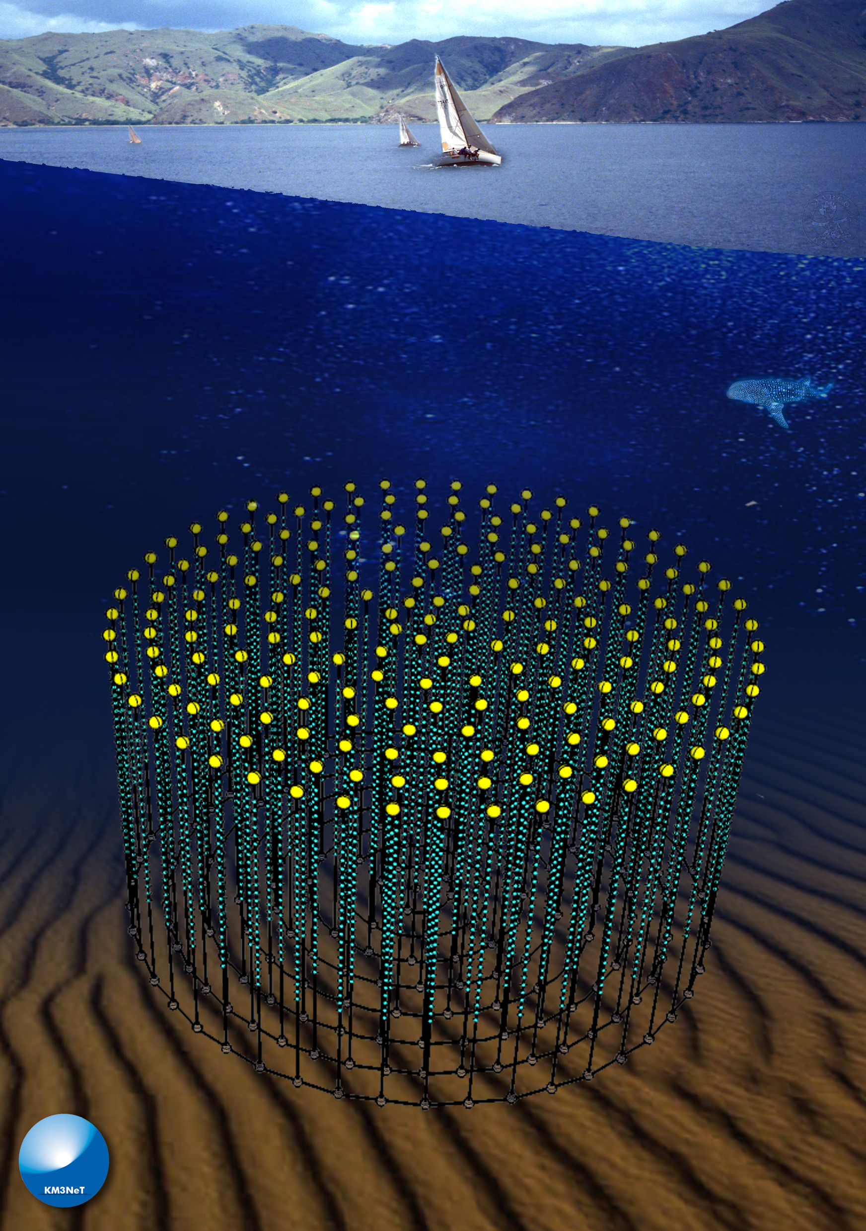
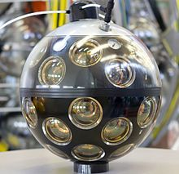
KM3NeT
SVN repo
A legacy SVN repo being maintained as a reference
KM3DIA
DOM Integration Assistant (DIA) → database collecting all the informations from DOM integration sites
Redundance on more sites
Owncloud
A shared spasce to keep documents

Slide 16
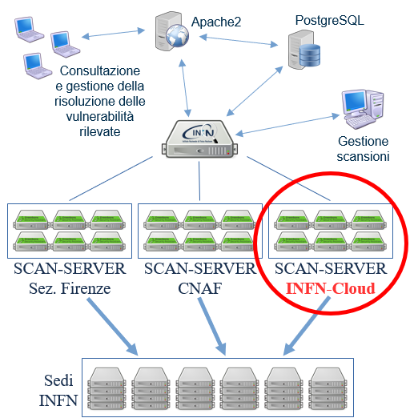
NUCS – NUcleo Cyber Security
Scan-Servers
6 virtual-machines instantiated on INFN-Cloud alongside the previous 12 at INFN-CNAF and INFN-Firenze

Slide 17
Conclusions
WP2 deals with user support and training
Interaction with projects
Support for the adoption of Cloud-native technological solutions
Collaboration with other groups present in INFN Cloud
New challenges are expected as DataCloud begins
Update on-boarding procedures for new non-INFN users
Guides and training to support the evolution of services

Slide 18
Thanks for the attention!

