Slide 1
e-Science Activities in China
Gang Chen Institute of High Energy Physics, CAS
ISGC2024
March 27, 2024

Slide 2
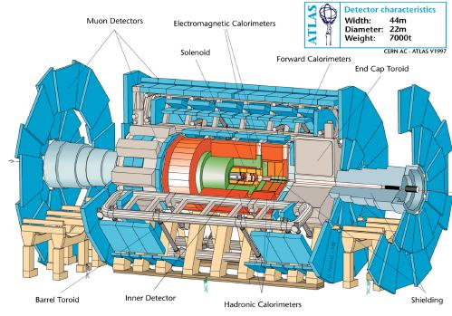
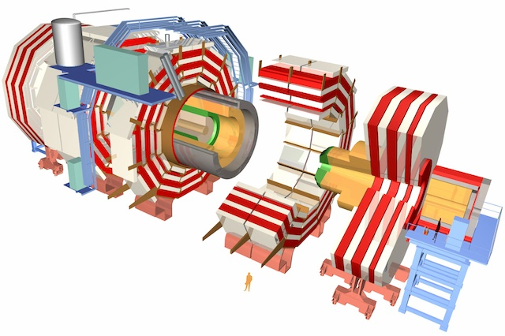
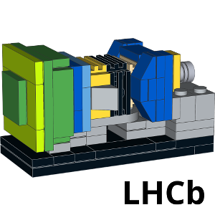
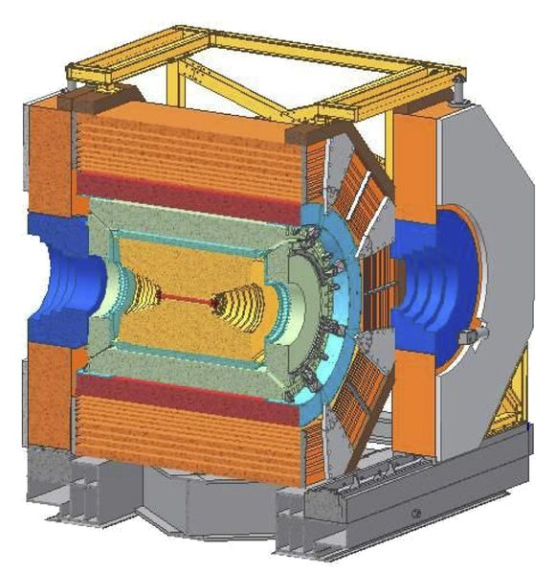
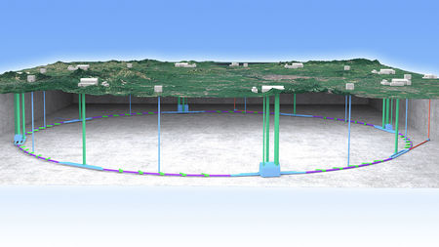
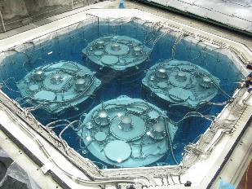
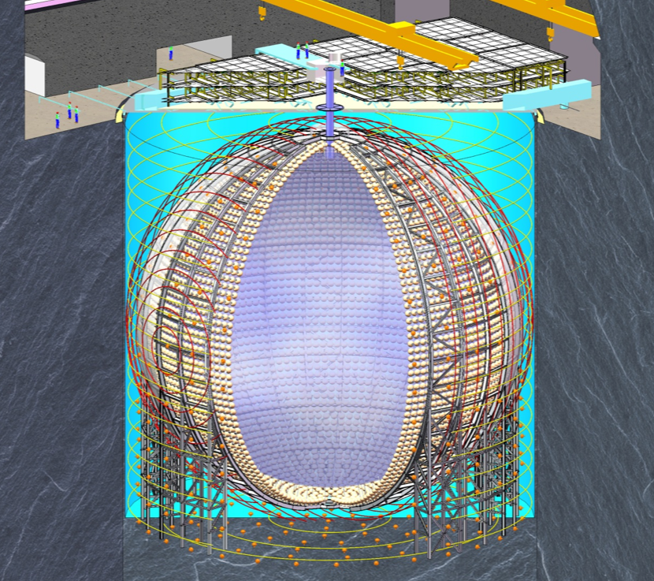
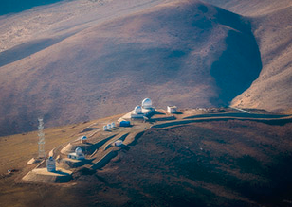
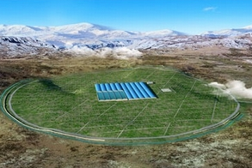
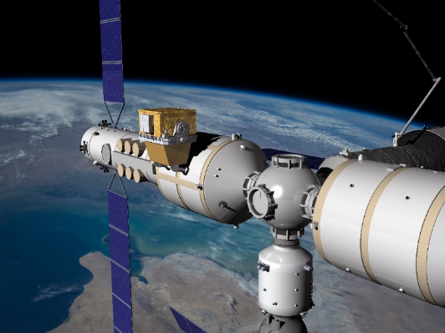
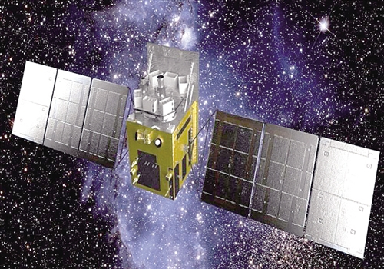
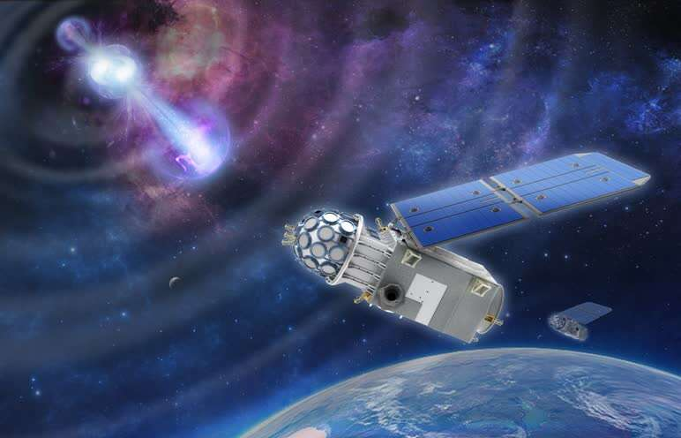
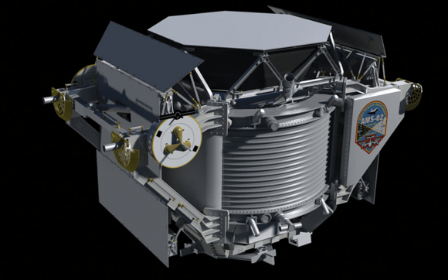
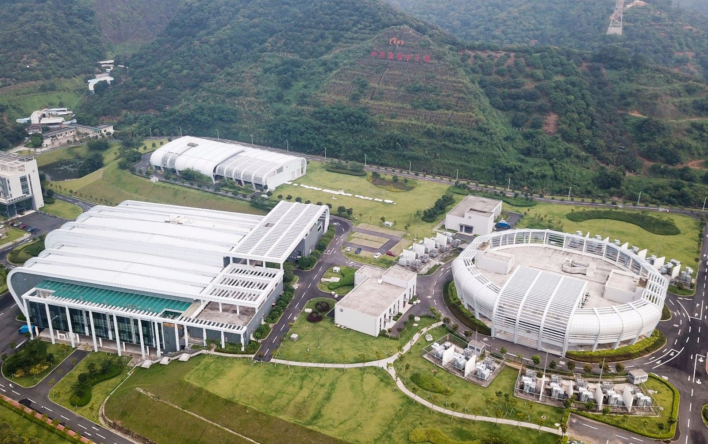
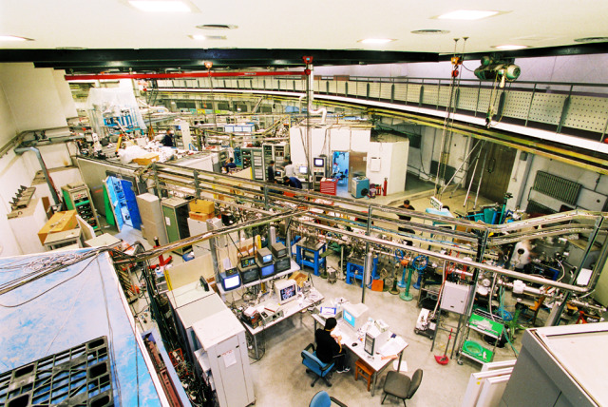
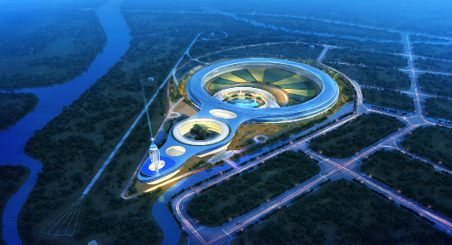
HEP Related Projects
Accelerator based particle physics
ATLAS
BESIII
CEPC
CMS
BELLE II
DYB
AliCPT
JUNO
DUNE
Cosmic ray and astrophysics experiments
HERD
HXMT
GECAM
AMS02
LHAASO
BSRF
Neutron Source and Synchrotron Radiation Facilities
CSNS
HEPS

Slide 3
Facilities of IHEP
BEPCII/BESIII
BSRF
HEPS
AliCPT
AS𝛾
LHAASO
CSNS
JUNO
Daya Bay

Slide 4
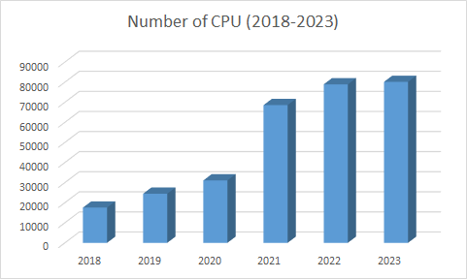
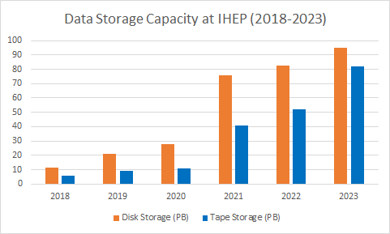
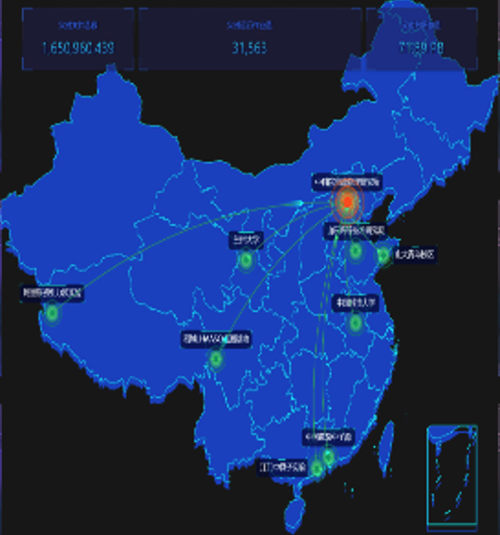
Computing and Data Storage
Distributed Locations
Beijing, Dongguan, Daocheng, Jiangmen
Quantity of resources grew exponentially
~100K CPU cores
~100PB Disk Storage
~80PB Tape Storage
HTC and HPC for experiments/applications
28 experiments/applications

Slide 5
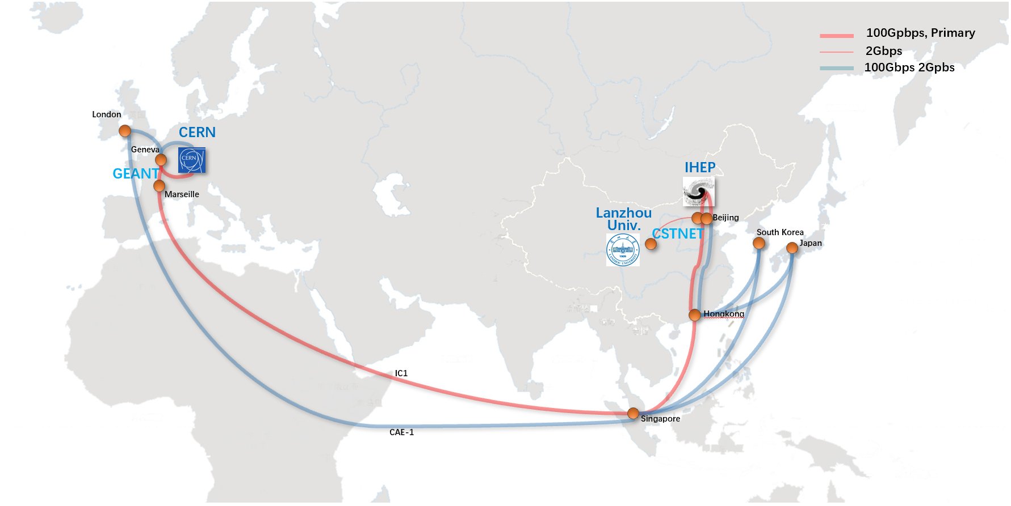
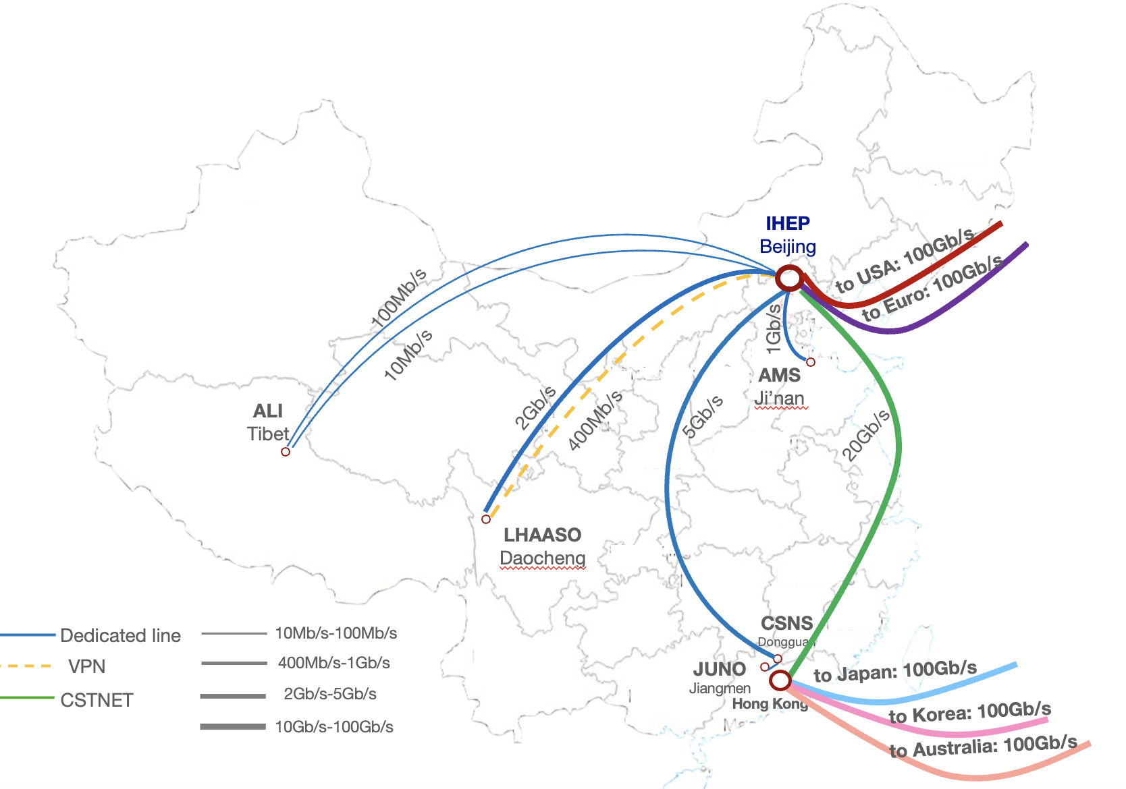
International Network Upgrade
International network link has been upgraded to 100Gbps in 2023
With helps from CSTNET, GEANT and CERN
The peak performance of data transfer between IHEP and Europe is about 50Gbps
Dedicated links between IHEP and remote sites
HEPS-IHEP: 100 Gbps
CSNS-IHEP: 20 Gbps
LHAASO-IHEP: 2 Gbps (3Gbps since last month)
JUNO-IHEP: 2 Gbps
AMS-IHEP: 1 Gbps
ALi-IHEP: 110 Mbps
International network connection of IHEP

Slide 6
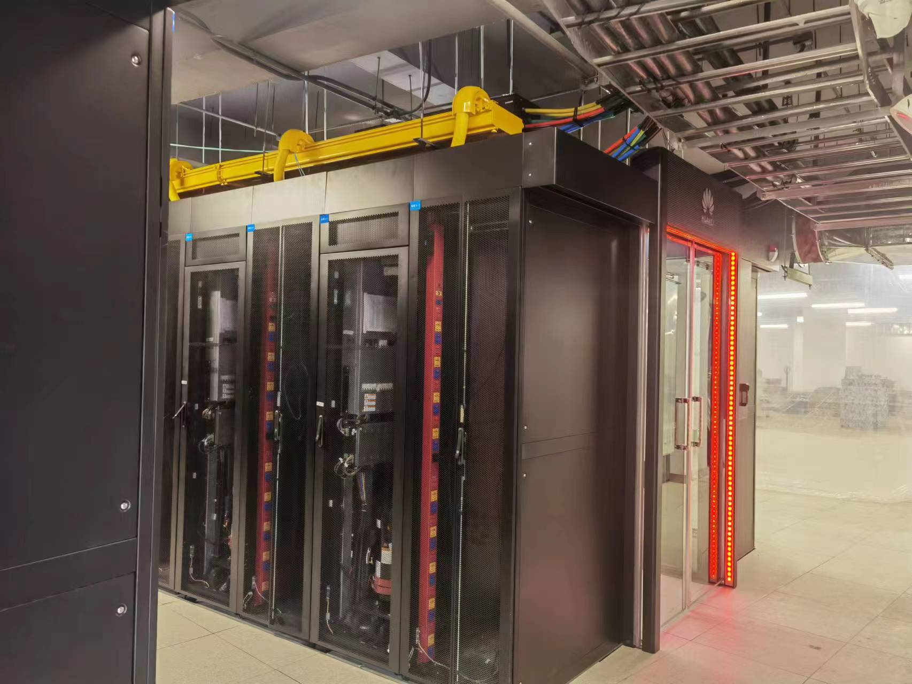
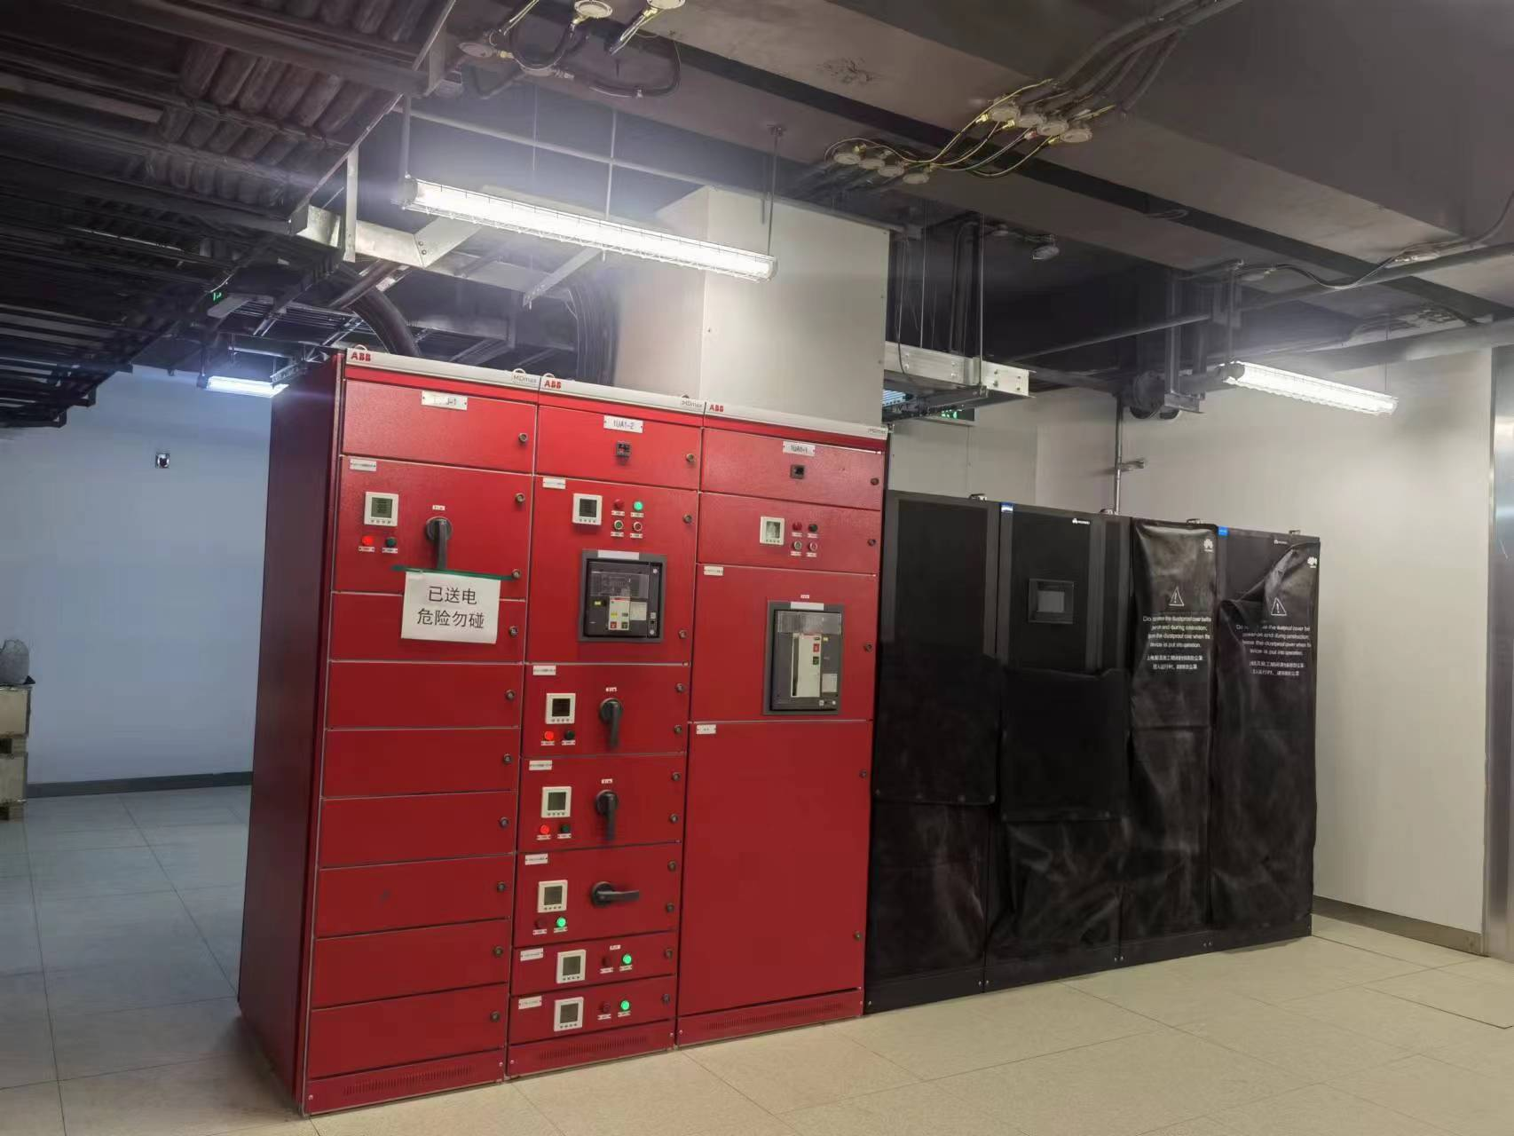
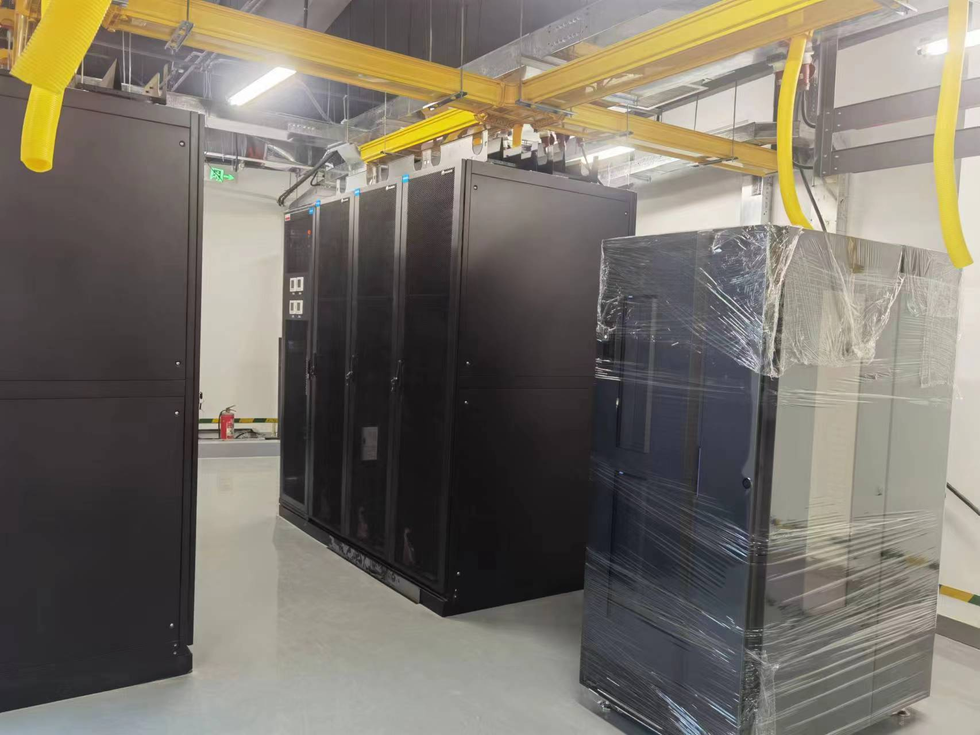
New Machine Room for HEPS
HEPS data center is located 100km north of IHEP
The main machine room is 520㎡
47 racks in Phase I: 20 for storage, 21 for computing and 6 for network
Power infrastructure
2500kVA+2500kVA
800kVA UPS providing a backup time of half an hour for core service servers.
15kW/rack for storage，30kW/rack for computing
Cooling equipment
The server devices are under procurement

Slide 7
Services Provision
Applications/projects supported
BESIII/LHAASO/JUNO/HEPS/LQCD/HERD/LHC/GECAM/EP/…
WLCG
CPU-core hours | CPU jobs | CPU efficiency | GPU card hours | GPU efficiency
335,825,720.8 | 160,693,904 | 85.36% | 1,318,144.3 | 60.19%
ATLAS | CMS | LHCb | BELLEII | JUNO/CEPC
444 cores, 400TB | 444 cores, 680TB | 1680 cores, 375TB | 576 cores, 280 TB | 1214 cores, 2PB
2,690,731 core hours | 2,150,407 core hours | 10,150,000 core hours | 1,261,440 core hours | 2,540,400 core hours

Slide 8
Grid Site Status
CPU: 4232 cores
Intel Golden 6338: 1152 Cores
Intel Golden 6238R: 672 Cores
Intel Golden 6140: 2160 Cores
Intel E5-2680V3: 696 Cores
Intel X5650: 192 Cores
CE & Batch: HTCondorCE & HTCondor
VO: ATLAS, CMS, LHCb, BelleII, JUNO, CEPC
EOS: 1750TB
4TB * 24 slots with Raid 6, 5 Array boxes
DELL MD3860 8TB * 60 slots
DELL ME4084 10TB * 42 slots
DELL ME4084 12TB * 84 slots
DPM replaced last May

Slide 9
New Budget for ATLAS and CMS
New budget for ATLAS and CMS Beijing Tier-2 site
Total budget: RMB 3 million (~380k €)
Allocation:
CPU：60,000 HepScore (~2300 cores)
Disk storage：2.5PB
Upgrade of ATLAS and CMS Beijing Tier-2 will be completed in 2024

Slide 10
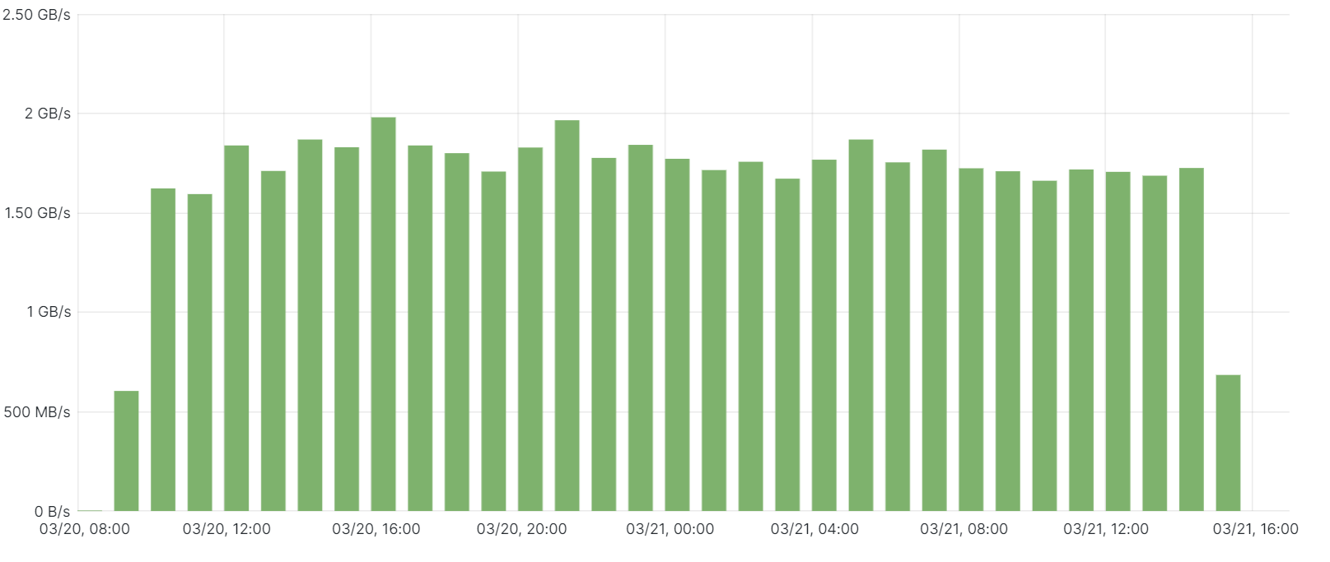
LHCb Tier1 Upgrading
All the hardware is ready
Computing: 3216 CPU cores, 40 worker nodes (Intel & AMD)
Disk storage: ~3.2PB, 4 sets of storage array
Tape storage: ~3PB, 170 tapes, 4 drivers (IBM)
Network equipment: 6 switches, 1 router, 2 band cards
Management servers: 10 servers
Currently, Tier1 site is also reusing part of the existing hardware
Firewall device, tape library, CA system, …
First data challenge has been done
189TB data was transferred into IHEP Site in ~2 days last week
The average transfer speed is about 1.55GB/s (Max is 1.98GB/s)
Transfer efficiency is close to 100%

Slide 11
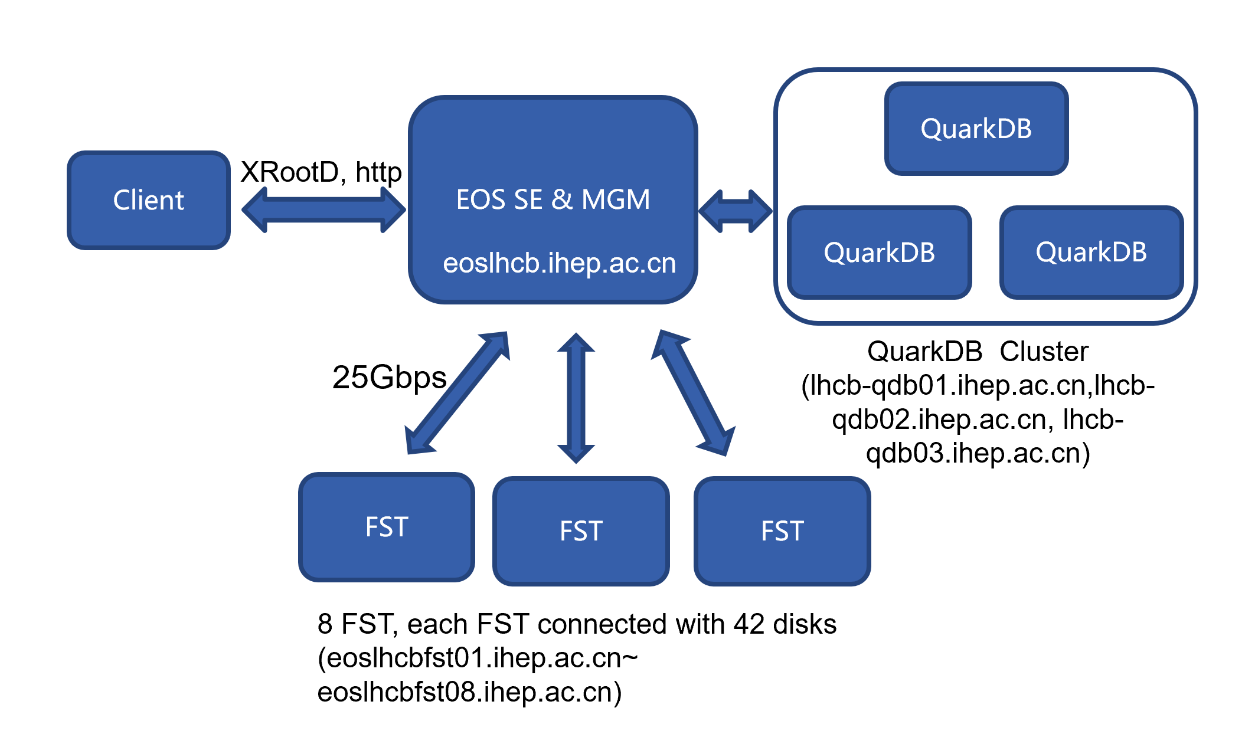
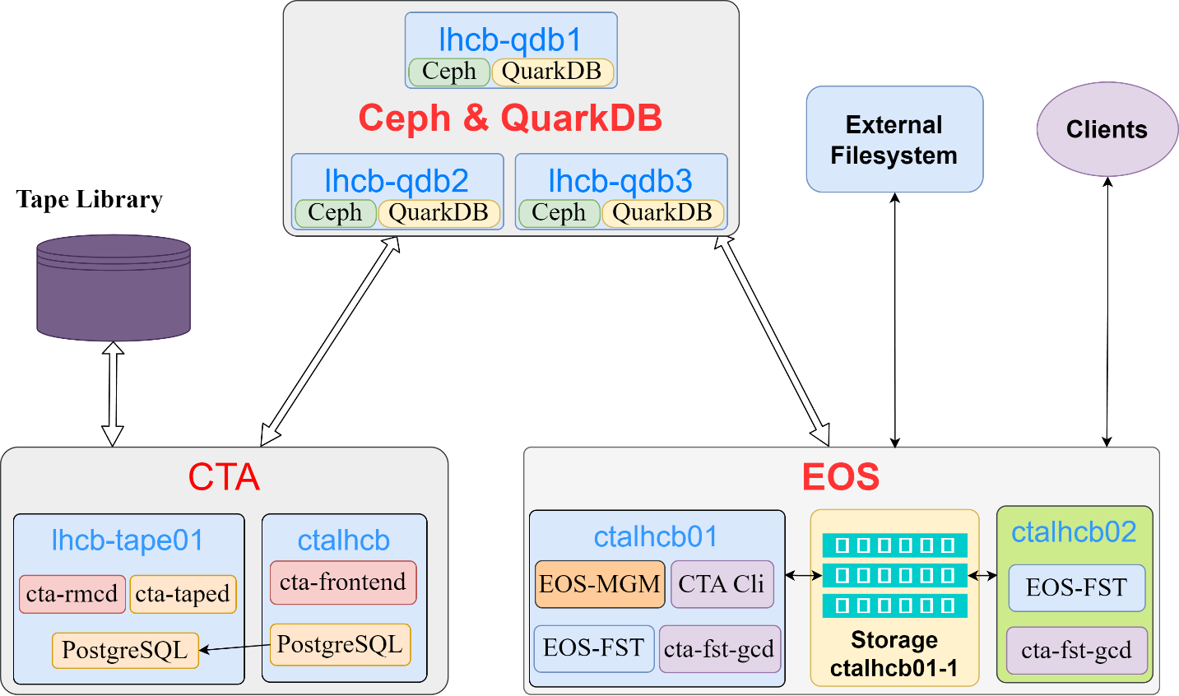
LHCb Tier1 Upgrading
Disk storage: EOS
services: QuarkDB, MGM, FST
protocol: xrootd and http
Tape storage: EOS & EOS-CTA
Protocols: xrootd and http
CE: HTCondor-CE & HTCondor
Support for SCIToken and GSI
Other middle software
Argus, BDII, APEL

Slide 12
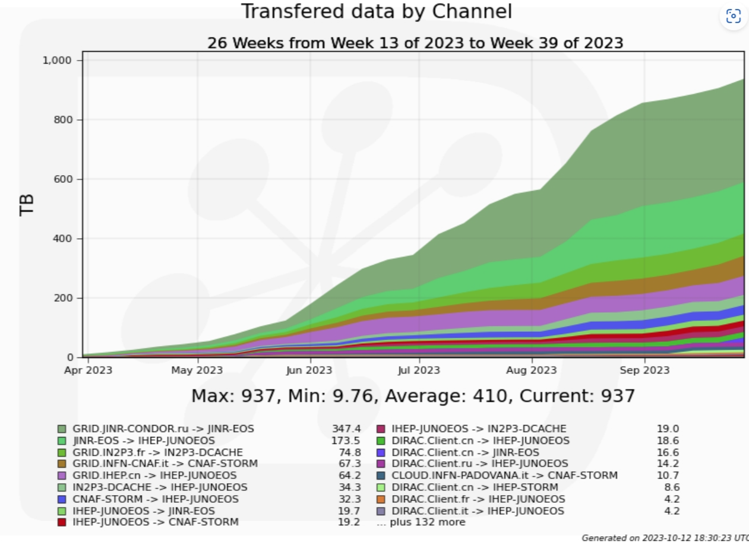
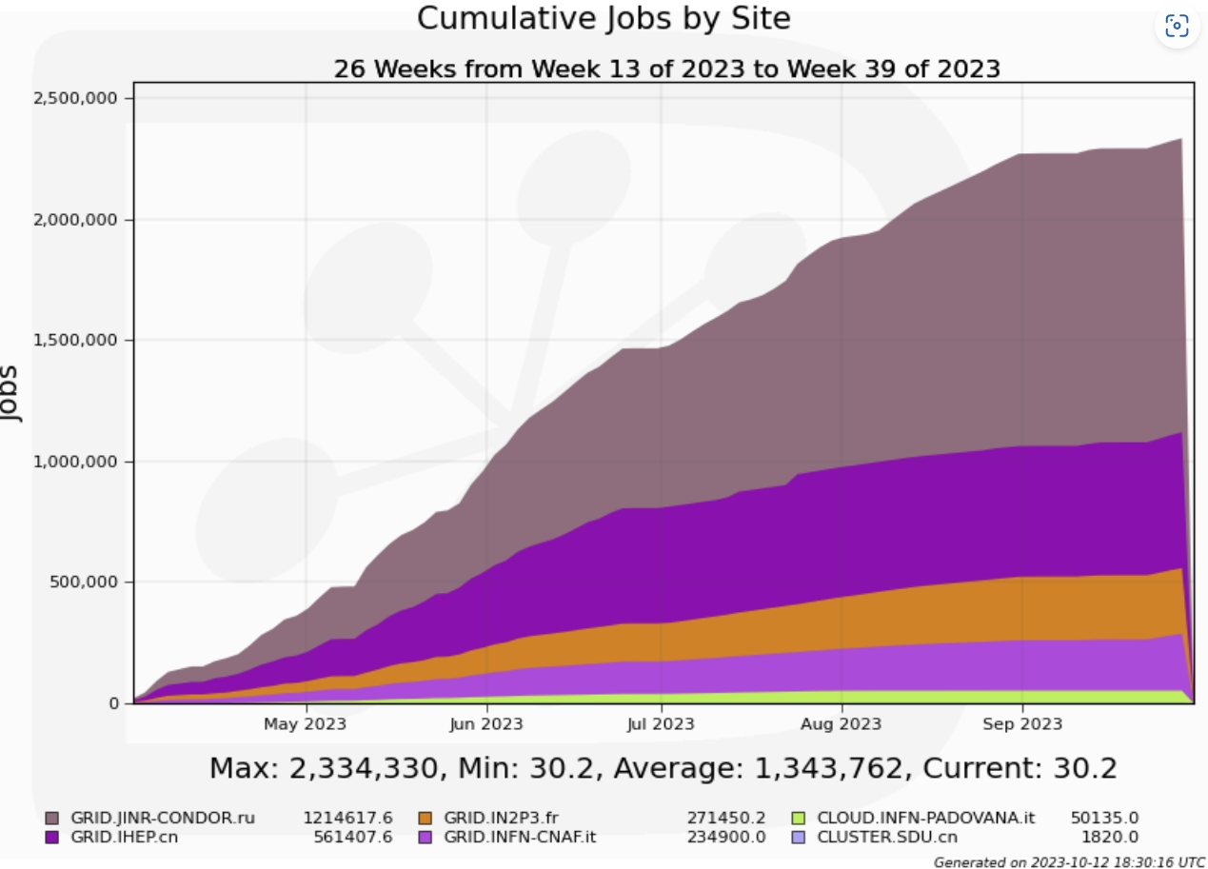
Distributed Computing
DIRAC at IHEP
Serving BESIII, JUNO, HERD, CEPC
DIRAC for computing and data management, upgrade to v8.0.26 and move to distributed deployments since July 2023
Start to manage JUNO’s First Data Challenge (DC1)
Rucio at IHEP
HERD Rucio API development and deployment completed, provides an integrated API to experiment software
Grid middle-ware services
HERD IAM at IHEP deployed and in test
Service monitoring system and site monitoring system for distributed computing are under development

Slide 13
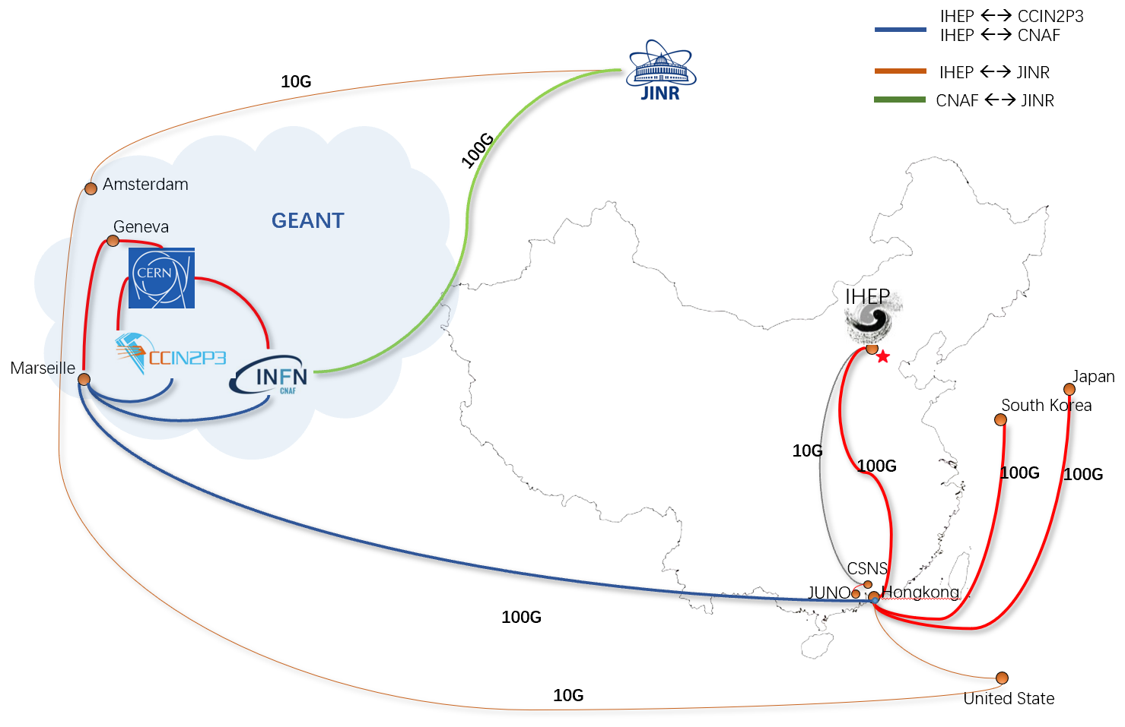
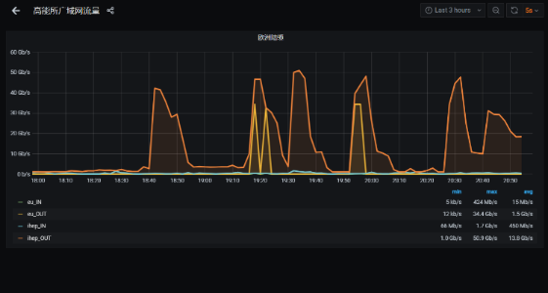
JUNO at IHEP
Sites | Resources
 | CPU (KHS06) | Disk (PB) | Tape (PB)
IHEP | 180 | 8 | 4
CNAF | 20 | 3 | 1
IN2P3 | 15 | 0.2 | 2
JINR | 120 | 10 | 10
JUNO: Jiangmen Underground Neutrino Observatory
To take data in 2024
Grid Computing started since 2018,
Includes INFN, CC-IN2P3, JINR, IHEP
Grid computing platform at IHEP:
DIRAC system with IHEP-extensions
monitoring, production system and job-submission API
Shared middleware and infrastructures: FTS3, VOMS, TPC, etc.
Software deployed at IHEP:
Storage: EOS, Lustre on disk, EOS-CTA on tape.
Computing: HTCondor on x86, Slurm on ARM and GPU.
Data Challenge 1:
12th ~ 26th Feb 2024, corresponding to WLCG DC24.
IHEP -> CNAF/IN2P3 transfer worked well, almost no failure. IHEP->JINR is bad and always get stuck.
data transfer between IHEP and INFN, IN2P3

Slide 14
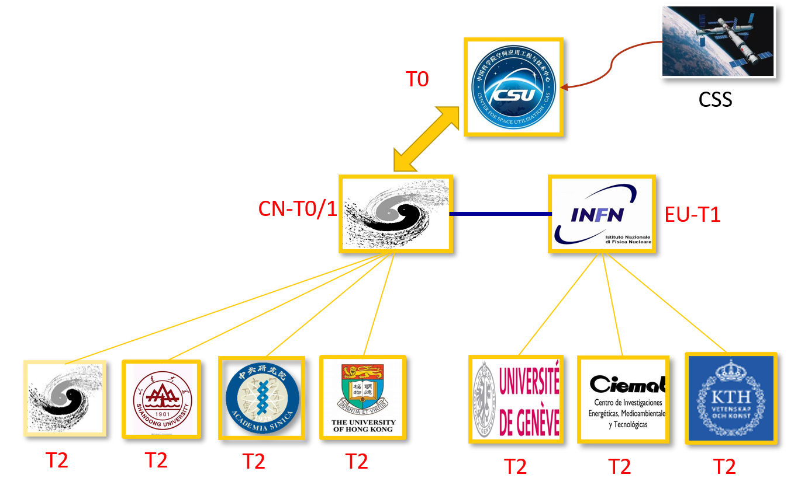
HERD & CEPC Plan at IHEP
HERD and CEPC
HERD: High Energy cosmic Radiation Detection facility
CEPC: Circular Electron Positron Collider
HERD: To be docked on Chinese Space Station in 2027
Storage requirements: 45.5 PB in 10 year
Computing requirement: >13,000 CPUs in 10 years.
Computing model:
Two Tier-1 sites in China and Europe
Several Tier-2 sites
Computing system: DIRAC + dHTC (HTC&HPC)
Data storage and transfer management: Rucio.
CEPC: At the very beginning, working on TDR and EDR
Distributed Computing System: DIRAC + Rucio integration in developing.
Infrastructure and middleware: IAM, FTS3, etc.
Computing Model of HERD

Slide 15
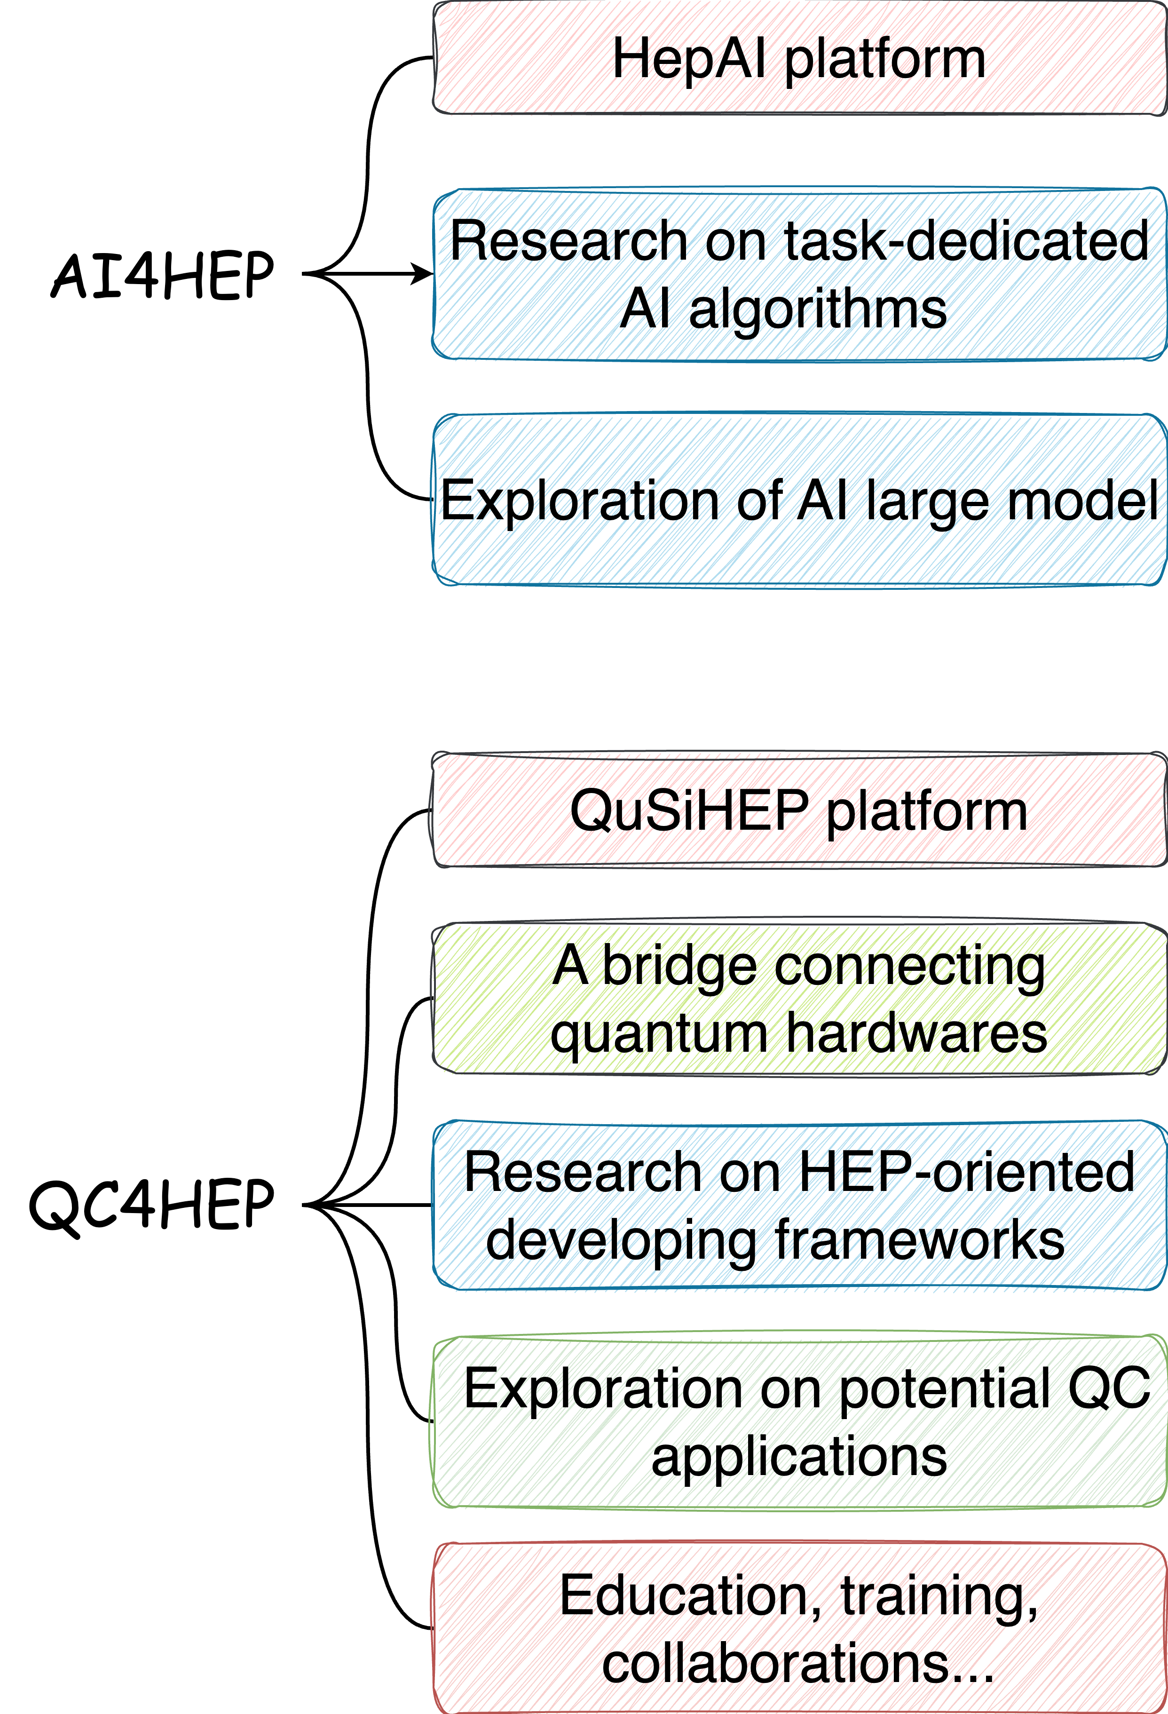
AI & QC
Objectives
Promoting high energy physics research with the power of AI and Quantum Computing
Two fundamental developing platforms for physicists
High Energy Physics Artificial Intelligence platform (HepAI, https://ai.ihep.ac.cn)
Quantum Computing Developing & Simulation Platform for HEP (QuSiHEP, https://qc.ihep.ac.cn)
AI large model research
ChatHEP, a HEP-oriented text model similar to ChatGPT
Cooperation with physicists, research on AI-ready data & LLM for HEP is ongoing
Quantum Computing
Ported Qiskit from NVIDIA CUDA platform to AMD ROCm platform
Trying Qiskit simulation on ARM platform with NEON vectorization instruction
Quantum simulation on QCD (in collaboration with LQCD group)

Slide 16
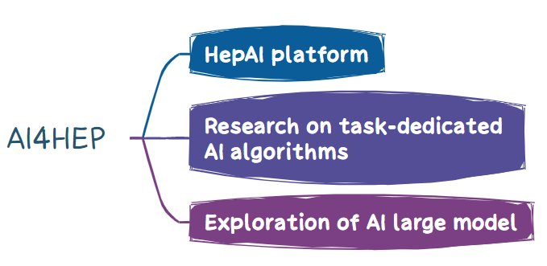
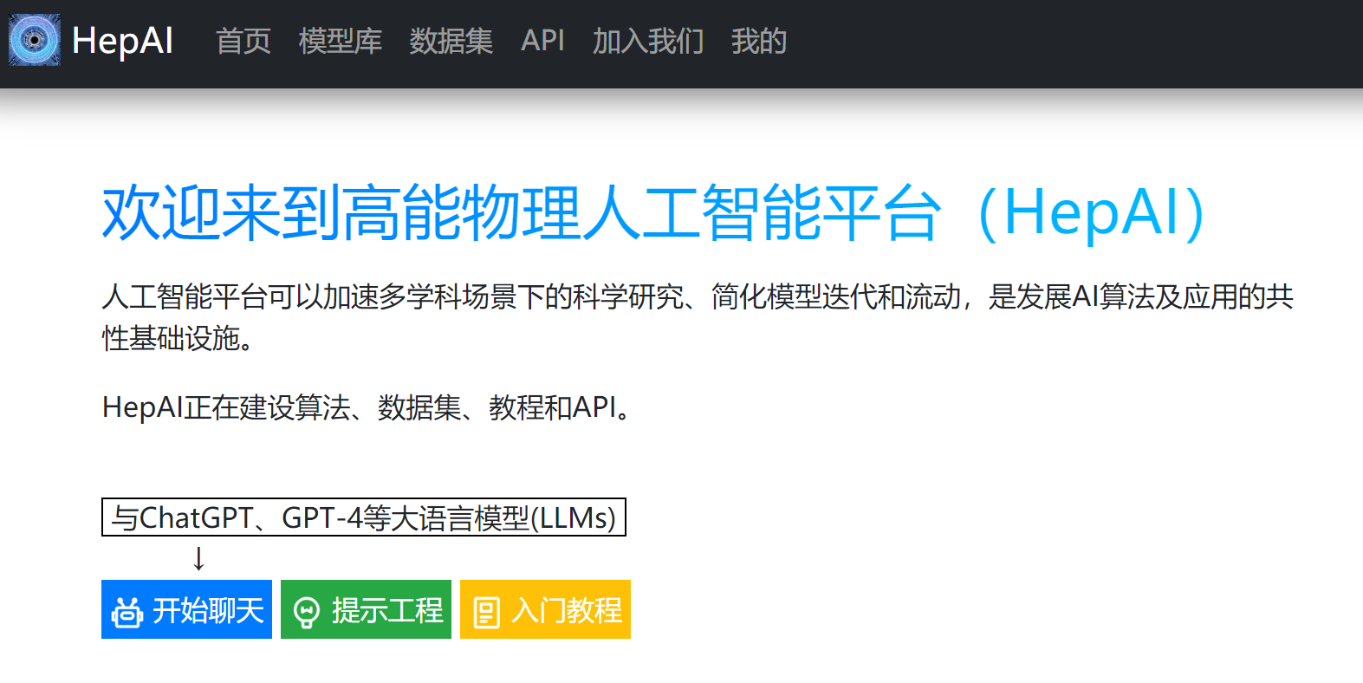
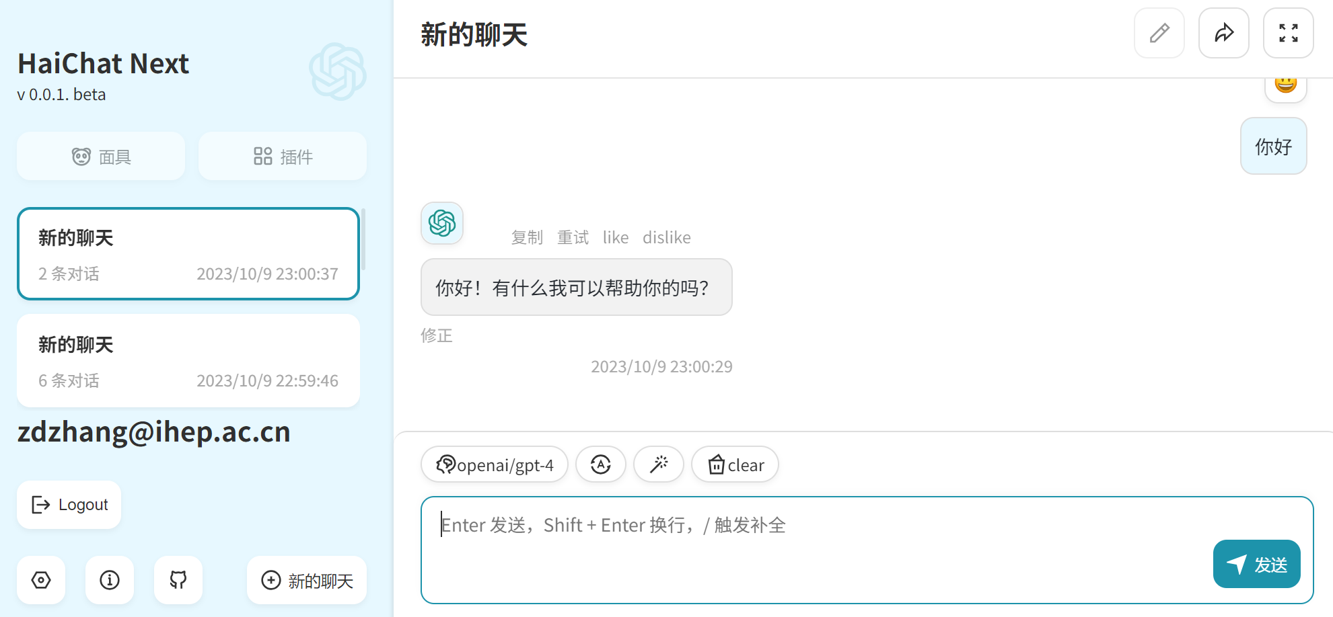
AI Platform
HepAI platform
The Distributed, cross-system, high-concurrency Deployment Framework (HepAI DDF) has been developed and deployed
Several AI models (LLMs, SAM, PointNet, ParticleNet) are integrated into the platform
Task-dedicated AI algorithms
An AI algorithm for fast reconstruction of Ptychography is under development
An AI algorithm for intelligent analysis of microscopic defects for X-ray additive manufacturing images is under development
Large Language Model
Xiwu, a large language model boasting 13B params with just-in-time learning for HEP has been developed
The research on enhancing the language model's capabilities and exploring the feasibility of rediscovering Zc(3900) is currently underway

Slide 17
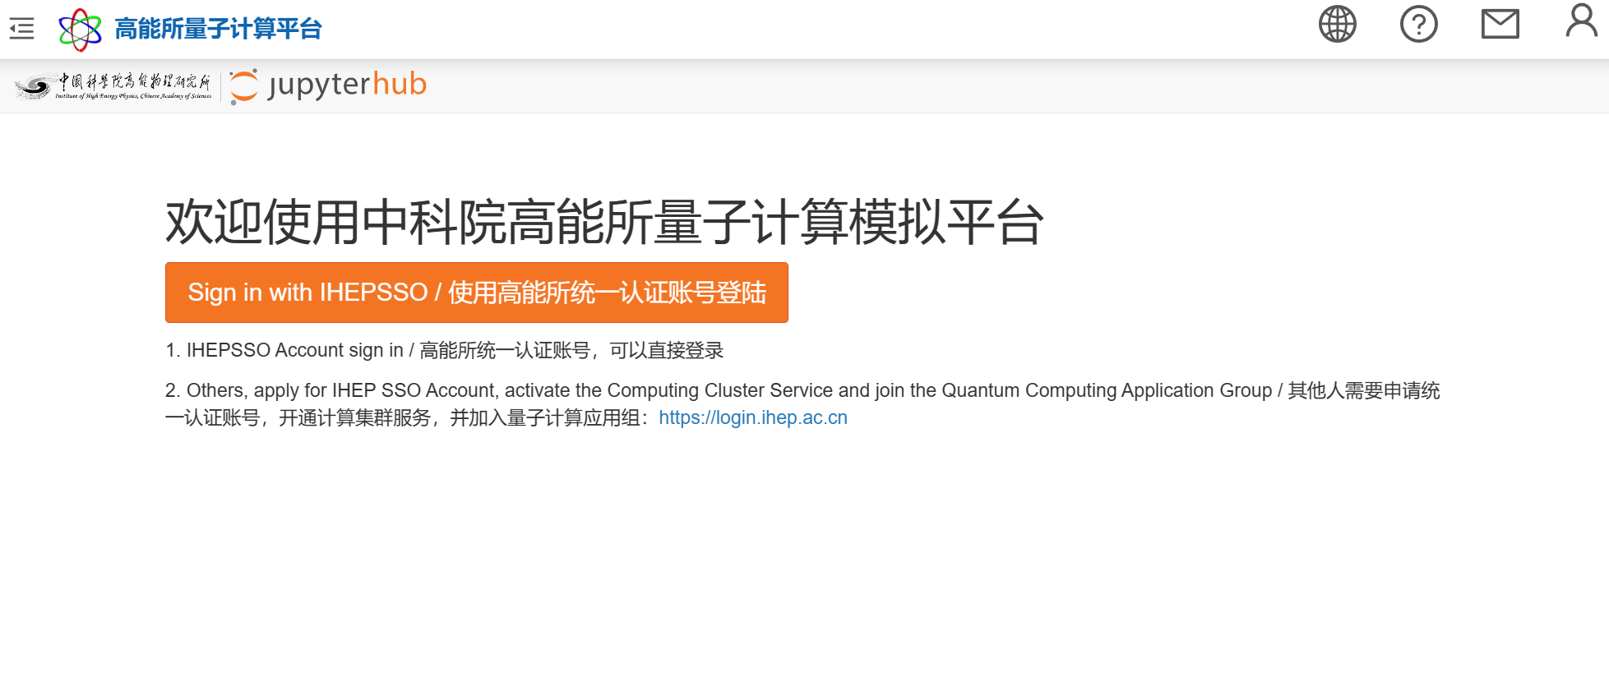
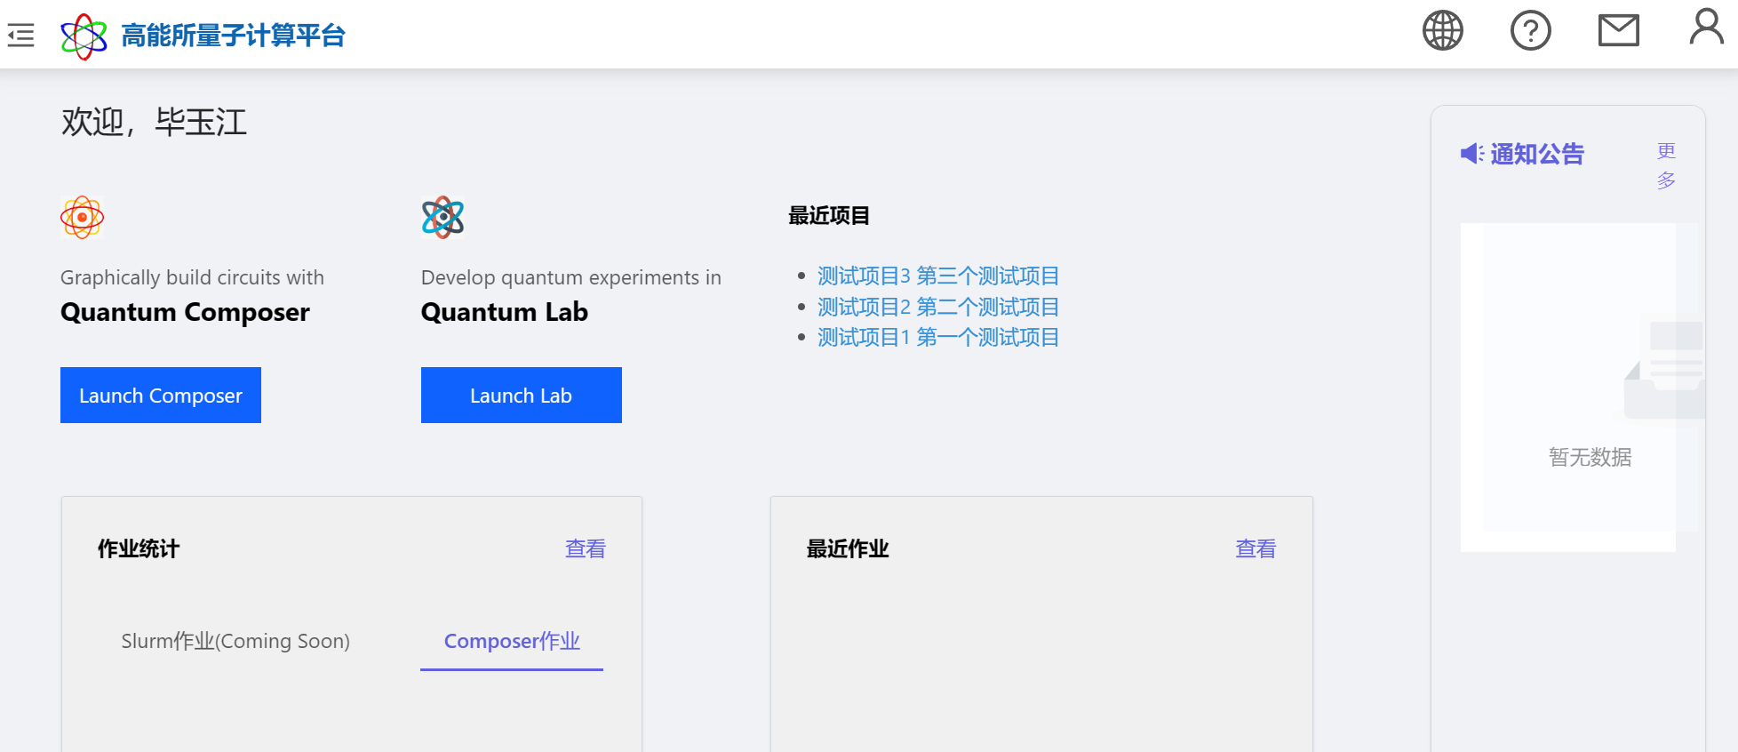
Quantum Computing
QuIHEP
A distributed heterogeneous interactive developing platform
Explore quantum algorithms in HEP experiments
LQCD, CEPC, BESIII, etc.
Connect IHEP HPC cluster to QuIHEP platform to Provide more GPU resources
Qiskit simulation on AMD platform
Ported qiskit-aer from CUDA to ROCm platform

Slide 18
Comments and Acknowledgement
More projects are supported by e-science since new HEP-related facilities and experiments have emerged in the last few years.
New areas such as AI and QC are being explored.
Special thanks to Jingyan Shi, Fazhi Qi, Xiaowen Jiang, …, for contributing to this talk.

Slide 19
Thank you

