Slide 1
臺灣
Leibniz Supercomputing Centre (LRZ),
Data Infrastructure & Environmental Computing Projects
ISGC24 “Env Comp Workshop” | 27.3.2024 Taipei 台北, Taiwan 臺灣

Slide 2
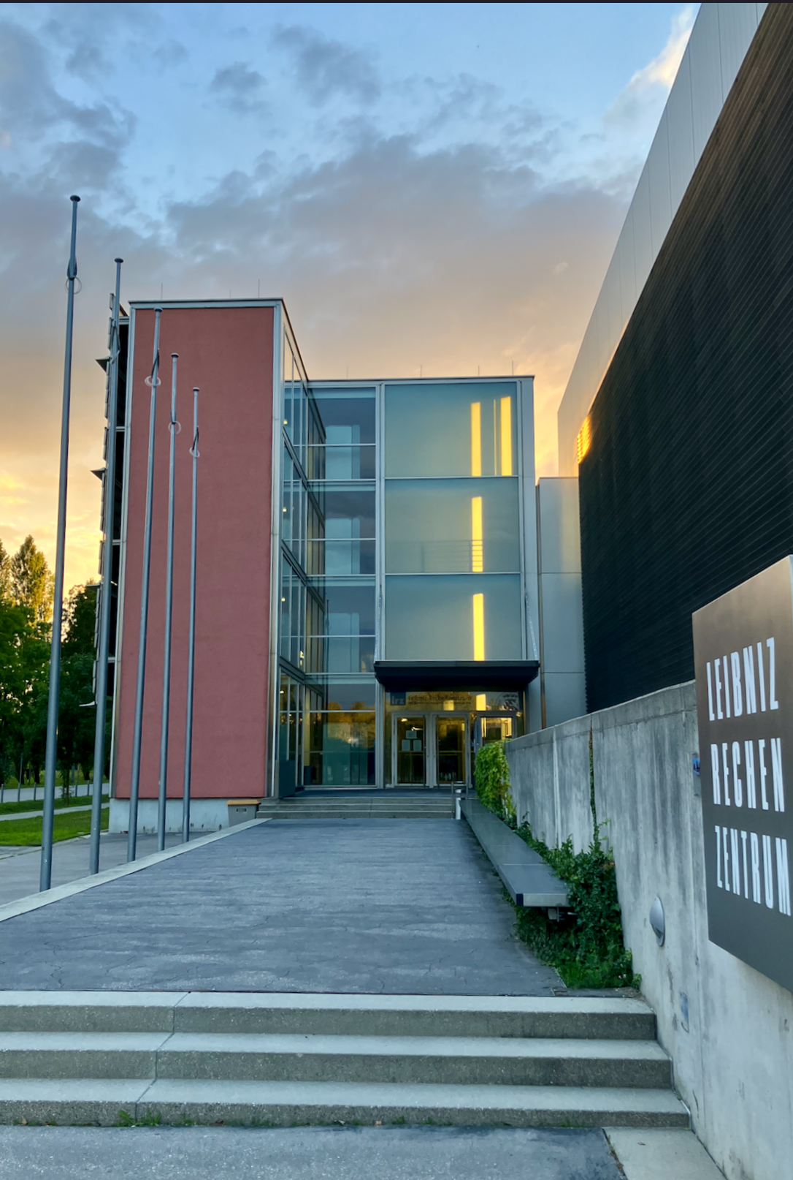

Leibniz Supercomputing Centre (LRZ)
Institute of the Bavarian Academy
of Sciences
and Humanities
IT Service Provider for Munich Universities
IT Solutions for Science
慕尼黑
HPC
High-Performance
Computing
110,000
students
~ 270
employees
approx.
V2C
Virtual Reality
and Visualisation
262,5
Gbit/s internet
connection
30,000
employees
QC
Quantum-computing
62
years of
IT support
8,500
scientists
Big Data
Competence
Centre
4,900
WLAN
access points

Slide 3

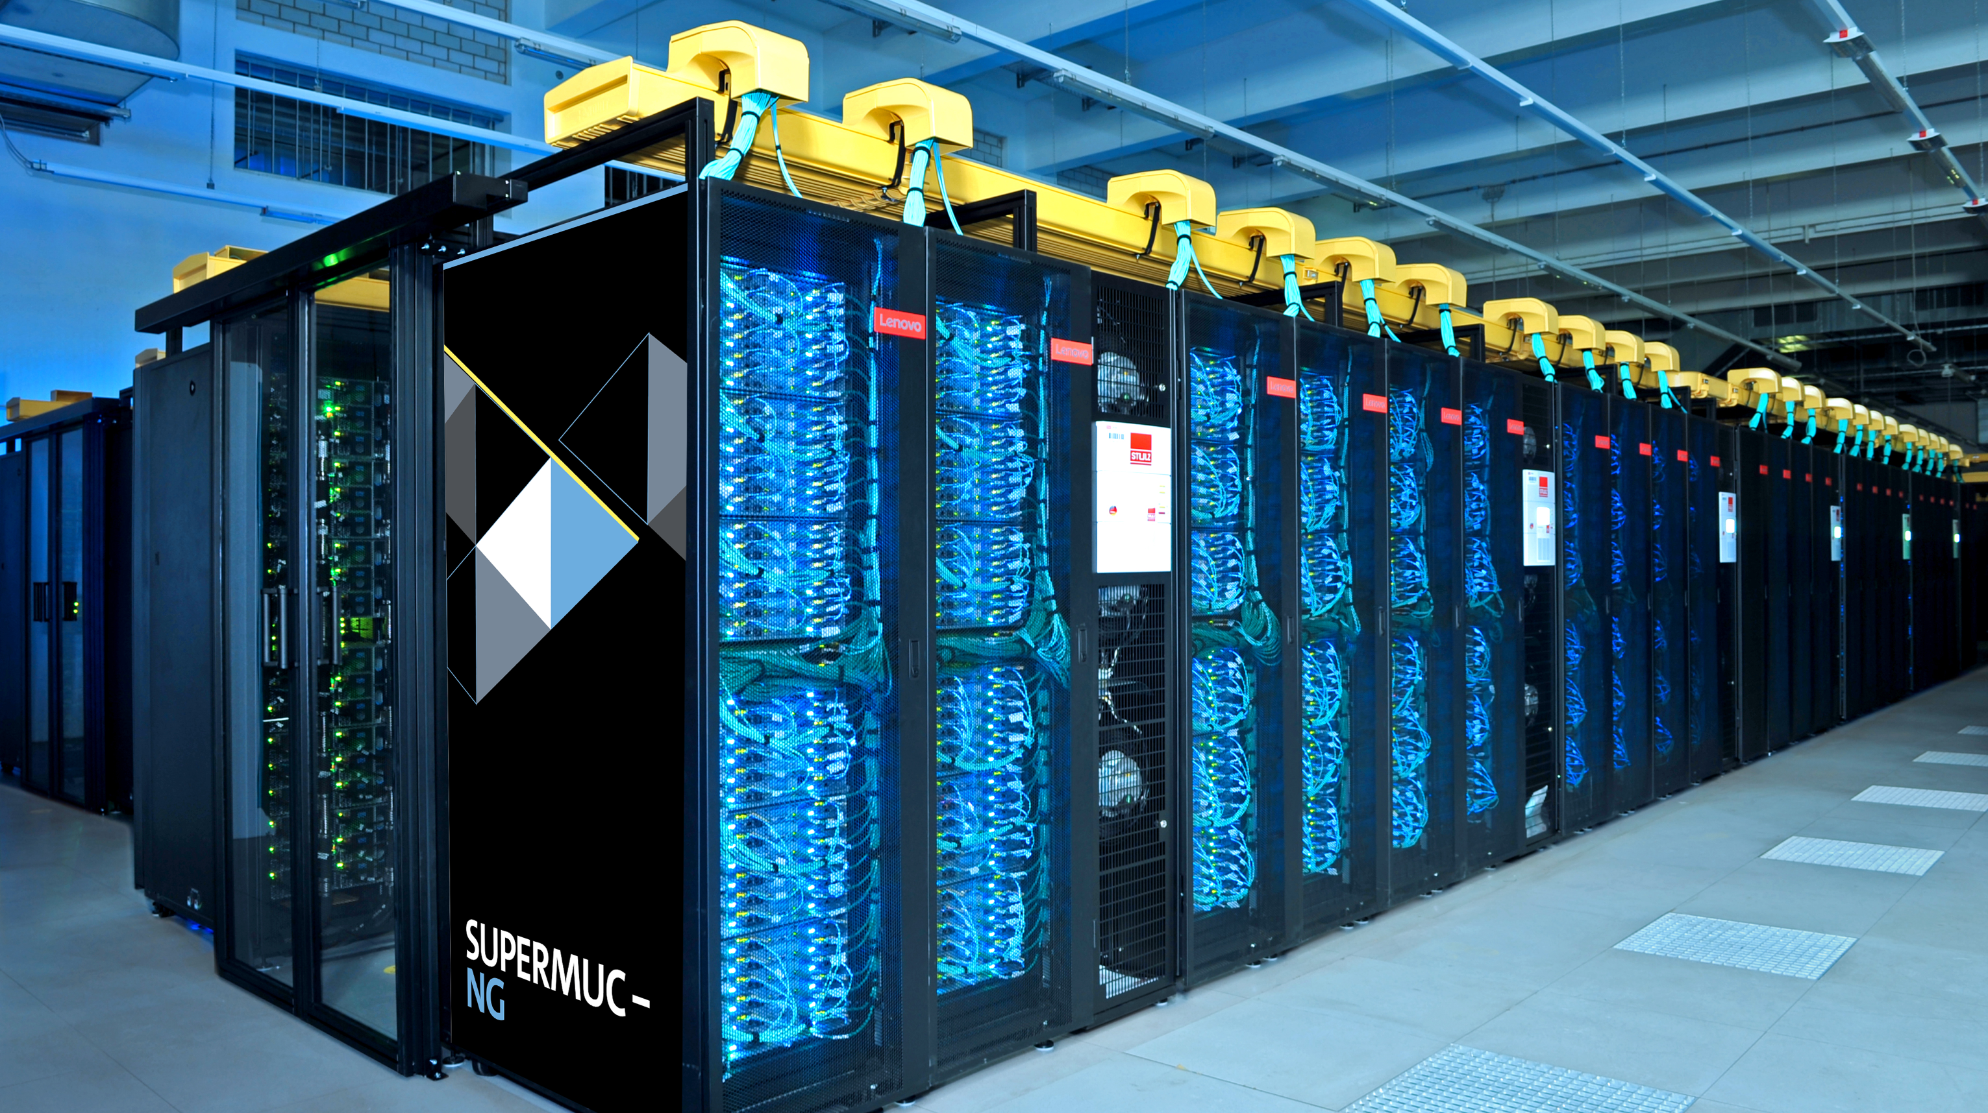
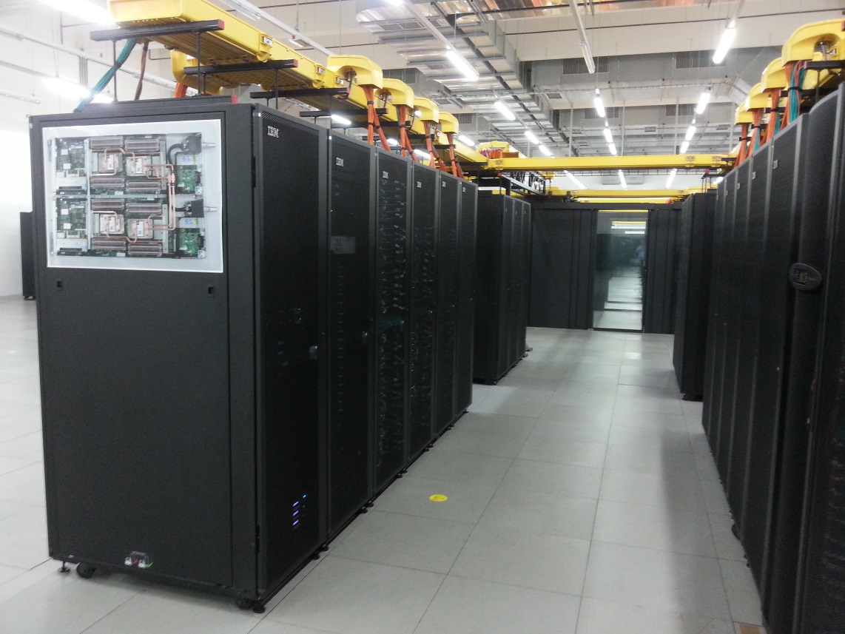

SuperMUC-NG, Compute Cloud, Linuxcluster
Infrastructure
Top500 2019: #8
Lenovo/Intel (2019)
311,040 cores Intel Xeon Skylake
26.9 Petaflops Peak
70 Petabyte Disk
719 Terabyte Main Memory
OpenStack (2015)
82 Intel Xeon Gold Nodes
32 GPU Nodes– 2x Nvidia Tesla
384/768 Gigabyte RAM per Node
6000 Gigabyte on Huge Node
LinuxCluster (2016)
400 Haswell nodes (CooLMUC-2)
6TB Teramem (Intel Broadwell)
150 mem HP DL580 64 KNL 7210-F Omnipath (CooLMUC-3)
1 Petaflops Peak

Slide 4
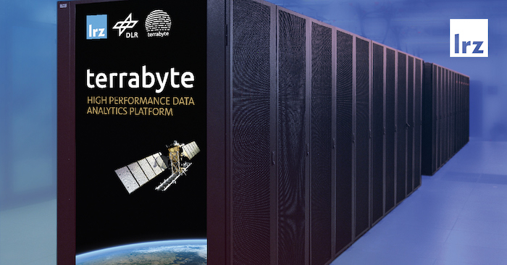
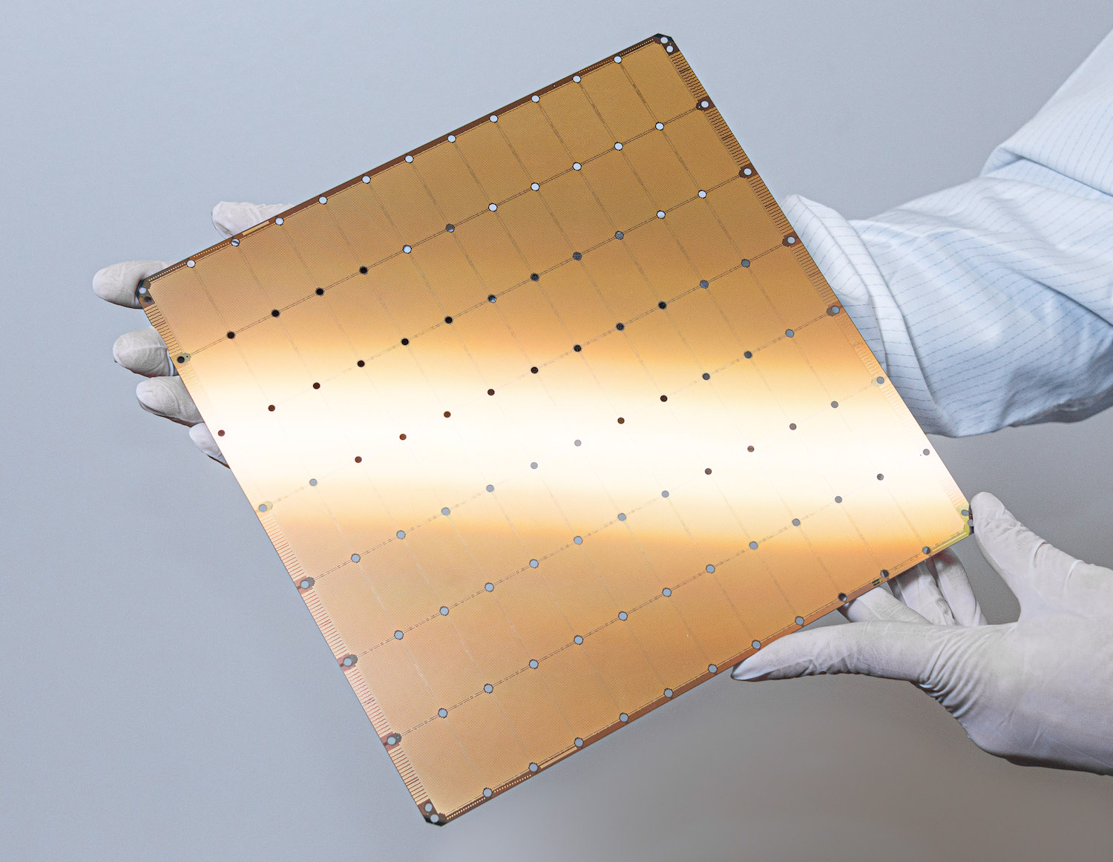

Terrabyte, Cerebras, BEAST
Infrastructure
Top500 2019: #8
Terrabyte (2023)
62 2x40 core Intel Xeon
15 nodes Nvidia GPU A100
100 Gigabit DLR connection
1,3 Petaflops total
Cerebras (2022)
WSE-2 Chip with 850 000 cores
HPE Superdome Flex Server
specialized hardware for AI applications
BEAST (2020)
Intel Cascade, Cooper, IceLake NVRAM-(Optane)
AMD (Rome) GPUs MI-100
ARM-Marvell (ThunderX2), Nvidia-GPUs (V-100) and Fujitsu (A64FX)

Slide 5

Environmental Computing Technical Elements
LRZ as national supercomputing centre
SuperComputers
Databases
Monitoring
Modeling & HPC
Pipelines & DataAnalysis
Sensoring & IoT
Data Curation & Citizen Science
Visualization
Machine Learning
Cloud

Slide 6
Modeling & High Performance Computing (HPC)

Slide 7
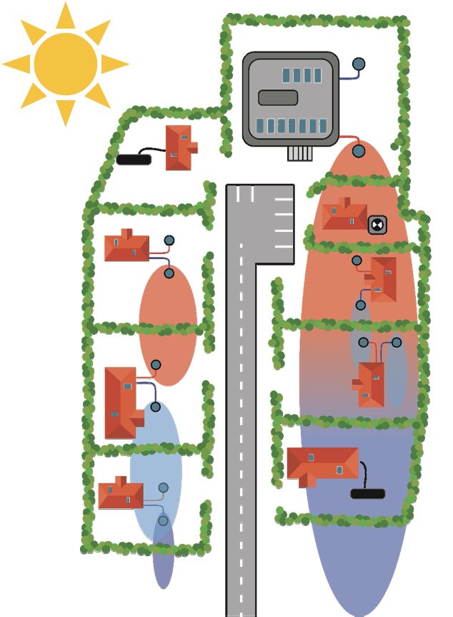
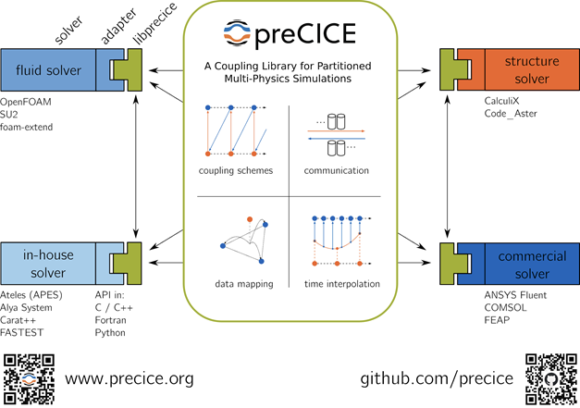
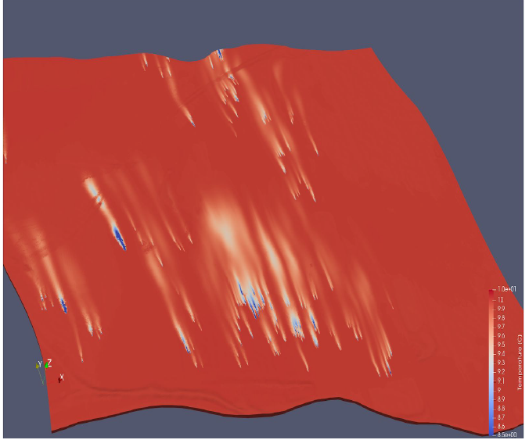
Geo.KW Project
Further ESS Projects where LRZ’s Environmental Computing Team is involved
Utilizing thermal potential of groundwater
Avoid interference of appliances
Coupling codes via preCICE library
Partners: TUM + UGS (universities), SWM (Munich City energy provider), LfU (Bavarian State Office for Environment)
Simulation of Thermal Plumes (PFLOTRAN)
Sketch of overlapping plumes
(TUM-HYD)

Slide 8
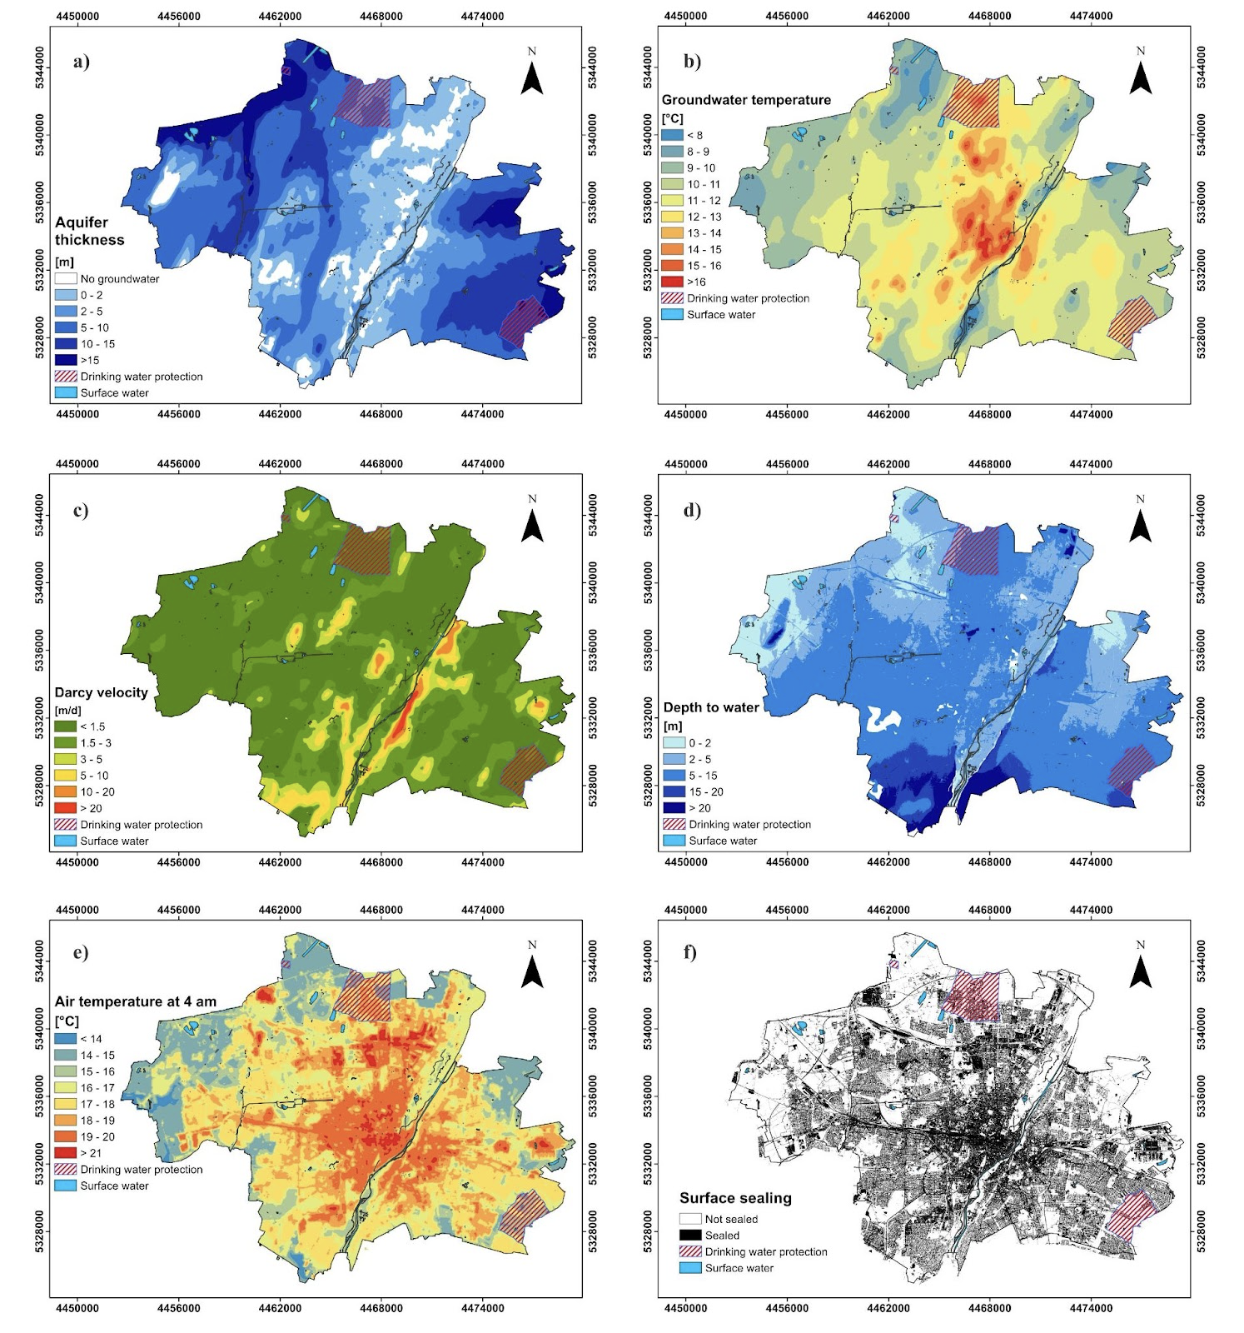
Geo.KW Project
Further ESS Projects where LRZ’s Environmental Computing Team is involved
Using Subsurface Hydro-Geological code PFLOTRAN
Concurrently with energy optimization tool
Coupling with multiphysics library preCICE
Mesh generation with three layers
Add infrastructure (tunnels, dükers)
Need for boundary values at all layers
Model Complexity issue underestimated
Groundwater properties (TUM-HYD)

Slide 9
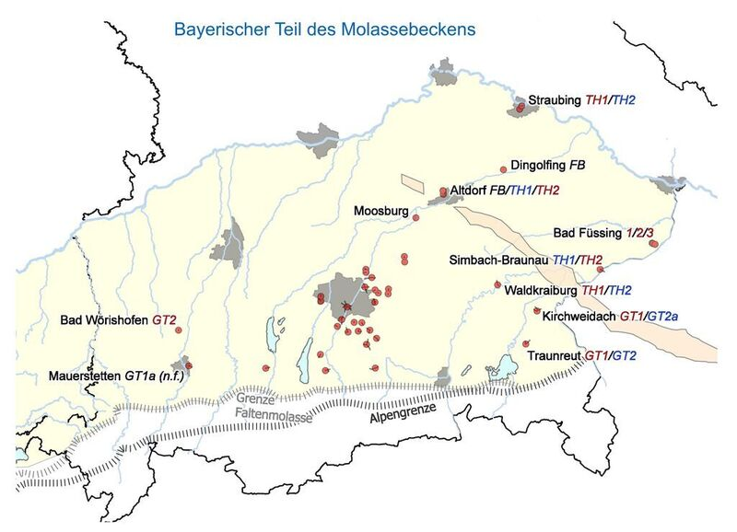
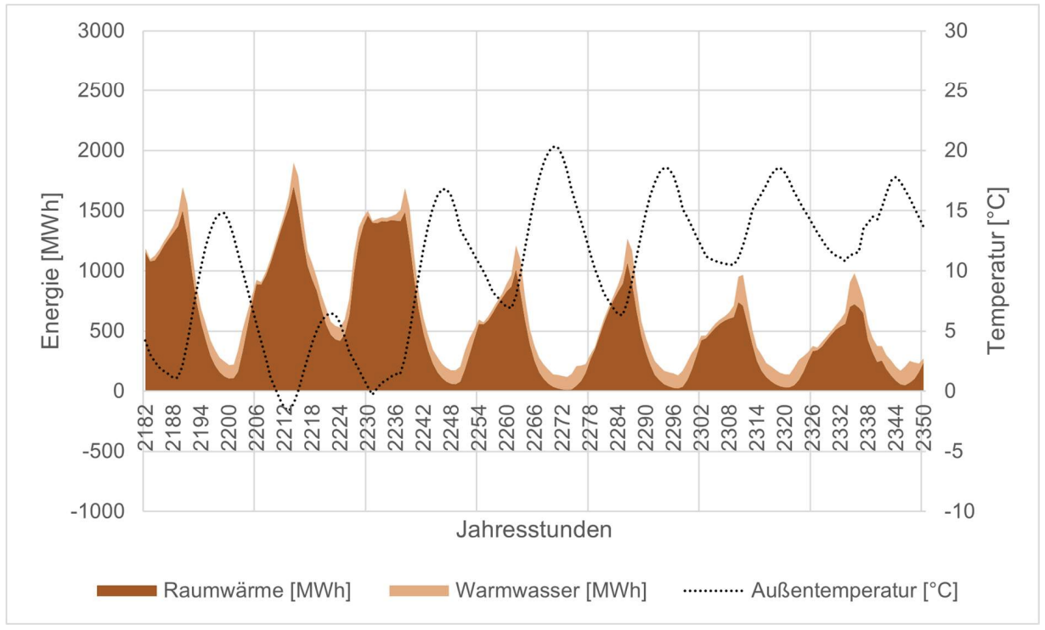

Bem-TG Project
Further ESS Projects where LRZ’s Environmental Computing Team is involved
Deep geothermal
  Munich (GIGA-M)
  And Bavaria (BeM-TG) area
Reservoir modelling
  3D seismic information
Well drilling evaluation
Surrogate model tests (ML)
Build a planning tool (WebApp)
Deep Geothermal Map South Bavaria
(TUM-HYD)
Heating demand in April (TUM, Hamacher)

Slide 10
Cloud, Pipeline & Data Analysis

Slide 11



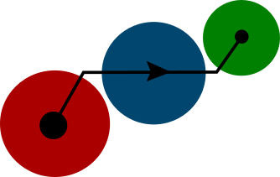

Trace chemicals monitoring in water with AI: K2I Project
Further ESS Projects where LRZ’s Environmental Computing Team is involved
Surface water is exposed to trace substances and microorganisms
Among all substance inputs, only a fraction can be identified by „Target Screening“
Using LC-HRMS data for „Non-Target Screening“ (NTS)
msconvert
converting NTS-data to
mzXML format
WebUI
management, data upload, meta data collection, trigger
APIs
MinIO
S3 storage of raw data
enviMassCL
Preprocessing (separately for each lab)
Grafana Dashboards
Visualisation
PostgreSQL
data collection
Python-Skripte
Postprocessing

Slide 12
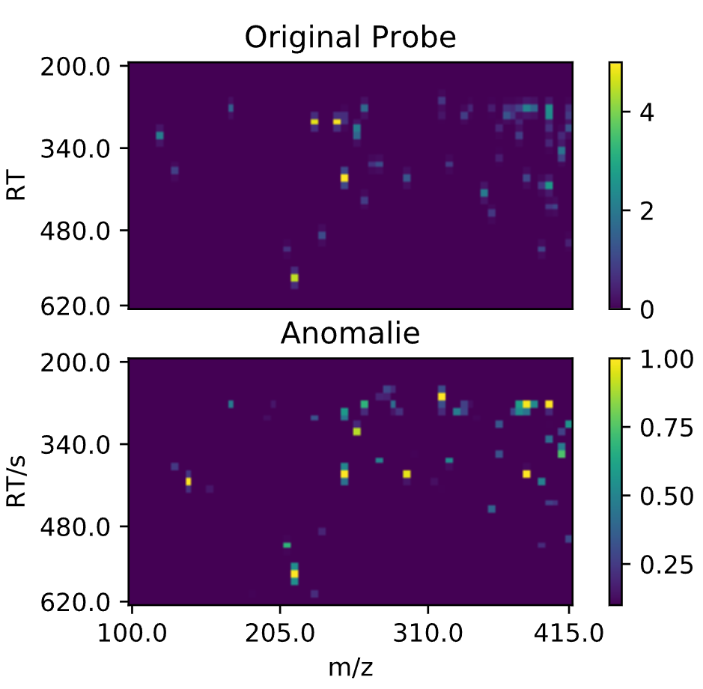
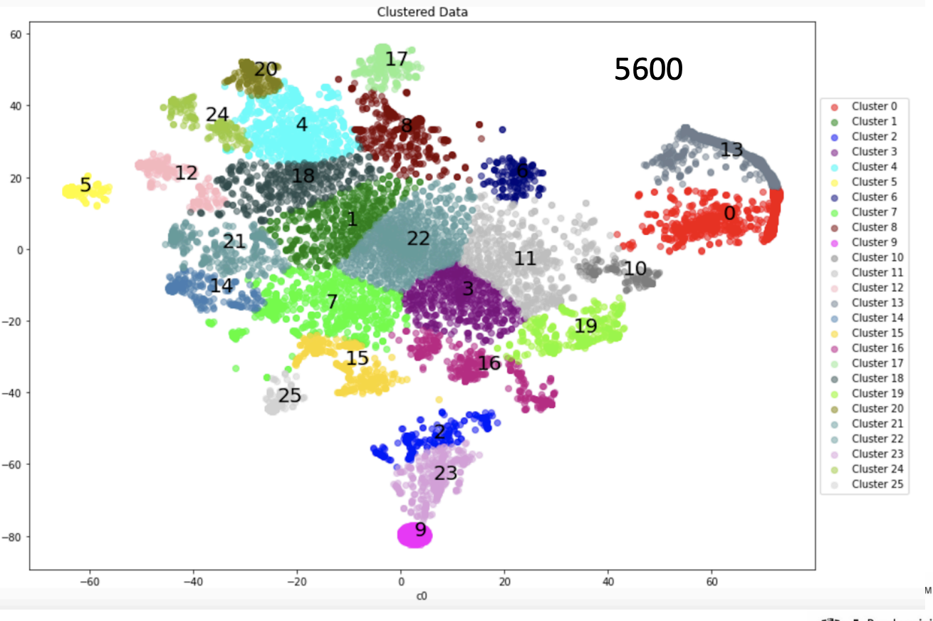
Data Mining and Machine Learning for LC-HRMS
Further ESS Projects where LRZ’s Environmental Computing Team is involved
Autoencoder:
  Making a substance grid in mass/RetentionTime space
Clustering Techniques:
  T-sne, DB-SCAN…
Original Donau-Probe, 10. April 2021
Intensität
Retentionszeit/s
Autoencoder-Anomalie
*
Scores
Masse-zu-Ladungsverhältnis

Slide 13
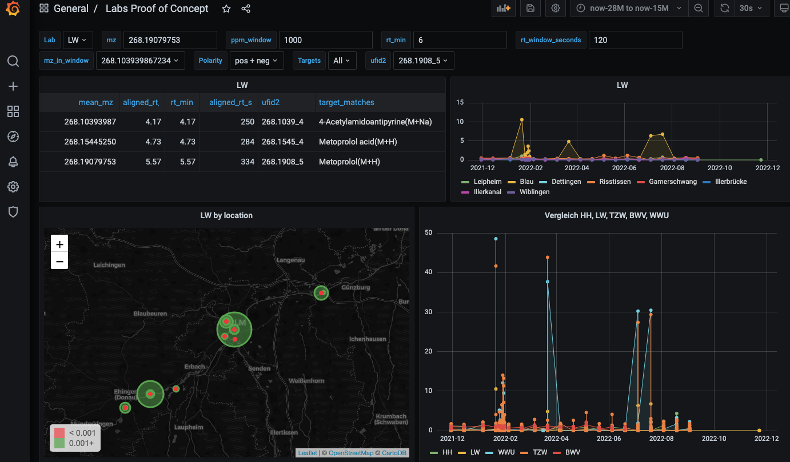
Trace chemicals monitoring in water with AI: K2I Project
Further ESS Projects where LRZ’s Environmental Computing Team is involved
Processed chemical profiles can be plotted as
  Timeseries
  Geolocation
  Anomaly score
can help to evalutate unusual events
  Example: Metoprolol dumped into tributary river of the Danube

Slide 14
Sensoring & IoT

Slide 15

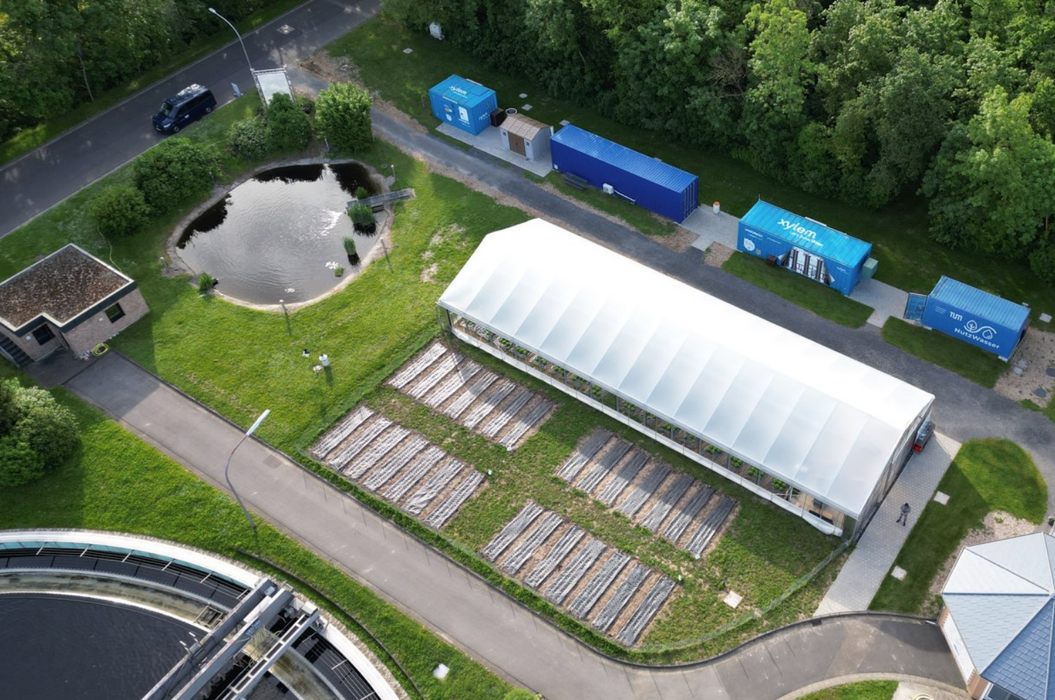
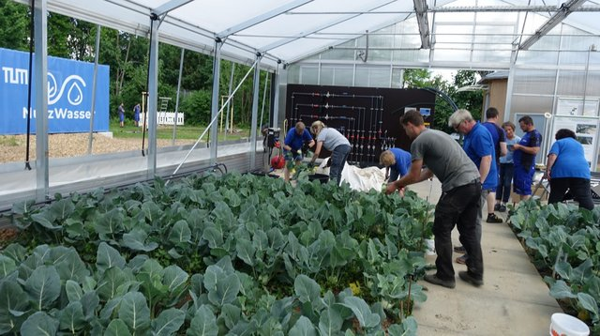
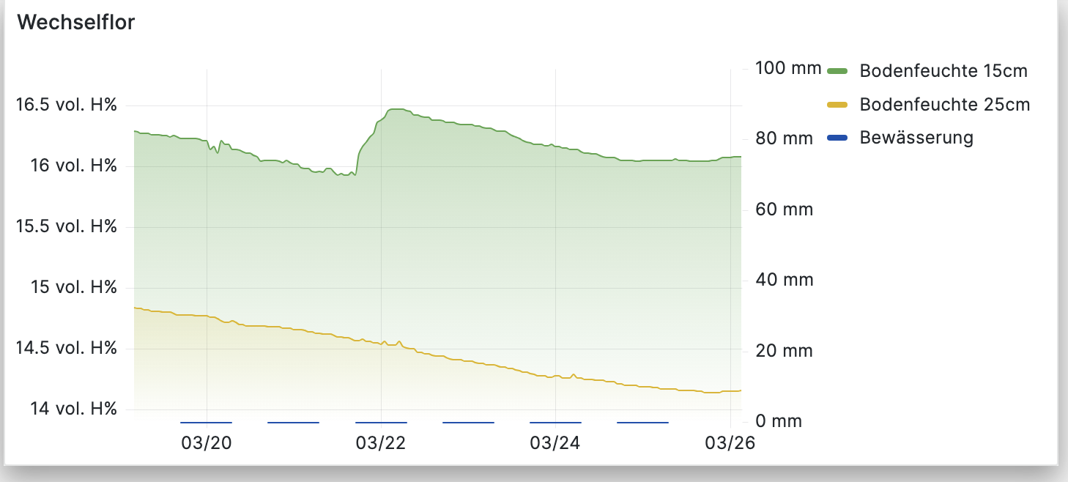
Nutzwasser (used water) Project
Further ESS Projects where LRZ’s Environmental Computing Team is involved
water reuse to combat dry spells
Monitor water quality
using ultra filtration and ozoning
assessing the current water demand and the amount natural sources can deliver
data collection in DB –>monitoring
Test greenhouses in Schweinfurt
Monitoring rainfall and moisture

Slide 16
Nutzwasser (process water) Project
Further ESS Projects where LRZ’s Environmental Computing Team is involved
Internet of Things (IoT) technology used to collect data in near realtime
LRZ compute cloud used for data storage and analysis
Visualisation and Monitoring with Grafana
Online presence / website
  https://www.nutzwasser.org/

Slide 17
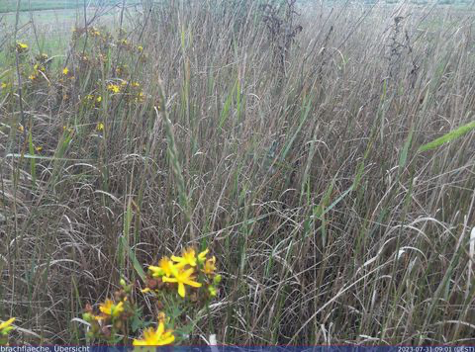
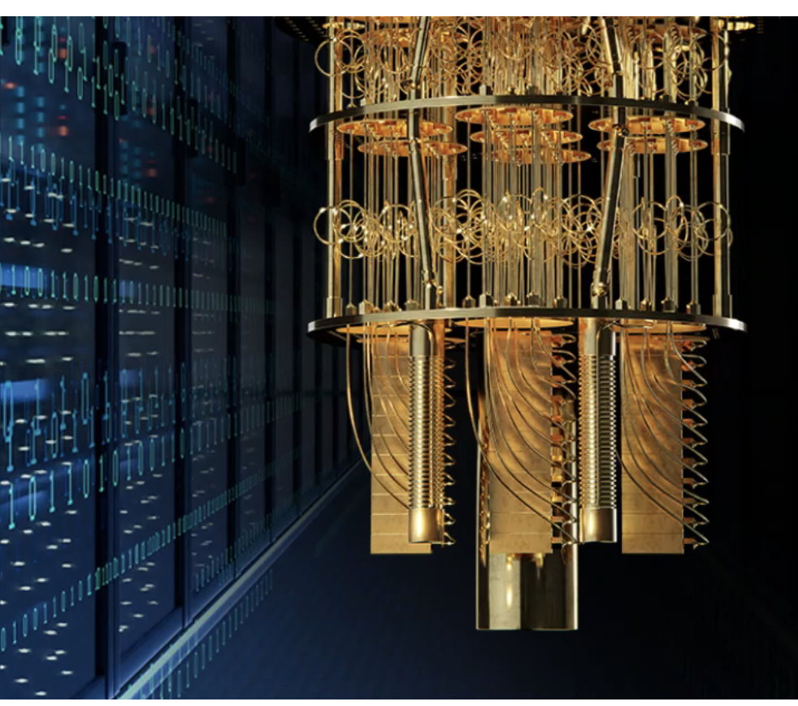
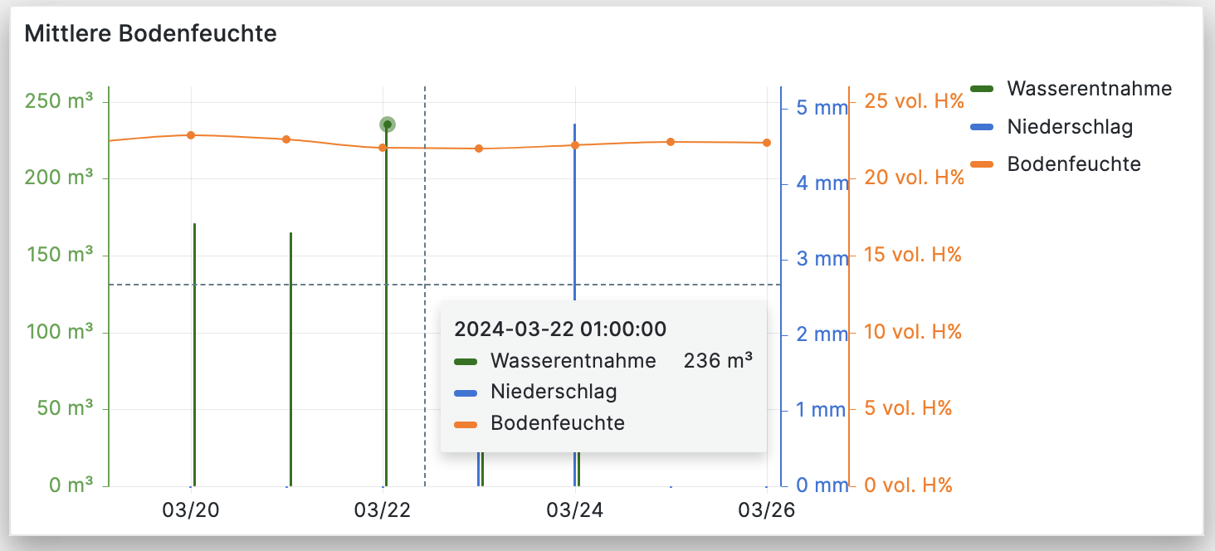
Scope of IoT- Projects
Further Projects where LRZ’s Environmental Computing Team is involved
Blühstreifen (Wildflower-Strip) Monitoring: https://www.biomasseinstitut.de/bluehstreifen-webcam/
LRZ internal use of sensors to monitor quantum computer environment
Data collection of geothermal appliances in München/Kranzberg
Wildflowers
Quantum Computers
Soil hydration

Slide 18
Data Curation & Citizen Science

Slide 19

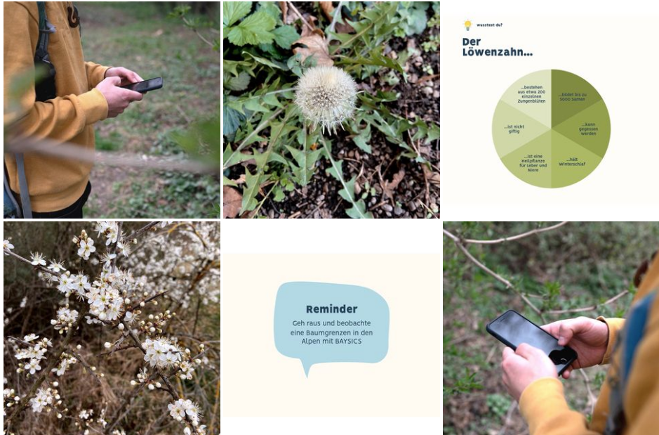
BAYSICS Citizen Science Project
Further ESS Projects where LRZ’s Environmental Computing Team is involved
Public engagement in collecting data
Upload of images and information
Web and mobile app
Building a database for Research
Education
  In schools
  Of interested laypeople

Slide 20
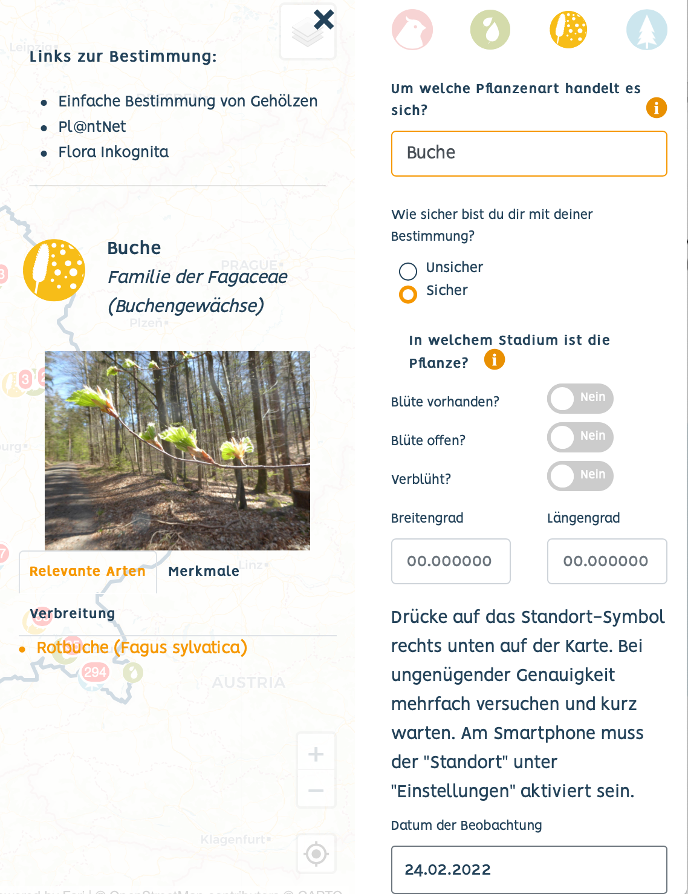
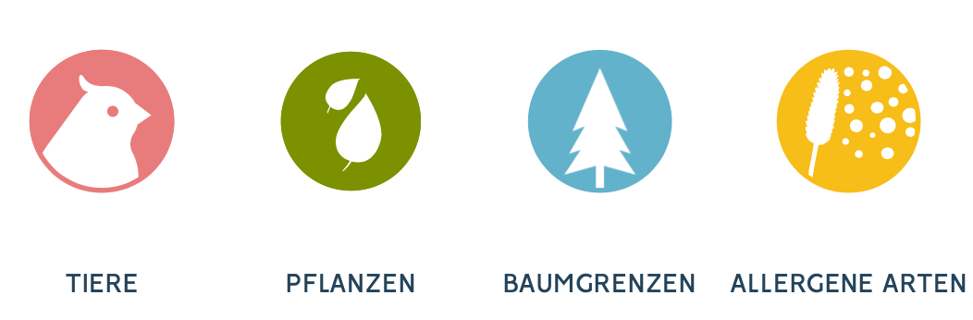
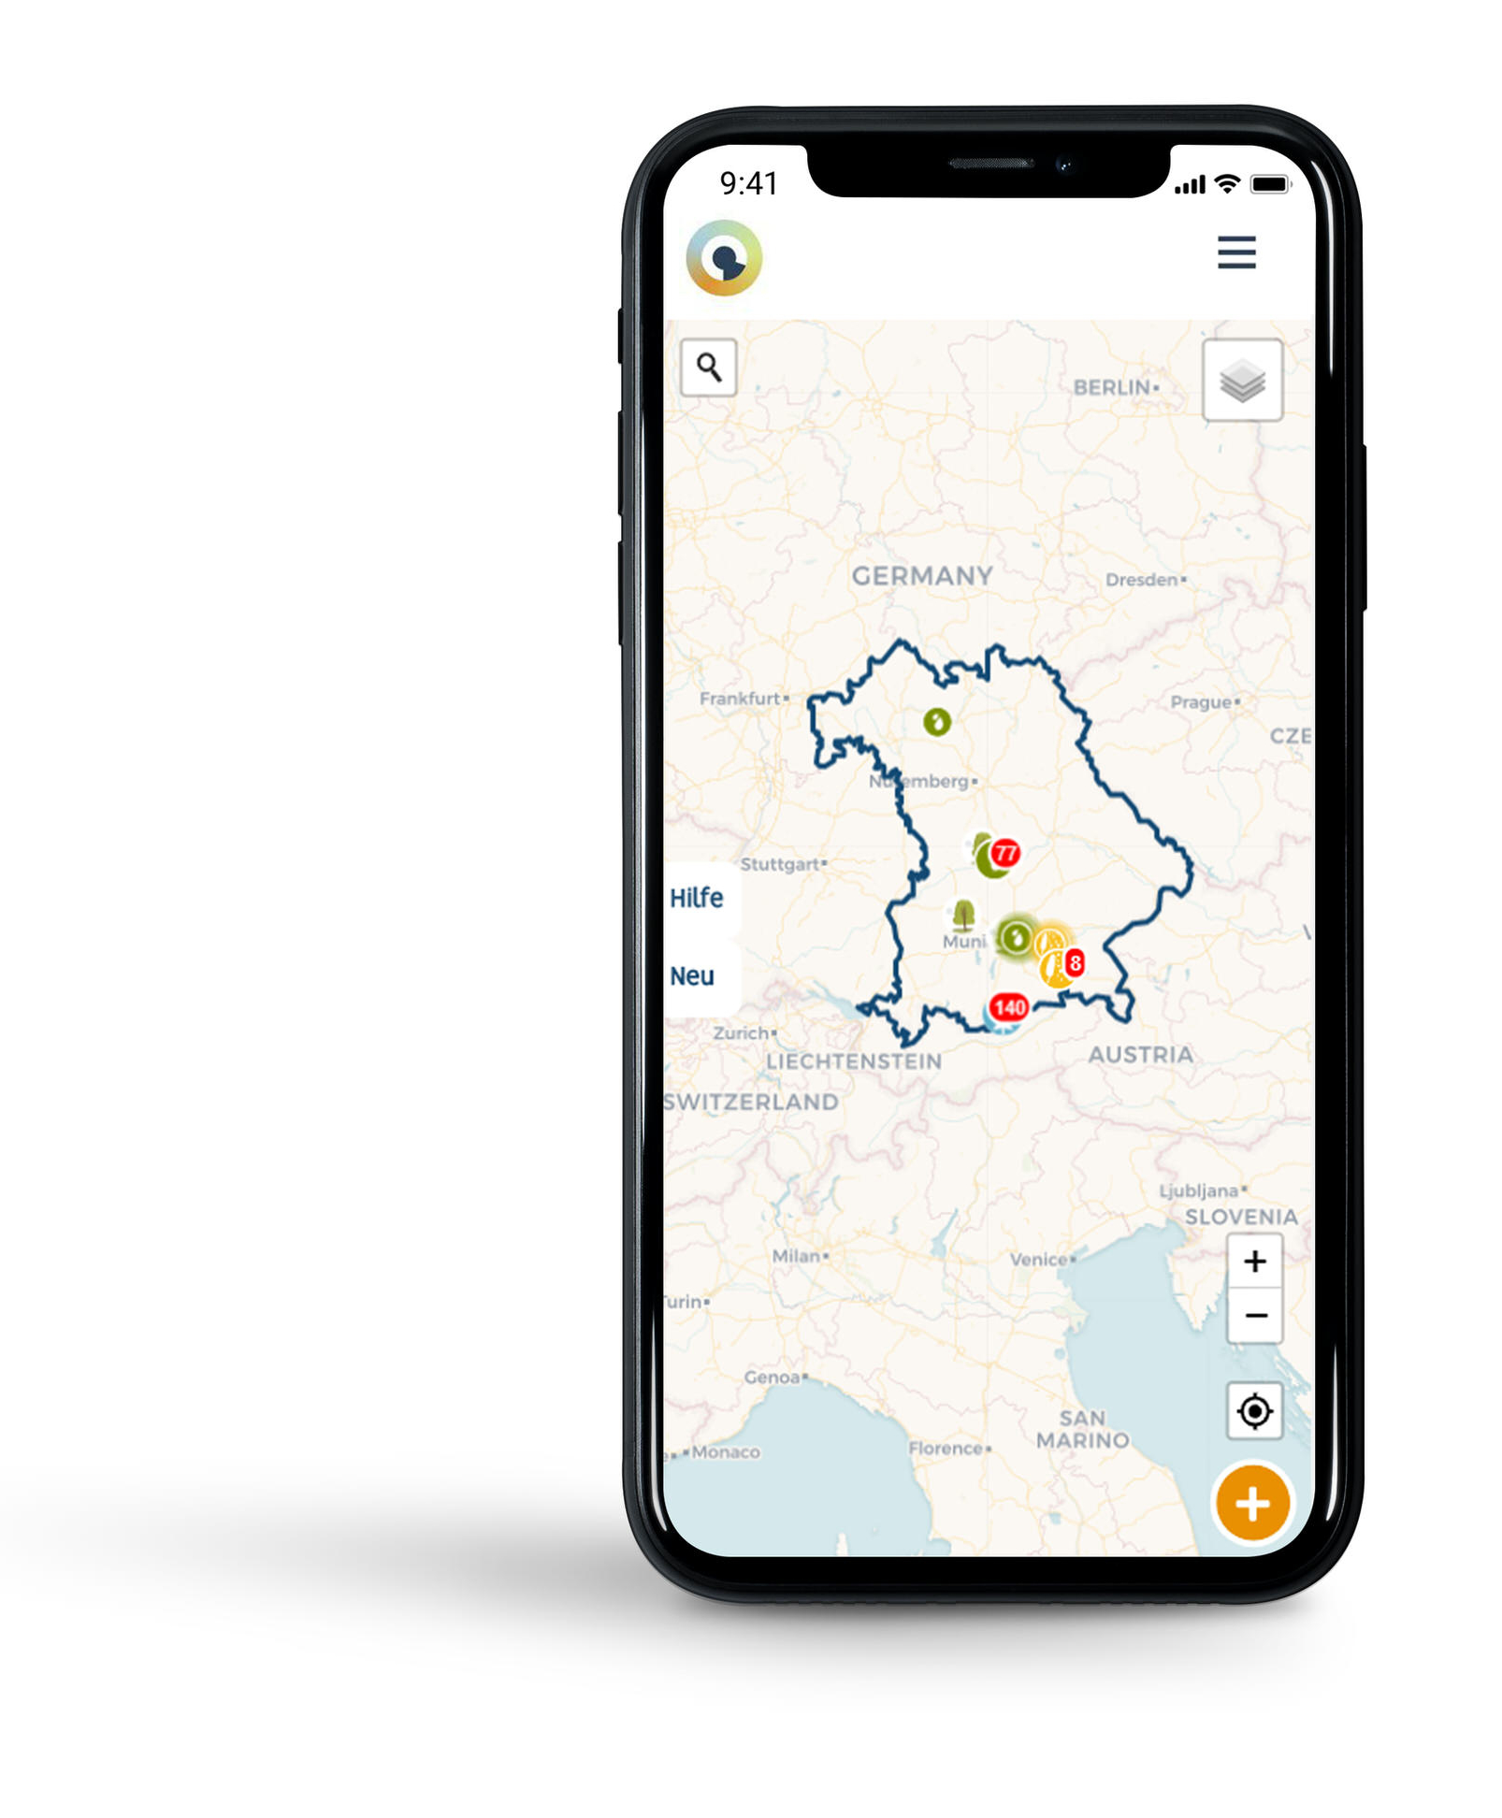
BAYSICS Citizen Science Project
Further ESS Projects where LRZ’s Environmental Computing Team is involved
Research topics:
  treeline, plants, allergenic species, and animals
> 900 registered users
> 3300 observations submitted
Online platforms
  Website: www.baysics.de
  Portal: www.portal.baysics.de
  Natureexplorer: www.natureexplorer.baysics.de
  Mobile app planned

Slide 21
Cross-Site Workflows & Big Data

Slide 22



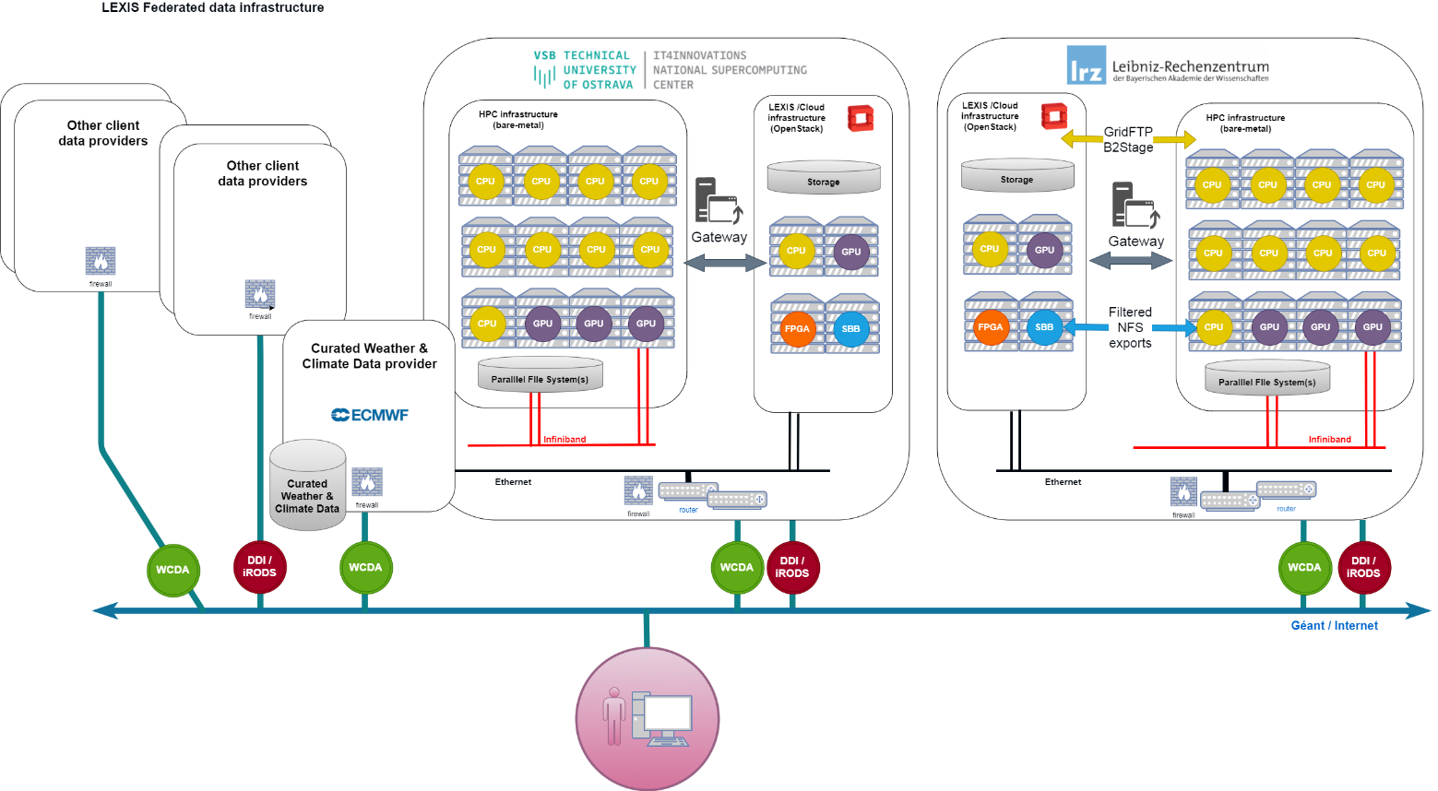



Combine Supercomputing, BigData, FAIR European Data
LRZ Research Data Management & EnvComp Teams: Current EU Projects (lead: IT4Innovations/CZ)
LEXIS
Aim: automated, geo-distributed, mixed Cloud+HPC workflows with data handling
3 „pilots“: Climate - Tsunami - Aeronautics
Co-funded by the Horizon 2020
Framework Programme of the EU
Grant Agreement Number 825532
HPC/Cloud/AI workflows with
for example
Irrigation, physics data
using DBs & distributed data systems
Connectivity, analytics workflows
Super-
computing
„Extreme
Data
Database“
EUDAT,
Data
Spaces

Slide 23
Environmental Computing Technical Elements
LRZ as national supercomputing centre
SuperComputers
Databases
Monitoring
Modeling & HPC
Pipelines & DataAnalysis
Sensoring & IoT
Data Curation & Citizen Science
Visualization
Machine Learning
Cloud

Slide 24


Feel free to contact us.
LRZ Environmental Computing & Research Data Management Teams
Environmental Computing Team:
envcomp@lists.lrz.de
Leads:
Viktoria Pauw (pauw@lrz.de – admin)
Anudari Batsaikhan (batsaikhan@lrz.de – strategy)
Mohamad Hayek (hayek@lrz.de – tech)
Research Data Management Team:
rdm@lists.lrz.de
Leads:
Stephan Hachinger (hachinger@lrz.de – admin)
Johannes Munke (munke@lrz.de – tech)

