Slide 1
Digital Forensics: Data Analysis
Daniel Kouřil

Slide 2
Analysis of storage images

Slide 3
Analysis aims
The aim is to analyze collected evidence
Imagine you have a large (GBs) image and need to do its analysis (e.g. access files and recover deleted data)
Clarify the objective before starting the actual analysis
Recovering deleted data vs. secure evidence about malicious activities

Slide 4
Analysis environment
The analysis does not depend on the system where we got data from
Artifacts related to MS Windows architecture can be analyzed on Linux-based environment and vice versa
A Linux environment based on CLI will be used thorough the course
Many tools are common commands or are available from distribution packages
Always keep the primary data intact and work only with its copies

Slide 5
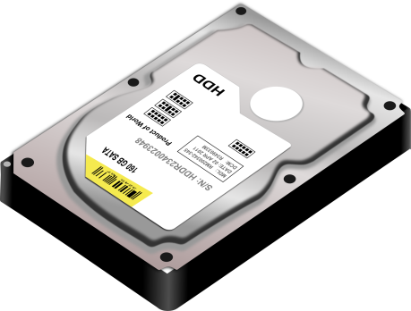
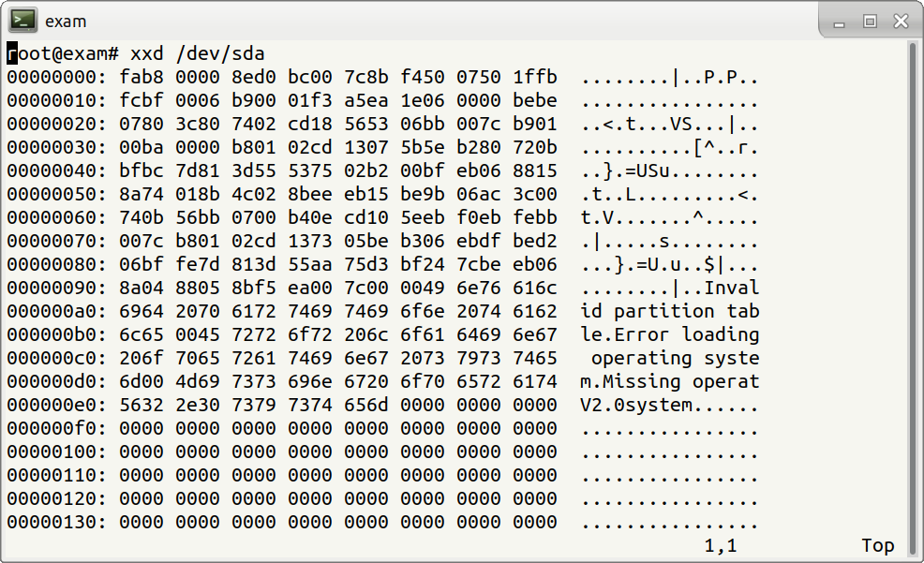

Slide 6
Image analysis
Image is a sequence of bytes (just a file)
Internal structure needs to be established
File
File system
Volume (partition)
Physical device’s image
Some objects may be embedded
Files containing other images (VM disks)

Slide 7
Procedure to analyze an image
Take the input image as a single volume
Break down the current volume to additional volumes (if any)
Detect all visible volumes and their types
Detect unallocated space
Process identified volumes one by one
If the volume hosts a file system -> mark for subsequent analysis
Other (known) volumes (auxiliary) -> check if they contain other volumes (or their parts) and reconstruct them
Unknown volume type -> ad-hoc analysis
Process file system volumes
Gather and evaluate information about files stored
Files can contain volumes also (ie. start again)
Examine unallocated space

Slide 8
File system

Slide 9
File system
Organization of data on storage
Data kept in files
File content
File metadata
File systems differ from forensics view
Different features
Different support of tools

Slide 10
File Content
File is a logical sequence of bytes
The type is determined by the content, not by name, location or extension
File analysis is dictated by the objectives
User data (data content)
System files (logs, configurations, installed SW)
Executables

Slide 11
File metadata
Metadata information
Owner identifier
Group identifier
Permissions / ACL
Addresses of data blocks (content)
Important timestamps
No need to access content
Smaller space needed
Less privacy issues

Slide 12
Analysis using timelines

Slide 13
Timelines
Common analysis technique important for many objectives
Timeline provides a simple overview of events that happened on the system
Can be constructed from any data where timestamps is recorded
Logs, events (users logins)
Application data (mail/document manipulations)
File metadata (file utilizations)

Slide 14
File timestamps
Common types of timestamps (POSIX)
m-time (modification time) – the last time the content was changed
a-time (access time) – the time of last access (content)
c-time (change time) – the last time metadata was changed
Additional timestamps on some file systems
d-time (deletion time)
b-time (creation time) (sometimes cr-time)
Timestamps only refer to the very last action performed

Slide 15
A malicious PHP file (backdoor) shell.php was found on a web server. Examine the time stamps of archive.php, upload.php, gallery.php and determine which file was likely used to store the malicious payload and select timestamp when the backdoor was used for the last time.

Slide 16
Fimetis by CSIRT-MU (https://github.com/CSIRT-MU/fimetis)

Slide 17
Working with file timestamps
Executing a file changes its Atime
The precision of a-time depends on configuration
m-time and a-time can be easily changed by file owner
happens when copying/moving files, or deploying software from packages
c-time can’t be changed easily
Pay attention to time zones and granularity
FAT uses system time, NTFS uses UTC
Precision is among days (FAT), secs (ext3), and nanosecs (ext4)

Slide 18
Obtaining metadata
fls and mactime commands (only for supported FS)
Simple ’find’ command (recursive walk through the filesystem)
find / -xdev -print0 |
xargs -0 stat -c "%Y %X %Z %A %U %G %n"
Leif Nixon’s timeline-decorator.py to format
Be prepared for a lot of data (hundreds thousands of records)

Slide 19
Live Analysis

Slide 20
Live analysis
Access to volatile information kept by OS
Some crucial aspects to consider
Reliability of the collected data
Modifications to the system done during the process
The goal is to capture information for off-line analysis, not doing analysis on the host

Slide 21
Areas of Live Analysis
Obtaining volatile information available from kernel and applications
Obtaining content of memory
A complete host memory or memory of selected processes
Recovering data that would be lost
Deleted, still open files on Linux

Slide 22
Obtaining OS information
Network status
Open/established connections, listening/bound processes
allocated IP (4/6) addresses
VPN connections, routing tables, neighbors
Firewall state
Information on the system setup
Available devices
Mounted file systems, mapped drives, shares
Data and “auxiliary” (RAIDs,…)

Slide 23
Obtaining OS information
Information on processes
List of active processes and their attributes
The full path of the program, command line parameters, running time
List of files open by processes
Information on inter-process communication (shared memory, queues)
Information on the OS
Loaded kernel modules/drivers, OS messages (dmesg), running OS version
Configured time-zone, uptime
Clipboards contents
Auxiliary info (partially available also offline)
Logged users

Slide 24
Extracting information on processes
Processes may contain important information
Resources used (e.g. network connections, files being processed, IPC)
Memory contains pristine information, including sensitive data
Encryption keys, passwords

Slide 25
Linux specifics

Slide 26
Getting process information
Process may have multiple file-descriptors opened
Used executable, libraries
Particular files on file system
Network sockets
Information on processes can be accessed using standard system commands
lsof –p PID

Slide 27
/proc filesystem
Linux kernel exposes some internal structures in the /proc virtual file
System commands mostly use data from /proc
/proc can be useful to access data that is not available through commands (or spot anomalies)

Slide 29
Deleted files
Deleted files are available until they are closed
If a file is open by a process, it’s removed from the filesystem but its content can still be still accessed
“symbolic links” in /proc can be used to recover the data
cp /proc/$PID/exe /tmp/exe
The process must be alive (even stopped)
Holds for both executable and open files (see the fd directory)

Slide 30
Notes:
Pridat cp suspicious /tmp

Slide 31
Network
Getting information on network status
Three different ways:
netstat -tnp
ss -tnp
Check the /proc virtual filesystem
All should yield the same information (in different formats though)
If not, some of the commands might be modified
tcpdump might be handy to check live traffic

Slide 32
Open network connections (netstat –tnp)
Active Internet connections (w/o servers)
Proto Recv-Q Send-Q Local Address Foreign Address State PID/Program name
tcp 0 0 127.0.0.1:9050 127.0.0.1:34902 ESTABLISHED -
tcp 0 0 127.0.0.1:44280 127.0.0.1:8118 ESTABLISHED 31418/wget

Slide 33
Dumping process memory
gcore –o dump
Part of the GDB package
Some (soft) errors might be triggered
Outputs an ELF file containing the process memory

Slide 34
Analysis of executable files

Slide 35
Executable files
Scripts
List of commands, script constructs
Easily readable by human (if not obfuscated)
Binary executables
Machine code (produced by compiler)
byte code (Java)
ELF, PE formats
Libraries
Static / dynamic
Library functions, variables (internal / exported)
Export interface (ABI/API)

Slide 36
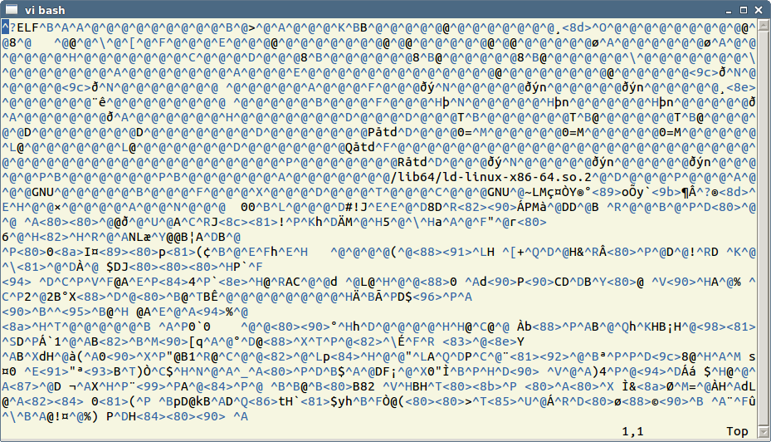
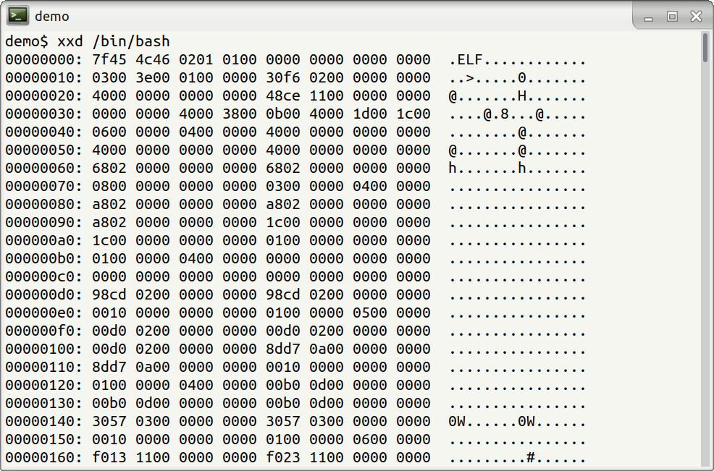
Binary executable files
System specific formats
Dynamic vs. static analysis

Slide 37
ELF

Slide 38
A quick look inside an ELF executable
https://binvis.io/
Statically vs. dynamically linked binaries
file exe
exe: ELF 64-bit LSB executable, x86-64, version 1 (GNU/Linux), for GNU/Linux 2.6.32, statically linked, stripped
strings –a exe (Reveals human-readable strings)

Slide 39
Quick examination
file exe exe: ELF 64-bit LSB executable, x86-64, version 1 (GNU/Linux), for GNU/Linux 2.6.32, statically linked, stripped
A number of other tools is available

Slide 40
Useful links
https://confluence.egi.eu/display/EGIBG/Forensics+Howto
https://www.dfn-cert.de/en/Trainings.html#ITForensics

