Slide 1
e-Science Activities in China
Gang Chen Institute of High Energy Physics, CAS
ISGC2018
March 22, 2018

Slide 2
e-Science in China
Ministry of Science and Technology
Promote the construction of sci. & tech. information platform
Super Computers
Ministry of Education
CERNet
Education and Research
Chinese Academy of Sciences
CSTNet
Supercomputing
Clouds of sci. & tech. management, education
Data services
National Development and Reform Commission
Networks
Large Scientific Facilities
Chinese Academy of Social Sciences
digital Chinese Academy of Social Sciences
National Natural Science Foundation of China
Related basic scientific research
Chinese Academy of Agricultural Sciences
Data resources sharing
Digital academy of agricultural
China Meteorological Administration
Intelligence Meteorology

Slide 3
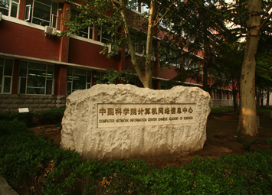
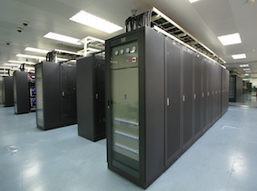
About CNIC
Part of CAS, officially established in 1995.
434 regular employees including 169 senior technical professionals, 197 graduate students including 55 PhD level candidates, by the end of 2017.
Dedicated Institute focusing on IT R&D, services and supports to the institutes of CAS and beyond.

Slide 4
e-Science at CAS by CNIC
China Science and Technology Network (CSTNET)
China National Grid (CNGrid)
National Data Sharing Service Platform for Basic Science
Virtual Science Museums of China for science outreach
China Internet of Things Name Service Platform
eduroam CN Wireless Networking Roaming Center
CAS Supercomputing Grid
CAS Data Cloud
CAS Data Storage Environment
CAS Cybersecurity Service Platform
CAS Portal for Continued Education
Other Supporting Services:
Infrastructure and Instrument Sharing Services
Academia Resource Planning System of CAS
Email, Website system, Conference Planning Service, Video Conferencing, Unified AAA (Passport)，…
national-level
CAS-level
Courtesy: Haiyan Xu @ CNIC

Slide 5
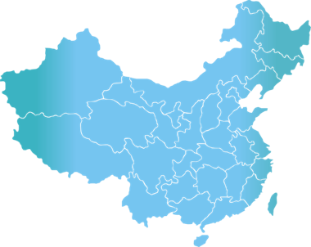
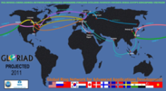
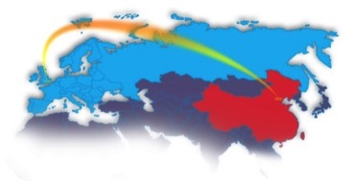
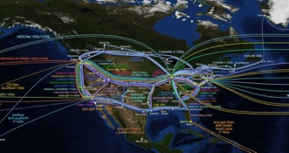
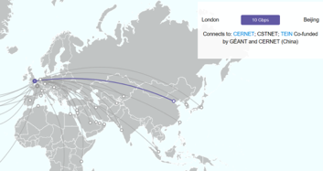
CSTNET
299 institutions connected, with 99.99% Usability
International Bandwidth 52G
GLORIAD with U.S.: 10G
GEANT with EU : 10G
Hongkong Exchange Point: 32G
Domestic Bandwidth 109.5G
Corenetwork：100G
Backbone Network：1 of 10G, 7 of 2.5G，4 of 1G，2 of 155M, 4 of 4over6
哈尔滨
乌鲁木齐
沈阳
长春
乌鲁木齐南山
北京
石家庄
烟台
大连
西宁
山西
青岛
兰州
西安
南京
上海
羊八井
武汉
合肥
拉萨
成都
宁波
10G
长沙
福州
2.5G
昆明
贵阳
台北
1G
深圳
厦门
155M
西双版纳
广州
lower than 155M
香港
IPv4/IPv6 connections

Slide 6
CNGrid
Support 14 supercomputing service platform
ATLAS Experiment Monte Carlo Simulation Platform
Industrial Product Design Community
New Medicine Discovery Community
Digital Media and Cultural Creation Community
OPUS Operation Supporting Platform
Computing Chemistry Service Community
GridMol molecule visualization software
Cold Environment Monitoring Research Cloud
Stem Cell and Biomedicine Cloud
Materials Science Integration Platform
Microgravity Effect Simulation Platform
Large-scale parellel hydrological processing platform
Combustion Dynamics Center of Sichuan University
Beijing Fingerprint Comparison Platform
Resources including 6 National Supercomputing Center
- computing capacity exceeding 200PFlops
- storage capacity exceeding 160PB
- usability>99%
- 900+ users, 0.97 million+ tasks, 0.14billion+work-hours
2016 16 nodes
Tsinghua University Shenzhen Institute of Advanced Technology, CAS
National Supercomputing Center in Shenzhen
Beijing Institute of Applied Physics and Computing Mathematics
Huazhong S&T University Shanghai Supercomputing Center
National Supercomputing Center in Guangzhou
Gansu Computing Center
2014 4 nodes
2015 8 nodes
Hongkong University
National Supercomputing Center in Tianjin
National Supercomputing Center in Jinan
CNIC, CAS
China S&T University
Shandong University
Xian Jiaotong University
National Supercomputing Center in Changsha

Slide 7
R&D in Supercomputing
Center of Scientific Computing Application & Research
Chinese Academy of Sciences (COSCAR)
Computational Science
Algorithm Optimization &Implementation
Heterogeneous Platforms
Software Production Line
Academy of Mathematics & Systems Science
National Astronomical Observatories
Institute of Atmospheric Physics
Institute of Biophysics
Dalian Institute of Chemical Physics
Institute of Physics
Computer Network Information Center of CAS
Office of General Affairs of CAS

Slide 8
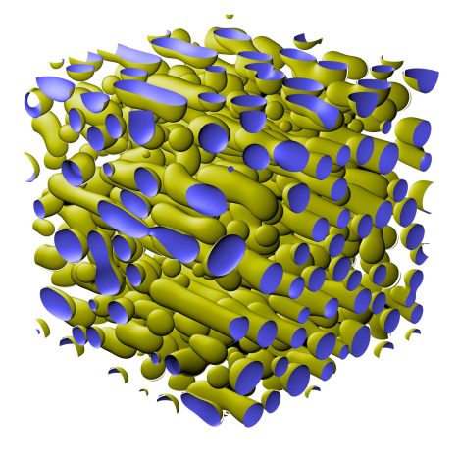
R&D in Supercomputing
Self-developed software ‘ScETD-PF’ to achieve the world's largest parallel computing (9 million cores)
Nomination for 2016 Gordon Bell Prize
Actual performance is 39.678 PFLOPs double precision.
Parallel efficiency of the software is 40% vs common software 5%
It breaks through the difficulty of large-scale simulation of titanium alloy microstructure.
Phase field simulation of
phase separation process
Notes:
9M-CORE CPU simulation of microstructure of alloy.
Nomination for 2016 Gordon Bell Prize

Slide 9
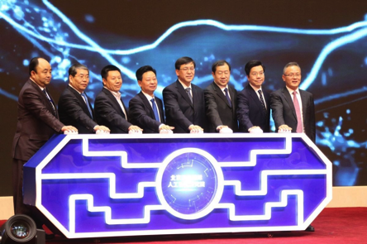
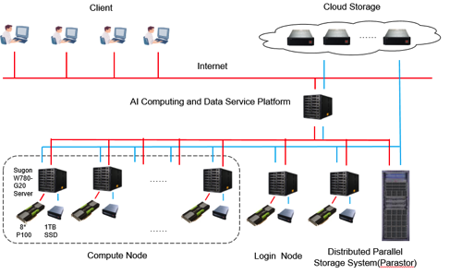
AI Computing and Data Service Platform
Beijing International AI Institute
Launched on Feb 8, 2018
To promote the collaborations and applications of AI, SC and Big Data
Leading Organization
CNIC of CAS
Participating Organization
SenseTime
Face++
KSYUN
Compute Nodes: 48 (P100*8)
Peak speed: 1,786 Tflops，Parastor: 400TB，Network：56Gb/s FDR
AI Softwares: TensorFlow, Caffe, MXNet, PyTorch, …

Slide 10
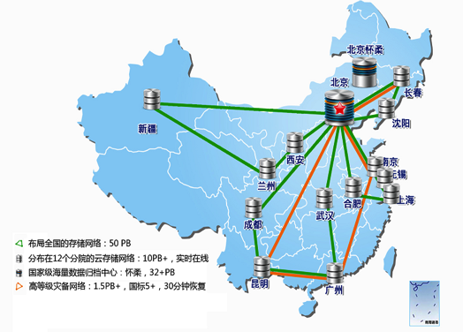
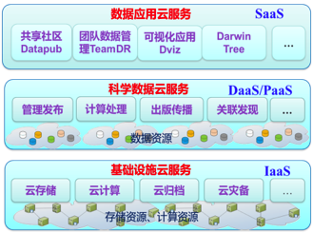
Infrastructure and Resources
for Scientific Data
Develop and run Cloud Storage distributed in 12 cities, total storage is 52PB.
Deploy and manage the Scientific Databases of CAS, 1340 databases and 688TB data.
Establish the National & Local Joint Engineering Laboratory for Big-Data Analysis Computing Technology

Slide 11
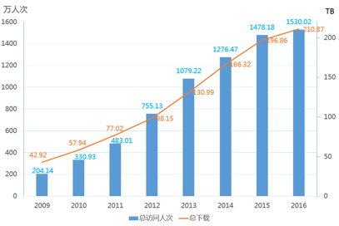
National Information System： National Data Sharing Service Platform for Basic Science
Servicing key R&D activities and engineering endeavors of the nation with more than 180 typical applications
Visits (in 10⁴ )
Downloads (TB)

Slide 12
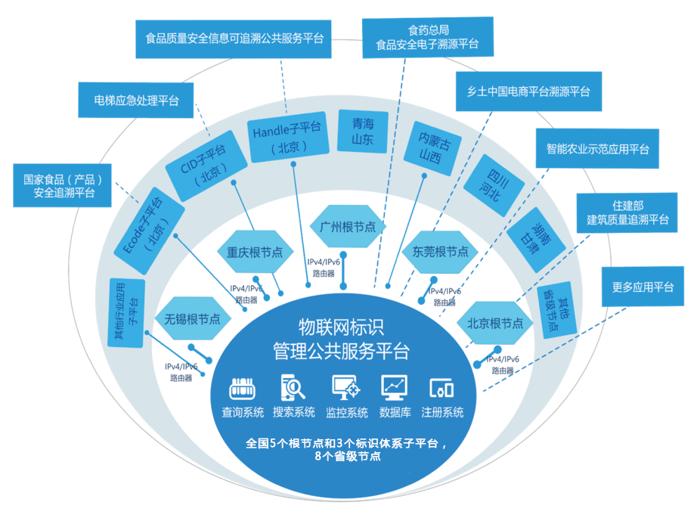
National Information System： Internet of Things Name Management Service Platform
Initiated in 2012 under the Internet of Things Research and Industrialization Project of National Development and Reform Commission.
Leading Organization
CNIC, CAS
Participating Organizations
GS1 China
No. 1 Institute of Electronics of MIIT
Academy of Telecoms of MIIT
Registered names：10.8 billion
Daily analysis amount：5 million
Total analysis amount：0.82 billion

Slide 13
Science Outreach
CAS Science Outreach Cloud has supported more than 250 teams to create and release popular science contents via Virtual Science Museums of China (www.kepu.cn) with an annual average PV of more than 250 million.
Collaborative Content Creation CNIC as a bridge for connecting content creation endeavors
SELF Forum 15 sessions of public science lectures, 5000+ audience, 100 million＋views
Science Video 200+ original videos, various ministerial level prizes, 4D science movie formally released
Big Family of Science: CAS official Wechat account for science outreach
nearly 200 active scientists responding to hot issues, 50 thousand + fans
Demonstration Base and Camp for Science Explorer more than 30 partner schools across the country

Slide 14
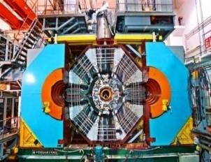
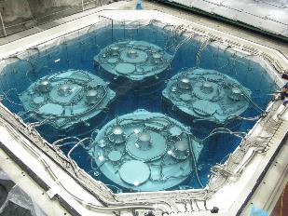
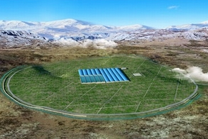
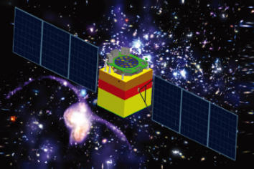
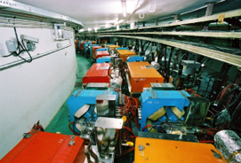
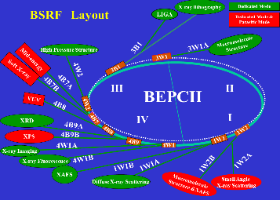
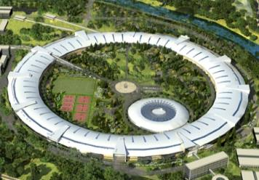
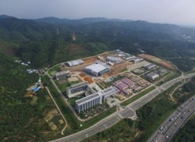
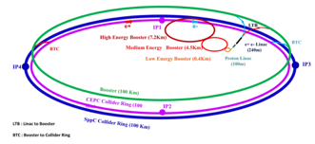
IHEP in Brief
Employee: ~ 1400
Students： ~ 600
Visitors: ~ 400
Budget：~ 1.4 B RMB/year
Theoretical Physics
Spallation Neutron Source (Dongguan)
Computing Center
Applied Tech. Center
BESIII DYB Neutrino LHAASO HXMT
Experimental Physics
Astro-particle physics
BEPCII CEPC/SppC BSRF HEPS CSNS
Accelerator Physics
Multi-discipline research

Slide 15
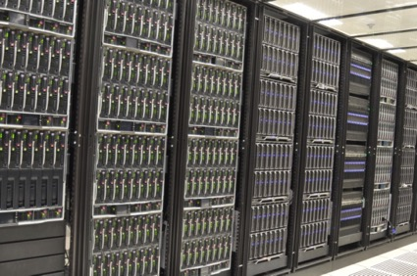
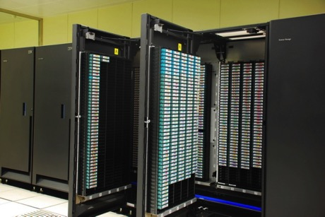
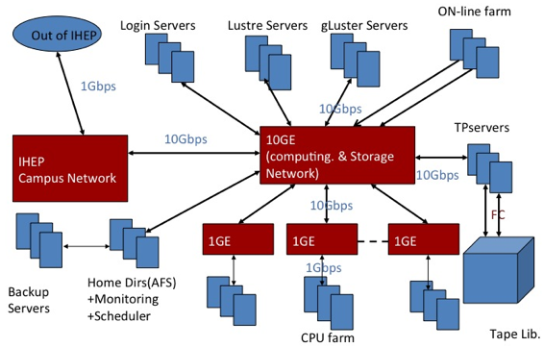
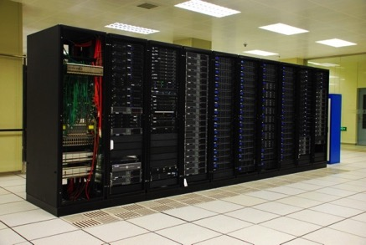
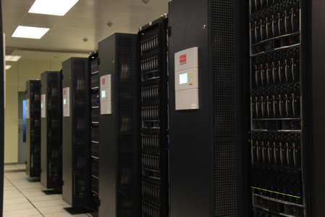
Computing platform
Independently developed (home-made) high performance computing platform
云计算环境
磁带库
~20,000 CPU cores
5PB tape library
云存储系统
云计算服务
>5PB disk space
Grid, Cloud, …

Slide 16
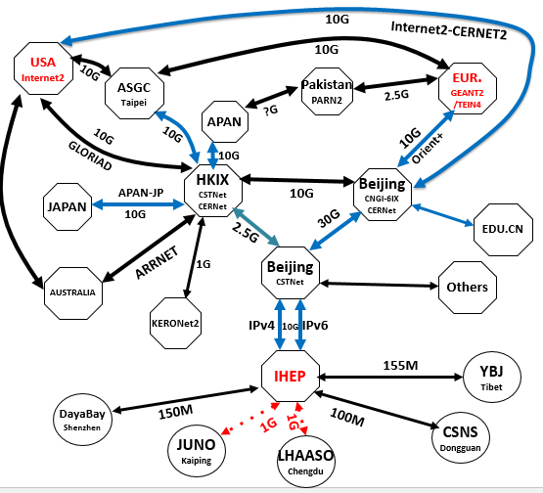
Network Connections
IHEP-EUR.:
10Gbps
IHEP-USA:
10Gbps
IHEP-Asia.:
2.5Gbps
IHEP-Univ.:
10Gbps

Slide 17
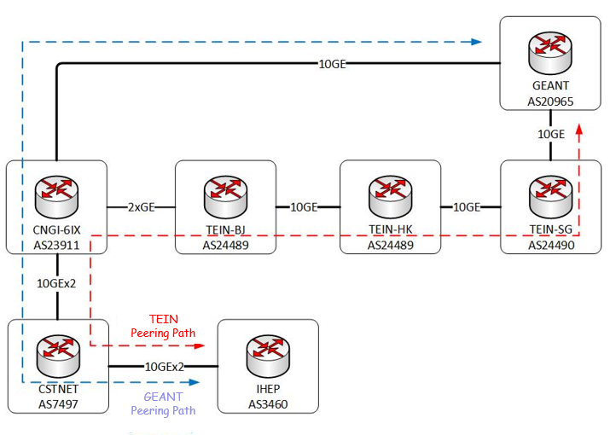
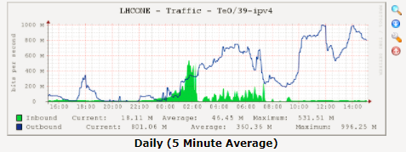
LHCONE in China
IHEP in China connected to LHCONE in Dec. 2017, Thanks to
CERN, CSTNet, CERNet, ASGC, GEANT, ……
VRF Peerings have been set up for IHEP-Eur.
Peering between CNGI-6IX and TEIN in Beijing
VRF Peering between CNGI-6IX and GEANT (over Orient+)
More Peerings should be launched
ASGC、Internet2、ESNet、 KREONET ……

Slide 18
Tier-2 for ATLAS and CMS
Hardware renewed in 2015
940 TB disk space
400 TB, dpm for ATLAS
540 TB, dCache for CMS
888 cores, divided equally by ATLAS and CMS
HEPSPEC06: 16710

Slide 19
Running Status Last Year
Cream CE hardware problem

Slide 20
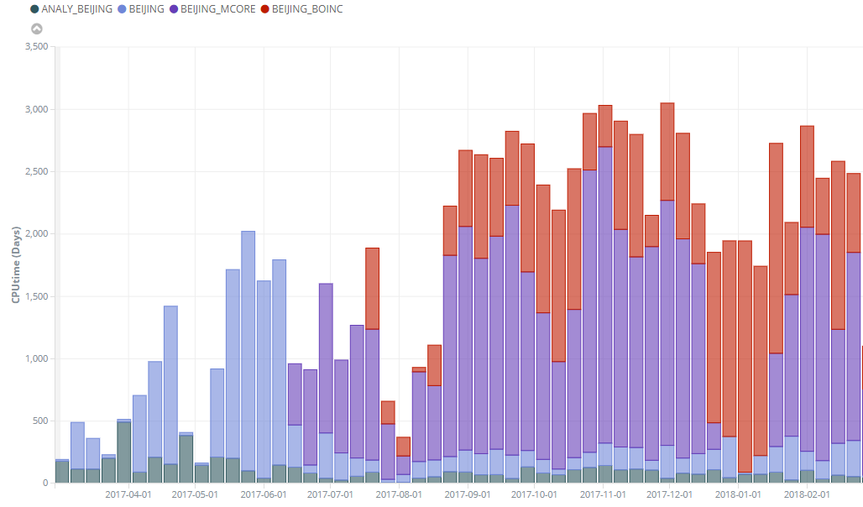
ATLAS Job Last Year
Weekly Consumed CPU days (2017.2-2018.2) 468 Cores
Extra CPU time exploited by BOINC jobs

Slide 21
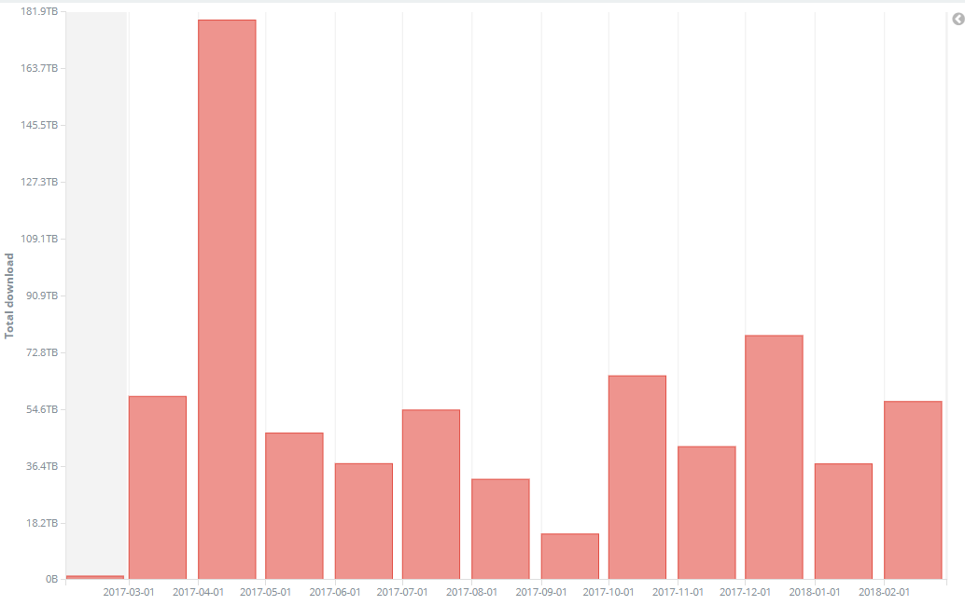
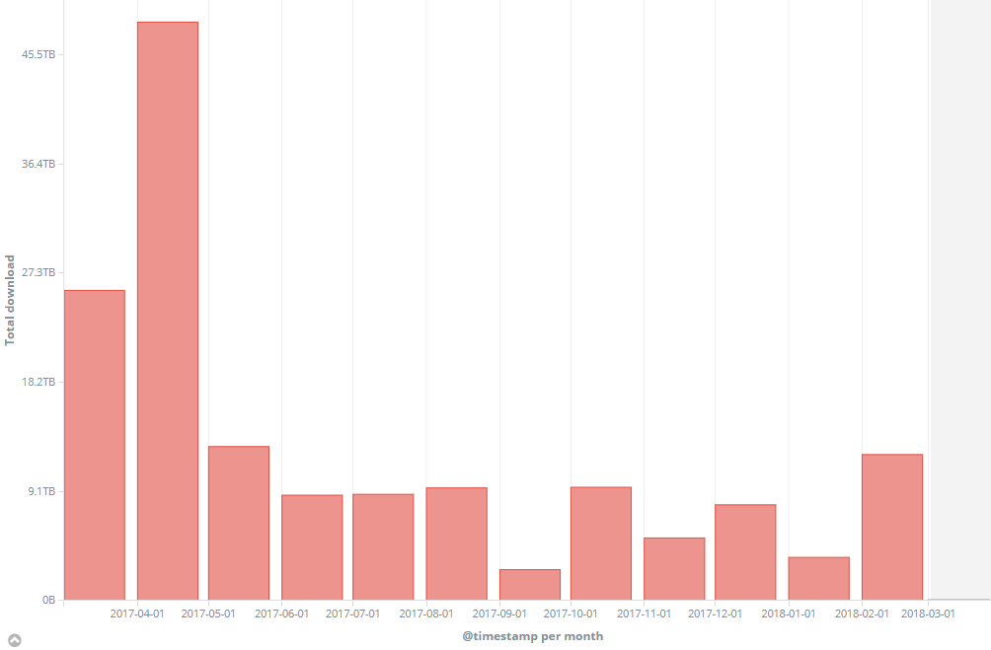
ATLAS Data transfer Last Year
850 TB data produced and transferred (2017.2-2018.2)
Download 700 TB
upload 150 TB

Slide 22
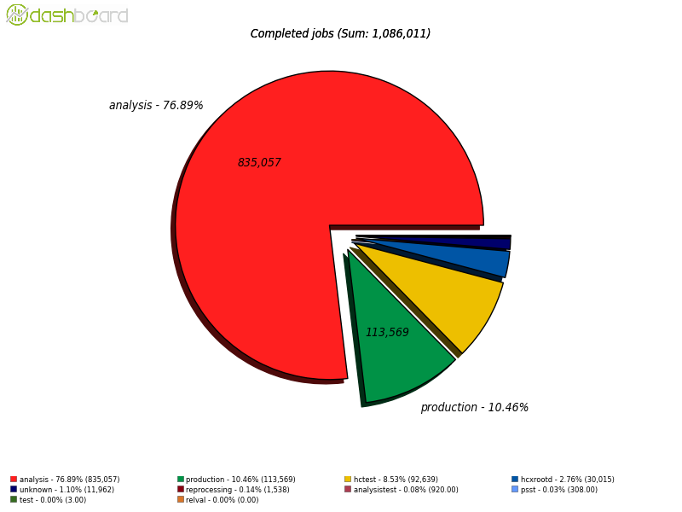
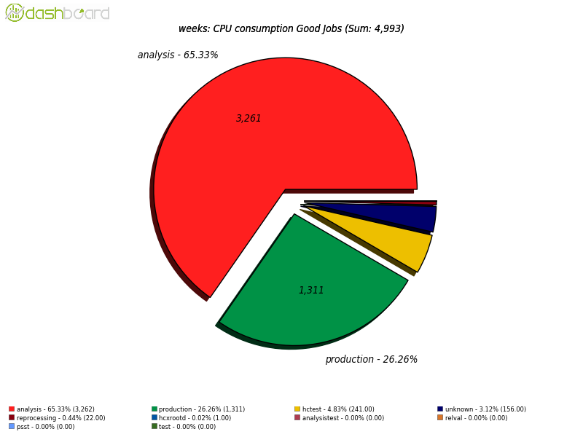
CMS Job Last Year
Processed about 1.1M jobs (2017.2-2018.2)

Slide 23
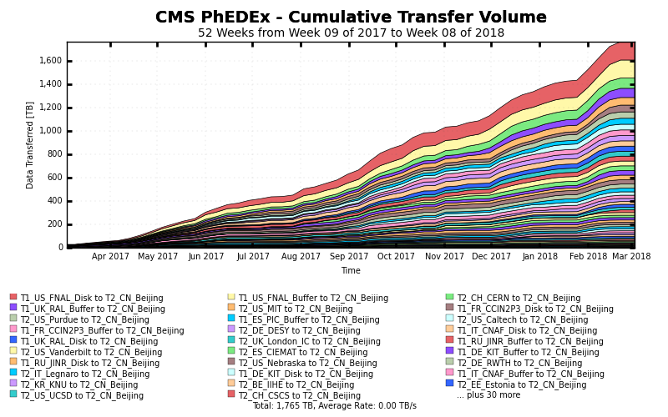
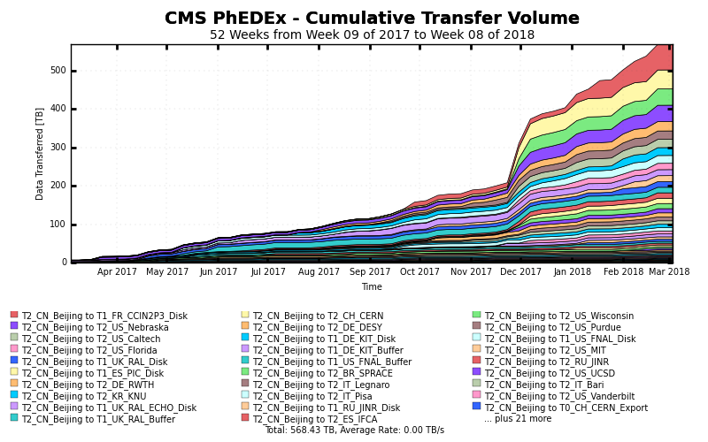
CMS Data Transfer Last Year
1.94PB data produced and transferred (2017.2-2018.2)
Download: 1.77PB,
Upload: 0.57PB

Slide 24
ALICE
Deployed and operated by CCNU
Resources:
148 cores and 100TB
Larger computing resources being installed
Bandwidth problem for long time due to the network policy of university
IHEP and CCNU had some discussions last year looking for the solutions
Establish a temporary route via VPN to redirect part of traffic to IHEP
IHEP is helping CCNU to improve the routing via CERNet

Slide 25
LHCb
Four Chinese universities joined LHCb.
Some IHEP staff will join the LHCb Chinese group soon. Therefore IHEP decided to support LHCb computing.
The Chinese group will purchase the hardware. A small Tier-2 site will be installed at IHEP.
Technique details are being discussed. We hope to put the system into operational in the year.

Slide 26
HEPHPC Project
HPC projects of National Key R&D Plan: to Support serval applications including biomedicine, Energy exploration, Digital media rendering, Astrophysics, life sciences, high energy physics, etc.
Project of High Performance Application Software System for High Energy Physics (HEPHPC)
Grant Agreement n. 2017YFB0203200
Start date: 1 July 2017
Duration: 36 Months
3 Work Packages
Key technologies R&D
HEP application development
Large-scale deployment

Slide 27
HEPHPC Objectives and Progress
Develop a software system for HEP to support many cores platform.
Deploy the software in national Supercomputing environment and optimize the performance
Support LQCD, event simulation, partial wave analysis (PWA), etc.
Aims to run program on millions of cores in parallel
Ported LQCD to Sunway, the number one supercomputer
Compiled and run LQCD on Tianhe-2 , the second largest machine
Rewriting PWA software based on OpenACC to support many-core
Developing parallel version of physical simulation software
Applications
Applications
（BES, CEPC, …）
Academic users
（CAS, PKU, …）
HPC software for HEP
LQCD
simulation
PWA
Common libraries and tools
Supercomputing
environment

Slide 28
Thank you

