Slide 1
Unified Account Management for High Performance Computing as a Service with Microservice Aarchitecture
Cao Rongqiang，Lu Shasha, Xiao Haili, Wang Xiaonig
caorq@sccas.cn
Computer Network Information Center
Chinese Academy of Science
2018.03.20

Slide 2
Outline
Introduction to our team
China National Grid
China Scientific Computing Environment
Unified Account Management
Future work

Slide 3
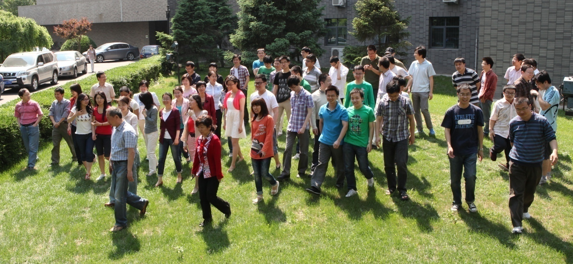
Introduction to our team
Build and maintain China National Grid (CNGrid);
Develop and optimize massively parallel computing applications in various subjects;
Provide technical support and consultation on HPC.

Slide 4
CNGrid
China National Grid
  Started from 2002
  “High performance computer and core software”, 863 Key Project, 10th five-plan
  “High productivity Computer and Grid Service Environment”, 863 Key Project, 11th five-plan
  “Application Service Optimization In High Performance Computing Environment”, 863 Key Project, 12th five-plan
  “Construction and Resource Upgrade of High Performance Computing Environment”, National key research and development plan, 13th five-plan
    Phase 1, 2016.07-2018.06
    Phase 2, 2018.07-2020.12
Notes:
简单说历史，几个五年计划

Slide 5
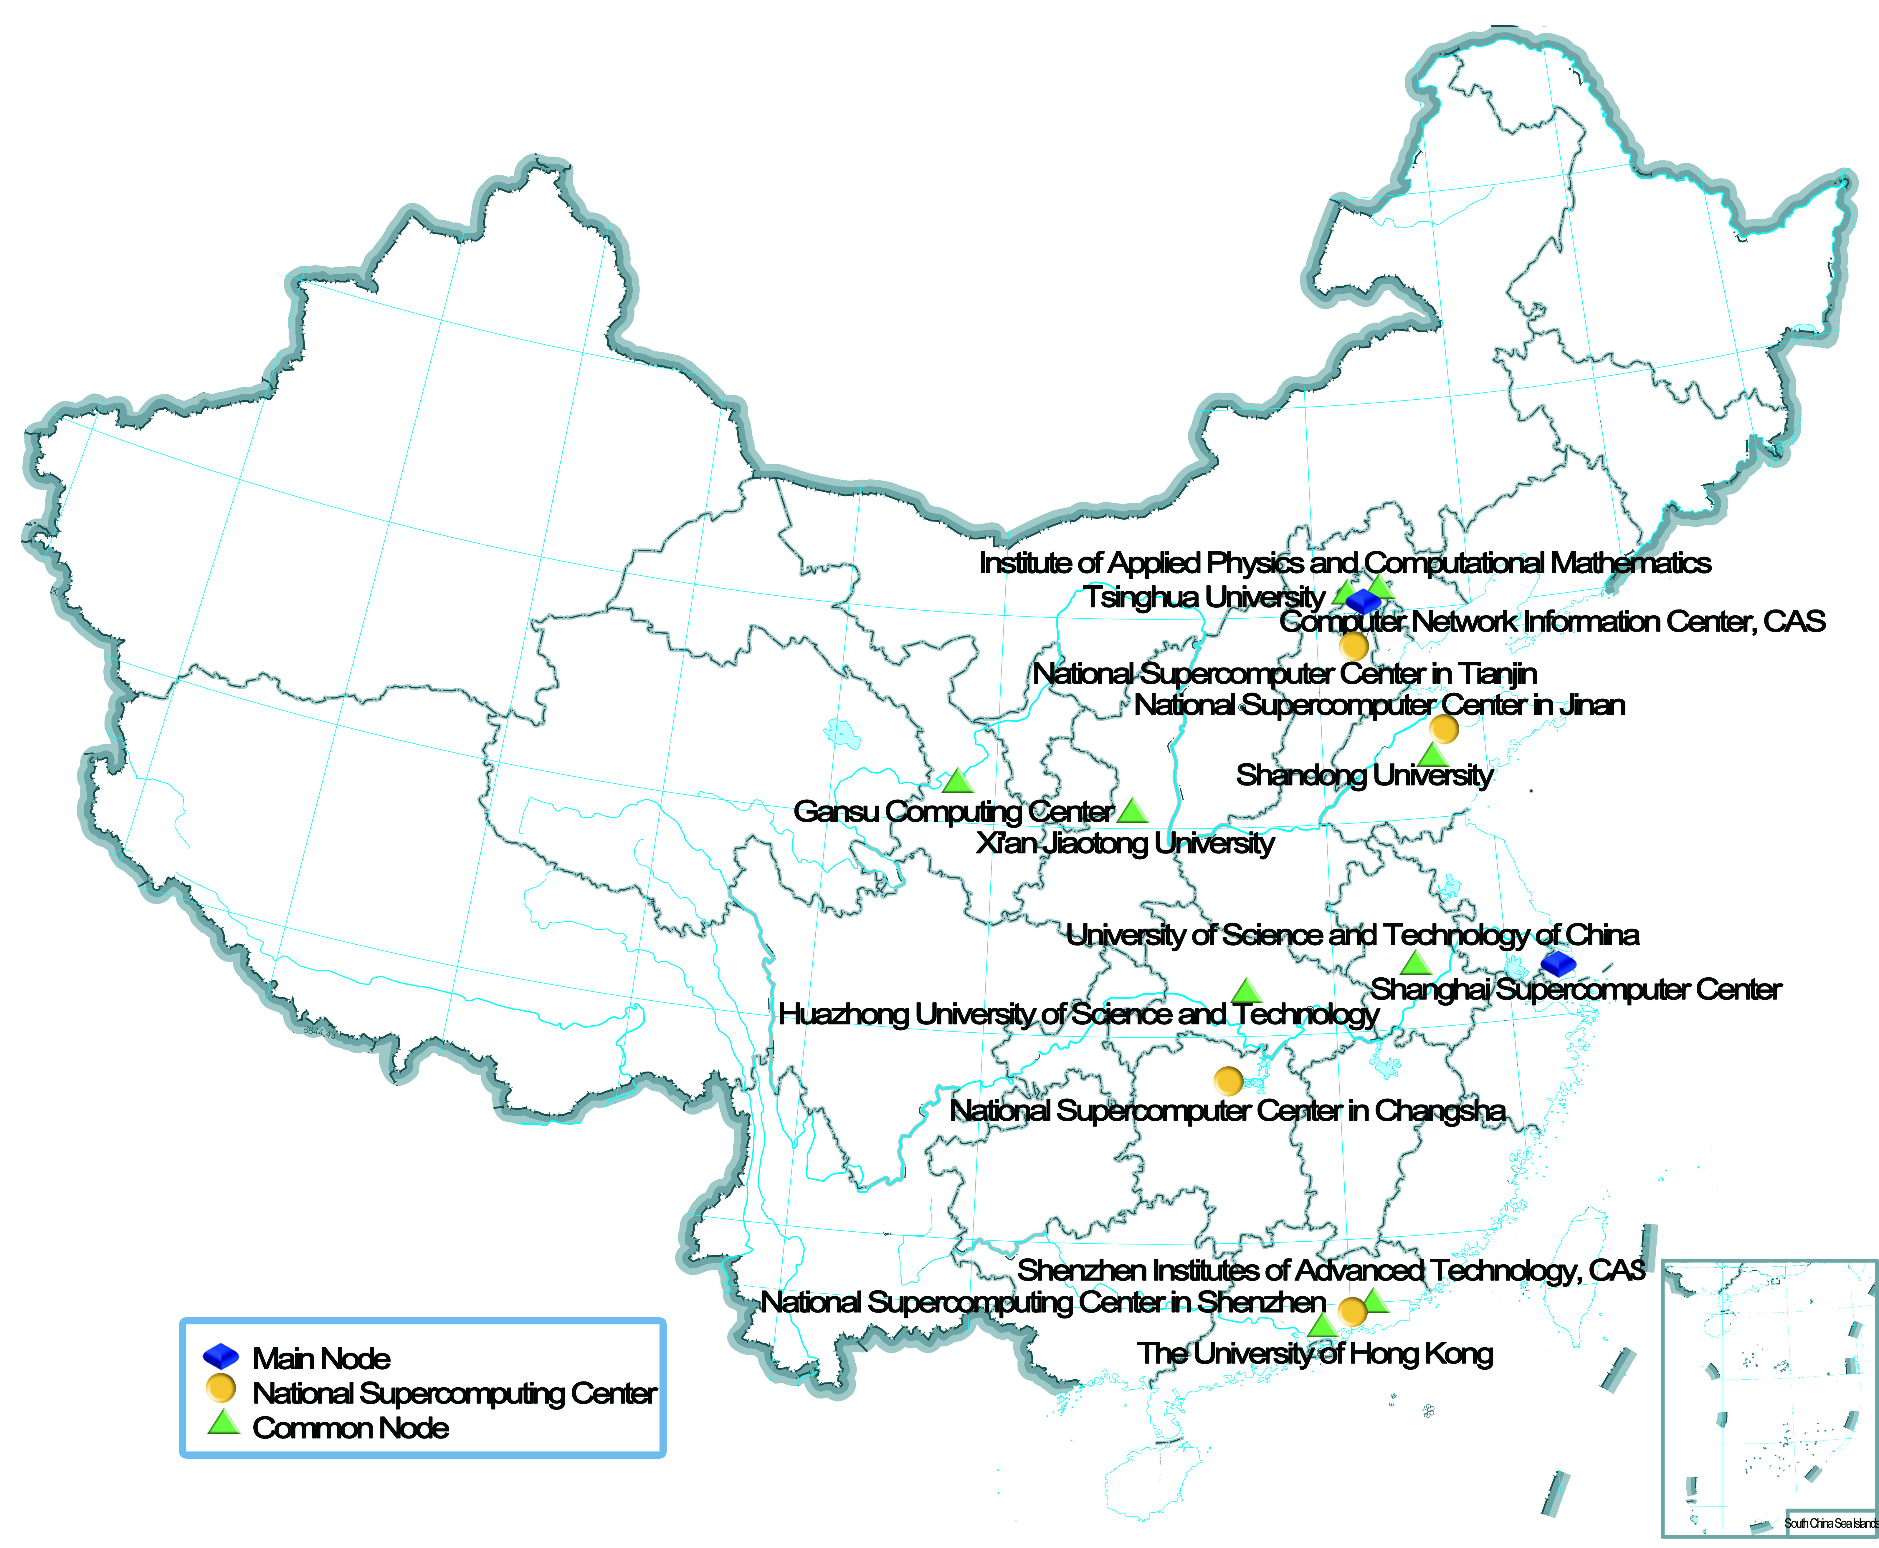


CNGrid
19 nodes
200PF Computing Resource
160PB Storage Resouce
All 6 National Supercomputer Centers
  Wuxi, Tianjin, Jinan, Changsha, Shenzhen, Guangzhou
Notes:
In particular,

Slide 6
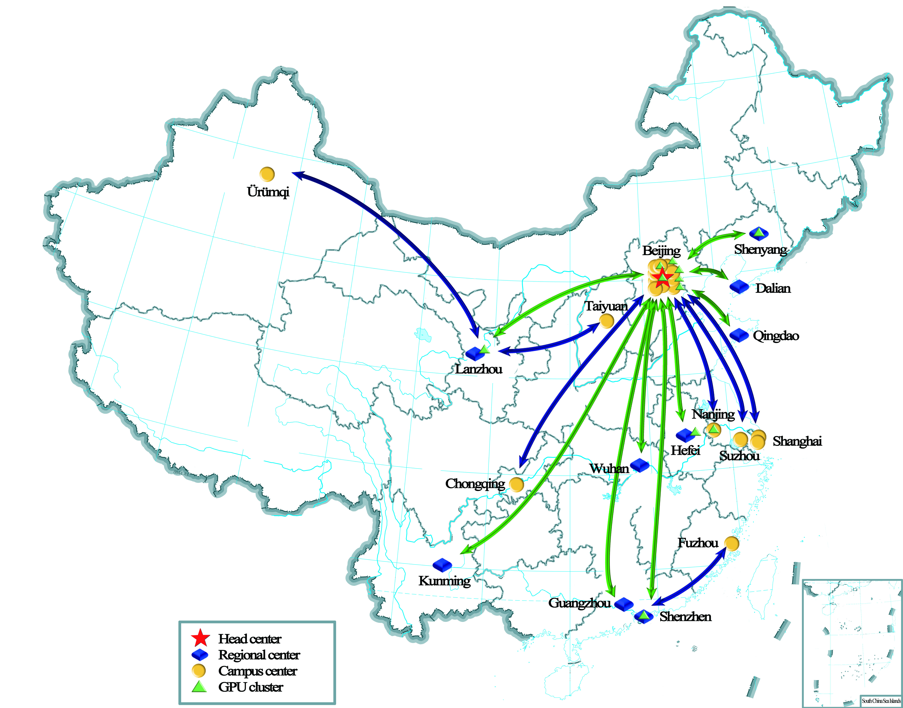
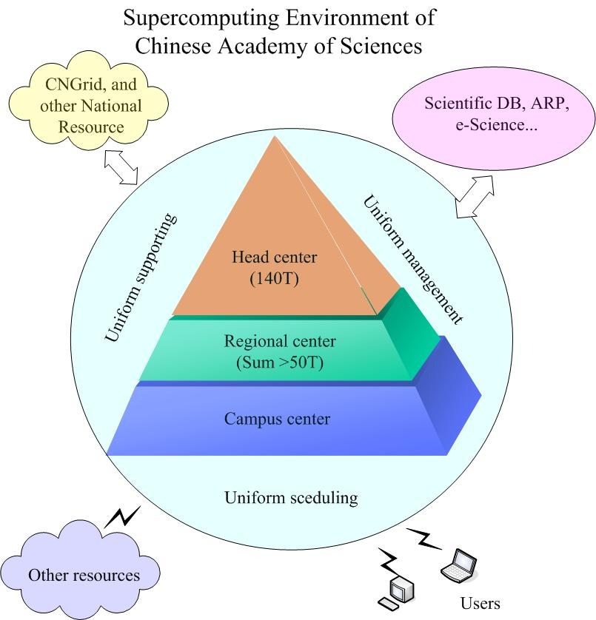

China Scientific Computing Environment
started in 11th five-year plan in Chinese Academy of Science (CAS)
CPU: 1300Tflops
  deepcomp7000; ERA phase 3 AI
GPU: 3000 Tflops
  11 institutes from CAS
Notes:
Artificial Intelligence

Slide 7











China Scientific Computing Environment
100+ Grid Apps
BioInfo
Chem
Algorithms
Material
CFD
Others
Development

Slide 8
China Scientific Computing Environment

Slide 9
Outline
Introduction to our team
China National Grid
China Scientific Computing Environment
Unified Account Management
Future work

Slide 10

Unified Account Management
Unified Account Management as a Service (UAMS)
Problem
  issues between global accounts of CNGrid and local accounts of heterogeneous HPC resources.
Goal
  allows users to use tens of HPC resources via only an account
  single sign-on （SSO）capability between many clients
  makes it easy for developers to implement clients and services related HPC with advantages of numerous users
UAMS
CNGrid

Slide 11
UAMS
simplicity, compatibility and reusability
a group of RESTful web services
implemented in several self-contained microservices

Slide 12
UAMS
1. Non-login Microservice
  A web portal
  potential users to apply for an account to access CNGrid.
  Normal users to set and reset their passwords
the registration process in the non-login microservice

Slide 13
UAMS
2. Account Management Microservice
  A web portal for administrators
  customized account workflow of full life-cycle management
    creating an account
    mapping global accounts to multiple HPC local accounts
    enabling and disabling any account
    logging and tracking
the account workflow of full life-cycle management in the account management microservice

Slide 14
UAMS
（1）Approve and Create Accounts
  approve or deny the application
    mainly based on the parallel scalability and related research projects.
    Prefer to massively parallel computation algorithms and software.
    supports basic research projects
  LDAP to store account information
    hierarchical, expandable
    incremental synchronization
    distributed services

Slide 15
UAMS
(2) Map Global Accounts to HPC accounts
Main Methods of Mapping Accounts
Number of global Accounts | Number of Local Accounts in a HPC resource | Comments
One | One | Simple, needs lots of local HPC accounts.
One | Multiple | Not necessary at the same time.
Multiple | One | Complicate, needs a few of local HPC accounts.
Multiple | Multiple | Most complicate and flexible.
From one-to-one to multiple-to-one

Slide 16
UAMS
(3) Enable and Disable Accounts
  manage privileges of accounts at varying degrees of granularity.
  The basic method: turn on or off the full privileges of an account.
  individual or combine methods
    Job submit
    Application
    HPC resource

Slide 17
UAMS
(4) Log and Audit
  a record consists of timestamp, client name, operator name, target object name, operation name, and status of the action.
  stored into a MySQL database and a logging system simultaneously.
  an analysis system is used to find any risky event online based on these records.

Slide 18
UAMS
3. Account Update Microservice
  A web portal for users
  Update the HPC requirements
  Collect the achievements of users

Slide 19
UAMS
4. LDAP Authentication Microservice
  A RESTful web service and a command-line toolkit.
  provides username and password authentication scheme
    Web service
    desktop applications
    command line tools
    and scripts on Linux/Unix system.

Slide 20
UAMS
5. SSO Authentication Microservice
  Single Sign-On based on Apereo Central Authentication Service (Apereo-CAS)
  bridge authentication information to LDAP
  Authenticated by account, password and CAPTCHA

Slide 21
UAMS_RESTful WEB SERVICE AND API
Main Methods of UAMS
 | Method | URL |  | Comments
Simple Authentication | POST | /users/login | Login into a client based on the LDAP library in CNGrid.
 | GET | /users/logout | Logout from the client by a token in headers of a request.
Account Management | GET | /account | Get a list of accounts specified by a group of attributes.
 | PUT | /account/{user}/ldap | Create an account and store it in the LDAP database.
 | GET | /account/{user}/ldap | Get an account from the LDAP database specified by user.
 | DELETE | /account/{user}/ldap | Delete an account from the LDAP database specified by user.
 | PUT | /account/{user}/ldap/attribute | Update an attribute of a LDAP account specified by user.
 | GET | /account/map | Get a list of mappings specified by a group of global accounts and name of HPC resources.
 | PUT | /account/map | Add or update a group mappings specified by a data structure in the body of a request.
 | GET | /admin/cluster | Get a list of privileges specified a group attributes, for example, accounts, computing queues, applications, and names of HPC resources.
 | POST | /admin/cluster | Add or update a list of privileges. Each privilege is specified by a group attributes and enables/disables a rule.
 | GET | /account/remarks | Get a list of remarks specified by a group of attributes.
 | GET | /account/{user}/remark | Get a remark specified by user.
 | PUT | /account/{user}/remark | Add a remark for the user.
Account Update | GET | /account/self/profile | Gets account information including projects and softwares from the MySQL database specified by the login account.
 | GET | /account/self/profile/projects | Get projects information specified by the login account.
 | GET | /account/self/profile/softwares | Get projects softwares specified by the login account.
 | PUT | /account/self/profile | Add or update account information including projects and softwares for the user specified by the login account.
 | GET | /account/self/remarks | Get a list of remarks specified by the login account.
 | PUT | /account/self/remarks | Add a remark for the user specified by the login account.
SSO Authentication | POST | /casv4-service/v1/ticket | Login into a client based on the LDAP library and get a Ticket Granting Ticket (TGT).
 | DELETE | /casv4-service/v1/ticket/{TGT} | Logout from the client for the user specified by the TGT.

Slide 22
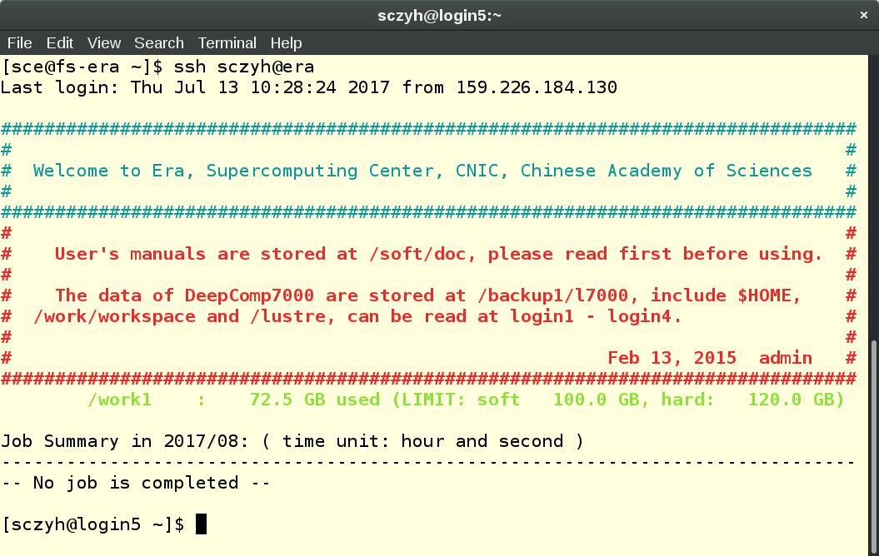
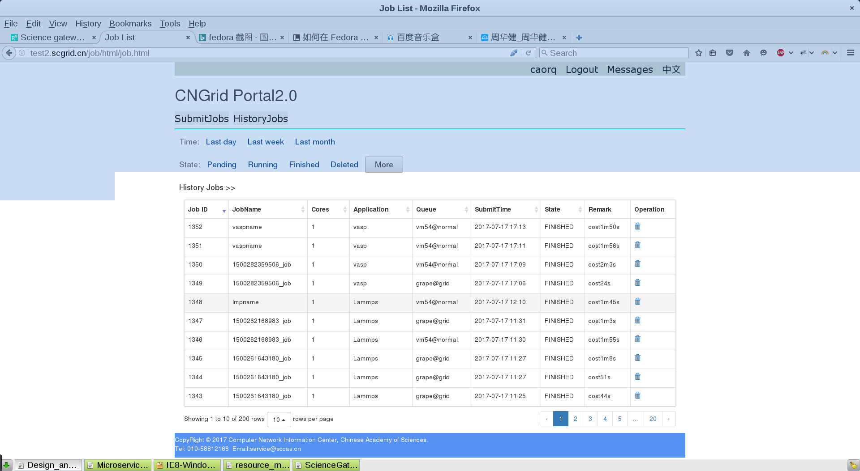
UAMS_ AUTHENTICATION SCHEMES AND USE CASES
1. basic username and password authentication scheme
2. LDAP Authentication Scheme
  utilize authentication capability brought by OpenLDAP.
  add the CAPTCHA verification, throttle limit and other policies to prevent malicious attacks
3. SSO Authentication Scheme
  login once and access everywhere
  mainly for the web applications, consisting of desktop and mobile web applications

Slide 23
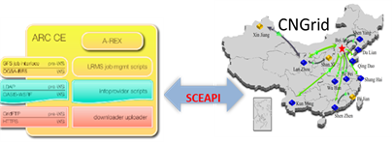
UAMS_ AUTHENTICATION SCHEMES AND USE CASES
RESTful API Authentication Scheme
  provides flexible and compatible authentication scheme for developers
  Utilize cross-language and cross-platform features of the RESTful API and the popularity of the HTTP protocols.
the integration to ARC-CE based on SCEAPI for the ATLAS experiment

Slide 24
UAMS_PEFORMANCE AND TEST
Settings:
  x86_64 Linux
  CPU with two cores at 2.27 GHz
  4GB memory and 20GB disk storage
  Time unit: millisecond
creating accounts
authenticating accounts
changing passwords

Slide 25
Future work
federated account service
  enable a local HPC account similar to a global account
  Add multi-level authorization based on account attributes
More resources
More users
More areas
Easy-to-use
Stability
Security
Simple & flexible
Feature-rich
Job schedule
Stable Easy-to-use Professional

Slide 26
Thank you!

