Slide 1
Responding to Environmental Change: Research Collaborations, Data Integration, and Deep Mapping David J. Bodenhamer The Polis Center at IUPUI International Symposium on Grids and Clouds Taipei, March 2018
Prepared for Environmental Change: An IU Grand Challenge
IUPUI

Slide 2
An IU Grand Challenge: Goals, Aims, Requirements
SECTION 1

Slide 3
Prepared for Environmental Change
One of three Grand Challenges launched by Indiana University. (The other two are precision medicine and addictions.)
The overall purpose of the Grand Challenges program is to use the university’s resources in a focused way to solve often intractable problems of central importance to the state and nation.
All Grand Challenges must be multidisciplinary and involve at least two campuses of the IU system. They also must have external partners in government and industry.
Funding for each GC is around $50 million over five years.

Slide 4
PfEC Goals
Foster Indiana’s resilience in adapting to environmental change.
Predict the impact of environmental change on all sectors of Indana society and economy.
Inform policies that minimize adverse impact while creating opportunity.
Develop solutions that prepare businesses, communities, and individuals for minimizing adverse consequences and maximizing social, economic, and political opportunities.

Slide 6
Common Drivers
Present
Solutions and Policies
Past
Forecasts

Slide 7
Socio-Ecological Model
PUBLIC POLICY
INTRAPERSONAL Knowledge, behavior…
PRIMARY SOCIAL GROUPS Family, friendships…
INSTITUTIONAL FACTORS Formal and informal rules
COMMUNITY FACTORS Relationships among institutions

Slide 8
Knowledge Platform
Integrate findings from research clusters
Explore patterns and trends
Identify new research questions
Allow multiple views to understand complexity of these issues
Explore policy implications of the research findings
Develop narratives about change
Enlist citizen scientists
Communicate problems and solutions
Engage communities

Slide 9
Summary of Requirements: Functions
Discover
Change over time
Multiple formats (maps, chart, histograms, infographics, etc.)
Explore
Explore the impact of policy scenarios on environment, people, and places
Learn
Experience a place – its surroundings, history, change
Explore correlations between and among variables (e.g., demographic, cultural, economic and biophysical)
Tell stories using the data
Prepare exhibits and other forms to demonstrate impact and change over time
Find data and content by:
Visualize
Place
Time
Topic
Document the data holdings, content, and derivative products for each cluster
Data from one or multiple clusters
Mine news feeds and other sources for contextual information
Compare geographies
Contribute
Allow users to collect and contribute data to the initiative (Citizen/ resident/ student science)
Collect and share perceptions and contributed information
Share findings from the research and modeling efforts with the general public

Slide 10
Data Challenges
Types of data:
Quantitative: e.g., water quality, stream discharge, nitrate load, groundwater levels, flooding frequency, % greenspace, trail usage,
Qualitative: e.g., surveys, histories, images, reports, narratives, digital and non-digital media
Categories of data: meteorological, hydrological data, geological, species, demographics, perceptions
3. Multiple temporal and geographic scales
Notes:
Types of Data
Quantitative: stable isotope biochemistry useful for studies of species distribution and migration (some intersection with movement ecology), vector shield traps, species tracking; physiological data, Pleasant Run (fine-scale air, water, soil data, % greenspace by type); trail greenway use, particulate matter sampling, and Cyanobacteria Carbon Sinks: quantifying the effectiveness of systems at trapping carbon dioxide and generating energy
Qualitative: Survey, histories, images, reports, narratives, Data from all types of media digital and nondigital
Categories of data:
water quality, stream discharge, nitrate load, groundwater levels, flooding frequency​,intersects with Public-Private Conservation) ; geological data
Pleasant Run: fine-scale air, water, soil data, % greenspace (by type); trail greenway use, particulate matter sampling
Cyanobacteria Carbon Sinks: quantifying the effectiveness of systems at trapping carbon dioxide and generating energy

Slide 11
Structural Challenges
Editorial: what vetting process will ensure integrity of information
Management: who manages data within clusters and between clusters
Support: help desk function, training function, etc.
Coordination: clusters are working mostly in silos
Communication: who and how
Maintenance and sustainability

Slide 12
Knowledge Platform
SECTION 2

Slide 13
Raw Data
Derivative and Curated Data
Knowledge Platform
RESEARCH CLUSTERS
DATA LINKED BY SPACE AND TIME
FUNCTIONAL MODULES
C2
C3
C1
Predictive Scenarios
Discover
Explore
C5
C4
Historic Trends
C6
Visualize
Learn
Survey Summaries
POLIS DATA
Demographics
Administrative
Spatial Inventories
Contribute
Economy
Natural Disaster
Descriptive Statistics
OTHER DATA
Water Quality, Air Quality, Earth Systems, Migration
Notes:
Lots of data – how do we bring it together in such a way that allows it to be explored, used, and repurposed by and for researchers in PfEC, communications team, general public, policy makers, etc.
Walk through a story board showing how a person (researcher, public, policy makers) would walk through the site and what they might explore and experience

Slide 14
Summary of Modules
Discover
Timelines: animated and basic
Basic maps
Explore
Simple simulations (user adjusts parameters to view scenarios)
Learn
Faceted browsing (multiple views of data)
Exploratory Spatial Data Analysis
Spatial narratives, cultural narratives
Story telling – includes narrative
Online exhibits (e.g., photos, art)
Data catalog
Visualize
Search feature: find data and content by geo x time x topic
Contribute
Citizen/resident/student science
Perceptions, Anecdotal information
Experimental Areas:
Virtual Reality, Immersive Environments
Augmented reality

Slide 15
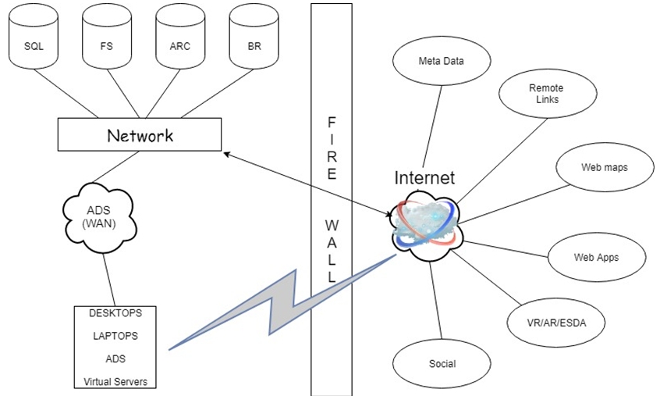
Network Architecture

Slide 16
Technology Stack and Services
Physical Servers, Virtual servers, Desktops etc.
Oracle -> Apex
SQL Server
Hadoop -> HBase
Polybase
.Net Latest version
JavaScript Libraries (jQuery, Angular, d3 JS, KO JS, leaflet JS etc.)
CSS3 or CSS4, bootstrap
HTML, HTML5
Excel, Word
FIS
Access
ArcGIS Online
Python
R

Slide 17
Notes:
Included just to show that this isn’t easy – lots of communication and coordination is required across the clusters

Slide 18
Limitations and constraints
Data availability
Lack of detailed knowledge about what data available
Timing of when data will be available
Data challenges:
Quality
Consistency
Ability of the data to be integrated
Skillset availability
Are all the skills needed in place?
The timing of hiring of those
Data managers – for clusters, overall, working with Polis
Researcher mobility

Slide 19
Deep Mapping
SECTION 3

Slide 20
Dynamic and Scalable Map
A cartographic form that embodies the reciprocal influence of geographic and constructed space on culture and society.
Fuses quantitative, qualitative, and image data.
Manages uncertainty and ambiguity.
Links time, space, and culture dynamically.
Operates at multiple scales.
Changes continuously with new data; versioning, path traceable

Slide 21
Alt. GIS
Neogeography
Non-cartographic maps (e.g., tree maps, bubble charts, etc.)
Virtual globes
Spatial narratives, story maps
Gazetteers, spatial semantics, text-to-GIS
Augmented reality
Immersive environments

Slide 22
Implementation: Phase One
SECTION 4

Slide 23
Raw Data
Derivative and Curated Data
Knowledge Platform
RESEARCH CLUSTERS
DATA LINKED BY SPACE AND TIME
FUNCTIONAL MODULES
C2
C3
C1
Predictive Scenarios
Discover
Explore
C5
C4
Historic Trends
C6
Visualize
Learn
Survey Summaries
POLIS DATA
Demographics
Administrative
Spatial Inventories
Contribute
Economy
Natural Disaster
Descriptive Statistics
OTHER DATA
Water Quality, Air Quality, Earth Systems, Migration

Slide 24
Prioritizing Functionality
I
Functional Priorities
What are the functionality needs?
What data are available?

Slide 25
Phase 1 Modules
I
Timelines – animated and basic
Spatio-temporal visualizations
Faceted browsing – maps, charts, histograms, others as appropriate for the data
Data finder
Citizen science data collection (urban green inventory)
Online exhibit (e.g., photos of runoff to demonstrate erosion, art, etc.)
Spatial narrative – demo via ESRI Story Map
Basic simulator
ESDA – relationship between variables

Slide 26
Timeline for Phase 1

Slide 27
Knowledge Platform Visualized
SECTION 5

Slide 28
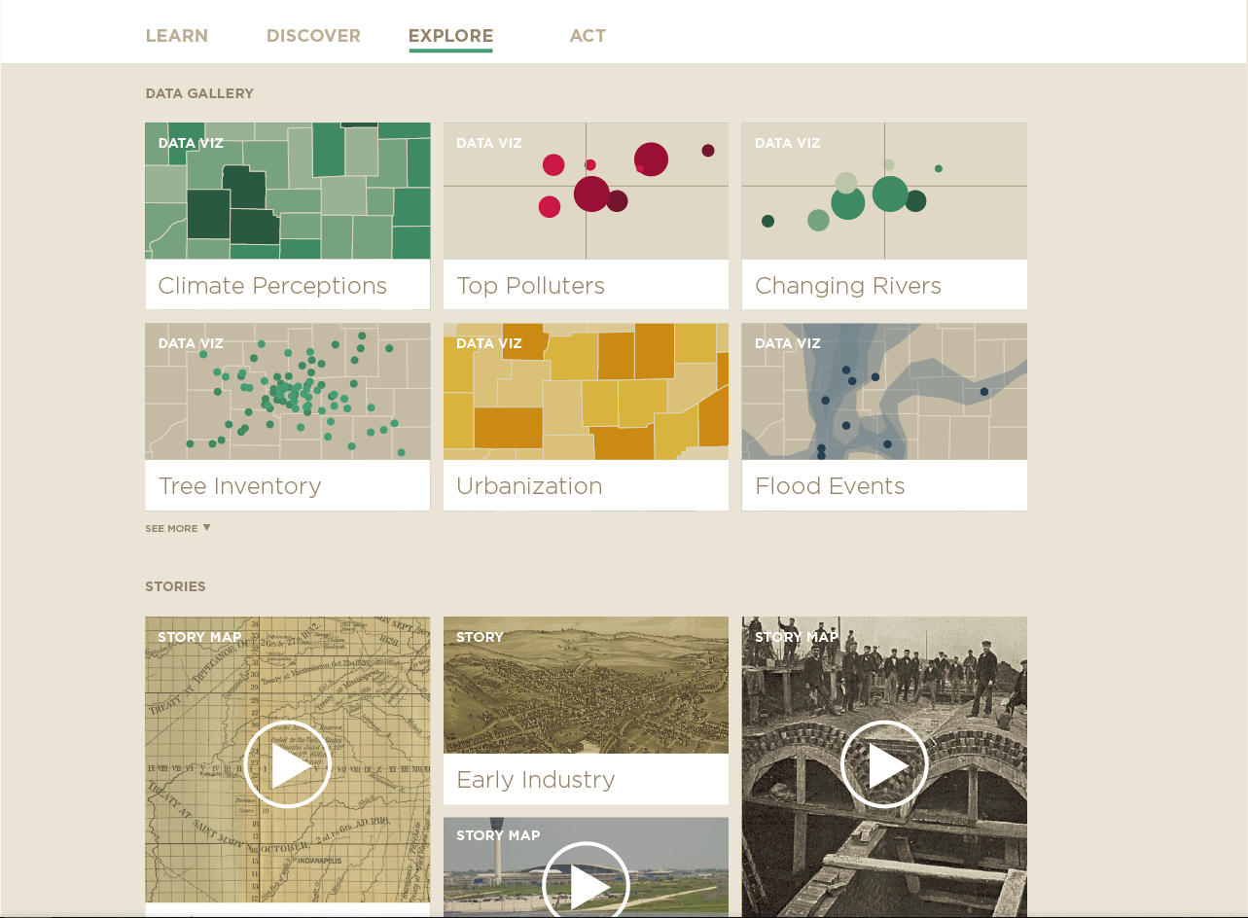

Slide 29
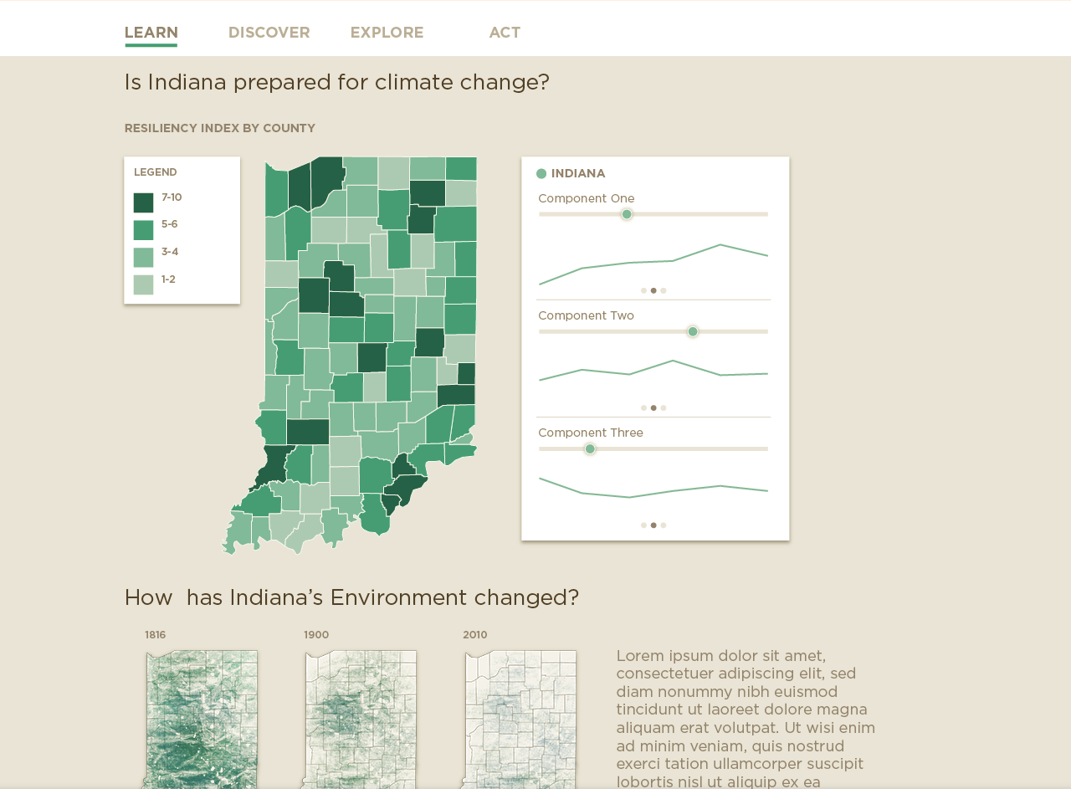

Slide 31
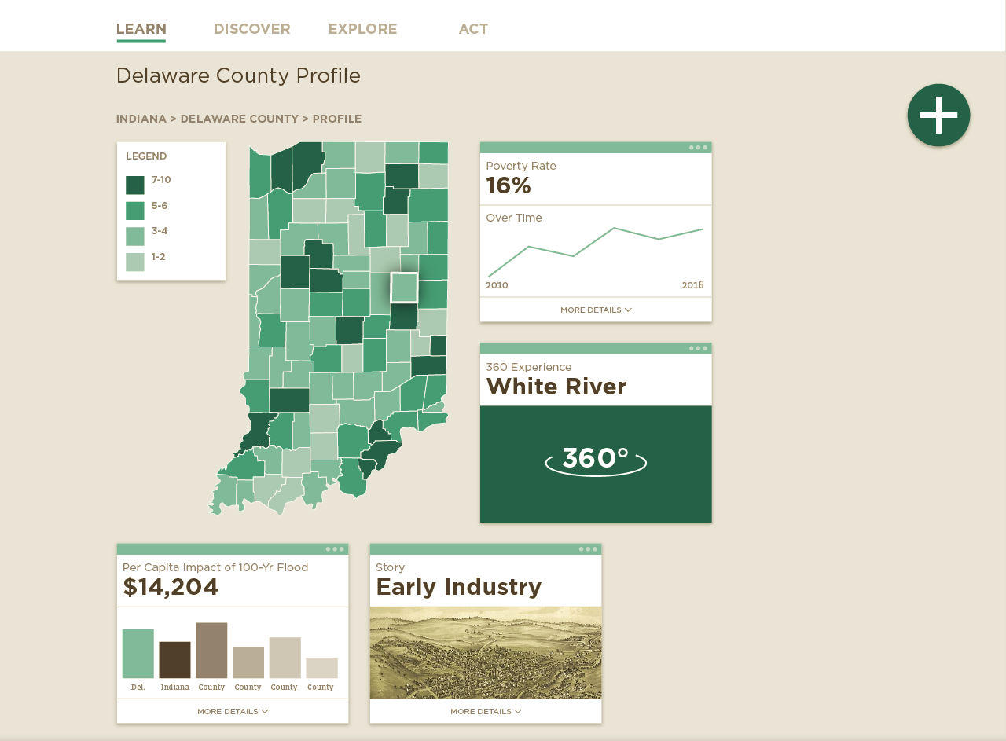

Slide 32
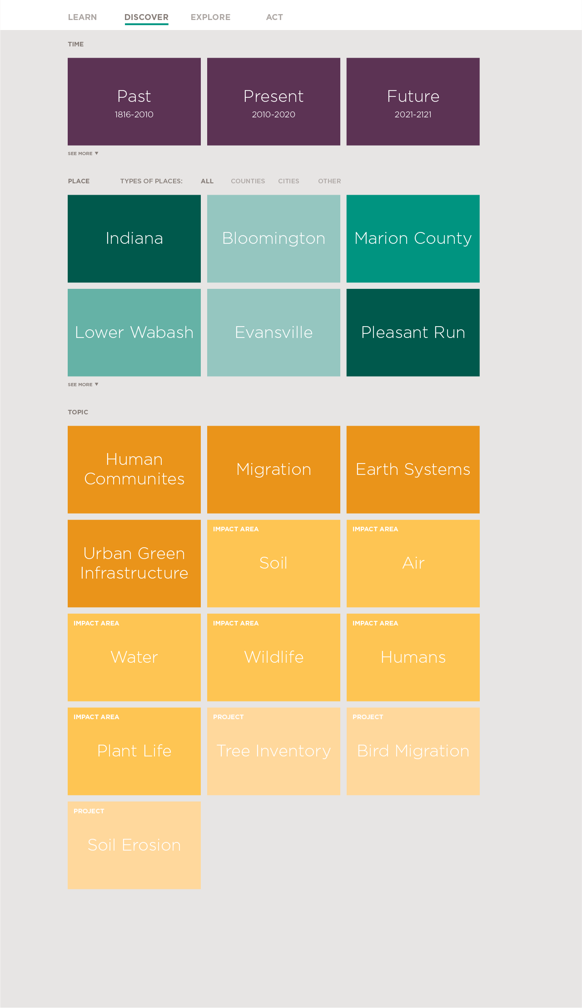

Slide 33
