Slide 1
Develop Environmental Sensor Network Case study : Indonesia
Basuki Suhardiman
basuki@Itb.ac.id
Institut Teknologi Bandung

Slide 2
Outline
Background
Design Model
Protyping and Testing model
Future works and collaboration

Slide 3
IDeate
By combining the satellite data with meteorological records, Field established that Indonesian fires often occur in association with the ultra-dry conditions in the region that accompany El Niño, a major cyclical weather system. These dry out the underlying peat to the point at which it can catch fire and can’t be extinguished until monsoon rains arrive months later. A next step might be to refine the predictions further by including the combined effects of high temperatures and low humidity on peat moisture, says Field.
He also found that less than 4 millimeters of rain per day during the annual dry season, from August to November – combined with El Niño conditions – seems to be a “tipping point” beyond which fires can to suddenly take off.
https://www.newscientist.com/article/2099496-indonesian-fires-sent-huge-smoke-plume-halfway-around-the-globe/?utm_medium=Social&utm_campaign=Echobox&utm_source=Facebook&utm_term=Autofeed&cmpid=SOC%7cNSNS%7c2016-Echobox#link_time=1470082665

Slide 4
Fire Report on Mar 2018
http://fires.globalforestwatch.org/report/index.html#aoitype=PROVINCE&dates=fYear-2018!fMonth-3!fDay-8!tYear-2018!tMonth-3!tDay-15&aois=Aceh!Bali!Bangka-Belitung!Banten!Bengkulu!Gorontalo!Jakarta%20Raya!Jambi!Jawa%20Barat!Jawa%20Tengah!Jawa%20Timur!Kalimantan%20Barat!Kalimantan%20Selatan!Kalimantan%20Tengah!Kalimantan%20Timur!Kepulauan%20Riau!Lampung!Maluku!Maluku%20Utara!Nusa%20Tenggara%20Barat!Nusa%20Tenggara%20Timur!Papua!Papua%20Barat!Riau!Sulawesi%20Barat!Sulawesi%20Selatan!Sulawesi%20Tengah!Sulawesi%20Tenggara!Sulawesi%20Utara!Sumatera%20Barat!Sumatera%20Selatan!Sumatera%20Utara!Yogyakarta&dataSource=gfw&reporttype=indonesiaspecialtyreport

Slide 5
Define
What we (Indonesia) need it ?
Automated Weather Station
Rainfall
Temperature
Humidity
Air quality Index and Polution Standard index measurements
NOx, SOx , CO , NH3 , O3 , CH4 and PM 2.5 (10)
Sensors and sensors network
Prediction models (computing capacity)
Socialize to peoples
https://en.wikipedia.org/wiki/Pollutant_Standards_Index

Slide 6
Contraints/obstacle
In the field
There is no power
Limited converage by telecommunications system
No sensor available
Source of the fire
More than 50 km from nearest town

Slide 7
Build Prototype
Build prototype for AWS+sensor base on Arduino
Board (I/O)
Communication
GSM/GPRS/Wifi
Ethernet
USB/Storage System
Sensors
Temperature
Wind speed
Wind direction
Humidity
Rainfall rate
CO
Particulate Matters 2.5 and 10 Micron
CH4 ?
Develop Service Oritented Services (SOA) for the
Put the AWS+Sensors in the area with near forestry/ peatland

Slide 8
WEATHER DATA RECORD AND COLLECTION TROUGH TCP/IP NETWORK IMPLEMENTATION
A MODEL OF WEATHER MONITORING WITH ARDUINO base SENSORS AND RASPBERY CPU

Slide 9
Introduction
Background
Internet of Thing consist of set of devices and systems that interconnected sensors and actuators to the Internet. The systems consist of different system. In this presentation we will show the arduino sensors and mqtt software implement on a weather monitoring system and the data should show on Internet.
As the background of choosing this application is the weather data should be more benefit for human life if the data should receive immediately and the weather data collection still limited on a small area or city, hence in a wide area like at plantation or agriculture area in Indonesia,they required collected the data by themself from local weather station manually, because the weather monitoring station prepare by the government still lack at agriculture area, plantation area etc..
There is a demand to collect data from field, then in a year the data should be calculated the rain volume average, climate type and other parameters to fullfill the activity demand. In a wide area with lack of data communication facility will require a data communication facility installation like weather station we tested. The weather data should send trough a gsm cell phone facility from weather station to a server on the base station. Then from base station the data should distributed to Internet.
We hope this weather monitoring equipment model should be use by government or private instritution in the future to fullfill their weather data requirement and they could share it on Internet for their neighbour people or institution.
The weather monitoring station should record weather data per time periode automatically. It built from arduino cpu and mqtt server, gsm modem and raspbery cpu. The data send via gsm network to a web server, then web server distribute it to Internet.

Slide 10
Prototype 1.0 (2017)
Forestry (School)
GSM/GPRS Modul
TCP/IP
ITB
Web Server
For collecting data
And
Portal
Arduinno
Microcontroller
GPS modul
USB /Storage
AWS
-Wind Direction
-Wind speed
-Temperature
Humidity
Rain fall
CO sensor
And other sensors
Middle Ware
Network of Science Community
NASA/NOAA web server ,etc

Slide 11
IOT Architecture
Choose of the purpose

Slide 12
Integrated System by WSO2
Choose of the purpose

Slide 13
Methodology
The architecture model
Mobile weather
Sensors include Ethernet and TCP/IP and GSM modem
RASPBERY CPU
SENSOR
ARDUINO
MQ Telemetri Transport
UTP Cable OR
Wireless LAN
Free BSD Server +
Apache + TCP/IP
GSM Network
Smart Phone
The above is a system with simple web server.
Components : weather sensor (air temperature, wind direction, wind velocity, altitude, and longitude), arduino, gsm module, raspberry pi, FreeBSD server with Apache Web Server

Slide 14
Mobile weather
Sensors include Ethernet and TCP/IP and GSM modem
RASPBERY CPU
SENSOR
ARDUINO
UTP Cable OR
Wireless LAN
Free BSD Server +
WSO2ESB +Tomcat Web Server + TCP/IP
MQ Telemetri Transport
GSM Network
Smart Phone
The above model is the mature system with WSO2ESB proxy and Web Server. It should receive data from more weather equipment.
Mechanism Data Collection, Send, Record and Distributed to Internet
The sensors will measure the environment parameters, it send to MQTT server, and by raspbery it send to FreeBSD server via TCP/IP network. It should also send to GSM smartphone.
On the FreeBSD server, the txt format file data processed by stream editor and awk program become xml format file. The file then presented by apache web server on the internet. If there will more sensors implemented, the web server should added with wso2esb which act as proxy between mqtt server and web server.

Slide 15
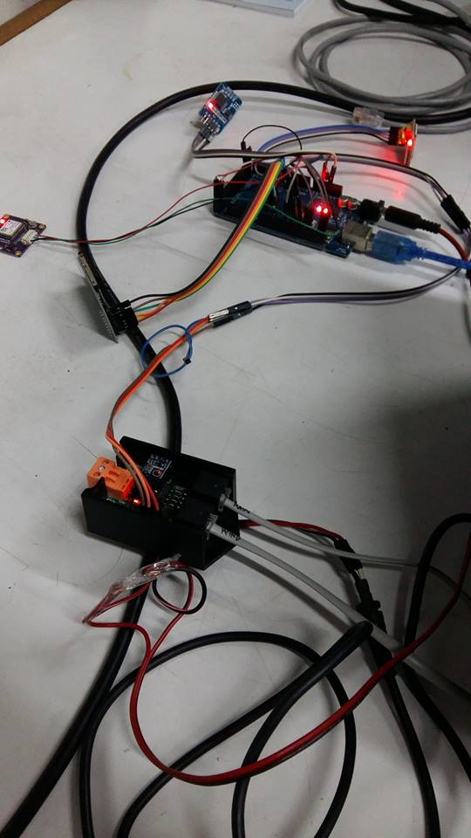
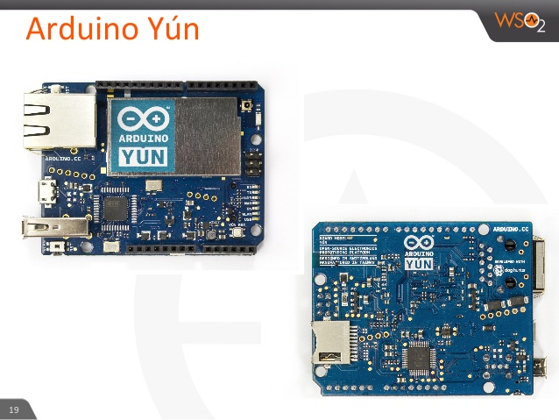
Arduinno
Arduinno Mega 2560
Atmega 2560 ,
Ram 8 Kbytes
Digital Input
GPS
GPRS
CO /CH4
Analog input
Humidity
Temperature
Pressure
Rainfall rate

Slide 16
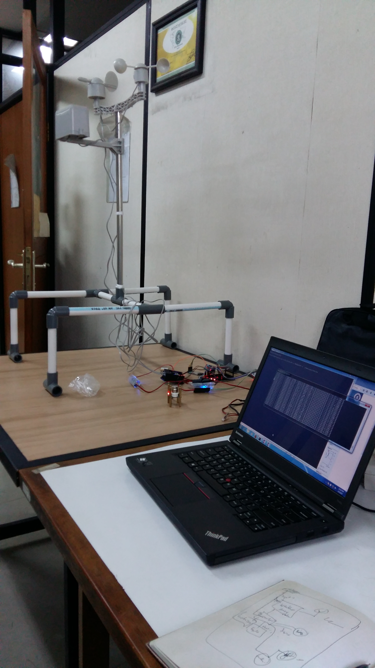
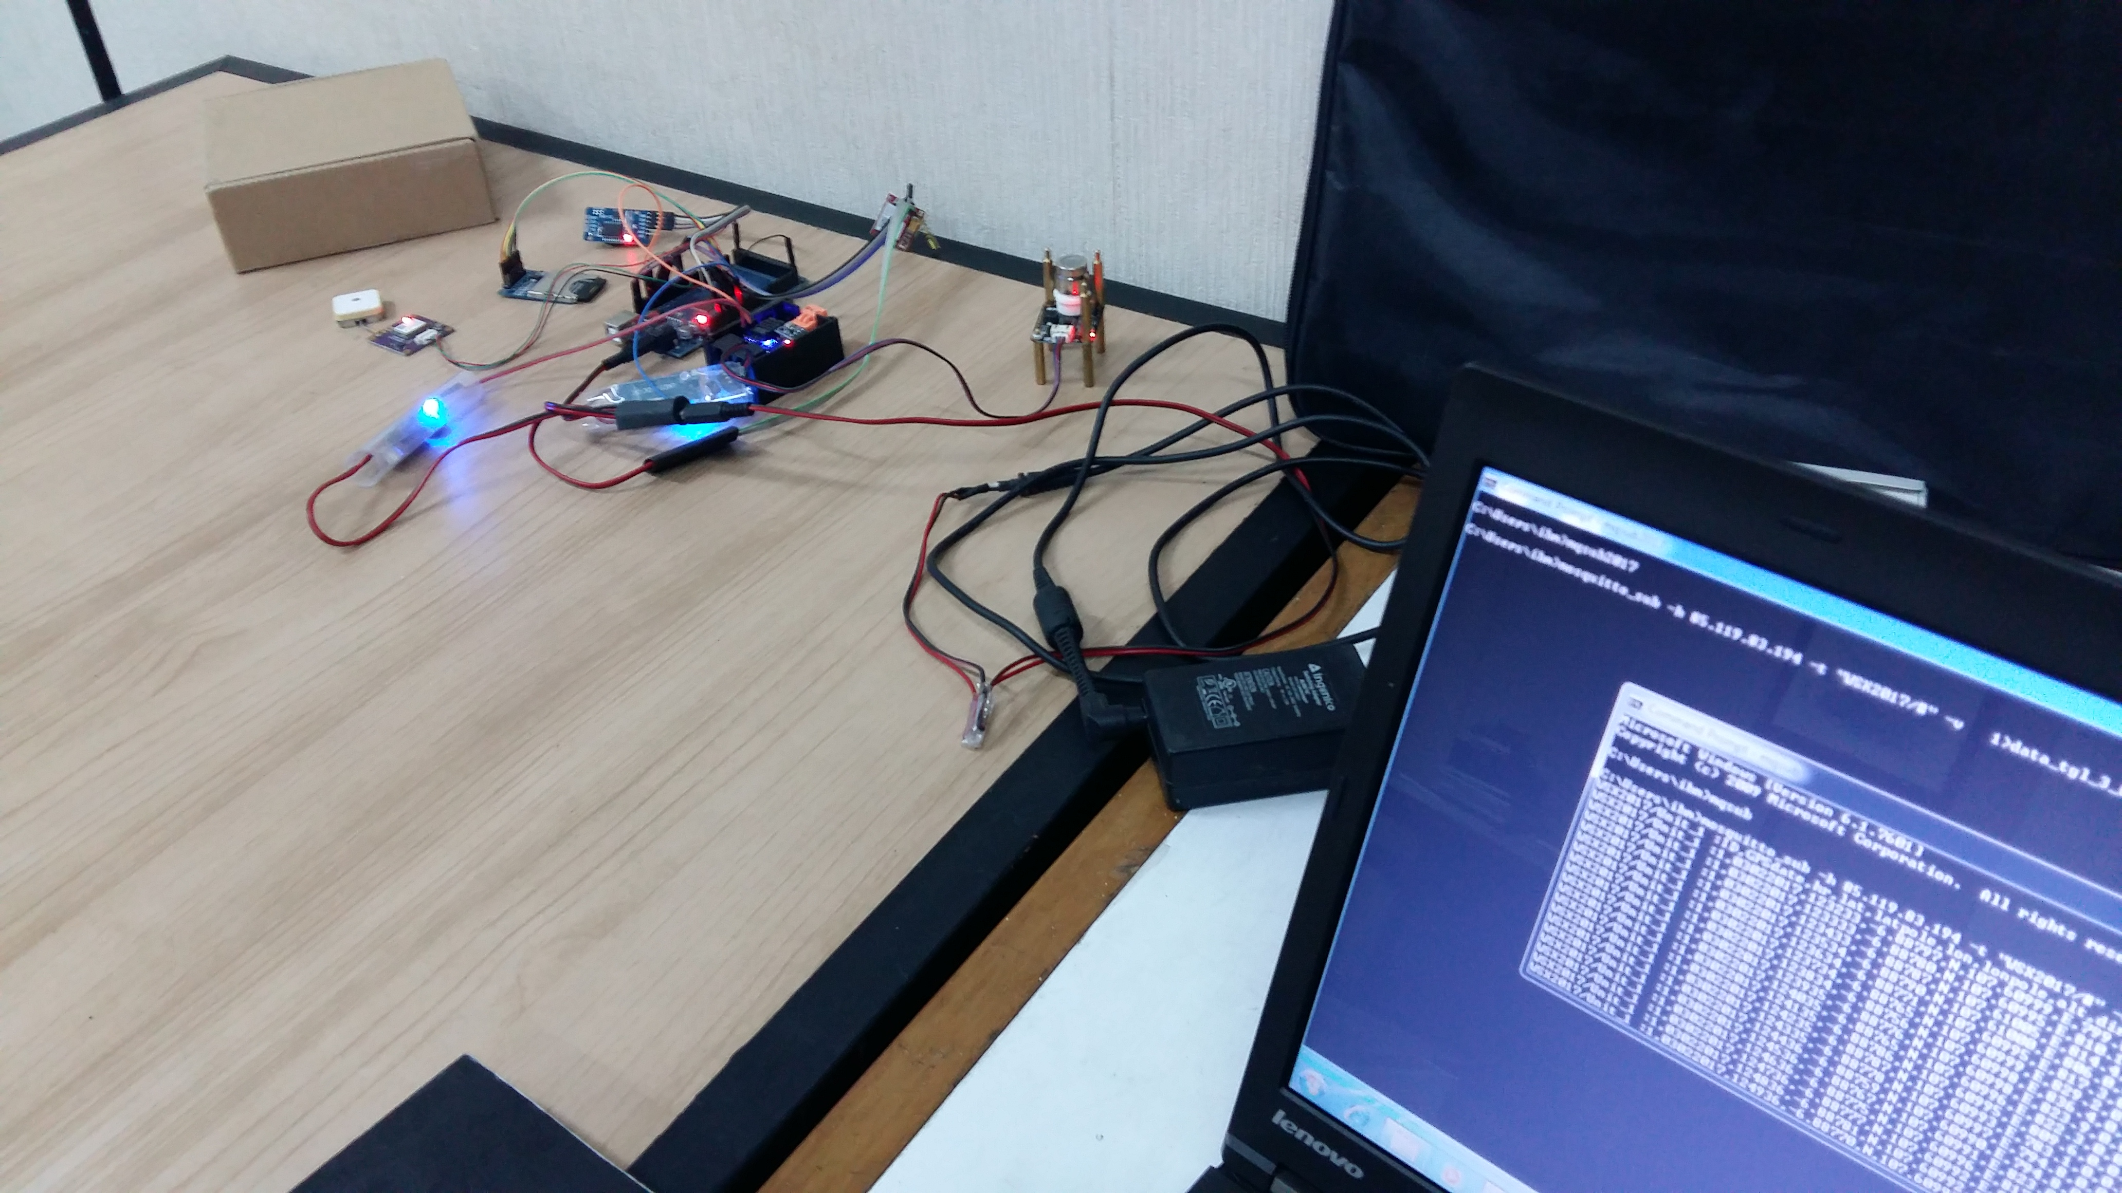
Testing on the Lab
AWS
Windspeed, wind direction, temperature, pressure, humidity, CO2 sensor ,etc
GSM /GPRS

Slide 17
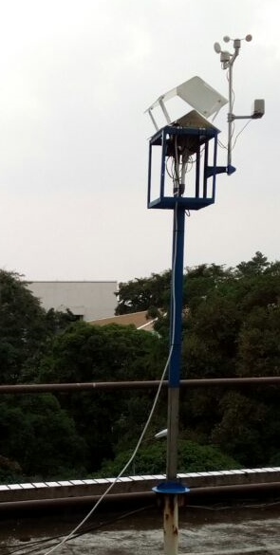
Hardtest
18 meter above ground
Parameter
Unitx, date , time (GMT), alt, longitude, height, wind direction , wind speed, rainfall,
temperature ,humidity , pressure , CO2 , CH4
Push the data to IOTserver
Middleware server (WSO2)

Slide 18
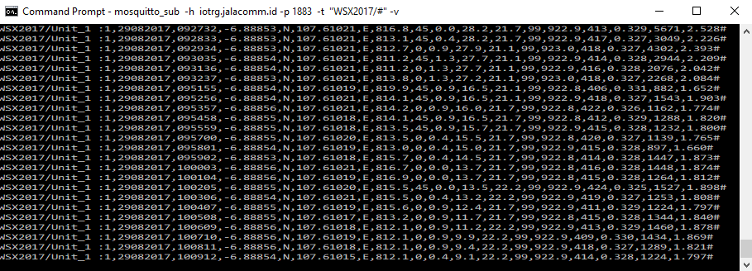
Stream Data to server
Data :
Per minutes
Push the data to the IOT server (MqTT)

Slide 19
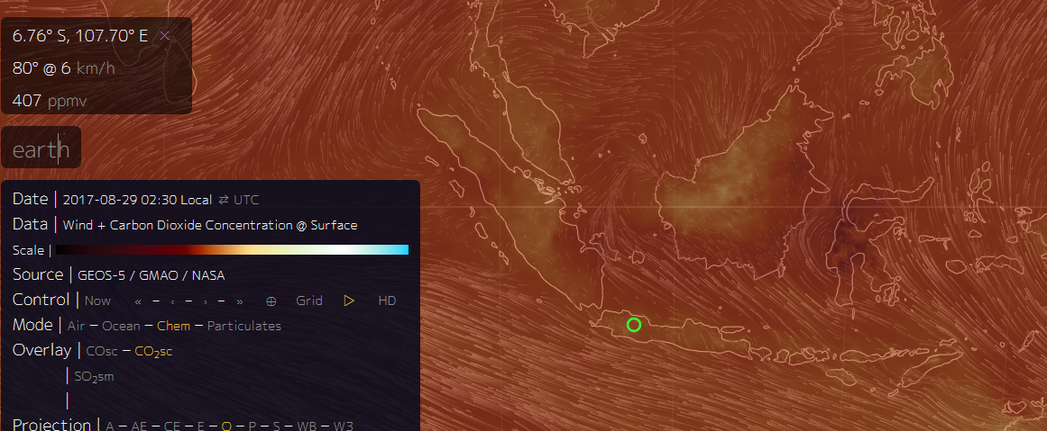
Compare data with earthnull
CO2
400 ppmv
CO2
414 ppmv
Bandung
https://earth.nullschool.net/#current/chem/surface/level/overlay=co2sc/orthographic=-255.00,0.00,1112/loc=107.698,-6.763

Slide 20
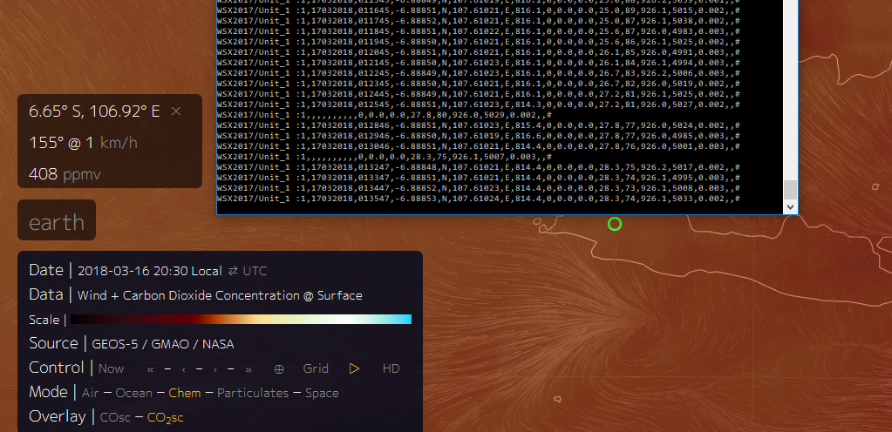
Compare data with earthnull 17-03-2018
Problems with
CO2 Sensor

Slide 21
Running Operational Test
Start on July 2017 – Nov 2017
Cause of hardware failure
AWS sensor on
Humidity sensors
Started again on Feb 2018
Problems with
CO2 sensor , CO and Methane (CH4)

Slide 22
Data Capture on Oct 2017
date | time | loc | Height (m) | Wind dir (0-360) | Wind speed (m/s) | Rainfall rate (mm/hour) | Temperature (Celc) | Humidity (%) | Pressure (barr) | CO2 | CO
2.10.2017 | 61057 | 10761021 | 807.5 | 225 | 0.4 | 2.5 | 26.7 | 99 | 921.0 |  | 389
 | 61158 |  |  | 225 | 0.9 | 2.5 | 26.1 | 99 | 921.2 | 391 | 333
 | 61259 |  |  | 270 | 0.9 | 2.5 | 25.6 | 99 | 921.1 | 392 | 456
 | 61400 |  |  | 270 | 1.3 | 2.5 | 25.6 | 99 |  | 391 | 385
 | 61501 |  |  | 225 | 0.9 | 2.5 | 25.6 | 99 |  | 393 | 674
4.10. 2017 | 34436 |  |  | 0 | 0.4 | 0.0 | 29.4 | 79 | 923.4 | 393 | 300
 | 34537 |  |  | 90 | 0.4 | 0.0 | 28.9 | 80 | 923.5 | 393 | 400
 | 34638 |  |  | 270 | 0.0 | 0.0 | 28.9 | 80 |  | 389 | 329

Slide 23
Problem Occur
Sensors
Availabilty in contiunues operation in long term
Humidity sensor has broken
Calibration methods
Compare with other standard measurements
Standard Calibration
Methane (CH4)
CO
CO2

Slide 24
Model vs real world
Model 1
Model 2
Model 3
Symbolic model
Evaluation : No Good
Evaluation : Poor
Evaluation : OK
Real World
Data
New Data
New Data
New Data
The decision making process. Design for Decision by Irwin Bros, 1953 by Macmillian

Slide 25
Collaborate
ASGC (TW) for running the simulation model for firewatch (DMCC program)
WRF-Fire
WRF-Chem
Virtualization, remote access
Ministry of Forestry and Environment
Put AWS+Sensor in peatland areas
Open the data on Public Server

Slide 26
Future Works (collaboration)
Data sharing
Data are available only in web based information systems
Need to develop web services to make those data available to others
http://weather.meteo.itb.ac.id/aws.php is one example that have some of their data available to others using web service (by request)
Build the model for reduce impact on Disaster
Fire on Forestry / Land fires
CO/CO2 models
PM (Particulate Mattes 2.5 micron)
Build the Sensor Network
AWS (Automatic Weather Station)
Carbon Monoxide (CO)
Carbon Dioxide (CO2)
Particulate Matter
Methane
Need Collaboration for
Callibration for the sensors network
Calibration for the Sensors

Slide 27
Thank You

Slide 28
References
http://fires.globalforestwatch.org/home/
http://weather.meteo.itb.ac.id/awsmap.html
https://www.slideshare.net/wso2.org/io-t-referencearchitecturewebinar
https://www.slideshare.net/Nibodha/enterprise-architecture-and-iot
http://www.iotarchitecturegroup.com/
https://wso2.com/whitepapers/a-reference-architecture-for-the-internet-of-things/
http://standards.ieee.org/develop/wg/IoT_Architecture.html
https://www.ibm.com/developerworks/library/ws-mqtt/index.html
https://lynx2015.files.wordpress.com/2015/08/arduino-mega-pinout-diagram.png

