Slide 1
Evolving the trust fabric with AARC and EGI
The AARC CILogon pilot and redistributed responsibility
David Groep
AARC NA3 Activity Lead
Nikhef, Physics Data Processing Group
EGICSIRT F2F Prague meeting
Incorporating element from
EGI-ENGAGE funded under SA1 and JRA1
29 January 2016

Slide 2
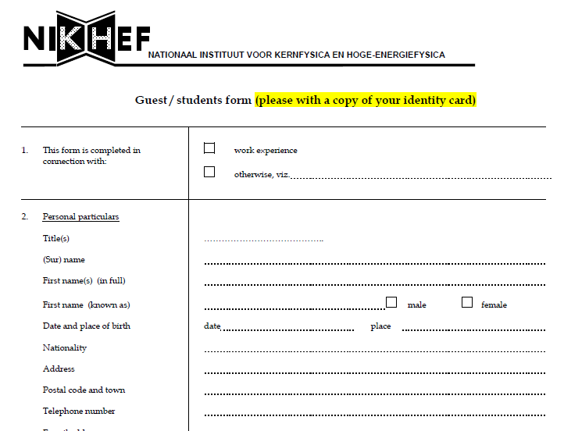
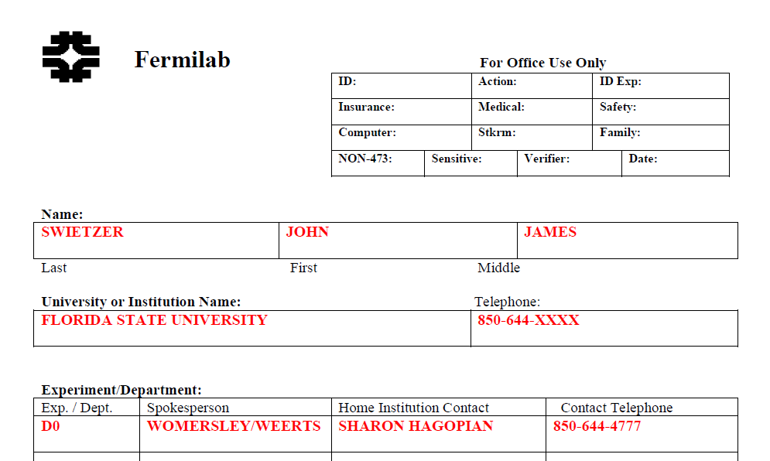
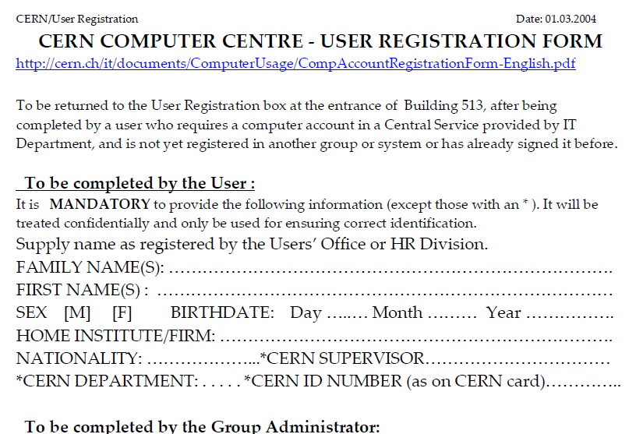
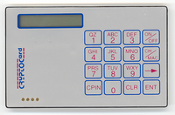
You all remember the bad old days …

Slide 3
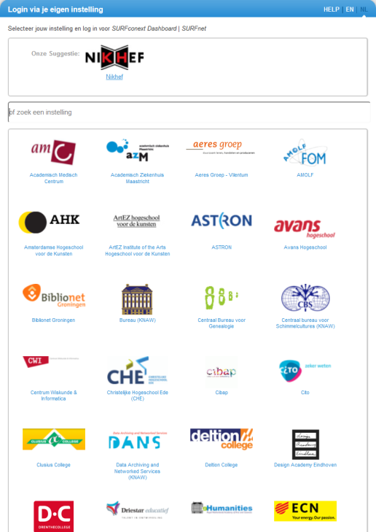
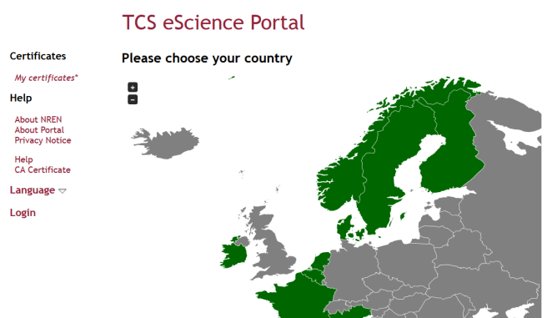
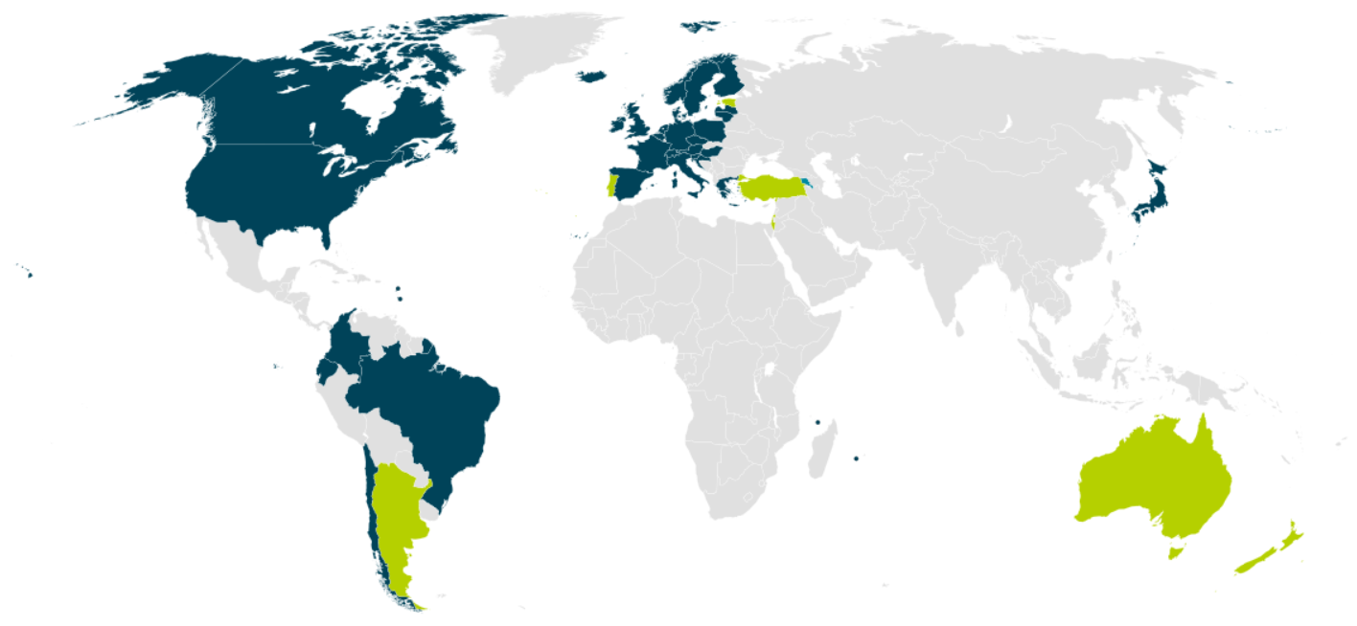


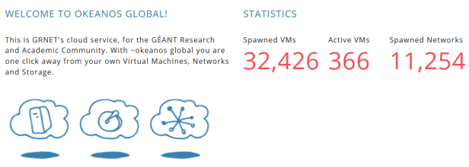

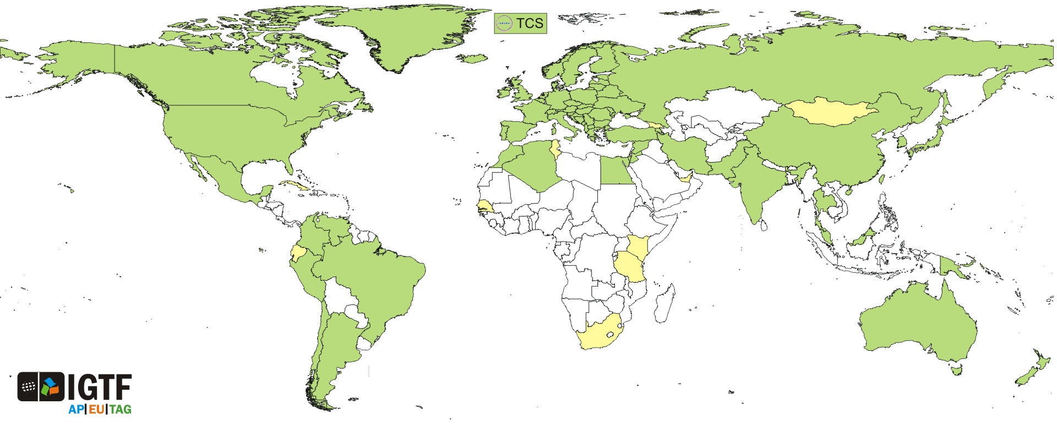
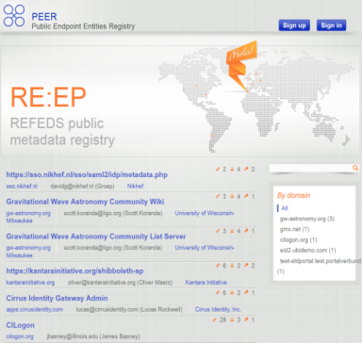
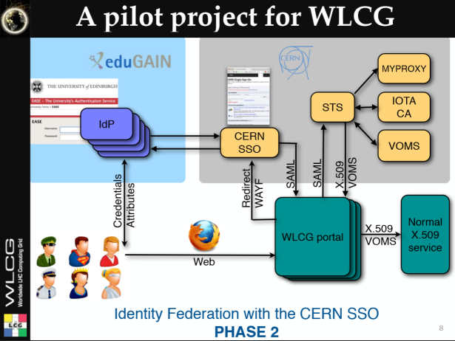

And now we have this!
wLCG FIM4R pilot
background: eduGAIN connected federations as of November 2014 – Brooke Schofield, TERENA

Slide 4



AARC Vision and Objectives – link to EGI
Improve federated access by addressing current challenges
Integrate existing R&E AAIs to create a highway for identities
  Avoid the creation of project-specific AAIs by enabling researchers to use their existing credentials to access different resources
EGI JRA1 and CCs
Harmonise policies among e-Infrastructures to ease service delivery
Define a training package for institutions and services to support federated access
Other RIs and e-Infra

Slide 5
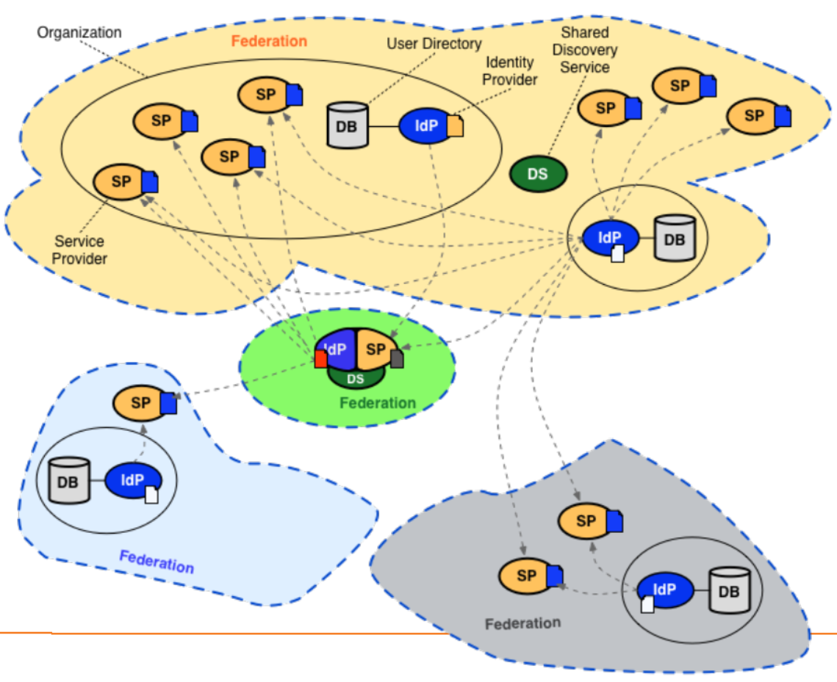
Conventional R&E federations (web-only, selected services only)

Slide 6
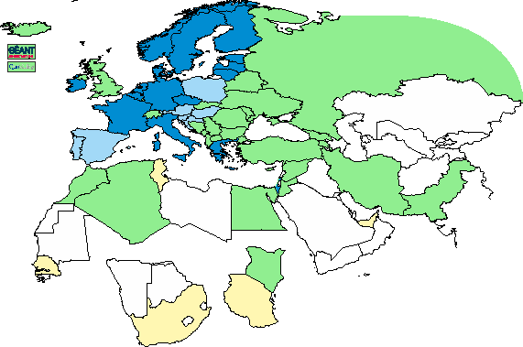
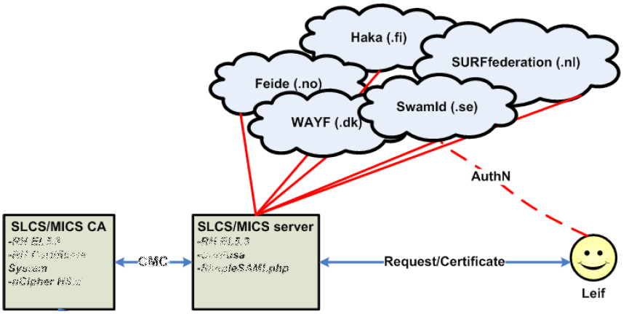
Leveraging R&E federations: TCS, DFN SLCS, CILogon … - with extended LoA
Bridging conventional R&E federated organisations to the trusted e-Infra world requires more
Release of relevant attributes, unique non-reassigned ID, higher assurance profile via contracts
Graphic: IGTF 2015
Graphic from: Jan Meijer, UNINETT

Slide 7
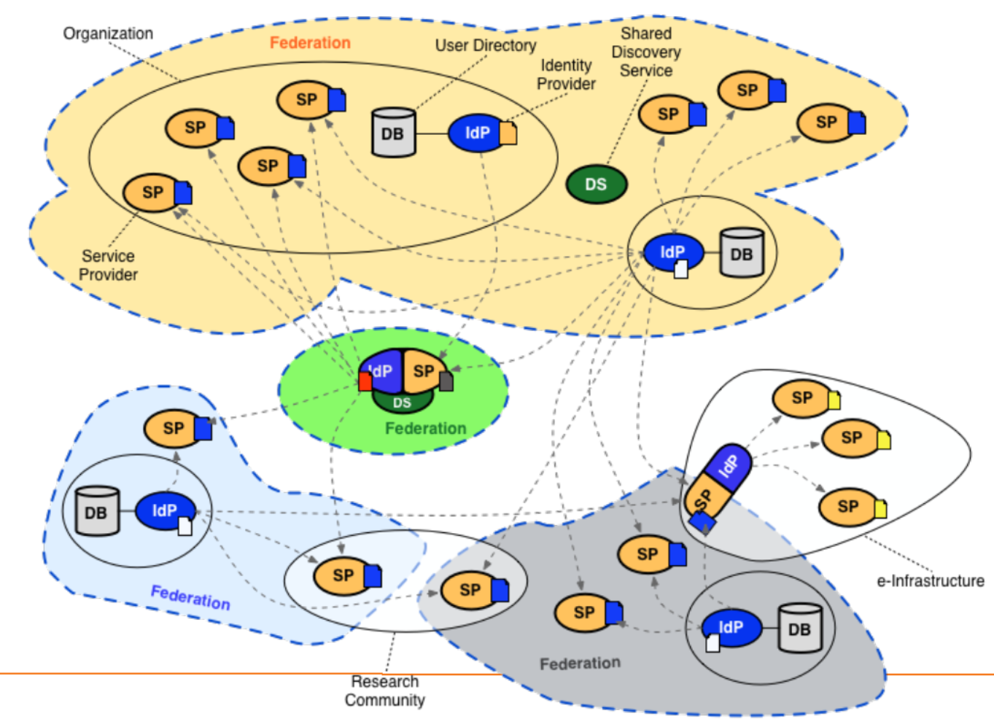
Complex and composite federations space – integrating RIs and e-Infra
Technical bridging
Federation LoA challenges
Distributed responsibilities
in EGI with WLCG VOs
Bridging services
CILogon in Europe
Science Gateways and
Credential Management
Full credentials, proxies, or Robots with ‘PUSP’?
Towards non-Web SSO
Eligibility of federated IDs
SirTFi trust framework
What have we missed?

Slide 8
AARC Pilots and the EGI AAI evolution
Most infrastructures move to completely hiding PKIX from the end-user
  “we’ve found all people in the world who understand PKI” (and they by now all got a certificate ;-)
  EEPKI + RFC3820 proxies do solve both the CLI and delegation use case rather nicely!
Bridging and translation is the pragmatic approach
  Does not require major technical changes in existing R&E federations
  Allows for community-centric identities-of-last-resort (or first resort, for that matter!)
  Time line is more predictable, because fewer entities are involved –
  and those entities have a stake in and the benefits off the results
Emerging as a pattern in many Research Infrastructures that use CLI or brokerage
  ELIXIR, UMBRELLA, WLCG, INDIGO DC
  SAML->OIDC, SAML->X509, X509->OIDC, X509->SAML, OIDC->X509, …

Slide 9
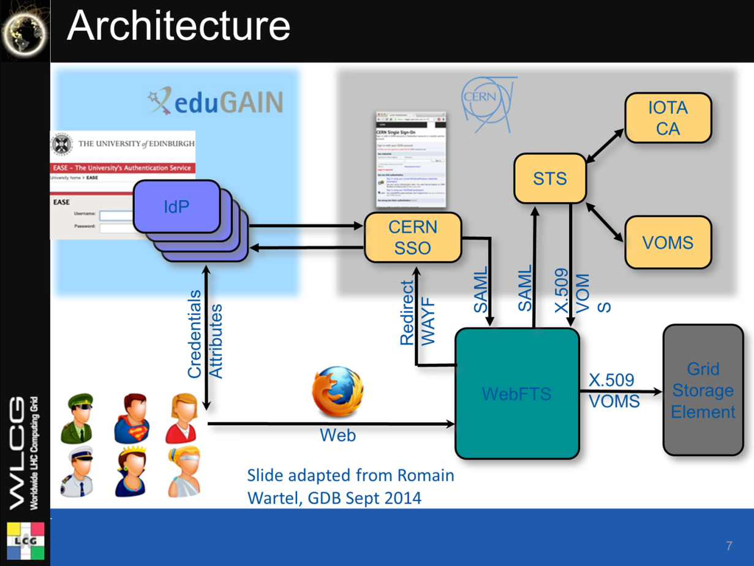
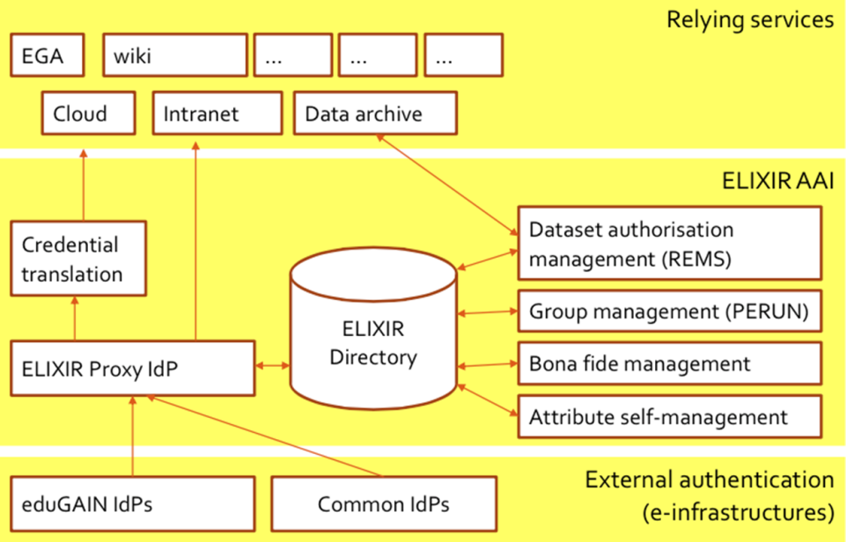
Just R&E federation is not enough for RIs and e-Infrastrucutures
WebFTS ‘FIM4R’ in wLCG
Romain Wartel
ELIXIR reference architecture
Mikael Linden et al.

Slide 10
Background: WebFTS
Web based tool to transfer files between grid/cloud storages
Protocols: gsiftp, https, xrootd and srm
Cloud extensions: dropbox, CERNBox
Based on FTS3
Low-level data movement service
Moves LHC data across WLCG infrastructure
Allows participating sites to control usage of network resources
20PB per month (max: 2PB/day) transfer volume
Slide: Paolo Tedesco, CERN IT/IS

Slide 11

Current prototype
Current working prototype based on “internal” CA
Must move to accredited CA
WebFTS
CA
Get proxy certificate
EduGAIN credentials
Grid
Storage
Element
Access grid with proxy
Slide: Paolo Tedesco, CERN IT/IS

Slide 12
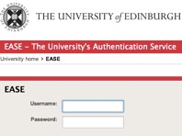
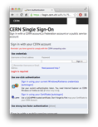

EduGAIN IdP
CERN SSO
eduPersonPrincipalName
Proxy is requested for the user in the context of a VO
2: Auth
3: SAML
CERN LCG IOTA CA
4: get proxy for user in VO
Security Token Service for WebFTS
PKI Service
WebFTS
2: get proxy signing certificate
1: browser
3: generate proxy
5: access Grid
1: get user data
STS service access restricted on service (WebFTS) and VO base (ATLAS)
Grid Storage Element
LHC VOMS
Slide: Paolo Tedesco, CERN IT/IS

Slide 13
CERN LHC IOTA CA
CA Infrastructure consists of
  PKI Service
  STS Services (one per client)
PKI Service:
  Issues certificates only to STS
  Issues CRLs
STS Service
  Issues certificates (proxies) to client applications
  Enforces restrictions on VO membership
  Enforces restriction on unique user ID
CERN LCG IOTA CA
Security Token Services
PKI Service
Security Token Services
Slide: Paolo Tedesco, CERN IT/IS

Slide 14
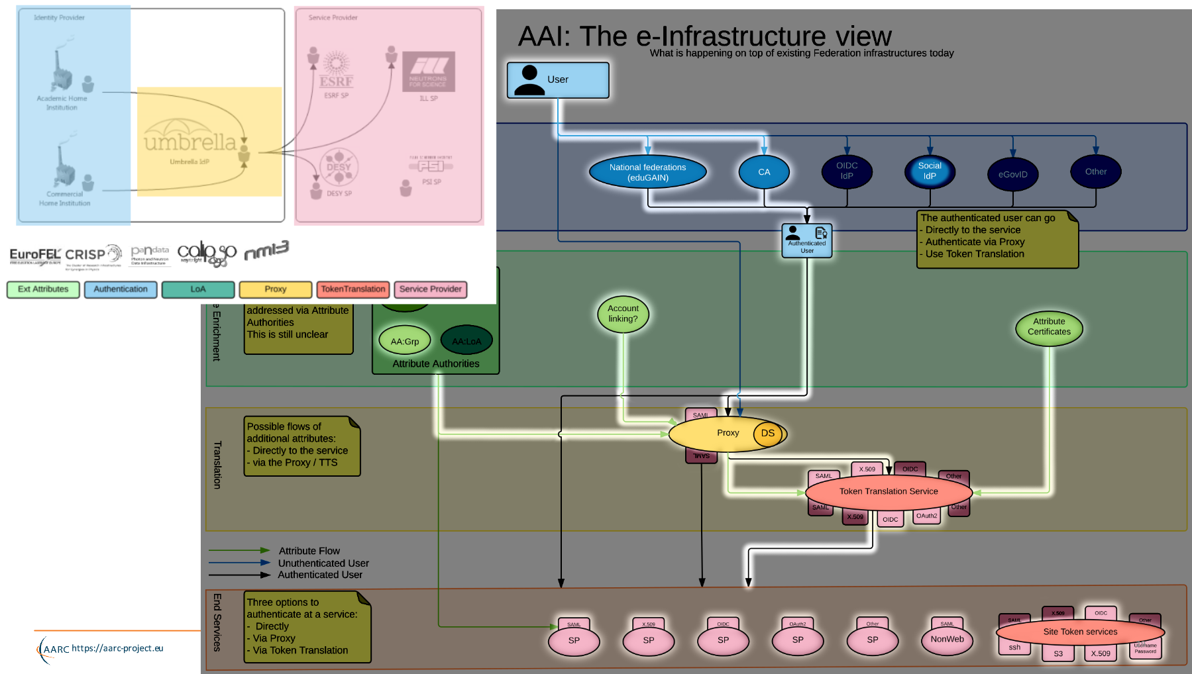
Example:
Umbrella
Marcus Hardt, KIT and AARC
https://aarc-project.eu/wp-content/uploads/2015/11/20151102-JRA1.2-Blueprint-Status-Hardt.pdf

Slide 15
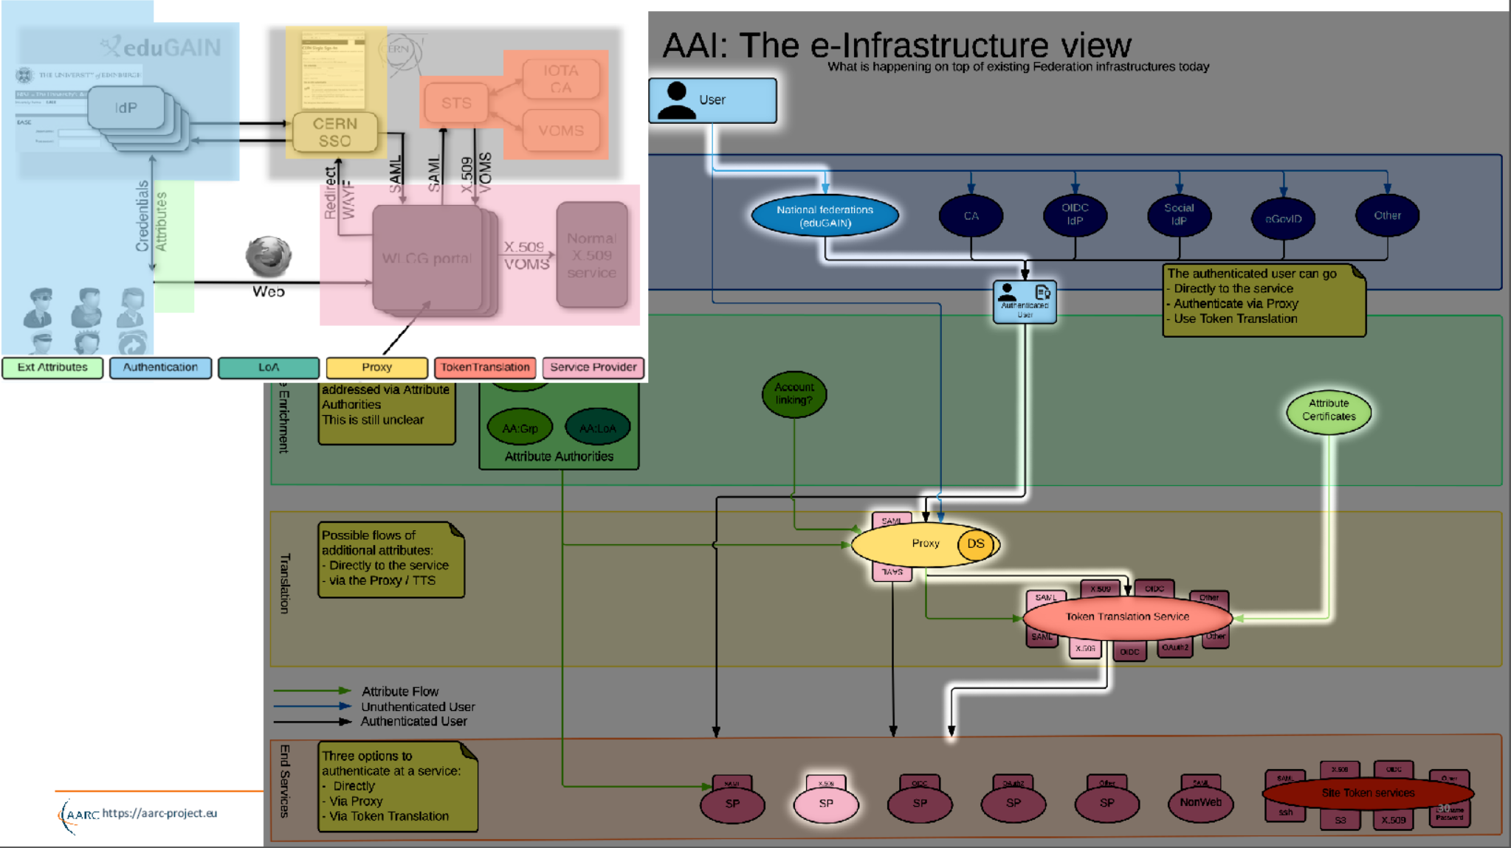

Slide 16
Issues hindering the adoption of FedAuth
Although many production federations are pretty good, and
quite a few IdPs have good processes …
public documentation, self-assessment and peer-review are missing
it’s not consistent across IdPs
and processes are not designed for collaboration use cases
re-use of identifiers occurs (also an issue for social IdPs)
the identity providers provide no identity … or it’s non-consistent
identifiers generated are specific to each SP (defeating brokering)
and may not provide traceability needed for valuable resources
some allow users to change their own data (including e.g. their email address and all contact data), or do not collaborate in case of issues
engage help of others, in particular some well-organised user communities

Slide 17
Baseline Assurance Profile for low-risk use cases
AARC MNA3.1 (Mikael Linden et al.):
“Recommendation on minimal assurance level relevant for low-risk research use cases”
Accounts belong to a known individual (i.e. no shared accounts)
Persistent identifiers (i.e. are not re-assigned)
Documented identity vetting (not necessarily F2F)
Password authN (with some good practices)
Departing user’s account closes/ePA changes promptly
Self-assessment (supported with specific guidelines)

Slide 18
Redistributing responsibilities with IOTA
Who can absorb the responsibilities, if not the identity providers?
Requirements:
End-to-end traceability must remain the same
Changing or documenting federation and IdP processes is a ‘lengthy’ process – but adding some requirements does work (e.g. SiRTFi on incident response)
… so who can absorb the responsibility?
The resource centres – and go back to 1995 with per-site vetting ☹
The Infrastructure or funding agencies, through a rigorous registration process – PRACE ‘home sites’, or XSEDE registration + NSF granting
EGI UMP – that’s what’s happening partially in the LToS service
Or the communities?

Slide 19
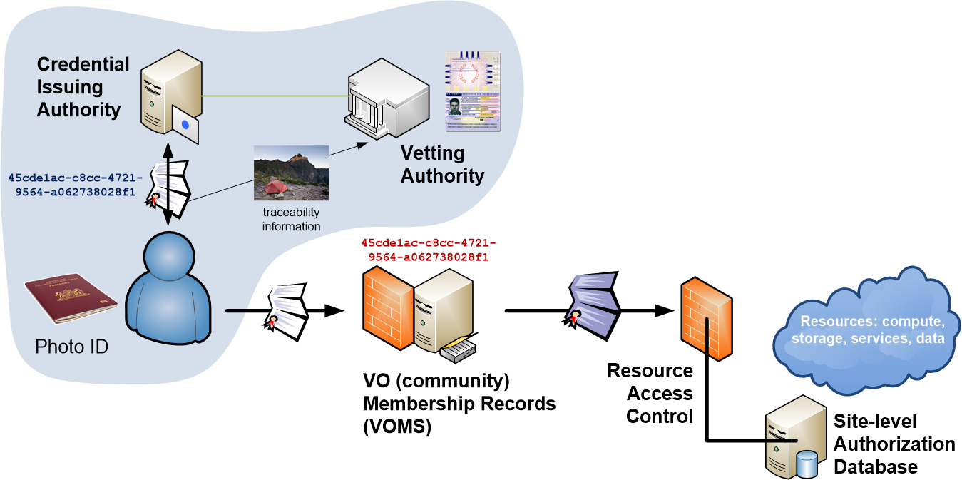
Distributed Responsibilities I:
Trusted Third Party

Slide 20
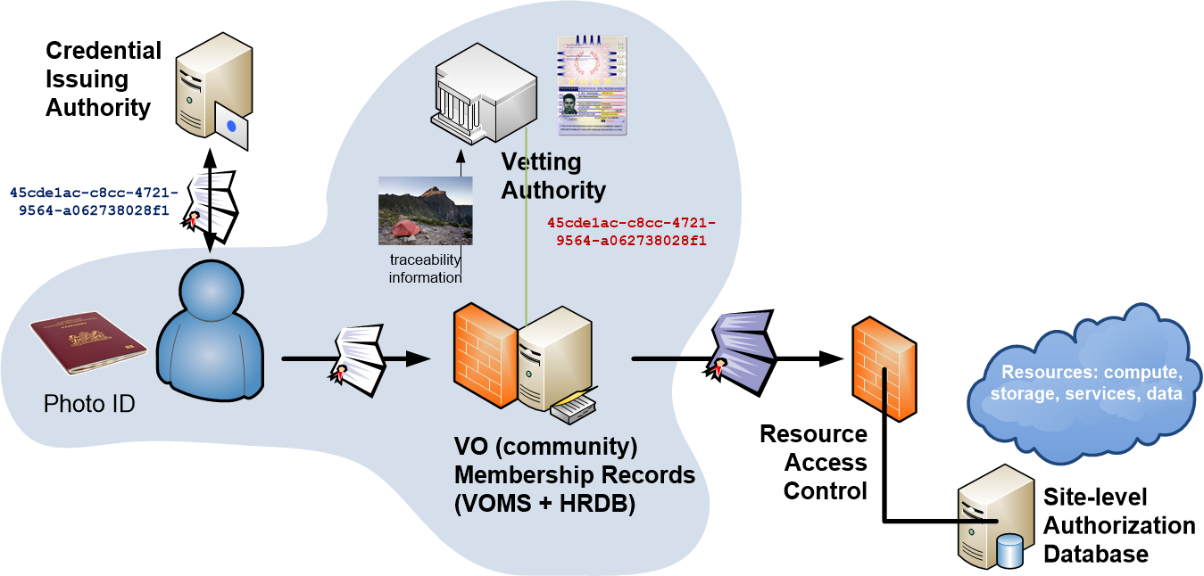
Distributed Responsibilities II:
Collaborative Assurance & Traceability

Slide 21
Moving the bar towards differentiated assurance
http://igtf.net/ap/iota (part of http://igtf.net/ap/loa)
IOTA AP assurance level ‘DOGWOOD’ is different, and remainder of the elements
must be taken up by
somebody else – the VO or the sites
Only thing you get is an opaque ID
Consider questions about
  Real names and pseudonyms
  Enrolling users in a community
  Keeping audit records
  Auditability and tracing
  Incident response
Identity elements
identifier management
re-binding and revocation
binding to entities
traceability of entities
emergency communications
regular communications
‘rich’ attribute assertions
correlating identifiers
access control

Slide 22
Assurance profiles as charted by the IGTF
So many production federations and IdPs are pretty good, but …
they are all different, and the lowest common denominator is quite low
… so IGTF for ‘conventional’ assurances requires additional per-user controls
… and the (‘uniqueified’) AP ‘DOGWOOD’ (IOTA) leaves an assurance gap
…3,4
LoA 2: 1, 2-factor vetting, verified traceability, externally audited as matter of course
2
Assurance profiles BIRCH, CEDAR (MICS, Classic):
identified naming, traceability, longer-term, limited auditing
Kantara-like
Assurance
Scale
ASPEN (SLCS): identified naming, point-in-time traceability, time-limited
RP task
DOGWOOD (IOTA): unique identification, no identity , limited traceability
1
LoA 1: verified email address with mail-back
* somewhat
my personal
view …
sorry for bias
LoA 0: ‘like conventional unsigned email’

Slide 23
IOTA in the EGI context
EGI – by design - supports loose and flexible user collaboration
300+ communities
Many established ‘bottom-up’ with fairly light-weight processes
Membership management policy* is deliberately light-weight
Most VO managers rely on naming in credentials to enroll colleagues
Only a few VOs are ‘special’ – the CERN LCG IOTA CA
LHC VOs: enrolment is based on the users’ entry in a special (CERN-managed) HR database, based on a separate face-to-face vetting process and eligibility checks, including government photo ID + institutional attestations
Only properly registered and active people can be listed in VOMS
*) https://documents.egi.eu/document/79

Slide 24
Can you combine two policies within the same infrastructure?
Can been done if new policy does not negatively affect the other one
Which in this case is OK, since the specific new CERN IOTA CA
  In itself implements all the policy requirements of a traditional CA by insisting on LHC membership
  the same requirement that already governs the Classic CERN CA
But note that is does not generally hold for arbitrary IOTA CAs
Have to wait for “VO+CA-authZ” before adding e.g. InCommon Basic
Technically it is a relatively easy change

Slide 25
Software support for DiffLoA
What is needed it for the infrastructures (resource centres) to differentiate between ‘light-weight VOs’ and ‘heavily-managed VOs’
Preferably on a per-VO basis
Allowing IdPs with a lower assurance profile to be used for heavily-managed VOs’
Whilst ensuring light-weight VOs can continue to enjoy airiness since they’re combined with higher-assurance IdPs (CAs)
Logic foreseen for such a decision
( VO:/pvier && CA:IGTF-Classic,IGTF-MICS,”NL-eInfra-Zero-CA” ) ||
( VO:/atlas && CA:IGTF-Classic,IGTF-MICS,IGTF-SLCS,IGTF-IOTA ) ||
( VO:/* && CA:IGTF-Classic,IGTF-MICS,IGTF-SLCS )

Slide 26
Dependencies in policy installation
‘lcg-CA’
or explicit
configuration
For EGI-only sites: nothing changes!
For EGI sites also under wLCG policy and installed post-EGEE:
just install both policy packages “egi-core” and “lcg”
ca-policy-egi-core
IGTF Classic
ca-AEGIS
…
IGTF MICS
ca-TCS
…
IGTF SLCS
ca-DFN-AAI
…
ca-policy-lcg
IGTF Classic
ca-AEGIS
…
IGTF MICS
ca-TCS
…
IGTF SLCS
ca-DFN-AAI
…
ca-CERN-LCG-IOTA

Slide 27


Translation services – beyond the specific use case
NCSA (IL,USA) operated service and project
InCommon backed MICS and IOTA
Generic ‘opaque’ certificate in Europe
Helps with PII data protection and integration with ESFRIs and e-Infrastructure
CERN wLCG IOTA CA
eduGAIN backed with added
CERN HR DB controls
GEANT Trusted Certificate Service TCS
could be turned into a translation service, when each subscriber would enable that since it has a subscriber-centric validation model

Slide 28
AARC operational pre-pilot: bridging R&E federations with non-web & PKI
Proposal-identified pre-pilot: certificate-less access to existing services with “CILogon for Europe”
Aligned with the EGI “JRA1” activity around the evolution of the AAI technology (ChristosK)
Using actual use cases from EGI competence centres and AARC communities
“It’s always a challenge to pilot something with a real community –
the expectations are usually much higher than what can be provided in a pilot …”
AARC will not operate any long-term services (that’s for GEANT, EGI, PRACE, EUDAT …)
But will pilot actual technology combinations that are useful to (research) communities

Slide 29
AARC SA1 “CIlogon-like Pre-Pilot”
Establish a CILogon (like) service in Europe
Integrated closely with R&E federation landscape (with all of full-mesh, H&S, mixed-models)
Integration with user community services and attribute services
Close co-operation with the CILogon Project (Jim Basney et al.)
Pre-pilot work, so based on pre-AARC requirements gathering
FIM4R requests, alignment with known user communities (EGI evolution, ELIXIR)
Potential to support the EGI ENGAGE community ‘competence centre’ work
Leveraging existing components and services: CIlogon + ‘OAuth4MyProxy’ components, VOMS Attribute Certificate service, OIDC libraries, …
Try to fit first in the existing policy framework: Approved Robots (and “PUSPs”), Trusted Credential Stores, PKP Guidelines, IGTF ‘DOGWOOD’ – unless the pilot runs aground …

Slide 30
Desired feature set
Certificate or proxy retrieval possible for federatively-authenticated end-user
inside a community (VO) portal or science gateway
Work with the existing (SAML2) R&E federations
Credential repository feature: manage credentials on behalf of the user
Provide – on the user’s request – delegated credentials to science gateways
Make end-user facing science gateways really light-weight: VOs should not need to know about protecting long-term secrets (and need a way to authenticate users)
Support both certificate and non-certificate science gateway use cases in the same way
Provide simple way for users to obtain ‘opaque’ CLI credentials (proxies) on their own system
Constraints:
No new software components (only limited glue)
Deployable in a scalable way – with a sustainability model behind it
As few CAs as possible (preferably: just one)

Slide 31
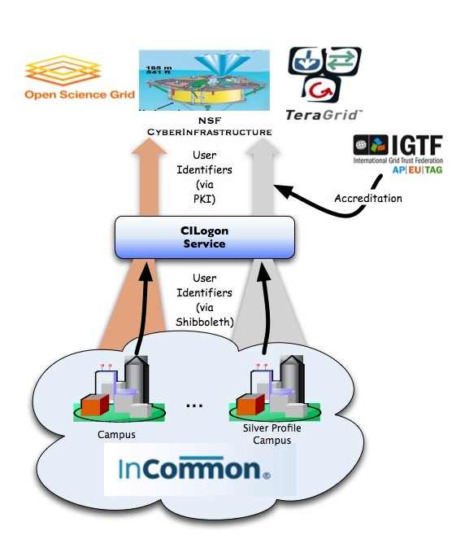
CILogon service and project (Jim Basney et al.)
Enable campus logon to CyberInfrastructure (CI)
  Use researchers’ existing security credentials at their home institution
  Ease credential management for researchers and CI providers
Multiple interfaces
SAML/OpenID Web Browser SSO
  PKCS12 certificate download
  Certificate issuance via OAuth
  OpenID Connect token issuance
  SAML ECP for CLI issuance
Slide content: Jim Basney, based on http://www.cilogon.org/docs/201106-cilogon-cern.pptx?attredirects=0&d=1
and http://www.cilogon.org/docs/20141030-basney-cilogon.pdf?attredirects=0&d=1

Slide 32
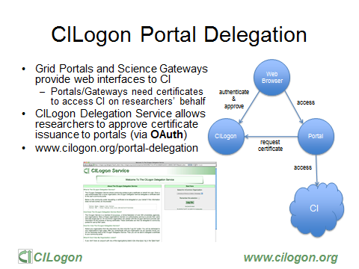
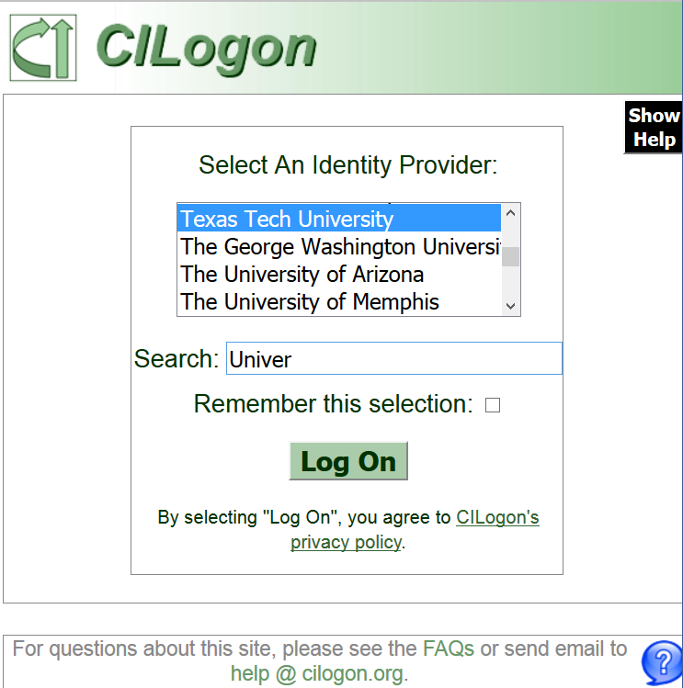
Slide: Jim Basney,
NCSA and CILogon

Slide 33
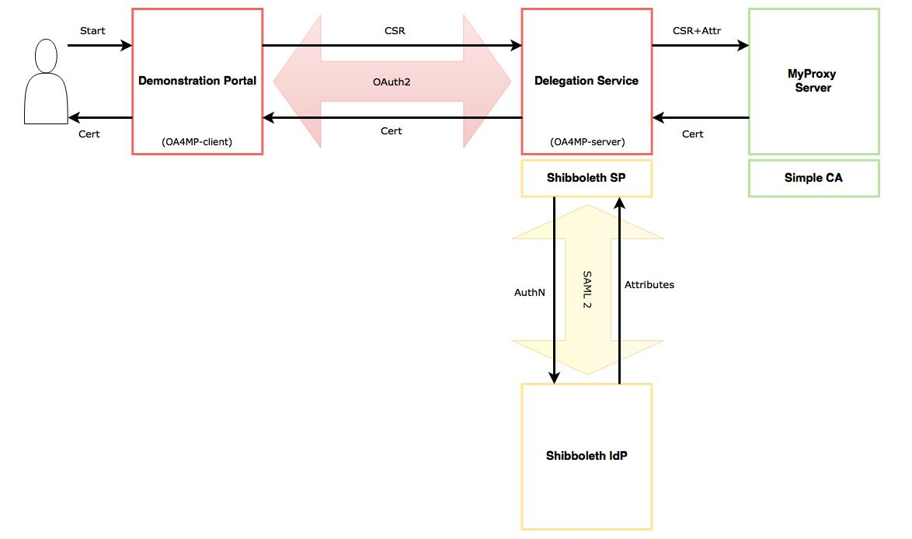
CILogon demo portal: Delegation of credentials using OAuth4MyProxy
OA4MP : using both the client and the server
components from the latest OAuth 2.0
implementation (3.1.1)
Shibboleth : using the latest Identity Provider (3.0),
and Service Provider (2.0)
MyProxy Server : using official releases from epel (6.1.13)
SimpleCA : using official release from epel (4.20)

Slide 34
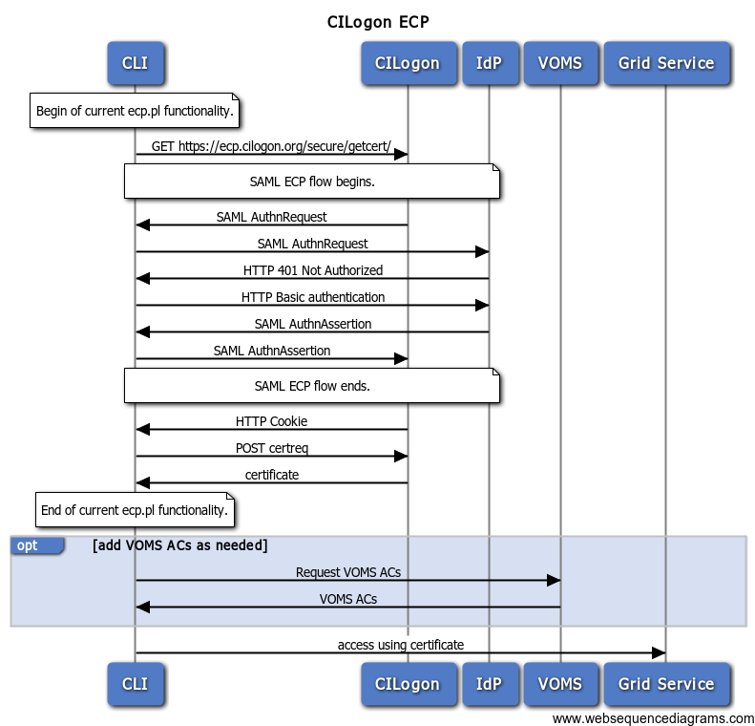
CILogon and SAML ECP
SAML federated login via ‘Enhanced Client’ (read: CLI)
or ‘Proxy’ (read: brokered access)
https://wiki.oasis-open.org/security/SAML2EnhancedClientProfile
A heavy (trusted) client sends credentials and
receives assertions from a specific IdP ECP end-point
Supports non-web
… if it were supported by the IdP
Most prominent use case: Office365
Limited update & support (only in Shib, and only v3+)
Unlikely to fly in Europe – but there many alternatives
like Moonshot, but also a move to OIDC, OAuth2, …
Flowchart: from CILogon

Slide 35
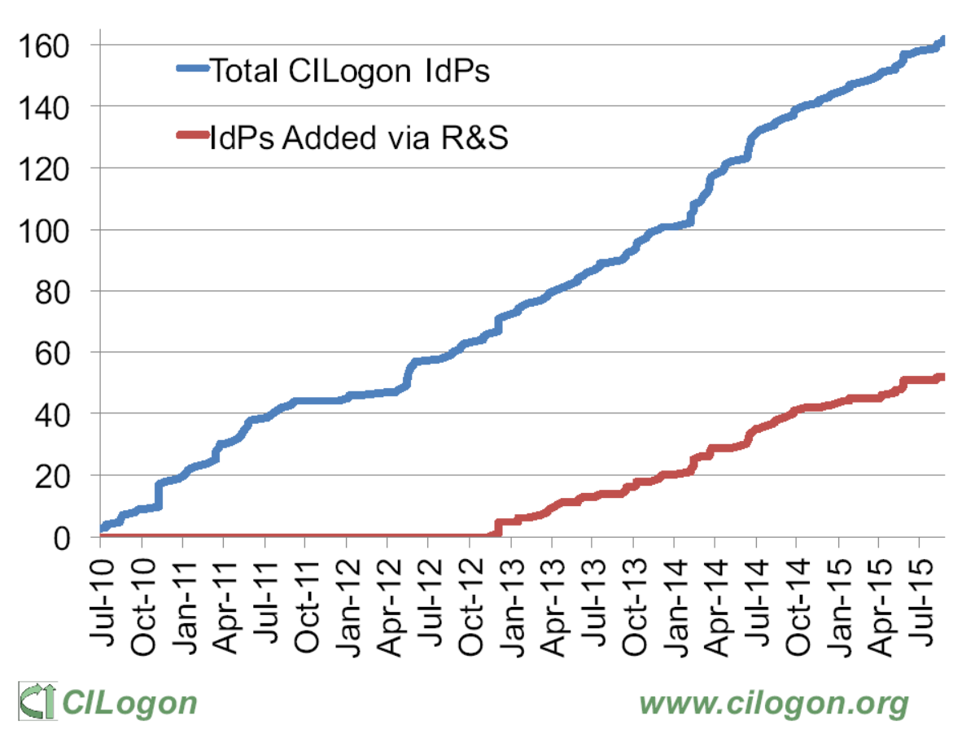
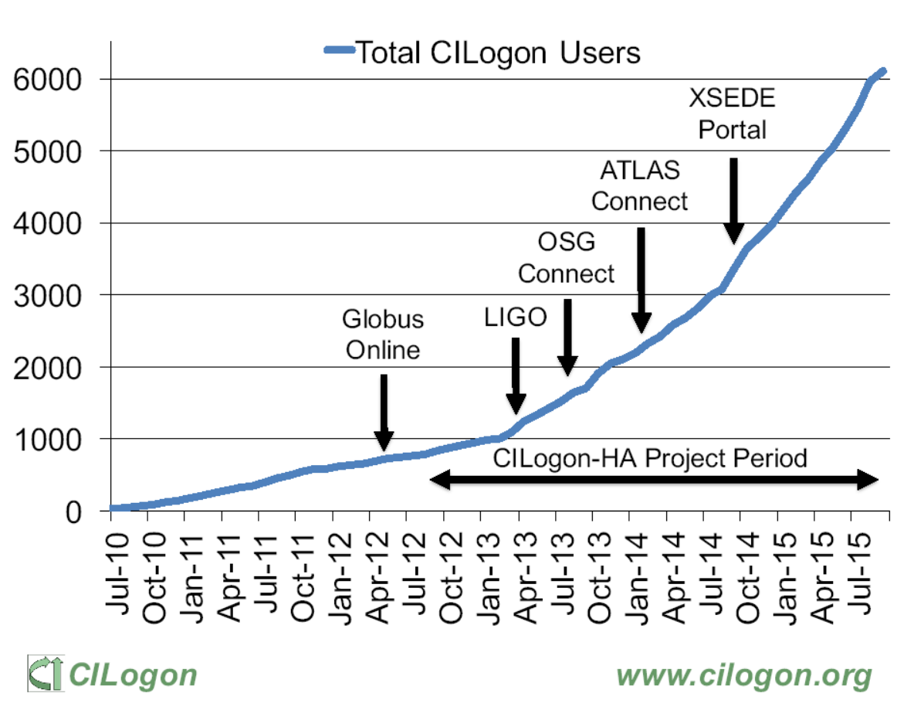
CILogon adoption in the US/InCommon
http://www.cilogon.org/docs/2015-09-cilogon-ha.pdf?attredirects=0&d=1

Slide 36
End-user credential hiding in the AARC CILogon-like Pilot
Do not assume any changes in the IdPs: no ECP, no new policies, no nothing (reality, sorry!)
Assume no major changes in the e-Infrastructures: interfaces remain a mix of Web and PKIX, policies remain mostly as-is
Should show results ‘fairly soon’ (i.e. in a few months work) for a broad audience
Leverage existing CILogon and MyProxy, thanks to the collaboration of AARC-CTSC/MyProxy
Beyond CILogon
CILogon assumes the e-Infrastructures (CIs) build the portals and interfaces
CILogon assumes that users in the end might retrieve certificates explicitly
Larger RIs and e-Infra in Europe could do it, but not the large number of small communities
So the AARC Pilots adds additional control elements: credential management, light-weight portal interfacing, (VOMS) attribute management, optional: opaque credential retrieval

Slide 37
Components
http://wiki.nikhef.nl/grid/CILogon_Pre-Pilot_Work

Slide 38
Authorization at the VO level
The VO light-weight portals (gateways) can re-use this system for both AuthN and AuthZ
Can be used besides a conventional (SAML) login to science gateway when a proxy is needed
Or even …
User ability to complete the OIDC login to the VO web portal (each time) does AuthN
Ability of the portal to successfully request VOMS attributes for an AuthZ/membership check
Successful authN and failed AuthZ? Suggest enrolment or auto-enrol members!
VO portal must be on a trusted list of the Master Portal
  Needs to be able to do OIDC in a trusted way
  Using a VO portal client ID + client secret (but there are server certs as well for the web site itself)
  User must be able to trust that the Master Portal will only relinquish user credentials to intended places
  OIDC consent mechanism informs the user of where the user credentials are sent

Slide 39
X509 (proxy) certificates as opaque access tokens
VO or Master Portal can offer user to register user's SSH pubkey with Master Portal
Master Portal can store (uid, pubkey) pairs in a directory service (e.g. LDAP) associated with the MyProxy user identifier (username)
SSH Server runs cron job and creates authorized_keys file:
  Using a single special account, runs a myproxy-logon wrapper, similar to what SVN servers do*
SSH-agent forwarding: central login node, client UI, VDI server, laptop retrieves proxy
Any script wrapper to save proxy: looks similar to a Kerberos ticket
  No need for either extra password, ECP, Moonshot etc.
  Very similar to GitHub, SourceForge, etc.
* /usr/local/sbin/mkgroup-sshlpk \
-c 'command="svnserve -t -r /srv/svn --tunnel-user=@UID@", no-pty' \
-o ~svn/.ssh/authorized_keys --filter '(authorizedService=ndpfsvn)' nDPFSubversionUsers
... [gives] ...
command="svnserve -t -r /srv/svn --tunnel-user=tsuerink",no-pty ssh-rsa AAAAB3...2w== t@net

Slide 40
Distribution of Roles in a Sustainable Model
VO Portal (Science GW)
One per application
Many deployed throughout
Reduced policy and compliance burden
Master Portal
One per country, ESFRI
Must be well-managed
Can be managed because there are few
CA and Delegation Service
As few as possible: just one!

Slide 41
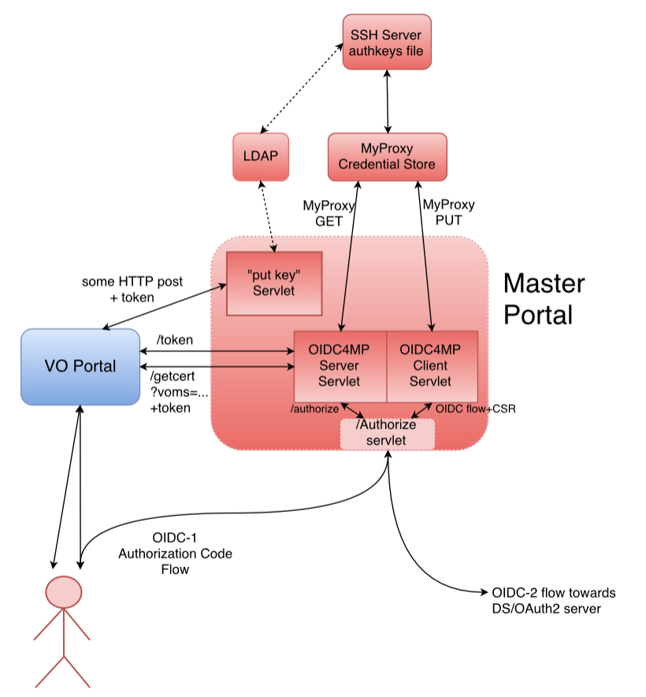
Master portal is a rather critical service
This is the component that – with a credential store and an (OIDC) authentication interface –takes care of the user credential management
The back-end CA provides
  Identifier uniqueness
  Revocation capability
but not much more!
It is a highly trusted component, of which there should not be many
But it may still be better then end-user managed keys – for authentication, that is …

Slide 42
Relevant (IGTF) policies
IOTA AP: LoA DOGWOOD and PKI Technology Guidelines
  https://www.igtf.net/ap/iota
  https://www.igtf.net/ap/loa
  https://wiki.eugridpma.org/Main/PKITechnologyGuidelines
PKP Guidelines
  https://www.eugridpma.org/guidelines/pkp
Guidelines on the Operation of Credential Stores (draft)
  https://www.eugridpma.org/guidelines/trustedstores/
Consensus on compliance of a CILogon
Use proxies and/or EECs with a validity less than 1 Ms (11 days)
Long-running workflow support (including reminders to the user to refresh credentials) is
in the domain of the VO community and not supported by the master portal (needs re-login)
Align Trusted Credential Store guidelines with PKP – and educate Master Portal Operators
PKP Guidelines remain as-is. The IOTA CA instance will be an on-line model B CA with L2 HSM + controls

Slide 43
Towards a CILogon CA for Europe
As a first phase, Jim may actually just open up the existing CILogon to ‘eduGAIN’
Once InCommon has also technically joined eduGAIN
For qualified entities in eduGAIN: R&S + SirTFi
Uniqueness enforced by the CILogon CA itself (as long as there’s no true ‘ePUniqueID’)
Aim for (a single) IOTA CA in Europe (EU/EEA) to back the Master Portals
This would be a generic IOTA CA, but it can be modeled closely on the existing ones
Model yet to be worked out (extend CERN’s IOTA CA? A new one?)
Support as many (European) eduGAIN IdP as feasible
Potentially including qualified IdPs of last resort operated by RI/e-Infrastructures, or qualified proxy services like the VOPaaS IdP gateway (with LoA support)
Having it issue only short-lived credentials would make things like DPCoCo compliance easier

Slide 44
Another alternative: replace the CA with a single Robot &
‘Per-User sub-proxies’ (PUSPs)
PUSPs are already used by the EGI “Long Tail of Science” gateways
RFC3820 proxy certificates generated from a single Approved Robot:
  embedded in the naming is a unique identifier
  the generator (portal) can associate the identifier with an individual Web User
This can also replace the CA it ‘just’ take the portal setup outside the PKP scope
but … is this the best way to do things??
"/C=IT/.../CN=Robot: Catania Science Gateway - Roberto Barbera/CN=user:jdoe" jdoe_localuser
"/C=IT/.../CN=Robot: Catania Science Gateway - Roberto Barbera/CN=*" .portal_users
https://wiki.egi.eu/wiki/Fedcloud-tf:WorkGroups:Federated_AAI:per-user_sub-proxy

Slide 45
Access to a CILogon service from ‘all of eduGAIN’ - requirements
eduGAIN is a policy-neutral interfederation exchange mechanism
– so it has no single policy ☹
To make it trustworthy and usable, it is wide to consider requiring e.g.
R&S attribute release,
so a service gets eduPersonPrincipalName, mail, and (displayName OR (givenName AND sn))
gets a non-reassigned identifier
may be ePPN, could be the (useless but at least unique) eduPersonTargetedID or NameID
aligned with the SirTFi Framework
for IdPs, attribute auhorities and other SPs

Slide 46
SirTFi – 1.0 !
defines basic security incident response capabilities
to which member organizations can self-assert compliance
initial draft intended to be a simplified framework – approved now by REFEDS to stimulate adoption by IdPs and promotion via federations (but the framework is general)
Based on SCI grouping of capabilities
Self-assertion is a rather newish concept in conventional R&E federations, but fits the RIs and e-Infrastructures for the prevalent use cases – the IGTF does peer-review supported self-audits
To scale self-assertion to 10k+ entities (IdPs, SPs, attribute authorities) needs automation
EWTI working group on the self-assessment tool collected initial requirements (Mikael, Hannah)
https://wiki.refeds.org/display/GROUPS/SIRTFI

Slide 47
SirTFi – assertions and capabilities: OpSec
Managing access to information resources, maintaining their availability and integrity, and maintaining confidentiality of sensitive information is the goal of operational security.
[OS1] Security patches in operating system and application software are applied in a timely manner.
[OS2] A process is used to manage vulnerabilities in software operated by the organisation.
[OS3] Mechanisms are deployed to detect possible intrusions and protect information systems from significant and immediate threats
[OS4] A user’s access rights can be suspended, modified or terminated in a timely manner.
[OS5] Users and Service Owners (as defined by ITIL [ITIL]) within the organisation can be contacted.
[OS6] A security incident response capability exists within the organisation with sufficient authority to mitigate, contain the spread of, and remediate the effects of a security incident.

Slide 48
SirTFi capabilities: IR
Assertion [OS6] above posits that a security incident response capability exists within the organisation. This section’s assertions describe its interactions with other organisations participating in the Sirtfi trust framework.
[IR1] Provide security incident response contact information as may be requested by an R&E federation to which your organization belongs.
[IR2] Respond to requests for assistance with a security incident from other organisations participating in the Sirtfi trust framework in a timely manner.
[IR3] Be able and willing to collaborate in the management of a security incident with affected organisations that participate in the Sirtfi trust framework
[IR4] Follow security incident response procedures established for the organisation.
[IR5] Respect user privacy as determined by the organisations policies or legal counsel.
[IR6] Respect and use the Traffic Light Protocol [TLP] information disclosure policy.

Slide 49
SirTFi Capabilities: TR and PR
To be able to answer the basic questions "who, what, where, and when" concerning a security incident requires retaining relevant system generated information, including accurate timestamps and identifiers of system components and actors, for a period of time.
[TR1] Relevant system generated information, including accurate timestamps and identifiers of system components and actors, are retained and available for use in security incident response procedures.
[TR2] Information attested to in [TR1] is retained in conformance with the organisation’s security incident response policy or practices.
All participants (IdPs and SPs) in the federations need to rely on appropriate behavior.
[PR1] The participant has an Acceptable Use Policy (AUP).
[PR2] There is a process to ensure that all users are aware of and accept the requirement to abide by the AUP, for example during a registration or renewal process.

Slide 50
Is this good enough for you, for now?
IOTA CA backed by ‘all of eduGAIN’ in Europe and beyond, giving a non-reassigned ID
Traceability only via the home IdPs
  Follow-up may take a while
  Service can ban known-bad IdPs (as per policy)
  But its retroactive banning
  IdPs-of-last-resort will be there, but filtered on some LoA criteria (community-operated, or otherwise classified with a defined, identifiable, but not necessarily sufficient LoA)
At least some reasonable attributes that are ‘probably OK’
Filter on SirTFi self-assertion as an option (how hard would you need that to be?)
Included for both structured VOs (WLCG, ELIXIR, &c) and looser EGI VOs
Supported by software that will enable (VO+IdP/CA) decisions?
What did we miss?

Slide 51
Thanks to all AARC folk whose slides and work I used in here –
esp. Mischa Sallé, Tamas Balogh, Jim Basney, Paul van Dijk
davidg@nikhef.nl

