Slide 1
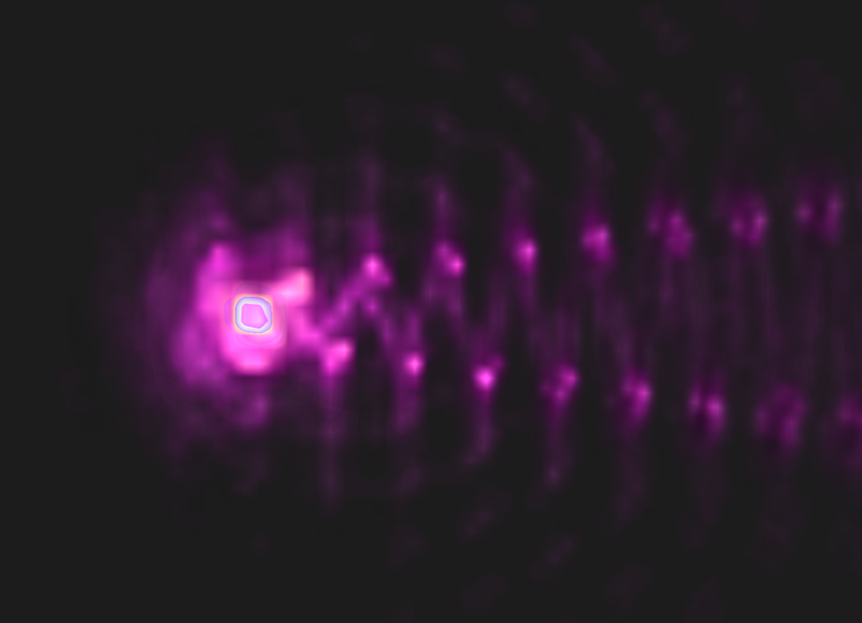
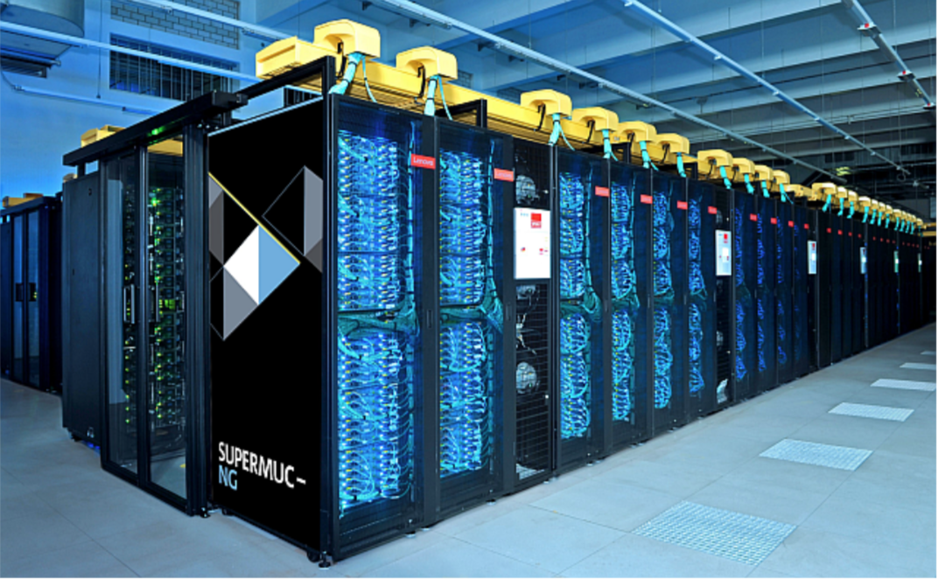


Database aided Workflows on HPC for Plasma Physics Simulation Data
Viktoria Pauw
20.03.2025 ISGC, Taipei, Taiwan

Slide 2
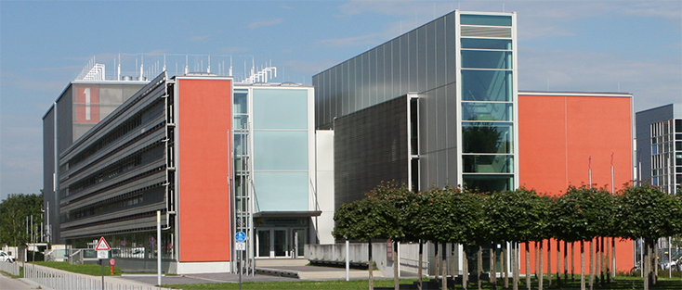
Relevant groups at LRZ
Resources
Research Unit:
  Future Computing (FC)
  Big Data & Artificial Intelligence (BDAI)
  Environmental Computing (EnvComp)
  Research Data Management (RDM)
  Trusted Research Environments (TRE)
  Research & Information Management (RIME)
  Virtual Reality and Visualization (VVR)
High Level Application Support:
  Astro + Plasma Physics Lab

Slide 3

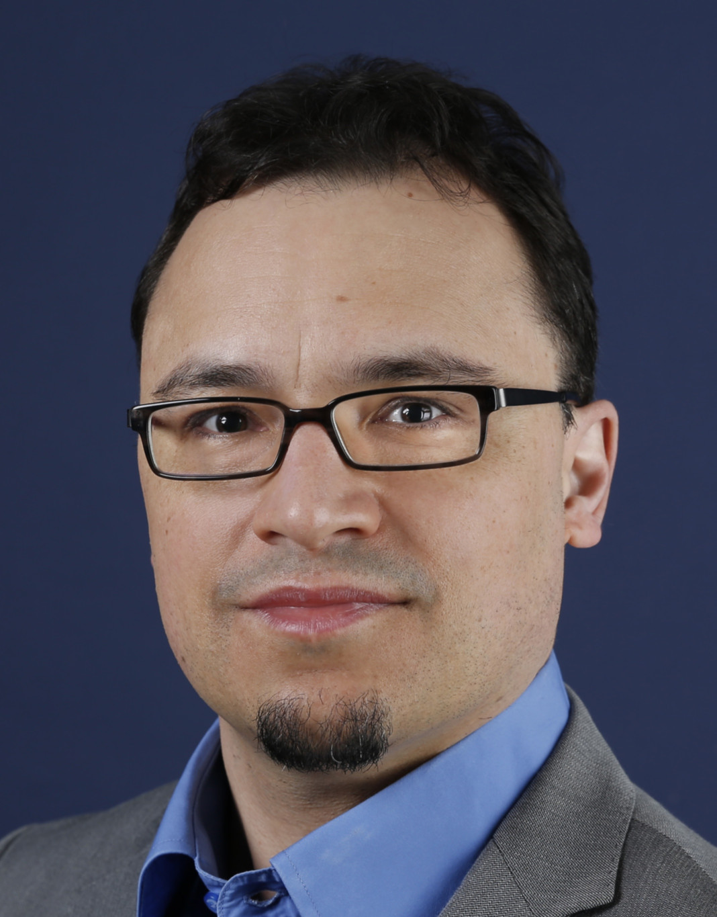

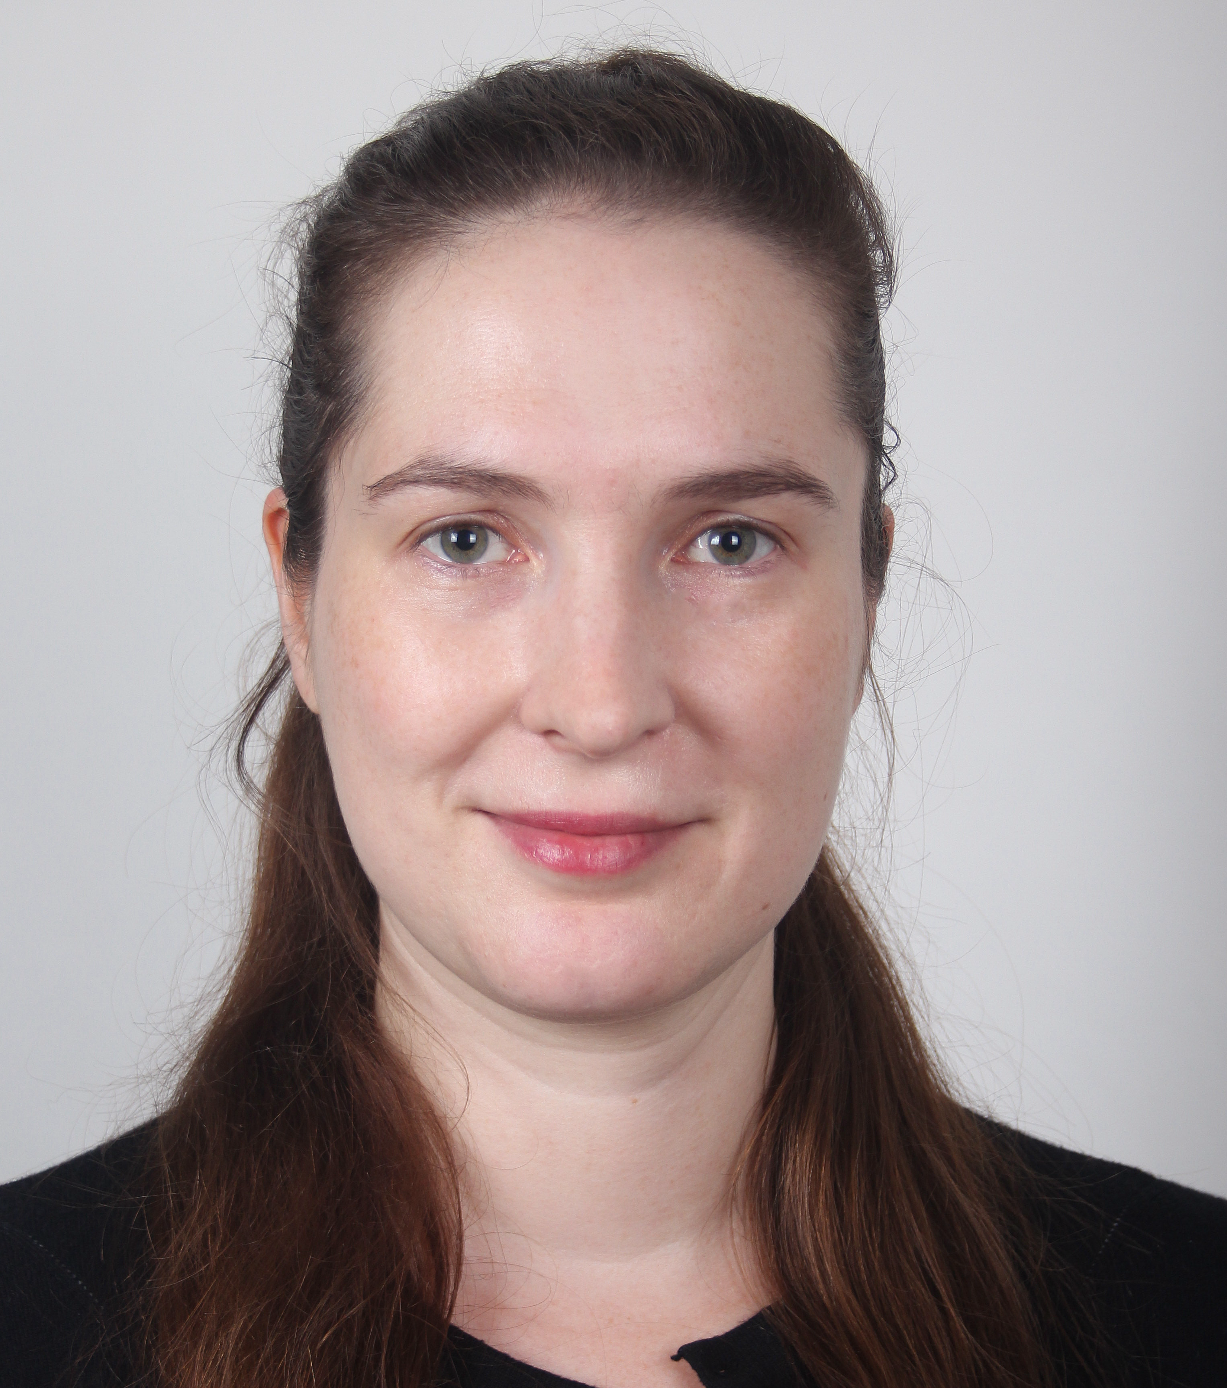

Research Data Management & Environmental Computing
Connected LRZ Research Teams
FAIR Data
Databases
Monitoring
Research Data Management
(RDM)
Stephan Hachinger
Johannes Munke
Environmental Computing
(ENV)
Mohamad Hayek
Viktoria Pauw
HPC
Cloud
Integrated Infrastructure
Machine Learning

Slide 4
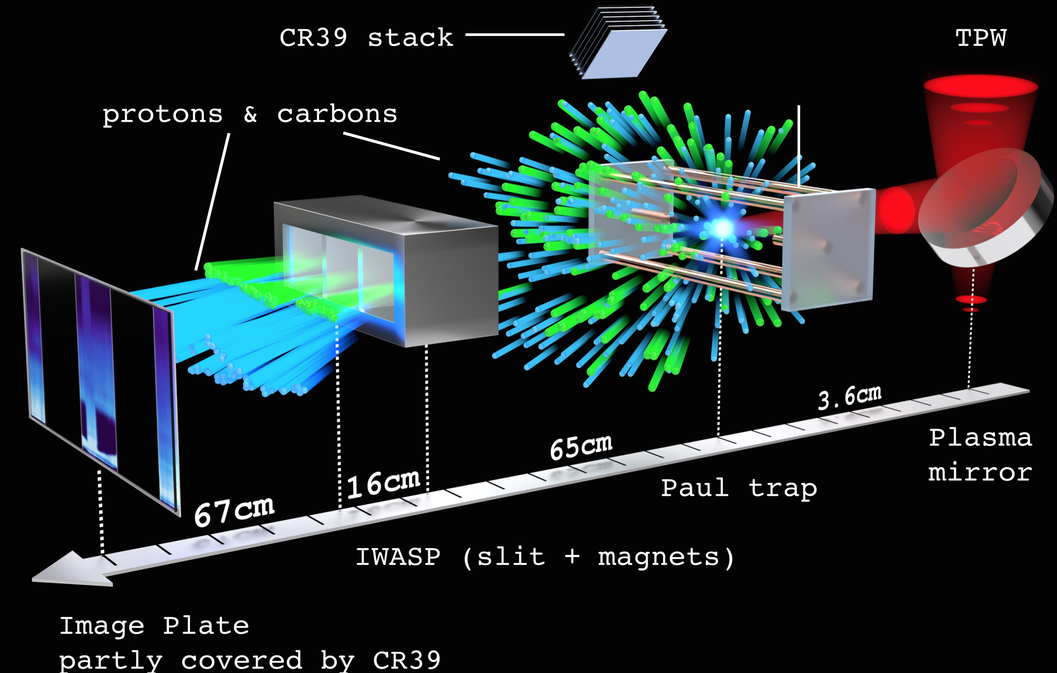
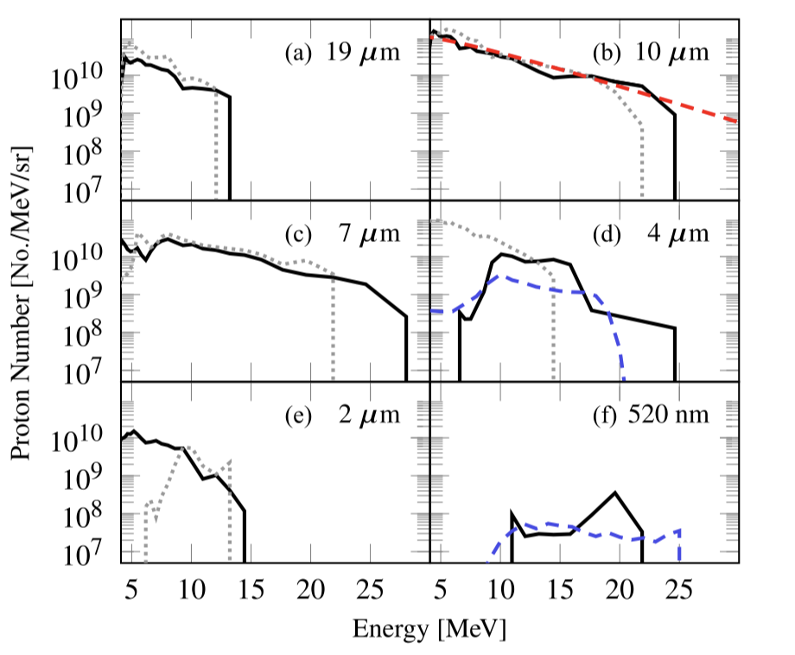
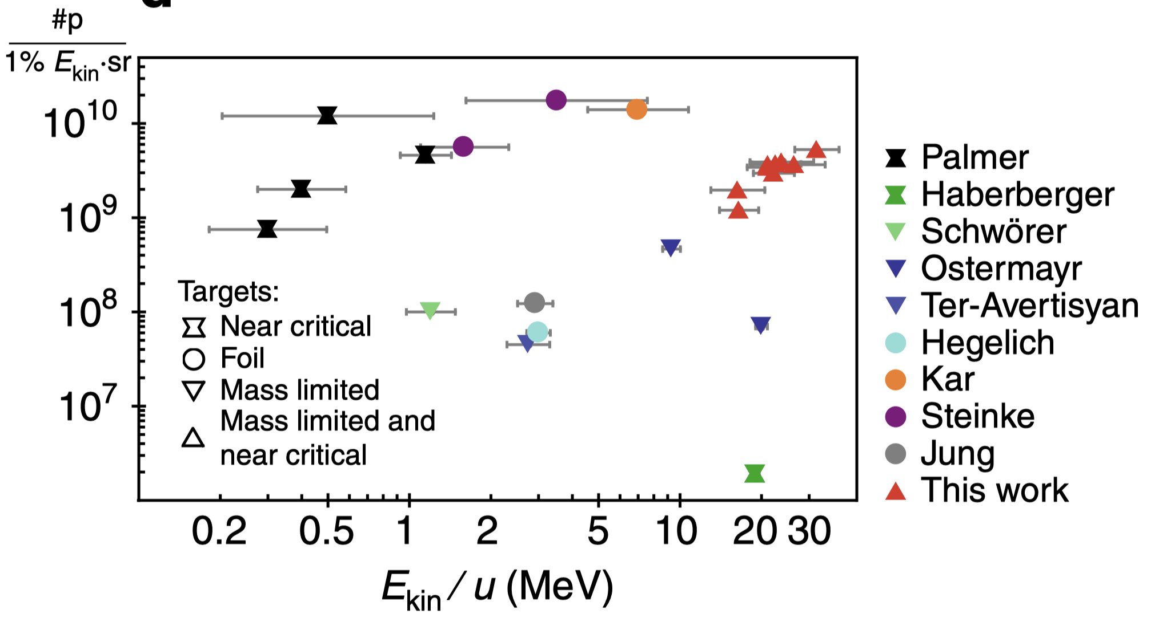
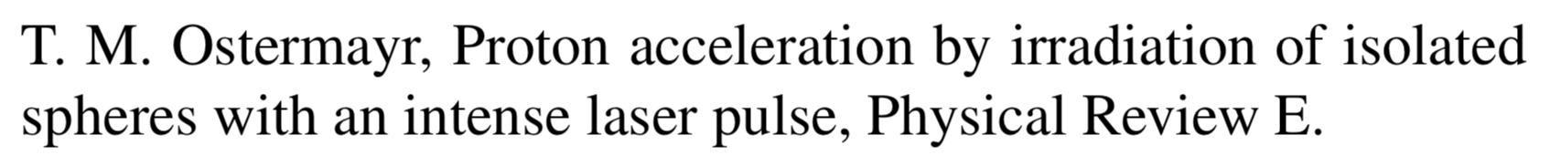
HPC Data Case Study: Simulations for Laser Plasma Acceleration-Experiments
The GCS project pr74si
Experiments at Texas Petawatt Laser and PHELIX
Plastic Sphere (CH) is levitated in Paul trap
I=10²⁰-10²¹ W/cm² , a₀=10-17, 150 - 500 fs FWHM
PSC - Plasma Simulation Code (Chair for Computational and Plasma Physics at LMU): Prof. Hartmut Ruhl, K. Germaschewski, K Bamberg, N. Moschüring
Experiments by J.Schreiber’s group (LMU): Tobias Ostermayr, Peter Hilz

Slide 5
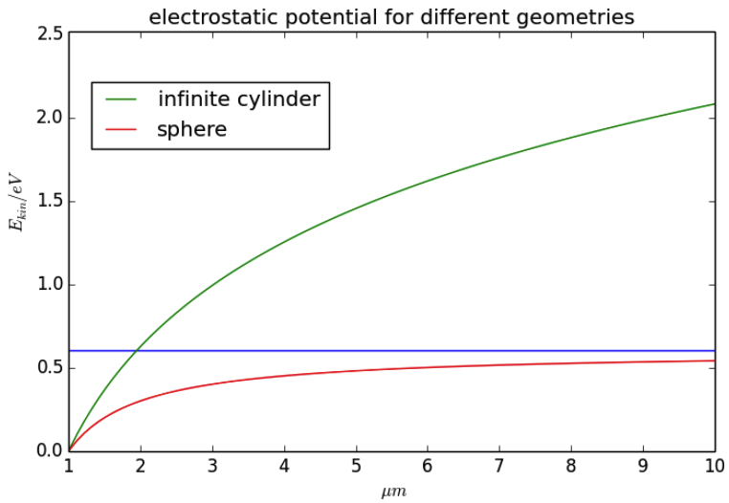
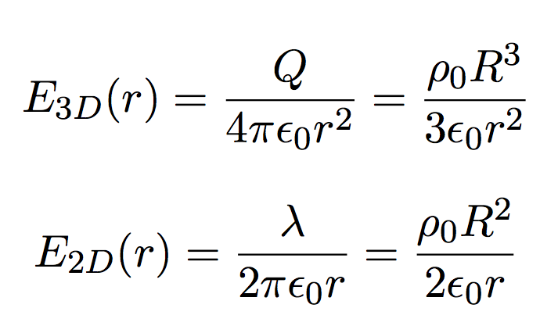
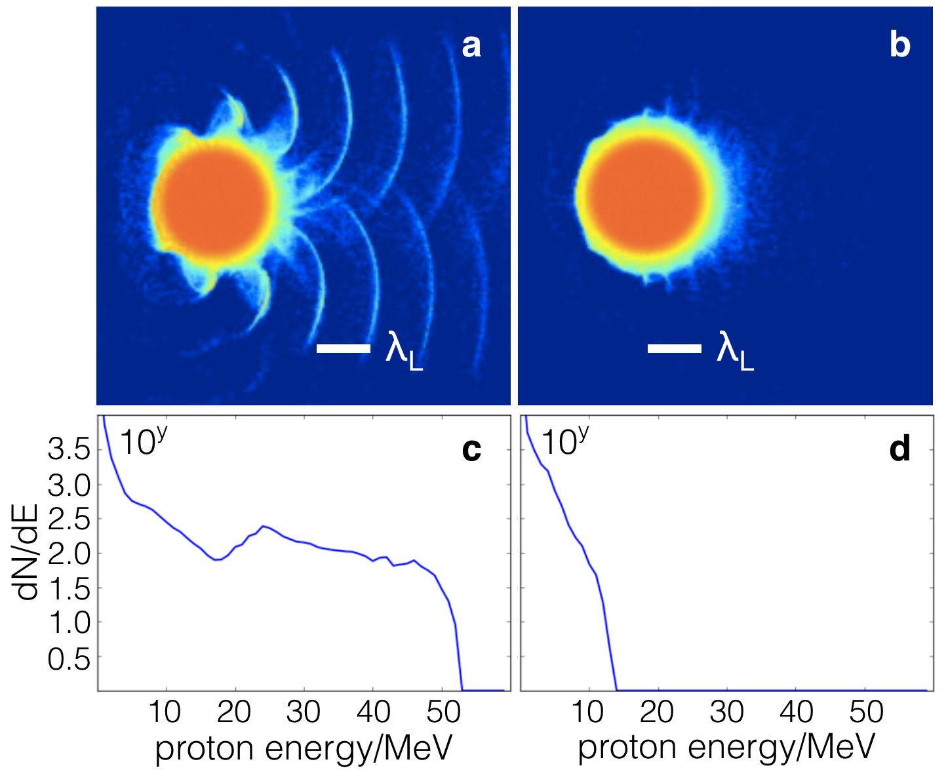
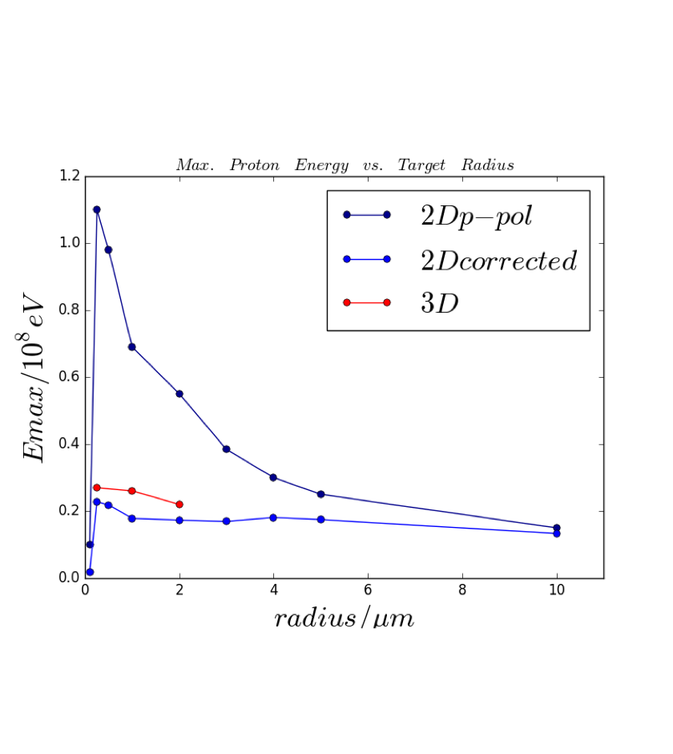
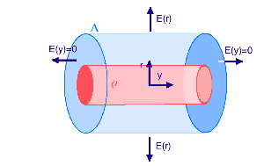
Particle in Cell (PIC) - Going from 2D to 3D
2D simulation not able to model correct dynamics
V. Pauw et al., Particle In Cell Simulation of Laser Irradiated Two-Component Microspheres in 2 and 3 Dimensions,
Nuclear Inst. and Methods in Physics Research, A(2016), 10.1016/j.nima.2016.02.012

Slide 6
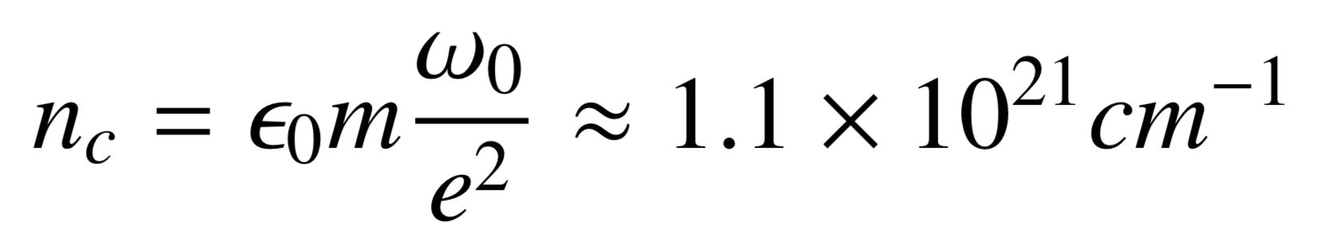
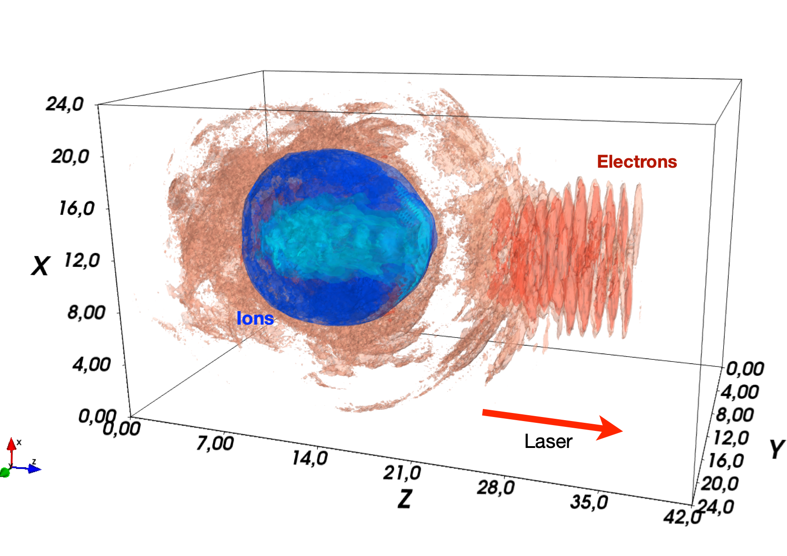
Parameter studies inspired by P.Hilz experiments
densities from 2 n_{c} to 288 n_{c}
target 0.5 µm to 3 µm, H/CH
30 or 90 fs, 100 J pulse energy
focus matching target size
field changed keeping pulse energy constant a₀=52,75,63,90,112

Slide 7
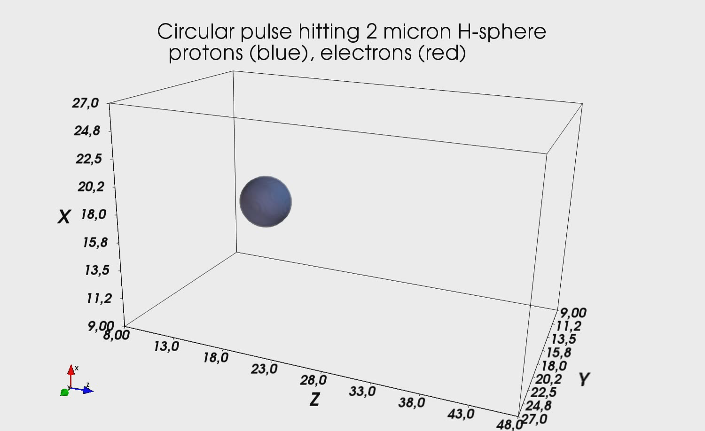
50 J
150 fs
I=2x10²⁰ W/cm²
a₀=12
8.3 µm focus
100 J
90 fs
I≈10²¹ W/cm²
a₀=34,52,64
2.2, 3.4, 5.1 µm focus
100 J
30 fs
I≈10²² W/cm²
a₀=75,90,112
2.2, 3.4, 5.1 µm focus

Slide 8
Challenge of Data Management – Data Volume
2304x2304x4032 grid cells, 10 quasi-particles per species and cell
  0.5-20 GB particle data per output timestep
  10 000 - 100 000 timesteps
  stored in hdf5 files
5 sizes x 2 pulse lengths x 16 densities = 160 runs
H and CH (two ion species)
Linearly or circularly polarized pulse
      ~ 200 simulations
Let it rot in tape archive?

Slide 9
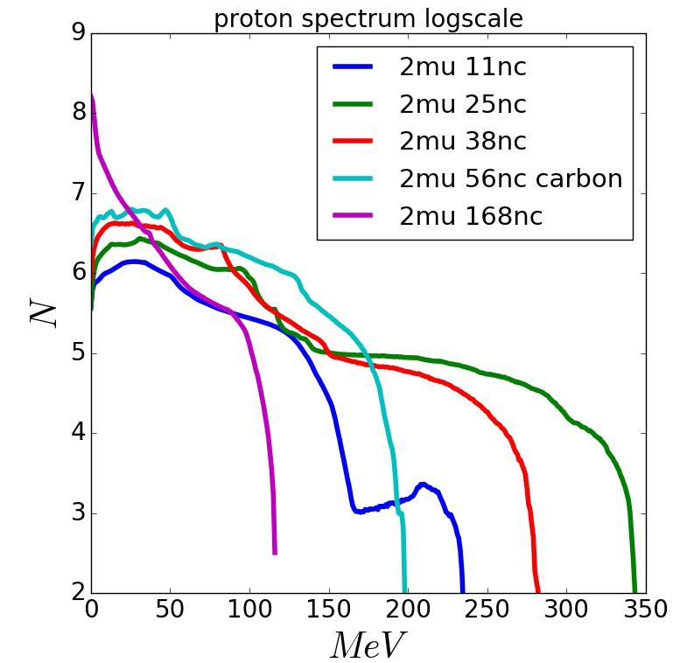
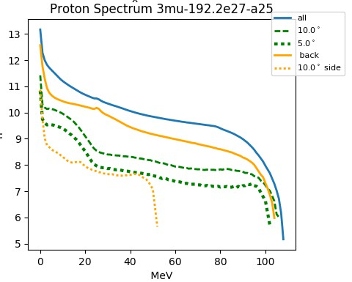
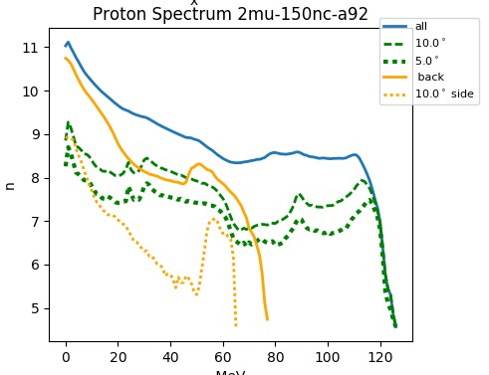
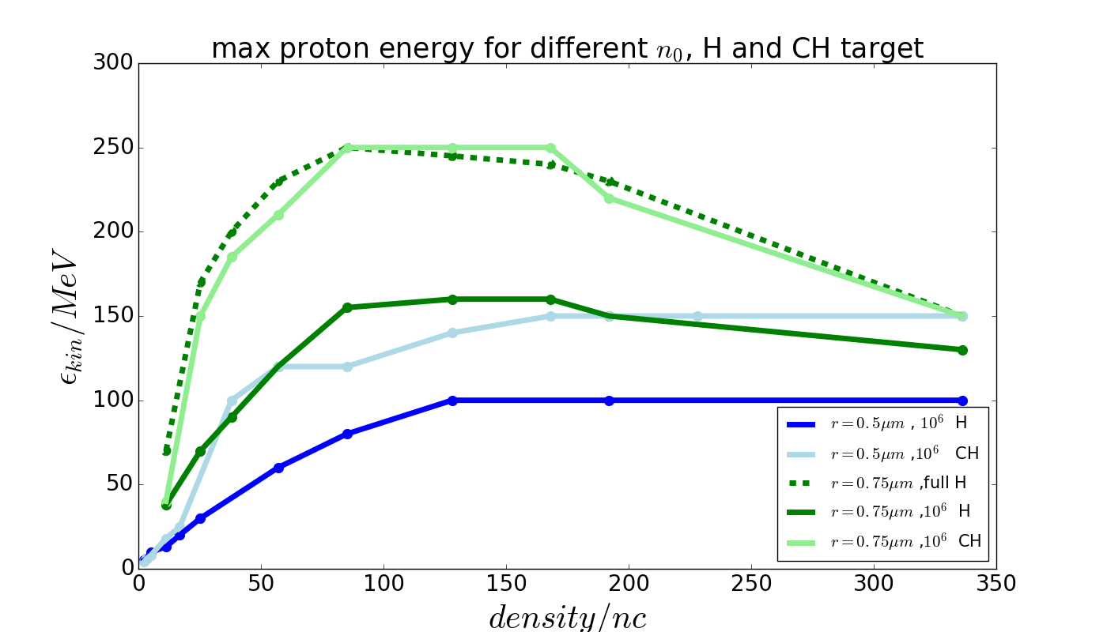
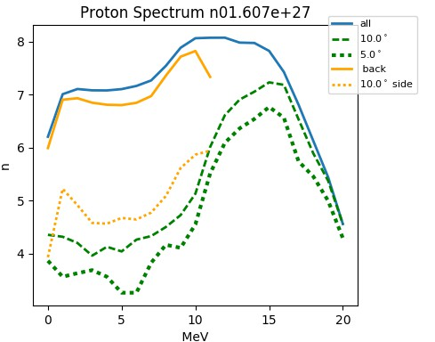
Multi-faceted analyses – endless possibilities
Accelerated Proton Energies
  Spectral features
  Evaluate forward, sideward and backward cones
Electron movement
  removal from target
  removal from box
  temperature
Multispecies effects
  Carbon Proton
  Proton only
Pulse Shape dependend dynamics
  Focal size
  Polarization
...
TNSA
RPA
Coulomb

Slide 10

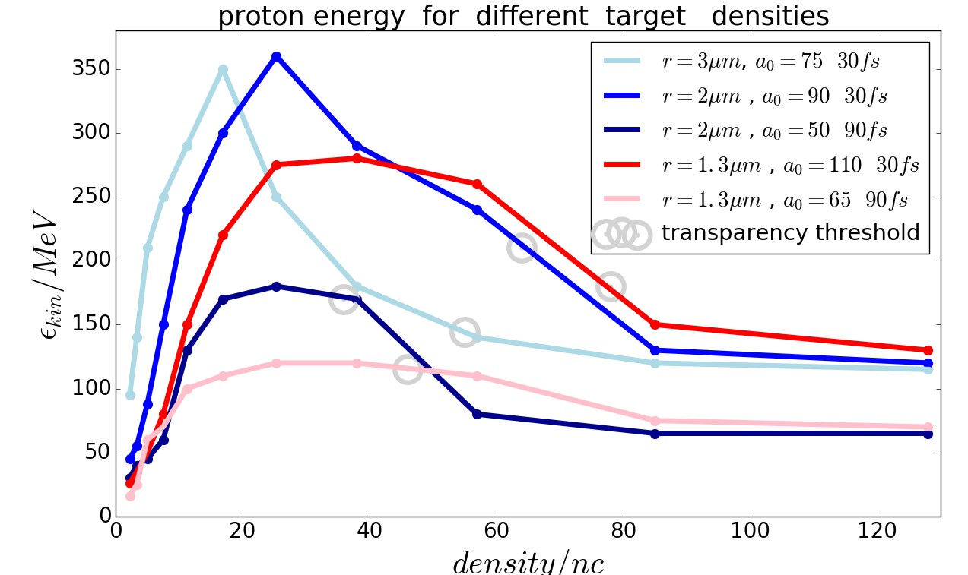
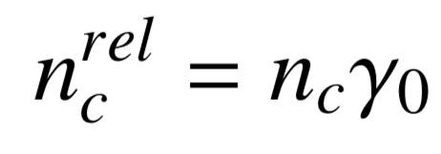
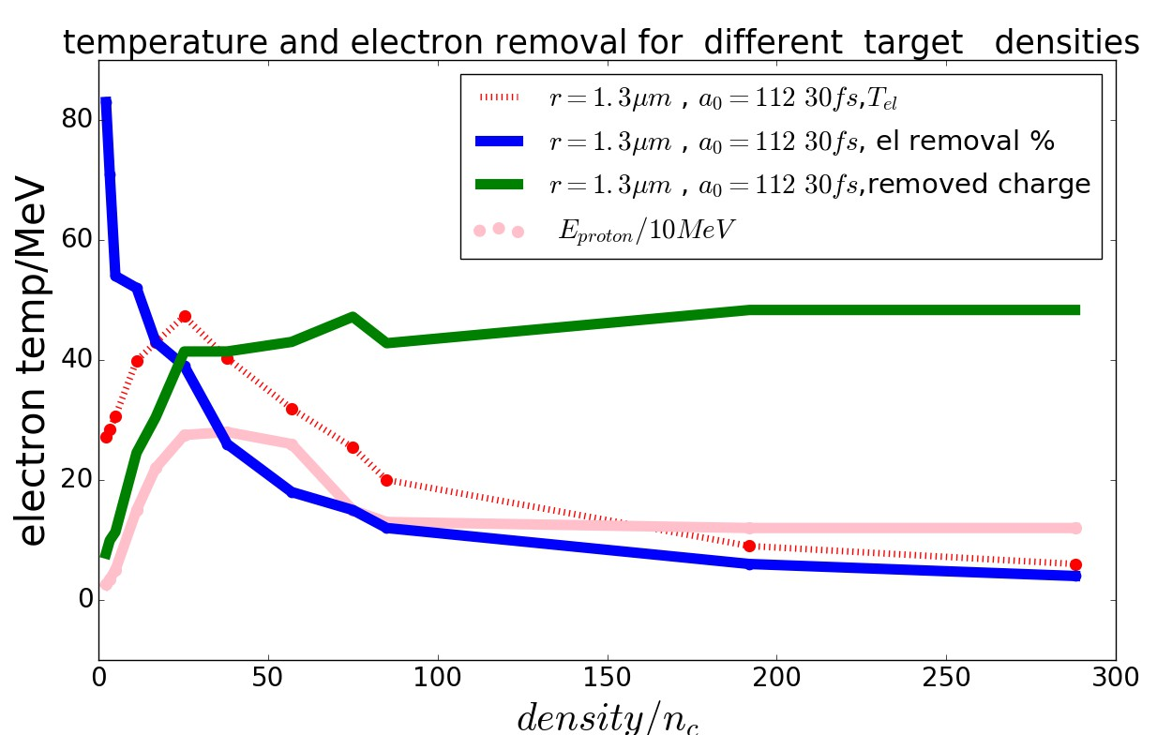
Findings: Max proton energies by overlay of acceleration dynamics
Optimal „areal density“:
Scanning densities from 2 n_{c} to 288 n_{c}
highest energies reached in "near critical range“
Why even higher?
10 Min
optimal range
Esirkepov (2006)

Slide 11
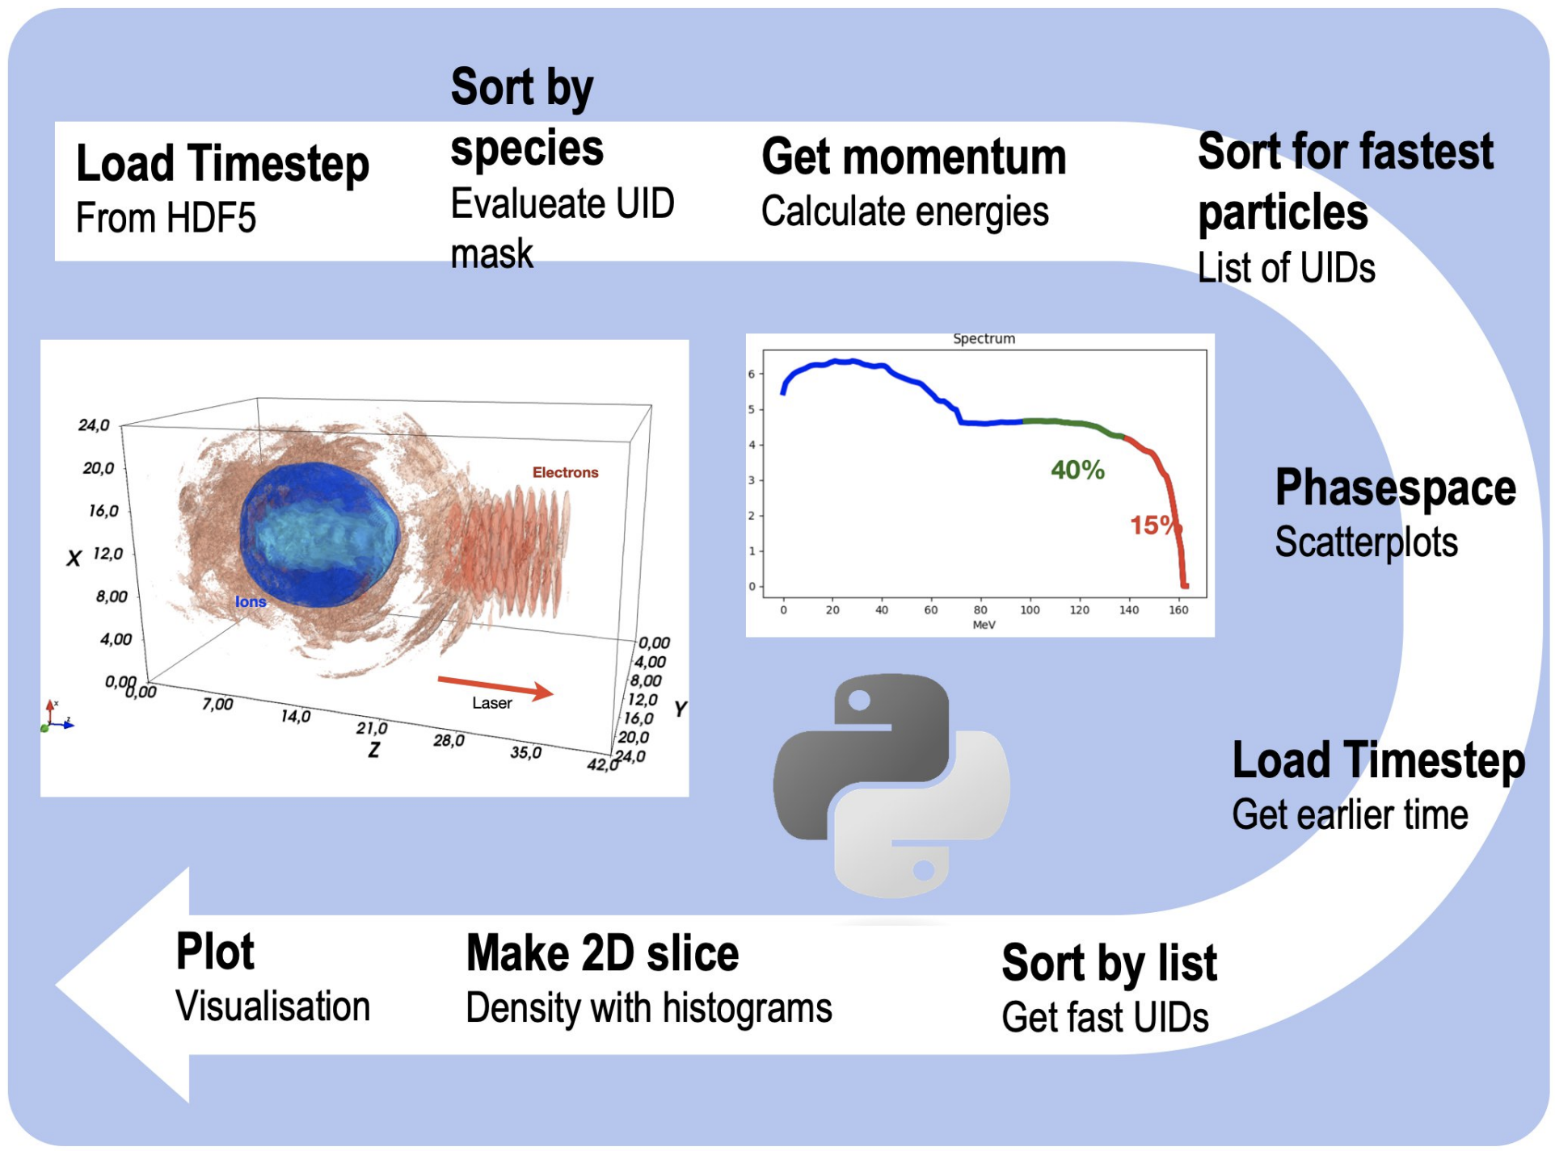
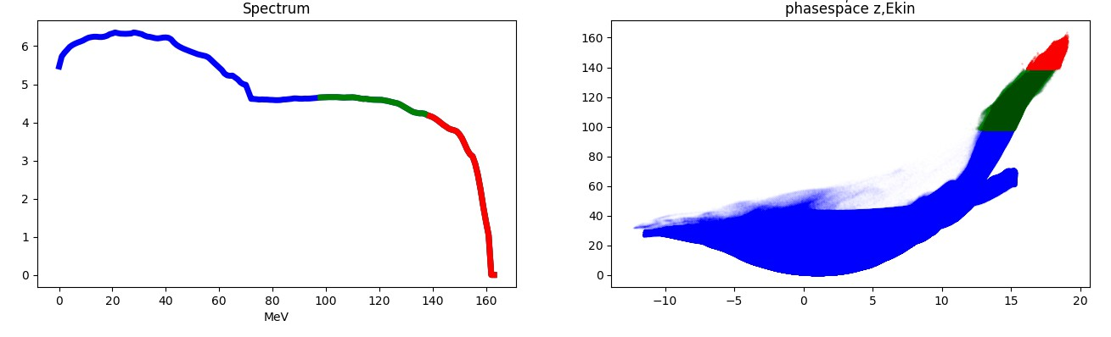
Objective: Finding the mechanism behind the extra peak for 2mu target!
Each particle has a unique ID
tag particles with the highest energy at the end simulation
trace back to position at earlier times
shed light on acceleration history
tag „max“ ->
tag „high“ ->
40%
15%
Python workflow writing out intermediate files

Slide 12
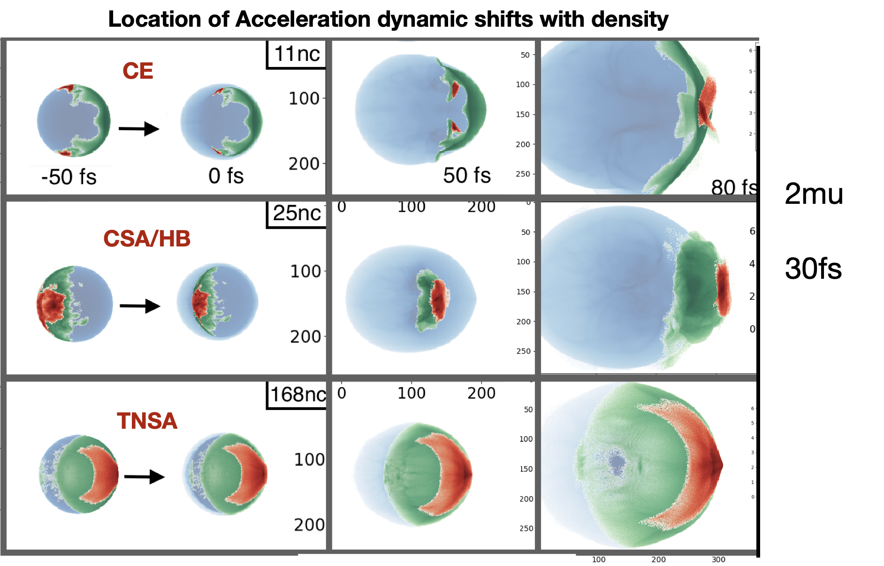
Changing initial position of fastest proton
Scanning densities from 2 n_{c} to 288 n_{c}
coulomb driven in transparent range
highest energies reached in near critical range
Pulse shock driven maximum
over critical density appears heating driven

Slide 13
Keeping Track of simulations
Resources
Use in-buit management tools of dbs
Excel sheet hell

Slide 14
Keeping Track of simulations and results with a DB
Data Management
You can use
Meta data tables
        find IDs of simulation runs, FAIR information
In-built management tools of DBs
      indices, views, namespaces, functions
Access to DB from various places
    spin up a new server or access remotely (if FW allows)
Managment User access with credentials
permissions and privileges can be set individually or with groups

Slide 15



Supercomputing Workflows - Projects with LRZ participation
Investigating new best practices
Connectivity & Analytics Workflows
LRZ-RDM is participating in projects for Scientific Data Management
Data Staging to HPC
Exploring DBMS for Science
F A I R ification with EUDAT tools
M.D. Wilkinson et al., “The FAIR Guiding Principles for scientific data management and stewardship”, Scientific Data 3 (2016) 160018, https://doi.org/10.1038/sdata.2016.18
„Extreme
Data
Database“
EUDAT,
Data
Spaces
Super-
computing
lead: J. Marinovic, IT4I
https://exa4mind.eu

Slide 16
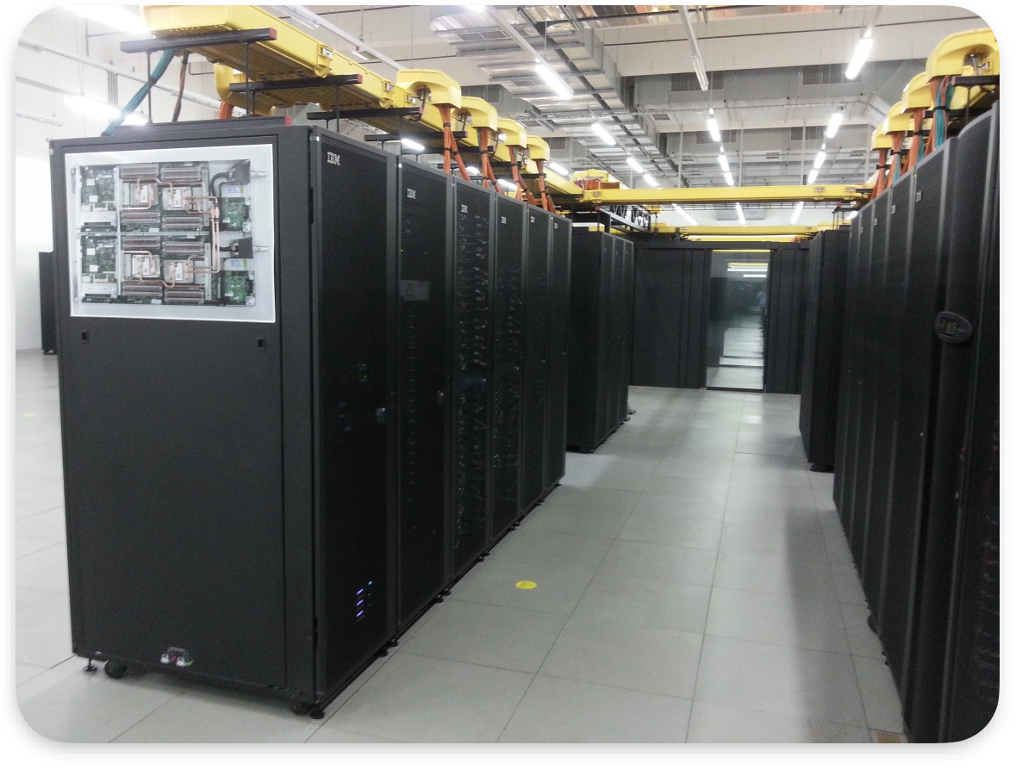

Cloud based workflow vs HPC workflow
Resource Connection
research groups:
  Future Computing (FC)
  BigData-ArtificialIntelligence (BDAI)
  EnvironmentalComputing (EnvComp)
  ResearchDataManagement (RDM)
  QuantumComputing (QC)
User Support:
  AstroLab
  GeoLab
Services:
  Cloud-Service for TUM,LMU & collaborators
  Gitlab(+CI), Archive…
What is an HPC workflow?
  highly concurrent
  utilizes fast interconnect
  high demand on memory
  manually optimized
What is Cloud workflow?
  mostly serial tasks
  can be modular
  larger group of potential users - access management
  usually small RAM - few cores
research groups:
  Future Computing (FC)
  BigData-ArtificialIntelligence (BDAI)
  EnvironmentalComputing (EnvComp)
  ResearchDataManagement (RDM)
  QuantumComputing (QC)
User Support:
  AstroLab
  GeoLab
Services:
  Cloud-Service for TUM,LMU & collaborators
  Gitlab(+CI), Archive…
DASK! HDF5!
?

Slide 17
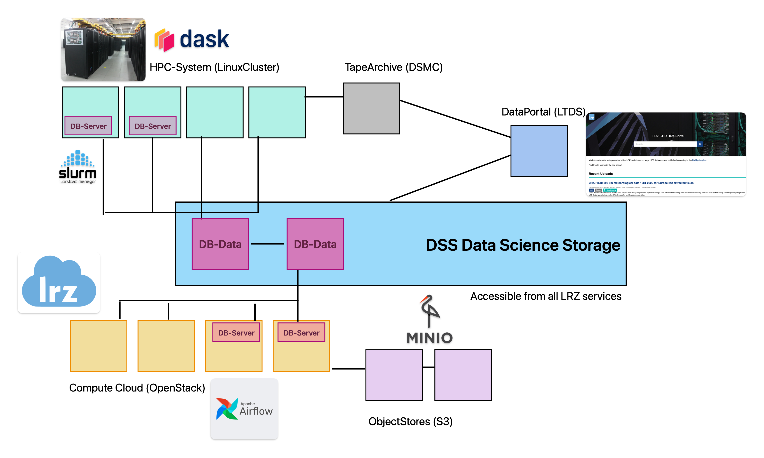

Utilizing LRZ Data Science Storage
Resource Connection

Slide 18
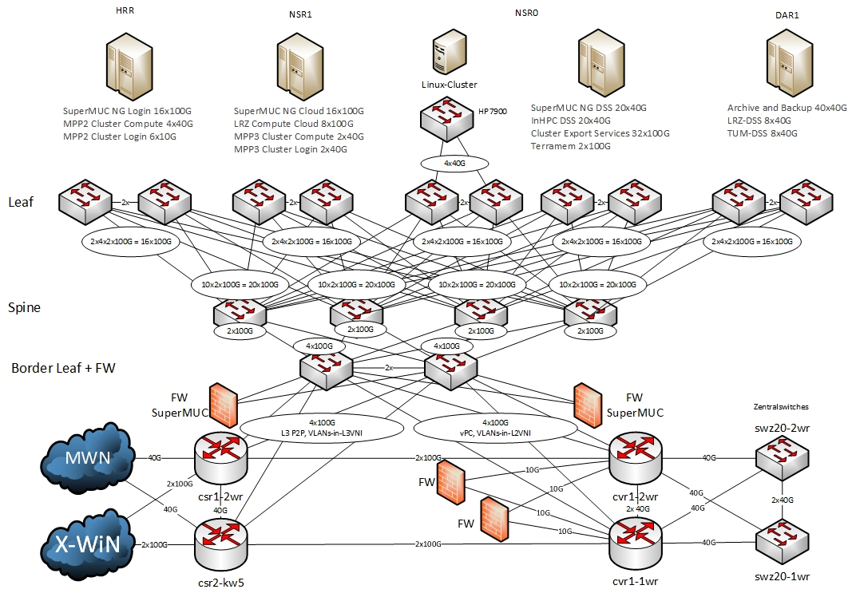
Set-Up of DSS
Resource Connection
mounted parallel file system for all LRZ services
  HPC systems (SNG, LinuxCluster, Compute Cloud…)
Multi PB capacity
File Transfer via Globus
https://doku.lrz.de/data-science-storage-10745685.html

Slide 19
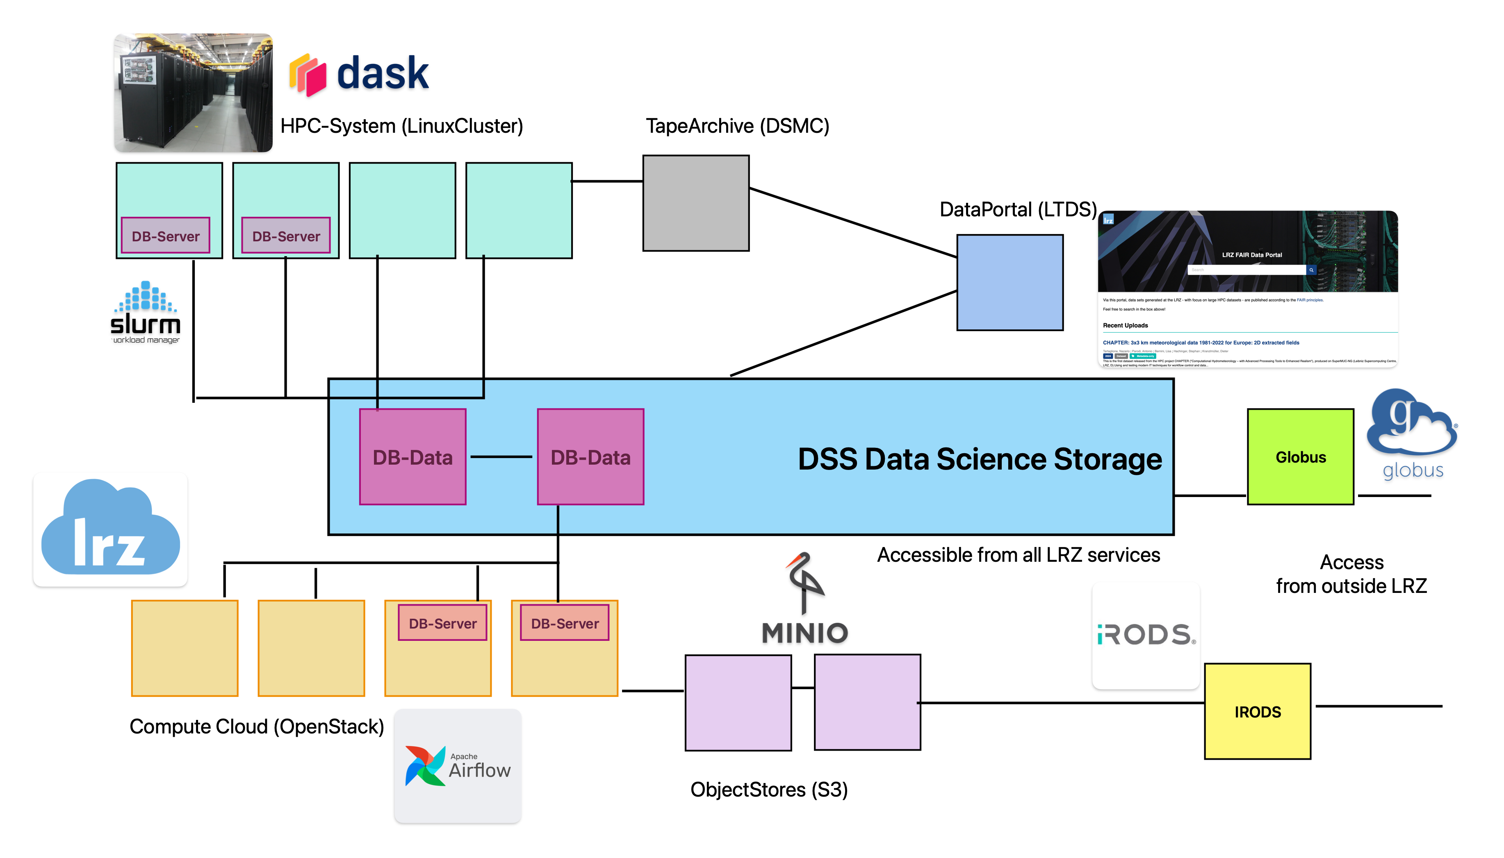


Ensuring good findability and re-usability
Resource Connection

Slide 20
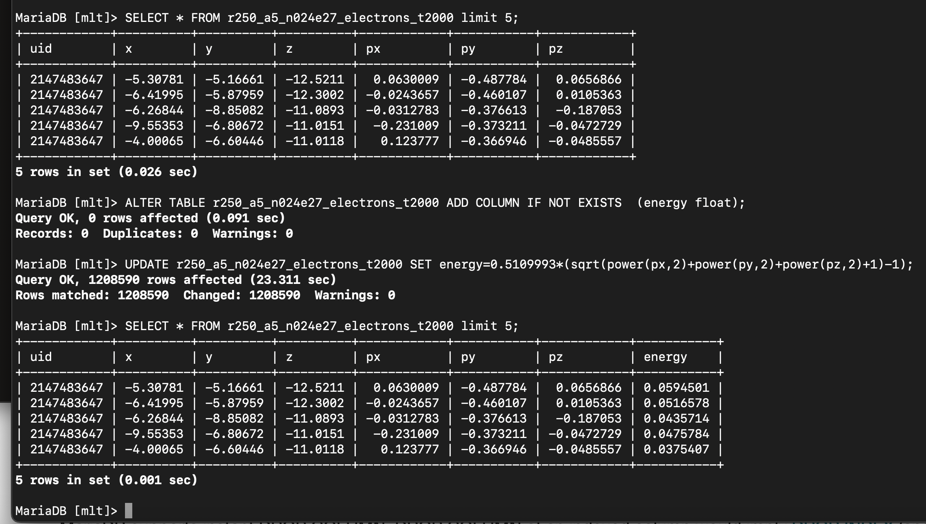
Interactive calculations in DB - add columns
Resources
interactive shell for exploring
fast overview
fast persistent manipulation of tables
quick calculations and table joins
MariaDB [test_db]> SELECT 0.5109993*sum(sqrt(power(x,2)+power(y,2)+power(z,2)+1)-1) AS total_energy FROM wf1_test_normal ;
+-------------------+
| total_energy |
+-------------------+
| 404312569.6585682 |
+-------------------+
1 row in set (47.196 sec)
MariaDB [test_db]> SELECT 0.5109993*sum(sqrt(power(x,2)+power(y,2)+power(z,2)+1)-1) AS total_energy FROM wf1_test_column ;
+-------------------+
| total_energy |
+-------------------+
| 404312569.6585225 |
+-------------------+
1 row in set (14.924 sec)

Slide 21
Calculations in DB - not slow!
Resources
interactive data calculation like ipython
fast data manipulation
    filtering with where clauses
    adding columns
    Joining tables
  …
implement 8 of 9 steps in workflow in 1 SQL statement
MariaDB [test_db]> SELECT 0.5109993*sum(sqrt(power(x,2)+power(y,2)+power(z,2)+1)-1) AS total_energy FROM wf1_test_normal ;
+-------------------+
| total_energy |
+-------------------+
| 404312569.6585682 |
+-------------------+
1 row in set (47.196 sec)
MariaDB [mlt]> SELECT 0.5109993*avg(sqrt(power(x,2)+power(y,2)+power(z,2)+1)-1) AS avg_energy FROM r250_a5_n024e27_electrons_t1000 WHERE z>-8.;
+------------------+
| avg_energy |
+------------------+
| 4.62398394925504 |
+------------------+
1 row in set (0.643 sec)
MariaDB [mlt]> SELECT 0.5109993*avg(sqrt(power(px,2)+power(py,2)+power(pz,2)+1)-1) AS avg_energy FROM r250_a5_n024e27_electrons_t1000 WHERE sqrt(power(x,2)+power(y,2)+power(z,2))>7 ;
+----------------------+
| avg_energy |
+----------------------+
| 0.012934290495074498 |
+----------------------+
1 row in set (0.851 sec)
 | hdf5 & numpy | row DB | column DB
Distance small | 0.2 s | 0.09 | 0.11 s
Energy small | 2.6 s | 0.04 s | 0.06 s
Distance Large | 73 s | 46 s | 13 s
Energy Large | 51 s | 46 s | 15 s
MariaDB [test_db]> SELECT 0.5109993*sum(sqrt(power(x,2)+power(y,2)+power(z,2)+1)-1) AS total_energy FROM wf1_test_column ;
+-------------------+
| total_energy |
+-------------------+
| 404312569.6585225 |
+-------------------+
1 row in set (14.924 sec)
Example: Calculating the avg energy of >10⁶ particles

Slide 22
DB vs HDF5 pro and cons - when to keep actual data in DB
Resources
Pros
relational DBs can easily link/merge different data sets (tables)
manage parameter studies with in-built metadata (indices, descriptions, pg_stats)
retrieval and insertion of few rows is fast (filtering)
DB cluster can manage automatic syncing with back-up
easy changes of data sets (e.g. adding columns)
Cons:
memory overhead compared to hdf5 (but smaller than text)
not elegantly parallelizable I/O
need DB server to retrieve

Slide 23
Take Away and Outlook
Resources
Striving for more F A I R research data management in HPC
Defining optimal workflow platform for different use cases
there are several ways to approach scientific data management - keep exploring

Slide 24



Acknowledgements
Partners
The PlasmaSimulationCode is developed by H.Ruhl, K. Germaschewski, K. Bamberg, N. Moschüring, F. Deutschmann et al. At the Chair for Computational and Plasma Physics LMU Munich

Paul Trap experiments are carried out by the group of J.Schreiber from MPQ in Garching
Peter Hilz
Tobias Ostermair
Thank You for Your attention!
EXA4MIND is an initiative funded by the European Union’s Horizon Europe Research and Innovation programme under grant agreement N° 101092944

