Slide 1

Policy Innovations in Federated Identity
Insights from AARC
Maarten Kremers
AARC Policy WG
SURF, AARC Policy WG, GN5-2 T&I EnCo
ISGC 2025
Tapei, 21st March 2025

Slide 2
With many thanks to the other members
of the policy WG
David Groep, Nikhef & Maastricht University
David Kelsey, STFC-RAL
Catharina Vaendel, Nikhef
Arnout Terpstra, SURF
Hannah Short, CERN
And many others
ISGC 2025
Tapei, 21st March 2025

Slide 3


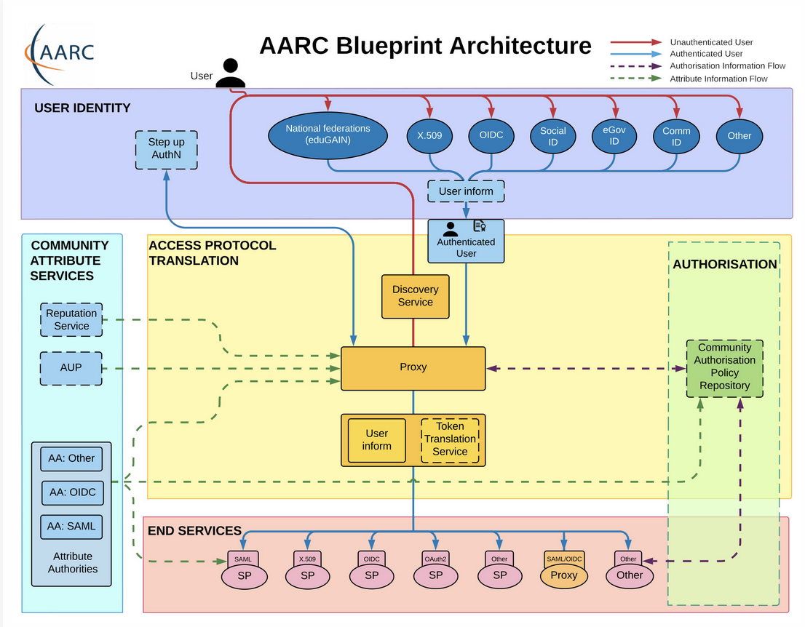








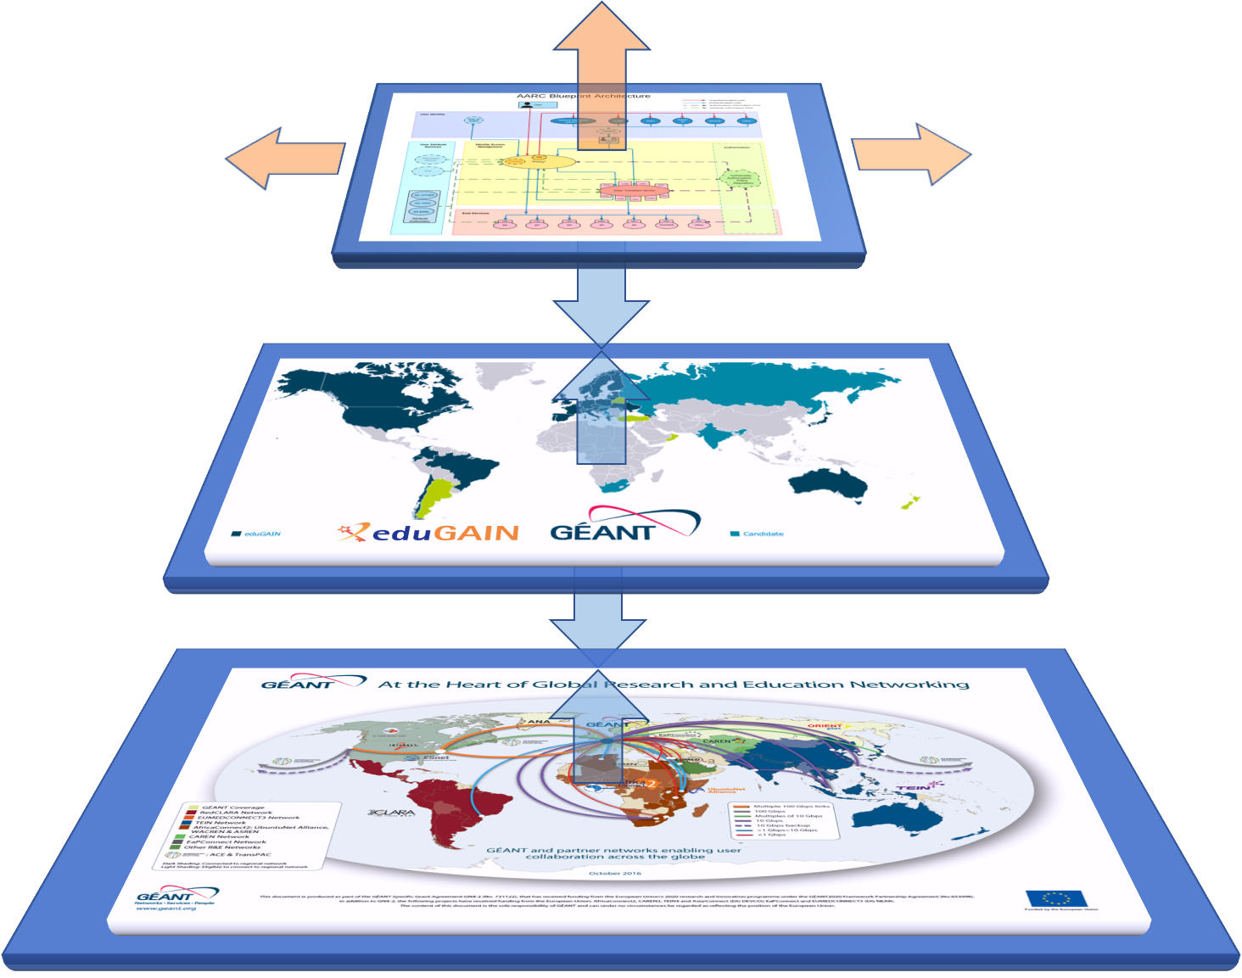
AARC Blueprint Architecture: many communities and collaboration, and full of fancy colourful pictures and stuff
…

Slide 4
What is the AARC BPA?
The Authentication and Authorization For Research and Collaborations BluePrint Architecture provides a set of building blocks for software architects and technical decision makers who are designing and implementing access management solutions for international research collaborations. By design the AARC BPA is technology agnostic and provides an architectural design for those the deploy AAIs.

Slide 5
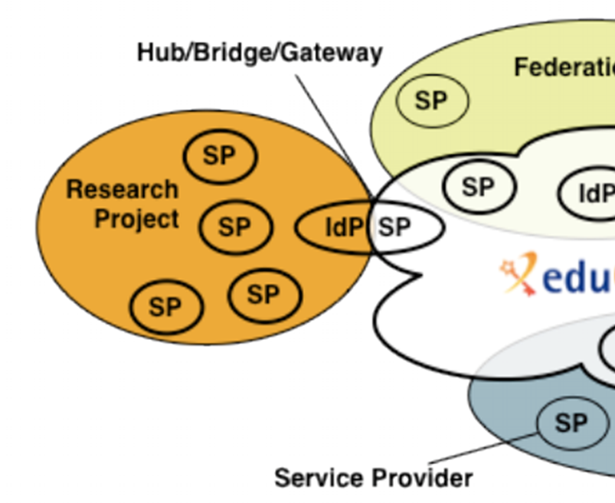
The AARC BPA: the IdP-SP proxy to enable federated access for research
Access services using identities from users’ Home Organizations, but hide complexity of multiple IdPs, federations, AA technologies
One persistent identity across all the community’s services through account linking
Access services based on role(s) users have in the collaboration.
For both web and non-web resources
Integration of guest identity solutions
Support for stronger authentication assurance mechanisms
Graphics: Ann Harding and Lukas Hammerle (SWITCH )– from a long time ago now!
Authentication and Authorization for Research Collaboration – https://aarc-community.org/

Slide 6
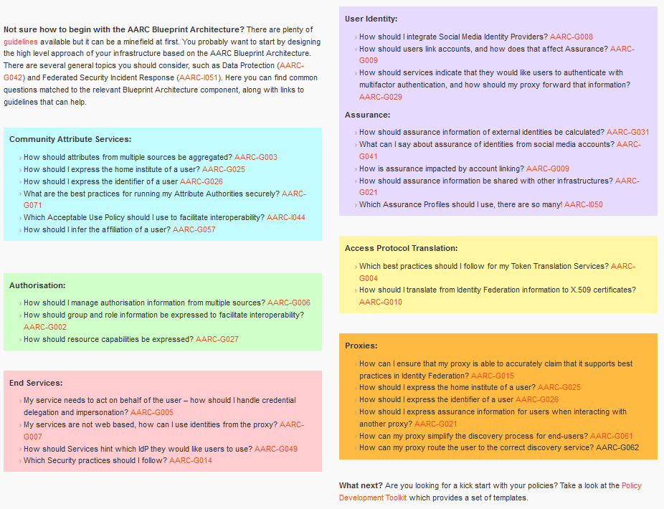
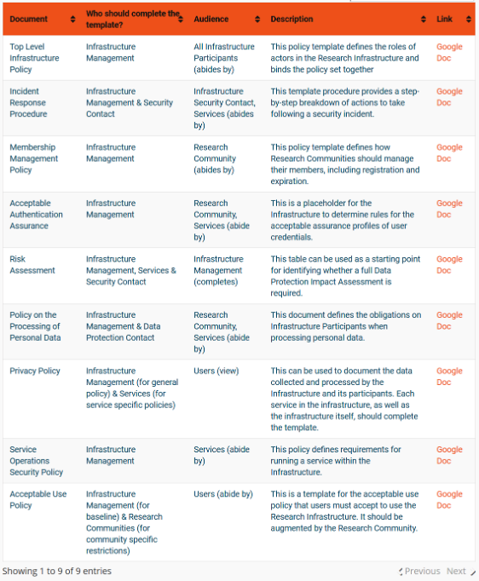

Interoperability – more than just the nice colours
https://aarc-community.org/guidelines/

Slide 7
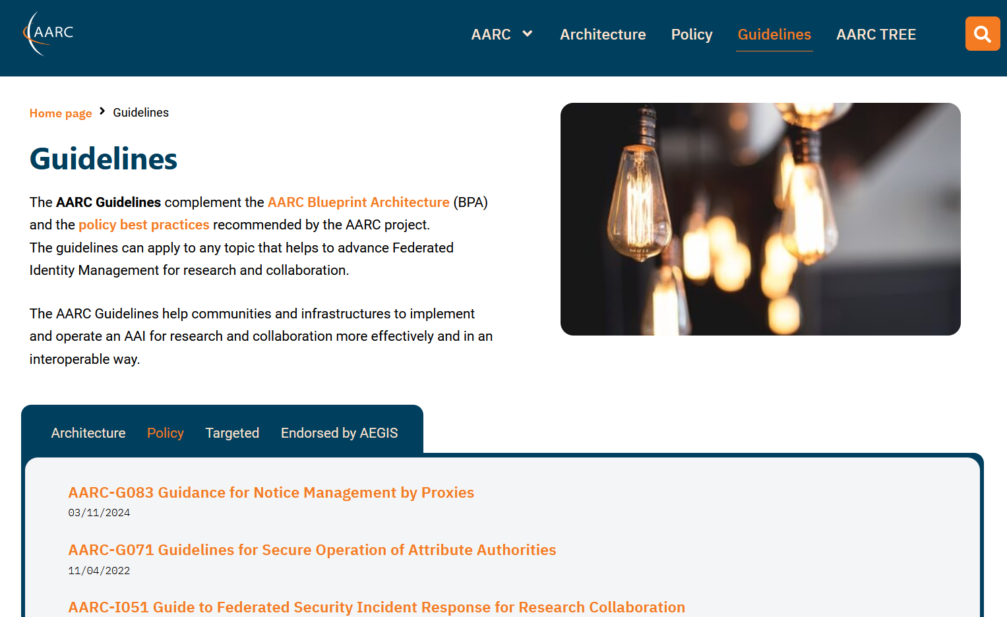
A common suite of architecture and policy guidelines
https://aarc-community.org/guidelines/

Slide 8

AARC BPA Guidelines – evolving interoperability with new guidance
Architecture
Protocols and profiles
Attribute specs and transport
Communications and interfaces
Policy
ISM interoperability
Policy development kit
Trust mechanisms and federation

Slide 9
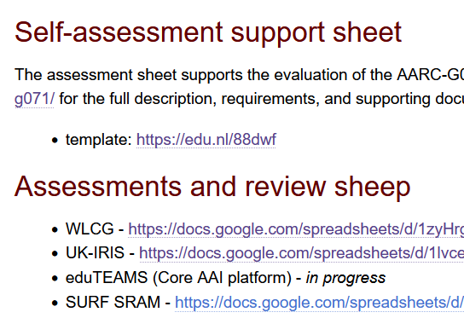
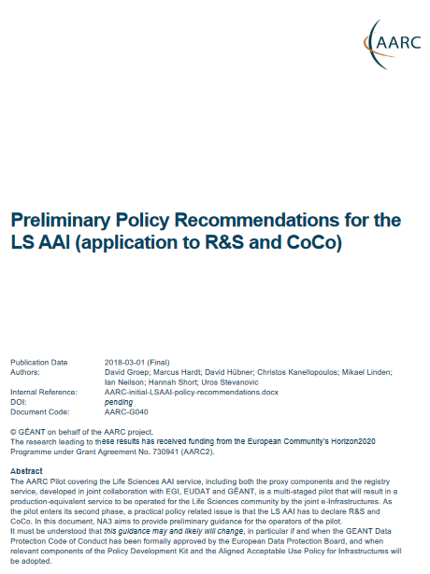

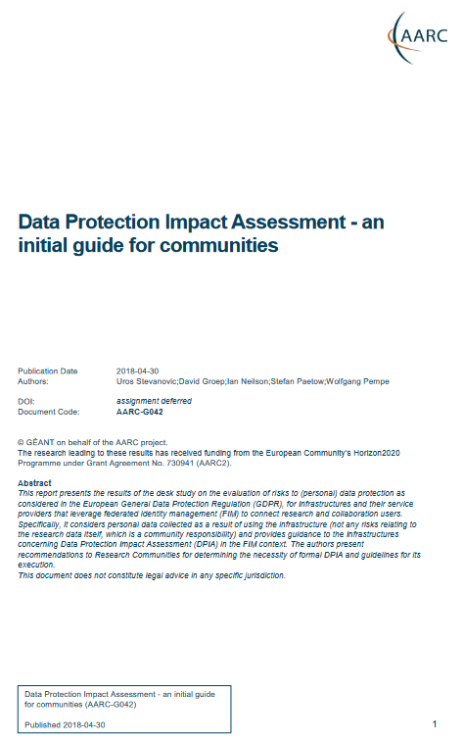

Policy and good practice underpinning the AARC Blueprint BPA
Infrastructure alignment and policy harmonisation: helping out the proxy
Operational Trust for Community and Infrastructure BPA Proxies
Increase acceptance of research proxies by identity providers through common baselines
Review infrastructure models for coordinated AUP, T&C, and privacy notices, improving
cross-infrastructure user experience (users need to click only once)
User-centric trust alignment and policy harmonization: helping out the community
Lightweight community management policy template
Guideline on cross-sectoral trust in novel federated access models
Assurance in research services through (eIDAS) public identity assertion

Slide 10
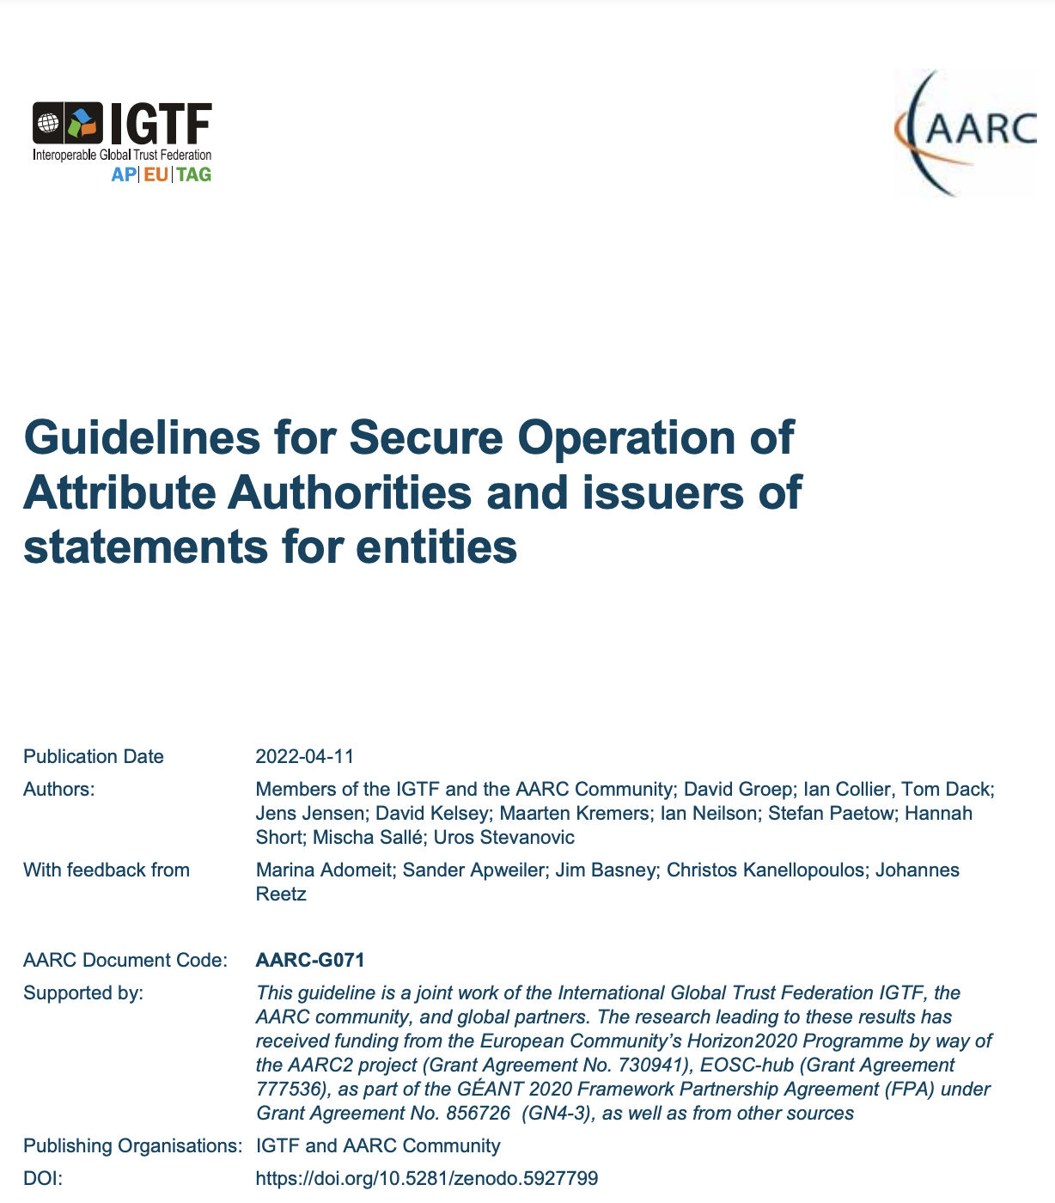
How to establish secure operation for your (AARC BPA) proxy?
The Challenge
How to securely operate proxies, attribute authorities and issuers of statements for entities?
Guideline
AARC-G071 Guidelines for Secure Operation of Attribute Authorities
Summary
Operational security processes and procedures
Requirements on traceability, auditability, and logging
Requirements on the secure operation
Requirements on securing the interactions

Slide 11
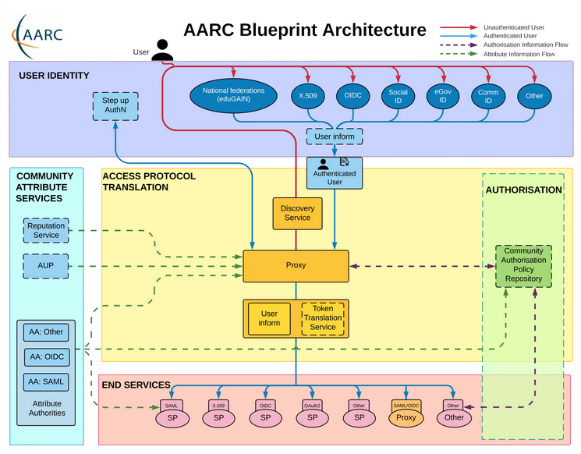
Operational security focus in the BPA: beyond just the IdPs
Community membership management directories and attribute authorities
integrity of membership
identification, naming and traceability
site and service security
protection on the network
assertion integrity
Community membership management directories and attribute authorities
integrity of membership
identification, naming and traceability
site and service security
protection on the network
assertion integrity
Guidelines for Secure Operation of Attribute Authorities and other issuers of access-granting statements
(AARC-I048, in collaboration with IGTF AAOPS)

Slide 12
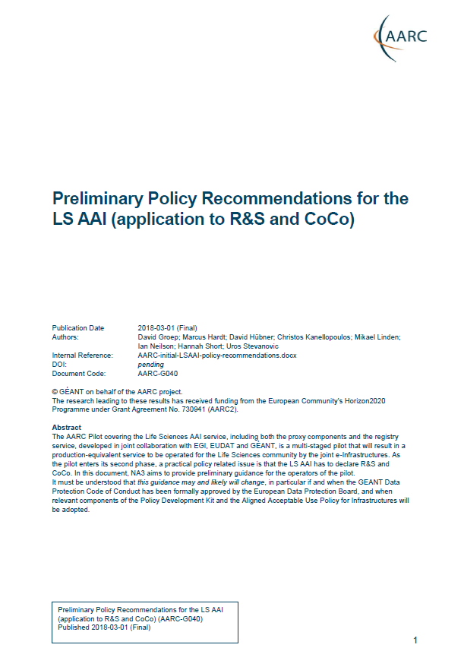
Proxies have more challenges as well: AUPs, T&Cs, Privacy notices, …
For large ‘multi-tenant’ proxies
some subset users in some communities use a set of services –
how to present their Terms and Conditions and their privacy policies, so that users
  only see the T&Cs and notices for services they will access
  this does not to need to be manually configured for each community
  is automatically updated when services join
For community and dedicated proxies
when new (sensitive) services join, who needs to see the new T&Cs?
can we communicate existing acceptance of T&Cs to downstream services?
What is an acceptable user experience in clicking through agreements?
What is effective in exploiting the WISE Baseline AUP? What do researchers need?
‘with fewer clicks to more resources’
beyond AARC-G040

Slide 13
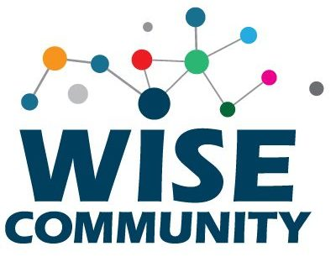
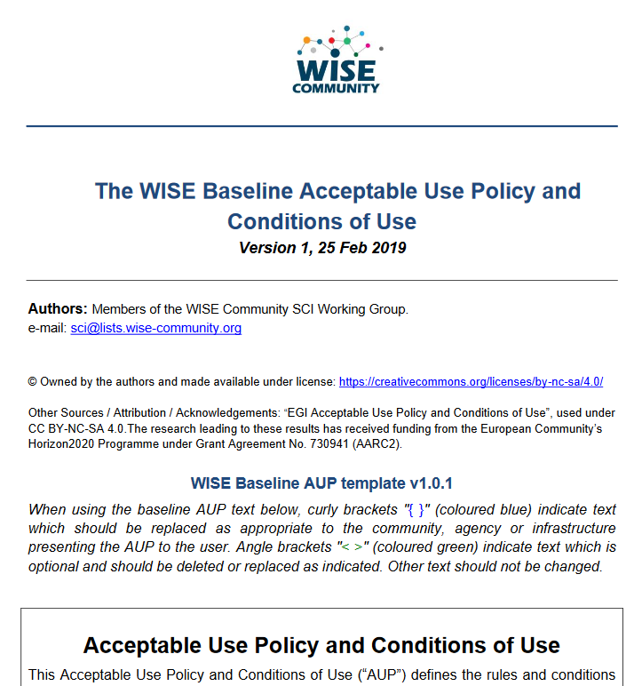
WISE Baseline AUP
Template for a common and cascading AUP and T&C notice
by intent focusses primarily on acceptable use
do not dwell on unintended use
guarantee and service levels are T&Cs, not acceptable use interoperability
Placeholder model for
scope of the AUP (purpose binding)
– mirrored in Service Security operational baseline
10 commandments
placeholder for additional T&Cs
privacy notice references and authority

Slide 14
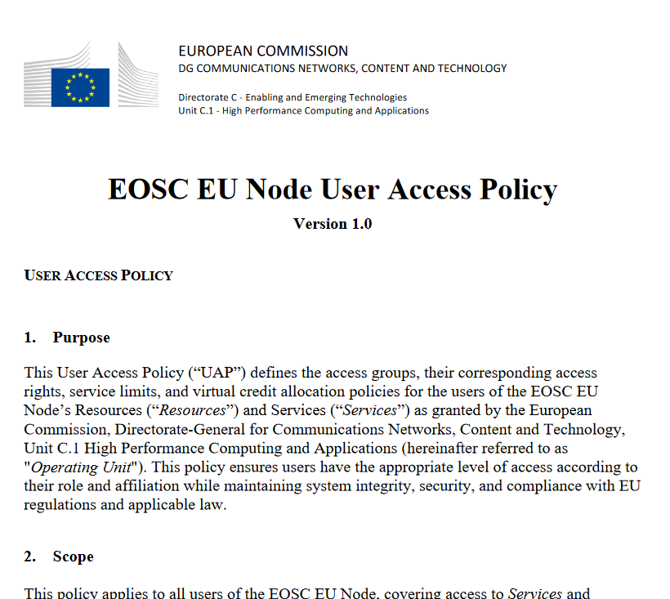
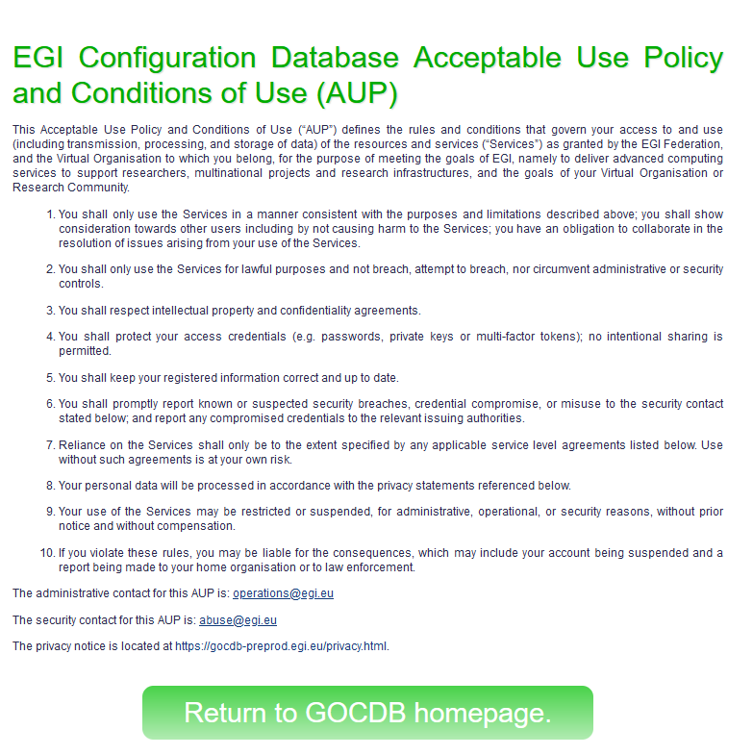
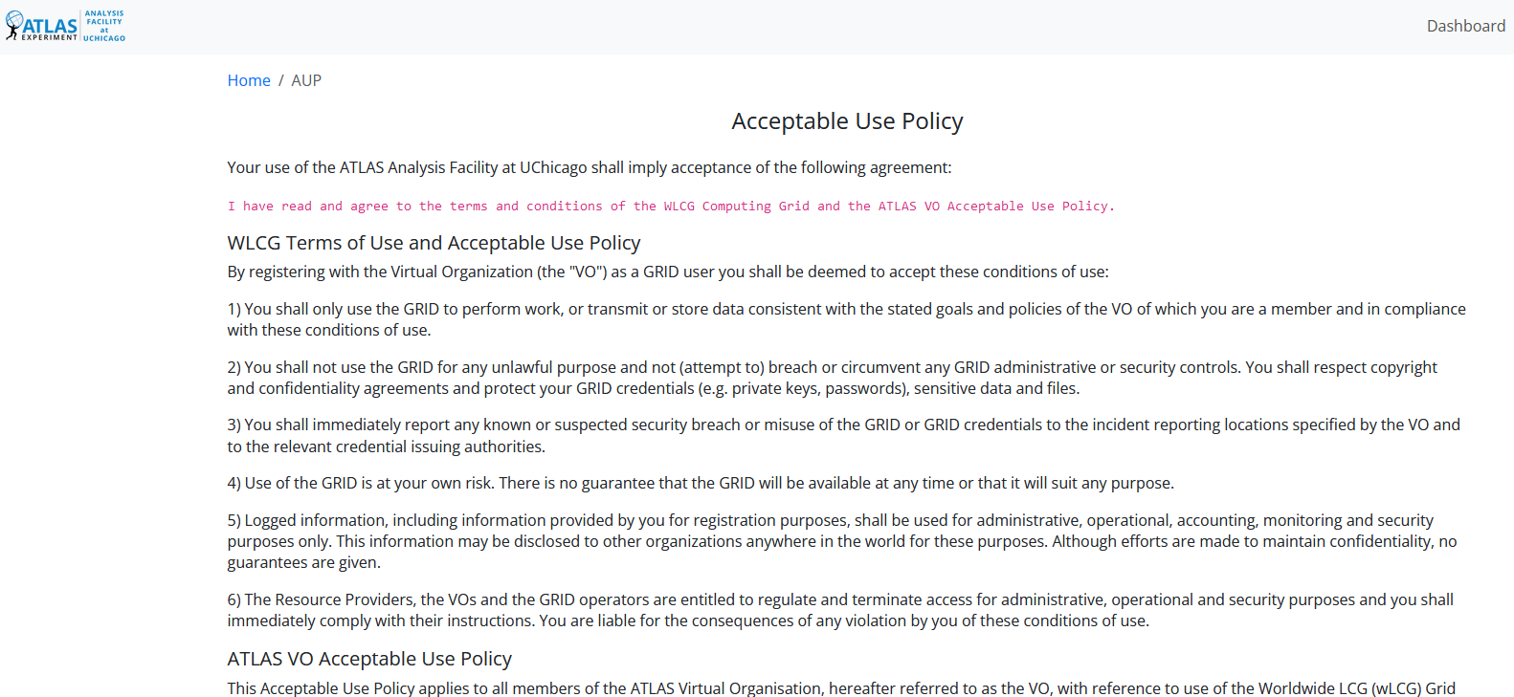
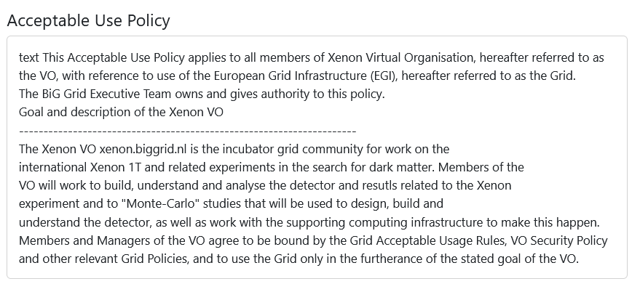
How many of these?

Slide 15
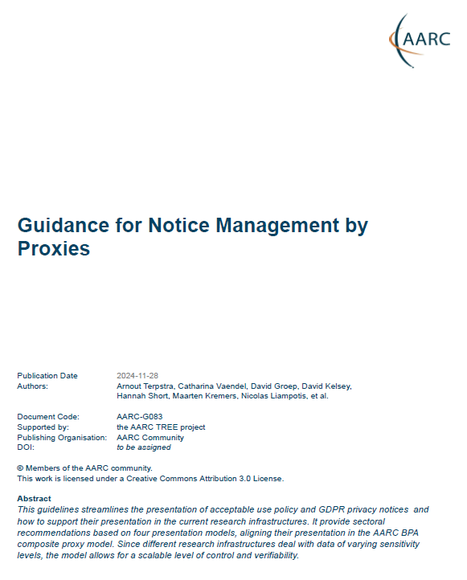
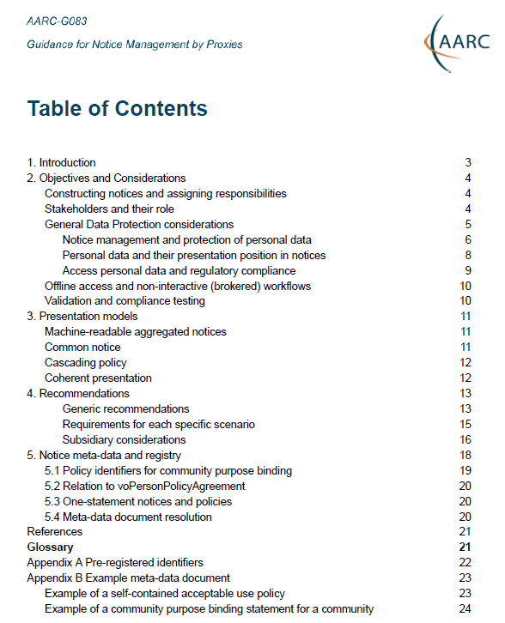
AARC G082 Notice Management by Proxies
Four presentation models. In order of preference
machine-readable aggregated notice
common notice (single common authority domain)
cascading notices (assume responsibility for underlings)
coherent presentation (you show what you need, but not more)
Generic recommendations
use the WISE Baseline AUP composition model, record what and when
user confirmed acceptance, and be able to confirm this downstream
plus a machine-actionable model to
construct notices based on a hierarchy of proxies
sufficient to build you a comprehensive WISE Baseline AUP
and a set of privacy notices (for those GDPR encumbered)
plus a namespace inspired by RFC6711’s LoA registry
https://aarc-community.org/guidelines/aarc-g083/

Slide 16
AARC Ixxx Lightweight Community Management
“small to mid-sized communities do not have the resources to maintain a bespoke community management policy”
this leaves communities and SP operators unclear about trust assurance level of members
This leaves communities and SP operators unclear about trust assurance level of members
5 commandments
Unique Name
AUP Compliance
Privacy Awareness
Valid Authorizations
Incident Response

Slide 17
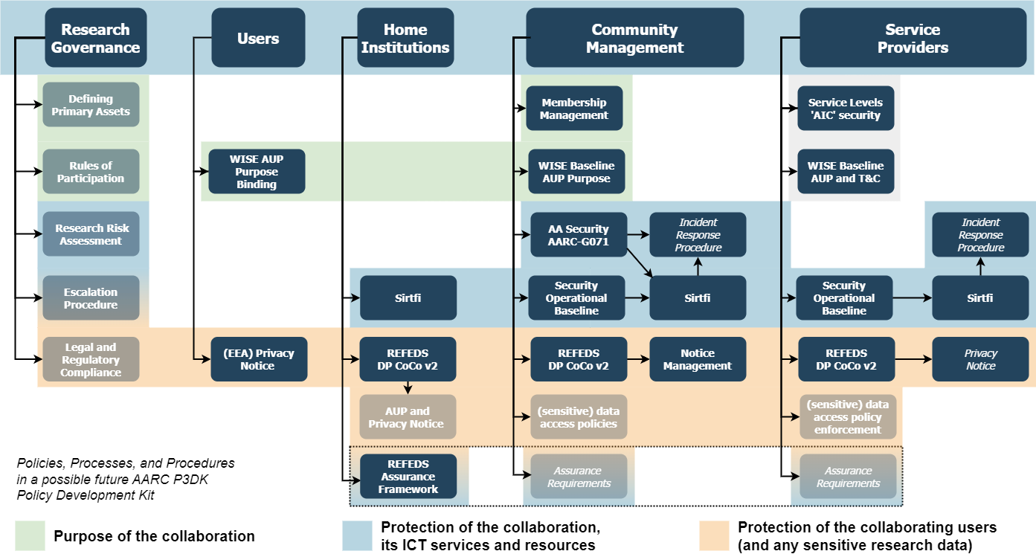
Policy Development Kit: simplify by re-using good practice
Source: David Groep

Slide 18






Policy Development Kit: simplify by re-using good practice
communities sourcing
‘well-operated’ community platforms
(SRAM)
and a few more …
through their scale gets
federations to trust our
AARC ‘middle boxes’
Source: David Groep

Slide 19

AARC Community - open for all
AARC Engagement Group for Infrastructures
The forum of e/r-Infras that operate an AARC BPA complaint AAI.
It’s a closed group on purpose as we want to get feedback from the hands on group.
They approve the AARC guidelines.
Technical WG
Led by Nicolas and Christos
Where technical guidelines are discussed
Anybody can join the discussion:
https://lists.geant.org/sympa/info/aarc-architecture
Policy WG
Led by Dave and David
Supported by EnCo and IGTF
Anybody can join the discussion: policy@aarc-community.org
https://lists.geant.org/sympa/info/aarc-na3

Slide 20
With many thanks to David Groep
for Input of the slides
maarten.kremers@surf.nl

