Slide 1
A Design of Automatic Certificate Management for a Zero Trust IoT System
ISGC 2025
Academia Sinica, Taipei, Taiwan
Eisaku SAKANE and Atsuko TAKEFUSA
National Institute of Informatics, Japan

Slide 2
Outline
What is Zero Trust IoT system?
What do we want to do?
Applying ACME protocol to certificate lifecycle in IoT system
ACME: Automatic Certificate Management System
Summary

Slide 3
What is Zero Trust IoT system?
“The term IoT, or Internet of Things, refers to the collective network of connected devices and the technology that facilitates communication between devices and the cloud, as well as between the devices themselves.” from AWS https://aws.amazon.com/what-is/iot/
Traditionally, we have trusted an entire collection of devices, such as the network segment they reside on.
Applying the concept of Zero Trust to IoT system
We try to establish security among individual devices rather than across the entire collection of devices.
If a vulnerability is found in an IoT system, the vulnerable device causing the problem will be eliminated without involving healthy devices.

Slide 4
What do we want to do?
We want to exclude only vulnerable IoT devices.
How do we detect a vulnerable IoT device? – Out of scope in this presentation.
Premise: IoT devices communicate via MQTT over TLS.
MQTT (Message Queuing Telemetry Transport) is a protocol that enables communication for IoT and M2M (Machine-to-Machine).
How?: By revoking the X.509 certificate used by the MQTT client, the MQTT server will reject TLS connection requests from the client (IoT device).
Communication security measure mechanism (CSMM)
realize the above design.

Slide 5
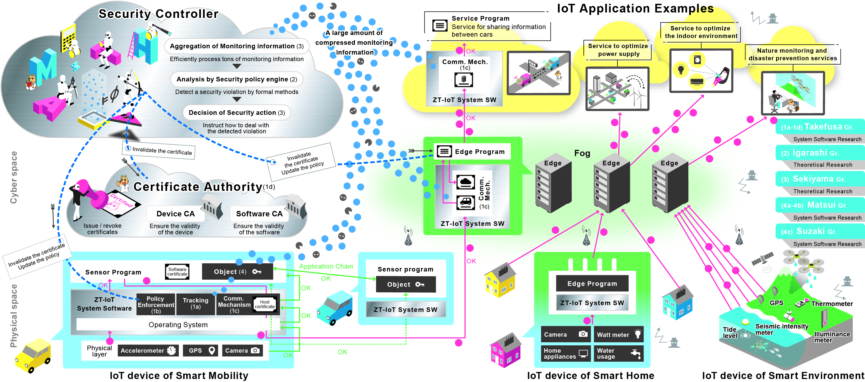
Overview of Zero Trust IoT System

Slide 6
Players in CSMM
Security controller
Aggregation on monitoring information
Efficiently process tons of security information
Analysis by security policy engine
Detect a security violation by formal methods
Decision of security action
Instruct how to deal with the detected violation
Device Certification Authority (CA)
Issue certificates to IoT devices

Slide 7
Requirement for CSMM
Certificate management should be automated.
Requests to revoke certificates for IoT devices can be made from something other than the device in question because vulnerable devices cannot be expected to make revocation requests voluntarily.
Security controller should be able to revoke certificates for IoT devices on behalf of the IoT devices in question.
Building ACME-based PKIX domain as an implementation of CSMM
IoT devices can be recognized as ACME clients.
IoT devices obtain their certificates from ACME server (CA).
Suppose that an IoT device is a network entity that can be uniquely identified by its FQDN. Its certificate profile is the same as “robot”.
How do we handle Security controller within the ACME specification?
ACME client that …

Slide 8
RFC 8555, 7.6. Certificate Revocation

Slide 9
Security controller as ACME client
Security controller behaves as an ACME client that holds authorizations for all of the identifiers in the IoT device certificate.
ACME server implementation: Boulder https://github.com/letsencrypt/boulder
HTTP/DNS challenge
ACME server (CA)
⑧DNS Challenge
DNS server
ag4.zt-iot.dev
Account 1 : ag4.zt-iot.dev
Account 2 : ag4.zt-iot.dev
①
Certificate signing request
②
Sending token
④
Issuing certificate
⑤
Certificate Signing Request
⑥
Sending token
⑨
Issuing certificate
③
HTTP
Challenge
ArmadilloG4
Security controller
⑦Setting token for DNS Challenge
Account key pair 1
Account key pair 2
Authorization verification is completed once the certificate is obtained.
The certificate will be deleted.
Then, certificate 1 can be revoked from either account 1 or 2.
OP-TEE
Certificate 1
ag4.zt-iot.dev
Private key 1

Slide 10
Authorization verification procedure for SC
An IoT device requests the CA to issue a certificate.
The CA sends the token to the IoT device to be verified via HTTP challenge. The IoT device starts a web server with the token configured.
The CA accesses the domain confirmed in the HTTP challenge and verifies the token.
If the token can be verified, the CA issues a certificate and sends it to the IoT device.
The security controller requests the CA to issue a certificate to obtain domain management authority.
The CA sends the token to the security controller to be verified via DNS challenge.
The security controller sets the token as a TXT record on the DNS server.
The CA queries the DNS server for the TXT record of the domain name confirmed in the DNS challenge and verifies the token.
If the token can be verified, the CA issues a certificate and sends it to the security controller. As the security controller only needs to obtain domain management authority, it discards the certificate and private key. The security controller can then revoke certificates for domains for which it has obtained authority.

Slide 11
Discussion
Revocation by Security controller
The security controller can now revoke certificates for IoT devices.
ACME server implementation: Boulder https://github.com/letsencrypt/boulder
However, currently, IoT devices can obtain certificates again by requesting issuance because the ACME account for the IoT devices in question is still valid.
It is necessary to design and implement a mechanism to issue certificates only to trusted IoT devices.
We need more challenge like “trusted IoT device challenge”.

Slide 12
“Trusted IoT device challenge”
Who ensures the reliability of IoT devices?
Security controller
How?
The security controller has a master database (blacklist) of IoT device safety information. We consider the following methods according to where the blacklist is checked when issuing a certificate:
Inquiring of Security controller
Checking the blacklist that CA has Internally
Including the safety status in DNS TXT record and checking it
like extended DNS challenge

Slide 13
Summary
We considered the design of automatic certificate management for a Zero Trust IoT system
We designed and implemented Community Security Measure Mechanism (CSMM)
revocation feature by Security controller
“trusted IoT device challenge” – now in progress
We are building PoC of Zero Trust IoT System and plan to conduct a demonstration experiment.

