Slide 1
IPv6 deployment on WLCG
Jiri Chudoba
Institute of Physics of the Czech Academy of Sciences
Most slides prepared by David Kelsey
ISGC 2025

Slide 2
On behalf of all members of the HEPiX
IPv6 working group - (many thanks all!)
G Attebury (UNL), M Babik (CERN), M Bly (RAL), N Buraglio (ESnet),
T Chown (Jisc), D Christidis (CERN/ATLAS), J Chudoba (FZU Prague),
P Demar (FNAL), J Flix Molina (PIC), C Grigoras (CERN/ALICE), B Hoeft (KIT),
H Ito (BNL), D P Kelsey (RAL), E Martelli (CERN), S McKee (U Michigan),
C Misa Moreira (CERN), R Nandakumar (RAL/LHCb), K Ohrenberg (DESY),
F Prelz (INFN), D Rand (Imperial), A Sciabà (CERN/CMS), T Skirvin (FNAL),
C J Walker (Jisc)
Many more in the past, and members join/leave from time to time
many thanks also to WLCG operations, WLCG sites, LHC experiments, networking teams, monitoring groups, storage developers…

Slide 3
Outline
The HEPiX IPv6 working group and WLCG - a reminder
IPv6 on data storage
IPv6 on CPU & worker nodes
Identifying and removing use of IPv4
Plans for IPv6-only WLCG (& IPv6-Mostly)
Summary & lessons learned

Slide 4
HEPiX IPv6 working group - History and drivers for use of IPv6
Phase 1 - 2011-2016 - analysis, investigations, testbed, fix storage
Phase 2 - 2017-2023 - deploy IPv6 on WLCG data storage
Phase 3 - 2019-onwards - move towards IPv6-only
  2023 onwards - deploy IPv6 on CPU services and WLCG clients
Sites running out of routable IPv4 addresses (avoid NAT)
  Use IPv6 addresses for external public networking
To be ready to support use of IPv6-only CPU clients
There are other drivers for IPv6:
  scitags.org – packet marking (in header of IPv6 packets)
  USA Federal Government – directive on “IPv6-only” (Nov 2020)

Slide 5
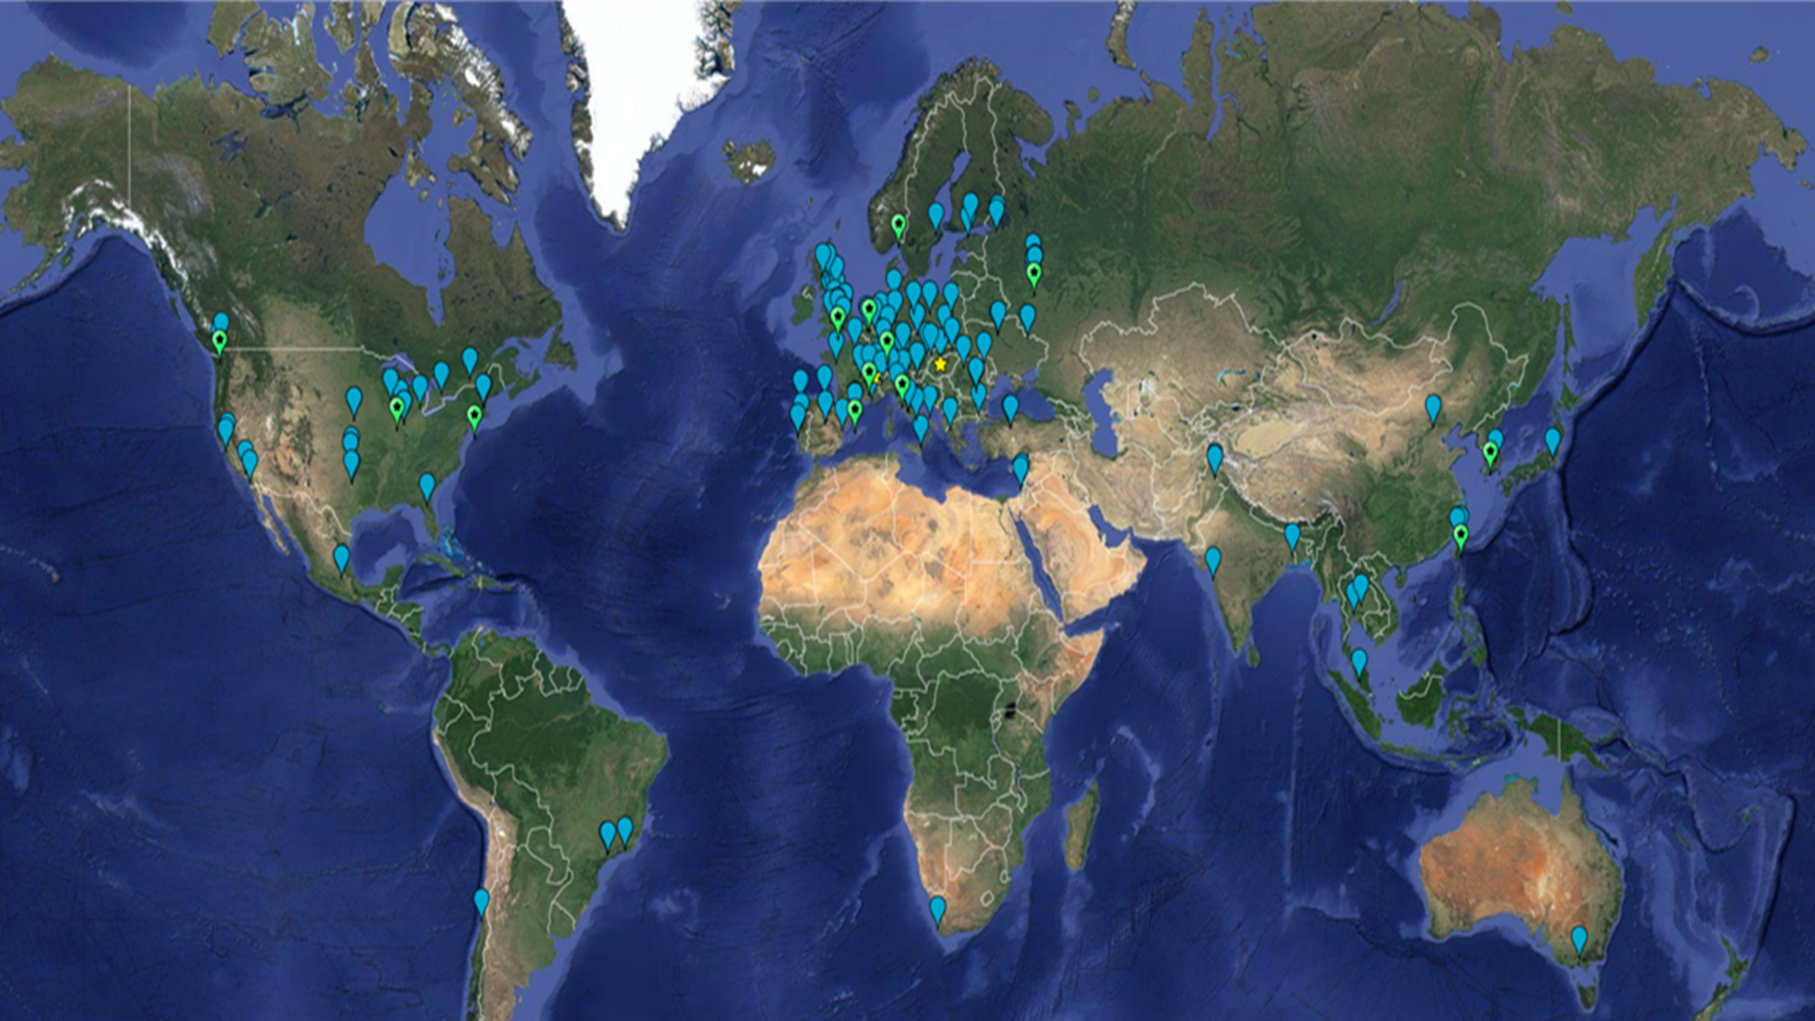


Slide 6
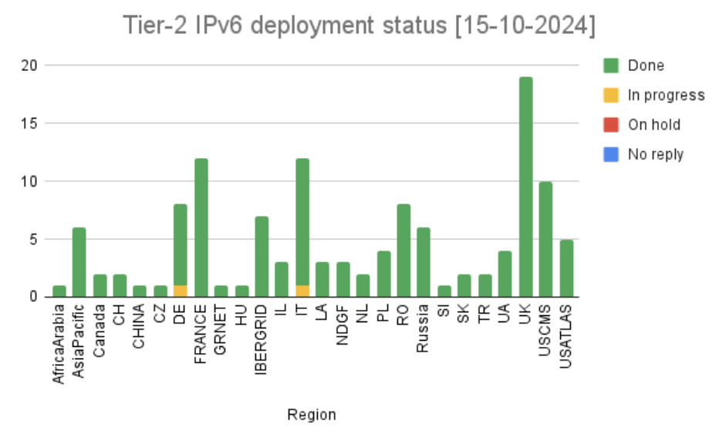
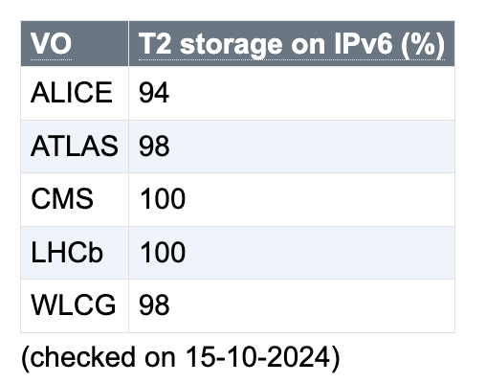
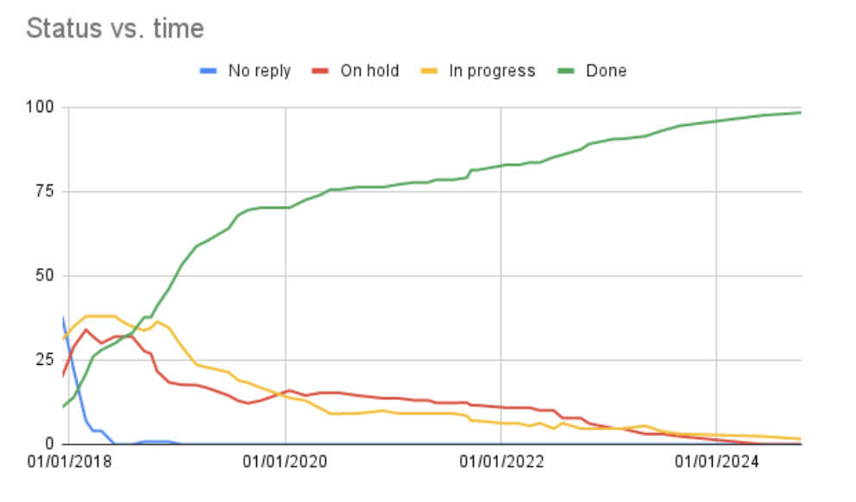
IPv6 on WLCG Storage (Tier2s)
“IPv6 on storage services” started in 2017
Goal to support IPv6-only WNs
Main reason for delay
- the institute networking
Today, essentially complete

Slide 7
IPv6 on CPU services and Worker Nodes
https://twiki.cern.ch/twiki/bin/view/LCG/WlcgIpv6

Slide 8
CPU - GGUS support ticket campaign
Eliminate IPv4 data transfers - between WNs and remote storage
  Approved by WLCG MB in October 2023
Launched end of November 2023 to all WLCG sites
“Please deploy dual-stack connectivity (IPv4+IPv6) on your computing services (computing elements and worker nodes) as soon as possible and by 30 June 2024 at the latest”
Provide estimates for timescale and details on the necessary steps
  If cannot meet the deadline, then explain why

Slide 9
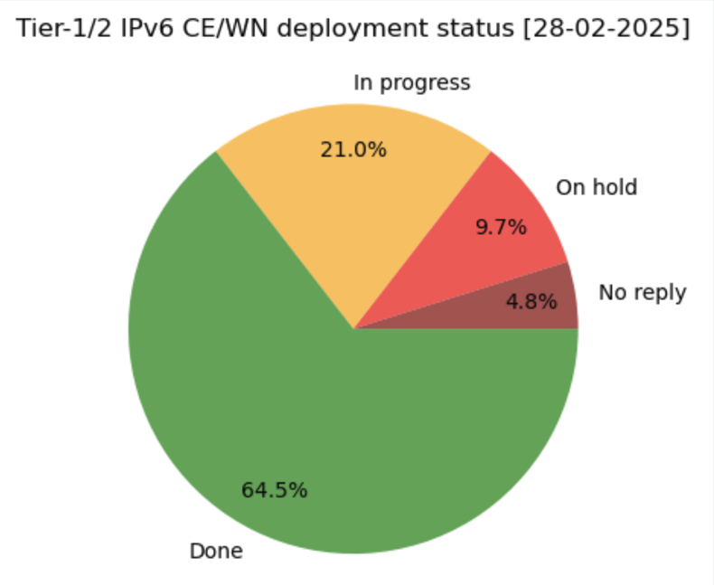
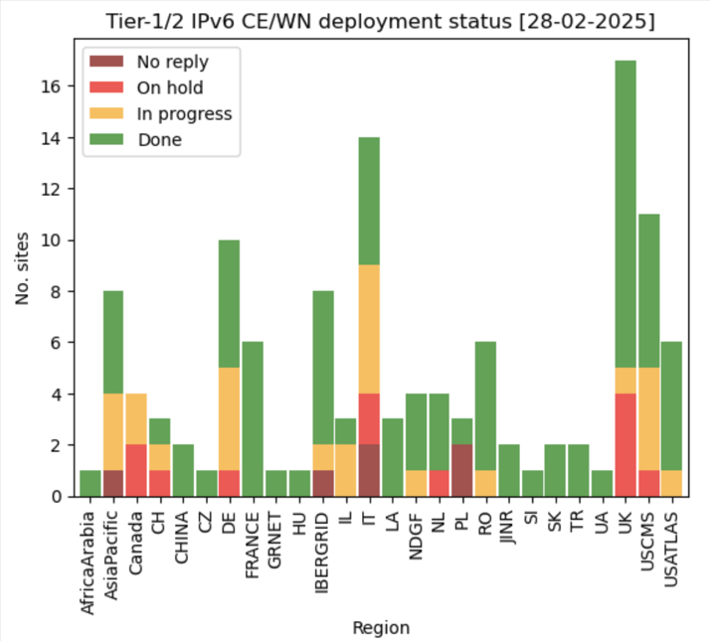
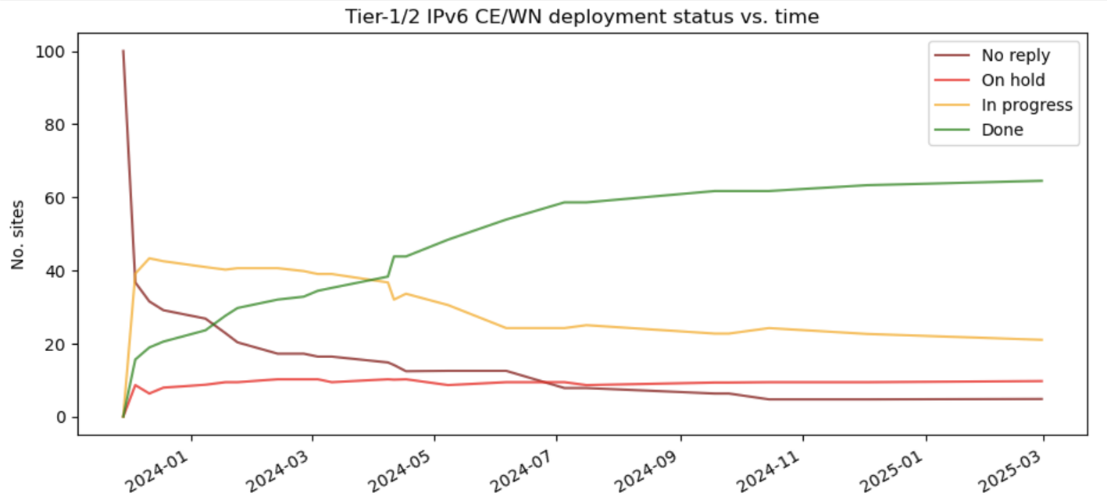
CPU/WN IPv6 status
65% sites are done
Status always visible from a twiki page

Slide 10
Issues reported with enabling IPv6 for WNs/CEs
Common examples:
Enabling IPv6 needs to be coupled to other changes
  new Data Centres, OS updates, hardware, internal routing changes
Some sites have more complex/special configurations to consider with respect to NAT for IPv4 and global IPv6
  e.g., needing to replace IPv4 NAT(s) with dual-stack router(s)
Other priorities: WLCG authZ tokens or handling the CentOS 7 end-of-life
Concern that WNs currently behind IPv4 NAT will become more “exposed”
Also worth noting that some sites keen to go IPv6-only now (though not yet recommended), e.g., Brunel University is currently piloting an IPv6-only cluster.

Slide 11
Issues reported with enabling IPv6 for WNs/CEs
Common examples:
Enabling IPv6 needs to be coupled to other changes
  new Data Centres, OS updates, hardware, internal routing changes
Some sites have more complex/special configurations to consider with respect to NAT for IPv4 and global IPv6
  e.g., needing to replace IPv4 NAT(s) with dual-stack router(s)
Other priorities: WLCG authZ tokens or handling the CentOS 7 end-of-life
Concern that WNs currently behind IPv4 NAT will become more “exposed”
Also worth noting that some sites keen to go IPv6-only now (though not yet recommended), e.g., Brunel University is currently piloting an IPv6-only cluster.

Slide 12
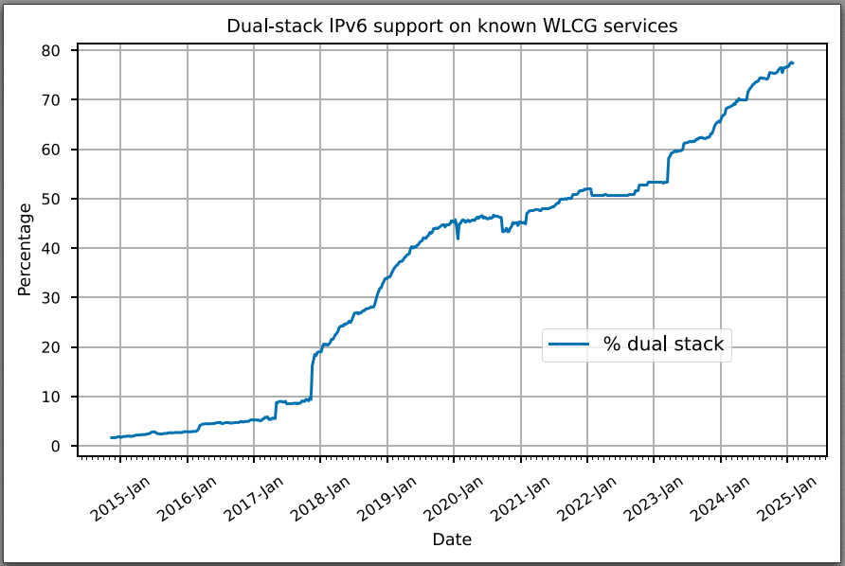
*All* WLCG services - “VOfeeds” https://orsone.mi.infn.it/~prelz/ipv6_vofeed/
6 Mar 2025:
~78% IPv6/IPv4
~22% IPv4

Slide 13
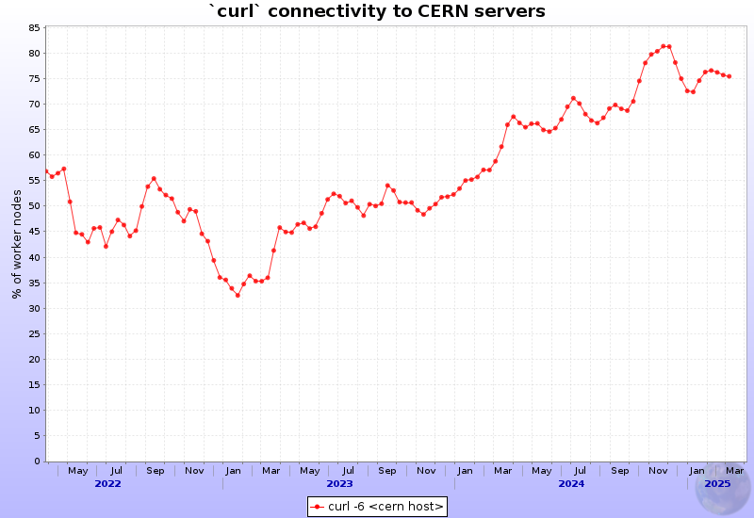
ALICE experiment monitoring
since May 2022

Slide 14
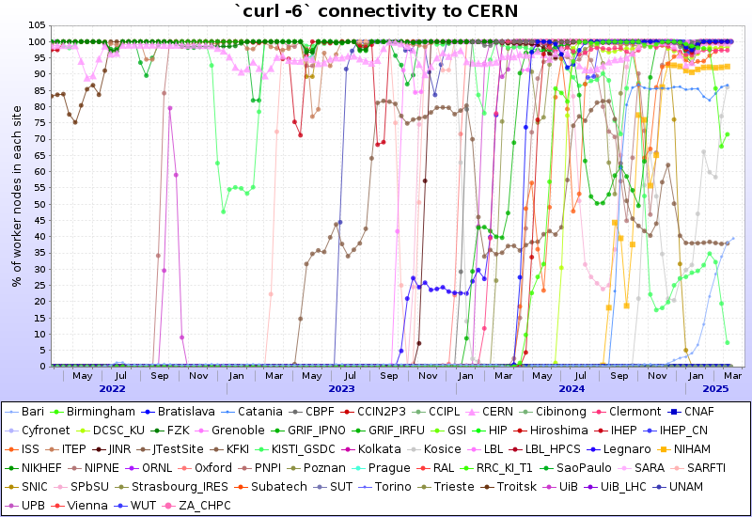
ALICE experiment monitoring
since May 2022

Slide 15
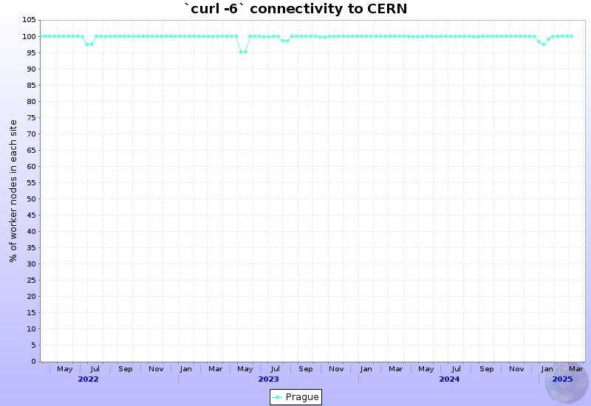
ALICE experiment monitoring
Prague site

Slide 16

ALICE experiment monitoring
CERN

Slide 17
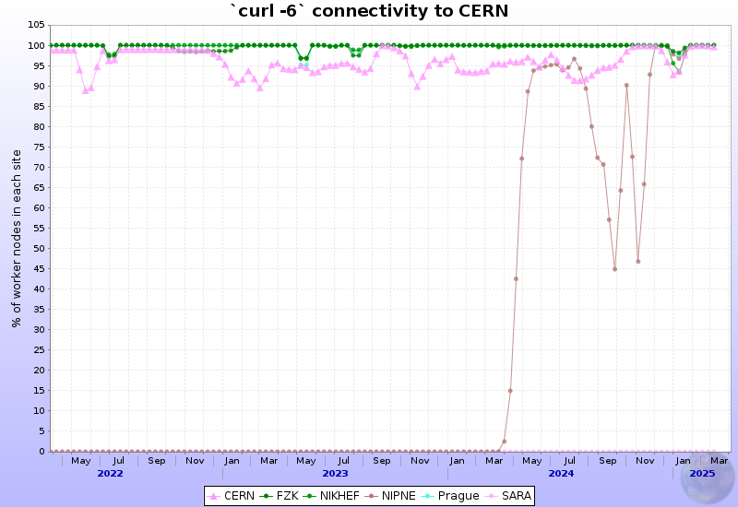
ALICE experiment monitoring
CERN, FZK (KIT), NIKHEF, NIPNE Prague, SARA

Slide 18
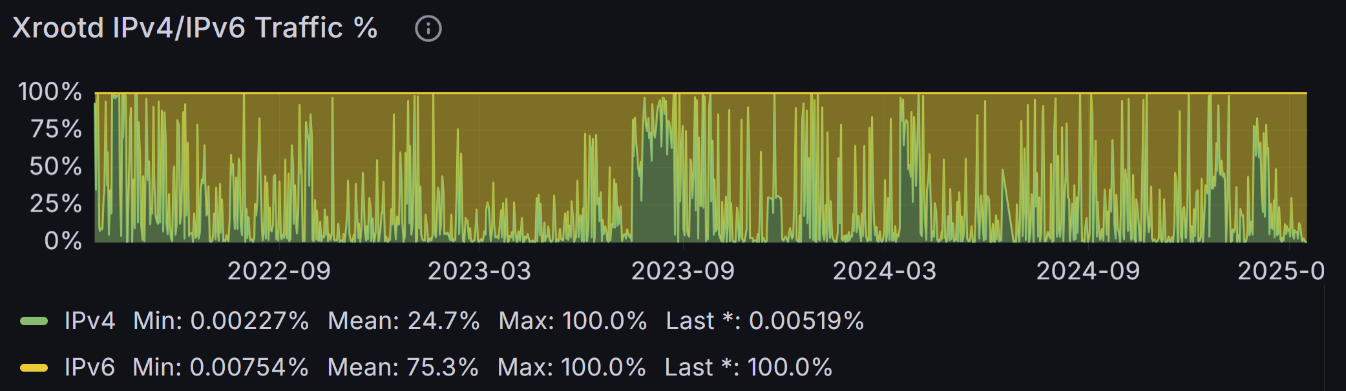
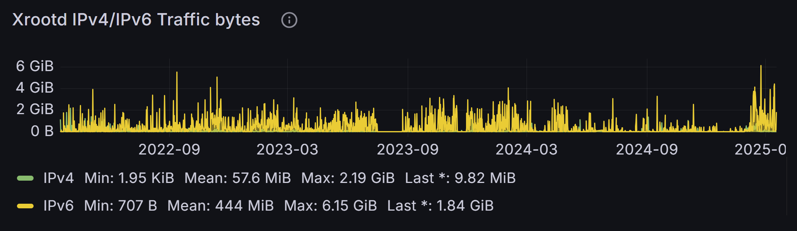
FZU site monitoring - ALICE
Bytes:
IPv4 < 1 % IPv6

Slide 19
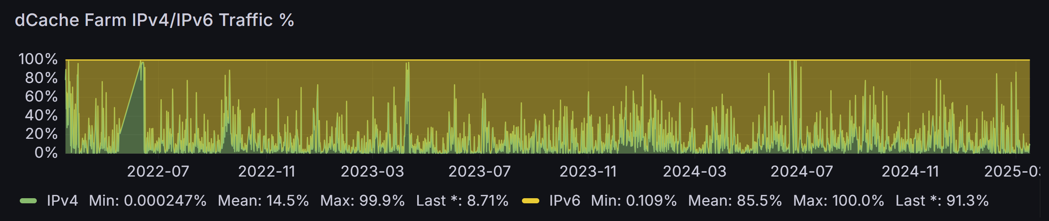
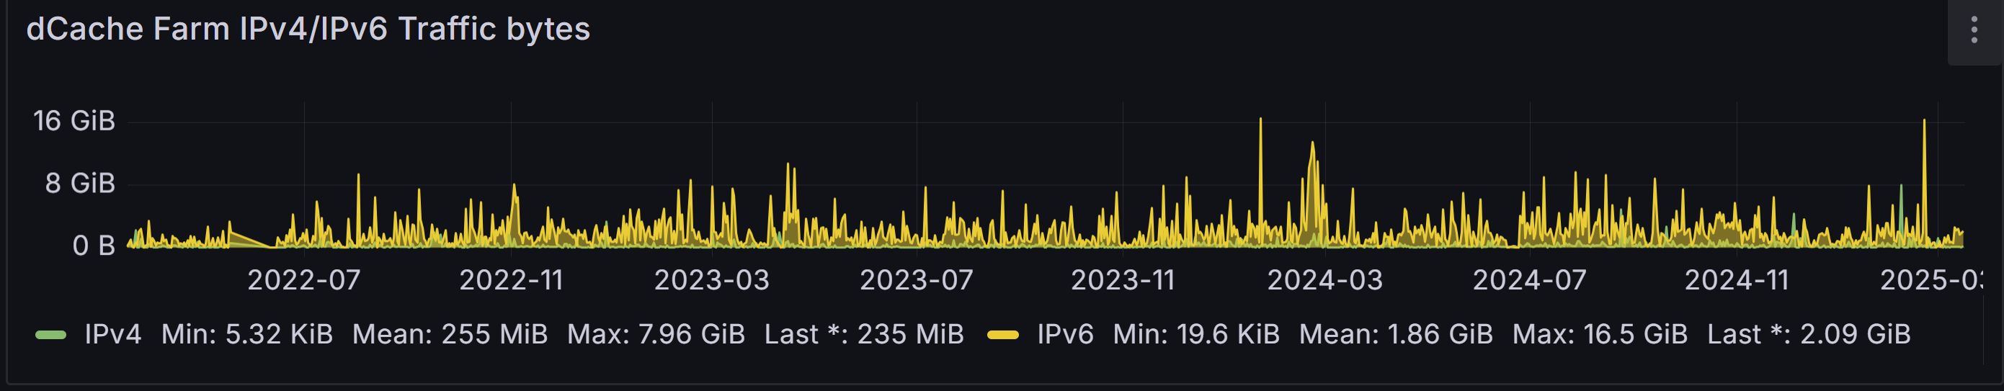
FZU site – ATLAS (mostly)

Slide 20
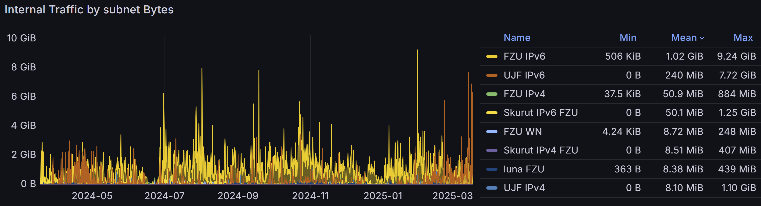
FZU site – internal traffic

Slide 21
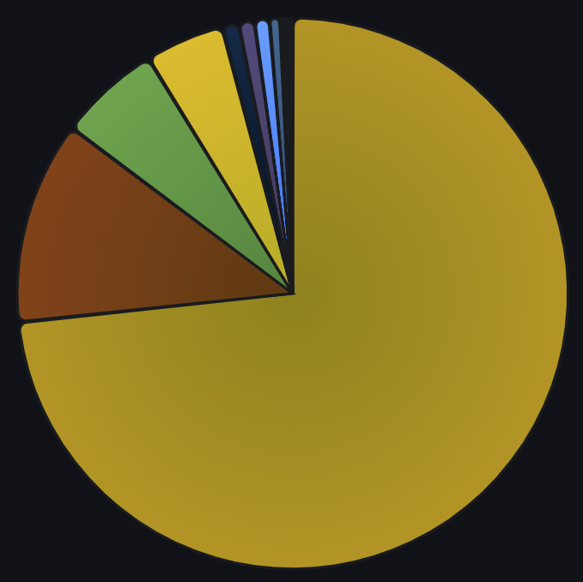
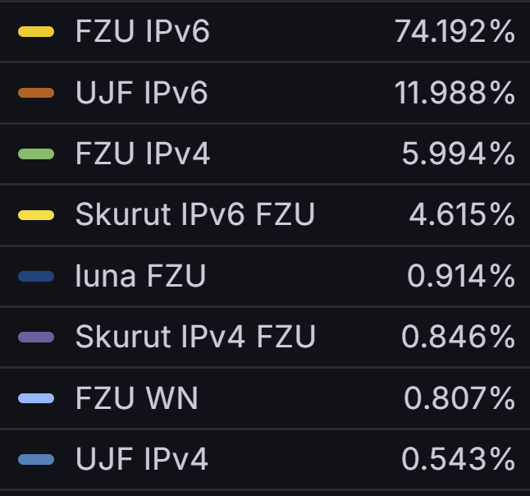
FZU site – internal traffic

Slide 22
Identifying use of IPv4

Slide 23
During WLCG DC24 - and ongoing too
Work to study the LHCOPN link between CERN and KIT
Understand when and why IPv4 is being used
Early on - large IPv4 transfer seen to ALICE at CERN
  Failed transfers on IPv6 failing over to use of IPv4
Later - some transfers from KIT to NL-T1
  All end-points were dual-stack but NL-T1 preferred IPv4 to avoid some observed problems with many concurrent IPv6 streams
Then XRootD file transfers from CERN
  Squid at KIT - all would work if IPv6-only but often fails back to IPv4
Lots of detailed investigations - and STILL ongoing

Slide 24
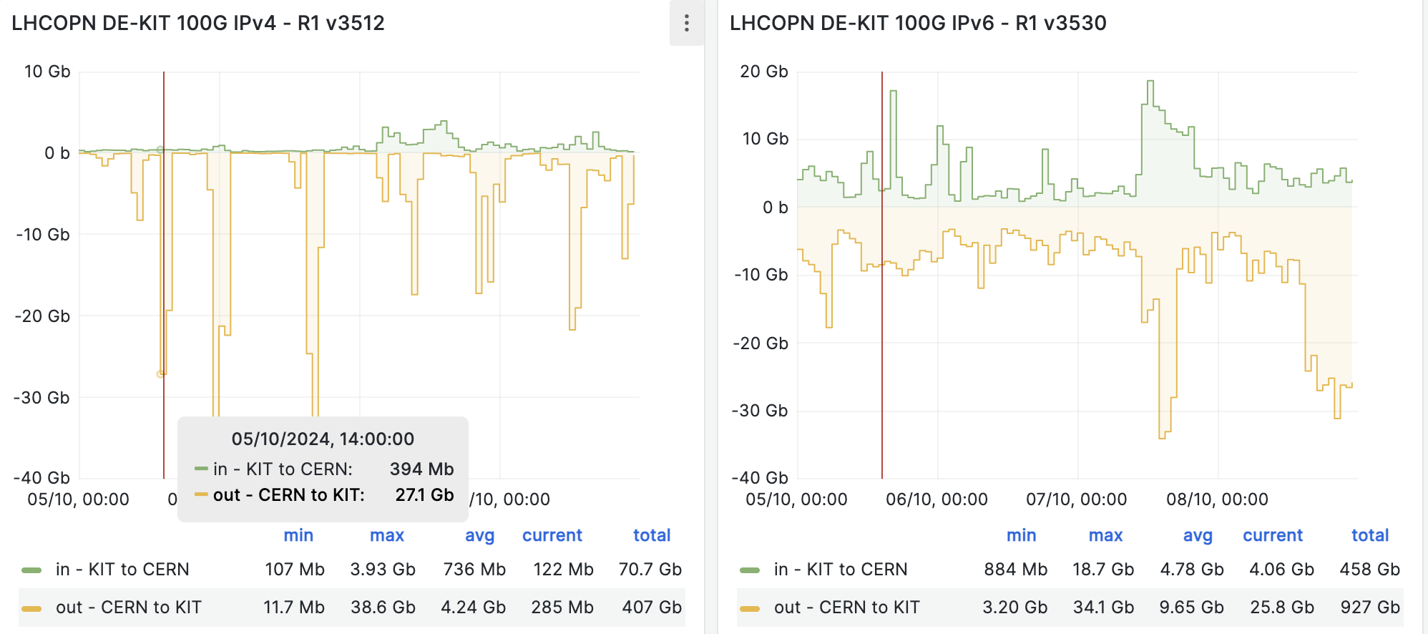
LHCOPN traffic (CERN- KIT) German Tier1 - large IPv4 peaks
IPv4 plot IPv6 plot
This traffic shown as an example - back in Oct 2024

Slide 25
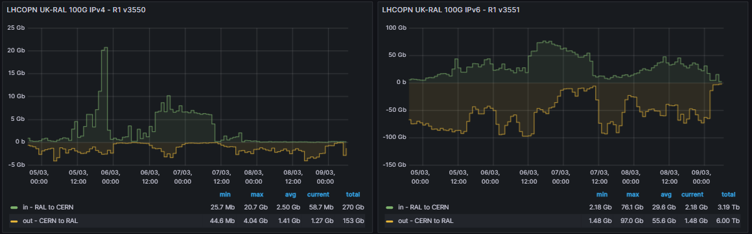
UK Mini Data Challenge 5-8 March 2025
IPv4
IPv6
Data Challenge CERN to RAL Tier 1 (LHCOPN) - this is one of the two 100 Gbps circuits
Normal production traffic plus injected traffic CERN to RAL (to saturate 2 *100 Gbps)
Total IPv4 traffic CERN to RAL 153 Gb; total IPv6 traffic CERN to RAL 6.0 Tb
~98% IPv6

Slide 26
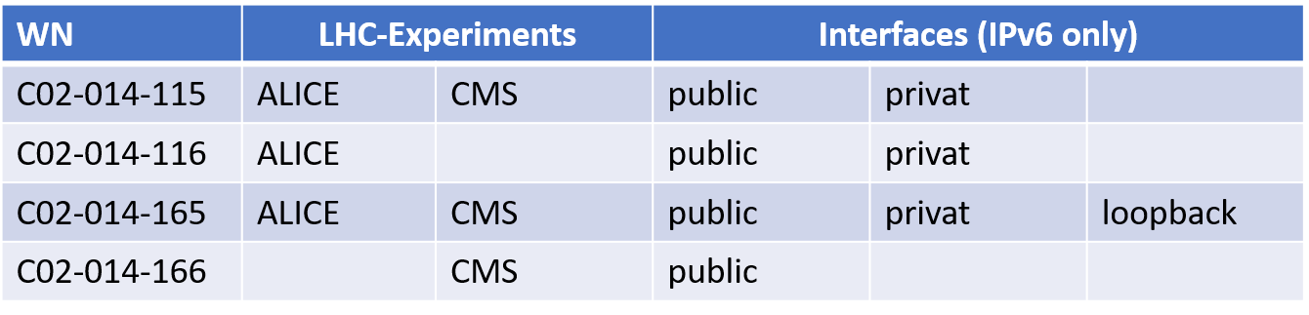
KIT IPv4 debugging
Each WN has 64 cores (up to 64 parallel jobs)
Jobs of two LHC experiments executed : ALICE and CMS
WNs IPv6 only deployed for one week

Slide 27
KIT IPv4 debugging
ALICE jobs at C02-014-165 failed
    → Loopback interface IPv6 only deployed
    ALICE software engineers analyzed
      hardcoded IPv4 address (127.0.0.1)
    After modifying the software
      → Allowing both protocols IPv4/IPv6
      Jobs could be executed successful even with loopback interface IPv6 only deployed

Slide 28
Plans for IPv6-only WLCG

Slide 29
IPv6-only on WLCG (CHEP2019) https://doi.org/10.1051/epjconf/202024507045
The end point of the transition from IPv4 is an IPv6-only WLCG core network - already agreed by WLCG MB - not a dual-stack network!
To simplify operations
  Dual-stack infrastructure is the most complex
  Reduced complexity reduces chance of making security errors
  And dual-stack does not reduce pressure on IPv4 address space
Large infrastructures (e.g. Facebook, Microsoft,...) use IPv6-only internally
This is the goal we are still working towards:
  i.e. all Wide-area data transfers over IPv6
Timetable still to be defined - but aiming for “well before LHC Run 4”

Slide 30
Plans for “IPv6-only” WLCG
The plan (LHCOPN):
By end Run 3 encourage the deployment of IPv6 on *all* WLCG services (today ~80%)
We need monitoring in place to continue to identify/remove IPv4 on LHCOPN
Propose IPv4 peering removed from LHCOPN as soon as possible/sensible
For transfers over LHCONE:
Identify/remove ongoing use of IPv4 on LHCONE network (WLCG traffic)
We need appropriate monitoring to achieve this
Prepare the WLCG LHCONE overlay to be IPv6-only (if can be shown to be sensible)
End point of the IPv6 work:
Complete all above during the first half of the LHC Long Shutdown 3
Well before start HL-LHC Run 4 - exact date still to be agreed with the WLCG MB

Slide 31
IPv6-Mostly see https://datatracker.ietf.org/doc/draft-ietf-v6ops-6mops/
The current approach in IETF to remove legacy IPv4 devices
Hosts with CLAT support to turn off IPv4 when NAT64 is available
The host uses DHCPv4 Option 108 to confirm that the network supports NAT64
The resulting IPv6-only traffic is then either sent natively to IPv6-enabled destinations or via the CLAT for IPv4-only destinations
See IETF RFCs: 6146, 6877, 8925
Has been deployed in production on the eduroam/WiFi at Imperial College London (UK)
A typical week - devices seen on IPv6-only (71K of 87K devices)
used DHCPv6 Option 108 and CLAT support included in iOS, Android and macOS
as support grows (Windows CLAT expected soon) the percentage of IPv6 will grow
legacy devices will be either dual-stack or in some cases IPv4-only
This approach is aimed at user-centric networks but could be useful in WLCG server networks
  given that Linux CLAT implementations are available

Slide 32
Working group observations/questions:
When should perfSONAR stop performing IPv4 tests?
  Just for WLCG dashboards?
  To remove more IPv4 traffic from LHCOPN/LHCONE
Can we add “IPv4 versus IPv6” traffic split in the WLCG Site egress monitoring network I/O (for DC24) (every minute)?
  Rather than just total traffic

Slide 33
Summary - and lessons learned
WLCG already supports use of IPv6-only clients
Majority of WLCG data transfers already use IPv6
Campaign for IPv6 on CPU and WN’s - well underway
We still observe ongoing use of legacy IPv4 on LHCOPN
  We continue to chase “preference of IPv6” in service configuration
Complete the move to IPv6-only well before start HL-LHC Run 4
Message to WLCG & LHC experiments:
  Deploy IPv6 on all services & clients and prefer its use
Main lessons learned (for other Research Communities)
  Everything takes longer than hoped for - start early (or start with IPv6)
  For all Research Communities using MultiONE - encourage “IPv6-only”

Slide 34
Questions, Discussion?
Notes:
test

Slide 35
Backup slides

Slide 36
“Obstacles” to IPv6
There are many reasons stopping the full use of IPv6/IPv4
Dual stack is an essential step on the journey to IPv6-only
The Obstacles that we have been addressing:
WLCG Sites not yet deployed IPv6 networking ~done
Sites have IPv6 but Tier-2 has no dual-stack storage ~done
IPv6 monitoring not available or broken
  Monitoring is essential
Service is dual-stack but IPv4 still being used
  We continue to chase these problems

Slide 37
Obstacles to IPv6 - being addressed
Non-storage services not yet dual-stack
  ~75% of all WLCG services are dual-stack today, we need 100%
WLCG client CPU (worker nodes, VMs, containers) some IPv4-only
  GGUS ticket campaign well underway
Services/clients outside of WLCG Tier-1/Tier-2 not yet addressed
  Tier-3, Public/Commercial Clouds, Analysis facilities, Experiment portals…
Use of new or evolving technologies not yet tested or tracked
  New CPU architectures (GPU, non-x86, …), container orchestration, …
Staffing issues can be an obstacle
  Lack of effort, lack of IPv6 training/knowledge, pressure of other work

Slide 38
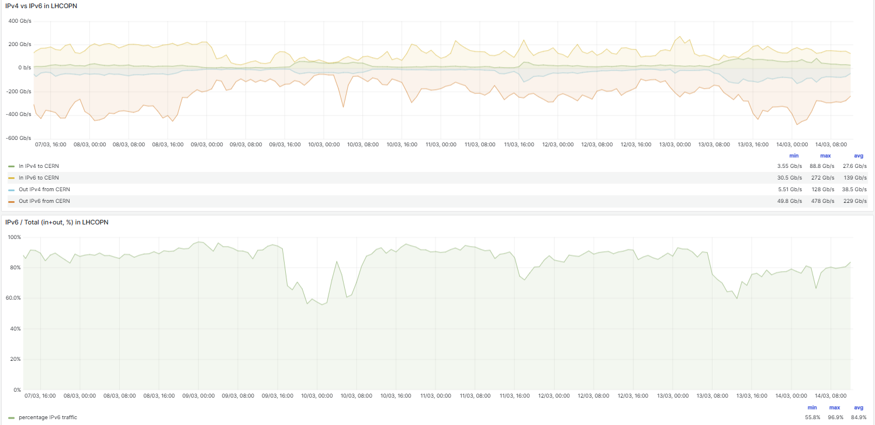
%IPv6 on LHCOPN (CERN) - March 2025

Slide 39
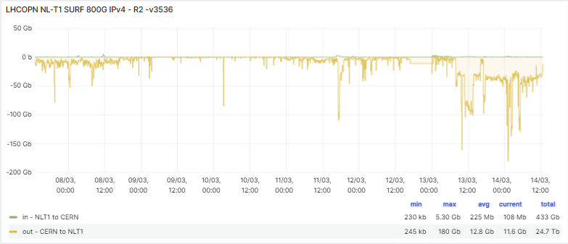
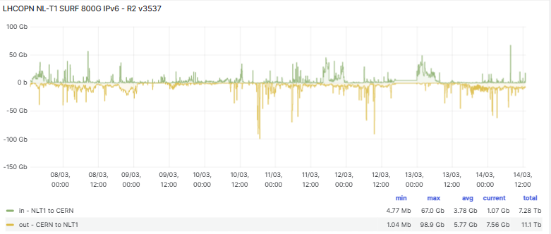
LHCOPN NL T1 March 2025
Large IPv4 traffic - CERN to NL
13 and 14 March 2025

Slide 40
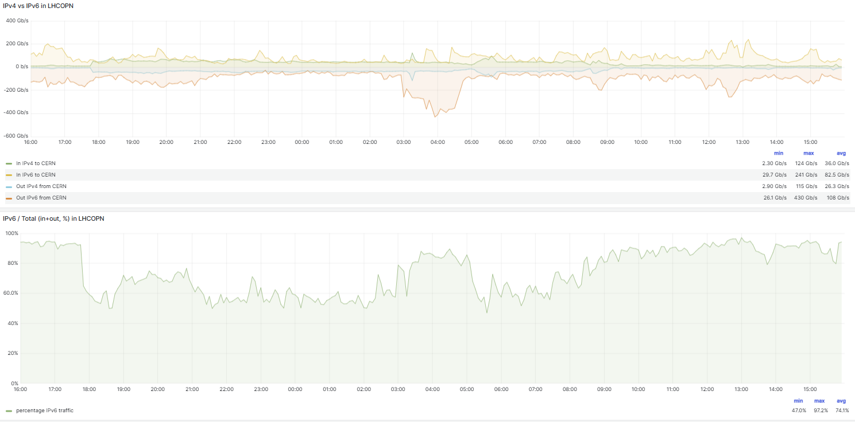
LHCOPN all - 9 to 10 Mar 2025 (16:00 to 16:00)

Slide 41
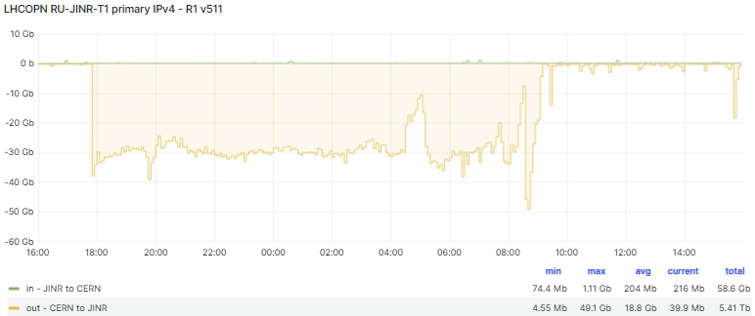
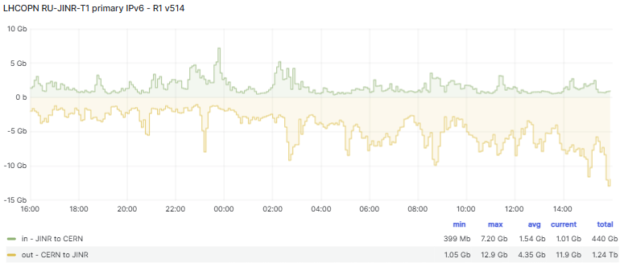
LHCOPN 9Mar to 10 Mar - RU-JINR-T1
30 Gbps IPv4 CERN to JINR
From 18:00 until 09:00

Slide 42
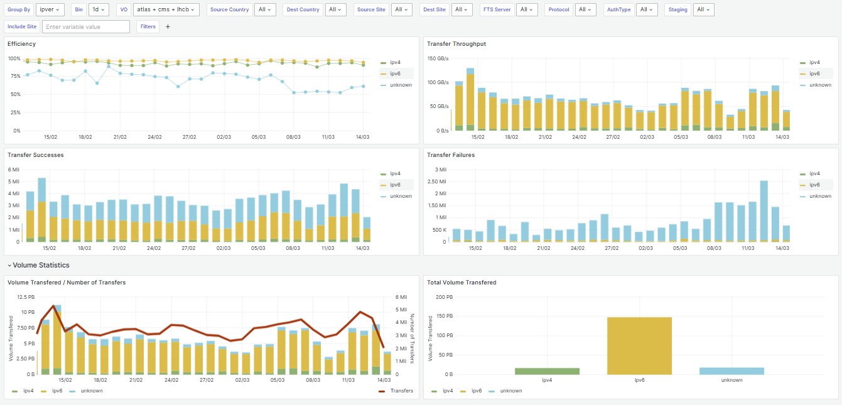
FTS Last 30 days All LHC VOs - All Sites

Slide 43
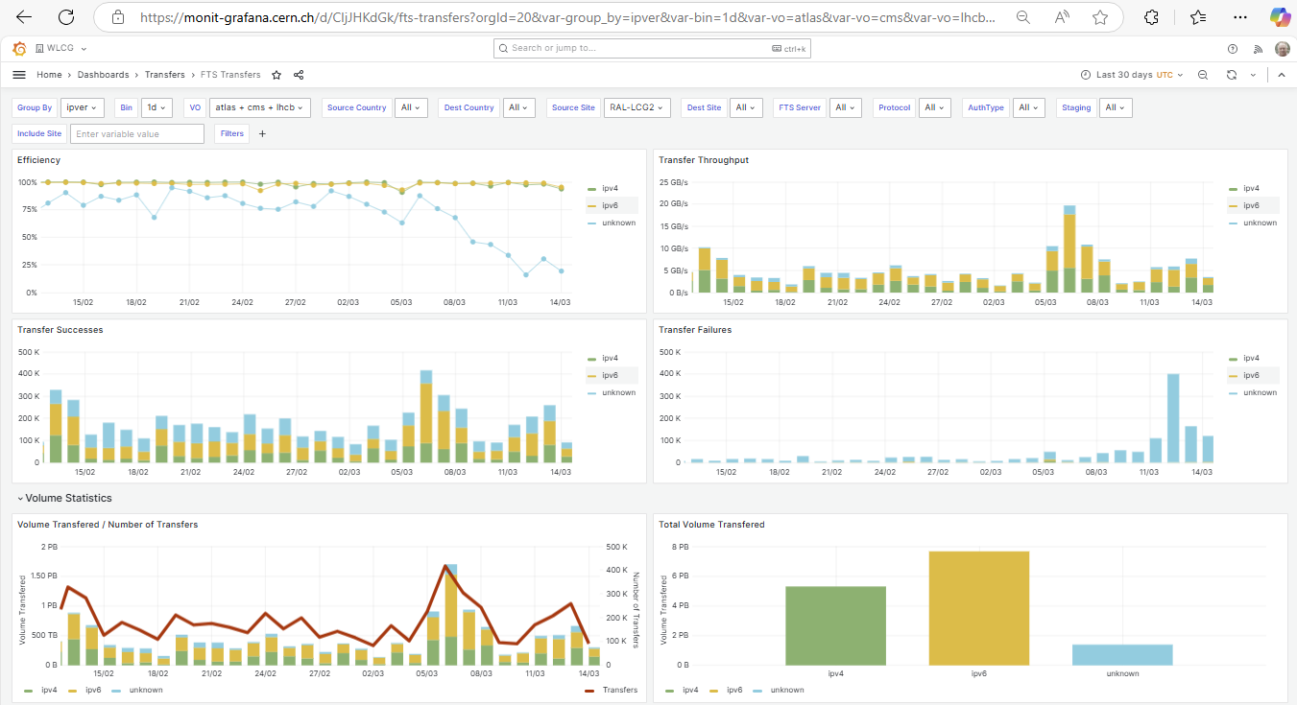
Same as last slide but Source RAL-LCG2
(but this includes RAL Tape which is IPv4-only)

Slide 44
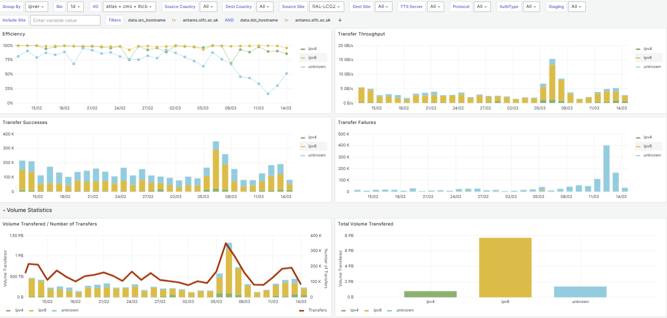
Same as last slide but Source RAL-LCG2
(Here exclude the RAL Tape which is IPv4-only)

Slide 45
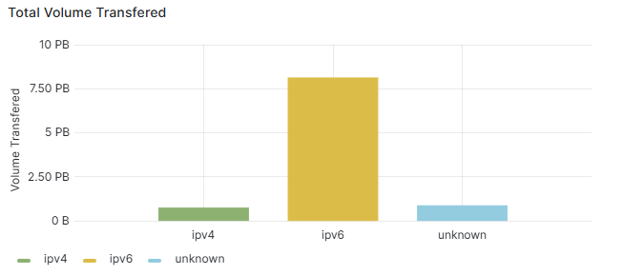
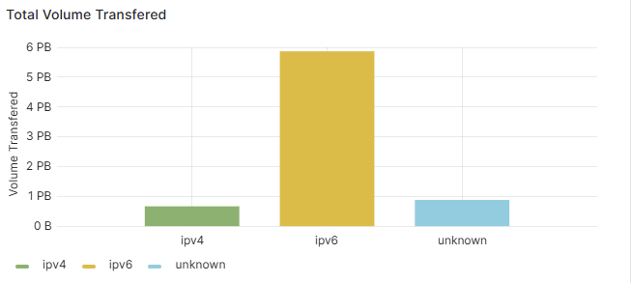
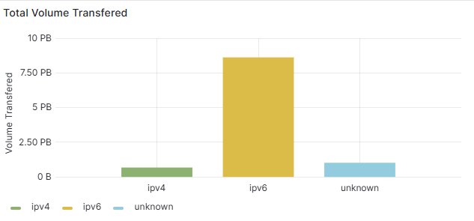
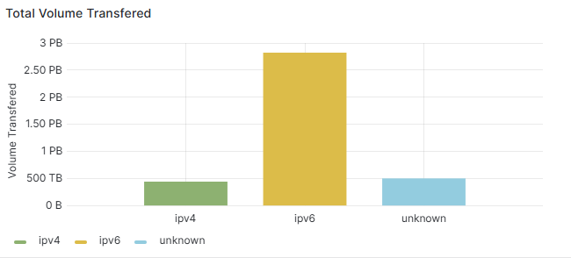
Same as before - various source Tier 1s
<- DE
<- DE
IT->
<- FR
NL ->

Slide 46
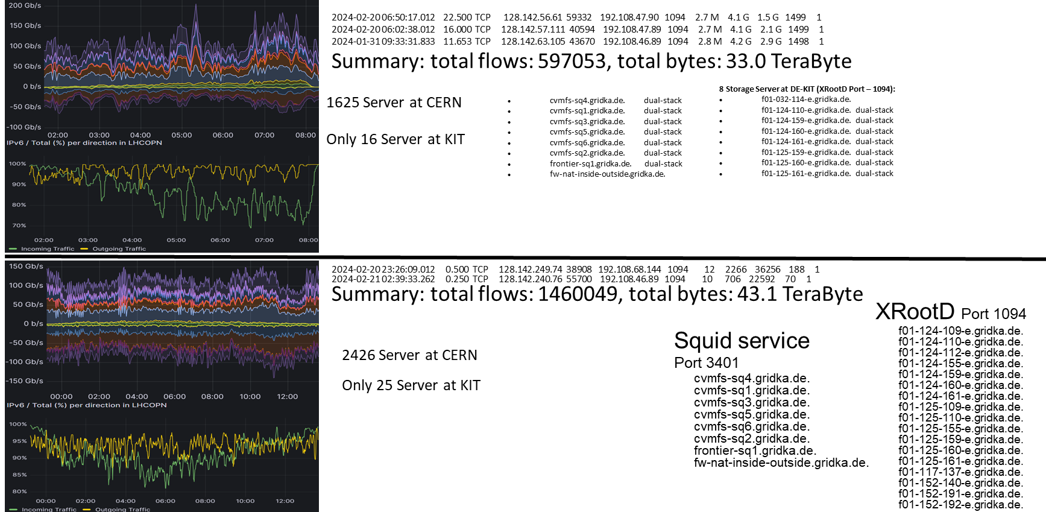
XRootD file transfer from CERN
Green line - CERN to KIT %IPv6 70 to 80%
Green line - and again

Slide 47
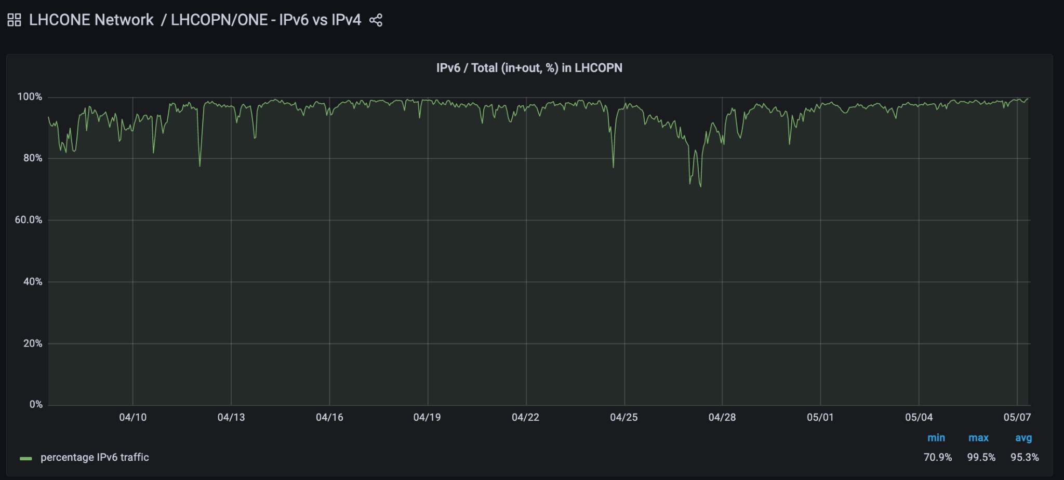
LHCOPN - %IPv6 traffic - shown at CHEP2023
7 April to 7 May 2023 - shows drops in %IPv6
Max
99.5%
100%
Max
99.5%
Avg
95.3%
Min
70.9%

Slide 48
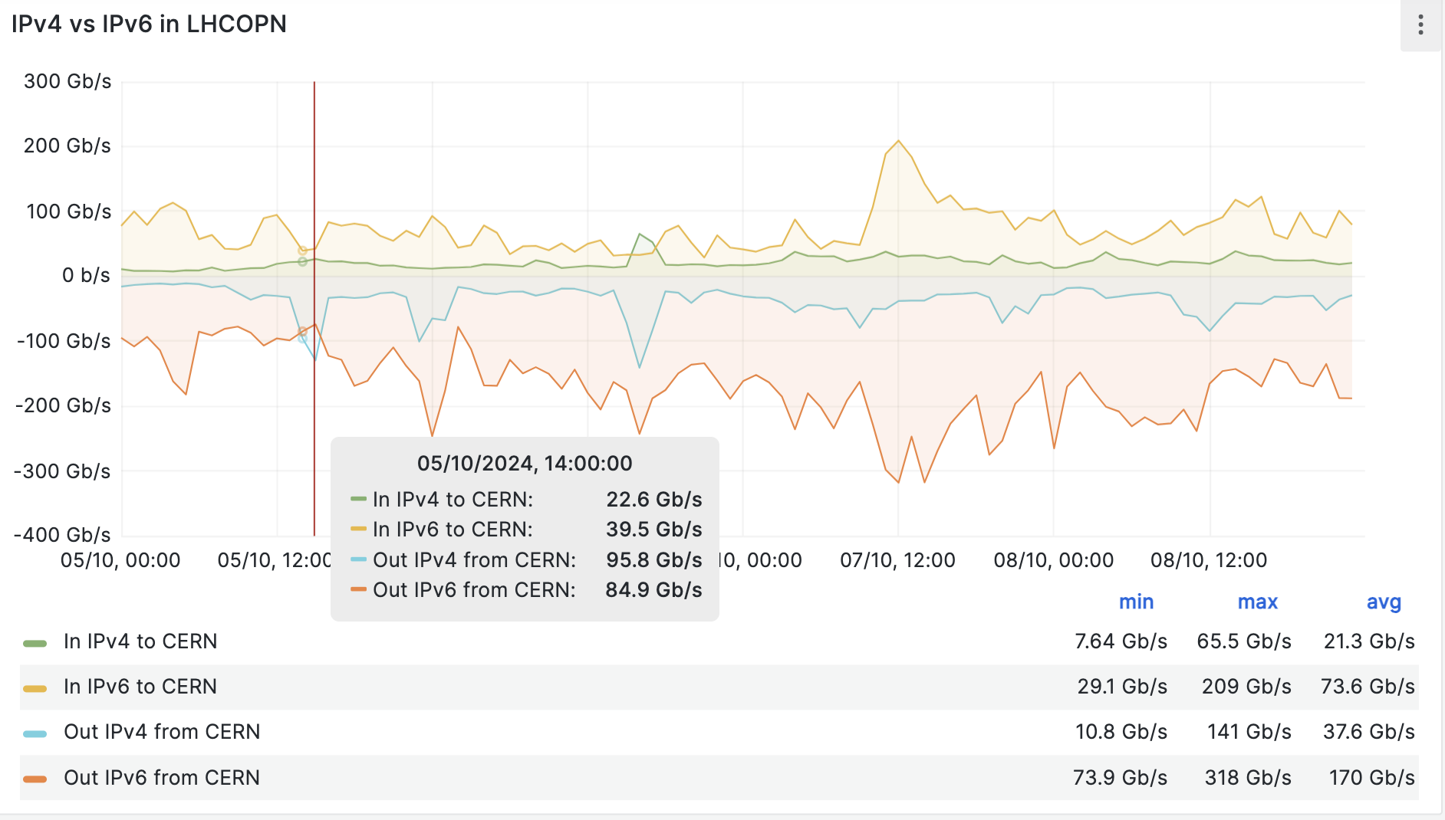
LHCOPN total traffic, split IPv4 & IPv6 (as seen at CERN)
https://monit-grafana-open.cern.ch/d/cumEJJb4z/lhcopn-one-ipv6-vs-ipv4?orgId=16&from=1728079200000&to=1728424799000
5 to 9 Oct 2024
IPv6 Out of CERN
  Avg 170 Gbps
IPv4 Out of CERN
  Avg 37.6 Gbps
BUT
  Large IPv4 peaks, e.g.
  5/10 @ 14:00
  Out 95.8 Gbps

Slide 49
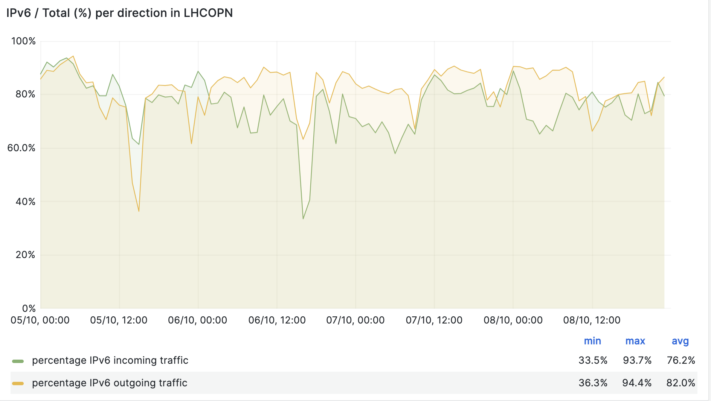
%IPv6 traffic - generally high - but large drops down to ~40%
%IPv6
In - avg 76.2%
  Min 33.5%
Out - avg 82.0%
  Min 36.3%

Slide 50
What are these large peaks of IPv4?
Not easy
Need access to Netflow data
Study IP addresses and Port numbers
  Aim to identify LHC Experiment
  Source and Destination address
  Type of data transfer
Work in progress
  But some evidence of Frontier/CVMFS/Squid, etc….

