Slide 1

Quantum Error Mitigation via Autoencoder Neural Networks
Xiao-Dao Lin¹, Hsi-Ming Chang², Jhih-Shih You³ and Hsiu-Chuan Hsu¹
¹ Graduate Institute of Applied Physics, National Chengchi University
² Brightlight Vision, Santa Clara, CA
³Department of Physics, National Taiwan Normal University
Academic Sinica @ ISGC

Slide 2
Content
Introduction
Methodology
Results & Discussion
Conclusion & Future work

Slide 3
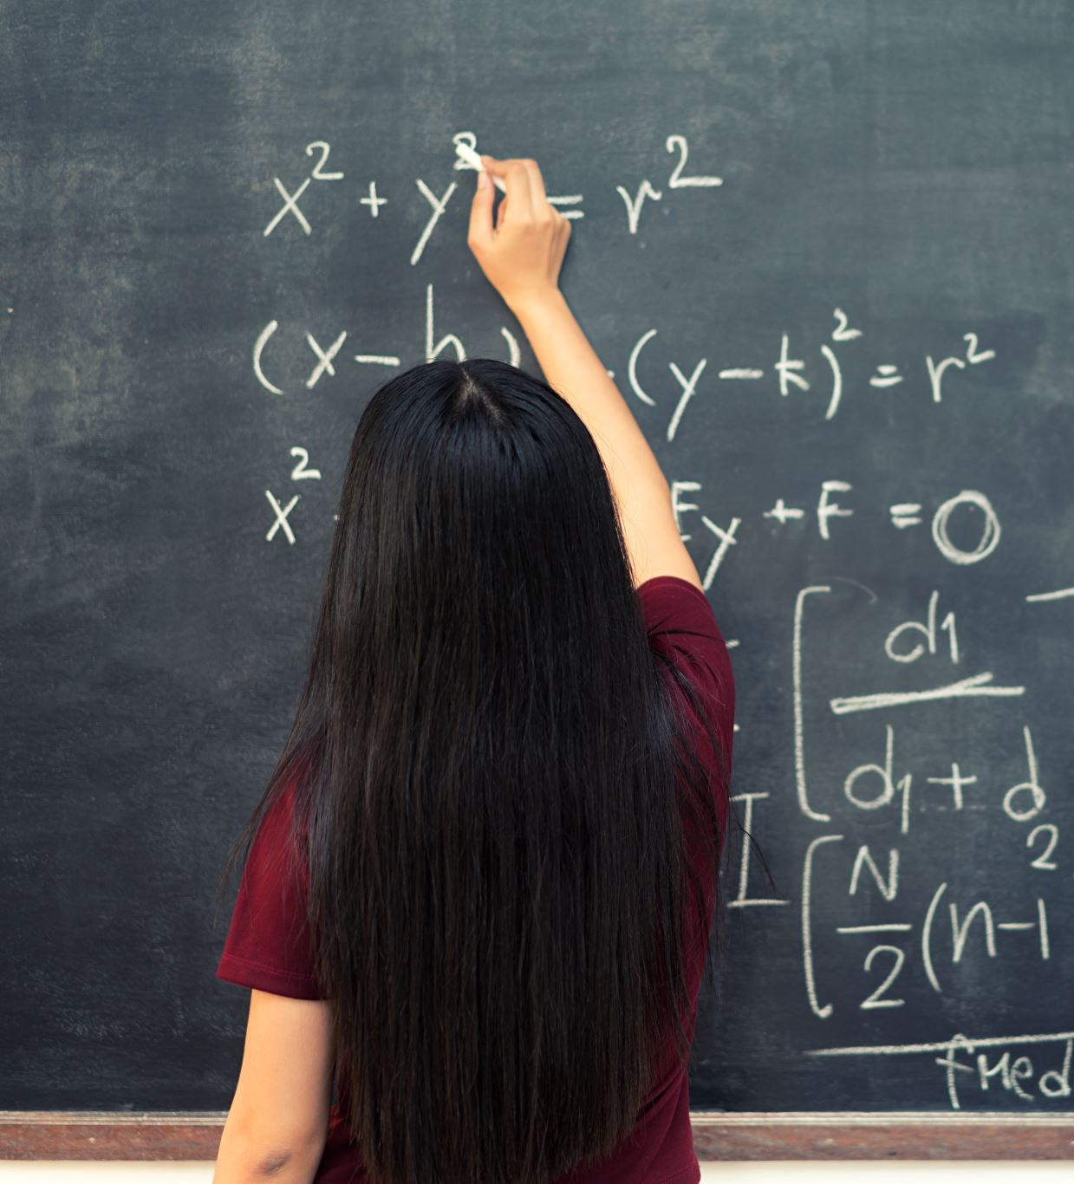
Introduction
Motivation, Previous work & research

Slide 4
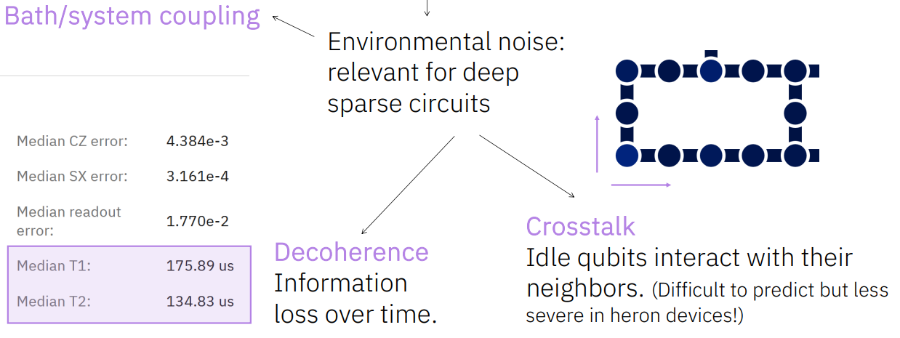
Background – Motivation & Previous work
Due to the challenging control of qubits in different techniques, there are some environmental perturbations that cause the errors in measuring the qubits (readout errors) .
A promising approach is quantum error mitigation which focuses on reducing errors. Common methods include zero-noise extrapolation(ZNE), probabilistic error cancellation, measurement error mitigation and learning-based methods [2].
Kevin J. Sung, Quantum Algorithm Engineer, IBM, "Execution on Noisy Quantum Hardware," Road to Quantum Utility Workshop 2025: Using Quantum Devices with More Than 100 Qubits, January 22, 2025. Image from IBM Quantum.
[1] S. Endo, Z. Cai, S. C. Benjamin, and X. Yuan, “Hybrid quantumclassical algorithms and quantum error mitigation,” Journal of the Physical Society of Japan, vol. 90, no. 3, p. 032001, 2021. [Online]. Available: https://doi.org/10.7566/JPSJ.90.032001
[2] Z. Cai, R. Babbush, S. C. Benjamin, S. Endo, W. J. Huggins, Y. Li, J. R. McClean, and T. E. O’Brien, “Quantum error mitigation,” Rev. Mod. Phys., vol. 95, p. 045005, Dec 2023. [Online]. Available: https://link.aps.org/doi/10.1103/RevModPhys.95.045005

Slide 5
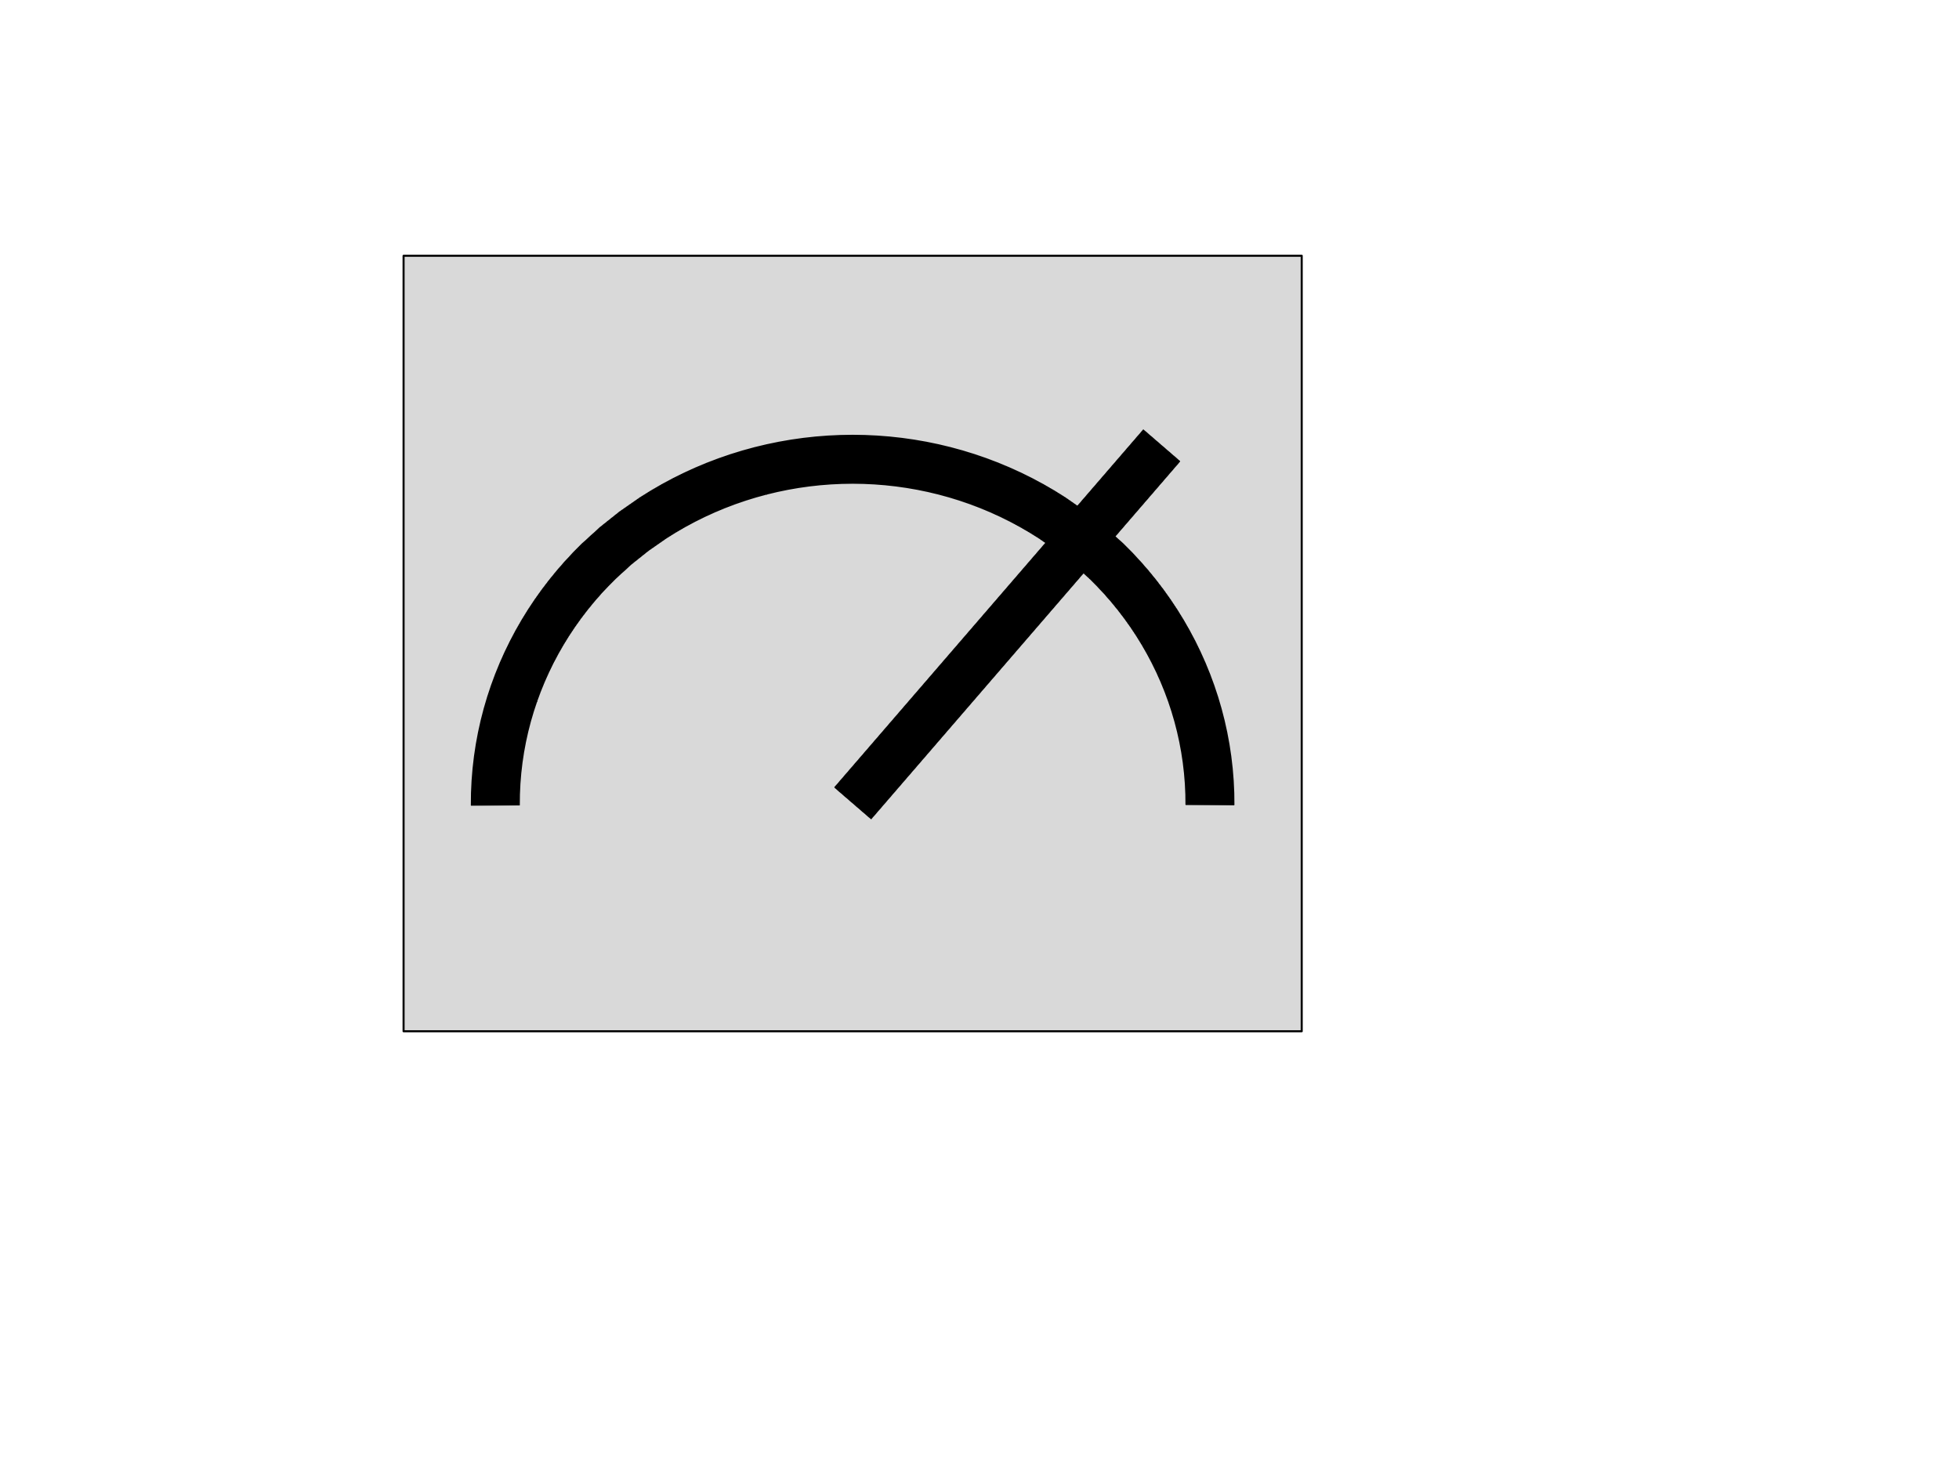






Background – zero-noise extrapolation
Two steps of ZNE:
  Intentionally scale noise
  2. Extrapolation to the noiseless limit
U
$$→ E_{origin}$$
Target
$$E_{origin}$$
data
U
U†
U
$$→ E_{first}$$
Exp value
$$E_{first}$$
$$E_{second}$$
U
U†
U
U†
U
$$→ E_{second}$$
0
Noise Level

Slide 6

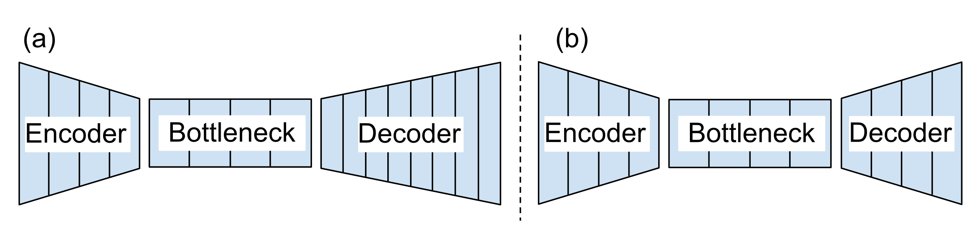
Background – Autoencoder
Vincent et al. [3], [4] introduced denoising autoencoders, demonstrating their capability to extract and compose robust features by reconstructing original signals from corrupted inputs.
Zhang [5] shows the effectiveness of convolutional autoencoders in image denoising tasks, demonstrating superior spatial feature learning compared to traditional fully connected architectures.
[3] P. Vincent, H. Larochelle, Y. Bengio, and P. Manzagol, “Extracting and composing robust features with denoising autoencoders,” Proceedings of the 25th International Conference on Machine Learning, pp. 1096– 1103, 2008.
[4] P. Vincent, H. Larochelle, I. Lajoie, Y. Bengio, and P. Manzagol, “Stacked denoising autoencoders: Learning useful representations in a deep network with a local denoising criterion,” Journal of Machine Learning Research, vol. 11, pp. 3371–3408, 2010.
[5] Y. Zhang, “A better autoencoder for image: Convolutional autoencoder,” in Proceedings of the International Conference on Image Processing, 2018.

Slide 7



This study
In this paper, we propose to use convolutional denoising Autoencoder to mitigate the readout errors in measurement probabilities of quantum circuits.
Noisy data
Targets data
$$\left[\begin{aligned}0.3 \\ 0.35 \\ 0.2 \\ 0.15\end{aligned}\right]$$
$$\left[\begin{aligned}0.25 \\ 0.25 \\ 0.25 \\ 0.25\end{aligned}\right]$$
Noisy data
Prediction data
Target
data
$$≈$$

Slide 8

Methodology
The methods.

Slide 9
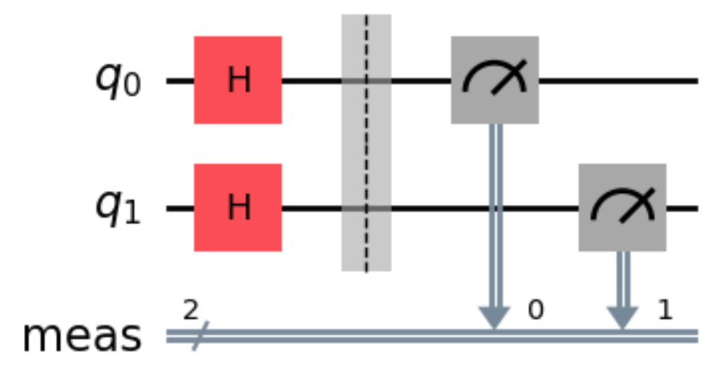

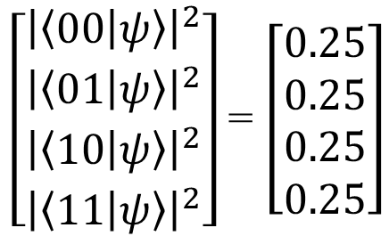


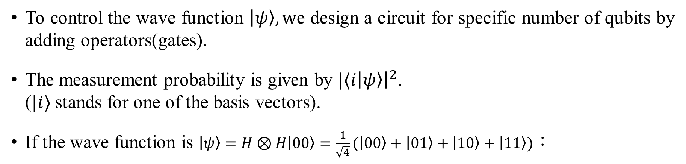

Quantum Measurement Probability
#We perform projective measurement onto computational basis.
To control the wave function $\left|ψ\right\rangle ,w$e design a circuit for specific number of qubits by adding operators(gates).
The measurement probability is given by $|⟨i\left|ψ\right\rangle {\left.​\right|}^{2}$.
($|i⟩$ stands for one of the basis vectors).
If the wave function is $\left|ψ\right\rangle =H⊗H\left|00\right\rangle =\frac{1}{\sqrt{4}}(\left|00\right\rangle +\left|01\right\rangle +\left|10\right\rangle +\left|11\right\rangle )$：
$$00, 01, 10, 11$$
One shot
$$\left[\begin{aligned}240 \\ 253 \\ 278 \\ 229\end{aligned}\right]$$
$\left[\begin{aligned}{\left|\left\langle 00 | ψ\right\rangle \right|}^{2} \\ {\left|\left\langle 01 | ψ\right\rangle \right|}^{2} \\ {\left|\left\langle 10 | ψ\right\rangle \right|}^{2} \\ {\left|\left\langle 11 | ψ\right\rangle \right|}^{2}\end{aligned}\right]$= $\left[\begin{aligned}0.25 \\ 0.25 \\ 0.25 \\ 0.25\end{aligned}\right]$
$$00$$
$$\left[\begin{aligned}0.24 \\ 0.253 \\ 0.278 \\ 0.229\end{aligned}\right]$$
(Readout)
$$≈$$
Measurement in 1k shots
(One experiment)
(Measurement Probability)

Slide 10
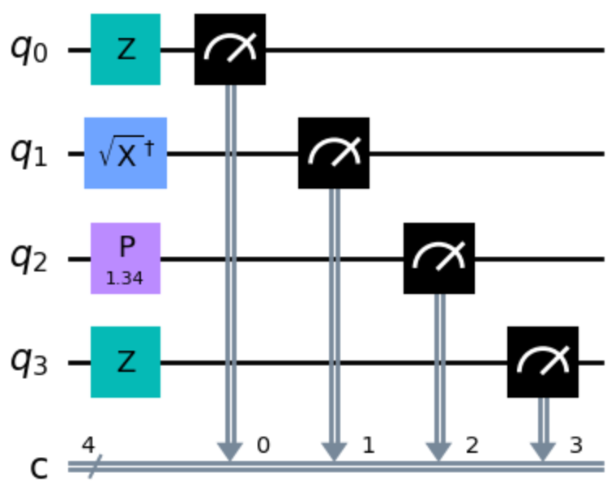
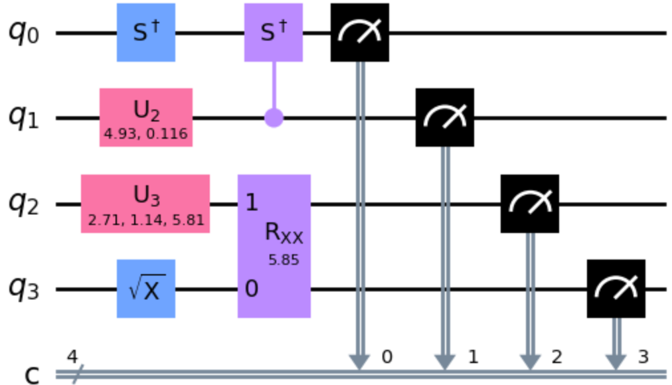
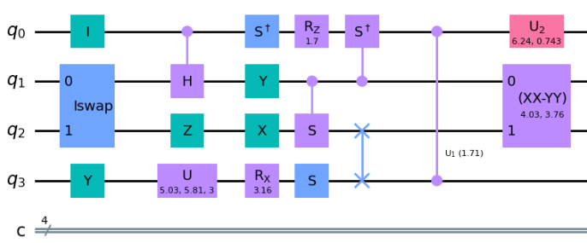
Datasets Generation – Q iskit SDK
Circuits : 700 four qubits Random circuits for each depth from 1 to 18.
Measurement probabilities for each circuits to get the target and noisy data:
Datasets | Experiment for each circuit | Shot per experiment | Backend (target & input) | Size of row data
1E1Ks | 1 | 1K | Aer & FakeLima | 700*18 = 12.6k
100E1Ks | 100(increase) | 1K | Aer & FakeLima | 1.26M
100E10Ks | 100 | 10K(increase) | Statevector & FakeLima | 1.26M
Depth1
Depth2
Depth 18
． ． ．
700 independent circuits

Slide 11
Models – Autoencoder
In our work, using 1D Convolutional layers instead of 2D layers contains the same performance without extra data transformation.
Below is the schematic plot to illustrate the model we use.

Slide 12
Training Process
During training:
Software & Hardware:
Type | Method
Cost function | Mean Squared Error
Optimizer | Adam
Learning rate | 0.0005
Training Epoch | 500 epochs
Batch size | 10k
Saved Checkpoint | At Minimal validation loss
Type | Method
Code implementation | Tensorflow
CPU(for data generation) | Intel(R) Core(TM) i7-10750H CPU @ 2.60GHz (6 cores, 12 threads)
GPU(for training model) | NVIDIA TITAN RTX GPUs (24GB VRAM each)

Slide 13

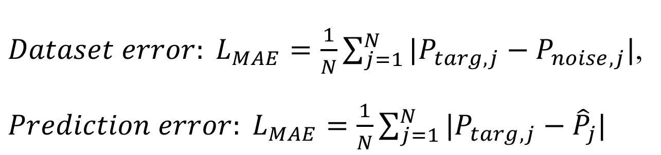
Model evaluation
Loss calculation method : Two metrics about Mean Absolute error(MAE).
*N is the number of basis vectors；$Ptarg,j$ & $P_{noisy},j$ is the target and noisy measurement probability for j-th basis vector；$\hat{P}j$ is the prediction measurement probability for j-th basis vector.
$Dataset error: L_{MAE}=\frac{1}{N}\sum_{j=1}^{N}{|P_{targ,j}−P_{noise, j}|}$,
$Prediction error: L_{MAE}=\frac{1}{N}\sum_{j=1}^{N}{|P_{targ,j}−{\hat{P}}_{j}|}$

Slide 14
Model evaluation
We use four common quantum circuits and algorithms as the evaluation datasets.
Trivial Paramagnet
A single depth of Random unitary gates drawn from Haar measure (Haar single)
Grover’s search algorithm with the target state |1111⟩
Quantum Fourier Transformation (QFT)

Slide 15
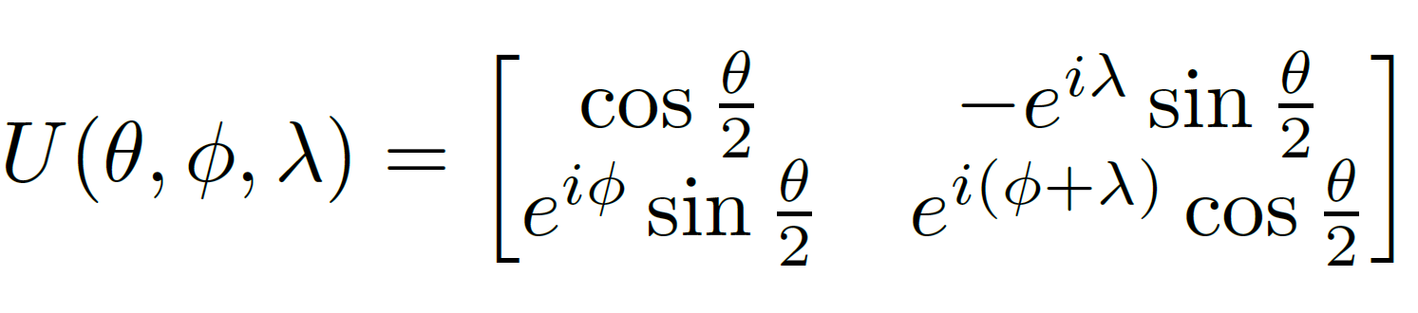
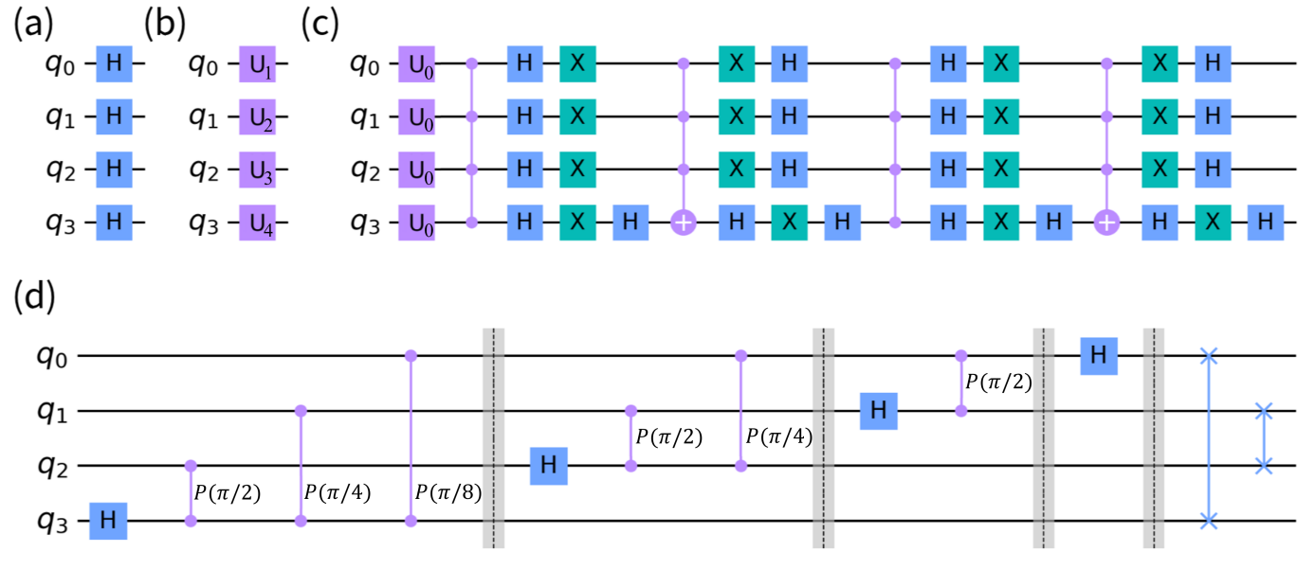
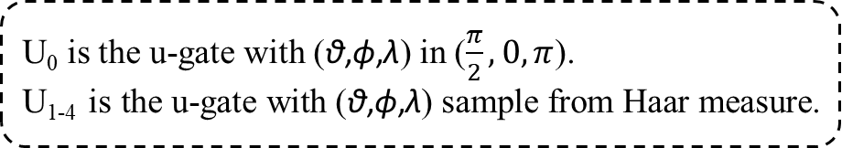
Model evaluation
U₀ is the u-gate with (θ,ϕ,λ) in ($\frac{π}{2},0, π$).
U₁₋₄ is the u-gate with (θ,ϕ,λ) sample from Haar measure.
(b) Haar Single
(a)Trivial Paramagnet (c) Grover’s Search
(d) QFT

Slide 16

Results
Discuss about the results.

Slide 17
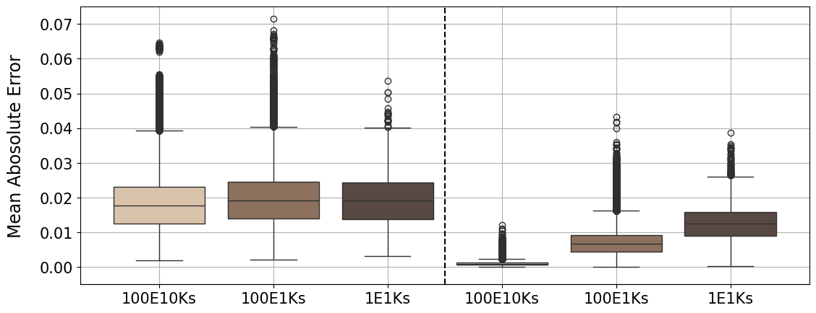
Datasets noise level & Prediction error
Dataset error
Prediction error
Dataset naming rule:
E: experiment
K: shot number
Dataset
Model
The noise level for the three test datasets is almost the same.
More training datasets improve the prediction. With more shots per experiment, the prediction improves further.
Take model trained by 100E10Ks for evaluating part.

Slide 18
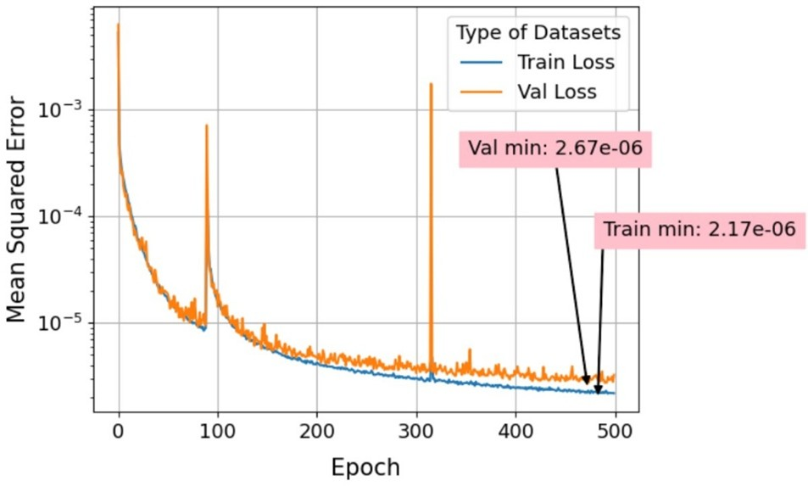
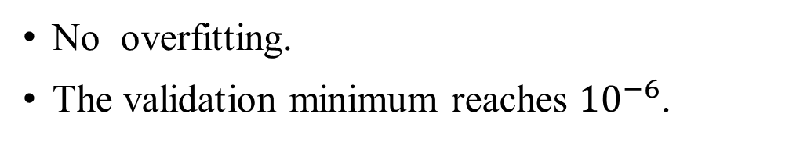
Loss curve
No overfitting.
The validation minimum reaches ${10}^{−6}$.

Slide 19
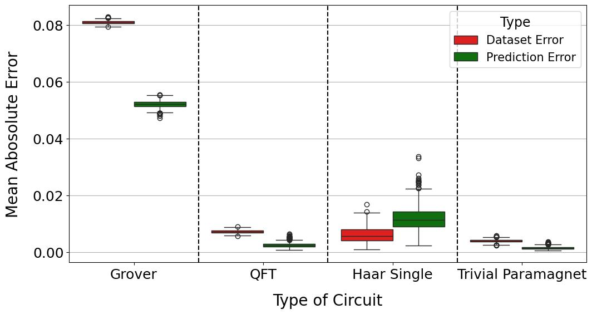
Evaluating with unknown circuits
For Grover's Search, Quantum Fourier Transform (QFT), and trivial paramagnet, our model denoises the error at different levels.
However, for Haar single, our model increases the error instead.
Notes:
Unmitigation represents the mean absolute error between the noisy and target data.
For mitigation, it represents the error between the noisy and prediction data.
** Noise level reduce by my model.
Haar single bit????
### MAE is shown below.

Slide 20
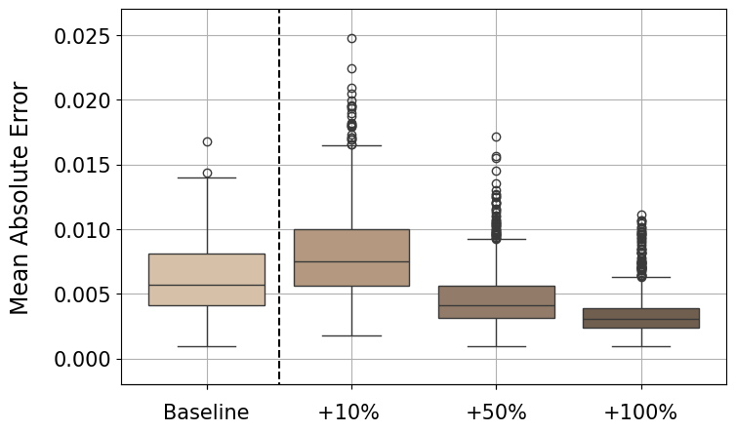
Bias datasets for Haar single
Prediction error
The datasets lack information about unentangled circuits.
We generate additional Haar single datasets to bias and add into the 10E10Ks datasets by different ratios.
Model

Slide 21
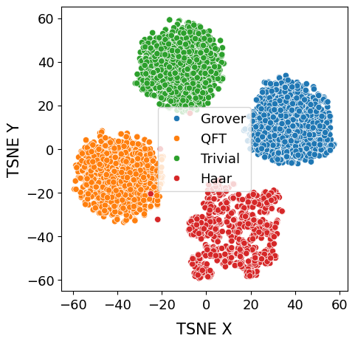
T-SNE Visualization
For four algorithm datasets inputs, we take the output from the last bottleneck layer and reduce it to two dimensions using t-SNE.
A clear classification into four distinct groups for the four different algorithms.
Embedding (4*512)

Slide 22
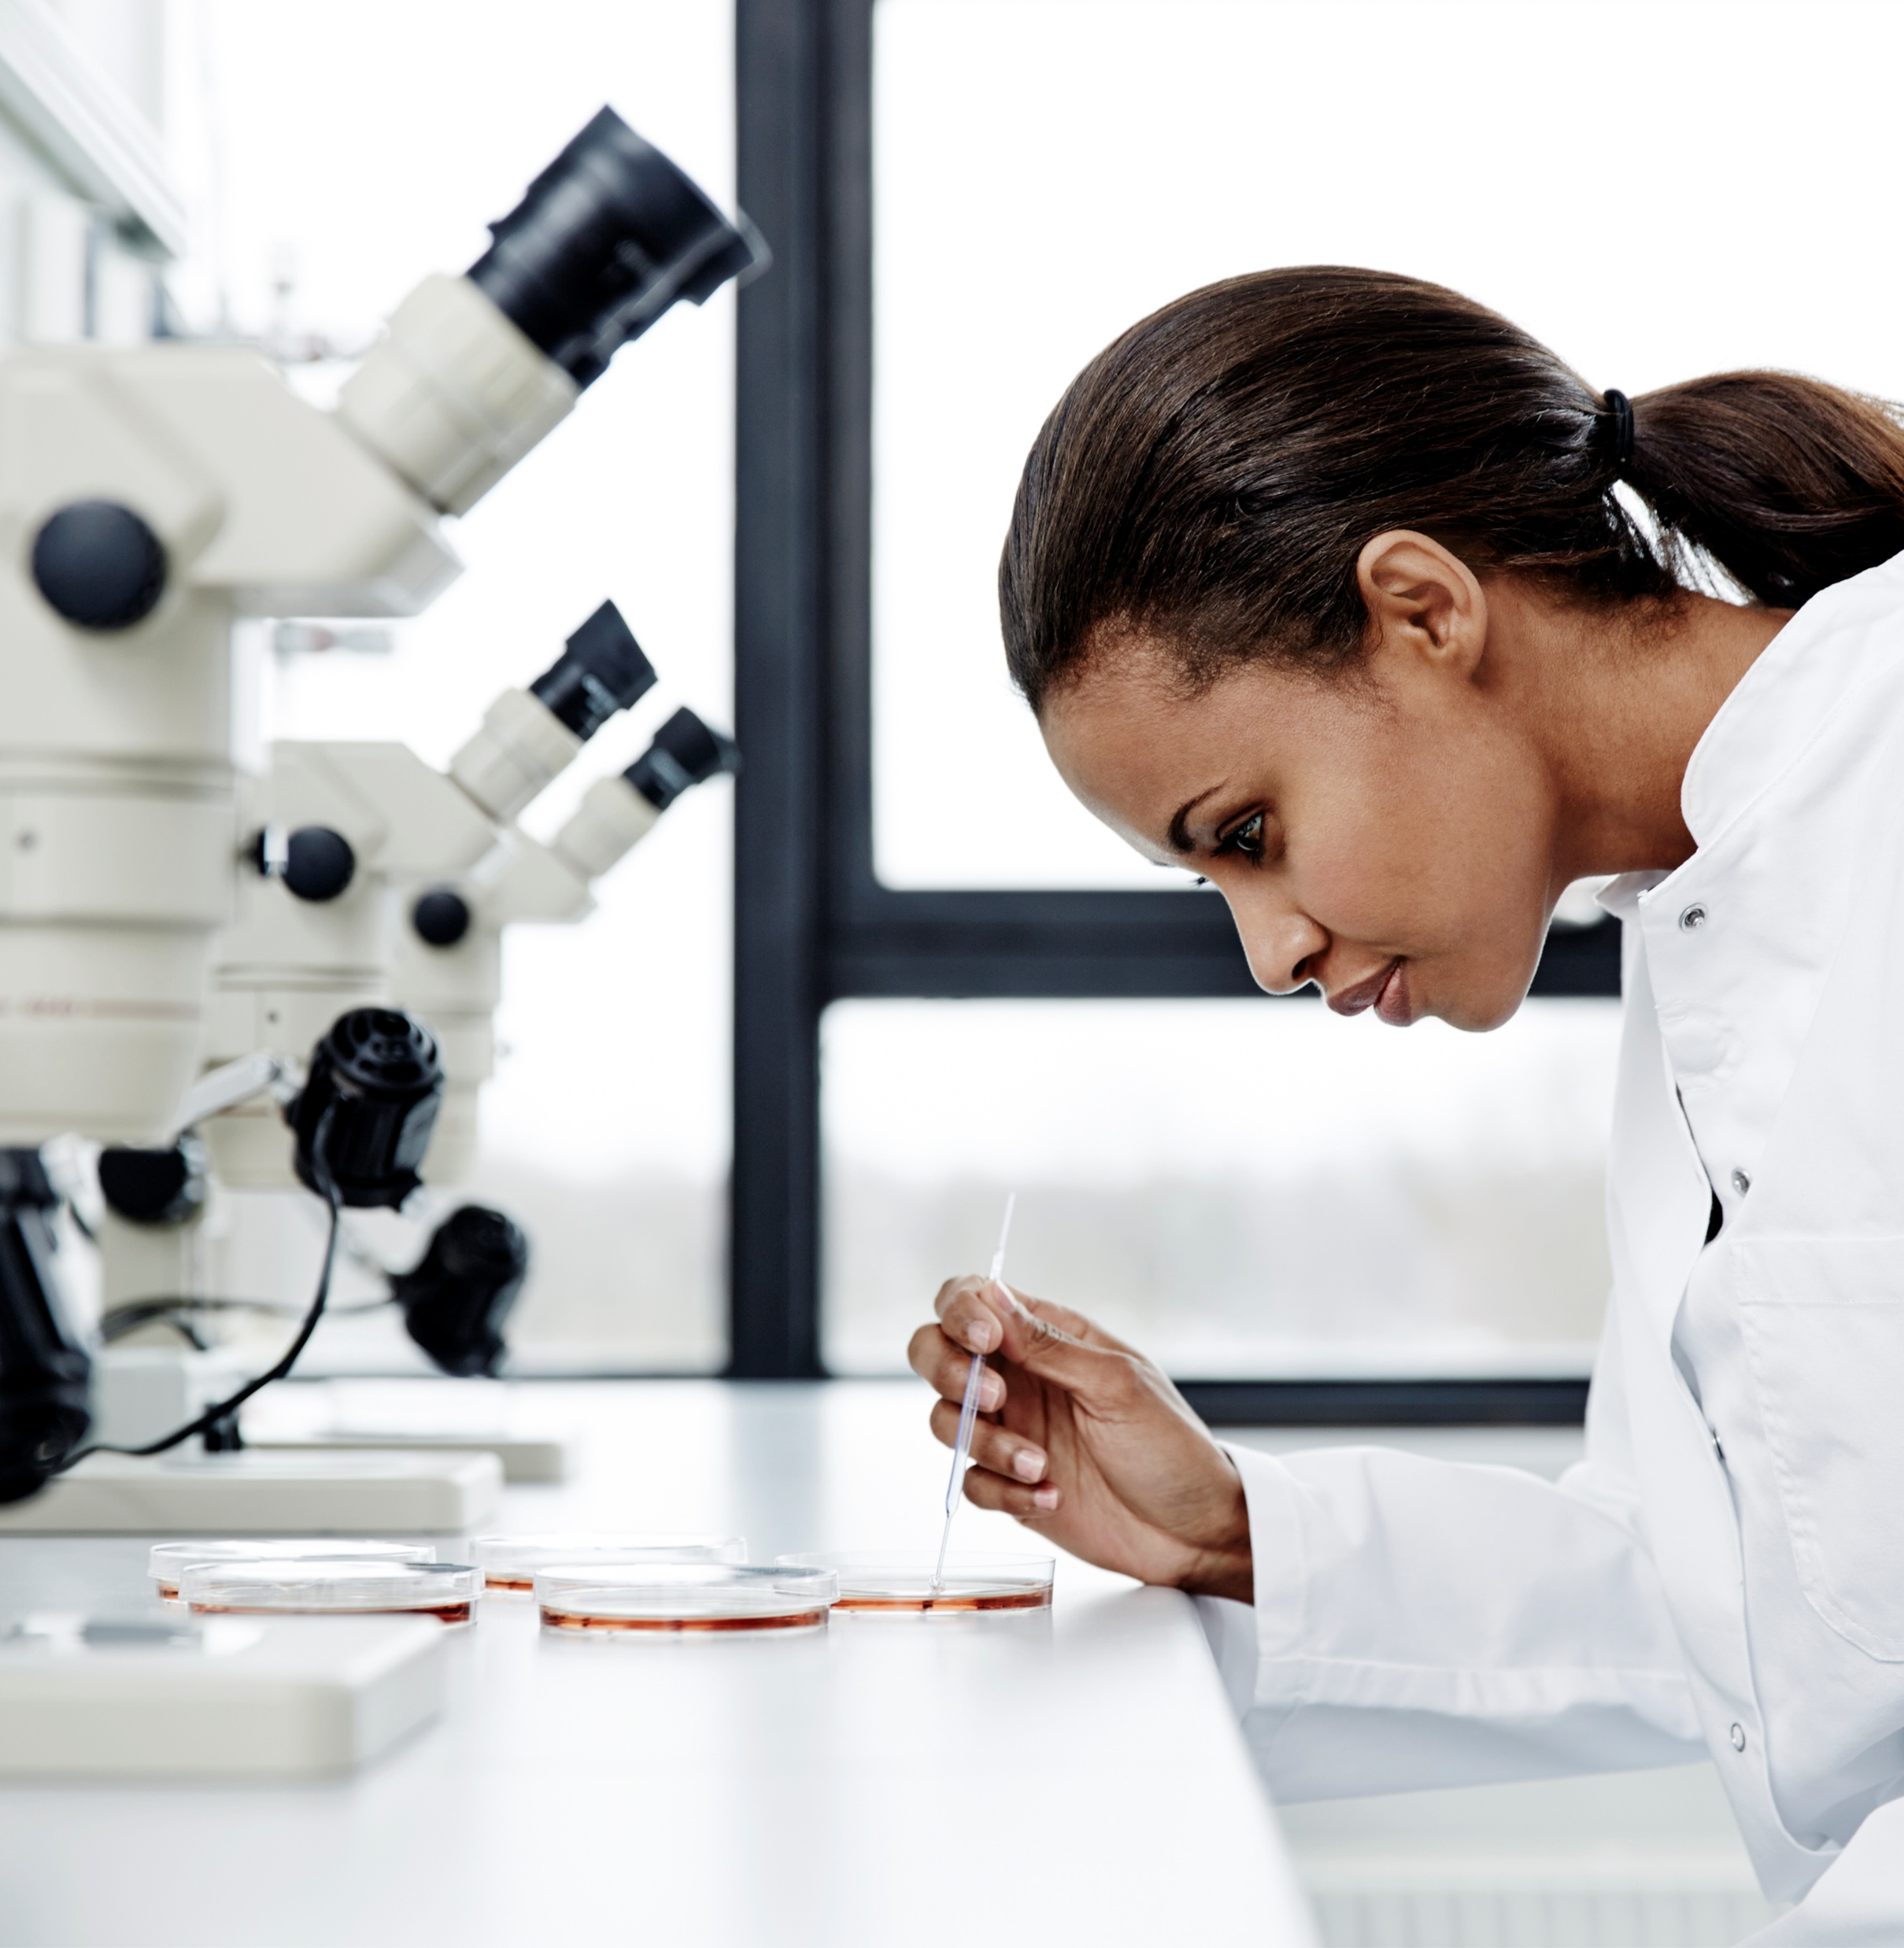
Conclusion
The conclusions.

Slide 23
Summary
Take-home message
  The statistical error in both target and noisy data sharply influences the convergence of the model.
  The autoencoder can reduce the noise in datasets from the noise model.
  For unseen circuits, the model mitigates the noise at different levels.
  The encoder successfully learns the features of the four common circuits.
Future work
  The noise model cannot reflect the noise level in real quantum machines, so we expect the model need to be fine-tuned with the real quantum machine.
  Accommodating different lengths of measurement probability inputs using a sequence-to-sequence model.

Slide 24
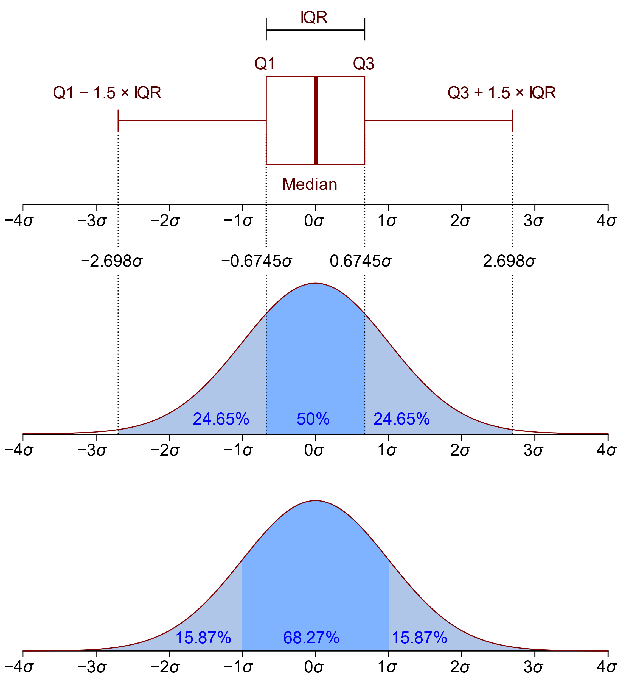
Appendix A - Boxplot
From Jhguch at en.wikipedia, CC BY-SA 2.5, https://commons.wikimedia.org/w/index.php?curid=14524285

Slide 25

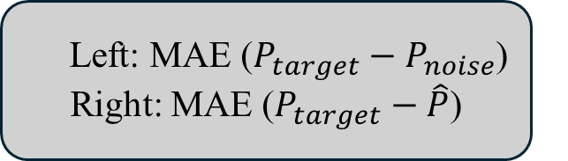
Datasets noise level & Prediction error
The left part shows the amount of noise for each dataset; the right part shows the prediction error from the model trained on different datasets.
The noise level for the three datasets is almost the same.
More training datasets improve the prediction. With more shots per round, the prediction improves further.
Left: MAE ($P_{target}−P_{noise}$)
Right: MAE ($P_{target}−\hat{P}$)
Take 100R10Ks model for the subsequent research
Notes:
Let’s take a look at the graph below. The x-axis represents the type of datasets, and the y-axis represents the mean absolute error. The left part shows the MAE of measurement probability between the target and noisy data, which shows the amount of noise for each dataset. The right part shows the MAE of measurement probability between the target and predicted data, which shows the prediction error from the model trained on different datasets.

