Slide 1

Speculative Design for Emotional Support in Future Family Structures: AI-Assisted Memory Management
Ms Chih-Yu Chang , Ms Pei-En Li,
Mr Ko-Chiu Wu ,Mr Chi-Hao Lung
Department of Interaction Design, National Taipei University of Technology
19th March, 2025
‹#›
Notes:
Good evening, everyone. I’m 張致瑜, a student from NTUT’s Department of interaction Design. I’m excited to present our research on how AI can enhance emotional connections in future families through speculative design.

Slide 2
Agenda
Research
Introduction Motivation
Purpose
Framework
Research
Speculative Design
Conclusion &
Future Work
Method

Slide 3
01
Introduction Motivation

Slide 4
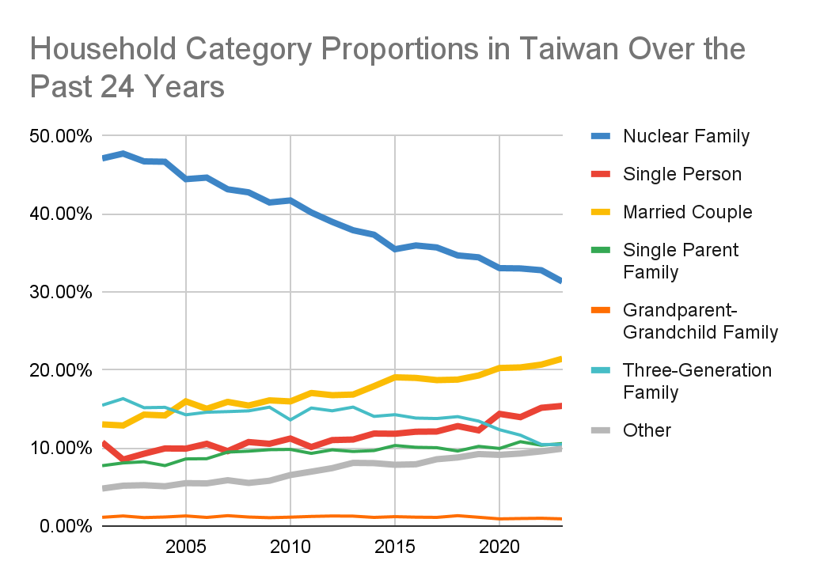
Family structure is changing
Over the past 24 years
The proportion of nuclear family households decreased by ↓15%
The total proportion of single-person, couple and other households increased by↑18%
Notes:
Over the past 24 years in Taiwan, core families have declined by 15%—a loss of 300,000 units—while single-person households have risen by 18%.

Slide 5
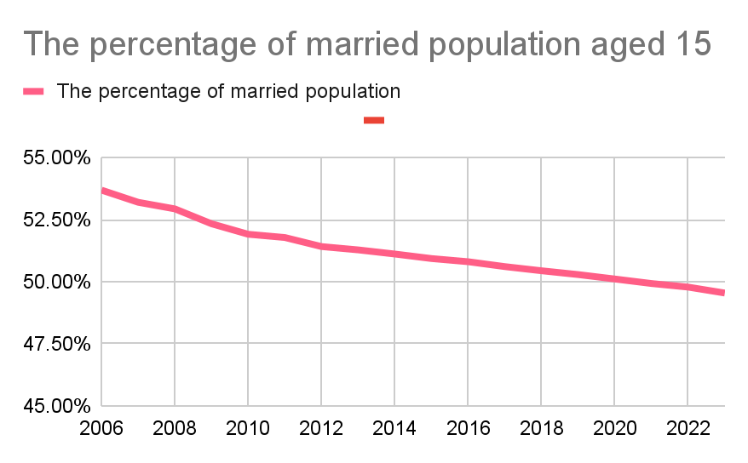
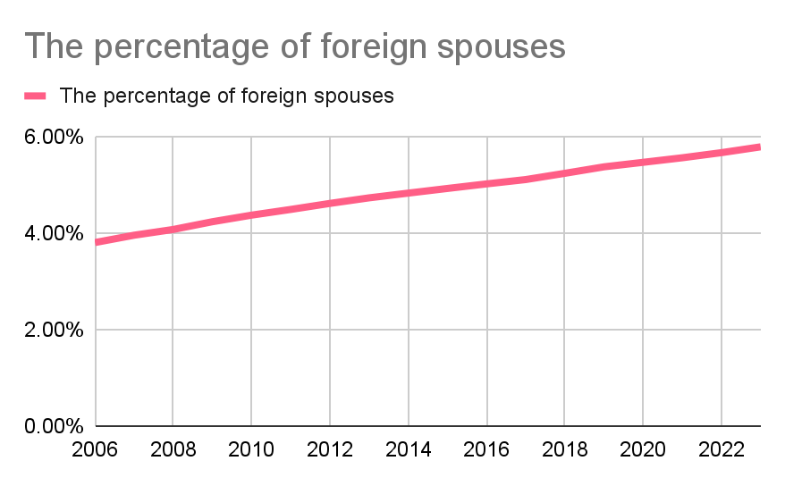
Family structure is changing
The proportion of couples over 15 years old has dropped ↓
At the same time, the proportion of foreign spouses in the population is gradually increasing↑
There is a tendency to be single, but cross-cultural families are increasing
Notes:
Despite fewer marriages, the proportion of foreign spouses has steadily increased.

Slide 6
Family Structural Changes
The number of relatives
Decrease
Family size
Reduction
Single-person households
Increase
Family networks
Aging
Notes:
Looking ahead to 2040, studies (Albrecht Gutierrez et al., 2024) predict a global kinship decline of over 35%, shrinking family sizes and aging networks. This shift weakens traditional emotional support, especially for children, who, per Amato (2005), thrive better in intact families.

Slide 7
What will "family" look like in 2040?
Notes:
So, with these changes in mind, what will the family of the future look like?

Slide 8
Our research focuses on...
Exploring AI solutions for future family emotional support
Fostering emotional connections through the "Memory-Tree" system
Demonstrating AI’s potential to address evolving social challenges
Notes:
To address these changes, our study explores AI solutions for sustaining future family emotional support. Using speculative design, we developed "Memory-Tree," a system fostering emotional connections and memory sharing across generations.
Memory-Tree bridges gaps, strengthens ties, and demonstrates AI’s potential to provide meaningful emotional aid in evolving family structures.
Our research confirms Memory-Tree’s feasibility and acceptance among target groups through surveys and interviews. It shows a clear link between enhanced family unity and stronger emotional support, offering a practical solution for future social contexts.

Slide 9
Research Framework
Introduction
Motivation
Speculative Design
Discussion
Phase C
Conclusion
Research Purpose
Phase B
Kano model
Future work
Phase A
Background Research
System design and development
Literature Review
Future Thinking
And Scene based-design
Family Emotional support
Family structure envolve
AI and Emotional Support
Questionnaire
Interview
Notes:
Our research unfolds in three phases:
Phase A: Establishing the topic and background.
Phase B: Implementing speculative design.
Phase C: Analyzing results and designing the system.

Slide 10
02
Research Method

Slide 11
Research Method Flow
How to maintain emotional support in families
amid future social structural changes.
Problem Background
Future Context
Feedback
and Modification
Needs and Function Validation
Literature Review
System Concept Development
Surveys and Interviews
Changes in Social Structure
Family Function Needs
Family Memory Management System
Family Needs Survey
Kano Analysis
Family Emotional Support
New Media Needs
Survey 1: Initial Exploration
AI in Family Interaction
Relationships and Privacy
Survey 2: Functional Validation
Memory Formation and Integration
Emotional Companionship
System Function Integrated
Survey 3: Revised Validation
Notes:
This diagram summarizes the research method flow of our project. Our core question is:
"How can emotional support within families be effectively maintained amid future social structural changes by 2040?"
We began by reviewing literature on evolving social structures and emotional support needs to build our foundational understanding. Based on this background, we developed the initial concept for our system, focusing on emotional needs, AI interaction, privacy, memory visualization, and emotional companionship.
To iteratively validate and refine the system, we conducted three rounds of surveys and interviews
Through this iterative process of feedback and revision, we've continuously refined our system concept to better address the emotional needs of diverse family structures in the future scenario of 2040.

Slide 12
Evolution of Survey Focus
Survey 1: Initial Exploration
1
Importance of Emotional Connection How important is maintaining emotional connections with family?
Current Communication Tools Are existing media (text, audio, video) effective for emotional communication within families?
Family Structures and Support Needs How do family structures influence emotional support needs?
Survey 2: Functional Validation
2
Sharing Memories & Family Bonding Does sharing family memories enhance emotional connections?
AI-Assisted Emotion Expression Would users accept devices assisting indirect emotional expression within families?
AI-Organized Memories How attractive is AI-assisted memory organization and management?
Survey 3: Revised Validation
3
Automated Memory Storage and Rituals How do users feel about automated memory categorization and creating family rituals?
Emotional Interaction & Privacy How acceptable is emotional interaction and comfort provided by an emotional-responsive device?
Digital Persona & Memory Privacy Would users appreciate having digital personas to manage memory privacy and inheritance?
System’s Impact on Family Cohesion Do users believe the system effectively enhances family emotional bonds?
Notes:
Here are the main content objectives of the three surveys.
Survey 1: Initial Exploration
Explored acceptance of initial concepts, current family communication challenges, and basic emotional support needs across diverse family structures.
Survey 2: Functional Validation
Used the Kano Model to evaluate preferences for proposed system features, identifying critical user concerns such as privacy in emotional communication.
Survey 3: Revised Validation
Reassessed adjusted features with continued Kano analysis, focusing specifically on digital privacy, emotional bonding, and overall system acceptance.
詳細版
Survey 1: Initial Exploration
This survey aimed to preliminarily explore foundational needs and validate key issues. It assessed respondents' current satisfaction with family connections, willingness to use technology for emotional bonding, and gathered initial feedback on early scenarios of the Family Memory Management System. It also collected demographic information regarding participants’ family backgrounds and their general expectations of emotional support.
Survey 2: Concept and Feature Validation
Focused on validating the core functionalities of the proposed system, this survey employed the Kano model (Must-be, Performance, and Attractive attributes) to evaluate user needs related to memory storage, visualization of family memories, emotional interaction, and privacy concerns. The goal was to clarify the importance and acceptance of each proposed feature among potential users.
Survey 3: Revised Functional Validation
Conducted to validate refined features based on earlier feedback, this final survey specifically targeted younger users (aged 20–29) to reassess functionality priorities using the Kano model. Detailed feedback was collected on refined scenarios, such as emotional interaction, privacy preferences, and system usability, to confirm and finalize the system’s feature set.

Slide 13
Questionnaire
－Survey Design Principles
1
Closed-Ended Questions
Utilized a five-point Likert scale to measure agreement levels on various features and needs.
2
Kano Model Structure
Employed a two-question format ("if feature is present/absent") to categorize core functionalities based on user reactions.
Example
Sharing memories with family can enhance emotional connections among family members.
Disagree ← 1 2 3 4 5 → Agree
Sharing memories with family does not enhance emotional connections among family members.
Disagree ← 1 2 3 4 5 → Agree
Notes:
In our questionnaire design, we applied two main principles:
First, we used closed-ended questions with a five-point Likert scale to clearly measure participants' agreement on various features and needs.
Second, we utilized the Kano Model structure, which involves asking each question twice—once positively and once negatively—to better understand users' true feelings about each feature. For example, we asked participants if sharing family memories would enhance emotional connections, and then repeated the question in the opposite way.

Slide 14
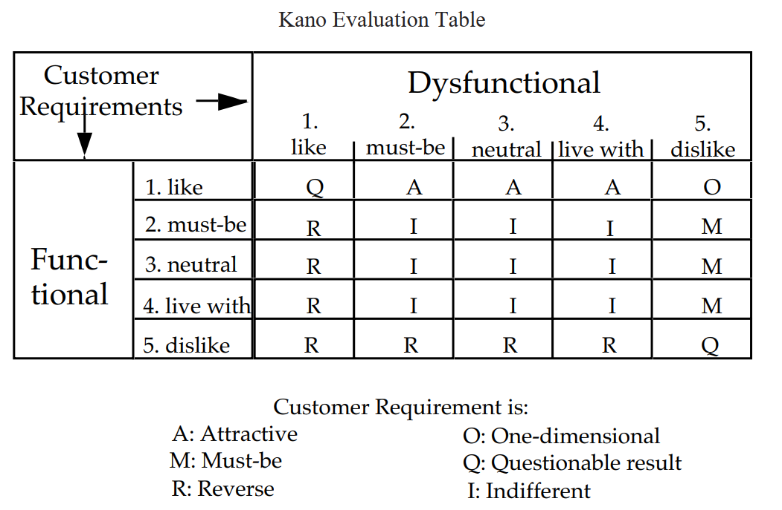
KANO model
Sharing memories with family can enhance emotional connections among family members.
Disagree ← 1 2 3 4 5 → Agree
Sharing memories with family does not enhance emotional connections among family members.
Disagree ← 1 2 3 4 5 → Agree
Berger, C., Blauth, R., & Boger, D. (1993). Kano’s methods for understanding customer-defined quality.
Notes:
Based on the degree of functional positivity and negativity, features can be classified into six different answer categories.
To know how function affect users

Slide 15
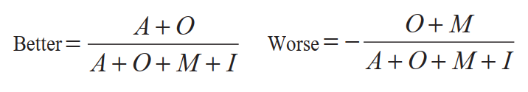
KANO model
Types of customer needs
Worse
0
Indifferent
Attractive
Better=0.5
Worse -0.5
Better 0
Better 1.0
Must-be
One-dimensional
Worse
-1
Notes:
By analyzing various samples and calculating their answer, we can obtain the better and worse values.
This allows us to categorize the features into four dimension.
再縮減版本
Must-be Quality: Basic requirements; absence causes dissatisfaction, presence is expected.
One-dimensional Quality: Satisfaction directly increases with improved quality—higher performance leads to higher satisfaction, and lower performance results in dissatisfaction.
Attractive Quality: Delights when present, absence doesn't cause dissatisfaction.
Indifferent Quality: Presence or absence has minimal impact on satisfaction.
—-----
•
Must-be Quality: These are basic expectations of a product or service. If these requirements are not fulfilled, it leads to extreme dissatisfaction. However, fulfilling them will not increase satisfaction; customers simply see them as a given .
•
One-dimensional Quality: For these requirements, customer satisfaction is proportional to the level of fulfillment. The more of this quality a product offers, the more satisfied the customer will be, and vice versa .
•
Attractive Quality: These are features that can cause satisfaction (or even delight) when present, but their absence does not lead to dissatisfaction .
•
Indifferent Quality: These are product or service aspects that the customer does not care about. Their presence or absence has no significant impact on customer satisfaction or dissatisfaction .
----- 原版本
The Kano model is a theory of product development and customer satisfaction. It prioritizes development efforts by classifying customer preferences into five different categories to help organizations understand how different product characteristics affect customer satisfaction. The Product Planning Guide (n.d.) explains the role of the Kano model in feature prioritization decisions to ensure customer satisfaction.
The Kano model categorizes customer needs into the following types:
-
Must-be: These are features that customers expect a product to have. If a product lacks these features, it will lead to high customer dissatisfaction. However, even if a product has these features, they do not significantly increase customer satisfaction because they are taken for granted. The Product Program Guide (n.d.) states that the lack of basic characteristics leads to dissatisfaction.
-
Desired Requirements (Performance): The degree to which these characteristics are met is directly proportional to customer satisfaction. The better the product performs in these areas, the more satisfied the customer will be. For example, battery life, download speed, etc., are all Desired Requirements. The Product Program Guide (n.d.) states that satisfaction is directly proportional to the presence of performance characteristics.
-Excitement
Excitement: These are features or services that are not expected by the customer and whose presence would be very surprising and satisfying to the customer. However, the absence of these features does not lead to customer dissatisfaction. Exciting needs are the key to increasing customer loyalty and competitive advantage. The Product Program Guide (n.d.) states that unexpected features can bring delight.
-Indifferent
Indifferent: These are features that don't affect customer satisfaction and customers don't care if the product has them or not.
-Reverse demand.
Reverse: The presence of these features may cause some customers to be dissatisfied. For example, an overly complex interface may be confusing to a customer who is not familiar with technology.
Application of Kano Model in Demand Mining and Product Design:
Kano models play an important role in product design by helping designers identify which features are necessary, which stand out, and which have little impact on customer satisfaction. By understanding these categories, product designers can focus on meeting the core needs of customers, increasing customer satisfaction and loyalty.
The American Society for Quality (ASQ, n.d.) explains in detail the importance of Kano's model in translating customers' verbalized needs into specific product requirements during Quality Function Deployment (QFD) to ensure that the product meets or exceeds customers' expectations. This is particularly useful in the requirements mining process to help identify needs that may not have been explicitly expressed by the customer.
In short, the Kano model is a powerful tool that helps product teams understand customer needs, prioritize features, and ultimately design products that better meet customer expectations.

Slide 16
Survey Results -
KANO First-phase
Function | A | O | M | I | R | Q | Better | Worse | Type
(Q1) "Maintaining emotional connections with family is important." | 3 | 9 | 2 | 8 | 0 | 0 | 0.55 | -0.5 | A (Attractive)
(Q2) "Expressing emotions through existing media is easy." | 0 | 7 | 0 | 13 | 1 | 1 | 0.35 | -0.35 | I (Indifferent)
(Q3) "Recalling good times provides emotional support." | 3 | 7 | 1 | 8 | 1 | 2 | 0.53 | -0.42 | A (Attractive)
Q1: Mostly O, some M → Contact a basic need
Q2: High I (13) → Media ease not critical
Q3: Some A/O, few M → Memory sharing boosts satisfaction
Notes:
First Survey
For Q1, maintaining family contact mostly falls into One-dimensional (O) answer, where better functionality increases satisfaction, though a few see it as a Must-be (M) answer , a basic need.
Q2 shows most people (I=13) answer are indifferent to the ease of current media, suggesting it’s not a major pain point.
Q3 on memory sharing boosts satisfaction answer (Attractive or One-dimensional), with a minority viewing answer it as a Must-be (M).

Slide 17
Survey Results
- KANO Second-phase
Function | A | O | M | I | R | Q | Better | Worse | Type
(Q1) "Maintaining emotional connections with family is important." | 1 | 11 | 3 | 22 | 1 | 0 | 0.324 | -0.378 | I (Indifferent)
(Q2) "I want to receive emotional support from family relationships." | 2 | 15 | 5 | 16 | 0 | 0 | 0.447 | -0.526 | M (Must-be)
(Q3) "Recalling good times with family provides emotional support." | 1 | 9 | 9 | 18 | 1 | 0 | 0.27 | -0.486 | I (Indifferent)
(Q4) "Sharing memories with family strengthens emotional bonds." | 1 | 9 | 5 | 21 | 1 | 1 | 0.278 | -0.389 | I (Indifferent)
(Q5) "Knowing my family members’ emotions helps maintain emotional connections." | 1 | 9 | 4 | 23 | 1 | 0 | 0.27 | -0.35 | I (Indifferent)
(Q6) "A device that helps express emotions indirectly would improve communication." | 0 | 2 | 4 | 30 | 1 | 1 | 0.056 | -0.167 | I (Indifferent)
(Q7) "Understanding memories of deceased family members increases my sense of identity." | 0 | 7 | 2 | 27 | 2 | 0 | 0.19 | -0.25 | I (Indifferent)
(Q8) "I find AI-assisted memory organization and filtering appealing." | 2 | 4 | 3 | 26 | 3 | 0 | 0.17 | -0.2 | I (Indifferent)
Covers AI: memory, emotion, deceased, privacy
O/M: Missing features upset; High I: Many indifferent; Low A: Mostly O/I
Notes:
Second Survey
This survey expands to AI features like memory organization, emotion detection, deceased family memories, and privacy.
Answers in One-dimensional (O) and Must-be (M) indicate missing features cause dissatisfaction, but many are indifferent (I) dimensions, showing limited interest in some AI aspects.
Attractive (A) responses are few, with most leaning toward O or I answers.

Slide 18
Survey Results -
KANO Third-phase
Function | A | O | M | I | R | Q | Better | Worse | Type
(Q1) "The system can store family moments and shared memories." | 8 | 2 | 0 | 20 | 1 | 0 | 0.33 | -0.07 | I (Indifferent)
(Q2) "The system can automatically categorize memories and establish family rituals." | 6 | 6 | 1 | 17 | 0 | 1 | 0.4 | -0.23 | I (Indifferent)
(Q3) "The system allows reviewing past family memories and rituals." | 12 | 7 | 0 | 11 | 0 | 1 | 0.63 | -0.23 | A (Attractive)
(Q4) "The system shape a unique family tree based on shared memories and culture." | 11 | 3 | 0 | 16 | 0 | 1 | 0.47 | -0.1 | I (Indifferent)
(Q5) "Forming a new family, the system generate a digital seed to continue memories." | 5 | 3 | 1 | 20 | 0 | 2 | 0.276 | -0.13 | I (Indifferent)
(Q6) "The system can sense emotional fluctuations and respond through light or leaf movements." | 11 | 3 | 0 | 17 | 0 | 0 | 0.452 | -0.09 | I (Indifferent)
(Q7) "Interacting with the system allows creating a digital persona for memory privacy management." | 6 | 6 | 0 | 18 | 1 | 0 | 0.4 | -0.2 | I (Indifferent)
(Q8) "I believe the system can help strengthen family emotional bonds." | 5 | 5 | 5 | 16 | 0 | 0 | 0.323 | -0.32 | I (Indifferent)
A (5-12): Features surprise; High I (16-20): Polarized views
Low M: Few essentials; Q3: A=12, O=7 → Memory review shines; Q6: A=11 → Emotional potential
Notes:
Third Survey
Several features score nearly Attractive dimensions shows polarized views.
Must-be (M) answer is rare, meaning few features are deal-breakers if absent; some questions have minor Reverse (R) or Questionable (Q) answers.
Q3, “reviewing family memories,” stands out with 12 Attractive and 7 One-dimensional answers , a key highlight, while Q6, “emotion perception,” scores A=11, showing potential.

Slide 19
Goal: Understand how people perceive emerging trends like diverse co-parenting, real-time memory sharing, and AI-assisted emotional support.
Interview Process
Scenario 1: Remote, Diverse Family & Shared Memories
Introduction
Scenario-Based Discussions
Scenario 2: Memory Preservation & AI Mediation
General Concerns & Personal Perspectives
Notes:
"In our interviews, we explored perspectives on family dynamics, technology, and emotional well-being. Our goal was to understand how people perceive emerging trends like diverse co-parenting, real-time memory sharing, and AI-assisted emotional support.We structured the interview into three main parts:"
First, we introduced the purpose and gathered basic information about each participant.
Next, we used two future scenarios to spark discussion."
Finally, we asked about broader concerns, such as privacy, security, and personal experiences with family relationships."

Slide 20
Findings of Interviews
Topic | Key Insights
👨‍👩‍👧‍👦 Future Family Trends | ✔ Co-living and diverse family structures may become a trend, but maintaining relationships and habits is a challenge.✔ Families don’t necessarily require blood relations—mutual support is the key.
📸 Memory Preservation & Sharing | ✔ Timely recording and cloud storage are considered beneficial.❌ Sharing should be a personal choice; recording and uploading shouldn’t be mandatory.
🎥 Real-time Remote Sharing | ✔ Some find the live-sharing concept helpful.❌ Others believe existing technology is sufficient, making additional devices unnecessary.
🤖 Role of AI in Emotional Support | ✔ AI can assist in organizing memories, such as categorization and documentation.❌ AI shouldn’t overly interfere with emotions, as it may have negative effects.
🔏 Privacy & Autonomy | ✔ Individuals should have control over which memories to pass on.❌ Many people are unwilling to share their mental or physical states, even with close family.
💬 Ways to Maintain Family Bonds | ✔ Regular family gatherings and daily sharing are seen as key to maintaining emotional connections.
Notes:
"In our interviews, we explored perspectives on future family trends, memory preservation, AI in emotional support, and privacy concerns. Here's what we found:
👨‍👩‍👧‍👦 Diverse family structures may become more common, but maintaining long-term relationships and shared habits remains a challenge. Many believe family is about mutual care rather than blood ties.
📸 People appreciate the ability to record and store memories in the cloud, but they want full control over what gets shared.
🎥 Opinions on real-time memory sharing vary—some find it helpful, while others feel existing technology already meets their needs.
🤖 AI can help organize memories, but it shouldn't interfere with emotions or replace human interactions.
🔏 Privacy is a major concern—most people prefer to decide for themselves what emotions or personal data they share, even with family.
💬 Finally, emotional connections are best maintained through regular interactions, like family gatherings and daily conversations.
These insights highlight the delicate balance that need to be carefully treated between technology, emotional support, and personal boundaries in future family interactions."

Slide 21
Findings in Survey and Interview
Core Emotional Needs
Strong emphasis on maintaining deep family emotional connections.
Strategies
Secure essential features (communication stability, privacy protection).
Improve core memory-management functions.
Introduce select attractive features (AI-driven rituals, emotional interactions).
Provide flexible privacy settings to balance innovation and user control.
AI Opportunities & Challenges
High attractiveness in memory rituals & emotional companionship, but many indifferent responses highlight the need for targeted scenarios.
Privacy Preferences
Privacy is essential for some users; others show low concern, reflecting diverse expectations.
Notes:
We summarized insights from three surveys and interviews using the Kano Model.
Overall, users emphasized fundamental emotional connections and deeper emotional needs within families. Attractive AI features, such as memory rituals and emotional companionship, showed promise but received many indifferent responses, suggesting the need for clearer scenarios and targeted groups.
Privacy emerged as essential for some users but indifferent to others, indicating diverse user expectations.
We recommend prioritizing essential features (stable communication and strong privacy), enhancing key memory-management functions, and selectively developing attractive, innovative features. Providing flexible privacy options is also crucial for user acceptance.
This balanced approach ensures the system meets varied user needs, strengthens family bonds, and respects privacy—truly reflecting human-centered design.

Slide 22
03
Speculative Design
Notes:
Making Use: Scenario-Based Design of Human-Computer Interactions - John M. Carroll - Google 圖書

Slide 23
Three Steps Process of Speculative Design
Step 1 : Define a context for debate
Step 2 : Ideate and find problems, and create a scenario
Step 3 : Materialize the scenario to provoke an audience
Notes:
Guided by The Young Designer’s Guide to Speculative and Critical Design, we used speculative design in three steps: context definition, scenario creation, and system function design.

Slide 24
Step 1 – Define a context for the debate
What will "family" look like in 2040?
Notes:
Step 1: Defined the 2040 family context via interviews, surveys, and future-thinking: What will "family" look like in 2040?

Slide 25

Step 2 –
Ideate, find problems
and create a scenario
Notes:
Step 2: Created a scenario where an AI memory system boosts emotional support and family ties by 2040.

Slide 26
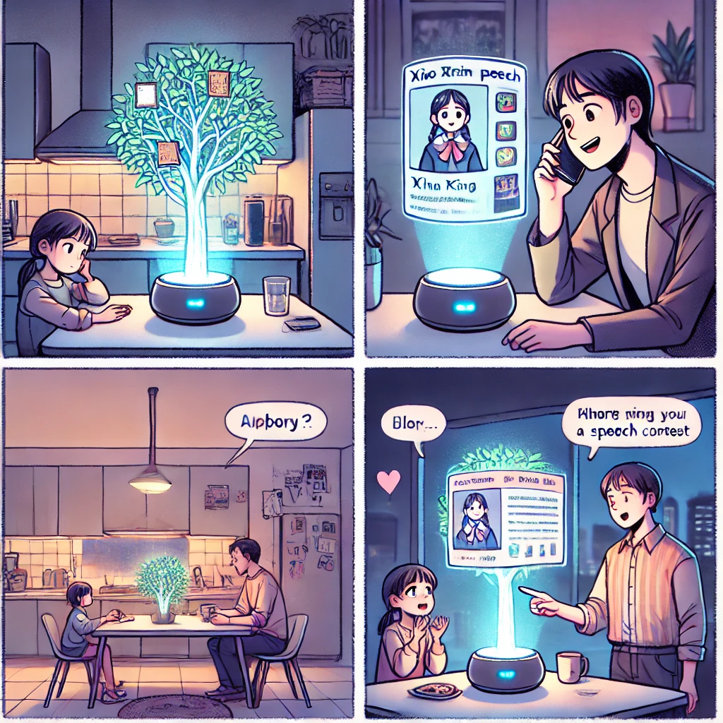
What would a home look like with a Memory-Tree?
1. Digital Plant Growth: A New Way to Materialize Memories
Xiao Rong's family stays connected through the "Memory-Tree”. Today, he added a block representing Xin Xin’s speech video, making the branches grow slightly. Fang Fang, viewing remotely, smiled with pride as Xin Xin spoke confidently on stage.
2. Biometric Technology: Emotional Interaction and Response
After her speech, Xin Xin told the "Memory-Tree" she felt disappointed with second place. Sensing her mood, it glowed softly and swayed to comfort her, then recorded the moment in her personal archive.

Slide 27


What would a home look like with a Memory-Tree?
3. Preserving Digital Family Identity & Heritage
On Winter Solstice, the family gathered to enjoy Xiao Rong’s special tangyuan, made with a citrus-infused ancestral recipe. As he cooked, he projected images of their family’s old orchard from the "Memory-Tree," sharing its history with Xin Xin. The "Memory-Tree" quietly recorded their laughter and the cherished tradition in the family archive.
4. A Warm Winter Solstice: A Visual Symbol of Tradition
Each year, they add Winter Solstice memories to the "Memory-Tree," making it a family ritual. Over time, these memories formed a glowing fruit, symbolizing their unique bond. Seeing it, Xiao Rong is reminded of the warmth and love of family.

Slide 28

Step 3 –
Materialize the scenario to provoke an audience
Notes:
Step 3: Designed system functions to meet emotional needs with intuitive AI responses for stronger bonds.

Slide 29
Maintaining Family Bonds
Emotional Support & Privacy
Distance
Support
How can system help maintain emotional connections amid diverse and dispersed family structures?
How does system identify emotional needs and provide timely companionship?
Privacy
Tradition
How can system support the transmission of family traditions through memory visualization?
How can system act as a trusted emotional confidant while ensuring personal privacy?
Memory Inheritance & Continuity
User Acceptance & System Value
Inheritance
Willingness
How can system effectively store and pass down family memories to future generations?
What features or designs can increase user willingness to interact with motional-sensing AI?
Continuation
Value
How does system maintain emotional continuity when family structures change or new members join?
How does system clearly demonstrate its value, motivating users to embrace it as part of family life?
Notes:
短講稿
We ask how the system could:
Maintain emotional bonds despite greater physical and social distances.
Preserve family rituals and traditions across diverse family forms.
Sense emotional needs and offer empathetic support, especially for vulnerable family members.
Act as a trusted emotional companion while fully respecting personal privacy.
Effectively store, visualize, and pass down family memories, balancing collective sharing with individual privacy.
Increase user acceptance by clearly communicating the system’s unique value and addressing privacy concerns.
These questions aim to provoke deeper reflection and encourage critical dialogue on the future role of technology in family life.
長講稿
Step 3: Materialize the scenario to provoke an audience
In this step, we transform our speculative scenario into concrete, thought-provoking questions to encourage deeper reflection and critical discussions about the future of family emotional support. Specifically, we outline key challenges and potentials for the Future Family Memory Management System, highlighting how it might reshape emotional connections and interactions in diverse family structures by the year 2040.
First, regarding Maintaining Emotional Bonds and Cohesion:
By 2040, family structures will become more diverse, and single-person households will significantly increase, causing greater physical and social distances within families.
How can the system bridge these gaps and strengthen emotional connections despite distance?
Traditional ways of preserving family traditions might struggle to adapt to new family forms.
How can the system visualize and preserve family rituals, values, and cultures across generations?
Next, considering Emotional Support and Privacy:
Insufficient emotional support negatively impacts mental health.
How can the system sense emotional needs and provide timely, empathetic companionship, especially for children, adolescents, and older adults?
Privacy and autonomy have become increasingly critical.
How can the system serve as a trusted emotional confidant while fully respecting personal privacy?
Third, addressing Memory Transmission and Privacy Management:
Family memories risk being forgotten over time.
How can the system effectively store, categorize, visualize, and pass down precious family memories to future generations?
Sharing memories can sometimes conflict with the need for individual privacy.
How can the system strike an optimal balance between collective memory sharing and individual privacy protection?
Finally, concerning User Acceptance and Value Creation:
Users have expressed concerns about AI-driven emotional sensing as potentially invasive.
How should the system's design evolve to reduce privacy concerns and increase user willingness to engage with emotional-support features?
Demonstrating the value of the system clearly is crucial to encouraging adoption.
How can we effectively communicate and highlight the unique benefits of using the system for preserving emotional bonds and family heritage?
By presenting these questions, we aim not only to provoke thoughtful debate about the integration of technology into future family life but also to actively engage audiences in considering the values and implications behind adopting such emotional support technologies.

Slide 30
Functions and System

Slide 31
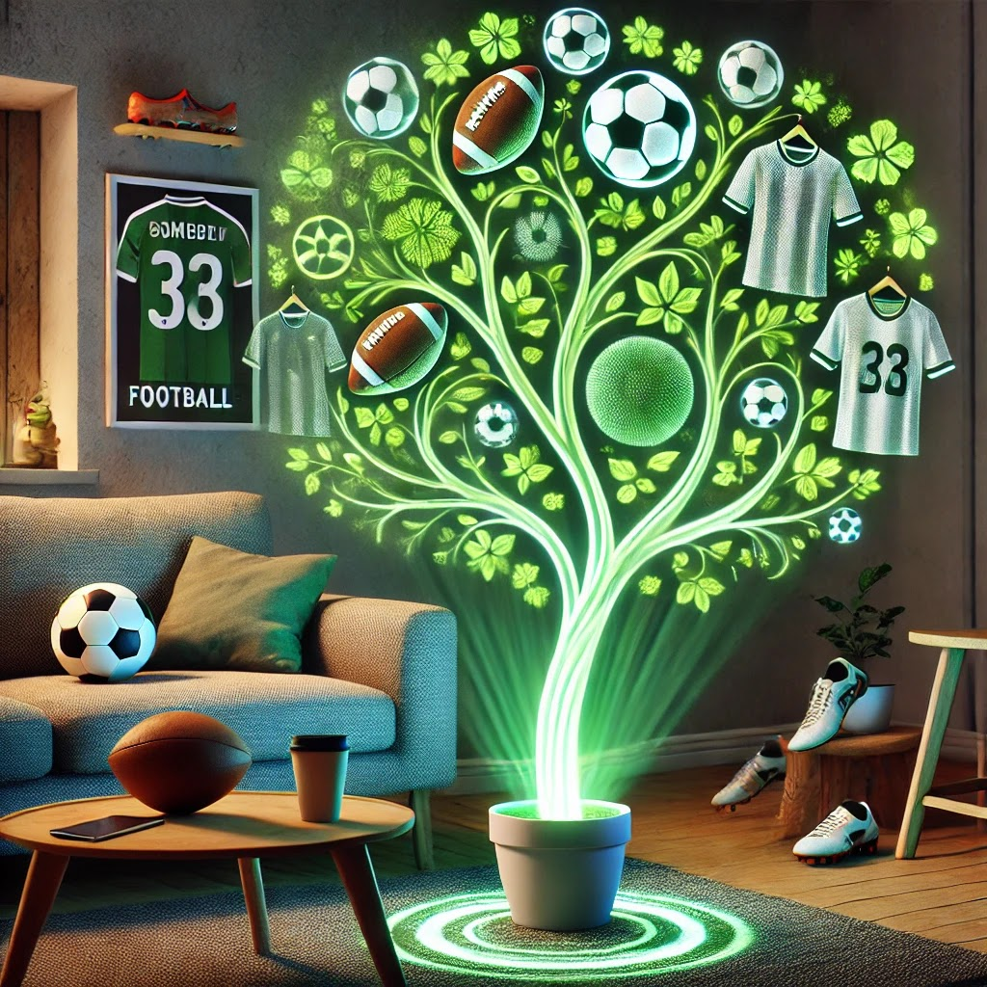
Memory storage and family-specific image cohesion
Family members can record moments in their lives into the tree, and these memories will be pieced together in the form of digital building blocks to form a figurative tree. Each family's culture and memories are unique, and the Tree will display the unique image of that family accordingly.
資料
數據
“回憶和家人一起度過的美好時光，能讓我感到情感上被支持 “; 第一次狩野問卷(n=22),SI=0.52 DSI=-0.42 魅力型產品 / 正向平均分數:4.4
“融樹能夠依每個家庭的回憶、文化塑造屬於每個家庭獨特的樹形有這個功能，您的感受是?"; 第三次狩野問卷(n=18),SI=0.61 DSI=-0.05 魅力型產品 / 正向平均分數:4.6
Notes:
"First, the Memory-Tree can store memories and create a unique representation that reflects the distinct characteristics of each family."

Slide 32

Emotional Companionship and Interactive Response
The tree is able to sense changes in family members' emotions. When family members talk about their memories or feelings, the tree will respond with a change in light or a slight vibration of its leaves, providing emotional companionship and comfort.
與植物交談可有效改善情緒、減緩壓力，因為它們不會回嘴。它們允許一個人表達自己的感受和情緒，而不會受到干擾或相互回饋。
Gandhi, A. (2022). The Effect of Talking to Plants in Order to Improve Emotions and Reduce Stress in High School Students. Journal of Student Research, 11(4). https://doi.org/10.47611/jsrhs.v11i4.3472
“融樹能夠陪伴並傾聽每一位家人的回憶點滴，感知家庭成員的情感波動，並通過光芒變化或葉片震動來給予回應與安慰 有這個功能，您的感受是?";
第三次狩野問卷(n=18),SI=0.5 DSI=-0.05 魅力型產品 / 正向平均分數:4.38
資料
數據
Notes:
The Memory-Tree also acts as an emotional companion, using light or vibrations to reduce stress and lift moods.

Slide 33

Memory Transmission and Visualization of Family Rituals
The Fusion Tree automatically categorizes and visualizes specific family memories, such as annual summer fireworks trips or ancestral recipes, which are transformed into family rituals that are passed down from one generation to the next. At the same time, family members can also use the tree to reminisce about important moments and family rituals from the past.
資料
數據
許多受訪者認為家庭儀式給了他們一種歸屬感。家庭儀式可以作為家庭成員表達和給予情感支持的方式。
家庭儀式作為共享記憶的重要部分。這些儀式不僅幫助回憶過去的事件，也成為家庭記憶的一部分
Smit, R. (2011). Maintaining family memories through symbolic action: Young adults’ perceptions of family rituals in their families of origin. Journal of Comparative Family Studies, 42(3), 355-367.
可以藉由融樹回顧過往的家族回憶與儀式有這個功能，您的感受是?;第三次狩野問卷(n=18),SI=0.59 DSI=-0.18 魅力型產品 / 正向平均分數:4.61
Notes:
The Memory Tree organizes memories into rituals, fostering belonging through family traditions.

Slide 34
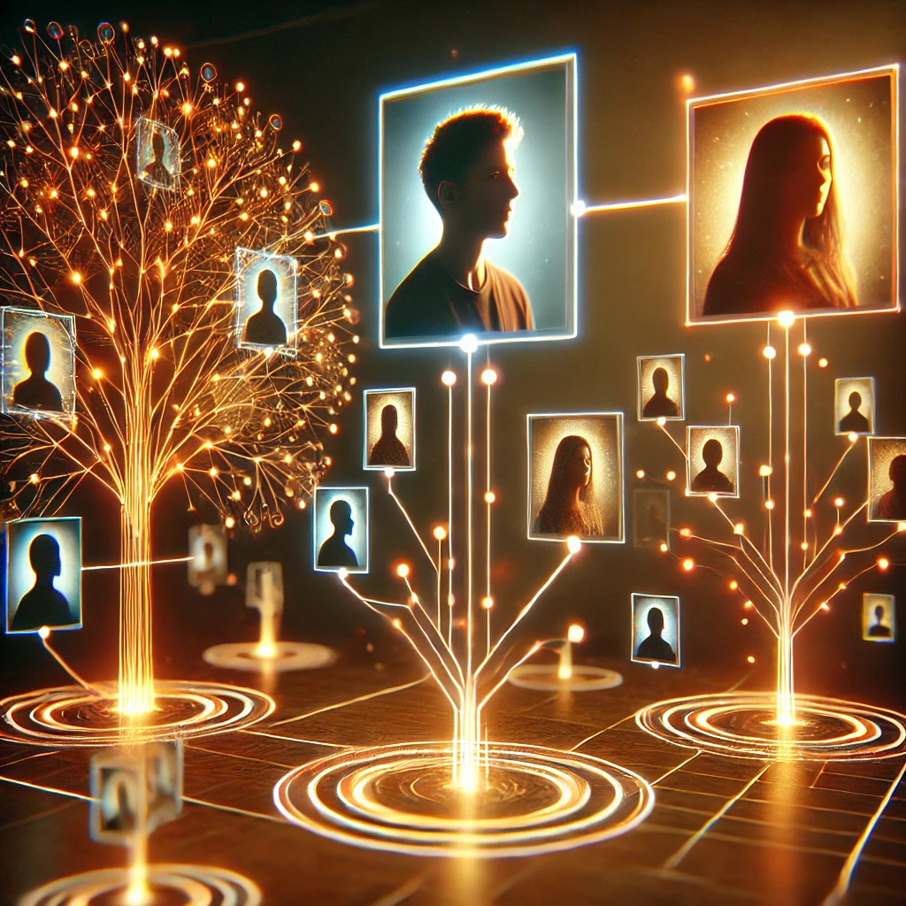
Diverse Family Branches and Growth Continuity
When a new family is formed, the Fusion Tree generates digital seeds that allow the new family to carry on the original memories and continue to grow.
It is also possible to maintain a relationship with an existing family. Memories are not limited to a single family, but can be continued across multiple families.
資料
數據
未來思考-家庭價值觀 P23.
我們推測在家庭功能轉為提供情感支持，型態可能包含多家長共養1孩、多元成家，
除了原生家庭，可能會有多個家庭，由不同興趣動機組成，新型態數位 遠距家庭。
Notes:
"When users start a new family, For new families, it generates a digital seed to pass down memories and traditions.

Slide 35
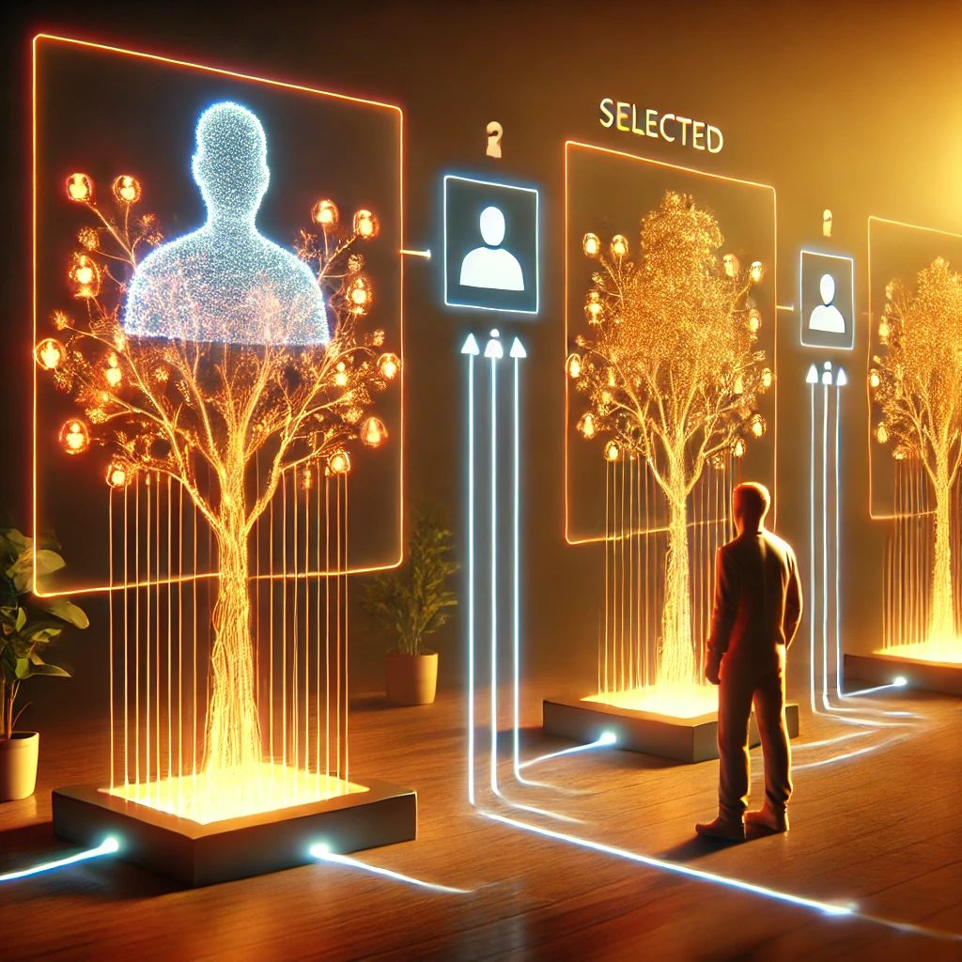
Digital Personality and Privacy Protection
Possible data asset issues with corresponding products
Fusion Tree is able to create digital personalities that distinguish between personal memories and multiple family memories, ensuring privacy while facilitating the sharing and bonding of common family memories. When a family member passes away, the digital personality can help determine which memories can be preserved and passed on to the next generation.
資料
數據
未來思考-跟回憶互動與隱私 P26.
我們推測在未來與回憶互動更個性化且隱私保存更加自動與個性化
Notes:
"So, how can we ensure that the memories we store are protected in terms of privacy?"
"This is another challenge we aim to address. To solve this, the Memory Tree ensures privacy with a digital persona, separating personal and family memories for selective sharing.

Slide 36
What is the role of AI in this study?
AI memory System WorkFlow
Emotional Support
家庭
Emotional Companionship
Interactive Response
Individual
(family member)
Family
family-specific image cohesion
Memory storage
Enhance Emotional
Bond
Digital Personality
Privacy Protection
AI memory System
Notes:
This diagram illustrates the role of AI in our study through the AI Memory System Workflow.
The Memory-Tree transforms individual memories into interactive responses, cohesive family images, and digital personas, enhancing emotional support.

Slide 37
05
Conclusion & Future work

Slide 38
Conclusion
Evolving family structures by 2040 and the rise of single-person households will significantly impact family emotional connections and support.
Challenge
Solution
The "Memory-Tree” AI system is proposed to enhance family cohesion by storing and inheriting memories, providing emotional support, and ensuring privacy.
Results
Initial surveys show positive reception of the system's features, with a confirmed link between family cohesion and emotional support.
Adjustments
Privacy concerns regarding emotional perception led to a shift in focus—emphasizing memory inheritance to foster family cohesion and indirect emotional support.
Notes:
Our research tackles emotional support challenges in 2040’s shifting family structures. Memory-Tree fosters cohesion via memory inheritance and companionship, with positive survey results. We’ve prioritized memory inheritance and privacy, with plans to expand user studies and refine functionality.

Slide 39
Future Work
1
2
Evolution of Human-Machine Symbiotic Interfaces
AI's Deep Understanding and Adaptation to Culturally Diverse Family Structures and Relationships
3
4
Mental health support system assistance
Legal and technical aspects of digital heritage and privacy management.
Notes:
In the future, **our research** will focus on Improving human-machine interfaces, Adapting to diverse cultural families,Enhancing mental health features, and Managing digital heritage and privacy.

Slide 40
Thank you for attention!
Q&A Time
Speculative Design for Emotional Support in Future Family Structures: AI-Assisted Memory Management
Ms Chih-Yu Chang , Ms Pei-En Li, Mr Ko-Chiu Wu ,Mr Chi-Hao Lung
Department of Interaction Design, National Taipei University of Technology
Notes:
THE END
That concludes the report. Thank you for your attention!
以上是我們的報吿，感謝您的注意力！

