Slide 1
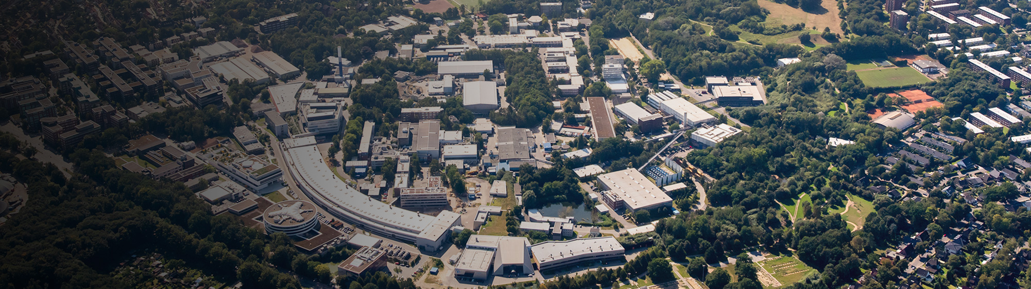


Access to Open Data at DESY for the scientific community
Tim Wetzel, Patrick Fuhrmann, Armando Bermudez Martinez, Uwe Jandt, Paul Millar, Sophie Servan, Franz Rhee, Peter van der Reest, Regina Hinzmann, Noel Barth, Johannes Reppin, Christian Voss, Linus Pithan, Anton Barty, ...
ISGC in Taipei, 2025
Presenter: Patrick Fuhrmann

Slide 2

As science is permanently improving ….

Slide 3
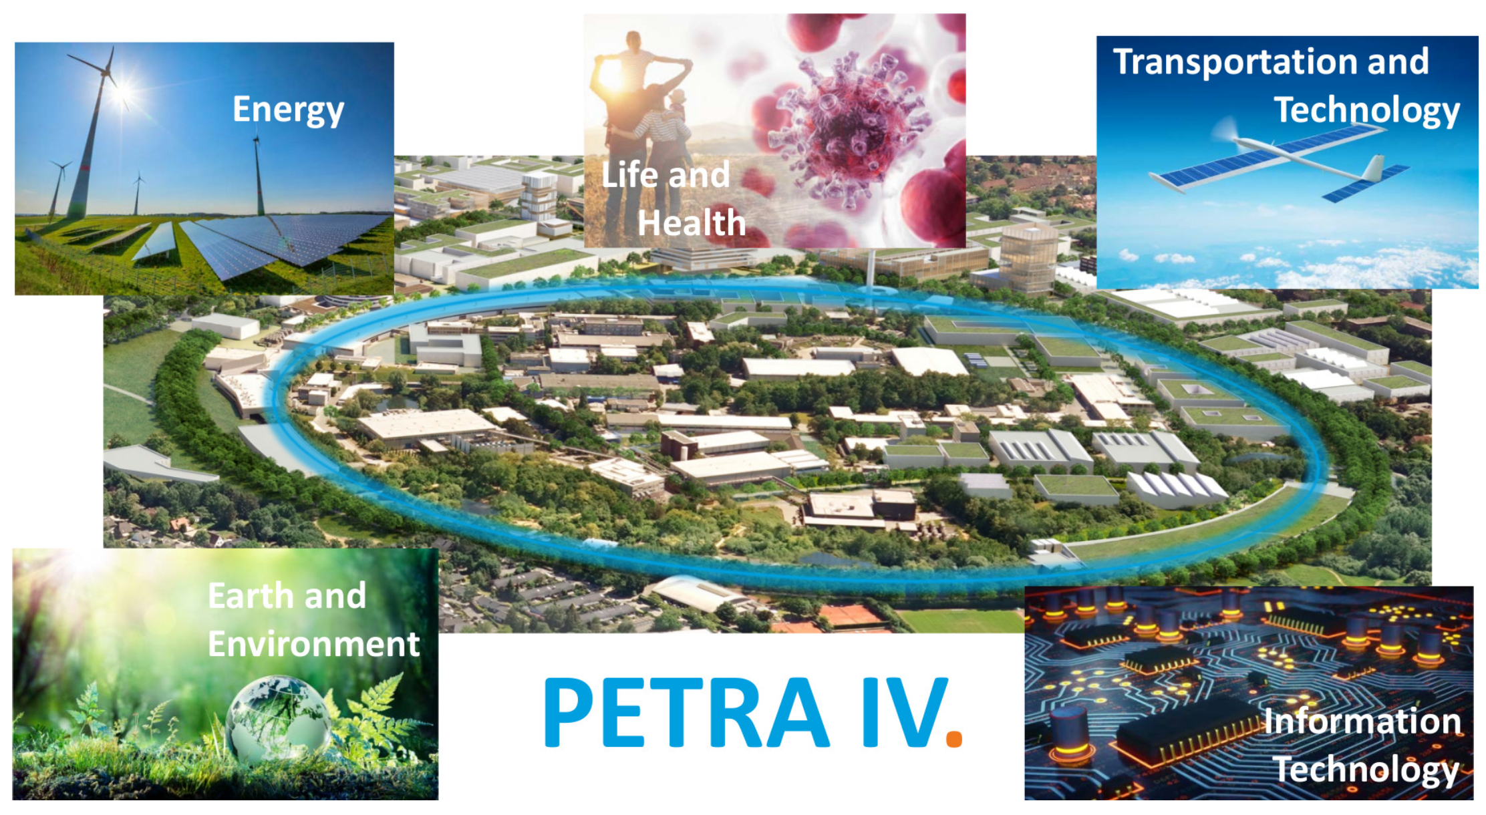
As is the DESY Synchrotron PETRA III

Slide 4
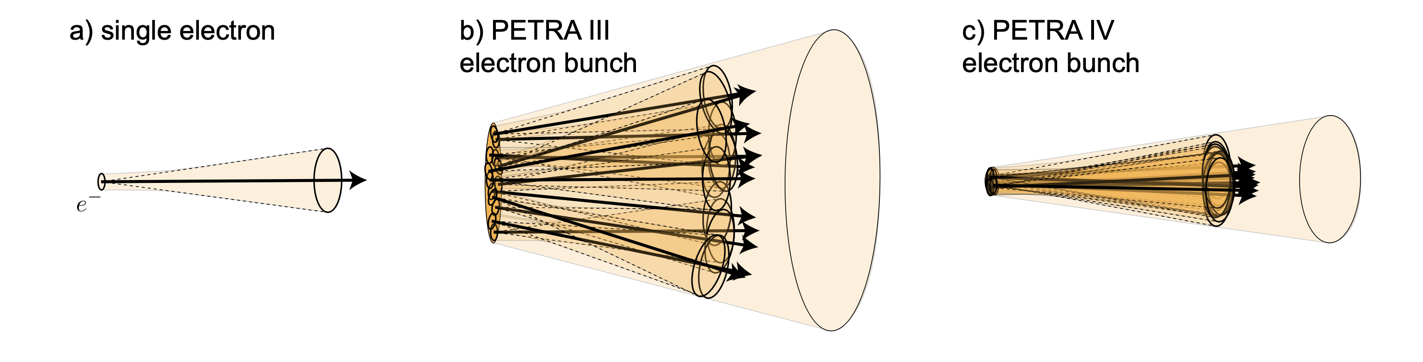
PETRA IV diffraction limit for electron bunches
What’s better?
A single electron emits synchrotron radiation in cone with a small opening angle and a corresponding small effective source size
In PETRA IV, the electron bunches approach the diffraction limit in both lateral size and diverence, this emitting diffration-limited radiation up to the X-Ray energies of about 10 keV.
The electrons in the bunches in today’s synchrotron sources are distributed horizontally well beyond the lateral diffraction limit in terms of size and divergence angle.

Slide 5
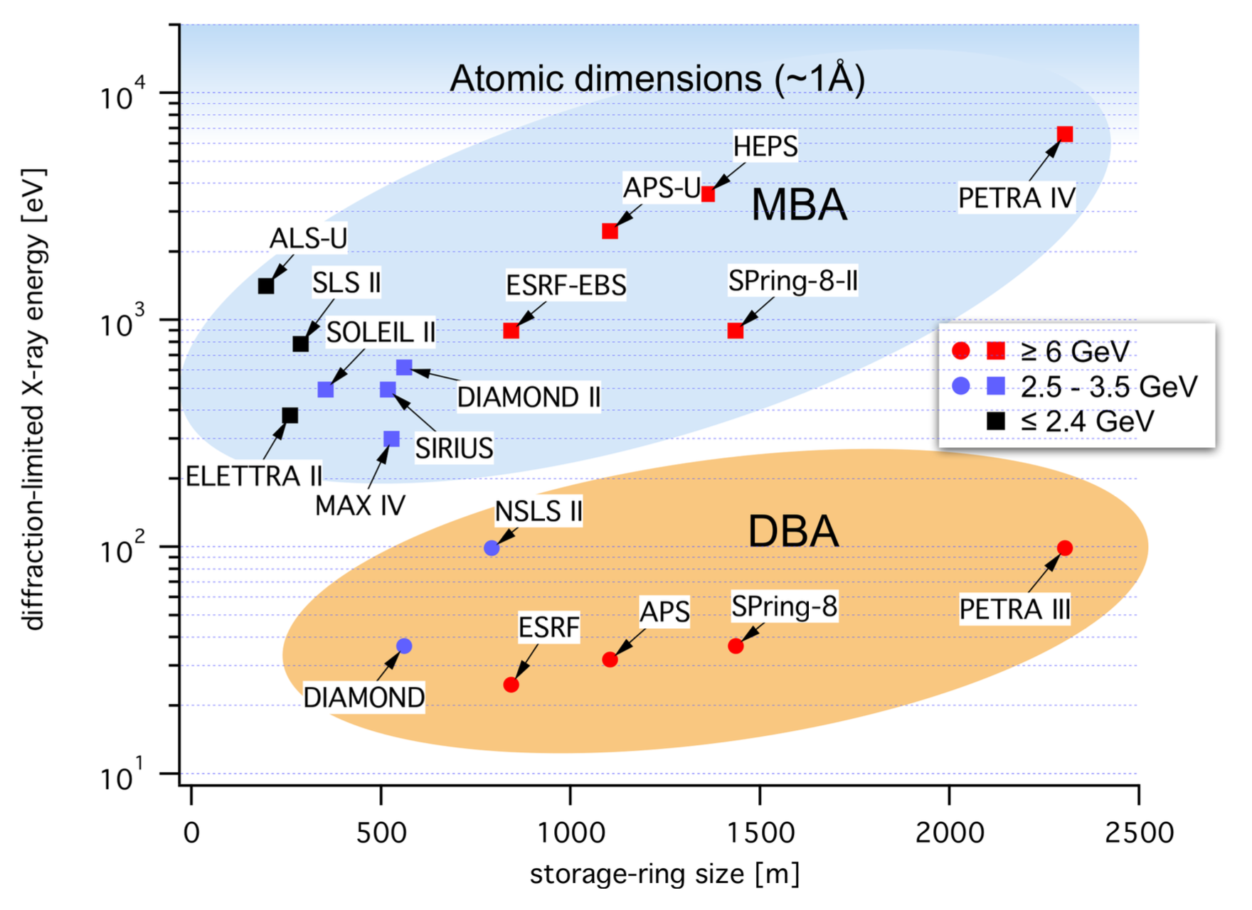
PETRA IV and Friends
Diffraction-limited photon energy for some synchrotron radiation sources and their future upgraders. PETRA IV will be the first source worldwide to reach the diffraction limit for hard X-ray energies.

Slide 6
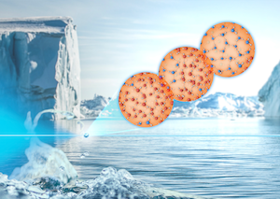
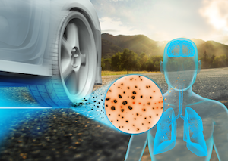
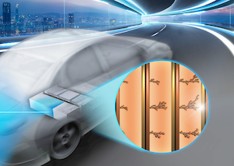
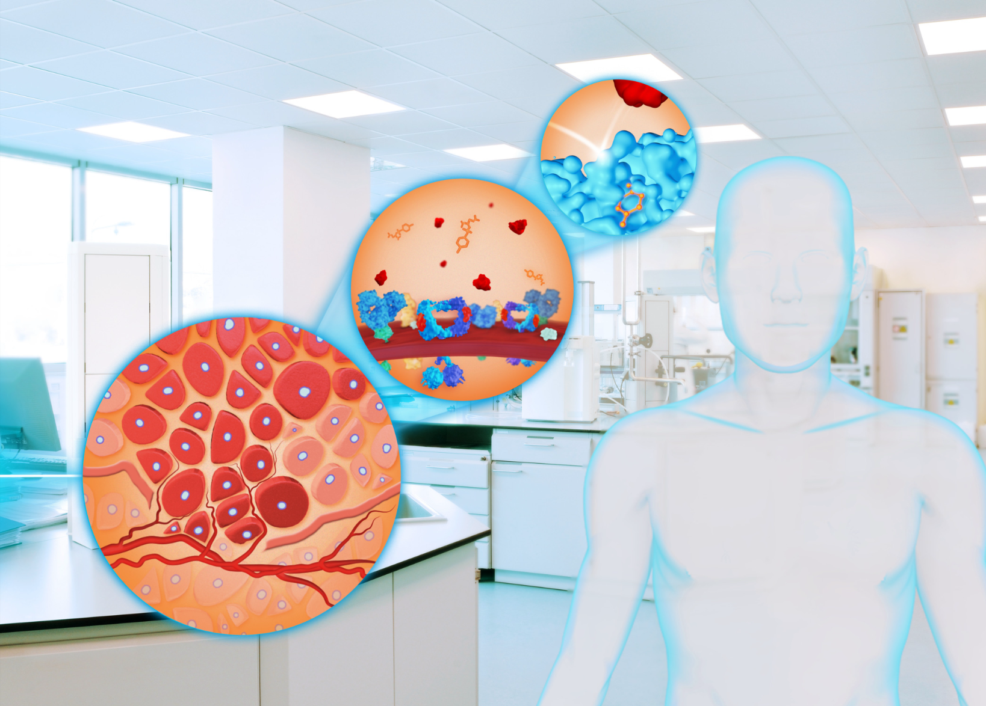
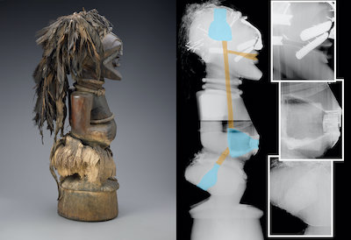
New Science enabled by PETRA IV
Role of Water
The complex dynamics of water and aqueous solutions can be followed using the highly coherent X-rays of PETRA IV on time scales ranging from nanoseconds to hours.
Battery
The X-rays of PETRA IV can scan a fully functional battery and allow internal processes to be monitored under operating conditions.
Fine Dust
The highly brilliant X-rays from PETRA IV penetrate matter and can reveal the formation of fine dust particles a the contact surface between two materials during abrasion.
Tumor Research
Experiments at PETRA IV will analyse cells as part of their natural environment e.g. tumour tissue, healthy tissue in the brain) with highly brillian X-ray light.
Cultural Heritage
PETRA IV is used in cultural heritage research to analyze artifacts and materials at a micro or nano level, enabling detailed studies of composition, deterioration, and physical-chemical processes.

Slide 7
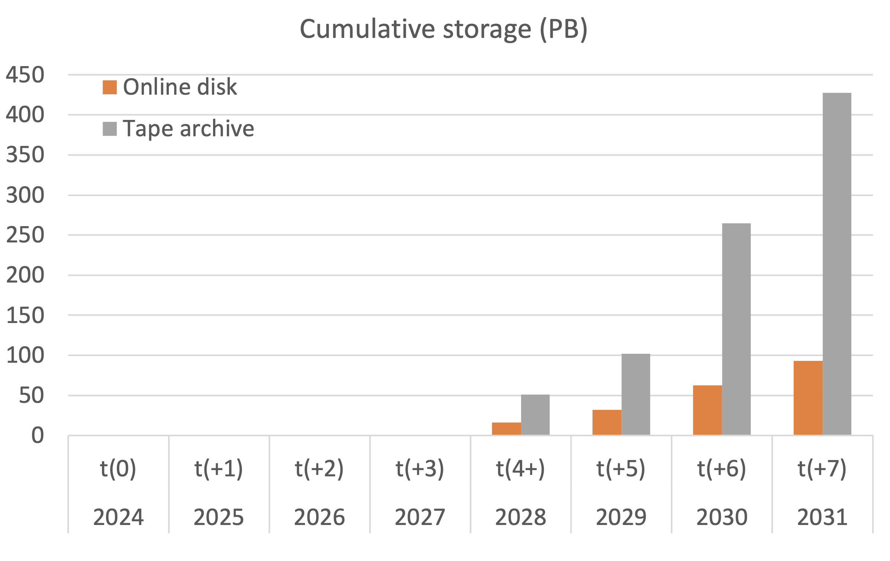
Consequence: Storage for PETRA IV
Timeline is shifted by one year!

Slide 8
Where we left off in ‘24
Light sources are huge infrastructures, providing extremely brilliant light, used with more than 200 techniques to look deep into matter for Biology, Material Science, Cultural Heritage and what not.
In 2019 Petra III at DESY had more than 6300 visits from 3150 national and international users at 21 beamlines;
Those beam times produce an enormous amount of extremely precious data, under the governance of the PI.
But, after the ‘embargo period’ all this data becomes ‘Open Data’ (public)
We still have a similar situation in almost all sciences.
Data which wasn’t used in publications is essentially lost.
After a publication, the future of the data only depends on the PI, who will have moved on to his/her next project. The future of that data is undetermined.
No one, except the original group, understands the details of those collected datasets.

Slide 9
So we need ….
Enforce a minimum set of well defined Meta Data!
Store you data safe and immutable!
Get a unique handle to your data and catalogue it!

Slide 10
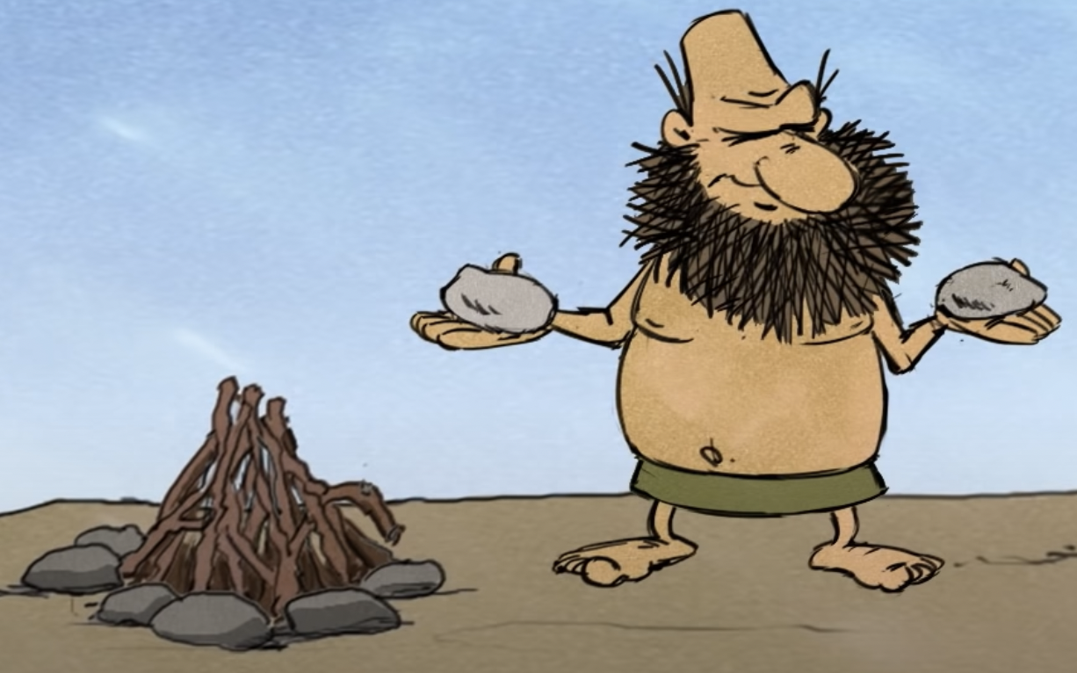
We have to build something to fix that!

Slide 11

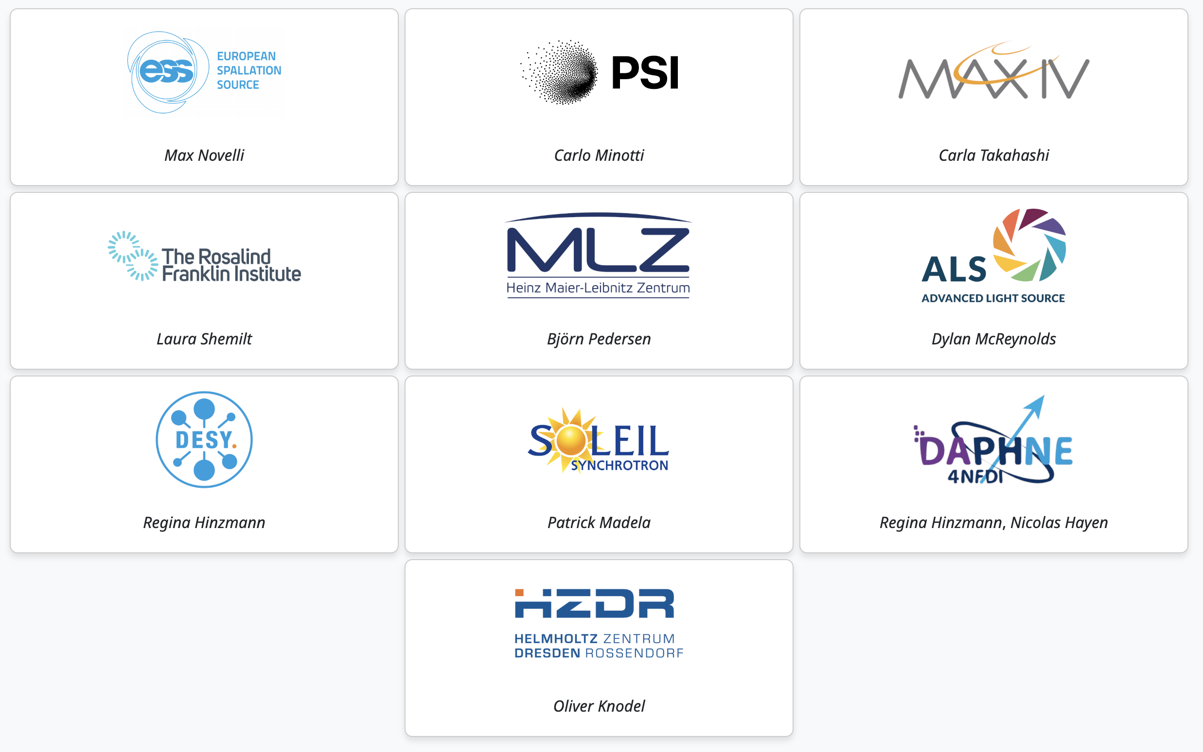
Joining the SciCat Callaboration!
Mission
SciCat is a community driven scientific metadata catalog designed to simplify metadata management, enabling data sharing, discovery, and collaboration. By providing a central hub for metadata, SciCat makes data easily findable and accessible for the entire community. With flexible integration into diverse infrastructures and a clear path to data publication, SciCat empowers organizations to foster an open and innovative data culture, driving high-quality science forward.
Surprise

Slide 12

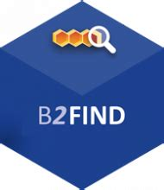






DESY Photon Open Science
OAI-PMH
The High Level View – a reminder
DOI minting
Exploitation
OPEN
DATA
Helmholtz AAI
Public Helmholtz
Spaces
Open Catalogue
We try to use standard protocols only to allow components to be replaced by components with similar functionality.
Out of
Embargo
DESY
HPC
System
Embargo’ed
Data
Synchrotron owned
Storage Spaces
Access Controlled internal Catalogue
Protected Embargo Area

Slide 13



The publishing process
HIFIS Staging Space
Open Data Portal
User Space
Daphne
Sisyphos
Machine or Manually generated preliminary Metadata
PaN Reflectivity
Database
Upload Tool
`
DOI minting
OMI-PMH
Data
Final
Publishing
Data
Data
Landing Page
Data
Curation Process
Persistent HIFIS Space
ORSO
Enforces Metadata following the defined metadata schema.
UI with Helper function
Data is immutable and no longer removable
NeXus
Metadata verification
Licence/Legal checks
Data Quality verification
Data
Data
HDF5
Data
Data

Slide 14
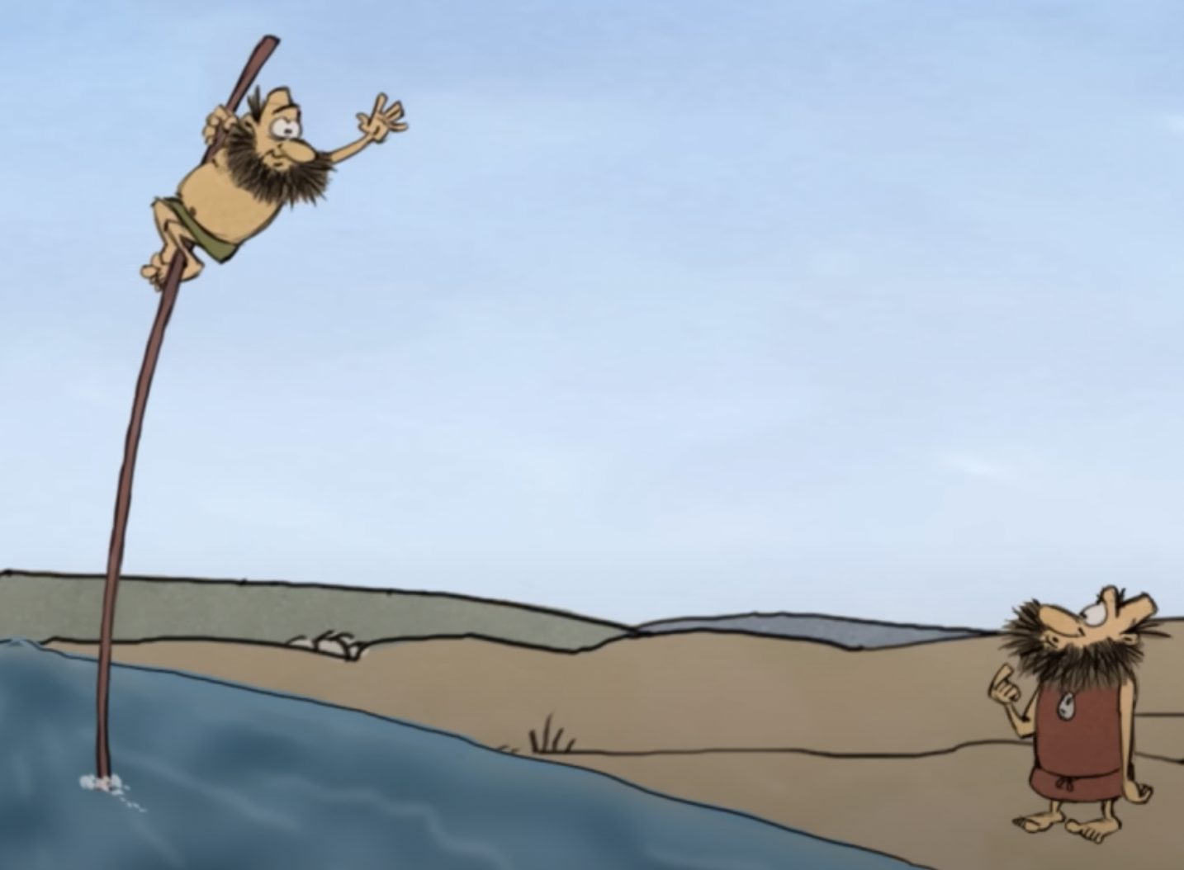
How does this all look like ?

Slide 15
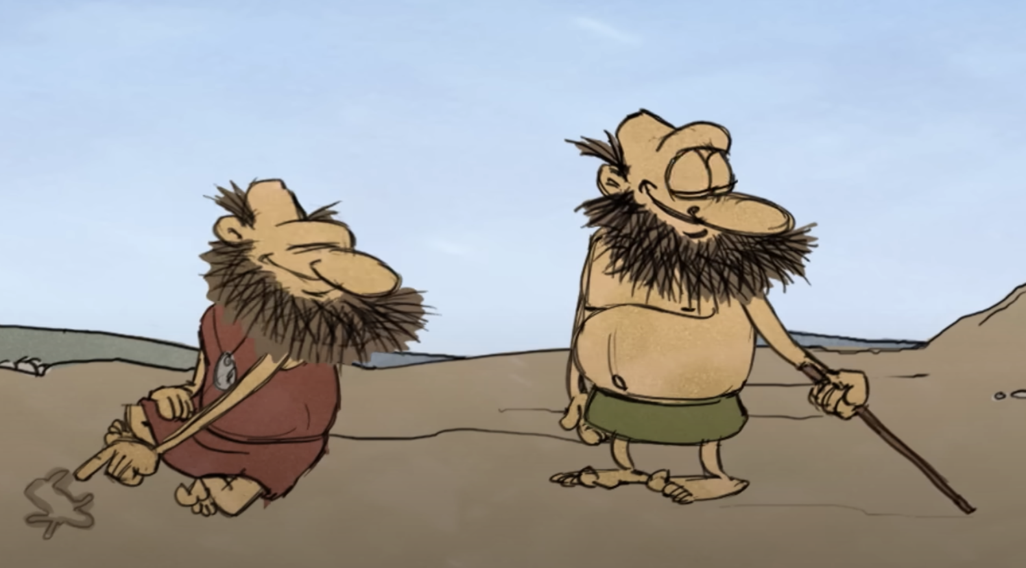
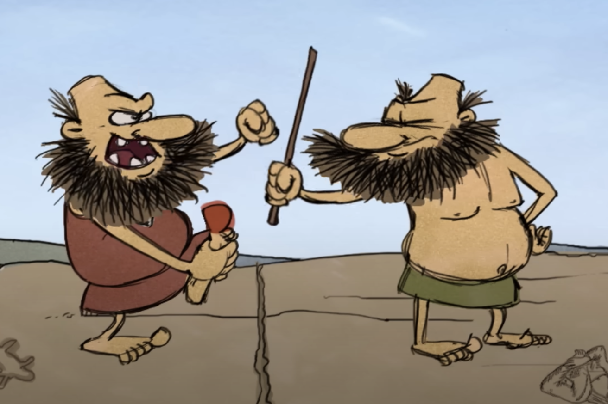
One of the biggest issues!
Metadata( CyroEM ) != Metadata( Crystalogrophy ) != Metadata( Dark Matter Search )

Slide 16





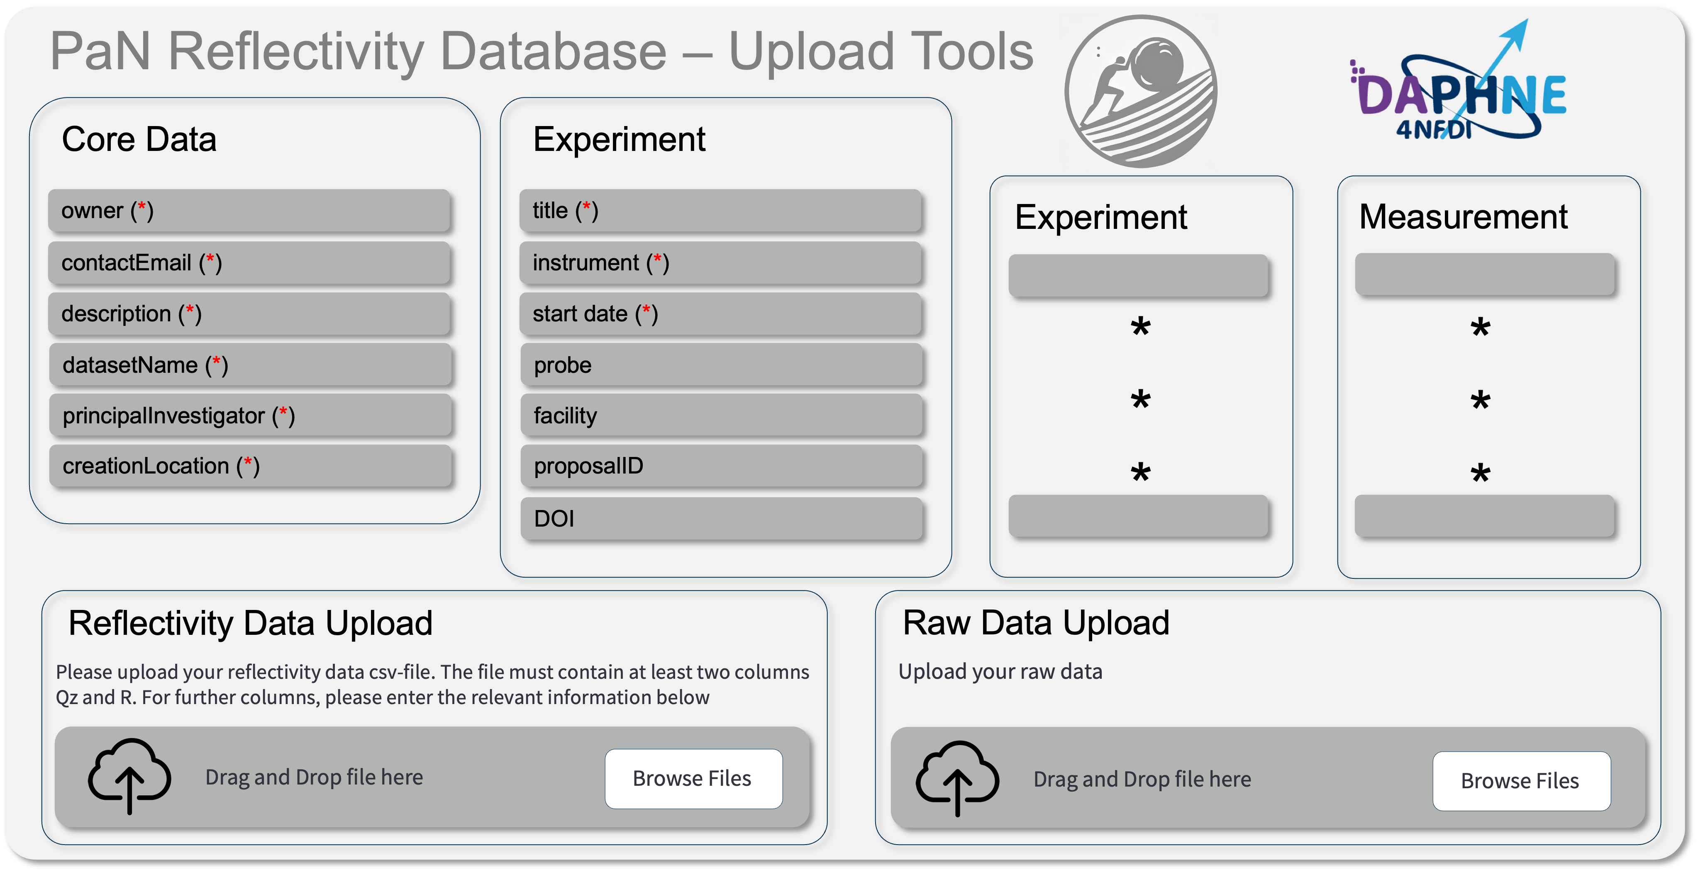
The meta data schema registry!
Domain Specific
Metadata Description
MDS
Convertion
W3C OWL
Metadata Schema
Registry
***
Reflectivity
Tomography
Domain Specific Meta Data Handling and Upload
***
Sisyphos
Meta Data Upload
Form Generator

Slide 17

Sisyphos: Meta Data Form based on Domain JSON-Schema
PaN Reflectivity Database – Upload Tools
Core Data
Experiment
owner (*)
title (*)
Experiment
Measurement
contactEmail (*)
instrument (*)
description (*)
start date (*)
*
*
*
*
*
*
datasetName (*)
probe
principalInvestigator (*)
facility
creationLocation (*)
proposalID
DOI
Reflectivity Data Upload
Raw Data Upload
Please upload your reflectivity data csv-file. The file must contain at least two columns Qz and R. For further columns, please enter the relevant information below
Upload your raw data
Drag and Drop file here
Browse Files
Drag and Drop file here
Browse Files

Slide 18
Uploading data and merging meta data!
Meta Data

Slide 19
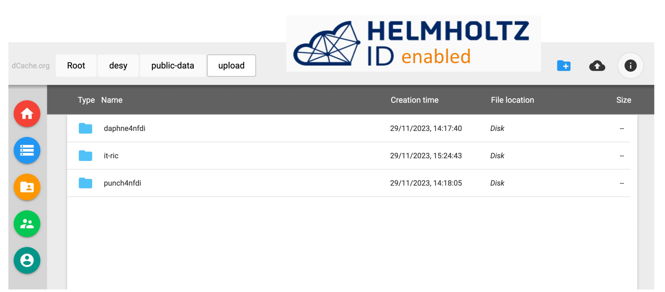
View your uploaded files
hifis-storage.desy.de

Slide 20
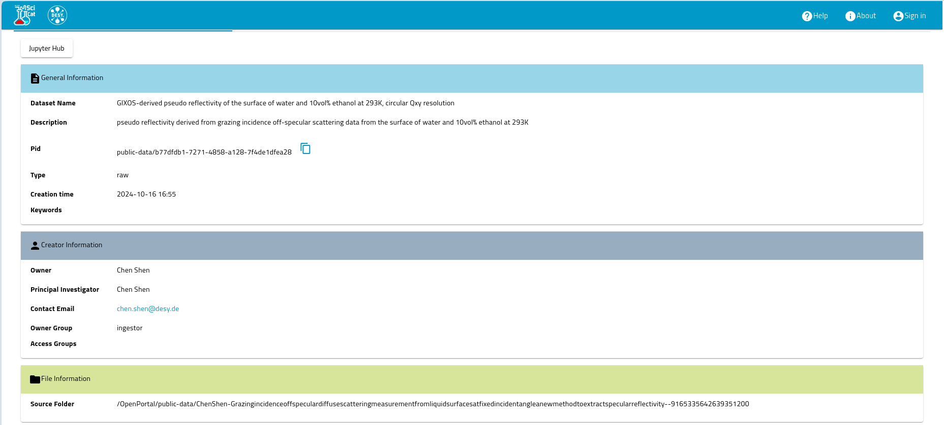
The Meta Data catalogue
public-data.desy.de
General Information
Dataset Name
Description
PID
Type
Creation Date
Keywords
Creator Information
Owner
PI
Contact
Group
Access Group
File Information
Source Folder

Slide 21
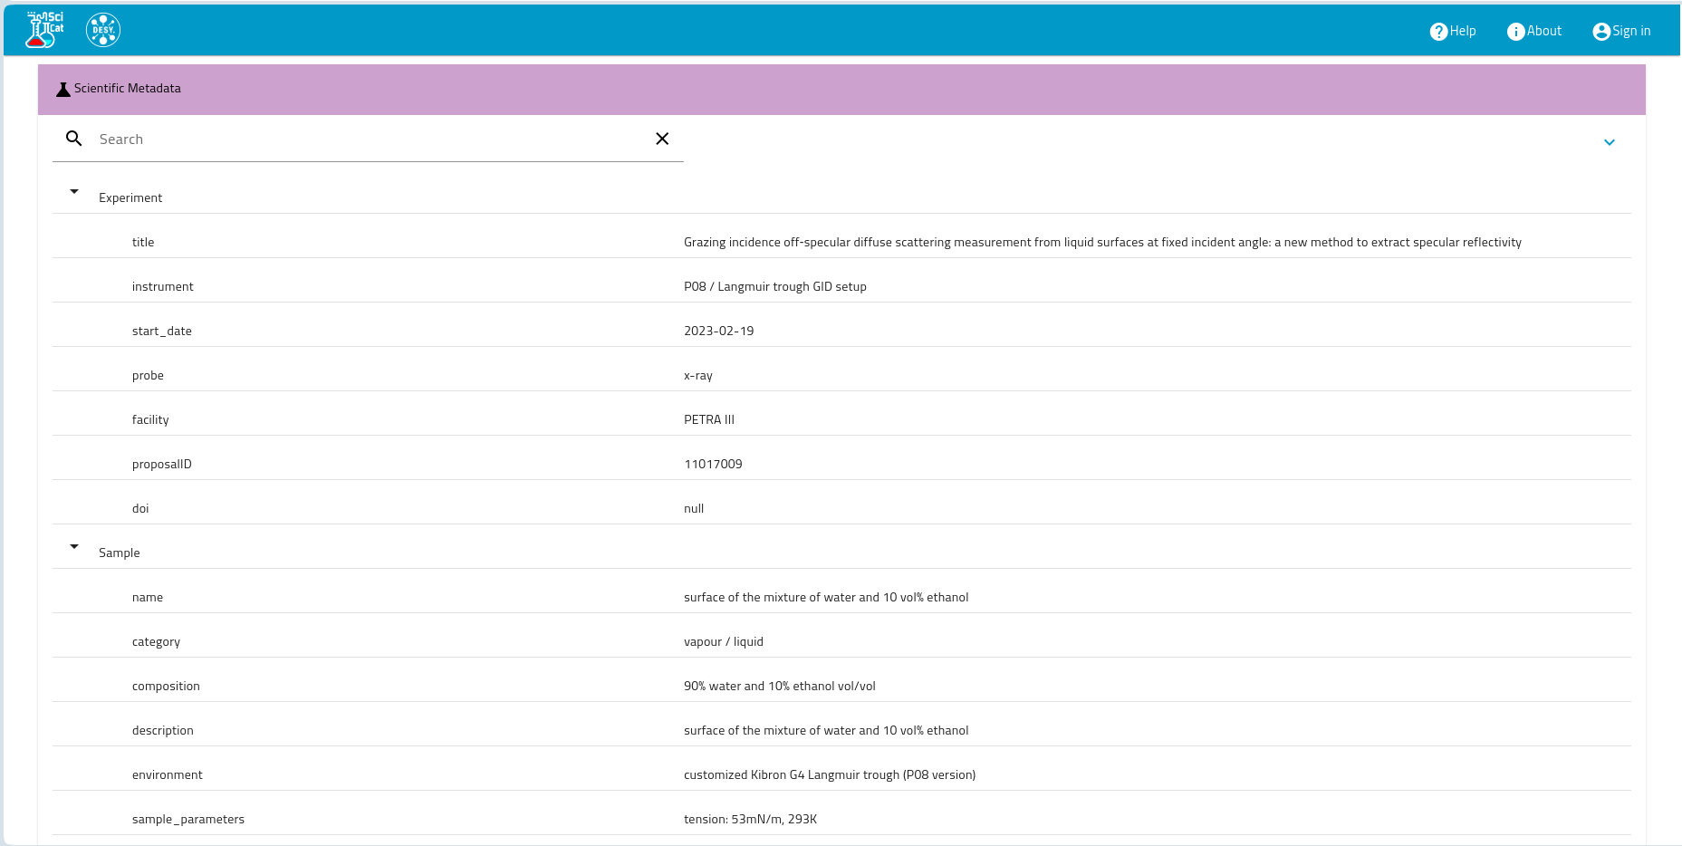
The Meta Data catalogue
public-data.desy.de
Scientific Meta Data
Search
Experiment
Title
Instrument
Start Date
Probe
Facility
Proposal ID
DOI
Sample
Name
Catagory
Composition
Description
Environment
Sample Parameters

Slide 22
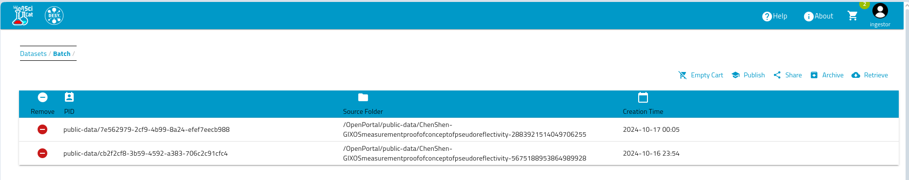
Minting a DOI
public-data.desy.de
PID
Source Folder
Creation Date

Slide 23
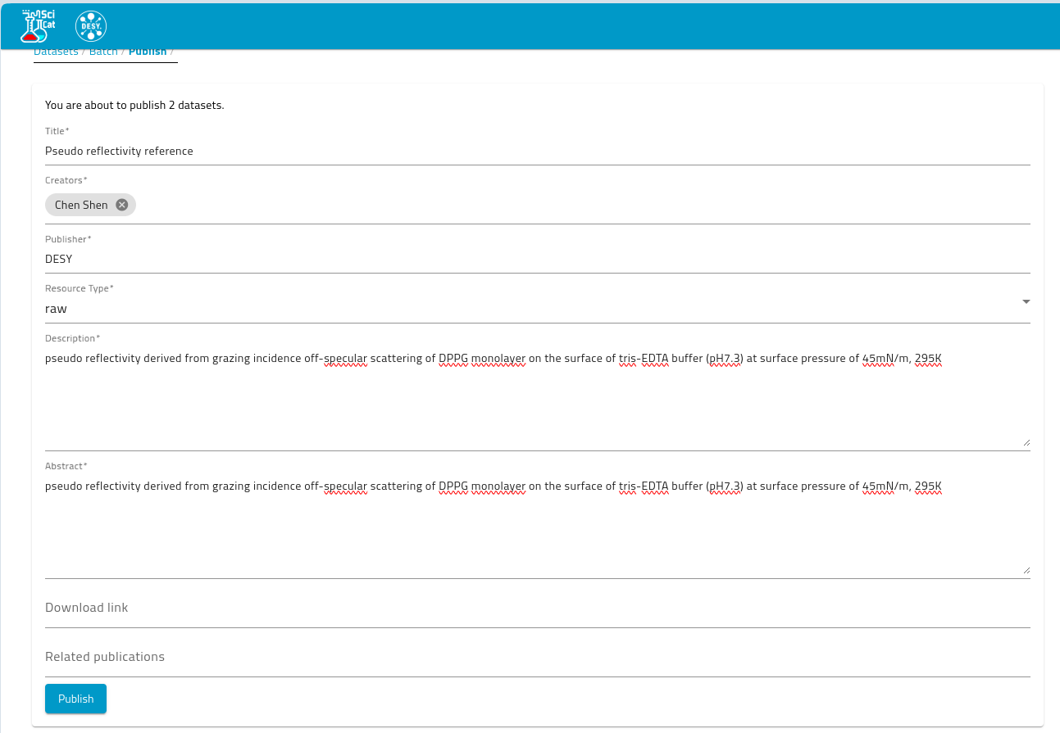
Minting a DOI
public-data.desy.de
Your are about to publish 2 datasets
Publish

Slide 24
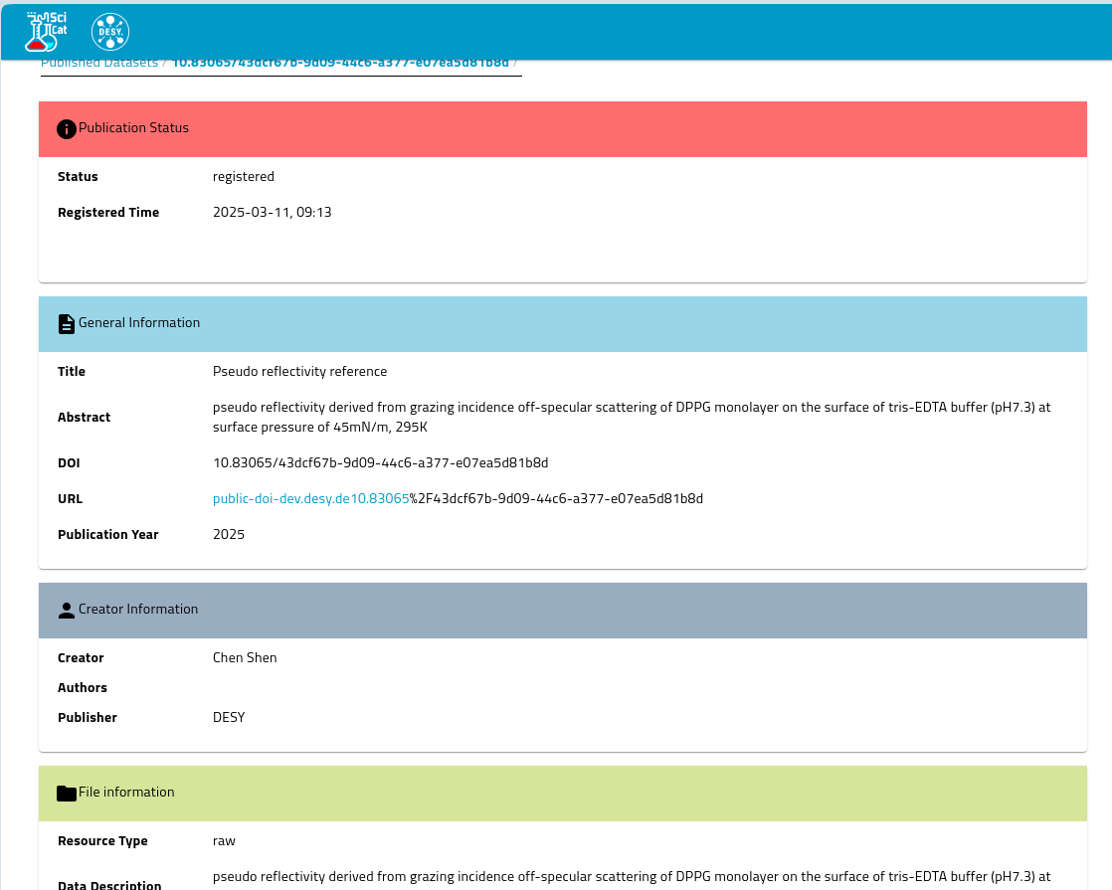
Minting a DOI
public-data.desy.de
Publication Status
Status Registered
Registration Time 2025-03-17. T. 9:30
General Information
Creator Information
File Information

Slide 25
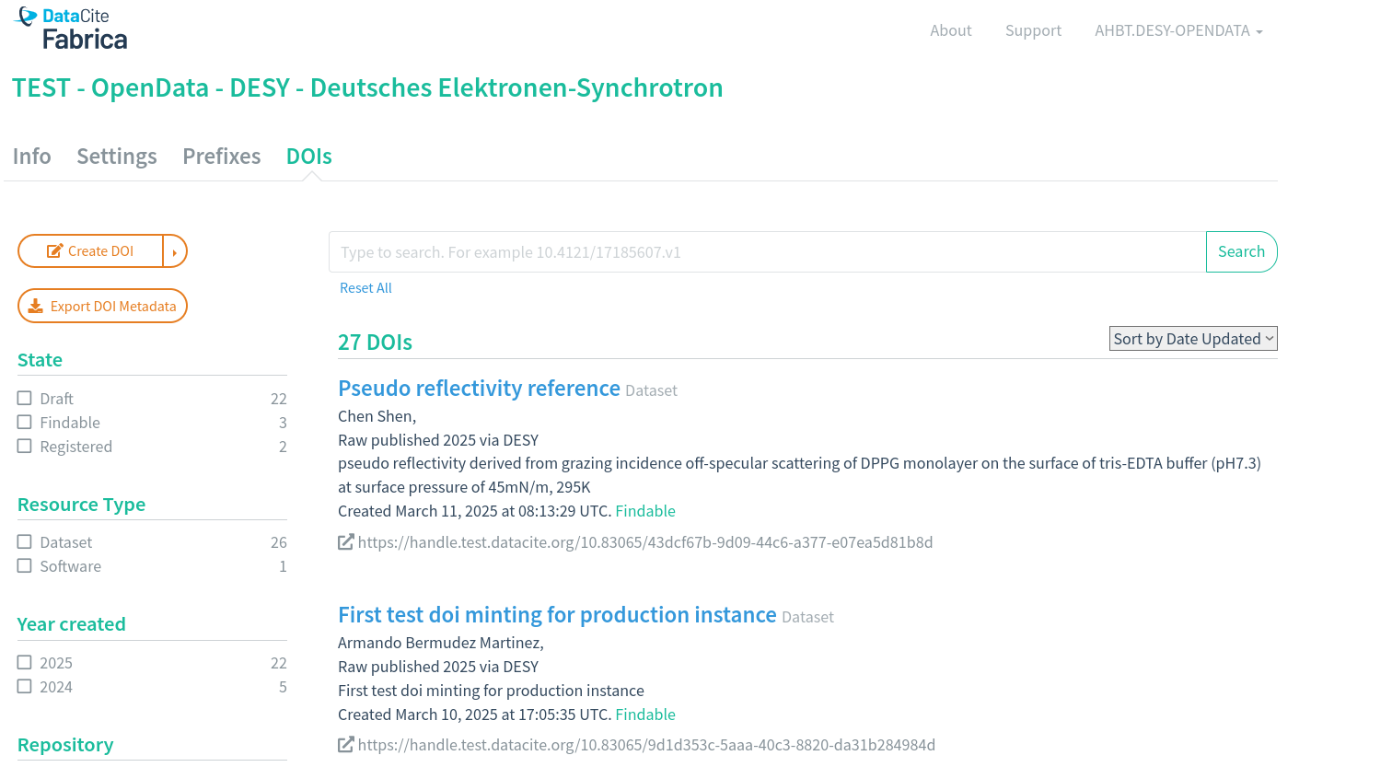
Find your minted DOI
DataCite Fabrica

Slide 26
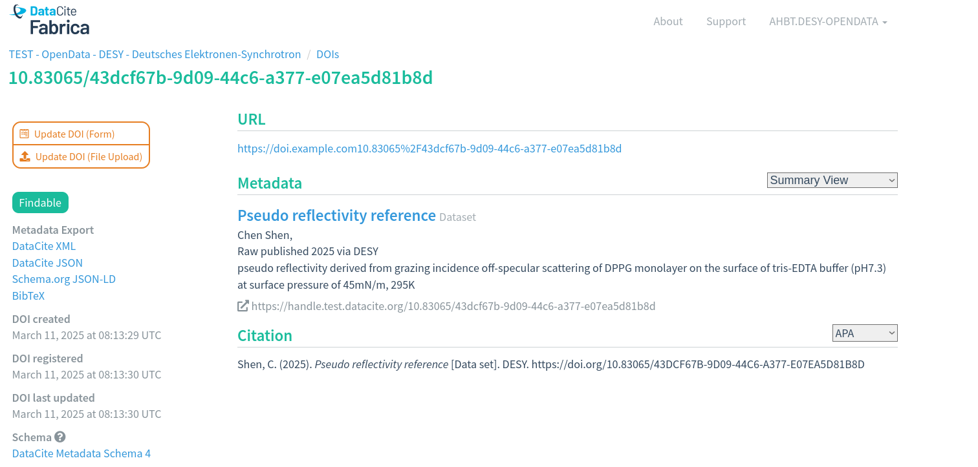
Find your minted DOI
DataCite Fabrica

Slide 27
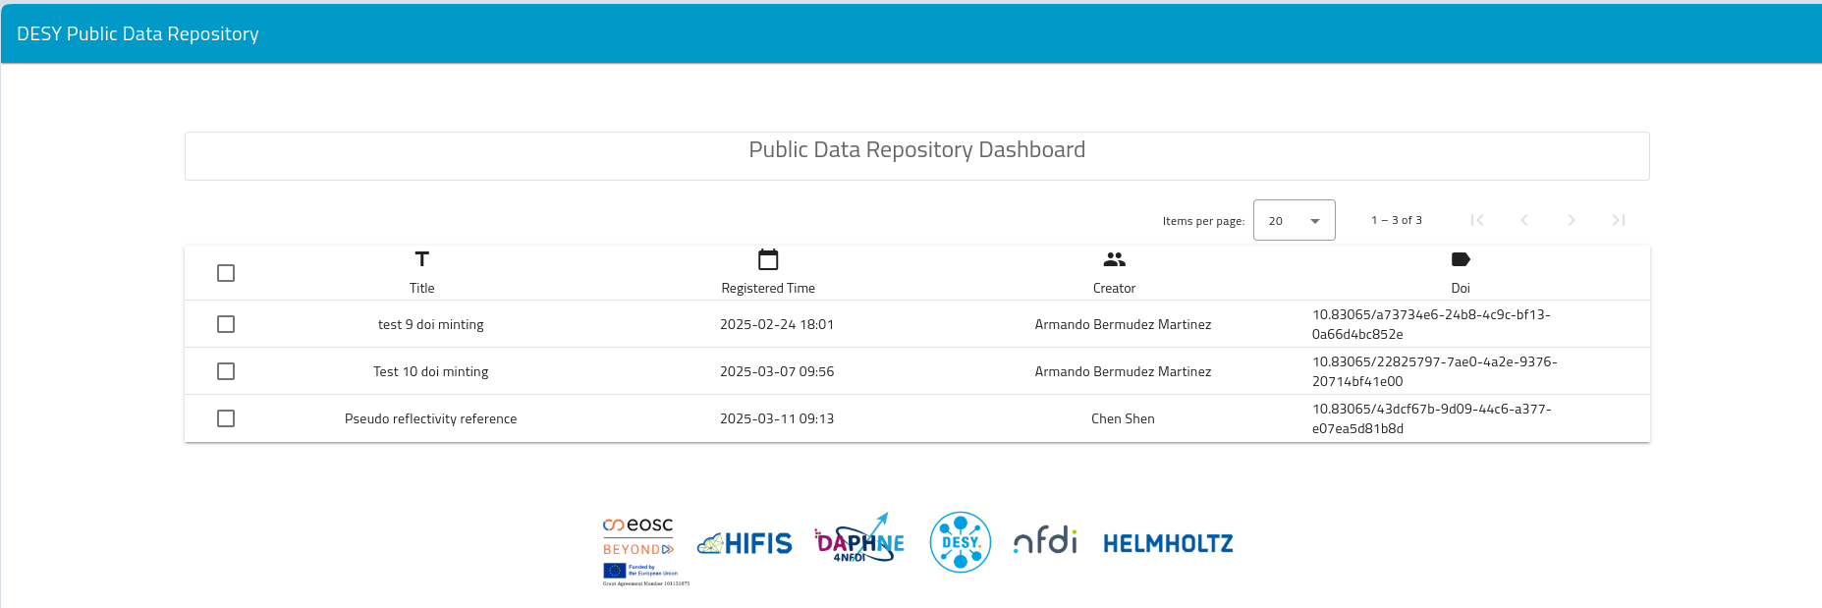
Find the datasets behind the DOI
public-doi.desy.de
DESY Public Data Repository

Slide 28
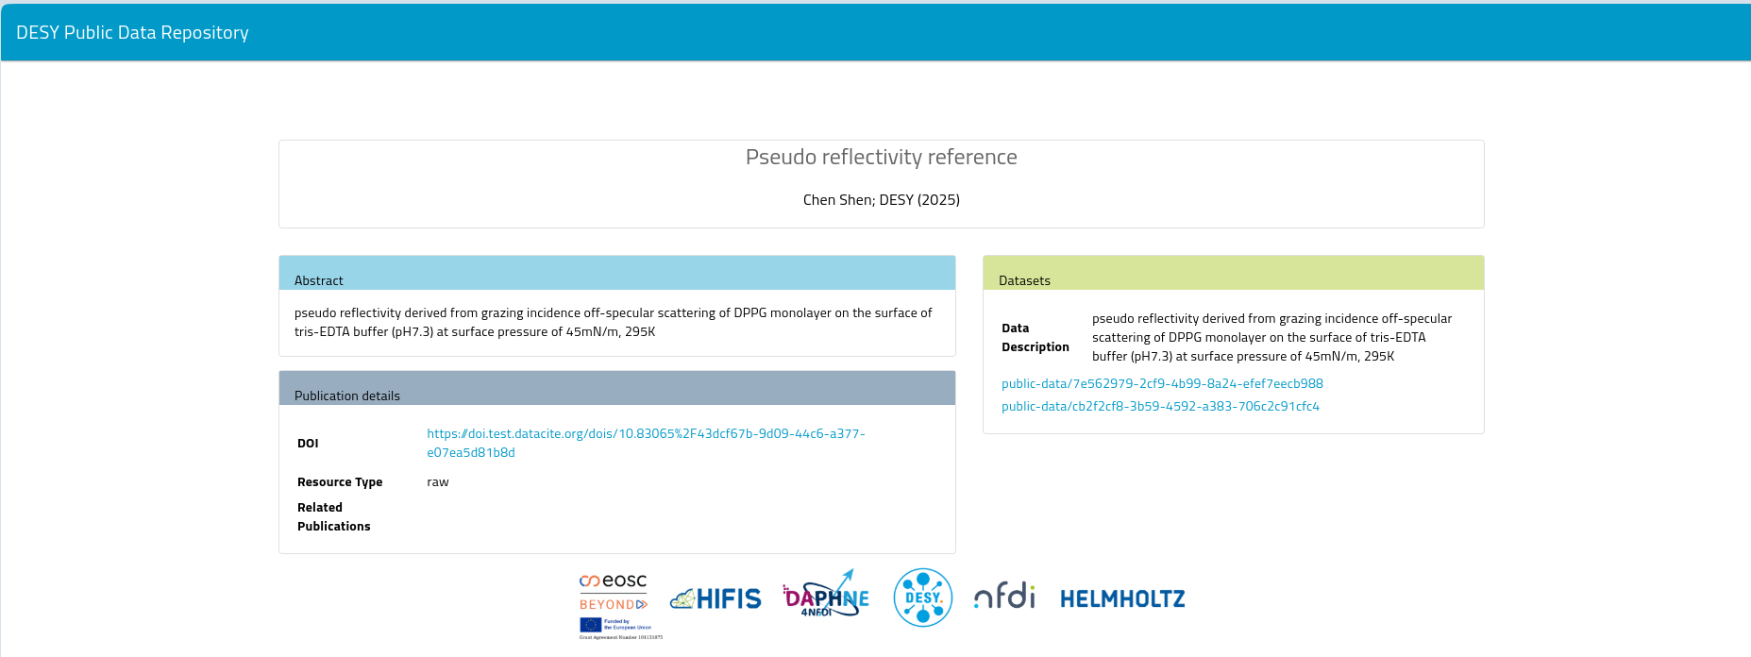
Find the datasets behind the DOI
public-doi.desy.de
DESY Public Data Repository

Slide 29
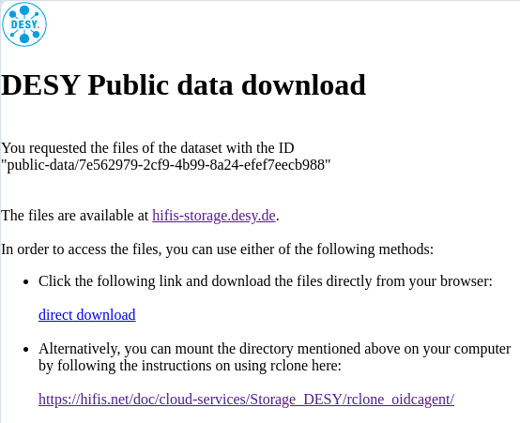
Find the downloadable data
public-data.desy.de

Slide 30
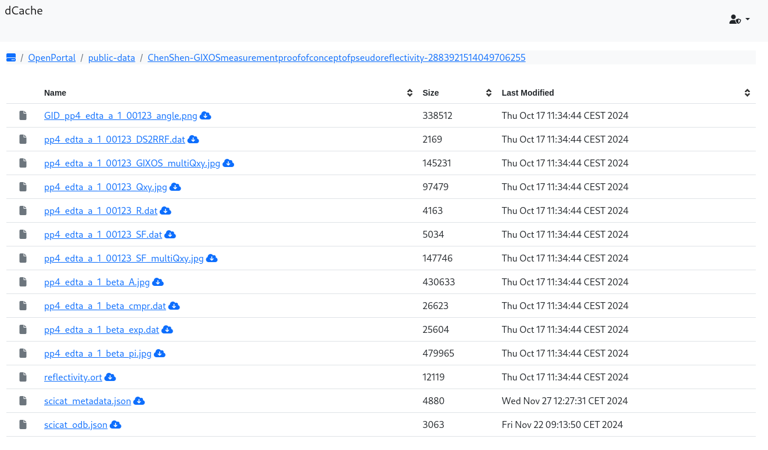
Find the downloadable data
public-data.desy.de
dCache

Slide 31
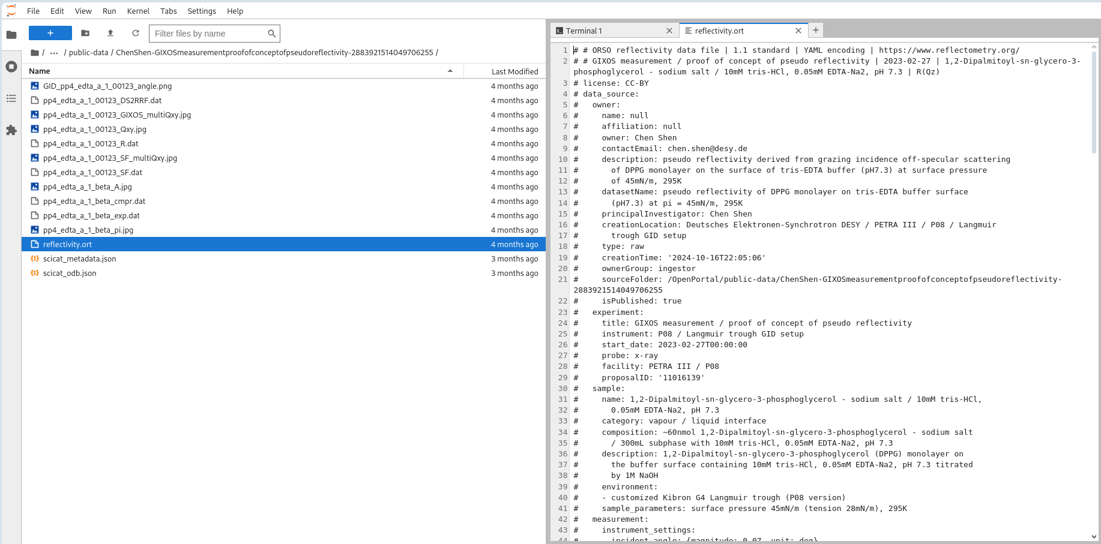
Explore the data before downloading it
jupyter.desy.de

Slide 32

How to move on?

Slide 33


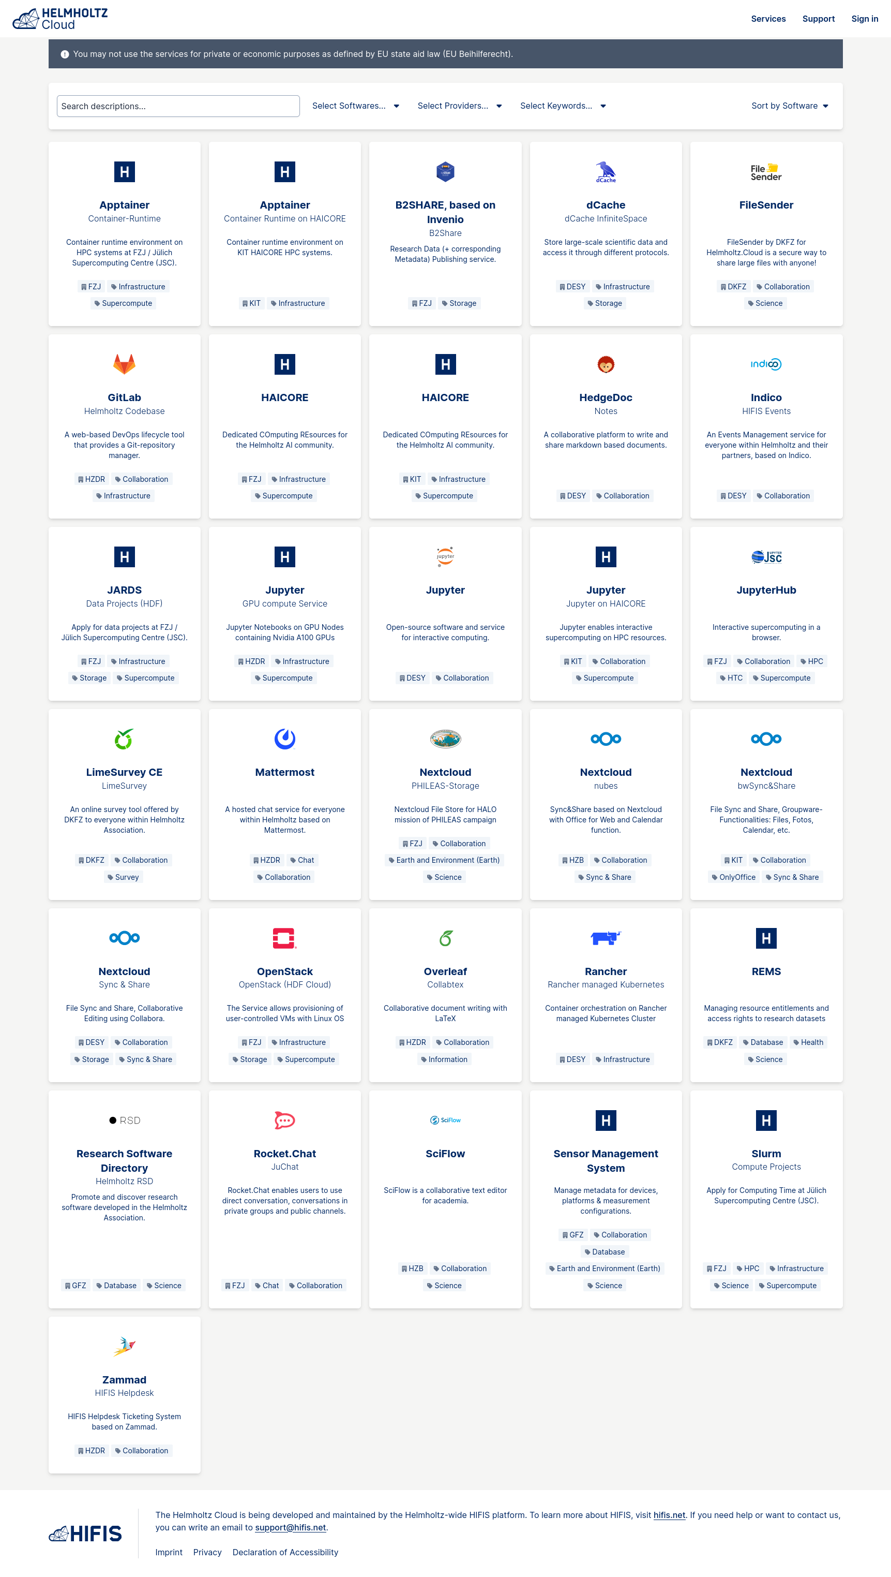



The Helmholtz and the EOSC Landscape
Thematic
Catalogues
Portal
Prototype Node
EOSC
Thematic/National
Node
Services
ILDG
Configuration
Catalogue
DESY
Open
Infrastructure

Slide 34
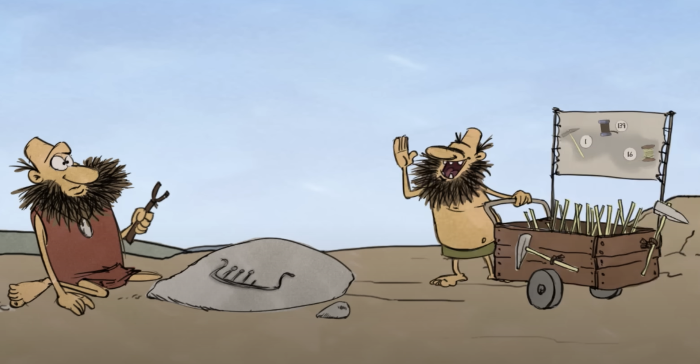
A little bit more technical!

Slide 35
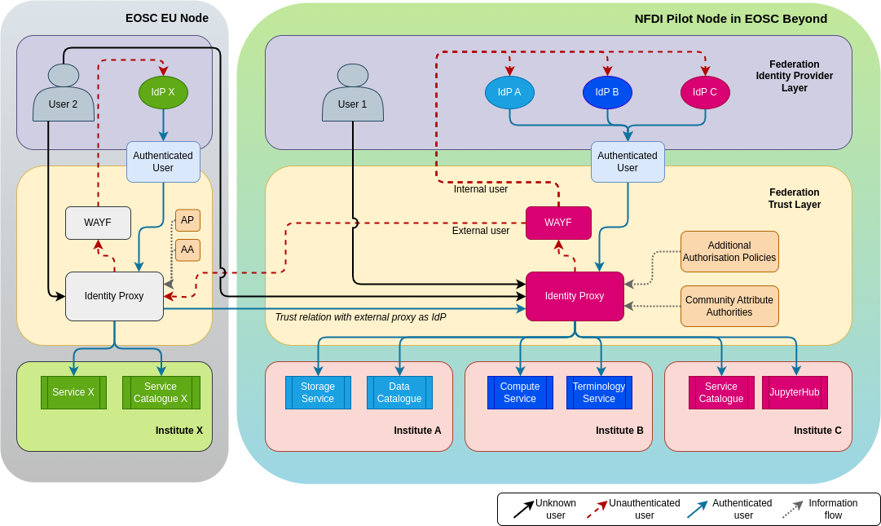
public-data in NFDI & EOSC
Interfacing with other European communities and services - WIP
The European Open Science Cloud is currently being set up as a network of community-provided platforms (“Nodes”)
Each node brings their own AAI and services behind it
The nodes are designed to be interoperable in order to bring synergies and interconnections for a more efficient scientific landscape.

Slide 36
public-data in NFDI & EOSC
Interfacing with other European communities and services - WIP
Mutual trust for authentication and authorization between communities allows for cross-community usage of
Identities
Services
Data sources
Infrastructure
...
In a modular, unified and transparent way to make it useful and easy for the scientists.

Slide 37
Thank you
Patrick Fuhrmann, Tim Wetzel
DESY IT
Patrick.Fuhrmann@desy.de, Tim.Wetzel@desy.de

