Slide 1
Data and Computing System for HEPS
Hao Hu, on behalf of HEPSCC
IHEP CC/HEPS CC Institute of High Energy Physics, CAS
ISGC 2025, Mar 16-21, Taipei

Slide 2
CONTENT
About HEPS & HEPS CC
Challenges for Data and Computing
System Design and Progress
Summary & Plan

Slide 3
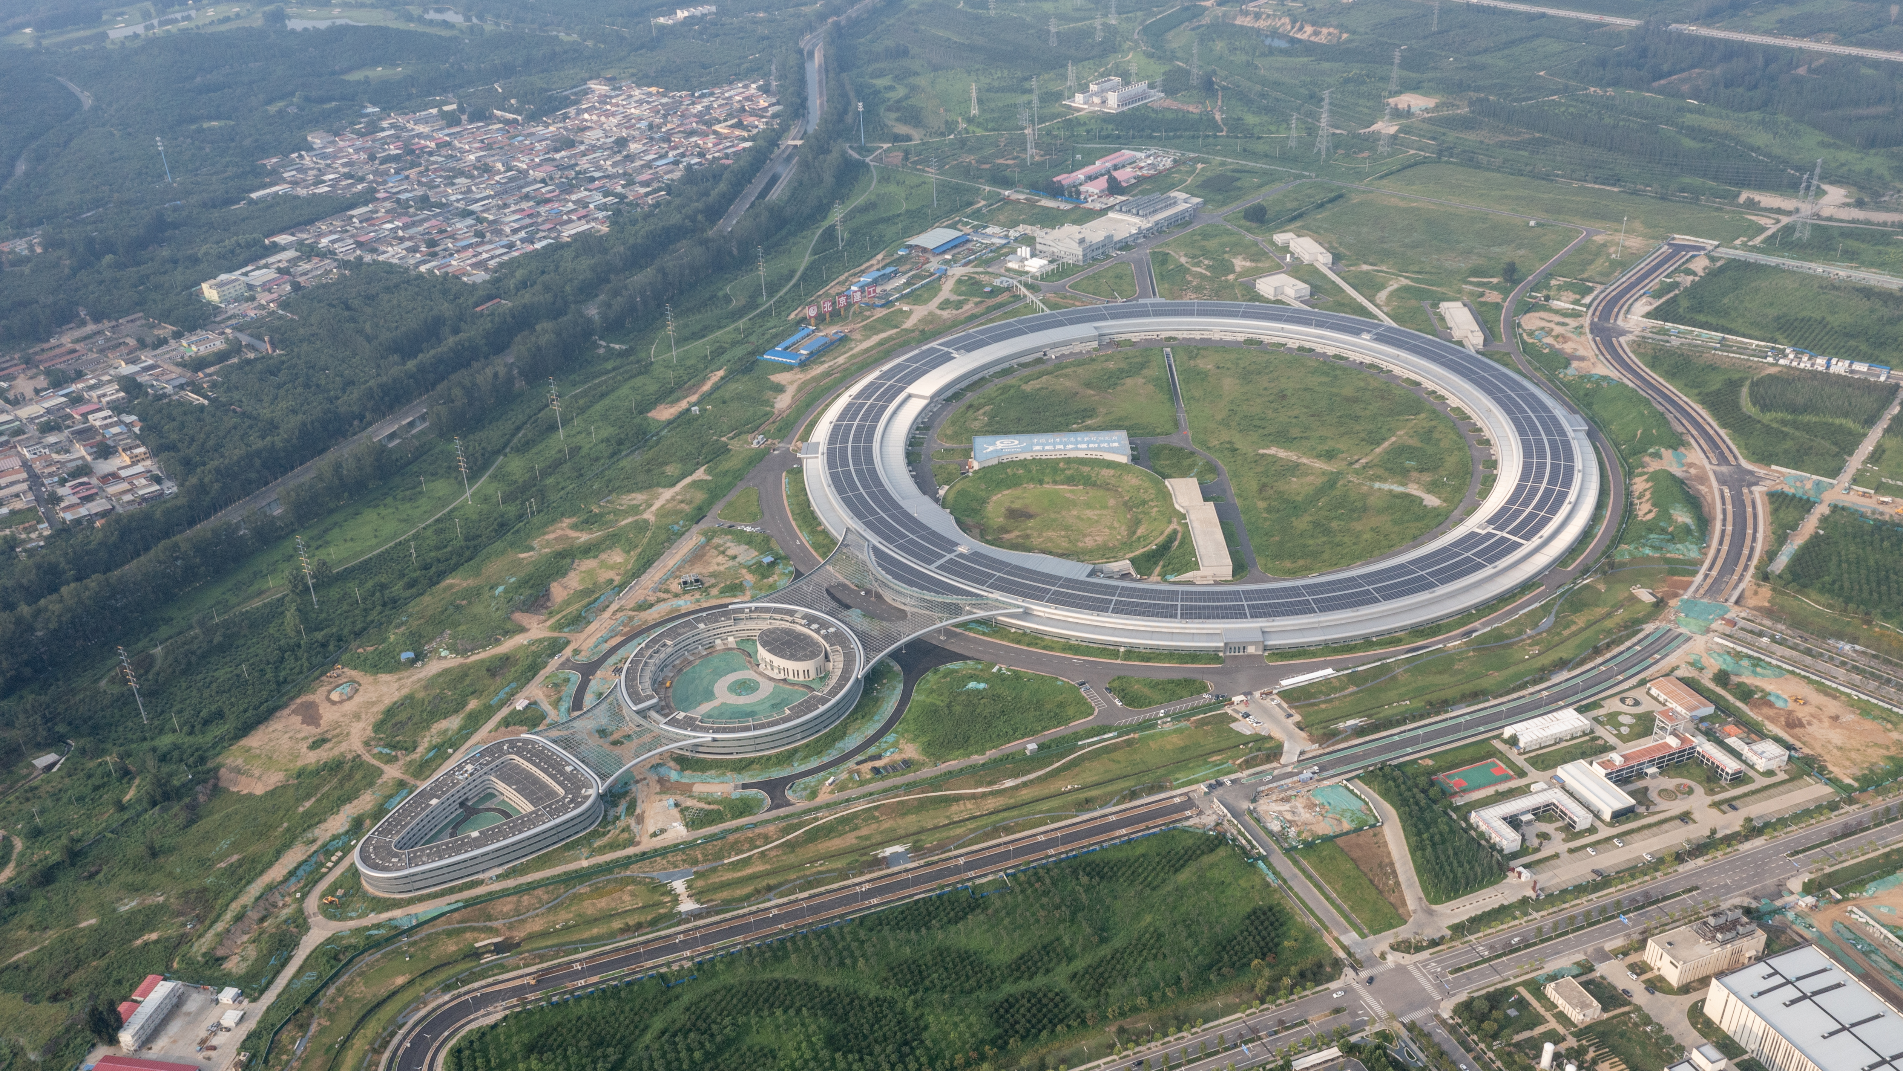
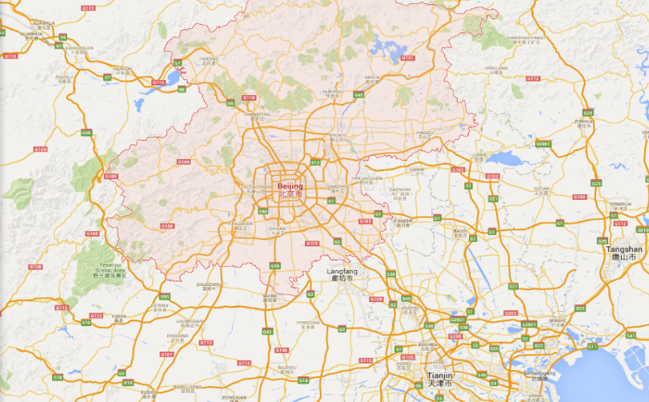
High Energy Photon Source (HEPS)
The fourth generation light source in China
— High energy, high brightness
Located in Beijing - about 80KM from IHEP
Officially approved in Dec. 2017, started in 2018
The whole project will be finished in 2025
First batch of beamlines began to install and debug equipment
Main parameters | Unit | Value
Beam energy | GeV | 6
Circumference | m | 1360.4
Emittance | pm∙rad | < 60
Brightness | phs/s/mm²/mrad²/0.1%BW | >1x10²²
Beam current | mA | 200
Injection |  | Top-up
HEPS
80 km
IHEP
Beijing

Slide 4
Data challenges
Data volume of Phase I Beamlines
>300PB raw data per year for HEPS Phase I
More than 90 beamlines finally, data volume will be ExaByte(EB) scale
Beamlines | Burst output（TB/day） | Average output（TB/day）
Engineering Materials | 600.00 | 200.00
Hard X-ray Multi-analytical Nanoprobe | 500.00 | 200.00
Structural Dynamics | 8.00 | 3.00
Hard X-ray Coherent Scattering | 10.00 | 3.00
Hard X-ray High Energy Resolution Spec. | 10.00 | 1.00
High Pressure | 2.00 | 1.00
Hard X-Ray Imaging | 1000.00 | 250.00
X-ray Absorption Spectroscopy | 80.00 | 10.00
Low-Dimension Structure Probe | 20.00 | 5.00
Biological Macromolecule Microfocus | 35.00 | 10.00
pink SAXS | 400.00 | 50.00
High Res. Nanoscale Elec. Struc. Spec. | 1.00 | 0.20
Tender X-ray beamline | 10.00 | 1.00
Transmission X-ray Microscope | 25.00 | 11.20
Test beamline | 1000.00 | 60.00
Total average: |  | 805
HEPS Phase I

Slide 5
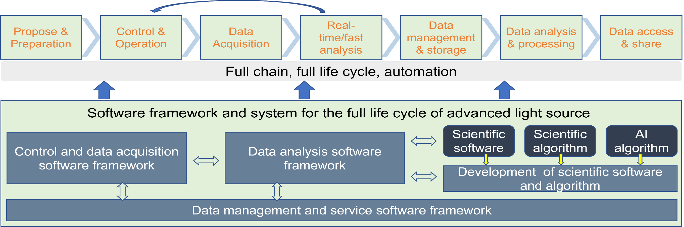
The Required capabilities in data and software
(Mamba)
(Daisy)
(Domas)
Infrastructure and Services: Storage , Computing , Database , Middleware , Software / Cyber and Data Security services
Policy and Rules
Common requirements : infrastructure + software framework and system for the full data life cycle
Specific requirements: porting, developing and integrating algorithms, tools and workflow for different beamlines

Slide 6
Objectives and Missions
Provide Data and Computing Services for all the beamlines/experiments
  Infrastructure
  Network & security
  Storage & Computing
  Scientific Data Software
  Public Information Services
Research & Development in Information Technologies related to HEPS
  High Performance Network, Computing and Storage technologies
  Scientific Software for Advanced Light Sources (DOMAS & DAISY)

Slide 7
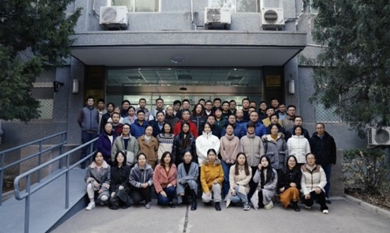
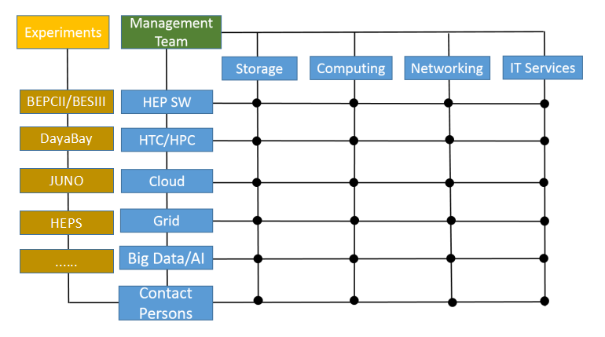
Manpower
40 members
  There are 100 members in IHEP Computing Center, working on IT for experiments @IHEP
  About half of the members of IHEP CC, and 3 from CSNS/Computing and Software group, 1 from Beamline, working on HEPS together with beamline scientists and software engineers
  Matrix management, share the knowledge and experience with other experiments

Slide 8
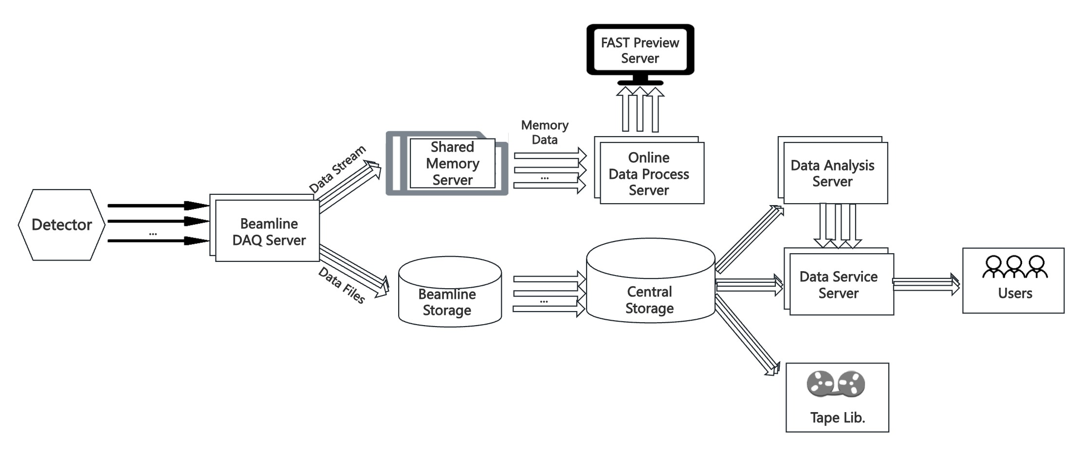
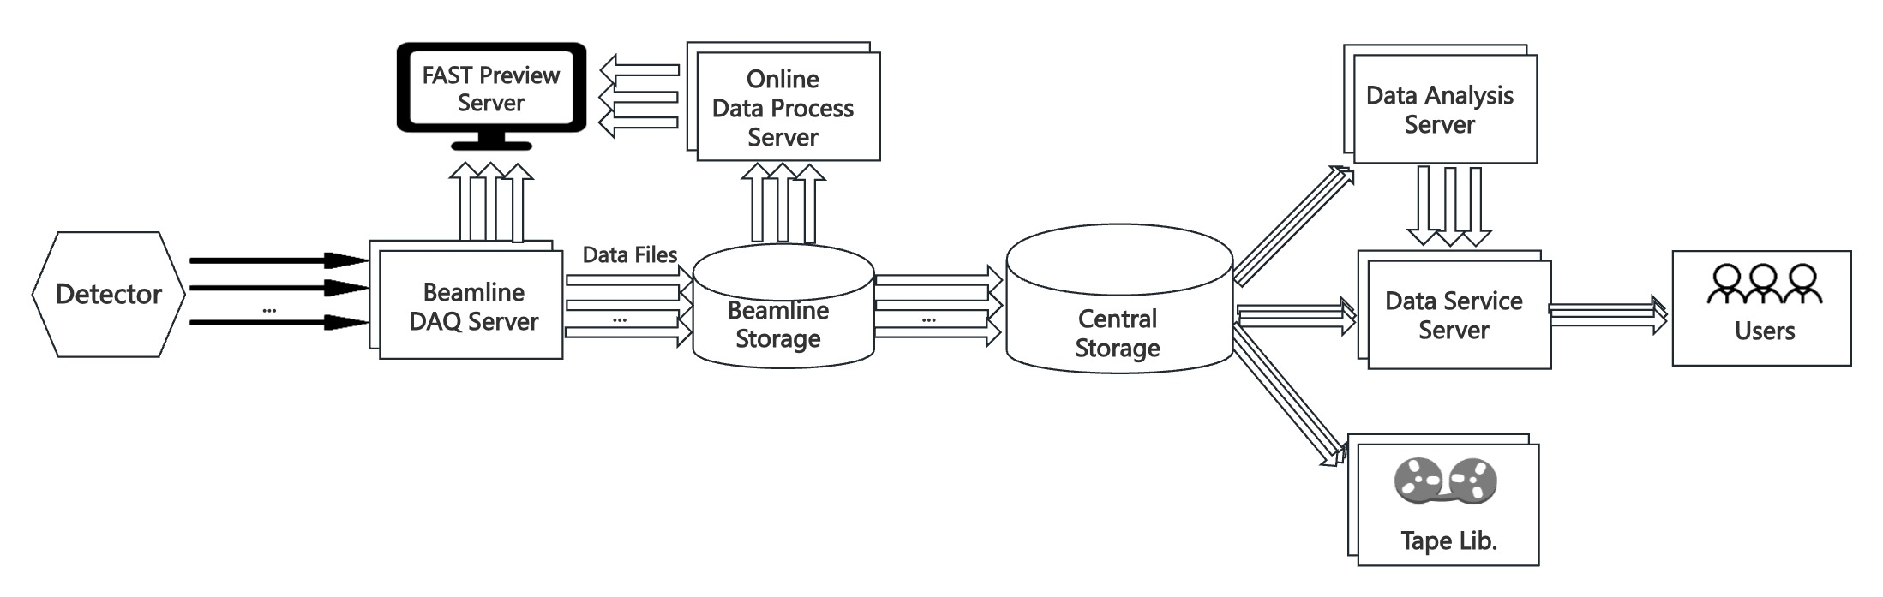
IT architectures for beamlines
Type I: Large data stream beamlines: B7,B2, BE, B4,B1…
Type II: Medium & Small data stream beamlines::BE, BA,B3,B6…
Notes:
Besides dataflow with data files, there is also dataflow for data streams，To ensure users can receive fast feedback results in near real-time

Slide 9
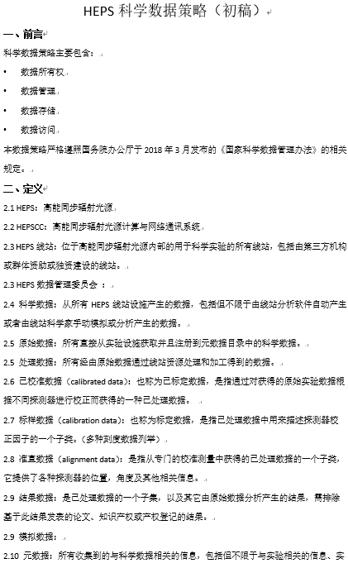
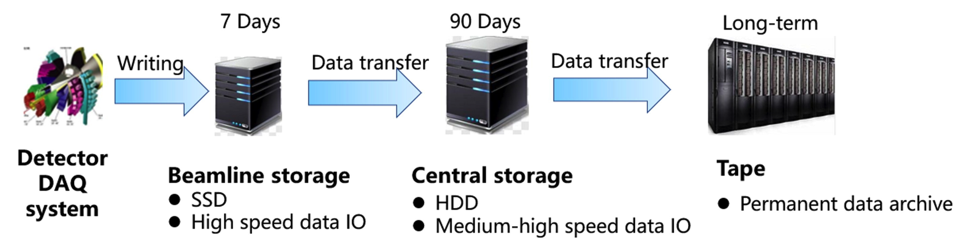
Data: Policy & Strategy
The ownership, curation, archiving and access to scientific data and metadata
Recommend providing at least 90 days disk storage and permanent tape archive
Provide permanent storage for raw data
Provide temporary storage for processed data, calibration data and result data
Each dataset will have a unique persistent identifier(CSTR/DOI)
Experimental teams have sole access to the data during the embargo period
After the embargo, the data will be released with open access to any registered users of the HEPS data portal
Apr, 2021
The Data Policy for
HEPS
--Draft Version
Mar, 2023
The Data Policy for
HEPS
--Revised Draft

Slide 10
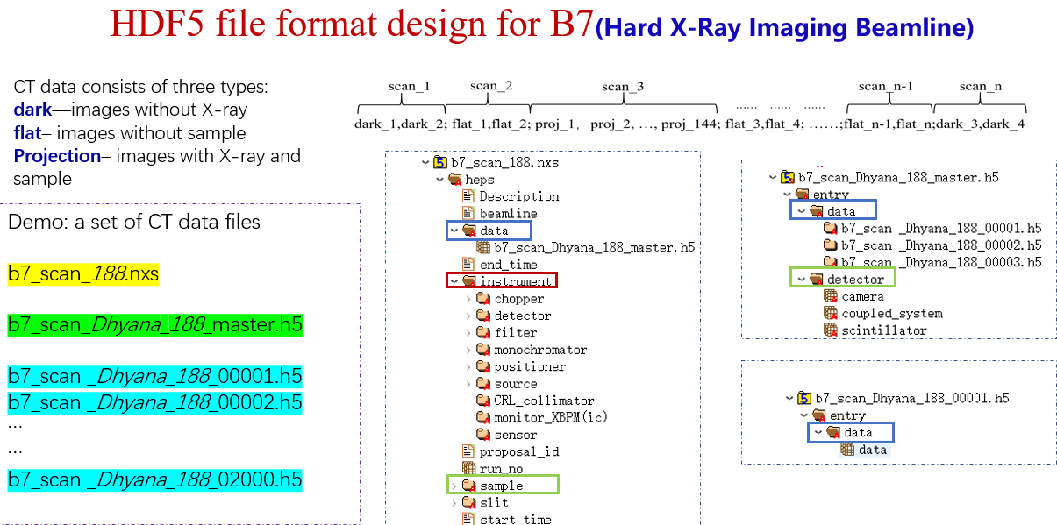
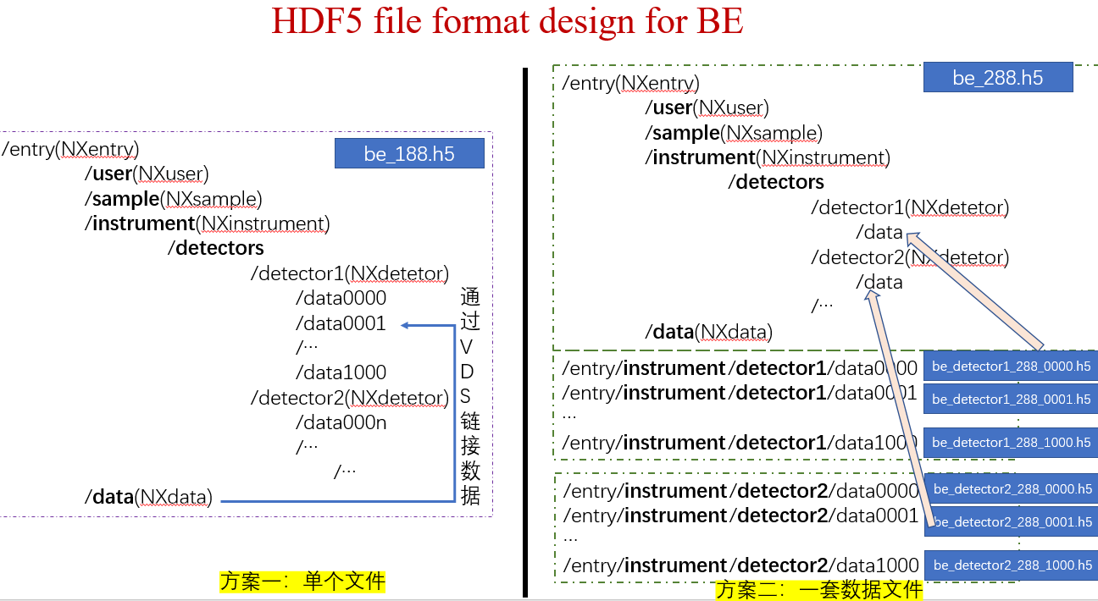
Data: Format
  Design HDF5 data format for each beamline
  Promote the standardization of the data format
    Spectroscopy, imaging, diffraction scattering
Data format design principle
Use HDF5 data format, follow the Nexus conventions
Metadata
  Instrument device parameters and experimental environment parameters
  Parameters used in analysis software
Files and data organization
  Single file or multi files
  Groups: user, sample, instrument, data
  ‘instrument’: including parameters and data obtained from instrument devices and equipment, as well as during the experimental process
  ‘data’: organizing and storing data that users care about or that is necessary for data processing.
Transmission X-ray Microscope

Slide 11
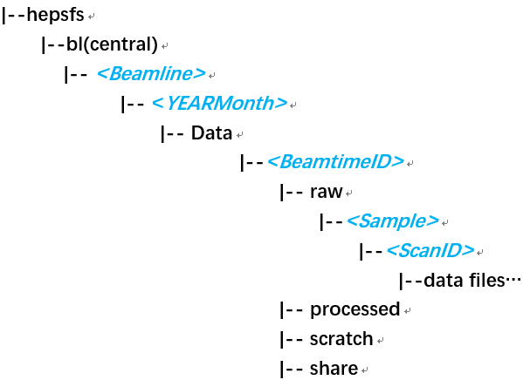
Data: Directory Structure and Permission
The data is organized under the related BeamtimeID directory
Data path : ../<Beamline>/<YearMonth>/Data/<BeamtimeID>
User access control is restricted by setting ACLs of file system on BeamtimeID folder
Users will be guided to use the directories accurately
Users information are coming from the user service system
Raw data
Customized folders by users
Folder | Data type | Permission | Permanent archive?
raw | Raw data/user data | Read only | Yes
processed | Processed data | Read, write | No
scratch | Temp data, snapshots, scripts, | Read, write | No
share | Snapshots, scripts, shared files… | Read, write, shared | No
Processed data
Snapshots, scripts,
shared files…
Data directory structure

Slide 12


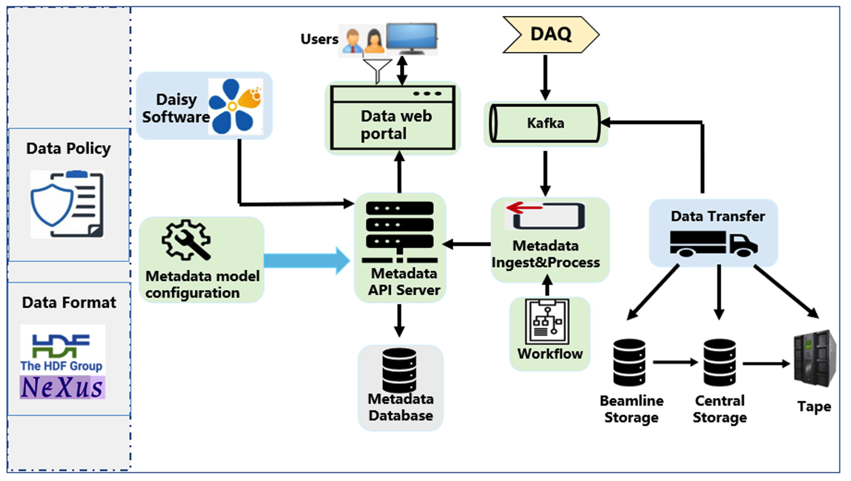
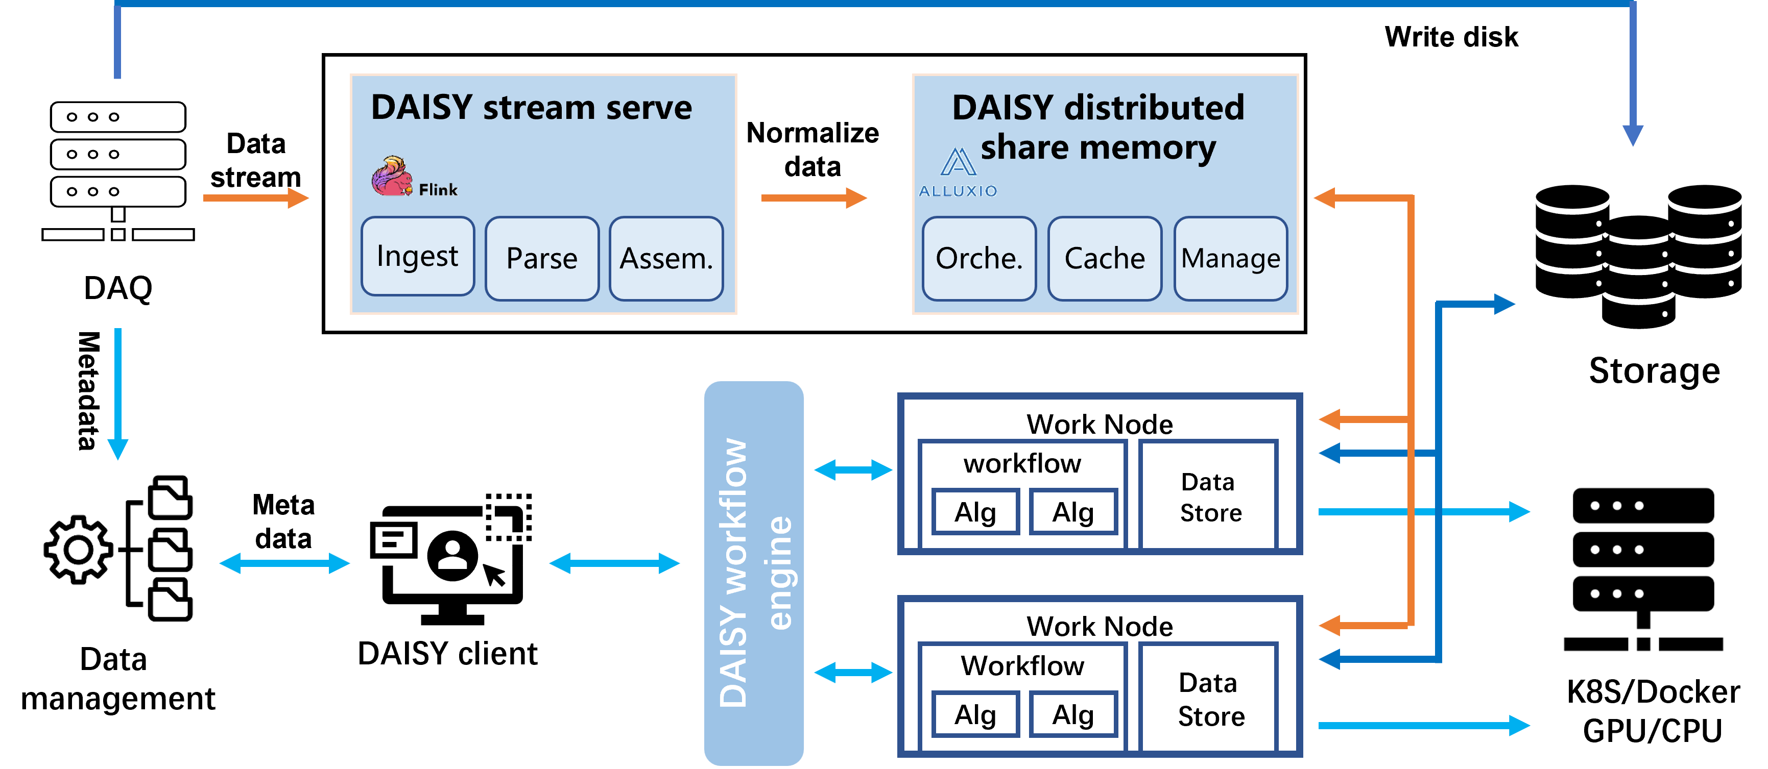

Data Software Framework
Data Management Organization Access System
Data Analysis Integrated Software sYstem
  Data processing framework to address common requirements
  Supporting batch processing, stream processing, distributed, and automated data flows
  Supporting the integration of multidisciplinary application software and algorithms through plug-in
  Providing development guide and support for beamline engineers
  The full lifecycle management, tracking, and utilization of scientific data
  Rapid development of data management systems for more facilities

Slide 13
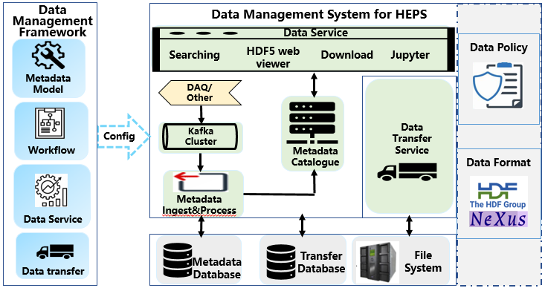
DOMAS: Data Organization Management and Access System
Core functional modules
    Metadata catalogue
    Workflow
    Data transfer
    Data service
Flexible and extensible
Can be used to build data management system for facilities quickly
Developed for HEPS and can be applied to more advanced facilities
Apply to other light sources in China(SHINE/CSNS)
DOI: 10.1107/S1600577524000043
Hao Hu *, Leilei , Haofan Wang , Bo Zhuang , Ruojin Zhang, Qi Luo , Xiaokang Sun , Fazhi Qi
Notes:
抽取科学数据管理通用功能与模块，提供可扩展、标准化接口
提供快速建立满足特定装置和实验站需求的数据管理软件系统能力

Slide 14
DOMAS function: Metadata-FAIR Principle
Metadata | Metadata Items | From
Administrative Metadata | Proposal Info, User Info, Exp types, Beamlines… | Proposal system, User service system, Transfer system, Storage, Analysis system
 | Data type: raw data, processed data, simulated data, calibration data
 | Dataset: PID, Path, Data file list, file size, checksum…
 | Status: disk/tape, transfer status, transfer check value
 | Analysis software, update time…
Scientific Metadata | Sample Info | Sample database, Proposal system,
 | Experimental environment：voltage、magnetic field、electric field… | DAQ system, Control system
 | Detector Info: scan, x-ray exposure params…
 | E-log | E-log System

Slide 15
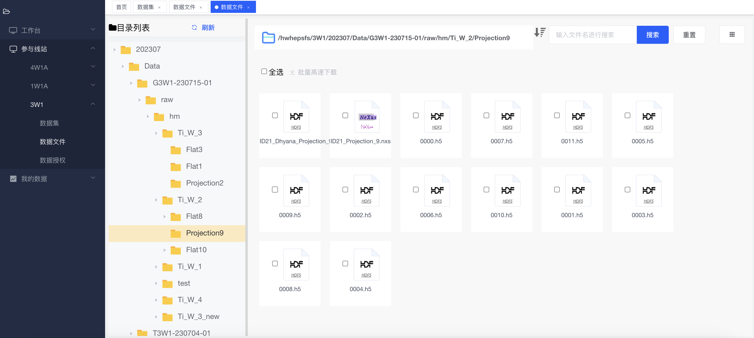
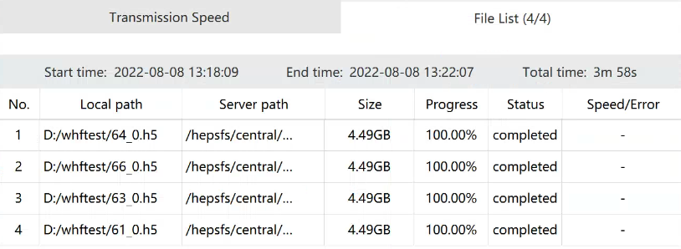
DOMAS Function: Online Data Services
Data search, download, access, analysis
Dataset search through metadata retrieval
Integrate a client for downloading
Maximizes the utilization of network bandwidth
Greatly improves the download speed
    Download speed test ：4*4.49GB files
 | Bandwidth | Duration | Speed
LAN | 1000Mbps | 2min52sec | 839Mbps
WAN | 100Mbps | 28min | 85Mbps

Slide 16
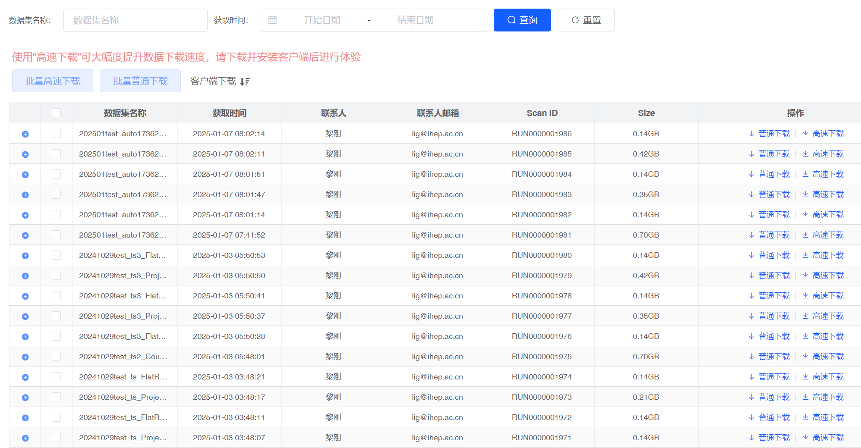
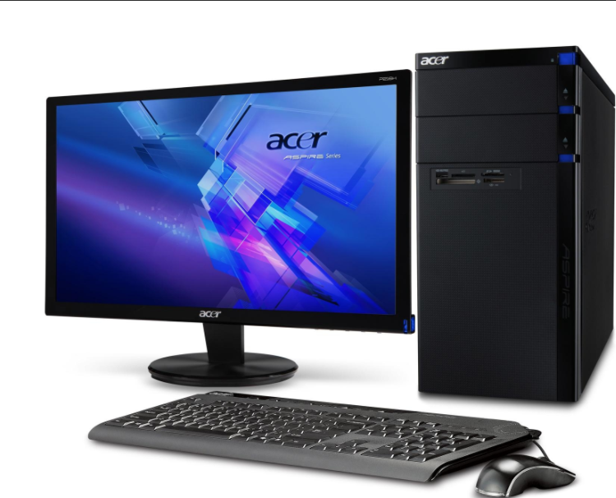
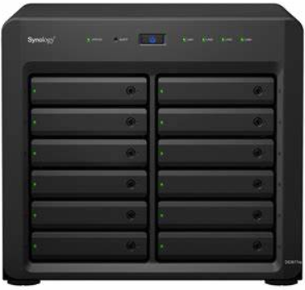
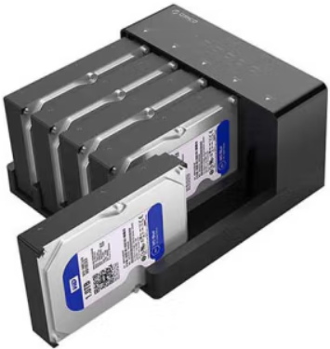
DOMAS Function: Online Data Services
Data service Online and API
https://data.heps.ihep.ac.cn
Open API to other services(Daisy ….)
The dedicated computer terminal for data downloading
placed at user center/user lounge
suitable for downloading huge volume of data
supports different storage device interfaces（NAS, disk array, mobile hard disk）
Raw data +processed data
Dedicated terminal for data

Slide 17

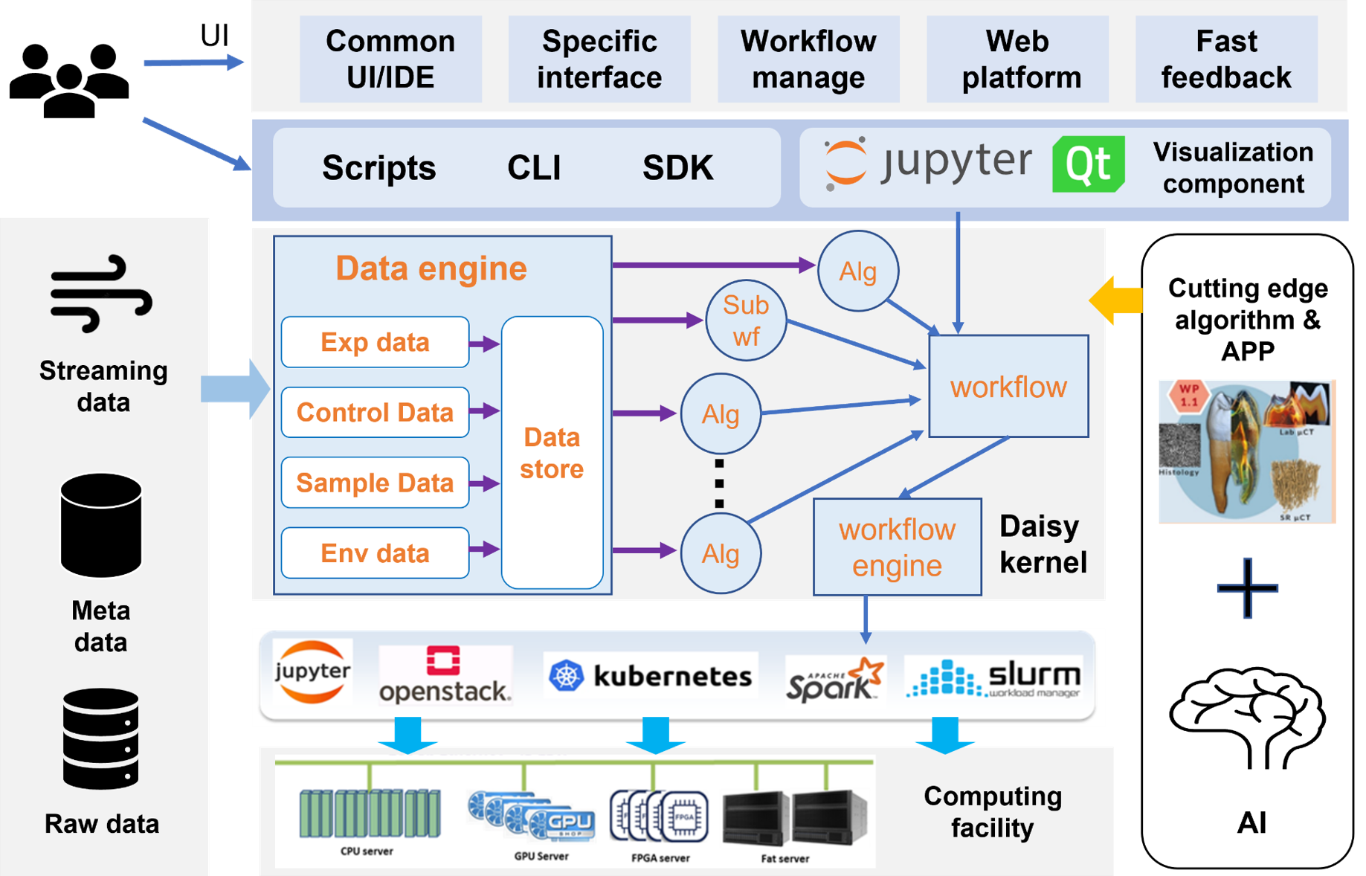
DAISY- Data Analysis Integrated Software sYstem
Data Analysis Integrated Software sYstem(Daisy)
Basic, common, scalable framework
  Data engine for data object management, dealing with high-throughput IO, multimodal and multi-source data access
  Workflow engine for algorithms orchestration
  Computing engine for distributed computing and parallel computing( computing resource application, tasks scheduling)
  Interface and developing environment for scientific software development
To establish a software ecosystem for data processing and analyzing for synchrotron radiation
The basic framework of Daisy has been released
https://daisy.ihep.ac.cn/
Daisy framework
https://doi.org/10.1051/epjconf/202125104020
Yu Hu¹, Ling Li^{1,2}, Haolai Tian^{1,2,3*}, Zhibing Liu^{1,2}, Qiulan Huang^{1,2}, Yi Zhang¹, Hao Hu¹ and Fazhi Qi^{1,2#}

Slide 18
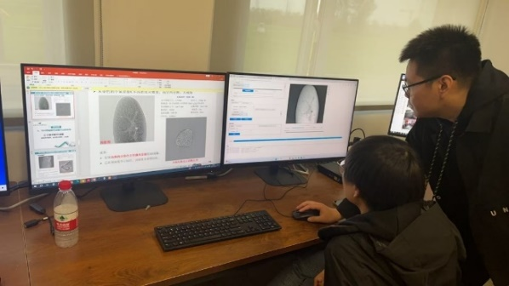
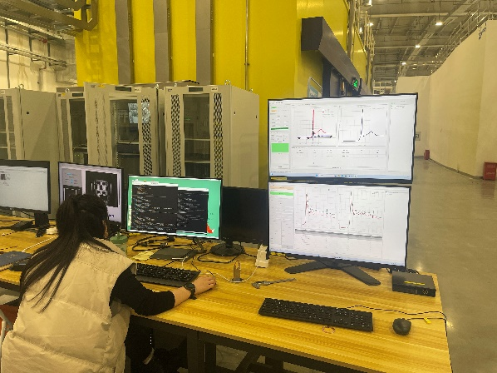
DAISY: Algorithms and Tools
Application based on DAISY serve multiple disciplines: imaging, diffraction/scattering, spectroscopy
Some applications already deployed on HEPS beamlines
HEPSCT at Hard X-ray imaging beamline（B7）
DAISY Scientific application | Integrated 3d-party software and algorithms | Applicable beamline(HEPS)
HEPSCT | mocupy, UFO, tomopy | B1，B2，B4，B7，BE
DAISY-HEPSPtycho | ePIE, rPIE, DM, W1-net | B2，B4
DAISY-PDF | PyFai, PDFgetX3, LiquidDiffract | B1、B3、B6
DAISY-BMX | XDS, cpp4, autoProc, dials, Phenix | BA
XASMatch | Larch | B8、BD
PCA&LCF | Larch | B8、BD
XRF-mapping | PyMca | Beamline with XRF
DAISY-SAXS | PyFai、Raw、ATSAS | B3，BB
DAISY-Holo | IRP, AP, CTF, TIE, ASTRA, mocupy | B2，B3，B4
DAISY-XPCS | Scikit-beam | B4
DAISY workflow | Various algorithms and software | General purpose
DAISY-BCDI | pyCXIM | B4
XASMatch and PCA&LCF at X-ray absorption spectroscopy beamlines（BD）

Slide 19
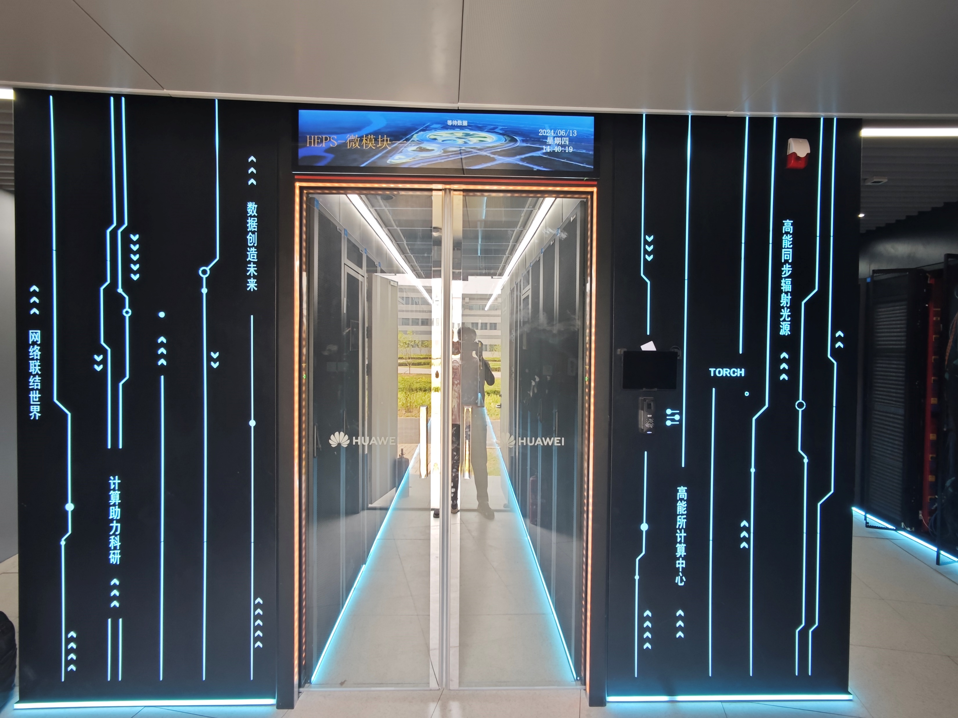
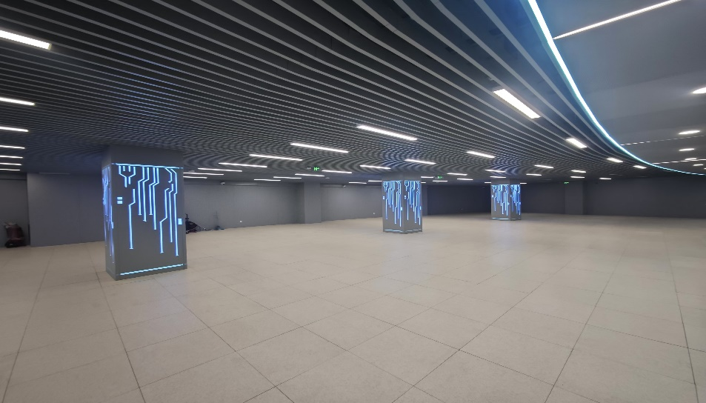
Infrastructure: Machine Room
~900㎡, includes Machine Room、Tape-Library Room and Power Distribution Room
Installed 47 racks and reserve space for expansion
Dual power supply of full link
  Total power capacity：2 X 2.5 MW
  IT power capacity：30kW/rack
  IT and air conditioner are supplied with dual power supply
Efficient and energy saving refrigeration system
  Natural cooling by fluorine pump
  Meet the vibration requirement of HEPS

Slide 20
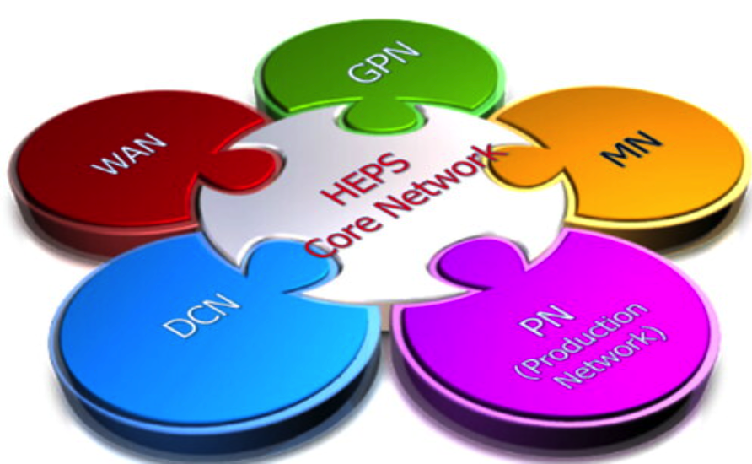
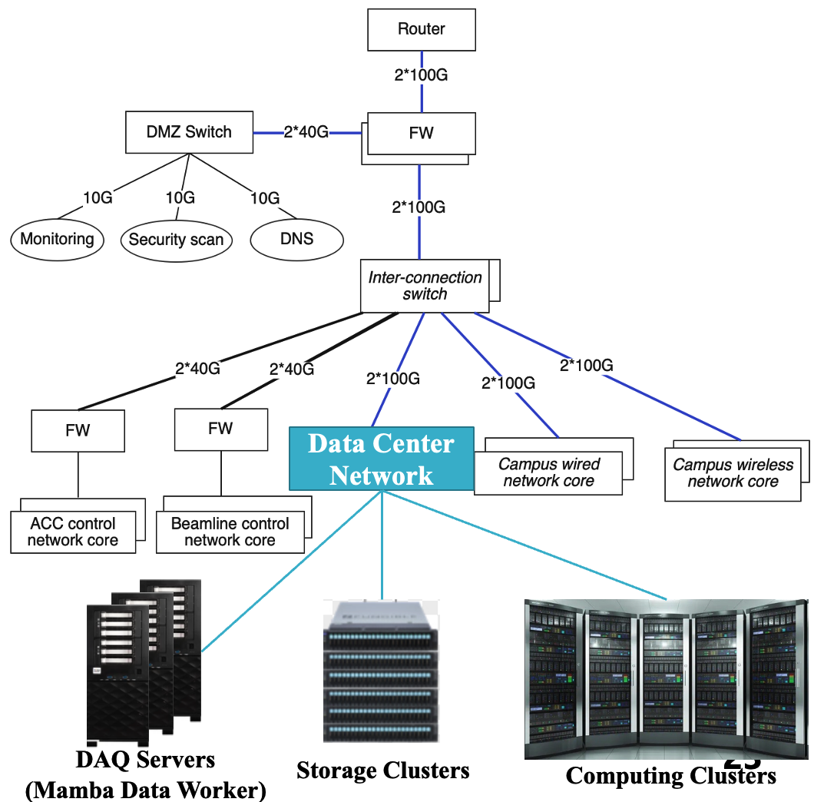
Infrastructure: Network
Meet the network access needs of various users, provide networks for daily office work and scientific research, and be partitioned according to functional areas
  General Purpose Network(GPN): Campus wired network + wireless
  Data Center Network (DCN)
  Production Network(PN): Beamline/Accelerator control and data transfer network
  Wide Area Network(WAN)
  Key features
  High performance: n*100Gb/s bandwidth, RoCE,
  High stability: link and device redundancy
  high scalability: spine-leaf architecture
  High security: network areas isolated according to requirements
  High usability: 100G P2P link with IHEP campus, sub-network of IHEP internal network

Slide 21
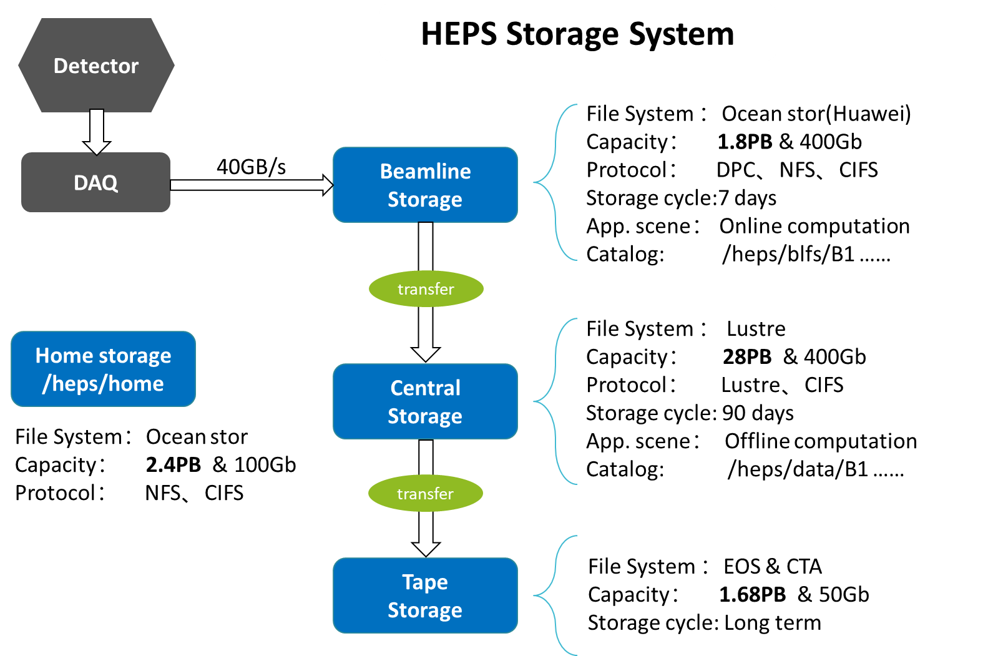
Infrastructure: Storage
Hierarchical storage architecture
  Beamline storage
    All-NVMe SSD disks provide high performance
  Central storage
    High-density HDDs provide large storage space
  Tape storage
    LTO9 tapes provide long-term preservation
  Home storage
    Save programs and provide backup services
Key features
  Hardware adopts high-reliability architecture
  Multi-protocol interoperability
  User ACL synchronization

Slide 22
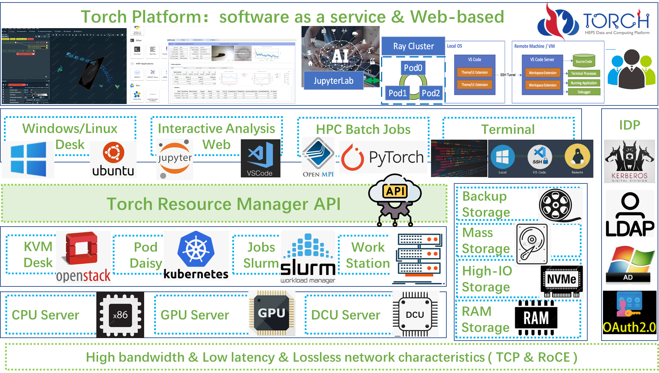
Infrastructure: Computing
Unified resource management and scheduling
  Scalable architecture, provide computing resources with necessary software and services
  All the hardware, operation system and public software(library) is managed centrally
  Resource pool: heterogeneous resources(CPU, GPU, DCU…), image repositories, software and so on
  Resource management middleware: kubernetes, Slurm, Openstack…
  HPC cluster, virtual cloud desktop and web-based analysis service
Computing Resources
  First stage: 2400 CPU cores >=120TFLOPS
  48 GPU cards>=360TFLOPS
  Big gap for requirements, more funding is needed
Resource Type | Resource Quantity | Resource Capability
CPU | 2400 CPU Cores | 120 TFLOPS
GPU | 48 GPU Cards | 360 TFLOPS
NVME SSD | 1.8 PB | IO : 40 GB/s
HDD | 14 PB | IO : 20 GB/s

Slide 23
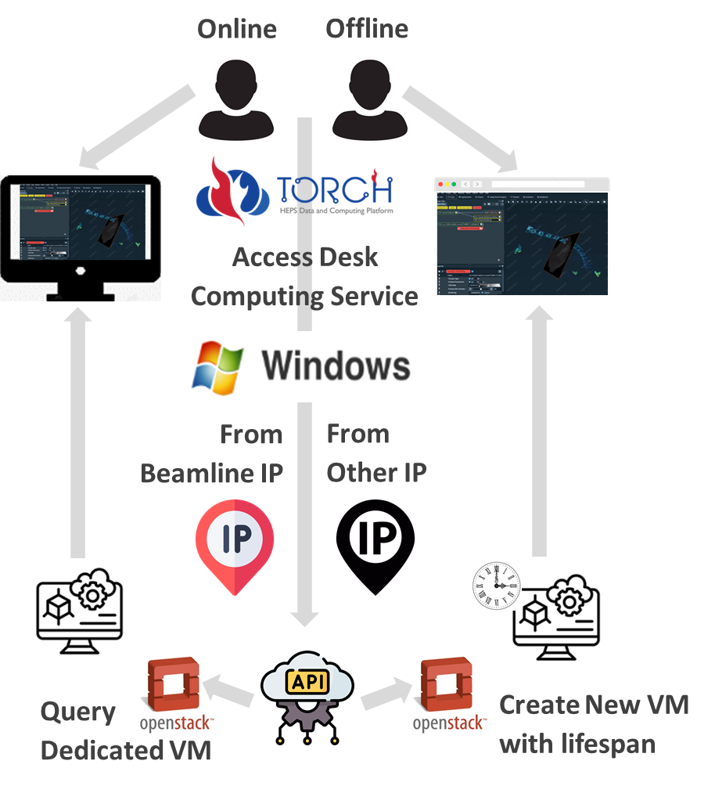
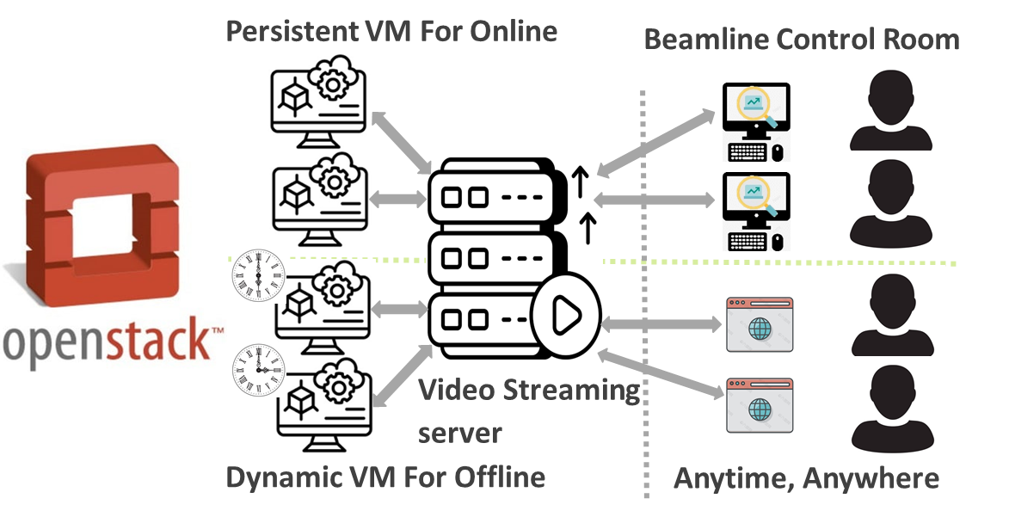
Computing Mode 1: Virtual Machine for Online & Offline
Reserve dedicated VM resources for beamlines
Offline users apply for time-share virtual machine resources
VM image pre-installed with data analysis software
Video streaming server forward the VM desk image
Users can access VM remotely
Resource Status: 8 nodes include 288 CPU Cores, 2*A6000 GPU, 4*A5000 GPU, 8*A4500 GPU

Slide 24
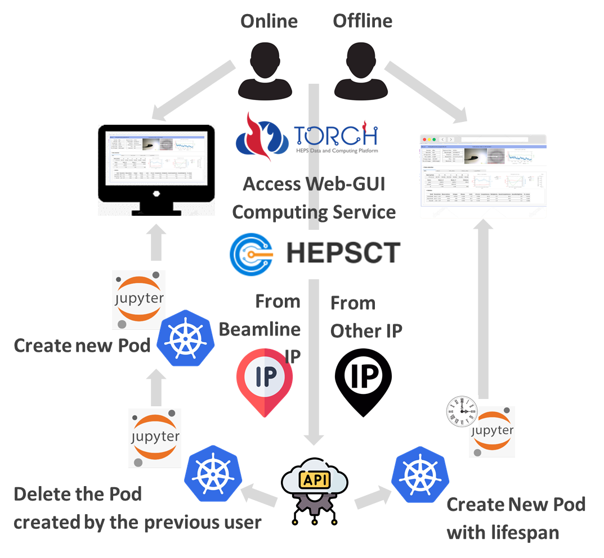
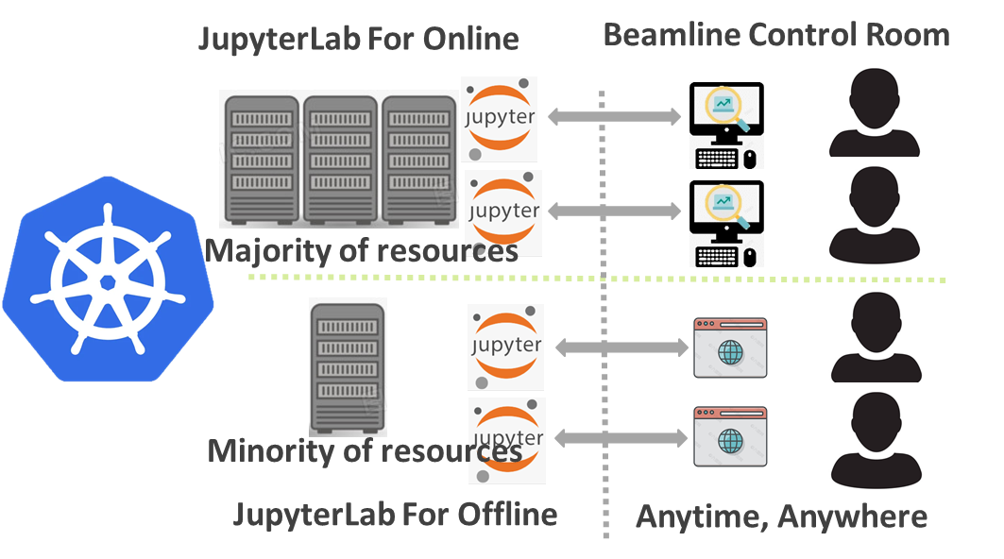
Computing mode 2: JupyterLab for Online & Offline
Reserve majority Kubernetes nodes for online computing
Minority Kubernetes nodes for offline computing
The application provides a GUI interface based on JupyterLab
Use containers to launch JupyterLab
Users can access JupyterLab by webpage
Resource Status:
11 CPU nodes + 11 GPU nodes, include 1792 CPU Cores, 6*A100 GPU, 12*A800 GPU, 26*L40 GPU

Slide 25
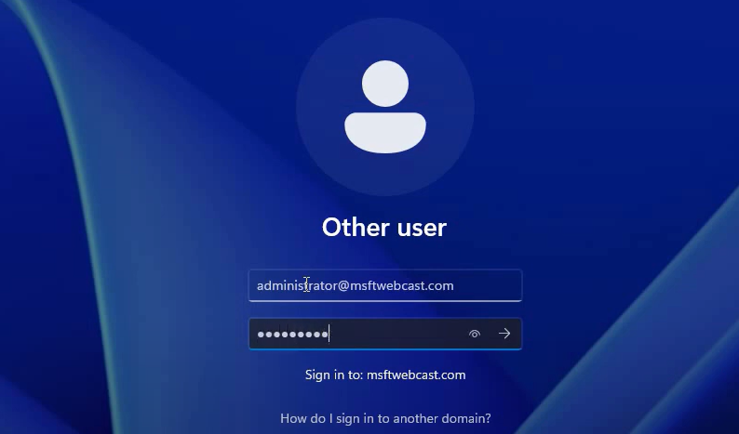
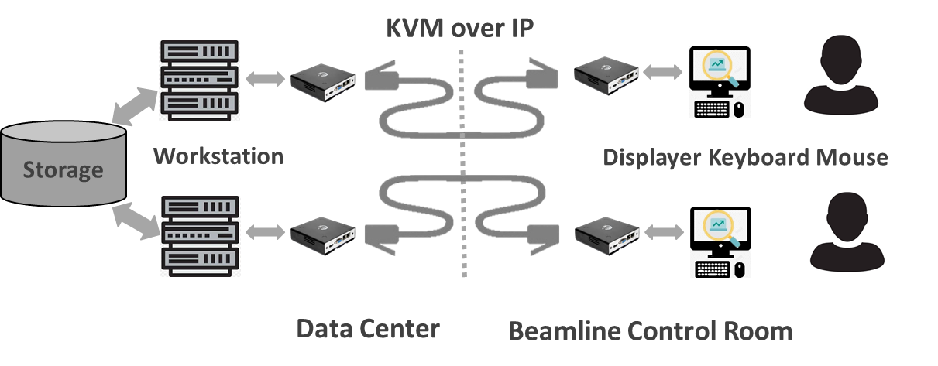

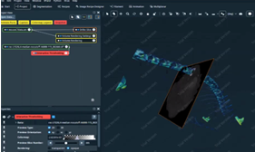
Computing Mode 3: Workstation for Online
Dedicated workstation resources used for beamlines(i.e: CT imaging beamline)
Located in machine room and centrally managed by Computing Center
Users can access workstation smoothly with KVM remotely,
  1.User login with AD Account
  2.Auto mount CIFS Storage with Current Account
  3. Launch the software to analyze the experimental data.
Resource Status: 5 Workstations with A6000 or A5000 GPU Card

Slide 26
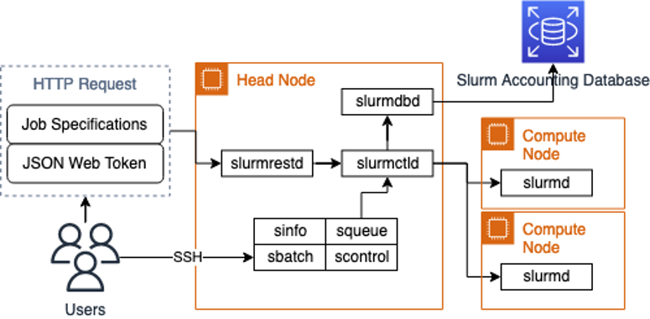
Computing mode 4: HPC for Offline
HPC services for beamline scientists and users with large-scale data analysis needs.
Users submit jobs from webpage or terminal
Wait for resource allocation to run computational tasks.
Resource Status:
2 CPU nodes + 3 GPU nodes, include 320 CPU Cores, 6*A800 GPU

Slide 27
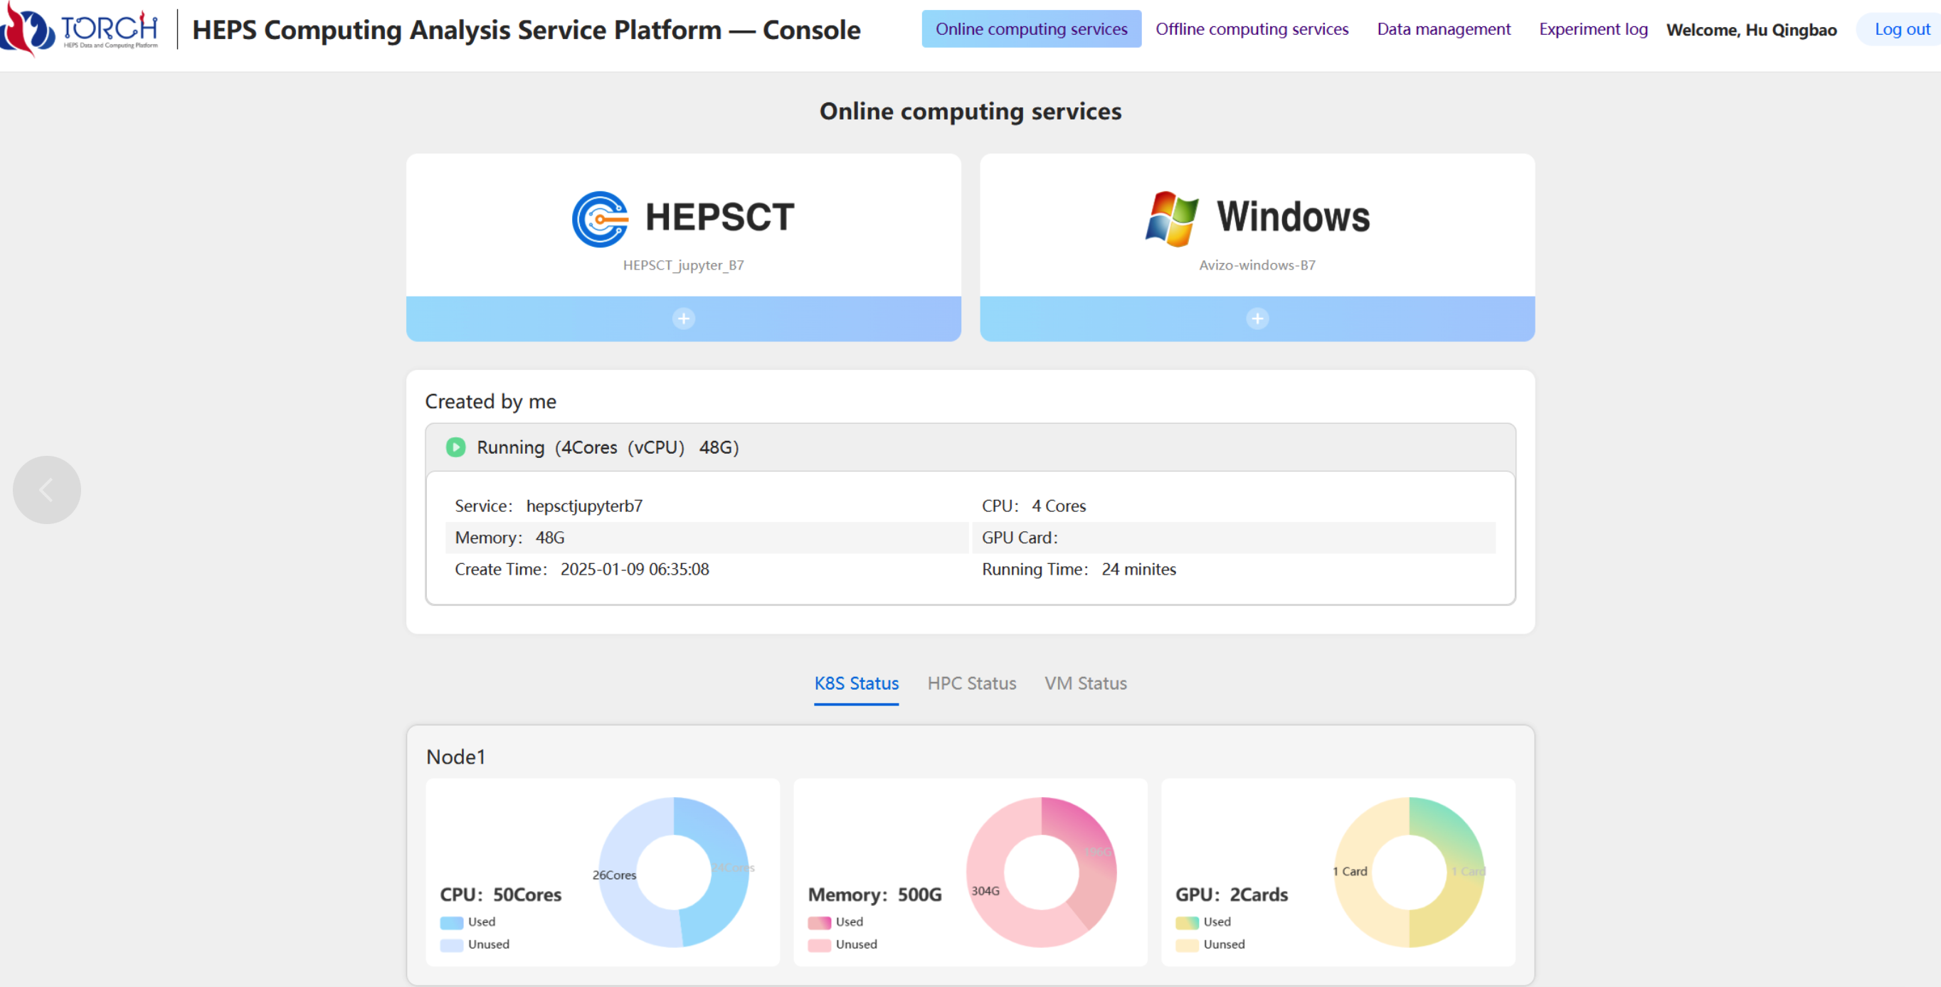
Computing Services Portal for Beamlines

Slide 28
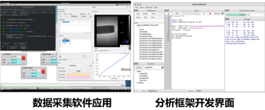
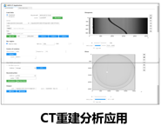
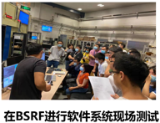
HEPS CC System Integration/Test bed/Production
Set up testbed at BSRF to integrate software systems to verify interfaces and process.
HEPS CC system has been tested in the real experimental environment, running in production.
1
2
3
2020-2021, built testbed at 1W1A/3W1 of BSRF
Network bandwidth updated to 10Gb/s
Beamline storage & Central storage: 80TB disk array, Lustre file system
Integrate MAMBA,DMS, Daisy, computing system
2022-2023, integration test at 4W1B/1W1A/4W1A of BSRF
Running in production environment
Network bandwidth updated to 25Gb/s
Beamline storage: Huawei Ocean Store 9950
Central storage: 80TB disk array, Lustre
Follow real experiment process, provide Pymca to do analyzing at 4W1B
June, 2024, HEPSCC system was
deployed at HEPS, running in production
The network, storage, computing system finished deployment
Data management, data analysis software framework, user service system are integrated with DAQ system
Data acquisition Analysis framework Interface CT reconstruction Integration test at HEPS

Slide 29
Summary
SRN: HEPS Data and Computing System
https://www.tandfonline.com/doi/full/10.1080/08940886.2024.2432321#d1e169
https://doi.org/10.1080/08940886.2024.2432321
Data, computing and software are very important for HEPS
We are always facing many challenges for HEPS data
We have had good progress so far, most of the modules are ready for production
More computing(CPU&GPU) and storage resources are needed
We are still facing the data processing challenge from high data throughput beamlines
  FPGA, parallel computing, data compression, machine learning…

Slide 30
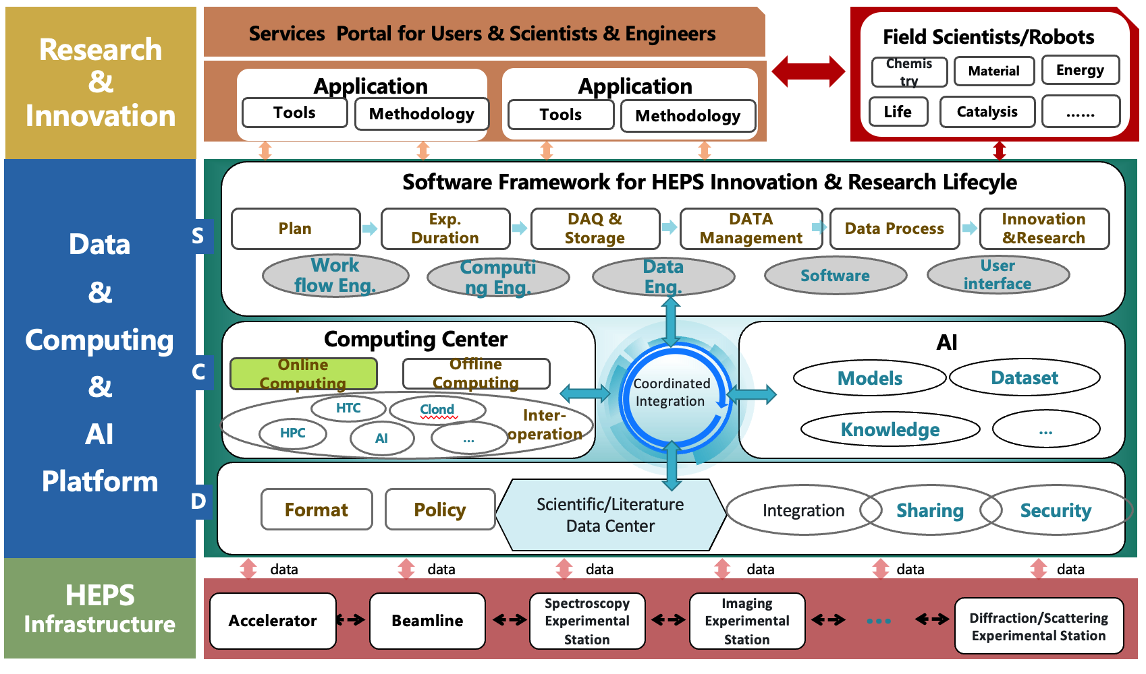
Plan
Collaborate with beamlines and users
Try to find more funding to inmprove the computing and data capabilities to meet the requirements from HEPS
Continuously develop and integrate more software/tools
Provide high performance data & computing services for beamlines and users
Provide AI service for the whole facility—Smart Light Source
Thanks you for your attention!

Slide 31



Data Streaming for High Data Throughput Beamlines
A unified module for streaming data access, parsing, management, and retrieval.
  Flexible splitting and merging of streams to meet application requirements and alleviate IO bottlenecks.
  Support for parallel computing, featuring high throughput and low latency characteristics.
  Development of a distributed cache pool for the temporary storage of experimental data.
Multi-stream data ingest
Stream parse
Specific data path
APIs for stream operation
DataRec
Read()
DataPrase
/path/A.dat
DAQ
DataRec
Write()
config
Online process
/path/B.dat
DataRec
ls()

