Slide 1


AI4EOSC: Artificial Intelligence for the European Open Science Cloud
Álvaro López García (aloga@ifca.unican.es)
Viet Tran (viet.tran@savba.sk)

Slide 2
What is AI4EOSC
AI4EOSC provides a user-friendly workbench and toolbox for developing and running AI models, tightly integrated with the EOSC ecosystem (and now available for new users).
  AI4EOSC is building a platform (https://dashboard.cloud.ai4eosc.eu),
  and the AI4OS software stack which powers it.
AI4EOSC is not focused on developing AI algorithms, but on helping researchers build their AI models and transforming them into services
  Exploiting transparently already existing compute resources in EU e-Infrastructures
Steps towards more FAIR, robust and trustworthy ML/AI models
  Federated learning beyond privacy scenarios
  MLOps and monitoring in production, drift detection
  Rich model provenance metadata covering the whole ML lifecycle

Slide 3
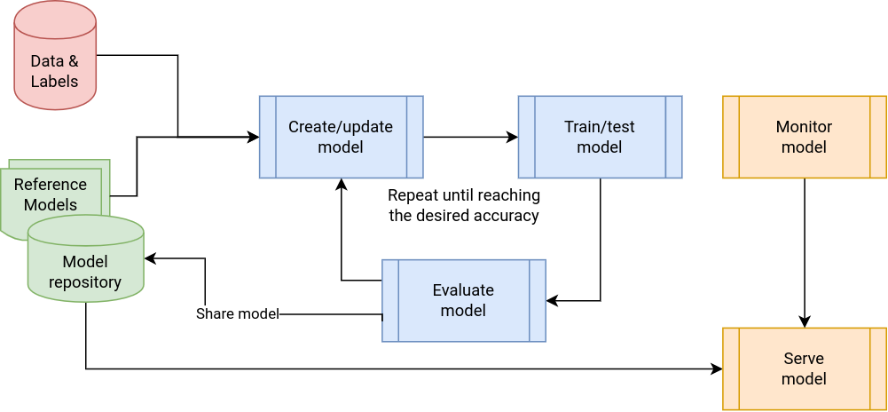
AI/ML application development lifecycle

Slide 4
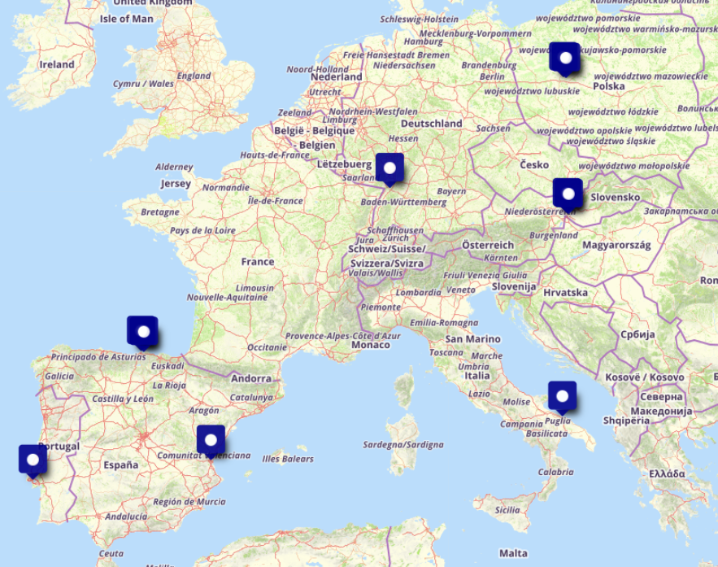



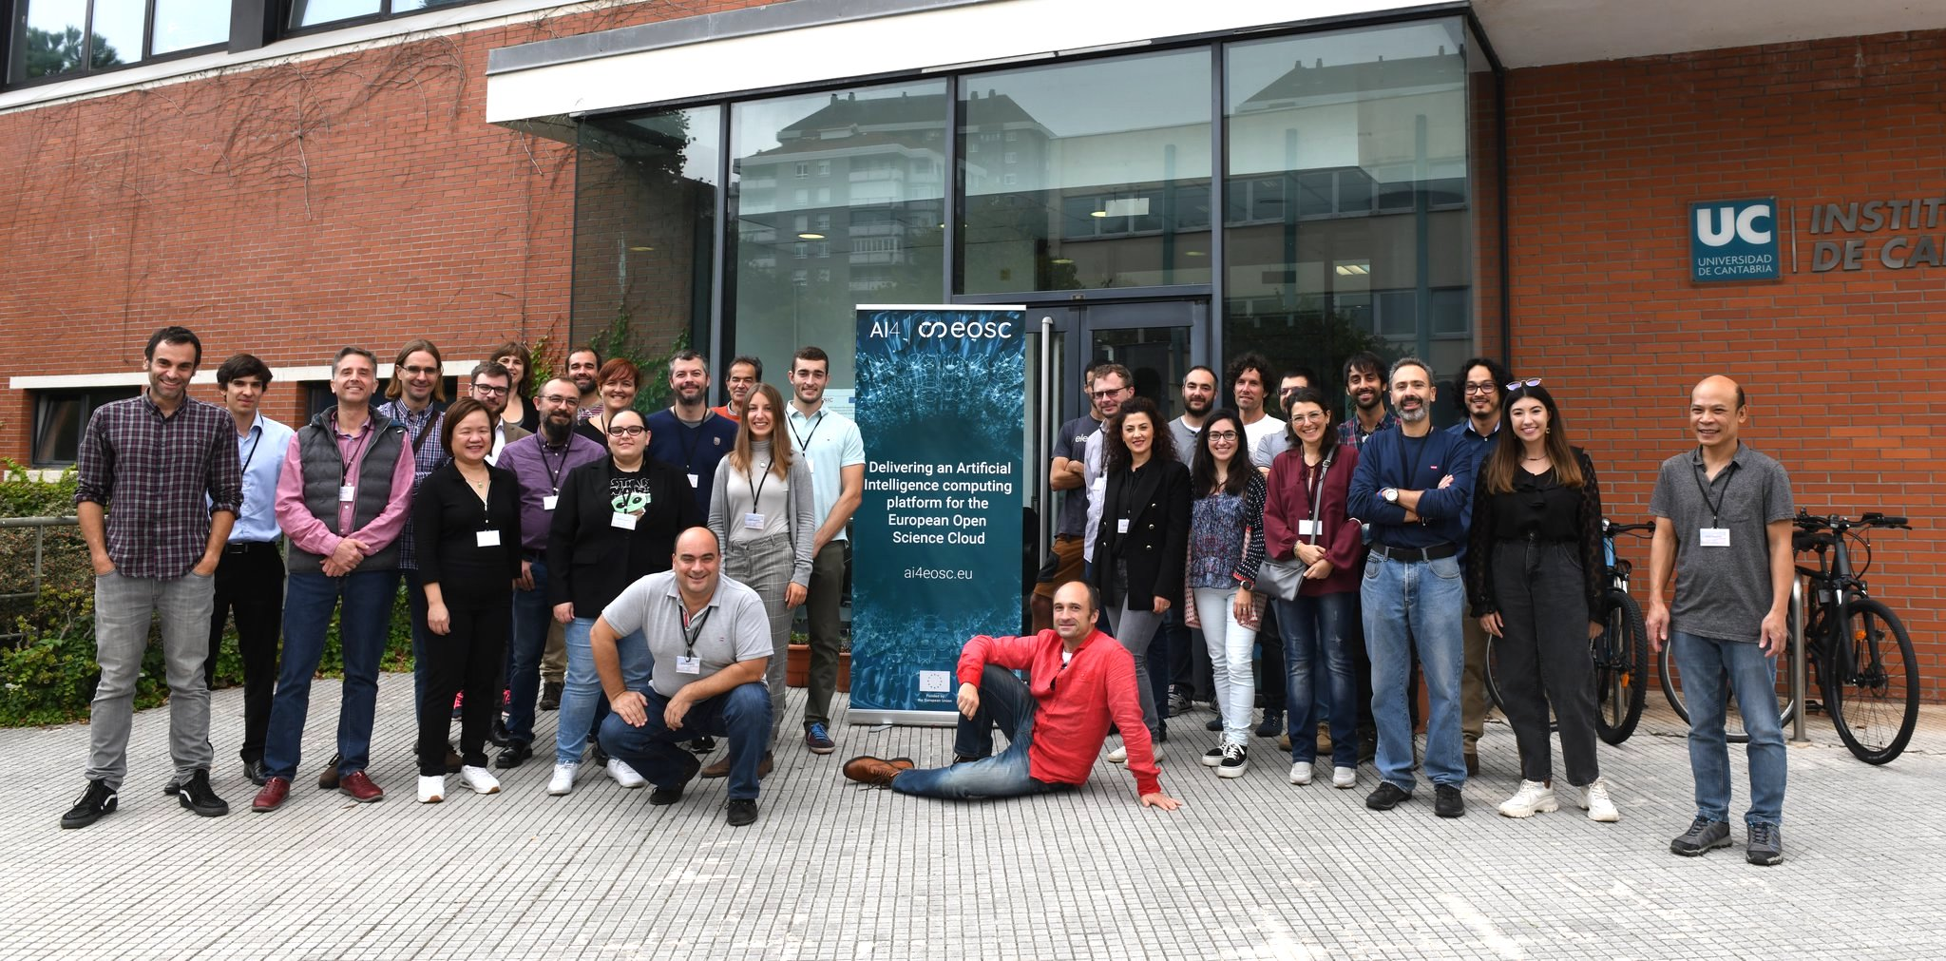





AI4EOSC
Project in a nutshell
Evolution of the DEEP Hybrid DataCloud platform
HORIZON-INFRA-2021-EOSC-01-04 call
Runs September 1st 2022 – August 2025 (36 months)
7 academic + 2 SME + 1 non-profit organization
Goal: Deliver an EOSC AI platform with advanced features for distributed, federated, composite learning, metadata provenance, MLOps, event-driven data processing, and provision of AI/ML/DL services

Slide 5















Background, ecosystem, collaborations
2016 | 2017 | 2018 | 2019 | 2020 | 2021 | 2022 | 2023 | 2024 | 2025 | 2026 | …
DEEP 3 → AI4EOSC platform
AI4OS → platform agnostic software stack
INDIGO-DataCloud
PaaS-based cloud solution for e-Science
DEEP Platform and services
AI4EOSC
Enhanced AI Platform for the #EOSC
uDocker
PaaS Orchestrator
Infrastructure Manager
Identity and Access Manager
Collaboration with INFRAEOSC projects
DEEP 1 platform
DEEP 2 platform
DEEP-Hybrid-DataCloud
AI/ML/DL PaaS, access to GPUs
iMagine platform, powered by AI4OS
iMagine (powered by AI4OS)
AI imaging platform for aquatic sciences
AI Compute platform for
the EOSC Compute Platform
EGI-ACE
AI services for the EOSC Compute
Support to SME support
in EOSC DIH
EOSC-Hub
Industry and innovate SME support
EOSC Future
Industry and innovate SME support
Notes:
Technology providers and development: INDIGO, DEEP and AI4EOSC, supporting use cases coming from the EOSC, the EOSC DIH, the EGI-ACE (like INRAE and JRC) and now iMagine

Slide 6
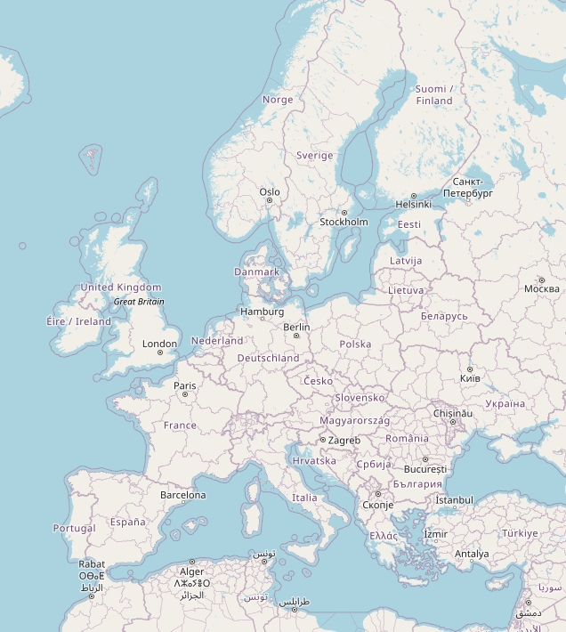

A distributed and federated platform
Integration of different cloud computing providers at European level
  AI4EOSC platform
    CSIC Scientific Cloud (es), IISAS Cloud (sk), INFN-CNAF
  iMagine platform
    CSIC Scientific Cloud (es), Walton Institute (ie), INCD Cloud (pt), TÜBITAK-ULAKBIM (tk)
Transparent access to pan-EU e-Infrastructures state of the art resources
  Distributed access transparent for users
  Integration with EOSC ecosystem
Not imposing any special libraries or hard requirements for users

Slide 7
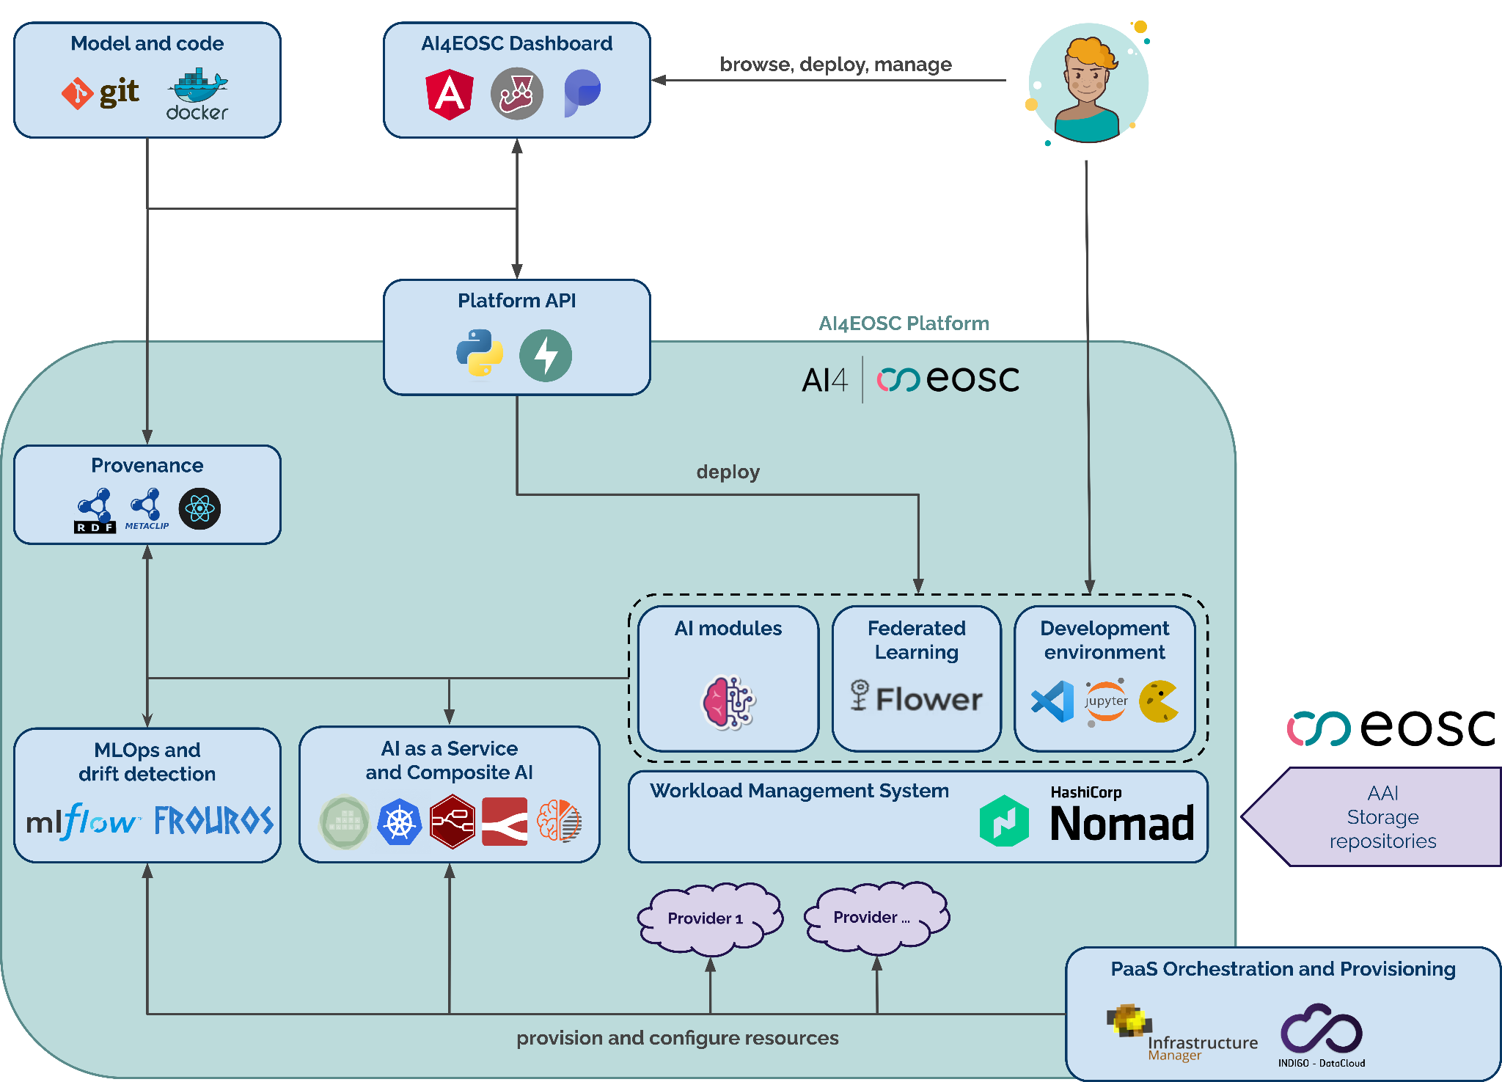

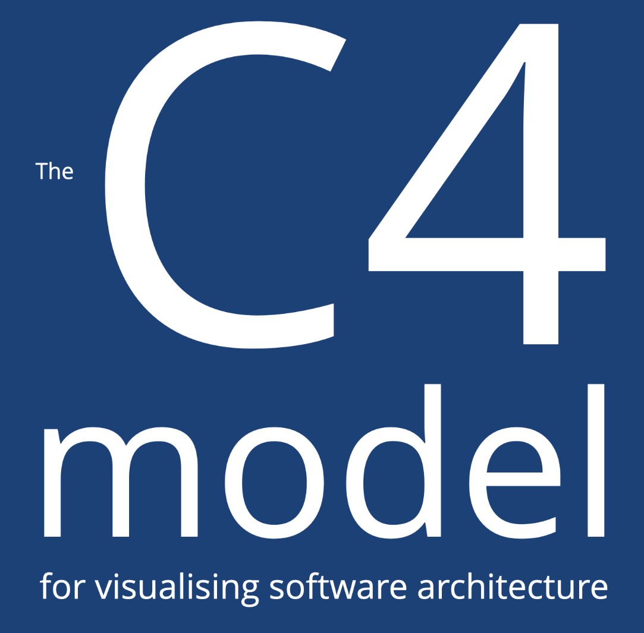
AI4EOSC high level architecture
Interactive C4 diagrams available here.

Slide 8





Not a lonely journey
Notably collaborations with other INFRA projects
  iMagine: Deploying customized AI4EOSC/AI4OS platform
  AI4Life: Deploying customized AI4EOSC/AI4OS platform
  RAISE: Accessing RAISE data from AI4EOSC platform
  SIESTA: Exploiting FL capabilities for sensitive data
  Skills4EOSC: FAIR ML/AI definition
  FairCore4EOSC: Metadata and crosswalks contribution to MSCR
Outside the INFRA realm
  EASiNet: EU-funded projects on AI and cybersecurity
And with industry:
  Flower.ai: Code contributions, participation in pilot programmes, FlowerLLM,
  MONAI FL and NVIDIA FLARE: Model compatibility
  EOSC DIH: collaboration with various SMEs

Slide 9
Feature timeline
2022
Projects start
Migration from legacy components and adaptation of user tools
2023
Customizable platform deployments
Federated learning
Enhanced interactive development environments
Updated data science templates
Initial version of composite AI tools
Federated multi-site platform deployments
2024
Fine-grained platform usage reports
Serverless AI as a Service for sync/async inferences
Zenodo and external repositories integration
Integration with external storage systems
Full Automation of resource provisioning
Online annotation tools
MLOps pipelines + drift detection services
2025
Streamlined deployment of AI models as services
Experiment-centric dashboard
Full integration with other EOSC storage systems and repositories
Integration with EOSC-node components
Integration with wider set of Cloud storage systems
LLM models

Slide 10

From online development tools
JupyterLab or VS Code, synced data from Zenodo and online storage

Slide 11
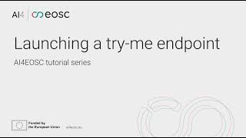
… to online services
Try-me simple endpoints

Slide 12
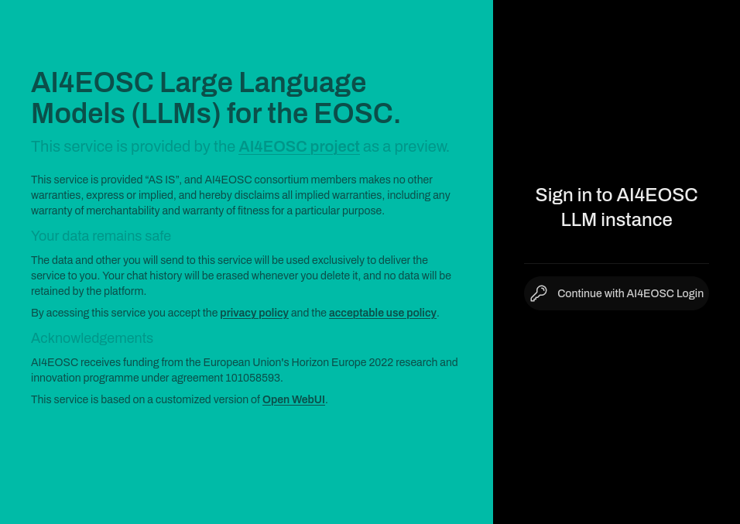
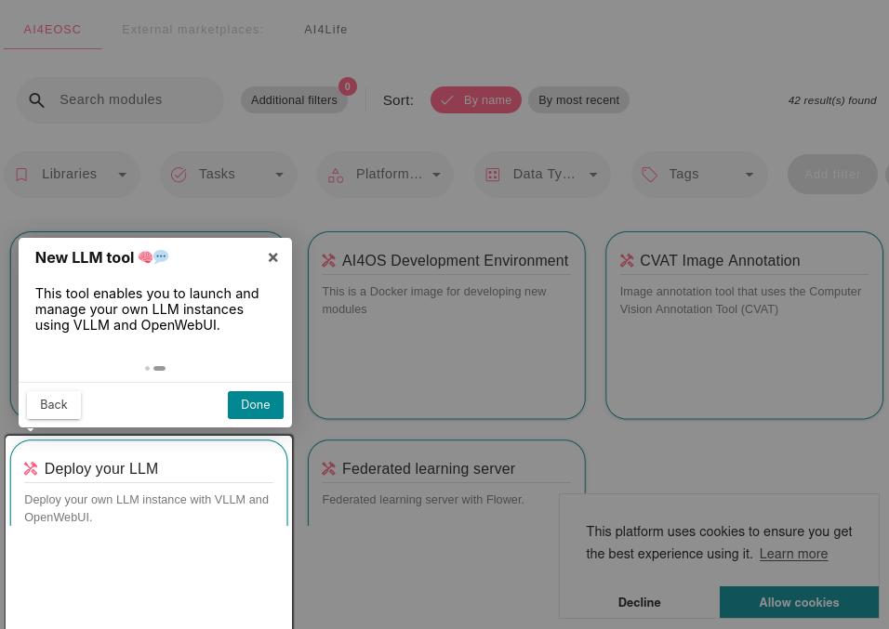
LLM4EOSC
Deploy your own LLM

Slide 13
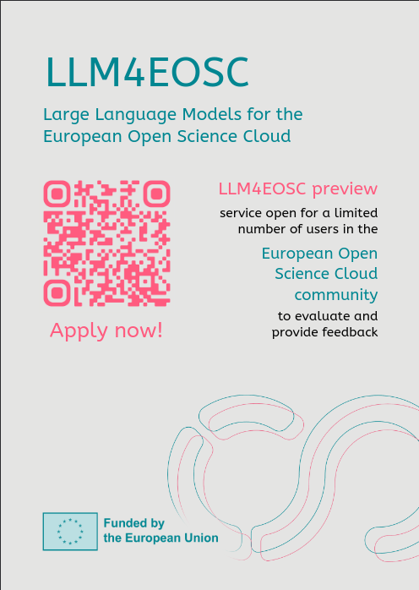
LLM4EOSC
Managed service from the AI4EOSC platform
Introduced in Nov 2024:
  https://llm.dev.ai4eosc.eu/ (UI) – https://llm.dev.ai4eosc.eu:8000/ (API)
It provides access to a LLM chatbot (based in Open WebUI) and an OpenAI API protected via API keys
Features:
  Explore several open source models and custom models with a
  knowledge base
  Integrate with any other tool seamlessly
  Easy implementation of Retrieval-Augmented Generation (RAG)
Benefits:
  Shared service with models managed by the platform
  Load balanced models, scalable architecture
  Easy to use, OpenAI compatible APIs
  Ideal for users who prefer a managed solution

Slide 14
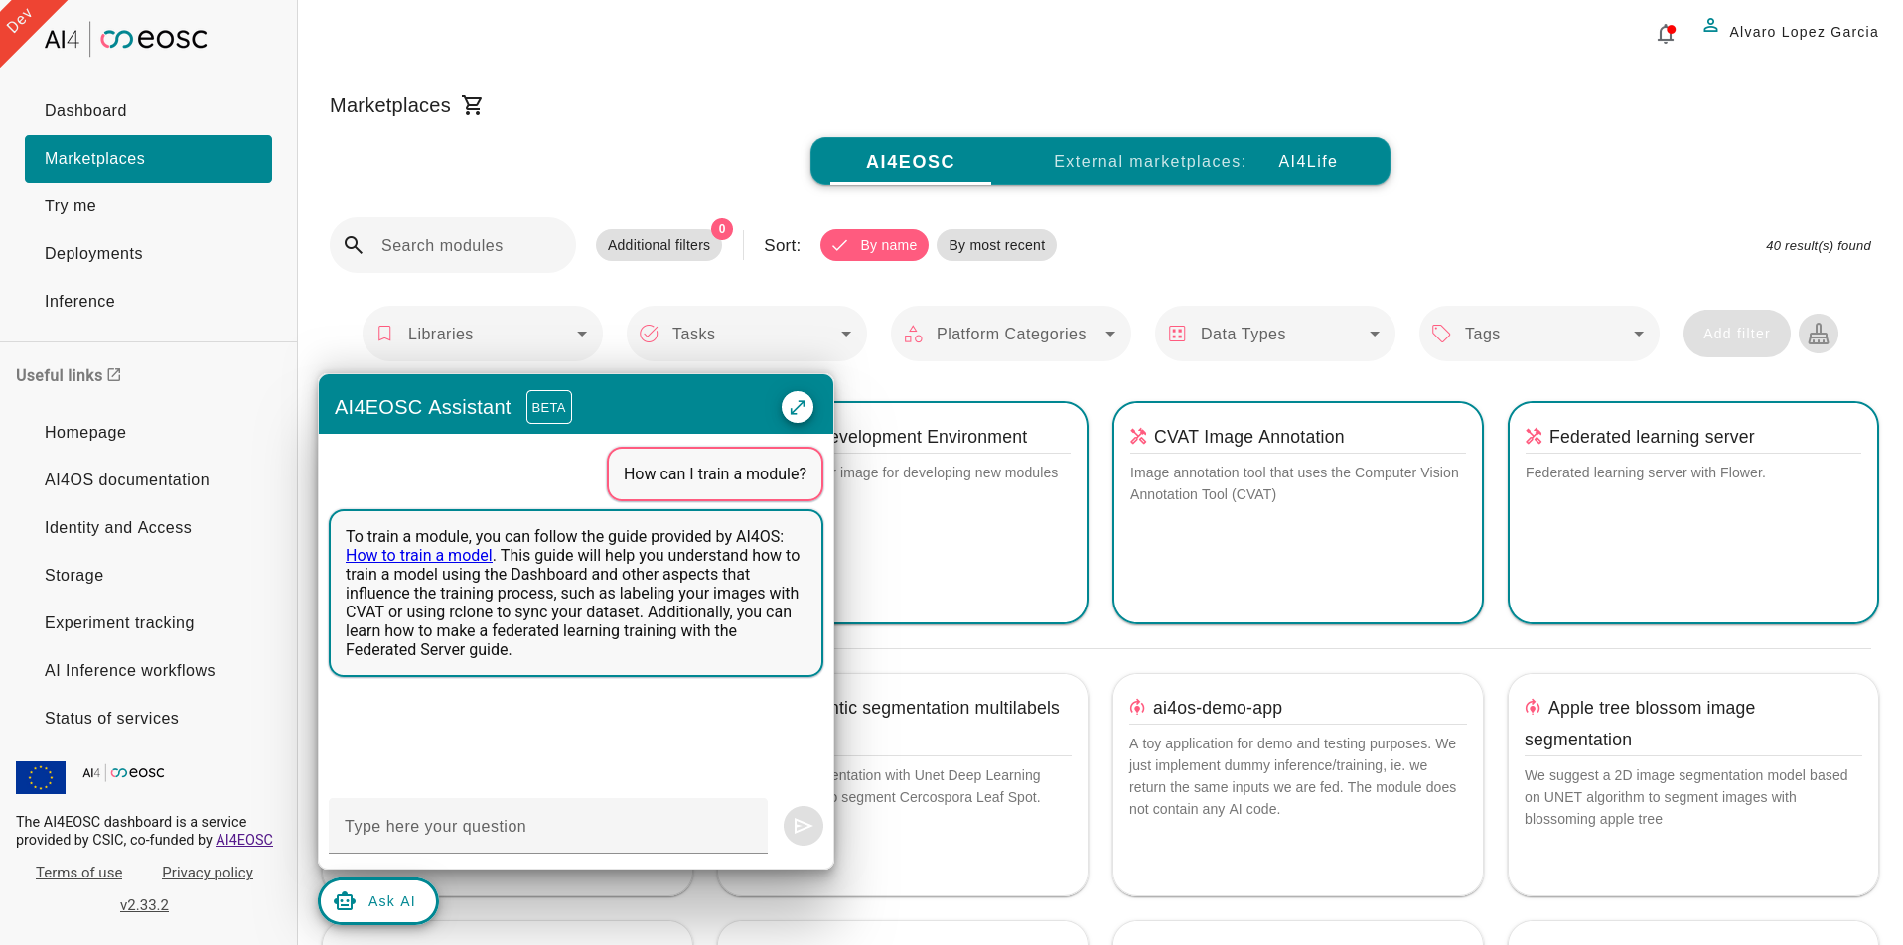
LLM4EOSC as an assistant
Who reads user documentation anyway?

Slide 15
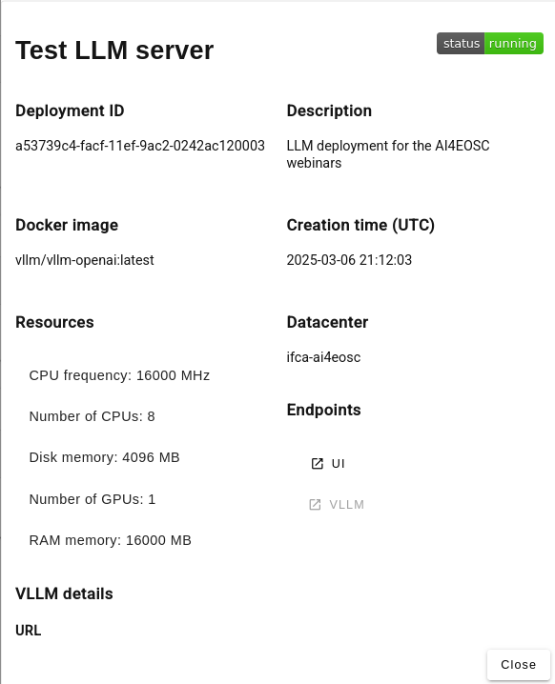
Deploy your own
Manage your own instance
New tool introduced in March 2025
Allowing users to self-deploy a dedicated LLM stack
Features:
  Deploy a chatbot, API service, or both
  Easy deployment via dashboard with a few clicks
  Choose from a list of smaller optimized models
(e.g. DeepSeek-R1-Distill-Qwen-1.5B, Qwen2.5-7B-Instruct-AWQ,
Llama-3.2-3B, etc.)
Benefits:
  Dedicated instance for each user
  Less powerful hardware requirements
  Greater control and customization options
  Ideal for users who need a tailored solution

Slide 16
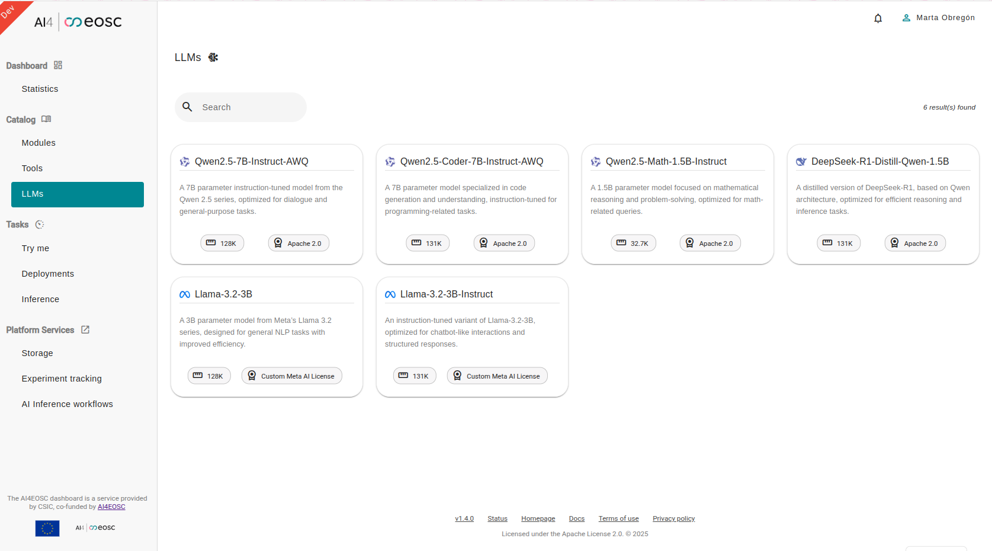

Slide 17
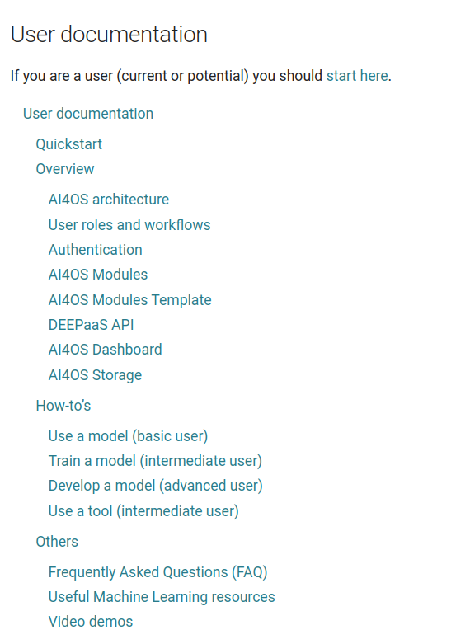
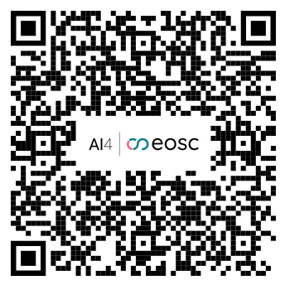
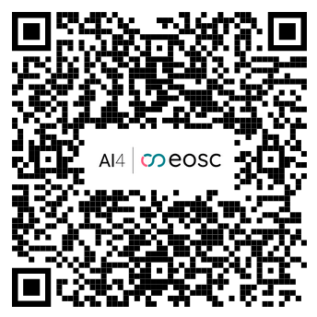
Documentation
https://docs.ai4os.eu/
Quickstart
Guides: storage (Nextcloud), authentication, module templates, etc.
Frequently Asked Questions (FAQ) section
Short tutorials (1-2min videos) for
specific functionality:
  Codespaces
  Linking with storage
  Try-me endpoints
  etc.
In depth Tutorials for new tools:
  MLflow
  Elyra
  Flowfuse
  Federated Learning
  New video tutorials playlist

Slide 18
AI4EOSC impacts
New horizontal and thematic services for the EOSC Exchange
  AI/ML generic (AI4EOSC platform https://dashboard.cloud.ai4eosc.eu) or community specific (e.g. iMagine https://dashboard.cloud.imagine-ai.eu/; AI4Life https://ai4life.cloud.ai4eosc.eu/)
Integration with other EOSC and open science repositories and tools, e.g.:
  Zenodo: automated publication of models and dataset gathering
  Open Data EU portal: automated dataset gathering
Transforming development of AI models for science in the EOSC
  Towards more FAIR, robust, trustworthy models
  Foster federated collaboration (i.e. FL) and exploit distributed nature of the EOSC
  Best practices for development AI and ML models
Improvement of robustness of AI systems -> Trustworthy AI
  MLOps infrastructure and services for AI scientists
  Drift detection tools and services to assess data/model/inference validity
  Provenance of models (reproducibility), model metadata
  FAIR-ification of ML assets

Slide 19
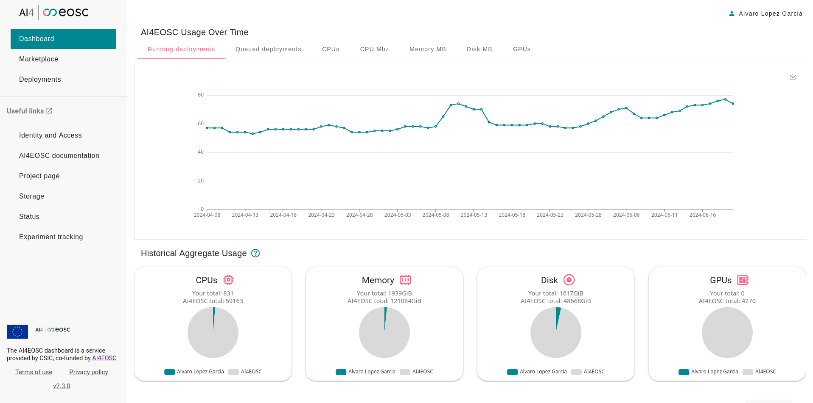
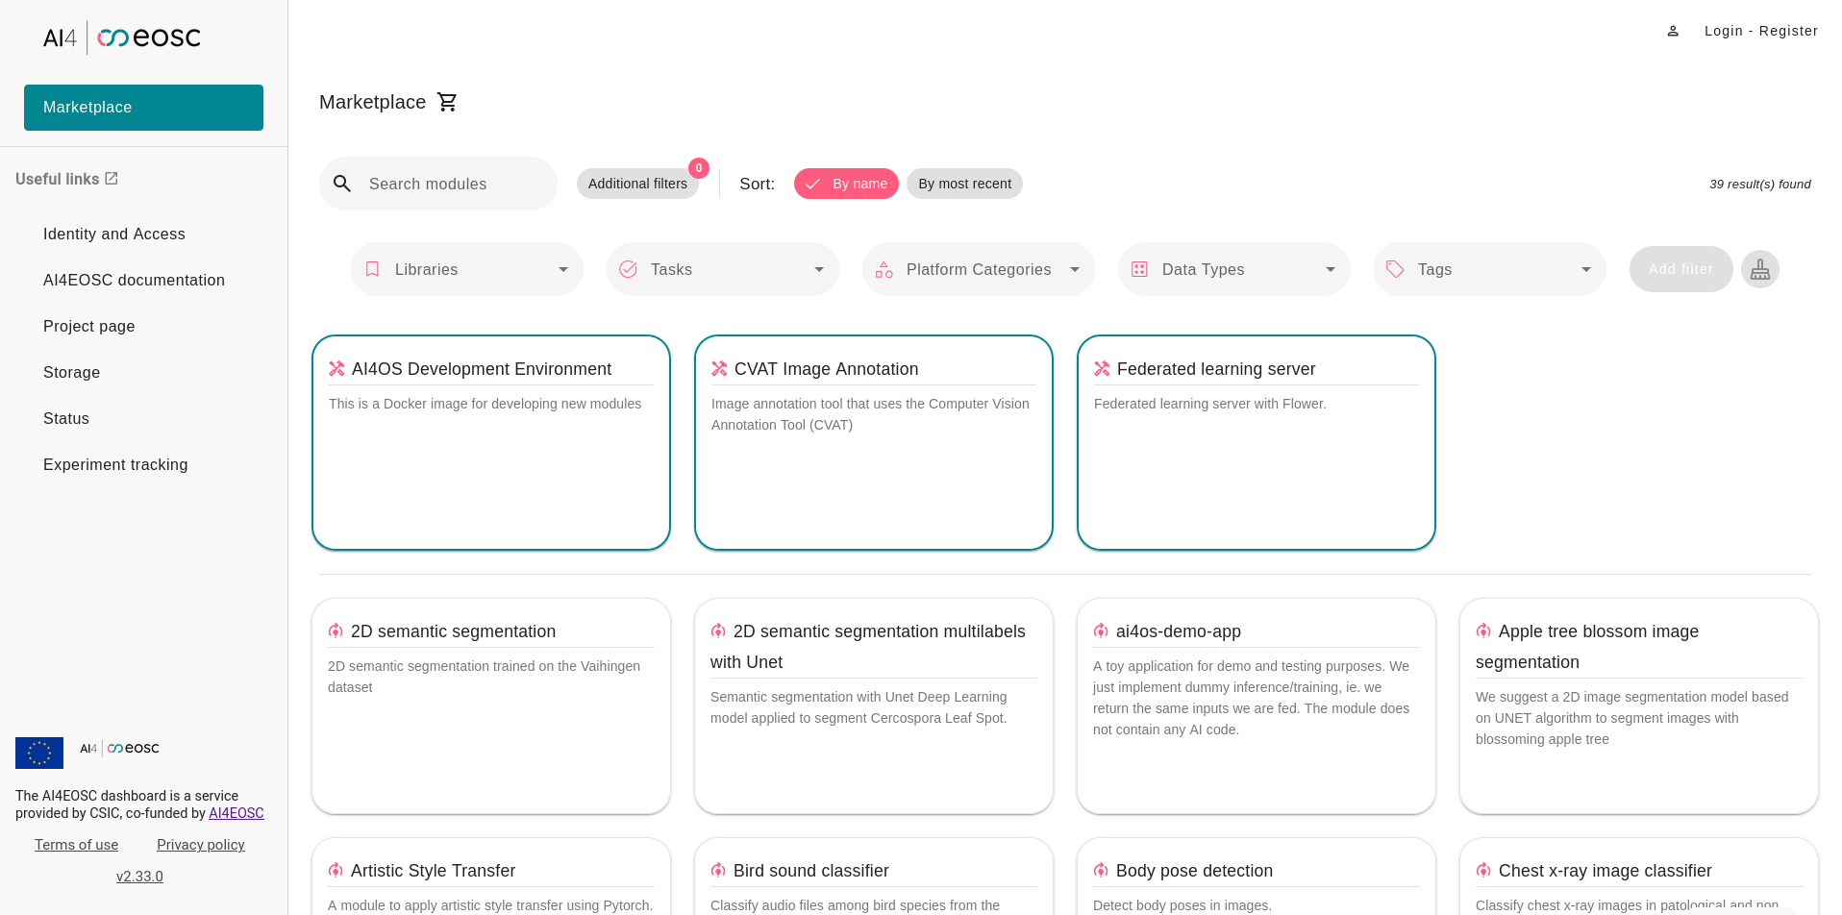
AI4EOSC research
AI4EOSC empowers scientific research by…
Providing users with advanced AI- focused tools:
  Model retraining (iterative learning, fine tuning)
  Federated learning (including client authentication)
  Parallel training in multiple GPUs
  (distributed training - data parallelism)
  Model monitoring: MLOps, drift detection
  Model inference and service delivery
Providing a simple and intuitive IDE for developing AI/ML/DL models (VSCode or JupyterLab)
Allowing seamless and transparent access to computational resources to accelerate model development
Deploying your models in production
  in a serverless environment (OSCAR), in a dedicated server (IM), as short-lived demo endpoints (Try-me) or dedicated instances for prototyping (Nomad)

Slide 20

Thank you for your attention!
The AI4EOSC platform
Viet Tran
viet.tran@savba.sk
on behalf of the AI4EOSC team
https://dashboard.cloud.ai4eosc.eu

Slide 21
BACKUP
BACKUP SLIDES

Slide 22
Objectives and indicators
O1
Feature rich services and platform to build and deploy custom AI applications in the EOSC
Custom platforms for different use cases
Integration with EOSC-core services
Inclusion of new infrastructure providers
AI4EOSC and iMagine platforms operational
Integration with AAI (EGI Check-In)
ML models as services via Try-me endpoints, OSCAR, IM, AI4EOSC persistent deployments
O2
Support for building AI systems on distributed datasets, with a particular focus on federated learning
Operational components, integrated in the platform at TRL >= 7
Operational platform at TRL 8
Federated learning (collaboration with NVIDIA and Flower.io) and distributed learning at TRL 8
Additional tools (pycanon, Frouros) at TRL 9
O3
Services to compose AI tools, enabling the development of complex data-driven AI applications
Operational framework and platform with composite AI capabilities
Documented MLOps principles
Cmposite AI available (TRL7-8)
MLOps pipelines In progress
O4
AI exchange/hub in the context of the EOSC, enhancing and increasing the application offer currently available
AI/ML/DL marketplace in EOSC portal
Inclusion of domain specific metadata
Interoperable assets with other initiatives
Deliver of best practices, training, etc.
AI4EOSC platform in EOSC registry (link)
Provenance metadata: In progress
Metadata and Interoperability: In progress
Extensive training with users
O5
Extend the service offer and the capabilities being offered through the EOSC portal, with focus on AI
Joint use cases with ongoing EOSC projects
Cross-project events, involving users
Ongoing (RAISE, FAIRCORE4EOSC)
Participation in INFRAEOSC and WinterSchool
2 X-project workshops, online workshops

Slide 23

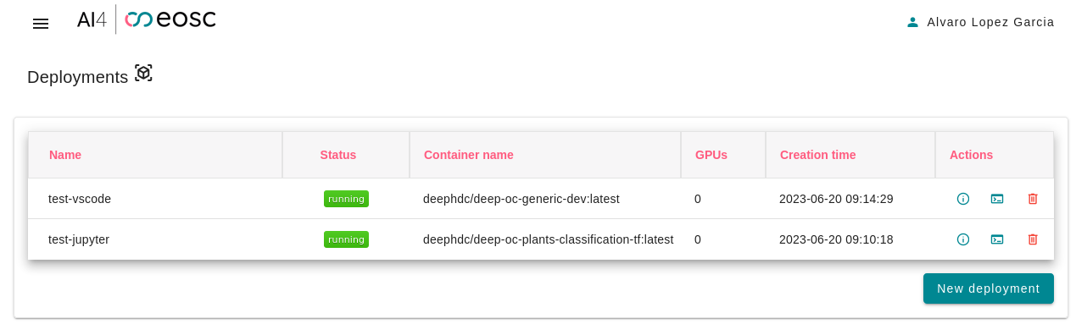
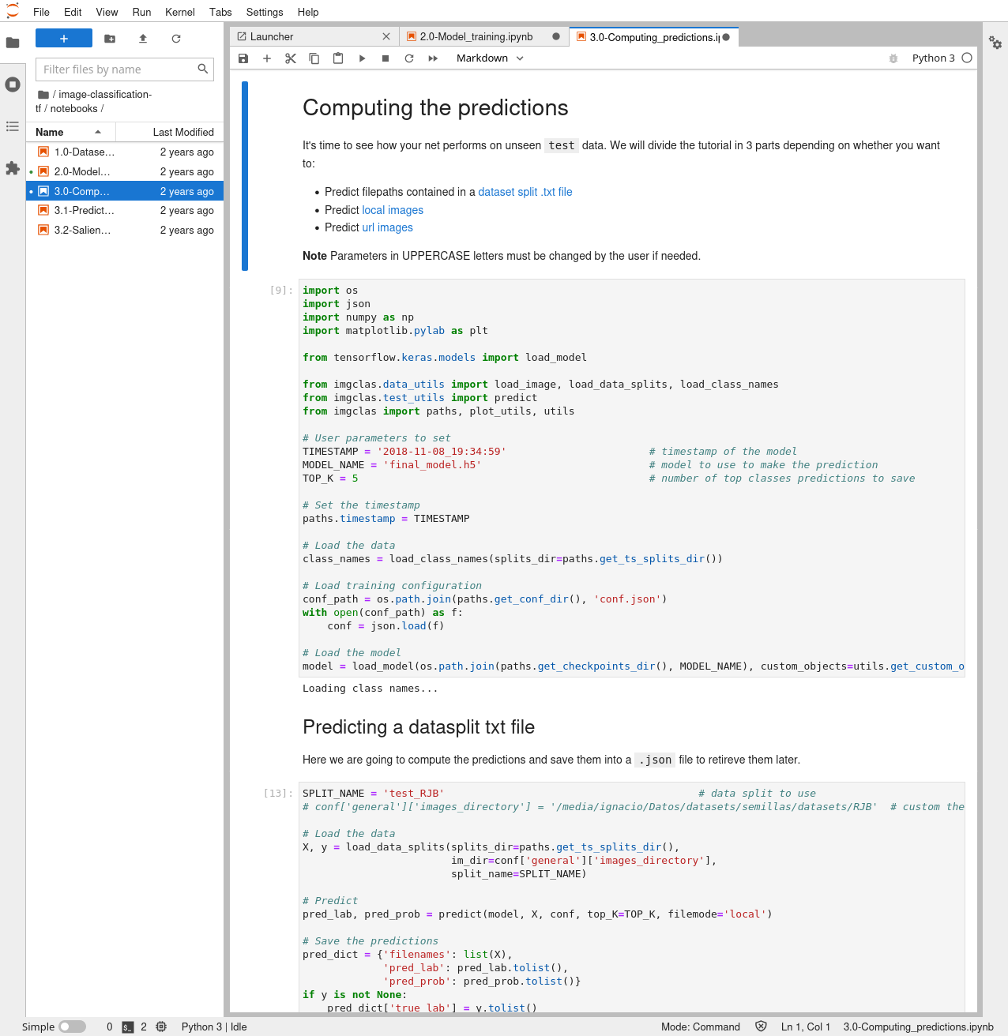
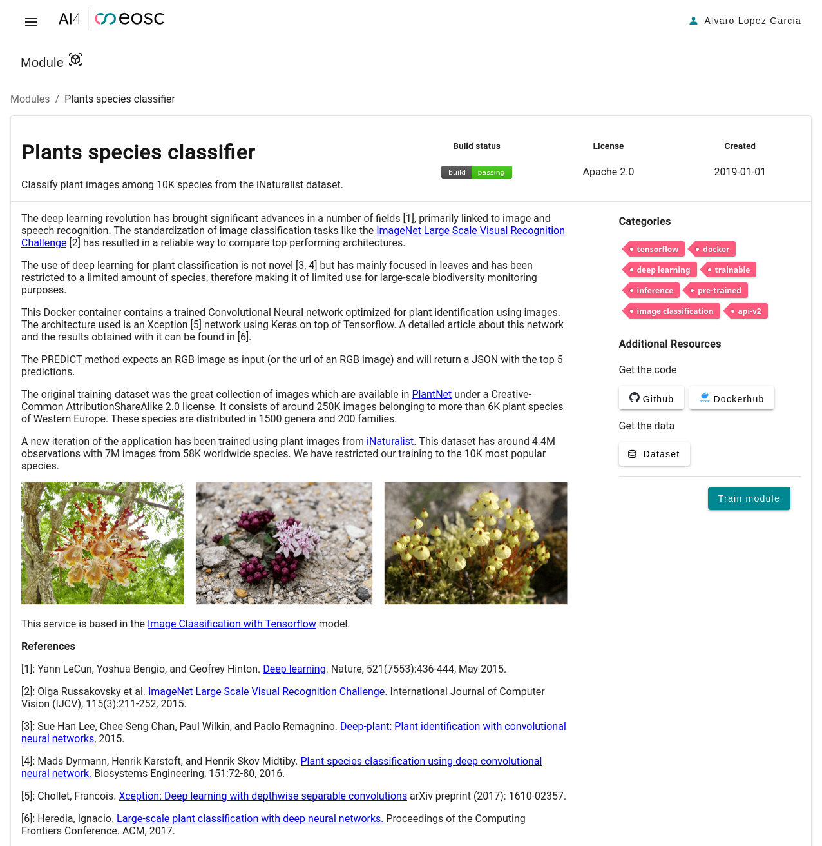
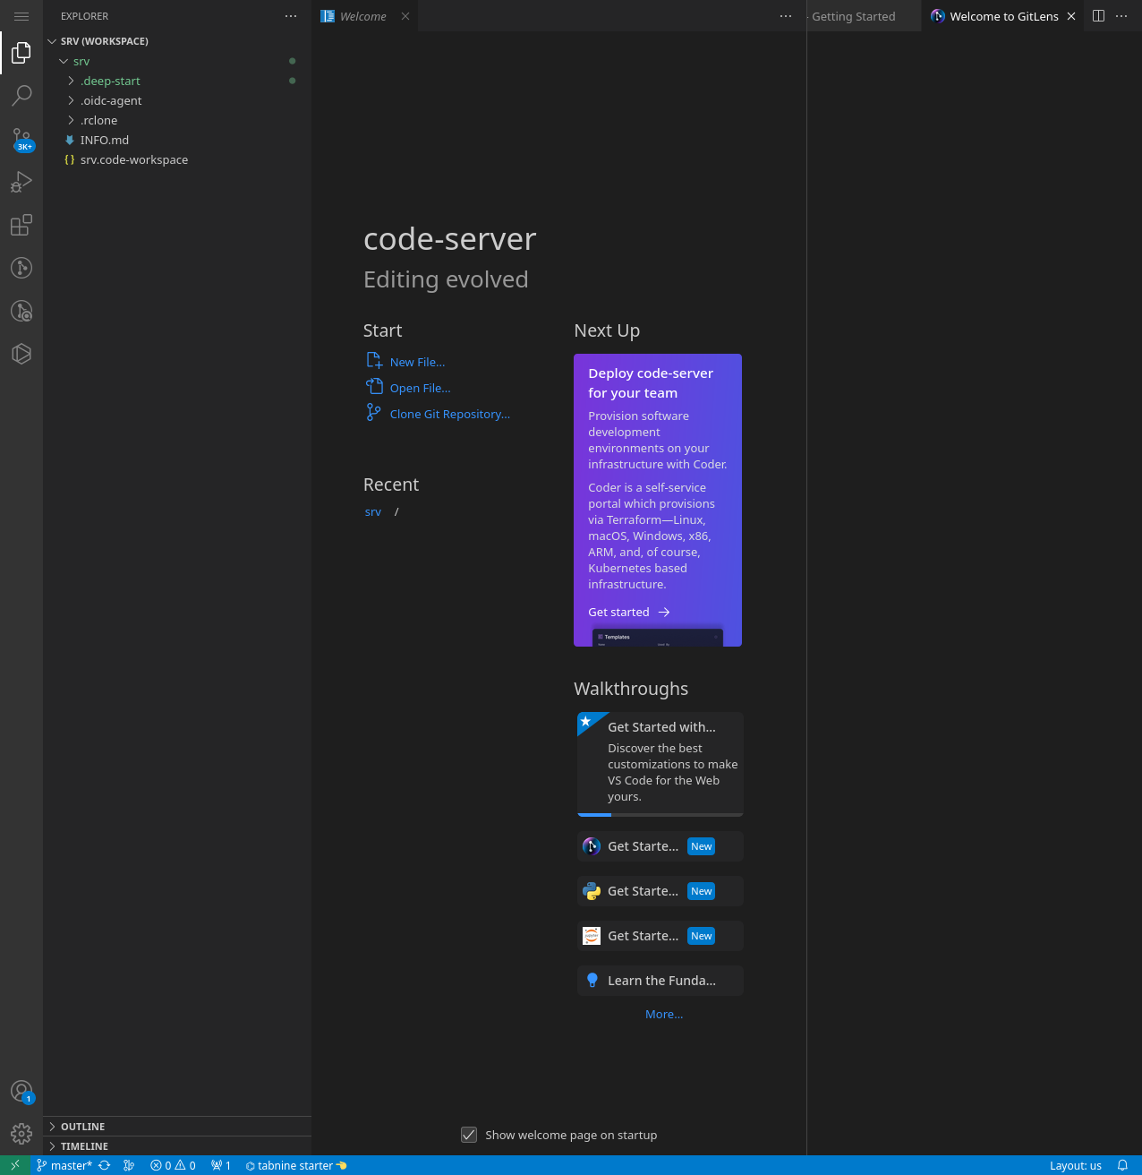


Services for AI/ML development
Dev tools: sandbox and online IDE

Slide 24
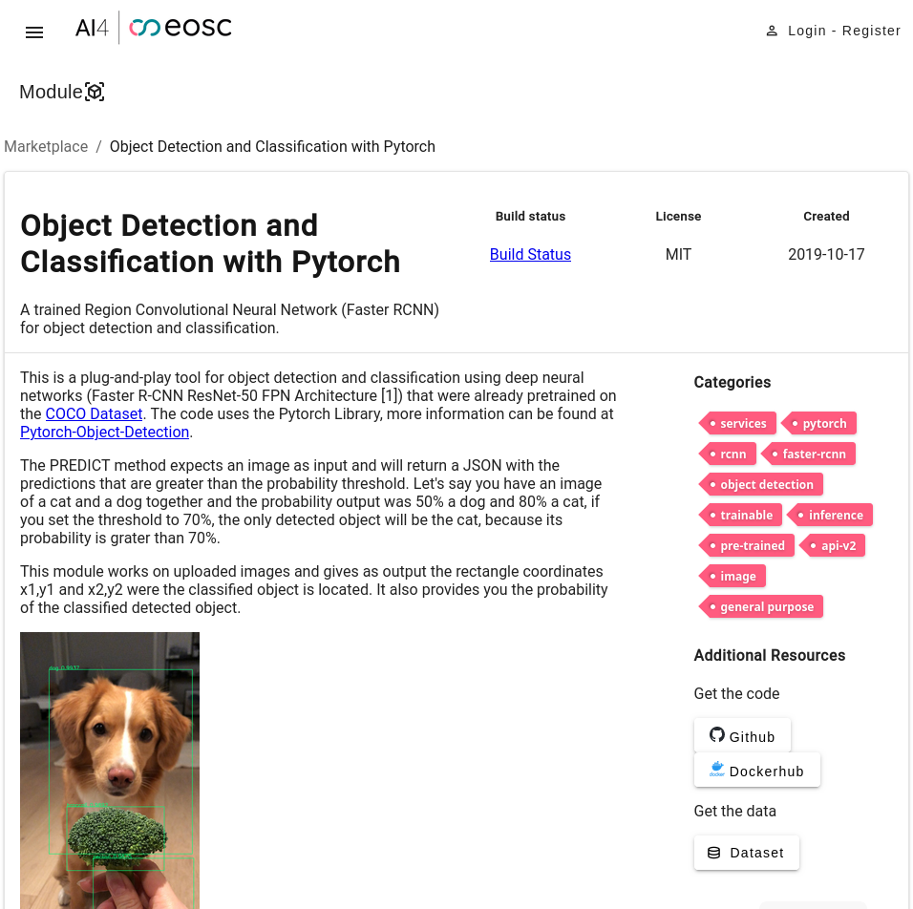
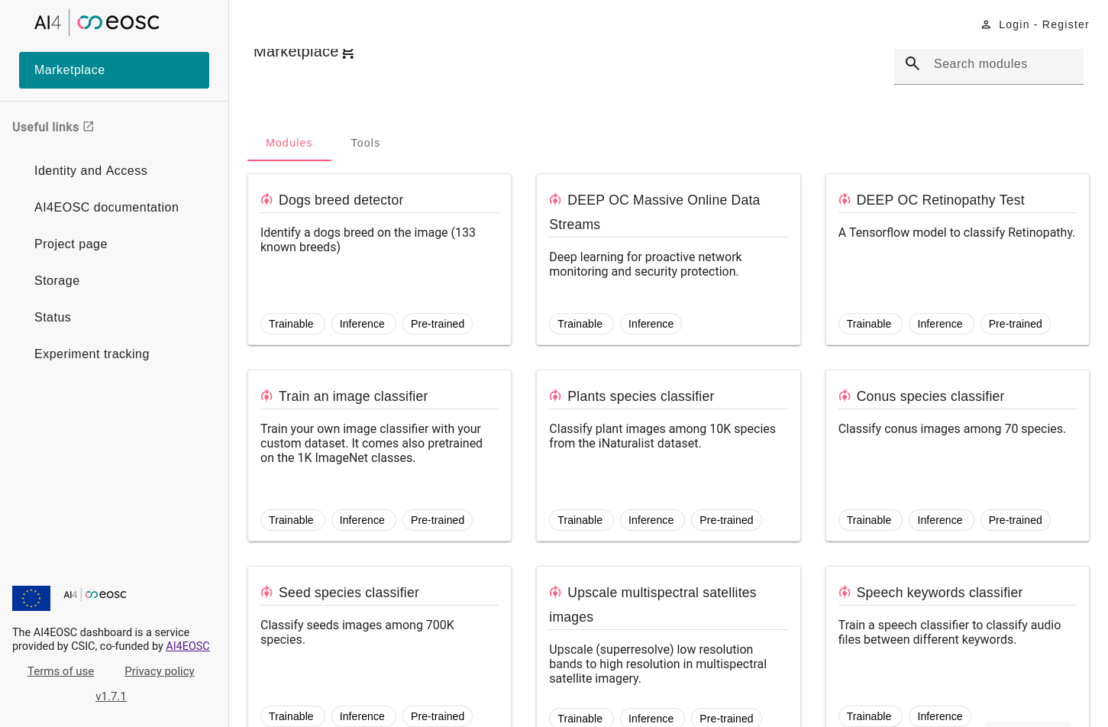
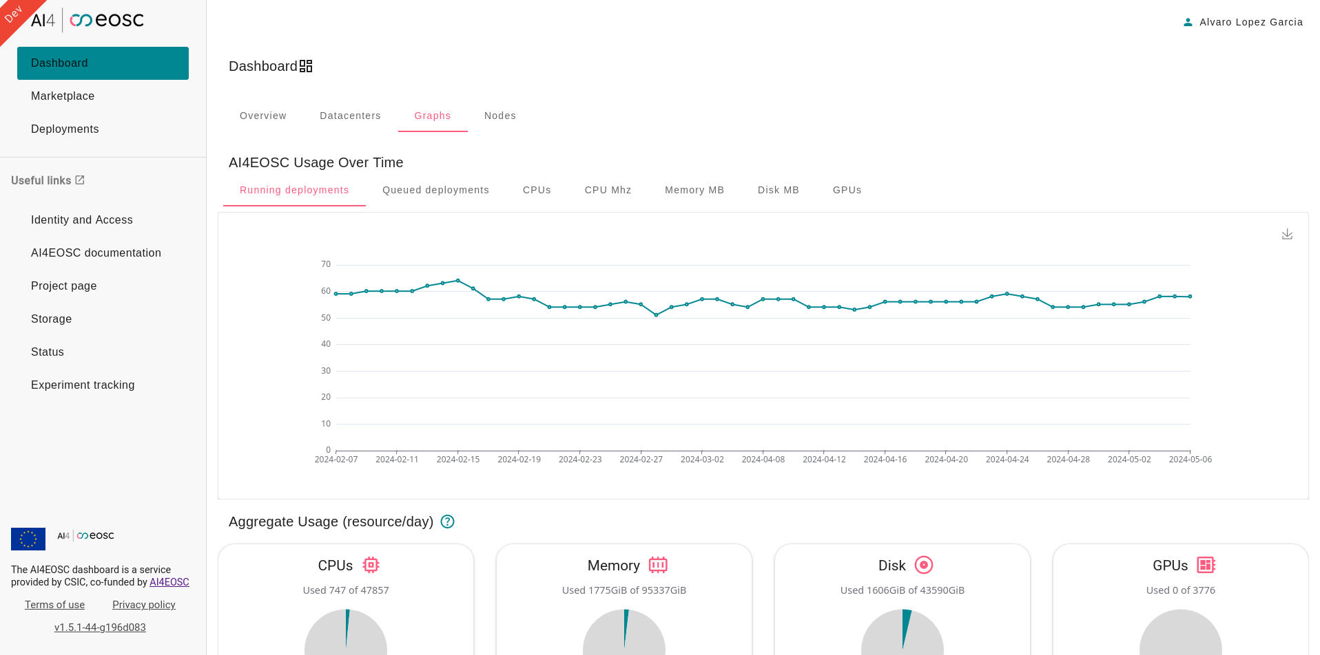

Services for AI/ML development
Model marketplace and dashboard
https://dashboard.cloud.ai4eosc.eu/
https://open-science-cloud.ec.europa.eu/resources/services/eosc.ifca-csic.ai4eosc_platform

Slide 25
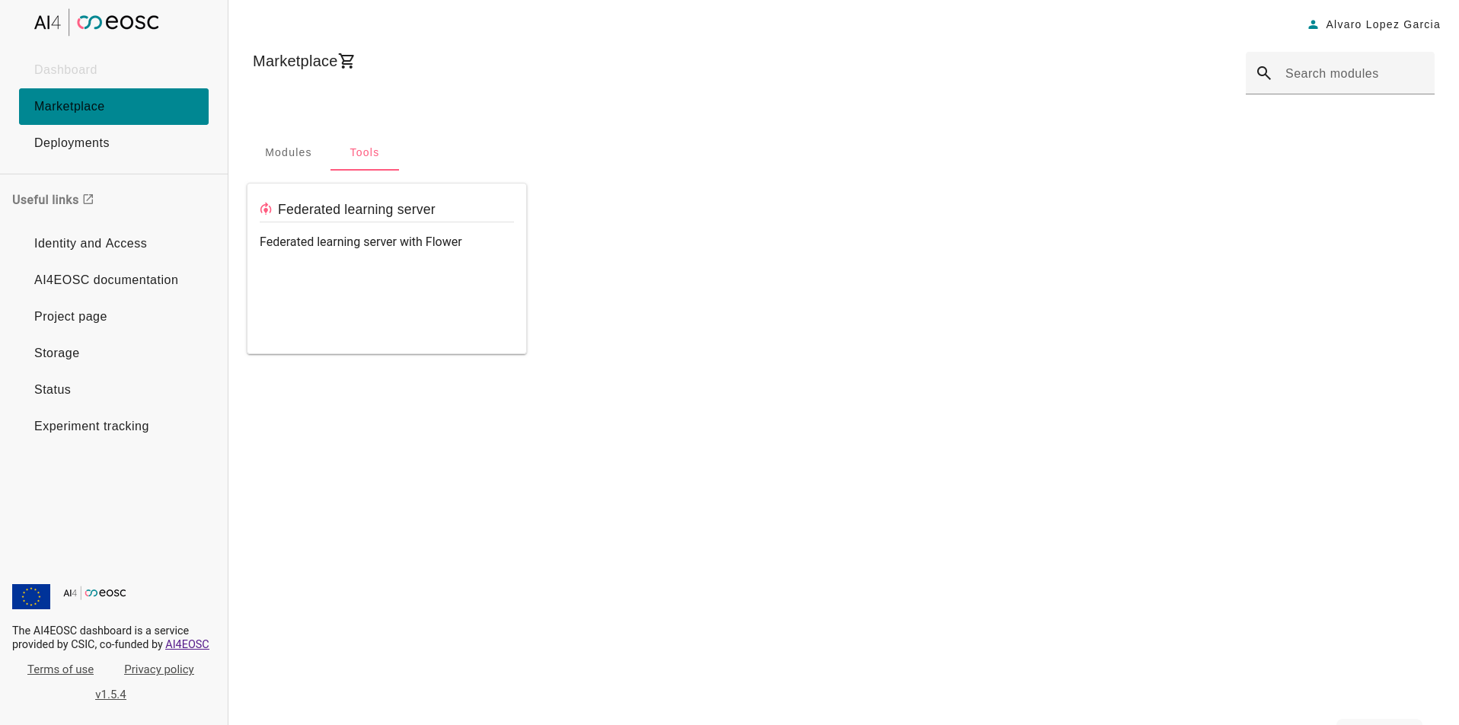
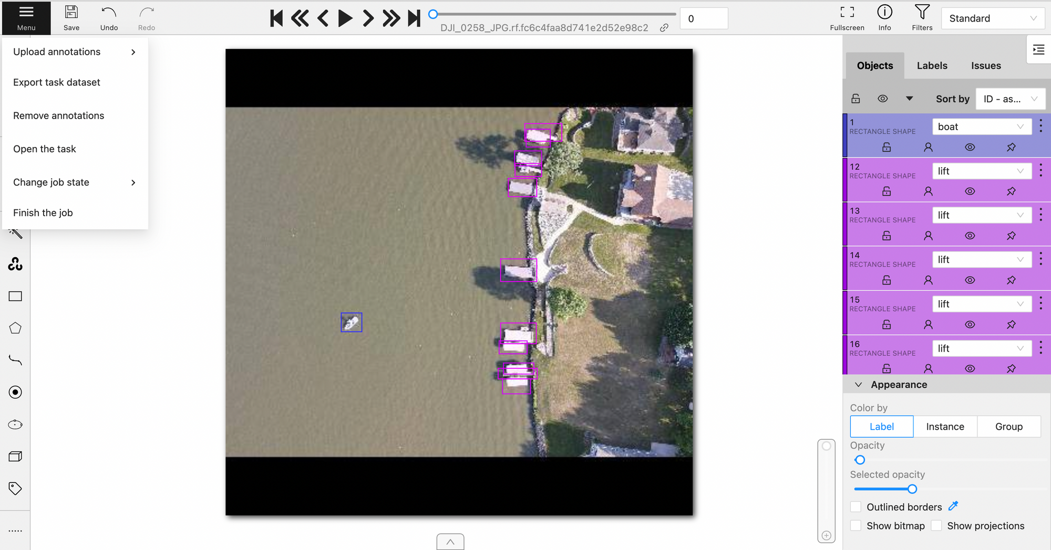
Services for AI/ML development
Dev tools: CVAT annotation

Slide 26
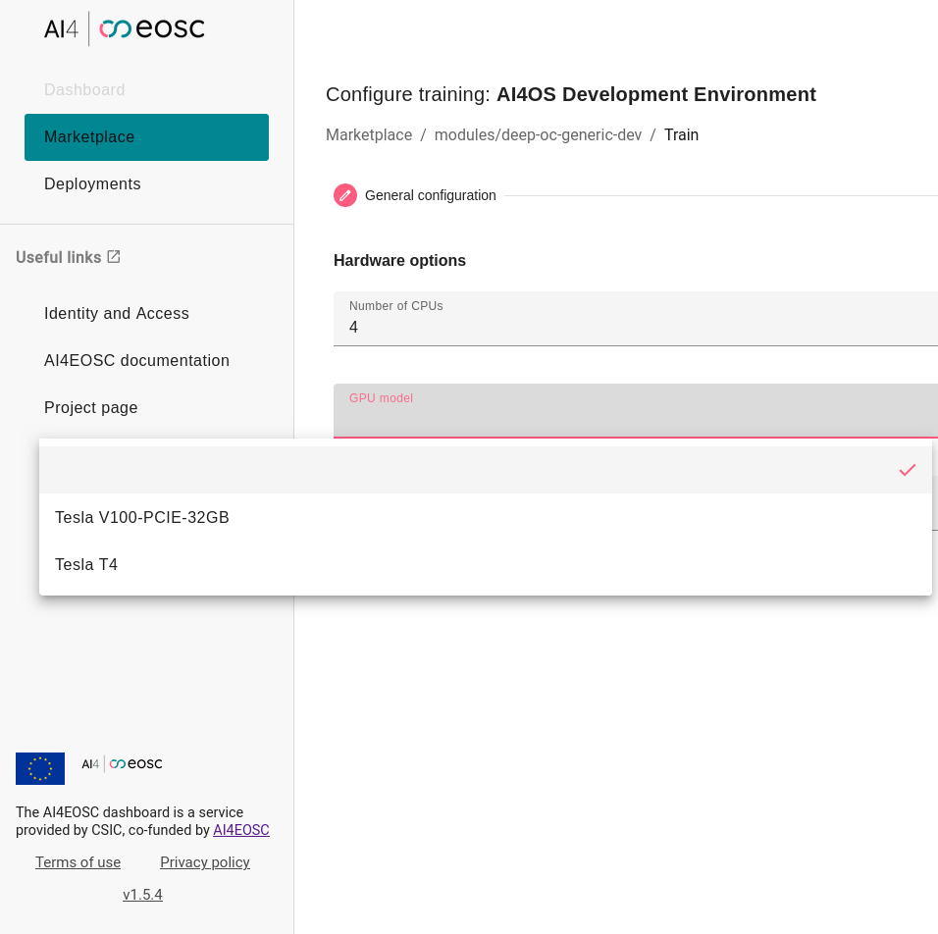
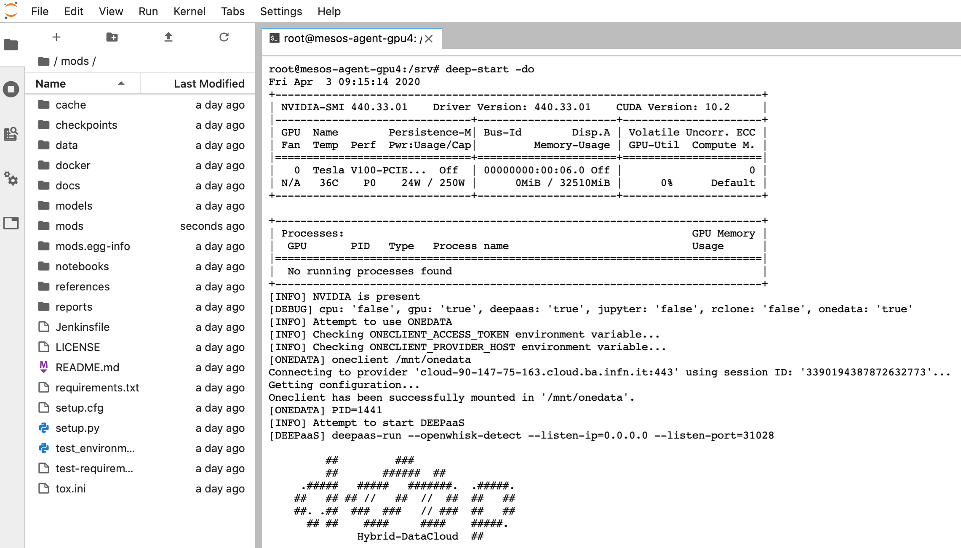
Services for AI/ML development
Training: Transparent GPU access

Slide 27
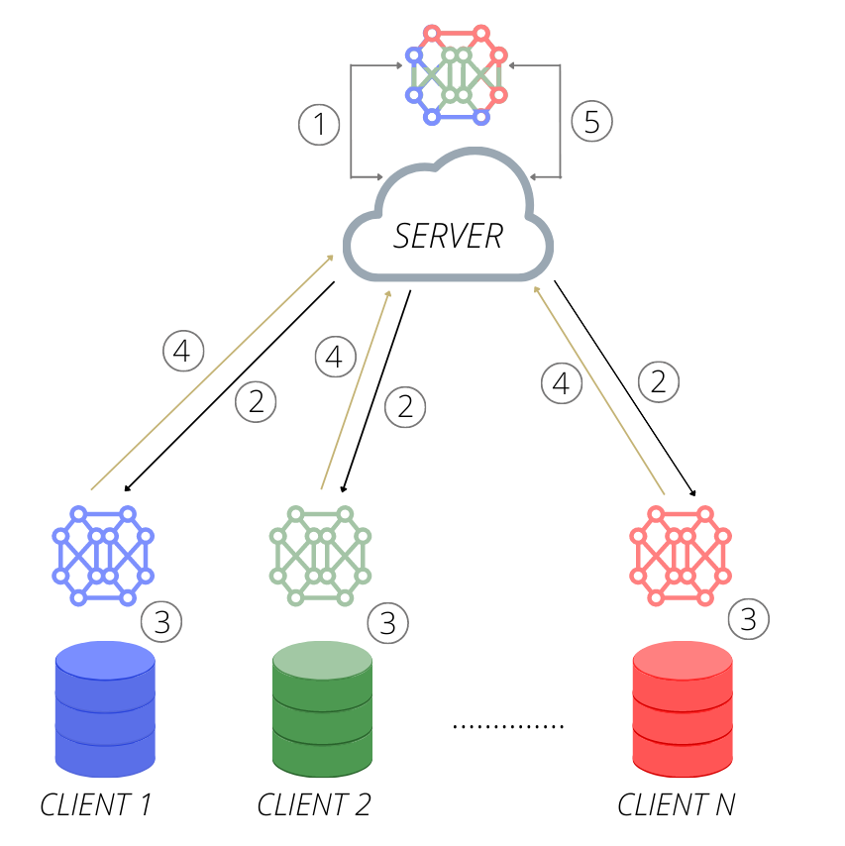
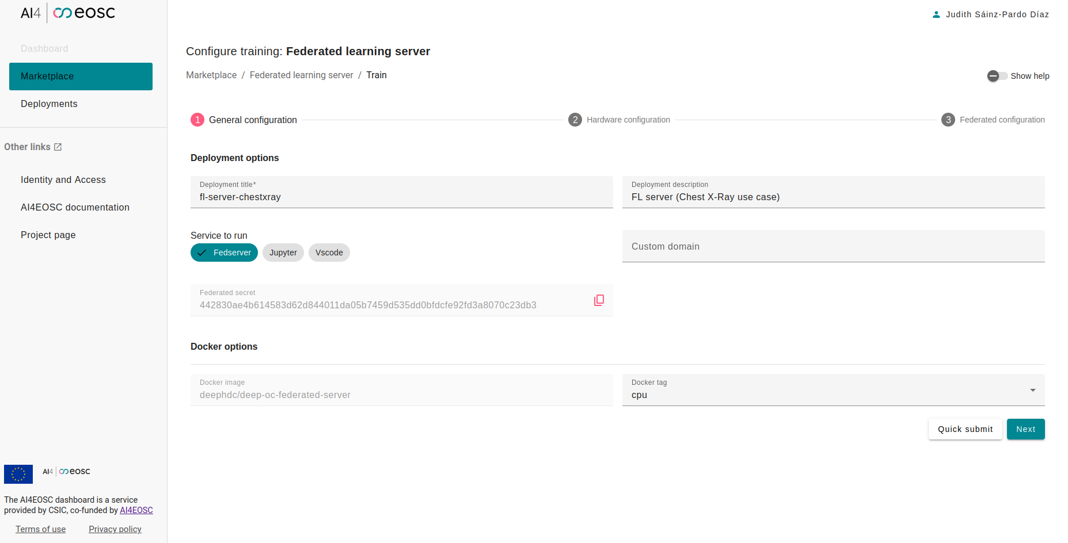
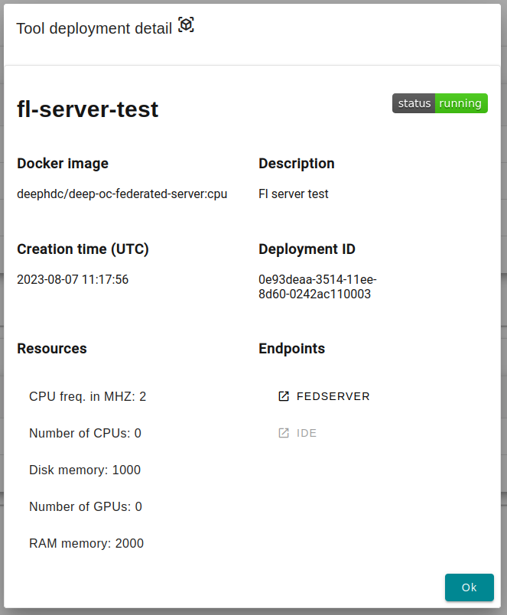
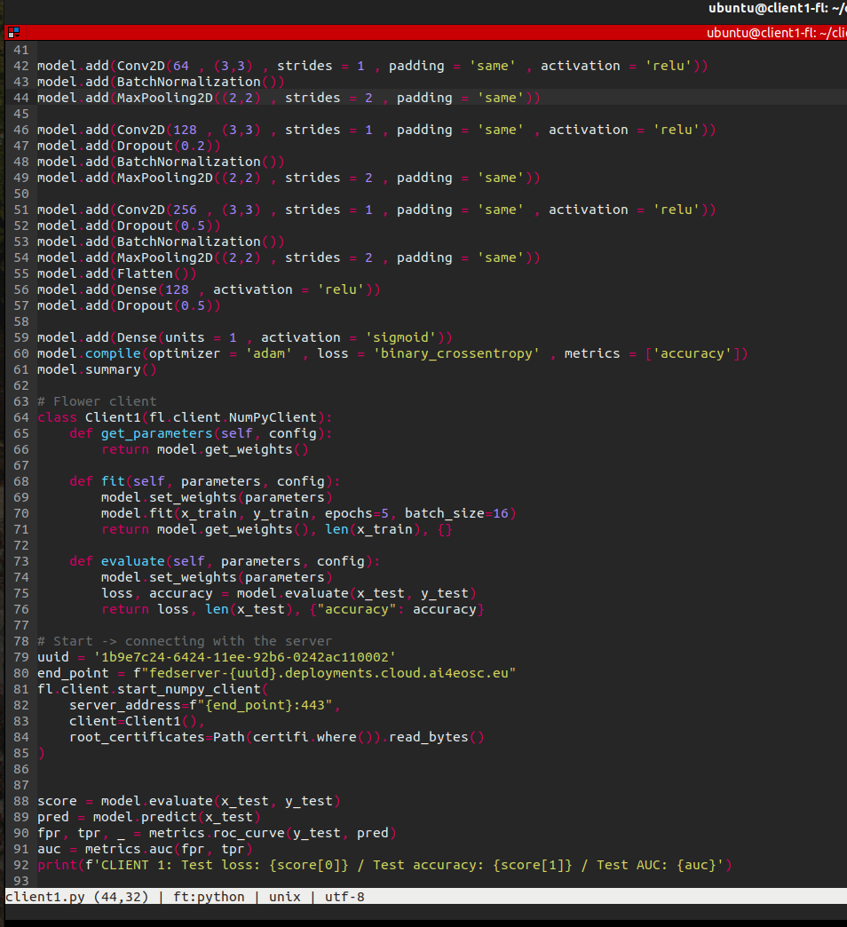
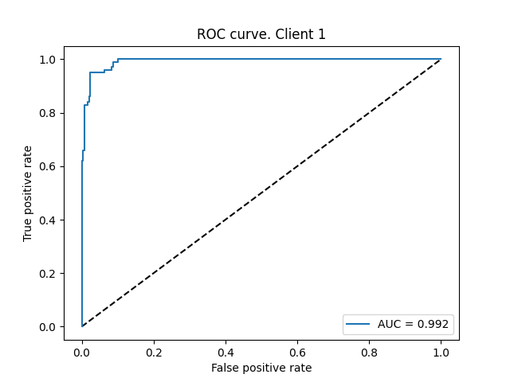

Services for AI/ML development
Training: federated learning
Collaborative and decentralized approach to build ML models
  No need to centralize a dataset (i.e. technical or privacy restrictions)
Management of experiments through platform dashboard
Participating clients both within AI4EOSC platform or external
(with authentication)
Webinar April 22nd
https://indico.ifca.es/event/3134/

Slide 28
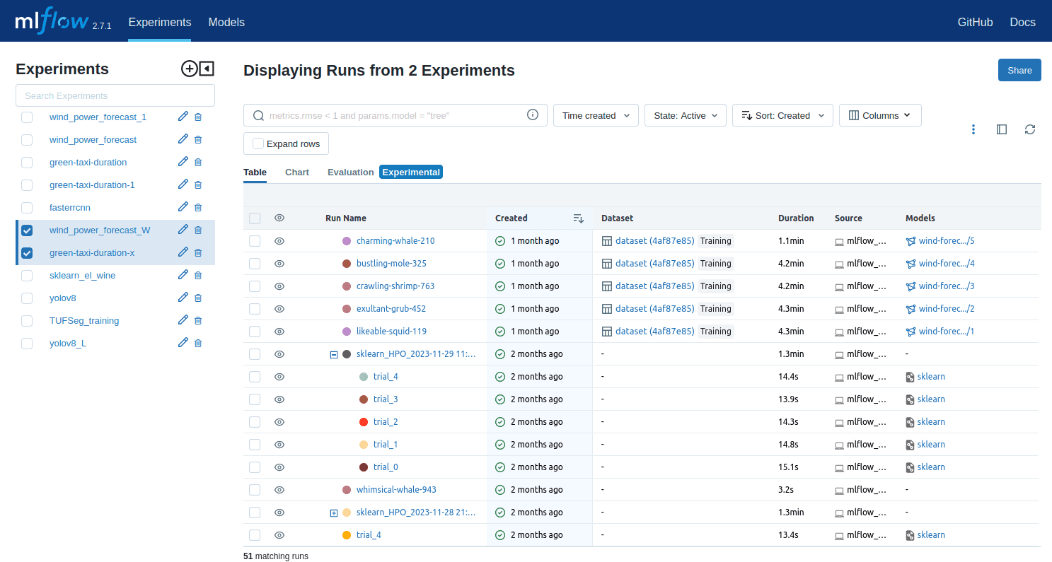

MLFlow for experiment tracking
MLFlow is an open source platform for the Machine Learning lifecycle
MLFlow helps user to improve the efficiency: streamlined experiment tracking and management significantly reduce the time spent on manual record-keeping
Ensures reproducibility: comprehensive experiment tracking and versioning capabilities provide a robust foundation for reproducibility
MLFlow in AI4EOSC:
  Authenticate in the MLFlow UI
  (interface) with the user
  credentials (email)
  https://mlflow.cloud.ai4eosc.eu/
  Integration with ML provenance

Slide 29
Services for AI/ML development
Deploy and monitor
Deployment
  Providing services for deployment as services:
    Through IM an a different cloud (done)
    Through OSCAR in a platform-managed cluster
      https://inference.cloud.ai4eosc.eu/ (done)
    Through AI4-PAPI in AI4EOSC AI platform resources (coming soon)
  Composite-AI tools (visually build more complex models) (coming soon)
MLOps
  CI/CD for ML development, deployment, monitoring and operations
    https://jenkins.services.ai4os.eu/
Monitoring
  Tools to instrument ML models in production (i.e. drift detection)

Slide 30
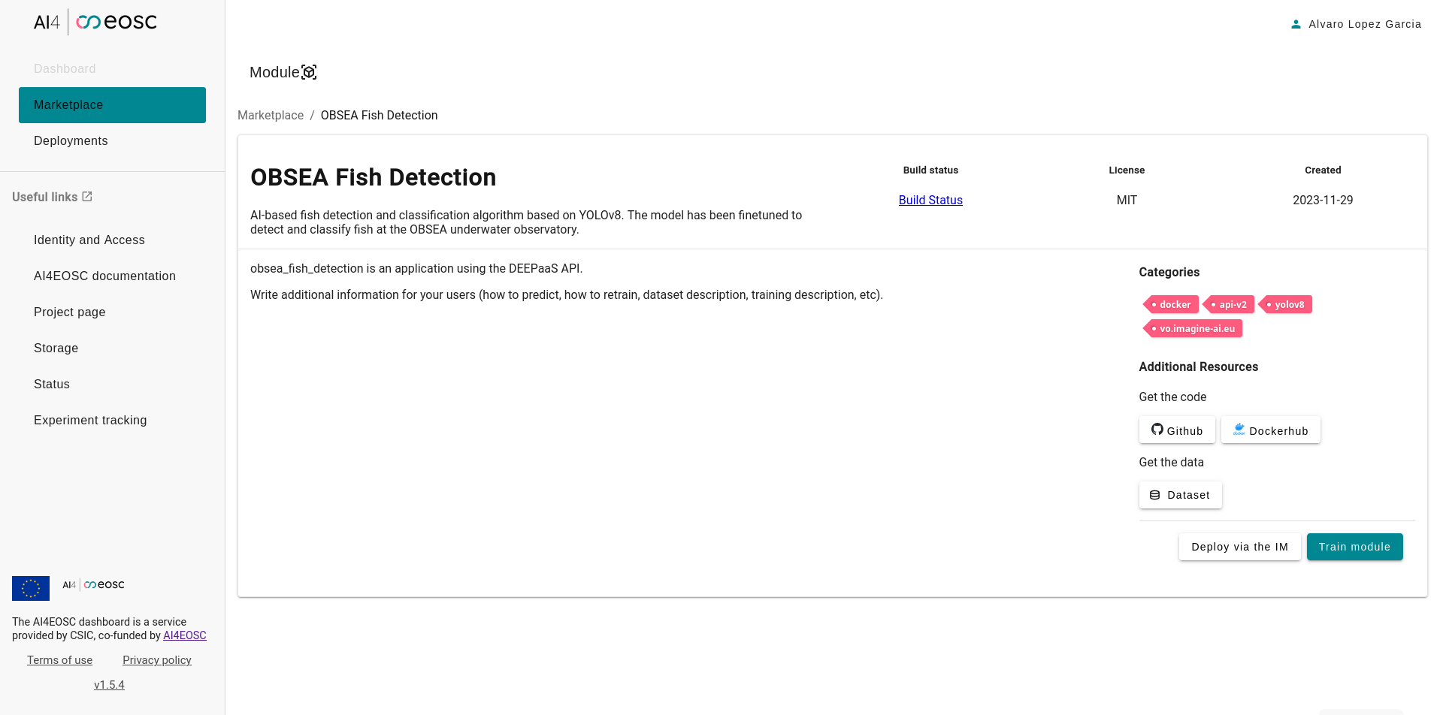
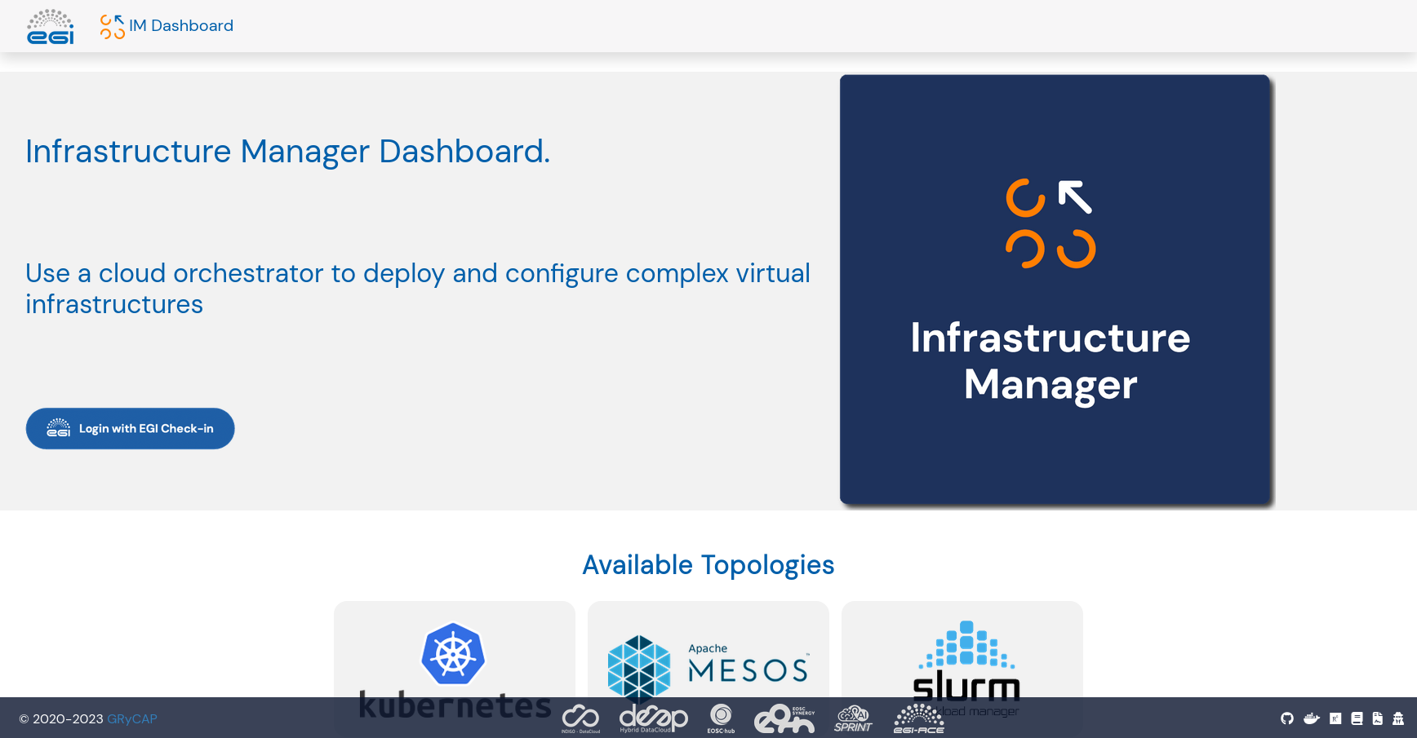
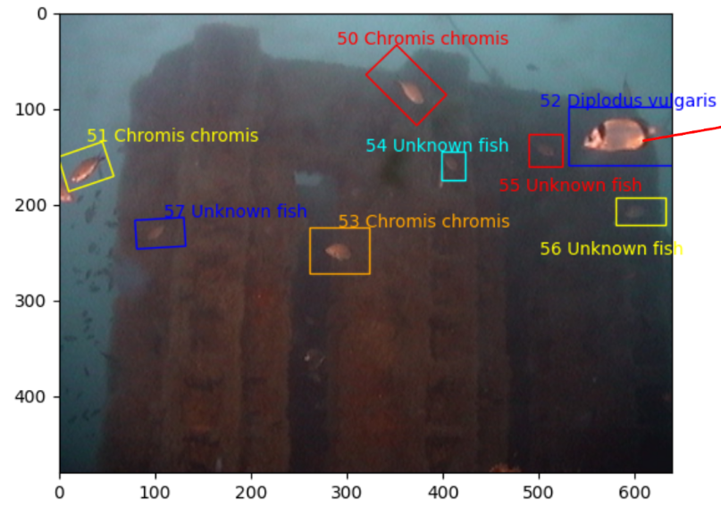
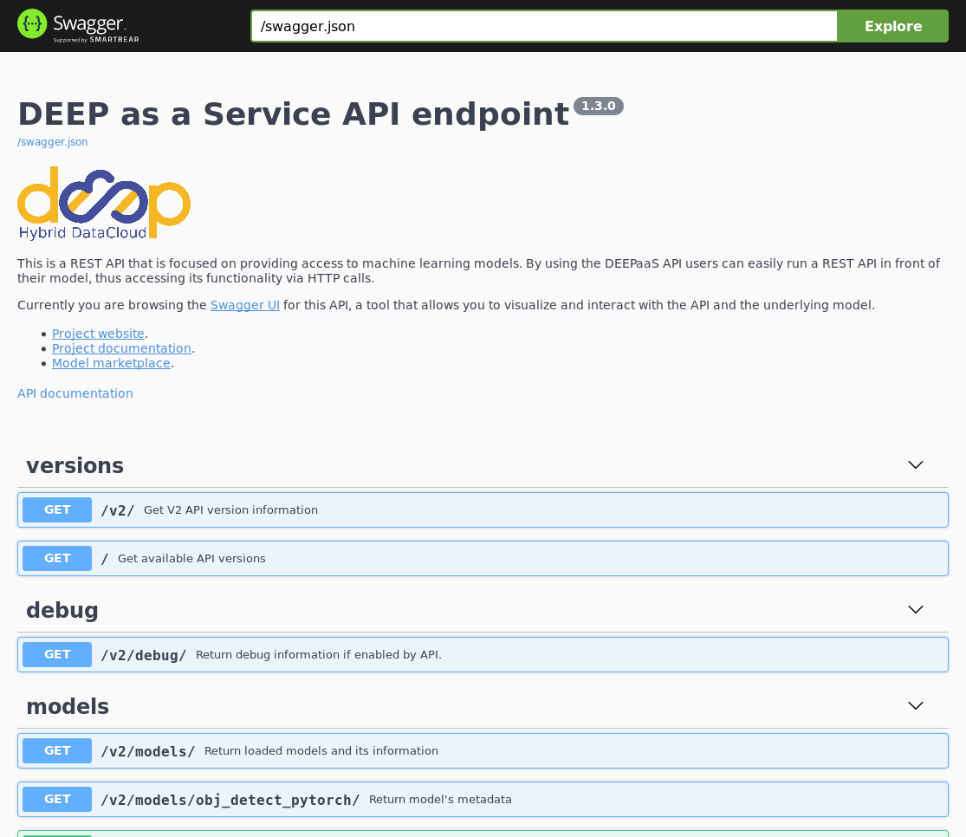
Services for AI/ML development
Deployment: standalone service

Slide 31









Services for AI/ML development
Deployment: Composite AI
Load video
Species identifier 1
Mean Probabilities
Visualization Result
Extract relevant frames
Species identifier 2
Use case: multiple AI models can be triggered for inference and later aggregate the results for enhanced accuracy
Reuse functions (subflow)
Visual support (drag & drop + customization)
Minimize orchestration costs

Slide 32
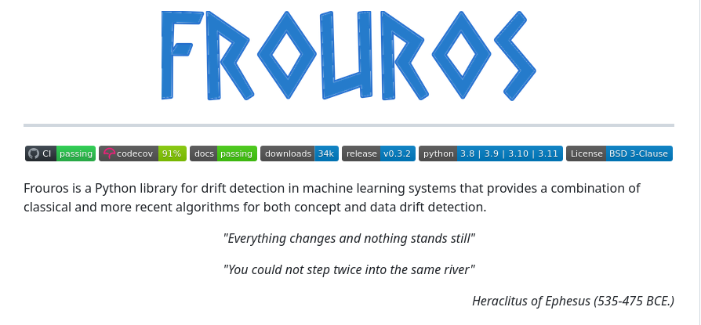
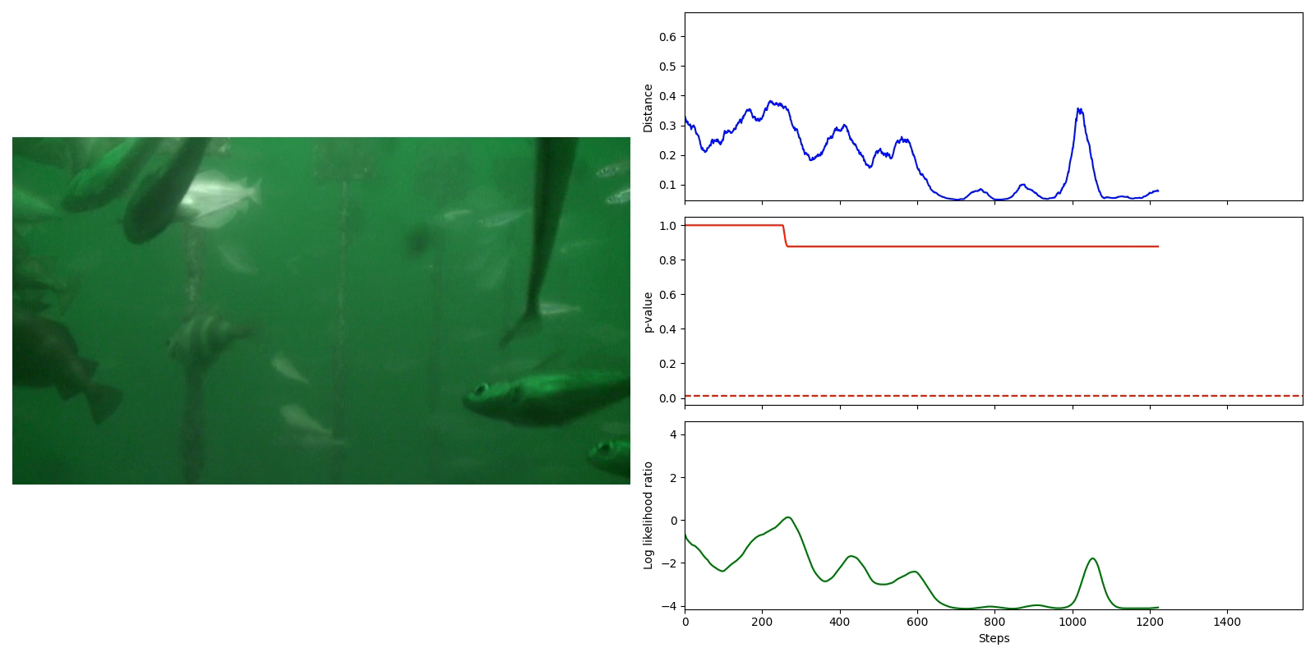
Services for AI/ML development
Deployment: Drift detection
Monitoring of models in production is not enough
  Model learns from data, data is not stationary
  Concept learnt by them model may change over time
Data and concept drift detection → essential to build more robust models
Frouros: state-of-the-art library for drift detection in ML problems
  https://github.com/IFCA/frouros
Ongoing work towards online services for drift detection → MLOps pipelines with drift detection
Example: data drift detection in underwater video

