Slide 1
DOCU-BOT
Jiří Chudoba¹, Michal Chudoba²
1 – FZU, 2 – Charles University Prague
ISGC 2025 20. 3. 2025
This work was partially supported by project FORTE CZ.02.01.01/00/22_008/0004632
Notes:
add institutions

Slide 2
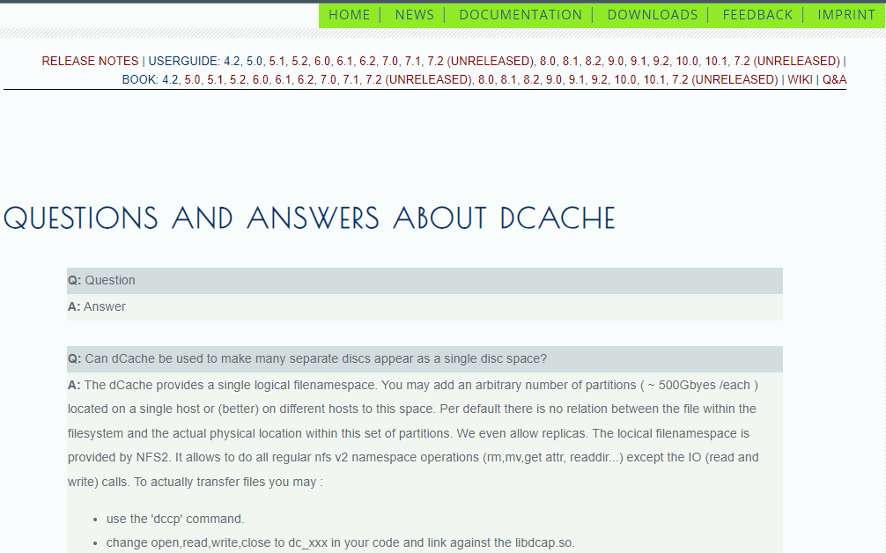
MOTIVATION
dCache documentation quite complex
  dCache book, user forum
Users ask questions that have already been answered
Difficult search in the provided documentation
  Q&A, Book, Users Guide

Slide 3


AI BASED SOLUTION
RETRIEVAL AUGMENTED GENERATION (RAG) BOT

Slide 4
BASE IMPLEMENTATION
Utilize online git repositories as a source of information about a product
Add private archive of emails to dcache-forum
Vectorizer to process questions
Use LLM to generate answers
Custom prompts, more custom documents

Slide 5
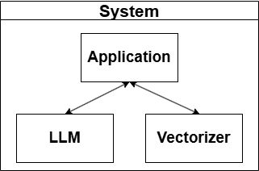
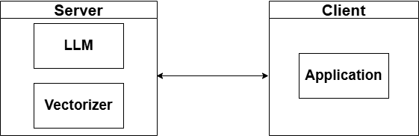
IMPLEMENTATION
V1 - Early 2024
  LLM and Vectorizer on same system as application.
V2 - Late 2024
  Server-Client Separation
Notes:
application: docu-bot (implementation based on gradio 5.5.0)

Slide 6
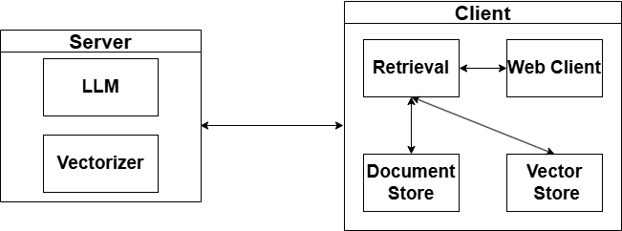
IMPLEMENTATION
V3 - Early 2025
  Application Modularity
Notes:
document store - lookup table in memory (also store in disk). documents in separate dir in original format (eg pdf, chunked in pages)
vector store has ids of documents, implemented in chromadb. In chunks (typically one paragraph per vector)
retrieval - processes user question to vectors, retrieves vectors from vector stores
retrieval sends text chunks to server, which tokenizes input and process it

Slide 7
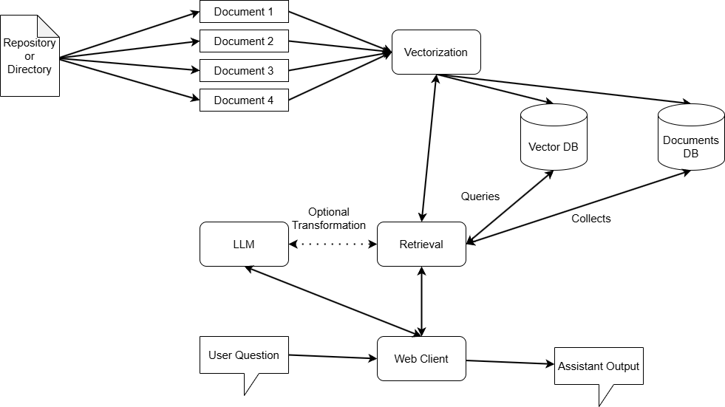
APPLICATION FLOW

Slide 8
TESTED RETRIEVALS
In search for better performance many different retrievals tested
  Context Query Alteration Retrieval
    New queries are generated based on retrieved context to user question
  Rerank Retrieval
    Retrieved documents are reranked by their usefulness by the LLM
  NER Retrieval
    Retrieval extracts Named Entities to be used as query
  Keyphrase Retrieval
    Retrieval extracts Keyphrases to be used as query
  Theme Retrieval
    Retrieval extracts general Theme to be used as query
  Document Retrieval
    Basic retrieval where user question is used for query
  Empty Retrieval
    No retrieval done, answers are based on LLM knowledge only
  Generative Retrieval
    Retrieval generates possible answer to the question to use as query
  Query Alteration Retrieval
    Retrieval generates alternatives to the user question to use as query
Notes:
Generative Retrieval - retrieval asks LLM for an answer and selects documents based on the answer
Query Alteration Retrieval - LLM used to modify the user question
Context Query Alteration Retrieval - the same as Query Alteration Retrieval but the modification is done after the question is answred

Slide 9
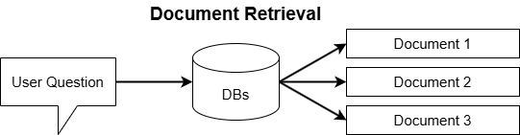
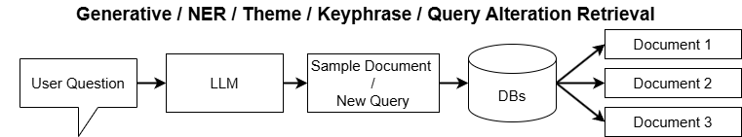
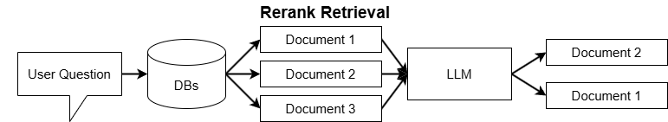
Retrieval Examples

Slide 10
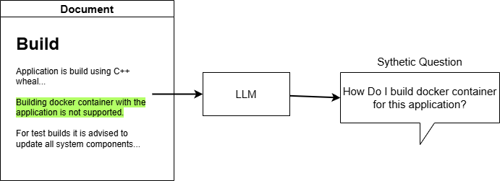
SYNTHETIC DATASET
Need Evaluation Dataset
  We don’t know if provided answers are correct
Generate it using the documents as reference
  We used GPT-4o and text-embedding-3-large from OpenAI
  For excerpt from documents generate question

Slide 11
SYNTHETIC DATASET
Generated Datasets for multiple projects
  dCache, DIRAC, DIRAC Pilot, CZ e-INFRA docs (IT4I)
  25 Examples for each project
Example contains
  Question - LLM Generated Question which excerpt answers
  Answer - Document excerpt
  Context - Document in which excerpt is located

Slide 12
EVALUATION
Evaluation on synthetic dataset using following metrics:
  Factual Correctness - Does the provided answer match what is expected?
    Evaluated by GPT-4o
  Faithfulness - Are stated claims supported by the extracted context?
    Evaluated by GPT-4o
  Context Recall - Are claims in reference and retrieved context similar?
    Evaluated by GPT-4o
  Semantic similarity - Between provided answer and ground truth
    Evaluated by text-embedding-3-large

Slide 13
EVALUATION
We have tested llama3.3-70b and aya-expanse-32b on 4 synthetic datasets using all retrievals

Slide 14
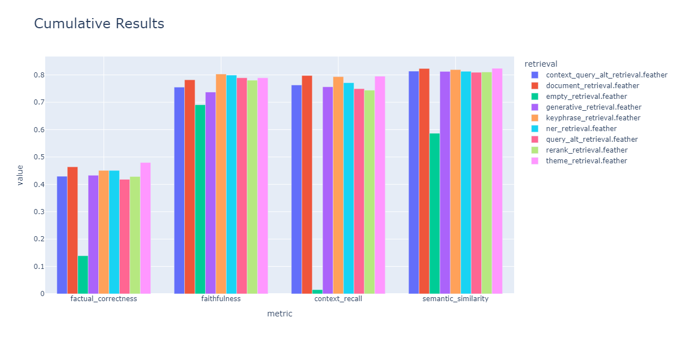
RESULTS
Notes:
Utilization of E-Infra Infrastructure
Free API for metacentrum users. Multiple LLMs for selection
earlier tests on T4 GPU - not these results
sentence-transformers/all-MiniLM-L6-v2
meta-llama/Llama-3.2-3B

Slide 15
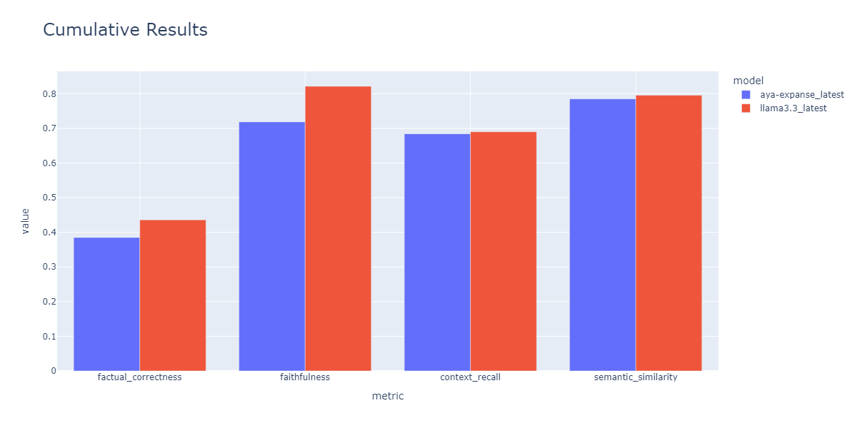
RESULTS

Slide 16
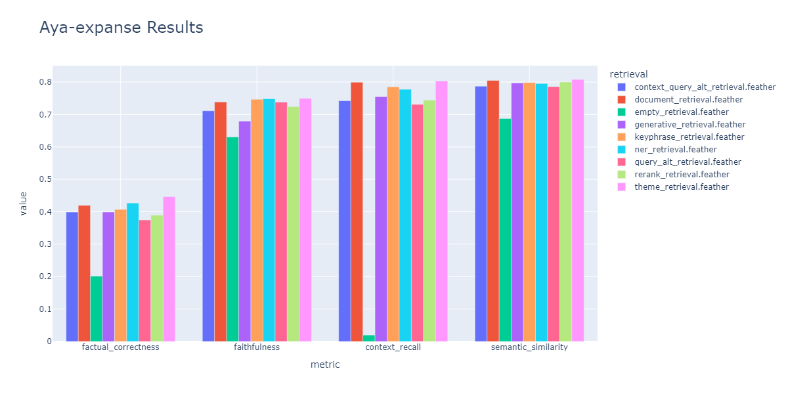
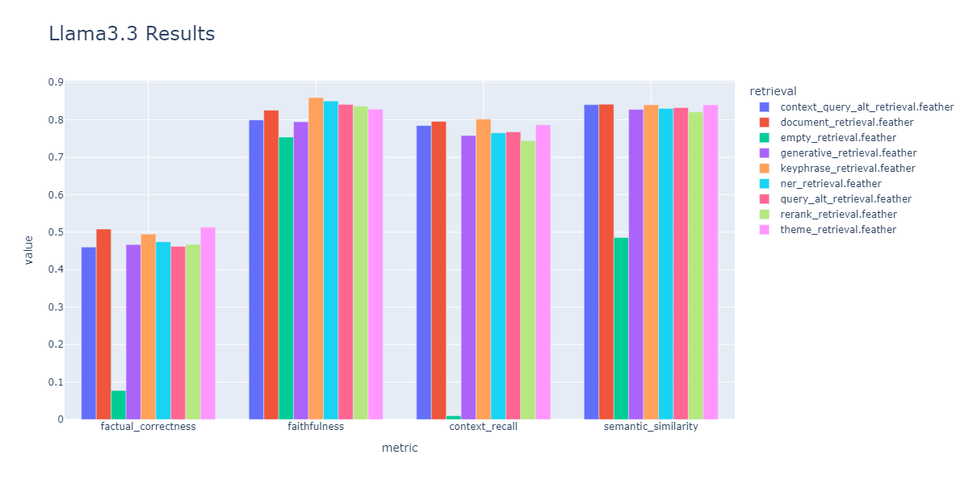
RESULTS
Llama3.3 better across all metrics using any retrieval

Slide 17
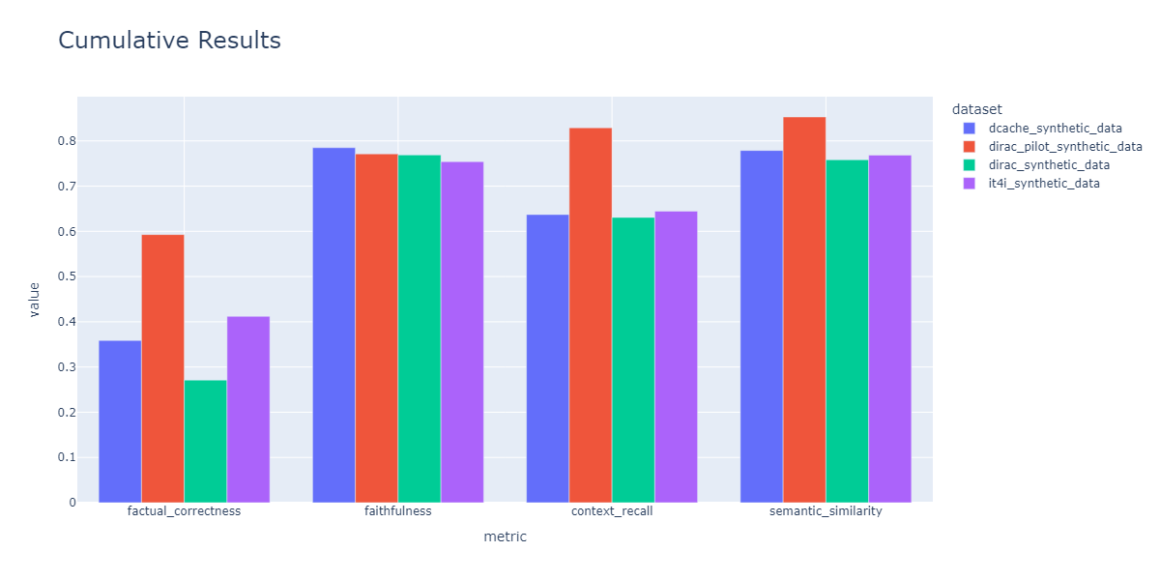
RESULTS

Slide 18
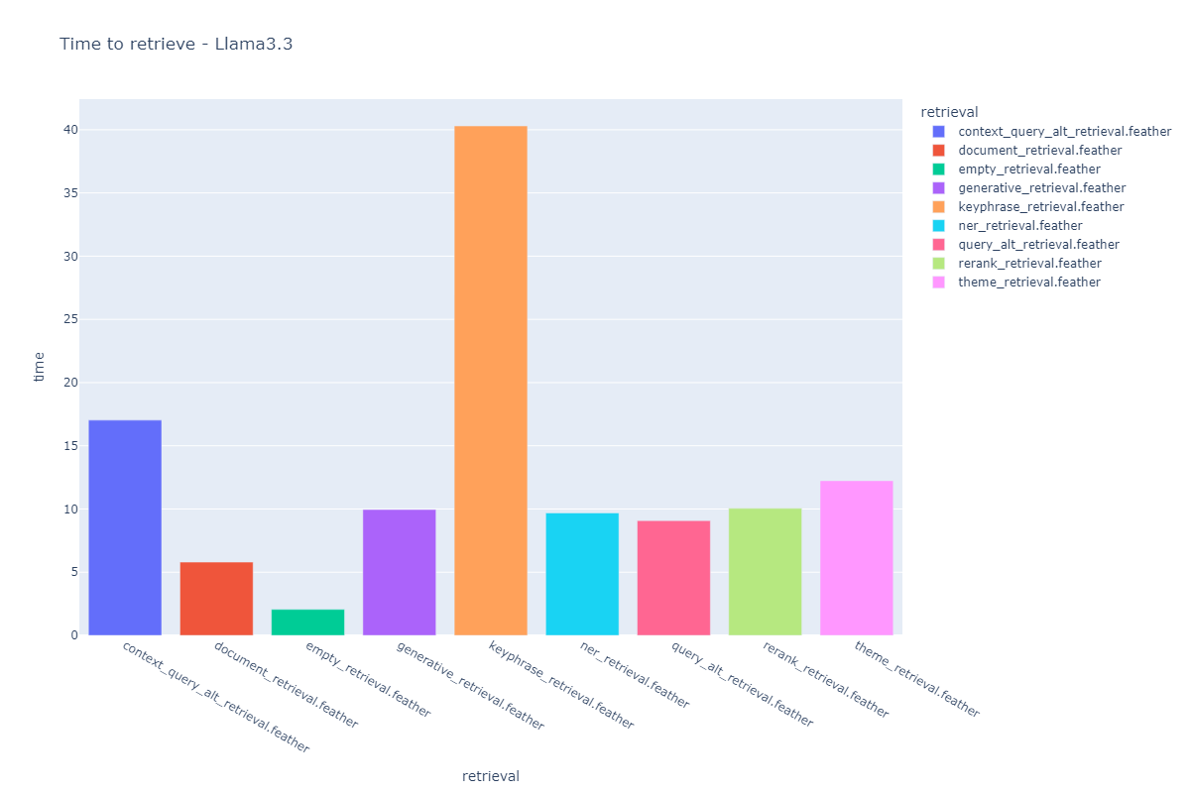
RESULTS
Retrievals have different complexity. Measured Time to retrieve – Llama3.3
Notes:
hw: A100, average for two tested LLMs

Slide 19
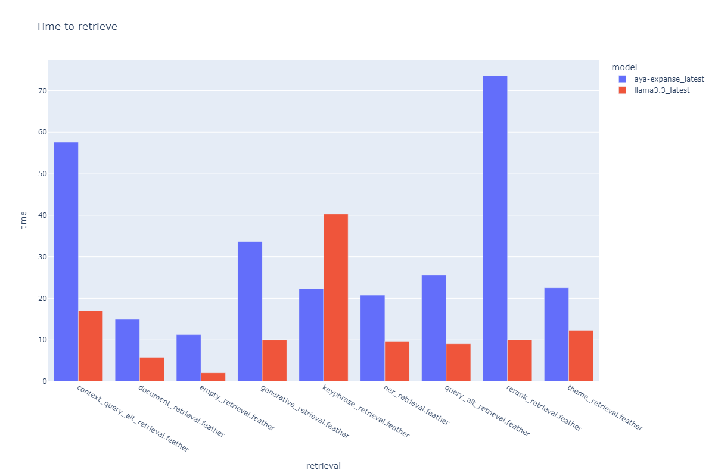
RESULTS
Models may struggle with tasks in retrievals
Notes:
hw: A100, average for two tested LLMs, used model running on CERIT-SC hw

Slide 20
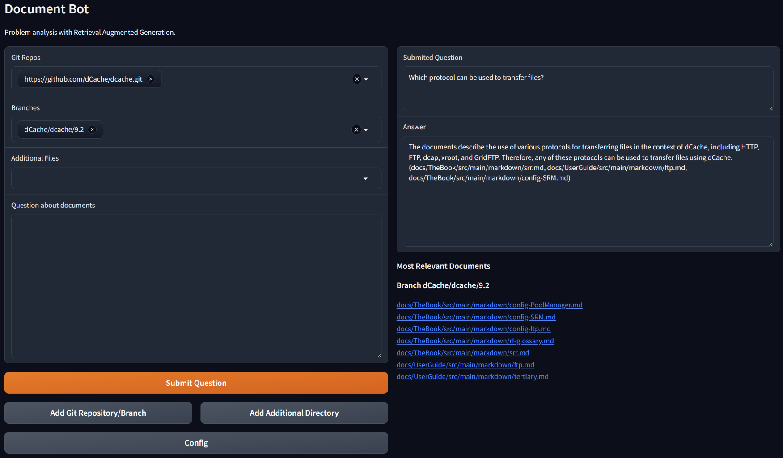
EXAMPLES

Slide 21

EXAMPLES

Slide 22
EXAMPLES

Slide 23
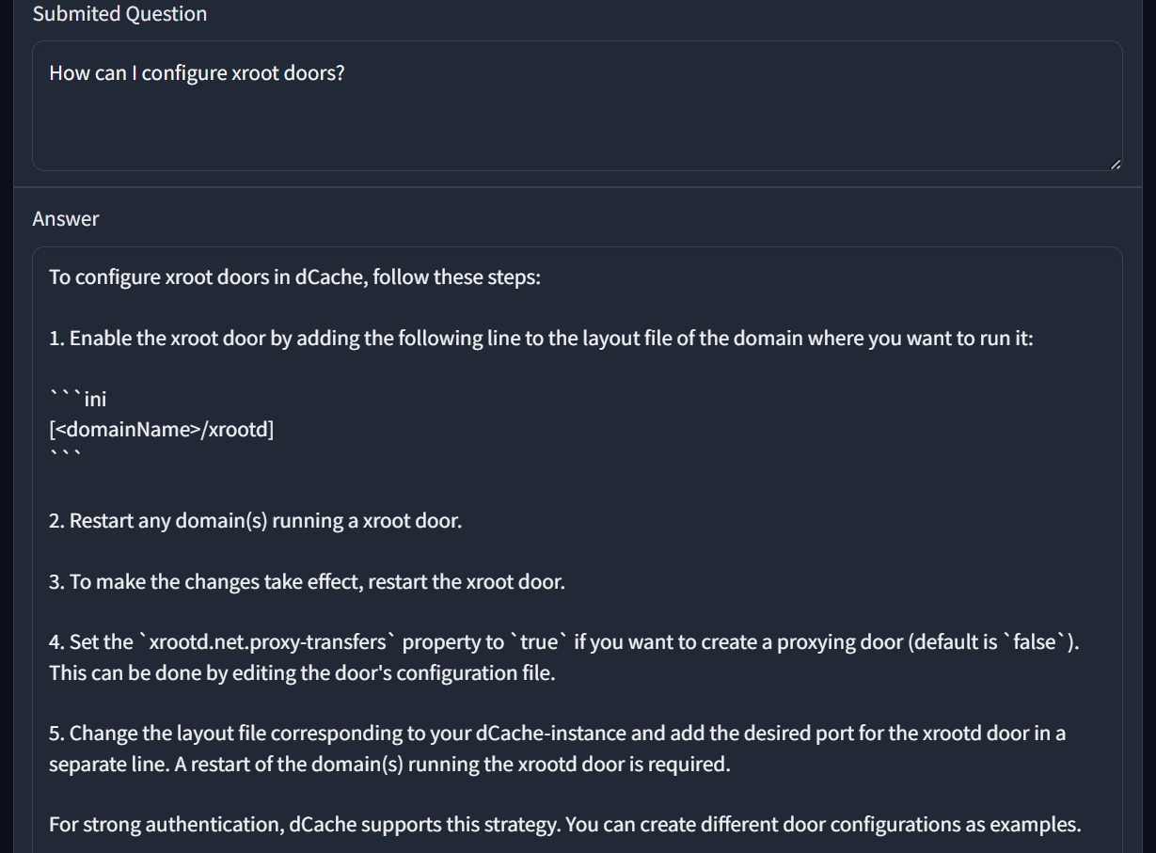
EXAMPLES

Slide 24
CONFIGURATION

Slide 25
CONFIGURATION

Slide 26
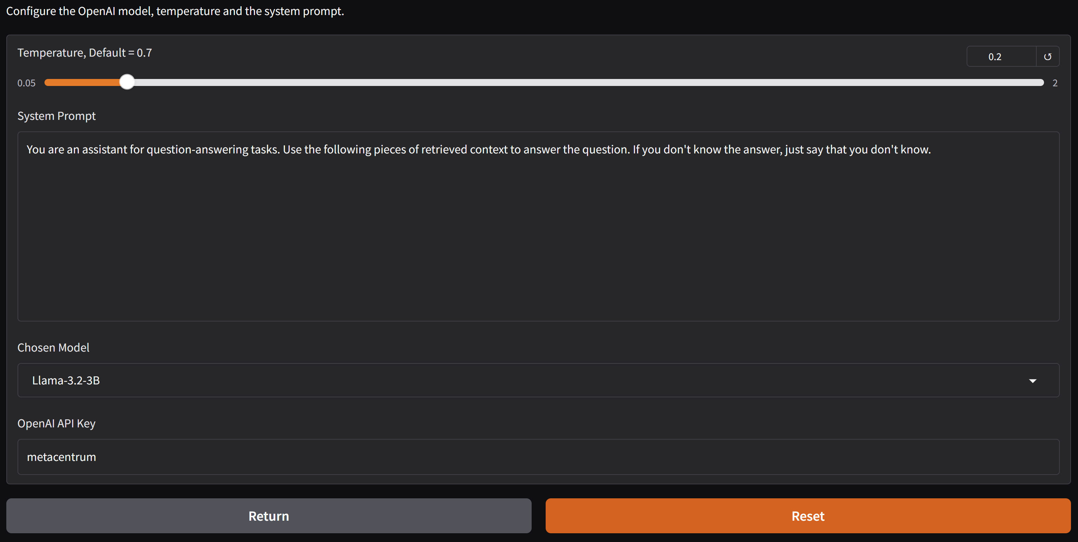
CONFIGURATION

Slide 27
SUMMARY

Slide 28
SUMMARY
Publicly available software for user support
  https://github.com/jinymusim/Docu-Bot/
  Demo: http://147.251.245.252:7860/
Private documentation can be added without sharing it publicly
Dedicated LLM instance quite costly
  API based access looks as most promising
  Shared model running in CERIT-SC used for these tests

Slide 29
BACKUP SLIDES

Slide 30
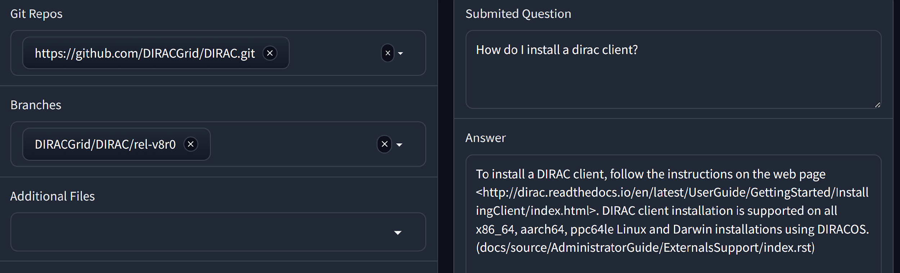
MORE EXAMPLES

Slide 31
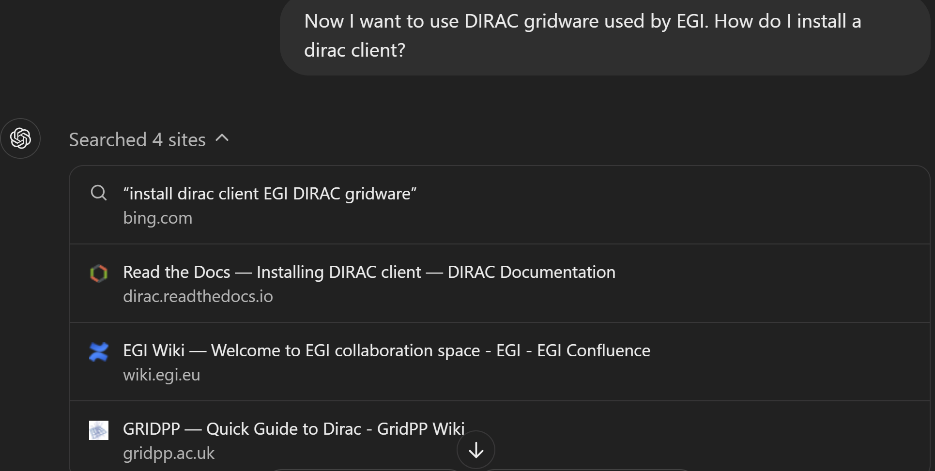
MORE EXAMPLES

