Slide 1
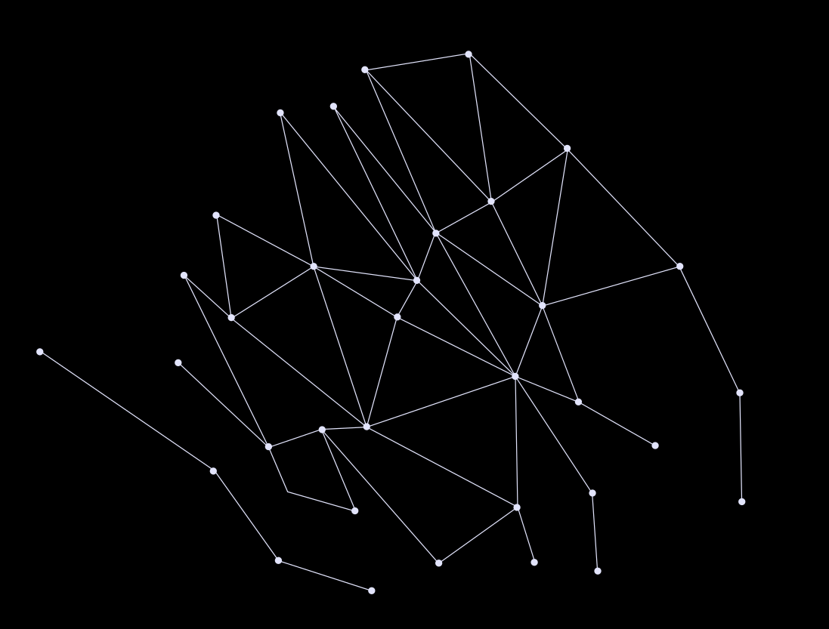


Comparative Analysis of Pretrained Language Models for Chemical Toxicity Prediction
Yueh-Hsi Chung¹, Chun-Wei Tung², Yung-Chun Chang³⁴*​
¹Department of Industrial Education, NationalTaiwan Normal University,Taipei, Taiwan
²Institute of Biotechnology and Pharmaceutical Research, National Health Research, Taipei, Taiwan
³Graduate Institute of Data Science, Taipei Medical University
⁴Clinical Big Data Research Center, Taipei Medical University Hospital, Taipei, Taiwan

Slide 2

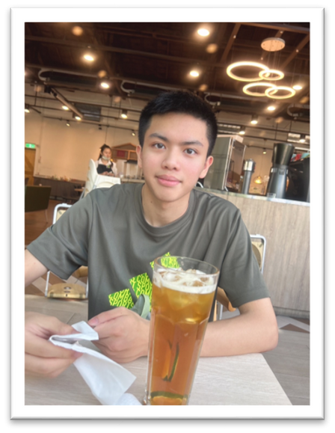

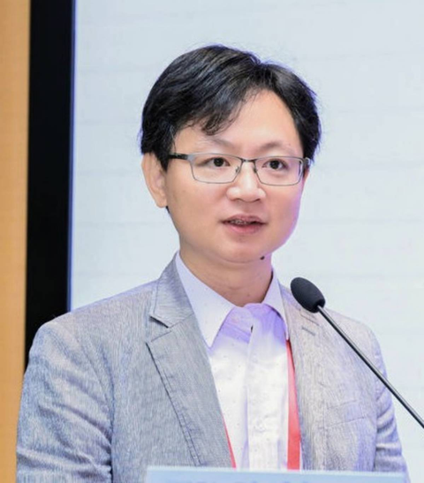
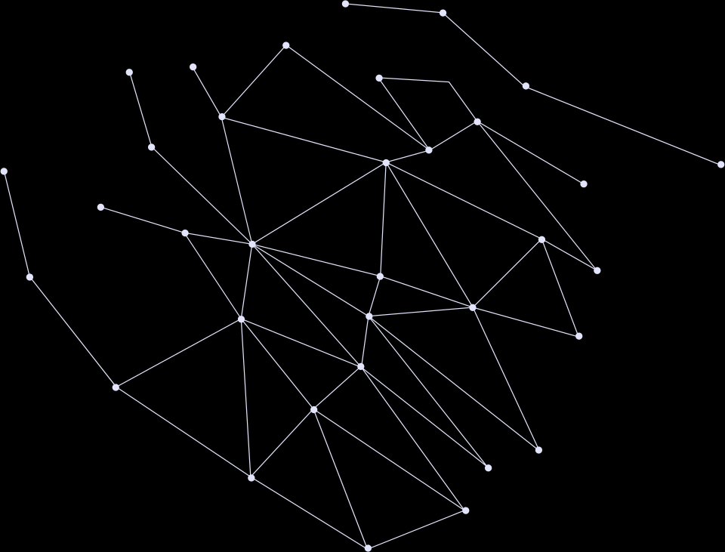
Authors
Yueh-Hsi Chung
First Grade in National Taiwan Normal University​
TMU Data Science M.S. Student
Chun-Wei Tung ​
Institute of Biotechnology and Pharmaceutical Research
Investigator
Yung-Chun Chang ​
TMU Data Science​
Professor

Slide 3

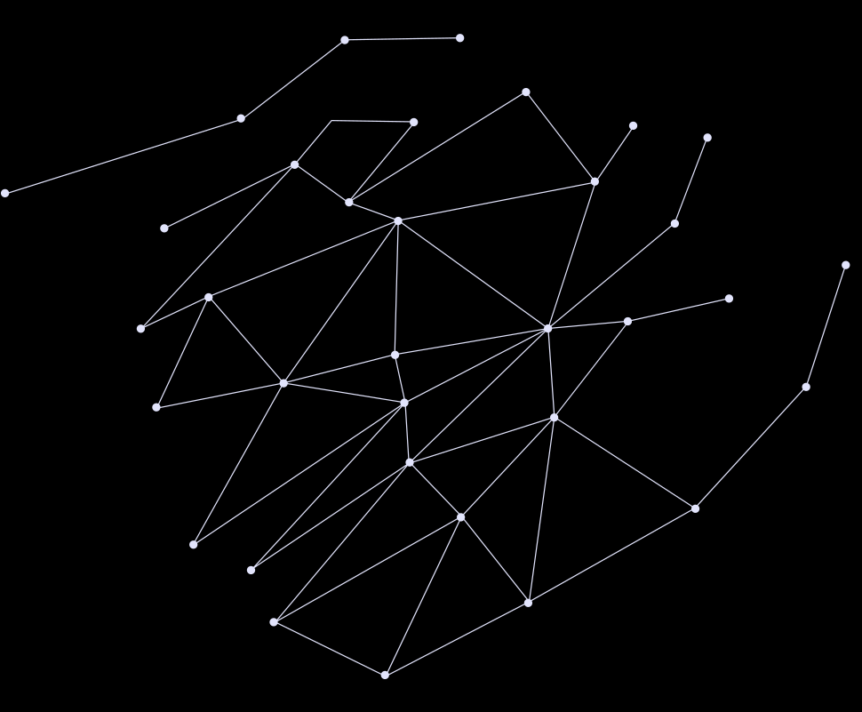
Table of contents
  Introduction
  Materials and Datasets
  Methods
  Experiment
  Results and Discussion
  Conclusion
  Future Directions
  Reference

Slide 4
Introduction

Slide 5
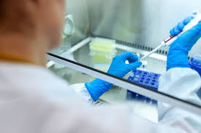


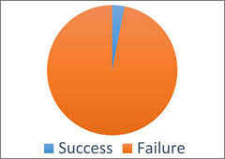
Motivation and Background
Costly Drug Development
High Failure Rates
costs exceeding $1.5B per compound
>90% failure rate
30% due to safety issues

Slide 6
Why Machine Leanring?
  Analyzing structure-activity relationships between chemical compounds and their biological effects
  SMILES: encoded molecular structure supported
  Scalability with large datasets.

Slide 7
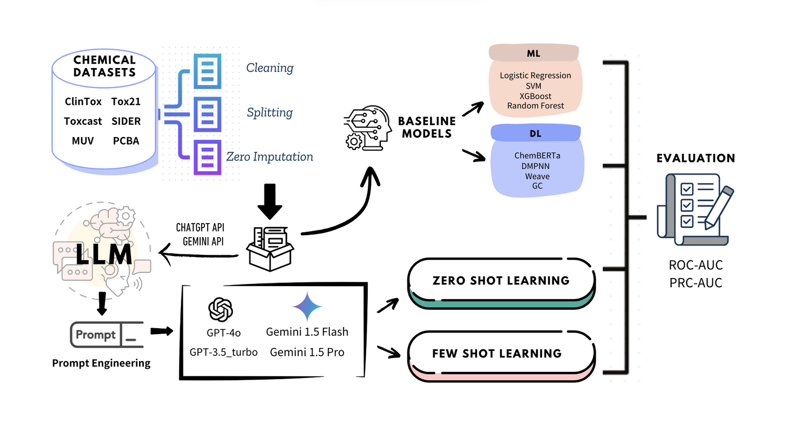
Objects
  Evaluate the performance of LLMs on SMILES-based compound toxicity prediction and chemical molecular activity

Slide 8


Why LLMs ?
  Strengths in processing textual data
  Well-suited to decode the sequential patterns and contextual information in SMILES representations
  Capture both local structural details (e.g., specific bonds and functional groups)

Slide 9
Materials and Datasets

Slide 10
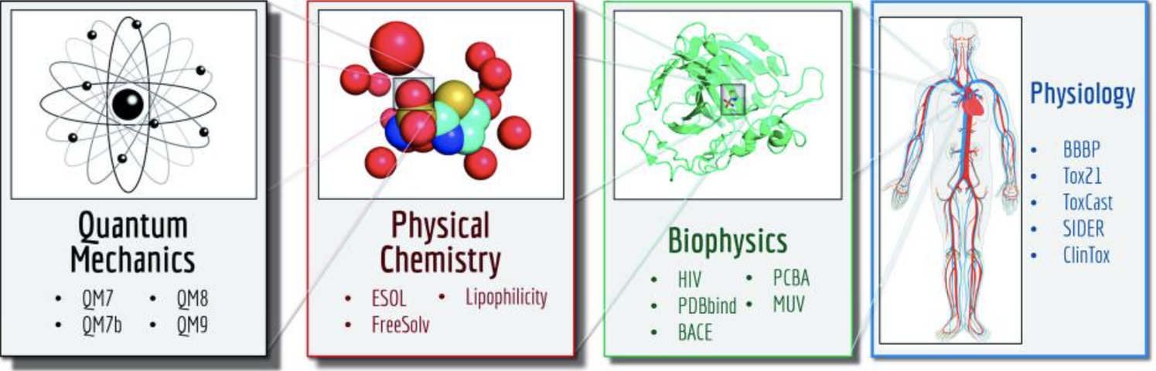
MoleculeNet Datasets
  A benchmark specifically designed for testing machine learning
  700,000 compounds evaluated for diverse molecular properties
  Includes chemical compound’s toxicity prediction and molecular activity

Slide 11
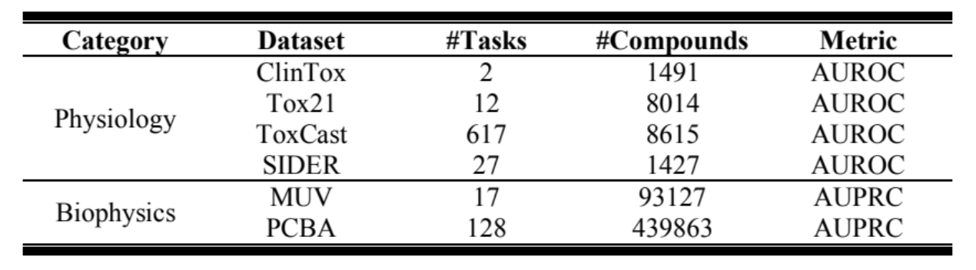
Datasets We Used
  Chose datasets related to chemical compound’s toxicity and molecular activity
  Dataset Names: Clintox, Tox21, ToxCast, SIDER, MUV, PCBA
  Datasets Distribution and Details

Slide 12
Datasets We Used (1/6)
  Clinical Toxicity ( ClinTox ):
    1,491 FDA-approved drugs with toxicity
    Differentiating FDA-approved drugs from those that failed due to toxicity.

Slide 13
Datasets We Used (2-3/6)
  Toxicology in the 21st Century (Tox21):
    8014 toxic chemicals
    multi-task learning and high-throughput screening
  Toxicity Forecaster ( ToxCast ):
    8,615 compounds
    A complementary resource to the Tox21, shares about 96% of chemical entries.

Slide 14
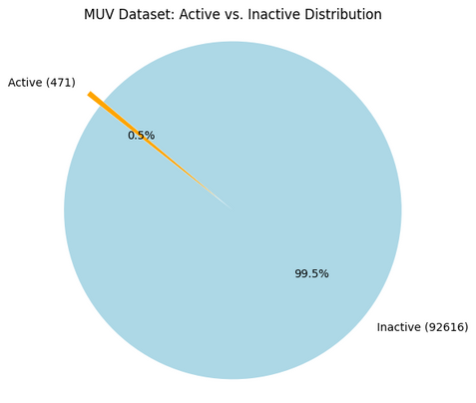
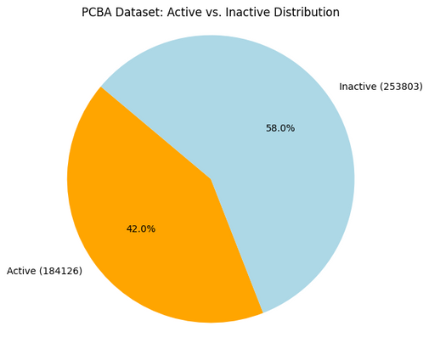
Datasets We Used (4-6/6)
  The Side Effect Resource (SIDER):
    1,427 marketed drugs
  Maximum Unbiased Validation (MUV):
    93,127 compounds from PubChem bioactivity data
  PubChem BioAssay (PCBA):
    130 million bioactivity outcomes
    These datasets test model performance on imbalanced data.

Slide 15
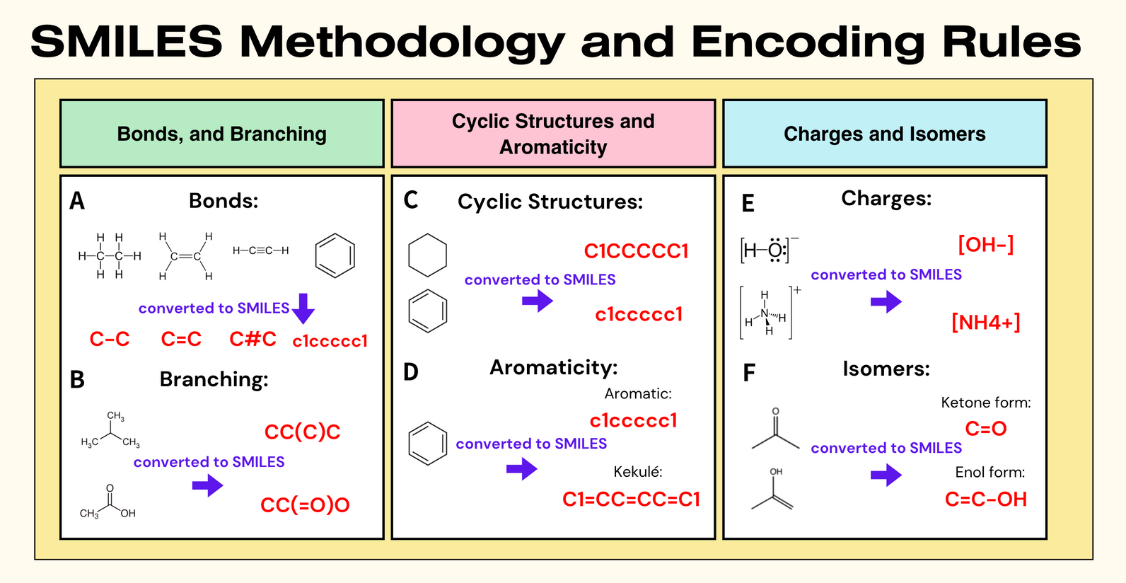
SMILES Representation
  Simplified Molecular Input Line Entry System
  Linear notation for representing chemical structures

Slide 16
Methods

Slide 17
Overview of Models
  Traditional Machine Learning Models:
    Logistic Regression, SVM
  Deep Learning Models:
    XGB, RF, IRV, MNN, BMN, GCN, WM, DMPNN, ChemBERTa
  Large Language Models:
    GPT-3.5 Turbo, GPT-4o, Gemini 1.5 Flash, and Gemini 1.5 Pro

Slide 18
LLM-based Approach: Tokenization
  Tokenization of SMILES strings:
    Byte-Pair Encoding (BPE):
      Break text into individual character and see them as basic token.
      Find most frequent pair of adjacent characters.
      Merge frequent pair into a new token iteratively.

Slide 19
Experiment

Slide 20
Experimental Setups
  Software Frameworks:
    PyTorch
    Hugging Face Transformers
  Hardware
    NVIDIA A100 Tensor Core GPU (80GB HBM2e)
    (Thanks ASGC for supporting us the computing power)

Slide 21
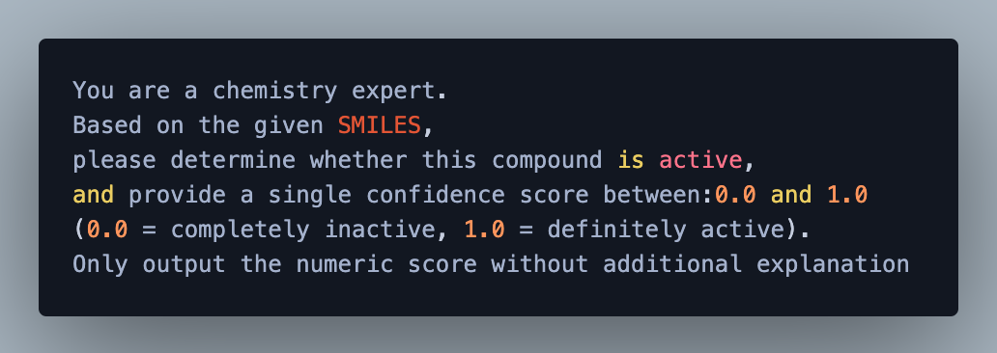
Example Prompt for LLMs
  Role Assignment
  Task Description
  Output Format

Slide 22
Results and
Discussion

Slide 23
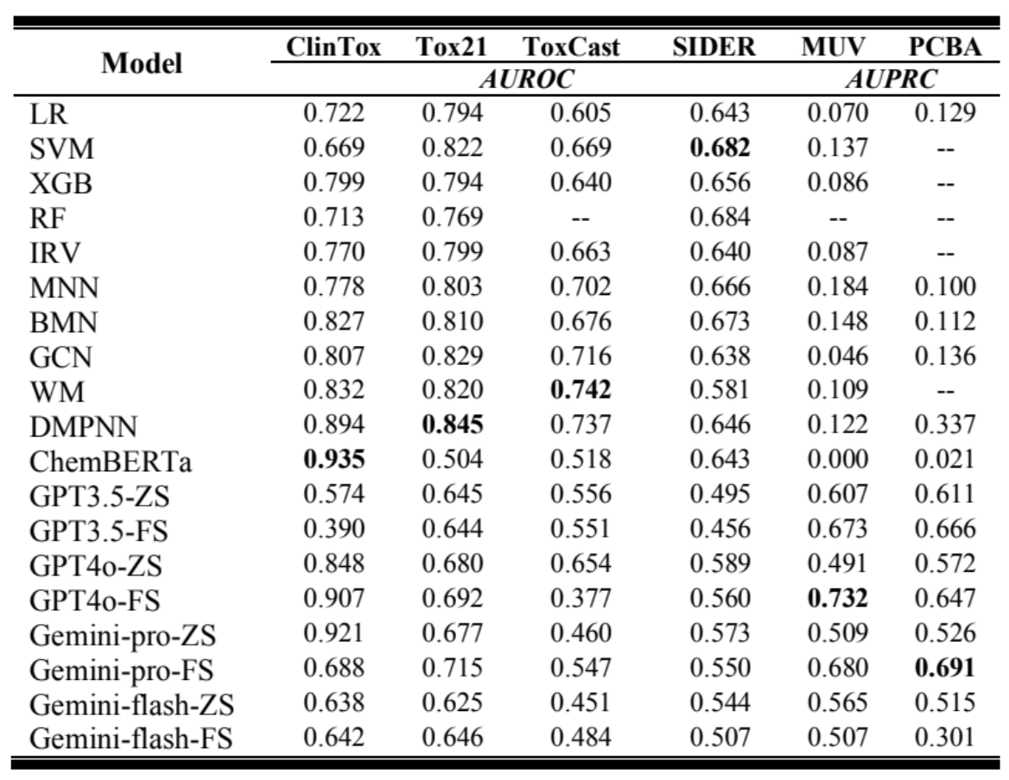

Results
Traditional ML Models
Deep Learning Models
LLMs Models

Slide 24
Discussion (1/2)
  Baseline and Limitations of Traditional Models:
    LR and SVM provide a performance baseline, but struggle with imbalanced datasets like MUV and PCBA.
  Improvements with Deep Learning Models:
    DMPNN and ChemBERTa show improvements over traditional methods, but their effectiveness can vary across different datasets.

Slide 25
Discussion (2/2)
  Adaptive Capability of Few-Shot Learning:
    With minimal labeled data, these LLMs can significantly enhance predictive accuracy.
    Highlighting their transformative potential in drug discovery and cheminformatics tasks.
  Essential Specification of Confidence Levels in Prompt Engineering
    Or else LLMs will give a binary answer which won’t be able to evaluate their AUROC and AUPRC.

Slide 26
Conclusion

Slide 27
Conclusion
  Superior Performance of LLMs:
    GPT-4o and Gemini-1.5 Pro ability to leverage minimal labeled data in few-shot settings underscores their effectiveness in addressing challenges like molecular complexity and dataset imbalance (MUV & PCBA).
  Transformative Impact of Few-Shot Learning:
    Utilizing limited labeled examples, it enhances precision, recall in imbalanced scenarios, reduces the need for extensive domain-specific fine-tuning.

Slide 28
Future Directions

Slide 29
Future Direction
  Hybrid Modeling Opportunity:
    Future research could integrate graph-based methods with transformer-based LLMs to develop hybrid models that further enhance predictive capabilities in cheminformatics.
  Broader Adoption and Transformation:
    The study paves the way for broader adoption of LLMs in molecular science, highlighting their potential to predictive modeling.

Slide 30
Reference (1/3)
  Dickson, M., & Gagnon, J. (2004). Key factors in the rising cost of new drug discovery and development. Nat Rev Drug Discov, 3, 417–429.
  Calcoen, D., Elias, L., & Yu, X. (2015). What does it take to produce a breakthrough drug? Nat Rev Drug Discov, 14, 161–162.
  Paul, S., Mytelka, D., Dunwiddie, C., et al. (2010). How to improve R&D productivity: the pharmaceutical industry's grand challenge. Nat Rev Drug Discov, 9, 203–214.
  Giri, S., & Bader, A. (2015). A low‐cost, high‐quality new drug discovery process using patient‐derived induced pluripotent stem cells. Drug Discovery Today, 20(1), 37–49.
  Scannell, J., Blanckley, A., Boldon, H., et al. (2012). Diagnosing the decline in pharmaceutical R&D efficiency. Nat Rev Drug Discov, 11, 191–200.
  Marrer, E., & Dieterle, F. (2010). Impact of biomarker development on drug safety assessment. Toxicology and Applied Pharmacology, 243(2), 167–179.
  Li, A. P. (2004). A comprehensive approach for drug safety assessment. Chemico-biological Interactions, 150(1), 27–33.
  Lo, Y. C., Rensi, S. E., Tong, W., & Altman, R. B. (2018). Machine learning in cheminformatics and drug discovery. Drug Discovery Today, 23(8), 1538–1546.
  Wigh, D. S., Goodman, J. M., & Lapkin, A. A. (2022). A review of molecular representation in the age of machine learning. Wiley Interdisciplinary Reviews: Computational Molecular Science, 12(5), e1603.
  Unterthiner, T., Mayr, A., Klambauer, G., & Hochreiter, S. (2015). Toxicity prediction using deep learning. arXiv preprint arXiv:1503.01445.
  Chithrananda, S., Grand, G., & Ramsundar, B. (2020). ChemBERTa: large-scale self-supervised pretraining for molecular property prediction. arXiv preprint arXiv:2010.09885.
  Weininger, D. (1988). SMILES, a chemical language and information system. 1. Introduction to methodology and encoding rules. Journal of Chemical Information and Computer Sciences, 28(1), 31–36.

Slide 31
Reference (2/3)
  Sivarajkumar, S., Kelley, M., Samolyk-Mazzanti, A., Visweswaran, S., & Wang, Y. (2024). An empirical evaluation of prompting strategies for large language models in zero-shot clinical natural language processing: algorithm development and validation study. JMIR Medical Informatics, 12, e55318.
  Costa, D., Dias, J., Nakano, C., & Monteiro, M. L. (2023). Assessing the Statistical Abilities of GPT-4 as a Zero-shot Reasoner: Strengths and Weaknesses.
  Yang, K., Swanson, K., Jin, W., Coley, C., Eiden, P., Gao, H., ... & Barzilay, R. (2019). Analyzing learned molecular representations for property prediction. Journal of Chemical Information and Modeling, 59(8), 3370–3388.
  Wu, Z., Ramsundar, B., Feinberg, E. N., Gomes, J., Geniesse, C., Pappu, A. S., ... & Pande, V. (2018). MoleculeNet: a benchmark for molecular machine learning. Chemical Science, 9(2), 513–530.
  Gayvert, K. M., Madhukar, N. S., & Elemento, O. (2016). A Data-Driven Approach to Predicting Successes and Failures of Clinical Trials. Cell Chem Biol, 23(10), 1294–1301. doi:10.1016/j.chembiol.2016.07.023
  Idakwo, G., Thangapandian, S., Luttrell, J., Li, Y., Wang, N., Zhou, Z., ... & Gong, P. (2020). Structure–activity relationship-based chemical classification of highly imbalanced Tox21 datasets. Journal of Cheminformatics, 12, 1–19.
  Richard, A. M., Judson, R. S., Houck, K. A., Grulke, C. M., Volarath, P., Thillainadarajah, I., ... & Thomas, R. S. (2016). ToxCast chemical landscape: paving the road to 21st century toxicology. Chemical Research in Toxicology, 29(8), 1225–1251.
  Altae-Tran, H., Ramsundar, B., Pappu, A. S., & Pande, V. (2017). Low data drug discovery with one-shot learning. ACS Central Science, 3(4), 283–293.
  Rohrer, S. G., & Baumann, K. (2009). Maximum unbiased validation (MUV) data sets for virtual screening based on PubChem bioactivity data. Journal of Chemical Information and Modeling, 49(2), 169–184.
  Wang, Y., Xiao, J., Suzek, T. O., Zhang, J., Wang, J., Zhou, Z., Han, L., Karapetyan, K., Dracheva, S., Shoemaker, B. A., Bolton, E., Gindulyte, A., & Bryant, S. H. (2012). PubChem's BioAssay Database. Nucleic Acids Research, 40(Database issue), D400–D412. doi:10.1093/nar/gkr1132
  Romanelli, V., Annunziata, D., Cerchia, C., Cerciello, D., Piccialli, F., & Lavecchia, A. (2024). Enhancing De Novo Drug Design across Multiple Therapeutic Targets with CVAE Generative Models. ACS Omega, 9(43), 43963–43976.
  Lin, C. F. (2004). Training algorithms for fuzzy support vector machines with noisy data. Pattern Recognition Letters, 25(14), 1647–1656.

Slide 32
Reference (3/3)
  Friedman, J. H. (2001). Greedy function approximation: a gradient boosting machine. Annals of Statistics, 1189–1232.
  Breiman, L. (2001). Random forests. Machine Learning, 45, 5–32.
  Swamidass, S. J., Azencott, C. A., Lin, T. W., Gramajo, H., Tsai, S. C., & Baldi, P. (2009). Influence relevance voting: an accurate and interpretable virtual high throughput screening method. Journal of Chemical Information and Modeling, 49(4), 756–766. doi:10.1021/ci8004379
  Ramsundar, B., Kearnes, S., Riley, P., Webster, D., Konerding, D., & Pande, V. (2015). Massively multitask networks for drug discovery. arXiv preprint arXiv:1502.02072.
  Ramsundar, B., Liu, B., Wu, Z., Verras, A., Tudor, M., Sheridan, R. P., & Pande, V. (2017). Is multitask deep learning practical for pharma? Journal of Chemical Information and Modeling, 57(8), 2068–2076.
  Duvenaud, D. K., Maclaurin, D., Iparraguirre, J., Bombarell, R., Hirzel, T., Aspuru-Guzik, A., & Adams, R. P. (2015). Convolutional networks on graphs for learning molecular fingerprints. In Advances in Neural Information Processing Systems, 28.
  Kearnes, S., McCloskey, K., Berndl, M., Pande, V., & Riley, P. (2016). Molecular graph convolutions: moving beyond fingerprints. Journal of Computer-Aided Molecular Design, 30, 595–608.
  Shibata, Y., Kida, T., Fukamachi, S., Takeda, M., Shinohara, A., Shinohara, T., & Arikawa, S. (1999). Byte pair encoding: A text compression scheme that accelerates pattern matching.
  Qian, C., Tang, H., Yang, Z., Liang, H., & Liu, Y. (2023). Can large language models empower molecular property prediction? arXiv preprint arXiv:2307.07443.
  Brown, T., Mann, B., Ryder, N., Subbiah, M., Kaplan, J. D., Dhariwal, P., ... & Amodei, D. (2020). Language models are few-shot learners. Advances in Neural Information Processing Systems, 33, 1877–1901.
  Gao, S., Fang, A., Huang, Y., Giunchiglia, V., Noori, A., Schwarz, J. R., ... & Zitnik, M. (2024). Empowering biomedical discovery with AI agents. Cell, 187(22), 6125–6151.
  Wolf, T. (2020). Transformers: State-of-the-Art Natural Language Processing. arXiv preprint arXiv:1910.03771.

Slide 33
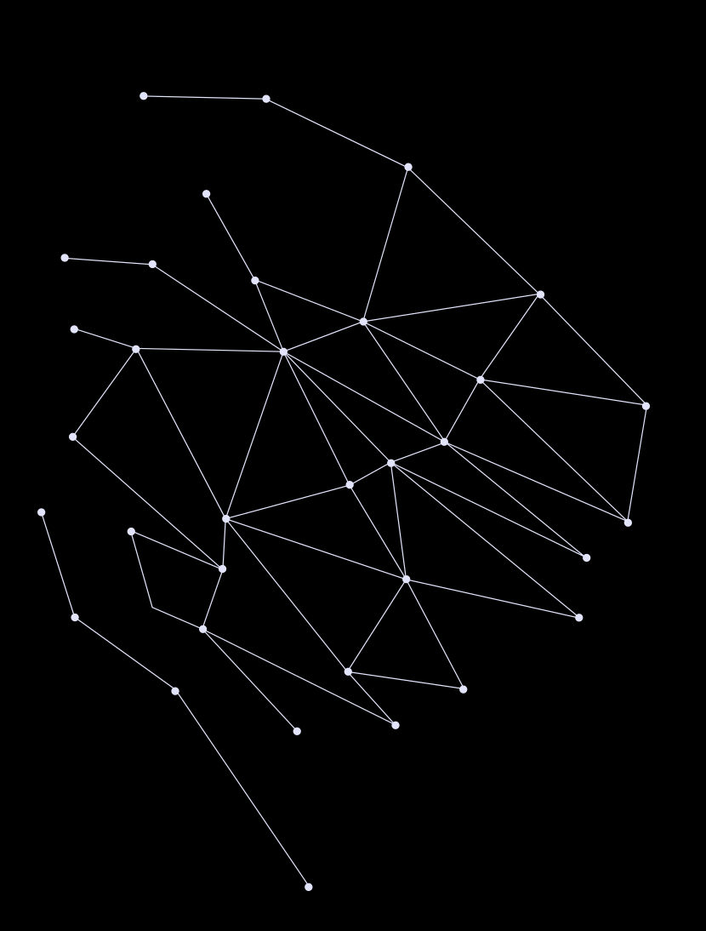
Thank You !!!

