Slide 1
e-Sciences Activities - an Australian perspective
19 March 2025
The International Symposium on Grids & Clouds
(ISGC) 2025
Ben Chiu
Director, Services
ARDC, Melbourne, Australia
Notes:
Image credits clockwise:
Mario Purisic - jG1z5o7NCq4 / unsplash.com
Janifest – 379768765 / adobestock.com
Gorodenkoff - 236237514 / adobestock.com
Hero Images - 316159695 / adobestock.com
themorningglory - 391783296 / adobestock.com
Gorodenkoff - 402341966 / adobestock.com
Marc Grimwade / ARDC

Slide 2
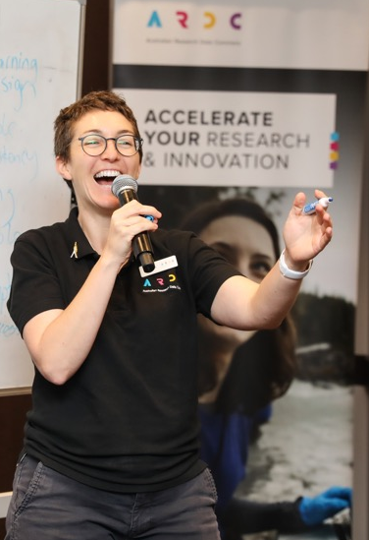



About the ARDC
The ARDC is Australia’s leading research data infrastructure facility.
Our Purpose
To provide Australian researchers with competitive advantage through data.
Our Mission
To accelerate research and innovation by driving excellence in the creation, analysis and retention of high‑quality data assets.
Notes:
ABOUT THE ARDC
The ARDC is Australia’s leading research data infrastructure facility.
The ARDC is enabled by the Australian Government’s National Collaborative Research Infrastructure Strategy (NCRIS).
OUR PURPOSE is to provide Australian researchers with competitive advantage through data.
OUR MISSION is to accelerate research and innovation by driving excellence in the creation, analysis and retention of high‐quality data assets.
Images Clockwise
Liz Stokes, ARDC, presenting at the ARDC Skills Summit - Renee Nowytarger / ARDC
Grant Sarra, facilitator, and Uncle Michael Williams, former head of the Aboriginal and Torres Strait Islander Studies unit at The University of Queensland, at the event, Bringing Data to Life: Co-Designing a Language Data Commons - Marc Grimwade / ARDC
Dr Paul Coddington and Darcelle Malby, ARDC, with partners from the ARDC Nectar Research Cloud nodes - Marc Grimwade /ARDC
Associate Professor Sandra Philips, Western Sydney University, at the event, Bringing Data to Life: Co‑Designing a Language Data Commons - Marc Grimwade / ARDC

Slide 3
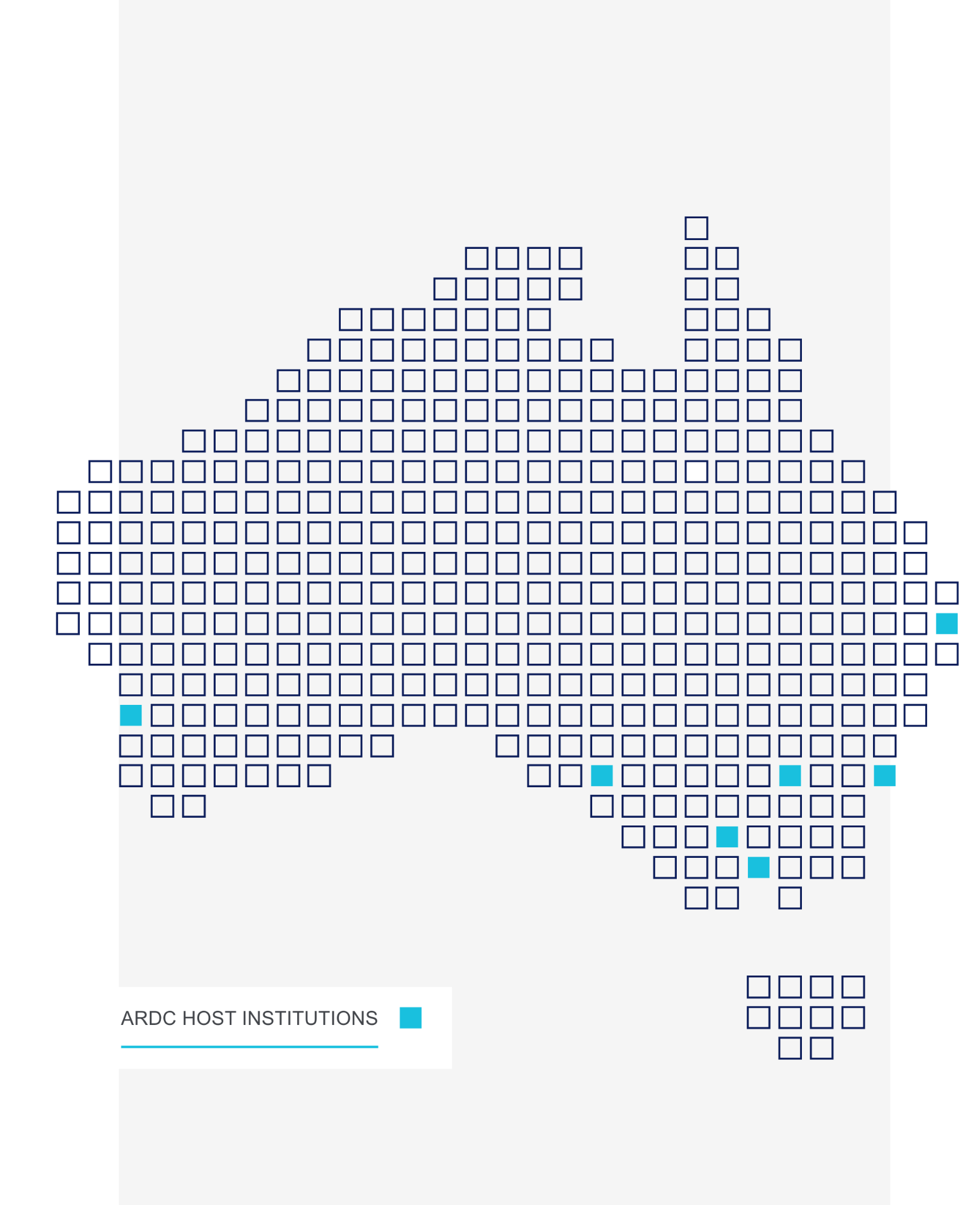

Members
Notes:
ARDC HOST INSTITUTIONS and MEMBERS
The ARDC has over 90 staff embedded at host institutions around Australia, including:
Australian National University
CSIRO
Curtin University
Federation University (our first Regional university host)
Monash University
The University of Adelaide
The University of Melbourne
The University of Queensland
University of Technology Sydney
UNSW Sydney
ARDC also has 28 member institutions, including universities and medical research institutes.
ARDC members:
participate in the development of Australia’s digital research infrastructure
help shape the ARDC’s emphasis and activities
are recognised as a champion of good research data management
attend and vote at Annual General Meetings.
The ARDC welcomes membership applications from Australian universities and research data-generating organisations.
If you don’t see your institution on this list, get in touch to see how you can become a member (NB. the Director, Outreach, ARDC manages memberships)

Slide 4


























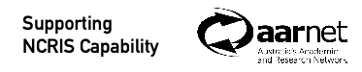
Australian Centre for Disease Preparedness
Australian Centre for Neutron Scattering
Centre for Accelerator Science
National Deuteration Facility
Notes:
NCRIS NATIONAL RESEARCH INFRASTRUCTURE - SUPPORTING AUSTRALIAN RESEARCH
The ARDC is enabled by the Australian Government’s National Collaborative Research Infrastructure Strategy (NCRIS), which is a unique program that has been running since 2006 and is the envy of the research community in the rest of the world.
The National Collaborative Research Infrastructure Strategy (NCRIS) gives researchers access to equipment, data, services and expertise to enable world-leading research for the benefit of all Australians.
All facilities are established as partnerships with coinvestment from the Australian Government.
Building world class research infrastructure is challenging and no single organisation can do this alone, so partnerships and collaborations with universities and research institutes are critical for making this happen.
Cutting edge research requires cutting edge infrastructure to drive research and industry innovation.
The ARDC is one of 28 national research infrastructure capabilities enabled under this program.
To find out more about all of the national research infrastructure NCRIS services, visit Research Infrastructure Connected https://riconnected.org.au/
Background note: Most of the NCRIS capabilities have their own logo, except:
NDF (uses ANSTO logo + “Nuclear Deuteration Facility” underneath
NSF (uses ANSTO logo + “Australian Centre for Neutron Scattering” and “Centre for Accelerator Science”)
ACDP (uses CSIRO logo)

Slide 5
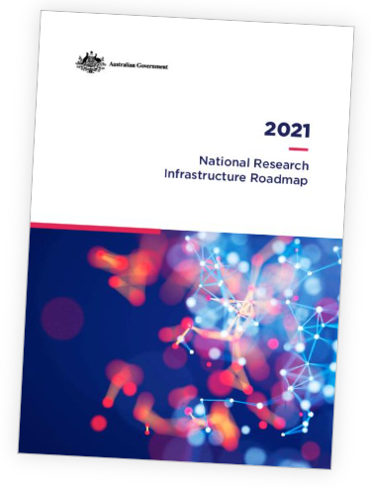
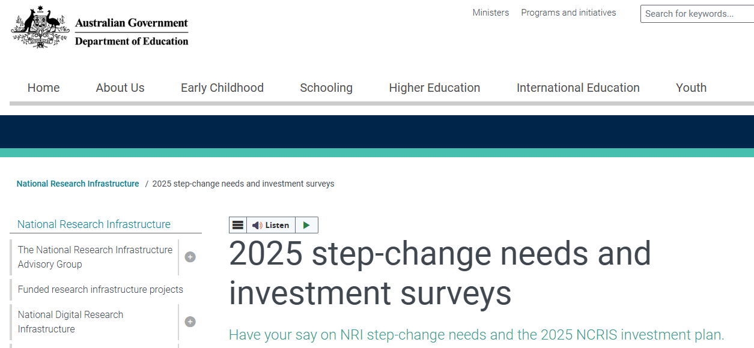
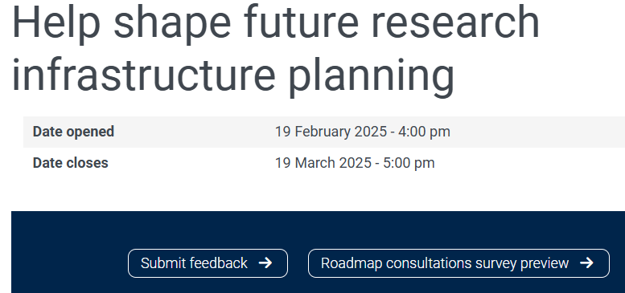


Slide 6
How the Australian Digital Nexus Alliance (DNA) is collaborating together
Outreach, Training, Support, Advice, Consultation, Policy
Access, Analysis, Curation Infrastructure
DNA Members
Integration
Analysis Tools
Visualisation Tools
AAF
Data Management Tools
Virtual Labs, Platforms, Portals
AARNet
National Information Infrastructure
ARDC
National Discovery
Identifiers
Terminologies
NCI/Pawsey
Data & Software Assets
Outside DNA
(e.g. commercial)
Underpinning Infrastructure
HPC/ HTC Infrastructure
Cloud Compute Infrastructure
Data Storage
& Retention Infrastructure
Network Infrastructure
Identity & Access

Slide 7
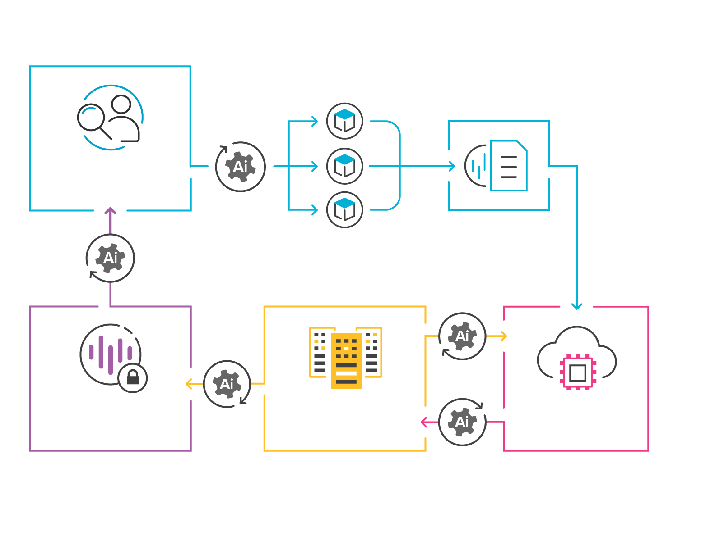
Collaboration & Convergence
MULTIDISCIPLINARY DATASETS
COMBINED, INTEGRATED DATASET
RESEARCHER
REQUEST
AUTONOMOUS AI AGENT
OUTPUTS
PROVIDED
SUPERCOMPUTER
ARDC NECTAR RESEARCH CLOUD
PROCESSING, ANALYSIS, MODELLING (CLOUD & HPC)
Notes:
Left image - text

Slide 8
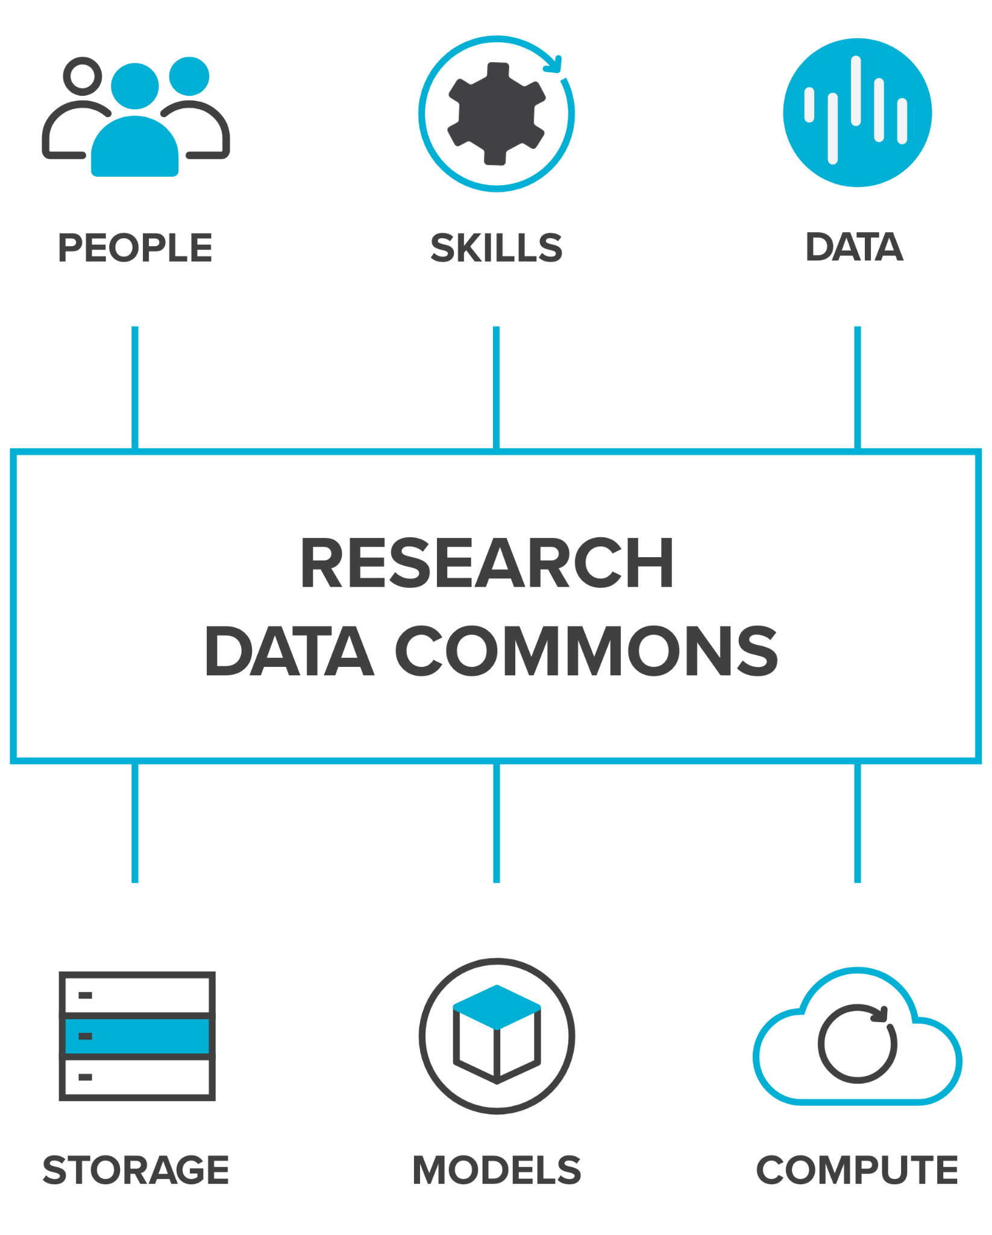
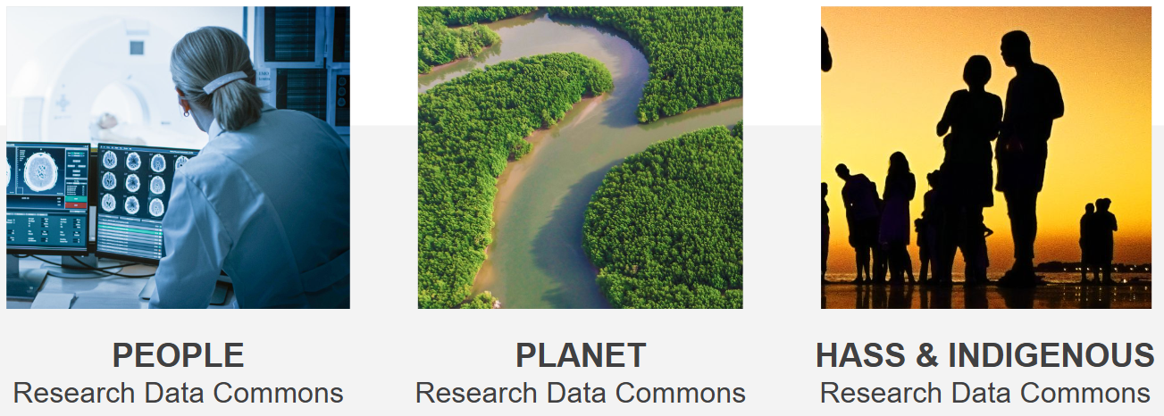
What is a Research Data Commons?
A research data commons brings together people, skills, data, and related resources such as storage, compute, software, and models to enable researchers to conduct world class data-intensive research.
Notes:
WHAT IS A RESEARCH DATA COMMONS?
A research data commons brings together people, skills, data, and related resources such as storage, compute, software, and models into one system.
By providing integrated resources and easy-to-use interfaces, it to enables researchers to speed up their existing research, and to undertake research that wasn’t possible before

Slide 9
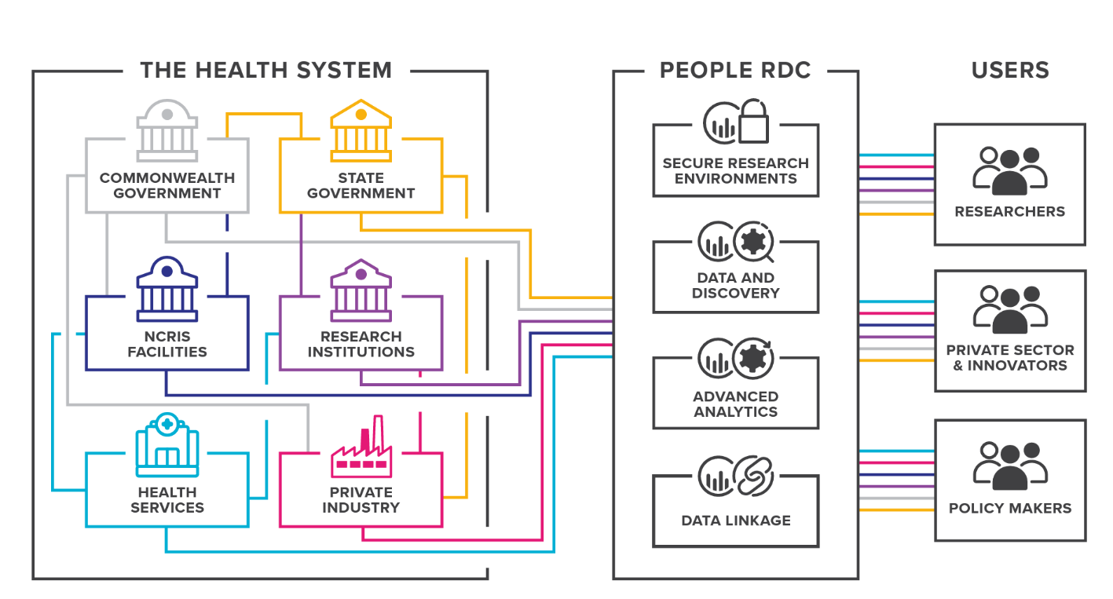
DATA INTEGRATION
Notes:
Researchers, innovators and policymakers seek to improve health outcomes for society, and yet the data and digital platforms they need span multiple layers of government, health service operations, health research studies, institutes, facilities and the private sector.
By establishing, promoting and deploying consistent approaches to these four focus areas, the People RDC will streamline and enable new types of health research.

Slide 10
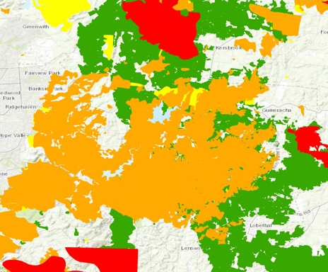
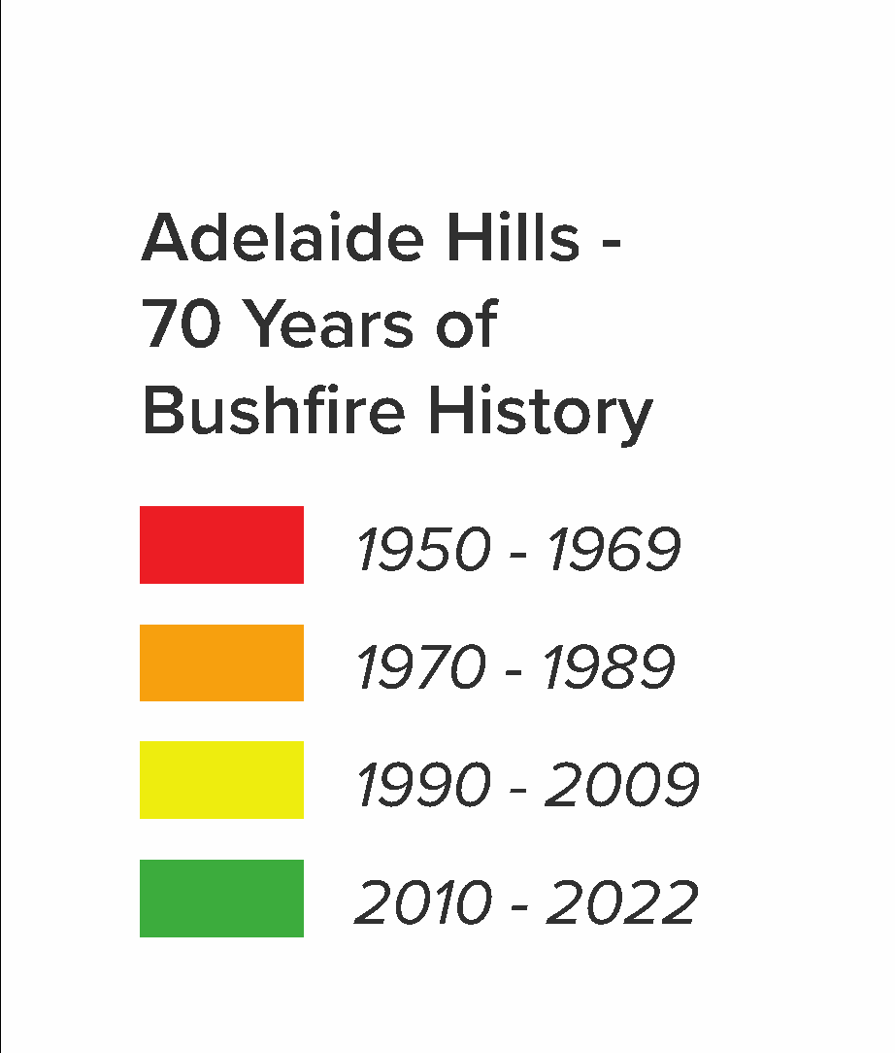
Bringing Together Bushfire History Data to Plan for the Future
Bushfire analysts and planners now have access to a national dataset of past fires, which will allow them to prepare a faster, more effective response.
Notes:
Case Study: https://ardc.edu.au/case-study/bringing-together-bushfire-history-data-to-plan-for-the-future
Impact Story summary: Bushfire analysts and planners now have access to a national dataset of past fires, which will allow them to prepare a faster, more effective response.
Full case study
Until recently, Australians could almost be forgiven for thinking bushfires stopped at state borders. That’s because the bushfire authorities of each state and territory gather their own data separately and have management responsibility only within their own boundaries. The media reports reflected that. Even the fire danger rating systems differed between states.
But the Black Summer fires of 2019–2020, which burned more than 240,000 square kilometres across multiple states and territories, clearly demonstrated the limitations of such an approach. A high level of information sharing and management between jurisdictions became a necessity.
Looking at that response and discussing needs with bushfire analysts, modellers and planners, the ARDC recognised the value of pulling together all the state/territory-based data into a harmonised, accessible national dataset documenting Australia’s bushfire history, said director of the Bushfire Data Challenges program Dr Sheida Hadavi. And the expertise to do so was available in the national bodies of Geoscience Australia and the Emergency Management Spatial Information Network Australia (EMSINA).
So, in 2021 the ARDC initiated, facilitated and invested in a $6 million program to deliver such a dataset, as well as alongside other data, tools and platforms for bushfire data. The bushfire history dataset was created using data from trusted state and territory agencies, who each contributed their own government database to Geoscience Australia through EMSINA. Geoscience Australia specialists then combined and standardised the data using advanced geospatial software.
The historical bushfire dataset documents fires from 1899 to 2022. It is available for anyone to access and use through the Digital Atlas of Australia, a new online geospatial platform being developed by Geoscience Australia. Currently in its beta phase, the atlas allows anyone to layer the historical bushfire data with other curated trusted national datasets on Australia’s geography, population, economy and environment. This integration will help unlock the full potential of the historical bushfire dataset, enabling a better understanding of collective challenges across borders and empowering proactive and informed decision making.
Bushfire Data That Goes Beyond Borders
The creation of the bushfire history dataset means that for the first time, researchers and emergency management professionals can look beyond borders to understand bushfire behaviour and plan accordingly.
“With how everything was set up before, you couldn’t really look beyond your own border,” said ACT Rural Fire Service fire behaviour analyst and modeller Ailish Milner. “But as ACT fire planners, we can’t just look at our own patch. We are a small jurisdiction with a large border with New South Wales. The fire history data allows us to adjust fuel accumulation rates for different vegetation types so we can put the best fuel inputs into the different fire behaviour models we use.”
The impact of the dataset will extend far beyond bushfire modelling. Energy Queensland has already been using it to assess when their electricity poles were last exposed to bushfire.
Knowing where, when and how frequently fire has struck is important in determining Australian Fire Danger Ratings and assisting disaster recovery, as well as for carbon accounting, planning controlled burning, Indigenous land management, water utility management, urban planning, determining insurance risk, and conserving nature and protecting species.
Creating the bushfire history dataset was only one of the 5 work packages on bushfire behaviour included in the Bushfire Data Challenges program. Another group worked on determining what information needed to be included and in what form. Yet other groups identified gaps in the data and secured resources to help fill them. And, a team has been looking at how remote sensing can best contribute to the assembly and assessment of bushfire data.
The bushfire work will be further developed by the CSIRO-based National Bushfire Intelligence Capability (NBIC).
In November 2023, the joint ARDC, EMSINA, GA and Minderoo team won the Geospatial Council of Australia’s ACT ‘Environment and Sustainability Award’ for developing the first version of the ‘National Historical Bushfire Boundaries’ dataset.
Download the Historical Bushfire Boundaries data and view it on the Digital Atlas of Australia.
Data and Platforms to Address Bushfire Data Challenges
More projects from the Bushfire Data Challenges program are launching in 2023, including:
a fire behaviour modelling platform, Spark
a framework for sharing bushfire data between jurisdictional agencies
bushfire research data management plans and catalogue
national-scale fuel data from state agencies, ground observations and remote sensing
curated biodiversity data, invertebrates traits data and the Australian Reference Genome Atlas
a federated air quality data system and a bushfire-specific air pollution exposure dataset
aggregated and integrated data on health outcomes associated with bushfires at a national scale.
Learn more about Bushfire Data Challenges.
This project received co-investment from the ARDC (doi.org/10.47486/DC001) and a contribution from Minderoo Foundation. It was led by Geoscience Australia and Emergency Management Spatial Information Network Australia was a partner.
Image — Geoscience Australia / Digital Atlas of Australia

Slide 11
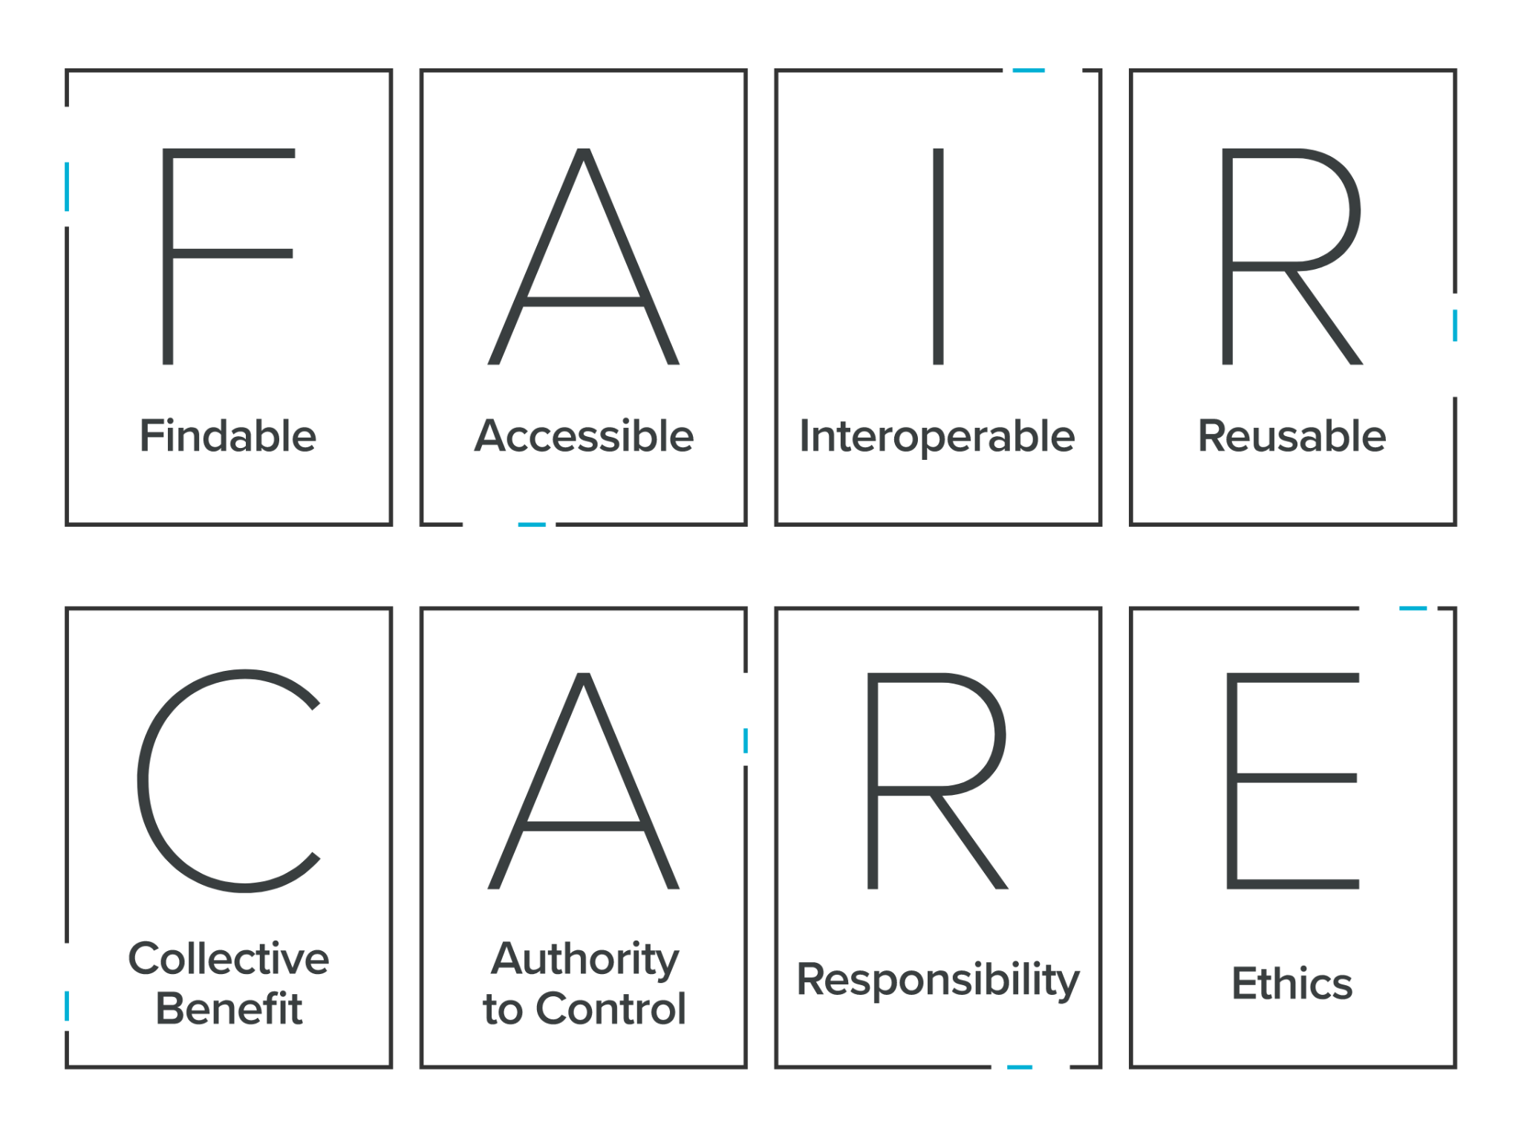

FAIR & CARE Principles
Notes:
FAIR AND CARE PRINCIPLES
The FAIR and CARE principles underpin everything we do.
The ‘FAIR Guiding Principles for scientific data management and stewardship’ were published in 2016 and relate to making digital assets findable (F), accessible (A), interoperable (I) (allowing data to work across different platforms) and also reusable (R).
We ask for research assets to be as easily accessible as possible because accessible research inputs and outputs drive research impact, quality, translation and innovation, which is great for research and society.
We recognise that translating the FAIR principles into practice will vary for each discipline.
In the context of the rise of the FAIR principles in the community of international data infrastructure builders, the Global Indigenous Data Alliance formulated the CARE principles, to address a clear deficit in FAIR regarding Indigenous peoples rights and interests.
‘CARE’ is the acronym for:
Collective benefits - Data ecosystems shall be designed and function in ways that enable Indigenous peoples to derive benefit from the data.
Authority to control - Indigenous peoples’ rights and interests in Indigenous data must be recognised and their authority to control such data be empowered.
Responsibility - Those working with Indigenous data have a responsibility to share how those data are used to support Indigenous peoples’ self-determination and collective benefit.
Ethics - Indigenous peoples’ rights and wellbeing should be the primary concern at all stages of the data life cycle and across the data ecosystem.
The CARE principles complement the existing FAIR principles.
While the FAIR principles are about making it easier to share and reuse data, the CARE principles ensure that data is used ethically and with appropriate governance.

Slide 12
Notes:
ARDC STRATEGIC PRIORITIES JANUARY 2024 - JUNE 2025 (18 MONTHS)
Between January 2024 and June 2025 we are conducting significant co-design activities for the Thematic Research Data Commons, as well as activities for the underpinning national cloud, national information infrastructure, skills and Research Link Australia and policy.

Slide 13
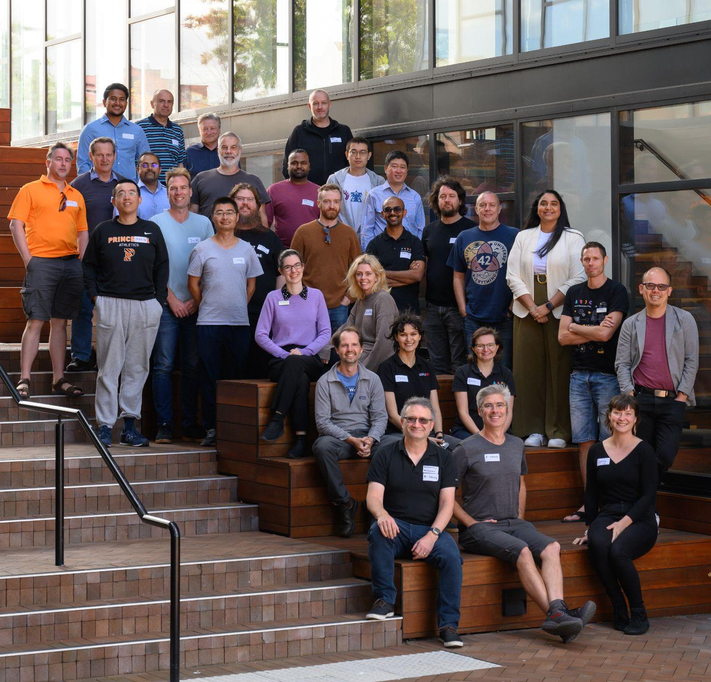


ARDC Nectar Research Cloud
is Australia’s federated national research cloud providing the research community with on-demand computing infrastructure and software
Notes:
ARDC NECTAR RESEARCH CLOUD
Australia’s national research cloud, is specifically designed for research computing is specifically designed for research computing, and enabling services, platforms and data collections <aligned with the Research Data Commons OR for researchers, industry, government and communities>.
Launched in 2012, Nectar provides Australia’s research community with fast, interactive, self-service access to large-scale computing infrastructure, software and data.
A powerful platform for collaboration, it allows researchers and research support staff to access compute resources, software and data from their offices and homes and easily share them with collaborators at other institutions.
Image credits clockwise
Image —Loic Le Guilly / ARDC - The team behind the ARDC Nectar Research Cloud – team members from the nodes and the ARDC at a technical workshop in 2024
Image —Marc Grimwade / ARDC - Jake Yip from the ARDC with Michael Mallon from QCIF, a node of the ARDC Nectar Research Cloud, at a technical workshop in 2022
Image —Marc Grimwade / ARDC - Darcelle Malby and Sonia Ramza from the ARDC at an ARDC Nectar Research Cloud technical workshop in 2022

Slide 14

















ARDC Nectar Research Cloud
In 2023/2024 ARDC Nectar Research Cloud supported:
545
25
26,616
ARC Grants
Cooperative Research Centres & Projects
Users
4,163
Active users
36
19
37
1,906
ARC Centres of Excellence & ARC Industrial transformation hubs/training centres
NCRIS Capabilities
Australian Universities
Projects
235
38
6,112
50,000+
ARC, NHMRC &
MRFF Research Grants
Research Platforms /
Virtual Laboratories
Research Projects
Researchers
All
Research Fields
241
>1,300
3.5 billion
370
NHMRC &
MRFF Grants
Research Papers
Virtual-Processor Hours
Collaborative Multi- Institutional Projects
Supporting National Research 2012 - June 2024
Research papers 2018 - June 2024
Notes:
IN NUMBERS
Nectar has enabled more than 24,000 researchers to work on 5,500+ groundbreaking research projects since 2012
In the last year there were over 4,163 active users of Nectar
Nectar hosts many research platforms and services that collectively have more than 50,000 users.

Slide 15


















ARDC Nectar Research Cloud
8,700+
Virtual Machines
34,000
QCIF
Brisbane
Physical CPU Cores
ISO27001 / SOC2 due
end 2025
150,000+
?
Perth
The University
of Adelaide
Adelaide
Virtual CPU Cores
Intersect
Sydney
248
AARNet
Sydney
VGPUs
2PB
Object Storage
The University of Auckland
Auckland
Monash
University
Melbourne
Swinburne University of Technology
Melbourne
The University
of Melbourne
Melbourne
5PB
University
of Tasmania
Hobart
File Storage
Notes:
IN NUMBERS
Nectar is a federated cloud service, with 7 partner nodes in Melbourne, Sydney, Brisbane and Hobart in Australia as well as Auckland in New Zealand.
We also have strong international connections as members of the OpenInfra Foundation.
Nectar uses the OpenStack open source cloud software and other open source technologies, and we are also contributors to the development of this software.
Its versatile cloud infrastructure can be used in many different ways to support research, such as a virtual desktop for a single researcher, or a powerful computational server that can be shared by researchers in Australia and internationally.
https://ardc.edu.au/services/nectar-research-cloud/

Slide 16






Services Powered by
ARDC Nectar Research Cloud
ARDC Nectar
Research Cloud
Compute & Storage
Virtual Desktop Service
National GPU Service
Jupyter Notebook Service
Kubernetes Services
BinderHub
Service
Notes:
SERVICES POWERED BY THE ARDC NECTAR RESEARCH CLOUD
As well as providing the ARDC Nectar Research Cloud for researchers to use for compute and storage, we also run a number of cloud services for researchers which are powered by Nectar.
Services powered by Nectar include:
Virtual Desktop Service
Jupyter Notebook Service
National GPU Service
Kubernetes Services
BinderHub Service

Slide 17



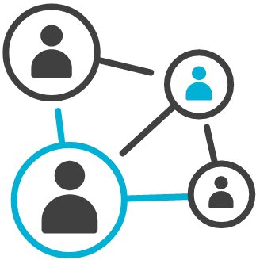

National Information Infrastructure
ARDC Research
Data Australia
ARDC Research Vocabularies Australia
Specialist platforms,
including
Identifier
Services
Health Data Australia
Research Link Australia
Notes:
RESEARCH DATA AND INFORMATION SERVICES
ARDC provides a number of connected data and information services that support the discovery of data, software and tools with related information on grants, research activities, publications, authors and contributors.
Our information services support unambiguous identification of data, materials, projects, vocabularies, activities and services.
This facilitates the interoperability, use and reuse of the data assets created.
Services include:
Research Data Australia - an online data discovery portal
Specialist platforms, including:
Health Data Australia - a national catalogue of Australian health data, starting with clinical data
Research Link Australia - a portal for bridging the information gap between research, industry, business and government for impactful innovation
Grants
Research Vocabularies Australia - an online service for creating, managing, finding and accessing controlled vocabularies, which make the meaning of research data clear and explicit
Identifier Services - a range of services for research organisations to create and manage persistent identifiers
All of these services are hosted on the ARDC Nectar Research Cloud - Australia’s national research cloud service.

Slide 18

ARDC Identifier Services
The ARDC offers several services
that enable researchers at Australian institutions to assign globally unique persistent identifiers to their data and to related materials such as samples, files, documents, tools and services.
2023 / 2024
781,485
DOIs minted
480,338
Services include:
Digital Object Identifier (DOI)
International Generic Sample Number (IGSN)
Research Activity Identifier (RAiD)
Handle
Handles minted
16,900
RAiDs minted
Notes:
ARDC IDENTIFIER SERVICES
With our partners, we have developed a National PID Strategy for Australian institutions.
The ARDC offers several services that enable researchers at Australian institutions to assign globally unique persistent identifiers to their data and to related materials such as samples, files, documents, tools and services.
This supports researchers in discovering, citing and attributing these resources.
Services to create and manage Persistent Identifiers for research data, samples, files, document, projects and other digital objects (DOIs, IGSN, ORCiD, RORs, RAiDs)
Contributing to national and international standards and practice for PIDs, inc samples, instruments and activities/projects
Enables the tracking of impact over research outputs
https://ardc.edu.au/services/identifier/
Image credit
Image — Rawf8 - 162076001 / AdobeStock.com

Slide 19
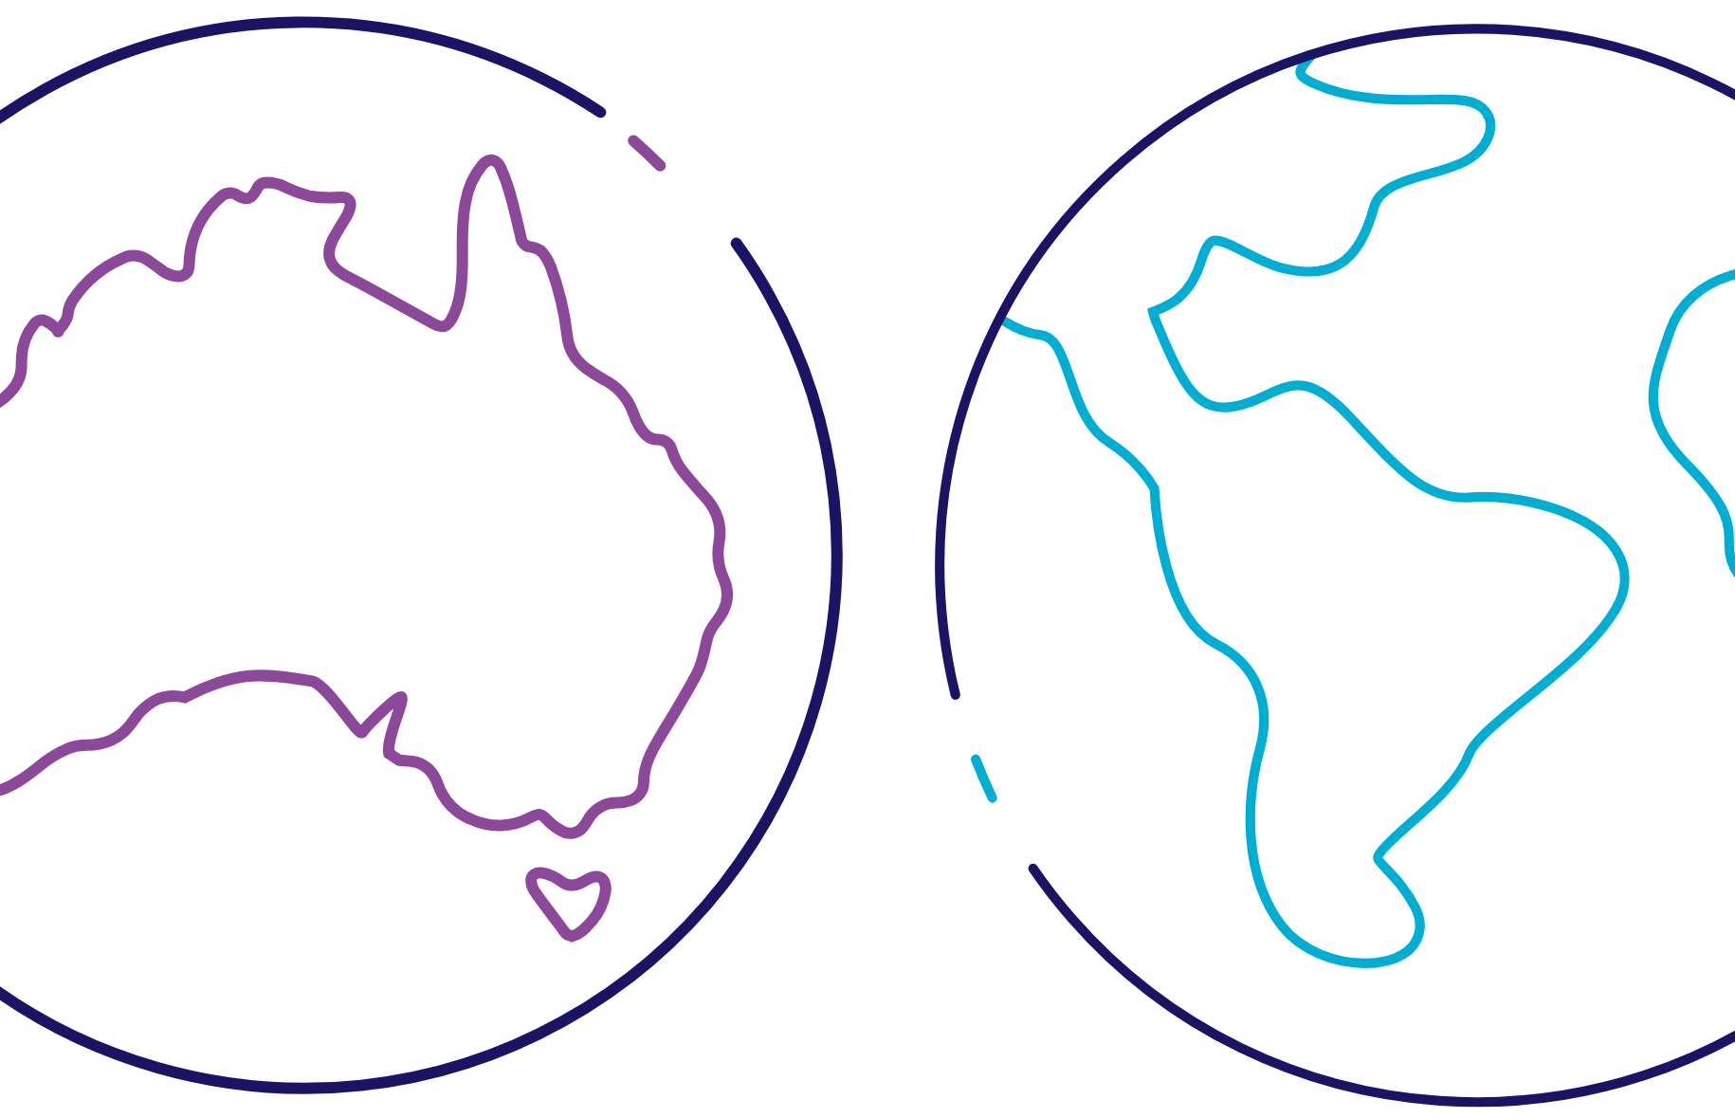





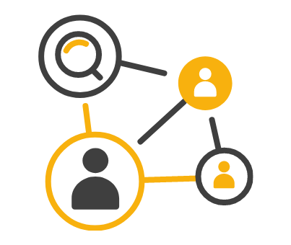
W
Skills & Workforce Development
W
Areas of focus for skills, training and community building
NDRI Workforce
International Exchange
W
W
PEOPLE
PLANET
HASS & INDIGENOUS
ARDC Nectar Research Cloud
National Information Infrastructure
ARDC Thematic Research Data Commons
ARDC Services & Tools
Notes:
Skills & Workforce Development
Areas of focus for skills, training and community building include:
NDRI workforce
International Exchange
ARDC Thematic RDCs
ARDC Services and Tools

Slide 20




Developing ARDC Partnerships
National Partnerships
International Partnerships
International Memberships
Research Discipline Partnerships
Notes:
OUR PARTNERSHIPS
Partnerships are essential for Australia to develop a national research data commons and collaboration is a core value of the ARDC.
Our national and international collaborations and partnerships ensure valuable data and software assets are developed, made available and sustained for everyone.
Over the past 10+ years, the ARDC has built strong partnerships and collaborations at a national and international level to benefit the national infrastructure being developed to serve the research community.
The ARDC continues to expand our collaborations and partnerships.
Our current partnerships include:
National partnerships
Peak bodies
Research organisations including ARDC members and ARDC host institutions
Research infrastructure providers including NCRIS and ARDC Nectar Research Cloud nodes
Government (state and federal)
Research Activity Identifier Service (RAiD)
Research Discipline partnerships for Thematic Research Data Commons
People RDC - Health and medical research partners
Planet RDC - Earth and environmental science partners
HASS and Indigenous RDC - HASS and Indigenous research data community partners
We also partner with international data and software infrastructure organisations around the world to ensure Australian researchers are best positioned to collaborate on global challenges and to optimise our own operational activities.
Our International partnerships include:
International partnerships
DataCite
Earth Science Information Partners
International Generic Sample Number
Open Research Contributor ID
International Openstack community
Research Data Alliance
Digital Research Alliance of Canada
CODATA
The ARDC is a member of the following international organisations:
International Memberships
Open Infrastructure
International Data Spaces Association
Research Data Alliance
Research Software Alliance
ORCID
https://ardc.edu.au/about-us/our-partnerships/

Slide 21
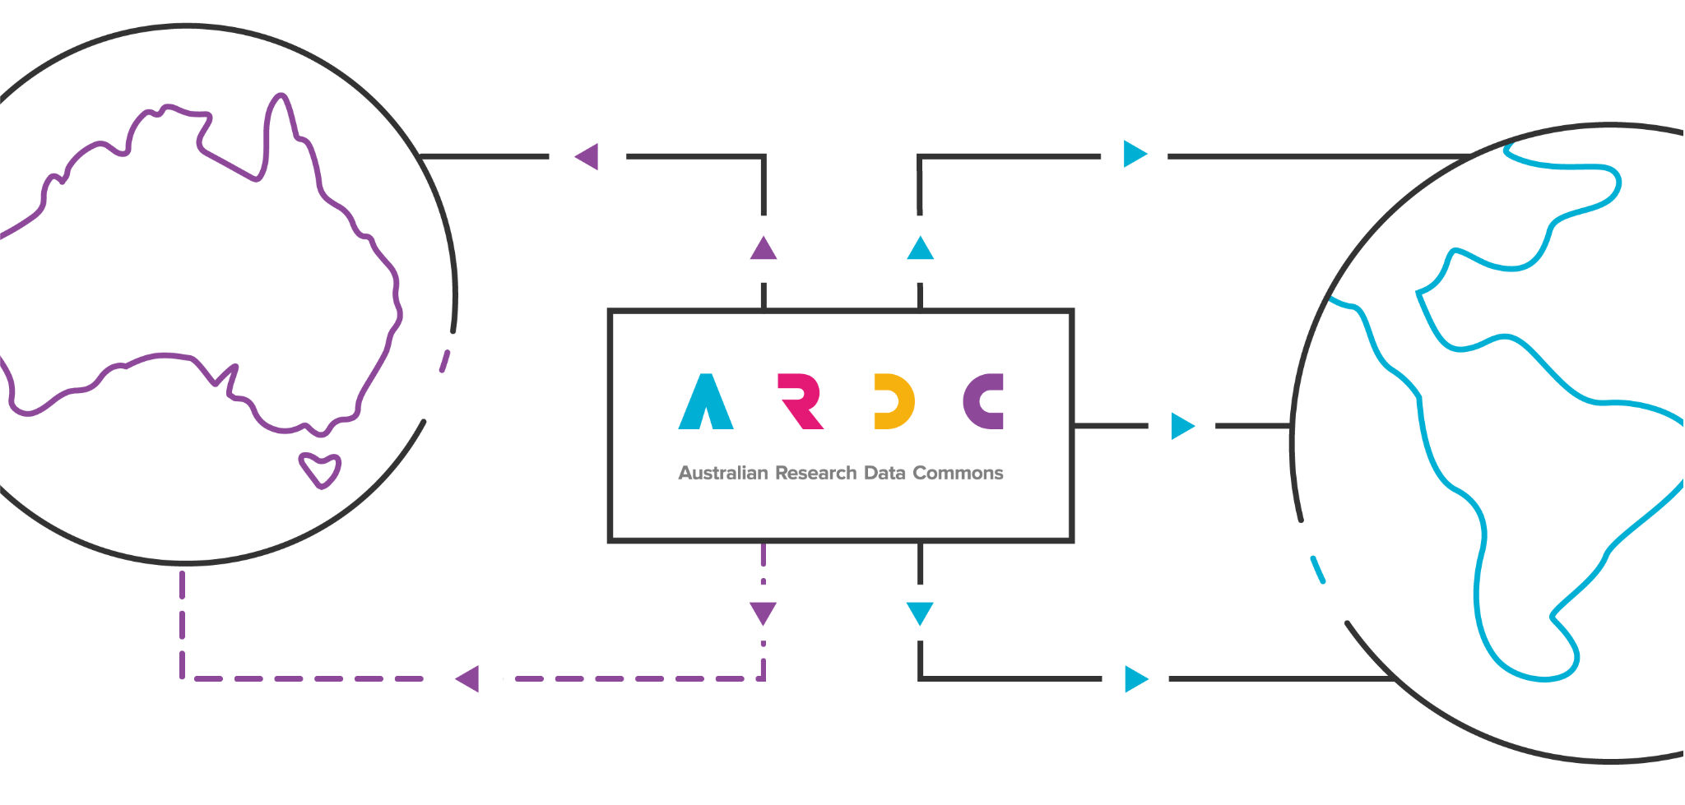
ARDC International Goals
Embed Practice
Empower Developments
Expand Networks
Enhance Reputation
Enhance Reputation
Notes:
ARDC International Goals
We want to increase our involvement internationally, but do it in a way that maximises our national leverage and move from a unidirectional flow of DRI IP and effort towards something more bidirectional.
Our four goals are to:
Enhance reputation through high-profile involvement
Empower through doing, not just talking
Expand networks to continue conversations that lead to convergence, not divergence
Embed good practice (ideally practice that we have helped shape) for national benefit
Note that these four goals all act to reinforce each other:
Enhanced reputation means that we will sought as network partners
Expanded networks give us earlier access to international developments
Empowered developments contribute to reputational enhancement
Empowered developments lead to more easily embeddable practice
Embedded practice increases national and international reputation of ARDC

Slide 22

Notes:
<PROMO for all audiences>
INTERNATIONAL DATA WEEK 2025
The ARDC is excited to be delivering International Data Week 2025 ARDC on behalf of RDA, CODATA and WDS
It will be held in Brisbane Australia 13-16 October 2025.
Save the date and start planning your visit.
Visit us at ardc.edu.au to sign up for updates
Image credit
Mel Campbell - 433531668 / adobestock.com

Slide 23


Slide 24





CONTACT
ardc.edu.au
ben.chiu@ardc.edu.au
Australian-Research-Data-Commons
Subscribe
https://ardc.edu.au/subscribe
Notes:
THANK YOU
Finally, thank you for your time today.
Please visit our website if you would like to know more about what we do.
We are on LinkedIn and X, but the best way to keep up-to-date with everything in national research data management and software, including the latest news, resources, events and jobs, is to subscribe to our newsletter.

