Slide 1
e-Science Activities in Korea
ISGC 2025 (International Symposium on Grids & Clouds)
Academia Sinica, Taiwan
March 17 ~ 21, 2025
2025. 3. 19
Kihyeon Cho (KISTI/UST)

Slide 2
Contents
e-Science?
Data Production (Remote Control Room)
Data Processing
KISTI-6 supercomputer
Summary

Slide 3
I. e-Science?
(e.g. High Energy Physics)

Slide 4
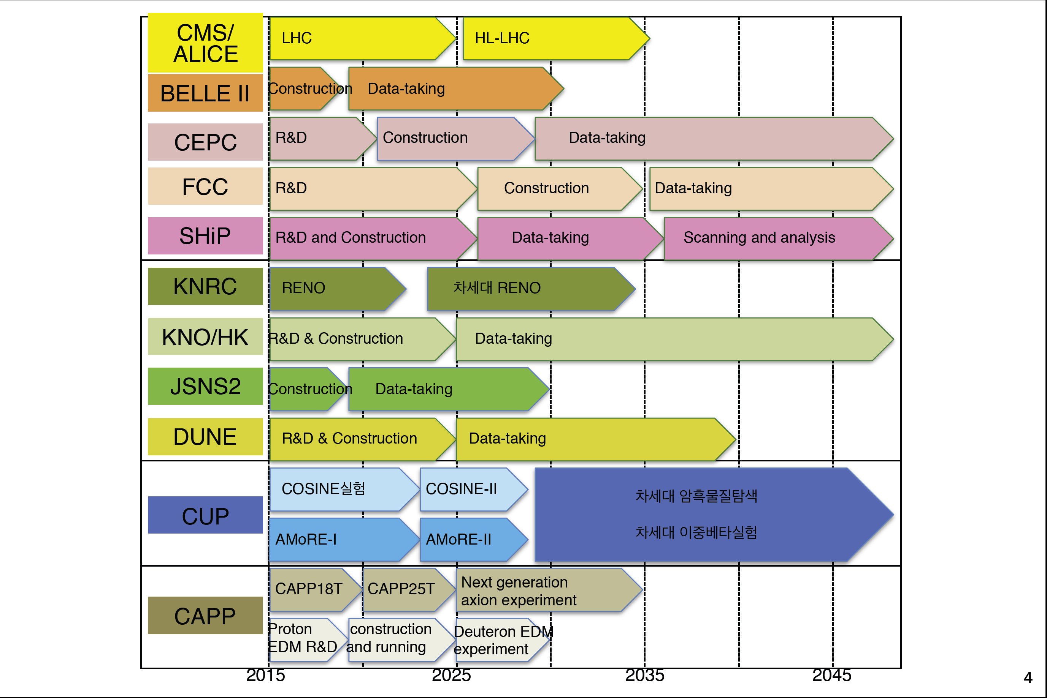
HEP Experiments in Korea
Abroad
Domestic
Neutrino
Abroad
Neutrino
Next Generation
Dark Matter Experiment
Domestic
IBS
Prof. Y. Kwon

Slide 5
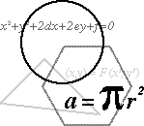

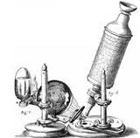

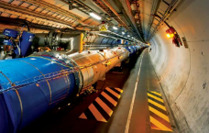
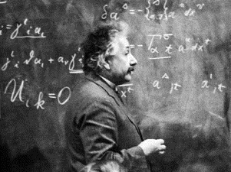
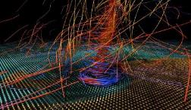
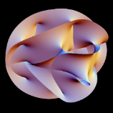
The nature of scientific research
Experimental
Theoretical
Computational
Simulation
Large Hadron Collider
Severe Storm Model (NCSA)
e-Science
8
Prof. D. Reed

Slide 6
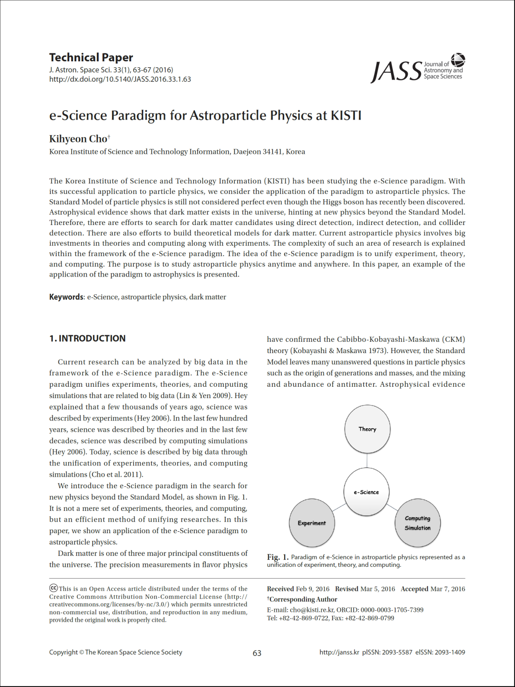
e-Science?
Theory-Experiment-Simulation
⇒ e-Science

Slide 7
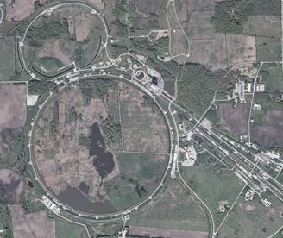
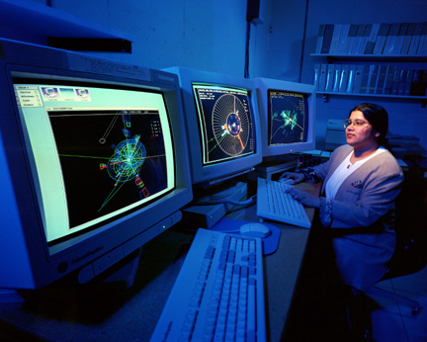
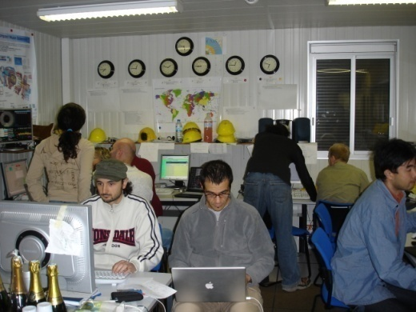
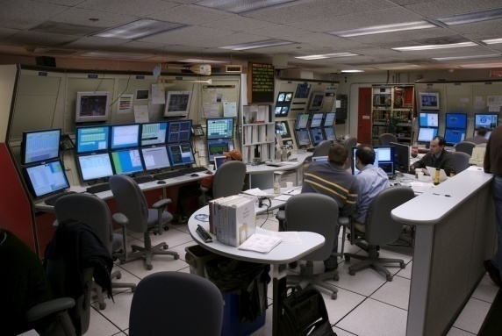
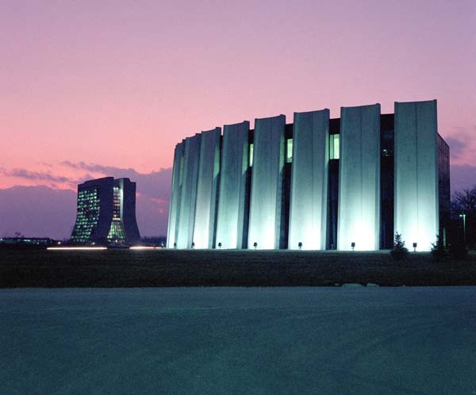
K. Cho, JKPS, 53, 1187 (2008)
e-Science revision
Fermilab, USA
Due to COVID-19, we could not visit on-site laboratory.
To study high energy physics any time even if we are not on site
⇒ The importance of e-Science is revised.
CDF
D0
1
3
1
2
Data Production
Data Analysis
Data Production
Data Processing
Notes:
이제는 고 에너지 물리관련
KISTI e-Science 사업단의 활동과 성과에 대해서 설명..
e-Science 기반의 하이 에너지 물리 즉 e-Hep은
“언제나, 어디서나, 가속기 연구소와 같은 연구 환경 제공”을 목표로 하고 있습니다.
구체적인 목표로,
실제 CERN이나 Fermi 연구소와 같은 외국의 거대 가속기 연구소의
일부분을 우리나라에 확장함으로써
가상 입자 가속기 연구소를 구축하려고 노력하고 있습니다.
앞으로 네가지의 가장 연구소의 시설을 규모와 중요도의 순서대로 제시하겠습니다.

Slide 8
e-Science
1. Date Production
  On-line
  Science any time anywhere
  - Off-line
  - Grid Farm, Supercomputing, etc.
  Machine Learning, GPU, etc.
2. Data Processing
3. Data Analysis

Slide 9
e-Science
1. Date Production ⇒ Remote Control Room
  On-line
  Science any time anywhere
  - Off-line
  - Grid Farm, Supercomputing, etc.
  Machine Learning, GPU, etc.
2. Data Processing ⇒ KISTI-5 supercomputer
3. Data Analysis ⇒ KISTI-6 supercomputer

Slide 10
II. Data Production
(Remote Control Room)

Slide 11


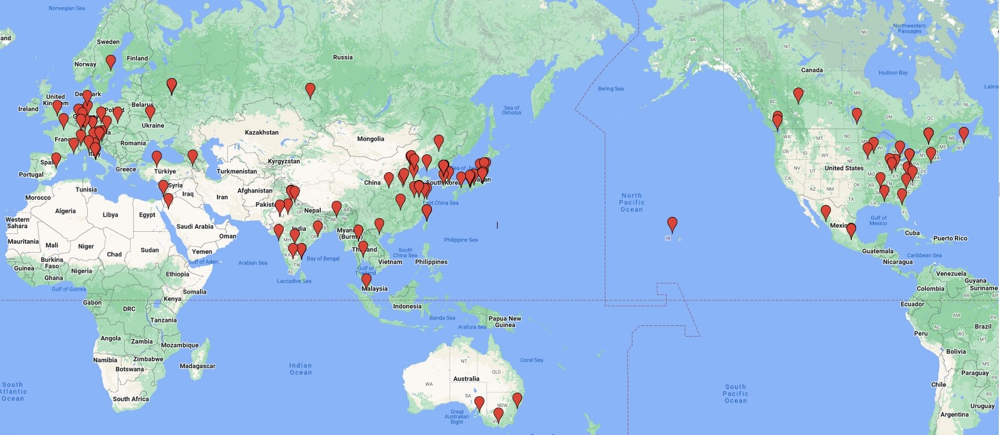
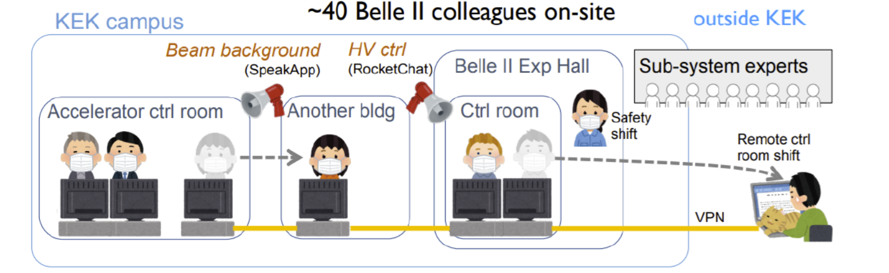


Belle II Remote Control Room
COVID-19
KISTI remote control room shift started on February 16, 2021
Usually Day shift 08:00-16:00 (KST)
29countries
114 institutions
1220 persons (2022.7)
27countries
126 institutions
1158 persons (2022.7)
SpeakApp
Rocket chat
Ref. K. Matsuoka

Slide 12
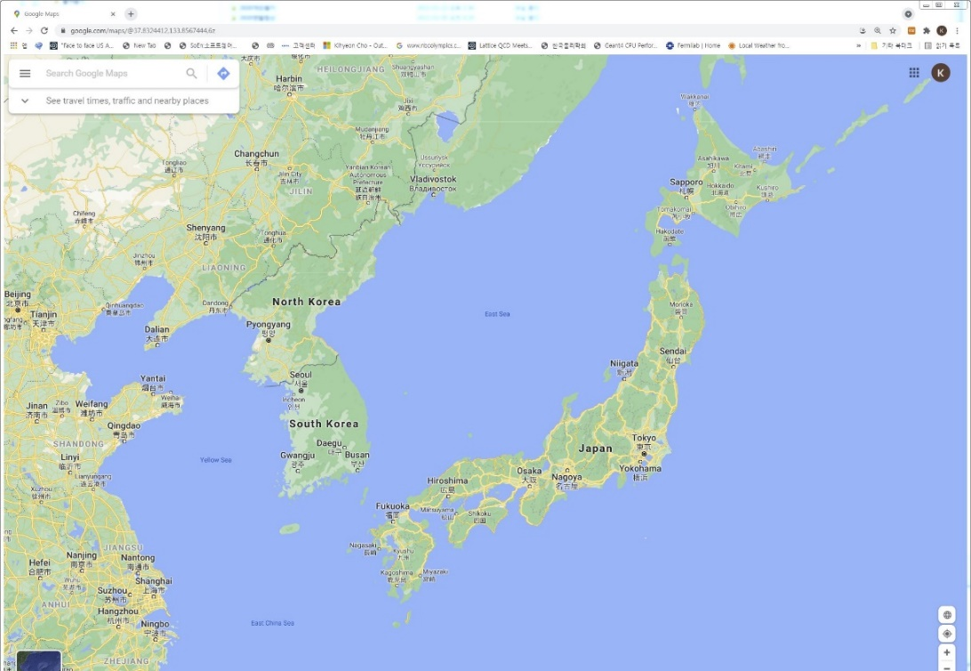
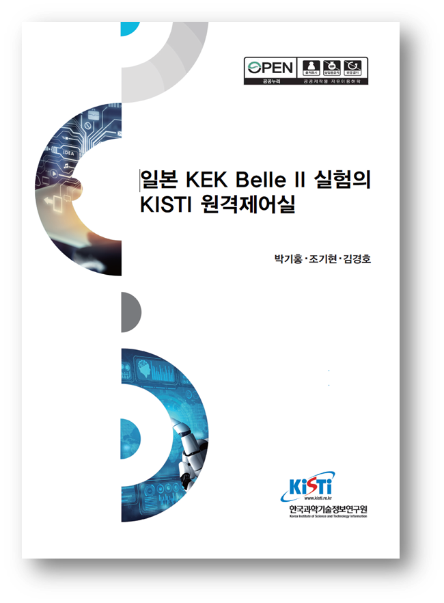
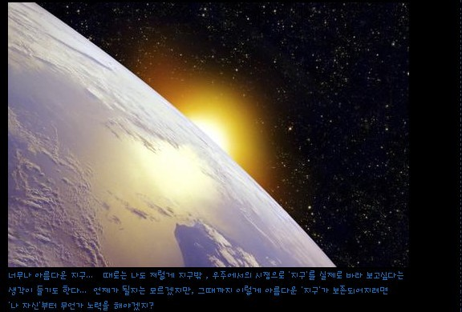
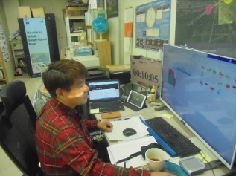
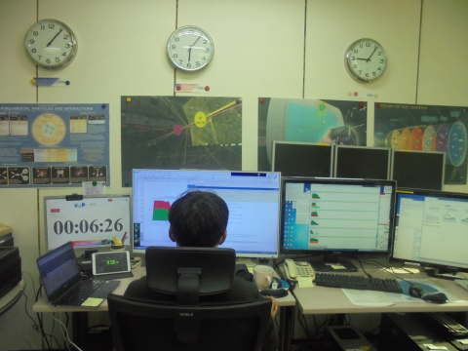
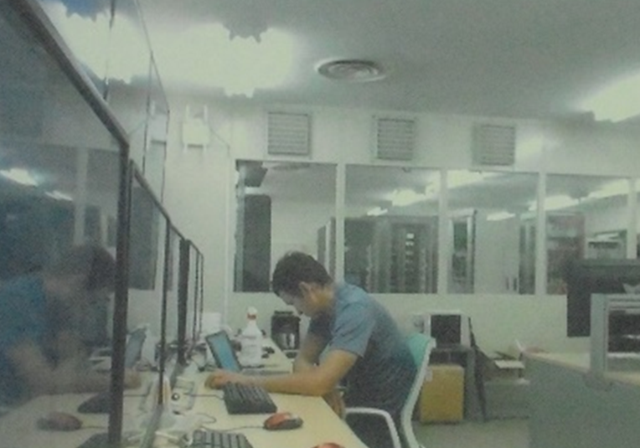
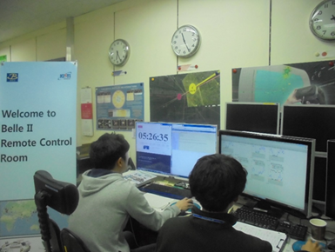
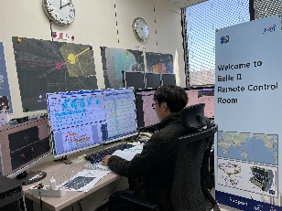
KISTI Remote Control Room
Both CR remote shift and
Data Production shift
KISTI Remote Control Room
KEK Belle II Control Room
  We take shifts at KISTI even if we are not at KEK.
Notes:
또한 세번째 상상 그 이상의 혁신적인 아이디어는 미국 페르미연구소 CDF 실험의 원격제어실을 만들어
국내 사용자에게 서비스하고 있다는 점입니다. 가속기가 없는 한국에서 가속기가 있는 미국 페르미연구소와
같은 연구환경을 구축하여, 국내 연구자가 페르미연구소를 방문하지 않고서도, 가속기 충돌 실험의
실시간 데이터 생산에 참여할 수 있다는 점입니다. 이 혁신적인 아이디어는 KBS등 언론에 14건 보도 되었습니다.

Slide 13
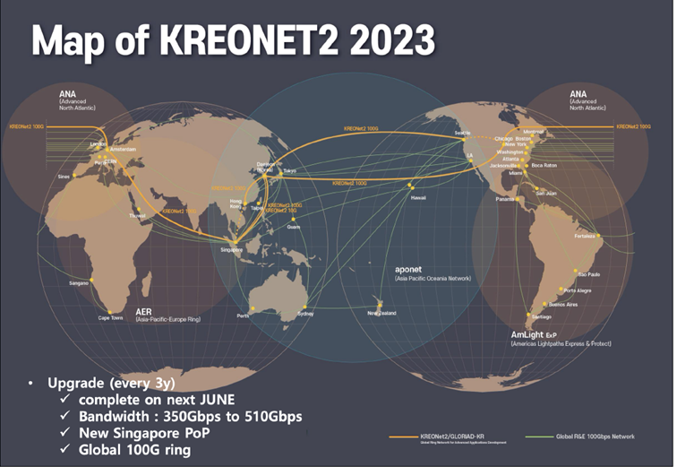
Connected via KRONET2
CERN
Yonsei
Univ.
KOREA
Korea Univ.
Soongsil Univ.
U.S.A.
1Gbps
10Gbps
1Gbps
U. Of Seoul
KREONET2
Seattle
SNU
Seoul XP
10Gbps
10Gbps
Hanyang U.
100Gbps x2
backup line
CAU
2X600Gbps
1Gbps
1Gbps
10Gbps
KISTI
10Gbps
Suwon XP
KREONET2
SKKU
10Gbps
600Gbps
300Gbps
Daegu XP
KNU
CNU
1Gbps
Kwangju XP
100Gbps
100Gbps
100Gbps
Japan
100Gbps
100Gbps
KREONET2
Hong Kong
JGN-X
SINET
KEK
100Gbps
Hong Kong
JGN-X
Hong Kong
KREONET2
Singapore
100Gbps
JGN-X
Singapore
HEP computing is connected with KISTI at 1~10 Gbps of KROENET2.
KREONET2(Singapore) will directly connected to SINET
Singapore

Slide 14

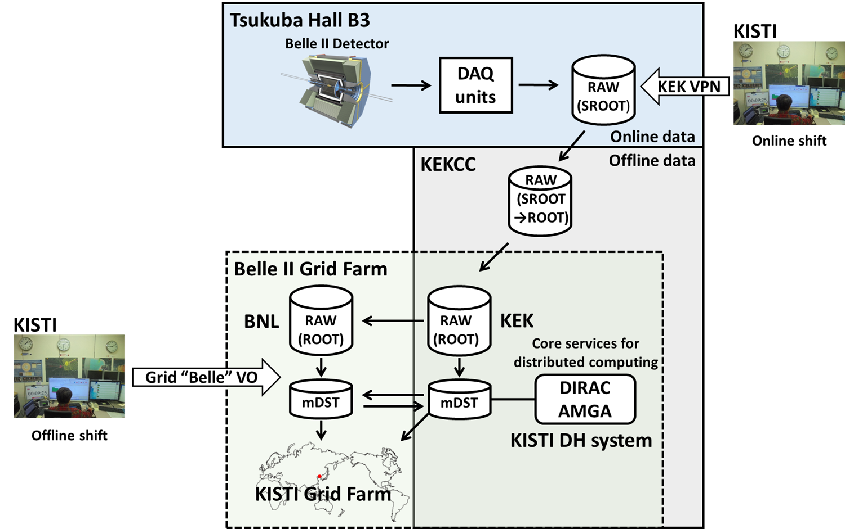
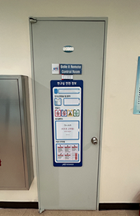

Slide 16
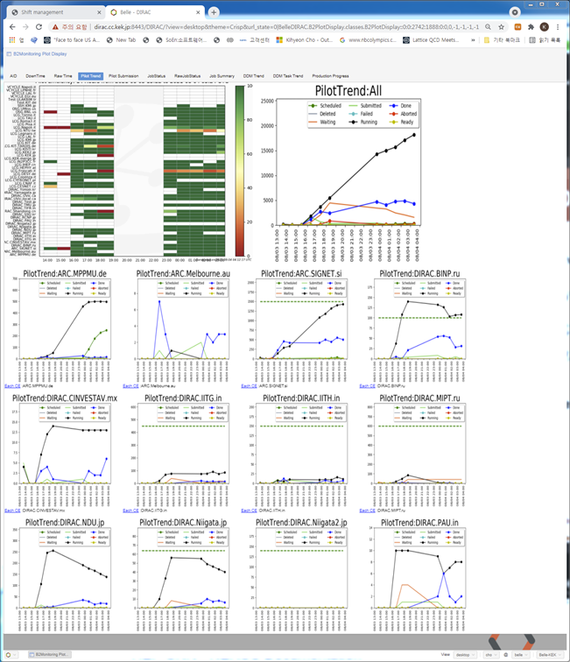
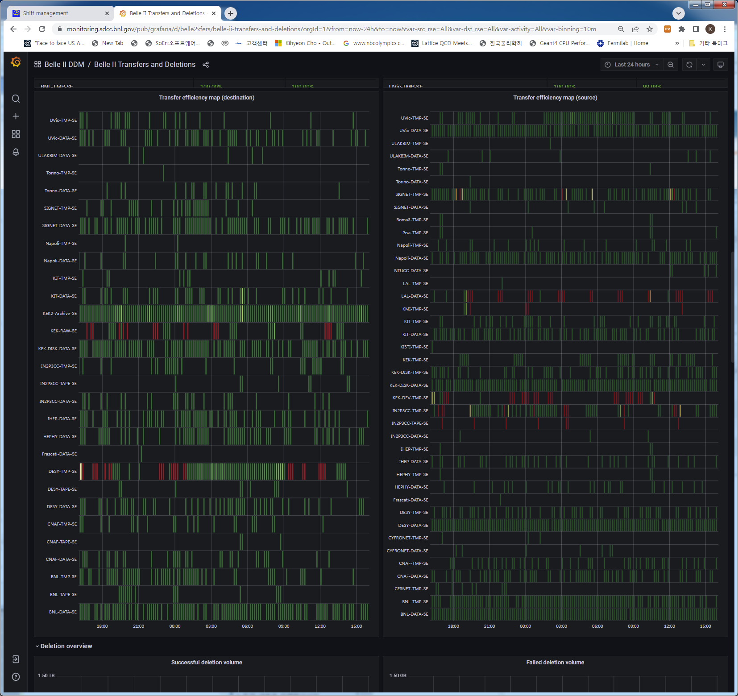
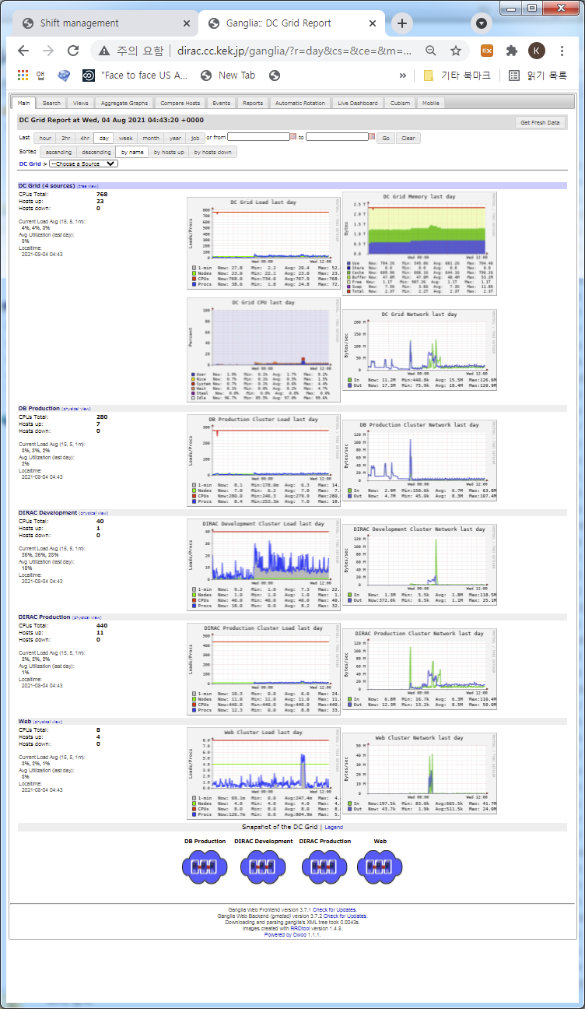
Monitoring
Monitoring based on Grid
Dirac Monitoring (WebApp)
  Workload (jobs status, system, component etc.)
Rucio Monitoring (Grafana)
  Distributed data (file transfer, deletion, merge etc.)
Ganglia Monitoring
  Load of Server and DB (Dirac, AMGA server etc.)
Dirac
Grafana
Ganglia

Slide 17
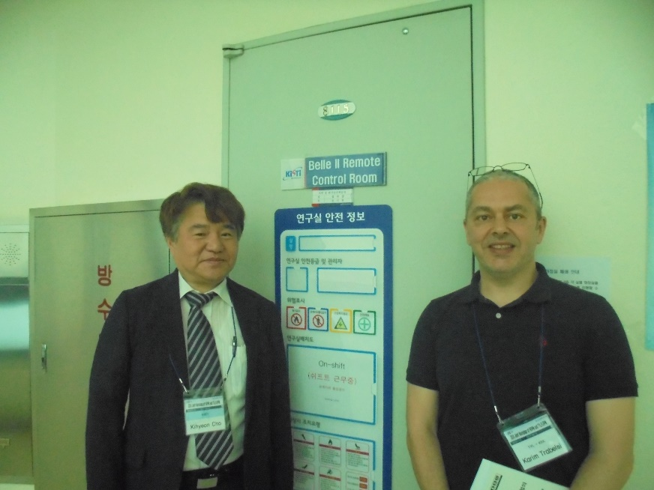
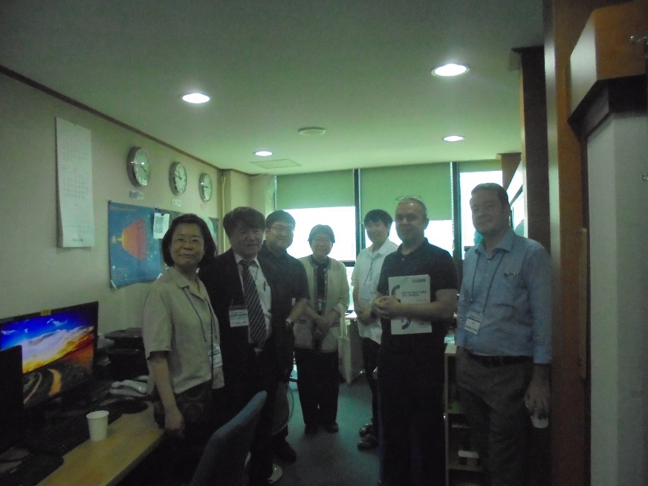
KISTI Remote Control Room (2024.05.22)

Slide 18
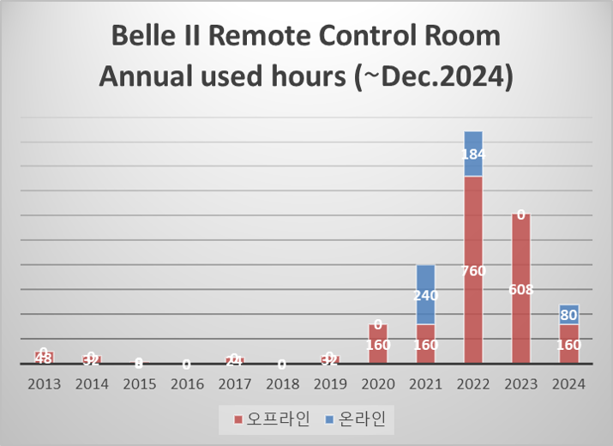
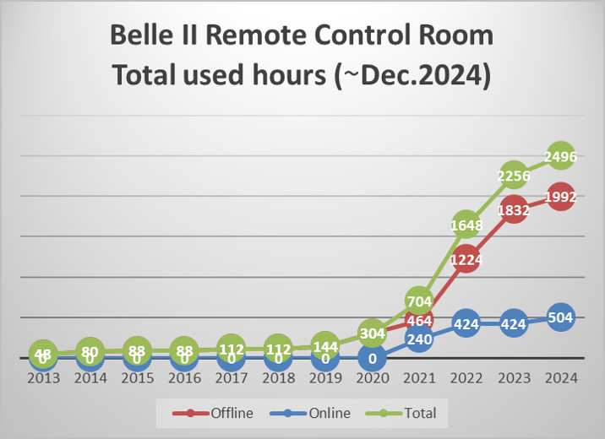
Shift (2024.12.31)
Every year
Accumulation

Slide 19
III. Data Processing

Slide 20

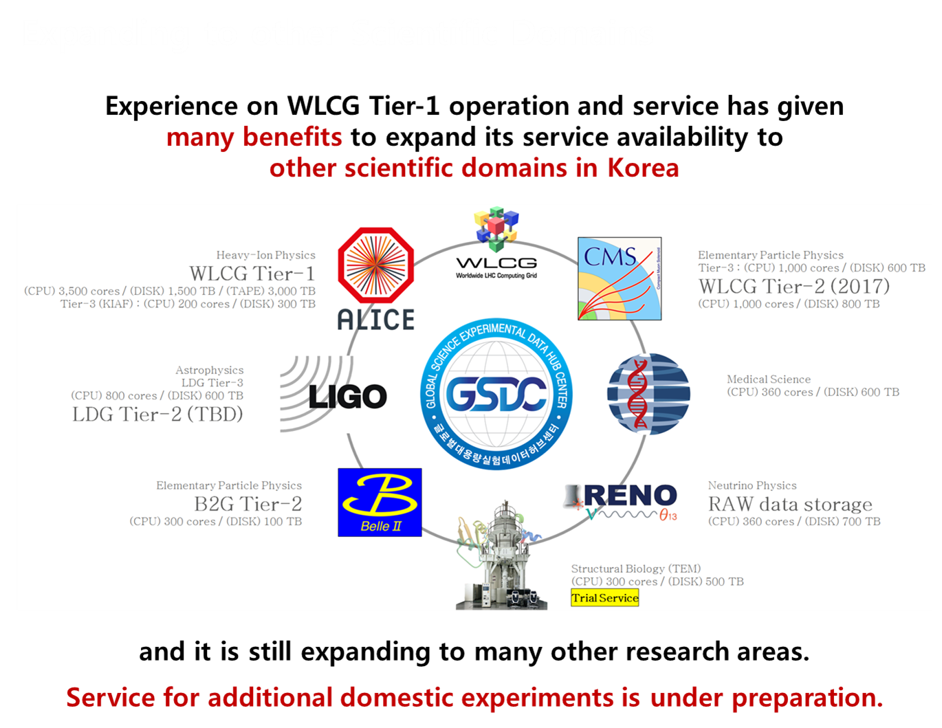
HEP computing sites in Korea
Soongsil U. / Yonsei U.
  Belle II Farm
KNU
  CMS Tier-3 center
KISTI
  GSDC
  KISTI Supercomputing center
Yonsei
Soongsil
KISTI
KNU

Slide 21
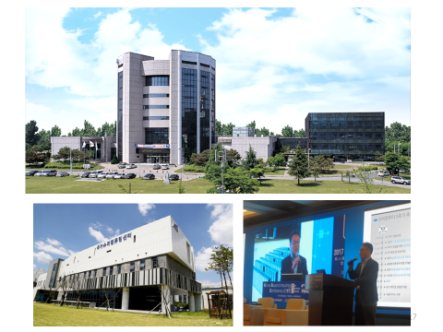
KISTI supercomputing center
The national supercomputing center, Daejeon, Korea

Slide 22
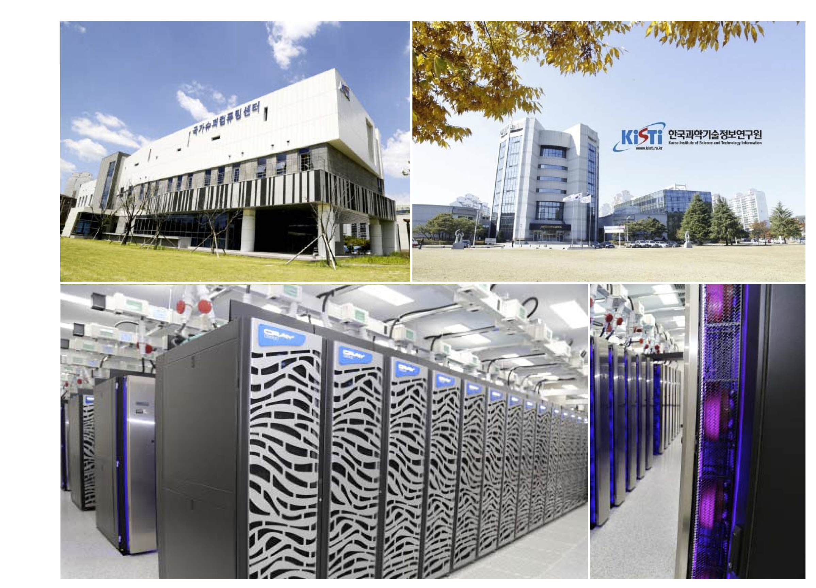

Slide 23
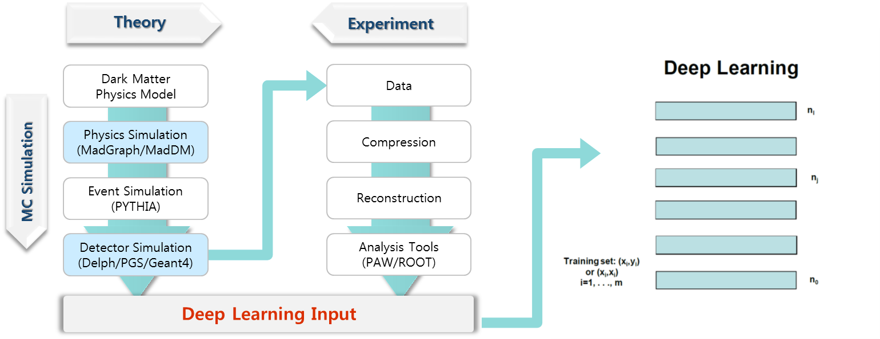
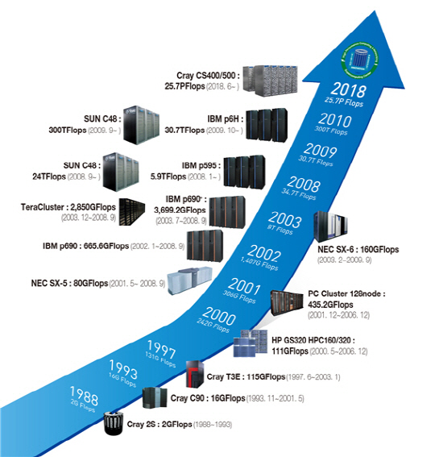
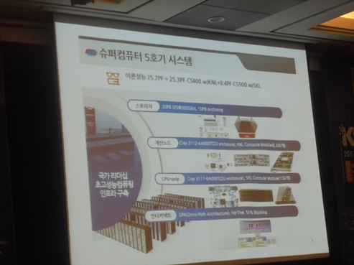
KISTI Supercomputing center
KISTI-5 Supercomputer
  Processing: 25.7PF
    Heterogeneous: 25.3PF CS400 w/KNL
    CPU-only: 0.4PF CS500 w/SKL
  Storage
    20PB SPS
    10PB Archive
  Launched in November 2018
KISTI-5

Slide 24
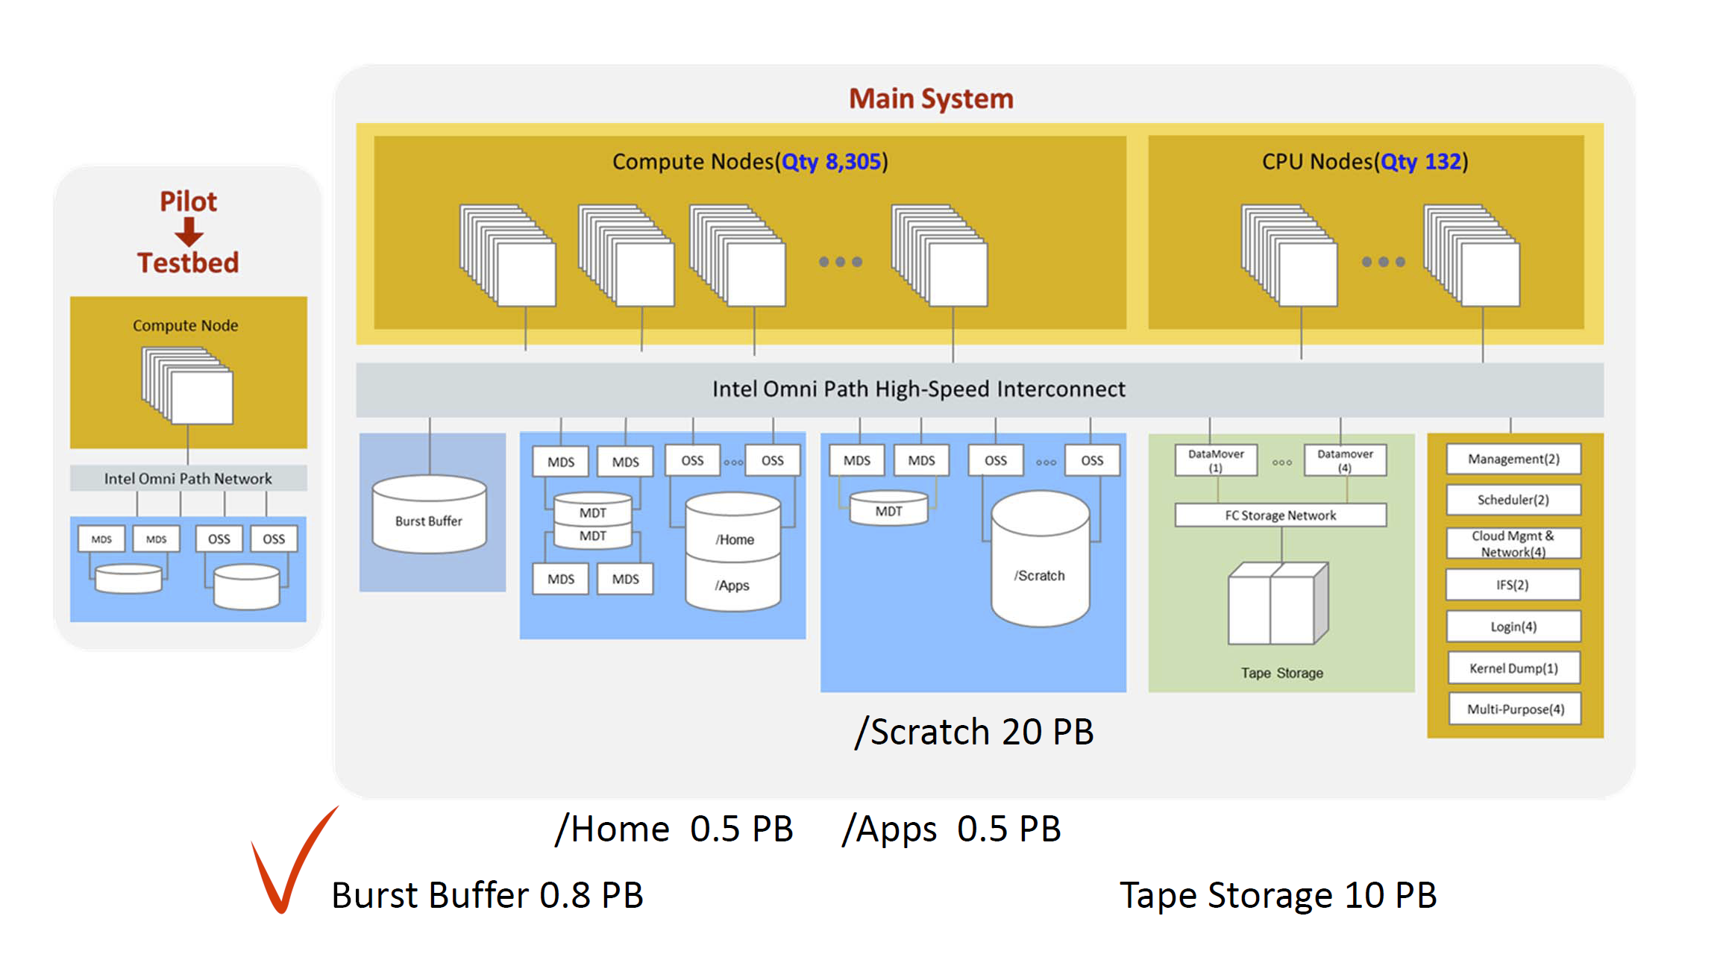
Architecture of KISTI-5 supercomputer
M.S. Joh

Slide 25
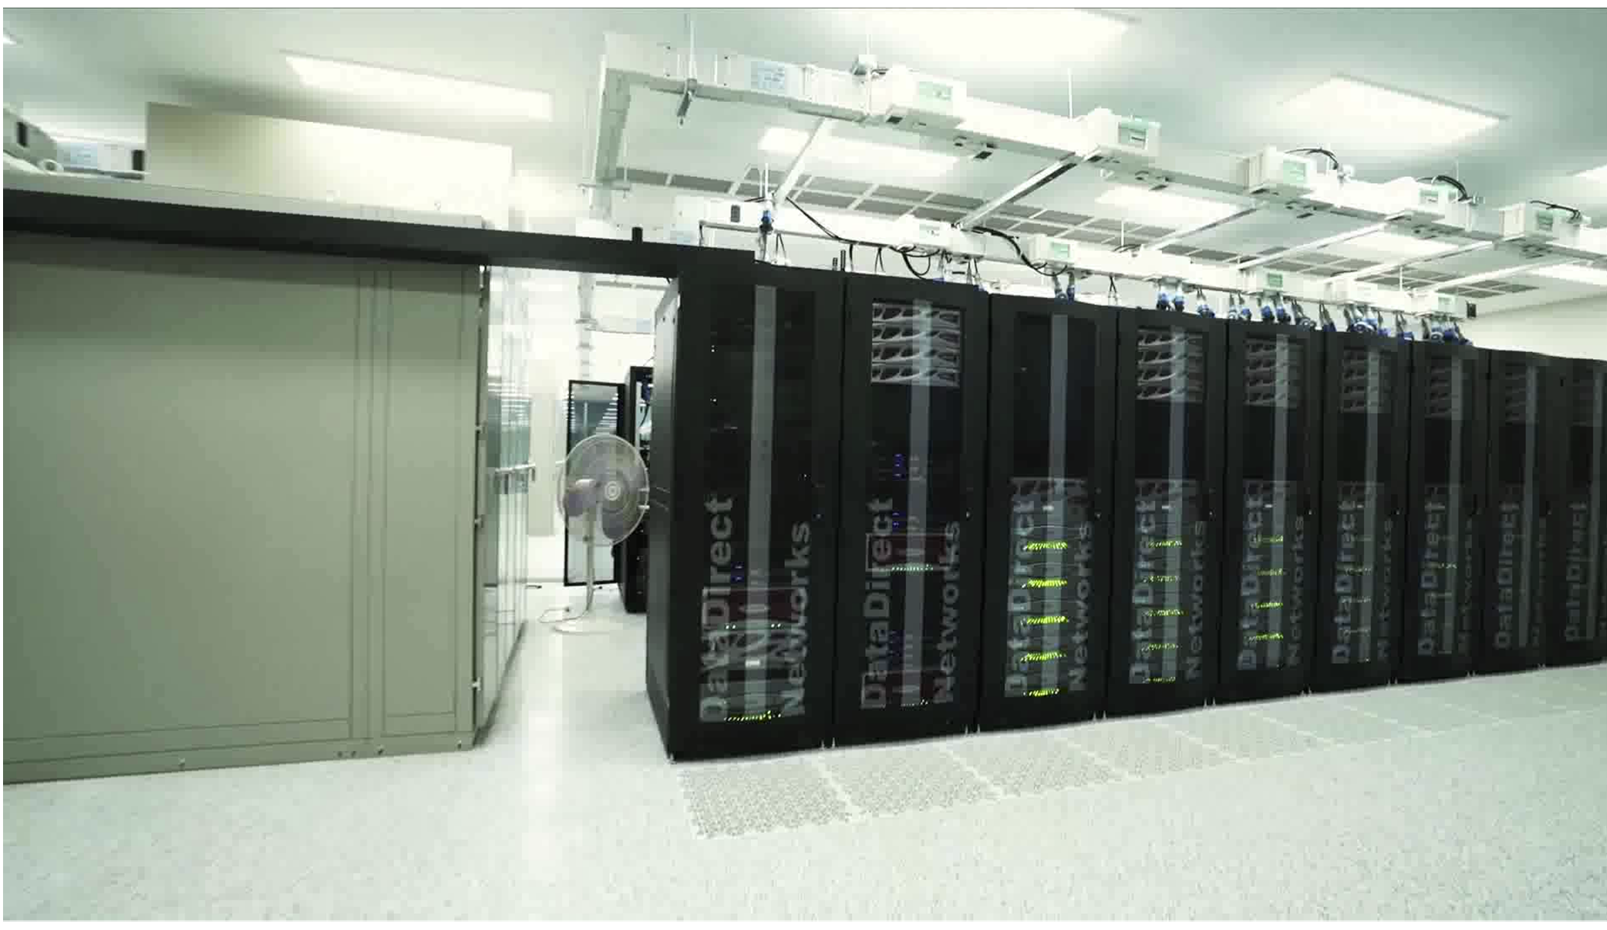
KISTI-5 supercomputer

Slide 26
Big Challenge Problem
What is the definition of big challenge problem?
  10,000 cores at the same time 1 account = 100 SRU
    SKL
      1 account = 3200 hour*node (SKL only)
      = 3200 hour*3600sec/hour*node (1node=68core)
      = 783,360,000 sec*core
      1 node (one month SKL only) = 68core*30day*24hour*3600sec
      = 0.225 account
    KNL
      1 account = 6400 hour*node (KNL only)
      = 6400 hour*3600sec/hour*node (1node=68core)
      = 1,566,720,000 sec*core
      (1SRU = 15,667,200 sec*core)
      1 node (one month KNL only) = 68core*30day*24hour*3600sec
      = 0.1125 account
      ⇒ 1500 node (one month KNL) = 168.75 account

Slide 27
Big challenge problem for HEP
Year | Topics | Exclusive node |  |  | Normal node
 |  | Accounts | No. of nodes | Period | Accounts | No. of nodes | Period
2021 | LHC Machine Learning | - | 4096 | 48hours (several times)
2022 | Nuclear lattice effective field theory for the evolution of universe | 338 | 1500 | 2022. 4.11 ~2022. 5.10 | 169 | - | 2022. 5. 1 ~2023. 4.30
2023 | Research on nucleus constraint and neutron drip line | 443 | 1500 | 2023. 5. 1 ~2023. 7.15 | - | - | -
2024 | Large-scale computational simulation of RAON experiment | 350 | 1500 | 2024. 5. 1 ~2024. 6.30 | - | - | -

Slide 28
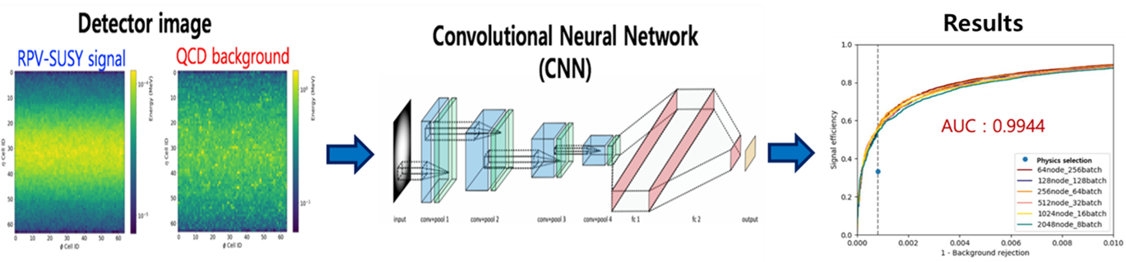
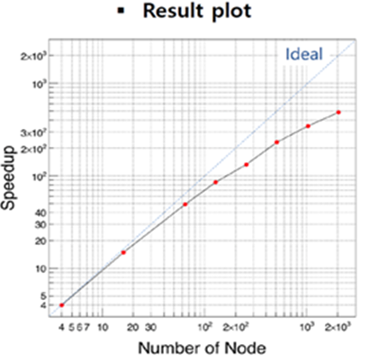
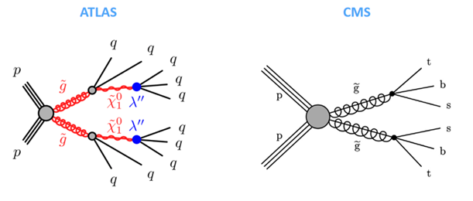
1. LHC Machine Learning
LHC Machine Learning (CNN) Utilizing the World's Largest KNL
4096 nodes (2021)
Kyunghee U. KNU, KISTI
Presented at ACAT 2021
RVP-SUSY model
The result of large-scale deep learning with 7 layers using KISTI-5 supercomputer (4096 nodes)

Slide 29
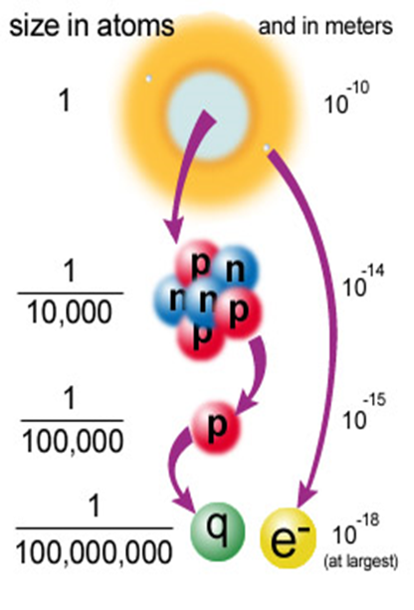
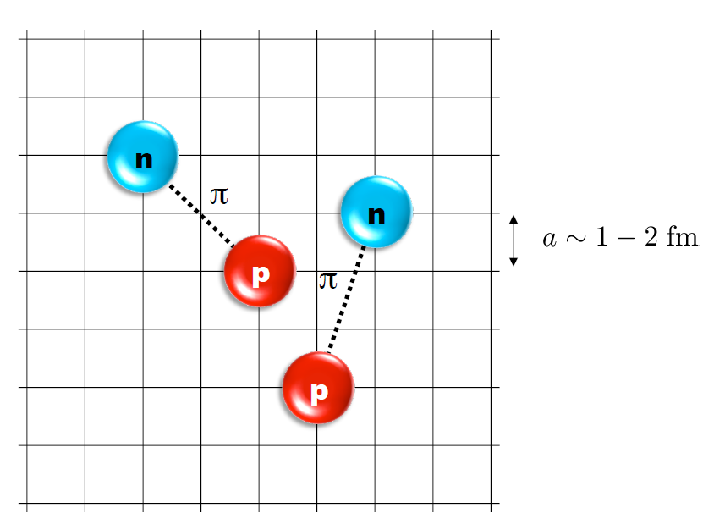
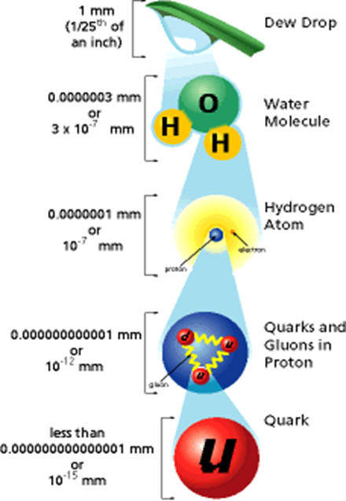
2. NLEFT
Nuclear lattice effective theory for the origin of universe element
338 account: 1500 node exclusive (22.04.11~22.05.10) and
169 normal account (22.05.01~23.04.30)
KISTI, IBS
⇒ Pioneering a new area of universe element research, a 21st century challenge
Lattice QCD (before)
NLEFT (This work)
u
u
d
p
1~2 fm

Slide 30

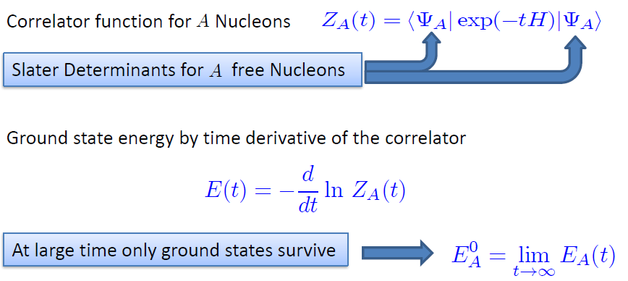
Nuclear Lattice EFT(NLEFT)
Ab initio nuclear structure and reaction
Use transfer matrix with auxiliary Fields MC method for the Euclidean time path integral
Advantage of identifying cluster structure of nuclei
The same code can be extended for nuclear reaction.
8

Slide 31
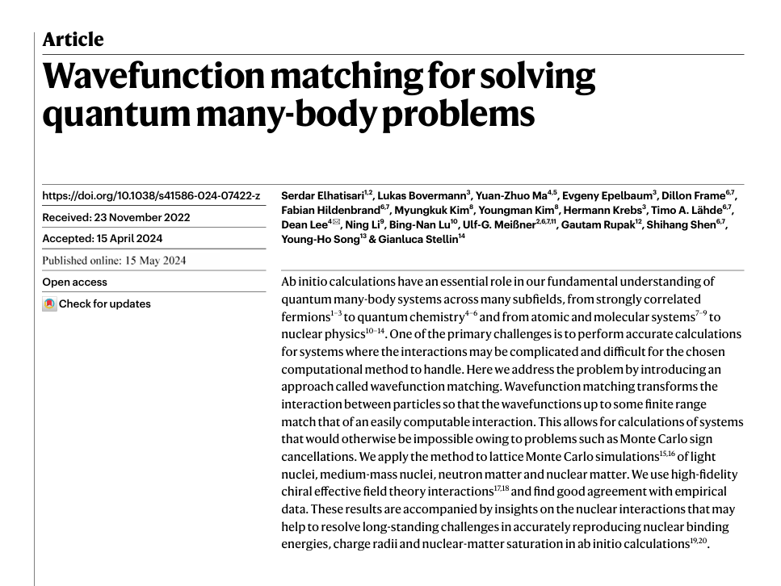
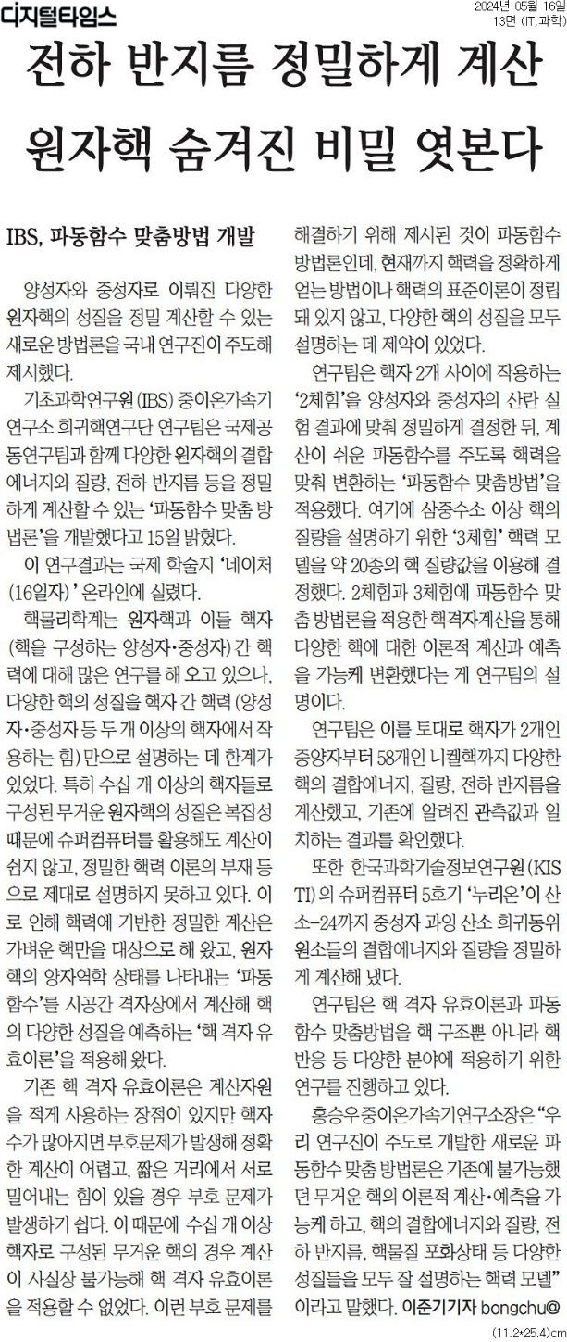



Result [Nature 630, 59-63 (2024)]

Slide 32

3. Neutron Drip Line
Research on Nucleus Constraint and Neutron Drip Line
KISTI, IBS
443 accounts, 2.5 months of 1500 exclusive nodes (2023.5.1~7.15)
"Why can't a nucleus be a neutron star that can't contain neutrons indefinitely?"
(양성자 수)
(중성자 수)
⇒ Using ab initio, a model independent from an existing model dependence
산소

Slide 33

Ab initio
Nuclear
Theory

Slide 34

4. RAON simulation
RAON experiment large-scale computational simulation
IBS, KISTI
350 accounts: two-month of 1500 exclusive node (2024.5.1.~6.30)
RAON experiment started in June 2024.
Pre-verification through giant computer simulation
⇒ Providing the subject of the experiment (The First)

Slide 35

RAON experiment

Slide 36


Slide 37

Why large scale of computer simulations?
Nuclei are finite quantum many-body systems
~10⁻¹⁴ meters
10¹⁷ kg/m³ ; 5500 kg/m³
While, the detectors are in the order of one meters.

Slide 38

Conditions of Simulation
Conditions of experiments
  Geant4 version: 11.2.0
  1,000,000 events per each condition
  PhysicsList: FTFP_INCLXX
  Ion counting condition
    Escaped from Be target
    Travel 100cm from target
    Forward direction with θ < 10°
Simulation | Geant4 beam |  | Target
 | Particle | Energy (MeV/u) | Materials | Thickness (mm)
Sn → Be | Sn132 | 200 | Beryllium | 1 ~ 10 mm (1mm step)
U → Be | U238 | 200

Slide 39


Conditions of Simulation
Conditions of experiments
  Geant4 version: 11.2.0
  1,000,000 events per each condition
  PhysicsList: FTFP_INCLXX
  Ion counting condition
    Escaped from Be target
    Travel 100cm from target
    Forward direction with θ < 10°
Sensitive part ($θ, φ<10°$)
cylinder with r=1cm
Simulation | Geant4 beam |  | Target
 | Particle | Energy (MeV/u) | Materials | Thickness (mm)
Sn → Be | Sn132 | 200 | Beryllium | 1 ~ 10 mm (1mm step)
U → Be | U238 | 200
30 cm
100 cm
Beam emission point

Slide 40

Amounts of Events
Tendency on distribution
  Thin target: beam penetrates the target.
  Thick target: secondary ions cannot escape from target.
  What is the best target thickness for given condition?

Slide 41


2D Distributions (Sn beam, 8mm Be target)
With event generation optimized thickness
  Sn beam for 8mm Be target

Slide 42
Summary of KISTI-5 supercomputer
KISTI-5 supercomputer produces good results
for big challenge problem for HEP.
However, currently research shows that big
data meets machine learning.

Slide 43



Big Data and Machine Learning
The changing nature of scientific research
Experimental
Theoretical
Computational
Simulation
Big Data and
Machine Learning
Large Hadron Collider
Severe Storm Model (NCSA)
Prof. D. Reed
e-Science
35

Slide 44

Big data & deep learning for large scale scientific applications
HEP
KISTI-6 supercomputer
Prof. M. Park
⇒ KISTI-6 supercomputer in 2025

Slide 45
VI. KISTI-6 supercomputer

Slide 46

KISTI-6 supercomputer
Specification: CPU (+ GPU)
  Computational power: 600PFlops
  Storage: 200PB
Purpose
  Basic research (40%)
  Public social issues (20%)
  Industrial utilization (20%)
  Utilize sharing (20%)
Plan
  Will be installed in 2025

Slide 47

Architecture of KISTI-6 supercomputer

Slide 48
KISTI-6 supercomputer
Specification |  | GPU Partition | CPU Partition
Architecture |  | Heterogeneous Cluster
Node | Total node | ~3000 node | ~1500 node
 | Total Rack | 30 | 8
CPU | CPU/node | 1 | 2
 | CPU/Partition | ~3000 | ~3000
 | Total CPU | ~6000
GPU | CPU/node | 4 | -
 | CPU/Partition | ~12,000 | -
 | Total CPU | ~12,000
Rpeak | Pflops | 600 | 10
 |  | 610
Memory | Method | DDR5 | DDR5
 | Memory/node(GB) | > 512 | > 512
 | Total Memory (PB) | 1.5 | 0.75
 |  | 2.25

Slide 49

Software
 | Content | Specification
System Software | Operating System
 | System program
 | Task management
 | Virtualization
Development Tool | Compiler/ Debugger
 | Parallel environment
 | Math Library
 | AI/ML framework
Application Software

Slide 50
Discovery
We are here.
KISTI-6 supercomputer

Slide 51
VI. Summary

Slide 52
Summary
e-science activities for HEP in Korea is very active.
Large scale science needs solutions of GPU machine.
Therefore, KISTI-6 supercomputer will brought to you in 2025.
⇒ Science will go beyond discovery.

Slide 53
Acknowledgement
Kyungho Kim, Youngman Kim, Young Ho SONG,
Ik Jae SHIN
The major institutional R&D program of KISTI (No. K25L2M2C3) and National Supercomputing Center with supercomputing resources including technical support (KSC-2022-CHA-0003, KSC-2023-CHA-0005, KSC-2024-CHA-0001).

Slide 54
Thank you.
cho@kisti.re.kr

