Slide 1
e-Science Activities at IHEP
Gang Chen
Institute of High Energy Physics, CAS
ISGC2025
March 19, 2025

Slide 2
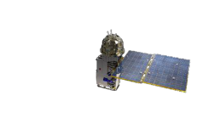
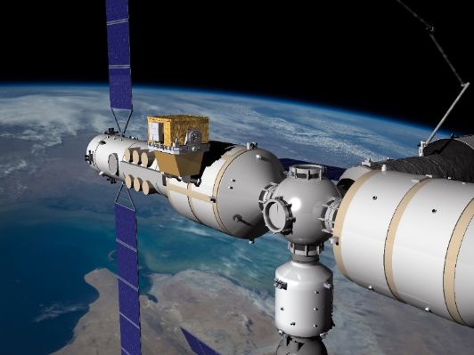
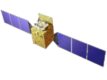








Facilities of IHEP
BEPCII/BESIII
BSRF
HEPS
AliCPT
AS𝛾
LHAASO
CSNS
JUNO
Daya Bay

Slide 3
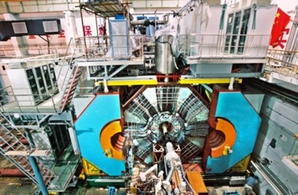
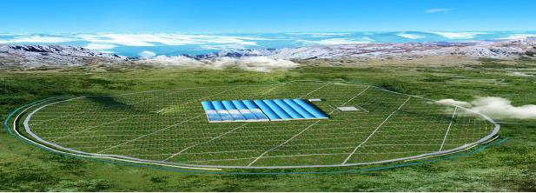
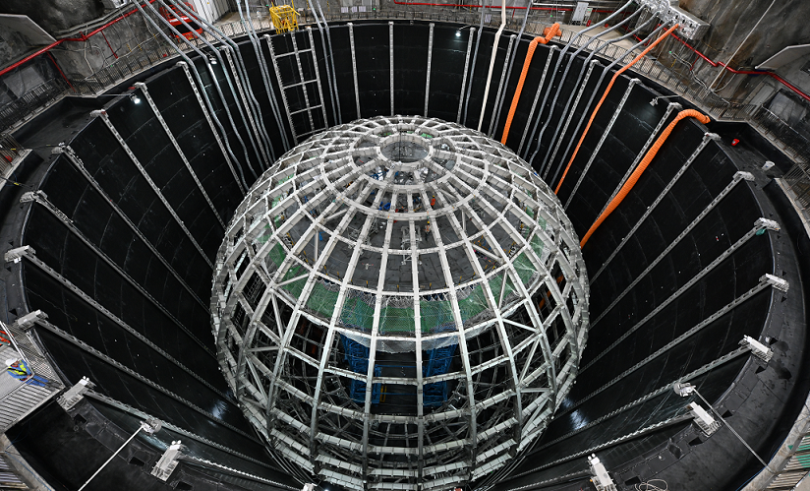
Particle Physics
BESIII on BEPCII
  Experiment on Charm physics, quacks and gluons
  2.0 ~ 4.6 GeV/C
  Hundreds of TB data per year, keep running to 2030
LHAASO
  A cosmic ray detection facility located in Sichuan at 4410m above the sea level.
  To study the galactic cosmic ray physics in the energy range 10¹¹ - 10¹⁷ eV.
  Data taking since 2018, ~ 13PB/year
JUNO
  To determine neutrino mass hierarchy and precisely measure oscillation parameters
  To be operational in the summer of 2025
  Data rate：~2PB/year

Slide 4
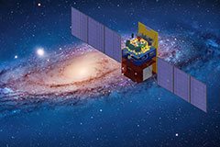
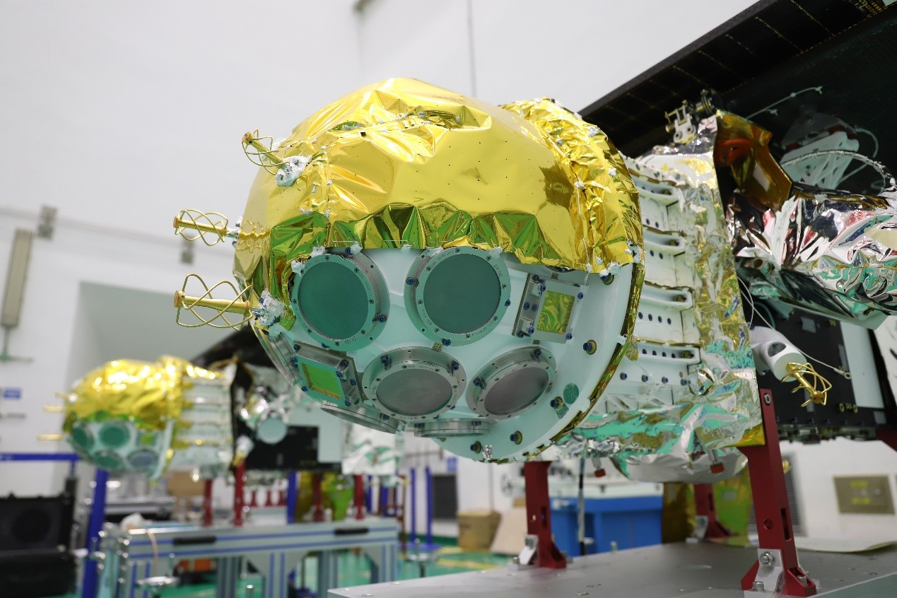
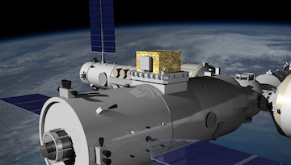
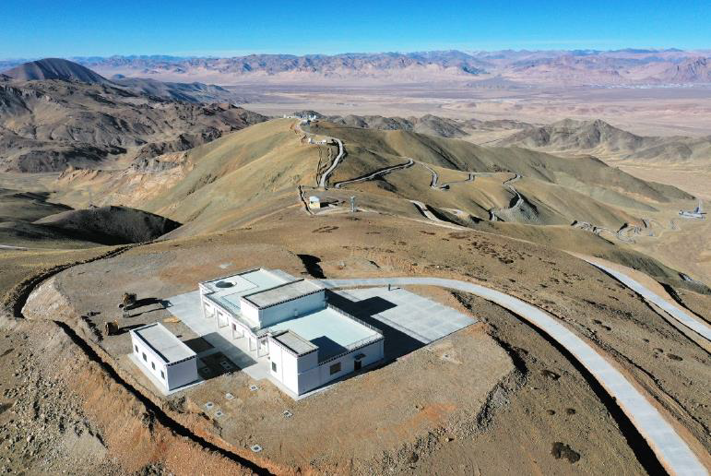
Astro-particle Physics
HXMT
  The Hard X-ray Modulation Telescope (HXMT)
  Launched on June 15, 2017
  Research on transient sources, X-ray binaries to study the dynamics and emission mechanism in strong gravitational or magnetic fields, and to study Gamma-Ray Bursts and Gravitational Wave Electromagnetic counterparts.
GECAM
  The Gravitational wave high-energy Electromagnetic Counterpart All-sky Monitor (GECAM)
  Launched on December 9, 2020.
  Gamma-ray all-sky to measure the positional, temporal and spectral properties of high energy transients.
HERD
  High Energy Radiation Detector
  To be docked the Chinese Space Station in 2027, ~5PB/year
  dark matter search, research on the origin, acceleration and propagation of cosmic rays
AliCPT
  Ali Cosmic microwave Polarization Telescope)
  Search for primordial gravitational waves
  Data taking will start in 2025，~180TB/year

Slide 5
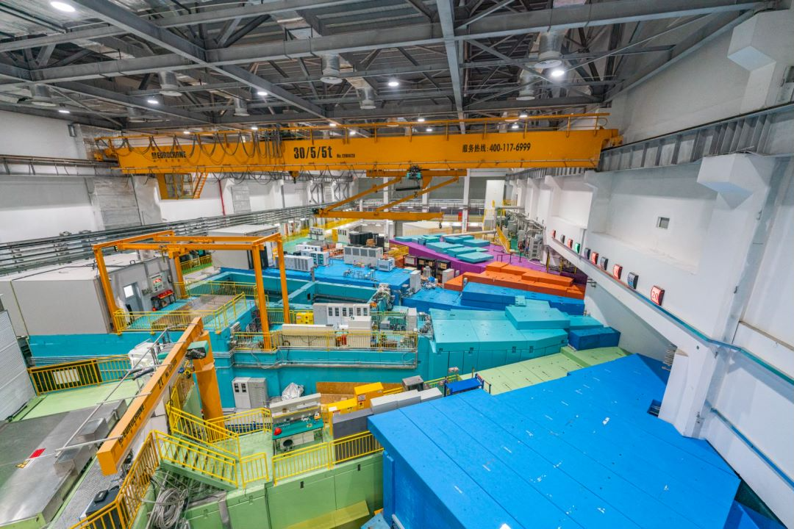
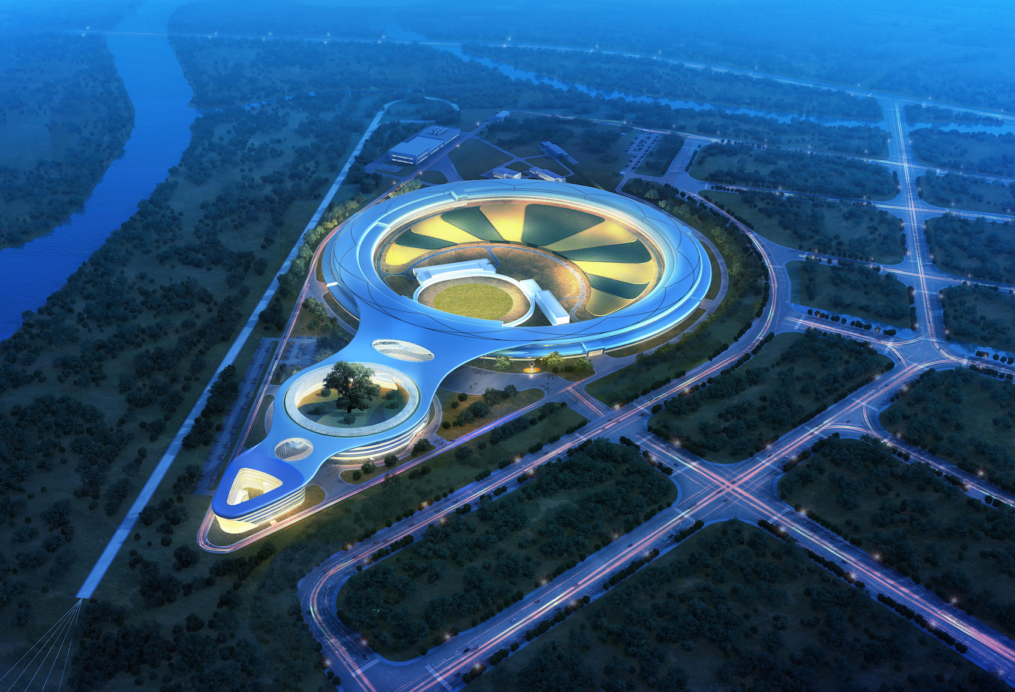
CSNS and HEPS
China Spallation Neutron Source (CSNS)
  Located in Dongguan, south of China
  3 experiment stations in 2018, 11 stations now, and will be 20 in next five years.
  To study the structure and properties of materials at the atomic and molecular level
High Energy Photon Source (HEPS)
  Being built in Huairou, 80km north of IHEP.
  To be operational at the end of 2025, with 14 beamlines and 90 ones in the feature.
  Multi-dimensional, real-time, in-situ research tools for the microstructure of materials
  ~300 PB/year initially, >600 PB later.

Slide 6
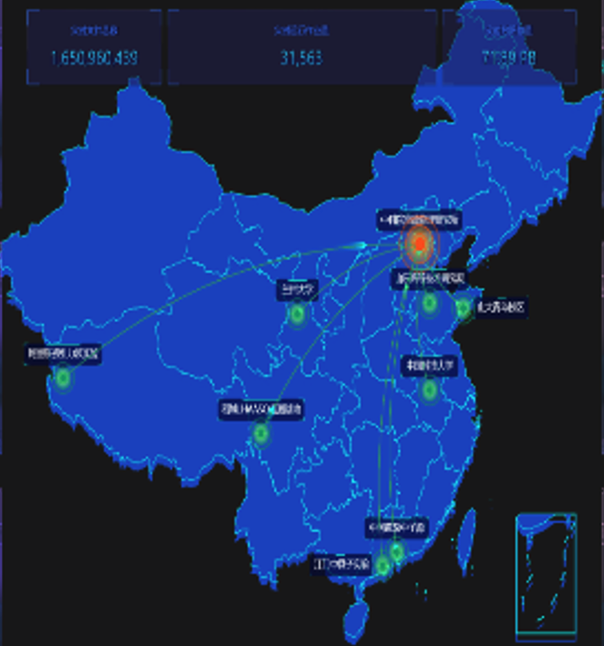
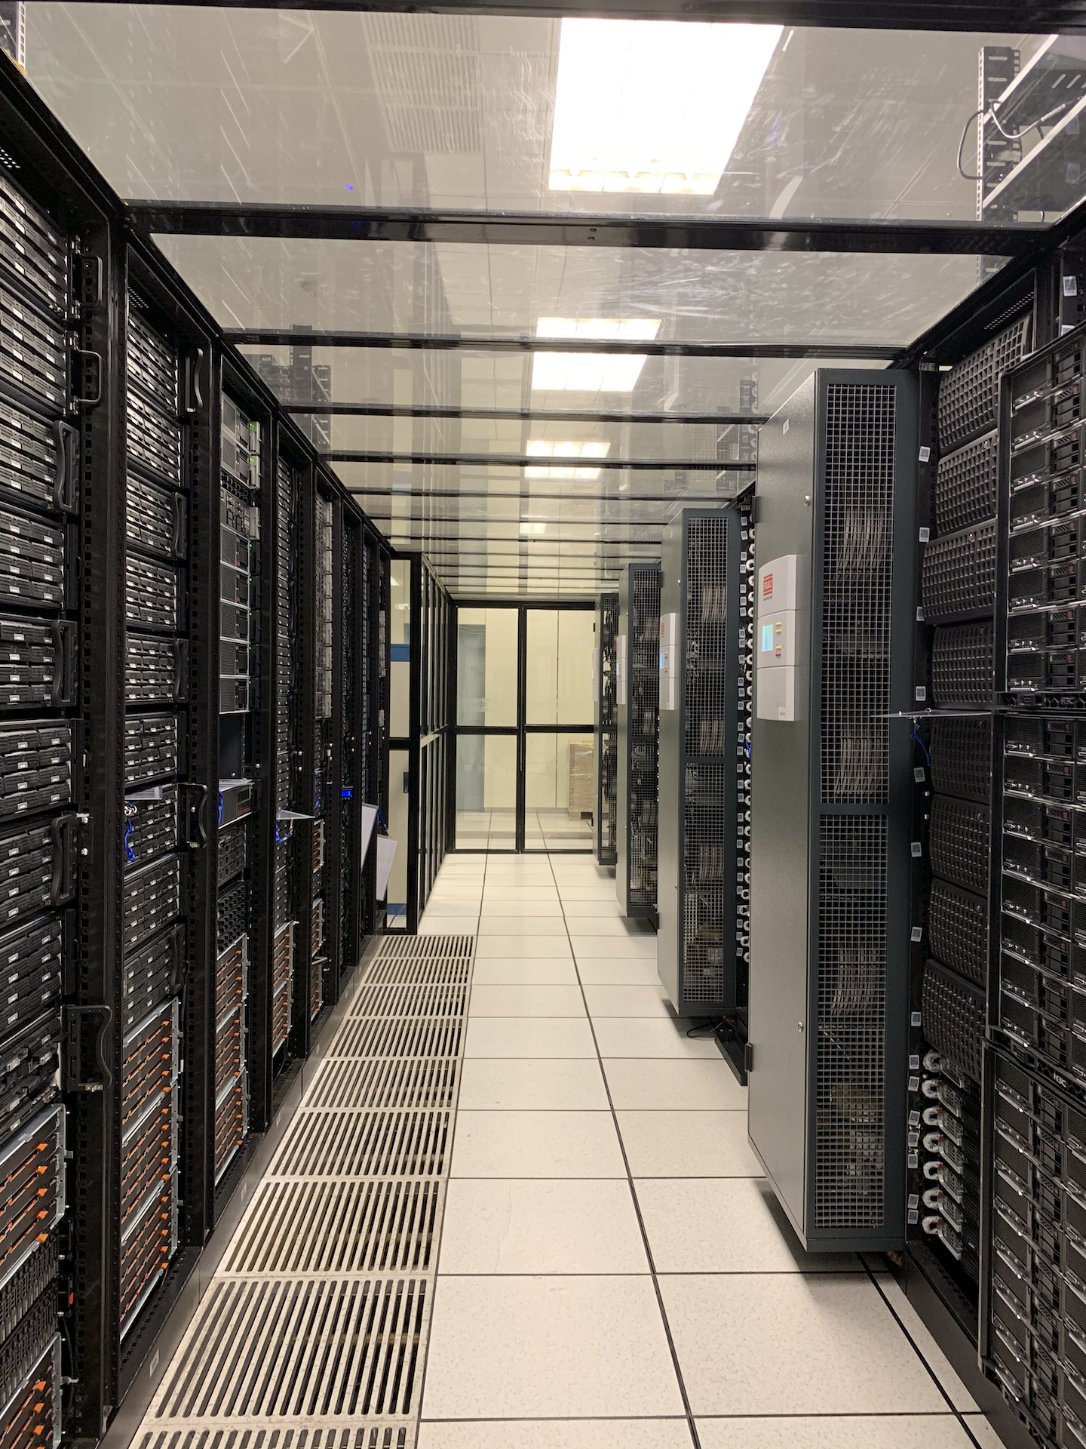
Computing Resources
Resources: 102k CPU cores
Distributed Locations
  Beijing, Dongguan, Huairou, Daocheng,
  Jiangmen, ….
Beijing:
  Local cluster: HTC,HPC
  Grid site
Dongguan for CSNS：
  Local cluster: HPC, with ~60k CPU cores
Huairou for HEPS:
  Being built, Computer room ready
  Interactive
  Local cluster: slurm

Slide 7
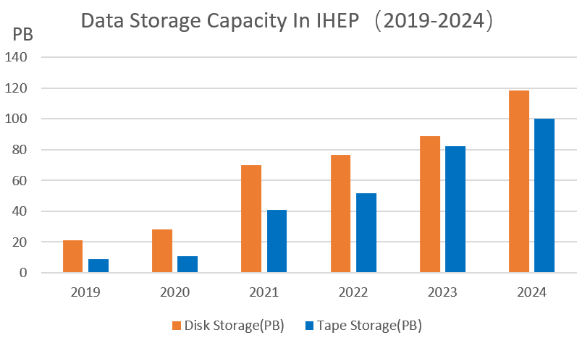
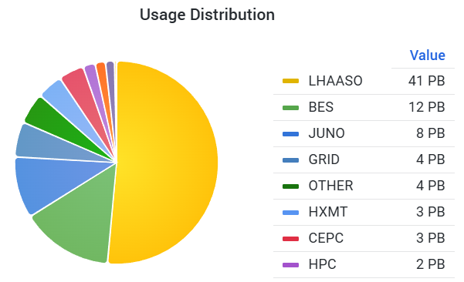
Storage Resources
~120PB Disk Storage
  Lustre: 45PB
    Mainly for BESIII/JUNO/HXMT/HPC…
  EOS: 75PB raw capacity
    Mainly for LHAASO/JUNO/GRID…
    Local: 60PB
    Grid: 15PB
~100PB Tape Storage
  EOSCTA for all experiments
WLCG SE
  LHCb T1 SE
    ~12 PB
  CMS/ATLAS/BELLEII/ALICE T2 SE
    ~3PB
Remote Site Storage
  Daocheng (LHAASO): 5.3PB
  Dongguan (CSNS): 8PB disk, 1.2PB tape
  Huairou (HEPS): 14PB disk, 2PB tape
  LZU Lhcb T2 SE: 4PB capacity
  USTC:3.8PB capacity
  SDU: 0.8PB capacity
Notes:
Starting with disk storage, we have around 120 PB in total:
Lustre has a capacity of 45 PB and is primarily used for experiments like BES, JUNO, HXMT, and HPC, with over 20 instances in operation.
EOS provides 75 PB of raw storage capacity, used mainly for LHAASO, JUNO, and GRID-related experiments. This includes 60 PB of local capacity and 15 PB for GRID.
Next, we have ~100 PB of tape storage.
This is managed by EOSCTA, supporting all experiments across 4 instances. Tape storage is crucial for long-term data archiving, especially for high-volume experimental data.
For the LHCb Tier 1 Storage Element (SE), we provide around 12 PB of raw capacity. Additionally, for Tier 2 SE, which includes CMS, ATLAS, BELLEII, and ALICE experiments, we have approximately 3 PB of capacity.
The graphs on the right give a visual overview of our storage capacity growth from 2019 to 2024, with both disk and tape storage steadily increasing. The pie chart illustrates usage distribution across various experiment, highlighting LHAASO, BES, JUNO, and others.
we have several remote sites supporting distributed storage needs， including Daocheng, Dongguan, Huairou, LZU USTC, SDU,etc.
站点状态一页
资源利用率、并行度
存储EOS 和

Slide 8
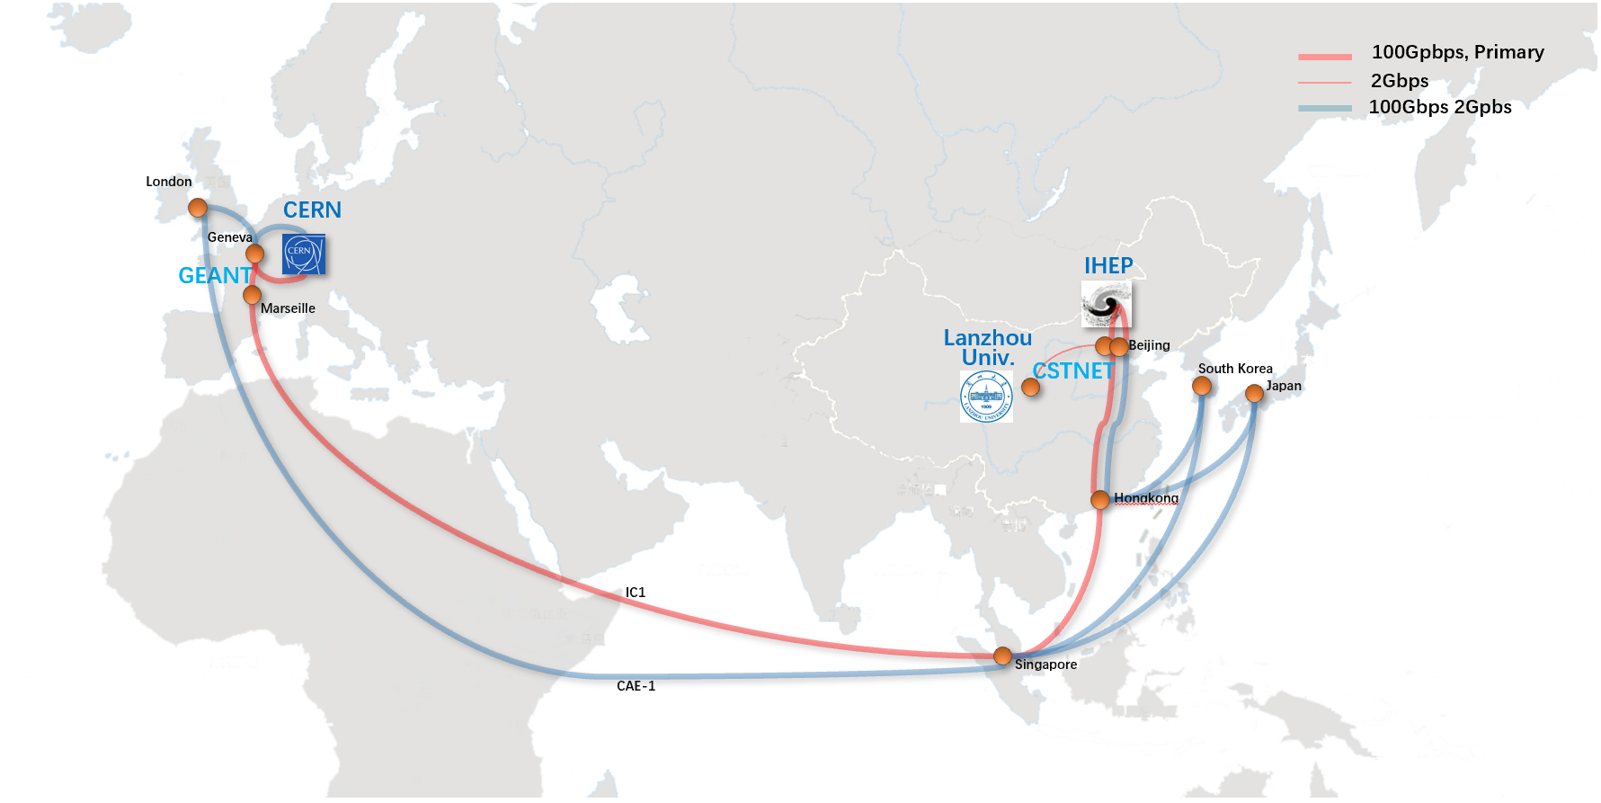
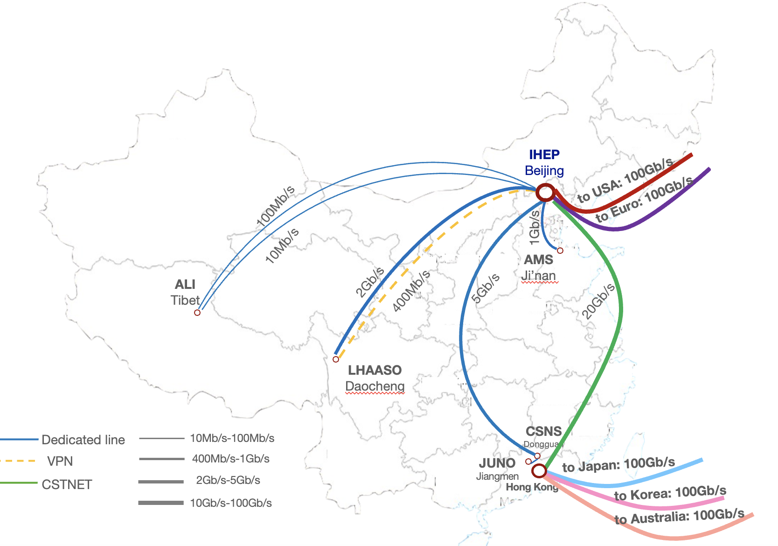
Network
International network links
  100Gbps between IHEP and Europe for LHCOPN and LHCONE, through CSTNet
  100Gbps to the US through CERNet, and to Asia-Pacific regions through CSTNet
Dedicated links between IHEP and remote sites
  HEPS-IHEP: 100 Gbps
  CSNS-IHEP: 20 Gbps
  LHAASO-IHEP: 3 Gbps
  JUNO-IHEP: 2 Gbps
  AMS-IHEP: 1 Gbps
  ALi-IHEP: 110 Mbps
International network connection of IHEP

Slide 9
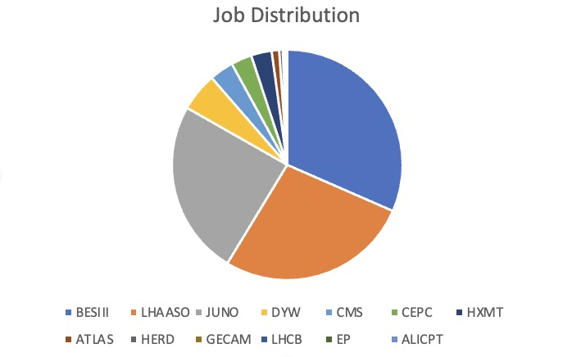
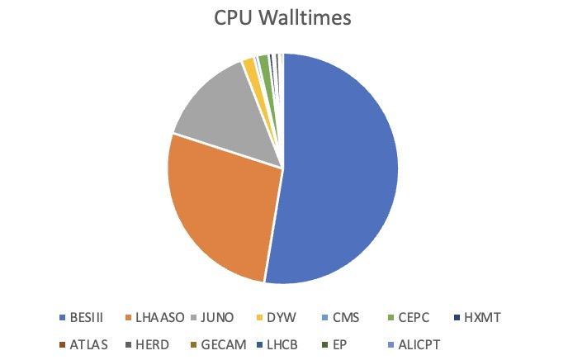
Services Provision
Applications/projects supported
  BESIII/LHAASO/JUNO/HEPS/LQCD/HERD/LHC/GECAM/EP/…
WLCG
CPU-core hours | CPU jobs | GPU card hours
420,708,300 | 207,773,776 | 1,018,111
ATLAS | CMS | LHCb | ALICE | Belle II | JUNO/CEPC
1728 cores, 1PB | 1728 cores 1.7PB | 3216 cores, disk 12.5PB, tape 10PB | 1152 cores, 0.84PB | 576 cores, 280 TB | 1584 cores, 2PB
6,371,949 core hours | 1,041,774 core hours | 24,154,756 core hours | 1,948,450 core hours | 1,244,053 core hours | 770,880 core hours

Slide 10
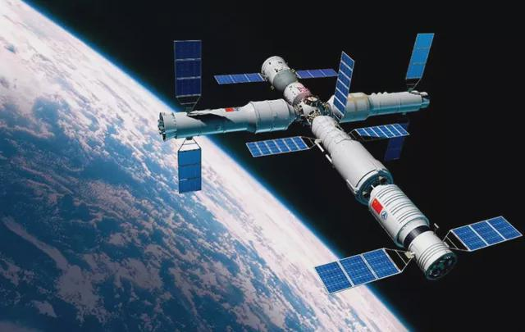
Scientific Data Platform for HERD
Simulation, Reconstruction
Study of Dark matter search, Cosmic ray origin
Data transfer, open sharing etc.
SDP：Scientific Data Platform:
  Receive experiment data from detector and engineering data
  Support data processing, scientific research and international collaboration.
Data
receiving
Data
Processing
Scientific
Research
Grid
Computing
User Management
Safety Certification
Information Services
Distributed Computing
Network Equipment
Computing Cluster
Data Storage
Tape Backup
Scientific Data Platform

Slide 11

HERD Data Processing Flow
Download data from Space Station, save to Data Transfer Cache
Move data to Unified Storage Area, Trigger different data processing procedure according to data type (engineering, telemetry and detector data)
Standard reconstruction，(Download again if problem with integrity)
For detector data, after checking, obtain a persistent identifier in the global storage system, and save to metadata management system (bookkeeping)
Data from Standard reconstruction is used for monitoring, calibration etc.
After calibration, data used for data analysis is generated by PassN Reconstruction
  Normally once/6 months；N in “PassN” means major change of software version, all of the data need to be reconstructed.
Workflow Engine
Data Transfer
Standard Reconstruction
Registration
PassN Reconstruction
Checking
Download from Space Station
Calibration Data
Detector Data
Data Transfer Cache
Unified Storage Area
Bookkeeping
House Keeping/
Time Dependent
Variables
Engineering/telemetry data

Slide 12




HERD Grid Computing Platform
Sharing of data and resources based on grid computing technology
T0 at CSU
  Data reconstruction, simulation etc.
  Data saving of all type, Tape backup
T1 in CN and EU, IHEP and INFN）
  Saving all type of data, Enable data and resource sharing
  Synchronize data with T0, distribute data to T2
  INFN site set by EU
T2s at institutes and universities in Asia and EU
  Data simulation, data analysis
  Accessing grid data and contributing resources
T3s in the other institutes/universities
  Accessing grid data
  Computing resource not shared
CSS
High speed dedicated line
(10~100Gpbs)
T0
CN-T1
EU-T1
High speed international link
(10~100Gpbs)
T1
CN-T2
EU-T2
T2

Slide 13

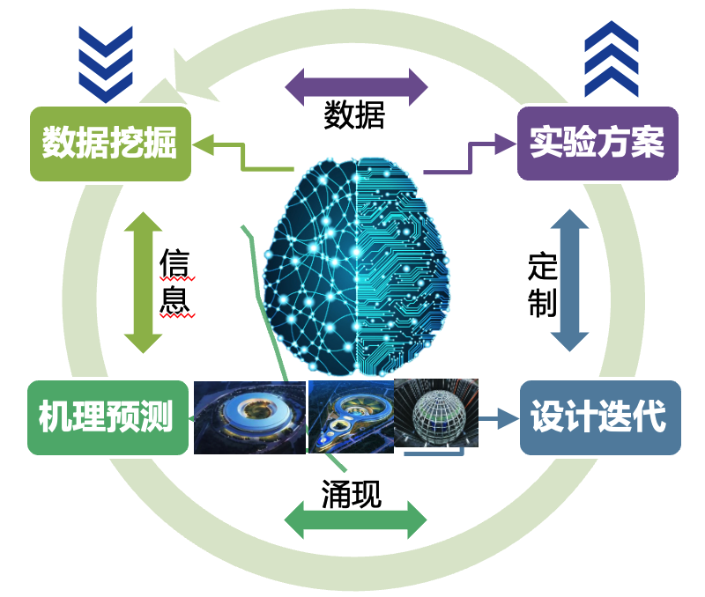
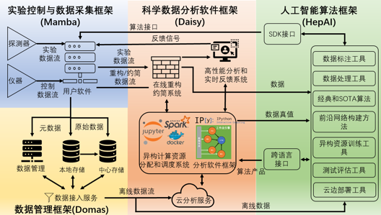
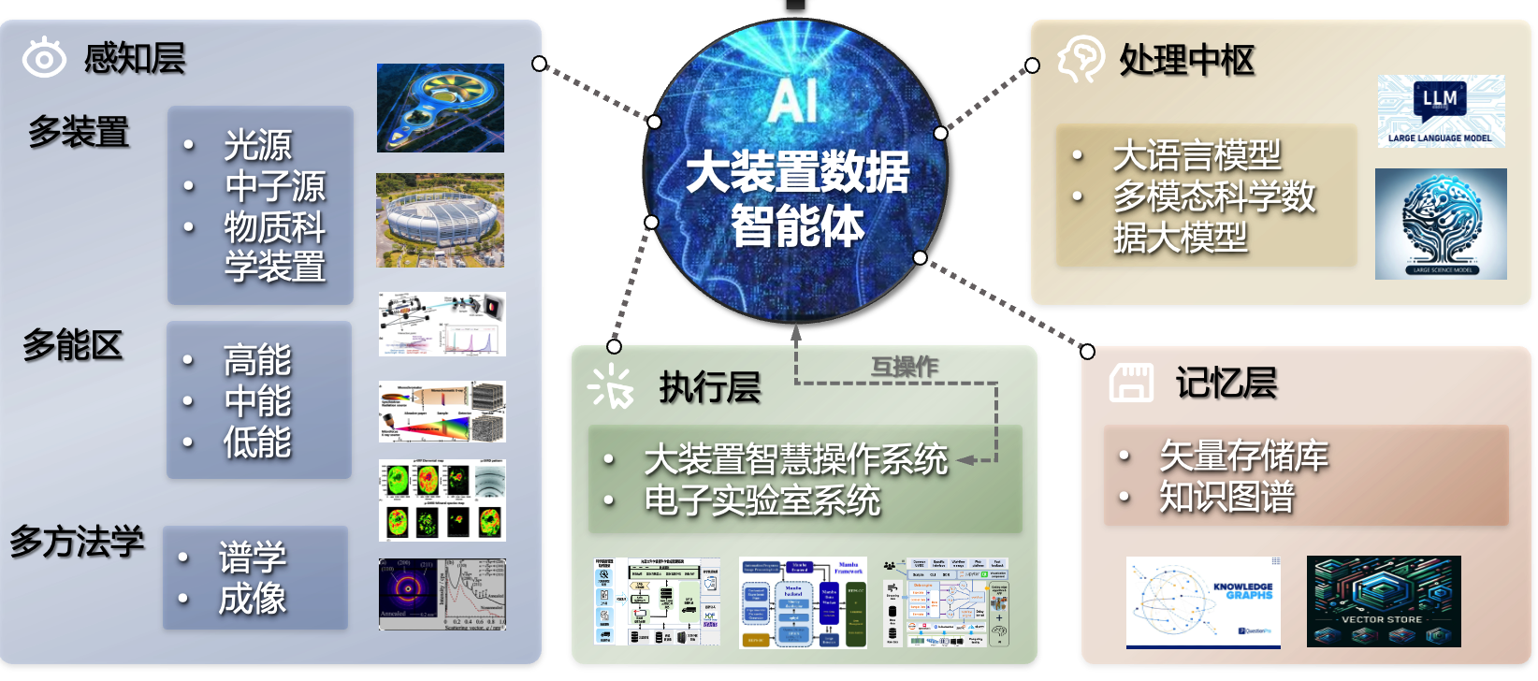
Computing for HEPS
Big data and computing challenges from HEPS
  Complicated facilities, huge size of data
Facility/instrument operations, conducting of the experiments and research are key processes for data generation and application
Data, Computing and Software (also, AI) are key elements in this chain
Data Generation and Preservation
Data Application
Experimentation
Data
Experimental Process Control
Multiple Facilities
Data Software Frameworks and Tools
Data Integration and Standardization
Facility Operation
Multiple Beamlines
Experimental Design
Multiple
Methodologies
Scientific Data Process
DATA
COMPUTING
SOFTWARE
Source：Hao Hu

Slide 14
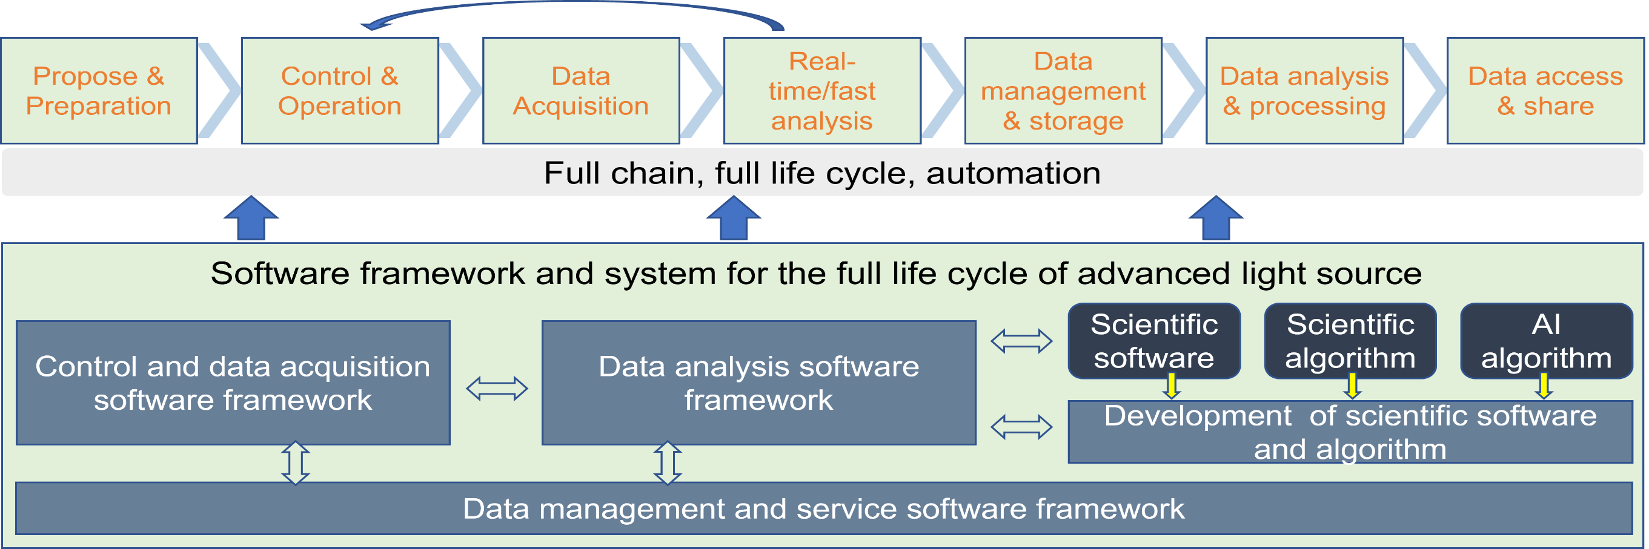
Computing for HEPS
(Mamba)
(Daisy)
(Domas)
Infrastructure and Services: Storage , Computing , Database , Middleware , Software / Cyber and Data Security
Policy and Rules
Common requirements : infrastructure + software framework and system for the full data life cycle
Specific requirements: porting, developing and integrating algorithms, tools and workflow for different beamlines ➔ Hao Hu and Yu Hu’s talks yesterday and tomorrow afternoons

Slide 15
AI Project: Dr. Sai for BESIII/HEP
AI Agent: AI tools capable of autonomously performing complex tasks
  LLM = brain -> AI agent = human
AI agent based on LLM model (switchable: GPT/LLaMa/DeepSeek)
  A demo: Xiwu model, based on Llama 3, trained with a part of BESIII internal data, e.g. memo/drafts, BOSS source code, Q-A during internal review
One milestone: AI assistant (https://drsai.ihep.ac.cn)
  Chatbot, MC generation, signal extraction, and a navigator inside BESIII
  Capable of simple task
  Ready for BESIII internal test !
Final goal: AI scientist, it can analyze the collision data automatically
  Developing new AI models, targeting at ~2027
Source：ZD Zhang

Slide 16
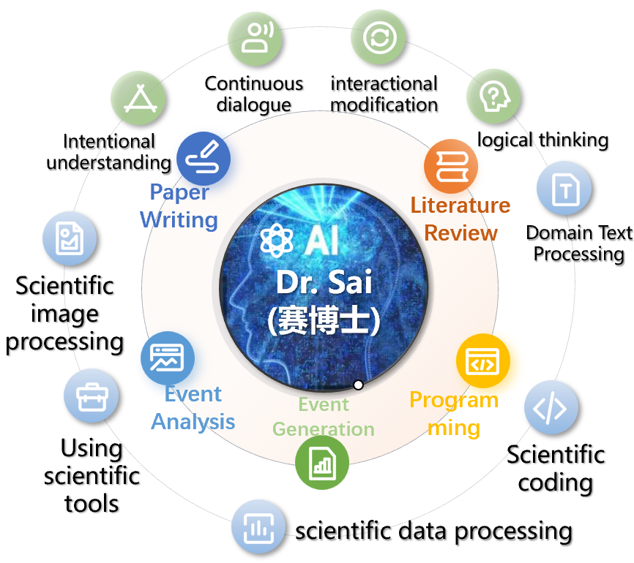
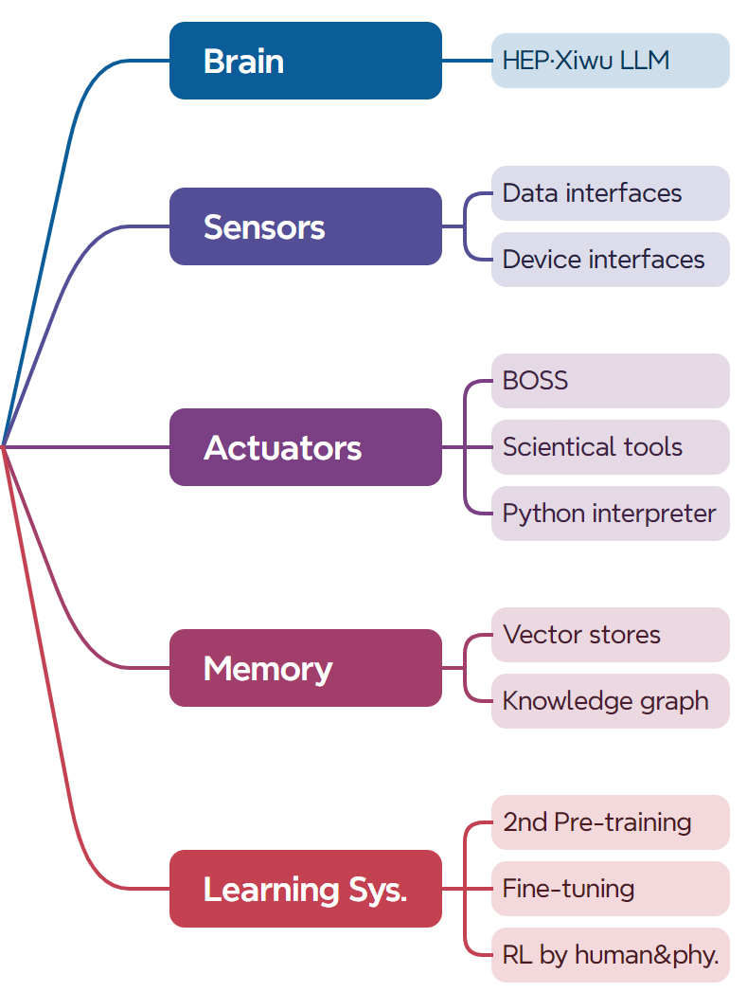
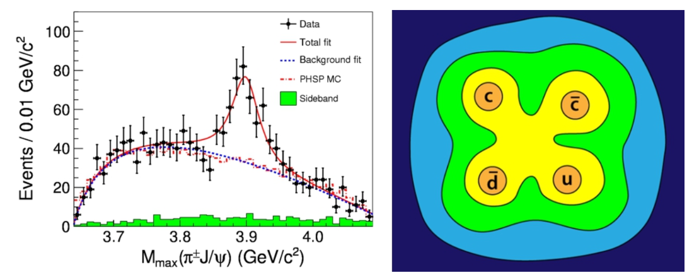
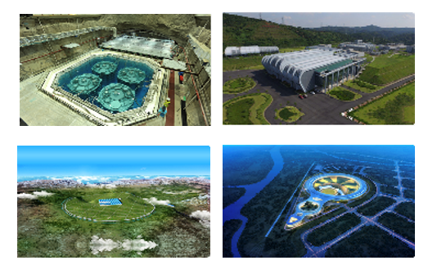
Overview of Dr.Sai Agent
Let the large model conduct particle physics research
Essential: Modeling the research process.
Rediscover
Zc(3900)
Applications
Tasks & Required capabilities
Components
➔ ZD Zhang’s talk Friday Morning
Source：ZD Zhang
Notes:
The basic idea is to let the large model conduct particle physics research - from literature review, to programming, event generation, event analysis, and even paper writing.
Of course, we equip it with the corresponding components to achieve the required capabilities.
If we can get the Dr.Sai to rediscover Zc3900 tetraquark resonance particle, then it could carry out research tasks given by scientists, and it might lead to new discoveries."

Slide 17
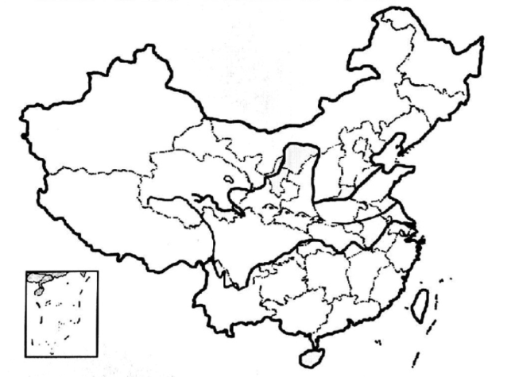
Grid Sites in China
WLCG Sites in China
New Sites
  Beijing-T1 for LHCb
  Lanzhou-T2 for LHCb
  Beijing-T2 for ALICE
Existing Sites at IHEP
  Beijing-LCG2 for ATLAS,
  CMS
  BelleII site
PKU-T3
(CMS)
BEIJING-T1
Tier1(LHCb)
BEIJING-LCG2
Tier2(ATLAS,CMS,ALICE,
BelleII)
Lanzhou-T2
(LHCb)
USTC-T3
(ATLAS)
HK-LCG2
(ATLAS)
Notes:
Now let’s take a look at the Grid sites in China
This figure shows the WLCG sites in China, new sites include Beijing-T1 for LHCb, Lanzhou-T2 for LHCb and Beijing-T2 for ALICE.
Existing sites at IHEP are Beijing-LCG2 for ATLAS, CMS and Bellell site.
I will introduce the new sites one by one.

Slide 18
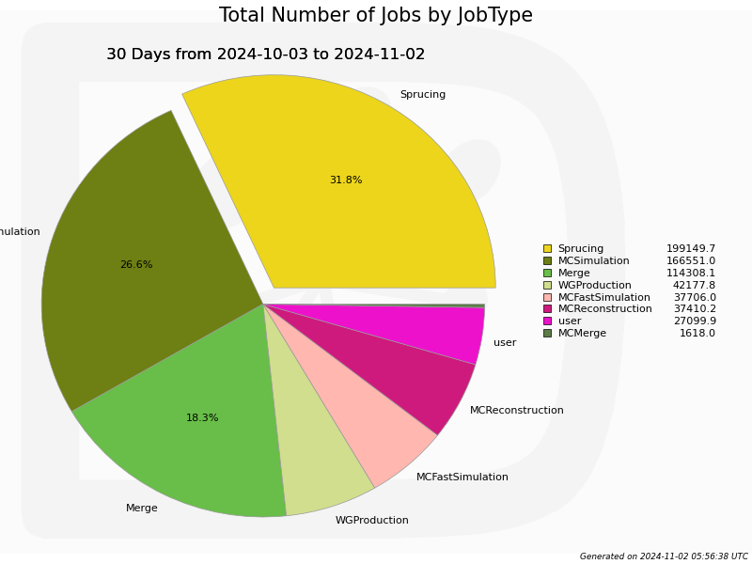
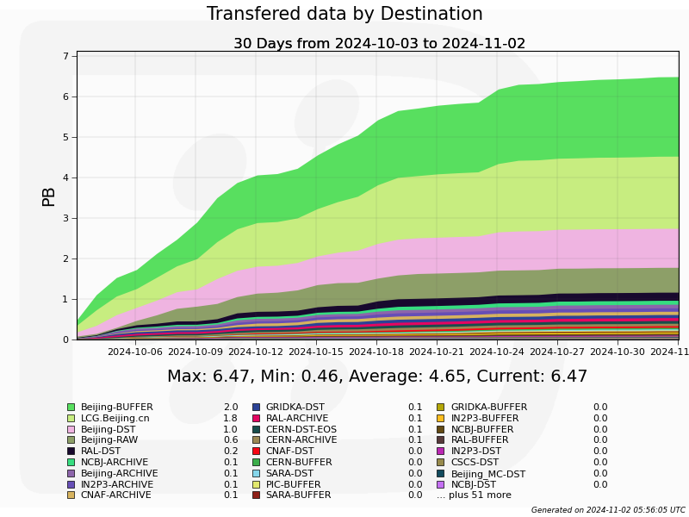
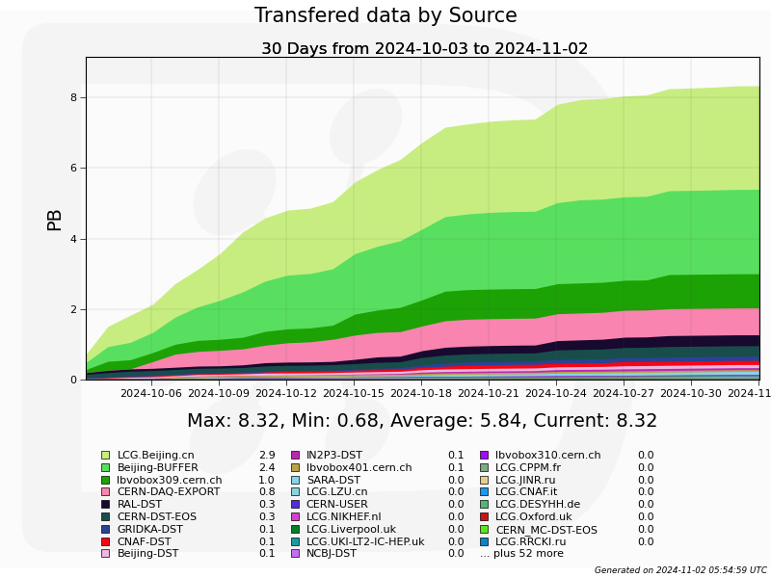
The LHCb Tier-1 Site at IHEP
Fully official Tier-1 site now
  Passed the site review in WLCG OB meeting in last June
  Fully functional support for LHCb in last September
Resources
  3200 CPU cores (will be double to ~6500 CPU cores)
  12.5 PB disk storage
  10 PB Tape storage
Total Number of Jobs
Data Volume of Read Out
Data Volume of Write In
Notes:
In June IHEP passed the site review in WLCG OB to become a Tire-1 site
In September, we begin to provide fully functional support for LHCb.
Currently, we provide 3200 CPU cores and it will be double to 6500 soon.
The storage support include 5.75 PB disk storage and 3 PB Tape storage, where 6.5 PB disk storage will be added in next two weeks, and 6 PB tape storage will be added as well.

Slide 19
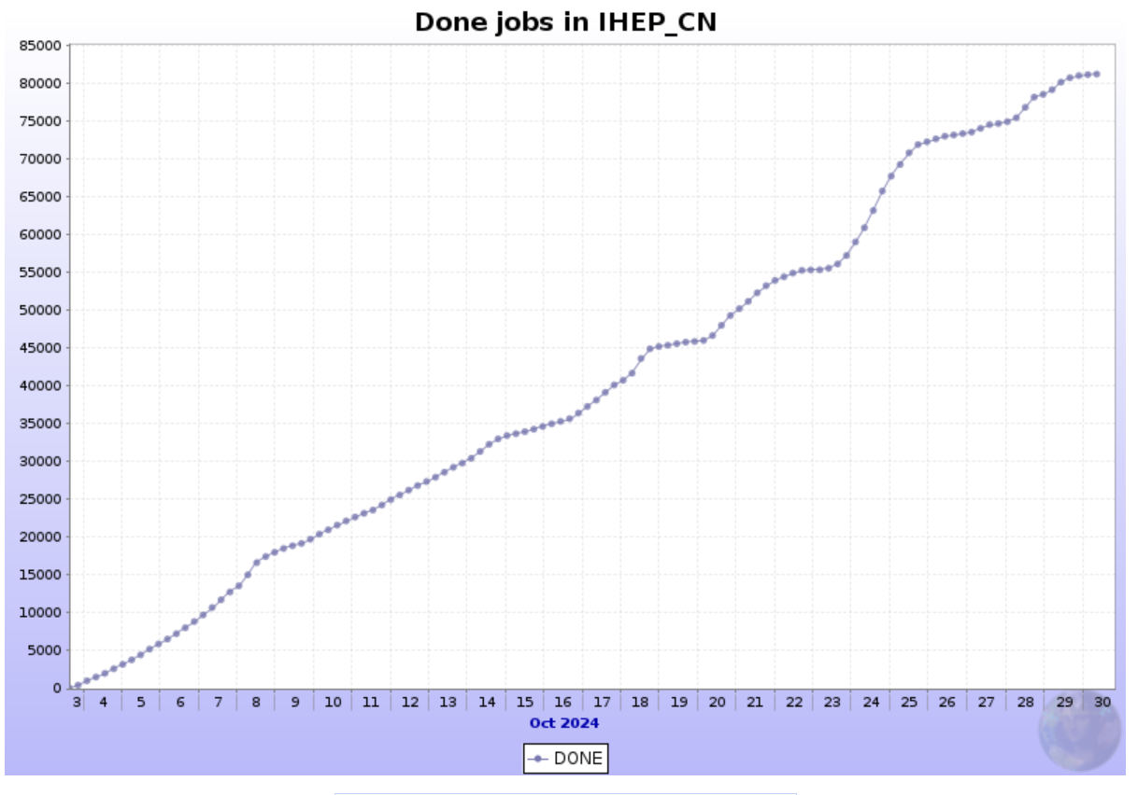
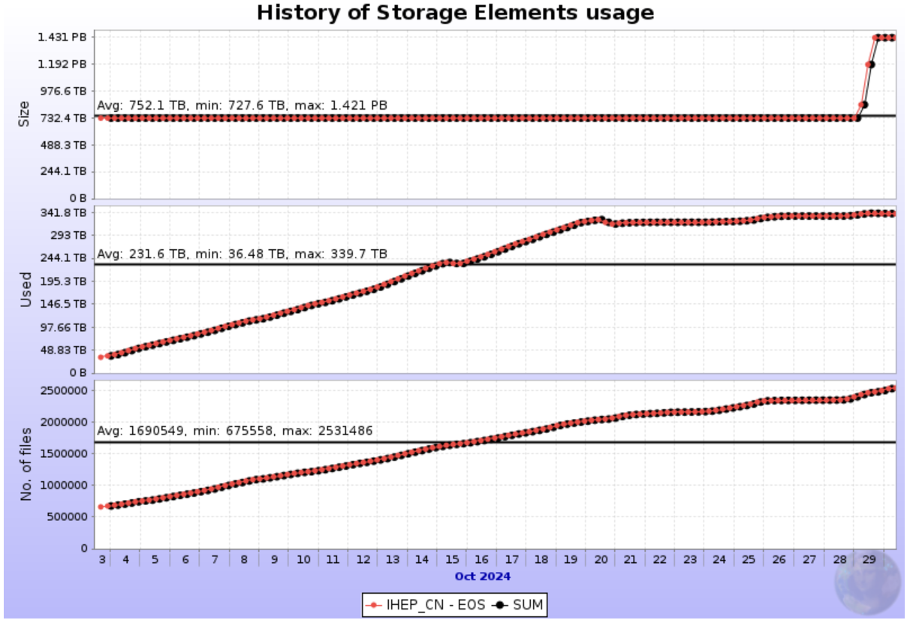
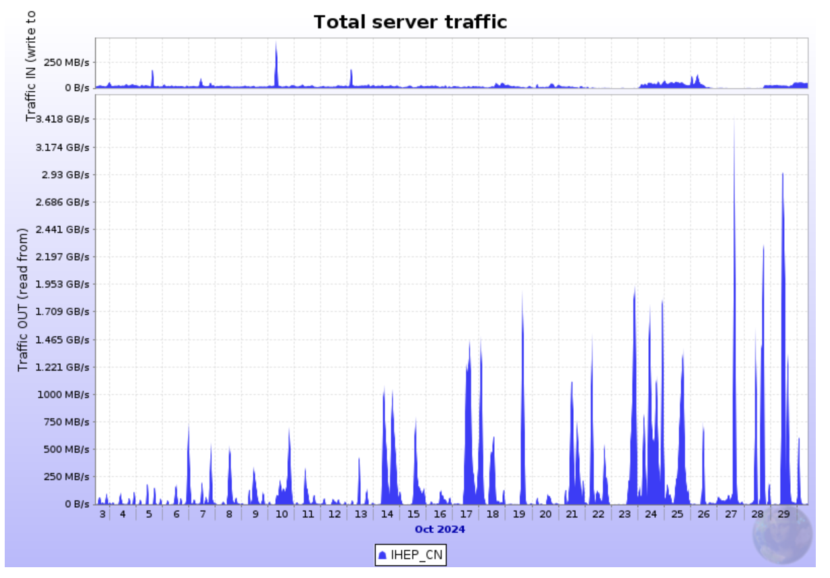
The Alice Tier-2 Site at IHEP
The first Alice Tier2 site in China.
Resources are provided by Fudan University.
  1152 CPU cores, ~800TB Disk Storage
  HTCondor CE + EOS SE
Services in production since the end of September.
Done Jobs
Usage of EOS SE
Network Traffic
Notes:
The alice Tire2 site at IHEP is the first Alice site in China. The resources are provided by Fudan University, with 1152 CPU cores and about 800TB of disk storage. The services are in production since the end of September.

Slide 20
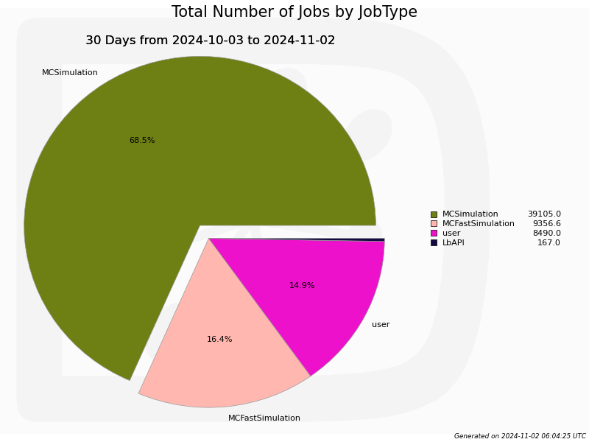
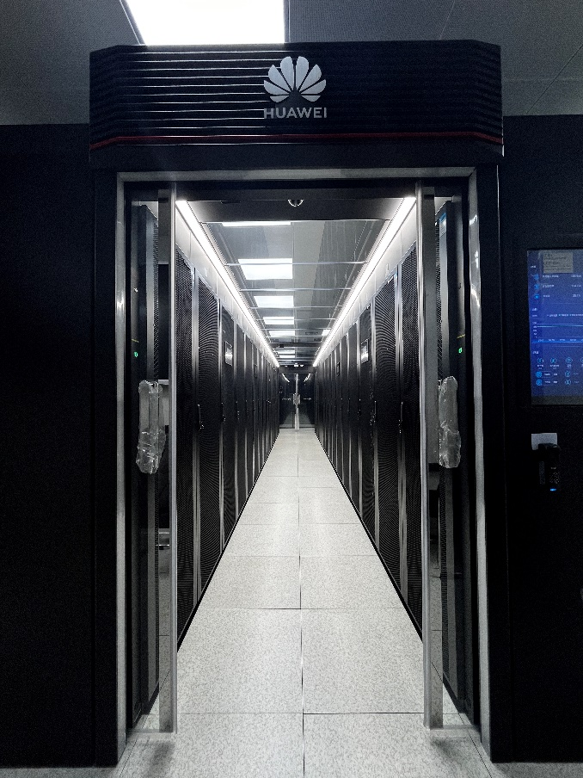
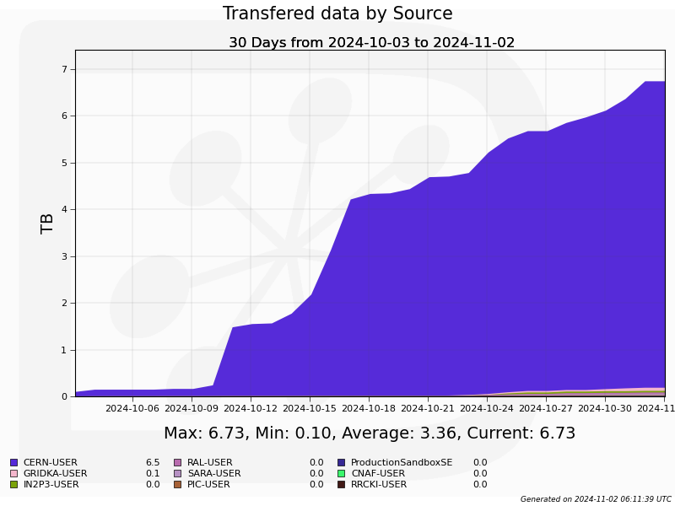
The LHCb Tier-2 Site at Lanzhou Univ.
Proposed at the end of 2021
  Tier2 Site for LHCb
  Local cluster for domestic Exp., such as BESIII, Super Tau Charm Facility etc.
Funds approved at the end of 2023: ￥60M
Ready for production in Sept. 2024
  LHCb Tier-2
    3520 CPU cores with 77K HS23
    3.4 PB disk capacity
  Local Cluster:
    2880 CPU core with 63K HS23
    2.1 PB disk capacity
  Network:
    WAN: dedicate link with 2Gbps to IHEP
    LAN backbone bandwidth: 800Gbps
Maintenance
  Hardware maintained by LZU
  System software maintained by IHEP
Total Number of Jobs at T2
Machine room
Data Volume of Write In
Notes:
The LHCb Tire2 site at LZU provides 3500 CPU cores and 3.4 PB of Disk storage. The services are also in production in September.

Slide 21
Comments and Acknowledgement
In addition to the expansion and upgrading of computing infrastructure, significant efforts have been devoted to artificial intelligence development in 2024.
The primary focus for 2025 will center on implementing AI applications in HEPS and CSNS.
With JUNO and HEPS scheduled to commence experimental data collection this year, more efforts must be made have the computing systems capable of supporting large-scale data challenges.
Special thanks to Hao Hu, Yu Hu, ZD Zhang, Jingyan Shi, …, for contributing to this talk.

Slide 22
Thank you

