Slide 1
WLCG Strategy for HL-LHC
International Symposium on Grids & Clouds (ISGC) 2025
Taipei
Simone Campana (CERN)

Slide 2
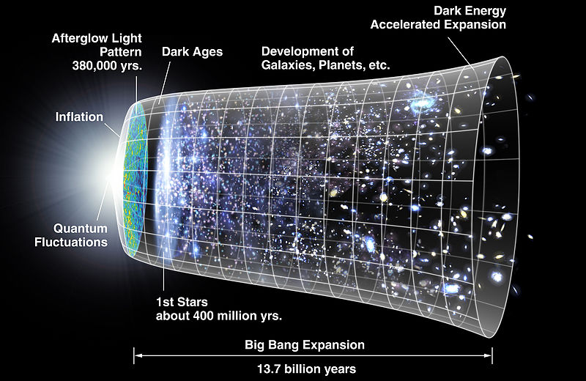
High Energy Physics
“The branch of physics dealing with the constitution, properties, and interactions of elementary particles especially as revealed in experiments using particle accelerators” (Webster)
Recreate the conditions of the early universe
– as “early” as possible –
by colliding particles as very high energy

Slide 3
The Large Hadron Collider @ CERN
27 km ring of superconducting magnets and accelerating cavities
Proton bunches
>10¹¹ protons/bunch
(colliding at ~40MHz)
p
p
p-p collisions with interesting parton interactions (<kHz)
New Particle!
(<<mHz?)
Four large detectors – ALICE, ATLAS, CMS, LHCb

Slide 4
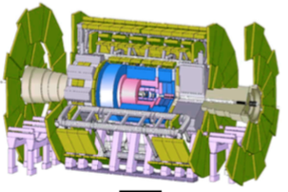
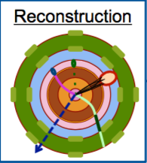
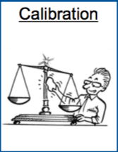
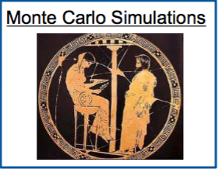
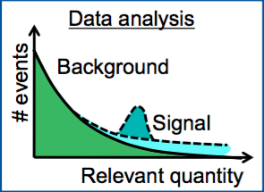
Computing @ High Energy Physics
“Online” – Real time
~40 MHz
L1 Trigger (HW)
HL Trigger (SW)
~ PB/s
~100 kHz
5 to 10 kHz
From Big Data (40 Million collisions/s
To Useful Data (>1000 events/s) for analysis
“Offline” - Asynchronous
>1MB/event
>200 PB/year

Slide 5
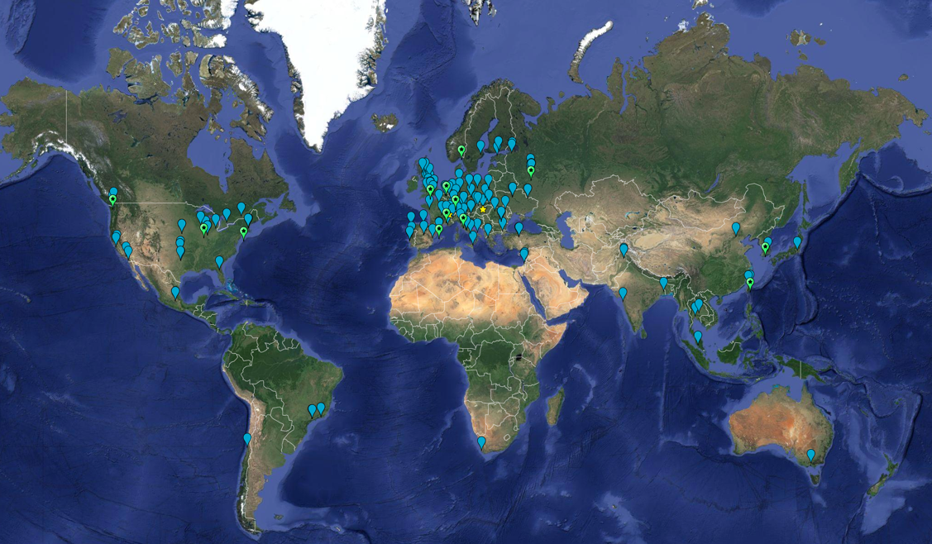
Distributed vs Centralised Computing
Large scale HEP computing embraced a distributed model since early 2000s
Based on network service technologies, federating national and international initiatives
The distributed grid model fits:
the national strategies of the Funding Agencies: develop the cyberinfrastructure for scientific computing in the country – data centres, networks and the required expertise
the distributed nature of the HEP community: hundreds of institutes contributing as part of the HEP experiments and international collaborations

Slide 6
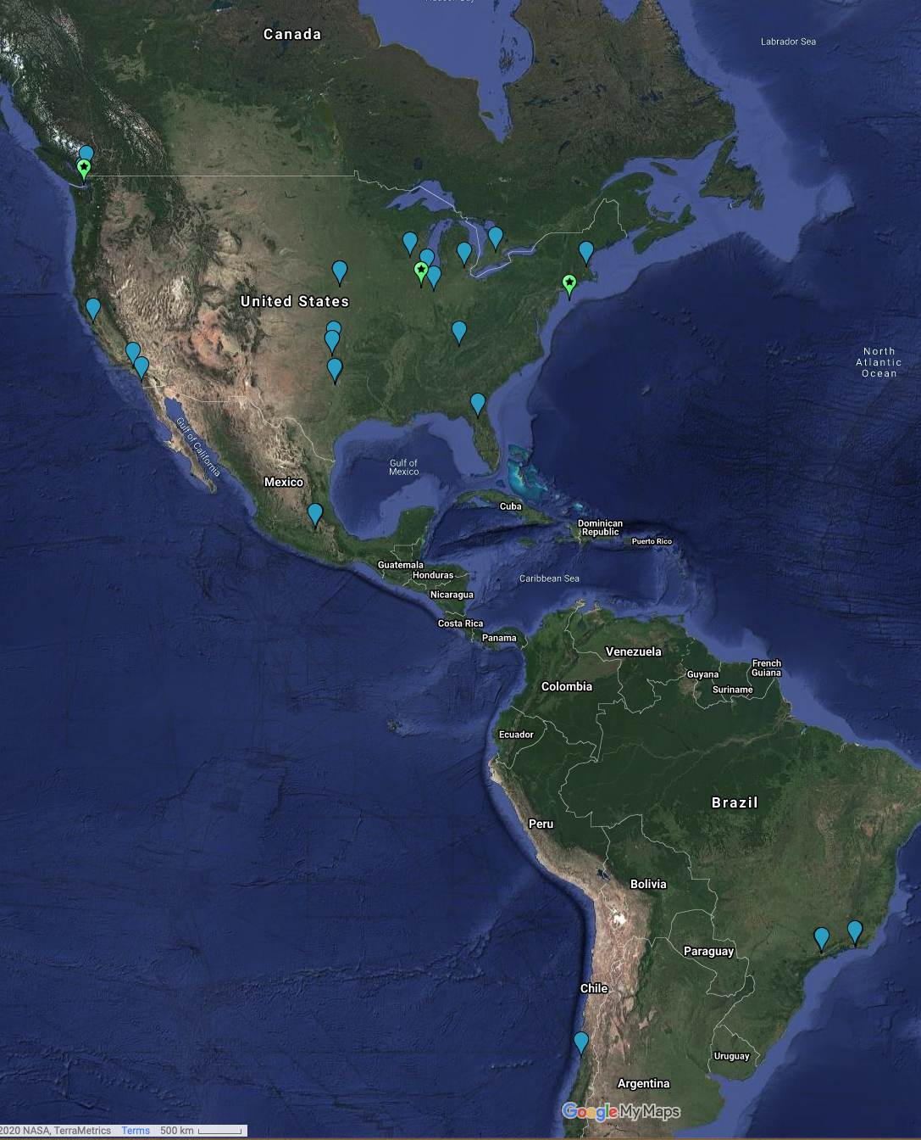
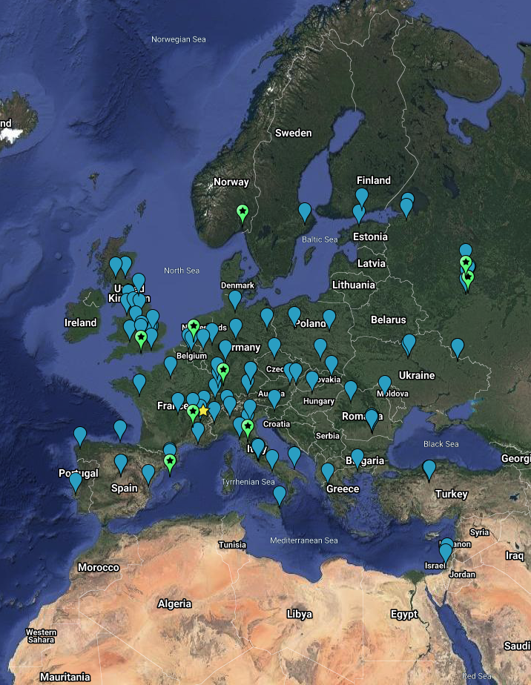
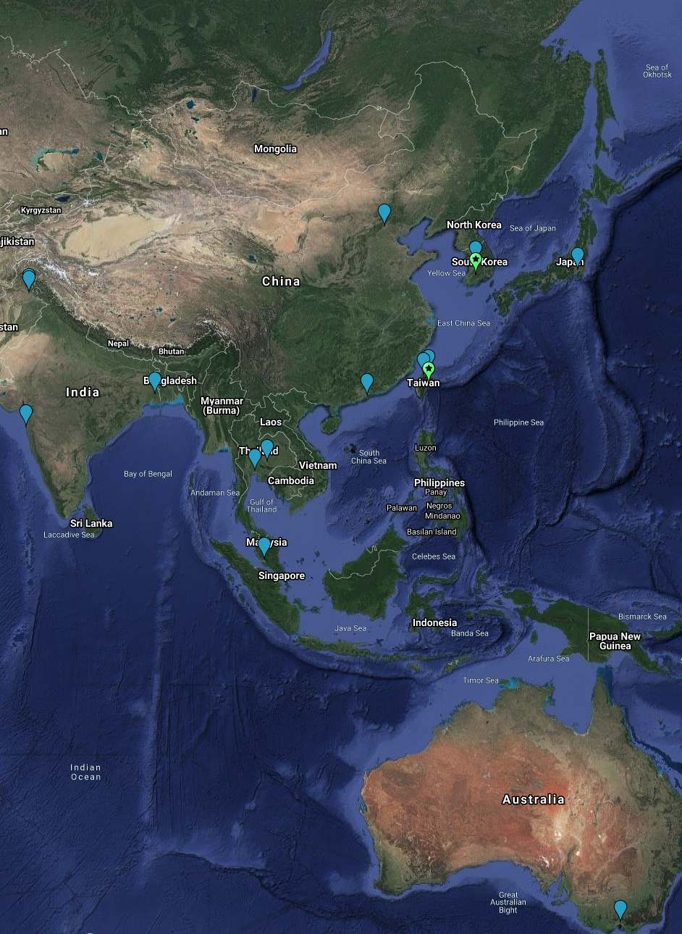
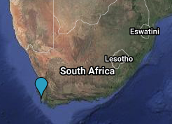
The WLCG Collaboration provides the distributed computing infrastructure
for the needs of the CERN Large Hadron Collider experiments

Slide 7
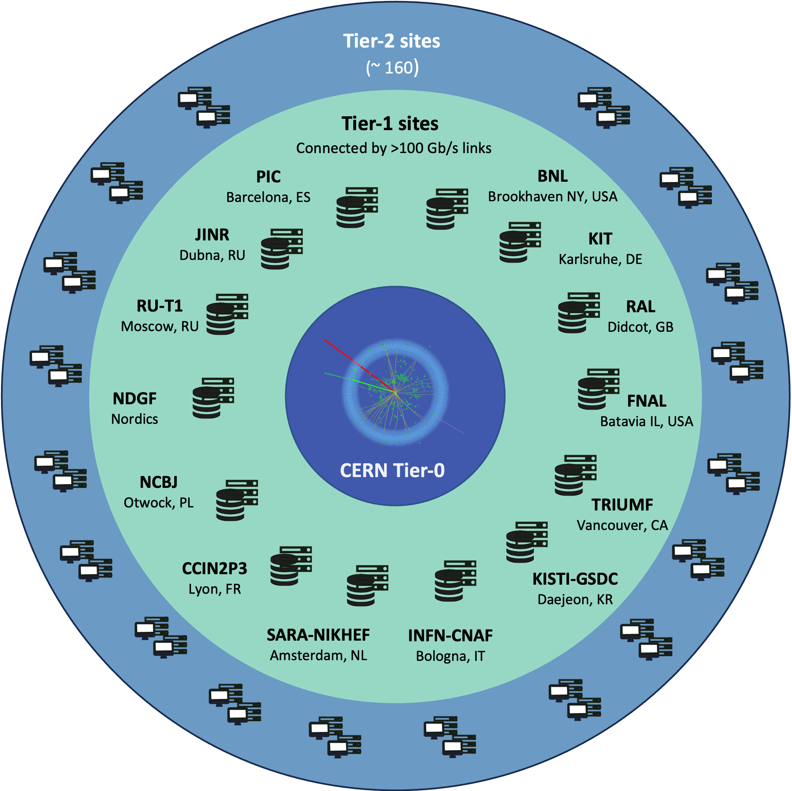
WLCG in Numbers…
65 MoUs, 40+ countries, 164 sites
The success: meets the needs of the LHC experiments
by the integration of globally distributed Exascale resources with services and software
within a trust framework that transcends site and national boundaries.
WLCG Resources 2025
CPU (cores) | ~1.3M
Disk (PB) | ~1EB
Tape (PB) | ~2EB

Slide 8
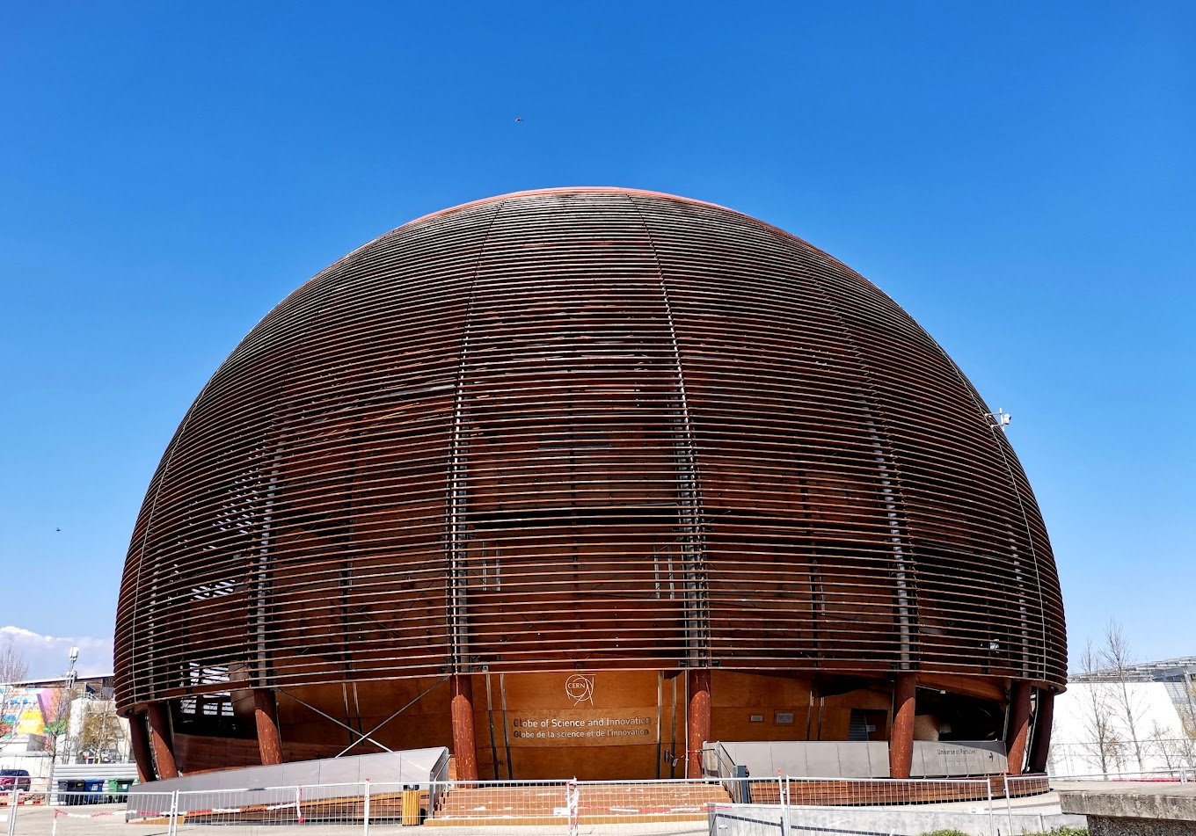
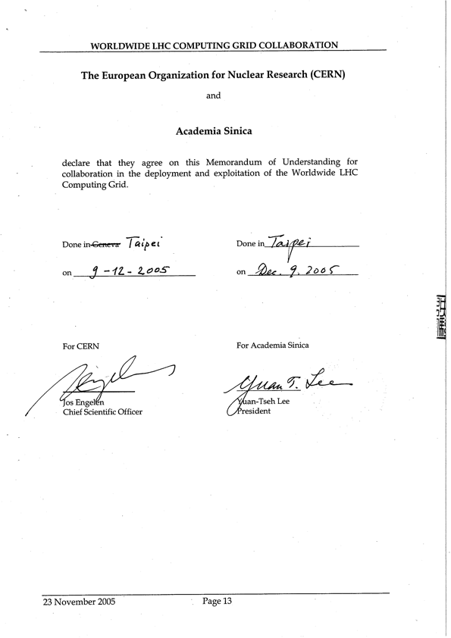
WLCG 20th anniversary
The first WLCG MoU was signed by CERN and Academia Sinica on Dec 8, 2005
Thanks to: Simon Lin, Eric Yen,
Stella Shen and Vicky Huang
and the whole ASGC team
WLCG 20th anniversary event at CERN on the Dec 8, 2025

Slide 9
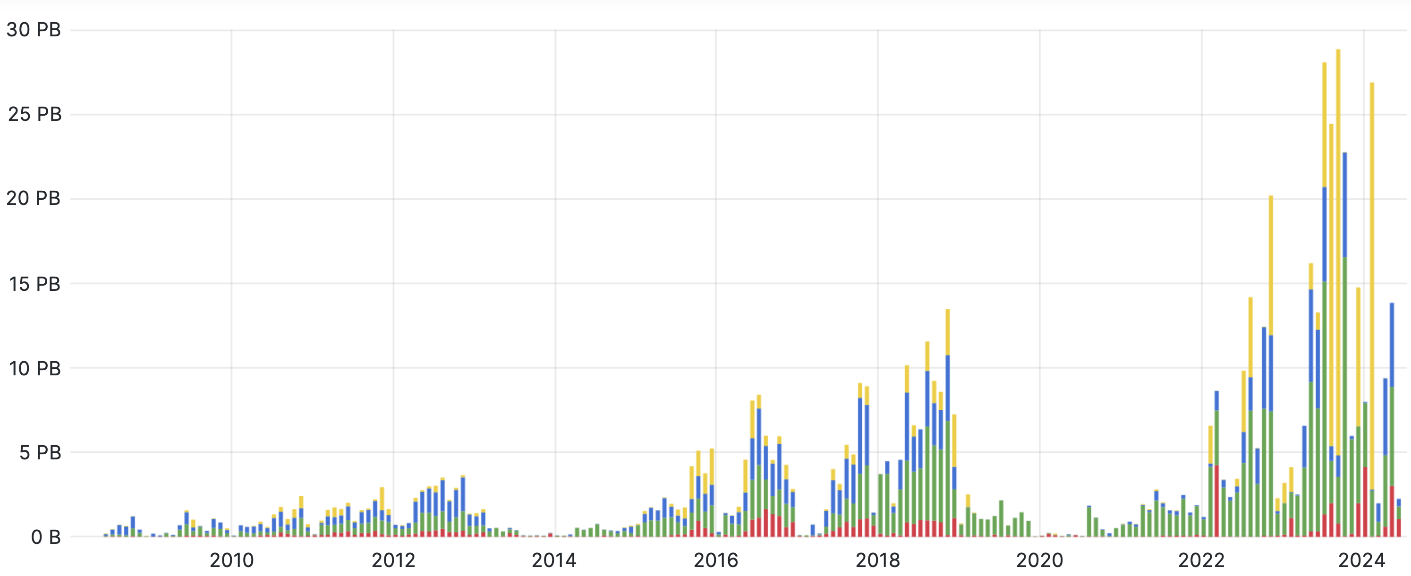
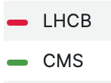

The LHC RAW data archive
The LHC physics program is organized in ”runs” interleaved by “Long –Shutdown” periods
Monthly volume of data archived at the T0 (PB) – since LHC started
Run-3
LS2
Run-2
LS1
Run-1

Slide 10
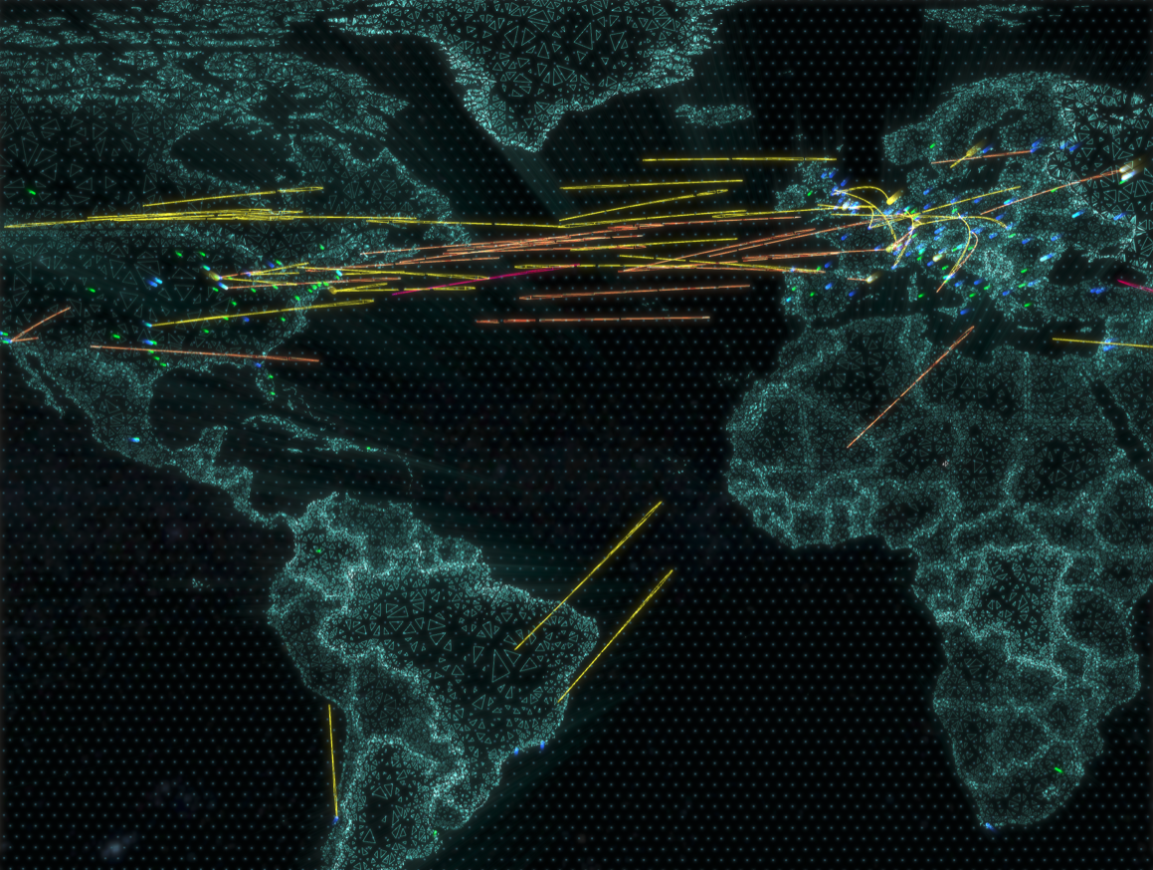
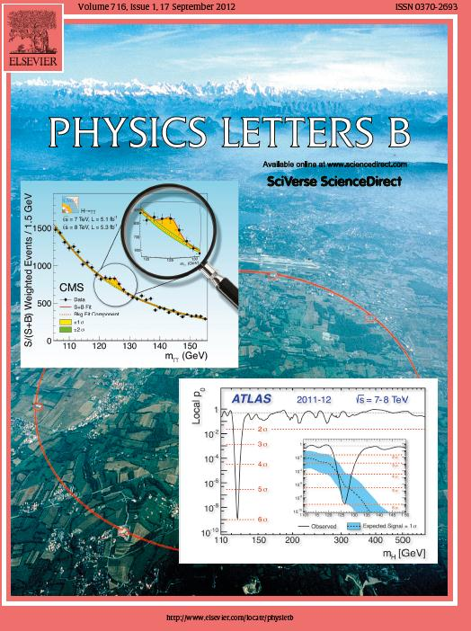
Worldwide data processing and data transfers 24/7/365, since 2006, increasing over time. Very high availability and reliability. Solid funding model.
Never a showstopper to physics. Fast turnaround.
It simply works … so what?

Slide 11
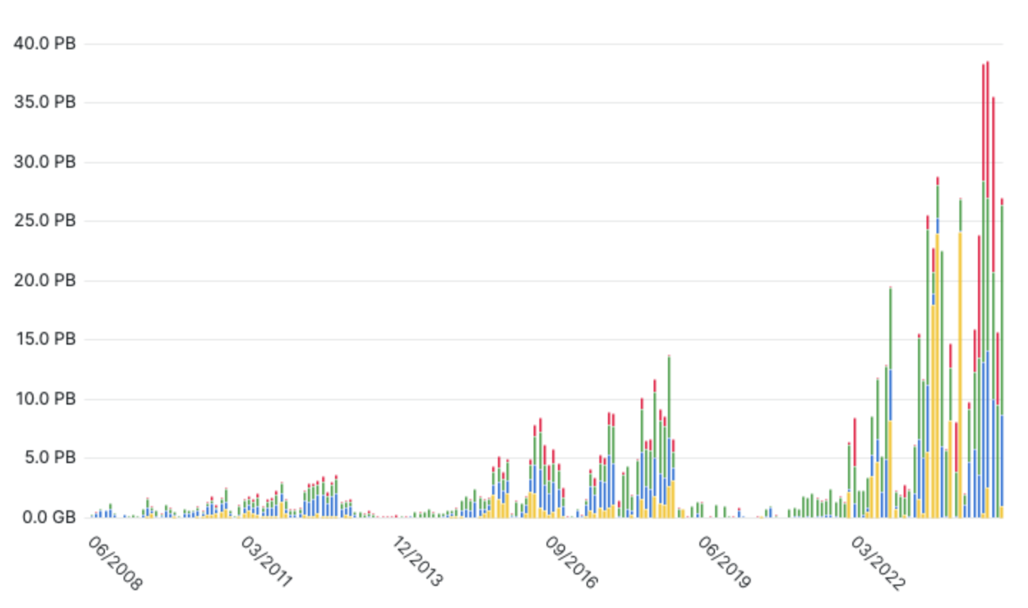
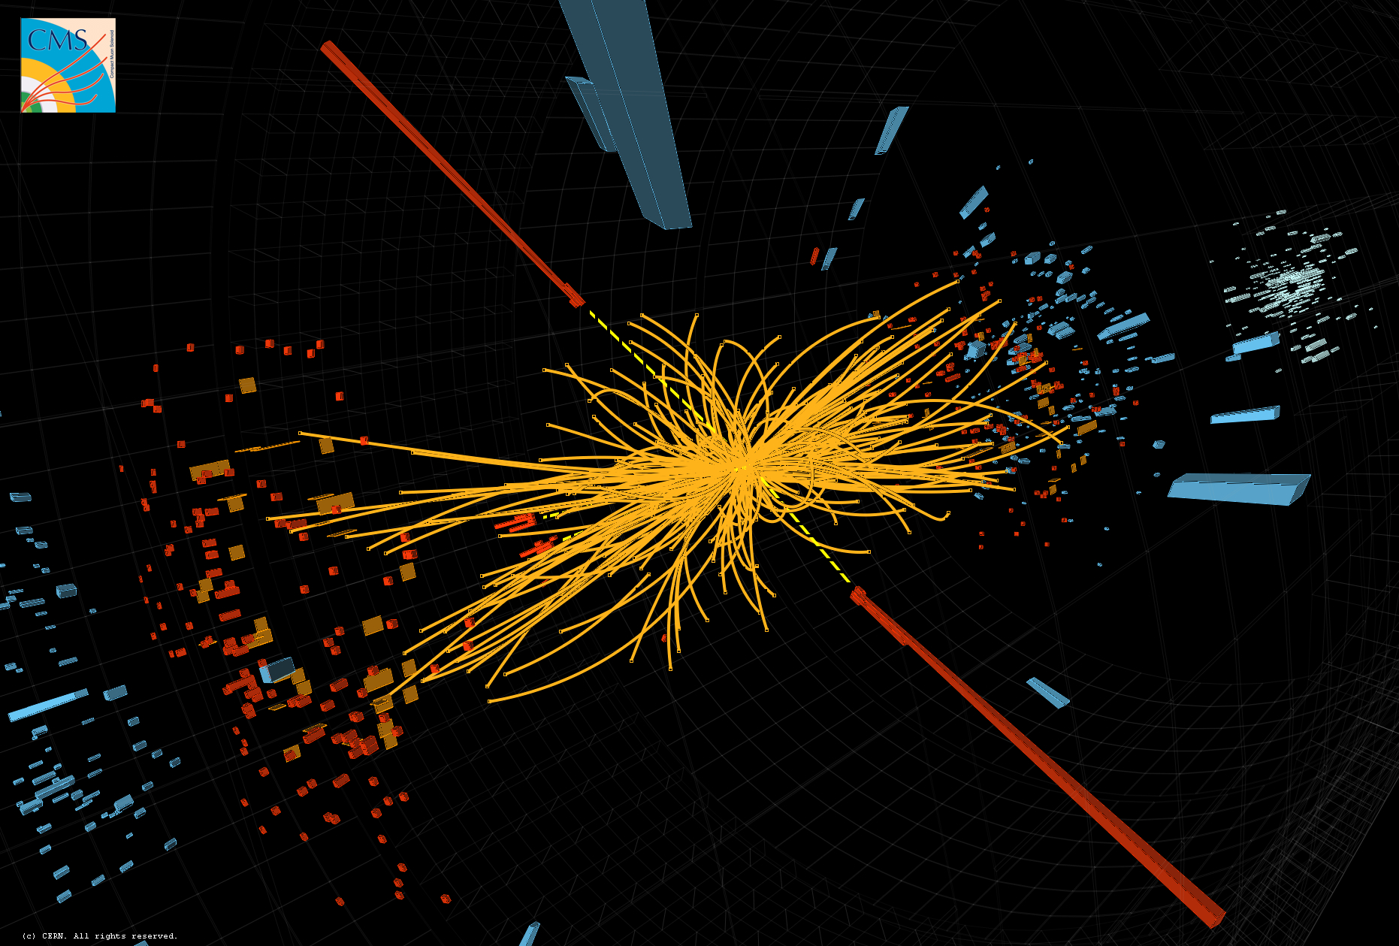
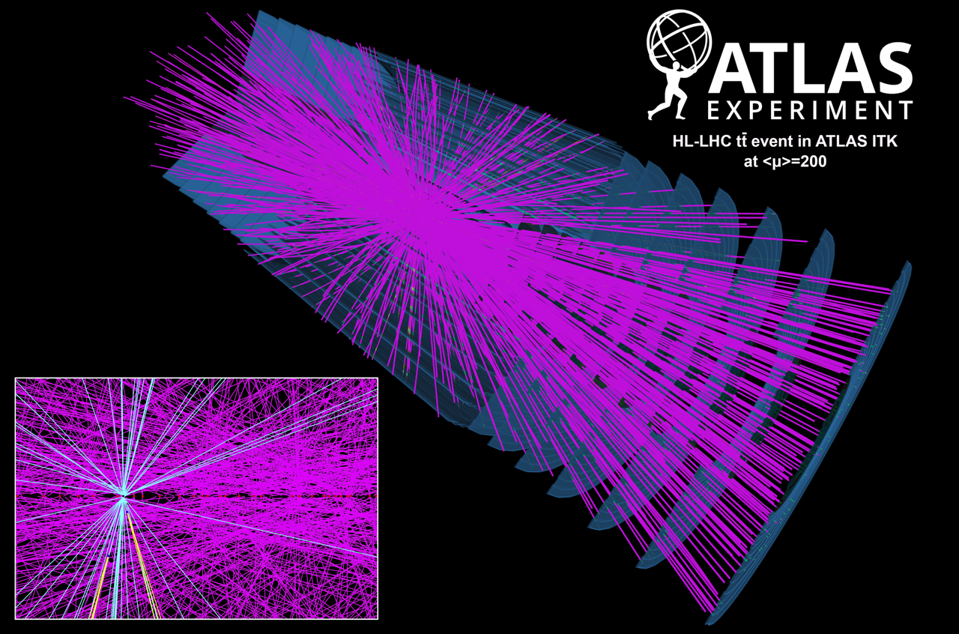
The HL-LHC challenge – data volume and complexity
LHC data written to CERN archive (PB/month)
2011 Higgs candidate
HL-LHC simulated event
2009
2010
2011
2012
2013
2014
2015
2016
2017
2018
2019
2020
2021
2022
2023
2024
2025
2026
2027
2028
2029
2030
2031
2032
2033
2034
2035
2036
2037
(…)
LHC Run-1
LS1
LHC Run-2
LS2
LHC Run-3
LS3
HL-LHC Run-4
LS4
HL-LHC Run-5
L=29 fb-1
L=156 fb-1
L~350 fb-1
L~900 fb-1
L~1200 fb-1

Slide 12
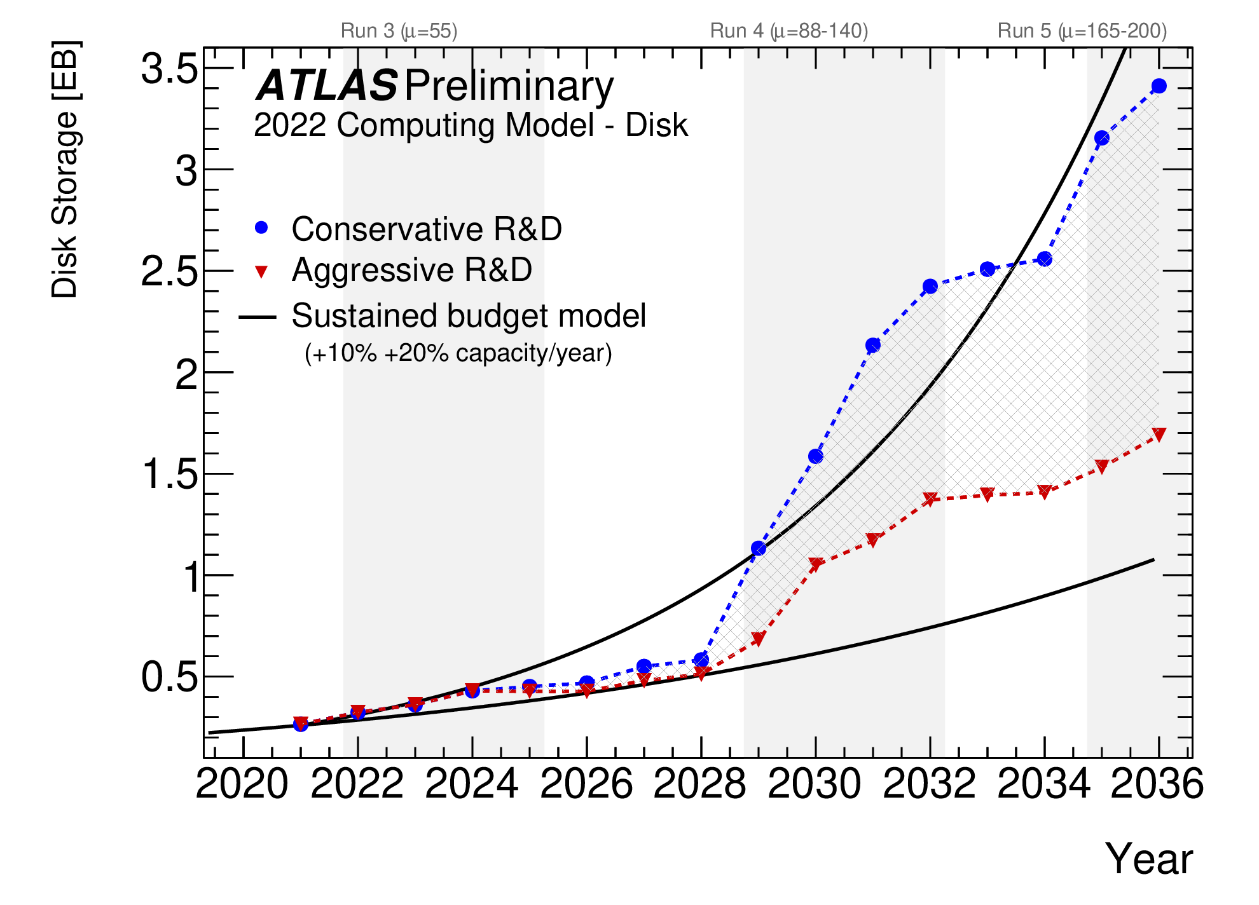
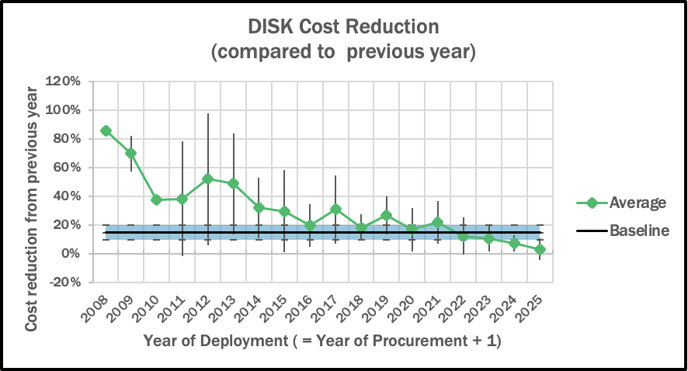

The HL-LHC challenge –hardware trends
Cost of hardware decreasing vs time 😄 … but not as steeply as before 😳
In general, trends driven by market (revenues) rather than technology
ATLAS Phase-2 computing model (2022)
10% cost reduction
Difficult to support the HL-LHC computing needs w/o a budget increase (unlikely to happen)

Slide 13

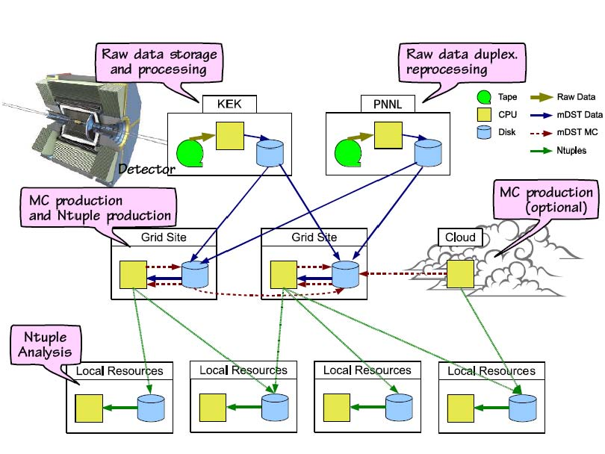


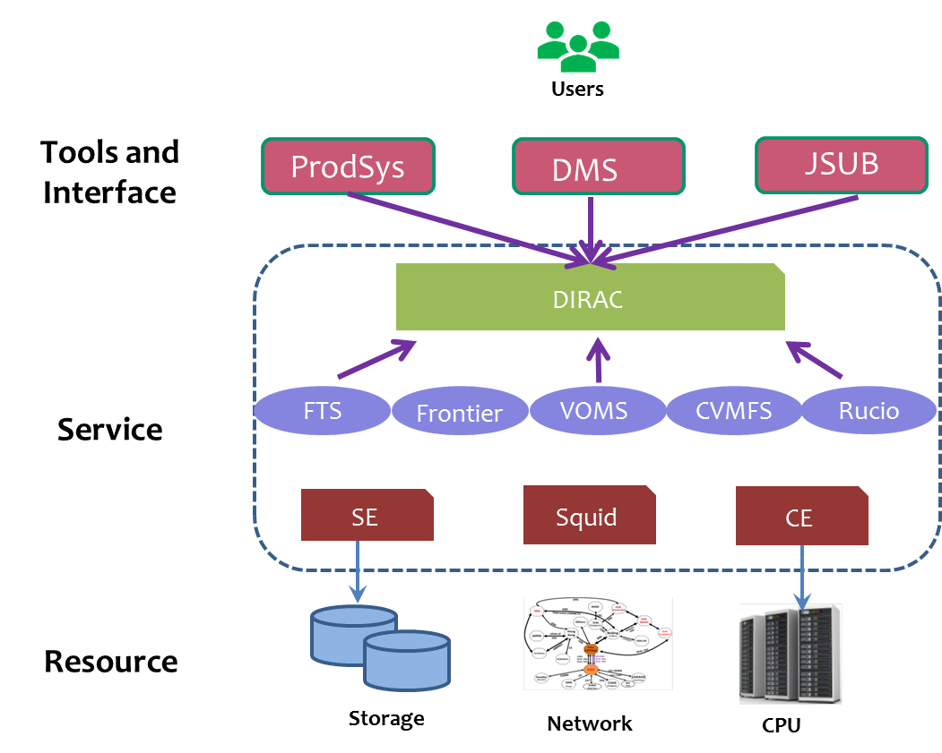
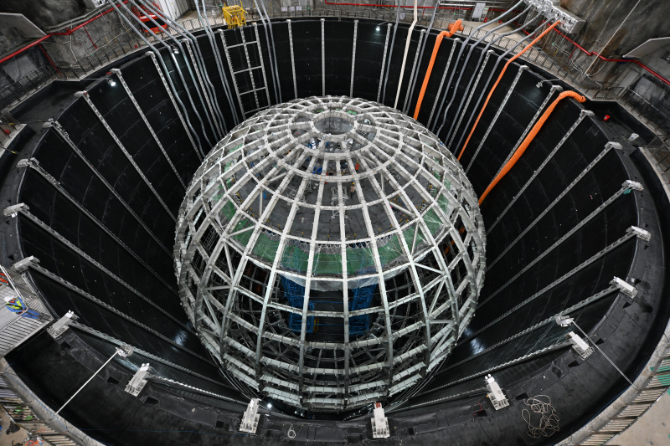
Not just LHC .. more HEP experiments in the 2020s
Computing needs:
~10% of HL-LHC

Slide 14
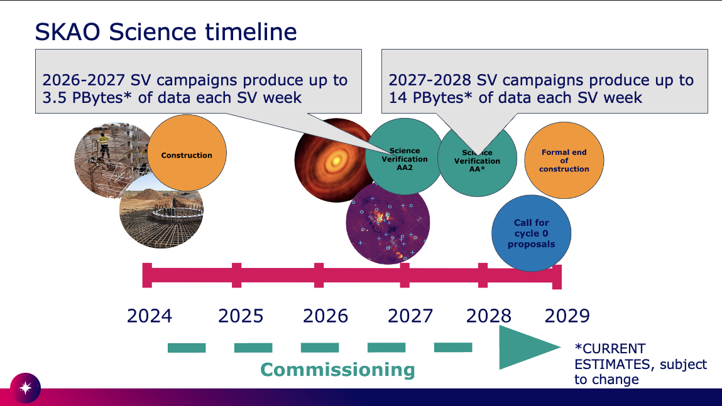
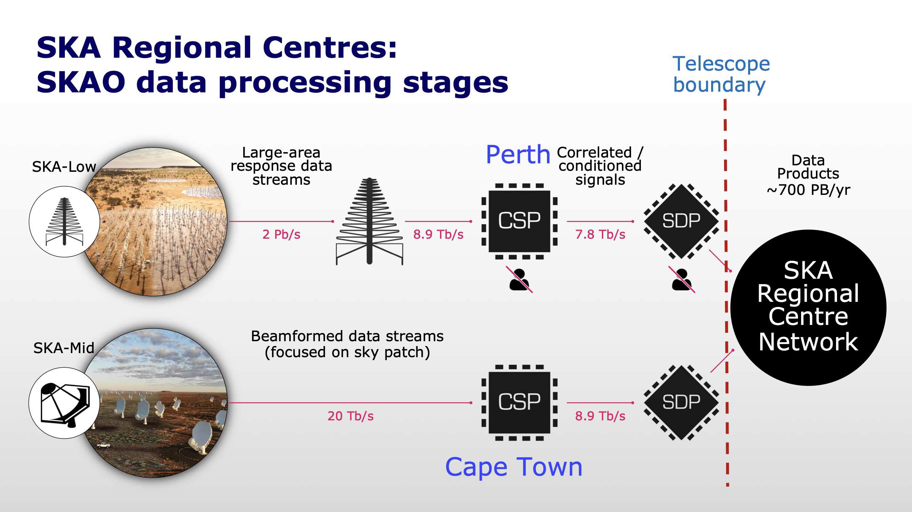
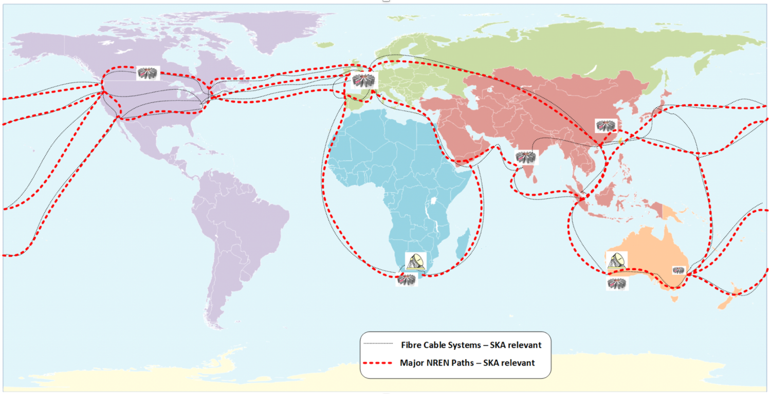
And more sciences …
Other sciences will have data needs like LHC in the same time horizon.
SKA is the main example: expect 700 PB/year of data products

Slide 15
The future HEP computing challenge in 6 points
1) 10x more data/year and 5x more complex. HL-LHC computing is the main driver
2) No considerable increase in funding for HEP computing expected in the coming years
3) Trends in hardware technology and costs not favorable to HEP
4) Geopolitical situation very unstable, impacting a distributed infrastructure and collaboration
5) Many HEP computing services were conceived in a different millennium and the Information and Communication Technology landscape changed considerably
6) The Funding Agencies want to see their investments to benefit multiple sciences

Slide 16
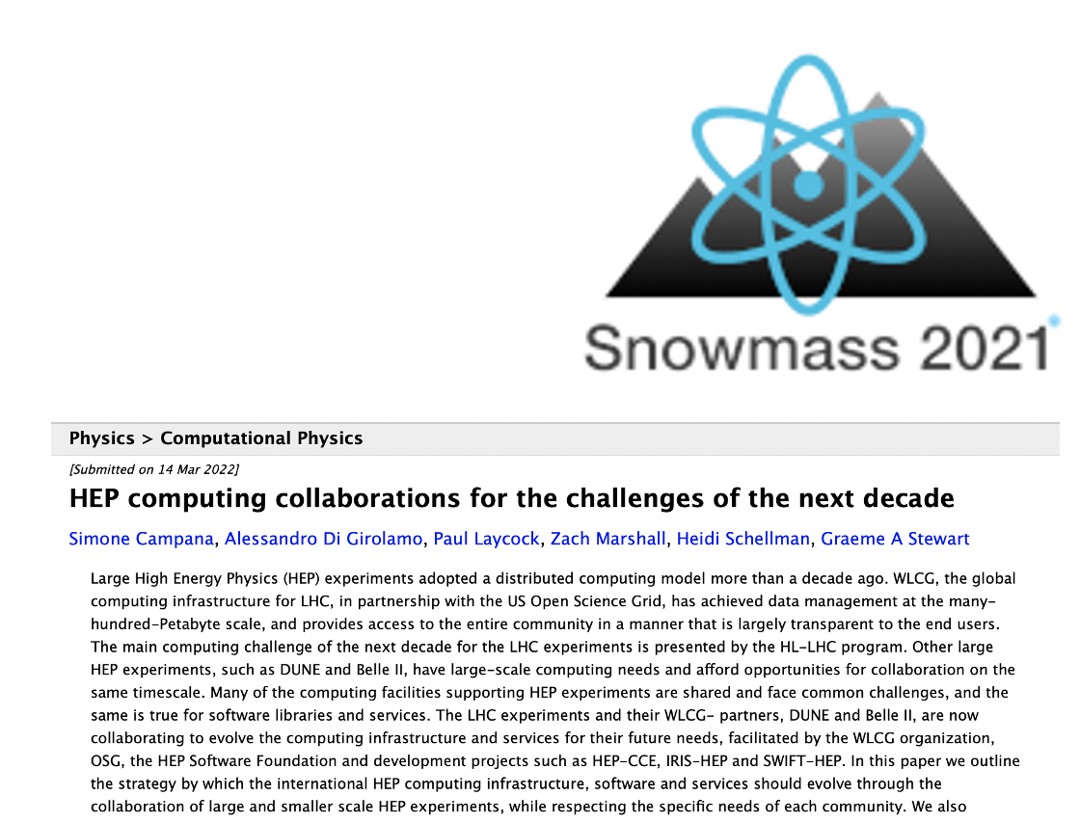

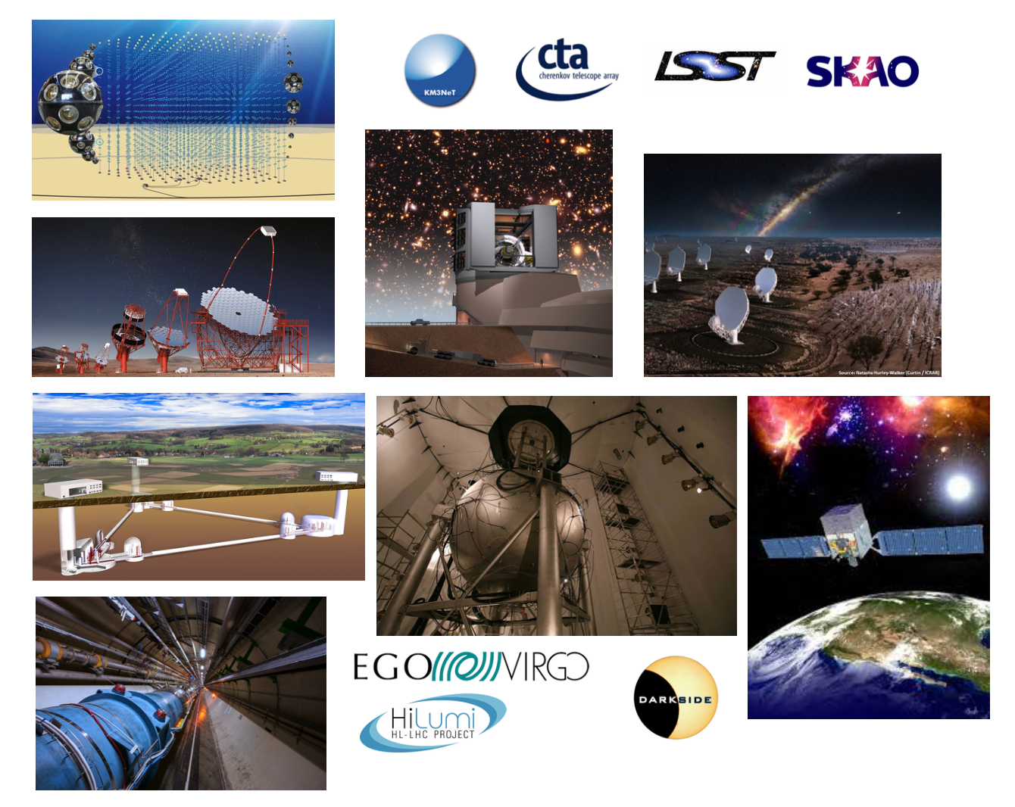
WLCG strategic vision: Innovation and Collaboration
WLCG presented:
its vision about a common scientific computing infrastructure at the European Strategy for Particle Physics in 2019
a joint paper with DUNE and Belle-2 to the Snowmass 2021 process, which detailed the strategic directions to address the computing challenges of the experiments over the next decade
The WLCG strategy for 2024-2027 has a strong focus on innovation and collaboration
Innovation: modernise software and services to leverage the most modern technologies and architectures
Collaboration: leverage synergies between HEP experiments and other sciences
Strike the right balance between common/custom, standard/specific

Slide 17
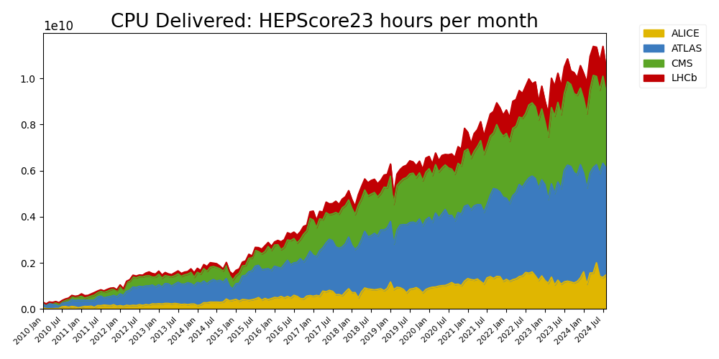
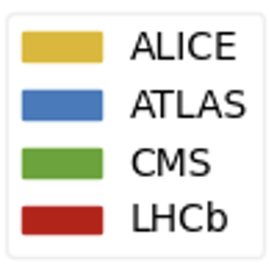
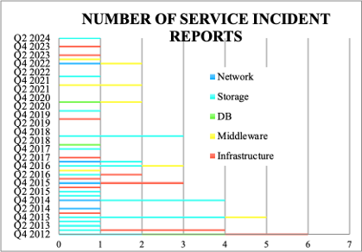
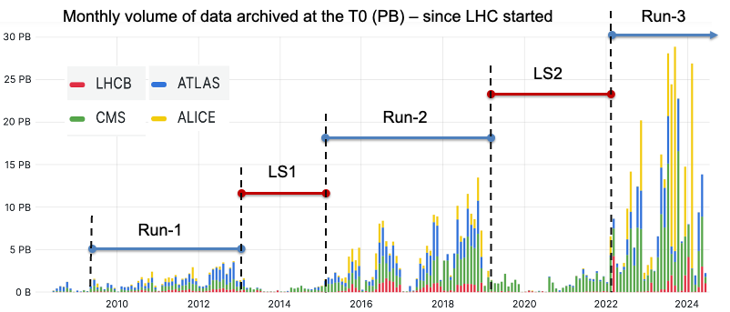
WLCG Service Operations
First of all … things MUST continue working
Disruptive changes need to be introduced in the production environment without disruption
Progress needs to be made in automation

Slide 18



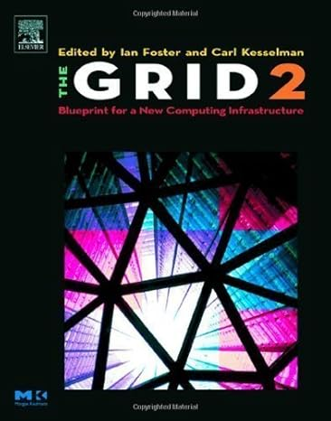
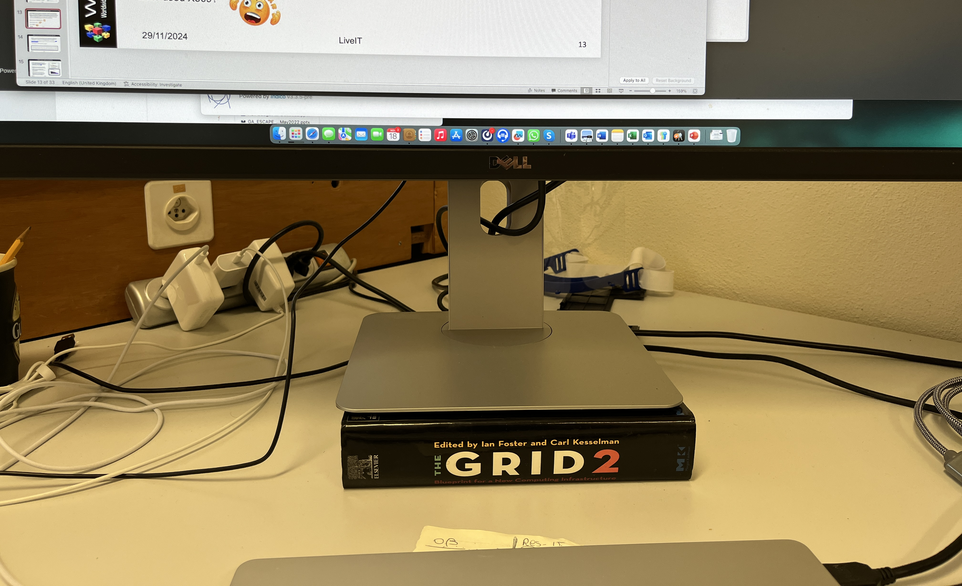


Technical Evolution
The WLCG middleware was conceived when no existing technology for distributed computing was available. WLCG needs to innovate the current stack in order to benefit from modern technologies
Example: the WLCG DOMA - Data Organization, Management, Access - initiative drives the evolution of Data Management tools, services and infrastructure for the needs of the experiments at HL-LHC
  Do you something about SRM and GridFTP?
  How about I tell you HTTP?
  Ever used X509?

Slide 19
WLCG Data Challenges program
The WLCG Data Challenges program was initiated to
Increasingly commission the WLCG data management infrastructure to the HL-LHC scale
Progressively evolve the service technology and introduce innovative solutions
A cornerstone of the WLCG strategy to bring prototypes in early production
with no service disruption
The plan is to use a similar approach in other areas (e.g. the Analysis Grand Chllenge)
Notes:
Offers opportunities to smoothen

Slide 20
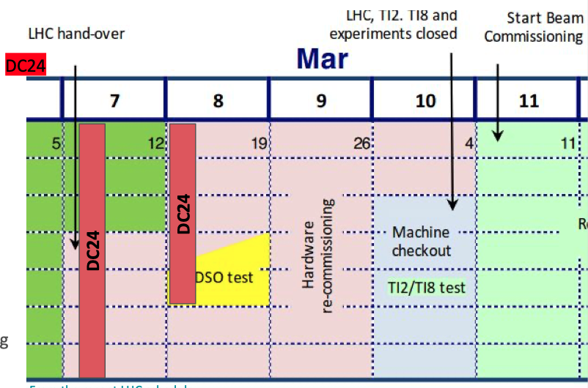
WLCG Data Challenges program
DC21 demonstrated the end-to-end data transfer capabilities at 10% of HL-LHC scale in 2021
DC24 in 2024 had 3 goals:
Measure the end-to-end data transfer capabilities at WLCG sites (target is 25% of HL-LHC needs)
Assess the progress integrating new technologies (e.g. tokens and monitoring)
Assess the status of different R&D initiatives
Lessons documented here.
DC24: from Feb 12 to Feb 23 in 2024
Next will be DC26 (in.. 2027…). In the next year WLCG will gradually prepare for it
Notes:
Offers opportunities to smoothen

Slide 21
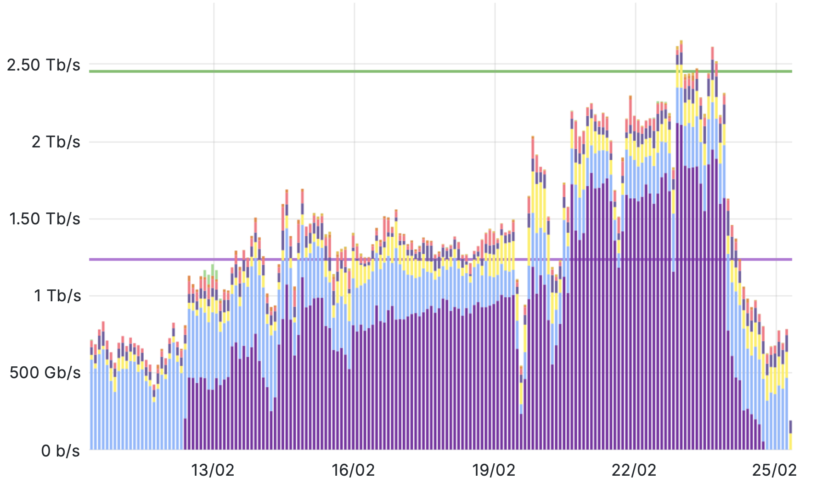
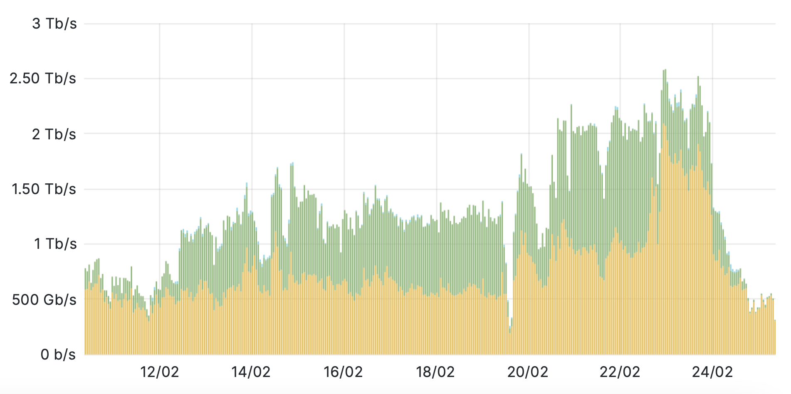
Data Challenge 2024 - Highlights
DC24 WLCG data transfers (Gbps) – 15 days: all targets achieved
Peak rate target
New technologies (e.g. authentication tokens) introduced and validated
Average rate target
tokens
X509
WLCG services successfully support DUNE and Belle-2 computing models
ATLAS
CMS
DC
Belle-2
ALICE (XRD)
CMS (XRD)
LHCb
DUNE
Notes:
Offers opportunities to smoothen

Slide 22
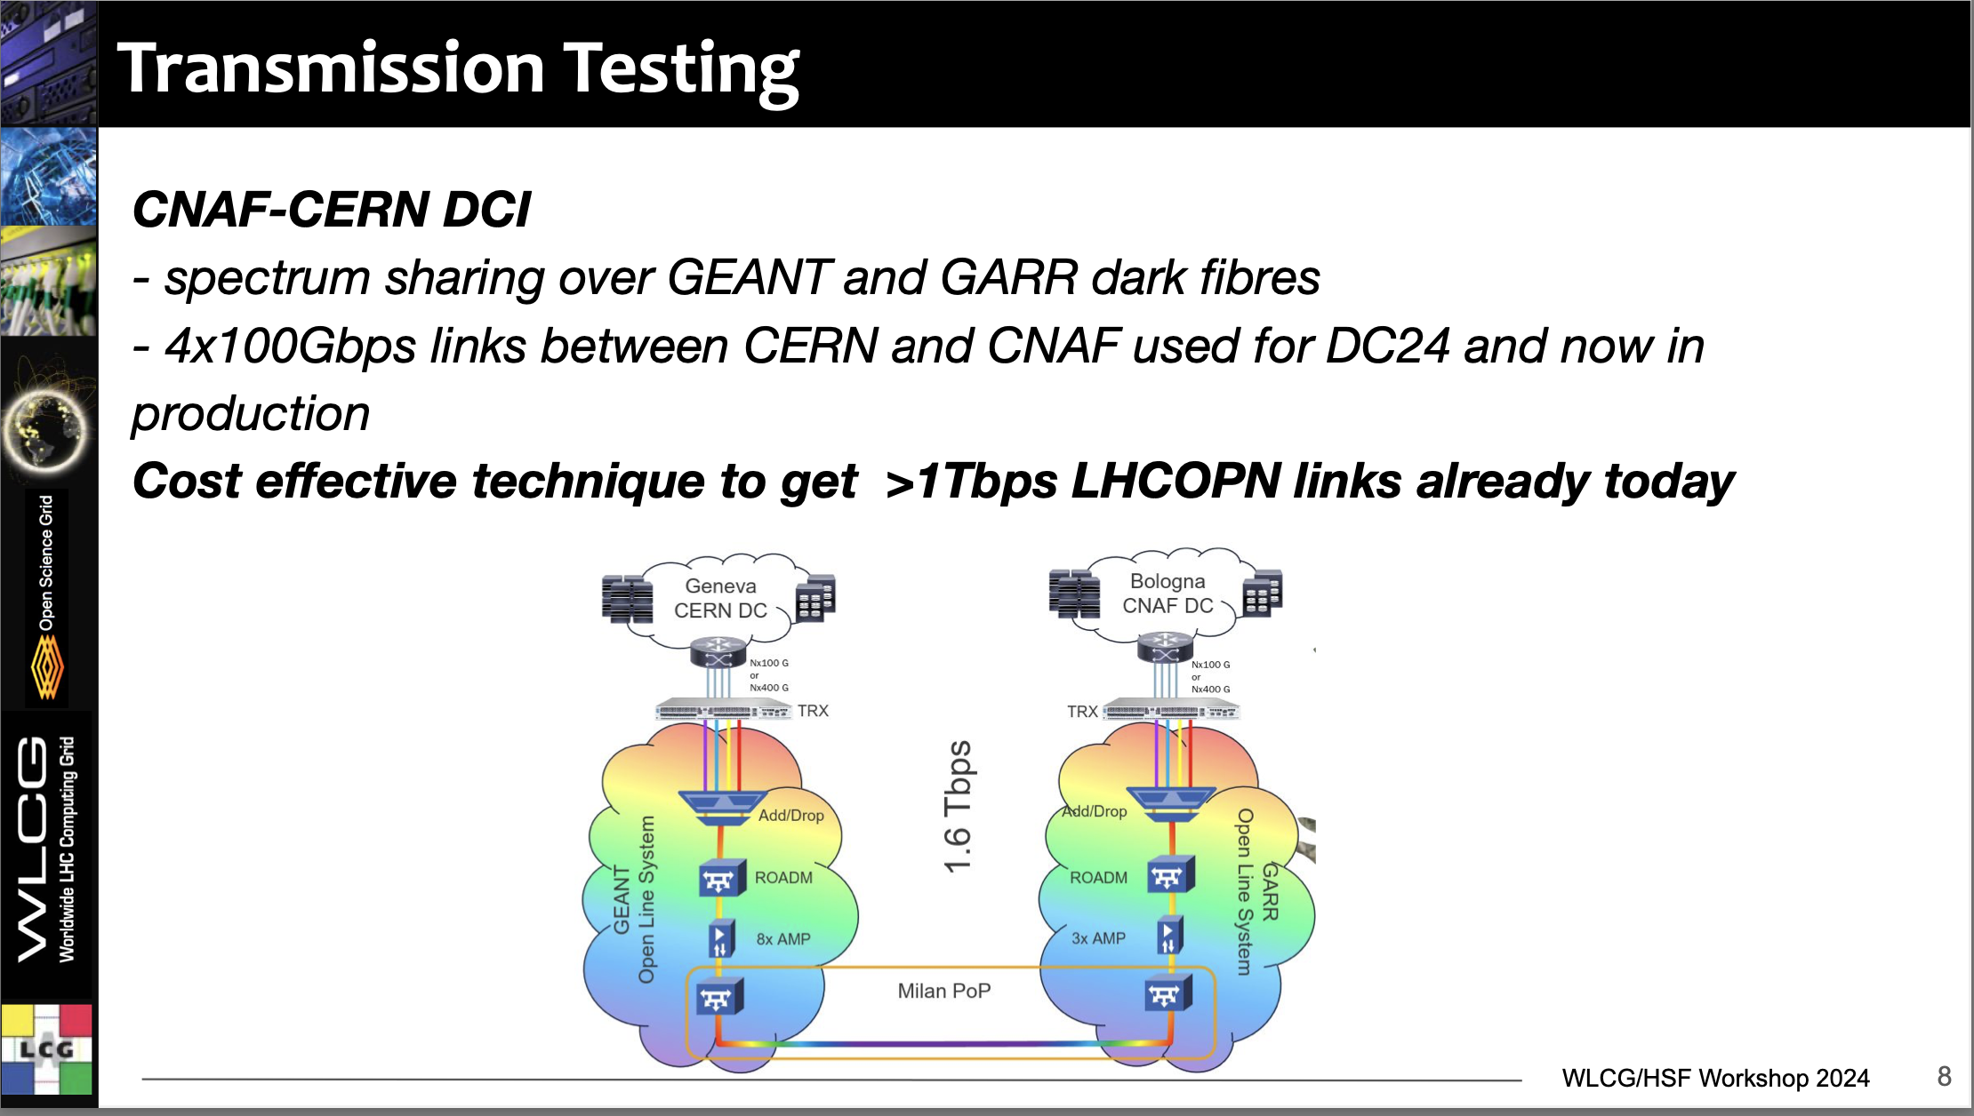
DC24 Network R&D – one example
R&D proposed as follow up of DC21. Deployed in time for DC24
In production today for Run-3 data taking
Reduces cost while providing more bandwidth (x2) and expansion capabilities
Reduces latency (30%)
Being tested now for longer network paths
More network R&D planned for DC26

Slide 23
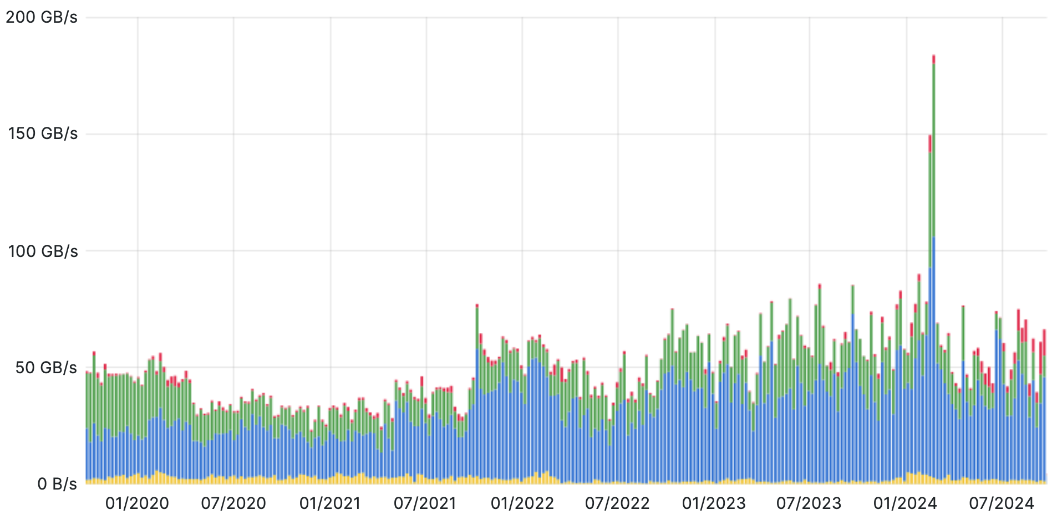
WLCG traffic (GB/s) in 12 months
WLCG data transfer capability supports well the experiments needs, with contingency. Excellent performance and reliability of the networks
2024 WLCG Data
Challenge (~260 GB/s)
50 GB/s in the last two years
2024 average (~60GB/s)

Slide 24
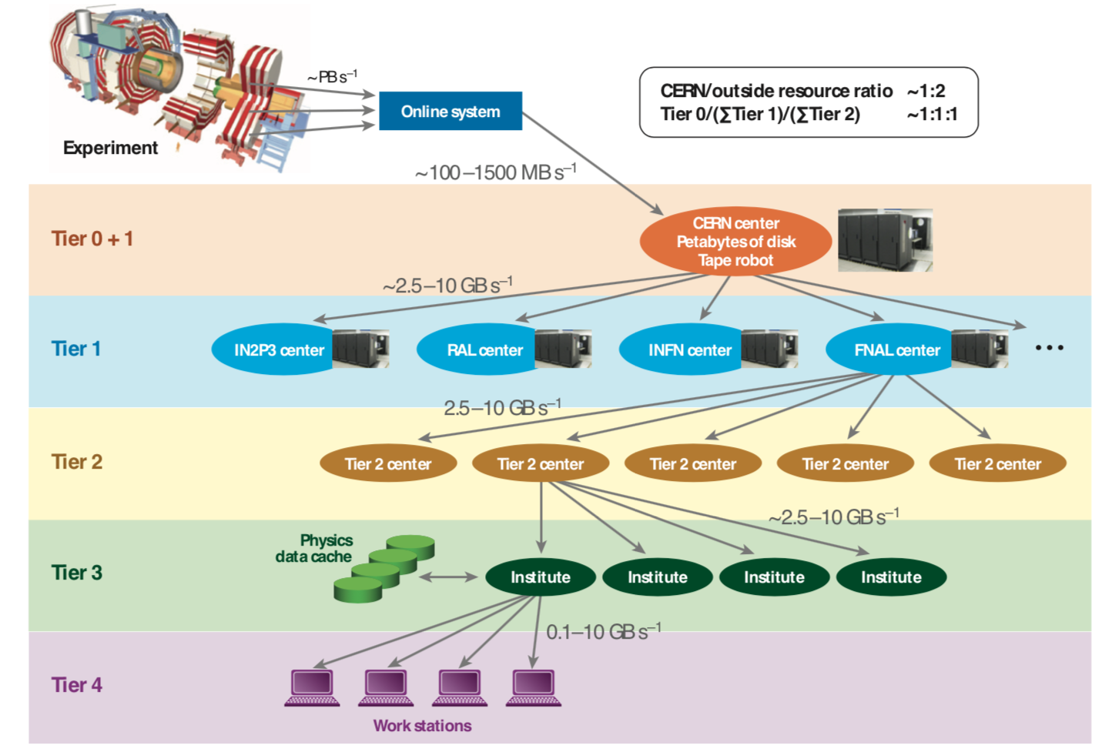
The initial Computing Model
This was the initial computing model (1999)
Uncertainty over network performance, reliability
Focus on distributing data globally to compute resources in a hierarchical structure
Every center runs a compute and a storage service
No concept of data remote from compute
Predefined roles of Tiers: T2s for simulation and analysis, T1s for reconstruction and archive
Quickly evolved …

Slide 25
WLCG networks
WAN connectivity increased x10 in the last 10 years
WLCG networks are an opportunity, not a limitation as initially expected
LHCOPN: Private network connecting Tier0 and Tier1s. Dedicated to LHC data transfers and analysis
LHCONE: Layer3 (routed) Virtual Private Network provided by the R&E network providers Worldwide network backbone connecting Tier1s and Tier2s. Bandwidth dedicated to High Energy Physics

Slide 26
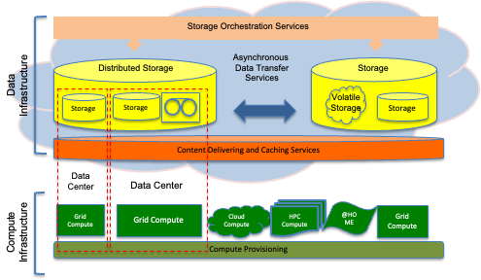



Heterogeneous Grid Infrastructure
Organisation of WLCG facilities in Tiers: simple but effective way to define the expected quality-of-service and target metrics specified in the WLCG MoU. But ..
Network connectivity not a limiting factor
Relaxing the Tier model increases flexibility
Heterogeneous facilities (HPCs and Clouds) offer additional opportunities
T2
T1
T0
T2
T1
T2

Slide 27
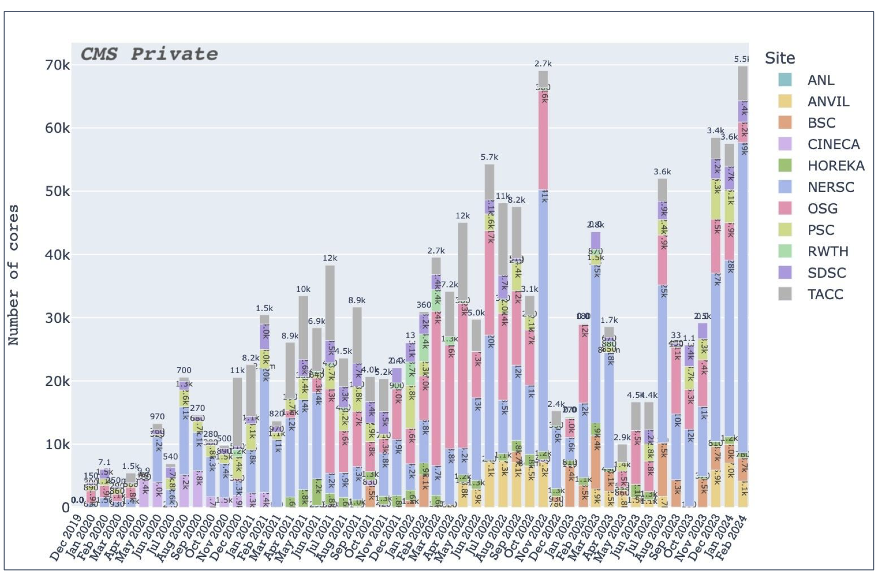
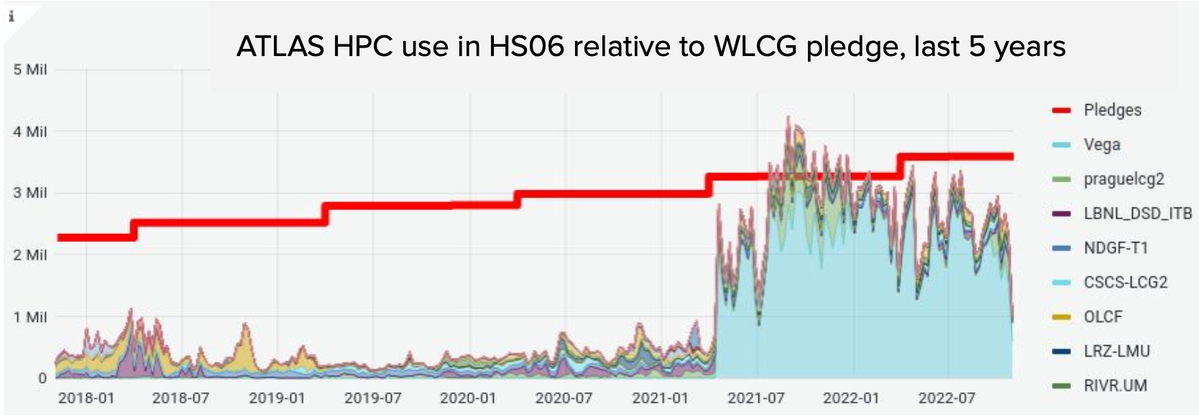
Leveraging Heterogeneous Facilities - HPCs
HPCs have been integrated as WLCG resources since ~ 20 years
Some HPC are very challenging to use: limited connectivity, special harware (GPUs, non-X86 CPUs) and configs (RAM, local disk), different AAI.
The benefits are considerable in many cases. Attempts to move the collaboration with HPC centers into consolidated partnerships

Slide 28
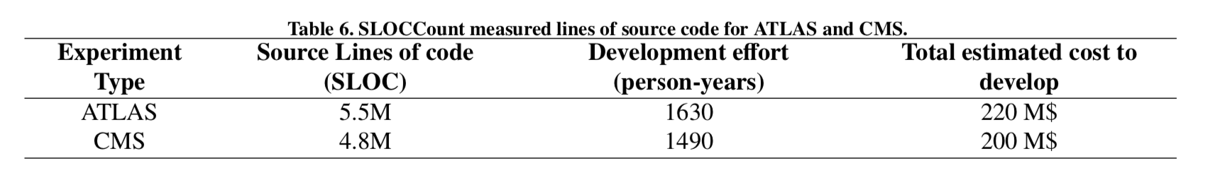
Software Performance and Portability
Software performance, modernization, innovation and portability is one of the key areas to address the future HEP computing challenge. It allows to:
access available resources otherwise not useful (e.g GPUs, non-X86 CPUs)
optimize procurement and deployment to guarantee the best value for money
support different experiments and sciences on the same resources
leverage the most modern hardware features (e.g vectorization)
reduce the resource needs/event (compute and storage)
It needs upfront large investments and forward-looking solutions
E.g. LHC experiments have a 20+ years codebase and rewriting from scratch is not an option
  Linux Kernel is: 15M sloc, 4800 FTEy, 650M$;
  Geant4 is: 1.2M sloc, 330 FTEy, 45 M$

Slide 29
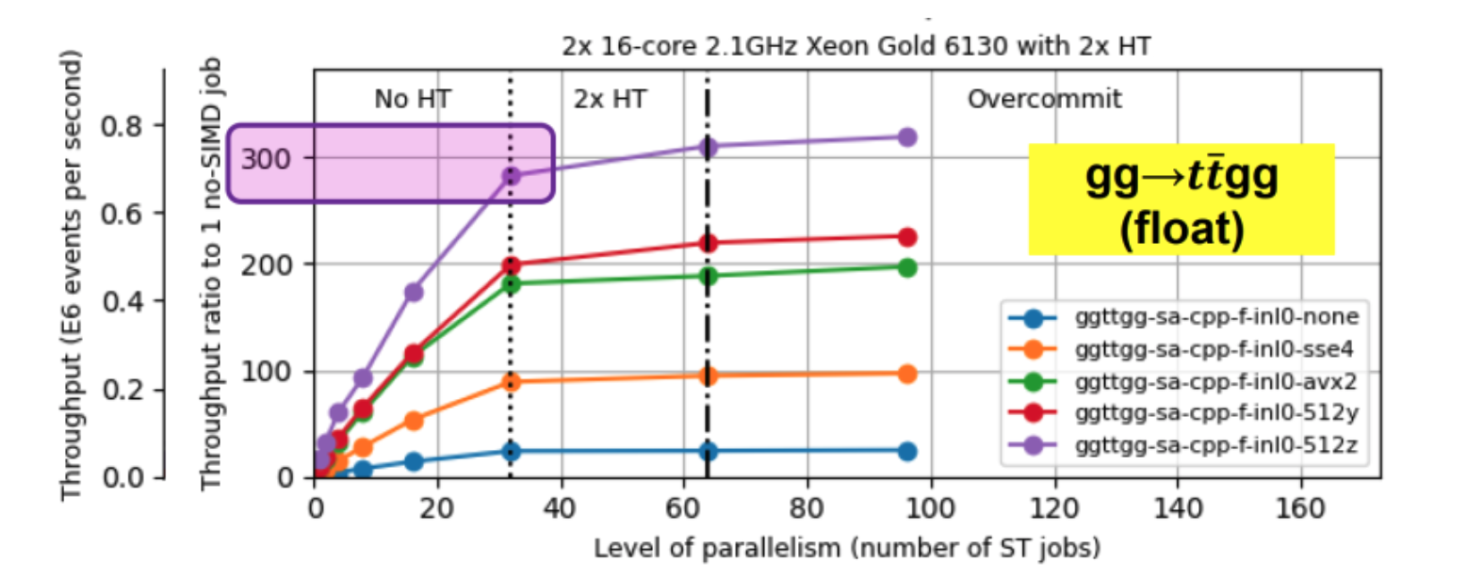
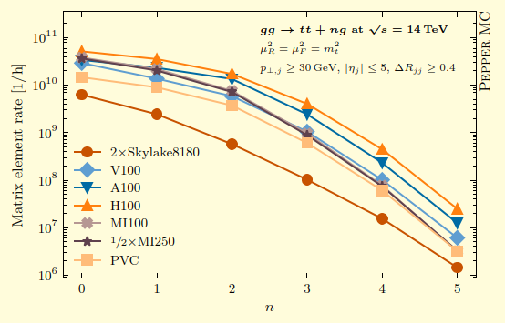
Event Generators on GPUs
A very good candidate for GPU acceleration with benefits for many experiments
CPU + GPU
Vectorisation
CPU only
No Vectorisation
Madgraph gg->tt+ng (n=2)
GPU-enabled Leading Order: being released to production.
By-product: enabling of CPU vectorisation: up to x8 gain in ME event throughput (x6 global). Note: all CPUs in WLCG provide vectorisation
GPU-related work brings immediate benefits also on CPUs
Sherpa gg->tt+ng
Matrix Element event throughput:
up to x10 gain when using GPUs
Available for production

Slide 30
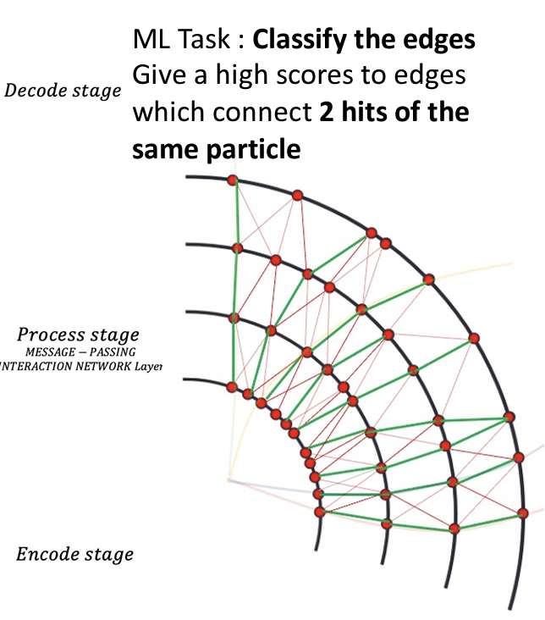

The raise of AI
The utilization of AI is not new in HEP. What is game changing is:
the availability of modern models (Transformers, LLMs, Normalizing Flows, …)
the availability of large (optimized) processing systems
WLCG needs to make progress in supporting AI applications

Slide 31


User Analysis
What should also not be neglected are the ways ’users’ want to use the computing resources and software environment:
Yesterday: program via ROOT/C++macros
Today: a lot of Python; jupyter notebooks/browser frontends; data science tools
Analysis Facilities: infrastructures tailored to provide an analysis ecosystem - tools and services
Possibly also centers for large scale AI training

Slide 32




WLCG partners and collaborators
Many communities collaborate with WLCG, share some of the same technologies, services and resources
DUNE, Belle-2, JUNO and VIRGO are now WLCG partners
Collaboration with Astronomy in the context of the ESCAPE Open Collaboration
Fostering this collaboration is essential for the sustainability of the WLCG infrastructure: optimise investments and effort

Slide 33


Scientific Data Management
Scientific Data Management is a clear example of successful collaboration in HEP and beyond
Rucio: initially developed for/by the LHC ATLAS experiment
Now a standard de-facto in HEP and beyond

Slide 34

From Data Management to a Research Environment
HEP, Astronomy and Astro-particle physics prototyped a distributed data infrastructure across Europe. Based on many of the WLCG building blocks and on top of many WLCG facilities
Virtual Research Environment
for Open Science

Slide 35



Open Science in a common Research Environment
SKA: data delivery from Perth and Cape Town to Europe and access through the Virtual Research Environment
LOFAR: observations stored in the data management system, accessed and analyzed in a notebook service in the VRE. Results and artifacts are all preserved.
I am told this is a Quasar …

Slide 36

Energy Needs per unit of “science”
In WLCG GWh/fb⁻¹ represent the energy needed to analyse the data - energy per unit of science
The scale on the right (RED) shows the energy and the scale on the left (BLUE) shows GWh/fb⁻¹ (log!)
Energy needs in Run-4 and Run-5: +100% compared to Run-2 in the pessimistic scenario, only +10% in the optimistic scenario
GWh/fb⁻¹ decreases a factor 10 between Run-1 and Run-5 (exponential trend fits well)
In Run-5, GWh/fb⁻¹ in the optimistic scenario is half compared to the pessimistic scenario
Invest in R&D

Slide 37
Conclusions
WLCG is providing a shared distributed infrastructure for the LHC experiments for 20 years.
The computing models together with the infrastructure and services changed with time adapting to the evolving landscape (experience and funding)
The HL-LHC will be an unprecedented challenge for us both in terms of scale and sustainability
Other very data intensive science projects will co-exist with LHC, with very similar use cases, on the same timescale and for a great majority on the same physical resources
There is an opportunity to share policies, tools, expertise, services and, when plausible, resources for the benefit of all our sciences

Slide 38
Backup

Slide 39


ATLAS and CMS computing needs for HL-LHC
The projected CPU needs of ATLAS and CMS at HL-LHC. Estimates produced for the 2021 HL-LHC computing review and updated in 2022 to reflect the changes in the LHC schedule

Slide 40


HL-LHC computing needs evolution
2015
2017
2018
2022
2020
2015 projections: resource needs = 10x more than budget allows
2022 projections: resource needs compatible with budget (optimistic scenario)

Slide 41


Tier-0 workflow in 2024
Receive the RAW data from the experimental areas and archive them for long term preservation
Perform data quality assessment and reconstruct the events into formats suitable for analysis.
Export RAW and reconstructed data data to WLCG centers. RAW data is archive at Tier-1s. Reconstructed data is further distributed for analysis.

Slide 42

Data produced by the CERN experiments
Data stored on tape at CERN

Slide 43


Private network connecting Tier0 and Tier1s:
- Dedicated to LHC data transfers and analysis
- Secured: only declared IP prefixes can exchange traffic
- Advanced routing: communities for traffic engineering, load balancing
- Star topology around the Tier-0 (CERN)
Numbers
- 14 Tier1s + 1 Tier0
- 12 countries in 3 continents
- Dual stack
IPv4-IPv6
- 1.4Tbps to the Tier0
- Moved ~XXX PB in 12 months

Slide 44


LHCONE
Layer3 (routed) Virtual Private Network:
- Worldwide network backbone connecting Tier1s and Tier2s at high bandwidth
- Provided by Research and Education Network providers
- Bandwidth dedicated to High Energy Physics data transfers
- Trusted traffic that can be allowed to bypass slow perimeter firewalls
Numbers
- 28 R&E networks
- 14 Tier1s and ~90 Tier2s in 5 continents
- ~250 perfSONAR instances
- 6 collaborations

Slide 45

WLCG traffic (GB/s) in the last 10 years
WLCG network used for data transfers but also Monte Carlo simulations
2024 WLCG Data Challenge
50 GB/s in the last two years
Run-3
LS2
Run-2
ALICE
upgrade

Slide 46


Data processing, simulation, analysis
CPU use in WLCG continuously increases despite shutdown periods
Simulations require a lot of CPU
A full analysis requires many years
WLCG sites provide ~40% additional capacity on top of their commitments
The grid model favors opportunistic provisioning of resources

Slide 47





WLCG performance and operations
WLCG Operations and Security Coordination teams ensure the functioning of WLCG services leveraging international initiatives
We monitor continuously and review regularly the performance of the sites against MoU targets

Slide 48



Evolution to a more flexible Computing Model
Type of workloads at a WLCG T2
Data is transferred in a full mesh rather than hierarchically
T1s and T2s run flexibly a mixture of workloads depending on their capabilities and the needs of the experiments

Slide 49
The TCB and the OTF
Computing never stops! But it’s crucial to periodically reflect:
Where we are
Where we need to be
Opportunities to exploit, and risks to manage
For WLCG’s Technical Evolution, we need a shared roadmap to tackle HL-LHC challenges.
WLCG Open Technical Forum (OTF): An open, bottom-up forum for the entire WLCG community to shape its technical evolution.
WLCG Technical Coordination Board (TCB): A closed board serving the Collaboration by coordinating technical challenges across experiments, partners, and facilities. Building on the OTF discussions, the TCB develops and maintains the technical roadmap for services and sites.

Slide 50
TCB – topics for Tech Roadmap
Draft of topics for the WLCG Technical Roadmap, developed collaboratively by WLCG TCs and MB members:
Data Management:
  Framework evolution (FTS, Rucio, etc.), Data Challenges, Storage protocols.
Analysis Infrastructure:
  Evolving strategies from ongoing WLCG discussions.
Security and AAI:
  Security must be integral. Tokens present an exciting challenge!
Heterogeneous Infrastructure:
  Adapting to changing architectures at scale.
Accounting:
  Ensuring robust methods to account for diverse resource types.
Facilities Evolution:
  Storage and compute systems at sites; HPC and Cloud integration.
Challenge: Drafting technical plans that unify the entire collaboration.

Slide 51


Leveraging Heterogeneous Facilities - Clouds
Cloud technologies were integrated in WLCG in ~2012. Academic clouds in use since then
Many initiatives integrating commercial clouds. Large variation in cost depending on choices being made
Commercial cloud TCO vs on premise at WLCG facilities is not obvious: see a recent and some previous studies
Not generally financially advantageous for large scale productions. Many benefits in flexibility (capacity, resource type).
WLCG needs to continue being prepared using commercial cloud resources from different vendors

Slide 52






Heterogeneous architectures in reconstruction
Heterogeneous architectures: complementing CPU capacity with accelerators (e.g. GPUs)
Playing a fundamental role in Run-3 already, in most online systems.
LHCb: exploitation of heterogeneous architectures in online system, thanks to Allen framework
Alice O2: Speed up from GPU usage + from algorithmic improvements + tuning on CPUs
Modern GPU replaces
40 CPU cores @ 4.2 GHz
Ongoing work in all experiments to leverage heterogeneous architectures in offline computing
Algorithm speed-up on CPU 20 - 25x v.s. to Run 2 Offline

Slide 53



Geant4 simulation for HL-LHC
Geant4 is the common workhorse of detector simulation. Its evolution follows a three-prong strategy, as recommended during the 2021 LHCC common software review
Improvements in the physics description. A continuous process, based on the dialog with the communities
Speed up of Full Simulation: same accuracy in the physics description, but faster. Again a continuous process, bringing still very considerable benefits e.g. a recent 20% improvement for ATLAS simulation
R&D
  Integration of Fast Simulation techniques in G4 including ML
  GPU prototypes: AdePT and Celeritas

Slide 54


ROOT foundation layer for HL-LHC
ROOT provides the common I/O layer for the LHC experiments.
The re-design of the internal ROOT data format (TTree to RNTuple) is a major upgrade in view of HL-LHC
10-20% smaller files, x3 to x5 better single core performance
enables fast adaptation to modern technologies, like object stores
RNTuple speed-up improvements measured in a real environment at CERN using a community standard analysis benchmark
RNTuple progress well on schedule for HL-LHC

Slide 55


Non-X86 CPUs
ARM CPUs process more events/Watt wrt X86
This is the case for the HW in Glasgow Tier-2
Differences between workflows
Modern AMDs perform similarly to ARM - again based on the HW in Glasgow Tier-2
See this presentation for details
All experiments ported main workflows to ARM
ATLAS, ALICE: physics validation successful
CMS, LHCb: in progress
ARM resources available at various WLCG sites
Older
time
Newer

Slide 56

Software-related activities and project
Software performance, modernization, innovation and portability is one of the key areas in order to address the HL-LHC challenge. It needs upfront large investments
The HEP Software Foundation: facilitates the cooperation and
common efforts in HEP software and computing
The Institute for Research and Innovation in Software for High Energy Physics (IRIS-HEP): R&D for the software for acquiring, managing, processing and analyzing HL-LHC data.
CERN Openlab: a public-private partnership that works to accelerate the development of cutting-edge ICT solutions for the worldwide LHC community

Slide 57





Custom or common or ... ?
We want to use as much commodity software products as possible, to minimize cost and manpower:
In some cases, using commercial libraries, e.g. for state-of-the-art Machine Learning (pyTorch, TensorFlow etc.) is a straightforward choice for using ML tools in HEP.
...but there is lot still specific to HEP (and/or science):
specific tools for simulation (Geant4), data persistency and analysis (ROOT),
Experiment and WLCG services for distributed computing
… and these all need long-term continuity of support ! To share the load and optimize resources, a lot of effort has been made (e.g. HSF)

Slide 58


Collaboration across sciences
https://zenodo.org/record/4889503

Slide 59

Energy efficiency
The electricity costs have been an unexpected development in the last couple of years. Environmental impact needs proper addressing!
What to do:
Improve software performance
Leverage modern architectures
Invest in the facilities
  There is no magic wand, however.
WLCG: the peak of energy need at the start of Run-5)
In a pessimistic scenario – little progress on all the above – the energy need is x2 than in an optimistic one

