Slide 1
In Infrastructures … we Trust!
v0.3
How trust and identity enable
global infrastructures for distributing computing
ISGC 2025
David Groep, March 2025

Slide 2
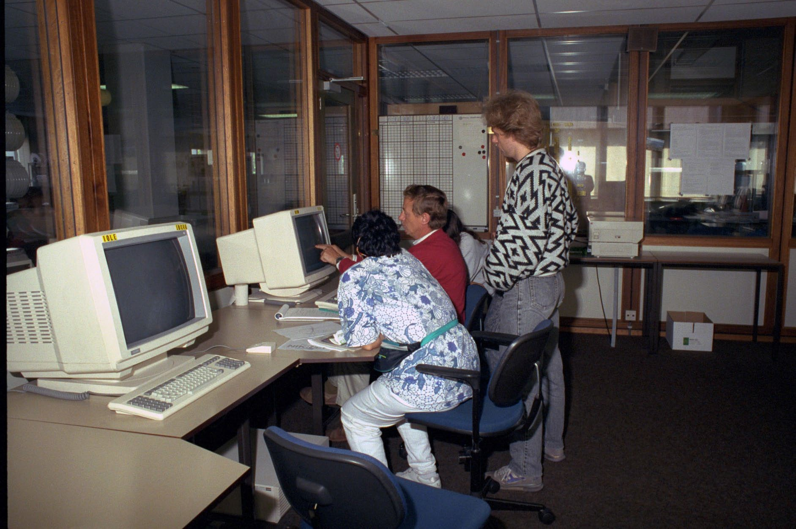
Collaborations: from small …
Nikhef user room H1.37 – terminal stations in the early 1990’s – image source: Nikhef

Slide 3
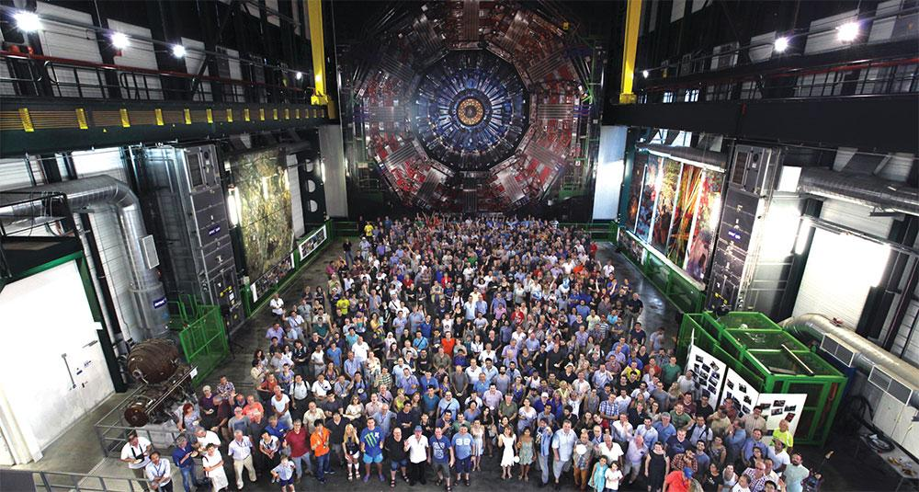
… to large collaborations (and shown here is a subset …)
a small part of the CMS collaboration in 2017, photo credit CERN on behalf the CMS collaboration, CMS-PHO-PUBLIC-2017-004-3

Slide 4
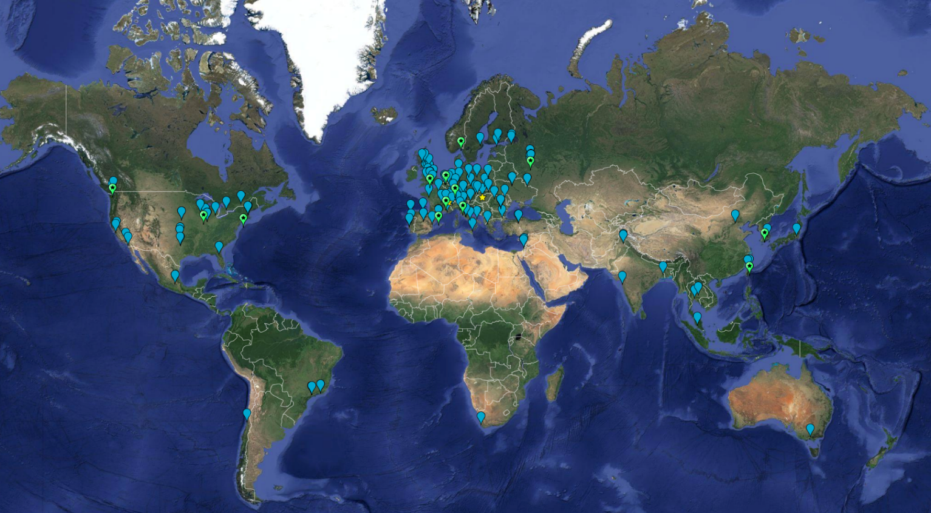
How many interactions? And just how many logins?
Worldwide LHC
Computing Grid (~ 2024)
~ 1.4 million CPU cores
~ 1500 Petabyte
disk + archival
170+ institutes
42+ countries
13 ‘Tier-1 sites’
some multi-community:
NL-T1 @ SURF & Nikhef
Earth background: Google Earth; Data and compute animation: STFC RAL for WLCG and EGI.eu; Data: https://home.cern/science/computing/grid ;
LHC Computing Grid: wlcg.web.cern.ch, EGI: www.egi.eu; ACCESS CI: https://access-ci.org/, NL-T1 and FuSE: fuse-infra.nl, https://www.surf.nl/en/research-it

Slide 5

Do we ask for ~ 12 000 x 170+ passwords for everyone?
Of course not!
But 12 000 people is still a lot,
and many more than you would
trust with your bank PIN …
Yet we have found mechanisms to
collaborate beyond the canonical
~150 people (“Dunbar’s number”)
but what we built, may both be unique
for our ‘high-trust’ research community
… and be an example for others
Image “trust fall” by Barret Anspach (https://www.flickr.com/photos/anspach/954545) used under CC-BY-2.0 license

Slide 6
Knockin’ on a service’s door
But let’s go back to computing for a bit ...

Slide 7
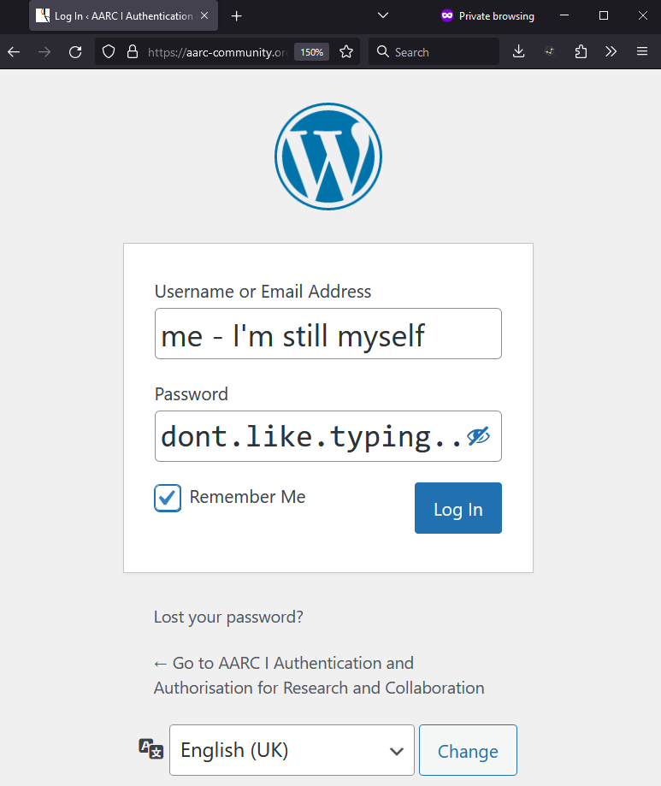
When you are asked to login again …
Authentication
demonstrating ‘you are you’
authenticator
‘you’ remains same ‘you’
vetted identity
‘you’ can be pseudonymous
‘you’ can be a vetted person

Slide 8
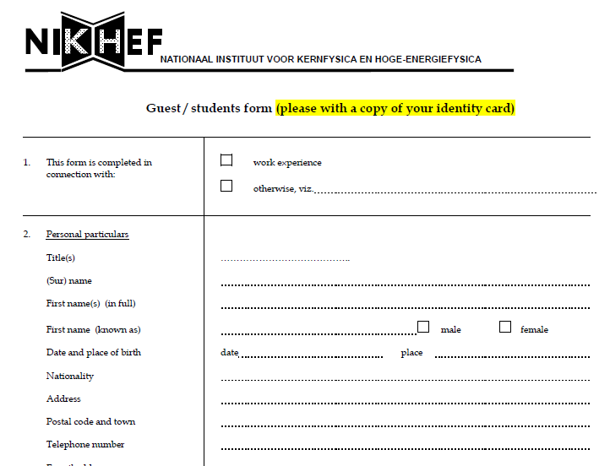
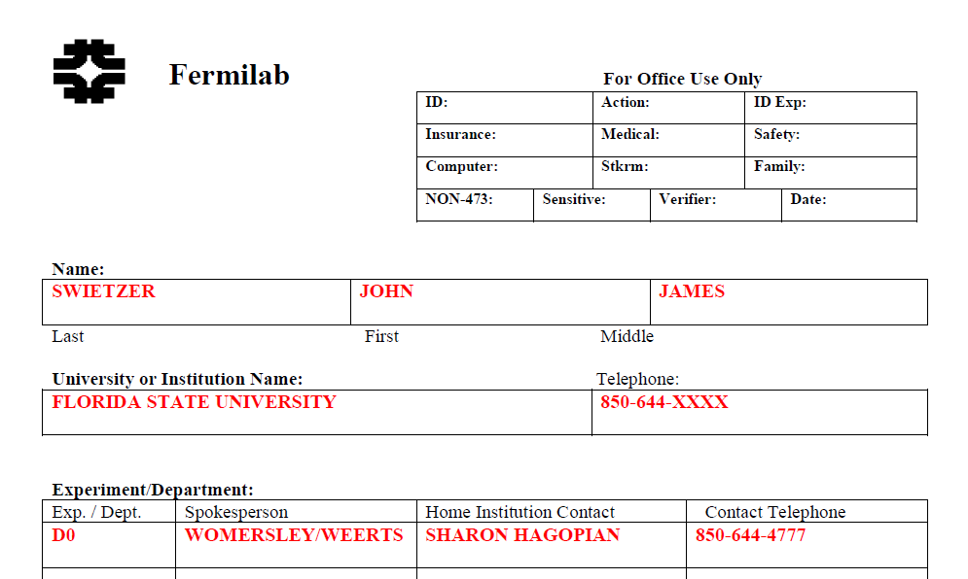
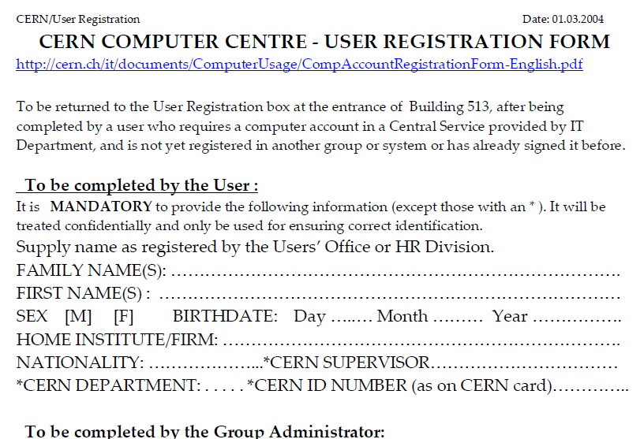
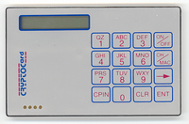
Self-asserted or ‘pseudonymous’ often not enough
state of EU DataGrid and
HEP computing in ~2000

Slide 9
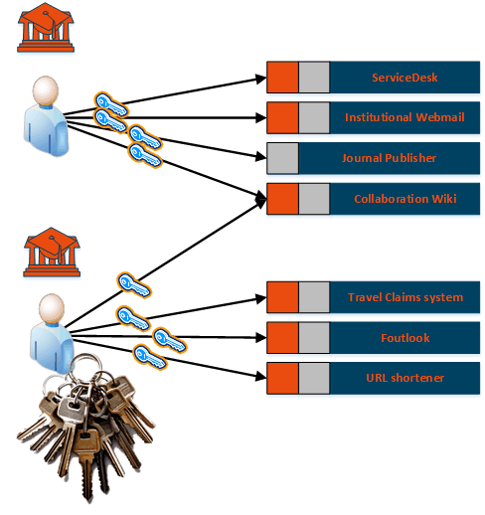
Scaling credentials: per service per user
Many start with credentials dedicated
to each service where you need access
In a multi-organizational system becomes
O(n_{services}) * O(n_{users})
usually creates a strong link to authorization:
different accounts for different roles, multiplying the number of credentials per user
Image imspired by AARC NA2 training module “Authentication and Authorisation 101” – keychain image created by generative AI

Slide 10
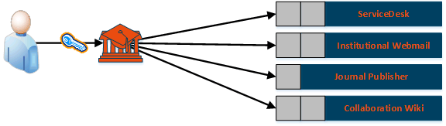
bilateral ‘SSO’: a single service, or a single identity source
#credentials required?
from previously
O (n_{services}) * O (n_{users})
to
O (n_{users})
+ O (n_{services}*n_{home-orgs})
in first order at least

Slide 11
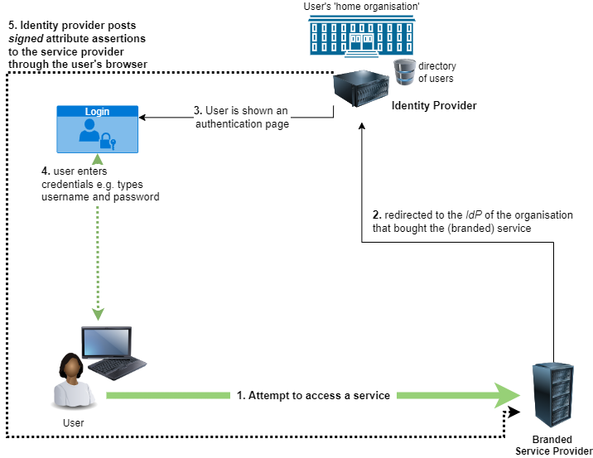
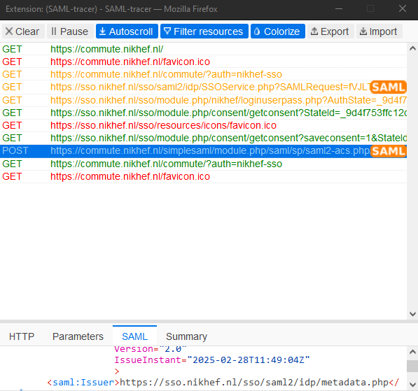
Single sign-on – why your browser keeps loading things
Glossary
‘SAML’ is the “Security Assertion Mark-up Language”
an XML blob with information, usually digitally signed
SAML-tracer plugin by Tim van Dijen (SSC-ICT) et al.
https://github.com/simplesamlphp/SAML-tracer

Slide 12
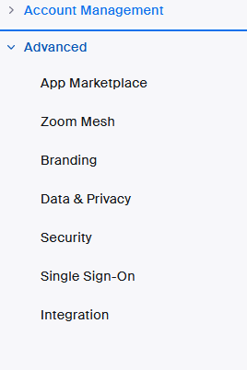
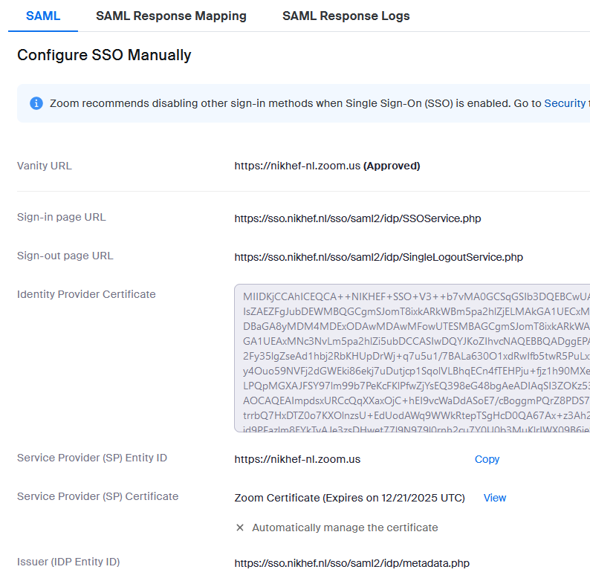
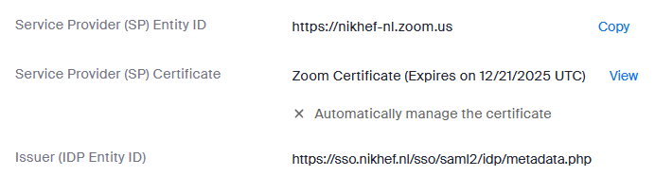
Establishing trust: when each service is bespoke
the trust relation is bi-lateral: different for each service, and - from the service view - different for each customer

Slide 13
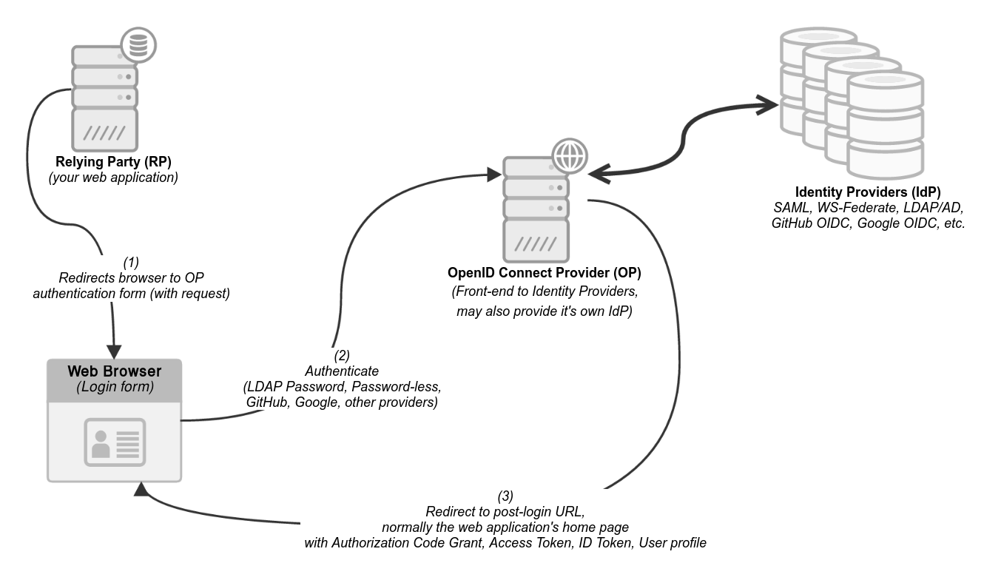
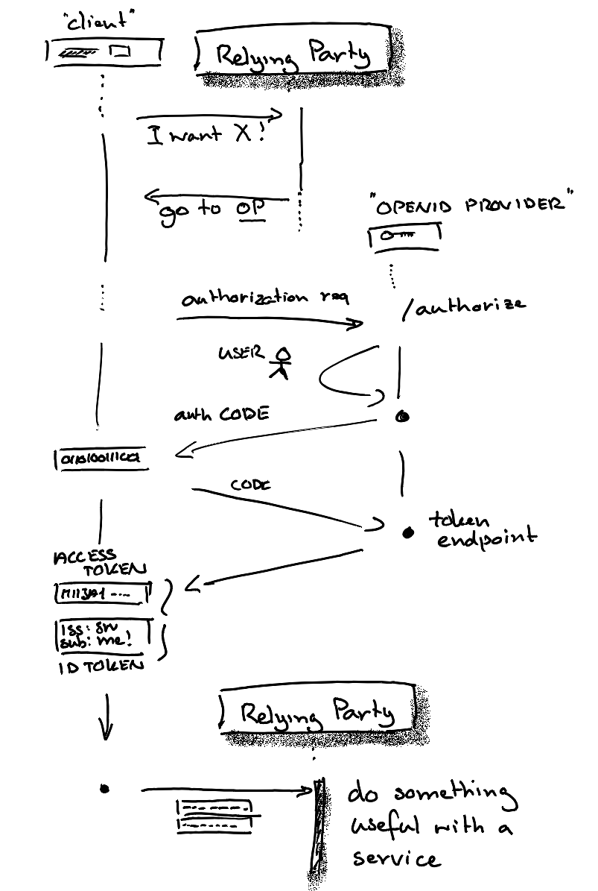
Different ‘modern’ protocol for the same: OpenID Connect
later introspection
or user_info possible
OpenID Connect flow diagram (left) based on work by Mozilla contributors, from https://infosec.mozilla.org/guidelines/iam/openid_connect.html under CC-BY-SA

Slide 14
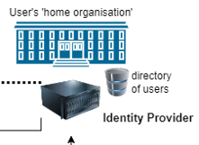


User-centric identity: ‘I take my passport anywhere by myself’
Your ‘home organisation’ does not have to be in the loop …
user-centric trust: you yourself hold a credential from a trusted third party and can use it
without having to ask ‘home’ each time:
Public Key Infrastructure client certificates (“X.509”)
Verifiable credentials in wallets
and who remembers CardSpace?
Passport image: cropped from original by Jon Tyson on Unsplash https://unsplash.com/photos/Hid-yhommOg

Slide 15
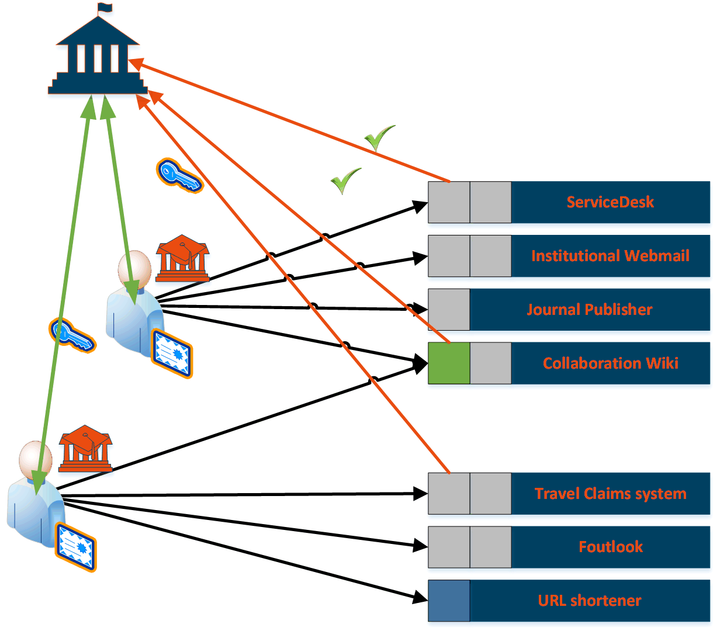
User-centric AAI
A trusted authority giving the user
a ‘self-managed’ credential, like a passport
a personal authentication digital certificate
a verifiable credential in a wallet
…
verified (on-line and also offline)
at the original trusted issuer
or at an independent trusted verifier

Slide 16
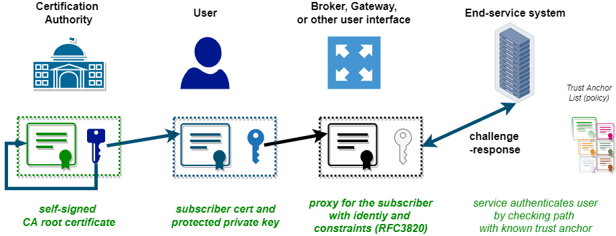
PKI client certificates – user (really?) credentials
Some of you will know the ‘venerable’ user-centric credential: PKI Certificates
Version: 3 (0x2)
Serial Number:
34:f3:e3:5f:c0:53:0b:a6:ef:2b:4a:79:01:b5:50:3b
Signature Algorithm: sha384WithRSAEncryption
Issuer: C = NL, O = GEANT Vereniging, CN = GEANT eScience Personal CA 4
Validity
Not Before: Apr 2 00:00:00 2022 GMT
Not After : May 2 23:59:59 2023 GMT
Subject: DC = org, DC = terena, DC = tcs, C = NL, O = Nikhef, CN = David Groep davidg@nikhef.nl
Subject Public Key Info:
Public Key Algorithm: rsaEncryption
RSA Public-Key: (4096 bit)
Modulus:
00:f0:0d:c0:ff:ee:f0:0d:f0:0d:c0:ff:ee:f0:0d:
...
ff:50:6d
Exponent: 65537 (0x10001)
X509v3 extensions:
X509v3 Key Usage: critical
Digital Signature, Key Encipherment
X509v3 Basic Constraints: critical
CA:FALSE
X509v3 Extended Key Usage:
E-mail Protection, TLS Web Client Authentication
X509v3 Certificate Policies:
Policy: 1.2.840.113612.5.2.2.5
RFC3820 ‘proxy’ certificates extend identity-certificate concept with (policy-restricted) delegation
think we found everyone in the world who could deal with certificates. about O(100 000) people …

Slide 17

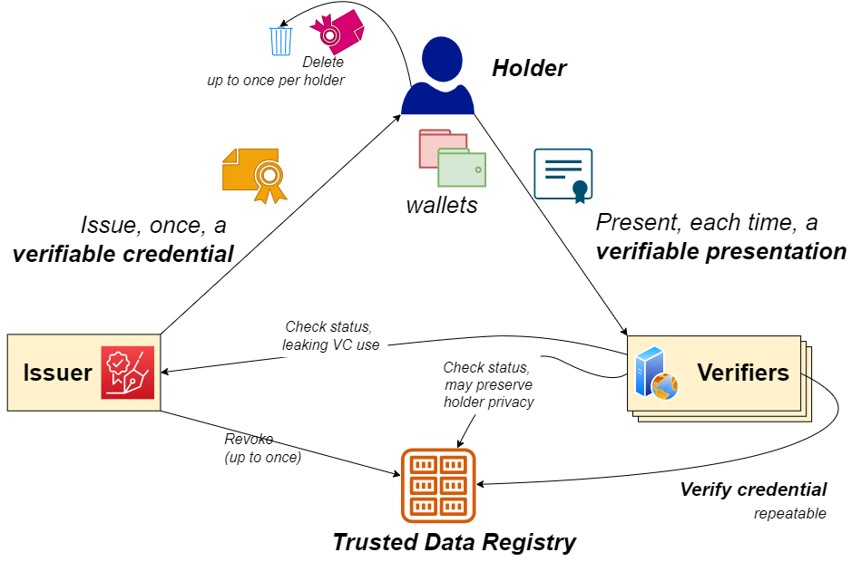

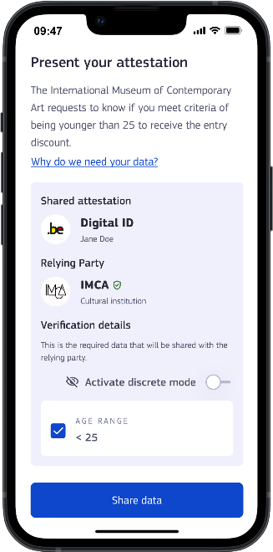
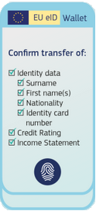
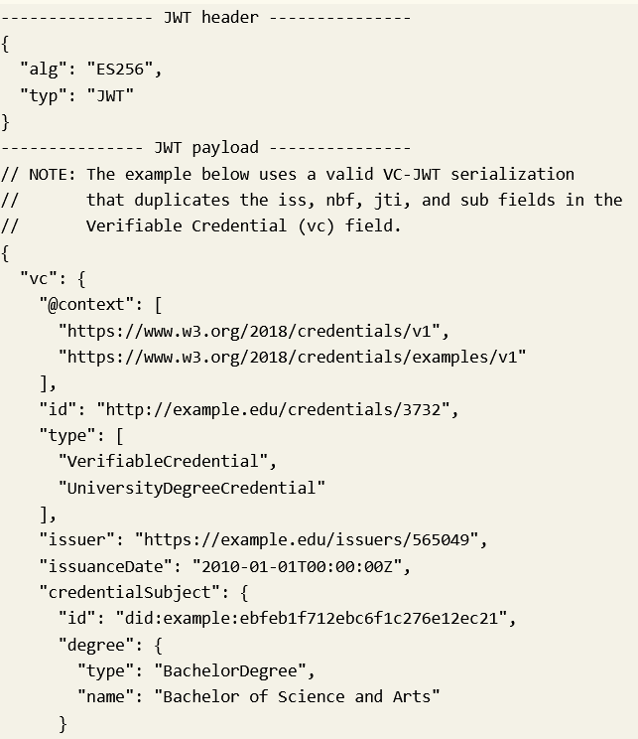
Identity wallets, held by the user, are another
the user as a
credential Holder
Flow diagram inspired by: Lifecycle Details (5.1), Verifiable Credentials Data Model v1.1, W3C Recommendation 03 March 2022, https://www.w3.org/TR/vc-data-model/
EU eID Wallet from https://commission.europa.eu/strategy-and-policy/priorities-2019-2024/europe-fit-digital-age/european-digital-identity_en
Appimage: European Commission, at https://ec.europa.eu/digital-building-blocks/sites/display/EUDIGITALIDENTITYWALLET/Security+and+Privacy

Slide 18
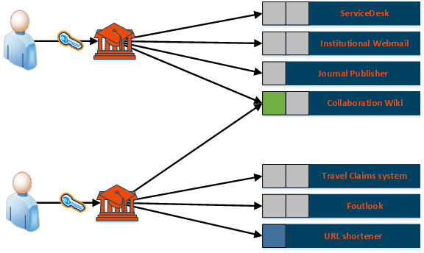
Can we scale better with an ‘federated’
Authentication and Authorisation Infrastructure (‘AAI’)
with one service provided to
several organisations (universities)
we will get to authorisation in a bit …

Slide 19
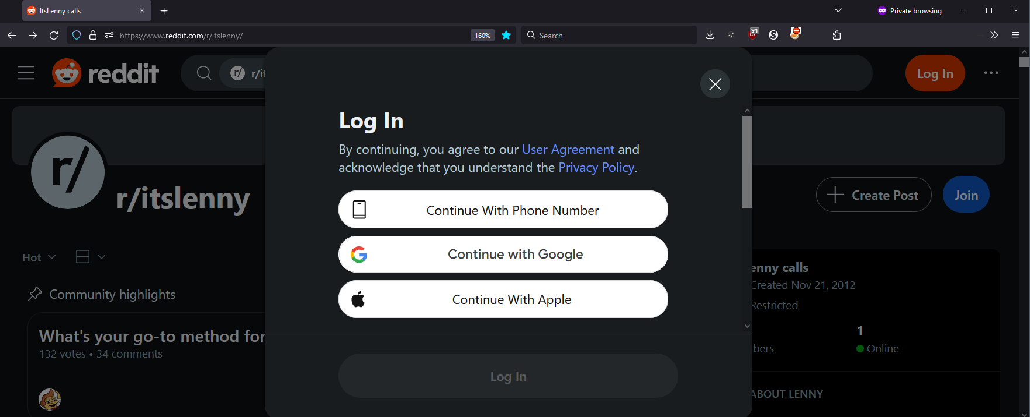
One service, with user credentials from more sources

Slide 20
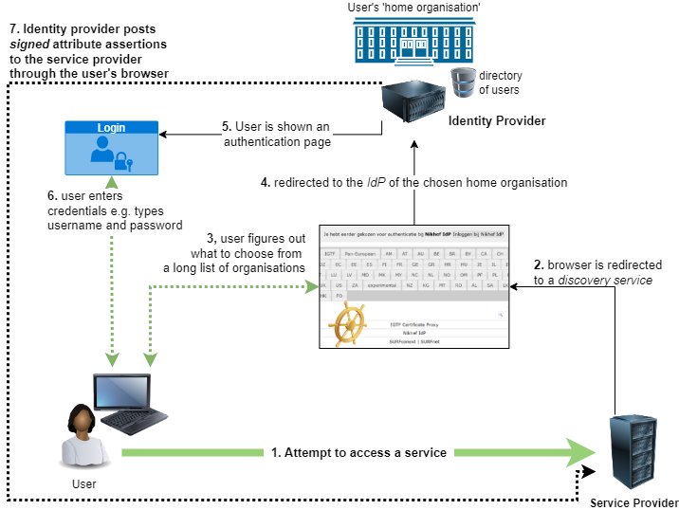
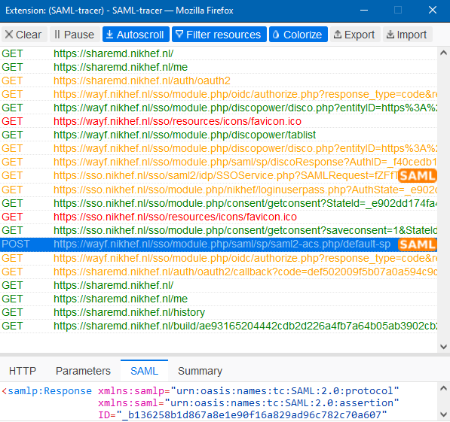
Is there still multilateralism in the world? At least in R&E!

Slide 21
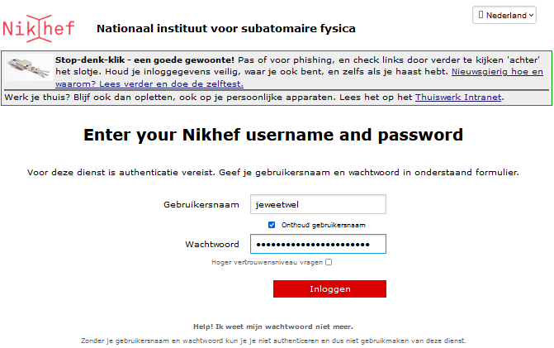
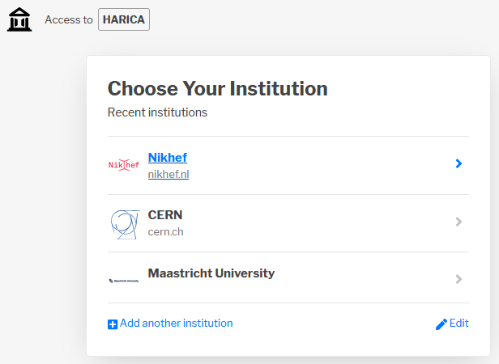
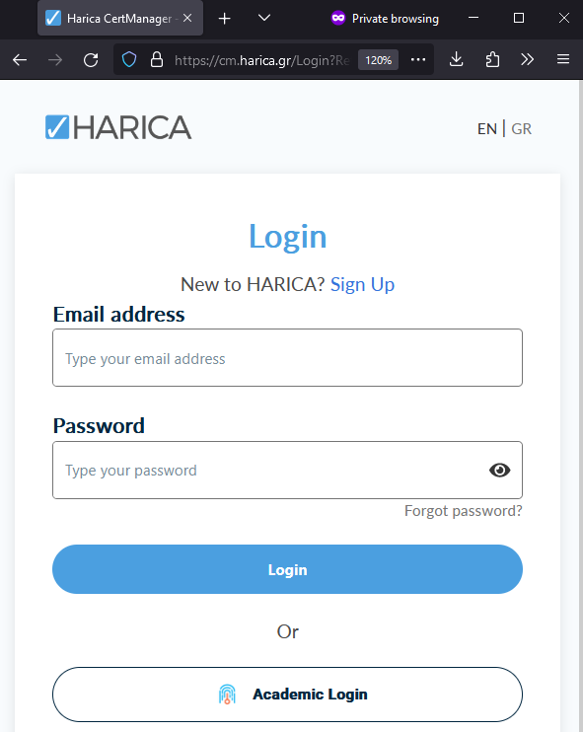
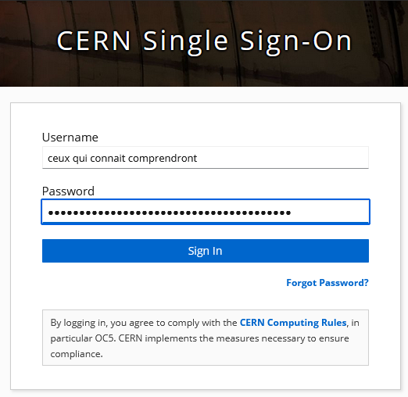
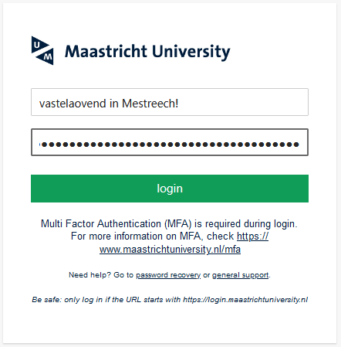
Where are ‘you’ in the federated space – discovery!
An example cross-institutional service by HARICA, the GEANT TCS G5 provider, presenting a SeamlessAccess.org discovery page

Slide 22
Here we are now, entertain us
Authentication is not enough!

Slide 23
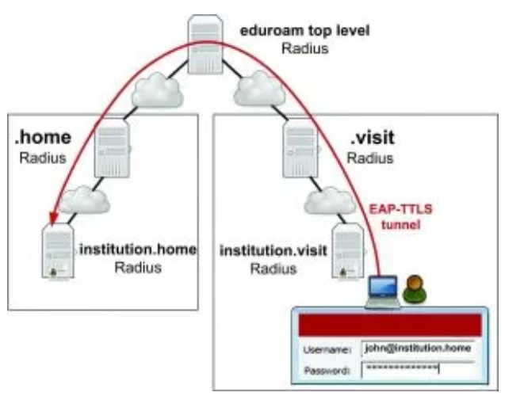

The federation you most likely know …
service-specific trust
between organisations
hierarchical server path, based on
a network-specific secure exchange
sending your credentials back
to only your home institution
found via <anon@domain.name>
eduroam image from https://eduroam.org/how/, GEANT ; RADIUS: RC2865 https://www.rfc-editor.org/rfc/rfc2865; see also freeradius.org

Slide 24


















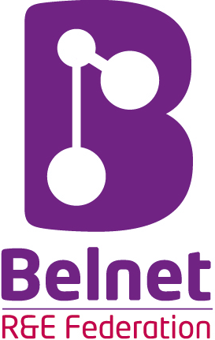















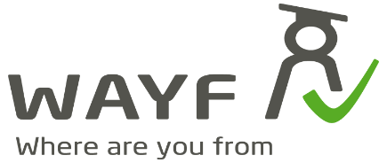
We live in a federated world!

Slide 25
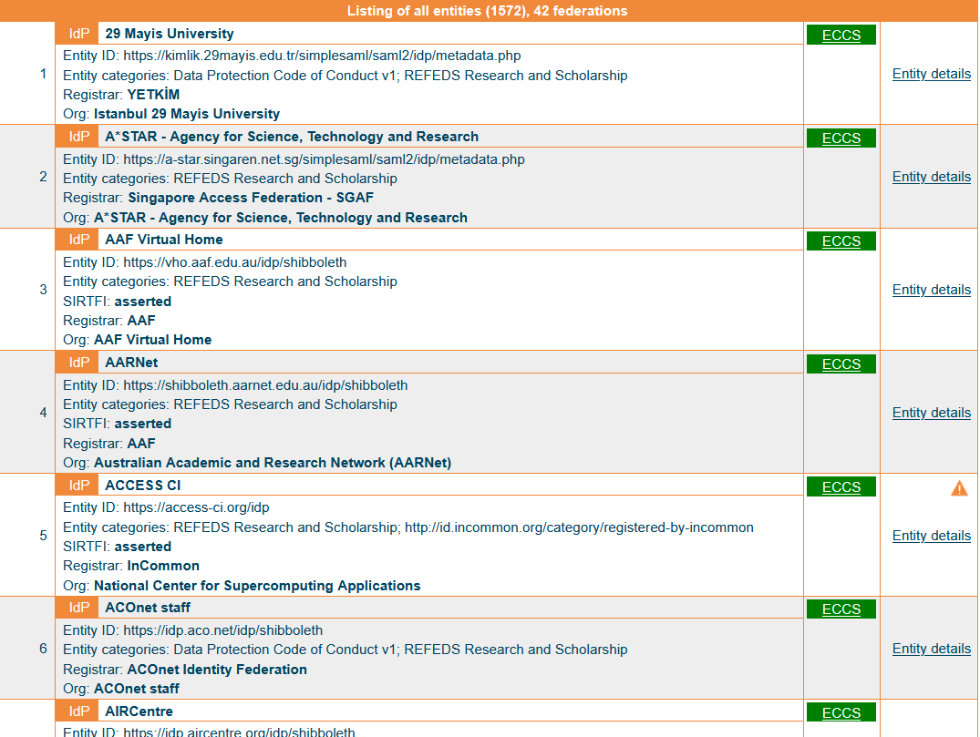
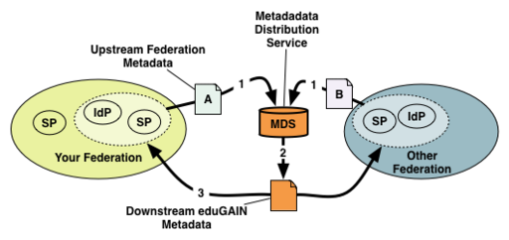
Meta-data and trust in IdP-SP ‘multi-lateral’ federations
#credentials required?
from O (n_{users}) + O (n_{services}*n_{home-orgs})
to ~ O (n_{users}) + O (n_{home-orgs}) + O (n_{services})
MDS meta-data flow: https://wiki.geant.org/display/eduGAIN/Metadata+Flow+in+eduGAIN
eduGAIN meta-data https://mds.edugain.org/edugain-v2.xml ; table excerpt from
https://technical.edugain.org/entities showing only R&S IdPs, i.e. those supporting research …

Slide 26
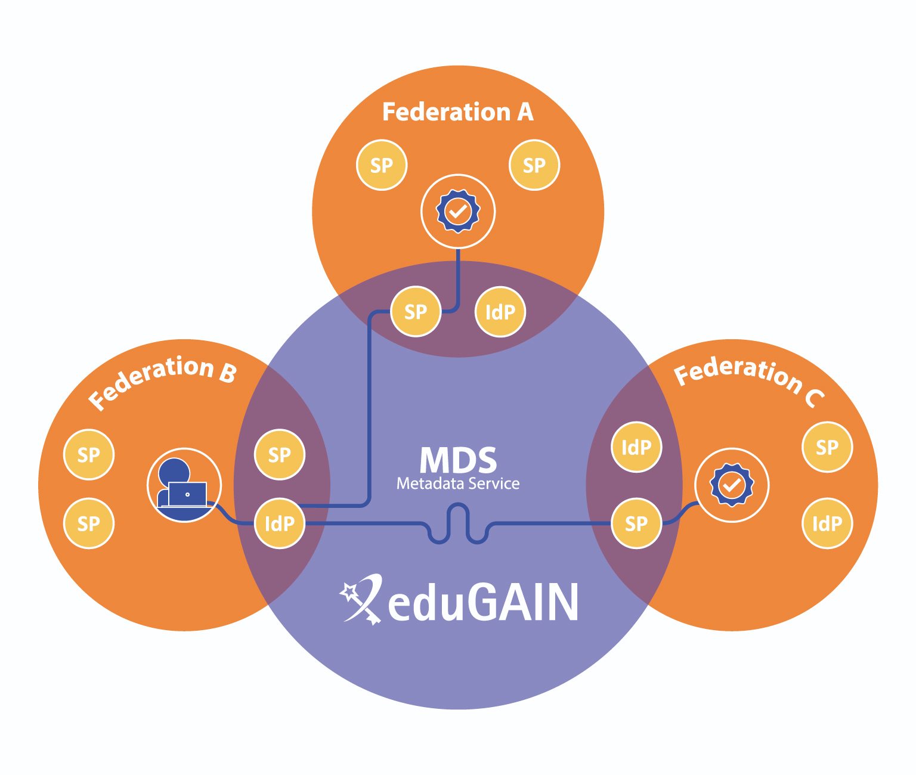
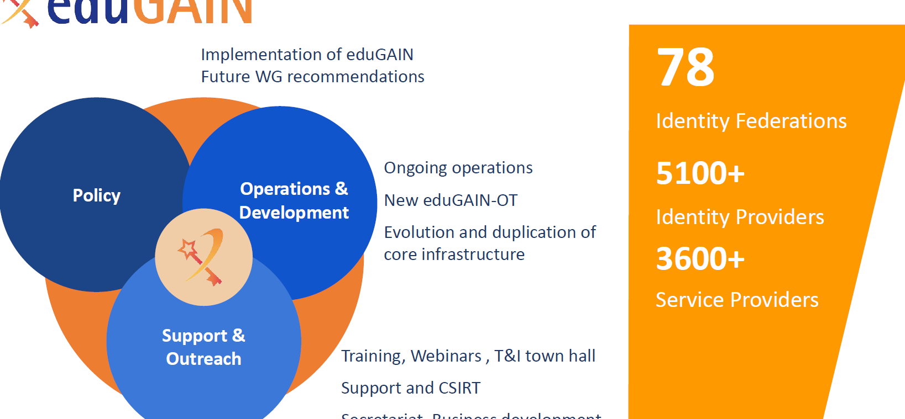
eduGAIN image: Davide Vaghetti, GARR for GN*-*

Slide 27
Different federation technologies, but the same idea
SAML - Security Assertion Markup Language and WebSSO (‘SAML2Int’)
  XML-formatted ‘attribute statements’ over web transport (usually POST)
  SAML-Metadata: list of entities with description of bindings with entityAttributes
PKI - Public Key Infrastructures
  digitally signed ‘X.509 certificates’ in binary format, by certification authorities (CAs)
  with subject name, issuer, serial number, and extensions
  CAs can sign end-entities as well as other CAs (hierarchically or by cross-signing)
  bridge CAs render a technical implementation of shared policy (assurance)
  policy-bridges don’t sign anything, but curate distributions
  (CA/Browser forum for public web trust, IGTF for research infrastructures)
OpenID Federation
  for end-points for OpenID Connect Providers and Relying Parties – otherwise quite similar
See www.oasis.org for SAML, RFC5280 (tech) & RFC3247 (policy) for PKIX, https://igtf.net/ and https://cabforum.org;
OpenID Connect Federation: https://openid.net/specs/openid-connect-federation-1_0.html

Slide 28
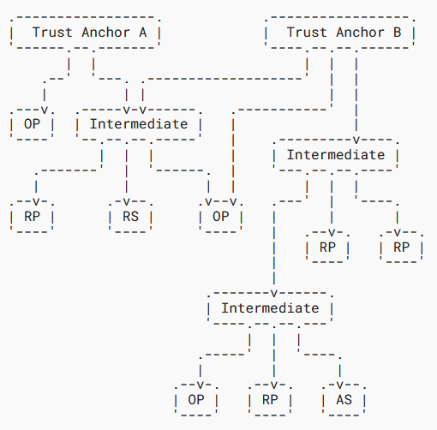
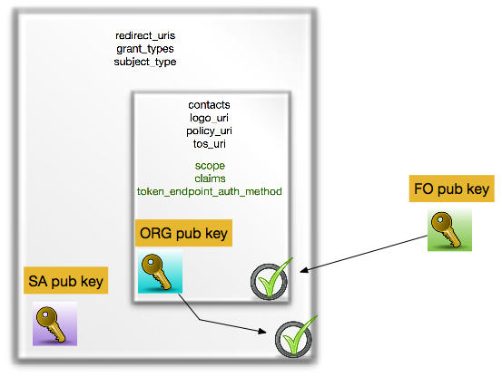
Federation concept is technology agnostic
Here showing
OpenID Federation
OpenID Federation signing image by Roland Hedberg; text diagram from OpenID Federation spec https://openid.net/specs/openid-federation-1_0.html

Slide 29
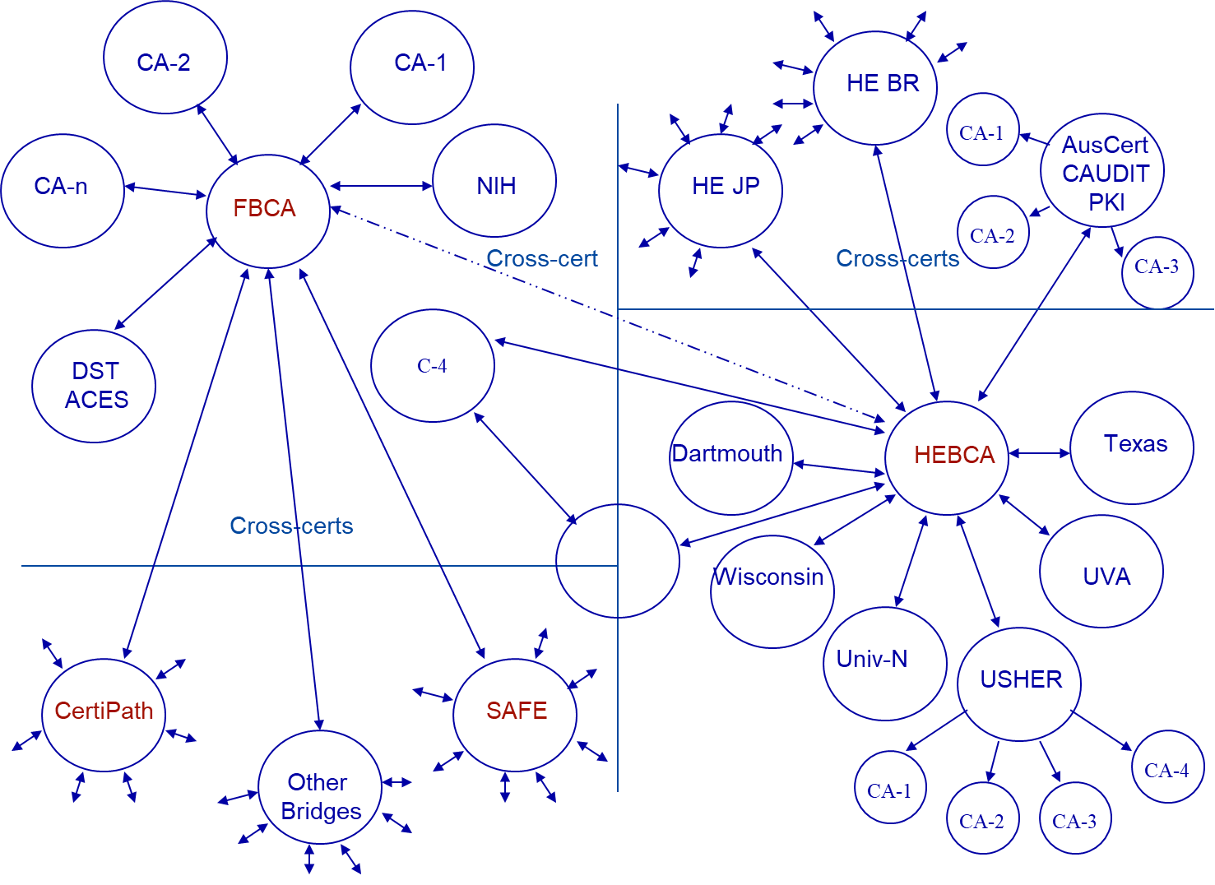
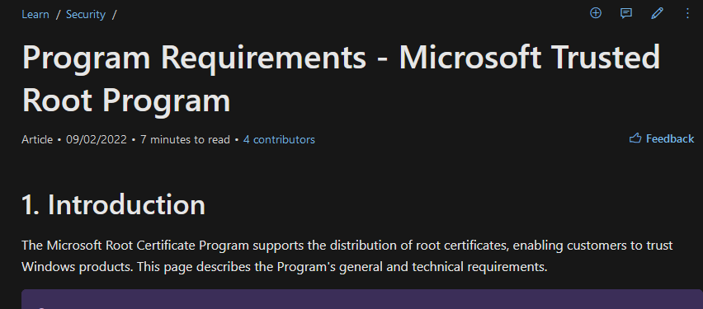



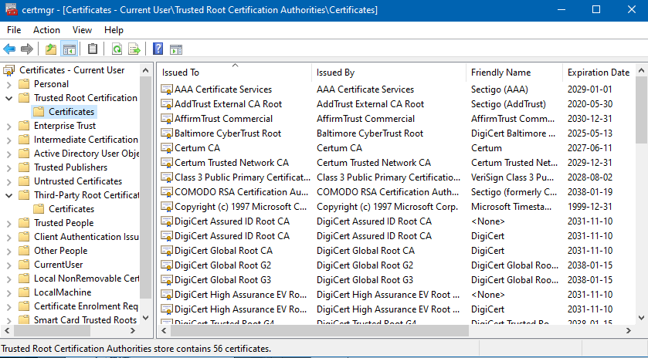
But why trust user-held credentials? Anyone could claim that …
trust decision remains with the relying party
bridged by trusted pathway to an anchor
via cryptographic cross-signing (complex)
Policy-bridge trust federation: EGI.eu infrastructure
leveraging the IGTF federation
local or infra policy decision
ca-policy-egi-core
IGTF Classic
ca-emsign
…
IGTF MICS
ca-TCS
…
IGTF Dogwood/ELM
ca-RCauth.eu
ca-GTS?
or by policy agreements and a trust list (common)
Left-hand image: 4 Bridges Forum, source: Scott Rea (then: Dartmouth)
Images: cabforum.org, WebTrust logo: from DigiCert.com;
image MS root store, https://learn.microsoft.com/en-us/security/trusted-root/program-requirements

Slide 30
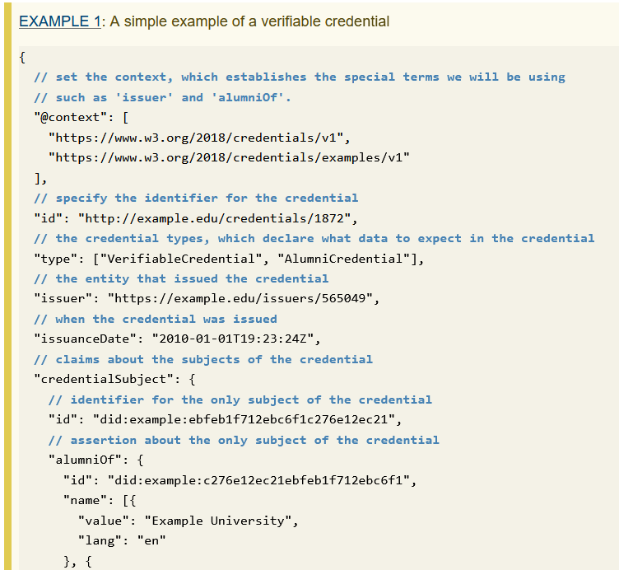
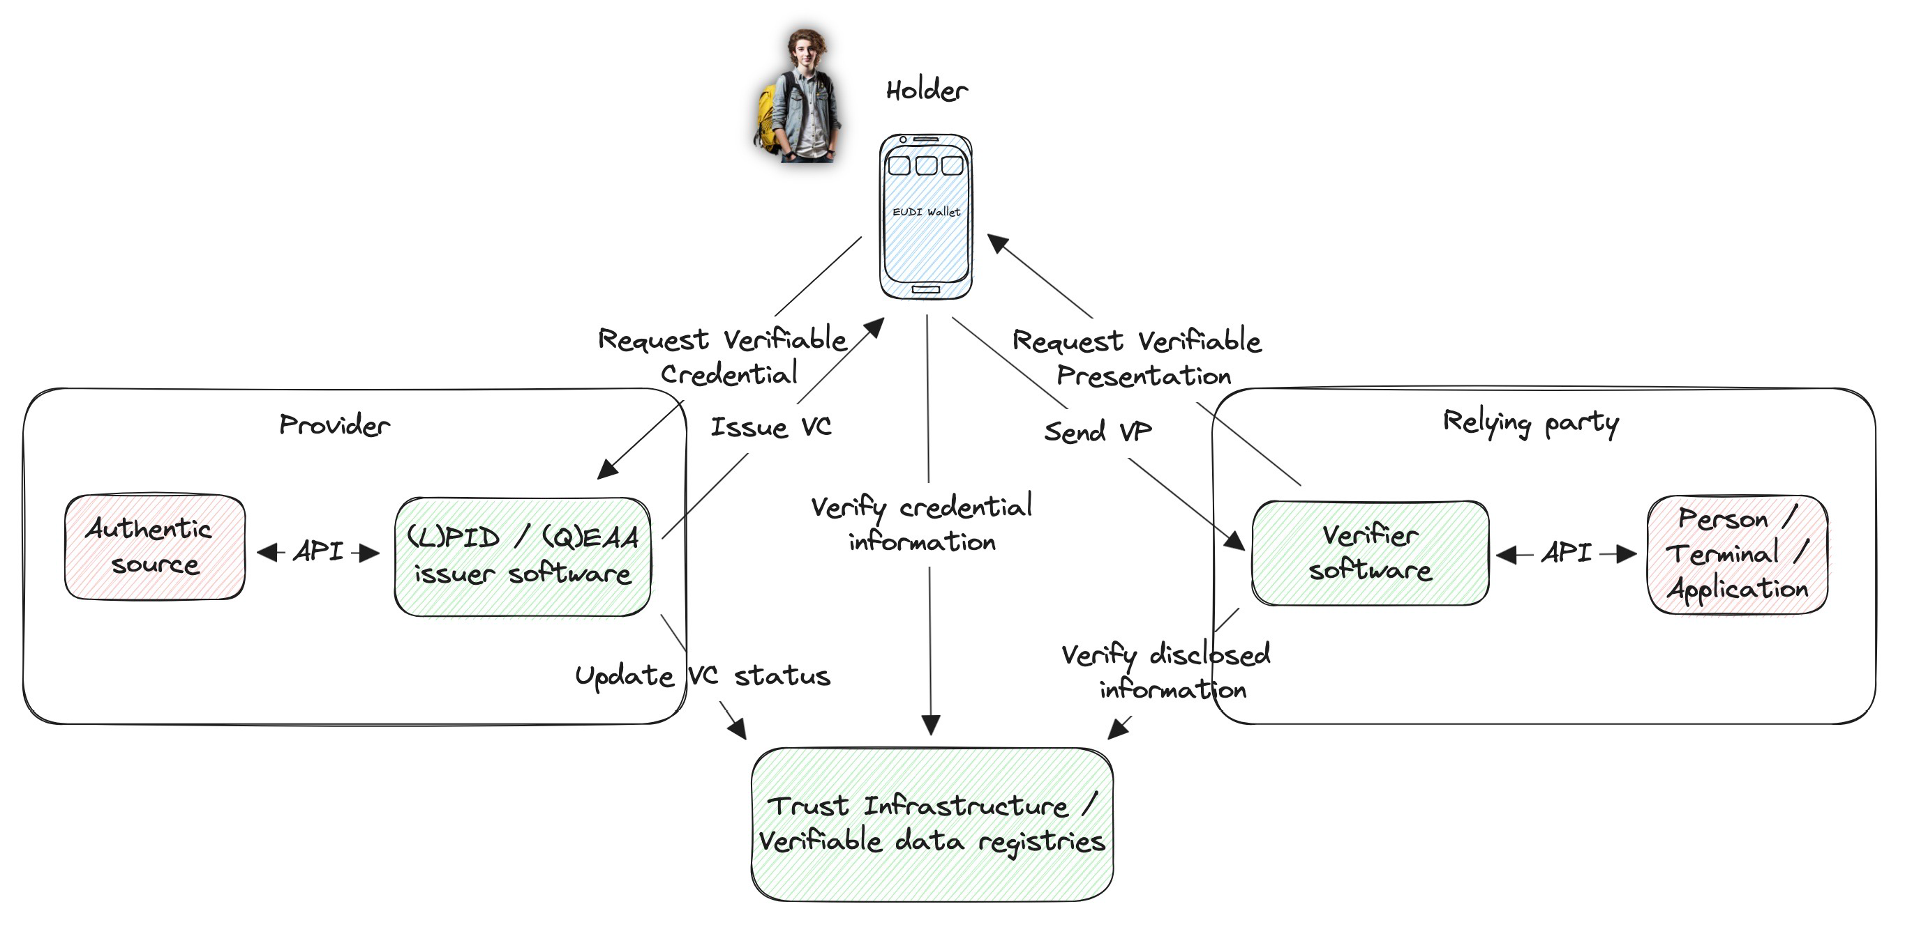
Also these modern ‘wallets’ are conceptually similar
Identity wallets:
user-controlled bundles of verifiable credentials
each signed by an issuer
which the owner can present
(as … a verifiable presentation ☺)
But then as a ‘JWT’
rather than a certificate
with a binary ASN.1 representation …
Verifiable credential example from: W3C https://www.w3.org/TR/vc-data-model/;
Wallet ecosystem image from Stefan Liström (SUNET), Géant T&I Infoshare Sept. 2024

Slide 31
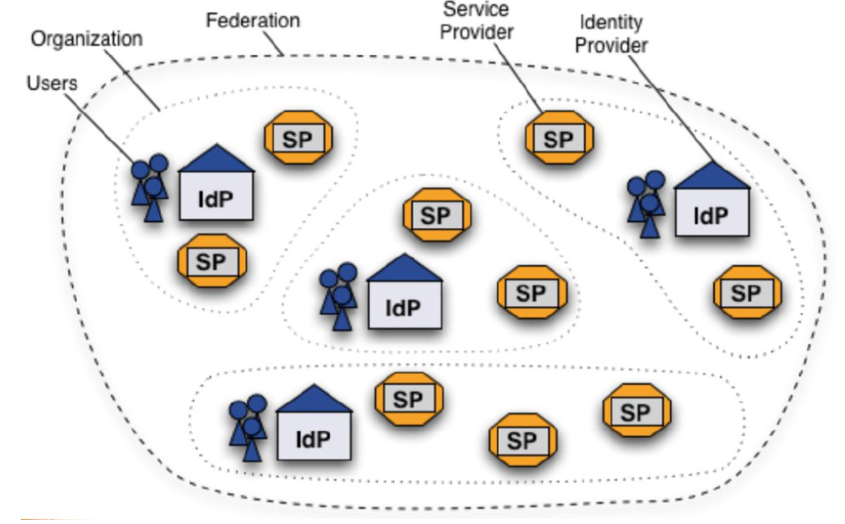
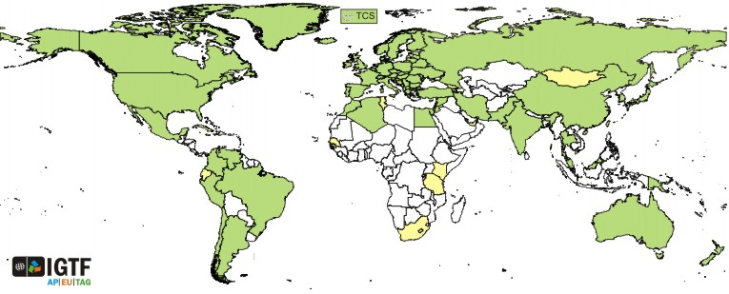

We progressed a lot since 2003 with identity federation
For eduGAIN federation the IdPs provide authentication from the home organisation, for the user-centric PKIX IGTF trust fabric, the CAs do.
Then Service providers perform authorization,
… maybe using attributes provided by the IdP. But do they get them??
Right-hand image: Shibboleth IdP federation, Lukas Hammerle, SWITCH (CH), user-centric PKI credentials: Interoperable Global Trust Federation, https://igtf.net/

Slide 32
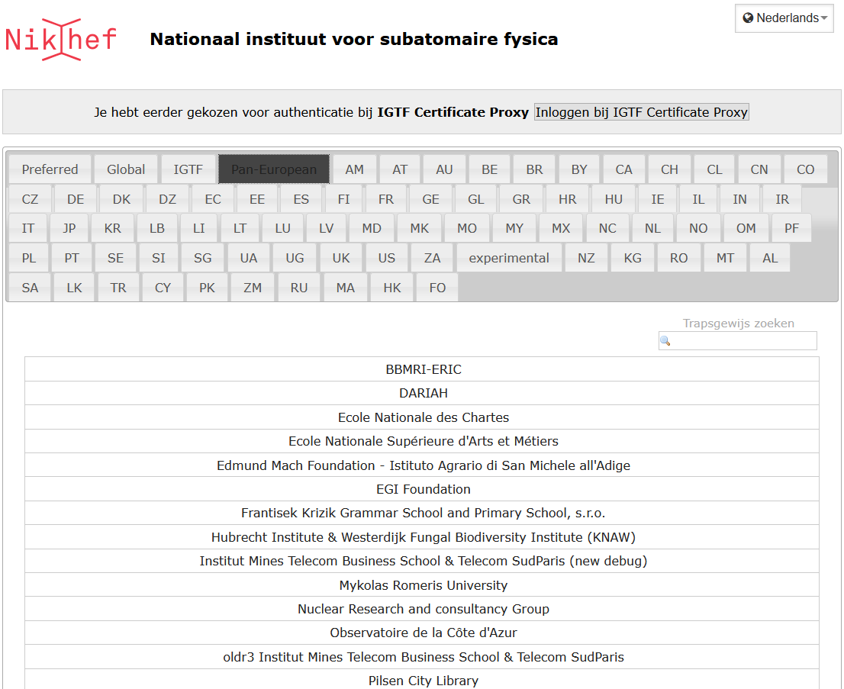



Federated Access
Federated Success!
Login to GW’s ifosim.org, to gitlab, or … via the service proxy
with any eduGAIN IdP
for user authentication
https://gitlab.nikhef.nl/
https://logbooks.ifosim.org/
https://wayf.nikhef.nl/
ifosim federated AAI integration implementation by Mischa Sallé; per-country WAYF selection is a bespoke Nikhef WAYF feature

Slide 33














Science infrastructures using our R&E ‘federated access’
LHCb
ALICE
ATLAS
Atlas
protons
Haarlemse Chemische Kring
33
Images: CERN https://wlcg.web.cern.ch/; HADDOCK, WeNMR, @Bonvinlab https://wenmr.science.uu.nl/; Virgo, Pisa, IT; artist impression Einstein Telescope EMR region; EOSC portal in 2023, EGI catalogue https://www.egi.eu/

Slide 34
They look similar, yet they are not …
In the Identity federation picture,
the source of authority is the
home organisation via its IdP
In the Community picture,
the source of authority
is the community itself
the AuthN-AuthZ separation is fundamental
to the Federated (R&E) AAI, global IGTF PKI, VOMS, ‘AARC BPA’ AAI architecture …
Right-hand image: Shibboleth IdP federation, Lukas Hammerle, SWITCH (CH)

Slide 35

Since collaborations and institutions slice in different ways

Slide 36

Research Infrastructures: what they actually need from ‘home’
Glossary
Affiliation: what type of entity are you (student, faculty, alumnus, …)
LoA: level of authentication assurance (like passport identity vetting
and ‘freshness’ of data)
MFA: multi-factor authentication (password, 6-digit code, SMS, fingerprint)
Source: Marina Adomeit, Janos Mohasci, et al. AARC TREE Use-case collection and analysis (D3.2), 2025 (under review)
The one infra that did ‘not need a unique identifier’ actually stated: “<our infra> assingns own identifier upon registration” – so the unique identifier is still there!

Slide 37



For starters: sharing good user identifiers is non-trivial ☹
of 6019 identity providers
in 77 federations,
only 1994 support R&S or Personalised access
33%
~ constant since 2018 ☹
Graph: InCommon: Attributes-WG-Recommendations-May2018.pdf; Entity Category stats as per 2025-03-03, from https://technical.edugain.org/entities

Slide 38

A fundamental scaling issue remained unique to research
for identity and user data
‘n x m’ agreements remain(ed)
IdP
Institute
or University
SP
Collaborative
Resource
at site

Slide 39

You need more than ‘just’ identity federation will give
Need to mix in authorisation based on community, project, or granting agency

Slide 40



Managing complexity: distributed diverse identity sources
WebFTS prototype
‘FIM4R’ in wLCG
Romain Wartel et al.
ELIXIR reference architecture
Mikael Linden et al.
they were composed of many services
each of which had to manage federation complexity
but most communities had started to invent
their own ‘proxy’ model to abstract complexity
Community images: Romain Wartel, CERN; Mikael Linden, CSC; Federation image (R): Lukas Hammerle, SWITCH

Slide 41

Proxy: let it act on behalf of many (our whole community)
Federation with SP Proxy image by: SWITCH (CH), Ann Harding, Lukas Hammerle

Slide 42

The IdP-SP bridge
often known as proxy!
Access services using identities from users’ Home Organizations,
but hide complexity of multiple IdPs, federations,
and different technologies for authentication and authorisation
One persistent identity
across all the community’s services through account linking
Access services
based on role(s) users have in the collaboration.
For both web and non-web resources
Integration of guest identity solutions
Support for stronger authentication assurance mechanisms

Slide 43


Adding a layer in the architecture for research collaboration
Bridging collaboration
and authorisation layer
to identity federation
Authentication
(academic, or govID, or ...)
Network layer(s)

Slide 44

AARC Blueprint – making the bridge a first-class citizen
Manage users and access rights
with interoperable building blocks for ‘AAI infrastructure’ architects
that are
technology-agnostic
have multiple implementations
come with policy templates &
good practice guides
AARC BPA 2019 ‘Community First’
https://aarc-community.org/guidelines/aarc-g045/

Slide 45




More than just nice colours
https://aarc-community.org/guidelines/

Slide 46

“Your attention to detail is appreciated”
Even a simple challenge …
“How to communicate
affiliation of a user with the community”
needs standards for interoperability!
AARC-G025 –
Guidelines for expressing affiliation information
AARC-G057 –
Inferring and constructing voPersonExternalAffiliation
Image: Guideline AARC-G025 (AARC community); quote from the MoinMoin wiki software

Slide 47







There is plenty of AARC deployments …
(SRAM)

Slide 48



Example: SURF Research Cloud Secure Supercomputing
SURF SRAM architecture, Raoul Teeuwen et al. from
https://servicedesk.surf.nl/wiki/display/IAM/Dienstbeschrijving+SURF+Research+Access+Management
SURF Research Cloud capture: from Introduction to SANE (Secure ANalysis Environment)
webinar February 2024, by Martin Brandt et al., SURF
https://www.surf.nl/themas/onderzoeksinfrastructuur/sane-veilige-omgeving-voor-analyse-van-gevoelige-data

Slide 49

… but one proxy is not enough in a research cloud
Community AAI
streamline researchers’ access to services,
both those provided by their own infrastructure
as well as the services provided
by shared infrastructures from other communities.
Infrastructure Proxy
enables Infrastructures with large number of resources,
to provide them through a single integration point,
where the Infrastructure can maintain centrally
all the relevant Policies and business logic
for making available resources to multiple communities

Slide 50

and with proliferation comes complexity ☹

Slide 51











Identity spaghetti: 1-loop, 2-loop and higher order diagrams
??

Slide 52

Not all that is possible is allowed in the AARC BPA

Slide 53
We have seen many arrows before … it needs federation!
Identity, community, infrastructure proxies and services form a federation of proxies
bilateral registration
but then you have a scalability issue again
meta-data distribution
of trust paths
  OpenID Federation
  SAML meta-data
discovery and identity provider hinting

Slide 54


European Open Science Cloud federation (2023 edition)
Identity Sources
Identity Sources
Identity Sources
EOSC Node
Proxy
EOSC Node
Proxy
EOSC Node
Proxy
EOSC Node
Proxy
Image: EOSC AAI for the EOSC Core and Exchange Federation for the EOSC European Node by Christos Kanellopoulos, Nicolas Liampotis, David Groep (June 2023)

Slide 55




And we need to ‘decorate’ the arrows with trust
Each side of each arrow has
independent parties
we allow them to do part of the work
we would otherwise do
to make it easier and faster for users
to perform their research
but we relinquish some control
beyond our organisation, our own policies, our own jurisdiction
Why would we trust them to do that?

Slide 56







Structuring trust ‘between boxes and arrows’ is complex!
https://aarc-community.org/policies/policy-development-kit/

Slide 57


And even a simple ‘Who are you?’ is not always easy …
IGTF interoperable global trust federation
REFEDS R&E federation
Kantara
industry identity assurance
eIDAS
government ID
REFEDS Assurance Framework and IGTF Profiles are ‘simpler’: academia is a higher-trust environment,
leveraging self-assessed peer review
Source: https://aarc-community.org/guidelines/aarc-i050, Ian Neilson et al.

Slide 58




Helping community and users: how much clicking through?

Slide 59



Good common practice: the WISE Baseline AUP
Purpose binding
ensure use is as intended for access grant
Terms and Conditions
research data access conditions, permits, grant conditions
WISE Baseline AUP
common 10 commandments that
allow seamless cross-sectoral user movement
Service level agreements
promises and recourse
Privacy notice references
for access personal data policies
https://wise-community.org/wise-baseline-aup/

Slide 60

It all started here!
Bob Cowles Acceptable Use Policy and Security Incident Response Strategy in the Open Science Grid – ISGC, 29 April 2005

Slide 61

Now: AARC guidance on Notice Management by Proxies
Four presentation models. In order of preference
machine-readable aggregated notice
common notice (single common authority domain)
cascading notices (assume responsibility for underlings)
coherent presentation: you show what you need (but not more)
Recommends WISE Baseline AUP plus
a machine-actionable model to
construct notices and communicate acceptance
based on a hierarchy of proxies
sufficient to build you a comprehensive WISE Baseline AUP
and a set of privacy notices (for those GDPR encumbered)
plus a namespace inspired by RFC6711’s LoA registry

Slide 62

Simplified Community Management – down to five items
Each Community must
Have a unique name (we recommend use DNS domain names)
Require members to accept an AUP that defines the community goals and does not conflict with the Infrastructure AUP
Inform members about how their personal information is processed, follow local legal requirements (e.g. a Privacy Notice)
Ensure its members and their authorizations are valid and
enforced (e.g. who is an administrator, who is in which group)
Be prepared for, and collaborate in, security incident response.
… and ensure that your provider can and will participate
in incident response and meets security requirements
including Sirtfi by providing contacts and sufficient logging
work in progress for
Community Support

Slide 63















What about unacceptable use? “who dunnit” essential
for incident response, but what have we just built?
full of valuable resources
(data, network, services)
So we have federation and single sign-on …
… but can we respond if something goes haywire?
… can we share security incident information when needed?
… timely and confidentially, protecting everyone’s reputation?
left: eduGAIN interfederation in 2025 (https://technical.edugain.org/status); logos on the right from the European e-Infrastructures and ESFRIs; center graphic: AARC

Slide 64



Multi-domain trust for research has its specific challenges
Authentication/identity sources
NIST SP800-63
FIPS140
ISO 27001
IGTF AP Profiles
REFEDS MFA
REFEDS Assurance Framework
Baseline security for operating
Attribute Authorities (AA)
and proxies in a trusted way
>
Service provider
operations
ISO27k
NIS2
ITSRM2
>
AARC G071 “AAOPS” https://aarc-community.org/guidelines/aarc-g071/ - review: https://wiki.eugridpma.org/Main/AAOperationsGuidelines

Slide 65



Security Operational Baseline for federated services
Everyone needs to work together, including users …
and bears responsibility
for what happens downstream!
https://doi.org/10.5281/zenodo.7396724

Slide 66



‘Sirtfi’ – what makes federated security different?
Organisations probably do ‘something reasonable’ for their own security ... but may not realise the implications for others
Sirtfi targets coordinated response in a federated context:
Enable communication and coordination
in managing federated security incidents
Relevant event data is available to help
collaborating incident responders.
Security protections are applied to federated transactions
Define capabilities for security incident response an IdP or SP organisation can self-asserts in federation meta-data
Operational Security
Incident Response
Tracability
User Rules & Conditions
https://refeds.org/sirtfi

Slide 67








A federated community security challenge
Can we coordinate our collective R&E response?
‘security challenges’ based on the Sirtfi contact model
parties involved in response challenge
Report-outs see https://wiki.geant.org/display/AARC/Sirtfi+Communications+Challenges%2C+AARC2-TNA3.1

Slide 68




Response across IdP-SP Proxies: the limits of Sirtfi version 1
Srtfi v1
|
|CSIRT
joint work with GN5 EnCo
and eduGAIN CSIRT

Slide 69






Trust … but verify
Communication:
Endpoints valid?
Form/Content OK ?
Containment
Ban ”malicious” users
Find/Stop malicious processes
Find submission IP
Forensics
Basic Forensics on binary
Network traffic

Slide 70

Federation security table-top exercises
What your role play brings you ☺
real time pressure to contain incidents
true gratitude for protecting your peers
collective recovery
exploring some gruelling conflicts of interest!
eduGAIN TTX – role play scenario from the ISGC Security Workshop 2024

Slide 71

Policy Development Kit: simplify by re-using good practice

Slide 72






Providers manage complexity for research communities
communities sourcing
‘well-operated’ community platforms
(SRAM)
and a few more …
through their scale gets
federations to trust our
AARC ‘middle boxes’
Notes:
Simplicification in AARC TREE – somebody can run these complex things for you …!
Hosted multi-tenant services as a way of simplifying control
and Snctfi compliance checks helps you as a community to select a good provider

Slide 73


Enabling research: using the ‘EOSC’ with federated login
AARC compliant federation of ‘national’ and ‘thematic’ nodes in the European Open Science Cloud
linked with other ‘data spaces’ and infrastructures
https://eosc.eu/eosc-about/building-the-eosc-federation/contributing-to-the-build-up-phase-of-the-eosc-federation/; See also https://wiki.geant.org/display/AARC/EOSC+AAI

Slide 74


And it needs everyone to work together
To scale trust in research infrastructures,
we need to keep challenging ourselves …
for eduGAIN: do we choose more trustworthiness and target
baseline assurance, or more inclusiveness, but maybe less trust?
for your university IT department: prioritize the primary mission
of education and research, as both are now globally connected
  ‘we can use existing services from outside’
  ‘we can contribute in collaborations in education and research’
  ‘we teach our students to understand, study, and work with
  interconnected services and systems that are globally connected’
… rather than get stuck in an enterprise egg-shell approach?
do our networks support a perimeter ‘fit for collaboration’?
Images: https://technical.edugain.org/entities, Maastricht University blocking access to … a privacy-friendly URl shortener ☹,

Slide 75









Make and treat computing as the research instrument it is today
– institutionally and globally
as well as JP’s HPCI,
US’s AccessCI, &c of course!
There are today as much
part of science
as detectors are to physics
and: users should move
seamlessly between tiers
Institutional:
Nikhef “Stoomboot”
Analysis Facility
National Infrastructure
SURF Snellius HPC
Photos: Nikhef NDPF, DelftBlue/TUDelft, SURF Data Repository, Snellius, SURF @ DigitalRealty; EuroHPC images: EuroHPC, LUMI Consortium, Jules Verne consortium

Slide 76




And education labs are much like ad-hoc research collaboration
just slightly more organised than research … I hope!
Photo by sunrise University on Unsplash; network diagram: FSE CSLab, Maastricht University; SRAM API: https://sram.surf.nl/apidocs/

Slide 77

So: did we solve this inherently-cross-domain issue … ?
Both Yes and No
Authentication and authorization ‘AAI’ infrastructures enable research every day
Building an interoperable system that enables multi-domain resource sharing remains a challenge
site map: WLCG sites 2021, visualization: CERN IT

Slide 78

The AARC Blueprint – a very digestible architecture … so
Photo credit: Marcus Hardt

Slide 79

The AARC Blueprint – take a piece and feed collaboration!
Photo credit: Marcus Hardt

Slide 80

So let’s digest all this …
This work has also been co-supported by projects that have received funding from the European Union’s Horizon programmes through grants AARC TREE and GEANT 5-2
Thanks to the AARC and global T&I Community, including folk from whom I re-used graphics in this overview. In random order: Licia Florio, Nicolas Liampotis, Christos Kanellopoulos, Marina Adomeit, Janos Mohacsi, Slavek Licehammer, Dave Kelsey, Ian Neilson, Marcus Hardt, Mischa Salle, Oscar Koeroo, Jouke Roorda, Davide Vaghetti, Floris Fokkinga, Sven Gabriel, Hannah Short, Maarten Kremers, and many others!

