Slide 1
Bridging Environmental Research Infrastructures in Europe
ENVRI-Hub Next
Marta Gutierrez, EGI Foundation
Angeliki Adamaki, Daniele Bailo, Magdalena Brus, Ulrich Bundke, Claudio Dema, Dario De Nart, Federico Drago, Tiziana Ferrari, Anca Hienola, Andreas Petzold, Alex Vermeulen, Zhiming Zhao, and many more

Slide 2

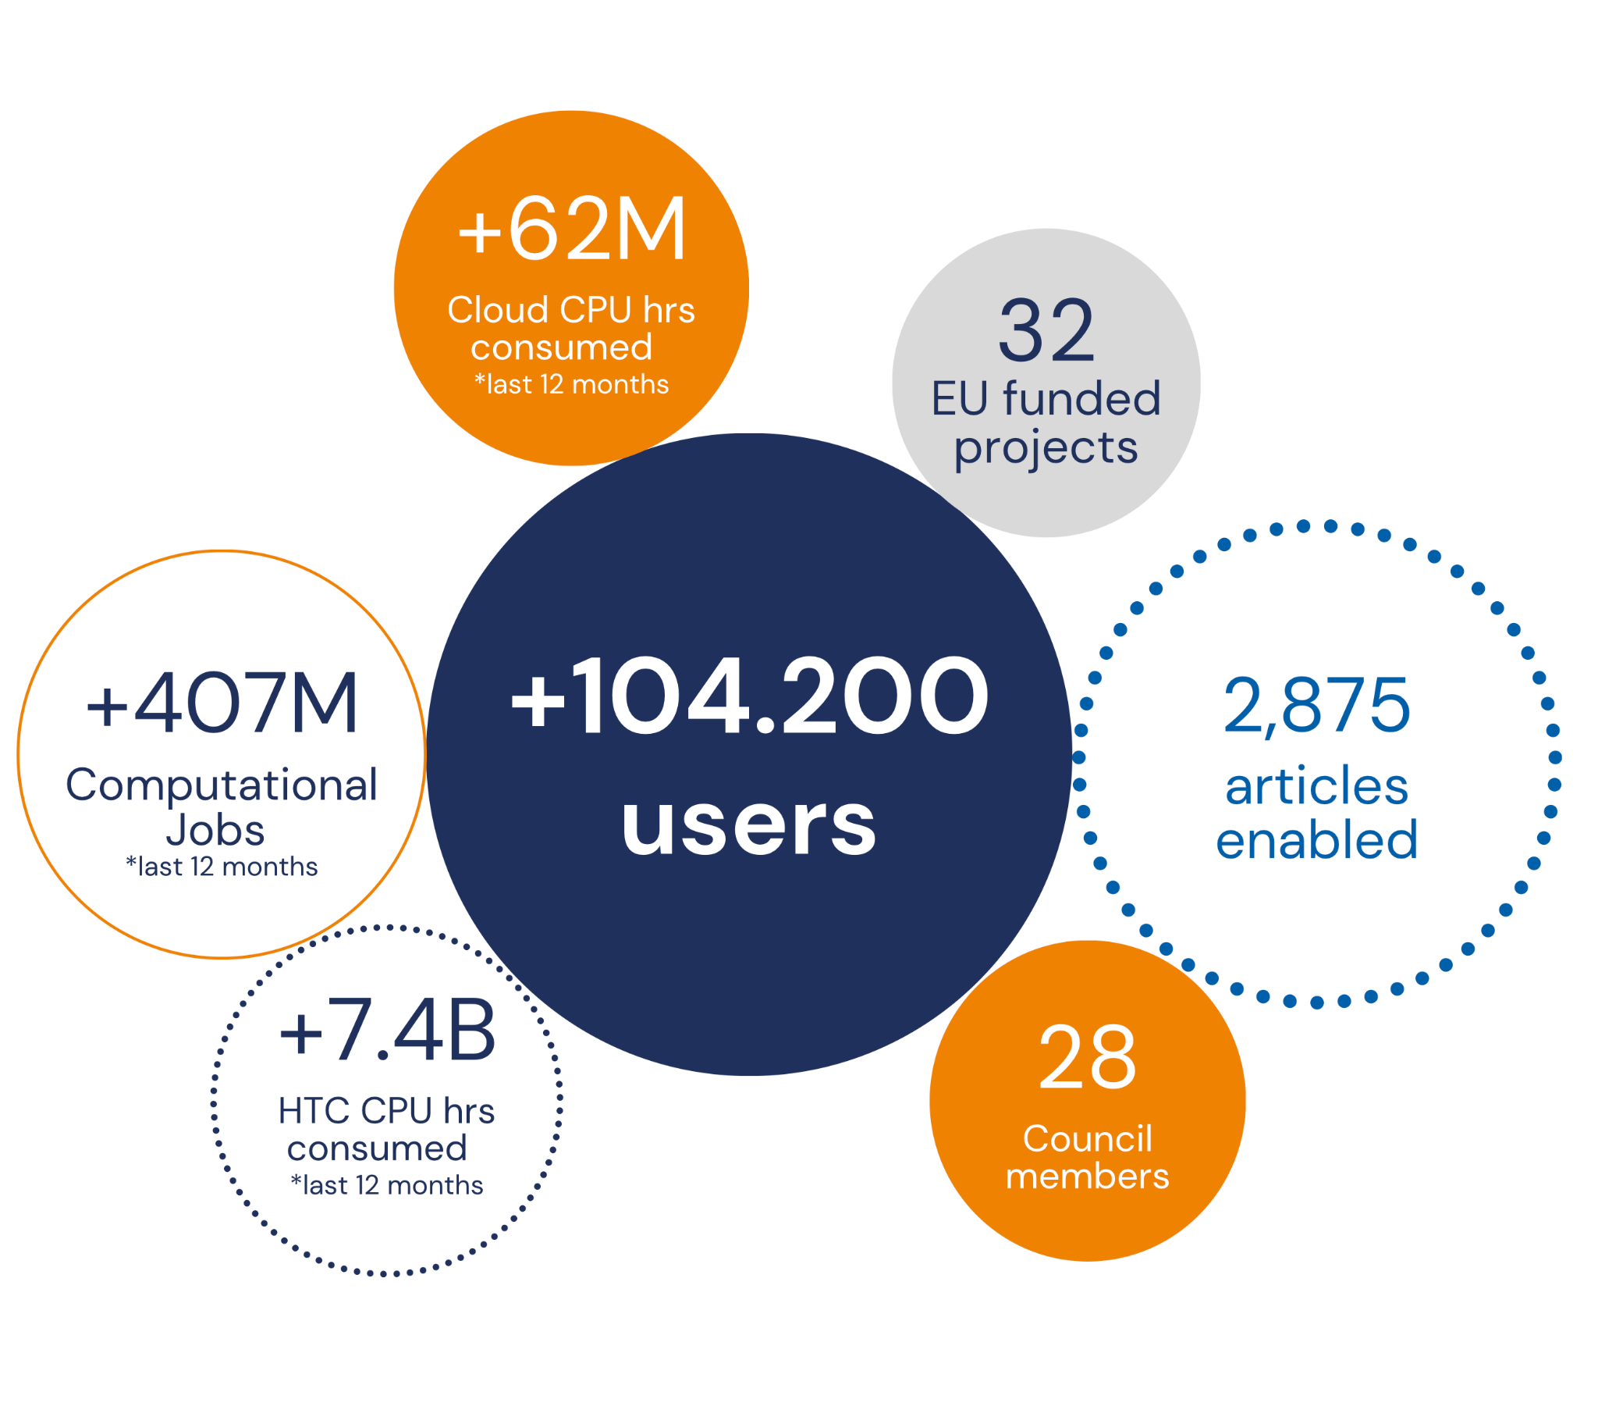
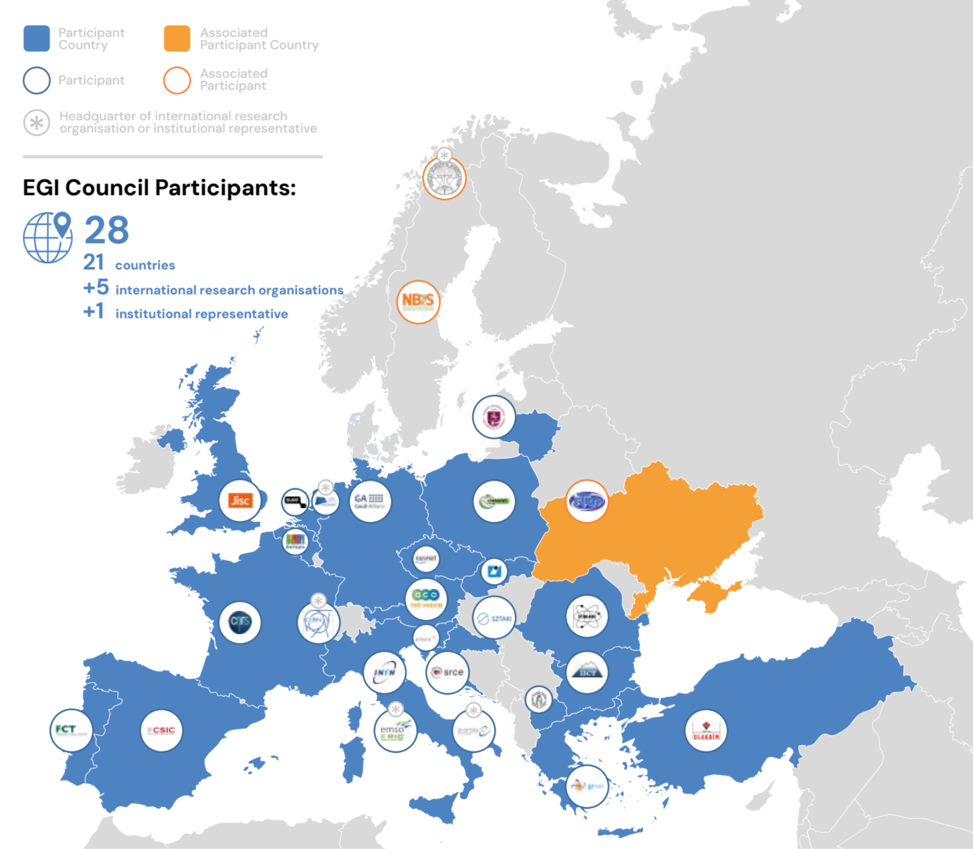
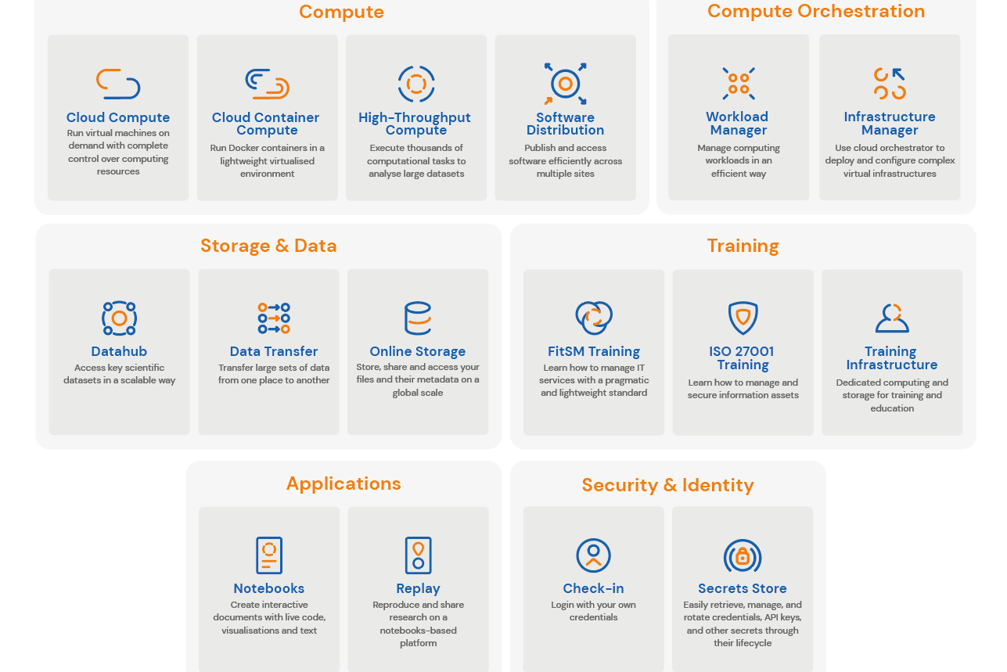
EGI in a Nutshell
www.egi.eu
EGI Federation
A European flagship digital infrastructure for data-intensive scientific computing
EGI in numbers¹
EGI Services
EGI delivers advanced computing services to support scientists, international projects, research infrastructures and businesses.
EGI services for research
Why a federation?
Support science at international scale
Build an hyperscale facility for research
Invest nationally, access globally
Bring computing to the data
¹ the key numbers are correct as of February 2025.

Slide 3
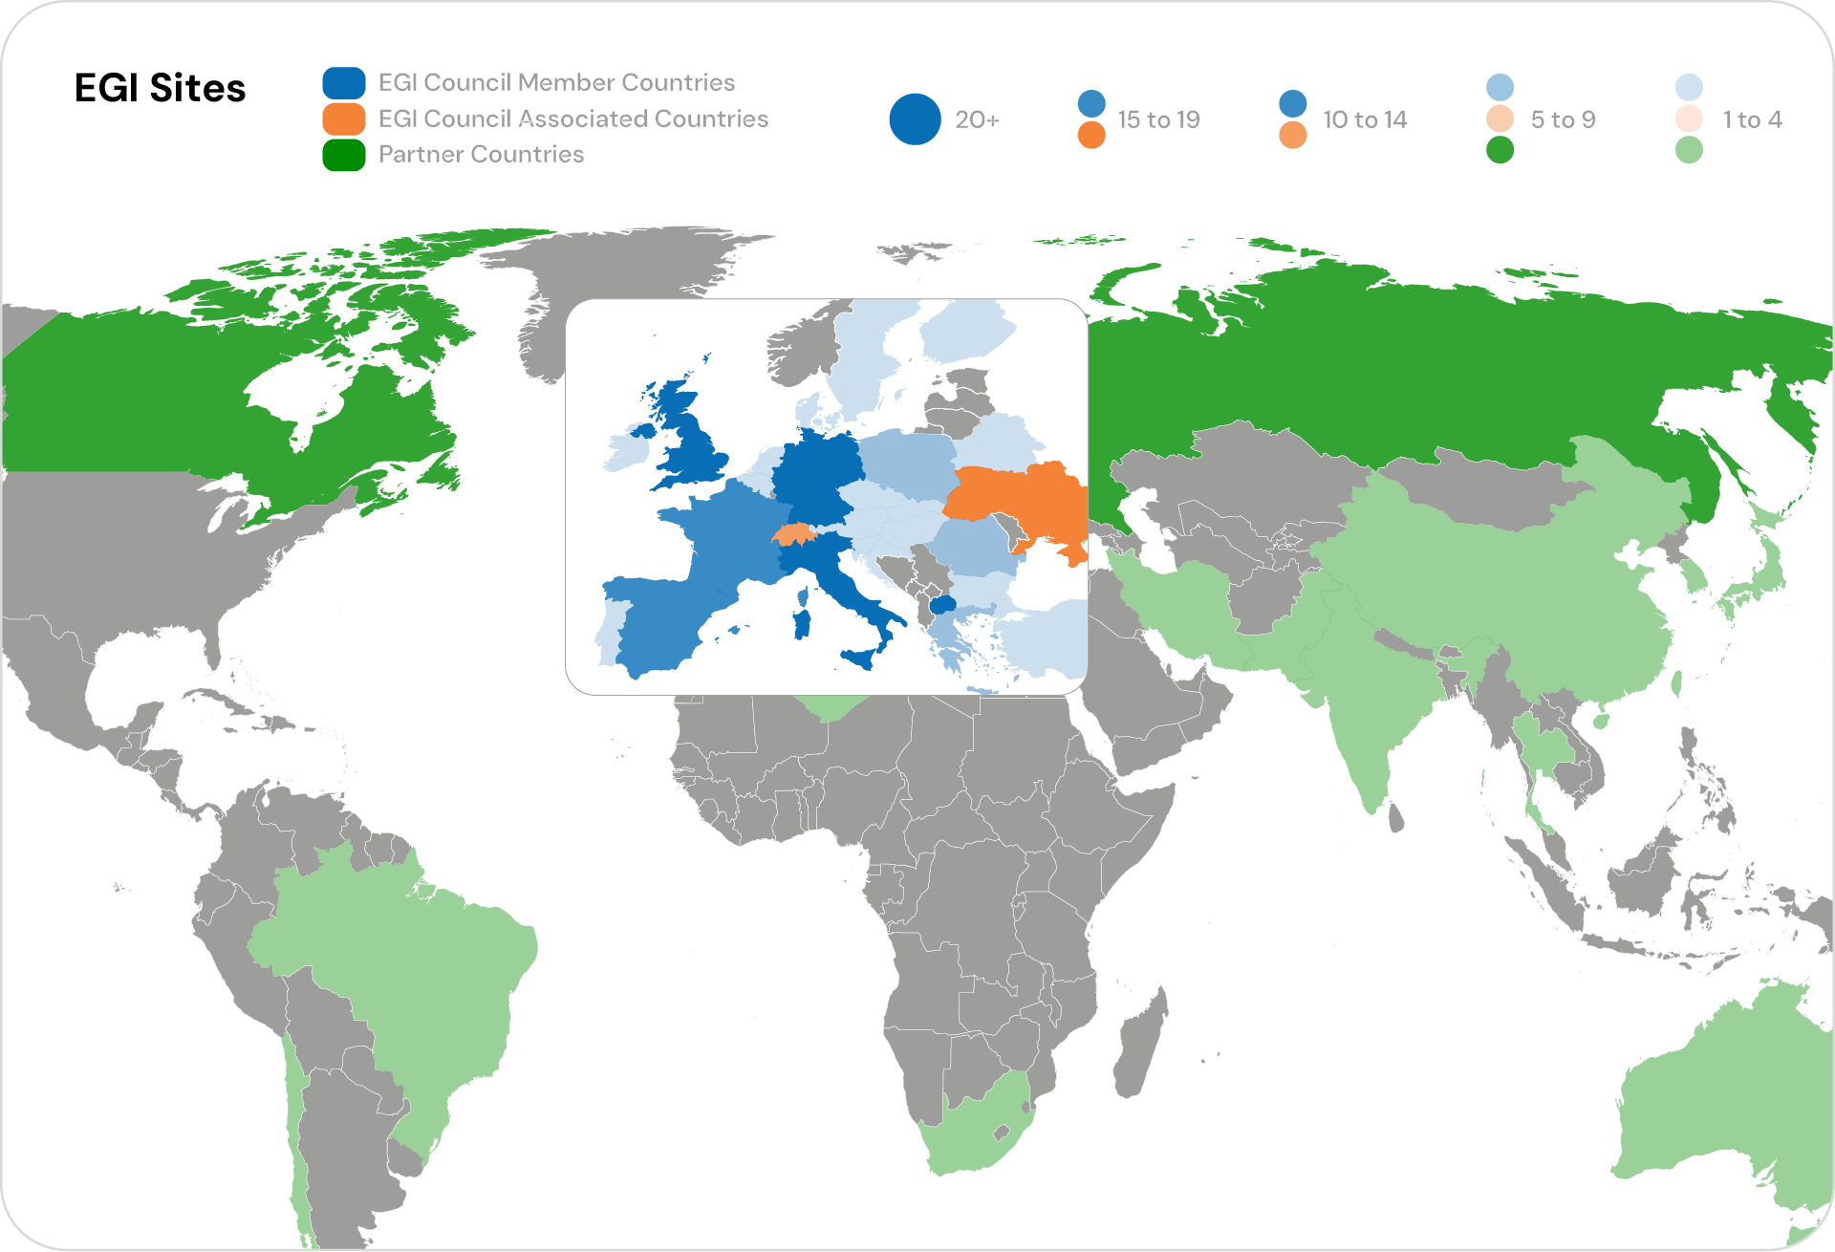
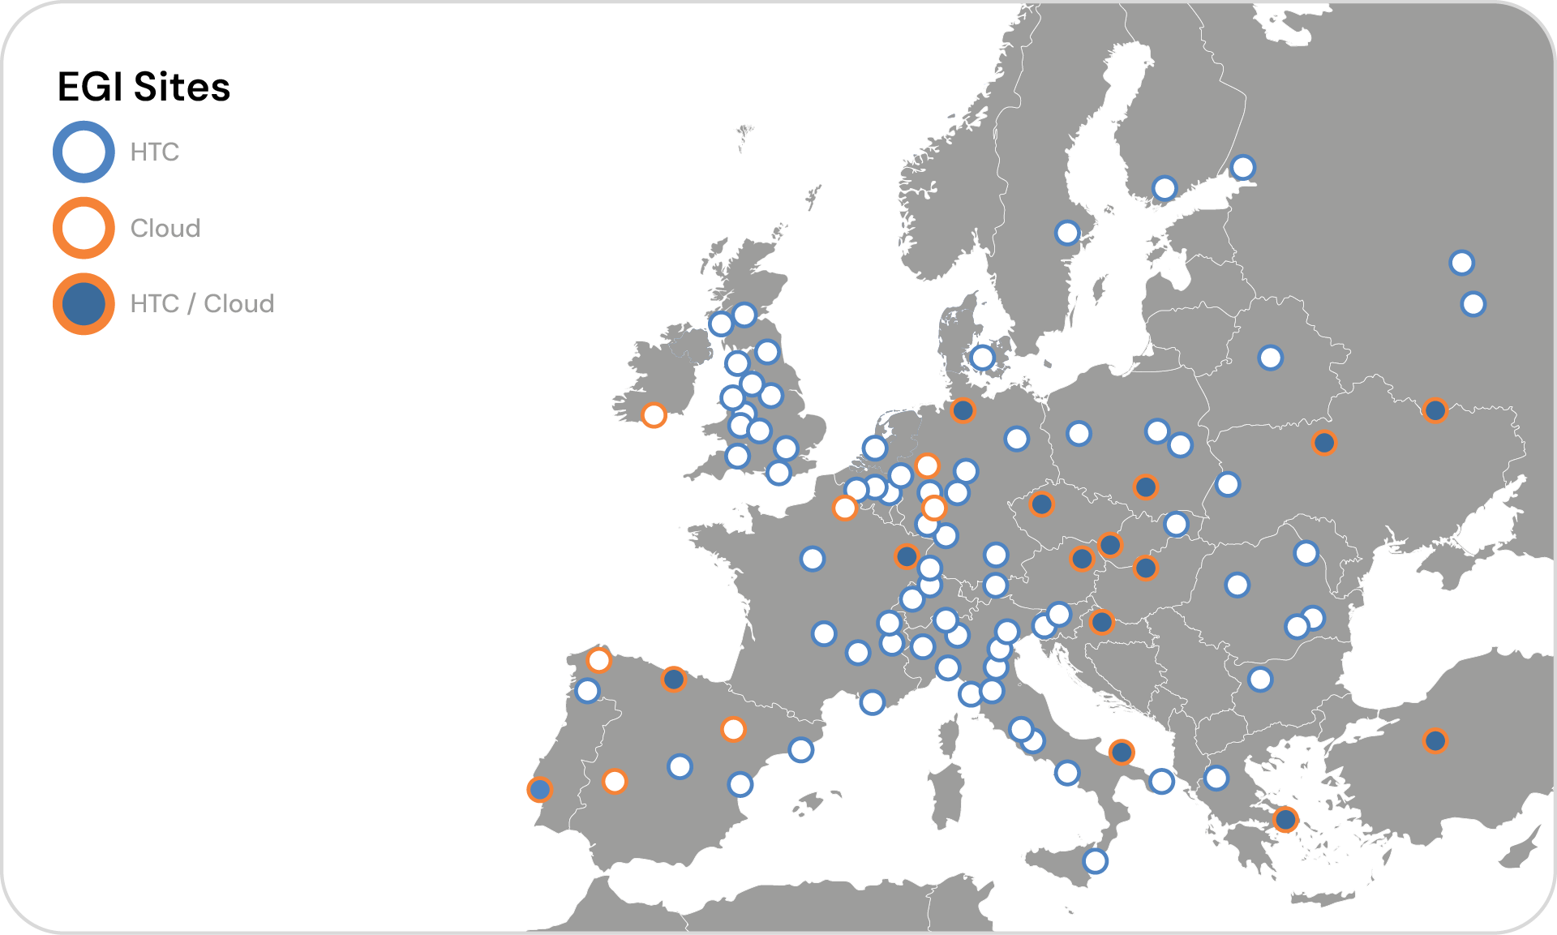
EGI infrastructure

Slide 4

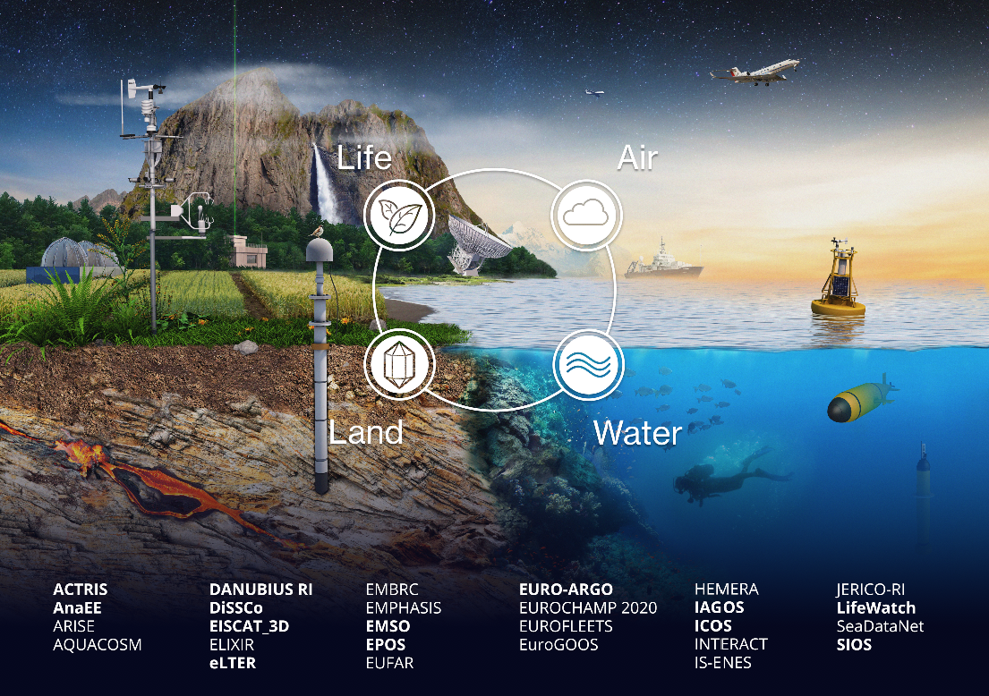
The ENVRI Community
27 Large Environmental Research Infrastructures in Europe
Notes:
Support disciplinary and interdisciplinary research approaches in the undrstanding of the Earth system approach

Slide 5
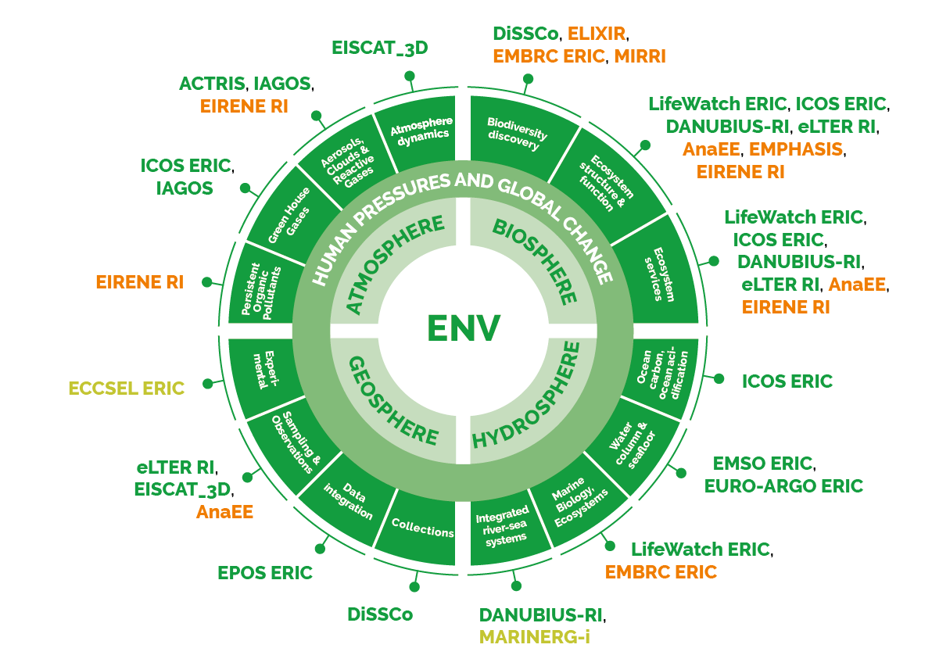
ENVRI RIs in the ESFRI roadmap
European Strategy Forum on Research Infrastructures
Source from the ESFRI landscape roadmap 2024
Notes:
ESFRI (European Strategy Forum on Research Infrastructures) is a strategic initiative established by the European Council in 2002 to support the development and integration of large-scale research infrastructures in Europe. Its main goal is to strengthen European research capabilities by coordinating investments in research facilities and ensuring their long-term sustainability.

Slide 6

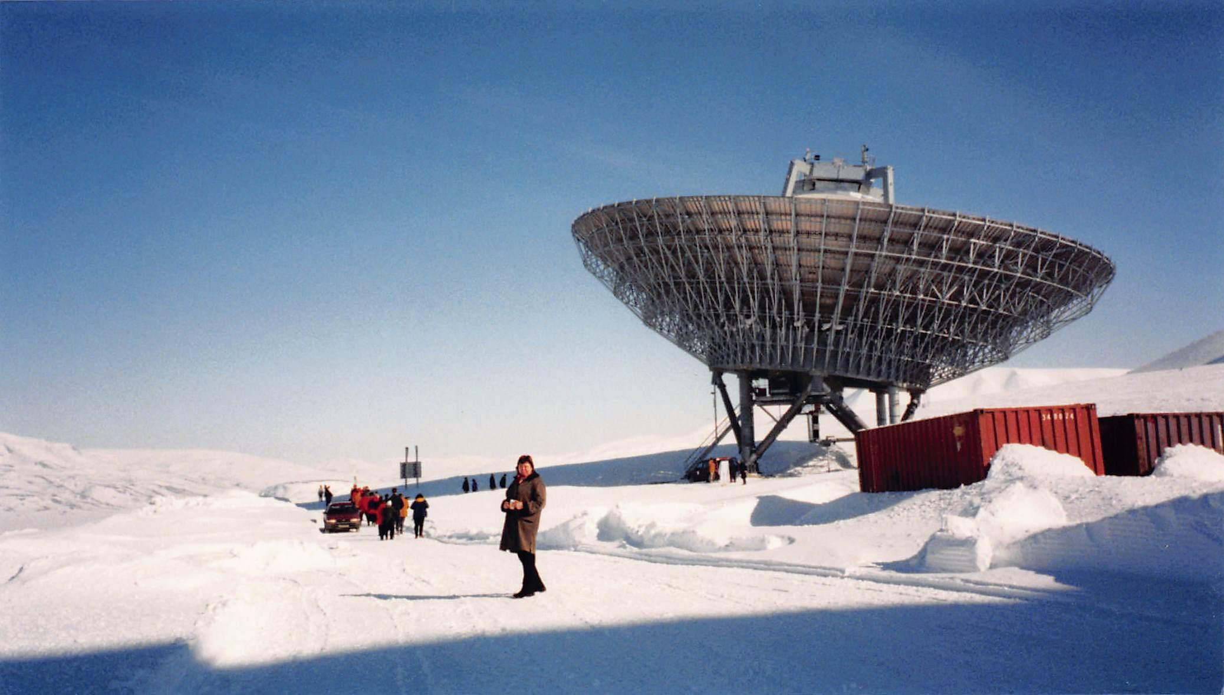
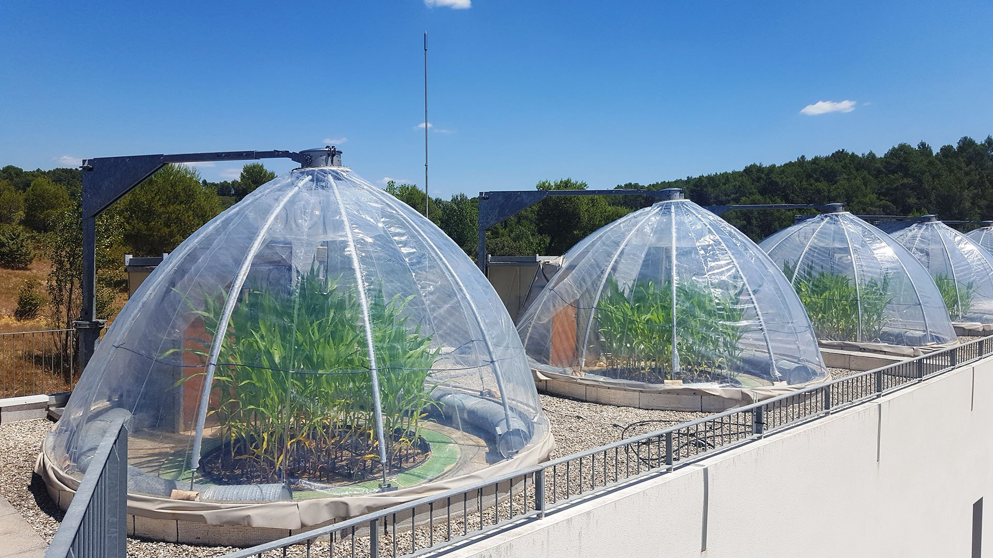
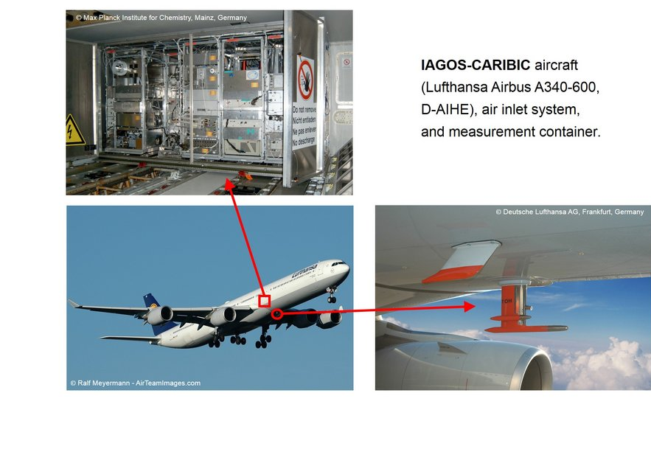
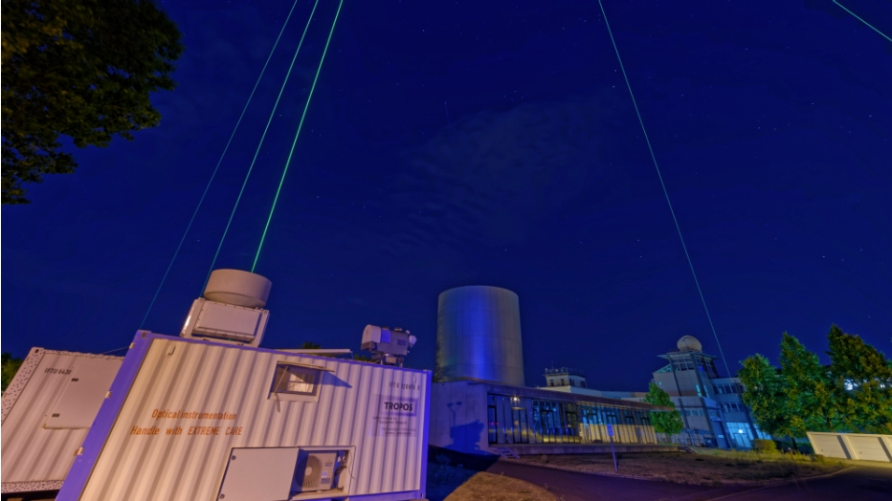
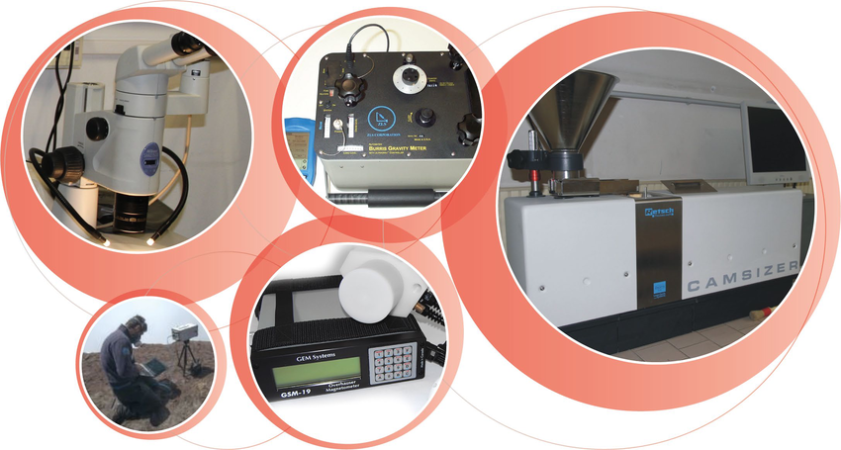
In situ - remote sensing - instrumentation observational data

Slide 7



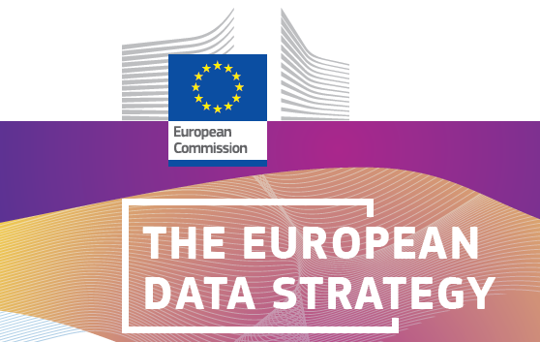
EU Policy Areas
ERA
Single market for research innovation
EU Green Deal
Climate Neutrality 2050
EOSC
Open science & FAIR Principles
EU Data Strategy Single data market

Slide 8
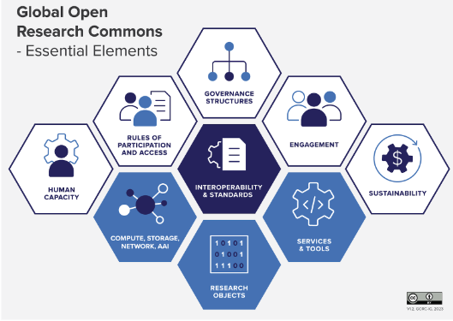

Supporting RIs through Data-Intensive-Computing continuum enabling Open Science
Collaboration is the hallmark of modern science
The Open Science Commons embodies this vision
The Global Open Research Commons International Model Report, Version 1; Payne,K., Corrie,B., Crawley,F., Harrower,N., Macneil,R., Maxwell,L., Sansone,S.-A., Treloar,A., Woodford, C., Åkerström, W.N.

Slide 9




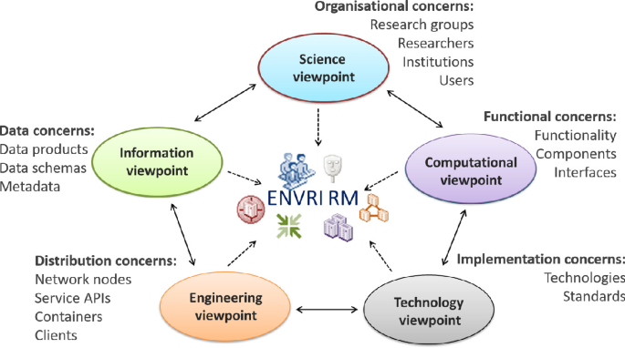

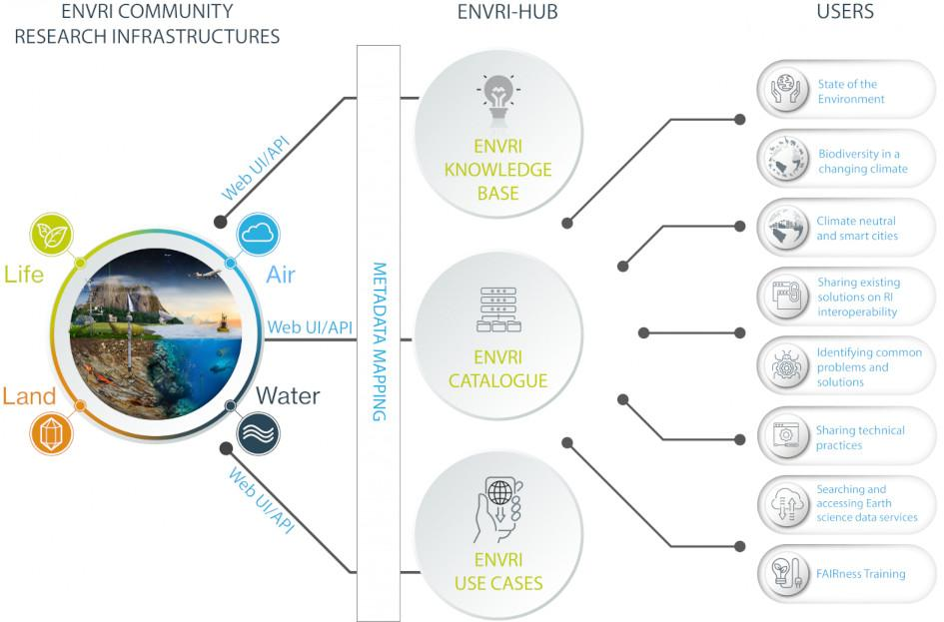
ENVRI together: 14 Years of collaborations
14 years of collaborations
ENVRI
2011.11-2014.10
ENVRI-plus
2015.3-2019.2
ENVRIFAIR
2019.3-2023.6
ENVRI-HUB next
2024.2-2027.1
Notes:
ENVRI (2011-2014) – The foundational project that established a strong network of European environmental research infrastructures, setting the stage for future collaborative efforts.
ENVRIplus (2015-2019) – Building on the success of ENVRI, this project aimed to integrate and enhance the capabilities of the environmental research infrastructures, fostering a more cohesive and effective community.
ENVRI-FAIR (2019-2023) – Focused on aligning the data management practices of environmental research infrastructures with the principles of FAIR (Findable, Accessible, Interoperable, Reusable), this project significantly improved data sharing and accessibility.

Slide 10
Challenges ahead
Research Infrastructures
E-Infrastructures
Discovery
Access
Composition
Usability
Processing
Notes:
Discovery barrier. Discovering data with required parameters from distributed data sources which often use diverse
metadata schema or vocabulary, is very difficult. It requires enormous human efforts to go through different systems
and infrastructures, check the existence of specific observations, and select the relevant data sets for computing a
specific ECV.
Access barrier. Accessing data from multi-sources if they do not share a common interface and protocol (e.g.,
ERDDAP38 and FTP39) and access controls (e.g., licences and AAI40), which hampers the automation of the data
processing workflow via direct machine-to-machine interactions, is challenging.
Composition barrier. Data is often behind service interfaces, and their diverse application programming interface
(API) and locations require customised integration of those data in the workflow applications, which makes the
reusability of the workflow for new data services very low, if without heavy code-level adaptation.
Processing barrier. ECVs are often used in policy verification or decision-making applications together with
simulation and data analytics, e.g., predictive greenhouse gas analysis in different decision scenarios. Such
applications often require high-performance or throughput computing infrastructures or Cloud; however, automating
the workflow with distributed data sources on remote infrastructure is still challenging.
Usability barrier. Many environmental and Earth science types of research by nature are interdisciplinary. The long
learning curve of the new technology and low usability for different application domains hamper users from
effectively using tools and services in their daily practices.

Slide 11
ENVRI-Hub Next : Objective
21 Partners
3 years: 2024-2027
ENVRI-Hub NEXT goal is to create a robust conceptual and technical framework that will empower the ENVRI Science Cluster to provide interdisciplinary science-based services.
These services will support climate change research, including the development of mitigation and adaptation measures and strategies and the assessment of the climate change risks.
Through this framework, ENVRI-Hub NEXT will facilitate the integration of the environmental sciences community into the European Open Science Cloud, guided by the science-based framework of Essential Climate Variables.

Slide 12
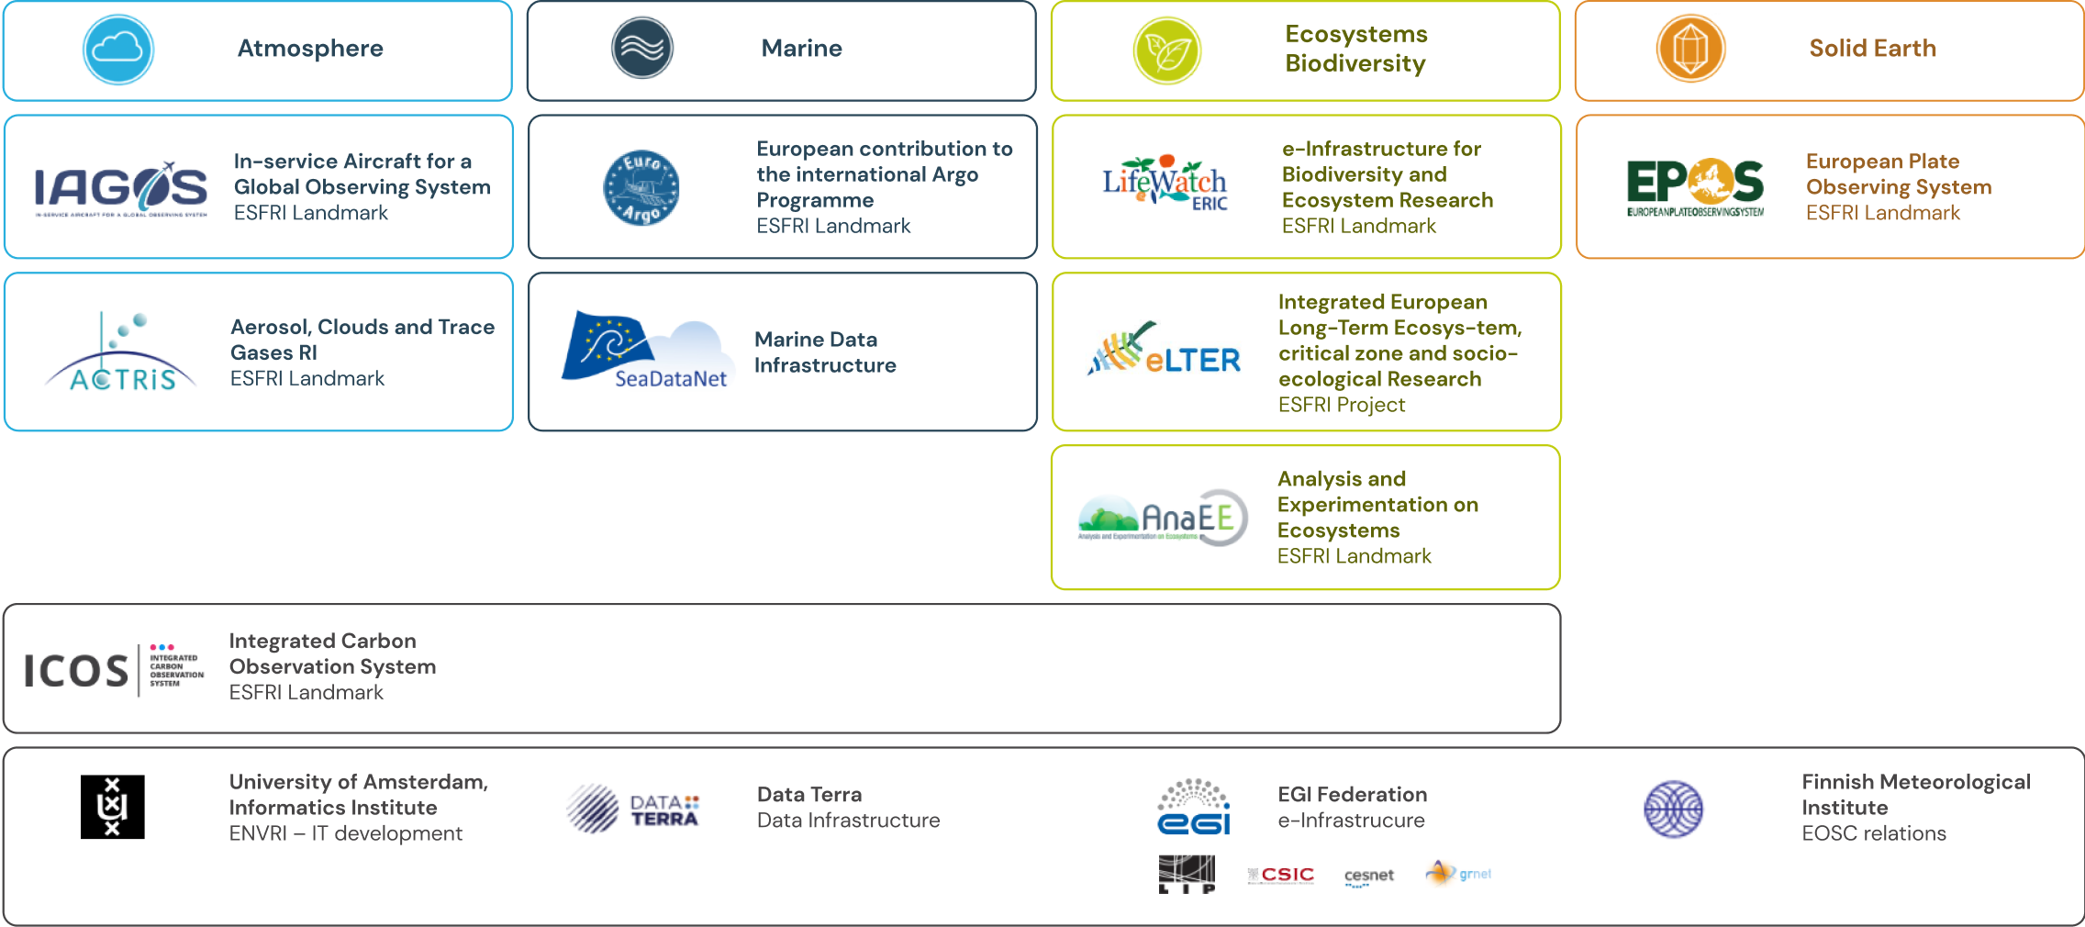
ENVRI-Hub Next

Slide 13
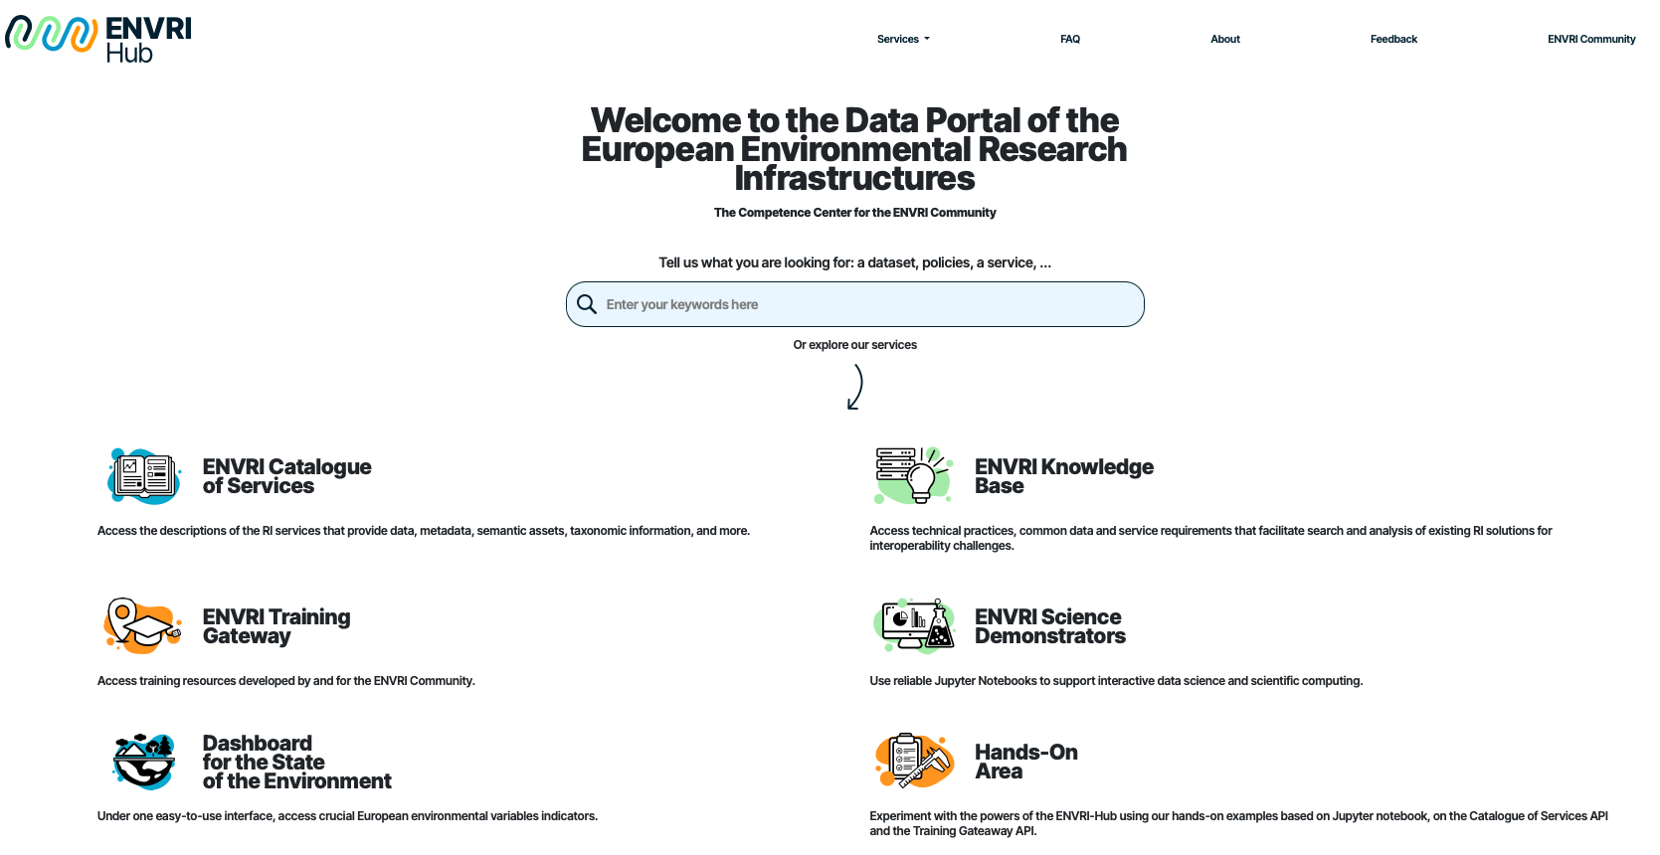

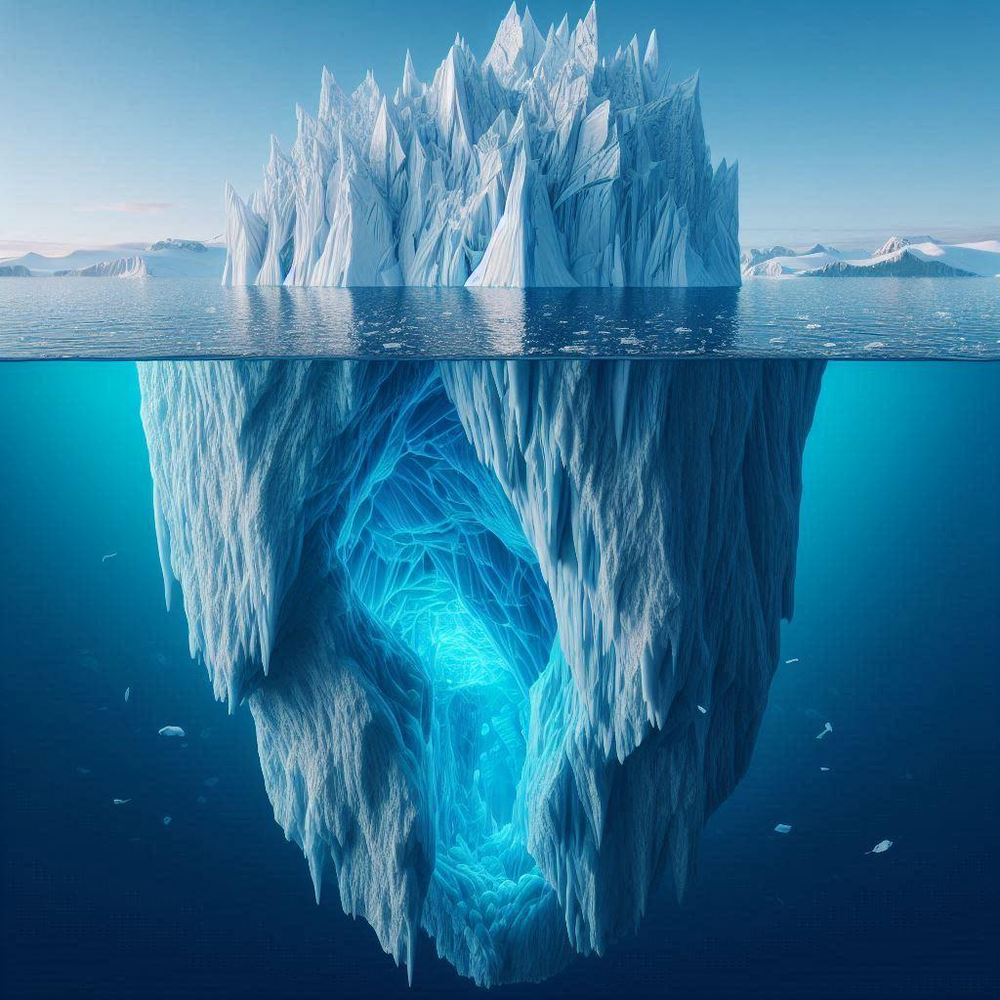
ENVRI-HUB : The gateway !
https://envri-hub.envri.eu/

Slide 14
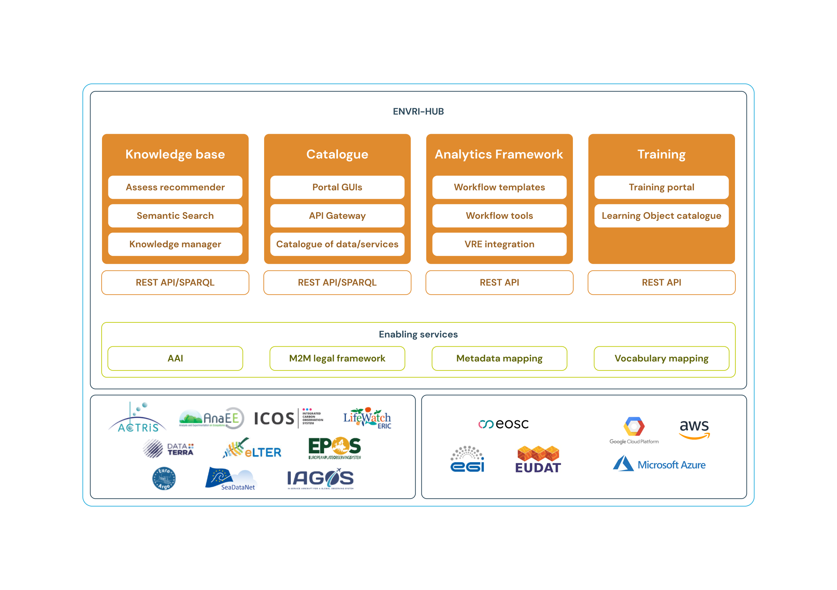
Under the surface: A service journey

Slide 15
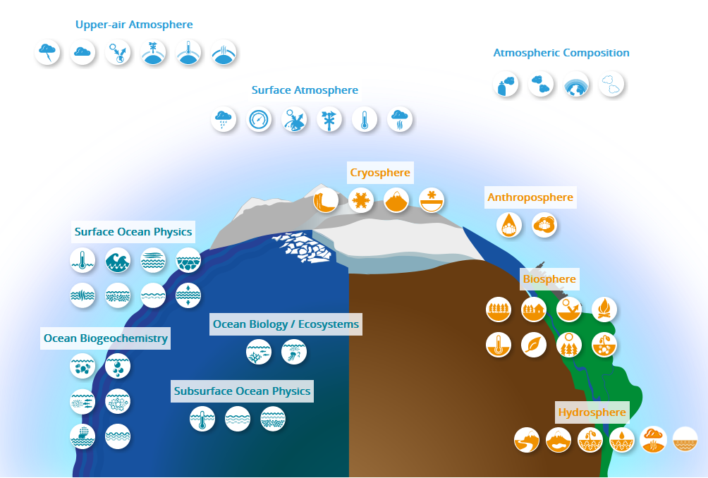

The science drivers : Essential variables
Critical variables for understanding monitoring and predicting Earth’s climate system
Ensuring a common understanding and representation of Essential variables across ENVRIs
Minimum units of interoperability
Source https://gcos.wmo.int/en/essential-climate-variables
Notes:
Global Climate Observing system is a global framework established to ensure the availability of comprehensive and reliable climate observations for climate monitoring, research, and policy-making. It supports international efforts to understand and predict climate change by coordinating global observations of the Earth's climate system.
Essential Climate Variables (ECVs) – GCOS defines and maintains a list of essential climate variables required for climate monitoring and research.
ECVs are the observations required to systematically observe Earth`s changing climate
are critical for understanding, monitoring, and predicting the Earth’s climate system

Slide 16
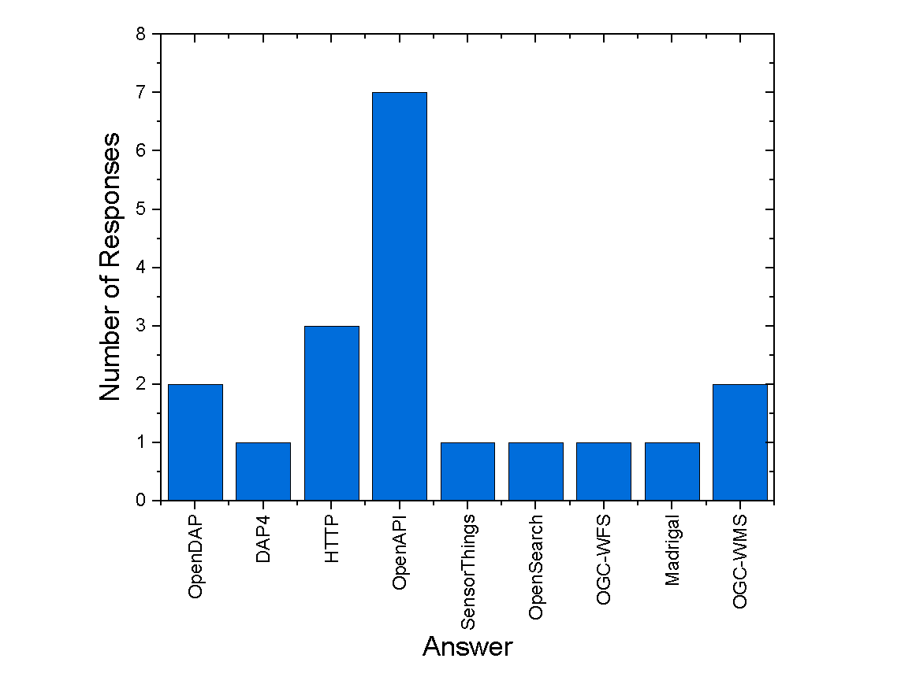
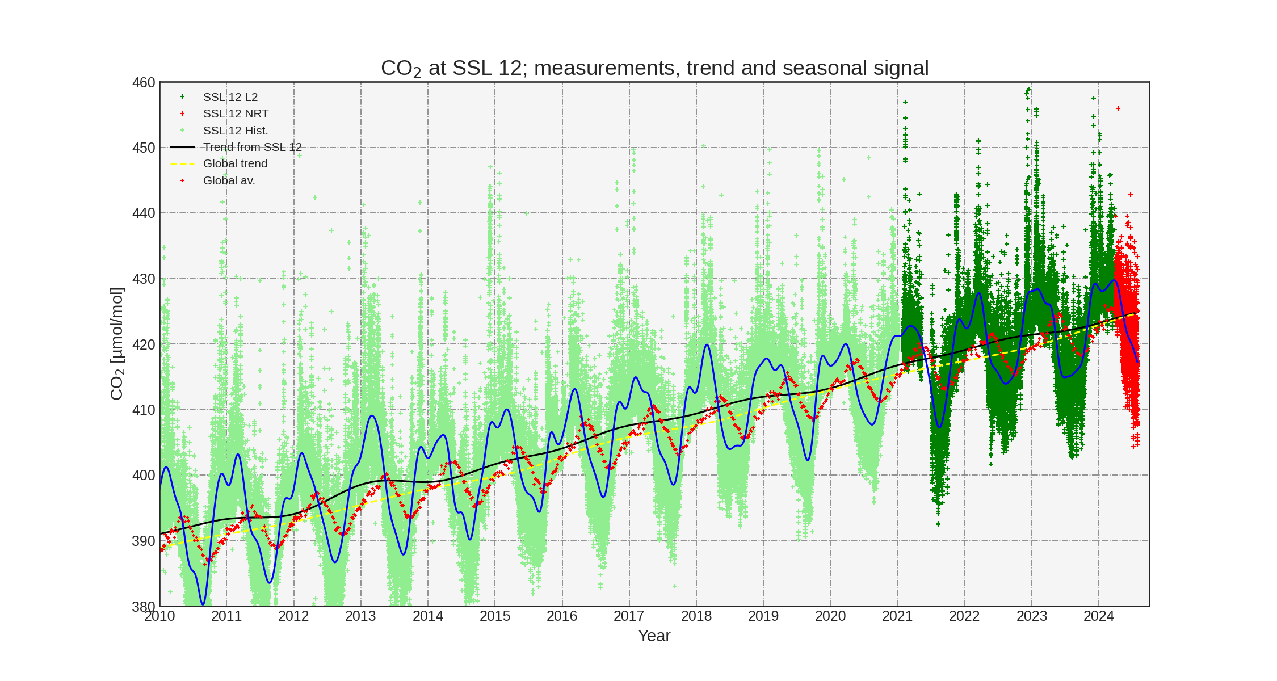
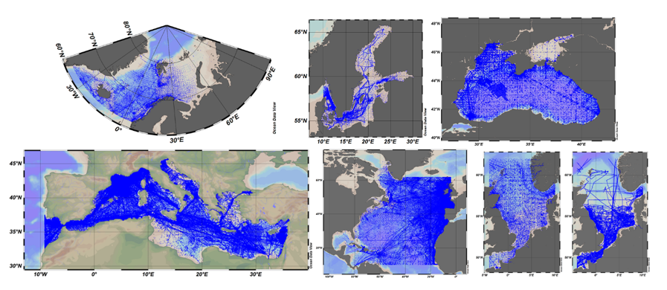
Catalogue: Services & Data
Catalogue of Services:
  Datasets are delivered via services interfaces
  Added value on service operations over datasets
Catalogue of Datasets:
  Direct access to datasets
  Added value on original datasets. e.g. Time series computation
Landscape Analysis Data End Points at RIs
Notes:
Services : Seadata Net aggregated datasets :https://www.seadatanet.org/Products/Aggregated-datasets
The aggregated datasets are regional ODV collections of all temperature and salinity measurements contained within the SeaDataNet infrastructure covering all the European sea basins (Arctic Sea, Baltic Sea, Black Sea, Mediterranean Sea, North Sea, and North Atlantic Ocean).
Data: https://www.icos-cp.eu/data-products/FSS8-53NX
Atmospheric Greenhouse Gas Mole Fractions of CO₂ collected by the ICOS ATC, covering the period 1972-2024, including final quality-controlled Level 2 ICOS data, release 2024-1 and NRT data up to 29 July 2024.

Slide 17
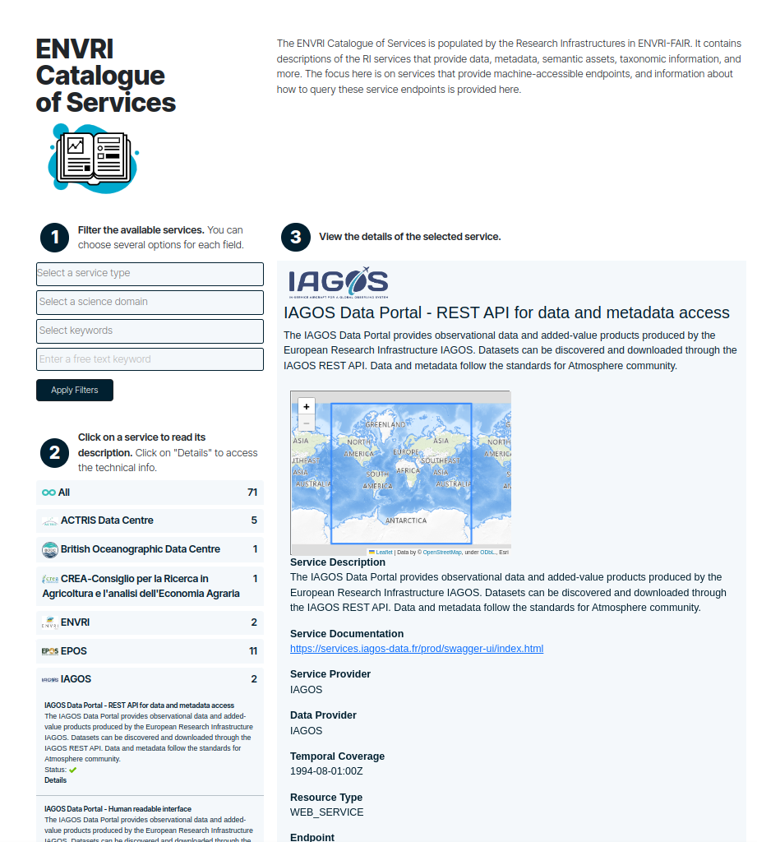
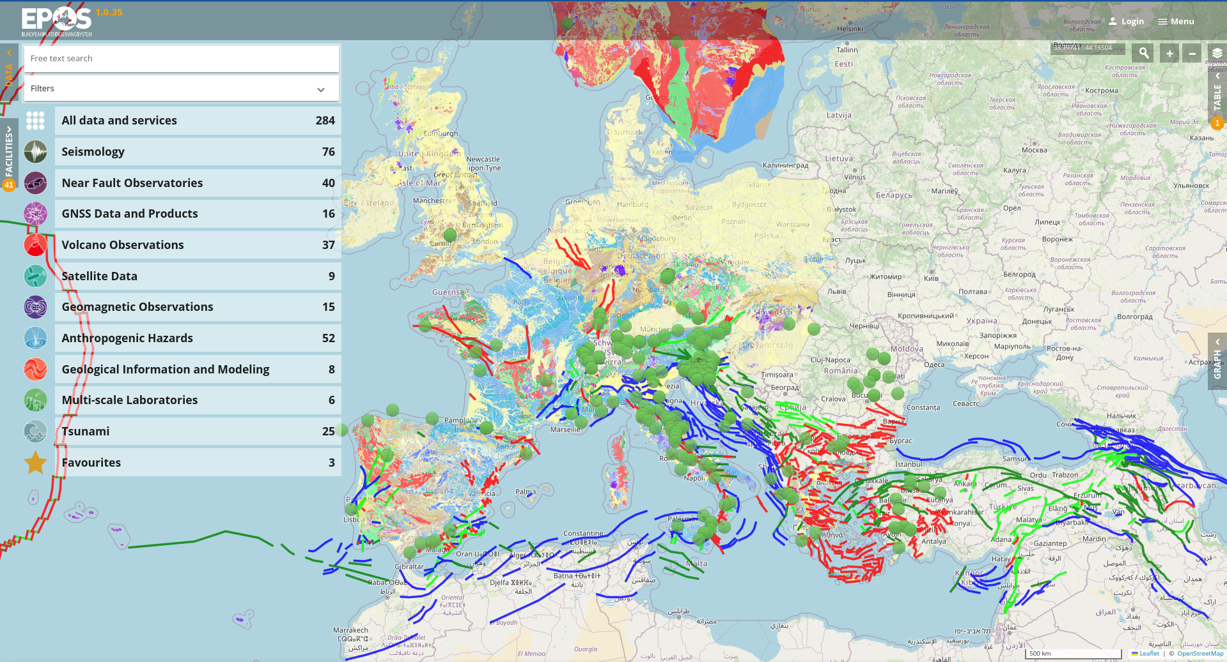
Catalogue of services user interface
Enabling the catalogue of services for Essential Variables
Notes:
Open Data and advancements in technology offer a huge amount of data for exploring complex phenomena and are driving new research opportunities.
However, managing this data presents challenges, requiring effective solutions for sharing and reusing it, such as adhering to the FAIR principles.
Interdisciplinary research intensifies these challenges due to the varying practices, data formats, and metadata standards across different fields.
Heterogeneous datasets to be made interoperable:
Web services can be described through semantic rich metadata information.
Homogenous access can then be achieved through advanced software that adopts semantic crosswalks for parameters mappings
Datasets may be converted in a common agreed standard if needed (e.g. to show datasets on a Graphical User Interface)
Data providers keep their own approach (e.g. technologies, metadata standards, protocols). Semantic information provided by the metadata catalogue and enabled by the interoperability layer

Slide 18
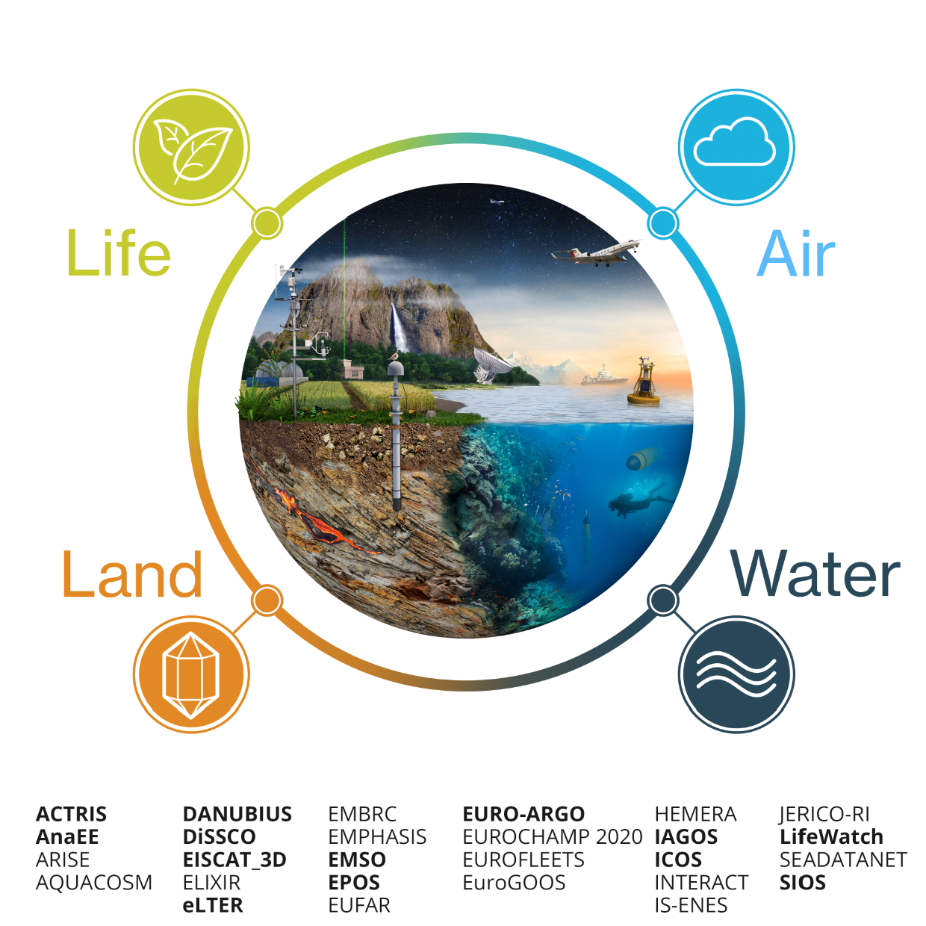
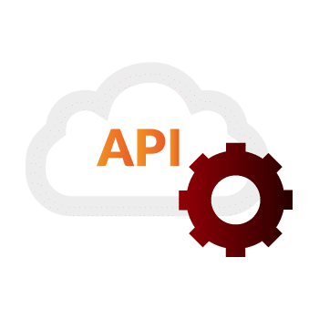
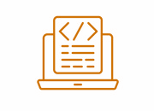

Behind the scenes
Catalogue population
RI Services
Metadata description
  EPOS-DCAT-AP
  Backoffice
ENVRI Catalogue population
ENVRI Catalogue APIs
  REST APIs (current)
  DCAT-AP Exposure and OAI-PMH (T8.5)

Slide 19
Catalogue of Datasets
Discovery of data through descriptive metadata catalogue in DCAT v3, extended with iAdopt variable information, mapping to native and community vocabularies.
Federated catalogues using Sparql and RDF query results, following Fair Data Point (FDP) specification
Direct open access to data set collections from a Catalogue, either file based or through service
Reference implementation of FDP available for test and development, extended with iAdopt, provides GUI client
Notes:
Client allows to search, add and edit catalogs and items of: catalogs variables, data sets, distributions and services and link them together.
Reference FDP server and Client useful for RIs without linked open data system and as integrating central node, simple docker based installation

Slide 20
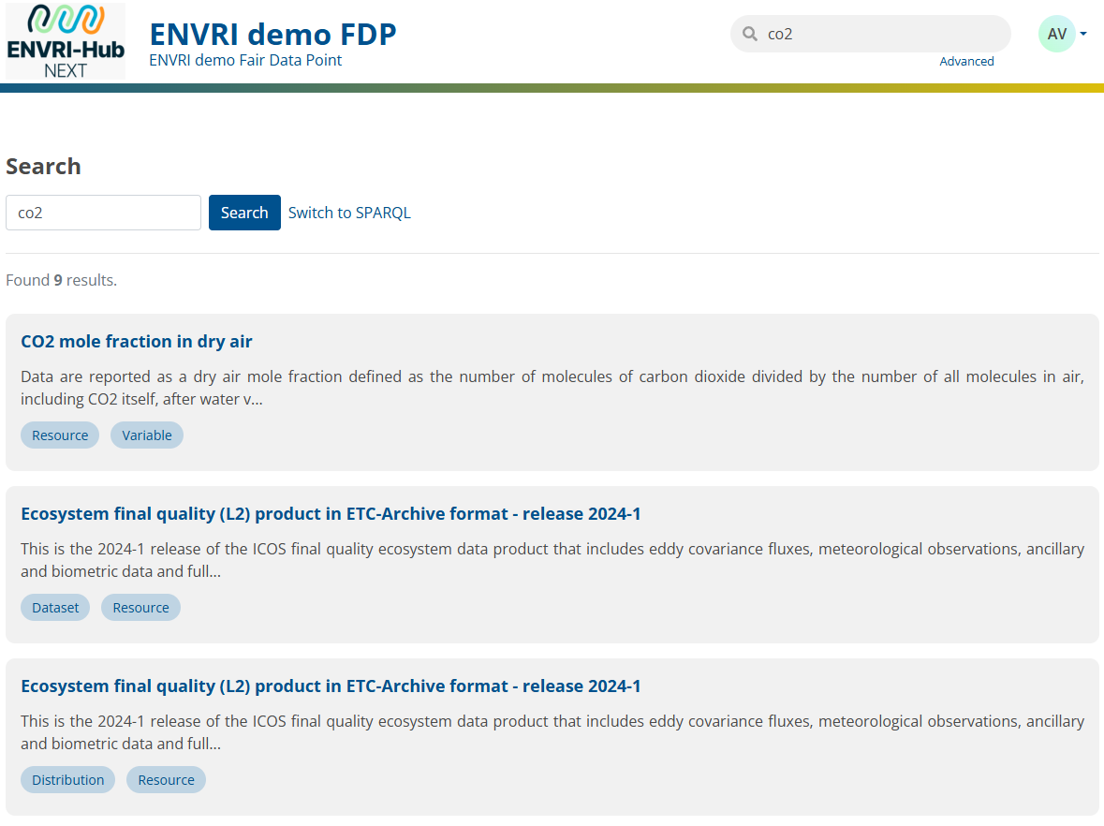
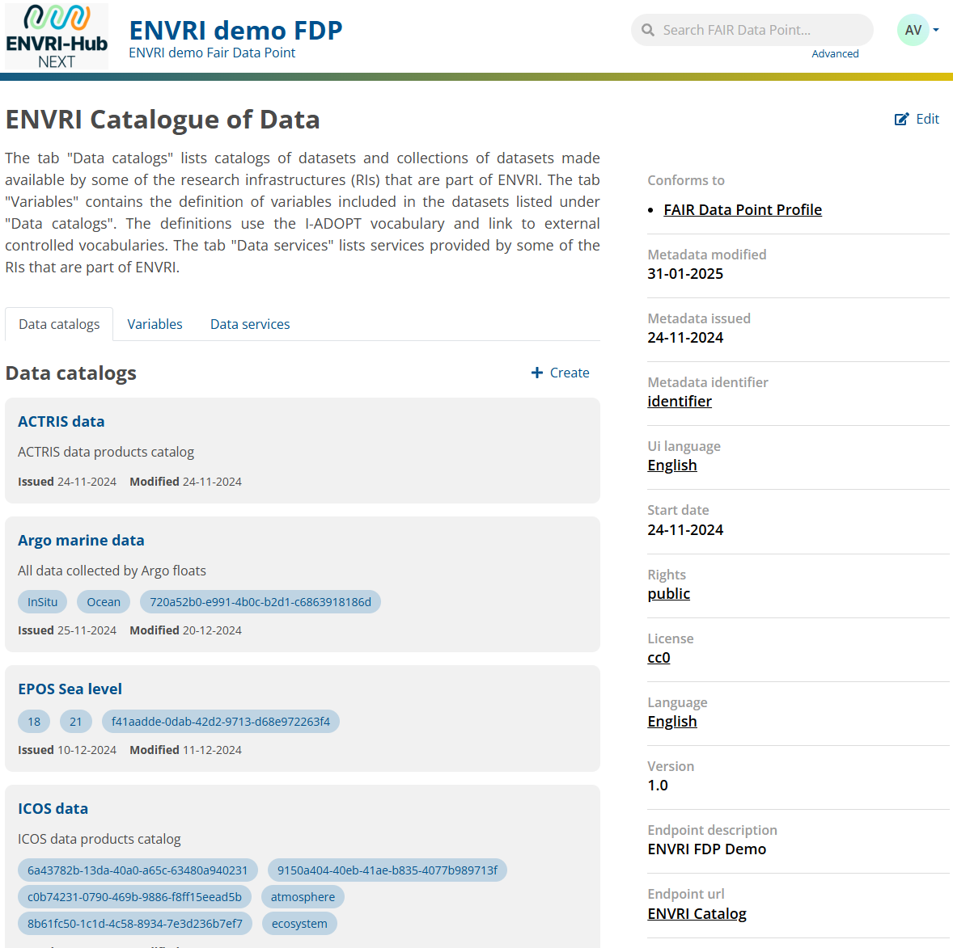
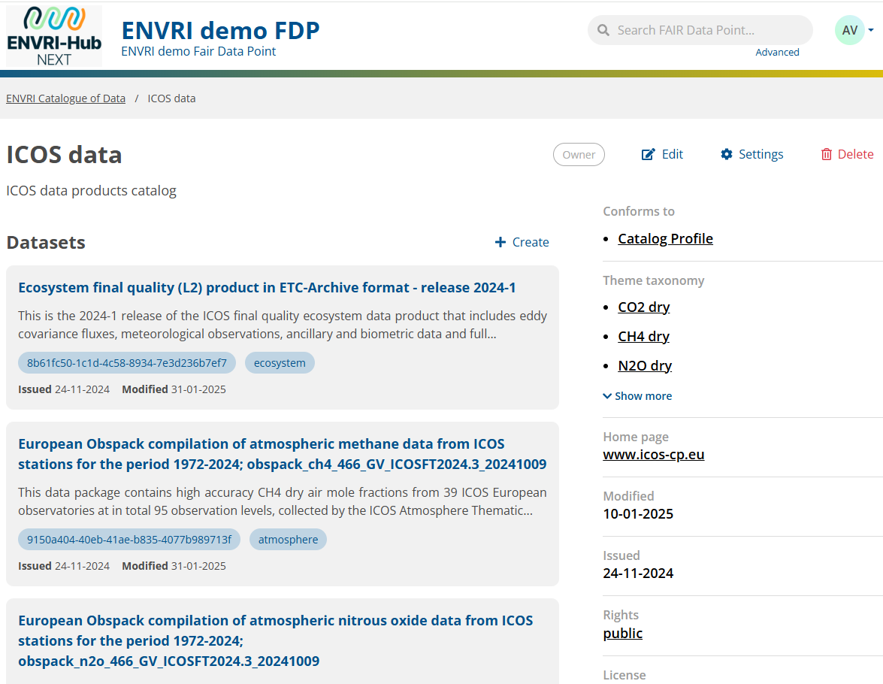
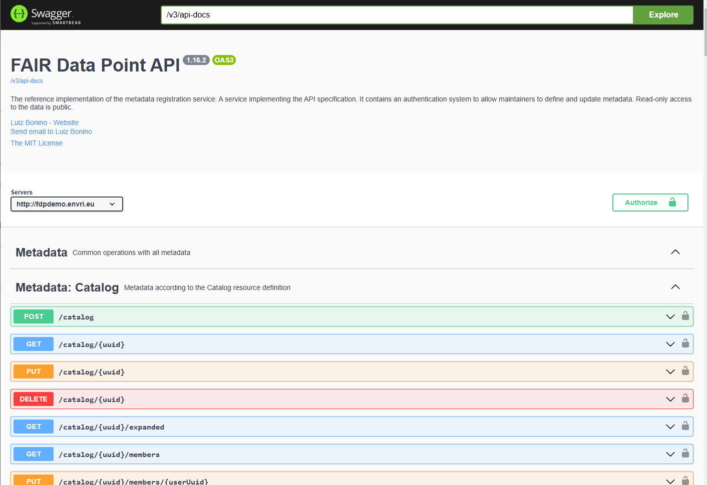
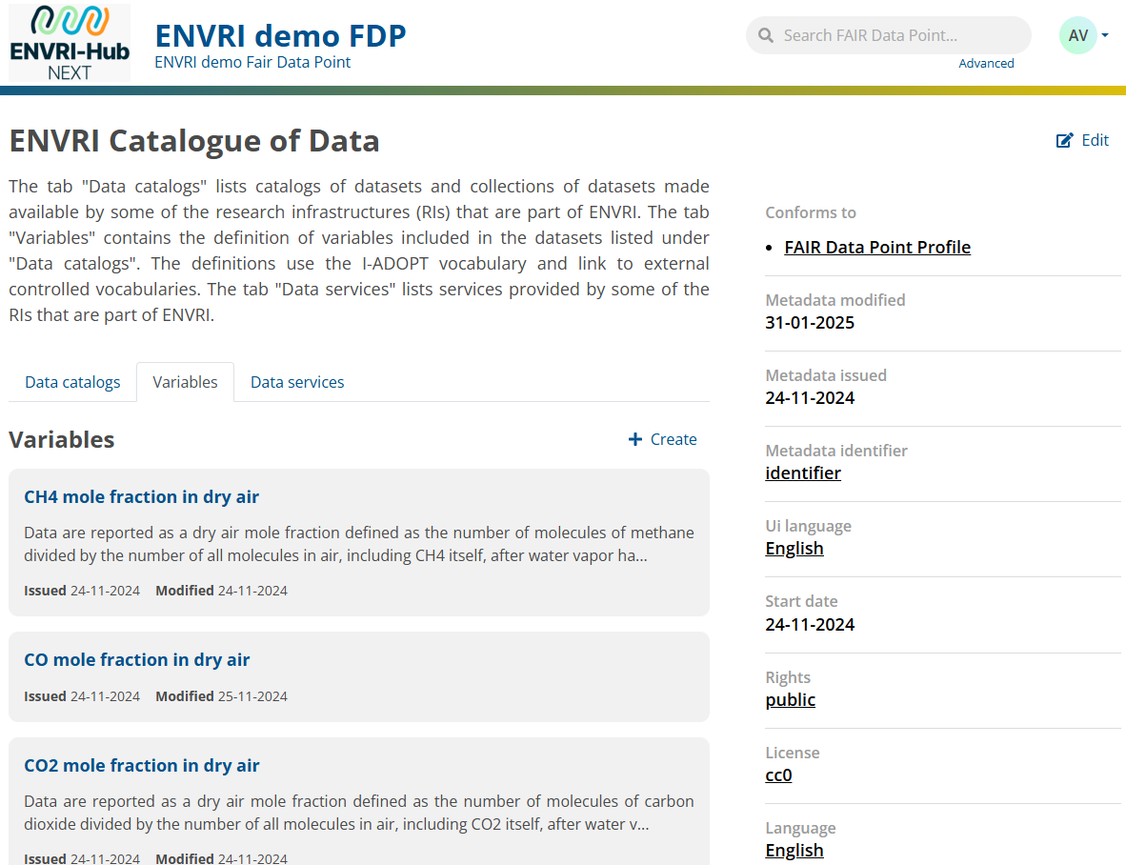
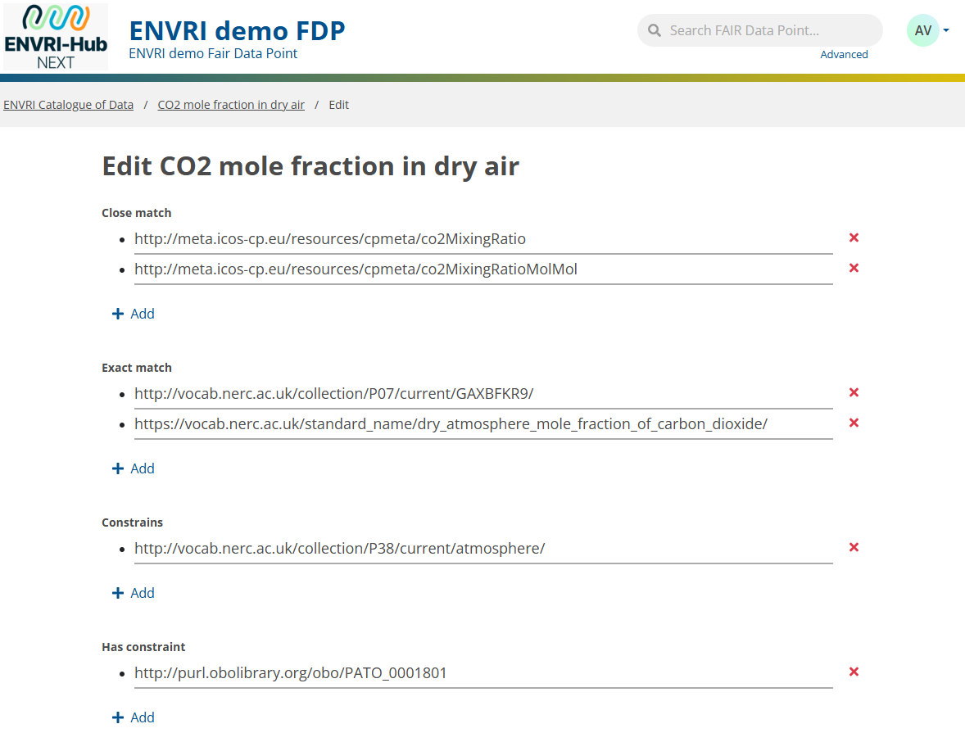
FDP GUI
Notes:
The main page of the client shows a set of tabs for the different catalogs available, each page is available through content negotiates in different machine readable formats, e.g. RDF.
Each catalog is filled with items, here we selected the catalog of ICOS datasets from the catalog of RI data catalogs. Each dataset can have one more or distributions
Each dataset is linked to one or more variables. The variables can be defined in the catalog of variables in the same way as catalogs, datasets and distributions
For this one can use the built in configurable editor shown here. It is based on user defined metadata schemas and resources descriptions using dash and shacl also editable and configurable in the client
Furthermore the user can use the client to search in the node and its children using a Sparql query for datasets, variable, keywords and description
Next to Sparql and the GUI, all functionality can also be reached through Swagger OpenAPI calls. This is how the harmonized data catalog will be allow to discover and access the environmental data in the VREs based on iAdopt variables, coverage and other metadata information
Discovery of data through descriptive metadata catalog in DCAT v3 DCAT extended with iAdopt variable information, mapping to native and community vocabularies (exact, close match)
Federated catalogs using Sparql and RDF query results, following Fair Data Point (FDP) specification https://specs.fairdatapoint.org/fdp-specs-v1.2.html
Direct open access to data set collections from Catalog, either file based or through service (in CoS)
Reference implementation of FDP available for test and development, extended with iAdopt, provides GUI client
Client allows to search, add and edit catalogs and items of: catalogs variables, data sets, distributions and services and link them together.
Reference FDP server and Client useful for RIs without linked open data system and as integrating central node, simple docker based installation

Slide 21
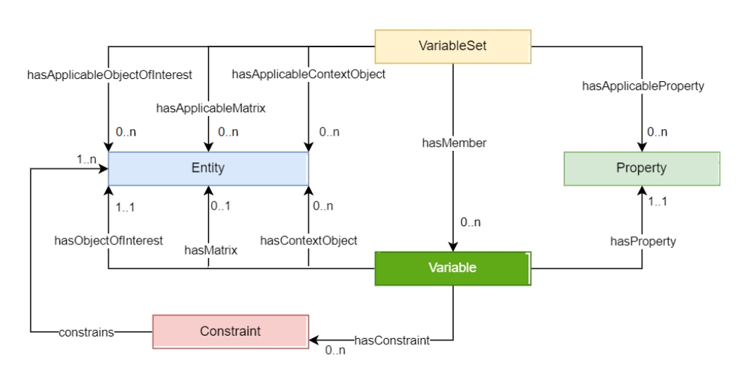
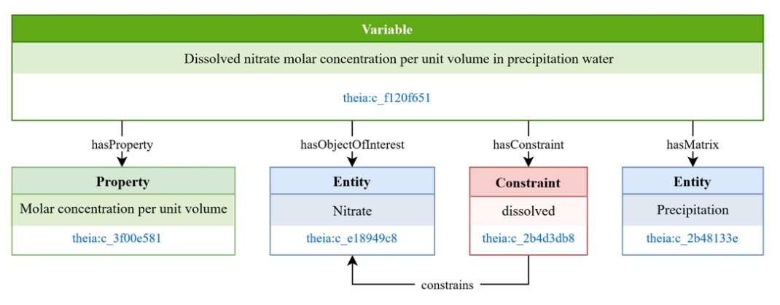
Supporting and enhancing Catalogues: vocabularies - I-ADOPT
I-ADOPT is a framework and an ontology to facilitate interoperability between terminologies used to describe variables in dataset annotations

Slide 22
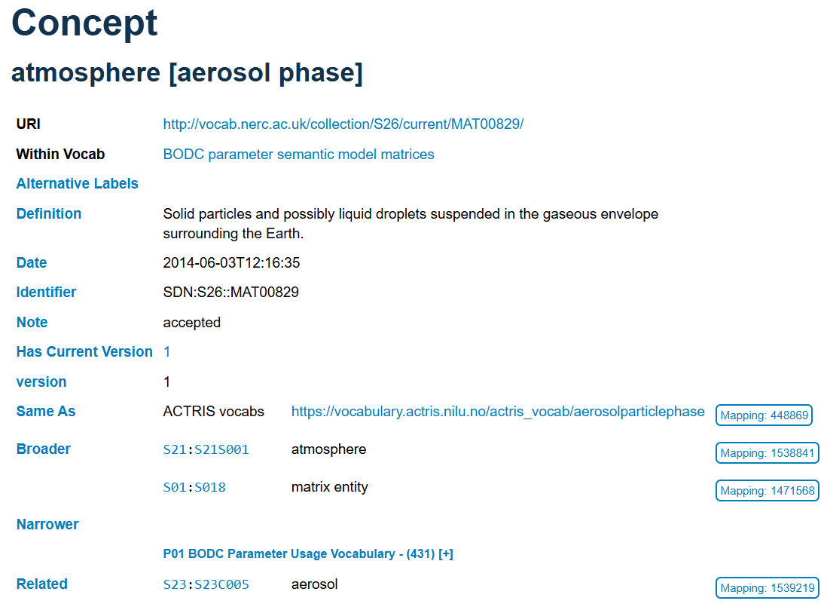
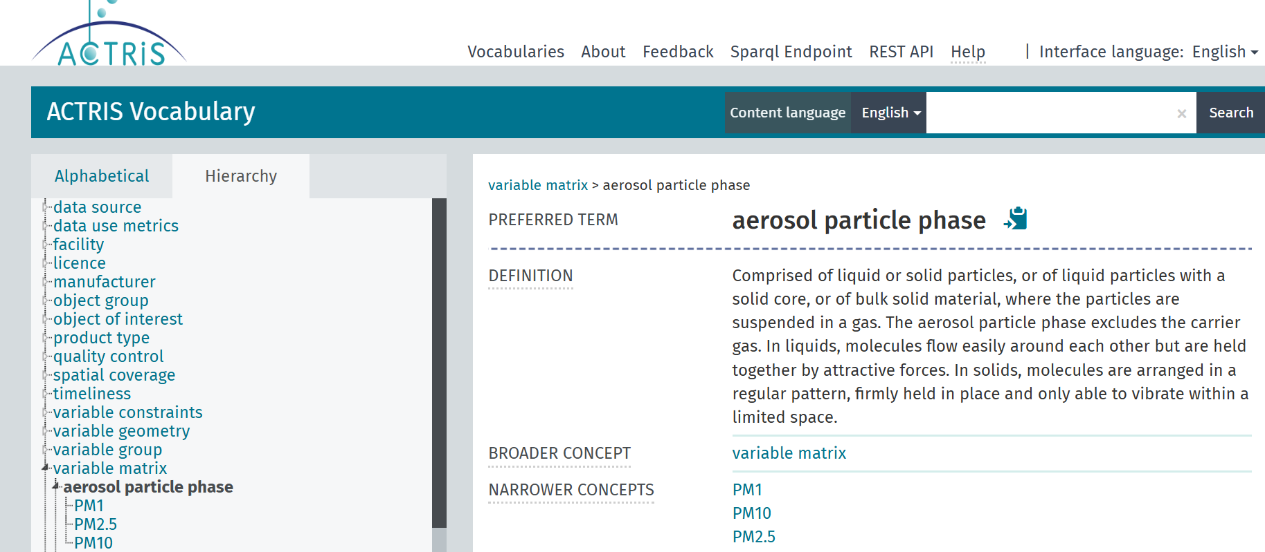
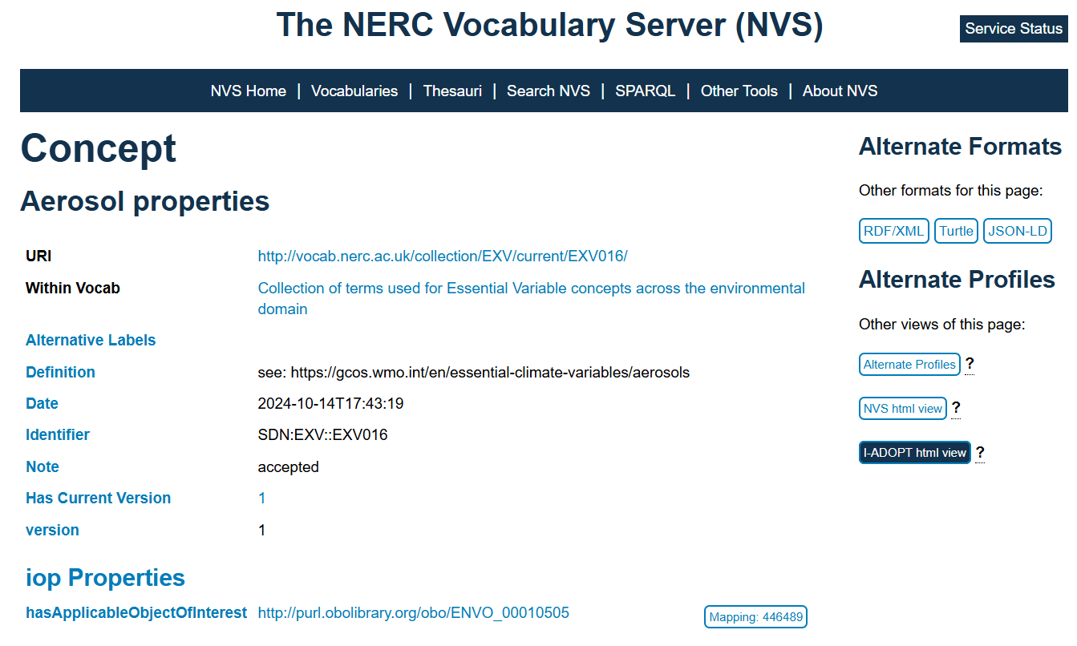
Supporting and enhancing Catalogues: vocabularies - I-ADOPT
I-ADOPT can be used to interconnect EV concepts to variables held in datasets
Example of using I-ADOPT and interconnected concepts from three terminology repositories: NVS, EnvO and ACTRIS to identify the matrix element of variables related to the chemical composition of aerosols

Slide 23
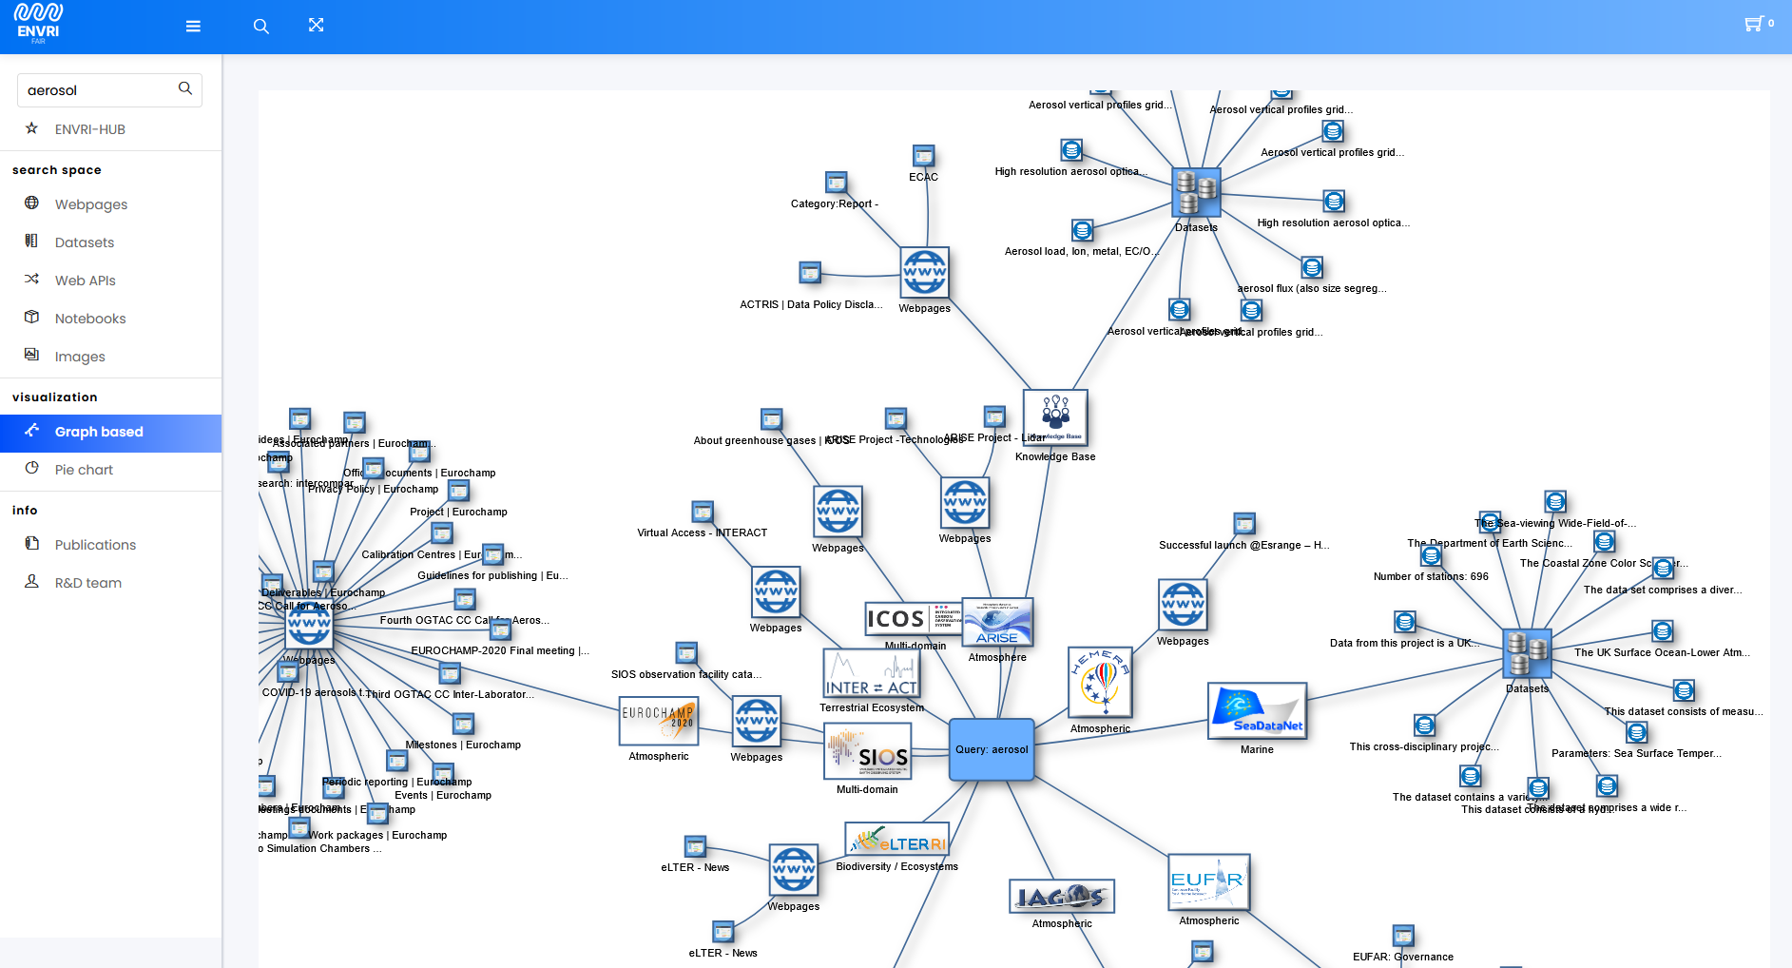
The Knowledge Base / Search Engine
The search engine crawls the Web
like Google
Automatic categorization/ indexing
Related Websites
Data owner
Data Set
START

Slide 24

Beyond data and services : The Knowledge Base, AI supported search & recommendations
Knowledge base user interface (KB-UI)
AAI Service
Knowledge manager (KB-Mnger)
Knowledge finder (KB-Finder)
Search service chain
User support tool
Index pipeline initializer
Quality control tool
Personalized Knowledge Agent: RAG
Knowledge base API (KB-API)
KB-ServiceLib (e.g. Indexing, search, intent modelling, recommender, dialogue …)
Knowledge storage
Notes:
Knowledge Base (KB) is an AI supported system which stores content in the knowledge, search the contents and recommends results based on user preference.
The Personalized Knowledge Agent (PKA) is an extendable part of the Knowledge Base, which can be easily integrated to other systems who wants to use our KB for searching and recommendation based on user preference.
For searching information from the KB, PKA uses Retrieval-Augmented Generation (RAG) to retrieve information based on user query information.
Since RAG uses the KB, extracting information using RAG ensures truthfulness of the LLM and ensures hallucination does not exist in the response.
LLM is also used to track users behaviour in order to ensure proper recommendations from the searches.

Slide 25
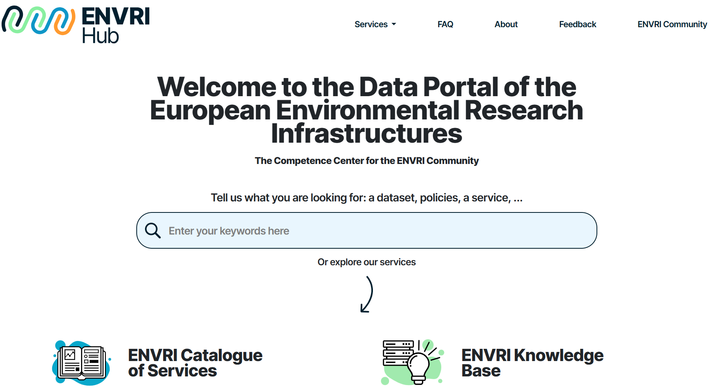
ENVRI-HUB-Core
Plugging everything together
User notebook
Analytical Framework
ENVRI ID AAI
semantic notebooks
VRE
Semantic
Predef. Queries
scientific demon-
strators
Catalog of Services GUI+API
ECV-rel.
notebooks
VOCab Server
I-Adopt Gui+API
SPARQL Endpoint
ENVRI
Training Catalog
GUI+API
Knowledge Base GUI+API)

Slide 26
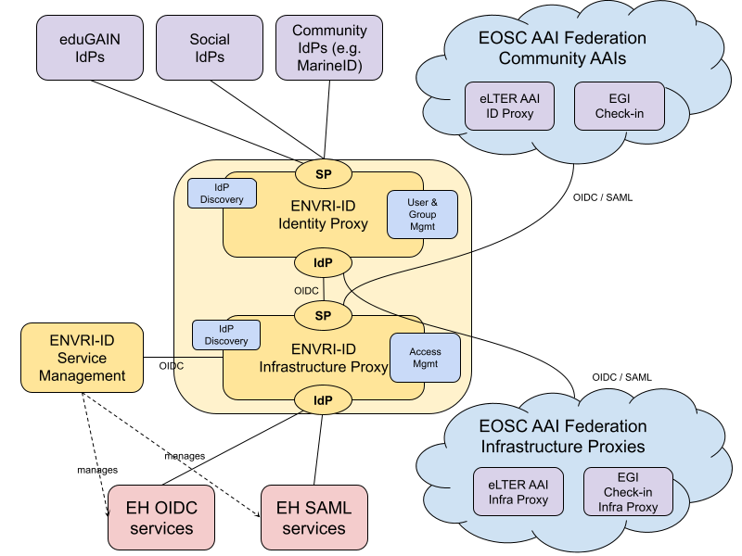
ENVRI-ID Architecture: Harmonised Authentication and authorisation across RIs
ENVRI-ID Identity Proxy
ENVRI-ID Infrastructure Proxy
ENVRI-ID Service Management
Notes:
The key components of ENVRI-ID are:
ENVRI-ID Identity Proxy: Responsible for user authentication and providing consistent ENVRI-ID user attributes to ENVRI-Hub services and other services within the EOSC AAI Federation.
ENVRI-ID Infrastructure Proxy: Responsible for connecting ENVRI-Hub Services.
ENVRI-ID Service Management: Handles the initial registration and manages the configuration of services connected to ENVRI-ID

Slide 27
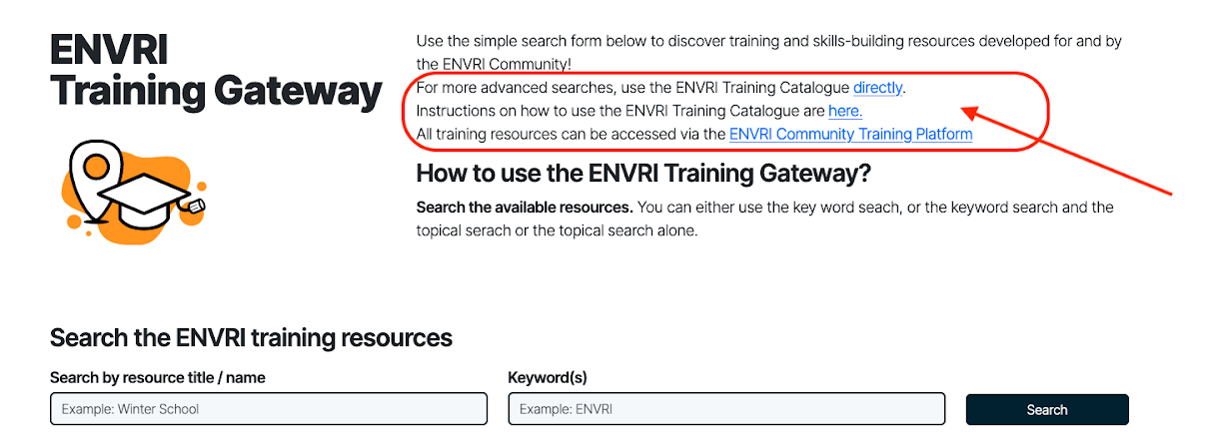
Learn and share: The training platform
ENVRI-Hub developers and end-users are supported by training, knowledge exchange, capacity building, tutorials, and documentation.
Training content metadata is harvested on the ENVRI-Hub via REST API.

Slide 28







Getting ready for Operations
To ensure the quality and security standards of applications to be deployed in ENVRI’s Kubernetes infrastructure, an automated pipeline performs the applications containerization, software quality and security assessments, and the publication of container images to secure, private registries.
Software Quality Assessment
Using SQAaaS
Container Security Assessment
Using Trivy
Application
Source Code Repo
Application Containerization
Gitlab CI pipeline
Publish Container Image
Gitlab Container Registry
Notes:
We start with the application's source code, managed within ENVRI’s group on Gitlab
A pipeline and some software quality assessment tools such as SonarQube and SQAaaS (from EGI) are constantly running some assessments against the source code on application’s repo.
A Gitlab CI pipeline alongside with a tool named Kaniko are used to automate the containerization process, using the Dockerfile and other relevant artifacts that must be present in the repo
The resulting docker image from the previous step is submitted to some security assessments using a tool named trivy. This tool scans for vulnerabilities and helps us identify and mitigate potential security risks in a easy way.
Finally, the validated and secured container images are published to the GitLab Container Registry, making them vailable for staging and prod environment clusters.

Slide 29



Getting ready for Operations
Following a GitOps approach, using Helm charts, and ArgoCD as a delivery tool, the deployment process ensures consistent and reliable application delivery across staging and production environments.
Create the application’s Helm Chart
(or update its values)
Deploy app in prod environment
Using ArgoCD
Deploy app in staging environment
Using ArgoCD
Notes:
This slide details the deployment phase, where we put in place some GitOps principles and use Helm charts and ArgoCD to deploy the containerized applications to Kubernetes.
This GitOps approach provides several benefits, including increased deployment speed, improved reliability, and enhanced auditability.
For the deployment phase, first we (WP5) need to create a Helm chart (this allows for templated deployments, and easy configuration changes) for further application deployment.
This is a one-time job for each application, meaning that if the helm chart already exists, only a few changes are required among different app versions deployment.
Deploy app to staging env: we use ArgoCD as a delivery tool (Continuous Delivery (CD) tool), to automatically deploy the application to the staging environment.
Argo CD monitors the Git repository where configurations are stored and applies the changes to the Kubernetes cluster, ensuring that the desired state is always maintained.
Also, allows to enforce on Kubernetes side the desired state defined on the git repo, ensuring no configuration drifts exists between the git repo and the deployment itself.
Deploy app in prod environment: once the application is validated in staging, we use the same Argo CD process to deploy it to the production environment. This ensures consistency and reduces the risk of errors.

Slide 30
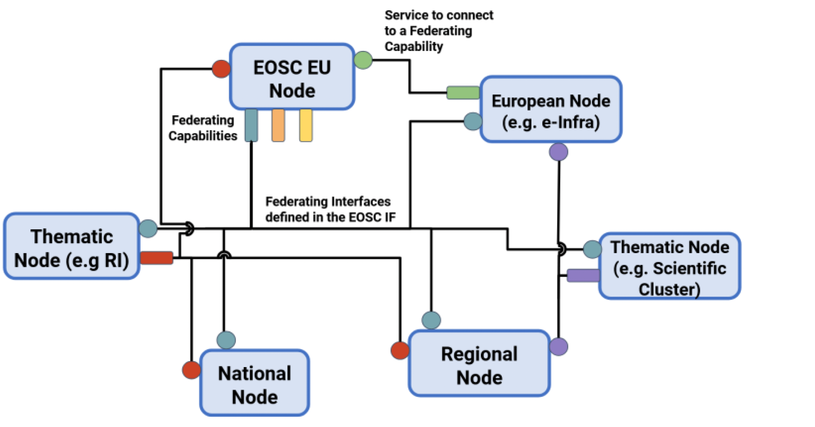
Getting ready for the EOSC Federation
EOSC Web of FAIR Data and services' for science in Europe
The ENVRI Node

Slide 31
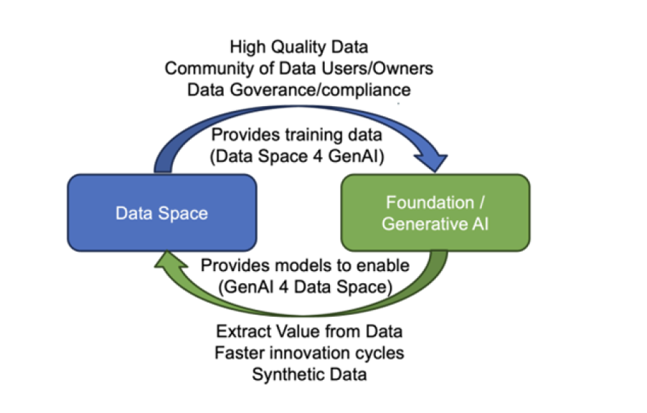
Data and AI can’t go apart
Data infrastructures AI
AI Factories
Data
Compute
Talent
Source: Foundation Data Space Models: Bridging the Artificial Intelligence and Data Ecosystems

Slide 32

User driven approach
The Envri-Hub User Group is an opportunity for researchers, data scientists, and environmental professionals to shape the development of digital research infrastructure. Members will have the opportunity to test new tools, provide feedback, define training needs, and contribute to the growth of ENVRI-Hub services.
A call for expressions of interest was launched in February 2025 https://envri.eu/envri-hub-user-group/
This group of interested people can be involved concerning feedback gathering, training opportunities, previews.

Slide 33
Connecting ENVRI and the world
ENVRI-Hub NEXT is actively involved and represented at key community events, ensuring links are established with ENVRI and the wider research community.
  Consolidated participation in EGU General Assembly, ICRI, EGI and EUDAT Conferences, as well as thematic happenings including the European Congress of Conservation Biology and BES Annual Meeting.
ENVRI-Hub NEXT co-leads a collaboration network with other ENVRI-related projects, leading to joint communication activities such as the joint ENVRI newsletter, collaborative social media management, joint booths at critical conferences.

Slide 34
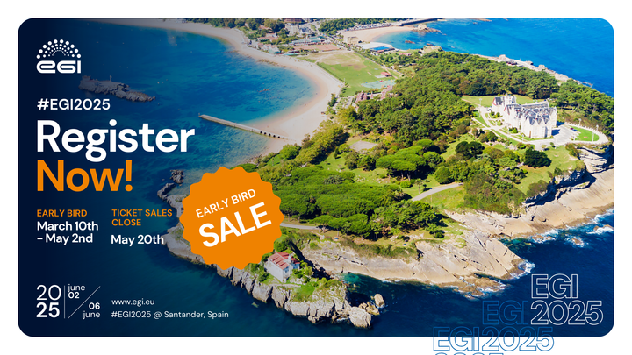
EGI Conference 2025

Slide 35
Thank you
Marta Gutierrez David
Marta.Gutierrez@egi.eu

