Slide 1


Enhancing Quantum Computing Stability in Noisy HPC Environments:
A Novel System Architecture for Environmental Noise Management and Error Mitigation
18.03.2025 | Hossam Ahmed, Telemetry Manager, and HPCQC Integration Researcher
Leibniz Supercomputing Centre (LRZ), Garching, Germany

Slide 2
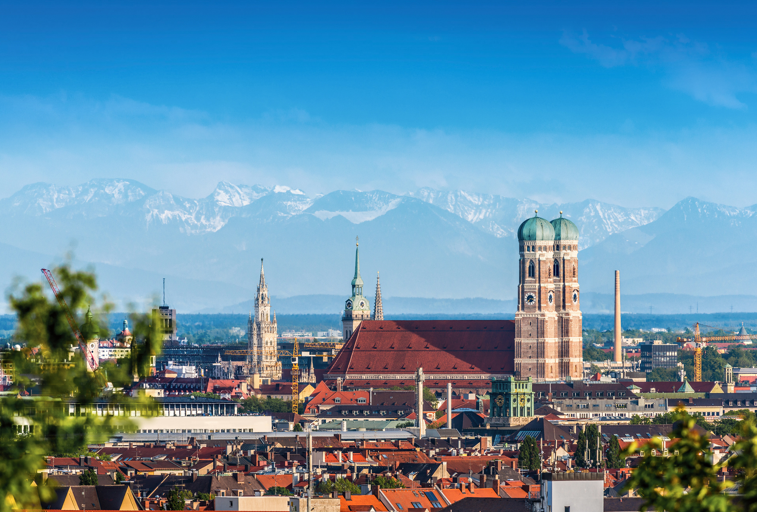

The Munich Quantum Valley develops and operates competitive quantum computers in Bavaria.
.
Superconducting. Neutral Atom. Ion Trap. Quantum-HPC Software.

Slide 3
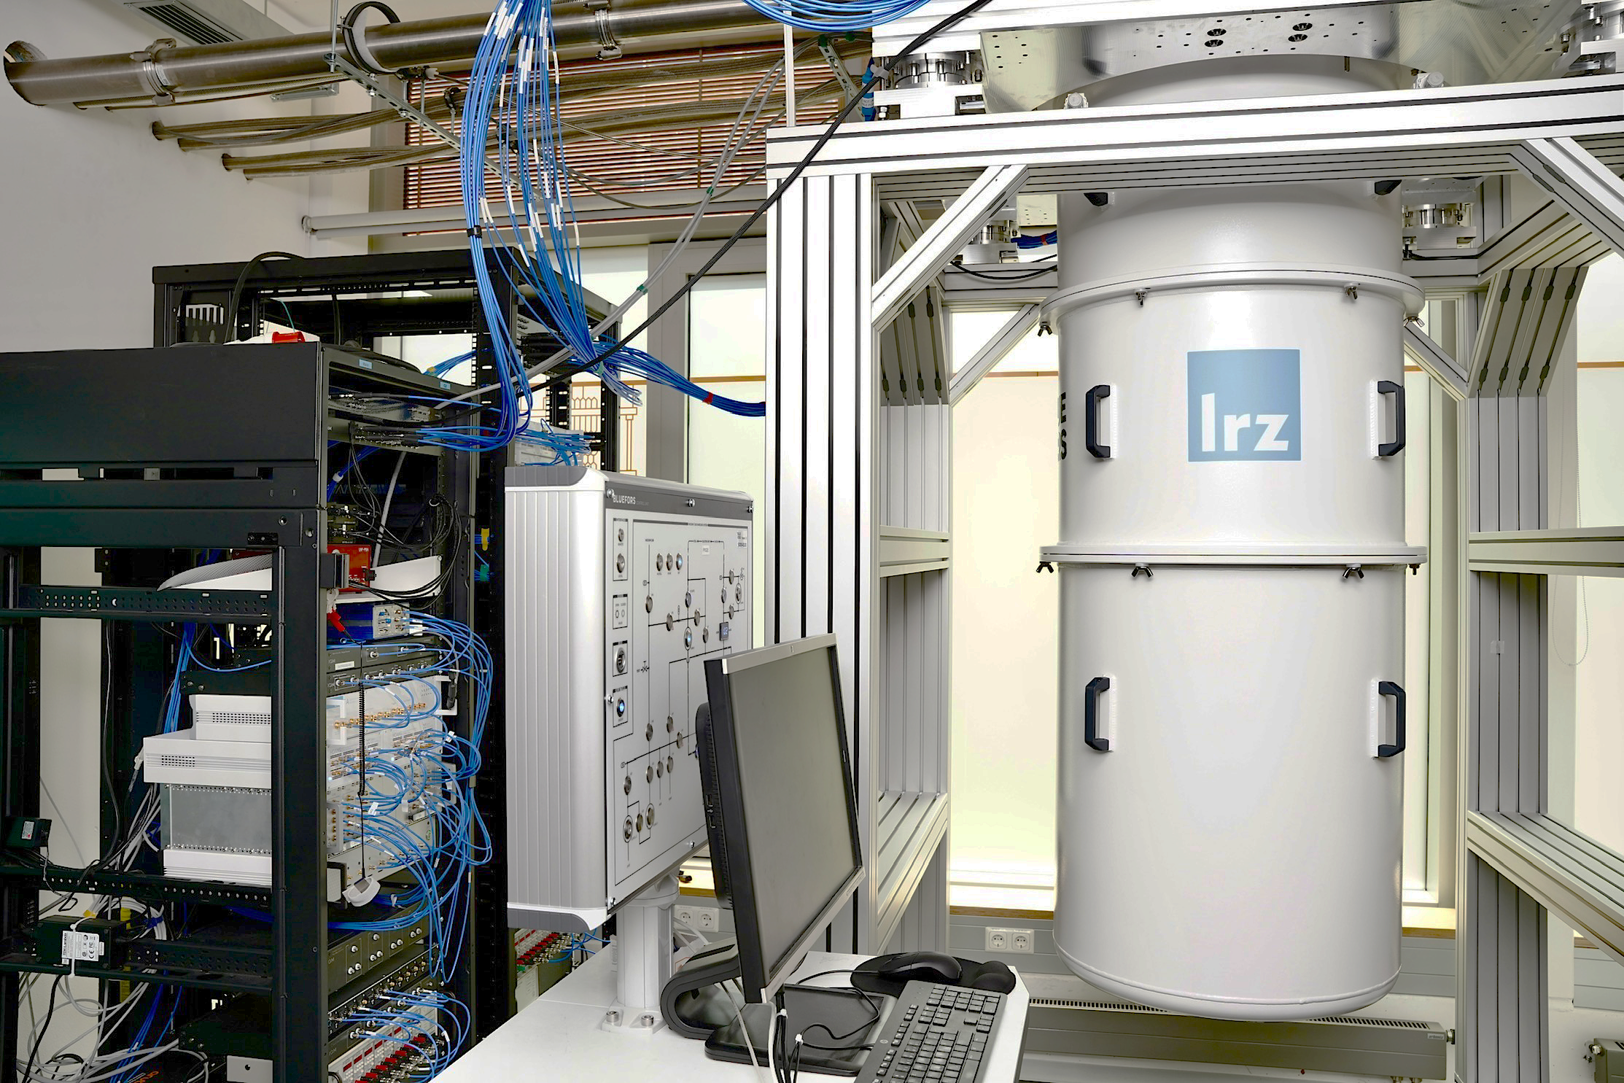
Can quantum systems function in HPC environments?
MQV: J Geuene
Rapidly evolving quantum systems with unique engineering and physics
Stable, robust mature HPC ecosystem geared toward traditional computer systems

Slide 4
Setting up IoT sensors in Quantum lab environment
Telemetry Project
512 sensor readings with sensor Resolution range from 3 sec. to 60 sec.

Slide 5
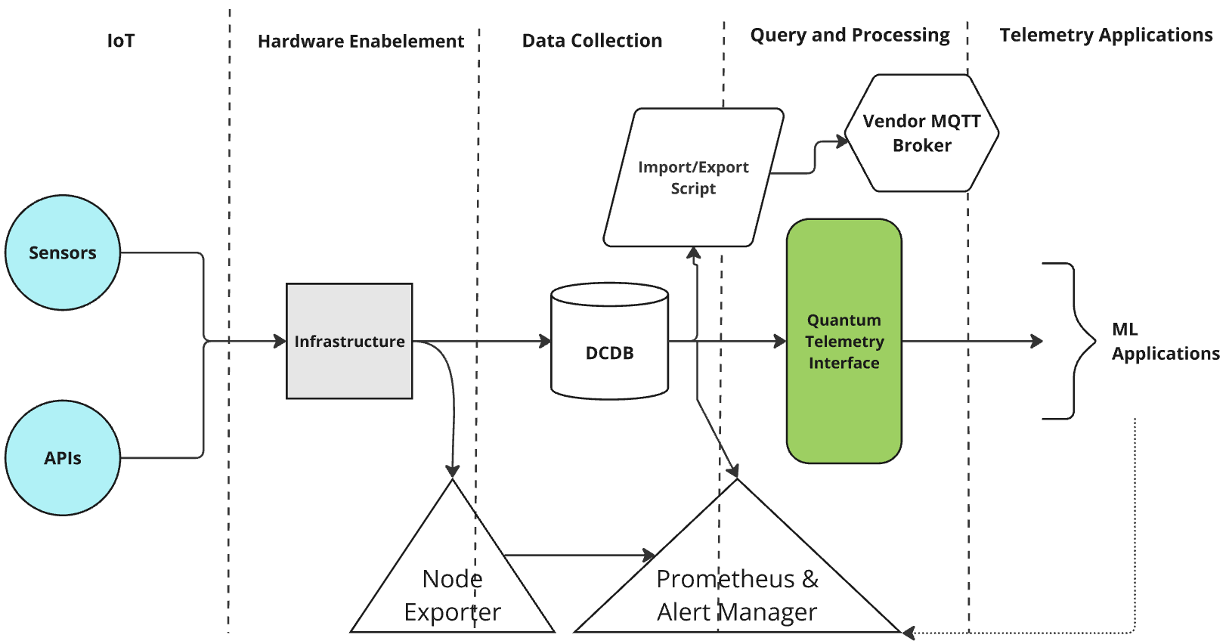
Telemetry System Architecture
Telemetry Project
The Telemetry System is used for lab management and Quantum Computing environmental Optimisation Through five main phases:
Internet of Things
Hardware Enablement
Data Collection
Query and Processing
Telemetry Applications

Slide 6
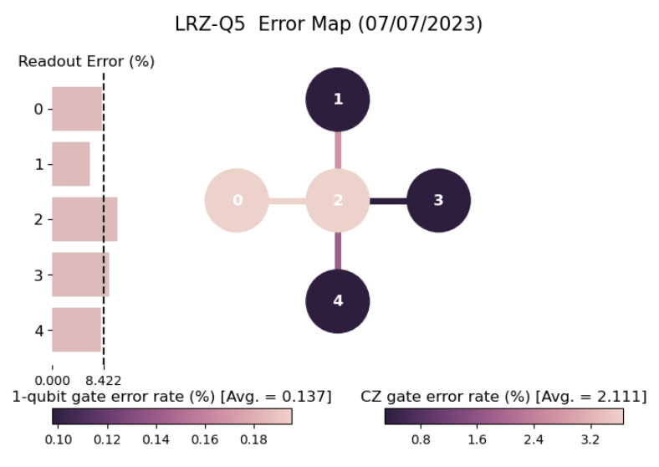
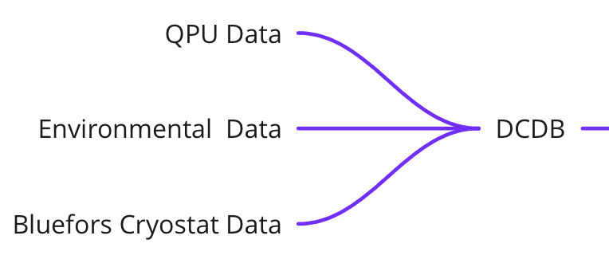
QPU Data
Measured Data

Slide 7
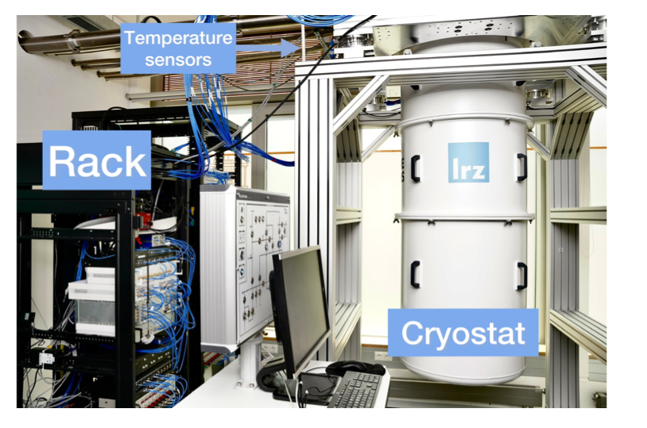
Environmental Data
Measured Data

Slide 8
Environmental Data
Measured Data
Temperature
Pressure
Humidity
Light
Movement
Amount of LN2
Power conditions
Vibration
Sound
Electromagnetic field
Radioactivity

Slide 9
Cryostat Data
Measured Data
50 K Flange
4 K Flange
Still Flange
Mixing chamber
Vaccum Can Pressure (P1)
Cryostat Pressure Level 2 (P2)
Cryostat Pressure Level 3 (P3)
Cryostat Pressure Level 4 (P4)
Mixture Tank Pressure (P5)
9

Slide 10
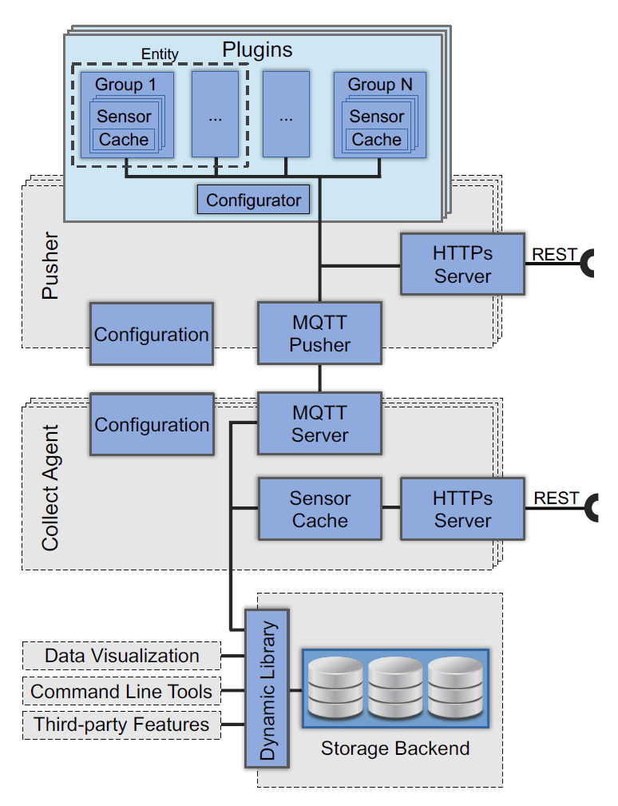
Data Center Data Base
Data Collection
[3,4]
10

Slide 11
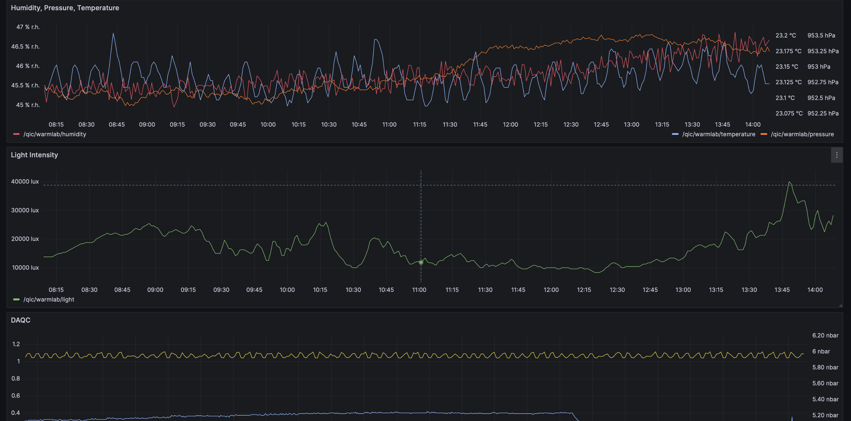
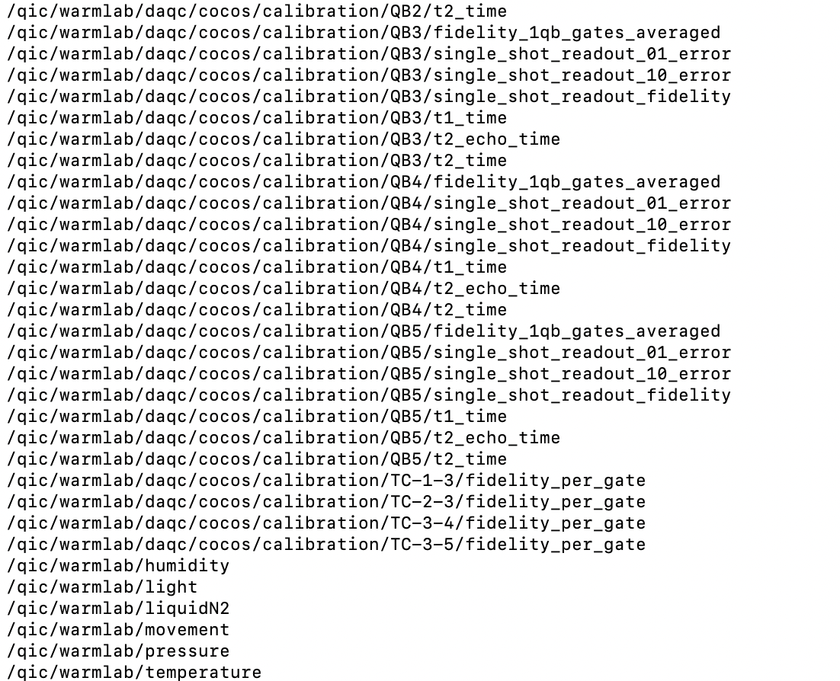
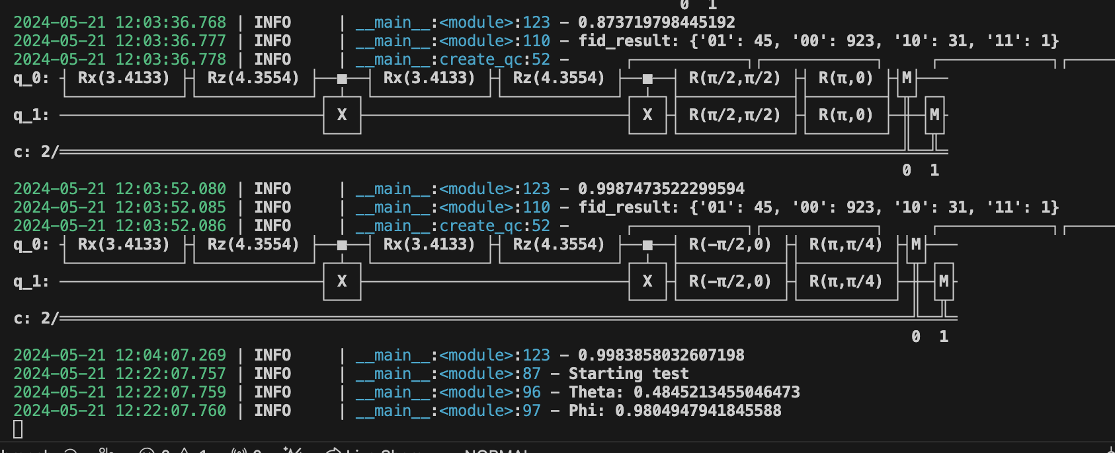
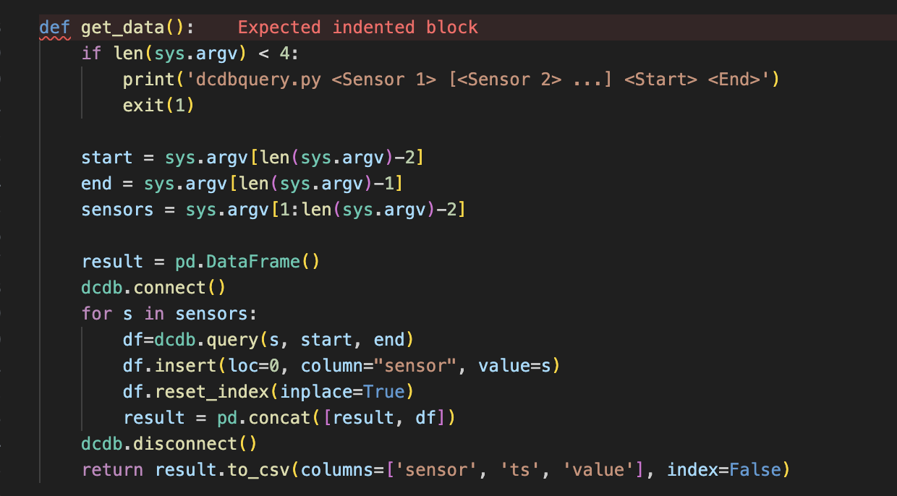
DCDB Access Tools
Data Representation

Slide 12
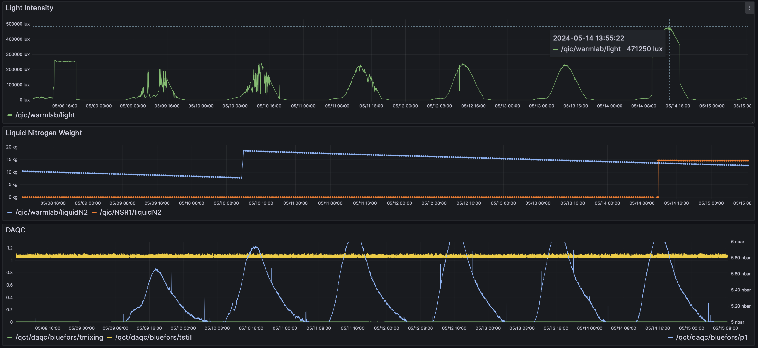
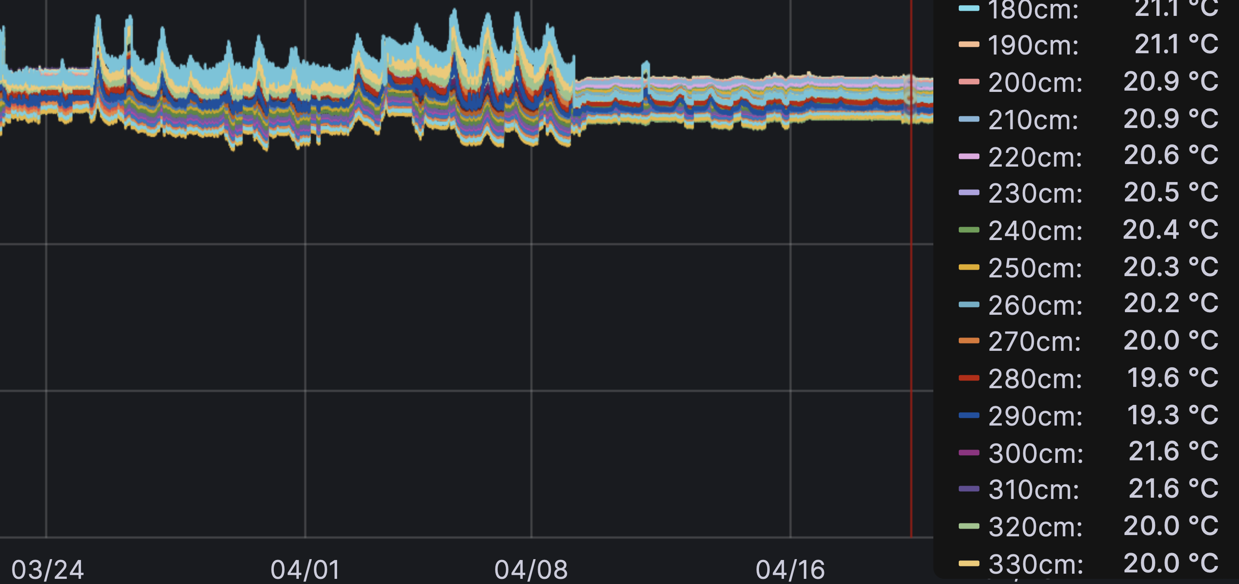
Grafana Phase
Finding Correlations
In Grafana, we are able to:
  Visually track for trigger events
  Analyse the effect of events
  Correlate events
  Determine solutions for adjusting
  the environment

Slide 13
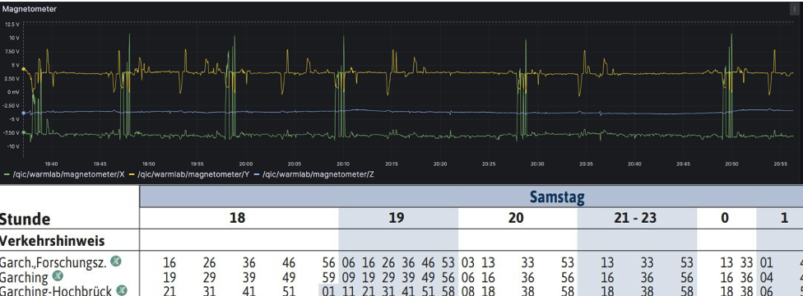
Grafana Phase
Causality studies
In Grafana, we are able to:
  Visually track for trigger events
  Analyse the effect of events
  Correlate events

Slide 14
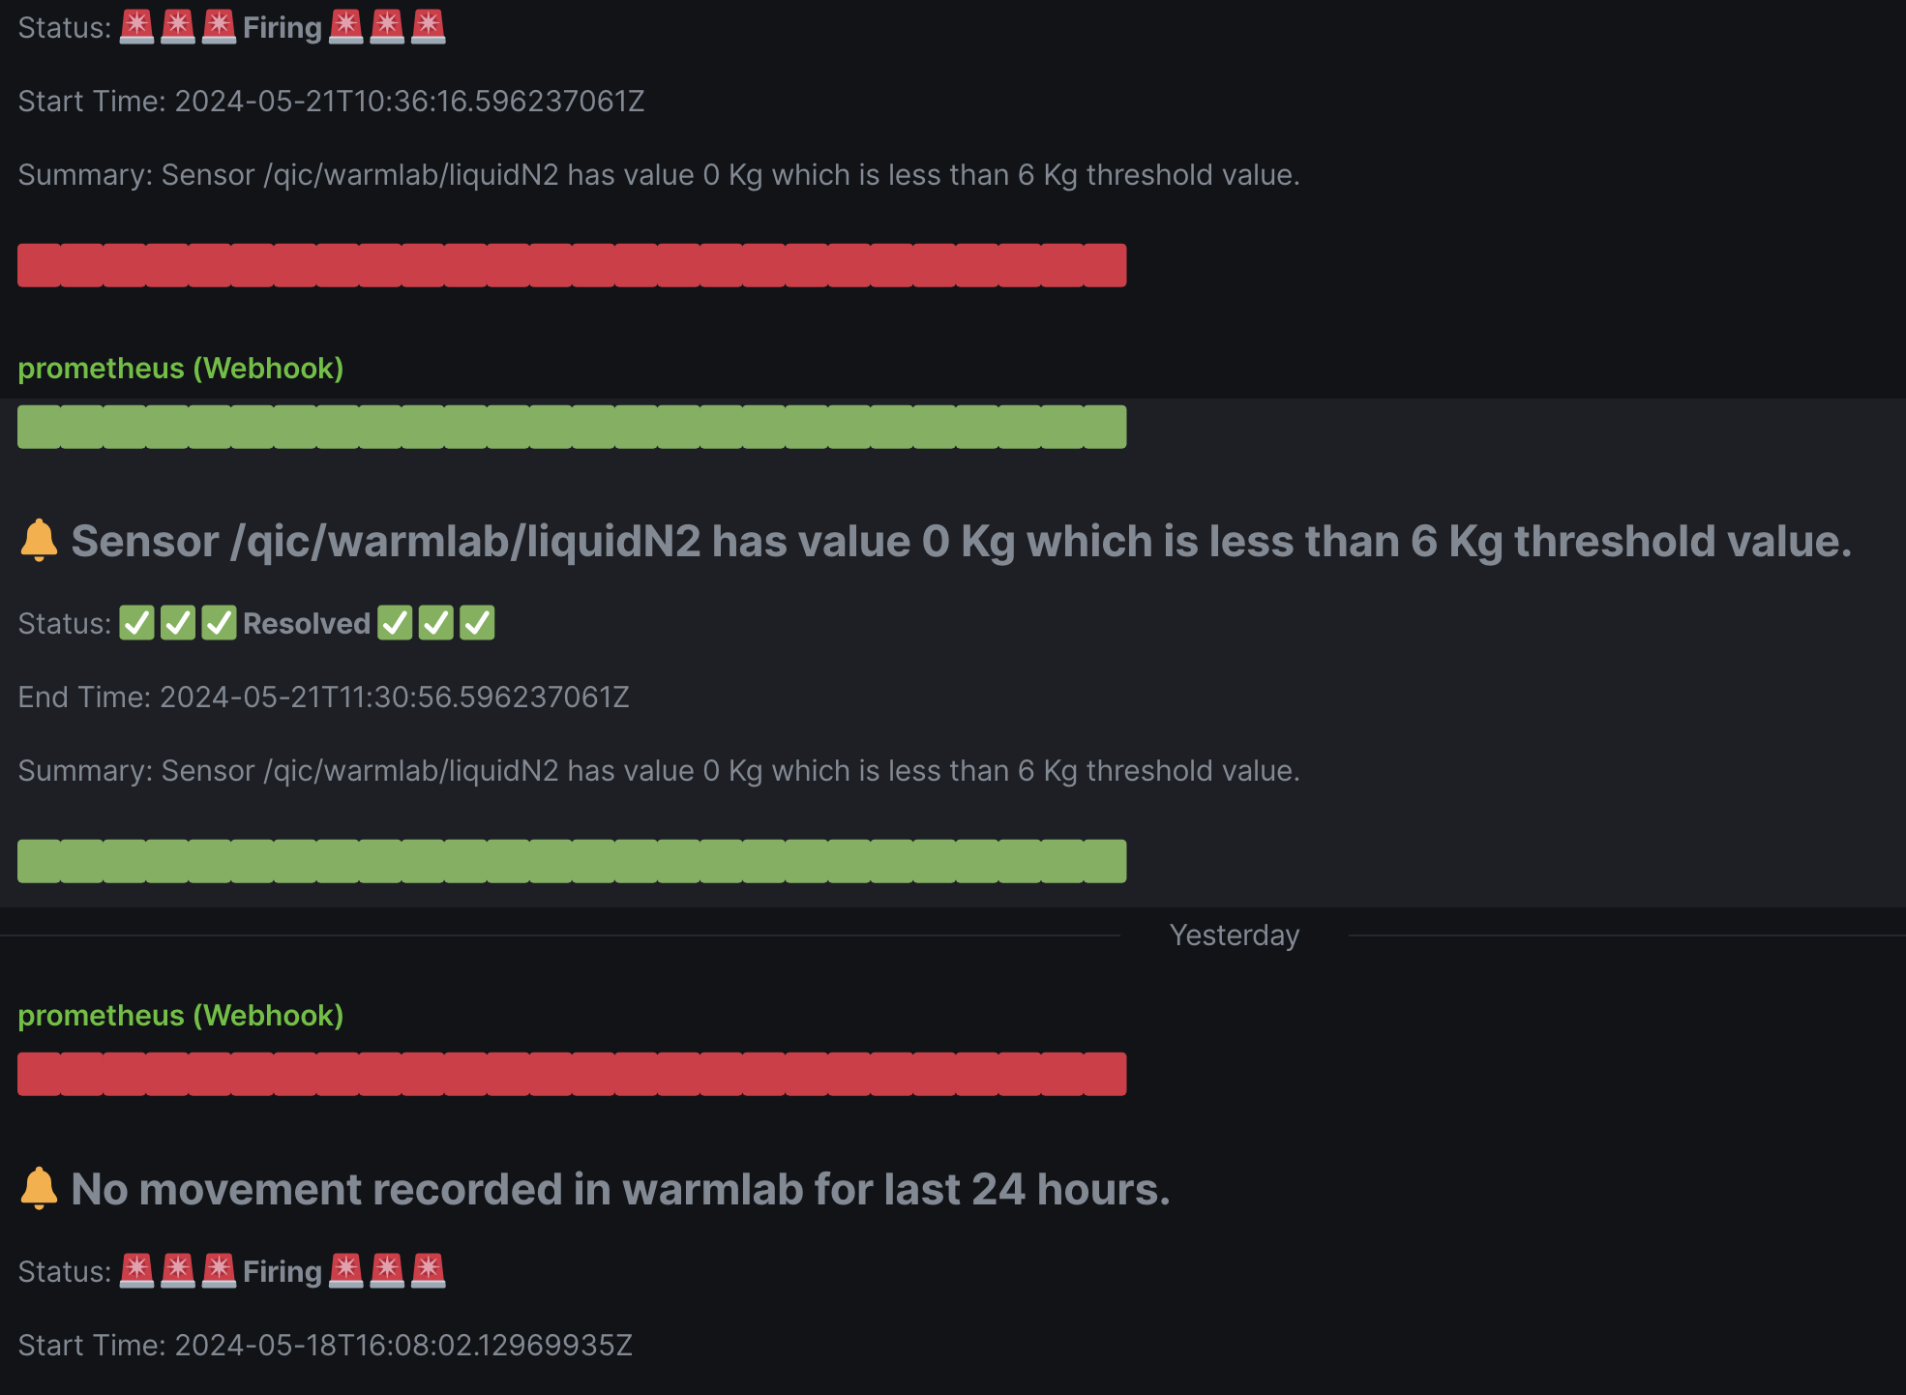
Notification System
Finding Correlations
Tracking changes in the Environment allows us to:
  Identify the limitations of the system
  Analyse error scenarios
  Create solution protocols
  Create notifications for expected hazards

Slide 15
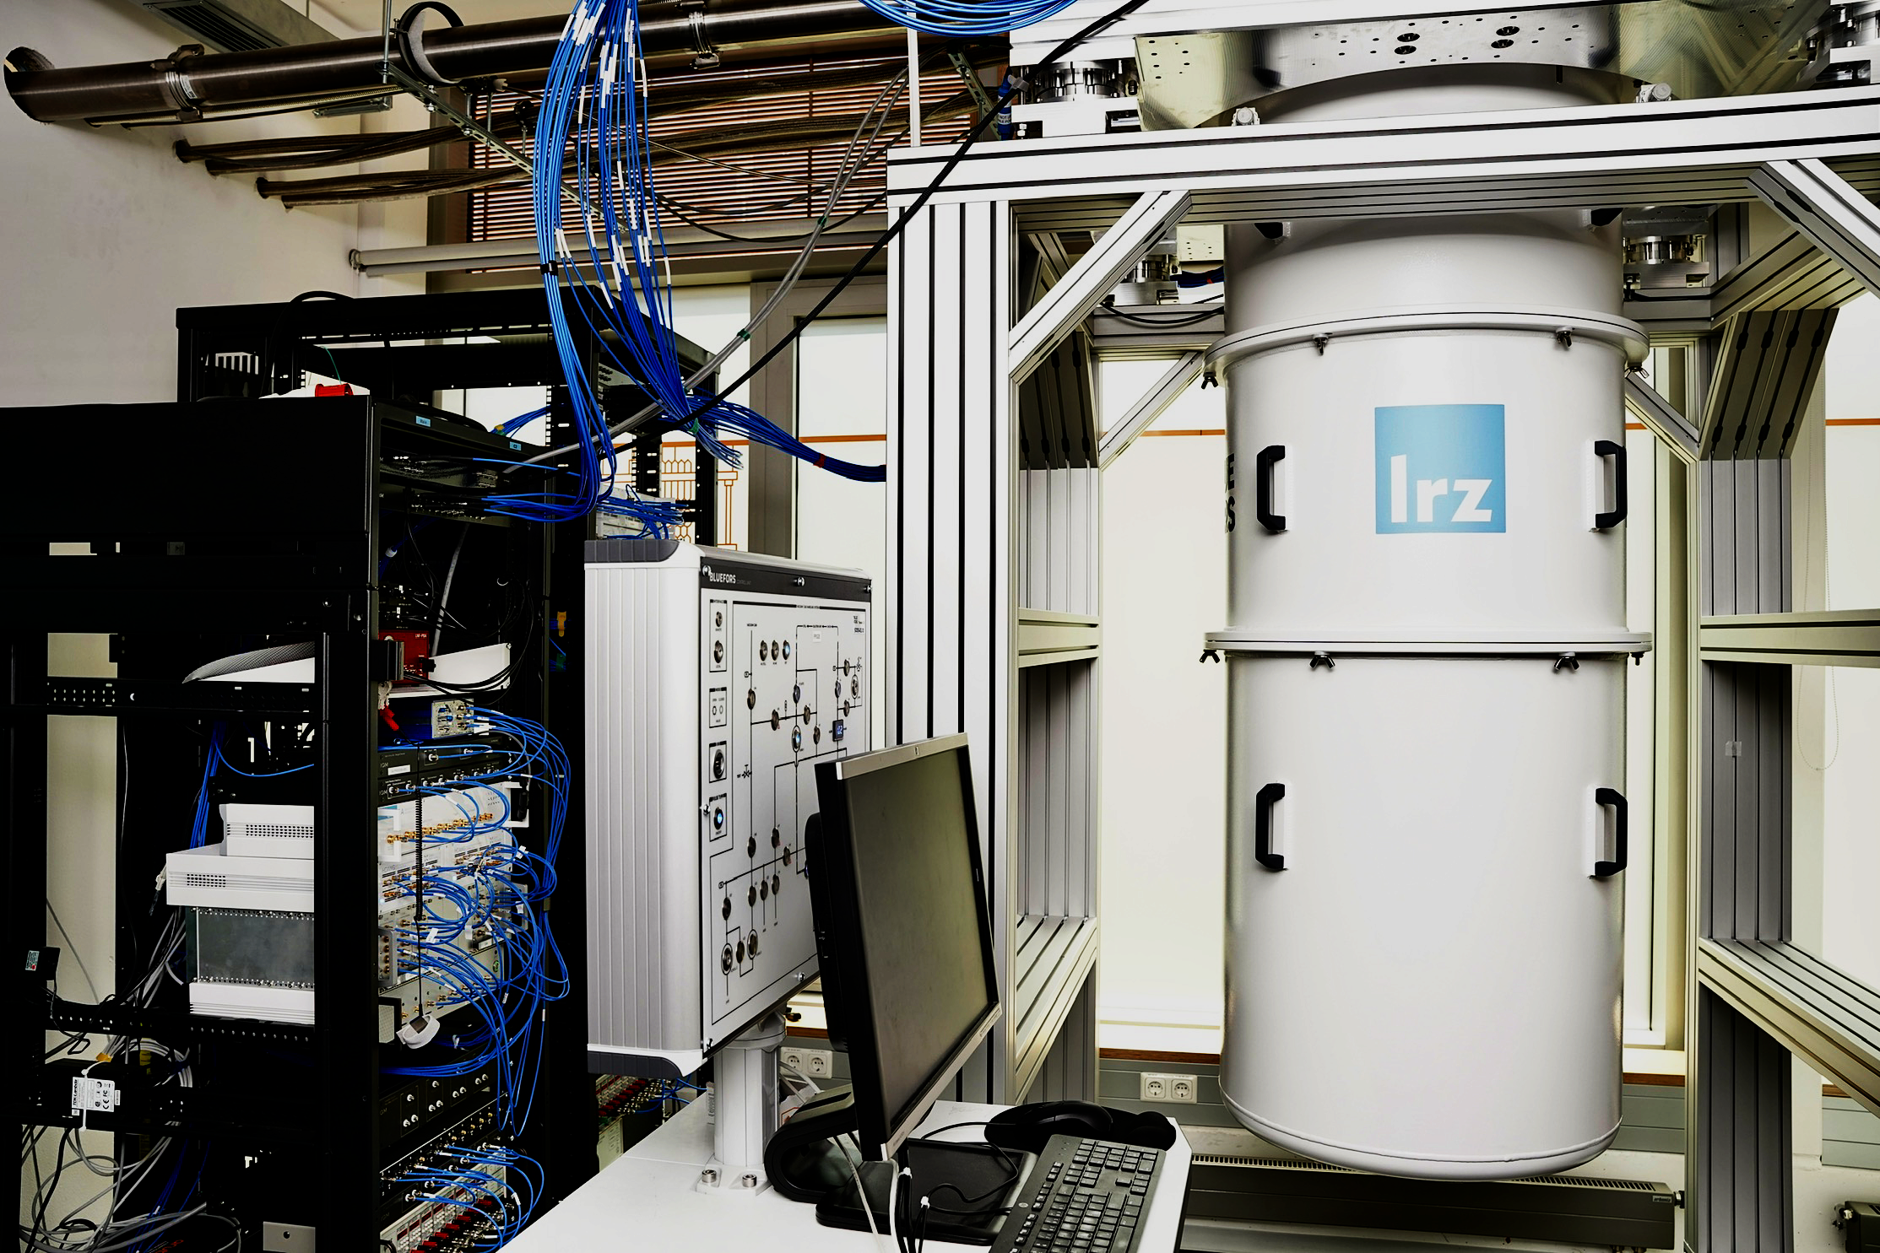
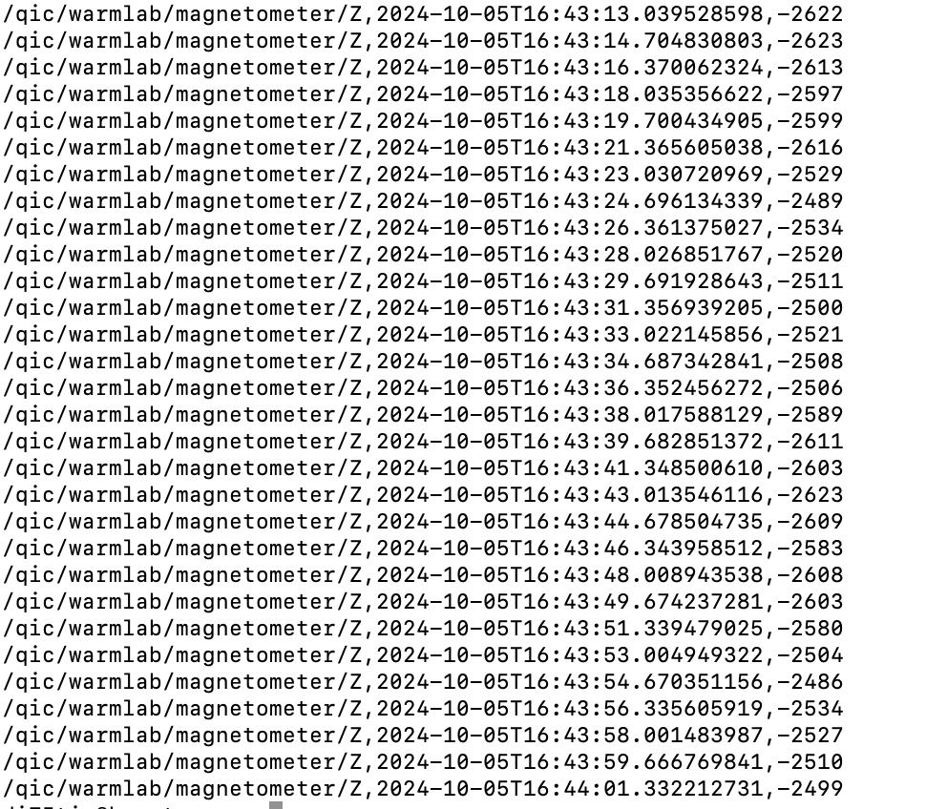
Establishing a Baseline
System Design
DCDB

Slide 16
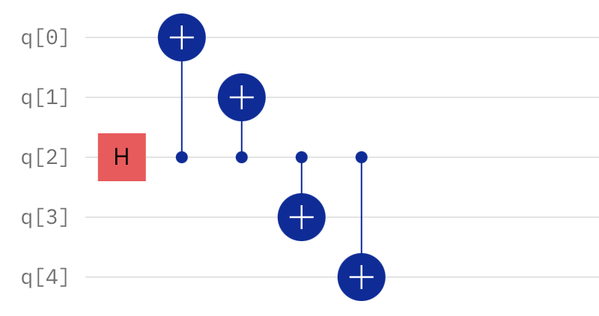
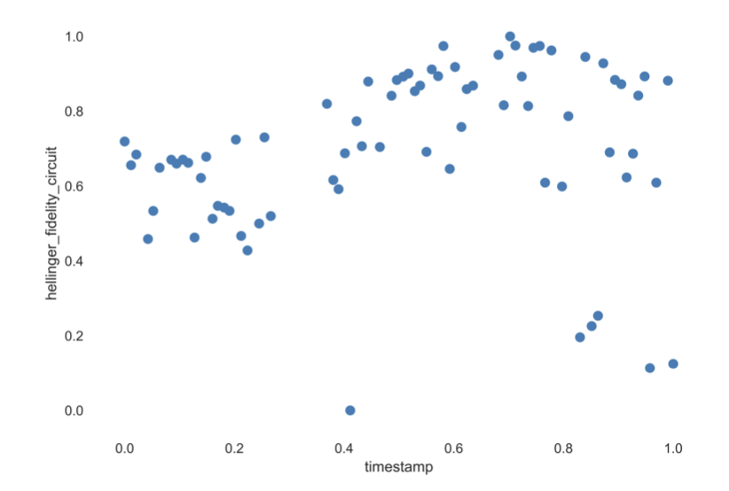
Correlation Phase
Finding Correlations
Benchmarking QPU over 72 hours while submitting GHZ-like state circuit every 10 minutes

Slide 17
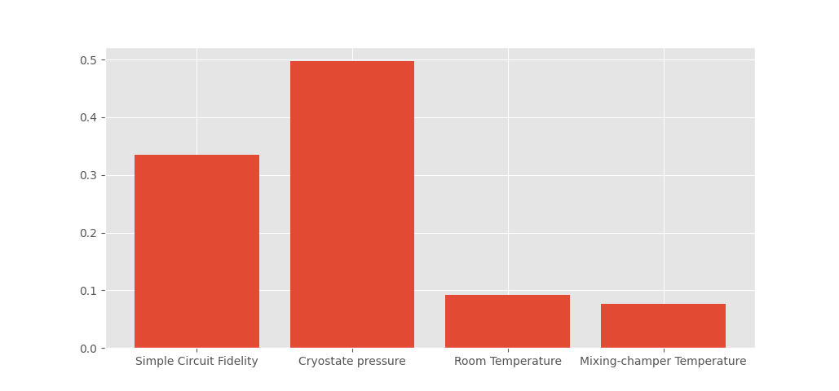
Feature importance
Finding Correlations
Pearson correlation Coeffecients( | Quantum Circuit- Fidelity | Quantum Simple Circuit- Fidelity
Cryostat Pressure Level 1 | 0.495 | 0,425
Average Lab Temperature | 0.042 | 0.627
Mixing Chamber temperature | 0.140 | 0.322
Simple Circuit Fidelity
Cryostat Pressure
Lab Temperature
Mixing Chamber Temperature

Slide 18
Correlations with Multiple Sensors
System Design
Quantum Job
Time Stamps Collector
Data labeling
DCDB
Pre-Processing

Slide 19
Characterization Using Perturbation Theory
Open Quantum Systems
$$H^{Total}$$ = $$H^{S}$$ + $$H^{E}$$ + $$H^{I}$$
$$H^{E}$$
$$H^{I}$$
$$H^{E}$$= $$H^{D}$$ + $$H^{Sensor}$$ + $$H^{Temperature}$$ + $$H^{Cryo}$$ +….
$$H^{S}$$

Slide 20
Applications Driven from System Architecture
Applications
          Characterization
Is the Hamiltonian Hermitian?
Are Errors Coherent?
Is it Markovian Noise?
  Can the noise be Unitary?
    Optimization
Error Mitigation
Error Suppression
Dynamic Decoupling

Slide 21
Applications Driven from System Architecture
Applications
Is the hamiltonian hermitian?
Error Mitigation
Is the noise
unitary?
Are errors coherent?
Characterisation
Optimisation
Error Suppresion
Is the noise Markovian?
Dynamic Decoupling
.
.
.

Slide 22
Applications Driven from System Architecture
Applications
Error Mitigation
Dynamic Decoupling
Error suppression
Characterisation
Optimisation
Are errors coherent?
Is the noise Markovian?
Is the Hamiltonian Hermitian?
Can the noise be represented as a unitary?

Slide 23
Open Quantum Systems Approach
System Design
Quantum Job
Time Stamps Collector
Data labeling
QAnalyzer
DCDB
Pre-Processing

Slide 24
Quantum Machine Learning
System Design
Quantum Job
Time Stamps Collector
Data labeling
QAnalyzer
Serialization
DCDB
Pre-Processing
Output Checker
Model Adaptor

Slide 25
Quantum Machine Learning
System Design
Quantum Job
Time Stamps Collector
Data labeling
QAnalyzer
Serialization
DCDB
Pre-Processing
Output Checker
Model Adaptor

Slide 26
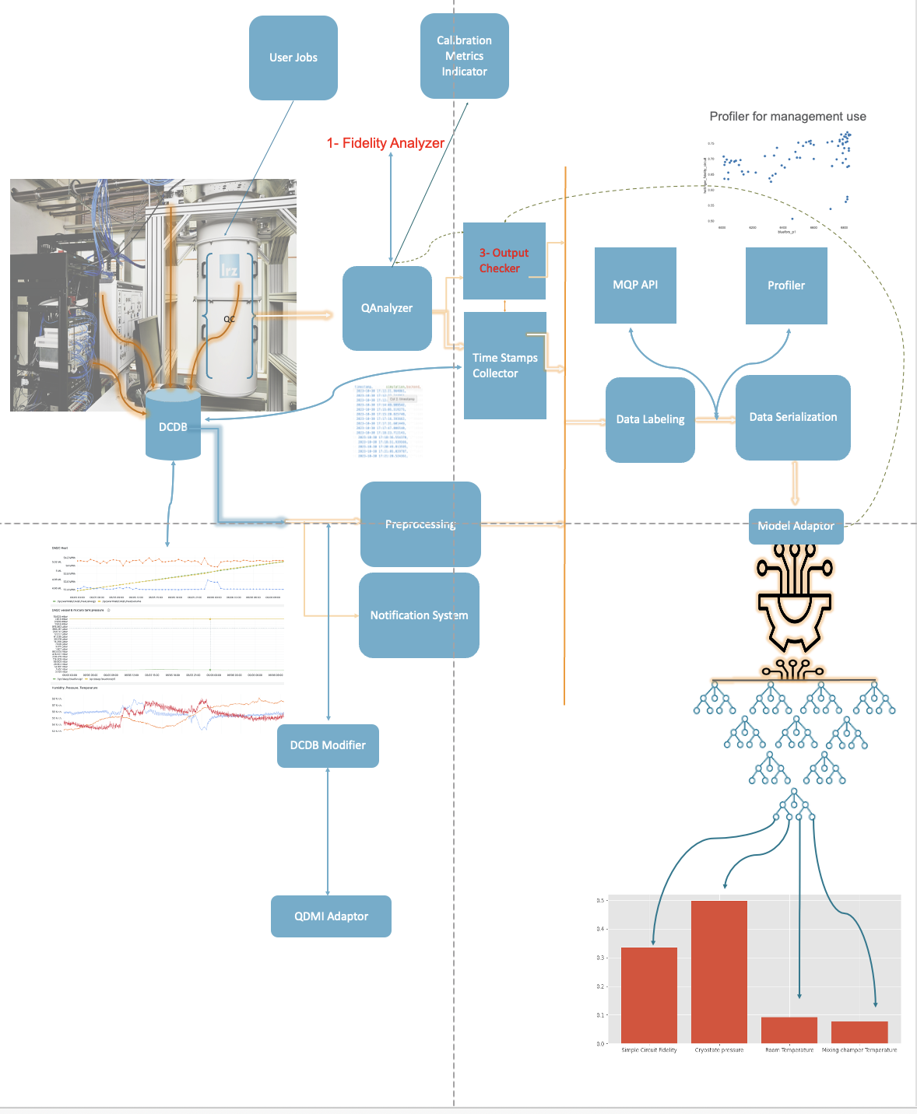
System Overview
System Design
Adding concurrency for better parallelization and tailoring the system to our environment and software stack

Slide 27
Features Ranking
From System Design to Application Use
The model allows for ranking of different environmental parameters by their correlation coefficients relative to QPU fidelity

Slide 28
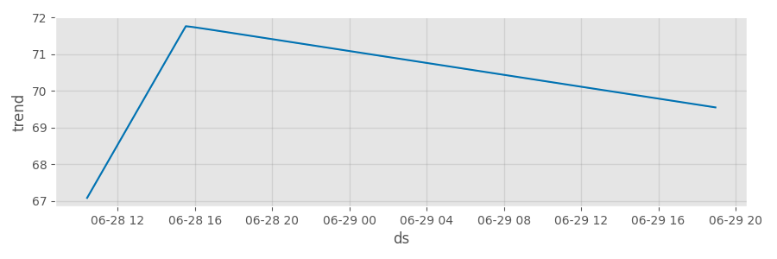
Fidelity Prediction
Applications
Fidelity prediction using data from 72 hours experiment to predict fidelity in 3 weeks period
Fidelity
[2]
Time

Slide 29
Real-Time Environmental Error-Mitigation
Applications
Quantum machine learning is used to identify the unitary operator to mitigate noise from the environment.
$$U^{Experiment}=U^{Noisy}U^{Exact}$$
$$U^{Noisy}(θ,φ,qubit)$$
[1]

Slide 30
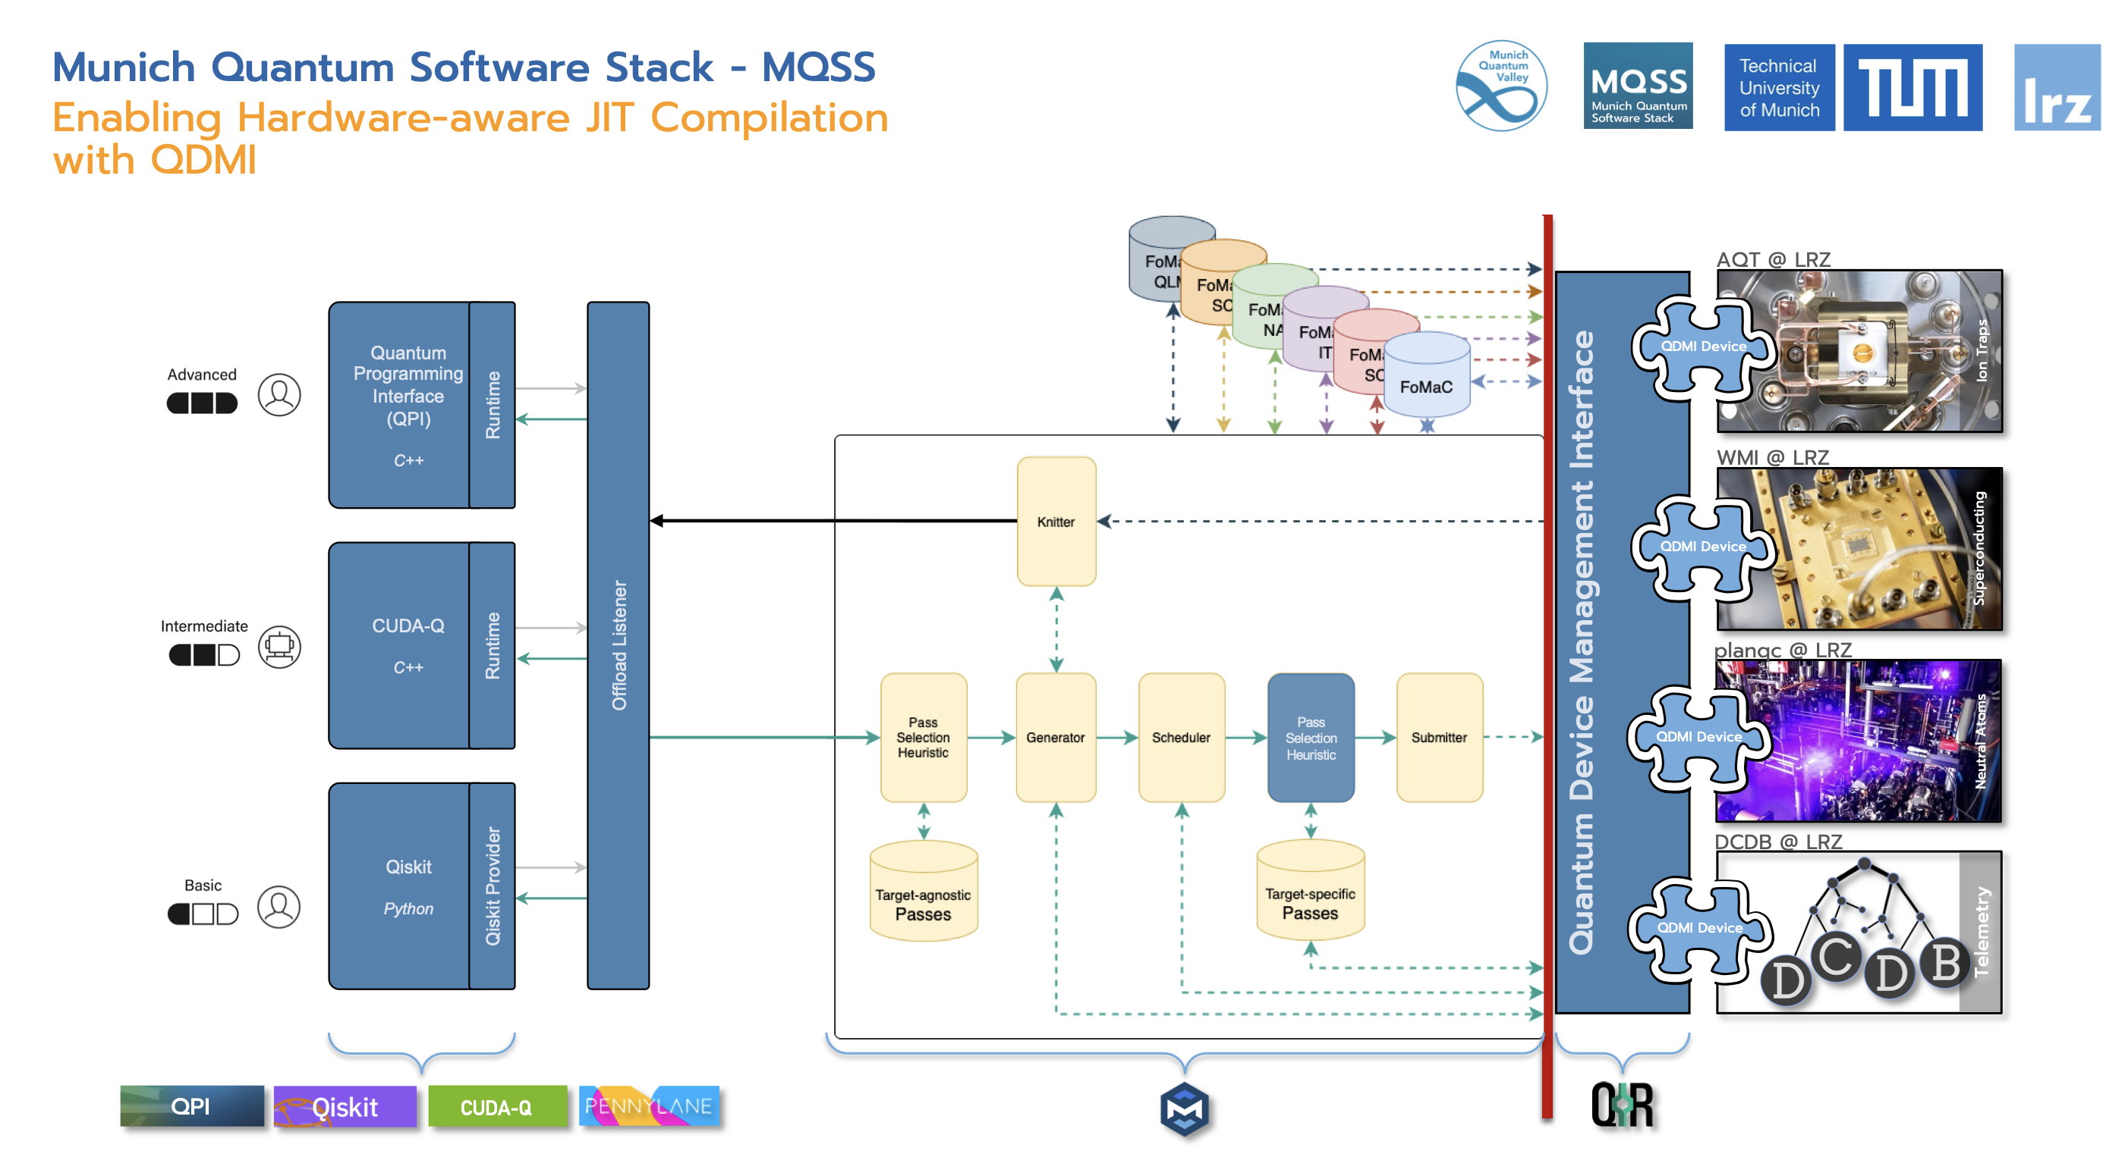

Slide 31
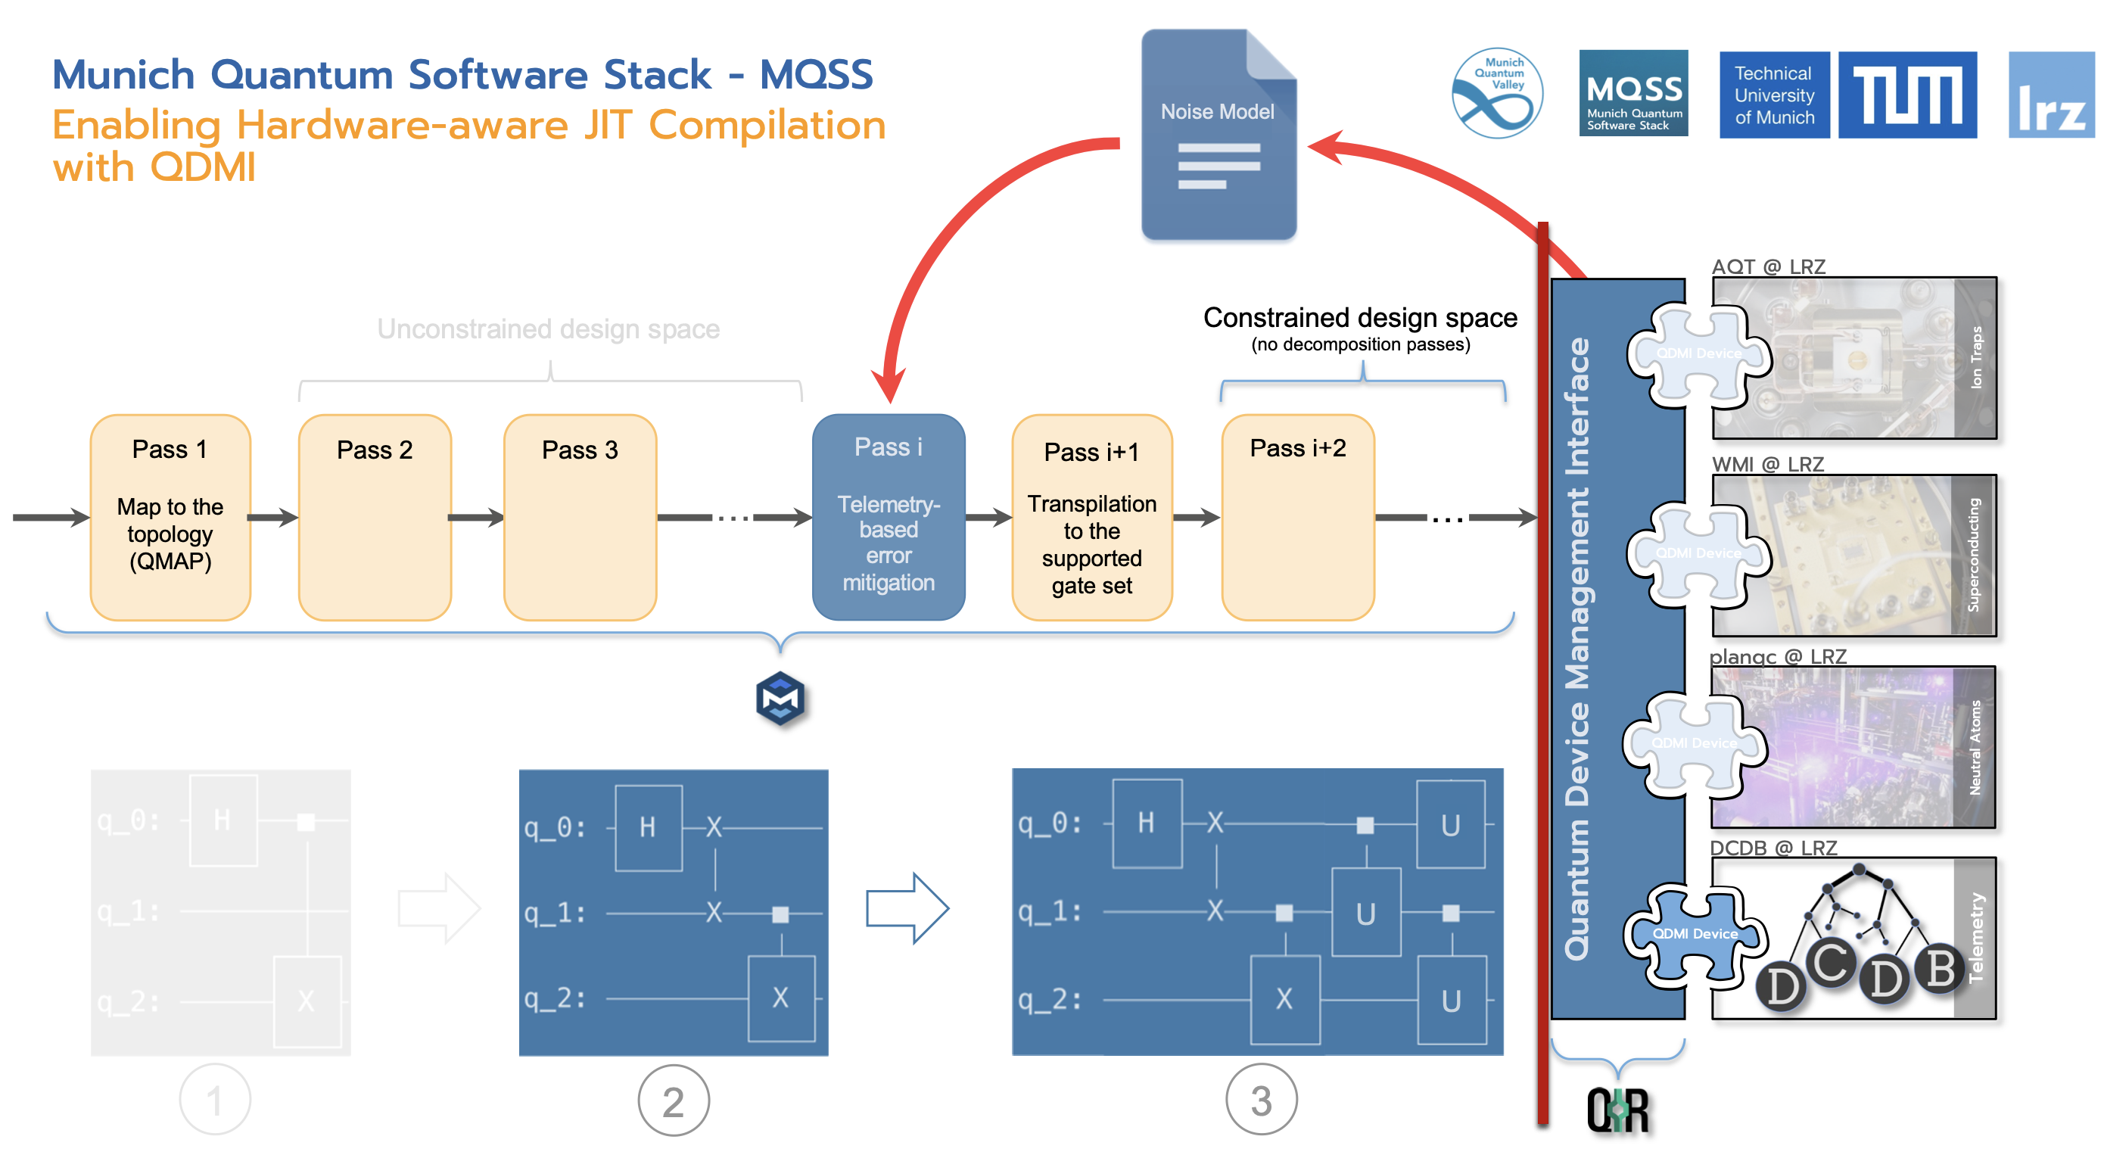

Slide 32
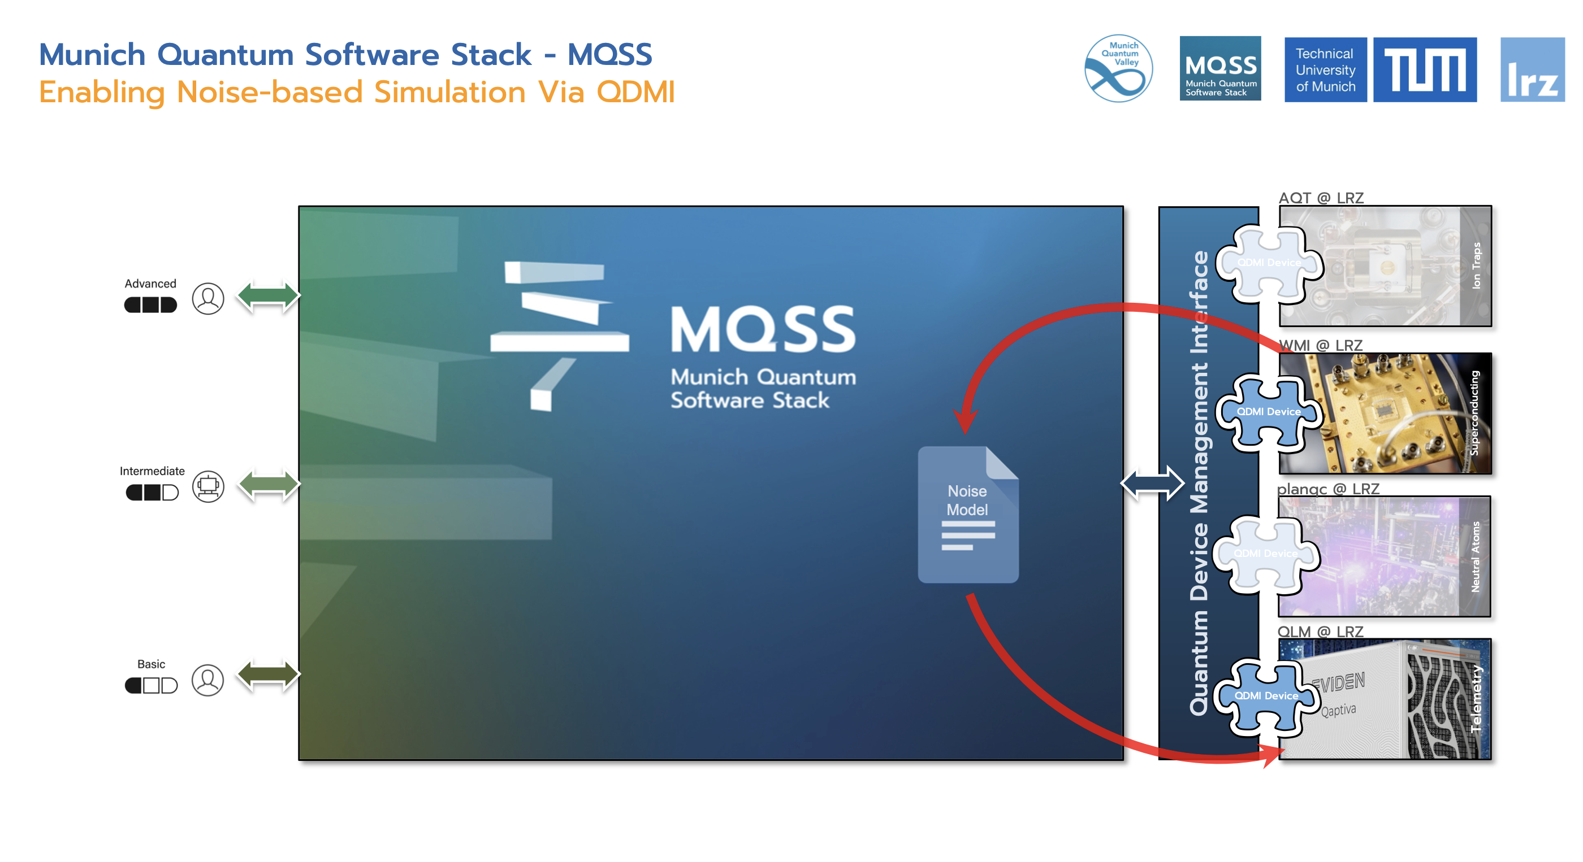

Slide 33
Conclusion
Quantum computing environment is very crucial for quantum computer operation
Quantum Software should be environment-aware
Techniques to characterize quantum environment is crucial in the NISQ era
There is a necessity to provide real-time environmental optimization through software
More advanced environmental challenges allows us create more advanced suppresion solutions.
MQV: J Geuene

Slide 34
References
Burak Mete, Amit Jamadaani "Environmental Telemetry for Error Mitigation in Quantum Computers Seated in HPC Centers", ISC 2024
H. Ahmed, X. Deng, H. Heller, C. Guillen, A. Zul-figar, M. Ruefnacht, A. Jamadagni, M. Tovey, M. Schulz, and L. Schulz, in 2023 IEEE International Conference on Quantum Computing and Engineering (QCE), Vol. 2 (IEEE, 2023) pp. 154-160.
Alessio Netti, Micha Mueller, Axel Auweter, Carla Guillen, Michael Ott, Daniele Tafani and Martin Schulz. From Facility to Application Sensor Data: Modular, Continuous and Holistic Monitoring with DCDB. Proceedings of the International Conference for High Performance Computing, Networking, Storage, and Analysis (SC) 2019
Alessio Netti, Micha Mueller, Carla Guillen, Michael Ott, Daniele Tafani, Gence Ozer and Martin Schulz. DCDB Wintermute: Enabling Online and Holistic Operational Data Analytics on HPC Systems. Proceedings of the International Symposium on High-Performance Parallel and Distributed Computing (HPDC) 2020.
Acknowledgement:
Laura Schulz acting department head for Quantum Computing and Technologies at the Leibniz Supercomputing Centre (LRZ)
Prof. Dr. Martin Schulz Professor in Computer Science and Member of the Board of Directors at LRZ
Dr. M. Farooqi & B. Mete from Quantum Integration Software at LRZ
M. Tovey & Dr. H. Heller from System & Labs at LRZ.
Notes:
acknowledgements

Slide 35







Hossam Ahmed
Leibniz Supercomputing Centre
Hossam.ahmed@lrz.de
quantum@lrz.de
Enhancing Quantum Computing Stability in Noisy HPC Environments:
A Novel System Architecture for Environmental Noise Management and Error Mitigation
The development of the Munich Quantum Software Stack (MQSS) is supported by a portfolio of projects, including projects funded by the Bavaria‘s HighTech Agenda (via MQV, in particular Q-DESSI), BMBF (DAQC, Q-Exa, MUNIQC- SC, MUNIQC-ATOMS, MAQCS), BMWK (QuaST), the EuroHPC JU (Euro-Q-Exa, DEEP-SEA, REGALE), the EU Quantum Flagship Program (OpenSuperQ+, Millenion), and the European Research Council (ERC).
Notes:
Lastly I would like to thank the funders for the

