Slide 1
Using Virtual Internet Exchange Point to Build Layer 3 Network Testbed: A Study Case
Reporter: Wen-Ju Chiang

Slide 2
OUTLINE
Motivation
Testbed Architecture
Use Case
Future work

Slide 3
OUTLINE
Motivation
Testbed Architecture
Use Case
Future work

Slide 4
Motivation
In recent years, the information, cyber-security and network function virtualization have become increasingly important in network operation and management.
While these changes have brought impacts on network research and education, especially for internet innovations.
Playing only with multiple VM and forwarding localhost packets shall not be the only option for a student.

Slide 5
Motivation (cont.)
Students are struggled
  Lack of compute resource
    A server, switch or router is way too expensive for an individual
    Second hand might be a choice, how about power or storage cost?
  Lack of real world packets
    You can control what you send or receive within your local network
    There will always be someone bombs you with unexpected packets
  Method to connect with others
    While coding is important in programming
    Communication, negotiation and cooperation is more important in networking

Slide 6
Motivation (cont.)
As a student, if you want to advertise your own IP prefix and connect to the world, you are required to.
  Have your own AS Number ($70/year)
  Have a running server 24/7 ($60/year)
  Have an IP Prefix ($720/year for IPv4, $5/year for IPv6)
  Monitor your network
These are costly and time consuming for a normal student.
How to provide a platform for student with hands on experience to connect and tackle with real world alike environments and problems.

Slide 7
OUTLINE
Motivation
Testbed Architecture
Use Case

Slide 8

IXP Manager
IXP Manager is an open-source management platform designed for Internet Exchange Points (IXPs). It provides tools for managing peering networks, automating configurations, monitoring traffic, and improving operational efficiency at IXPs.
Benefits
  Automated Configuration
    Generates BGP, route server, and switch configurations.
  Traffic Monitoring & Reporting
    Provide user-friendly UI/UX for real-time analytics.
  Security & Access Control
    Supports authentication, role-based access, and security best practices.

Slide 9
Virtualized Internet Exchange Point
Create a Virtualized Internet Exchange Point (VIXP) with a real world uplink.
Every users can advertise their own IPv6 address in order to gain internet access.
AS214821
Making sure that users doesn’t misconfigure and impact public network
Firewall
Aggregate prefixes
Replace private ASN to public ASN
VIXP (AS65000)
Internal Traffic
Internal Traffic
user
user
user
user
Only /64 are provided to students due to lack of IPv6 suffixes

Slide 10

Architecture
Configure
Manager
IXP Manager
Return Status
Dynamically Spawn
Create VPN if needed
VIXP (AS65000)
Route Reflector Router
Dynamic
Configuration
User Connect Point Containers
User Connect Point Containers
User Connect Point Containers
User Connect Point Containers
VPN
Linux bridge
Internet
Uplink Router (AS214821)
Users are able to connect to the VIXP via user connect point containers

Slide 11
OUTLINE
Motivation
Testbed Architecture
Use Case
Future work

Slide 12

ONOS
Open Network Operating System (ONOS) is an open-source SDN (Software-Defined Networking) controller designed for high availability, scalability and performance.
Benefits
  Programmability
    Allows dynamic network management via APIs and applications.
  Scalability
    Supports distributed architecture for handling large-scale networks.
  Features
    Intent for easy programming
  Open-Source

Slide 13

OVS
Open vSwitch (OVS) is an open-source, high-performance virtual switch designed to enable network automation, support SDN protocols (like OpenFlow), and optimize traffic in virtualized environments.
Benefits
  SDN Support
    Works with SDN controllers
  Features
    Provides GRE, VXLAN, QoS etc.
  Open-souce

Slide 14



Networks with Physical Routers
Physical routers
  1. Deal with routing decision.
  2. Deal with gateway exchange.
Every edge requires a router, running eBGP and iBGP protocols.
AS 65001
AS 65000
Switch
Switch
AS 65002
AS 65003

Slide 15

SDN Networks with Virtual Routers
SDN-enabled Virtual Routers
  Doesn’t requires router connection to edge.
  Only one BGP speaker is enough.
  Doesn’t need a real gateway.
AS 65001
AS 65000
BGP Speaker
(FRRouting)
OVS1
OVS2
AS 65002
AS 65003

Slide 16
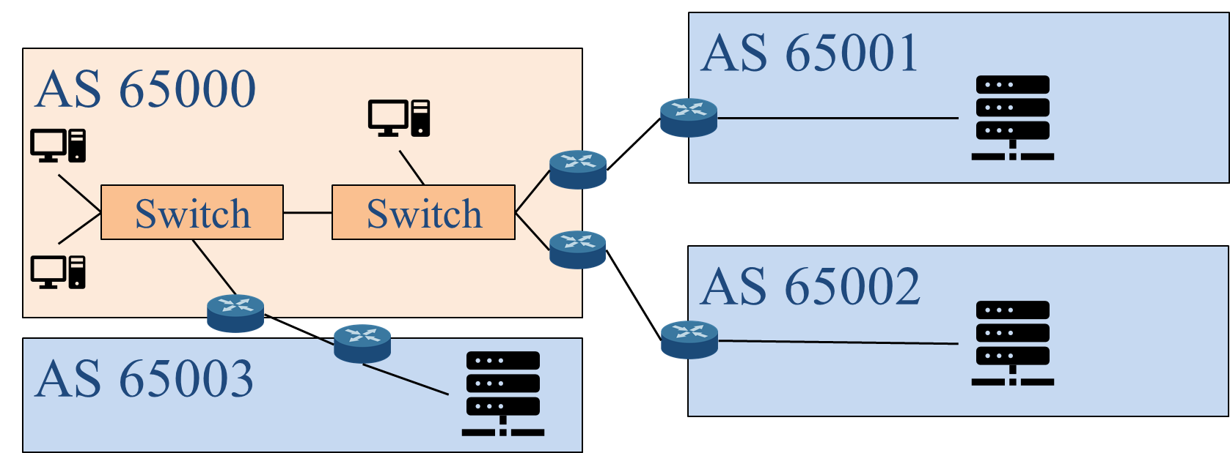
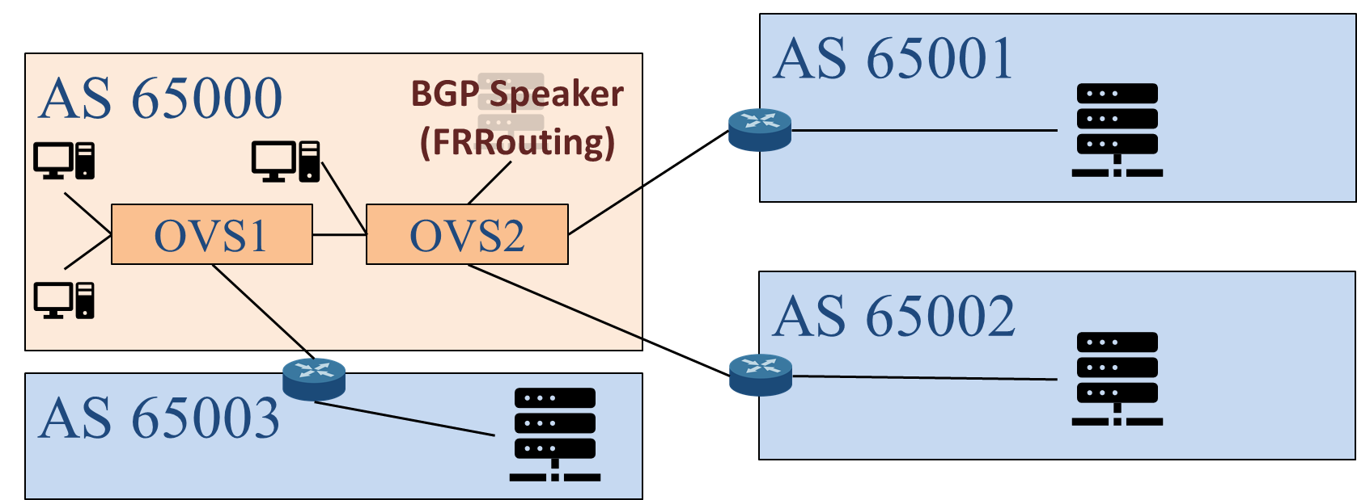
Virtual Router BGP Connection
Physical router:
  External routers connect with the boarder gateway.
Virtual router:
  External routers connect with BGP Speaker.
  Need to delegate BGP Speaker IP to edge switch.

Slide 17
SDNFV Training Platform
Software-Defined Networking & Network Functions Virtualization (SDNFV) is the combination of SDN (Software-Defined Networking) and NFV (Network Functions Virtualization) to create a more flexible, automated network infrastructure.

Slide 18
SDNFV Training Platform
Software-Defined Networking & Network Functions Virtualization (SDNFV) is the combination of SDN (Software-Defined Networking) and NFV (Network Functions Virtualization) to create a more flexible, automated network infrastructure.
SDN (Software-Defined Networking)
  Separates the control plane (decision-making) from the data plane (packet forwarding).
  Uses SDN controllers for centralized network management.
  Enables programmability and automation of network traffic flow.

Slide 19
SDNFV Training Platform (cont.)
Software-Defined Networking & Network Functions Virtualization (SDNFV) is the combination of SDN (Software-Defined Networking) and NFV (Network Functions Virtualization) to create a more flexible, automated network infrastructure.
NFV (Network Functions Virtualization)
  Moves traditional network functions (e.g., firewalls, routers, load balancers) from hardware appliances to virtualized software running on standard servers.
  Uses Virtual Network Functions (VNFs) to replace dedicated network devices.
  Reduces dependency on expensive proprietary hardware.

Slide 20
SDNFV Training Platform (cont.)
SDNFV is taught in National Yang Ming Chiao Tung University (NYCU) by professor Chien-Chao, Tseng.
This class aims to
  Enhance students with knowledges of SDNFV
  Using OVS and ONOS to provide SDN network environment
  Provide students with hands on experience with network management via NFV
Final Project of the class
  Provide a virtual Router (vRouter) to emulate router function.
  Create a Layer 3 network environment that can route the packet to the intended destination and drop unauthorized packets.

Slide 21
Project Architecture
Students are grouped to also peer with each other
VIXP (AS65000)
Students will form a group of 3.
Members in each group shall peer with each other.
Every student will connect to the VIXP.
stu-group 01
stu-group 02
A
B
C
stu1
stu4
stu2
stu3
stu5
stu6

Slide 22
Project Target
Students are required to produce a vRouter with SDN.
Students are required to deal with
  Intra-domain Traffics
    Hosts within the same AS communicates with each other
  Inter-domain Traffics
    External host communicates hosts within student’s AS
  Transit Traffics
    Traffics bypass student’s AS during communications between hosts
In this project, students are their own ISP, which is required to peer with others, transit others traffic and provide QoS capability.

Slide 23
Project Target (cont.)
Training students with layer 3 network knowledges and experiences
  Providing an environment for student to configure their own network settings
  Transform knowledge in books to hands on ability
  Students shall provide self protection in their application to not been effect by others within the network
Introducing real-world internet resources for students
  Students are able to connect their SDN project to IXP for practicing and exploring BGP, SDN, NFV with allocated IP resources
  Learn the value of public IP resources

Slide 24

Project Topology as a Group
Student x
TA
1Gbps Rate Limit
AS65xx0 (SDN Network)
AS65xx1
FRRouting
ONOS
Host 2
Host 1
VXLAN
VXLAN
AS65000
Student y
1Gbps Rate Limit
ONOS
AS65yy1
Host 1
FRRouting
VXLAN
Host 2
AS65yy0 (SDN Network)

Slide 25
Project Topology as a Student
192.168.63.1/24
192.168.70.xx/24
172.16.xx.69/24
192.168.100.3/24
fd63::1/64
fd70::xx/64
2a0b:4e07:c4:xx::69/64
AS65xx0
172.17.xx.1/24
2a0b:4e07:c4:1xx::1/64
Also FRRouting
192.168.100.2/24
1Gbps Rate Limit
FRRouting
ONOS
AS65xx1
Host 2
OVS1
TA
172.17.xx.2/24
2a0b:4e07:c4:1xx::2/64
192.168.70.253/24
fd80::fe/64
192.168.63.2/24
fd63::2/64
192.168.61.xx/24
OVS3
VXLAN
AS65000
Host 1
OVS2
172.16.xx.2/24
2a0b:4e07:c4:xx::2/64
192.168.60.xx/24
VXLAN

Slide 26
Project Configurations
Students are running an AS65xx0 and announcing prefixes
  172.16.x.0/24.
  2a0b:4e07:c4:xx::/64
Students help to transit prefixes announced by AS65xx1
  172.17.x.0/24.
  2a0b:4e07:c4:1xx::/64
IXP is AS65000 at 192.168.70.253/24 and fd70::fe/64
  Students have to announce the prefixes you know to the IXP
  Students can connect the IXP via
    192.168.70.x/24
    fd70::x/64

Slide 27
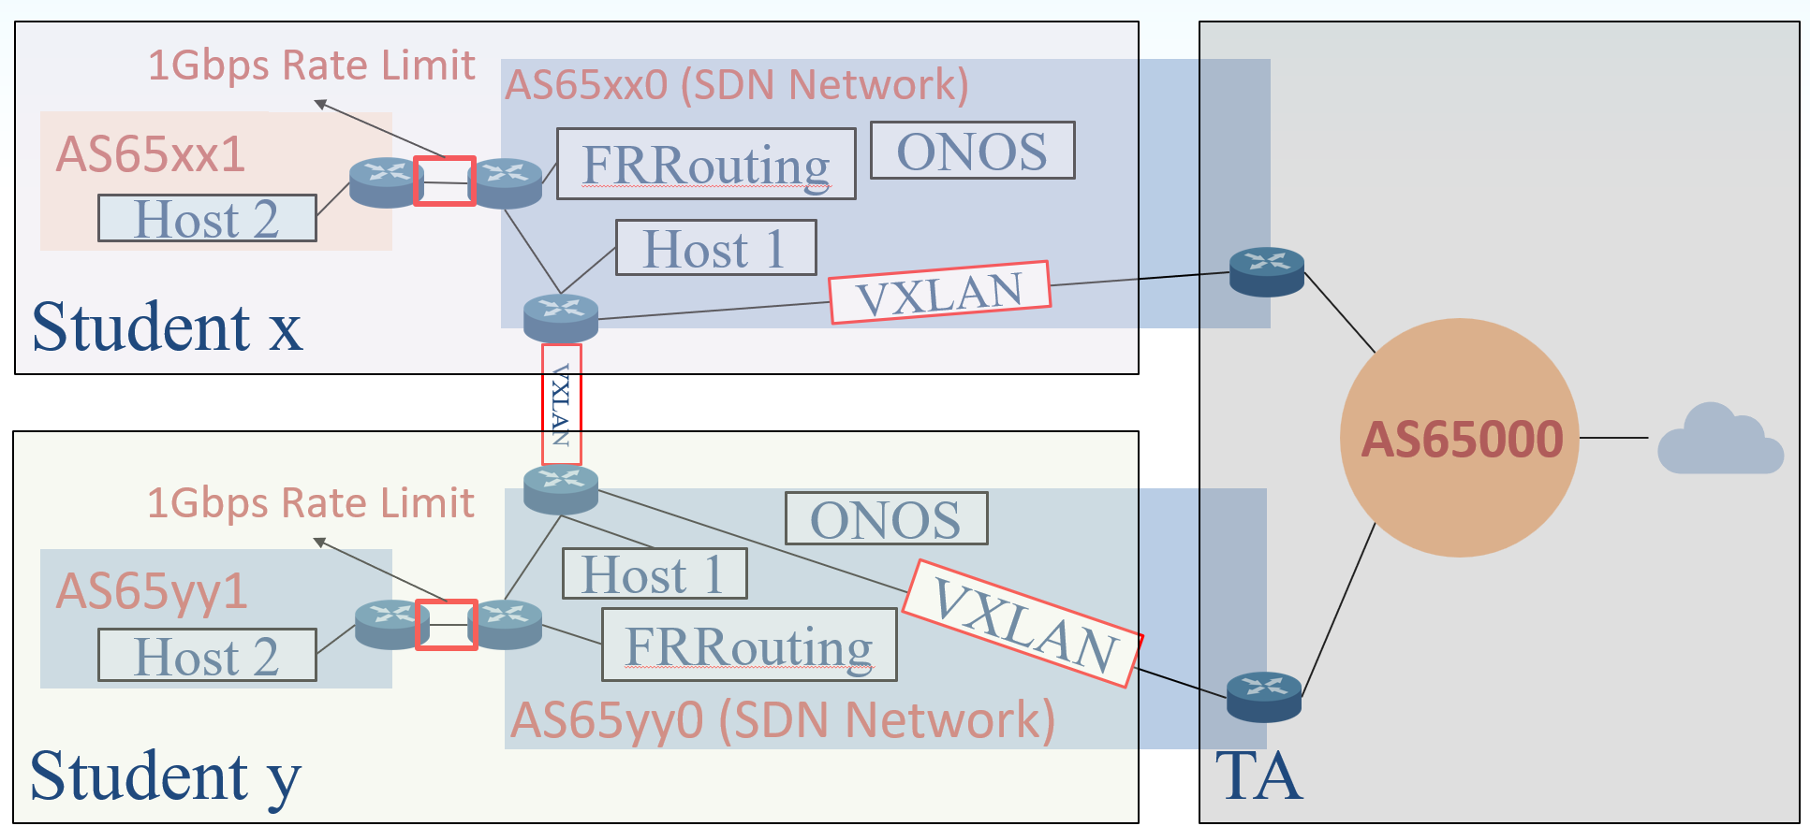
Testing Requirements
For service customers (AS65xx0 SDN Network, host 1)
  Able to ping FRRouting’s IP (172.16.xx.69/24). (Intra-domain Traffic)
  Able to ping student y’s FRRouting’s IP (172.16.yy.69/24). (Inter-domain Traffic + Peering)
  Use https://tools.keycdn.com/ipv6-ping to see ICMP replies. (Inter-domain Traffic + IXP Connection)

Slide 28
Testing Requirements (cont.)
For transit ISP (AS65xx1, host 2)
  Able to ping host 1 IP (172.16.xx.2/24). (Inter-domain Traffic + Peering)
  Able to ping student y’s FRRouting’s IP (172.16.yy.69/24). (Transit Traffic + Peering)
  Able to ping student y’s host 2’s IP (172.17.yy.2/24). (Transit Traffic + Transit)
  Use https://tools.keycdn.com/ipv6-ping to see ICMP replies. (Transit Traffic + IXP Connection)

Slide 29
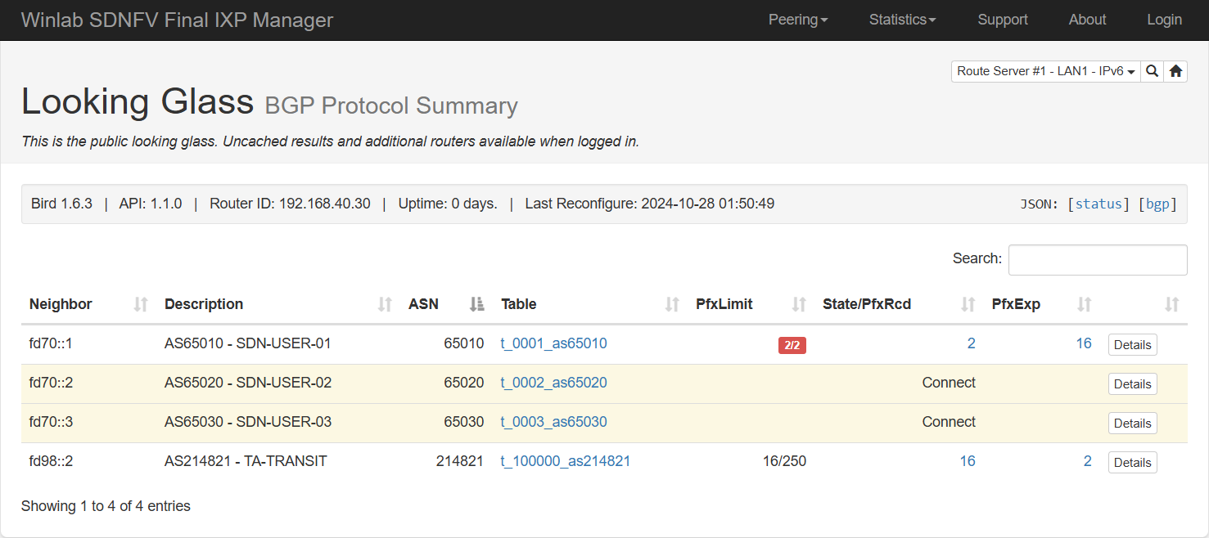
IXP Manager Looking Glass
You can see what you have announced via IXP Manager
Your ASN
Your x
Click to see what you have announced

Slide 30
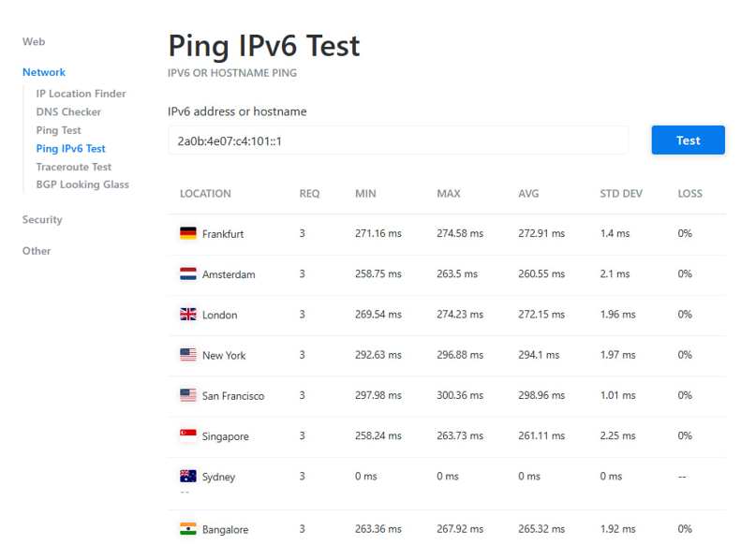
Expected Result
Students can test that they have connected to the outside world

Slide 31
Further Experiment
BGP hijacking
  A takeover of IP prefixes by manipulating the Border Gateway Protocol (BGP) by advertising prefixes that does not belongs to it.
The attack is performed to the students within the network
  Student’s packet are forwarded to malicious servers.
  Student are required to provide method to prevent hijacking
Attack influence scope
  The attack is only taking affect within the testbed.
  Blocked by the firewall and doesn’t leak to the real world.

Slide 32
OUTLINE
Motivation
Testbed Architecture
Use Case
Future work

Slide 33
Testbed Internal Protection
A switch loop is created within a group, since students have created the router and there are no switch loop protection.
Which results in
  Broadcast storm is formed within the testbed.
  All students received tremendous broadcast packets, leading to their own computer failure.
Network resource collisions
  MAC Address
  IP
These doesn’t effect the core system, but is a problem to other users; therefore, an internal protection/alert system shall be introduced.

Slide 34
Q&A
Thank you for your attention

