Slide 1


EUGridPMA Status Updates
David Groep
davidg@nikhef.nl
status of our authorities and trust fabric news
March 2025
part of the work programme of
GEANT 5-1 EnCo, and AARC TREE
the work has received co-funding
from the European Union
co-supported by Nikhef and the Dutch
National e-Infrastructure coordinated by SURF

Slide 2
Meanwhile in the EUGridPMA+ …
EUGridPMA and IGTF distribution matters
  constituency and developments
Root migration update for EL9+ (or: why people bother the fetch-crl devs)
TCS Gen5 update

Slide 3
EMEA area membership evolution
Europe⁺: GEANT TCS, and CZ, DK(+FI+IS+NO+SE), HR, NL, PL, RO, SI, SK, AM, MD, ME, MK, RU, TR, UA, UK
Middle East: IR, PK
Africa: DZ, KE, MA
CERN, RCauth.eu

Slide 4
Membership and other changes
Identity providers: both reduction and growth
  migration to GEANT TCS continues
  https://wiki.geant.org/display/TCSNT/TCS+Participants+Sectigo
  CERN joined TCS via Renater (FR)
  Discontinued: -GE, -BY, -PT, -AE, -FR
  Suspended: -KE, -MK
Self-audit review
  Cosmin Nistor tracks the status on the PMA Wiki
  real-time interaction between authority and reviewers helps, but …
.ch is now served by eMudhra

Slide 5
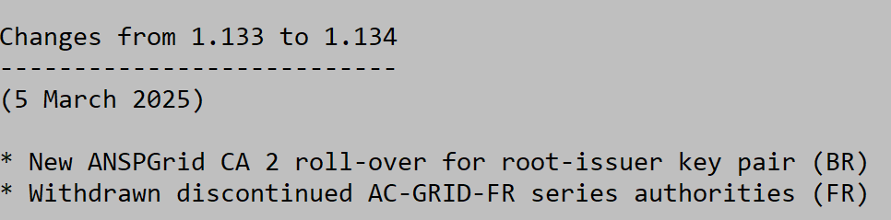
Updates in 1.133 and 1.134
Changes from 1.132 to 1.133
---------------------------
(XX February 2025)
* Updated re-issued GridCanada root with extended validity period (CA)
* Added GEANT TCS Generation 5 TLS ICAs and corresponding HARICA roots (EU)
* updated SHA-256 root CA for RDIG mitigating EL9/FedoraCore deprication
* MARGI put on hold due to domainname resolution issues (MK)

Slide 6
Distribution signing key update
error: Verifying a signature using certificate
D12E922822BE64D50146188BC32D99C83CDBBC71
(EUGridPMA Distribution Signing Key 3 <info@eugridpma.org>):
Key C32D99C83CDBBC71 invalid: not signing capable
In Fedora Core 38+ (and thus later in its derivatives, and maybe soon in Debian), RSA 1024 package signing no longer supported by default
(work-around with bespoke crypto-policies possible, not recommended)

Slide 7
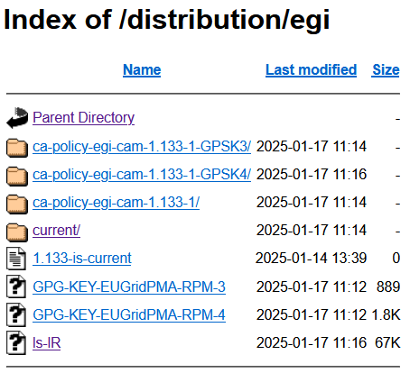
Distribution key update
In future releases we move
to a new GPG package key
RSA-2048
called GPG-KEY-EUGridPMA-RPM-4
distributed with 1.122+ releases
Retrieve new public key file from
https://dl.igtf.net/distribution/GPG-KEY-EUGridPMA-RPM-4
or from the public key servers: rsa/2048 dated 2023-07-29T12:06:23Z
fingerprint: 565f 4528 ead3 f537 27b5 a2e9 b055 0056 7634 1f1a

Slide 8
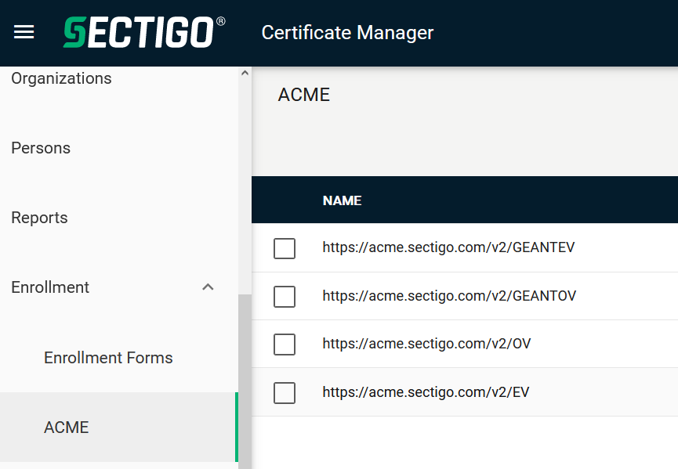
Other CABF things to keep in mind
Server SSL BR has already been updated
  the provision for using DC prefixing has been retained
But expect shorter validity periods in the future
  start preparing for 90-day max in your service deployment automation systems
  increased use of automation (ACME OV using client ID+secret)
[root@hekel ~]# certbot certonly \
--standalone --non-interactive --agree-tos --email davidg@nikhef.nl \
--server https://acme.sectigo.com/v2/GEANTOV \
--eab-kid DUniqueID_forthisclient --eab-hmac-key mv_v3ryl0n9s3cr3tK3y \
--domain hekel.nikhef.nl --cert-name OVGEANTcert

Slide 9
The challenge of self-signed roots and FF & RedHat’ s idea of what self-signed means …

Slide 10
Rocky9+, AlmaLinux9+, RHEL9+ and
With RHEL9 also deprecating SHA-1, but at the same time
still having self-signed SHA-1 based root certs in the ca-certificates
package, depends on a RedHat/OSSL proprietary set of ‘bonus bits’ appended to the end of the ASN.1 certificate blob.
For the others, there is – for now – a policy override:
update-crypto-policies --set DEFAULT:SHA1
update-crypto-policies --set LEGACY
even if that is a rather course-grained and blunt tool

Slide 11
Mitigations: SHA migration
Still,
if you still have a SHA-1 root
and you are able to re-issue with the same key (and new serial)
and your EECs do not have dirname+serial in their AKI
your CAs should probably re-issuing its root because that is just easier.
But:
for large ones, esp. e.g. the DigiCert Assured ID Root (2006), that will be hard
migrating to another (SHA-2 rooted) signing hierarchy will take at least 395 days ... and a lot of engineering on the RP and CA side
Root cause is with RH not understanding what a self-signed trust anchor is,
but that will not help us in the short term.

Slide 12
Reissuance of roots – state and progress
ASGCCA-2007 ArmeSFo
CESNET-CA-Root
DZeScience DigiCertAssuredIDRootCA-Root
DigiCertGridRootCA-Root IHEP-2013
KEK
MARGI
RomanianGRID
SRCE SiGNET-CA
TRGrid seegrid-ca-2013
Fixed by ‘now’: RDIG, GridCanada, CILogon basic/silver/OpenID, UKeScienceRoot-2007
Removed: DigiCertGridCA-*, DFN-GridGermany, CNIC, BYGCA , LIPCA, MARGI (suspended)
Pending withdrawal:

Slide 13
TCS Gen 5

Slide 14
by now 20 years of TCS …
based on a concept by Jan Meijer back in 2004
driven primarily by the NREN constituency, but with the e-Infra use cases very much in mind
NREN (GEANT constituency) requirements on public and (IGTF) authentication trust
in a way that scales to 45 countries and >500k active certificates today, increasing steadily
and also >10000 organisations, at varying states of automation maturity
now in its 5th iteration: GlobalSign, Comodo, DigiCert, S***tigo, and now HARICA!
1st CfP
SCS G1 (GlobalSign)
2nd CFP and start of TCS eScience with Comodo
issues with contracted provider – so recalibrate and find a good one
2004
2005
2006
2009
2015
2019
2020
2025
Gen4
TF-EMC2
concept
HARICA!
TCS G3 with DigiCert and eduGAIN
TCS G4 CfP

Slide 15
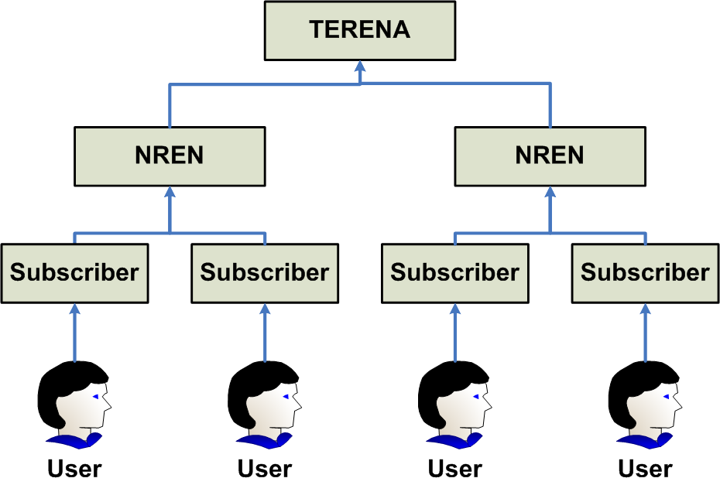

TCS: a stable constant factor
image source: Jan Meijer, 2008
Updates for TERENA – GEANT change in 2017

Slide 16
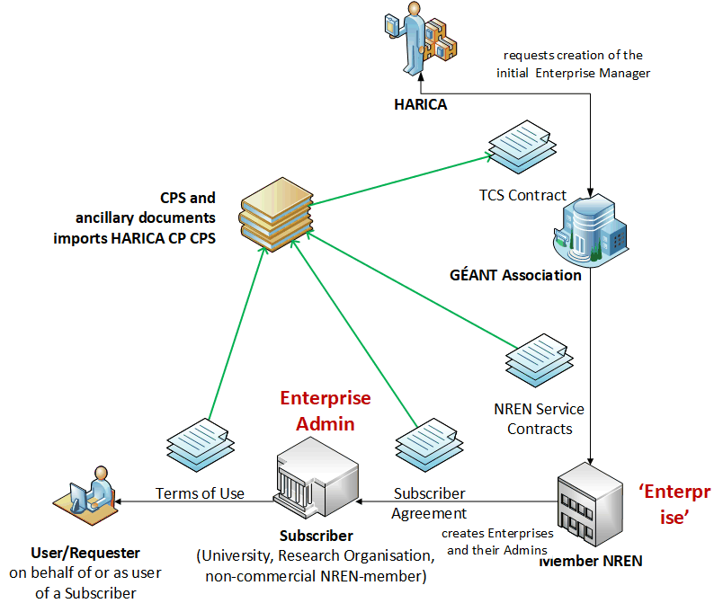
TCS G5 controls structure follows same model

Slide 17

Main IGTF relevant items
Europe joined TCS Gen 3 and Gen 4 on a large scale,
so we keep it as similar as possible
validation for server certs (CABF OV)
and model for personal/robot remains the same
adherence to TCS CP/CPS (v2.2) from Gen 4 TCS remains the same
augmenting the publicly trusted accredited provider CP/CPS for joint trust
so now on top of HARICA’s CP and CPS
HARICA: “Hellenic Academic & Research Institutions Certification Authority”
GREEK UNIVERSITIES NETWORK (GUnet)
University of Athens – Network Operation Center
See https://www.harica.gr/

Slide 18
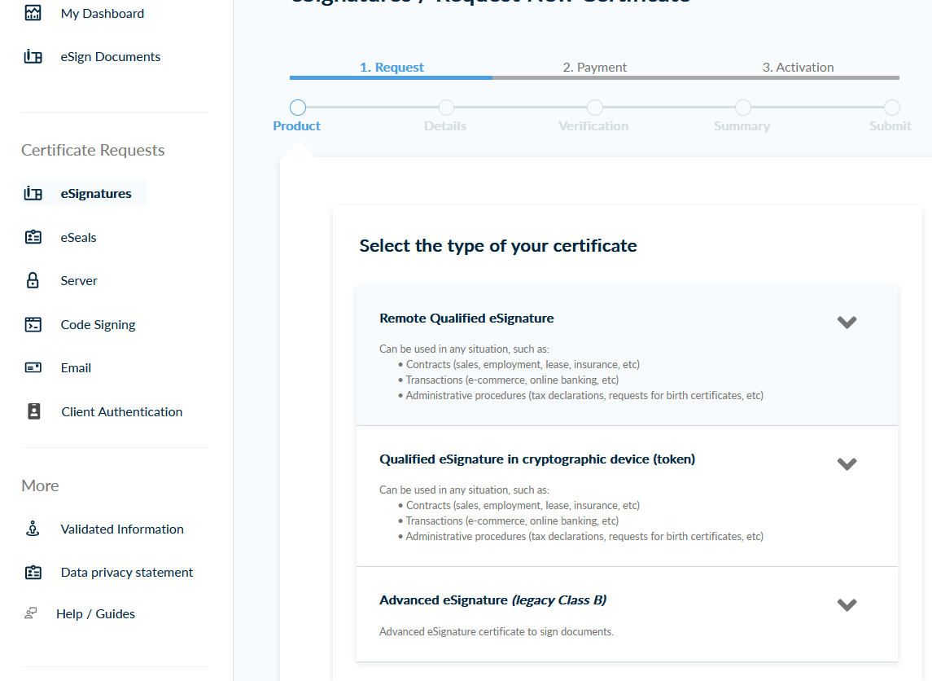
Some background on TCS G5 backed by HARICA

Slide 19
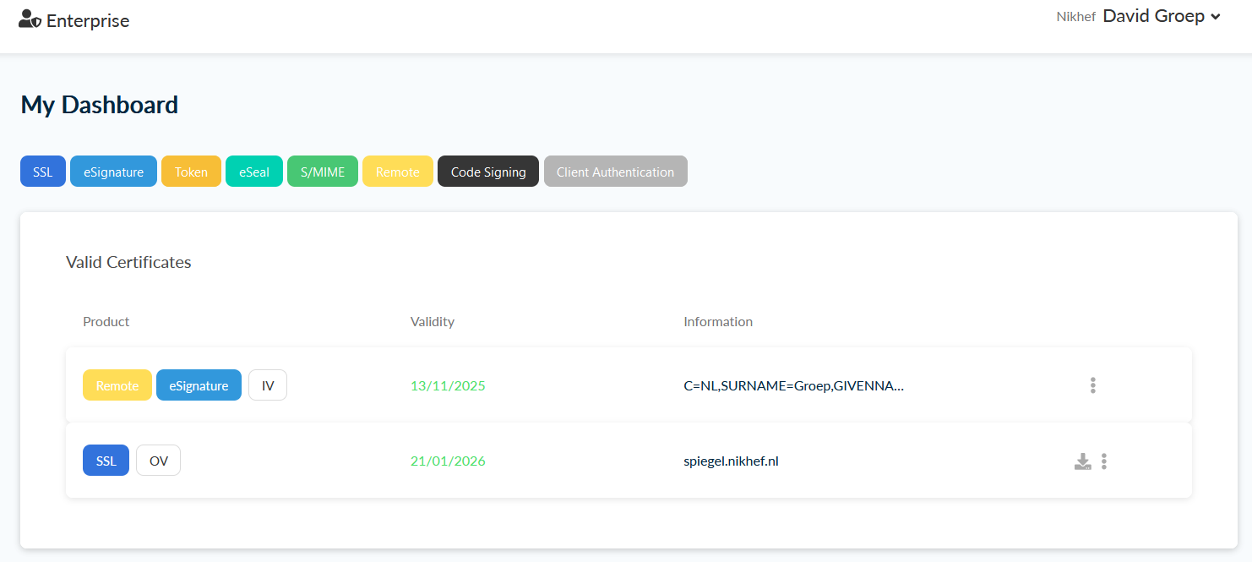

Slide 20
IGTF specific updates
Updates in the (compact) Technical Addendum
it is a new hierarchy (when installed correctly, ends in self-signed HARICA 2015)
keeps the current prefix /DC=org/DC=terena/DC=tcs/…
issuer names changed as needed, and since these show visibly in the UX
joint OV browser trust (and mail agent trust for personal certs) retained
distributed the new RSA Root and intermediates in 1.133 release (February ‘25)
continues both RSA and ECC
and besides regular TCS and joint-trust products, there are nice new things: eIDAS remote vetting for qualified signatures, remote e-signature, European Trust List, …

Slide 21
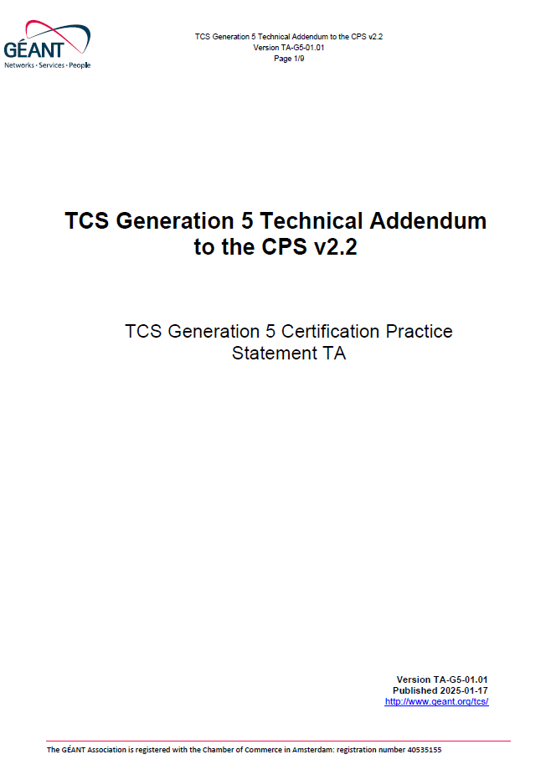
TCS G5 Technical Addendum
RFC 3647 – but only those section with stipulations are in:
1.3.1 Certification Authorities
2.1 Repositories
3.1.1 Types of Names (to highlight it remain the same)
3.1.5 Uniqueness of Names
allow for new SAML subject-id
7.1 Certificate profile
new root “CN=HARICA TLS RSA Root CA 2021”
7.1.4 Name forms
“The structure of subject distinguished names
of TCS Authentication End Entity Certificates
remains unchanged by this TA”

Slide 22
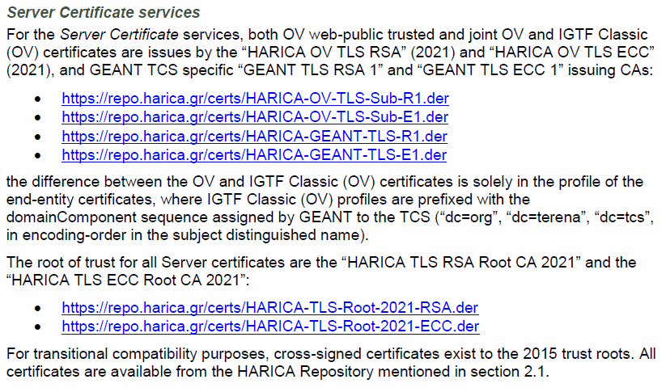
TLS joint-trust effects in ‘participants’ section 1.3.1

Slide 23
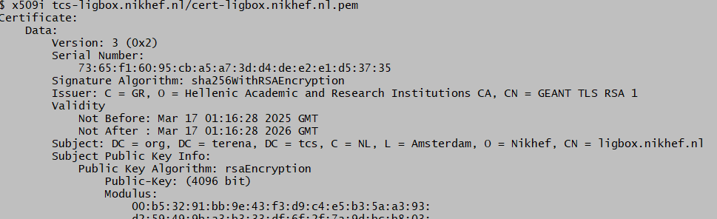
TCS Gen5 OV joint-trust certificates work
but the ASCIIfication is still work in progress – for countries with more than 7 bits …

Slide 24
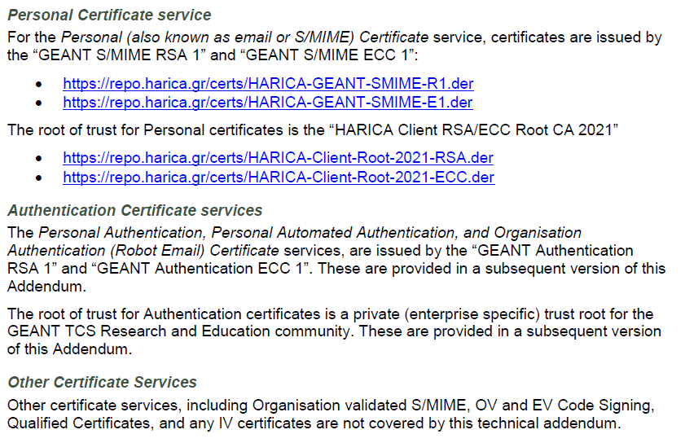
Personal S/MIME and authentication

Slide 25
Current state, January 2025
if you’re connected to eduGAIN, TCS ‘IGTF profile’ end-entity certs just work
native integration to eduGAIN via Seamless Access
using the same authorisation model
eduPersonEntitlement = urn:mace:terena.org:tcs:personal-user
credentials are either CSR upload,
or browser generated

Slide 26
On the to-do list
We got the trust roots and the TLS certificates,
we have mailbox-validated S/MIME, but ongoing items include
Done: mechanism to actually select the IGTF OV joint-trust profile
subscriber access to joint-trust profiles in ~March,
just OV (and DV) for now
ability to request Client Robot Email (org-role client authentication)
client SAML authentication issuance (ePEntitlement based)
S/MIME self-issuance

Slide 27
And, paraphrasing Wittgenstein, …
‚Wovon man nicht schreiben kann, darüber muss man sprechen‘
(the rest of this page intentionally left blank)

Slide 28

Building OUR global trust fabric
Questions?
David Groep davidg@nikhef.nl
https://www.nikhef.nl/~davidg/presentations/
https://orcid.org/0000-0003-1026-6606

