Slide 1
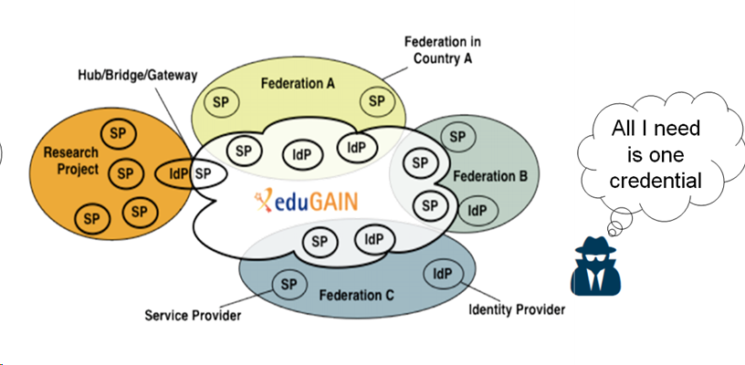
What is Sirtfi?
… imagine an incident spread throughout the federated Research & Education community via a single compromised identity?

Slide 2

Sirtfi - Security Incident Response Trust Framework for Federated Identity
Apply basic operational security protections to your federated entities in line with your organisation’s policies and priorities
Be willing to collaborate in responding to a federated security incident and notify others when you realise that an incident impacts them
Publish security contact and self-assert a Sirtfi “tag” so that others will know to trust this about you
SP
Patch, manage vulnerabilities, detect intrusions, manage access, log events
IdP
Respect user privacy and use the Traffic Light Protocol with other Sirtfi participants
<EntityDescriptor
…
Sirtfi tag
…
security contact
…
</EntityDescriptor>
Coordinate with your Federation Operator to publish in federation metadata

