Slide 1
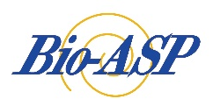


Deep-learning-based Speech Enhancement (with Its Application to Assistive Oral Communication Technologies)
You-Jin Li, Rong Chao
Research Center for Information Technology Innovation
Academia Sinica
PI: Yu Tsao
Notes:
Thank you very much
Prof. Hudan Studiawan
Hello Good afternoon everyone
I am Yu Tsao From Research Center for Information Technology Innovation Academia Sinica
The title of my presentation is
Deep-learning-based Speech Enhancement with Its Application to Assistive Oral Communication Technologies

Slide 2


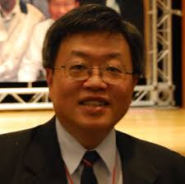
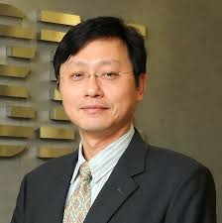
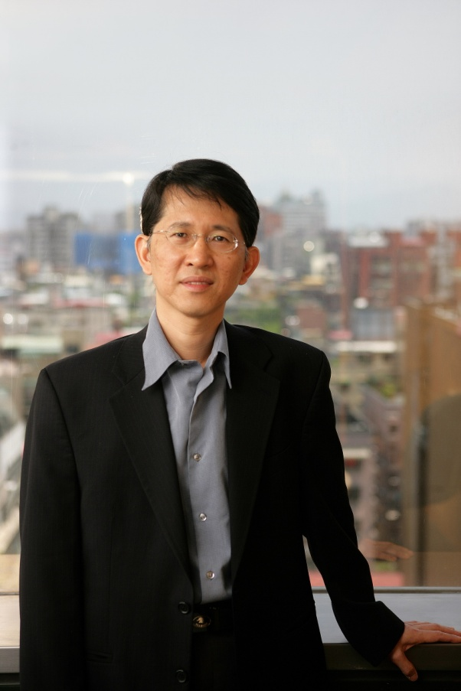
Research Center for Information Technology Innovation (CITI)
Taiwan Information Security Center
Intelligent & Ubiquitous Computing Center
Artificial Intelligence Computing Center
Director: Dr. Ai-Chun Pang
First Director: Dr. Ming-Syan Chen
NTU, Vice President
Second Director: Dr. Tei-Wei Kuo
NTU, President
Multimedia (audio, speech, image, and video), mobile communication, security, and FinTech.
Third Director: Dr. Yennun Huang
MODA, Minister
Notes:
This is the research center that I belong to
The full name is Research Center for Information Technology Innovation
Usually we call it CITI
There are three centers in CITI
Taiwan Information Security Center
Artificial Intelligence Computing Center
Intelligent & Ubiquitous Computing Center
In total, we have around 15 research fellows
We are working on research topics about multimedia (audio, speech, image, and video)
mobile communication, security, and FinTech
This is our current director
Dr. Yennun Huang
This is our first director,
Dr. Ming-Syan Chen
He is now the vice president of NTU
NTU is the top university in Taiwan
This is our second director,
Dr. Tei-Wei Kuo
He was the president of NTU

Slide 3

Dr. Yu Tsao (曹昱), Research Fellow, Deputy Director
  Education
  - B.S. in EE, National Taiwan University, 1995-1999
  - M.S. in EE, National Taiwan University, 1999-2001
  - Ph.D. in ECE, Georgia Institute of Technology, 2003-2008
  Work Experience
  - Researcher, National Institute of Information and Communications Technology,
  SLC Group, Japan (2009/4-2011/9)
  - Research Fellow (Professor) and Deputy Director Research Center for Information
  Technology Innovation (2020/9-present)
  Academia Services
  - Chair, Speech, Language, and Audio (SLA) Technical Committee, APSIPA
  - Distinguished Lecturer, 2019-2020, APSIPA
  - Associate Editor of IEEE Signal Processing Letters
  - Associate Editor of IEEE/ACM Transactions on Audio, Speech and Language Processing
  Lab at CITI (Academia Sinica)
  Research Fellow, Deputy Director of CITI, Academia Sinica
  Biomedical Acoustic Signal Processing (Bio-ASP) Lab
  Research Interests
  Assisitve Speech Communication Technologies, Audio-coding, Biomedical Signal Processing, and Speech Signal Processing
Notes:
First, let me briefly introduce myself
My name is Yu Tsao
I received my PhD degree in 2008 under supervision of Prof. Chin-Hui Lee in Georgia Tech

Slide 4
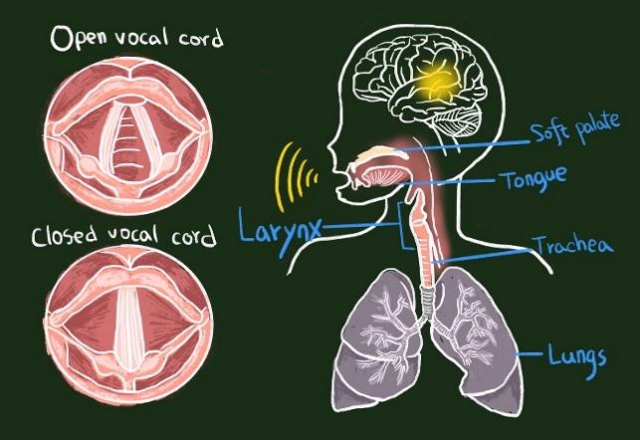
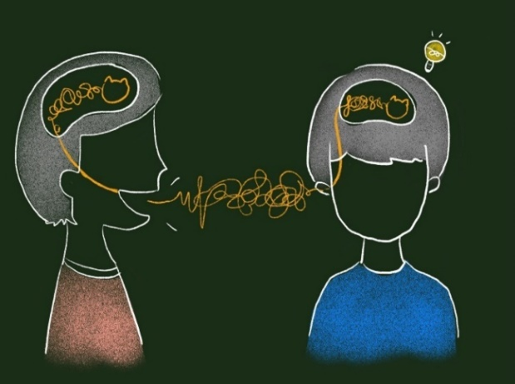
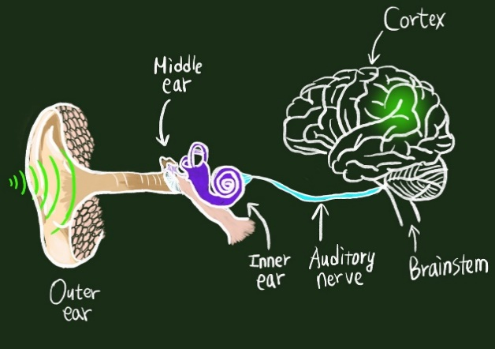
Speech Chain to Assistive Speech Chain
(1)
(1)
(5)
(2)
(2)
(3)
(4)
(5)
(4)
Predicting speech production with neuroimaging (1)
Speech disorder classification and interaction with hearing-loss students (2)
Improving the quality and intelligibility of impaired speech (2)
Deep learning-based gaze-tracking and EEG-assisted beamformer (3)
Hearing-loss-pattern-oriented speech enhancement algorithms (4)
Auditory processing and reading in Chinese (5)
Assistive speech chain is a very focused and social welfare related project.
An interdisciplinary project that requires close collaborations of experts from brain and hearing research, electrical engineering, and computer science.
Clinical tests will be conducted in medical institutes and Taipei School for The Hearing Impaired.
Notes:
In the following few years, we will continue on the project of Toward Barrier Free Oral Communication
We believe that this project can make great impacts and it will need interdisciplinary collaborations
We will closely collaborate with medical institutes and Taipei School for The Hearing Impaired.
This is the final goal of the project
We try to investigate the problems and identify solutions from the brain of speaker all the way to the brain of the listener

Slide 5
Outline
Deep Learning (DL) based Speech Enhancement (SE)
  Basic DL-based SE system architecture
  Key factors to the DL-based SE performance
Assistive Oral Communication Technologies
Summary
Example :Universal Speech Enhancement
Notes:
This is the outline of my presentation
First, I will introduce Deep Learning based Speech Enhancement (SE)
I will first present the basic architecture
Then, I will introduce key factors to the Speech Enhancement performance
Next, I am going to present how to use the Speech Enhancement approaches to design better oral communication technologies
Finally, I will summarize this talk by providing some concluding remarks

Slide 6
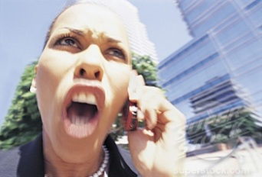

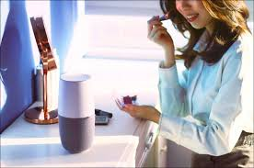
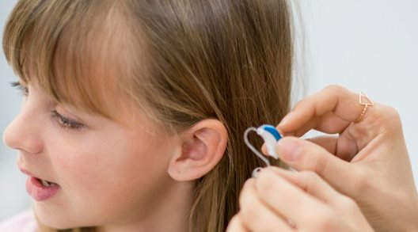
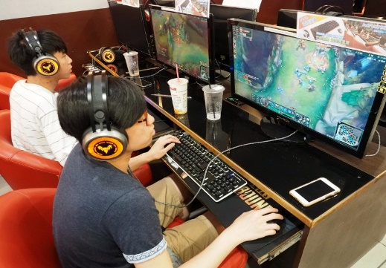

Speech
….Easily Got Distorted

Slide 7

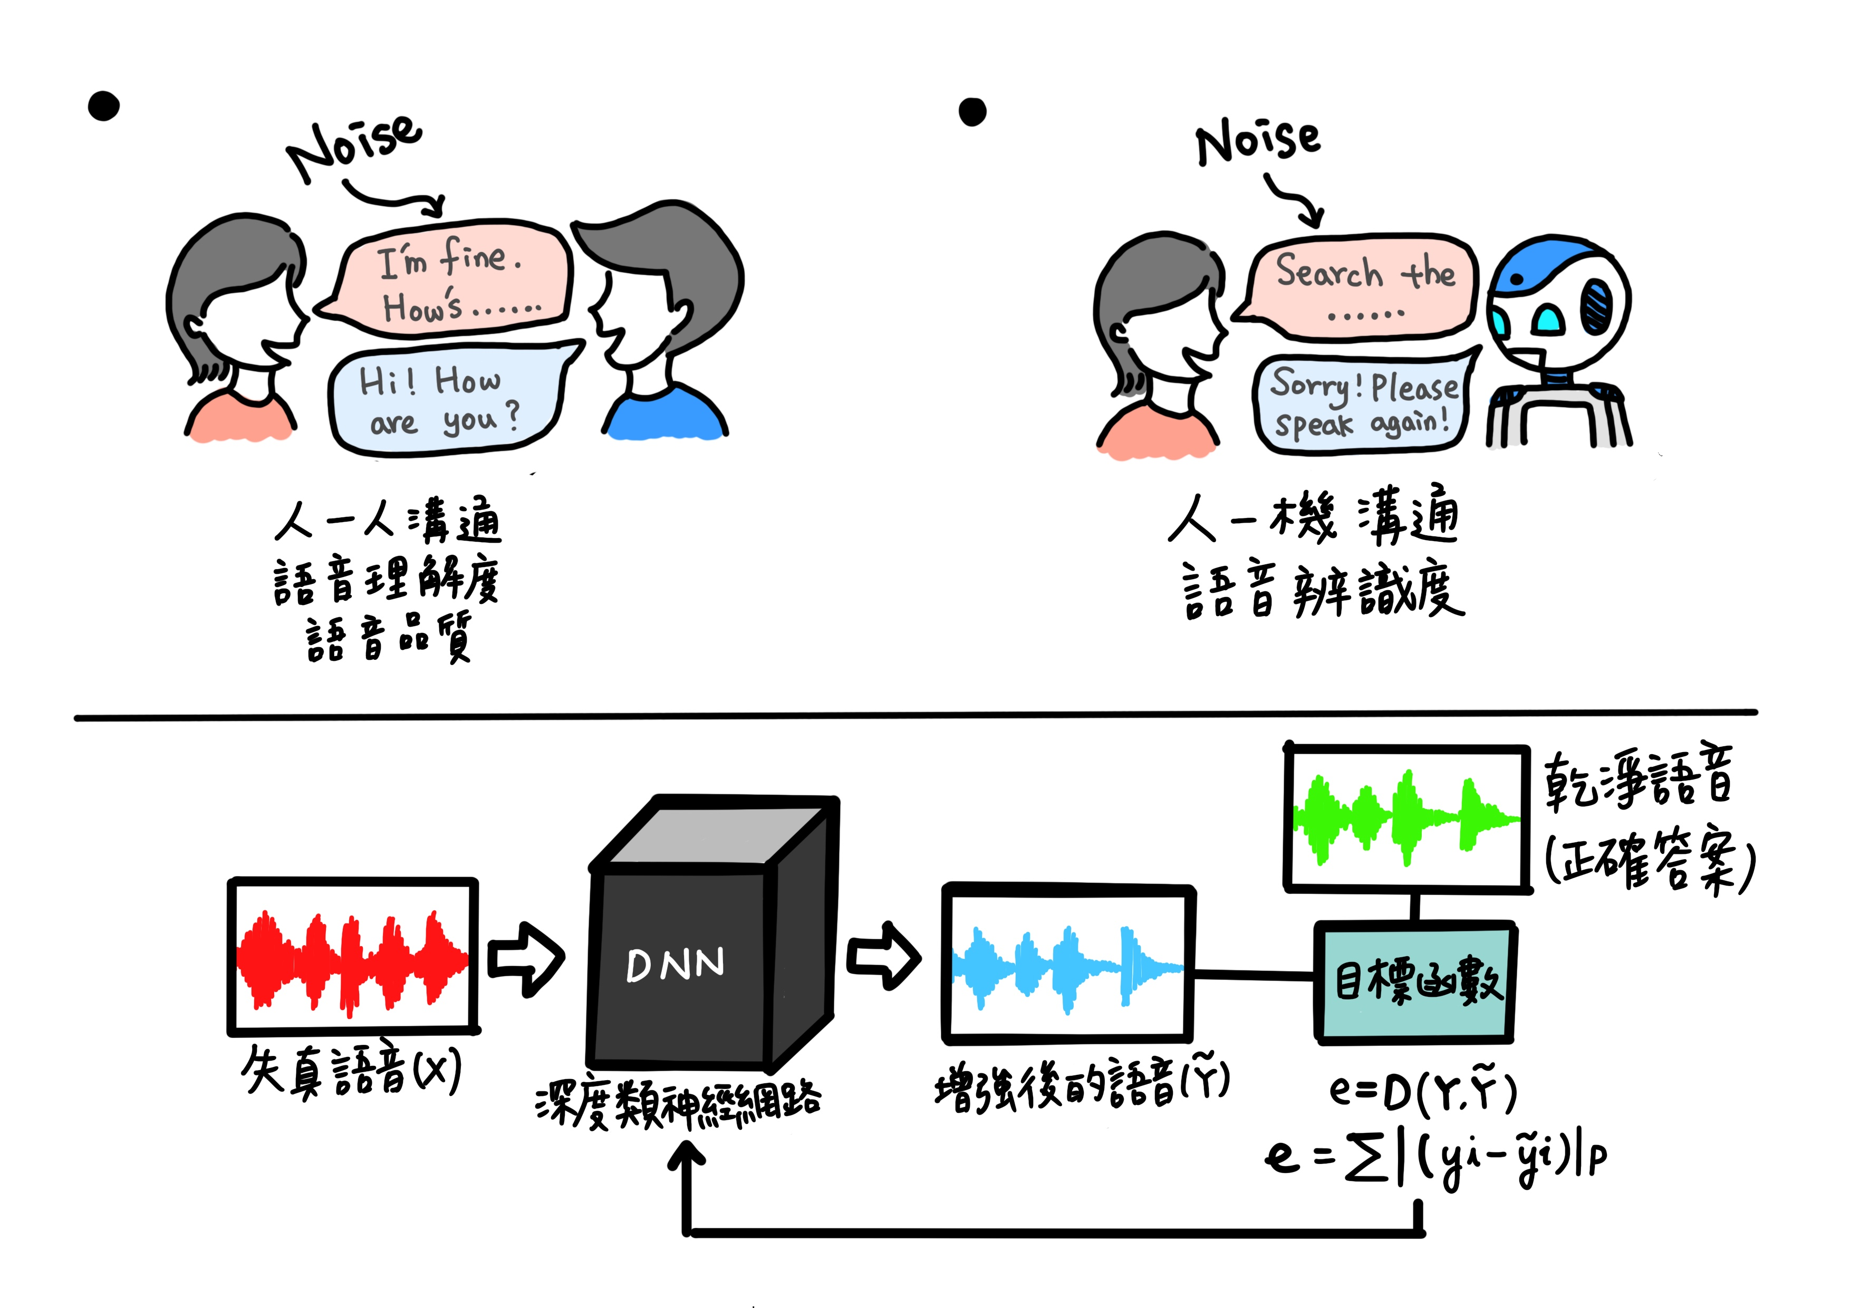
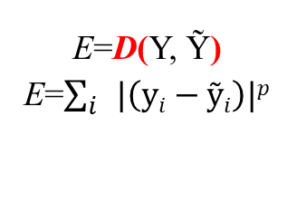
Deep Learning Based SE System
Noise
Noise
Human to Human
Speech Intelligibility
Speech Quality
Human to Machine
Speech Intelligibility
Deep neural network model
Clean speech
(Y)
DNN
Objective
Function
Noisy Speech
(X)
Enhanced Speech
(Ỹ)
E=D(Y, Ỹ)
E=$\sum_{i}{|\left(yi−ỹi\right)|p}$
Notes:
(STOP)
The deep learning based speech enchantment is a regression task and has two phases
In the training phase, we prepare paired noisy and clean speech
Both noisy and clean speech signals are first converted to spectral features by applying short time Fourier transform
The speech enhancement model transforms the noisy spectral features and generate outputs
Then we compare the difference of outputs and clean features
Usually, we can use L1 norm or L2 norm or SI-SDR to measure the difference
Based on the difference, we then update the parameters of the speech enhancement model
In the testing phase, the noisy speech waveforms are first converted to spectral features
Then the trained speech enhancement model transforms the noisy features to generate the enhanced ones
By a waveform reconstruction process, we can then obtain the enhanced speech waveforms
The first work was proposed in 2013
If we look at this system now, the system is vey simple
But actually this is the first work that applies deep learning for speech enhancement

Slide 8
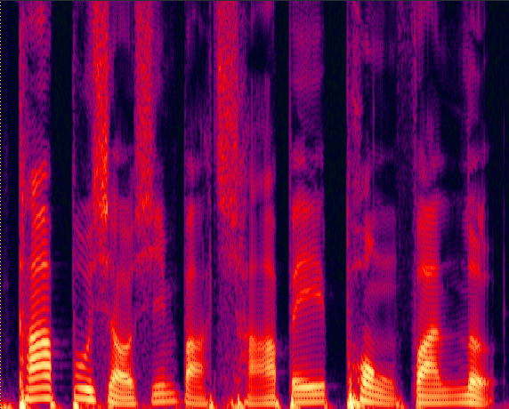
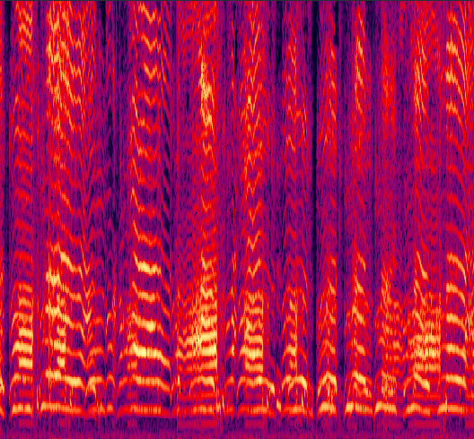

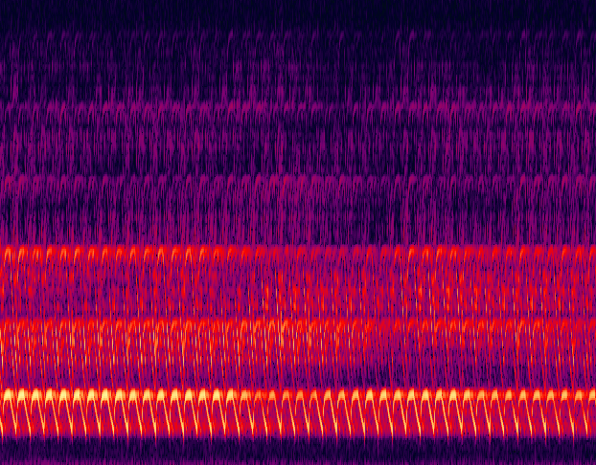
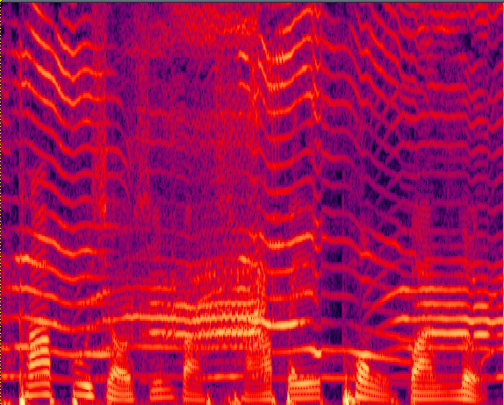
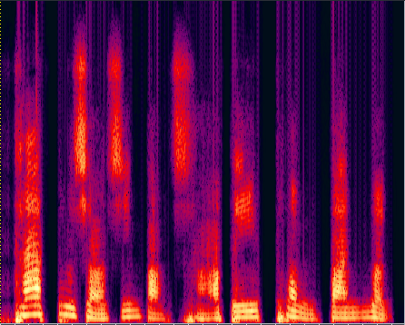
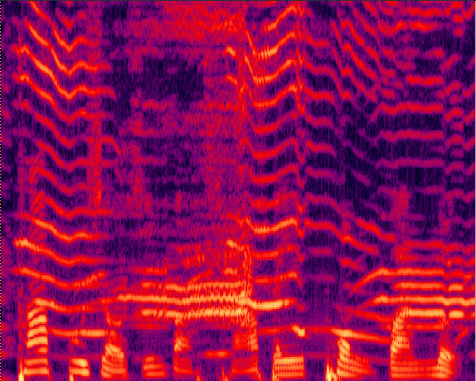
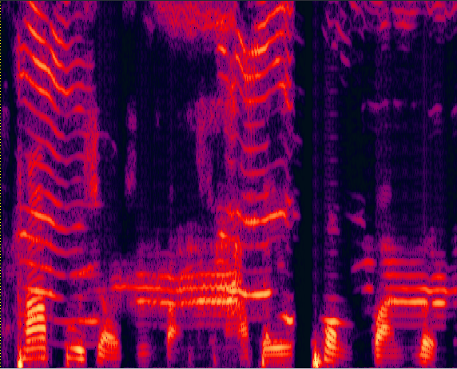
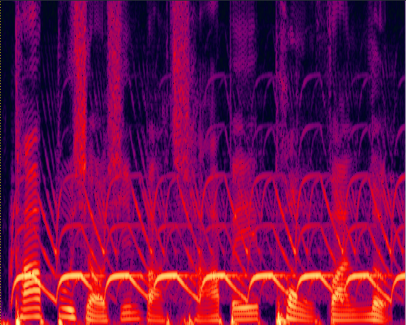
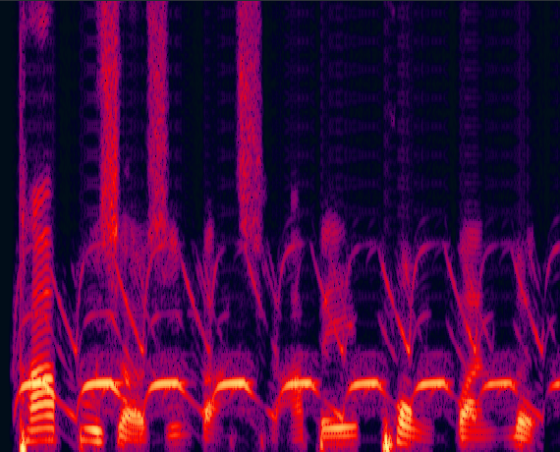
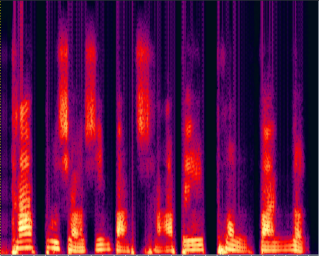
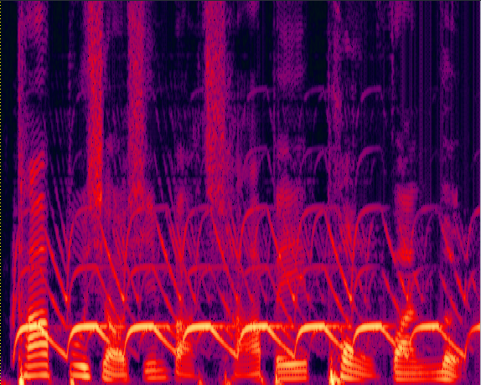
DL-based SE for Noisy Speech
 | Clean speech | Noise: 2baby Crying | Noise: Siren
2baby Crying | Original Noisy | MMSE (Trandtional-1) | KLT (Trandtional-2) | DDAE
Siren | Original Noisy | MMSE (Trandtional-1) | KLT (Trandtional-2) | DDAE
Notes:
(STOP)
Here are some demos
These are spectrogram plots
For each plot, the horizontal axis shows time
The vertical axis shows frequency
The color denotes the energy
A lighter color denotes higher energy
This one is noisy utterance
This one is the enhanced utterance processed by a traditional speech enhancement method, MMSE
This one is the enhanced utterance processed by another traditional speech enhancement method, KLT
This one is the enhanced utterance processed by a deep learning method, DDAE
Let me play these samples
From left to right
As can be heard, both speech quality and intelligibility of the deep learning results are much better than traditional methods
We can also see from the spectrograms
that the spectrogram of the deep learning based results show more clear speech structures with less noise components, as compared to the other two traditional methods

Slide 9
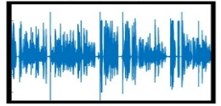
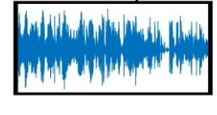
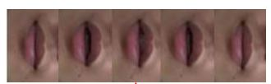
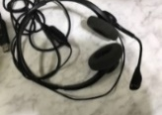
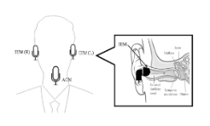
Deep Learning Based SE System
Clean
speech
Feature
extraction
(1)
Feature extraction
(3)
Noisy speech
(2)
Objective
function
SE model
Output
(5)
Lips
(4)
Model compression
and computation acceleration
Auxiliary input
Vibration
Real-world
applications
This is a...
(6)
Texts
Adaptability to new speaker and environments
Multi-mics
Notes:
To build a good deep learning based speech enhancement system
We should consider the following six factors
Features extraction
SE models
Objective functions
Auxiliary inputs
Ways to optimize the model architectures for real-world applications
(6) Ways to increase the speech enhancement model adaptability to new speaker and environments
The last two parts are very important to deploy the speech enhancement system in real-world applications

Slide 10



Objective Function
10
Training Phase
Clean
speech
Feature
extraction
Feature extraction
Objective
function
Noisy speech
SE model
Output
eg. MSE (L₂norm), L₁norm
Noise
Noise
Communication
Communication
Speech perception
• Quality
• Intelligibility
Automatic speech recognition
• Recognition accuracy
Mean squared error (MSE) and L1 losses aim to minimize the differences of enhanced and target and do not directly consider human perception and ASR performance.
Notes:
As mentioned earlier, convectional deep learning based speech enhancement models are trained using the L1 norm or L2 norm or other signal-level distances
The reason is that these distances are easy to compute and differentiable
Thus can be easily used to update deep learning based models
We argue that this is not perfect
For different tasks, we should design specific optimal objective functions
Based on this concept, we have been working on task-oriented objective function to replace the original L1 and L2 norms
For human-to-human, we should consider speech quality and intelligibility
For human-machine, we should consider ASR, or word error rate

Slide 11
Outline
Deep Learning (DL) based Speech Enhancement (SE)
  Basic DL-based SE system architecture
  Key factors to the DL-based SE performance
Assistive Oral Communication Technologies
Summary
Example :Universal Speech Enhancement
Notes:
This is the outline of my presentation
First, I will introduce Deep Learning based Speech Enhancement (SE)
I will first present the basic architecture
Then, I will introduce key factors to the Speech Enhancement performance
Next, I am going to present how to use the Speech Enhancement approaches to design better oral communication technologies
Finally, I will summarize this talk by providing some concluding remarks

Slide 12

大學曰：心不在焉，聽而不聞
Is it enough to suppress the noise?
聞
聽
Quality and Intelligibility are different
For speech communication assistive systems, intelligibility is more important.
Notes:
(STOP)
I always use this example to explain the difference of speech intelligibility and quality
Usually, we tell the meaning of Chinese oracles by its shape
This one is an ear
This one is a mouth
For the left word, there is a man, with a big ear, carefully listening
For the right word, there are two mouths, and only one ear
One ear listens two months speaking
The meaning of these two words are both hearing but are not exactly the same
For this word, there are two months speaking into one ear, meaning just hear something and may not fully understand
For this word, a man carefully listens, meaning listen and understand
This word is 聞 in Chinese, and this word is 聽 in Chinese
A famous book says : Hear but pay no attention; listen but not hear
We can infer that intelligibility and quality are different

Slide 13
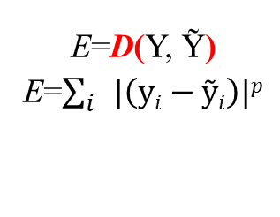
Speech enhancement model based on speech Intelligibility learning
Noise
Noise
Human to Human
Speech Intelligibility
Speech Quality
Human to Machine
Speech Intelligibility
Deep neural network model
Clean speech
(Y)
DNN
Objective
Function
Noisy Speech
(X)
Enhanced Speech
(Ỹ)
E=D(Y, Ỹ)
E=$\sum_{i}{|\left(yi−ỹi\right)|p}$
Notes:
(STOP)
The deep learning based speech enchantment is a regression task and has two phases
In the training phase, we prepare paired noisy and clean speech
Both noisy and clean speech signals are first converted to spectral features by applying short time Fourier transform
The speech enhancement model transforms the noisy spectral features and generate outputs
Then we compare the difference of outputs and clean features
Usually, we can use L1 norm or L2 norm or SI-SDR to measure the difference
Based on the difference, we then update the parameters of the speech enhancement model
In the testing phase, the noisy speech waveforms are first converted to spectral features
Then the trained speech enhancement model transforms the noisy features to generate the enhanced ones
By a waveform reconstruction process, we can then obtain the enhanced speech waveforms
The first work was proposed in 2013
If we look at this system now, the system is vey simple
But actually this is the first work that applies deep learning for speech enhancement

Slide 14
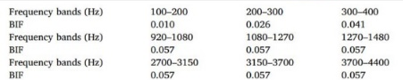
Objective Function
14
STOI-based Objective Function [Fu et al, TASLP 2018]
STOI Computation
STOI
score
Linear and differentiable
Clean
speech
Training Phase
Feature
extraction
Feature extraction
Objective
function
Noisy speech
SE model
Output
Notes:
This is the system of STOI computation
There are two inputs to the system, one is clean speech and the other one is noisy or processed speech
The overall STOI computation has feature extraction, filtering processing, and correlation computation stages
We can finally obtain the STOI score,
again this score has ve high correlations with speech intelligibility
Because all of these processings are linear
We can directly use this STOI as the objective function to train the model
Now the goal of speech enhancement is to increase the speech intelligibility when transforming the noisy speech signals to enhanced ones

Slide 15
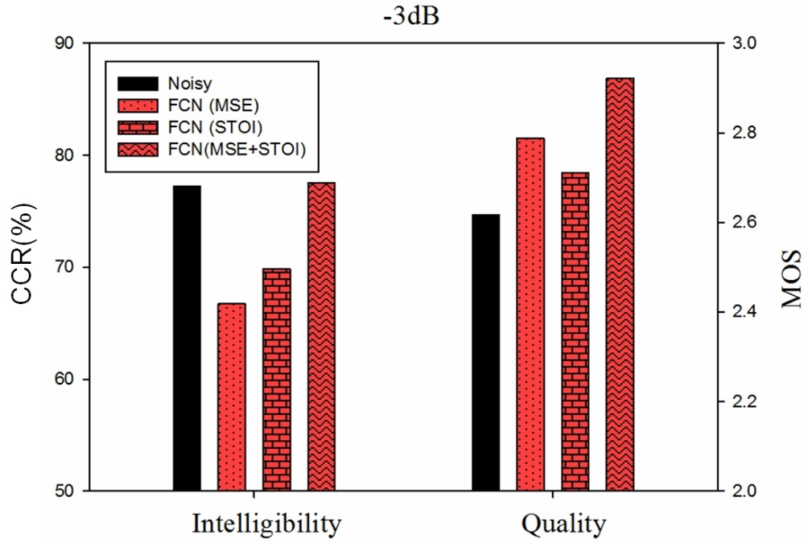
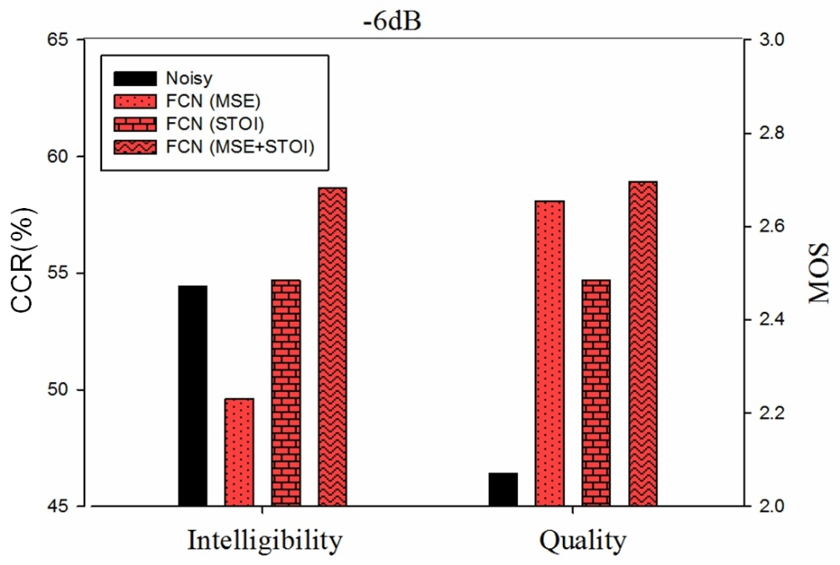
Speech enhancement system optimized for auditory intelligibility
15
Experiment (listening test)
Word recognition rate and sound quality listening test scores at (a) -3 dB and (b) -6 dB SNR
(1)The same DNN shows different performance under different objective functions.
(2)The speech enhancement model based on the (STOI + MSE) function has the best performance.
(3)This research was awarded the 2021 IEEE Signal Processing Society (SPS) Young Author Best Paper Award (the second time this honor has been awarded to Taiwan).
Notes:
(STOP)
These two figures show the results of human listening tests
Under two SNR conditions
We evaluated the intelligibility and quality
The range of intelligibility is 0 to 100
The range of quality is 0 to 5
We are comparing four approaches
Nosy, FCN (MSE), FCN (STOI), and FCN (STOI+MSE)
The FCN model is the same
But the objective functions are different
From the results, we can see that
in terms of quality, the combination of MSE and STOI performs the best (here and here)
In terms of intelligibility
The combination of MSE and STOI also performs the best (here and here)
We also note that
With the same model, but with different objective functions, the evaluation results are indeed different

Slide 16
Deep Learning Based SE System
Clean
speech
Feature
extraction
Feature extraction
(3)
Noisy speech
Objective
function
SE model
Output
Lips
Auxiliary input
[Zhao et al., ICASSP 2018],
[Le Roux, et al. ICASSP 2019],
[Germain et al., Interspeech 2019],
[Kolbæk et al., TASLP 2020],
[Kim et al., Arxiv 2019],
[Valin et al., Interspeech 2020],
[Xia et al., ICASSP 2020] ,…….
Vibration
This is a...
Texts
Multi-mics
Notes:
In addition to the above objective functions, there are numerous other works
I listed some of them for your references

Slide 17
Outline
Deep Learning (DL) based Speech Enhancement (SE)
  Basic DL-based SE system architecture
  Key factors to the DL-based SE performance
Assistive Oral Communication Technologies
Example :Universal Speech Enhancement
Summary
Notes:
This is the outline of my presentation
First, I will introduce Deep Learning based Speech Enhancement (SE)
I will first present the basic architecture
Then, I will introduce key factors to the Speech Enhancement performance
Next, I am going to present how to use the Speech Enhancement approaches to design better oral communication technologies
Finally, I will summarize this talk by providing some concluding remarks

Slide 18
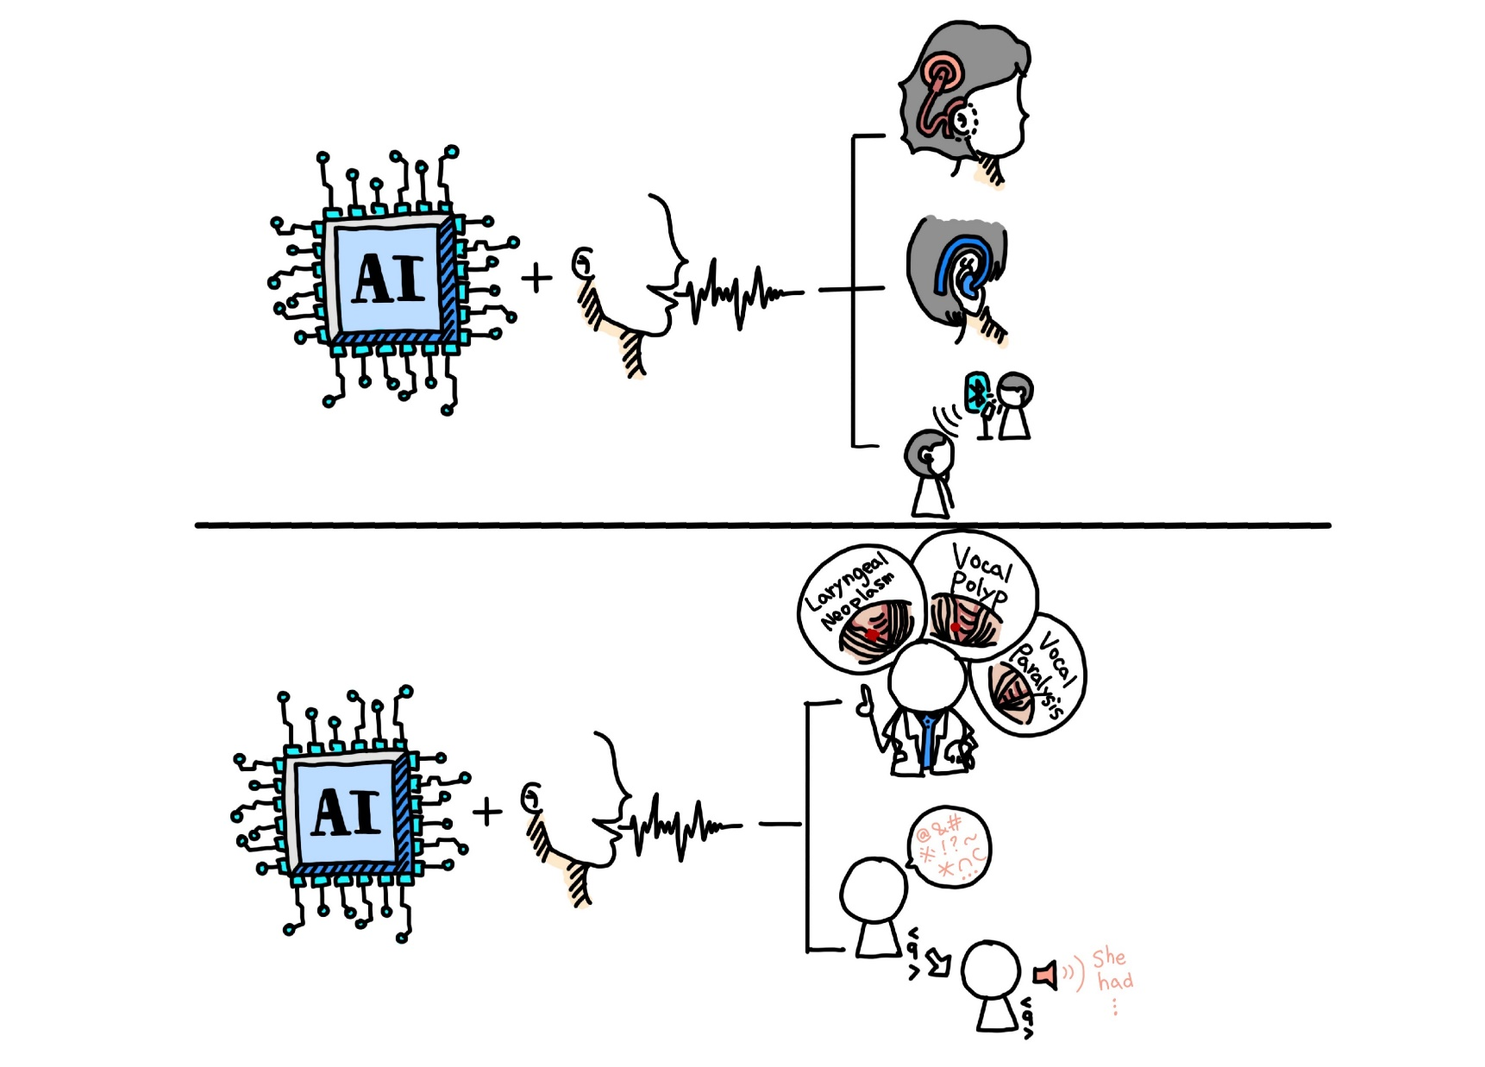
Assistive Oral Communication Technologies
18
Listening AI
Speaking AI
Hearing Impairment
Cochlear Implants
Hearing Aids
PSAP
Speech Disorder
Abnormal voice detection
Abnormal speech enhancement
Notes:
Assistive oral communications can be divided into assistive listening and assistive speaking
In my team, we have been working on both parts
In this presentation, I am going to present one example for each part
For assistive listening technology, I am going to introduce cochlear implant
For assistive speaking technology, I am going to introduce disorder speech enhancement

Slide 19
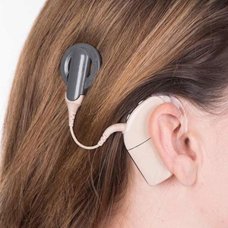
資料來源: https://www.hopkinsmedicine.org/health/treatment-tests-and-therapies/cochlear-implant-surgery
19
Cochlear Implants
RF 發射線圈
語音處理綺
1. 麥克風
2. DSP 處理器.
3. 電池
4. …
Notes:
This is a cochlear implant device
There are two parts
This part is a speech processor, which processes speech signals
This part is a transmitter coil, which sends power across the skin to the internal device by radio frequency transmission

Slide 20
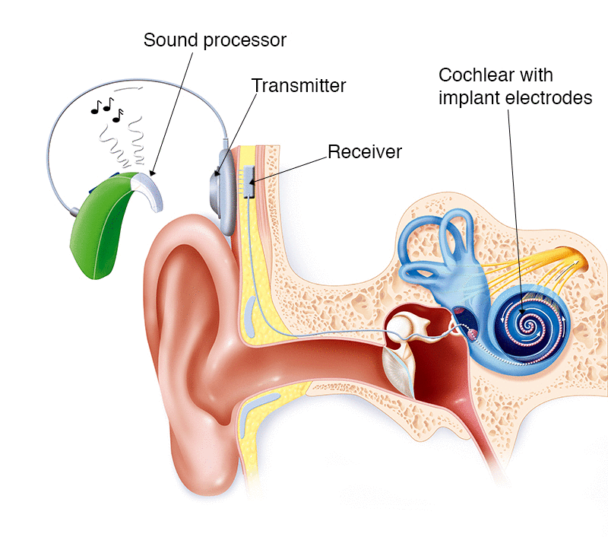
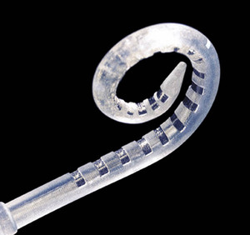
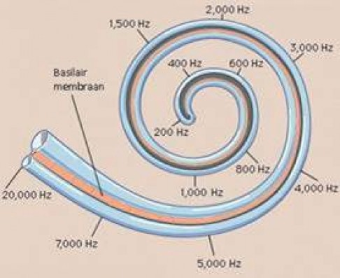

資料來源: https://www.healthdirect.gov.au/cochlear-implant http://www.yanthia.com/online/projlets/spear3/index.html https://medium.com/@mosaicofminds/maps-in-the-brain-f236998d544f
20
Cochlear Implants
Implanted electrodes
Traveling wave theory (Nobel Prize 1961)
Notes:
The figure shows the complete cochlear implant system
The speech processor in the outside will transmit the signals into the receiver
Which has been fixed on the skull
The electric signals are then passed to the electrodes to stimulate the nerves
The fundamental theory of electrode designs are based on the Traveling wave theory

Slide 21
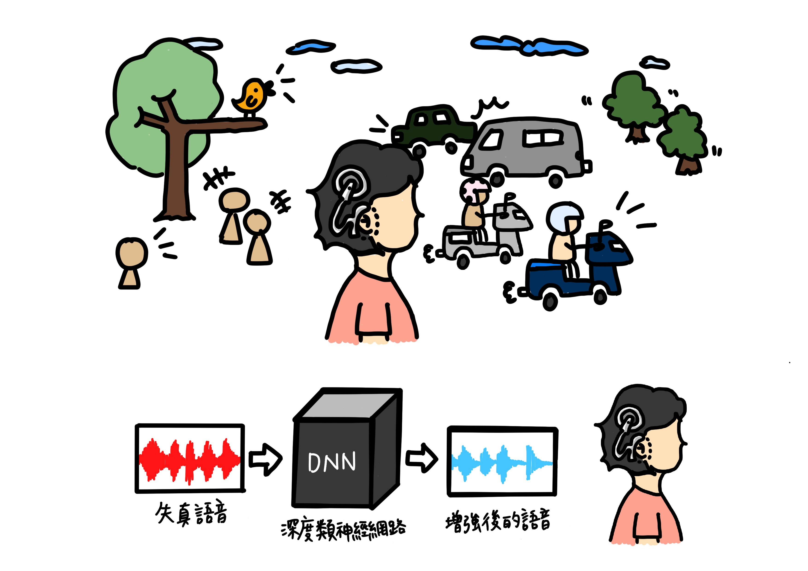

Cochlear Implants: A Modern Miracle
21
人工電子耳可以讓全聾者重新聽到聲音 (2018年人工電子耳納入健保)
在乾淨情況下，配戴者有高度辨識度，在有干擾情況下(特別是背景雜訊)，配戴者的理解度明顯降低
使用深度學習語音增強模型，提升配戴者的語音理解度
失真語音 (X)
增強後的語音 (Ỹ)
深度類神經網路
Notes:
The cochlear implant has been widely used and considered as a very successful assistive listening device
In quiet condition, speech understanding of cochlear implant users are very high
However, in noisy conditions, the performance of speech understanding degrades notably
Such phenomenon has been reported in this study published by Prof. Fei Chen
To handle this issue, deep learning based speech enhancement can be a feasible solution

Slide 22
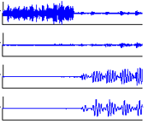
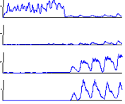
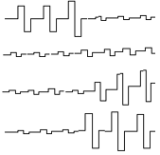
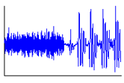
SE for Cochlear Implant
22
Electric array
Speech processor
Transmitter
Receiver
Microphone
skin
Band-pass
filter
Envelope detection
Compression
Pulse generation
Electrodes
Noise reduction
BPF 1
RECT.
LPF
COMP.
E 1
Microphone
BPF 2
RECT.
LPF
COMP.
E 2
BPF n
RECT.
LPF
COMP.
E n
Notes:
This is the block diagram of signal processing of a cochlear implant device
This is the speech processor
This is the transmitter
And this is the receiver
This is electrodes
The acoustic signals are first processed by band-pass filters, envelop detection, compression and pulse generation to generate electric stimulations
To verify the effectiveness of speech enhancement for cochlear implant
We place the speech enhancement unit right after microphone
The listening tests were conducted by playing noisy speech to cochlear implant users

Slide 23
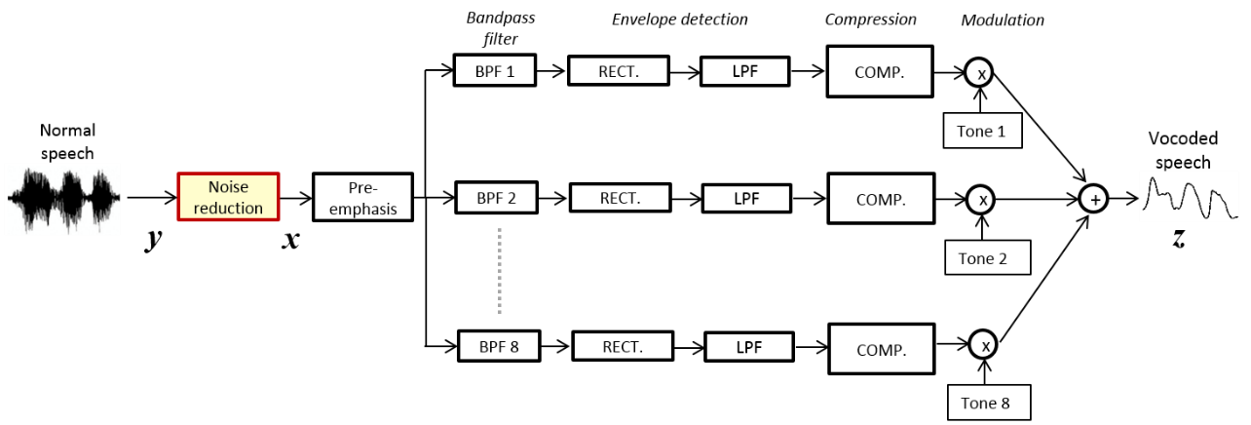
SE for Cochlear Implant Simulation
Vocoded speech
Clean | 2T Noise 0dB
MMSE | DDAE
Notes:
This plot shows the experimental results
The lower-bound (BLSTM-L) is the results without model adaptation
The number here denotes the number of utterances used for model adaptation
From the results, we can first note that the proposed method can effectively improve the PESQ scores over lower-bound
The results also show that when we have more adaptation data, the DAT can give higher PESQ scores

Slide 24
SE for Cochlear Implant Simulation
Normal speech
Clean | Babble Noise 0dB
MMSE | DDAE
Clean
Notes:
This plot shows the experimental results
The lower-bound (BLSTM-L) is the results without model adaptation
The number here denotes the number of utterances used for model adaptation
From the results, we can first note that the proposed method can effectively improve the PESQ scores over lower-bound
The results also show that when we have more adaptation data, the DAT can give higher PESQ scores

Slide 25
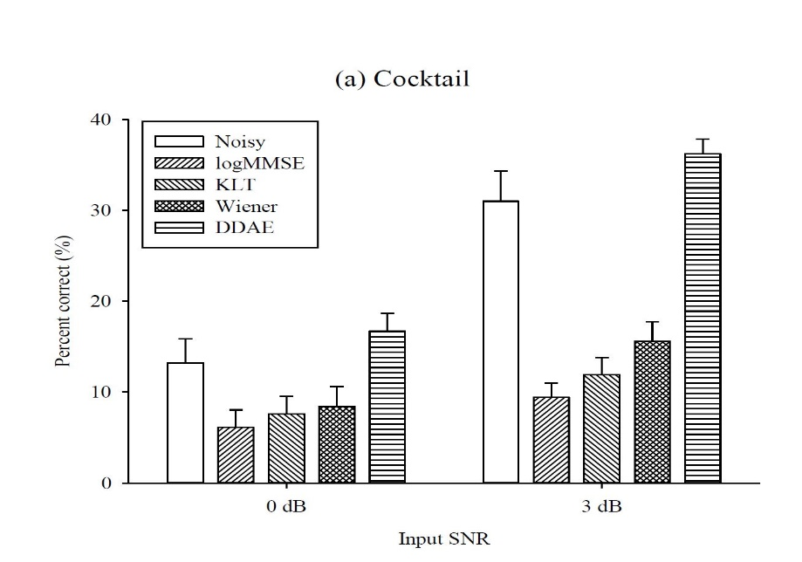


Experiment Results
objective measurement
subjective measurement(clinical).
Speech enhancement based on deep learning has made significant progress in objective evaluation, subjective evaluation (simulator), and subjective measurement (clinical trials).
This research outcome is the world's first application of deep learning speech enhancement in cochlear implants.
The research has been awarded the National Innovation Award (2018-2020) and the 2022 Future Science Award.
subjective measurement
Notes:
This plot shows the experimental results
The lower-bound (BLSTM-L) is the results without model adaptation
The number here denotes the number of utterances used for model adaptation
From the results, we can first note that the proposed method can effectively improve the PESQ scores over lower-bound
The results also show that when we have more adaptation data, the DAT can give higher PESQ scores

Slide 26
Assistive Oral Communication Technologies
26
Listening AI
Speaking AI
Hearing Impairment
Cochlear Implants
Hearing Aids
PSAP
Speech Disorder
Abnormal voice detection
Abnormal speech enhancement
Notes:
Assistive oral communications can be divided into assistive listening and assistive speaking
In my team, we have been working on both parts
In this presentation, I am going to present one example for each part
For assistive listening technology, I am going to introduce cochlear implant
For assistive speaking technology, I am going to introduce disorder speech enhancement

Slide 27

發音障礙:
構音異常、失語、口吃、口腔手術、聲帶損傷
文言版《説文解字》：訥，言難也
Notes:
This is another Chinese oracle
You may guess its meaning by its shape
This is a mouth locked inside of a door
Nowadays, the word becomes this
The explanation of this word is difficulty to speak
and the corresponding problem is speaking disorders
There are several speaking disorders, Dysarthria, apraxia, aphasia, stuttering, oral surgery, vocal damage

Slide 28
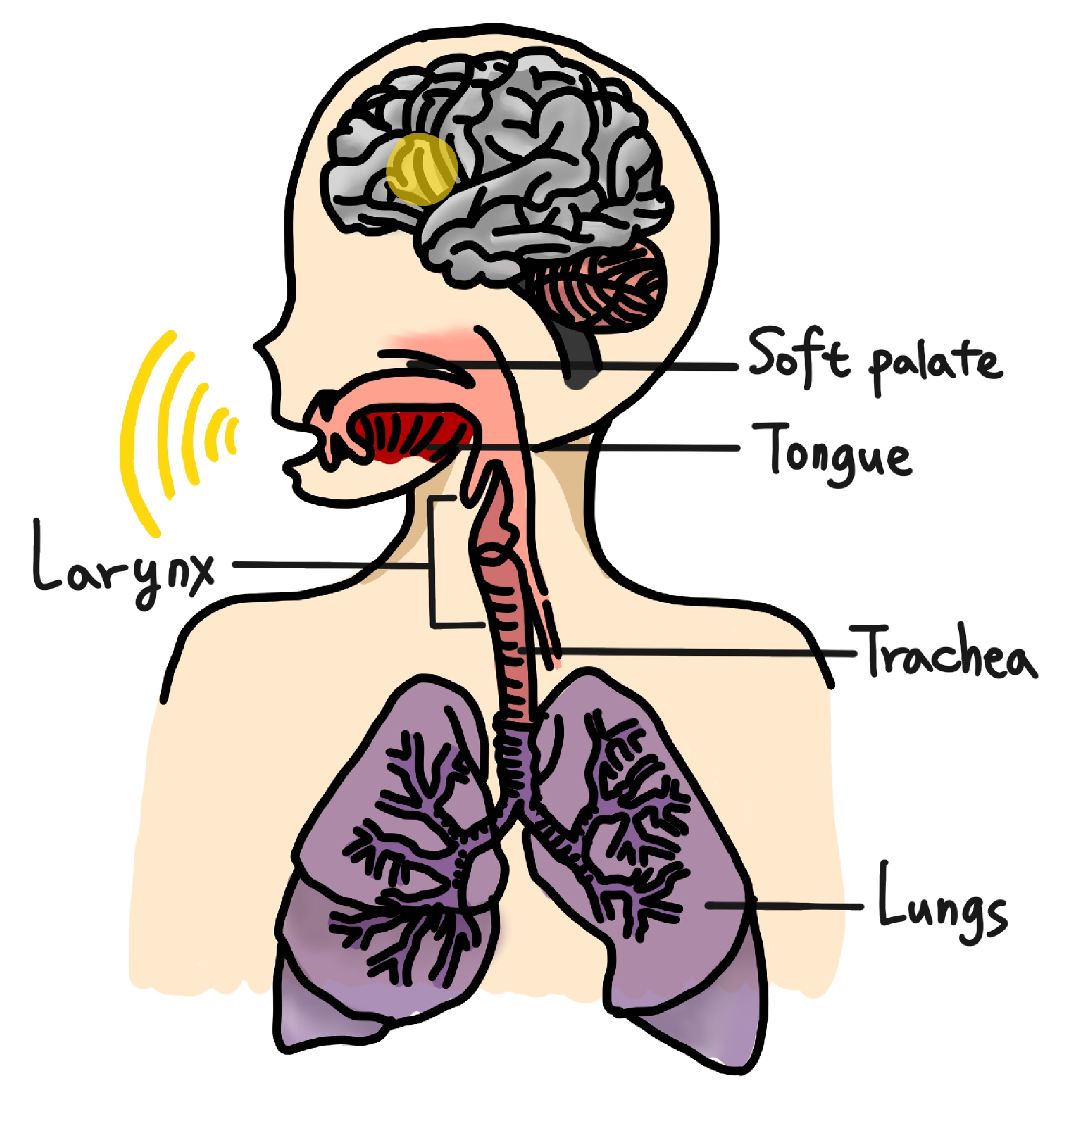


語音增強於改善說話障礙
成果1：口腔癌術後語音理解度改善
成果2：構音障礙語音理解度改善
成果3：人工電子喉語音理解度改善
解決方法： 基於深度學習的語音增強
失真語音 (X)
增強後的語音 (Ỹ)
深度類神經網路
Notes:
We can also use the speech enhancement approaches to improve the intelligibility of disordered speech
In our first work, the target is individuals who received oral cancer surgeries
These are the photos of individuals before and after receiving oral surgeries
It is clear that after oral surgery, some muscles or nerves may be hurt
Accordingly affect the pronunciation and generate speech with low intelligibility
Our goal is to convert the speech signals after surgery to the enhanced ones with improved speech intelligibility

Slide 29
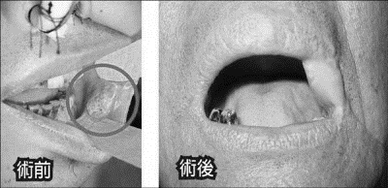
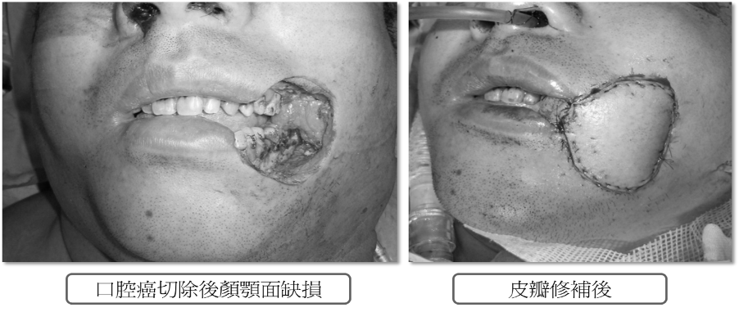
SE for Speaking Disorder
29
Task: improving the speech intelligibility of surgical patients.
Target: oral cancer (top five cancer for male in Taiwan).
Before
After
Before
After
Liberty Times Ltd..
Taipei Veterans General Hospital
Notes:
We can also use the speech enhancement approaches to improve the intelligibility of disordered speech
In our first work, the target is individuals who received oral cancer surgeries
These are the photos of individuals before and after receiving oral surgeries
It is clear that after oral surgery, some muscles or nerves may be hurt
Accordingly affect the pronunciation and generate speech with low intelligibility
Our goal is to convert the speech signals after surgery to the enhanced ones with improved speech intelligibility

Slide 30
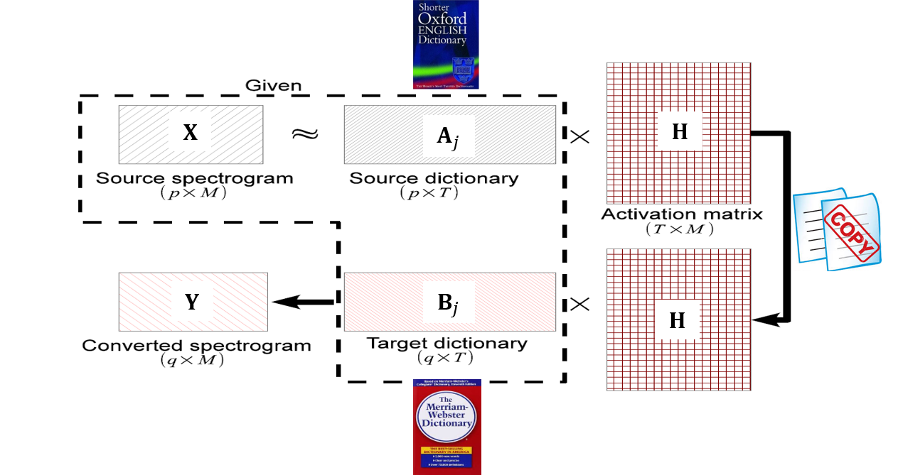
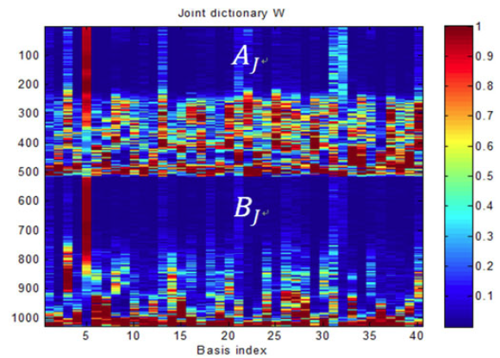
SE for Speaking Disorder
30
Proposed: joint training of source and target dictionaries with non-negative matrix factorization (NMF):
After Surgery
Before Surgery
Notes:
Our first work is based on non-negative matrix factorization (NMF)
The NMF approach is a dictionary learning method
We learned bases for both before surgery and after surgery
During online, we transform the distorted speech to normal speech
This figure shows the learned bases based on NMF
The top one is after surgery
The bottom one is before surgery
Each basis can be considered as a particular phonetic unit
For example, this one only has low frequency components and should be a vowel sound
this one only has high frequency components and should be a consonant sound
We can see the bases learned from before surgery speech are very clear
However, the bases learned from after surgery speech contain noise components, especially in the middle frequency regions
We can easily tell that the speech intelligibility should be poor with the bases from after surgery

Slide 31




語音增強於改善說話障礙 (口腔癌術後)
31
術後語音
語音增強後結果
衛生紙給我
遙控器在哪裡
Speech samples were from [Fu et. al., TBME 2017]
GAN-based solution
[Chen et. al., Interspeech 2019]
Notes:
Here are some demos
Top ones are after surgery
Bottom ones are processed by NMF
We can clearly see the speech structures become much clearer after enhancement
We also tested the STOI scores
The results show that the STOI scores are increased after enhancement
If you want to know more, please refer to our paper
Later on, we proposed a GAN-based solution
If you are interested in this work, please refer to this paper

Slide 32






語音增強於改善說話障礙 (腦性麻痺)
成果2：構音障礙語音理解度改善
使用兩階段轉換提升理解度之外並增加語音相似度
我們中秋節一起去賞月
W.-C. Huang, K. Kobayashi, Y.-H. Peng, C.-F. Liu, Y. Tsao, H.-M. Wang, T. Toda, “A Preliminary Study of a Two-Stage Paradigm for Preserving Speaker Identity in Dysarthric Voice Conversion," Interspeech 2021.

Slide 33




語音增強於改善說話障礙 (電子喉語音)
成果3：人工電子喉語音理解度改善
使用新穎的序列對序列 (Seq2seq) 轉換演算法
Original
MT-CLDNN
Seq2seq ELVC
那個牆上掛著一幅油畫
M.-C. Yen, W.-C. Huang, K. Kobayashi, Y.-H. Peng, S.-W. Tsai, Y. Tsao, T. Toda, J.-S. R. Jang, and H.-M. Wang, “Mandarin electrolaryngeal speech voice conversion with sequence-to-sequence modeling, ASRU 2021”
33
Notes:
聽一下聲音
Deep learning ?
成果

Slide 34
Outline
Deep Learning (DL) based Speech Enhancement (SE)
  Basic DL-based SE system architecture
  Key factors to the DL-based SE performance
Assistive Oral Communication Technologies
Example :Universal Speech Enhancement
Summary
Notes:
This is the outline of my presentation
First, I will introduce Deep Learning based Speech Enhancement (SE)
I will first present the basic architecture
Then, I will introduce key factors to the Speech Enhancement performance
Next, I am going to present how to use the Speech Enhancement approaches to design better oral communication technologies
Finally, I will summarize this talk by providing some concluding remarks

Slide 35
Universal Speech Enhancement
Most existing SE research has limitations on the coverage of:
  Speech Enhancement (SE) sub-tasks
  Data diversity
  Data amount
  Evaluation metrics
Notes:
This is the outline of my presentation
First, I will introduce Deep Learning based Speech Enhancement (SE)
I will first present the basic architecture
Then, I will introduce key factors to the Speech Enhancement performance
Next, I am going to present how to use the Speech Enhancement approaches to design better oral communication technologies
Finally, I will summarize this talk by providing some concluding remarks

Slide 36
Universal Speech Enhancement
Urgent Challenge: A speech enhancement (SE) challenge aiming to build universal, robust, diverse, and generalizable SE models.
The challenge involves diverse distortions, including
  Additive noise
  Reverberation
  Clipping
  Bandwidth limitations.
Universal:
  All types of sampling frequencies (8kHz ~ 48kHz) needing to be supported for a single model.
Notes:
This is the outline of my presentation
First, I will introduce Deep Learning based Speech Enhancement (SE)
I will first present the basic architecture
Then, I will introduce key factors to the Speech Enhancement performance
Next, I am going to present how to use the Speech Enhancement approaches to design better oral communication technologies
Finally, I will summarize this talk by providing some concluding remarks

Slide 37


Universal Speech Enhancement
Notes:
This is the outline of my presentation
First, I will introduce Deep Learning based Speech Enhancement (SE)
I will first present the basic architecture
Then, I will introduce key factors to the Speech Enhancement performance
Next, I am going to present how to use the Speech Enhancement approaches to design better oral communication technologies
Finally, I will summarize this talk by providing some concluding remarks

Slide 38

Universal Speech Enhancement
Evaluation Metrics
Notes:
This is the outline of my presentation
First, I will introduce Deep Learning based Speech Enhancement (SE)
I will first present the basic architecture
Then, I will introduce key factors to the Speech Enhancement performance
Next, I am going to present how to use the Speech Enhancement approaches to design better oral communication technologies
Finally, I will summarize this talk by providing some concluding remarks

Slide 39

Universal Speech Enhancement
Dataset: (about 1.3 TB)
Notes:
This is the outline of my presentation
First, I will introduce Deep Learning based Speech Enhancement (SE)
I will first present the basic architecture
Then, I will introduce key factors to the Speech Enhancement performance
Next, I am going to present how to use the Speech Enhancement approaches to design better oral communication technologies
Finally, I will summarize this talk by providing some concluding remarks

Slide 40

Academia Sinica Grid-Computing
Academia Sinica Grid-Computing Centre (ASGC)
  GPU Resources
Notes:
This is the outline of my presentation
First, I will introduce Deep Learning based Speech Enhancement (SE)
I will first present the basic architecture
Then, I will introduce key factors to the Speech Enhancement performance
Next, I am going to present how to use the Speech Enhancement approaches to design better oral communication technologies
Finally, I will summarize this talk by providing some concluding remarks

Slide 41
Academia Sinica Grid-Computing
Academia Sinica Grid-Computing Centre (ASGC)
  Apps: Jupyter Notebooks
    If you only need 1 GPU for you task.
  Slurm: Terminal Command line
    If you need >= 2 GPUs for you task.
Notes:
This is the outline of my presentation
First, I will introduce Deep Learning based Speech Enhancement (SE)
I will first present the basic architecture
Then, I will introduce key factors to the Speech Enhancement performance
Next, I am going to present how to use the Speech Enhancement approaches to design better oral communication technologies
Finally, I will summarize this talk by providing some concluding remarks

Slide 42

Academia Sinica Grid-Computing
Academia Sinica Grid-Computing Centre (ASGC)
  Apps: Jupyter Notebooks
    If you only need 1 GPU for you task.
Notes:
This is the outline of my presentation
First, I will introduce Deep Learning based Speech Enhancement (SE)
I will first present the basic architecture
Then, I will introduce key factors to the Speech Enhancement performance
Next, I am going to present how to use the Speech Enhancement approaches to design better oral communication technologies
Finally, I will summarize this talk by providing some concluding remarks

Slide 43

Academia Sinica Grid-Computing
Notes:
This is the outline of my presentation
First, I will introduce Deep Learning based Speech Enhancement (SE)
I will first present the basic architecture
Then, I will introduce key factors to the Speech Enhancement performance
Next, I am going to present how to use the Speech Enhancement approaches to design better oral communication technologies
Finally, I will summarize this talk by providing some concluding remarks

Slide 44

Academia Sinica Grid-Computing
Academia Sinica Grid-Computing Centre (ASGC)
  Slurm: Terminal Command line
    If you need >= 2 GPUs for you task.
    squeue | grep –i v100
Notes:
This is the outline of my presentation
First, I will introduce Deep Learning based Speech Enhancement (SE)
I will first present the basic architecture
Then, I will introduce key factors to the Speech Enhancement performance
Next, I am going to present how to use the Speech Enhancement approaches to design better oral communication technologies
Finally, I will summarize this talk by providing some concluding remarks

Slide 45
Academia Sinica Grid-Computing
Academia Sinica Grid-Computing Centre (ASGC)
  Apps: Jupyter Notebooks
    If you only need 1 GPU for you task.
    Data Path:
    /dicos_ui_home/user_name/sharedfs/work/PI_name/
  Slurm: Terminal Command line
    If you need >= 2 GPUs for you task.
    Data Path:
    /ceph/work/PI_name/
Notes:
This is the outline of my presentation
First, I will introduce Deep Learning based Speech Enhancement (SE)
I will first present the basic architecture
Then, I will introduce key factors to the Speech Enhancement performance
Next, I am going to present how to use the Speech Enhancement approaches to design better oral communication technologies
Finally, I will summarize this talk by providing some concluding remarks

Slide 46
Universal Speech Enhancement
SEMamba
  Noisy waveform was first transformed into Compressed Magnitude and Uncompressed Phase for Feature Encoder,
  Then followed by multiple Time-Frequency (TF) Mamba blocks for powerful dual-axis processing across time and frequency.
  After that, enhanced features would be sent to magnitude and phase decoder parallel, and transform the output enhanced magnitude and enhanced phase back to waveform.
R. Chao, WH. Cheng, M. La. Quatra, SM. Siniscalchi, CHH. Yang, S.-W. Fu, and Y. Tsao, “An Investigation of Incorporating Mamba for Speech Enhancement,” Proc. of IEEE SLT 2024.
Notes:
This is the outline of my presentation
First, I will introduce Deep Learning based Speech Enhancement (SE)
I will first present the basic architecture
Then, I will introduce key factors to the Speech Enhancement performance
Next, I am going to present how to use the Speech Enhancement approaches to design better oral communication technologies
Finally, I will summarize this talk by providing some concluding remarks

Slide 47

Universal Speech Enhancement
SEMamba
R. Chao, WH. Cheng, M. La. Quatra, SM. Siniscalchi, CHH. Yang, S.-W. Fu, and Y. Tsao, “An Investigation of Incorporating Mamba for Speech Enhancement,” Proc. of IEEE SLT 2024.
Notes:
This is the outline of my presentation
First, I will introduce Deep Learning based Speech Enhancement (SE)
I will first present the basic architecture
Then, I will introduce key factors to the Speech Enhancement performance
Next, I am going to present how to use the Speech Enhancement approaches to design better oral communication technologies
Finally, I will summarize this talk by providing some concluding remarks

Slide 48
Universal Speech Enhancement
Deep Learning (DL) based Speech Enhancement (SE)
  Artificial intelligence and deep neural networks
  Basic DL-based SE system architecture
  Key factors to the DL-based SE performance
Assistive Oral Communication Technologies
Summary
Notes:
This is the outline of my presentation
First, I will introduce Deep Learning based Speech Enhancement (SE)
I will first present the basic architecture
Then, I will introduce key factors to the Speech Enhancement performance
Next, I am going to present how to use the Speech Enhancement approaches to design better oral communication technologies
Finally, I will summarize this talk by providing some concluding remarks

Slide 49


Universal Speech Enhancement
MODEL 1: STANDARD_SEMAMBA (4 Layers)
- 2.26 M parameter
- number of [TF-Mamba] = 4
- devices: Nvidia A100
- batch size: 4
MODEL 2: SEMAMBA_10Layers
- 3.93 M parameter
- number of [TF-Mamba] = 10
- devices: Nvidia A100
- batch size: 2
Notes:
This is the outline of my presentation
First, I will introduce Deep Learning based Speech Enhancement (SE)
I will first present the basic architecture
Then, I will introduce key factors to the Speech Enhancement performance
Next, I am going to present how to use the Speech Enhancement approaches to design better oral communication technologies
Finally, I will summarize this talk by providing some concluding remarks

Slide 50
Universal Speech Enhancement
MODEL 2: SFI_SEMAMBA (10 Layers)
- devices: NVIDIA A100 GPU x 1
- batch size: 2
MODEL 4: SFI_SEMAMBA (20 Layers)
- devices: NVIDIA A100 GPU x 4
- batch size: 4
Epoch 251:
PESQ ↑ : 2.5904
ESTOI ↑ : 0.8374
SDR ↑ : 14.4522
LSD ↓ : 2.5686
MCD ↓ : 3.6416
DNSMOS ↑ : 3.0515
NISQA_MOS ↑ : 3.3971
SpeakerSimilarity ↑ : 0.7261
Epoch 168:
PESQ ↑ : 2.8140
ESTOI ↑ : 0.8667
SDR ↑ : 15.9479
LSD ↓ : 2.5437
MCD ↓ : 3.2805
DNSMOS_OVRL ↑ : 3.0645
NISQA_MOS ↑ : 3.6297
SpeakerSimilarity ↑ : 0.7698
Notes:
This is the outline of my presentation
First, I will introduce Deep Learning based Speech Enhancement (SE)
I will first present the basic architecture
Then, I will introduce key factors to the Speech Enhancement performance
Next, I am going to present how to use the Speech Enhancement approaches to design better oral communication technologies
Finally, I will summarize this talk by providing some concluding remarks

Slide 51

Universal Speech Enhancement
Demo: Final Blind Test
  Additive noise
  Clipping
  Bandwidth limitations.
  Reverberation
https://roychao19477.github.io/speech-enhancement-demo-2024/
Notes:
This is the outline of my presentation
First, I will introduce Deep Learning based Speech Enhancement (SE)
I will first present the basic architecture
Then, I will introduce key factors to the Speech Enhancement performance
Next, I am going to present how to use the Speech Enhancement approaches to design better oral communication technologies
Finally, I will summarize this talk by providing some concluding remarks

Slide 52



Universal Speech Enhancement
Demo: Final Blind Test
  Additive noise
NOISY
SEMAMBA
Notes:
This is the outline of my presentation
First, I will introduce Deep Learning based Speech Enhancement (SE)
I will first present the basic architecture
Then, I will introduce key factors to the Speech Enhancement performance
Next, I am going to present how to use the Speech Enhancement approaches to design better oral communication technologies
Finally, I will summarize this talk by providing some concluding remarks

Slide 53


Universal Speech Enhancement
Demo: Final Blind Test
  Additive noise
NOISY
SEMAMBA
Notes:
This is the outline of my presentation
First, I will introduce Deep Learning based Speech Enhancement (SE)
I will first present the basic architecture
Then, I will introduce key factors to the Speech Enhancement performance
Next, I am going to present how to use the Speech Enhancement approaches to design better oral communication technologies
Finally, I will summarize this talk by providing some concluding remarks

Slide 54


Universal Speech Enhancement
Demo: Final Blind Test
  Additive noise
NOISY
SEMAMBA
Notes:
This is the outline of my presentation
First, I will introduce Deep Learning based Speech Enhancement (SE)
I will first present the basic architecture
Then, I will introduce key factors to the Speech Enhancement performance
Next, I am going to present how to use the Speech Enhancement approaches to design better oral communication technologies
Finally, I will summarize this talk by providing some concluding remarks

Slide 55


Universal Speech Enhancement
Demo: Final Blind Test
  Clipping
NOISY
SEMAMBA
Notes:
This is the outline of my presentation
First, I will introduce Deep Learning based Speech Enhancement (SE)
I will first present the basic architecture
Then, I will introduce key factors to the Speech Enhancement performance
Next, I am going to present how to use the Speech Enhancement approaches to design better oral communication technologies
Finally, I will summarize this talk by providing some concluding remarks

Slide 56


Universal Speech Enhancement
Demo: Final Blind Test
  Reverberation
NOISY
SEMAMBA
Notes:
This is the outline of my presentation
First, I will introduce Deep Learning based Speech Enhancement (SE)
I will first present the basic architecture
Then, I will introduce key factors to the Speech Enhancement performance
Next, I am going to present how to use the Speech Enhancement approaches to design better oral communication technologies
Finally, I will summarize this talk by providing some concluding remarks

Slide 57


Universal Speech Enhancement
Demo: Final Blind Test
  Bandwidth limitation
NOISY
SEMAMBA
Notes:
This is the outline of my presentation
First, I will introduce Deep Learning based Speech Enhancement (SE)
I will first present the basic architecture
Then, I will introduce key factors to the Speech Enhancement performance
Next, I am going to present how to use the Speech Enhancement approaches to design better oral communication technologies
Finally, I will summarize this talk by providing some concluding remarks

Slide 58


Universal Speech Enhancement
Competition Result
  Achieved 3rd Ranking in Validation Phase
  5th Ranking in Blind Phase, and
  4th Ranking in Challenge Final Result.
Received an invitation to present an oral presentation at the NeurIPS workshop 2024.
Notes:
This is the outline of my presentation
First, I will introduce Deep Learning based Speech Enhancement (SE)
I will first present the basic architecture
Then, I will introduce key factors to the Speech Enhancement performance
Next, I am going to present how to use the Speech Enhancement approaches to design better oral communication technologies
Finally, I will summarize this talk by providing some concluding remarks

Slide 59
Outline
Deep Learning (DL) based Speech Enhancement (SE)
  Basic DL-based SE system architecture
  Key factors to the DL-based SE performance
Assistive Oral Communication Technologies
Example :Universal Speech Enhancement
Summary
Notes:
This is the outline of my presentation
First, I will introduce Deep Learning based Speech Enhancement (SE)
I will first present the basic architecture
Then, I will introduce key factors to the Speech Enhancement performance
Next, I am going to present how to use the Speech Enhancement approaches to design better oral communication technologies
Finally, I will summarize this talk by providing some concluding remarks

Slide 60


結論
60
Key Factors
Assistive Oral Communication Technologies
Notes:
In this presentation, we first introduce the architectures of deep-learning based speech enhancement
Then, we present two factors that should be considered when building the speech enhancement systems
Next, I introduce applications of speech enhancement to assistive listening device and assistive speaking device

Slide 61





結論
聽說 AI
歡迎一起來作有溫度的研究

Slide 62







特別感謝
62
Contact: yu.tsao@citi.sinica.edu.tw
More Information: http://bio-asplab.citi.sinica.edu.tw/
Publications: https://www.citi.sinica.edu.tw/pages/yu.tsao/publications_en.html
Notes:
This is my team
Most of the works are done by these geniuses
I appreciate their help very much
Here are my contact and publication links
If you have any questions or anything for discussions, please feel free to contact me

Slide 63
63
Thank You Very Much for Your Attention
Notes:
This is the end for this part
Thank you very much for your attention

