Slide 1
SaaS Computing Service DiCOSApp
TPS 2025/1/15
Jingya You

Slide 2

Interactive Jobs - SaaS Computing Service
System Spec
Kubernetes and Openstack
High extensible and reliable virtual environment
Customized Application Deployment
Images Repository
JupyterLab and various scientific applications
Built by user’s requirements
Software-on-demand Web UI
No installation and easy to adopt
Working Space
Ceph Filesystem
Node Spec：NVIDIA GPU A100、RTX3090、RTX4090
Service Web Portal：
dicos.grid.sinica.edu.tw
Mount Space：
User Space：/dicos_ui_home/{user}
Group Space：/ceph/work/{group}
Backup Space：/ceph/project/{group} will be available in 2025

Slide 3
SaaS for Virtualized Computing Service
Scientific Software Repository
Interactive：Ovito(Molecular Dynamics)、cisTEM、RELION(Medical Image Reconstruction)
BioMedical：Cryosparc (* License required from users）
Anaconda Python packages for ML：JupyterLab、TensorFlow、PyTorch、PyRoot、DeepMD(Molecular Dynamics)…etc.
Scientific Software Repository & Customized Image Pool
Interactive UI
Specific OS or Application required
Dedicate node for rapid development for multi-core or GPU to develop and testing your task
When your job needs

Slide 4
DiCOSApp for SaaS Computing Service
System Architecture
CPU
Kubernetes
API
Server
Pod
DiCOS
Web
Server
GPU-3090
Client
GPU-P100
http
GPU-A100
Pod
Image
Repository
Ceph
/ceph/work/{group}
SE
SE

Slide 5
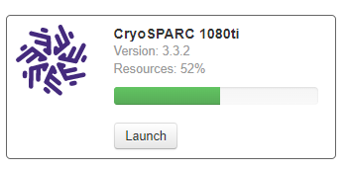
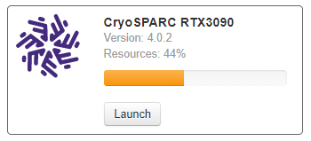
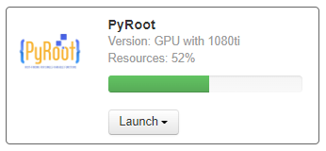
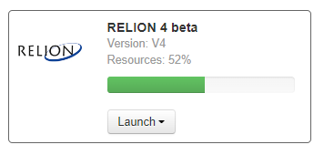
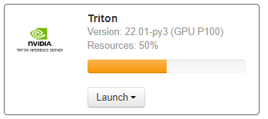
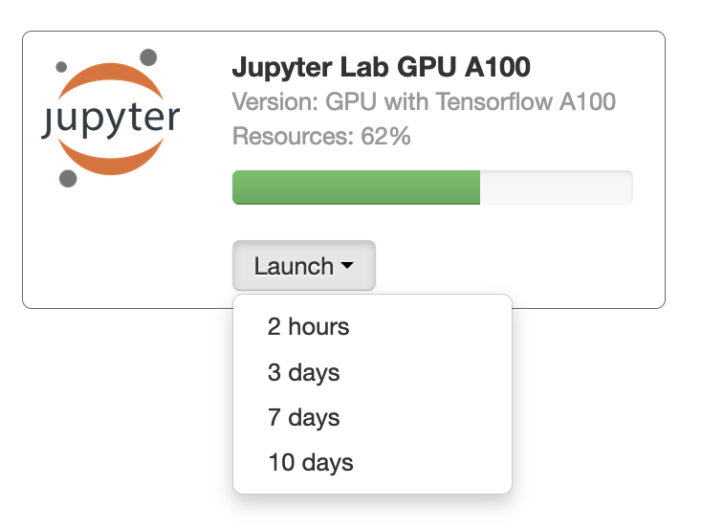
https://dicos.grid.sinica.edu.tw/dockerapps/
SaaS for Virtualized Computing Service -
Service Portal

Slide 6
The path of Disk Space
All user:
/dicos_ui_home/{user} (UI)
cryoEM group:
/activeEM/data/{group}/{user}
NSTCCore group:
/ceph/work/{group}/{user}
/ceph/project/{group}/{user}

Slide 7
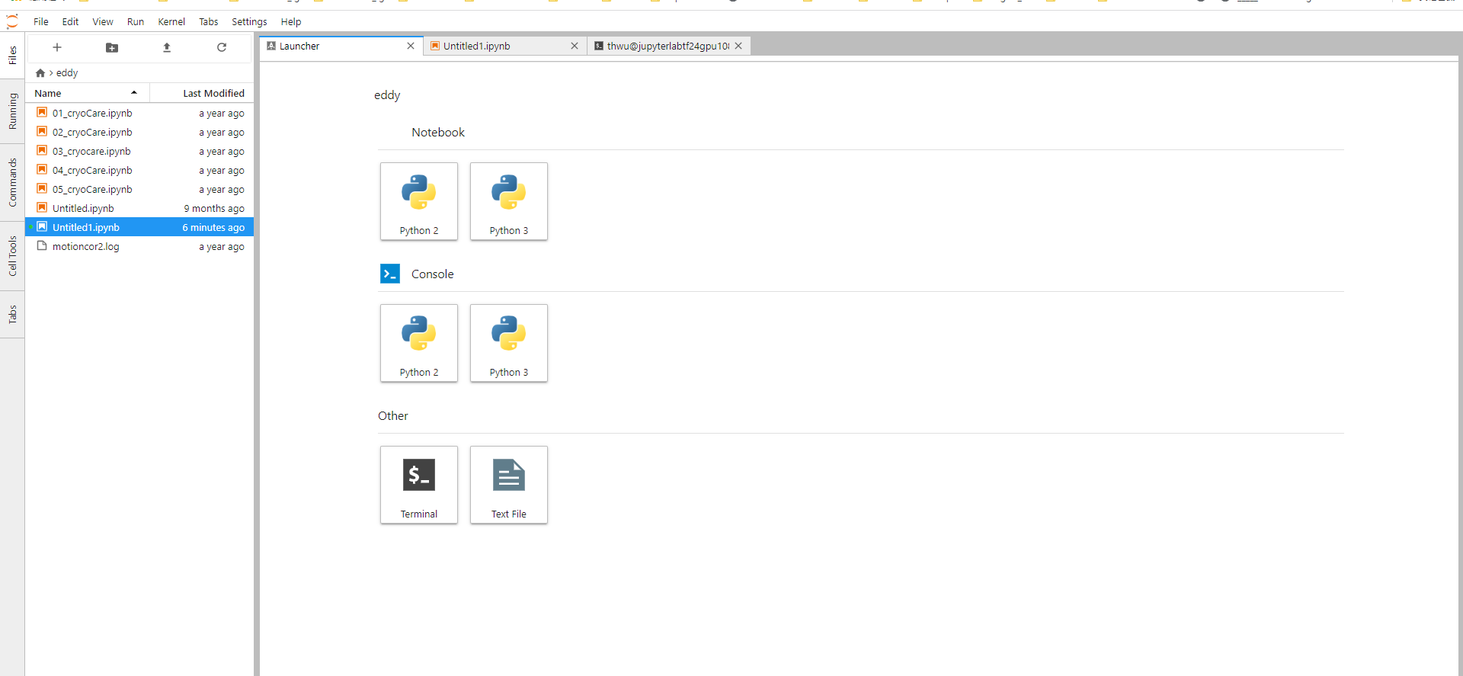
Example 1.1 (Open a Jupyter RTX 3090)

Slide 8
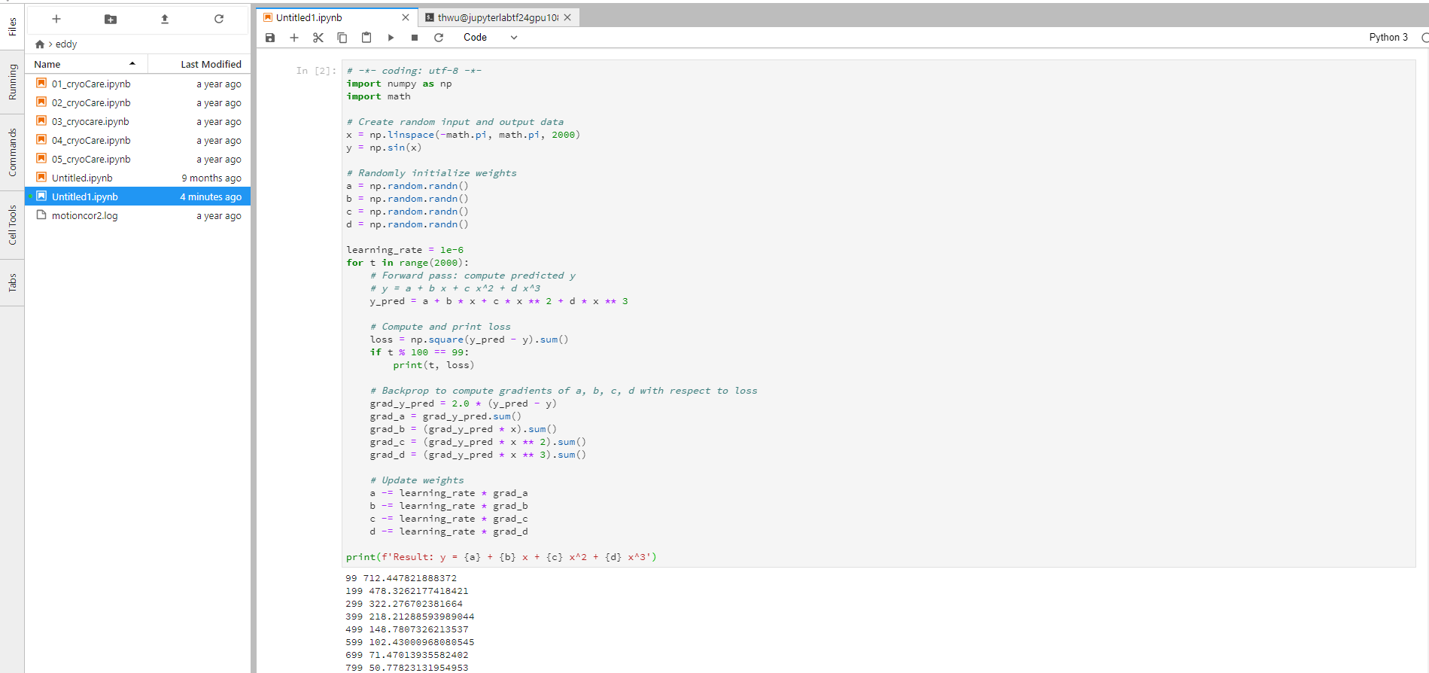
Example 1.2 (Open a Jupyter RTX 3090)

Slide 9
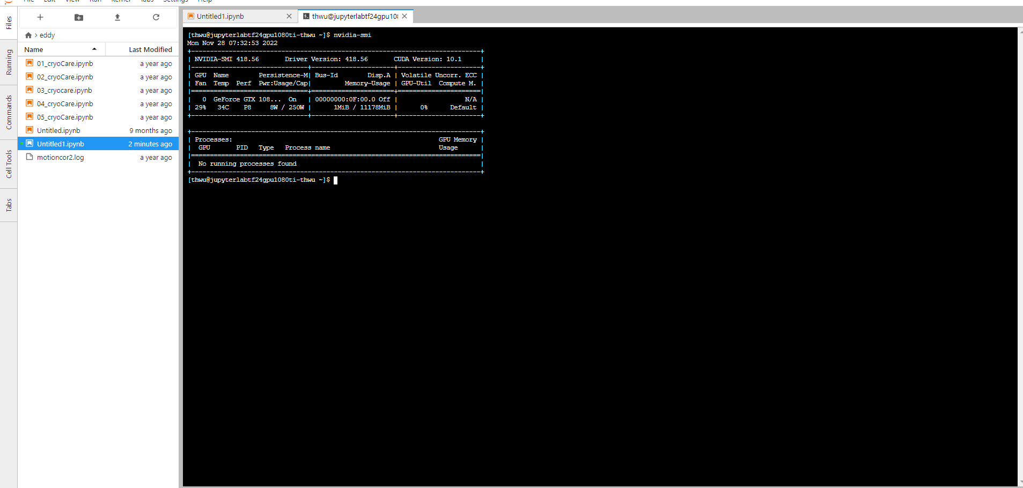
Example 1.3 (Open a Jupyter RTX 3090 with terminal)

Slide 10
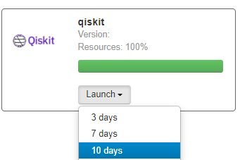
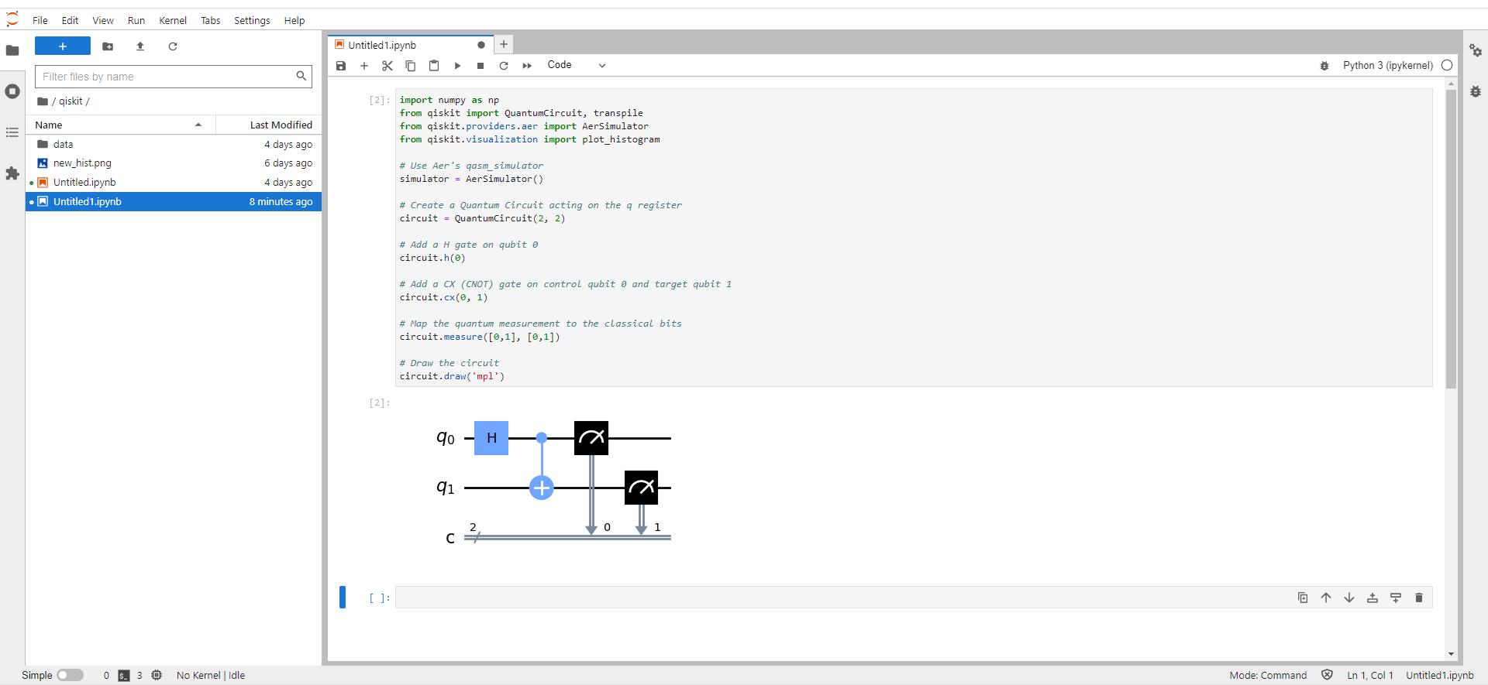
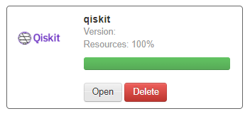
Example 2. (Open a QisKit app)
Shift + Enter

Slide 11
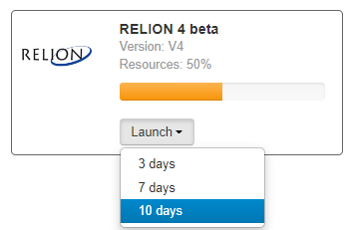
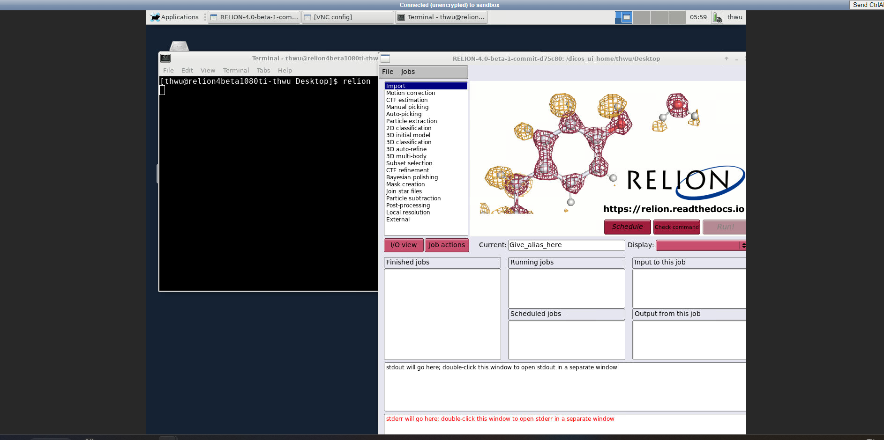
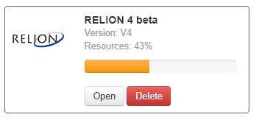
Example 3. (Open a Relion 4-beta app)

Slide 12
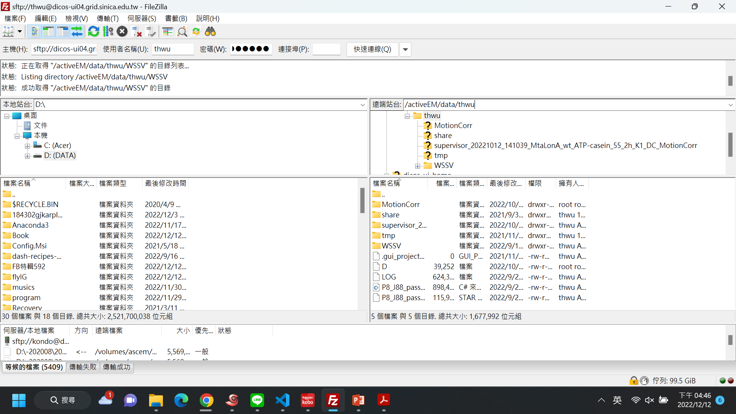
Upload and Download your data
Download FileZilla Client
Host (主機): dicos-ui.grid.sinica.edu.tw
Account (使用者名稱): account
Password (密碼): password+2FA
Port (連接埠): 22

