Slide 1
Introduction of NSTCCore Computing & Storage Services
15 January, 2025
https://nstccore.twgrid.org

Slide 2
Introduction of ASGC Computing Services
Funding from both Academia Sinica & NSTC(國科會)
ASGC Portals of Core Facility Services
  https://www.twgrid.org (ASGC website)
  https://scale.grid.sinica.edu.tw (中研院大數據分析與科學計算核心設施)
  https://nstccore.twgrid.org (國科會高效能科學計算服務 )
DiCOS Computing Service Portal
  https://dicos.grid.sinica.edu.tw

Slide 3
Introduction of ASGC Computing Services
Sustained Growth of Users, Utilization, Reliability and Satisfaction in 2024
  174 PI Groups, 595 Users from 25 Institutes in Taiwan
  Finished 4.94M CPU jobs, and 52.8K GPU jobs, with 99+ reliability
  26+ supported research publications
  Demands of advanced GPU keeps growing in 2024 - 20% utilization growth in high usage situation
Efficiency & Performance Improvements by Power Saving
  Onboarding new hardware and retiring legacy ones
  Expected to have >7,000 CPUCores and new GPUs, 15PB disk and new tape backup/archive in 2025
Persistent Capacity Building
  Research application efficiency, ease-of-use services
  User support, trainings, and thematic computational research workshop
  Flexible collaboration model and services

Slide 4
Introduction of NSTCCore Computing Service
 | 2024.04 ~ | 2024.09~2025.08 | 2025.08~2026.06
CPU | 1920 Cores *AMD Genoa + 768 Cores AMD Rome + 528 Cores *Intel FDR5 | 1920 Cores *New (2024. 12) + 1920 Cores AMD Genoa + 768 Cores AMD Rome + 256 Cores Intel-G4 | 1920 Cores *New + 3840 Cores AMD Genoa + 768 Cores *AMD Rome + 256 Cores *Intel-G4 | ＊ 後續計算能量依計畫核定狀況決定
GPU | V100 - 32 boards A100 - 8 boards *Current Resources | V100 - 32 boards A100 - 8 boards + 16 boards *Current Resources | V100 - 32 boards A100 - 8 boards *Current Resources
Storage (PB) | 3 *Buy-in every year | 6 *Buy-in 3TB every year | 9
Tape (PB) | 4 *Buy-in every year | 8 *Buy-in 4TB every year | 12
Computing Service
Storage Service
Technical Support
User Management
表、計算資源購置規劃表 2025.1

Slide 5



Scientific & HPC Computing Service
TWAREN/ TANet
100Gbps
AS Campus Network
WebUI for SaaS
SSH Terminal
2.5Gbps
100Gb/s Backbone
International R&E Network
Batch模式for HPC
雲端計算服務(SaaS)
Batch Jobs Computing Service
  Slurm Work Management System
Interactive Jobs Computing Service
  Scalable & Virtualized Service-as-Service (SaaS) Service Model
  Software on-demand Web-based UI
  Customized Application Deployment
  Slurm Workload Management
CPU Queues: short/long/dev/serial
GPU: A100, V100
Software Repository
Kubernetes Framework
Software Repository & Interactive UI
Scientific Software Repository & Customized Image Pool
Computing Resource
Ceph Storage Pools
Tape Remote Backup
System Architecture of NSTCCore Computing Service

Slide 6
Slurm System Architecture
DiCOSApp SaaS Architecture
hpa-wn01…n
Sma-wn01,02
CPU
Kubernetes
API
Server
HDR1
Pod
DiCOS
Web
Server
Client
ssh
Slurm
Control
Node
hpa-wn01…n
Login
UI
Client
EDR1
GPU-3090
http
GPU-P100
hpi-wn01
hpi-wn02
GPU-A100
Intel-G4
Pod
Slurm DB
GPU-A100
Image
Repository
GPU-V100
Ceph
/ceph/work/{group}
SE
SE

Slide 7
Batch Jobs Computing Service
Slurm System Architecture
  Scalable Cluster Management and Job Scheduling System
Computing Nodes
  CPU - EDR1、HDR1、Intel-G4
  GPU - A100、V100
Jobs Working Space:
  Ceph Cloud Filesystem
  Intermediate Space: Local Disk in Worker Nodes
Cluster | CPU | Nodes | Cores-Per-Node | Cores | RAM(GB) | Inter-connection | Local Disk (SSD)
Intel-G4 | Intel® Xeon® CPU E5-2650 v4@2.20GHz | 22 | 24 | 528 | 128 | IB:FDR, Eth:10Gbps | 2TB
HDR1 | AMD Rome 7662 @2.0GHz | 6 | 128 | 768 | 1536 | IB:HDR, Eth:100Gbps | 1TB
EDR1 | AMD Genoa 9654@2.4GHz | 20 | 192 | 3840 | 1536 | Eth: 100Gbps | 2TB

Slide 8
Interactive Jobs - SaaS Computing Service
Kubernetes and Openstack
  High extensible and reliable virtual environment
Customized Application Deployment
Images Repository
  JupyterLab and various scientific applications
  Built by user’s requirements
Software-on-demand Web UI
  No installation and easy to adopt
Working Space (* Customized User Data Pool)
  Ceph Filesystem

Slide 9

SaaS for Virtualized Computing Service
Scientific Software Repository
Interactive：Ovito(Molecular Dynamics)、cisTEM、RELION(Medical Image Reconstruction)
BioMedical：Cryosparc (* License required from users）
Anaconda Python packages for ML：JupyterLab、TensorFlow、PyTorch、PyRoot、DeepMD(Molecular Dynamics)…etc.
Scientific Software Repository & Customized Image Pool
Interactive UI
Specific OS or Application required
Dedicate node for rapid development for multi-core or GPU to develop and testing your task
When your job needs

Slide 10
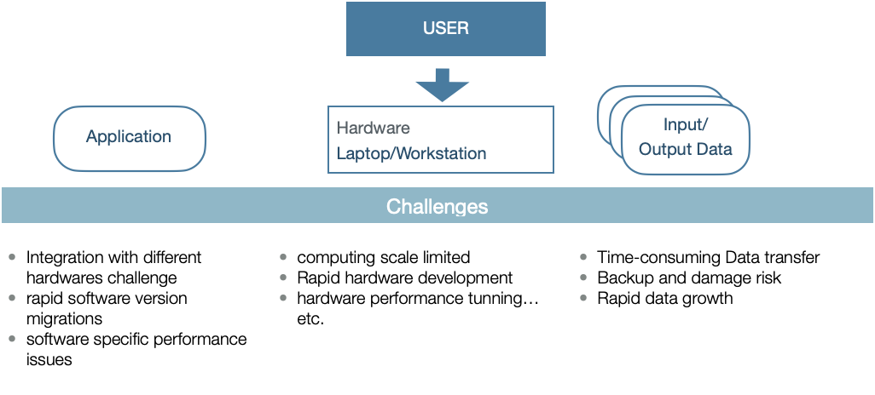
Users’ Challenges

Slide 11

Workflow of User Support
User Support & Customization
Application on various hardware platforms
Scalable computing resources according to your requirements
Transparent data space & easy data sharing in your research group
User Training & Consulting Service for Technical Issues
SLURM Service
DiCOS-Apps (Cloud SaaS)

Slide 12
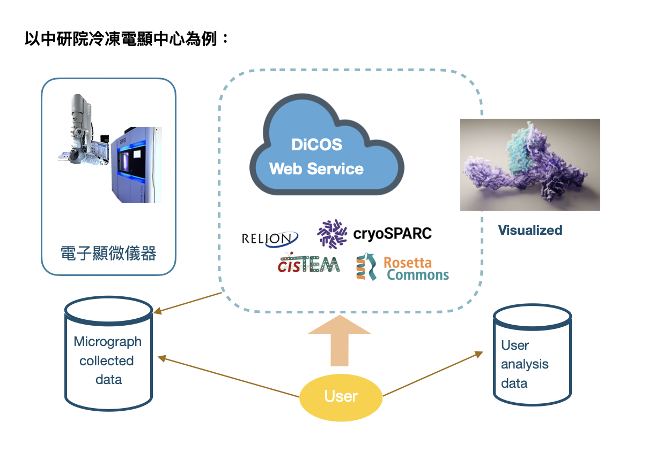

Slide 13
Storage Service
User Home Space
/dicos_ui_home/{user_account}
100GB Free space
Ceph Filesystem
  An open source distributed filesystem
  High-Throughput
Working Space
/ceph/work/{group_account}
Every Group has 3TB free space, PI has full permissions for data in this space. Buy more space according to your computing needs, 1TB/days as a purchase unit.
Tape as Backup Service is now in testing phase
/ceph/project/{group_account}
Backup and long-term preserved space. Buy as needed. 1TB/years as a purchase unit.
Data Transfer
Transfer by SFTP via dicos-sftp.twgrid.org

Slide 14
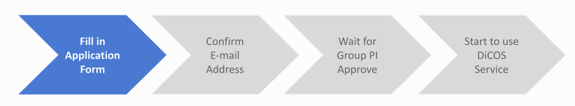
Group & User Management
PI
Users
Fill Group
Application
Form
DiCOS Admin
Approved
Notify PI when
Group Setup Done
User Account
Register under your PI’s Group
Your PI’s approval
Group Account
User Account
PI’s User Account
Group Accounts
  https://canew.twgrid.org/ApplyAccount/groupcreate.php
User Accounts
  https://canew.twgrid.org/ApplyAccount/ApplyAccount.php

Slide 15
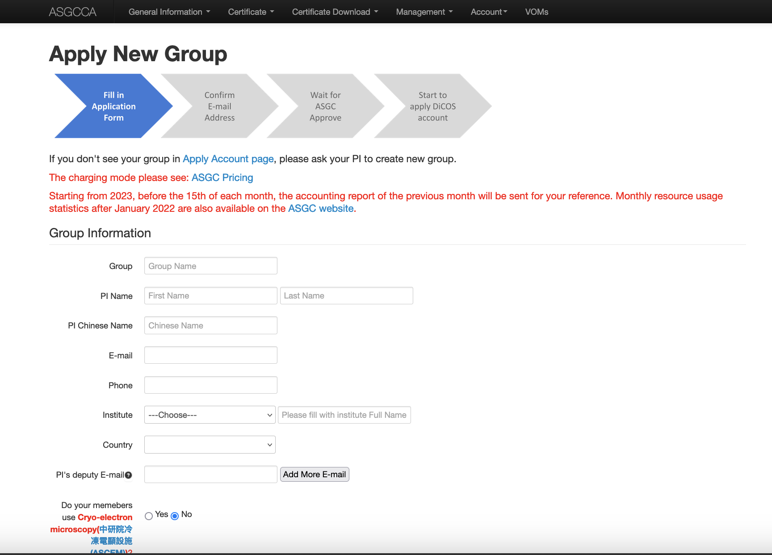
https://canew.twgrid.org/ApplyAccount/groupcreate.php

Slide 16
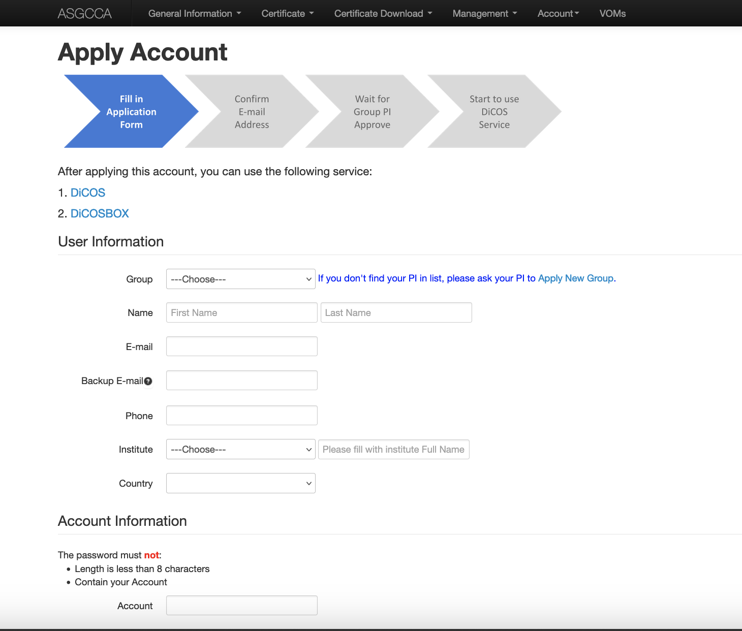
User Management

Slide 17

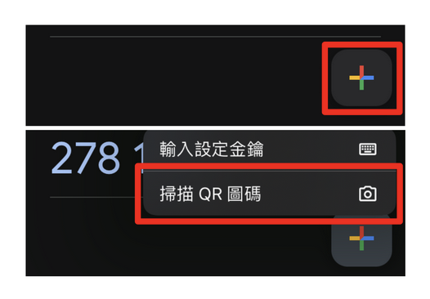
User Management - Two Factor Authentication
Two-Factor Authentication Support from January 2025
  Google Authenticator (Install on your mobile device)
  Get your own associated QR code and scan it to set up for your Google Authenticator
  Obtain 6-digit verification code to access the computing services.
  See instructions via https://canew.twgrid.org/ApplyAccount/howToSave2faCode.php

Slide 18
User Management - Account Policy
Password & Account Expiration (ISO security)
    6months validation, password & account expiry notification will be sent on 7, 15 and 30 days to expiration.
    Account Deletion: Your account & user space(UI_home directory & work directory) will be removed after 6 months of expiration.

Slide 19
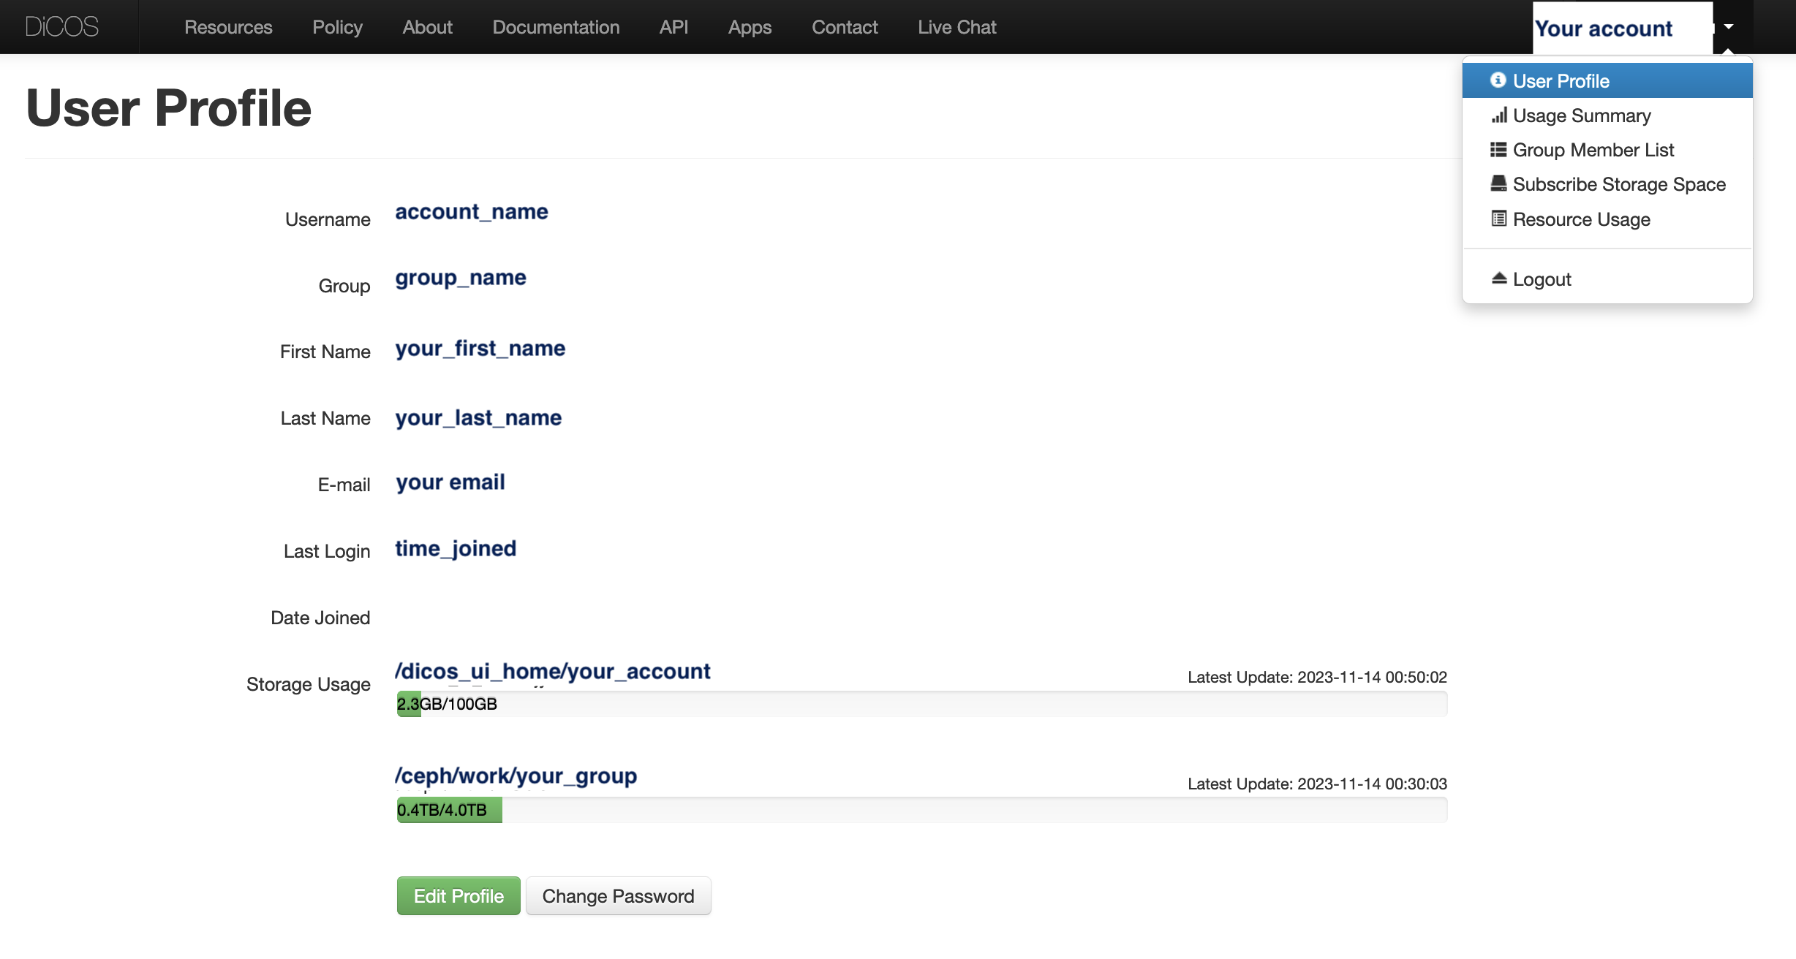
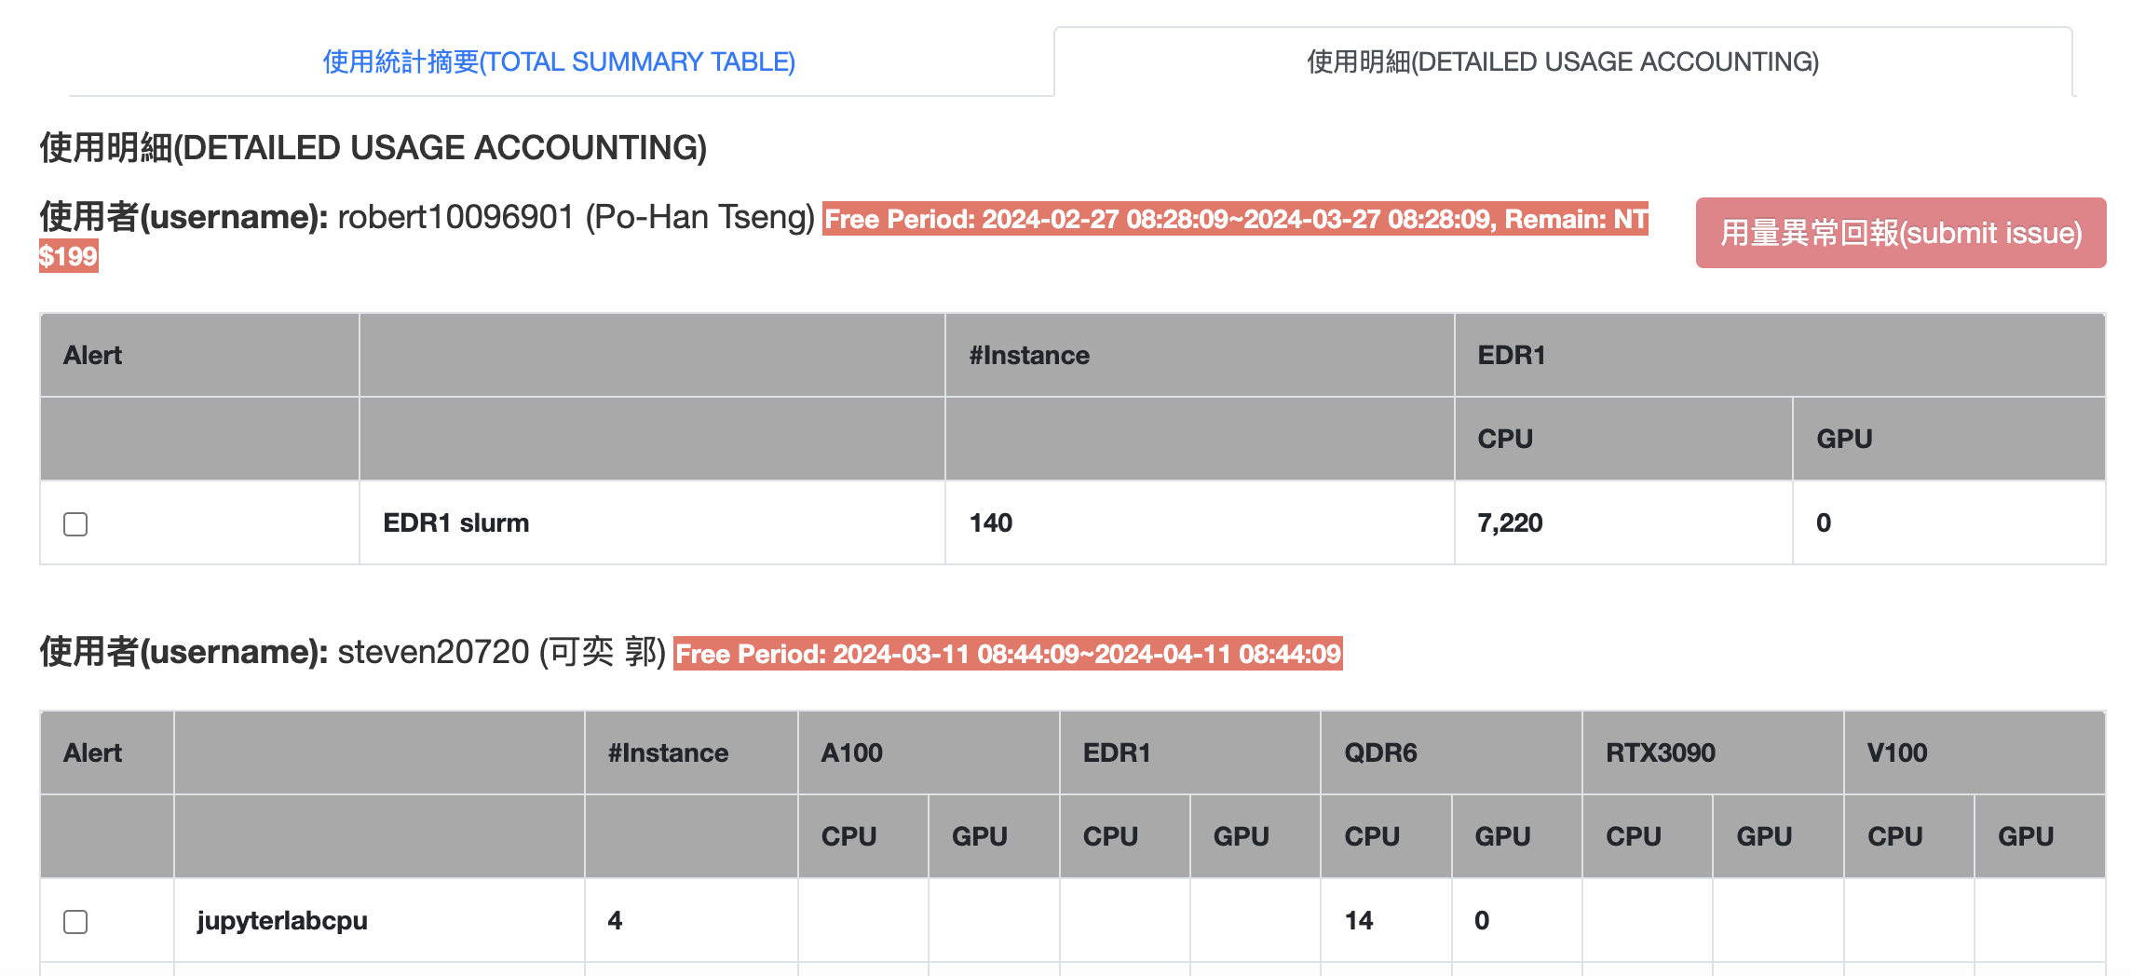
User Management - User
User Profile
  Change Group* (PI approve)
  Change Password*
    http://canew.twgrid.org/ApplyAccount/nocertModify.php
Resource Usage
  Free $200 Credits for Trial 1 month
  Storage Usage

Slide 20
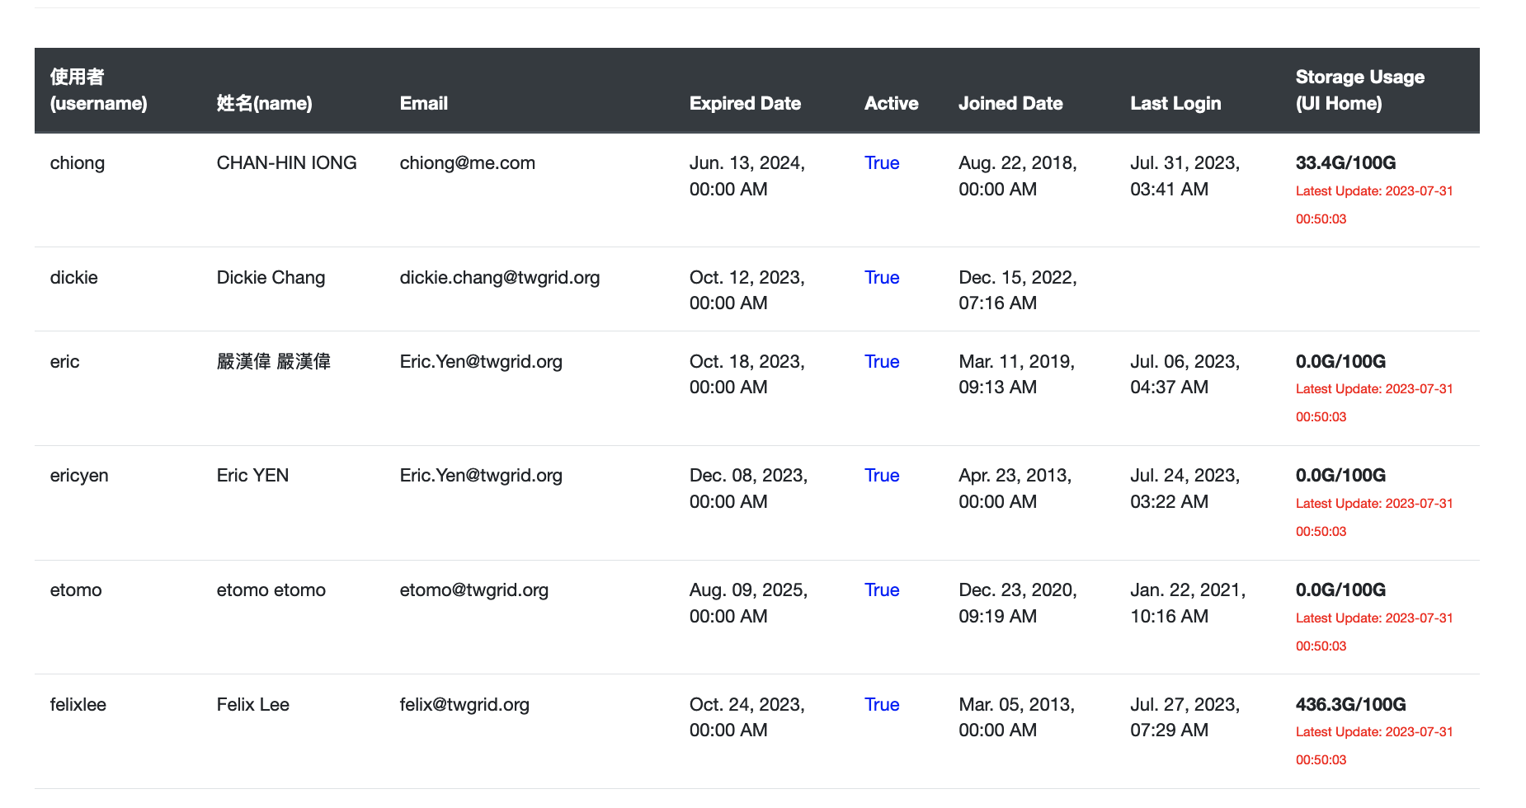
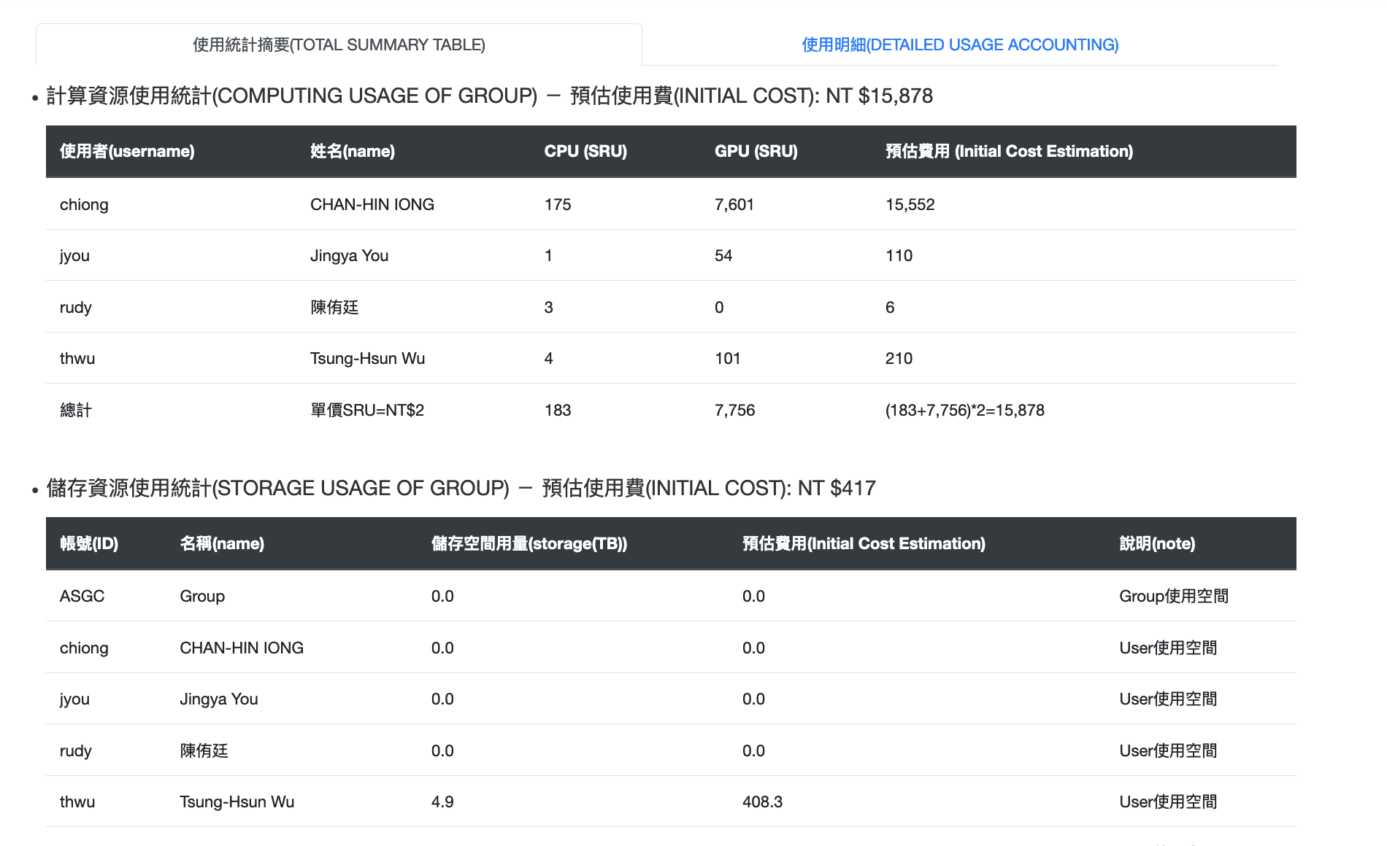
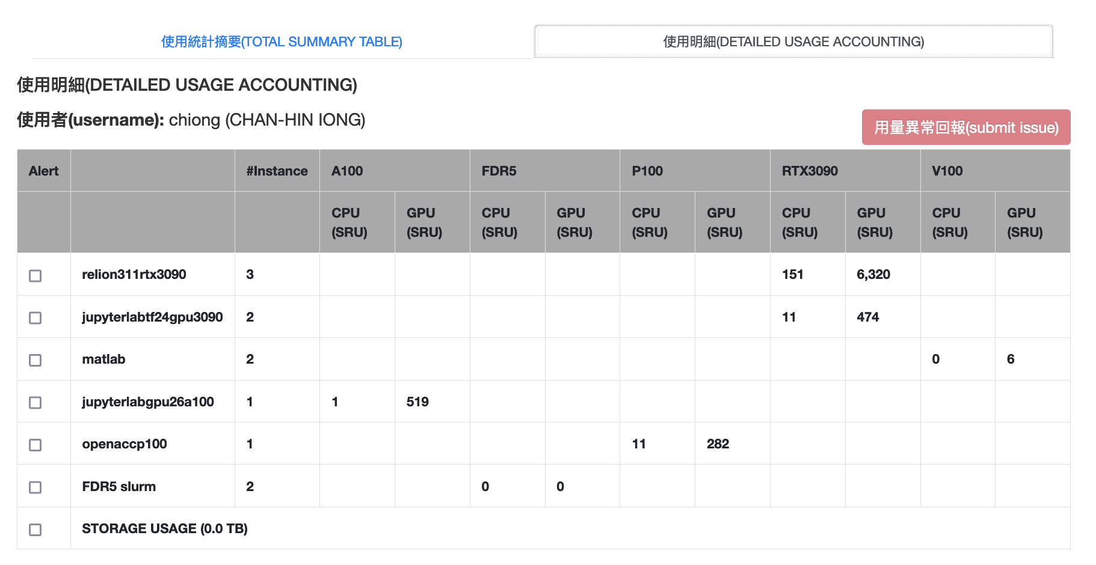
User Management - Group
Members management
  Members list
  Abnormal member usage report
  Member’s usage review

Slide 21
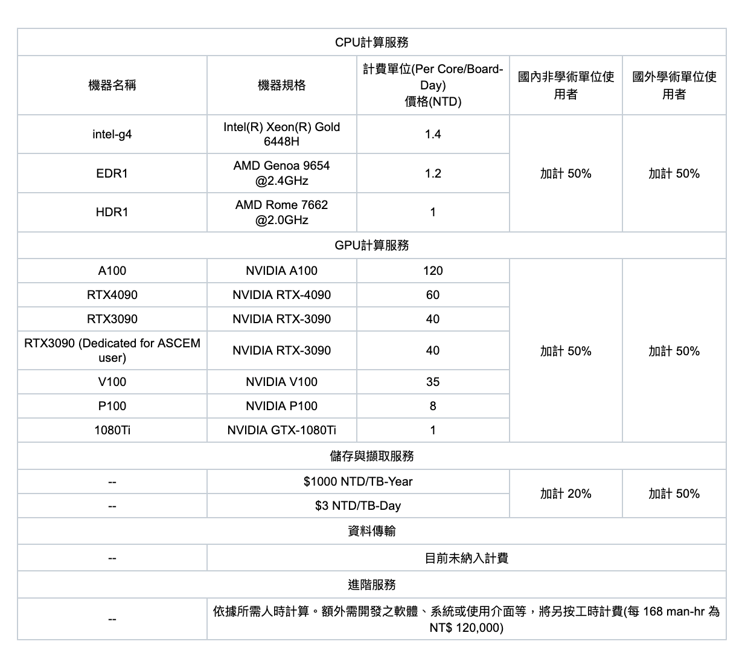
Pricing for Computing Service
More details in
https://dicos.grid.sinica.edu.tw/resources
https://nstccore.twgrid.org/access.php#pricing

Slide 22
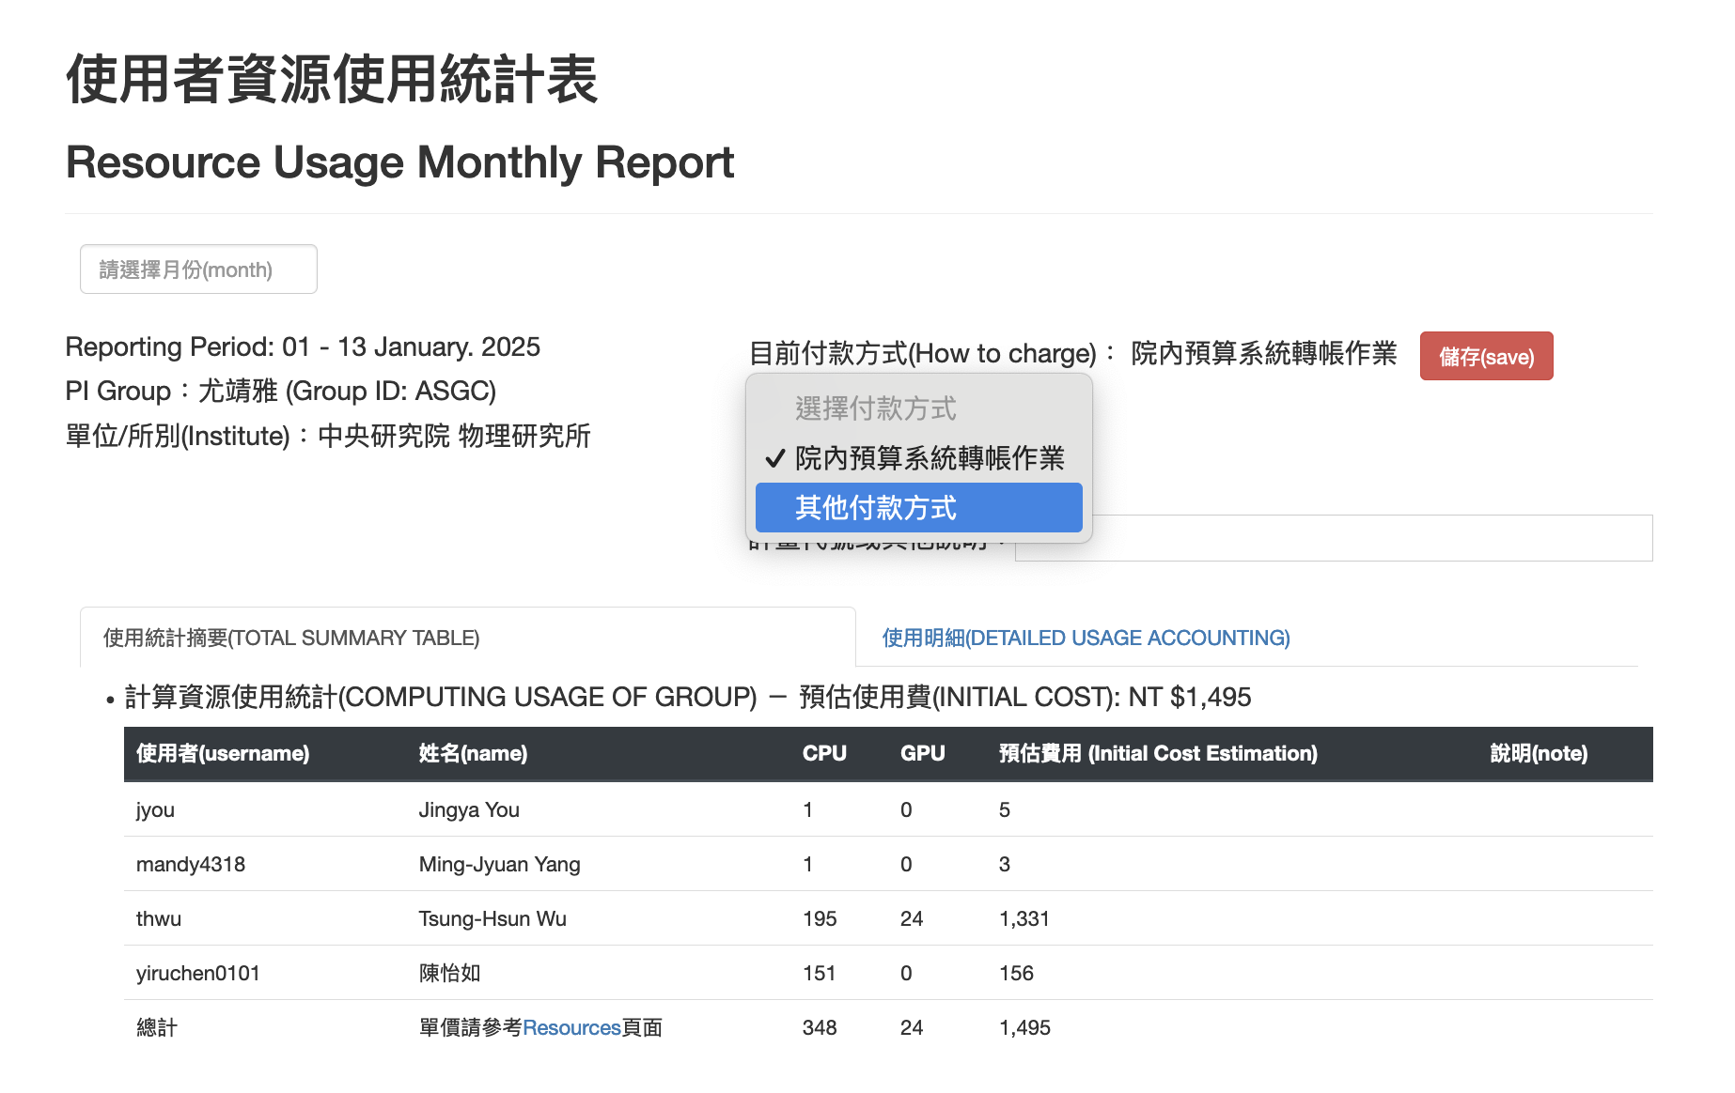
User Management - PI’s Billing Management
Resource Usage Management
  Resource Usage
Budget & Payment Management
  Monthly Bill will be delivered every month
    https://dicos.grid.sinica.edu.tw/accounting/bill/
  Payment Management
  How to Make Payment
      https://nstccore.twgrid.org/access.php#pricing

Slide 23

Technical Support
Help Desk & Service Notification
  Rocketchat online chat - https://rocketchat.twgrid.org/channel/general
  Email - dicos-support@twgrid.org
  Portal - https://nstccore.twgrid.org
    Release up-to-date services status, group usage, pricing and technical relevant information

