Slide 1
Storage & Data Transfer Service
April 10, 2025

Slide 2
Storage Space
Home Space
  /dicos_ui_home/{user_account}
Group Working Space
  /ceph/work/{group}
  3TB free for each group
Group Preservation & Backup Space (Will be available in the future)
Please back up to secure your data in these spaces

Slide 3
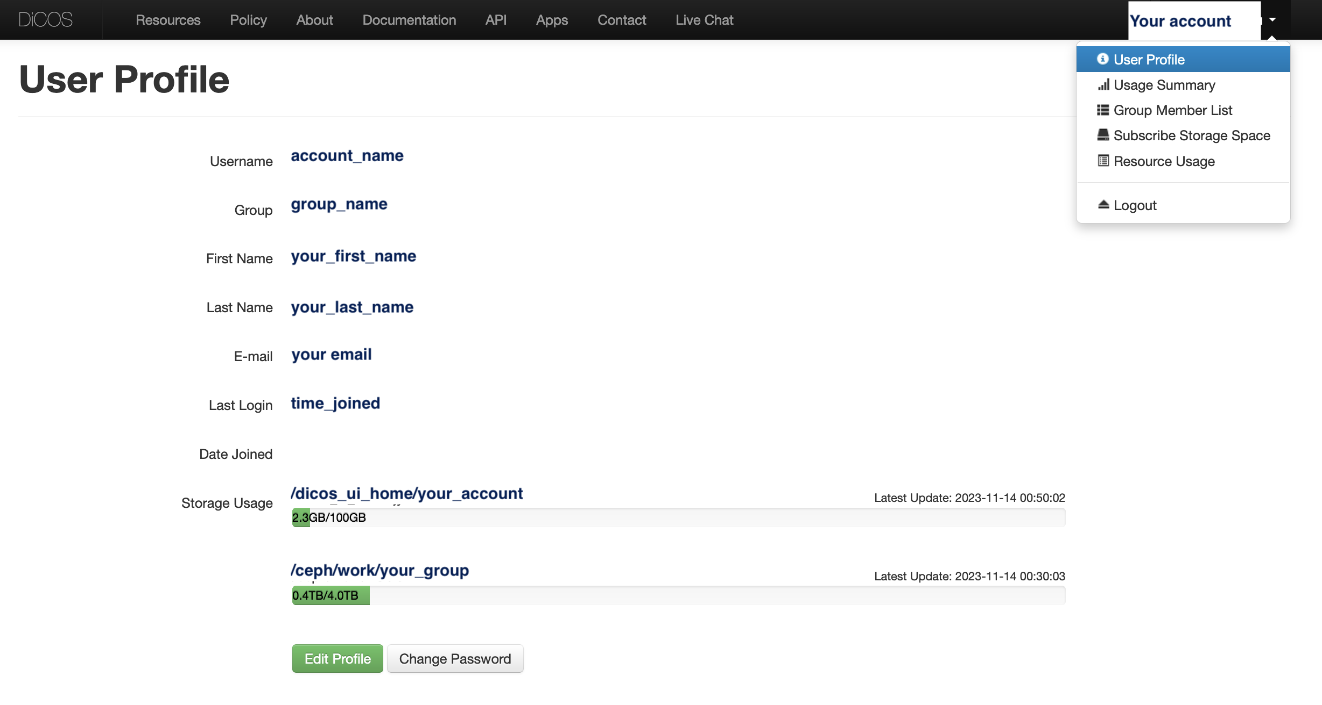
Storage Space
Check Your Usage https://dicos.grid.sinica.edu.tw/profile/info

Slide 4
Introduction of User’s Home Space
/dicos_ui_home/{user_account}
Backup your important data in Home Space
Home space will be cleared once your account is expired and deleted
Avoid using you home space as job’s working space

Slide 5
Introduction of Group Working Space
/ceph/work/{group}
3TB free space for each group
This space is shared among all members of the group
PI has full access and manage rights in this space
PI can subscribe & upgrade for more space via dicos.grid.sinica.edu.tw
*Backup your important data in Group Working Space

Slide 6
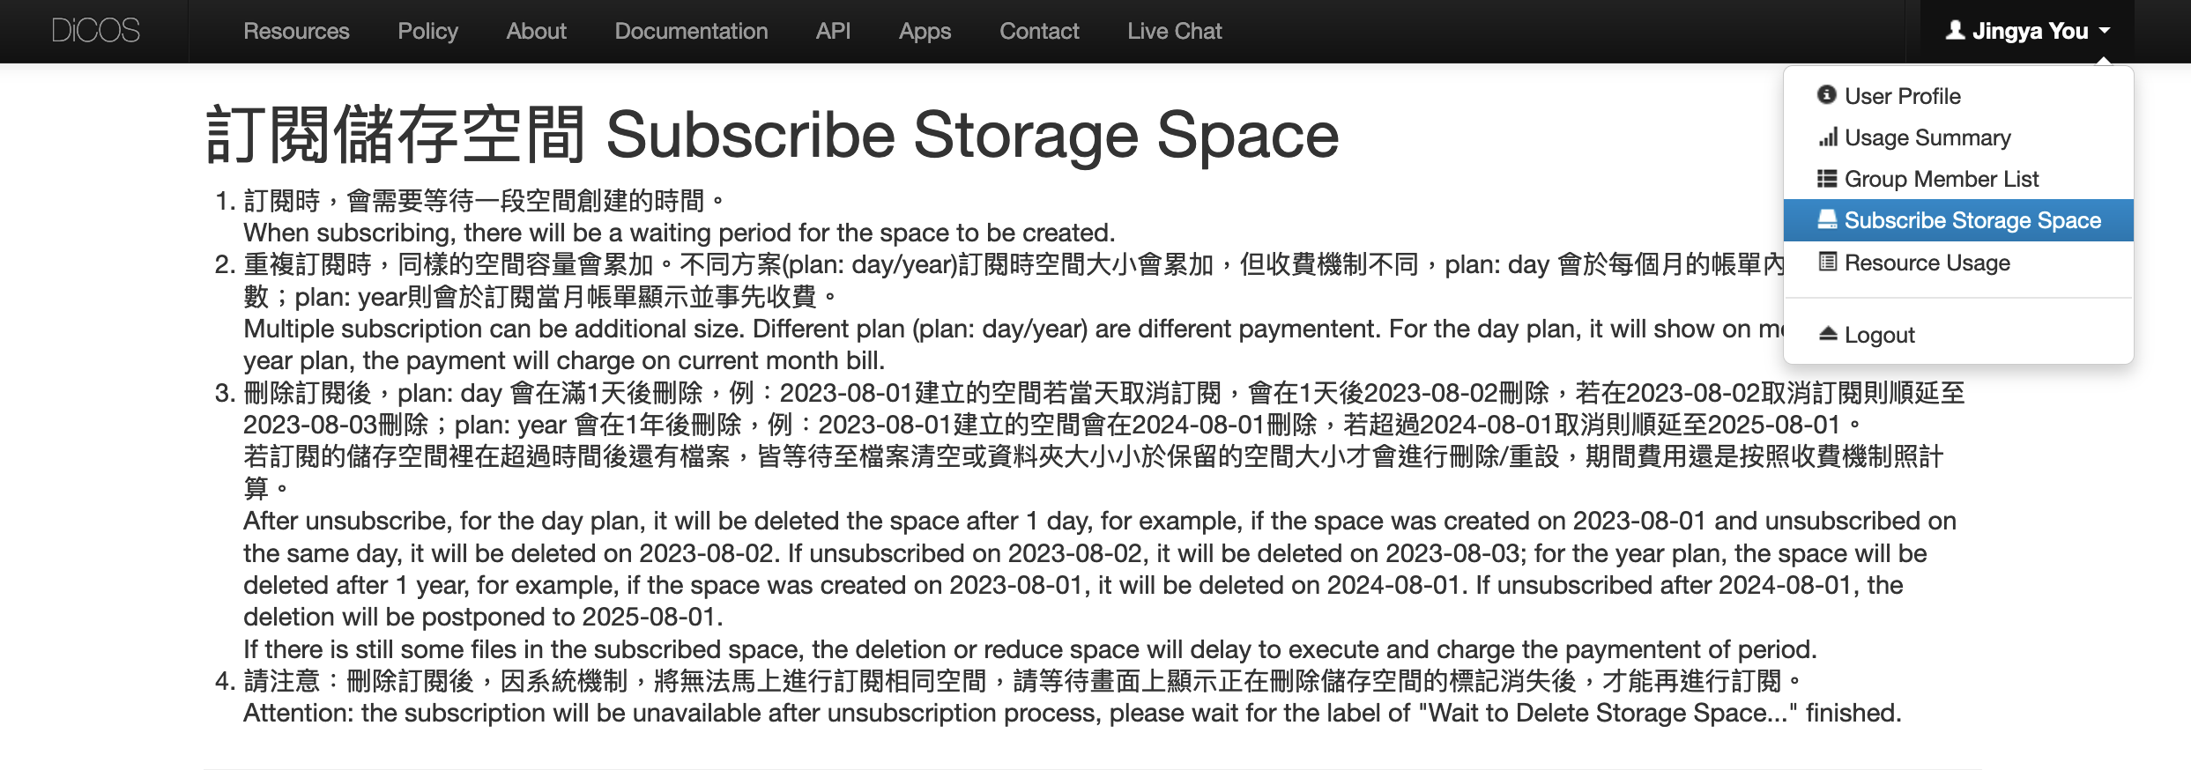
Subscribe More Group Working Space
PI can subscribe for upgrade storage space
  https://dicos.grid.sinica.edu.tw/accounting/subscribe-storage
Day plan NT$3 per day
Year plan NT$1000 per year
More pricing information in https://dicos.grid.sinica.edu.tw/resources

Slide 7
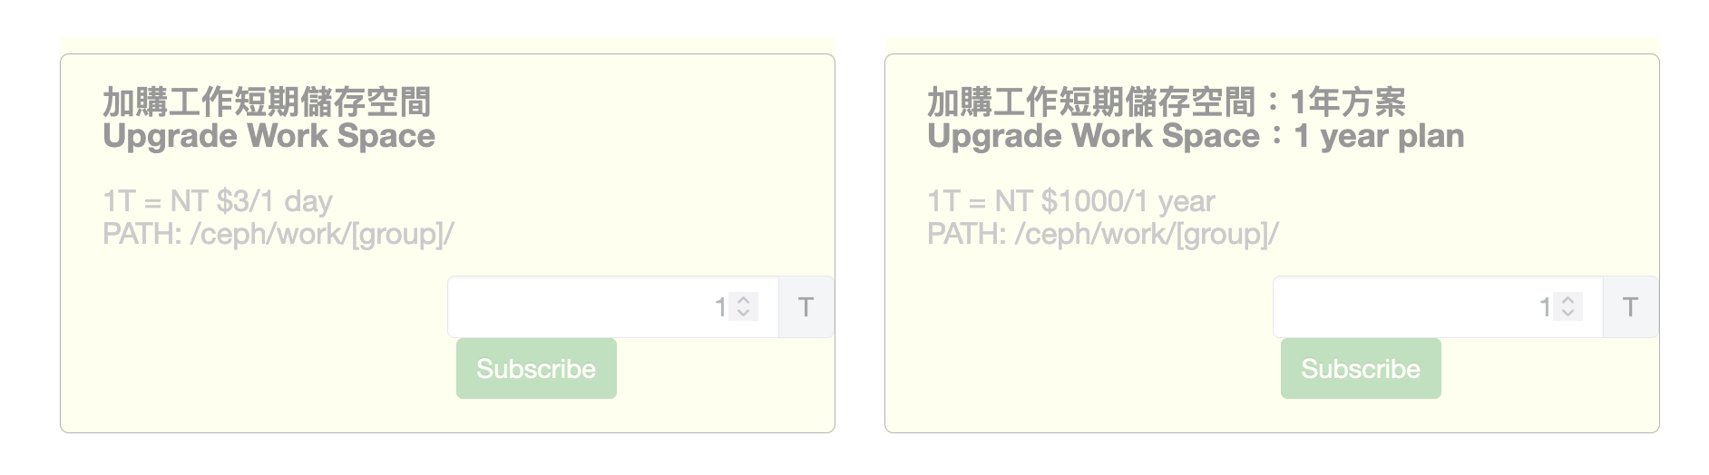
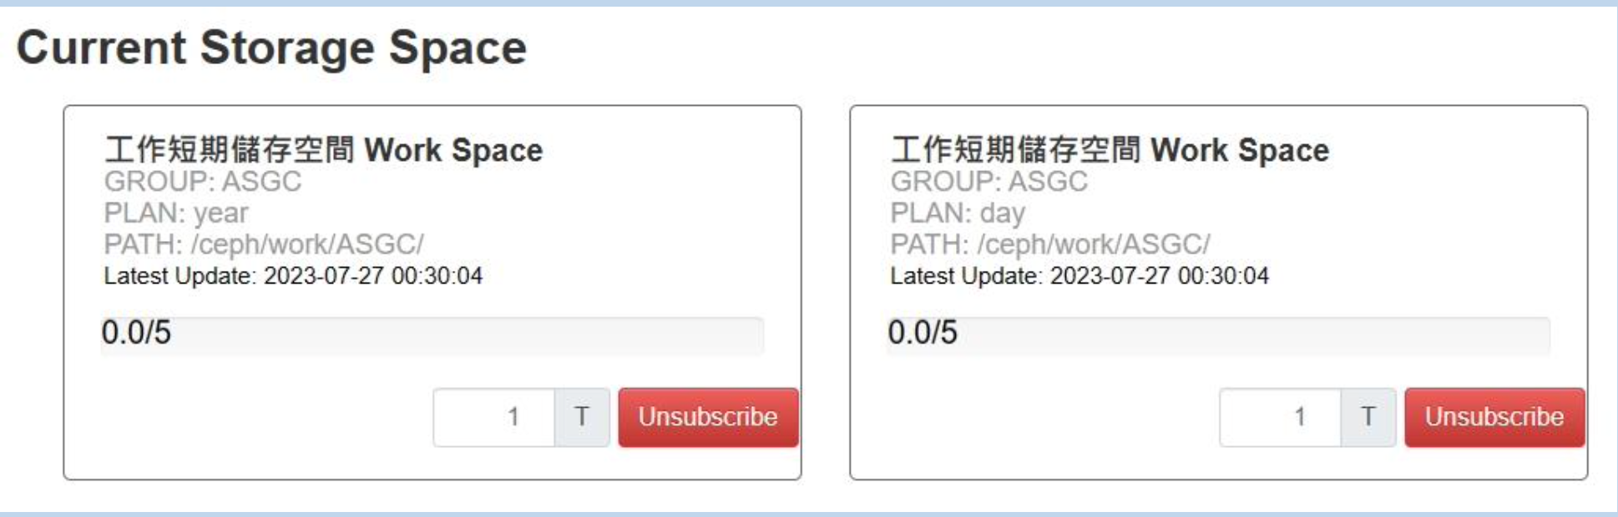
Subscribe More Group Working Space

Slide 8
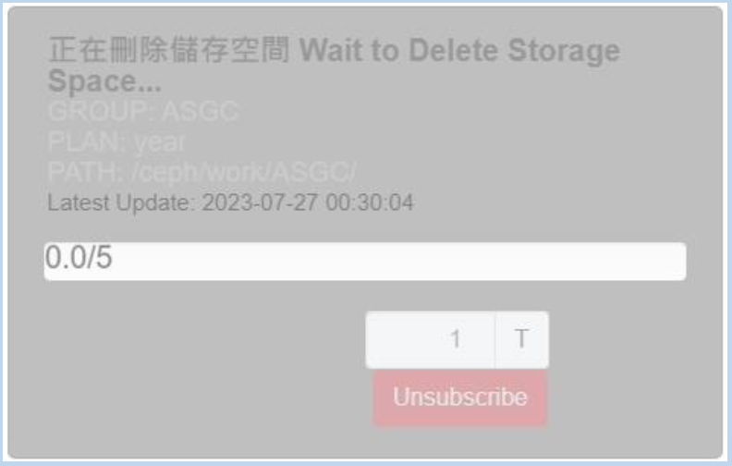
Unsubscribe Space
Clear your data and release your space before unsubscription.
Unable to unsubscribe if the space is not released
Unsubscription process will be blocked when space couldn’t release or cancelling year plan
  Please contact dicos-support@twgrid.org

Slide 9
Working Space for Computing Jobs
Group Working Space: /ceph/work/{group}
Specify output files in Group Working Space if your program has high IO wait.
You can also use /tmp as intermediate job working space
  See instructions
Data Transfer
  See instructions

Slide 10
Using /tmp as Intermediate Working Space
Start your task
Each worker node has different spec (e.g. SSD) & capacity
  [HDR1] SSD 1TB
/tmp directory will be cleaned anytime
Copy intermediate data to /ceph/work/{group}
Remove files from /tmp when tasks finish
Writing output to /tmp
Finish your task
Copy data to /ceph/work/{group}
Remove your data from /tmp
End of your script

Slide 11
Group Preservation & Backup Service
Tape System will be purchased next year
/ceph/project/{group_account}

Slide 12
Hands-on

Slide 13
Linux Basic Command to Manipulate Files
## Login
$ ssh username@slurm-ui.twgrid.org
$ ssh username@dicos-sftp.twgrid.org
## Show current path
$ pwd
## Move file
$ mv {src} {dest}
## Remove file
$ rm file_name
## Remove directory
$ rm -r dir_name

Slide 14
Using /tmp as Intermediate Working Space
Create Temporary File in Linux
$ mktemp
$ /tmp/1mjAhAH3YM
$ mktemp /tmp/jyou-XXXXX
$ /tmp/jyou-WxWtv
Create Temporary Directory
$ mktemp -d
$ /tmp/tmp.1mjAhAH3YM
$ mktemp -d /tmp/jyou-XXXXX
$ /tmp/jyou-WxWtv

Slide 15
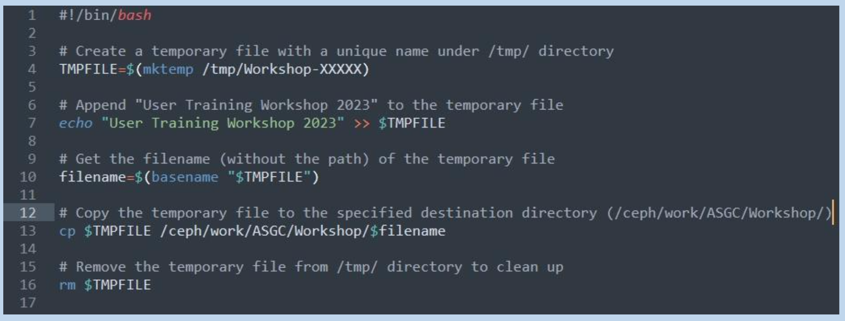
Using /tmp as Intermediate Working Space
Copy Temporary File:
  wget https://raw.githubusercontent.com/ASGCOPS/Hands-on_STORAGE_2023/main/temporary_file.sh

Slide 16
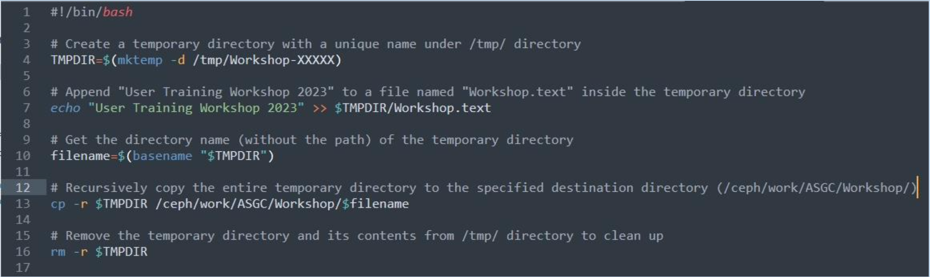
Using /tmp as Intermediate Working Space
Copy Temporary Directory:
  wget https://raw.githubusercontent.com/ASGCOPS/Hands-on_STORAGE_2023/main/temporary_directory.sh

Slide 17
Data Transfer using SFTP
Node for Data Transfer: slurm-ui.twgrid.org or dicos-sftp.twgrid.org
Linux Command
$ sftp username@slurm-ui.twgrid.org
## Upload file
$ sftp> put filename
## Download file
$ sftp> get filename
$ scp jyou@slurm-ui.twgrid.org:/ceph/work/ASGC/mydata/this.file .
$ scp -r jyou@slurm-ui.twgrid.org:/ceph/work/ASGC/mydata .

Slide 18
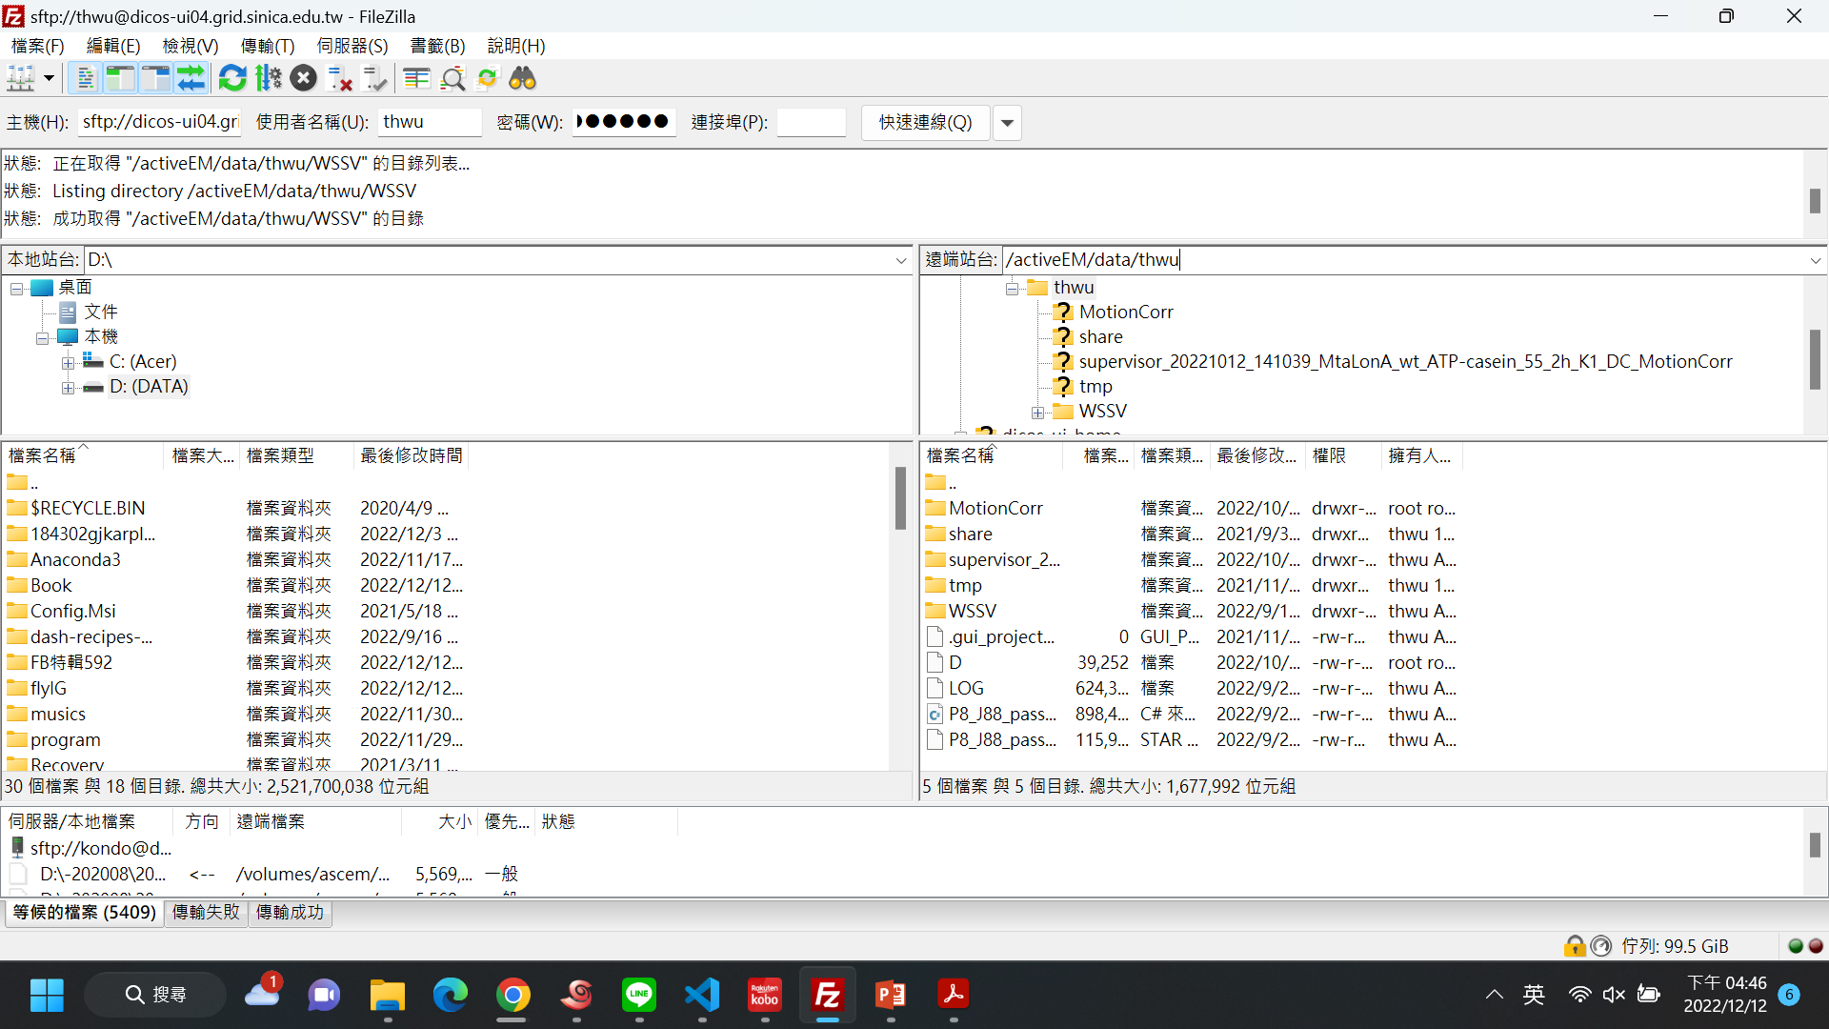
Data Transfer using FileZilla
Download FileZilla Client
Host (主機):
  dicos-sftp.twgrid.org
  slurm-ui.twgrid.org
Account (使用者名稱): account
Password (密碼): password
Port (連接埠): 22

