Slide 1
Introduction of ASGC Computing & Storage Services
10 April, 2025
Jingya You (jingya.you@twgrid.org)

Slide 2
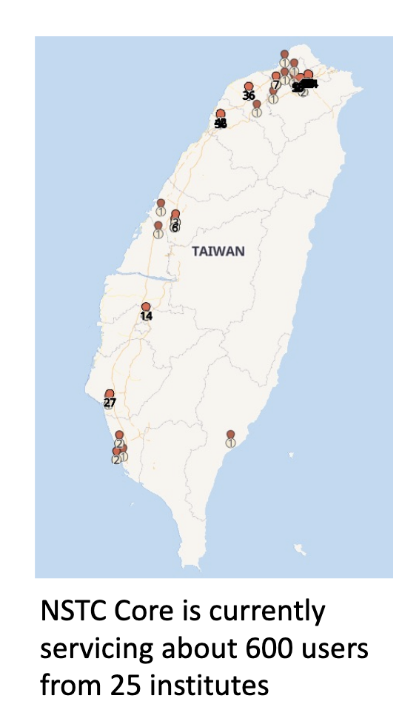
Introduction of ASGC Computing Services
Funding from both Academia Sinica & NSTC(國科會)
Our Mission is To serve all Taiwan Scientific communities:
Collaborate with research teams to
Assist in the customization of big data analysis processes
Improve the performance of big data analysis and scientific computing
Develop new analytical tools and methods
Maintain a stable research and analysis environment
Provide a convenient high-performance application environment
Research team does not have to go through the work to setup their own system and maintain it
Allow to focus on scientific issues

Slide 3
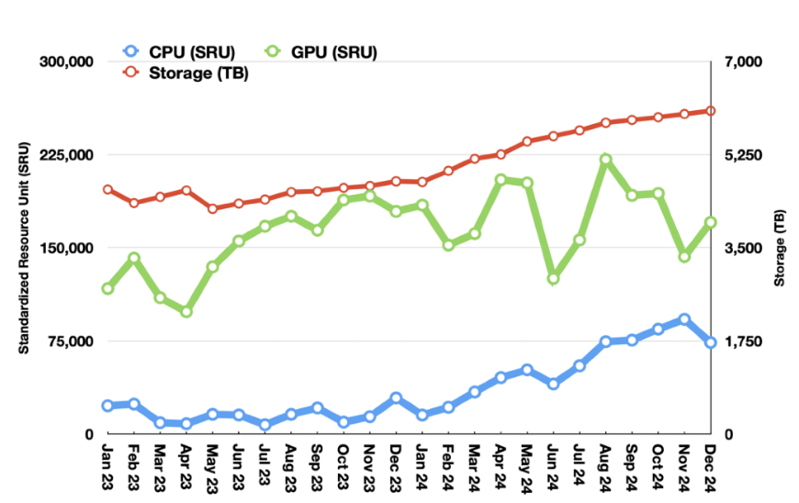
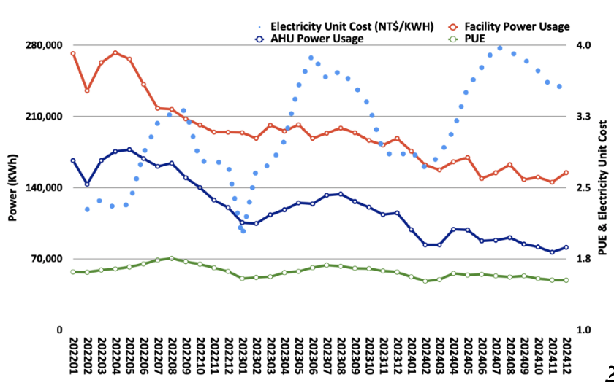
Introduction of ASGC Computing Services
Sustained Growth of Users, Utilization, Reliability and Satisfaction in 2024
174 PI Groups, 595 Users from 25 Institutes in Taiwan
Finished 4.94M CPU jobs, and 52.8K GPU jobs, with 99+ reliability
26+ supported research publications
Demands of advanced GPU keeps growing in 2024 - 20% utilization growth in high usage situation
Efficiency & Performance Improvements by Power Saving
Onboarding new hardware and retiring legacy ones
Expected to have >7,000 CPUCores and new GPUs, 15PB disk and new tape backup/archive in 2025

Slide 4
Introduction of ASGC Computing Services
ASGC Portals of Core Facility Services
ASGC website
https://www.twgrid.org
中研院大數據分析與科學計算核心設施
https://scale.grid.sinica.edu.tw
國科會高效能科學計算服務
https://nstccore.twgrid.org
DiCOS Computing Service Portal
https://dicos.grid.sinica.edu.tw
Training Materials
https://indico4.twgrid.org/category/3/
Today’s Sessions
13:30~13:50 Introduction
13:50~14:00 User Management: Accounts & 2FA
14:00~14:30 Computing service: SLURM
14:30~14:45 Computing service: SaSS Cloud Computing - DiCOSApp
14:45~15:00 Storage service & data transfer

Slide 5
Introduction of NSTCCore Computing Service
 | 2024.04 ~ | 2024.09~2025.08 | 2025.08~2026.06
CPU | 1920 Cores *AMD Genoa + 768 Cores AMD Rome + 528 Cores *Intel FDR5 | 1920 Cores *New (2024. 12) + 1920 Cores AMD Genoa + 768 Cores AMD Rome + 256 Cores Intel-G4 | 1920 Cores *New + 3840 Cores AMD Genoa + 768 Cores *AMD Rome + 256 Cores *Intel-G4 | ＊ 後續計算能量依計畫核定狀況決定
GPU | V100 - 32 boards A100 - 8 boards *Current Resources | V100 - 32 boards A100 - 8 boards + 16 boards *Current Resources | V100 - 32 boards A100 - 8 boards *Current Resources
Storage (PB) | 3 *Buy-in every year | 6 *Buy-in 3TB every year | 9
Tape (PB) | 4 *Buy-in every year | 8 *Buy-in 4TB every year | 12
Computing Service
SLURM
DiCOSApp
Storage Service
Technical Support
User Management
表、計算資源購置規劃表 2025.1

Slide 6

Storage Service
User Home Space
/dicos_ui_home/{user_account}
100GB Free space
Ceph Filesystem
An open source distributed filesystem
High-Throughput
Working Space
/ceph/work/{group_account}
Every Group has 3TB free space, PI has full permissions for data in this space. Buy more space according to your computing needs, 1TB/days as a purchase unit.
Tape as Backup Service is now in testing phase
/ceph/project/{group_account}
Backup and long-term preserved space. Buy as needed. 1TB/years as a purchase unit.
Data Transfer
Transfer by SFTP via dicos-sftp.twgrid.org

Slide 7



Scientific & HPC Computing Service
TWAREN/ TANet
100Gbps
AS Campus Network
WebUI for SaaS
SSH Terminal
2.5Gbps
100Gb/s Backbone
International R&E Network
Batch模式for HPC
雲端計算服務(SaaS)
Batch Jobs Computing Service
Slurm Work Management System
Interactive Jobs Computing Service
Scalable & Virtualized Service-as-Service (SaaS) Service Model
Software on-demand Web-based UI
Customized Application Deployment
Slurm Workload Management
CPU Queues: short/long/dev/serial
GPU: A100, V100
Software Repository
Kubernetes Framework
Software Repository & Interactive UI
Scientific Software Repository & Customized Image Pool
Computing Resource
Ceph Storage Pools
Tape Remote Backup
System Architecture of NSTCCore Computing Service

Slide 8
Slurm System Architecture
DiCOSApp SaaS Architecture
hpa-wn01…n
Sma-wn01,02
CPU
Kubernetes
API
Server
HDR1
Pod
DiCOS
Web
Server
Client
ssh
Slurm
Control
Node
hpa-wn01…n
Login
UI
Client
EDR1
GPU-3090
http
GPU-P100
hpi-wn01
hpi-wn02
GPU-A100
Intel-G4
Pod
Slurm DB
GPU-A100
Image
Repository
GPU-V100
Ceph
/ceph/work/{group}
SE
SE

Slide 9
Batch Jobs Computing Service
Slurm System Architecture
Scalable Cluster Management and Job Scheduling System
Computing Nodes
CPU - EDR1、HDR1、Intel-G4
GPU - A100、V100
Jobs Working Space:
Ceph Cloud Filesystem
Intermediate Space: Local Disk in Worker Nodes
Cluster | CPU | Nodes | Cores-Per-Node | Cores | RAM(GB) | Inter-connection | Local Disk (SSD)
Intel-G4 | Intel® Xeon® CPU E5-2650 v4@2.20GHz | 22 | 24 | 528 | 128 | IB:FDR, Eth:10Gbps | 2TB
HDR1 | AMD Rome 7662 @2.0GHz | 6 | 128 | 768 | 1536 | IB:HDR, Eth:100Gbps | 1TB
EDR1 | AMD Genoa 9654@2.4GHz | 20 | 192 | 3840 | 1536 | Eth: 100Gbps | 2TB

Slide 10
Interactive Jobs - SaaS Computing Service
Kubernetes and Openstack
High extensible and reliable virtual environment
Customized Application Deployment
Images Repository
JupyterLab and various scientific applications
Built by user’s requirements
Software-on-demand Web UI
No installation and easy to adopt
Working Space (* Customized User Data Pool)
Ceph Filesystem

Slide 11
SaaS for Virtualized Computing Service
Scientific Software Repository
Interactive：Ovito(Molecular Dynamics)、cisTEM、RELION(Medical Image Reconstruction)
BioMedical：Cryosparc (* License required from users）
Anaconda Python packages for ML：JupyterLab、TensorFlow、PyTorch、PyRoot、DeepMD(Molecular Dynamics)…etc.
Scientific Software Repository & Customized Image Pool
Interactive UI
Specific OS or Application required
Dedicate node for rapid development for multi-core or GPU to develop and testing your task
When your job needs

Slide 12
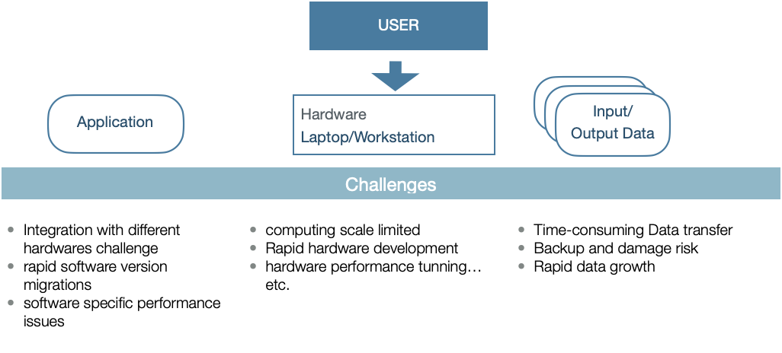
Users’ Challenges

Slide 13

Workflow of User Support
User Support & Customization
Application on various hardware platforms
Scalable computing resources according to your requirements
Transparent data space & easy data sharing in your research group
User Training & Consulting Service for Technical Issues
SLURM Service
DiCOS-Apps (Cloud SaaS)

Slide 14
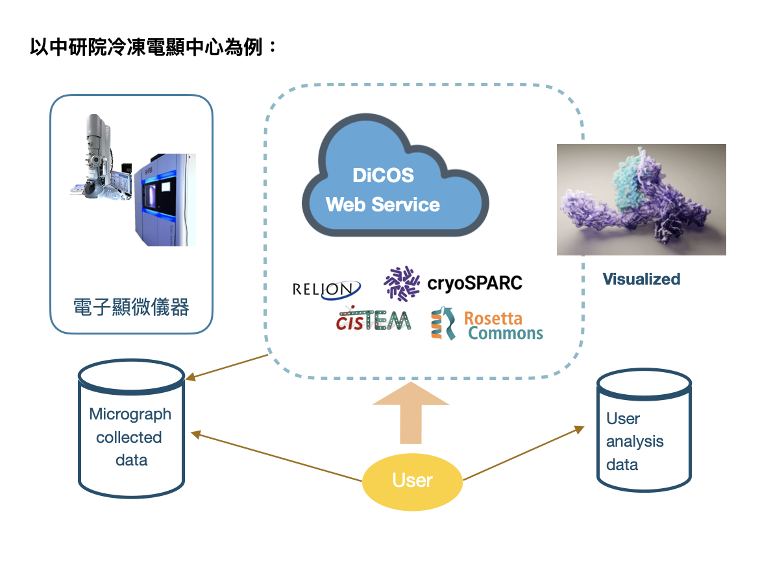

Slide 15
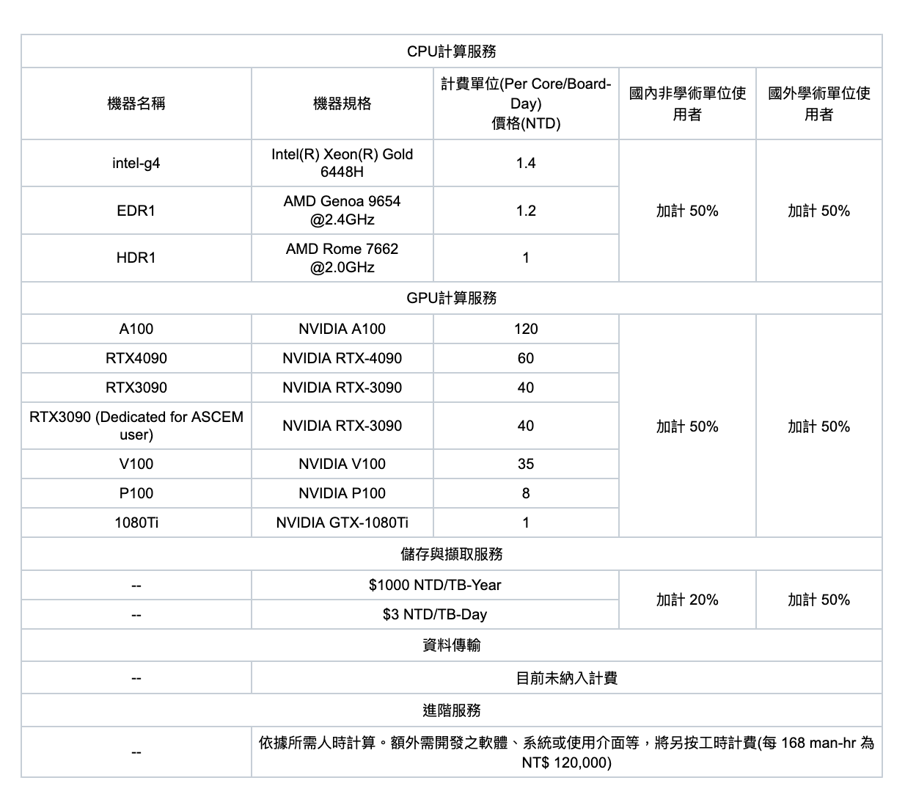
Pricing for Computing Service
More details in
https://dicos.grid.sinica.edu.tw/resources
https://nstccore.twgrid.org/access.php#pricing

Slide 16

Technical Support
Help Desk & Service Notification
Rocketchat online chat - https://rocketchat.twgrid.org/channel/general
Email - dicos-support@twgrid.org
Portal - https://nstccore.twgrid.org
Release up-to-date services status, group usage, pricing and technical relevant information

