Slide 1
User Management
10 April, 2025

Slide 2
User Management - Group & Account Policy
https://dicos.grid.sinica.edu.tw/policy
Group Accounts:
  PI is responsible for group management, including payment & members management
User Accounts:
  Password & Account Expiration (ISO security)
    6months validation, password & account expiry notification will be sent on 7, 15 and 30 days to expiration.
    Account Deletion: Your account & user space(UI_home directory & work directory) will be removed after 6 months of expiration.

Slide 3
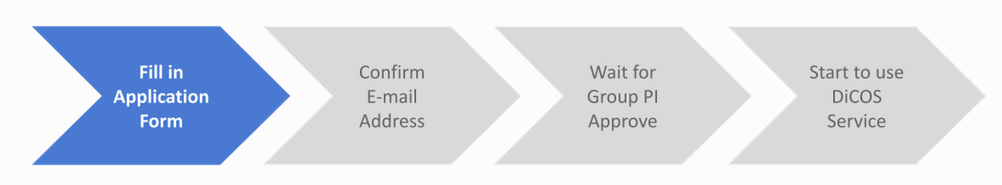
Group & User Management
PI
Users
Fill Group
Application
Form
DiCOS Admin
Approved
Notify PI when
Group Setup Done
User Account
Register under your PI’s Group
Your PI’s approval
Group Account
User Account
PI’s User Account
Group Accounts
  https://canew.twgrid.org/ApplyAccount/groupcreate.php
User Accounts
  https://canew.twgrid.org/ApplyAccount/ApplyAccount.php

Slide 4
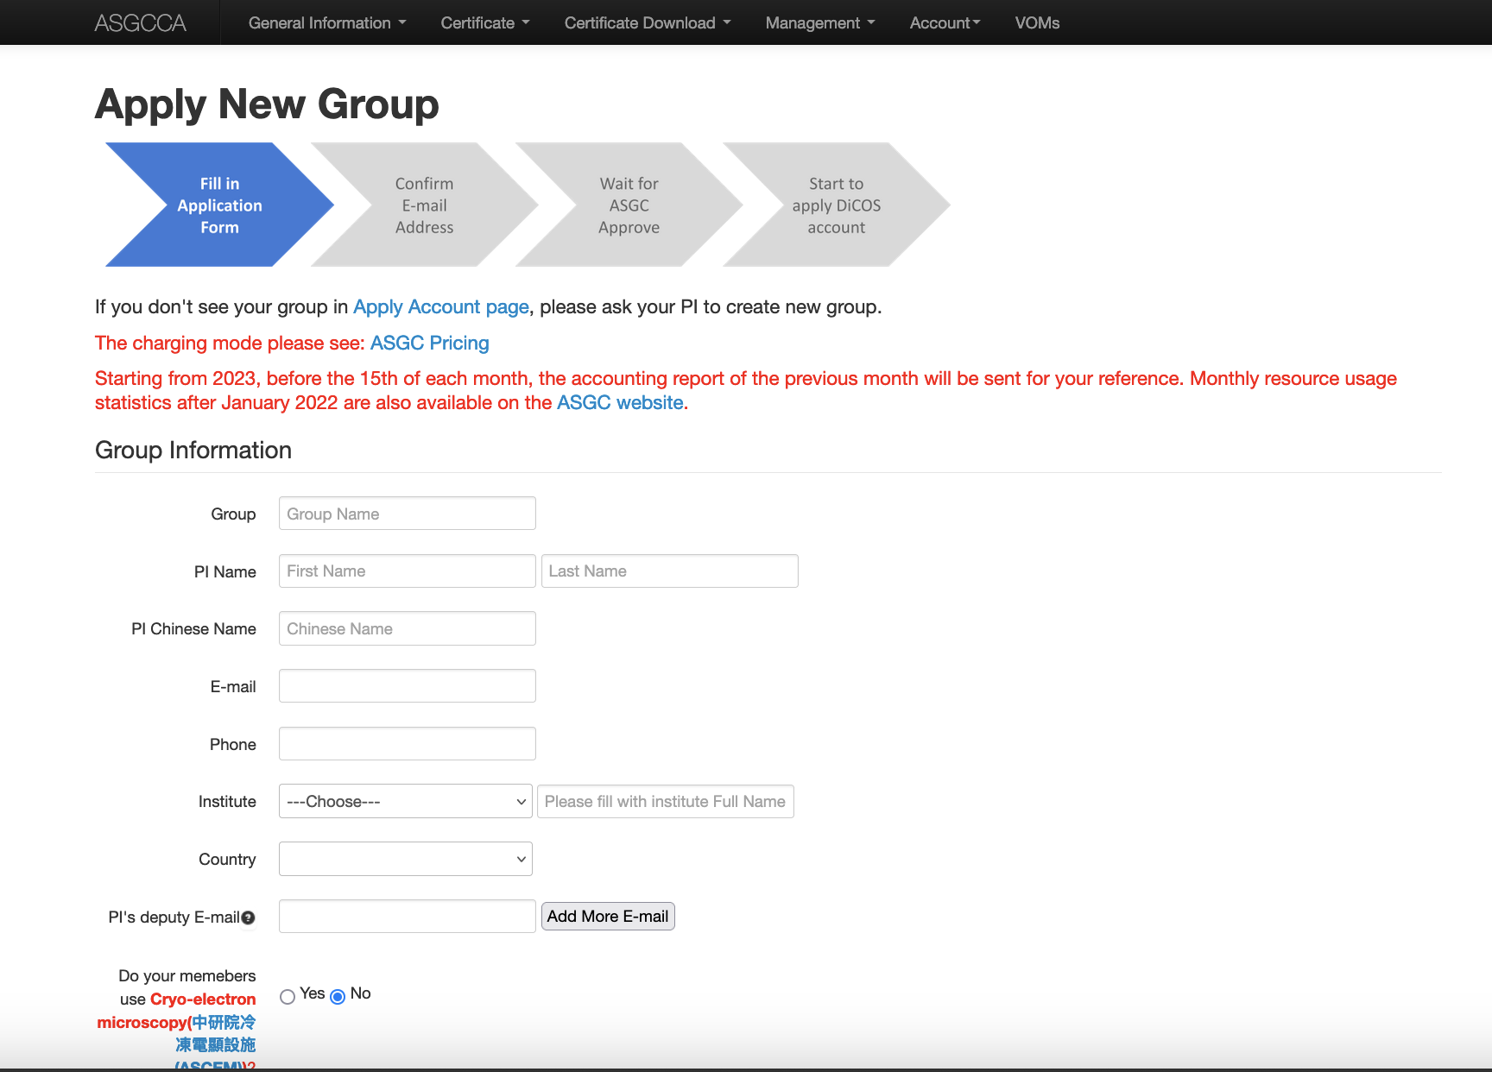
https://canew.twgrid.org/ApplyAccount/groupcreate.php

Slide 5
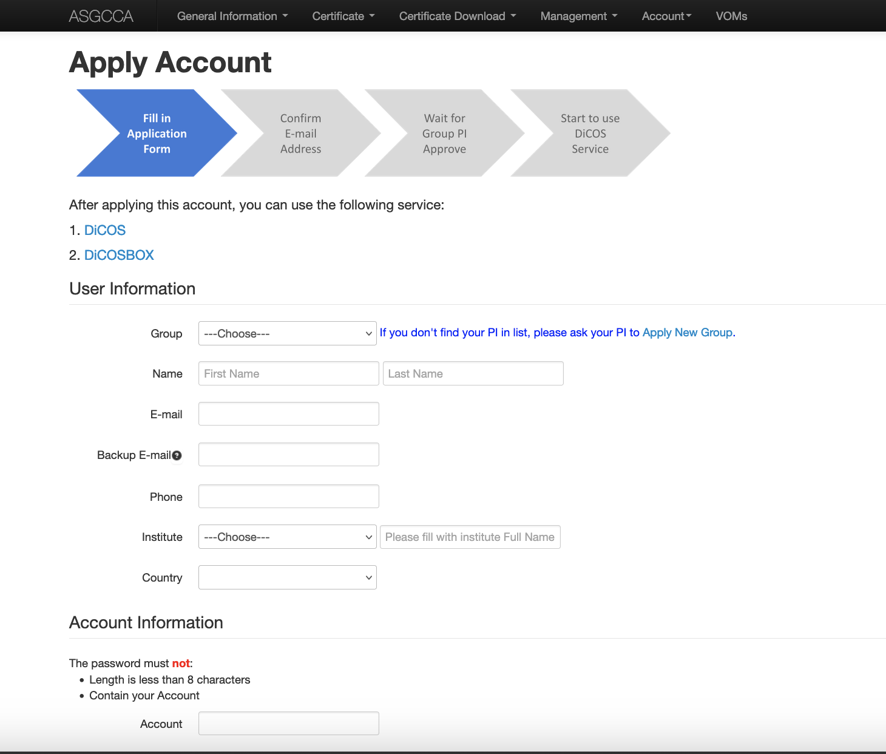
User Management

Slide 6
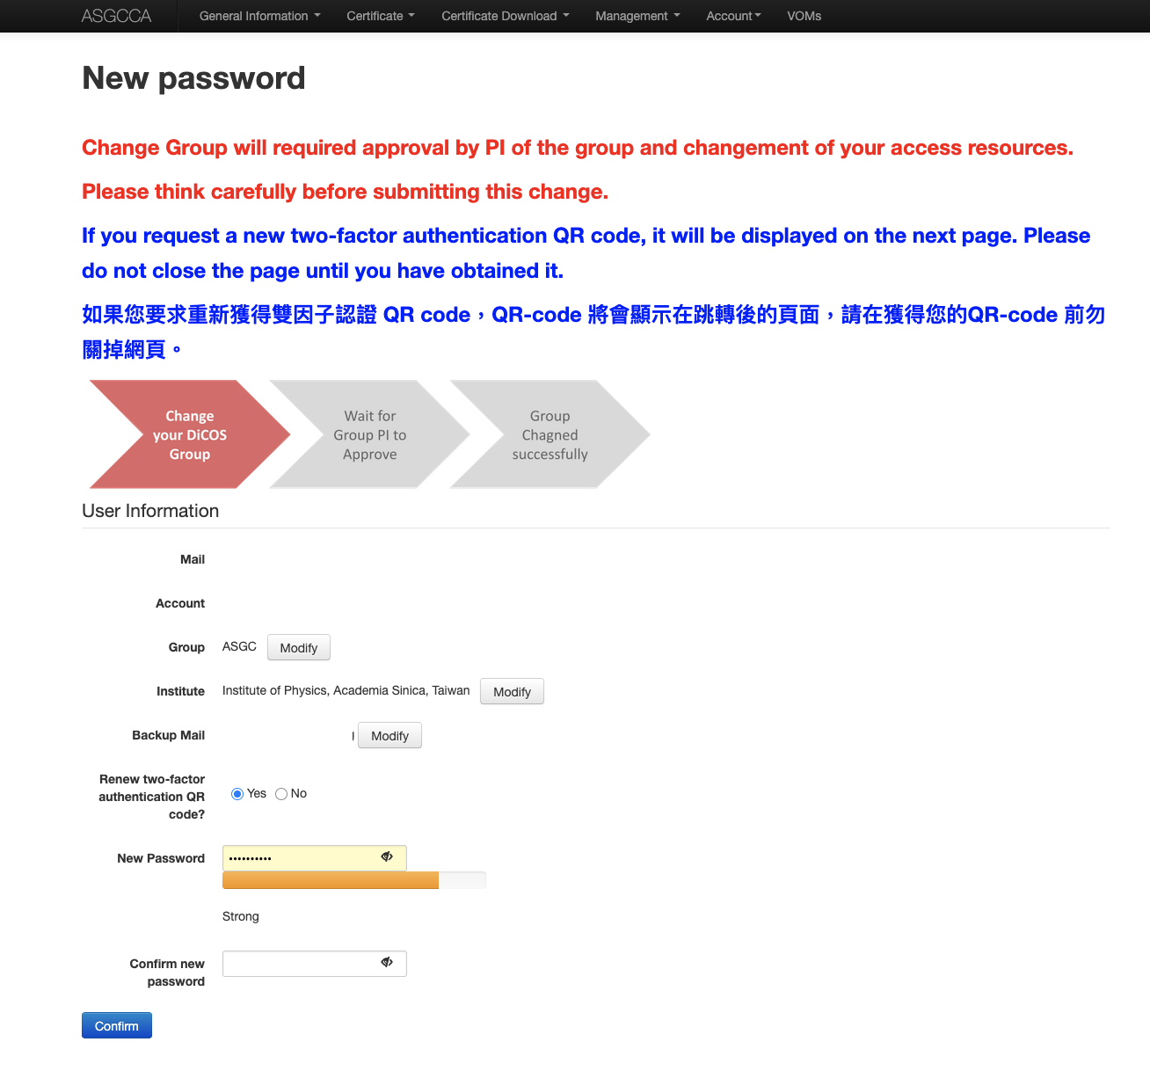
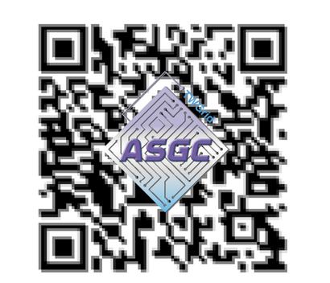
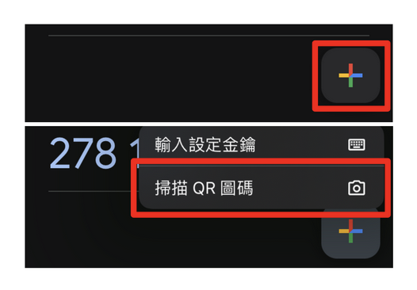
User Management - Two Factor Authentication
Two-Factor Authentication Support from January 2025
  Google Authenticator (Install on your mobile device)
  Get your own associated QR code via https://canew.twgrid.org/ApplyAccount/nocertModify.php
  Scan the QR code to set up for your Google Authenticator
  Obtain 6-digit verification code to access the computing services.
  See instructions via https://canew.twgrid.org/ApplyAccount/howToSave2faCode.php

Slide 7
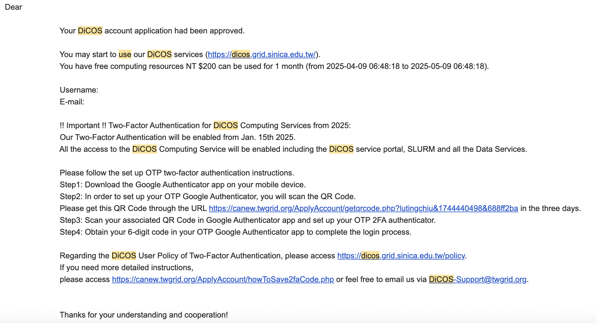
User Management - Two Factor Authentication
Two-Factor Authentication Support from January 2025
  Get your own associated QR code via https://canew.twgrid.org/ApplyAccount/nocertModify.php
  Receive an email as below to download your associate QR code

Slide 8
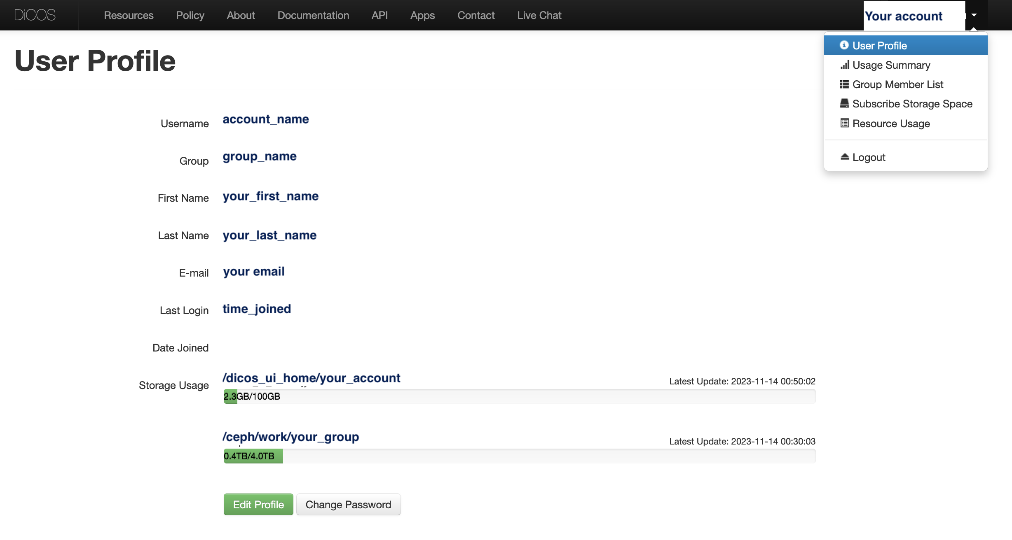
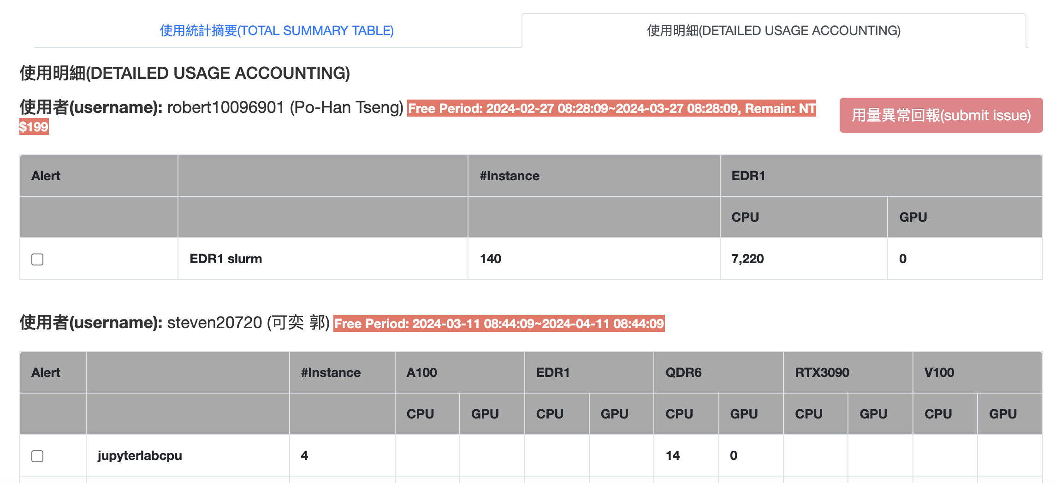
User Management - User
User Profile
  Change Group* (PI approve)
  Change Password*
    http://canew.twgrid.org/ApplyAccount/nocertModify.php
Resource Usage
  Free $200 Credits for Trial 1 month
  Storage Usage

Slide 9
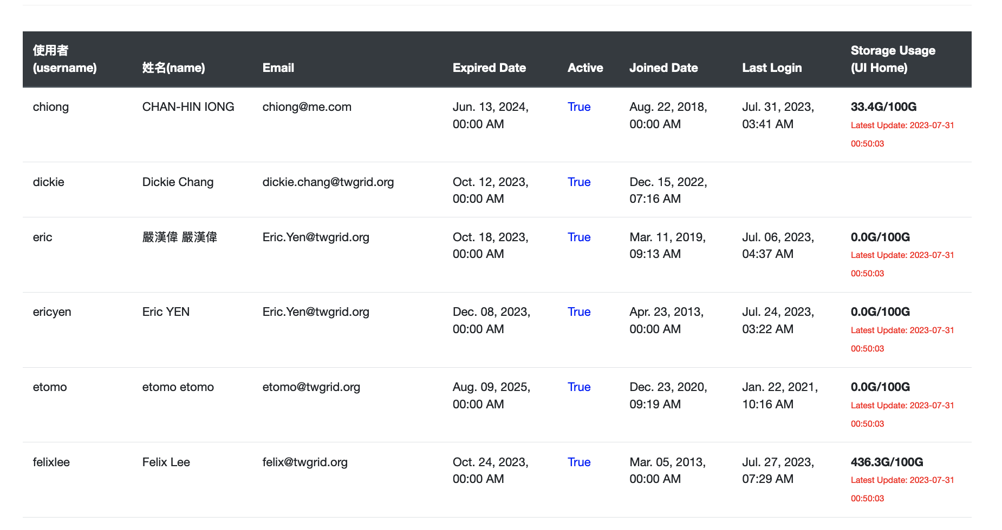
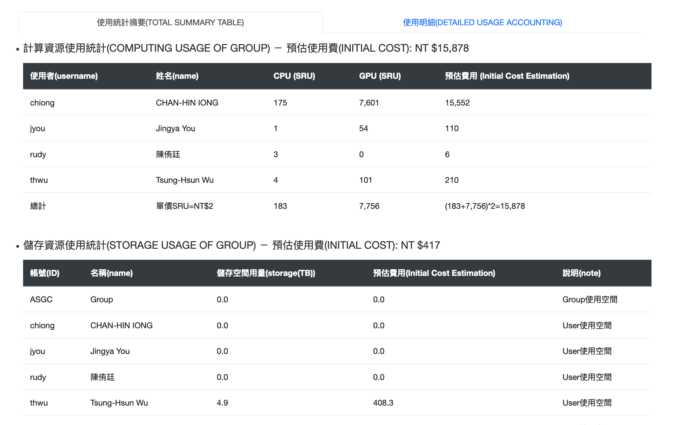
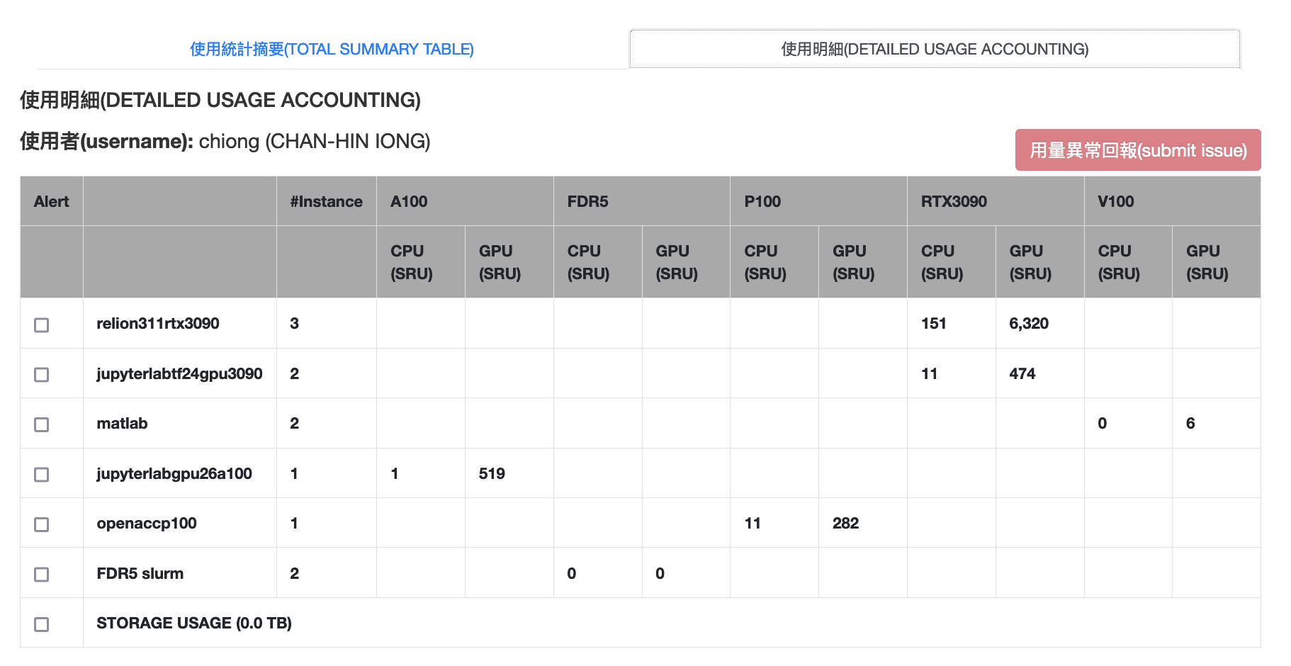
User Management - Group
Members management
  Members list
  Abnormal member usage report
  Member’s usage review

Slide 10
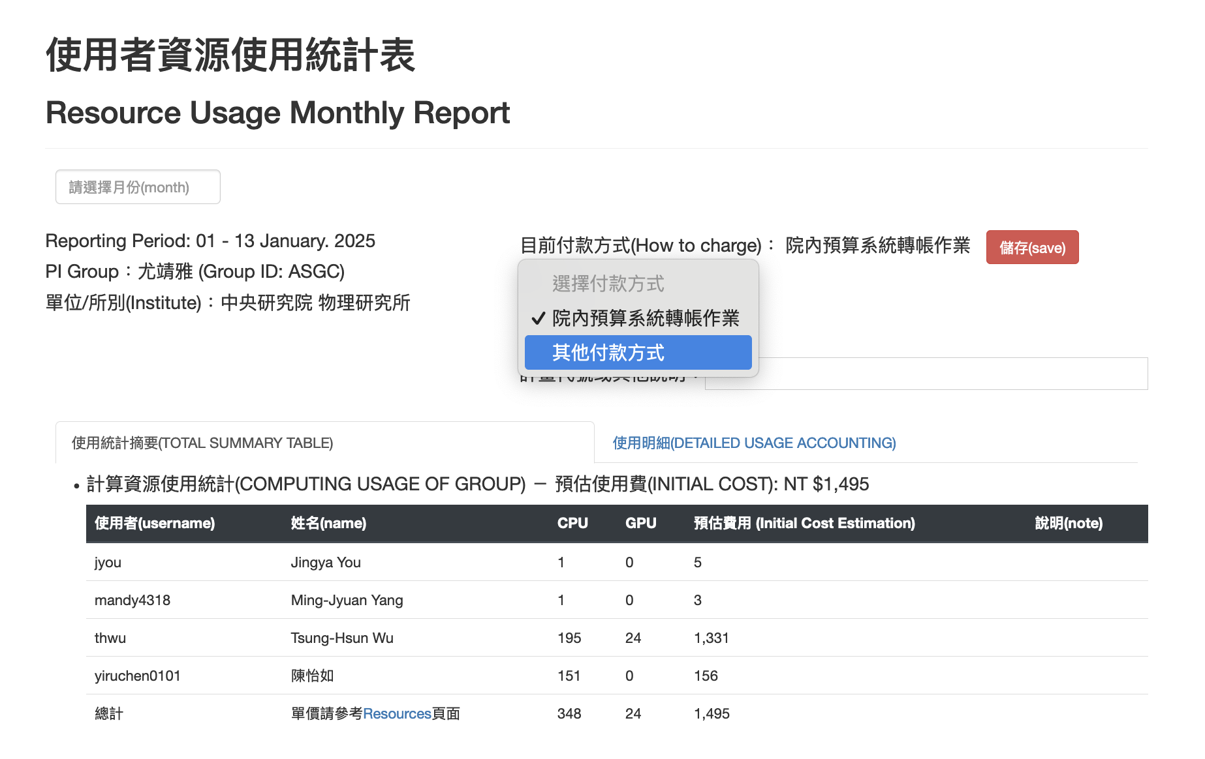
User Management - PI’s Billing Management
Resource Usage Management
  Resource Usage
Budget & Payment Management
  Monthly Bill will be delivered every month
    https://dicos.grid.sinica.edu.tw/accounting/bill/
  Payment Management
  How to Make Payment
      https://nstccore.twgrid.org/access.php#pricing

