Slide 1

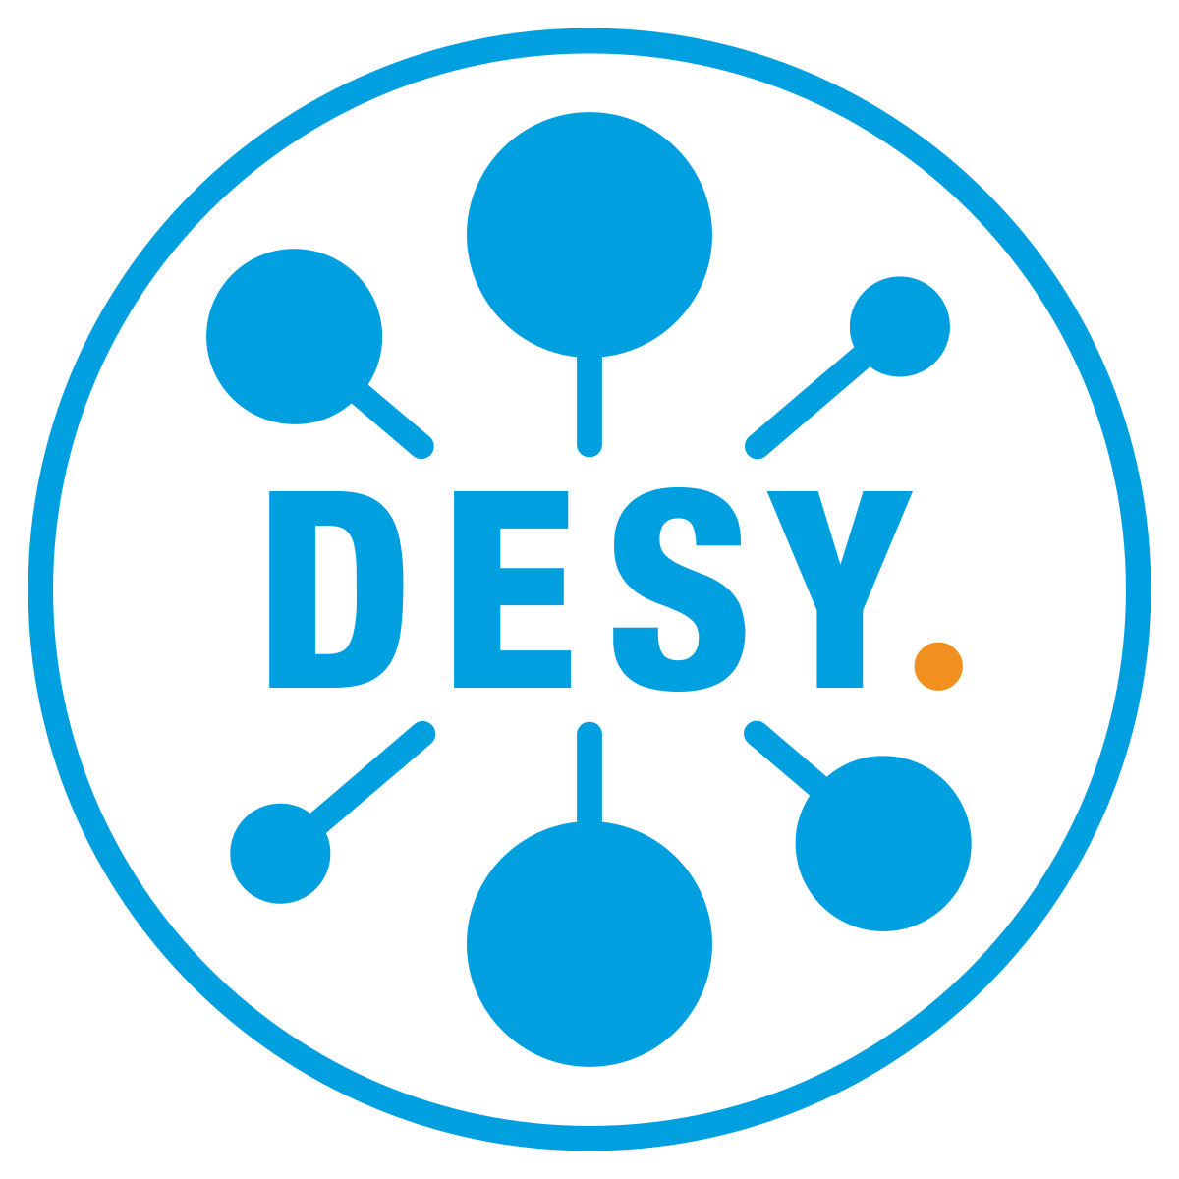




Unified Data Access and Visualization Framework for Photon Science
Field: Federated Infrastructure
PHOTONIC @ ISGC
Photon Science - Harmonized Online Tools for Open, Navigable, Interactive Computing
By Patrick Fuhrmann
With contributions by Linus, Devin, Sophie, Paul, Tim, Nicolas, Luca, Thomas, Shruti and Sebastian

Slide 2
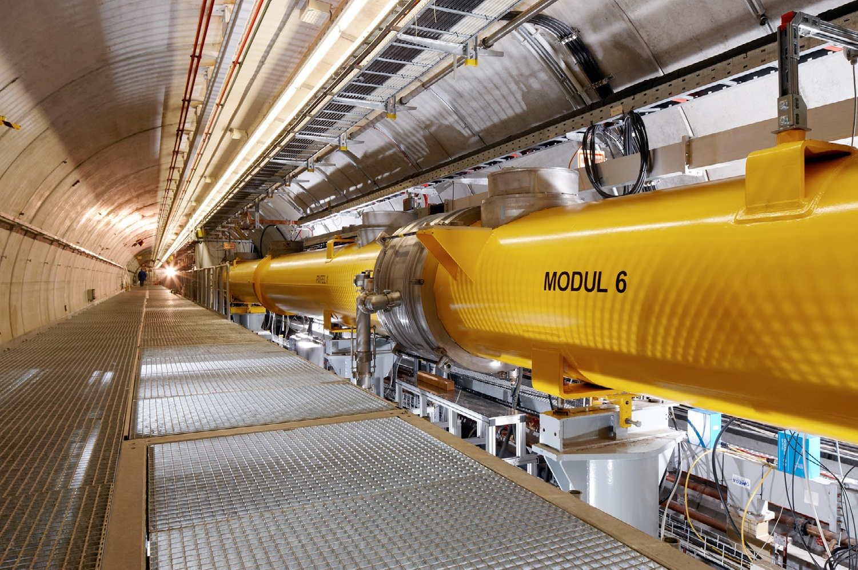
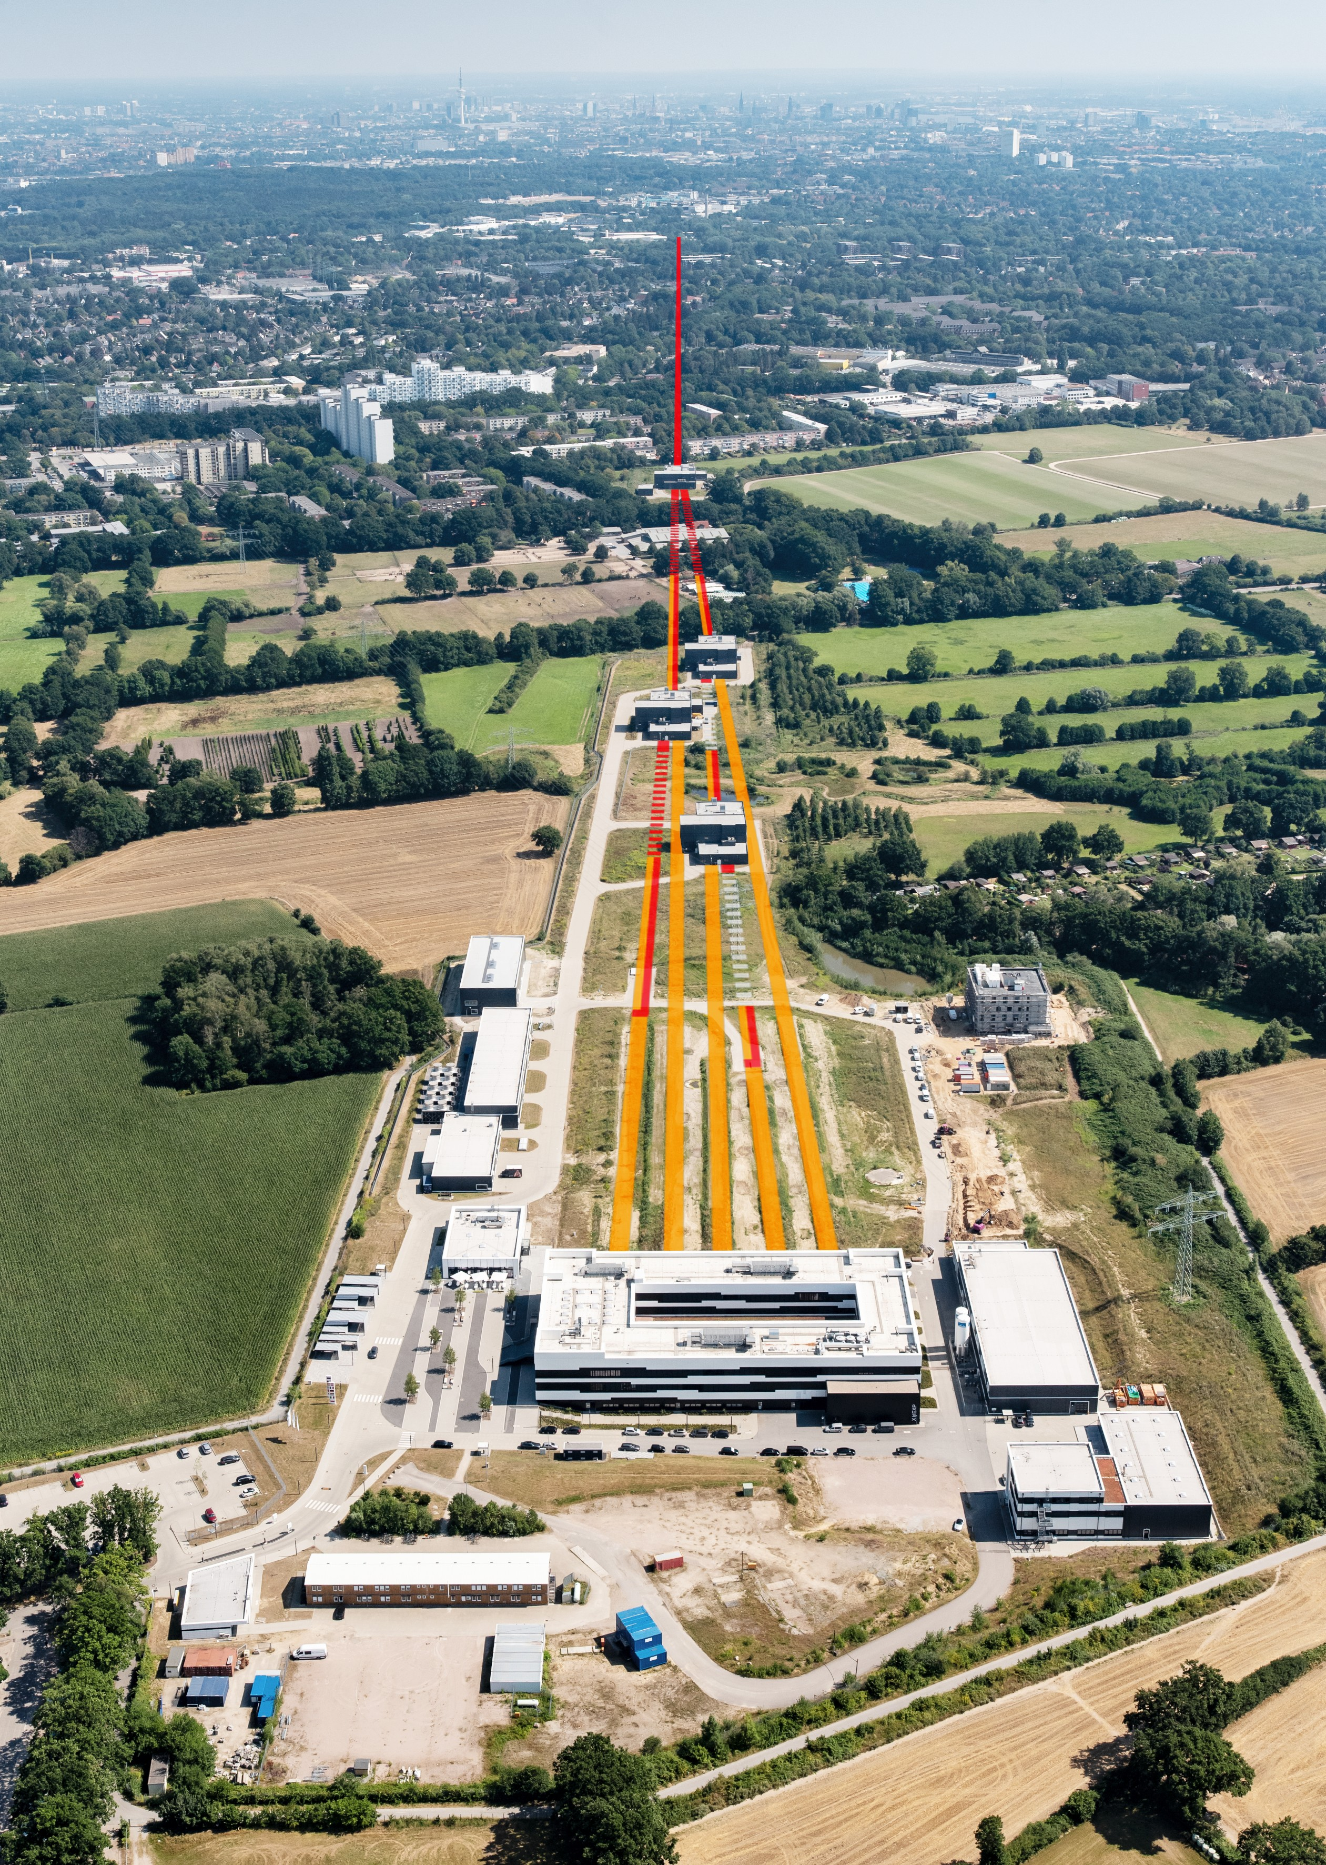
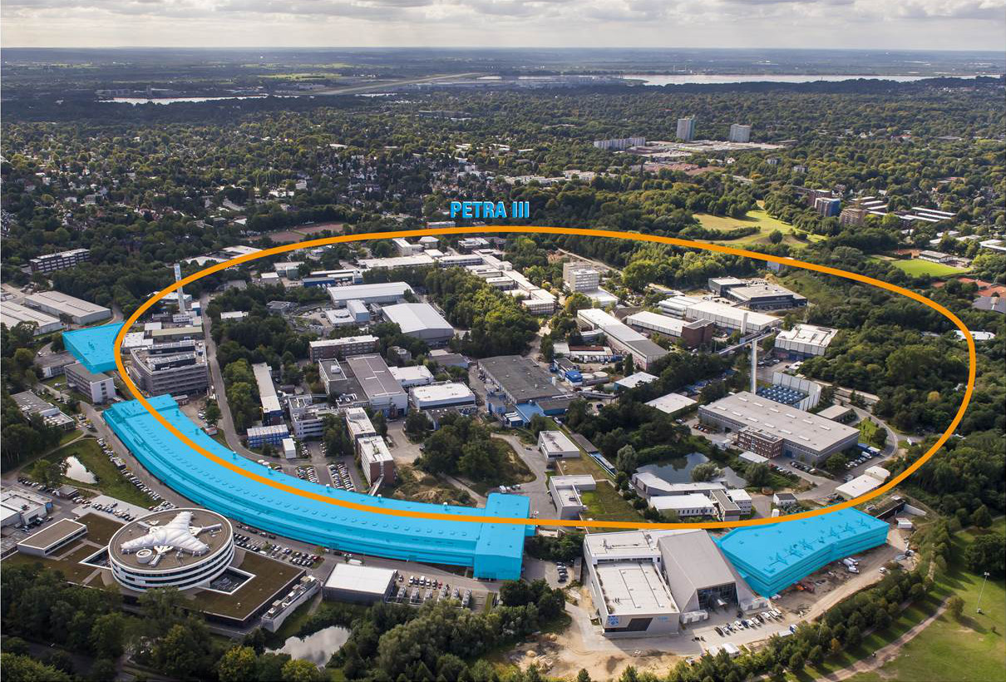
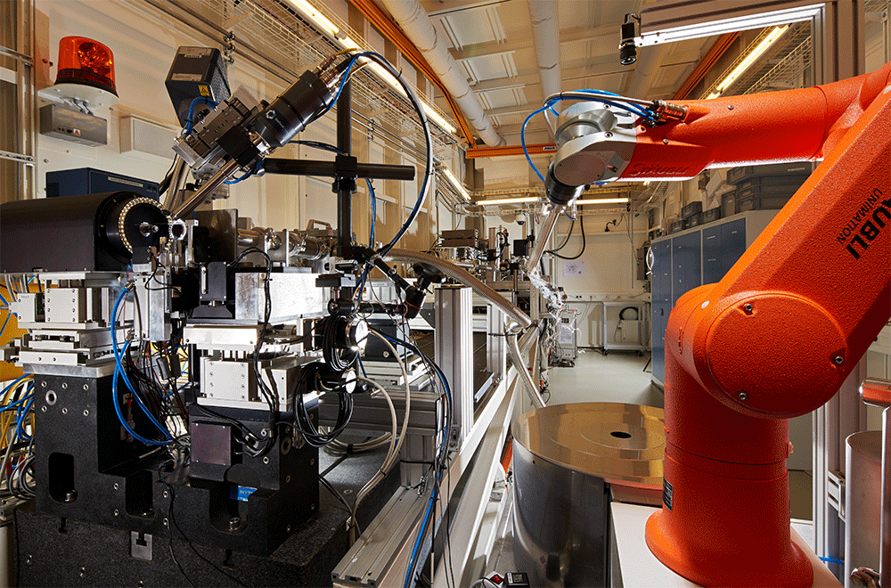
Our Data (light) sources
EU-XFEL
FLASH
PETRA III
P11 - High-throughput Macromolecular Crystallography beamline

Slide 3
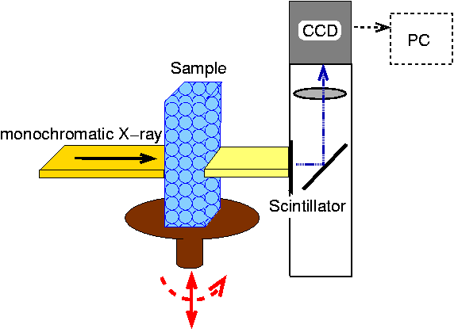
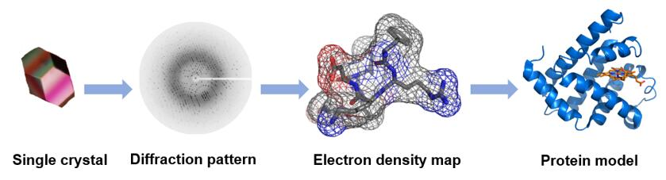
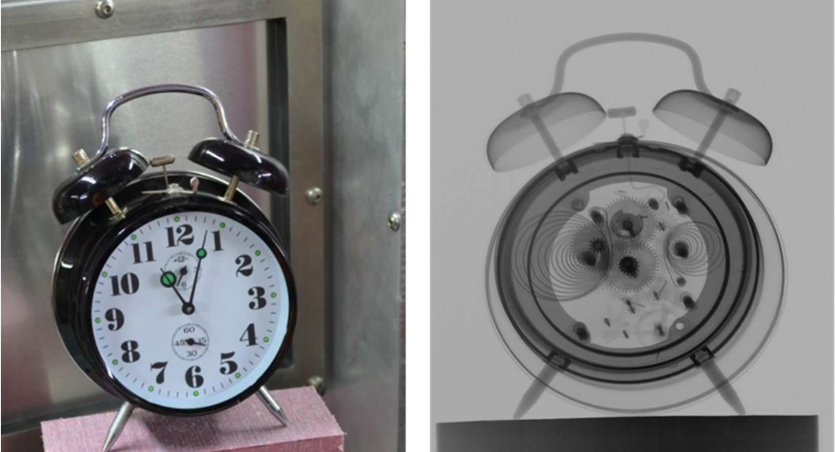
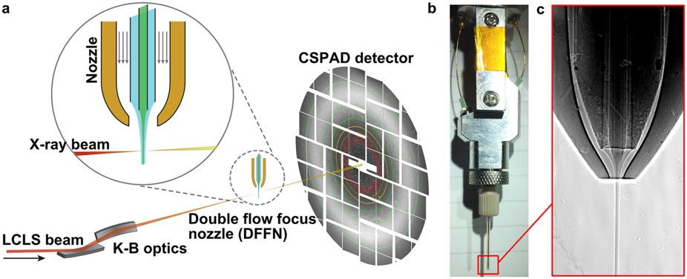
Using Photons and Neutrons
Conservative Crystallography
Photon Tomography
Neutron Tomography
Serial Crystallography
A new Neutron Radiography / Tomography / Imaging Station DINGO at OPAL
Plasma Physics, Quantum Physics , ******
See Lightsources.org
The experiments at the light sources at DESY range from basic to application-oriented research by science and industry in the fields of physics, chemistry, biology, medicine, life sciences, geosciences, materials science and the study of cultural assets.

Slide 4
Applications
The experiments at the light sources range from basic to application-oriented research by science and industry in the fields of
physics,
chemistry,
biology,
medicine,
life sciences,
geosciences, materials science
and the study of cultural assets.

Slide 5
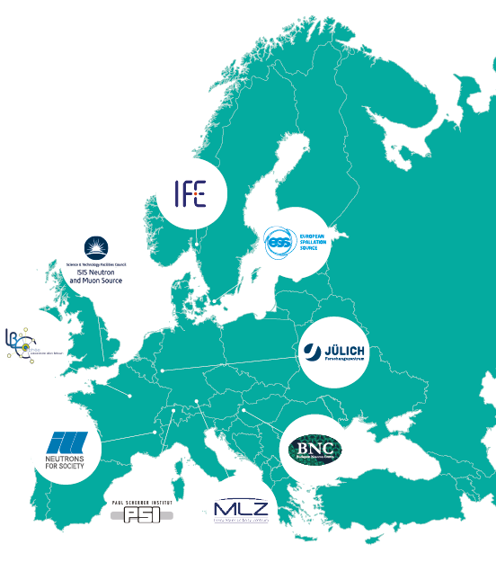
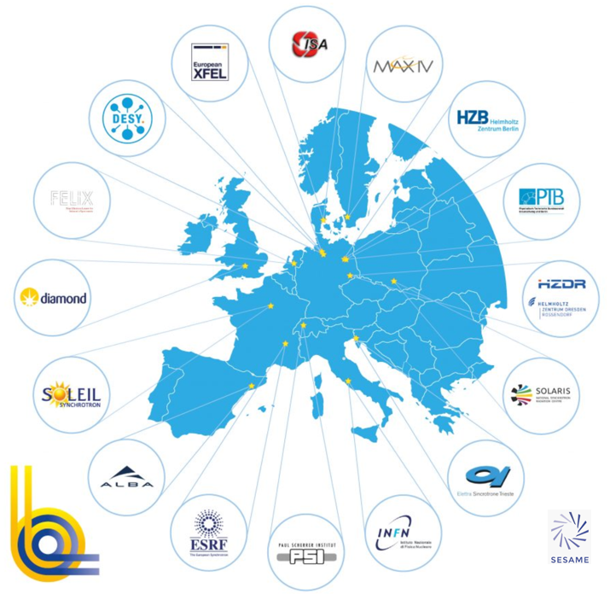


European Synchrotron Landscape
Photon (LEAPS)
Neutron (LENS)
Upgrade program
to generation 4. synchrotrons
Courtesy: LENS
Courtesy: LEAPS

Slide 6


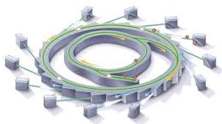

What is the issue we need to solve!
Those devices produce a huge amount of data, but the time and capacity of the connected RI (Computer Centre) is limited.
And a large portion of science is done by research groups (students) at the Universities.
GOAL: Providing universities with access to scientific data generated by high-volume facilities, such as synchrotrons, to enable remote visualization and analysis.

Slide 7
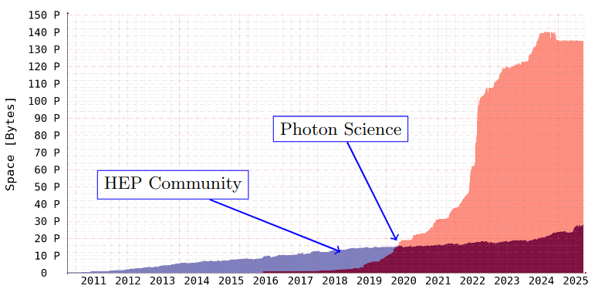
Why would that be an issue ?
On DISK storage per scientific community at DESY.
There are techniques (beamlines) creating petabytes of data per beamtime within a couple of days.
On DISK storage per scientific community at DESY. With the start of the EU-XFEL and PETRA III, the Photon Science community dominated the storage needs (significantly)

Slide 8
What does this mean for Uni’s
Depending on the experimental technique, synchrotron facilities generate data volumes that often exceed the transfer, storage and analysis capacities typically available at universities.
Providing carefully selected (“smart”) subsets of the data therefore enables much more efficient remote access to the information most relevant for analysis and live visualization.

Slide 9
What to do ?
Therefore DESY and the Uni’s Kiel and Siegen with partners like the Eu-XFEL and BESSY II (HZB) applied for a grant from our science ministry for provide a prototype to fix the issue.

Slide 10

The Cheat Sheet
Name | PHOTONIC
Funding ID | BMFTR : C3 13K2500180 PHOTONIC
PT | VDI Technologiezentrum GmbH
Start / Duration | 2025-11-01 for 3 years unti 2028-10-31
Partners | DESY, Uni Siegen, Uni Kiel
Associated | HZB, EU XFEL
Funding | DESY: 2 * 36 PM; Siegen: 36 PM; Kiel: 36PM
WP | Title | Lead | Partners / PM
 |  |  | DESY | U Siegen | U Kiel | Total
1 | Coordination | DESY | 12 | 1 | 1 | 14
2 | Backend Services | DESY | 49 | 0 | 0 | 49
3 | Standardization | DESY | 10 | 4 | 4 | 18
4 | Use Cases & Client Tools | Kiel | 0 | 25 | 25 | 50
5 | Dissemination, Outreach | Siegen | 1 | 6 | 6 | 13
 | Total |  | 72 | 36 | 36 | 144

Slide 11



The team and further info
photonic-project.org
gitlab.desy.de/photonic
Position | Team
Project Coordinator | Patrick
Technical Coordinator | Tim Wetzel
WP1 Coordination | Sophie Servan
WP2 Backend services & Data Access | Devin Bourke
WP3 Data Formats and Transcoding | Paul Millar
WP4 Use Cases and Client Tool integration | Bridget Murphy, Ajit later
WP 5 Dissemination and outreach | To be hired (good candidate)
Remaining team | Shruti, Sebastian, Ajit

Slide 12

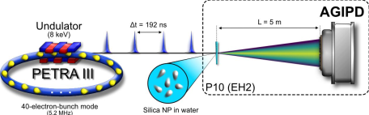
Two Use Cases
Use Cases
XRR
XPCS
X-Ray Reflectivity Analysis
X-Ray photon correlation spectroscopy

Slide 13

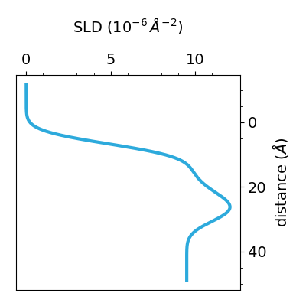
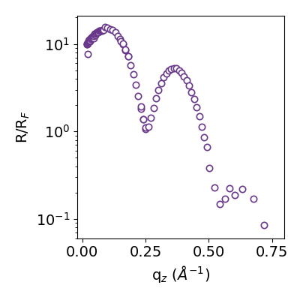




X-Ray Reflectivity (XRR) Analysis
From Nicolas
X-ray reflectivity measurements (XRR) is an established and widely used technique for investigating nanoscale structure at solid and liquid interfaces and surfaces, e.g. semiconductor components and lipid Langmuir films. From the characteristic curve of XRR, conclusions can be drawn about the nature of the sample interfaces, in particular the electron density, layer thickness, and roughness of the interfaces down to atomic resolution.
What can XRR reveal about surfaces and interfaces?
Reflectivity curves are converted to density (Scattering Length Density) profiles
Phase problem: XRR does not uniquely imply SLD
Modeling with prior assumptions + parameter optimization
Time- & Labor-intensive
$$z$$
$$ρ_{0}$$
$$ρ_{1}$$
$$ρ_{2}$$

Slide 14
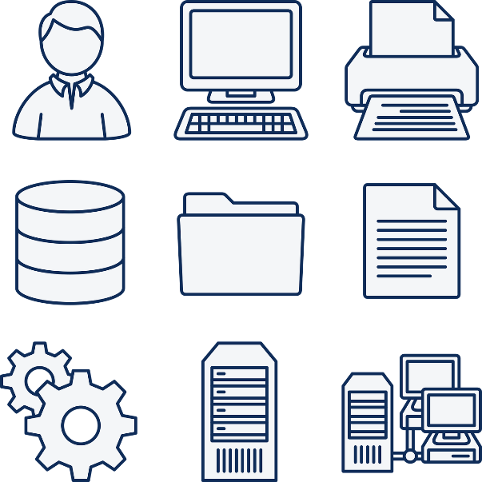
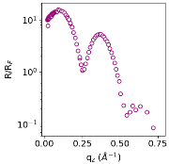

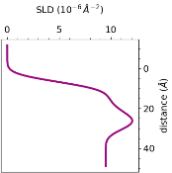
XRR Data Management
From Nicolas
Beamline GPFS
Core Fast Storage
After ≈ 6 months
Tape Archive
User Needs
Intuitive Real-Time Visualization
Data Comparisons
Access to Data from previous Beamtimes
Full Copy
Raw Data
Initial Extraction
User
University Storage
Re-Extraction
Model Fitting

Slide 15
XRR Summary
From Nicolas
XRR Requirements
XRR Users need interactive data exploration and visualization
Reusable analysis tools need common standards and stable interfaces
PHOTONIC’s work
Standard XRR data interoperability formats
Accessing & transcoding data
Integration with new client software

Slide 16
Use Case XPCS
X-Ray photon correlation spectroscopy
is a technique for studying dynamic phenomena in condensed matter systems in real time. XPCS is a rather young technique, which possible only due to the improvement of the coherence at modern synchrotron sources and free-electron lasers. The information on the dynamics, which can be extracted from the analysis, is rather unique in terms of the accessible time and length scales. The photon science use cases XPCS is performed at experimental stations MID at EuXFEL and P10 at PETRA III. These experiments produce extremely high data rates and volumes, often reaching petabytes per beamtime, requiring advanced tools for reaching near real-time analysis.

Slide 17
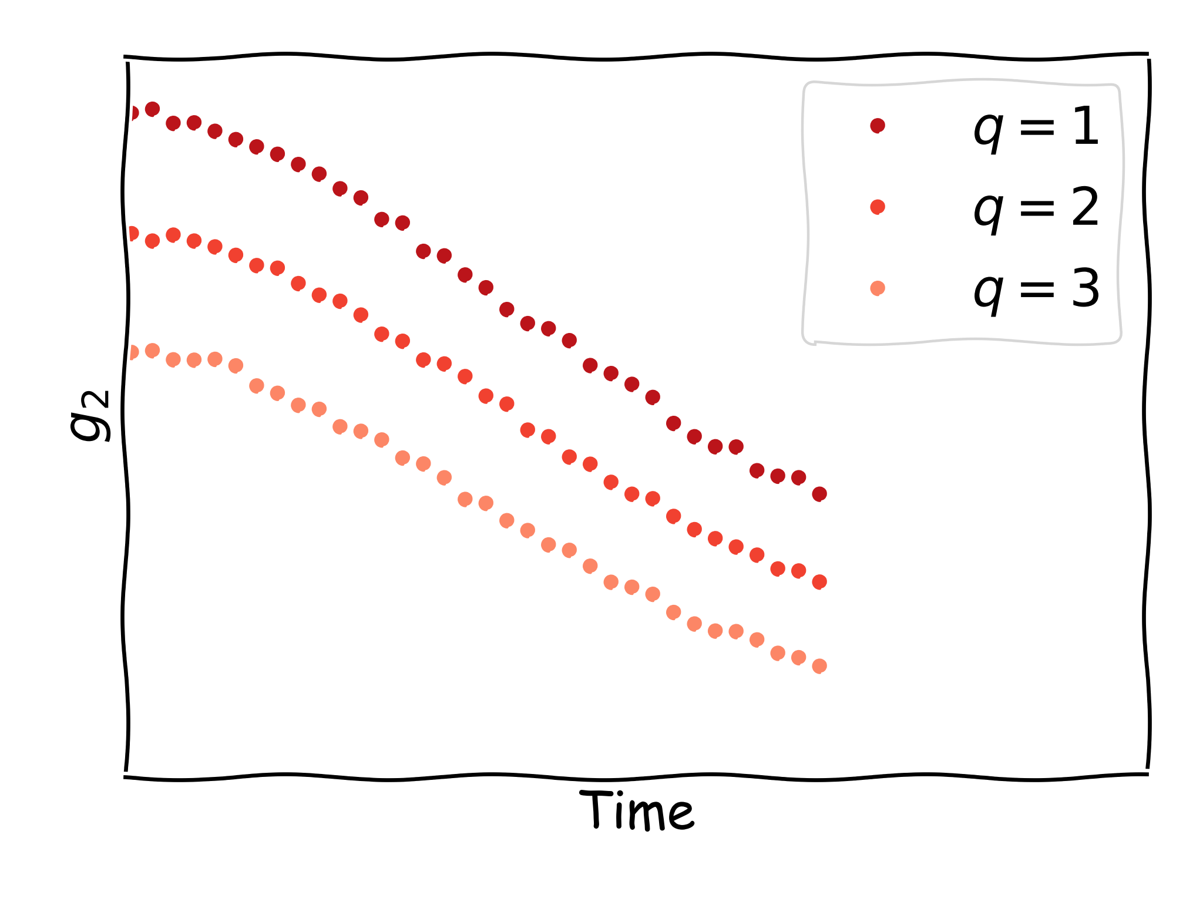
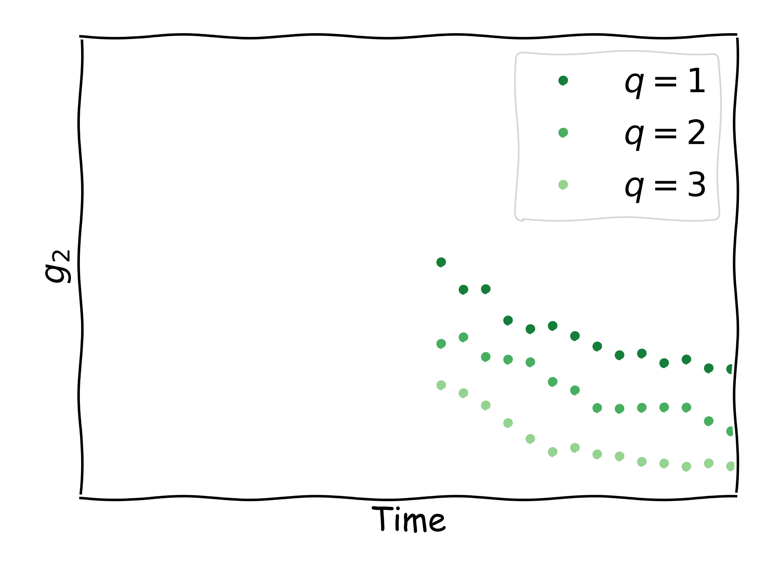
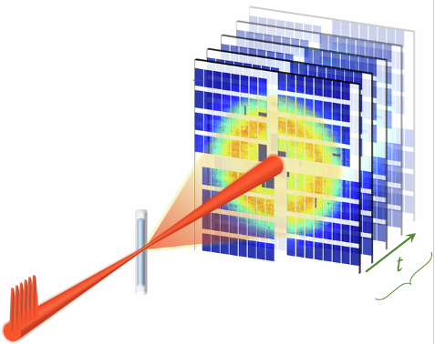
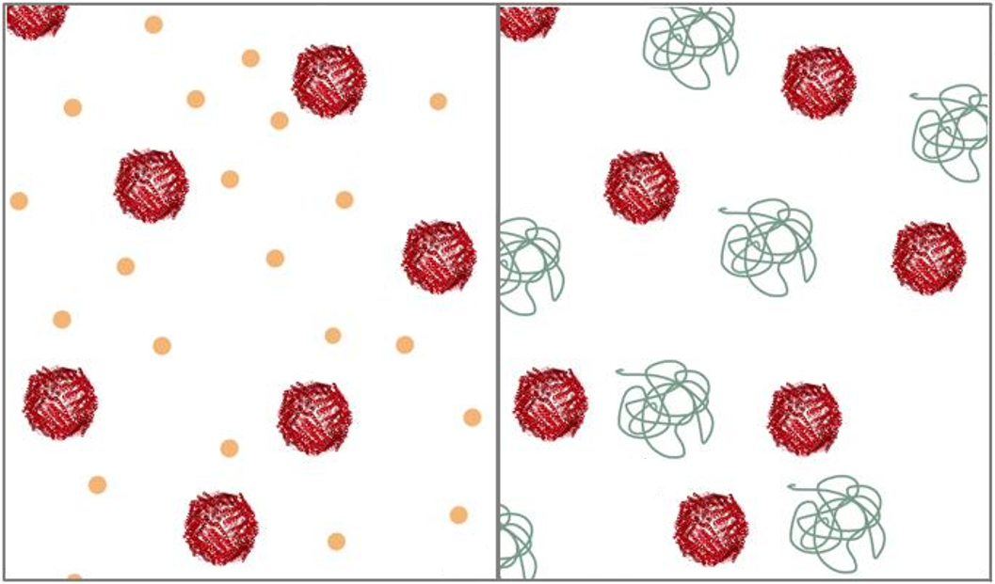


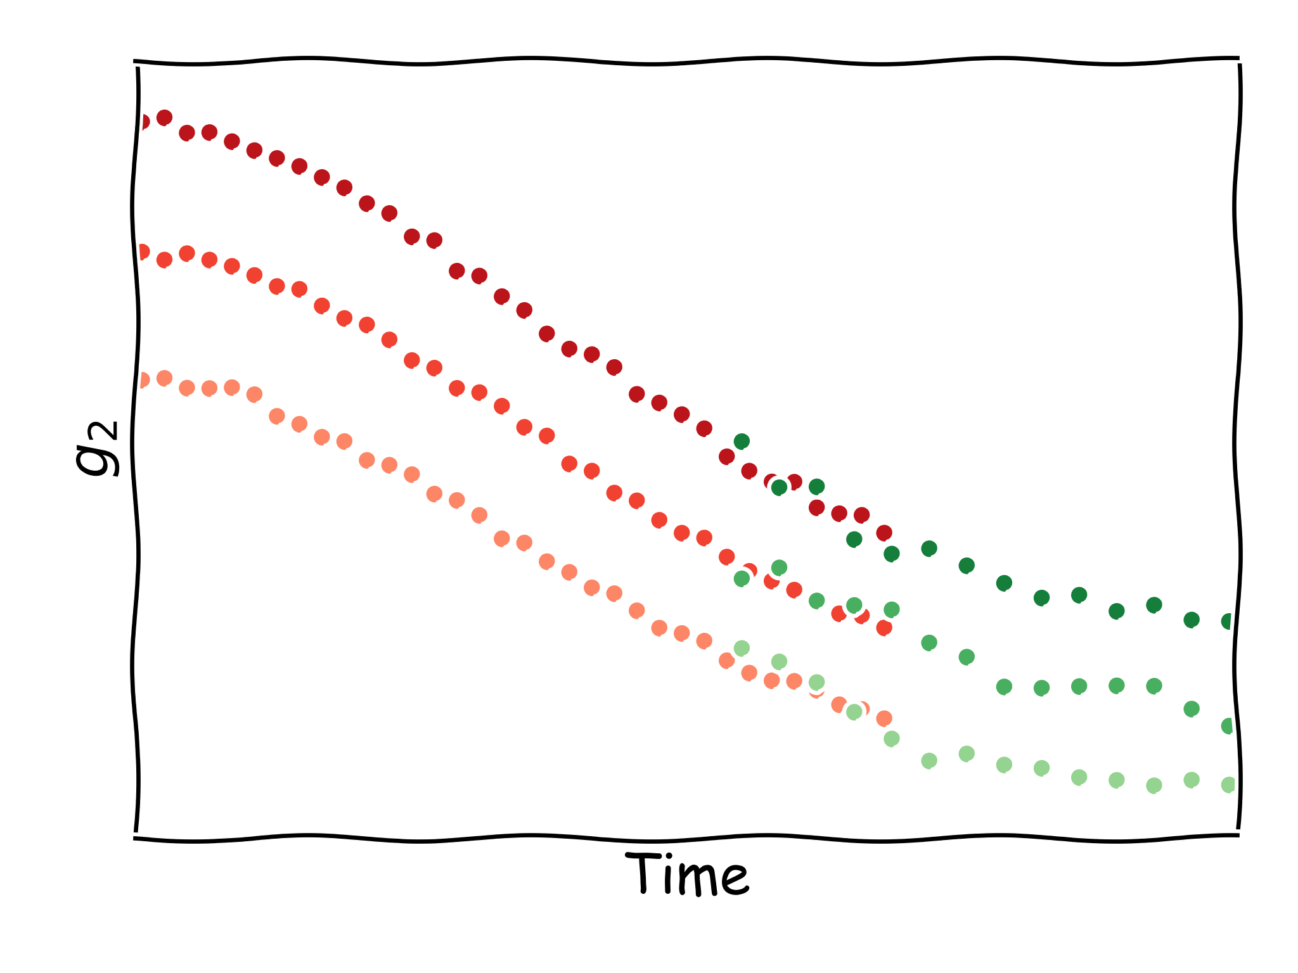
X-Ray photon correlation spectroscopy
From Luca and Thomas
10.1038/s41467-025-66972-6
from photonics import data
g2_euxfel = data(facility = "EuXFEL",
proposal = 8616,
run = 42)["g2"]
from photonics import data
g2_petra3 = data(facility = ”PETRAIII",
proposal = 11012345,
run = 3)["g2"]
XPCS delivers sample dynamics by correlating speckles in time.
Users can access XPCS results collected at EuXFEL and PETRA III, and use them together.
Results are transcoded to a common data format.

Slide 18
High level goals (more specific)
Now as we understand some use cases we can define more detailed requirements!

Slide 19
High level goals (more specific)
Accessing specific slices of data from a recent or ongoing experiment at their home institutions for visualization or ad-hoc data analysis.
Using a personal laptop during beamtime (e.g., via eduroam Wi-Fi) to conveniently access live data generated during the ongoing measurement.
Exploring experimental data after completing a beamline experiment, using facility-provided computing clusters for initial data reduction and analysis to identify publishable results.
Training on open datasets to prepare for and optimize upcoming beamtime experiments.
Supporting Open and FAIR data principles by enabling the download of datasets from other experiments once the embargo period has ended

Slide 20
The Architecture
From Tim
Existing
New Components
Data Sources / Facilities / Infrastructures
Universities
PETRA
EU-XFEL
Bessy II
Tiered
Storage
API Server
API Client
REST API
H5 web
Beamline
e.g.
ASAP:O
.nexus
e.g.
ASAP:O
Transcoding
Plugins
Analysis Pipeline
Beamline
nexus
.ort
ort
XPCS domain core
Beamline
.h5
ort
Beamline
---
XRR Visualization
--- ----
Access Permissions
Helmholtz ID

Slide 21
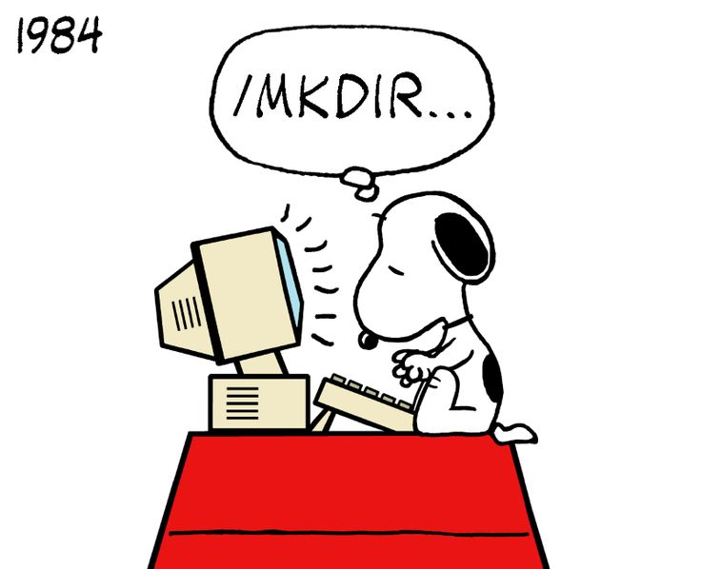
Our software stack
Our software Candidate(s)

Slide 22
Tiled by Bluesky
https://github.com/bluesky/tiled
https://blueskyproject.io/tiled/
From Devin
Tiled is a service that enables secure, structured access to scientific data.
Supports search, remote slicing, format conversion, and live data streaming.
Developed at NSLS-II, it is seeing production beamlines at American facilities and experimental use at Diamond and HZB BESSY-II.
Ships with a python client API for easy integration into server and client systems.
Two development instances now run in our DMZ-photonic Kubernetes cluster at DESY.

Slide 23
Tiled by Bluesky (cont.)
Tiled is a data access service for data-aware portals and data science tools.
Tiled integrates with Python data science libraries, but nothing about the service is Python-specific;
it also works from a web browser or any Internet-connected program.
Tiled’s service can sit atop databases, filesystems, and/or remote services to enable search and structured,
chunkwise access to data in an extensible variety of appropriate formats,
providing data in a consistent structure regardless of the format the data happens to be stored in at rest.
Tiled enables slicing and sub-selection to read and transfer only the data of interest,
Users can access data with very light software dependencies and fast partial downloads.
Tiled implements extensible access control enforcement based on web security standards
Tiled can be configured to use third party services for login, such as Google, ORCID. or any OIDC or SAML authentication providers.

Slide 24
Proof of concept : H5web by ESRF
h5web provides scientists with immediate insights into datasets through visual representation.
This allows users to efficiently identify and select the most relevant parts of a dataset for download.
h5web has gained a substantial user base beyond ESRF while also offering extensions for JupyterLab and Visual Studio Code.
Currently, the two approaches are not interconnected but can be viewed as complementary.
Significant value is anticipated from developing bridges between these tools, greater utility for scientific data workflows.

Slide 25







Service Infrastructure Architecture
Service to
Universities
Helmholtz
ID
DESY
Dynamic
Cloud System
Bluesky Tiled Services / REST Services
High Performance
Highly Redudant
ASAP:O
Tiered Storage

Slide 26

Integration
PHOTONIC integration into infrastructures, initiatives and stuff!
Sustainability !!!

Slide 27





Other friends

Slide 28
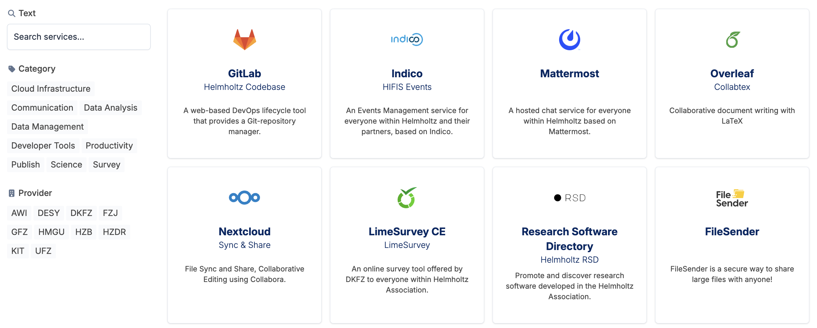
Intergration into the Helmholtz Cloud
Starting with TRL 7 - 8
PHOTONIC
Unified Data Access and Visualization Framework for Photon Science

Slide 29
And more links too ….
Helmholtz Research Software Directory, RSD
The RSD is Open Source and is developed by the Netherlands eScience Center in collaboration with the HIFIS Software Community.
Collaboration with the Bluesky/Tiled developers
We hope to be able to contribute the repay them for their support.
Project will be tracked by LEAPS, WP3
LEAPS - the League of European Accelerator-based Photon Sources is the network of all Synchrotron Radiation and Free Electron Laser user facilities in Europe
LEAPS WP3 gathers LEAPS experts on topics around FAIR data management and open science. The aim of the WG is to share best practices and recent developments at the different partner facilities to keep a community approach on the road to FAIRer science we all need to take. (Chaired by Paul Millar, DESY) and Majid Ounsy, SOLEIL.

Slide 30
And more links too ….
Helmholtz Federated IT Services , HIFIS
Letter of Support to closely collaborate with HIFIS to integrate the PHOTONIC service into the
Helmholtz ID (AAI) including group management, and
Provide essential core services such as onboarding, accounting and chechology consulting
Additionally, HIFIS will feature PHOTONIC in the Helmholtz Cloud ecosystem, ensureing broad accessibliilty beyond the projects’s partner and duration

Slide 31

An experiment
Science Traceability Matrix

Slide 32
Science Traceability Matrix (STM)
What ?
A Science Traceability Matrix (STM) is a structured mapping that shows how high-level scientific objectives are translated into concrete technical requirements, data products, and system capabilities—and how everything stays connected and verifiable throughout a project.
Example !
Science Objective | Science Question | Operation Capability | Software Capability | WP | Service Requirement | Performance Requirement
Enable easy data access | How can researchers access sliced data without full transfers? | API must support partial data retrieval (e.g., 1D/2D slices, metadata-only). | Develop Direct Data Access API with transcoding modules. | WP2 | N.A. | N.A/
*** | *** | *** | *** | ***
Why ?
Completeness | Justification | Change control | Review Rediness | Accountability
No science goal without technical support | No technical feature without a science driver | If a science goal changes, you immediately see what’s affected | Funders and reviewers can audit logic end-to-end | Clear ownership

Slide 33
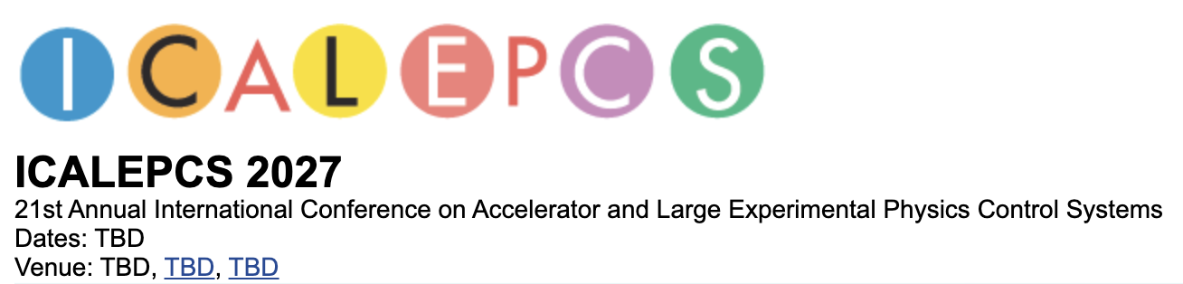
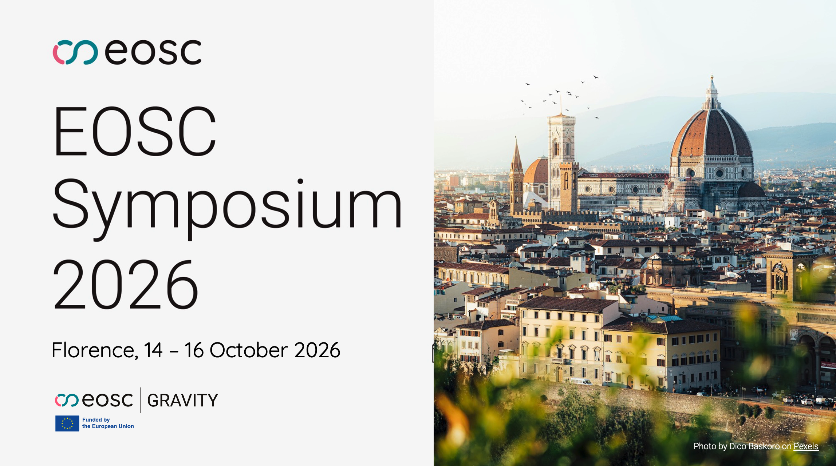

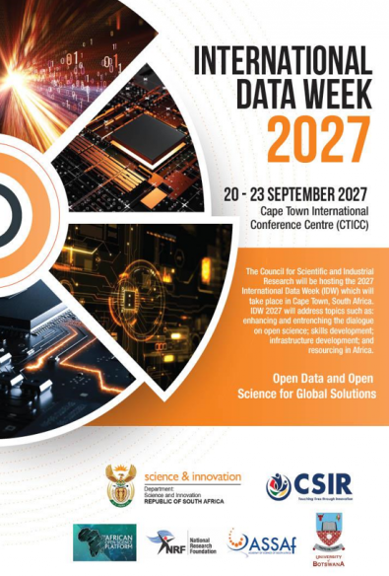
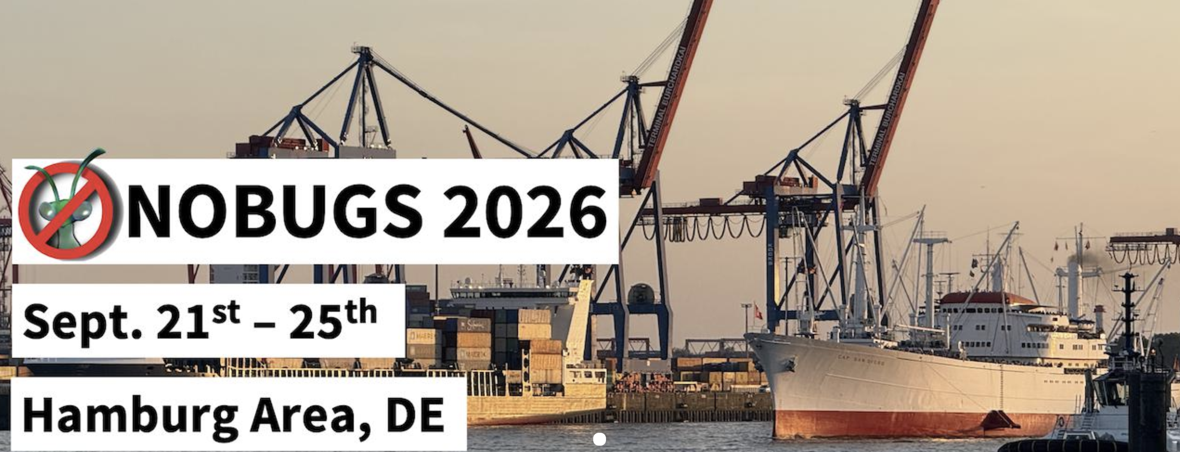
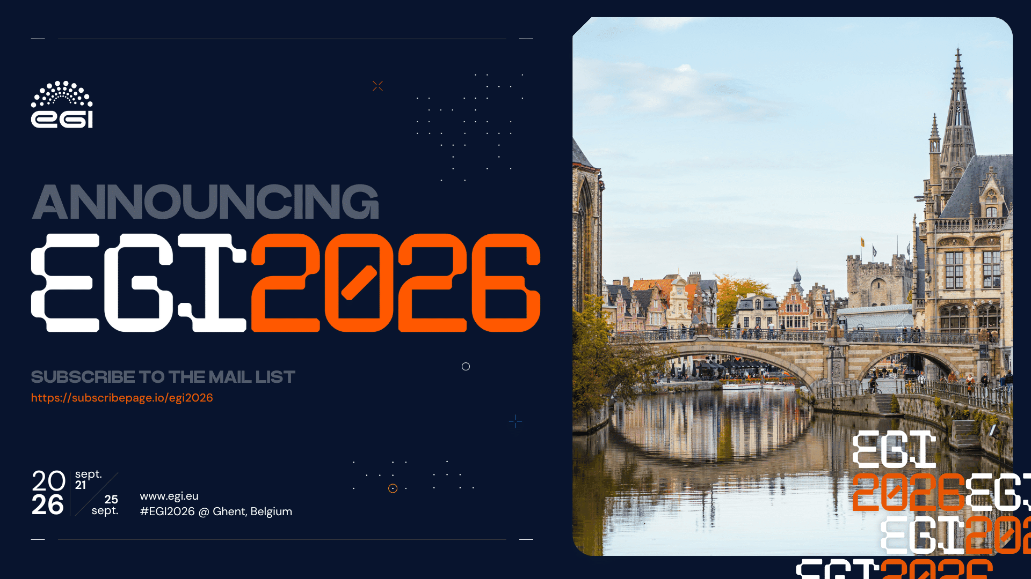
Dissemination @ Conference
Regular ErUM Events
Helmholtz Software events
NOBUGS
ICALEPCS 2027
EGI Community Events
EOSC Symposium (Nodes)

Slide 34
First steps
First Technical Steps

Slide 35
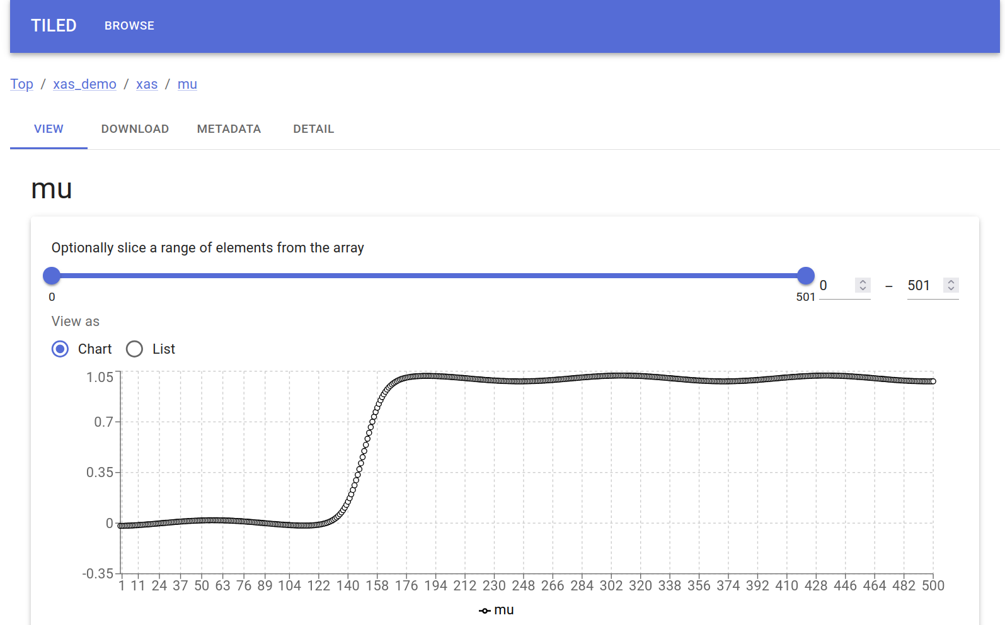
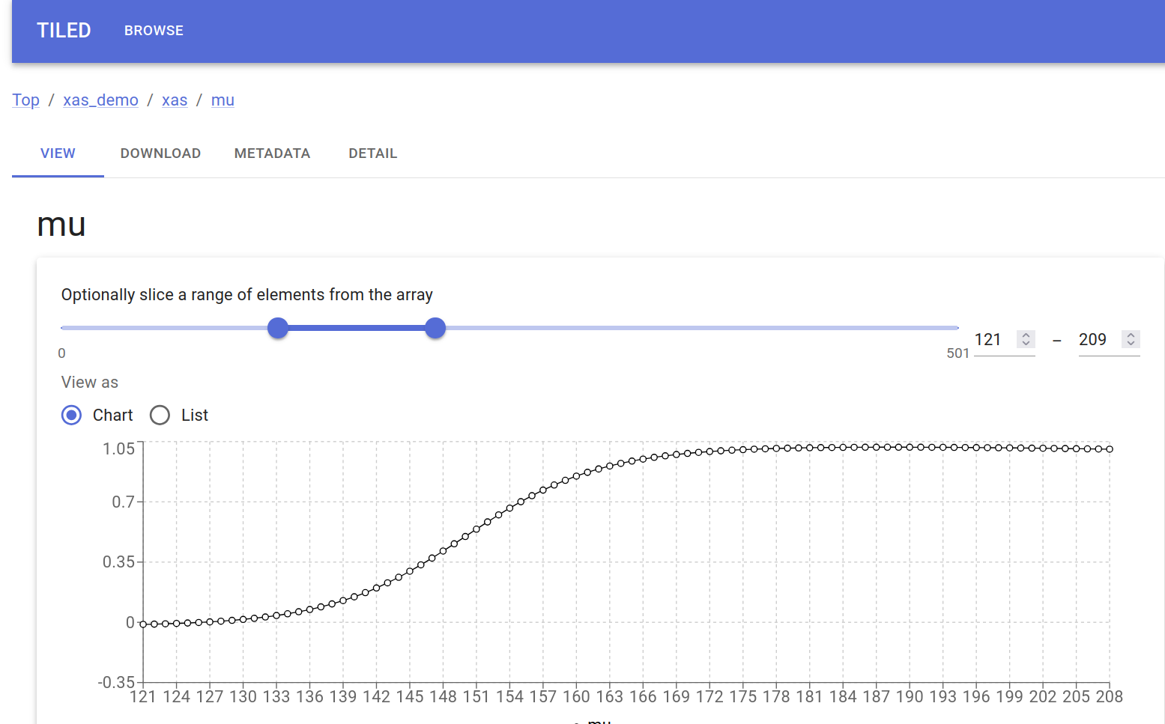
Already done ….
From Sebastian
PHOTONIC Kubernetes Cluster Created
Tiled server running
Testing the Tiled UI
Tiled understands the data on the server side.
Tiled UI
Full Data Table
Sliced Data Table

Slide 36
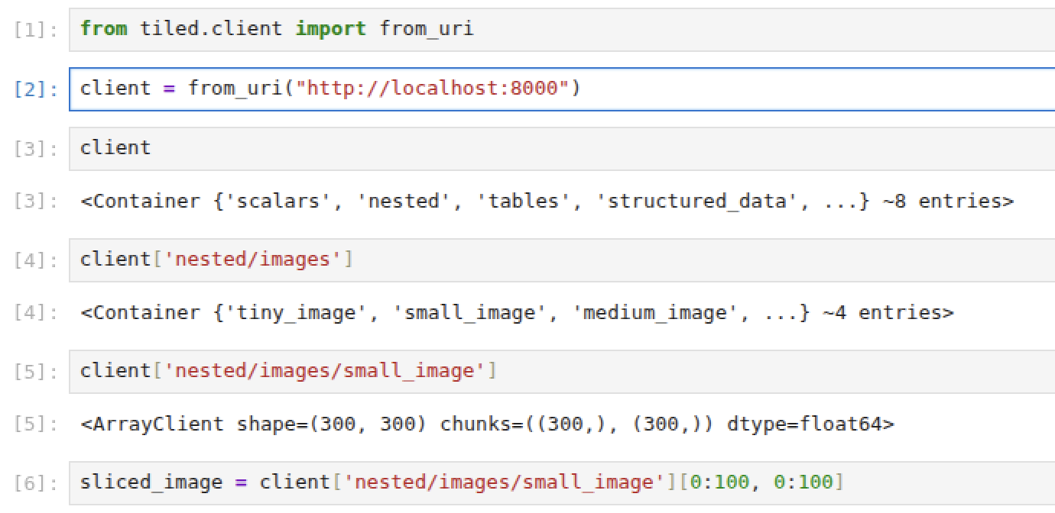
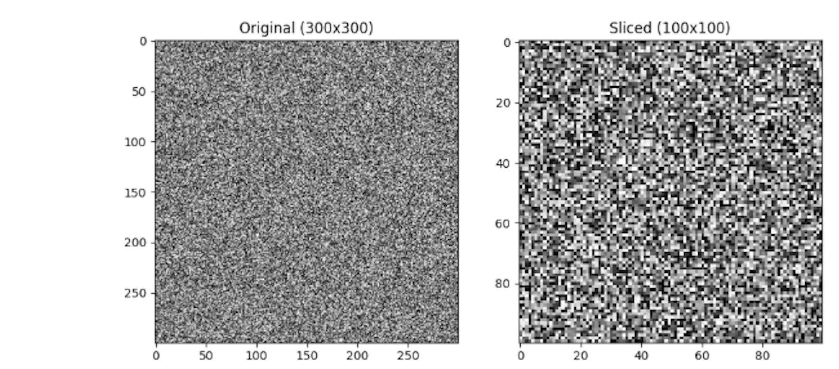
Already done ….
From Shruti
Checking server – tiled client in J-Notebook
Original (300 x 300)
Slice (100 x 100)
Client understands the data structure from the server side!
Client only downloads the slices needed!

Slide 37

Thanks
Contact:
Patrick Fuhrmann
Patrick.fuhrmann@desy.de

Slide 38
Work package Details and timelines

Slide 39
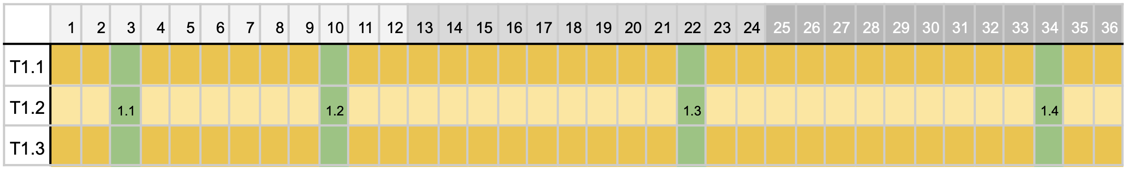
WP 1 Coordination
TASK | FROM | TO
T1.1 | 1 | 36 | Research and Analysis: Identify the different data formats in use and assess the feasibility of transcoding them
T1.2 | 1 | 36 | Data format definition: Define the unified data model to be served by the API developed in WP2
T1.3 | 1 | 36 | Plugin Development: Design, develop and test plugins capable of transcoding data
Ms | M | Description
M1.1 | 3 | Project management Infrastructure is place (shared storage, gitlab, meeting tools)
M1.2 | 10 | First All Hands Meeting
M1.3 | 22 | Second All Hands Meeting
M1.4 | 34 | Final All Hands Meeting

Slide 40
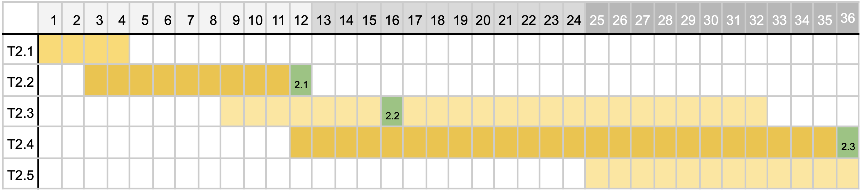
WP2 Backend Services
TASK | FROM | TO
T2.1 | 1 | 4 | Detailed research of possible technical solutions and assessment of existing software (M1-M4)
T2.2 | 3 | 12 | Architecture specification and integration roadmap
T2.3 | 9 | 32 | Definition and development of the server backend and outward facing API as defined in WP3
T2.4 | 12 | 36 | Deployment of the API server (incl. integration into central and beamline storage, monitoring & logging)
T2.5 | 25 | 36 | Documentation for users and administrators of the API and the server
Ms | M | Description
M2.1 | 12 | Backend server architecture defined
M2.2 | 16 | First prototype available for testing
M2.3 | 36 | Backend server deployed and interoperable with client libraries from WP4

Slide 41
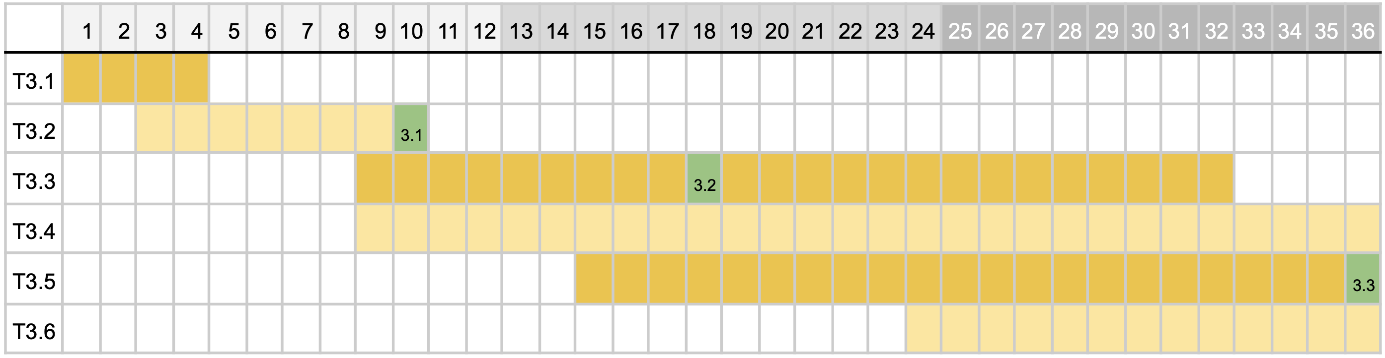
WP3 Standardization
TASK | FROM | TO
T3.1 | 1 | 4 | Research and Analysis: Identify the different data formats in use and assess the feasibility of transcoding them
T3.2 | 3 | 10 | Data format definition: Define the unified data model to be served by the API developed in WP2
T3.3 | 9 | 32 | Plugin Development: Design, develop and test plugins capable of transcoding data
T3.4 | 9 | 36 | Data Writing Process Update: If necessary, support the beamline staff in changing the data writing processes
T3.5 | 15 | 36 | Deployment and Integration: Integrate the unified data model into the system developed in T2.4 and deploy it for client access.
T3.6 | 24 | 36 | 36 Documentation and Training: Prepare comprehensive documentation detailing the new data model and provide necessary training to user
Ms | M | Description
M3.1 | 10 | Unified data format specified
M3.2 | 18 | Initial set of plugins developed and deployed in the first prototype of WP2
M3.3 | 36 | Final set of plugins developed and deployed

Slide 42
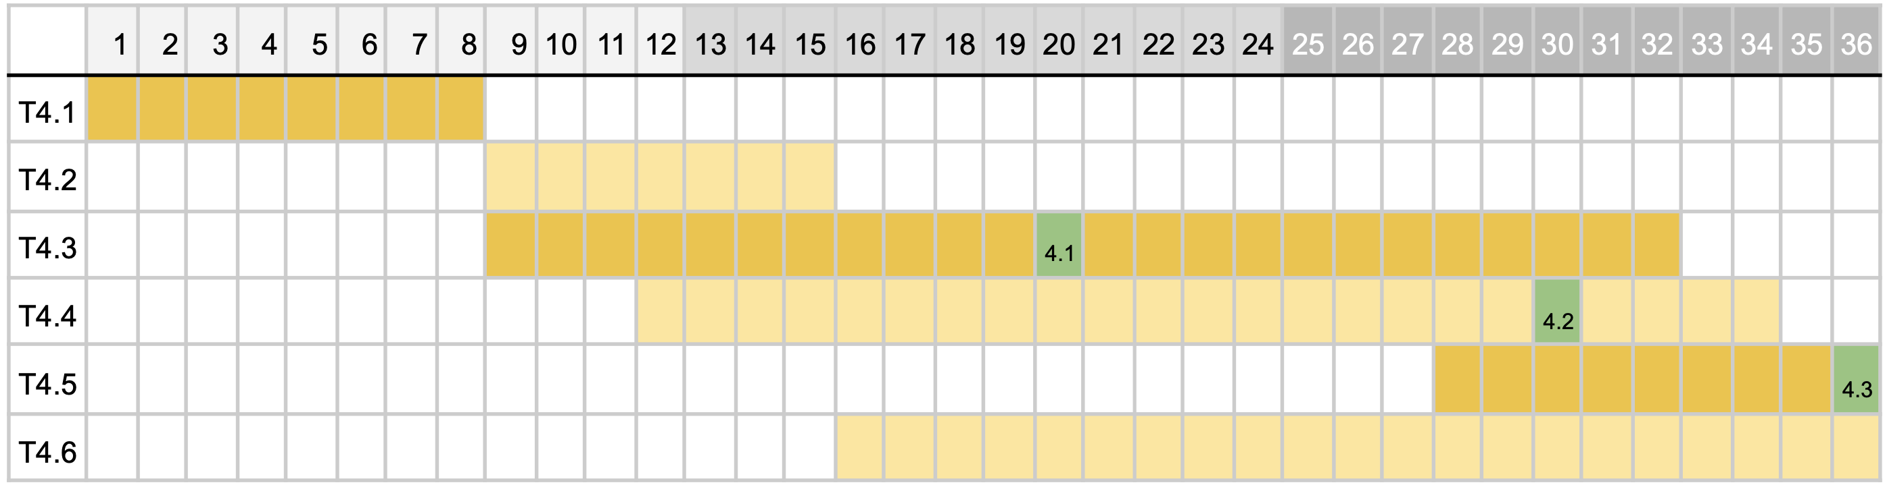
WP4 Use Cases and Client Tools
TASK | FROM | TO
T4.1 | 1 | 8 | Research and picking out candidate software packages for prototype development, form integration concepts with the unified data model
T4.2 | 9 | 15 | Architecture design: Designing the API access and user facing parts of the client library
T4.3 | 9 | 32 | Development: Develop and test the client library and integrate with existing analysis software
T4.4 | 12 | 34 | Embedding the previously developed client library in existing, commonly used software tools
T4.5 | 28 | 36 | Testing interoperability between different facilities
T4.6 | 16 | 36 | Documentation: document library usage and examples
Ms | M | Description
M4.1 | 20 | First prototype of the client library finished and tested with the API server
M4.2 | 30 | Final version of the client library deployed and tested against the API server of WP2
M4.3 | 36 | Provisioning of exemplary integration in existing scientific software

Slide 43
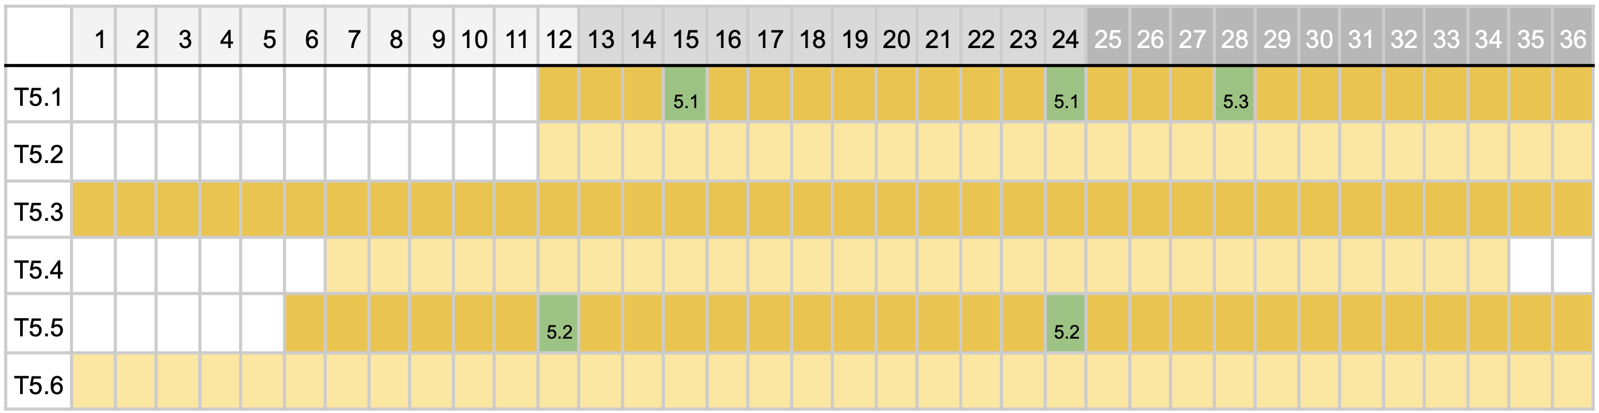
WP6 Dissemination and outreach
TASK | FROM | TO
T5.1 | 12 | 36 | Preparation and organisation of Workshops and Tutorials
T5.2 | 12 | 36 | Producing electronic material for training and education
T5.3 | 1 | 36 | Providing material and planning for Public Outreach
T5.4 | 7 | 35 | Outreach towards NFDI consortia and ErUM in workshops and meetings
T5.5 | 6 | 34 | Organize presence and feedback for the project at users meeting of facilities and national/international conferences
T5.6 | 1 | 36 | Initiate and organize publications from the project
Ms | M | Description
M3.1 | 15/24 | Conduct first workshop/tutorials for early adopters
M3.2 | 12/24 | Collect feedback from stakeholders
M3.3 | 28 | Web tutorial and publication ready

