Slide 1
Doing Science in the Cloud: Collaborative, Reproducible Workflows
Daphne van Dijken
DECTRIS CLOUD Technical Development Manager
daphne.vandijken@dectris.com
DECTRIS at ISGC 2026 2026.03.20

Slide 2

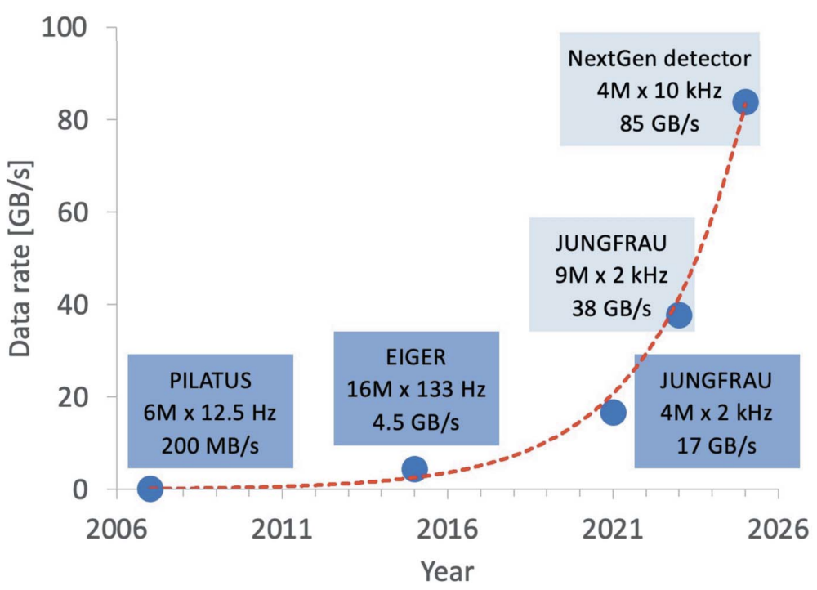
Decades of Progress on Data Rates
Data generation doesn’t wait.
Taken from: F.Leonarski, et.al., JSR 2022.
MATTERHORN

Slide 3



Digital Pillars of Insight Generation
Data
Software
Compute
Spatial and temporal coherence
Data, Compute and Software in
in the same place at the same time

Slide 4

Digital Pillars of Insight Generation
Data
Software
Compute
Spatial and temporal coherence
Data, Compute and Software in
in the same place at the same time
Drift over Time
Different Data Types / Storage Location
Different Tools and Versions
Ad-hoc sharing of data and algorithms
Fragile access control

Slide 5
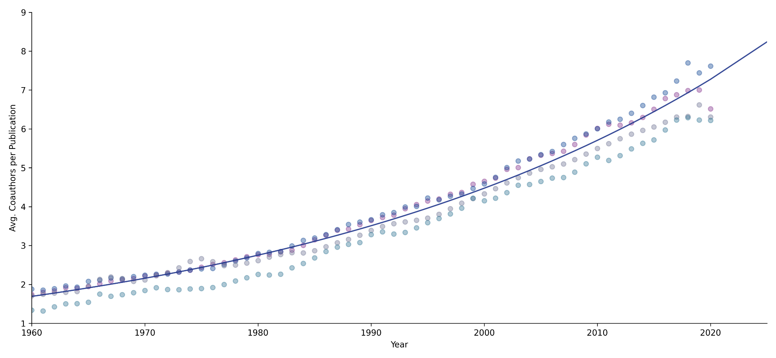
A Paradigm Shift in Science
Reference:
M. Thelwall, N. Maflahi; Res. Quant. Sci. Stud, 2022; 3 (2): 331–344
DOI: 10.1162/qss_a_00188

Slide 6

A Paradigm Shift in Science
Discovery shifted from individuals to distributed teams
Collaborative
Science
Reference:
M. Thelwall, N. Maflahi; Res. Quant. Sci. Stud, 2022; 3 (2): 331–344
DOI: 10.1162/qss_a_00188
Team
Research
Sole
Thinkers

Slide 7

A Complex Challenge
Challenge: Focus on science amid rapid changes and information overload
Information and data overload
New tools almost every day
Software and firmware updates
Complexity grows exponentially
Notes:
The rapid changes and information overload impose an complex challenge:
as there is an information and data overload, there are more tools and techniques, more experiments,
involving more people, more disciplines.
It becomes a challenge to focus on science amid rapid changes and information overload.
HOW TO FILTER THE BACKGROUND NOISE?

Slide 8


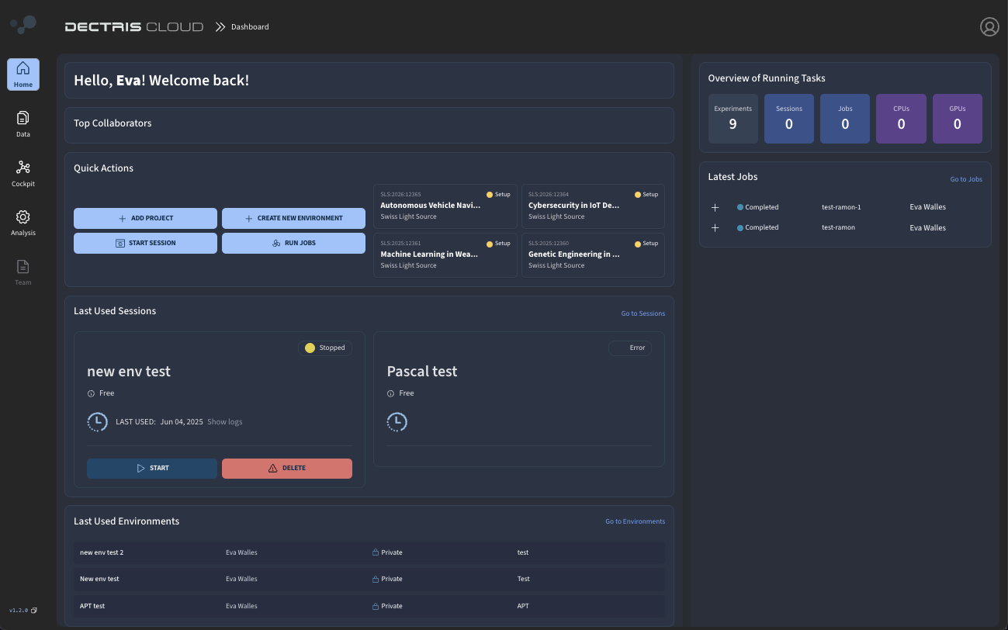






Exploration
platform
Analysis
Toolbox
Built for
Scientists
Community
Driven
Flexible
in scale
Globally
Accessible
The Science Platform for Collaborative Discovery
Notes:
DECTRIS CLOUD is an exploration platform
built for scientists
that is flexible in scale suitable for all kinds of science.
It works as a data analysis toolbox
that counts on a community driven effort to assure the main tools are available.
All that globally accessible via the web browser - so you can carry the toolbox wherever you go.

Slide 9









CLOUD Framework
Scalable Compute Cluster
Encrypted & Authenticated Upload
Local
Data Store
EU
Central Data Access
Data & Software Repository
US
ASIA
Global Accessible Web Application
app.dectris.cloud
Access to all data, tools, ressources, …
Architecture, Network and Application regularly penetration tested by 3rd party security experts

Slide 10











Automated Data Upload - SYNC assisted
INSTR. A
INSTRUMENT A
INSTRUMENT B
INSTRUMENT C
INSTRUMENT D
INSTR. B
INSTR. C
DC SYNC 1
DC SYNC 2
DC SYNC 3 & 4
INSTR. D
Local Infrastructure and IT
Outgoing traffic only/
incoming traffic blocked
Local IT provided bandwidth
Notes:
Now how fast do we get data into the cloud?
We provide high speed uplinks to facilities, which allows us to ingest data at up to 100 GBits per second per beamline.See on the right a typical bandwidth test where we uploaded 1.2 PetaBytes in 3 days with no interruptions.
To the user this means data is available in < 3 seconds in the cloud - wherever they are.

Slide 11

Automated Data Upload - HUB assisted
INSTR. A
INSTRUMENT A
INSTRUMENT B
INSTRUMENT C
INSTRUMENT D
INSTR. B
INSTR. C
DC HUB 1
DC HUB 2
DC HUB 3
DC HUB 4
INSTR. D
DECTRIS PROVIDED
Up to 100 Gbit/s per instrument
Penetration tested
Notes:
Now how fast do we get data into the cloud?
We provide high speed uplinks to facilities, which allows us to ingest data at up to 100 GBits per second per beamline.See on the right a typical bandwidth test where we uploaded 1.2 PetaBytes in 3 days with no interruptions.
To the user this means data is available in < 3 seconds in the cloud - wherever they are.

Slide 12


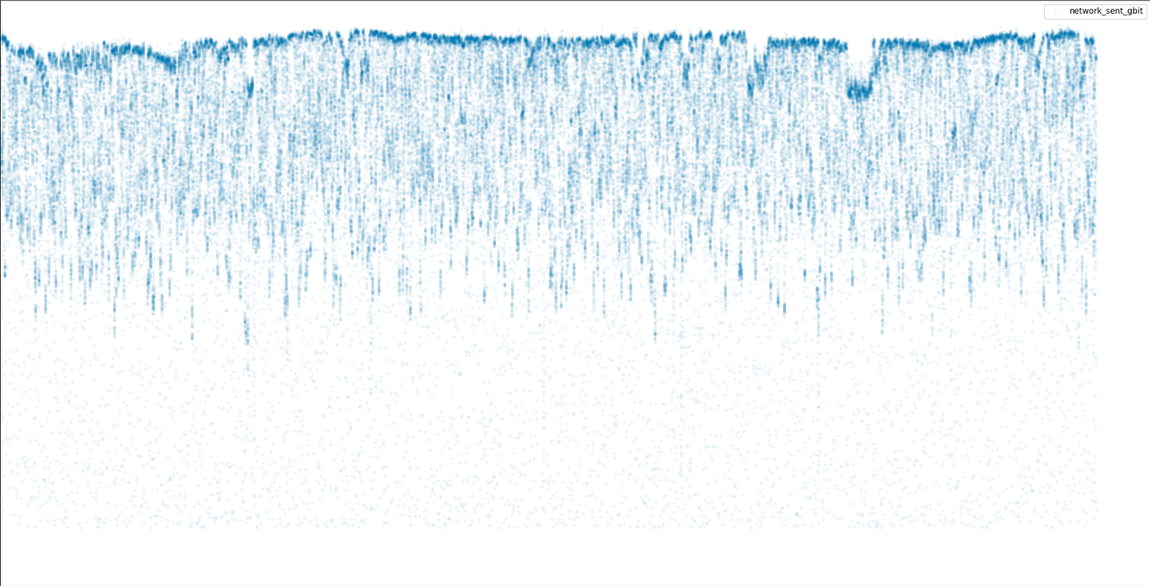
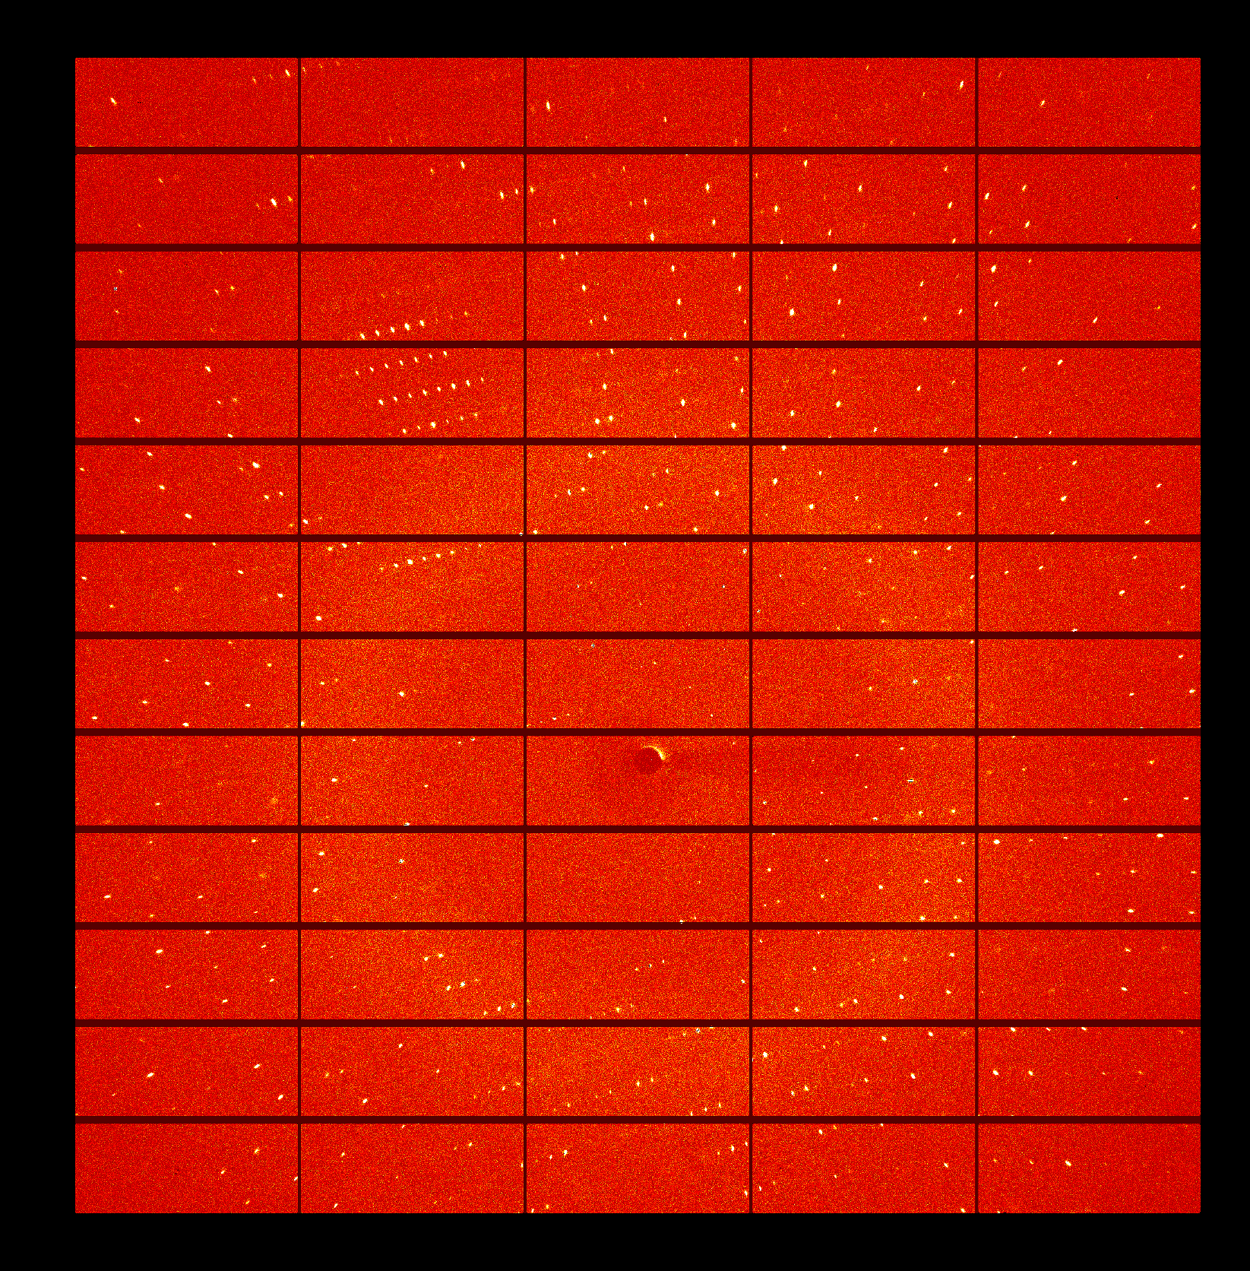
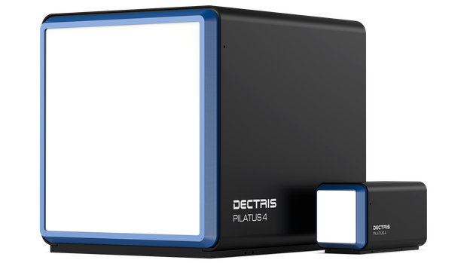




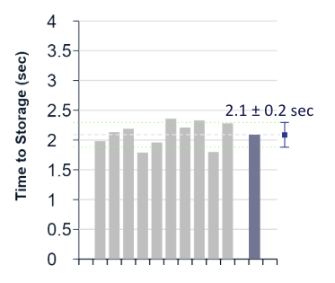
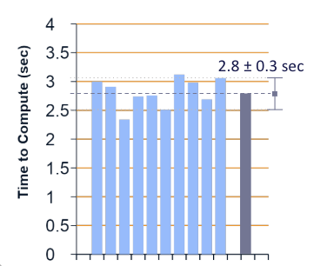
Data Upload - HUB assisted - Latency and Bandwidth
Uninterrupted upload of 1.2 PetaBytes in 72h. Average bandwidth of 92 GBits
Data Ingest per Instrument
CLOUD
storage
CLOUD
compute
100
images
EIGER2 X 9M
HUB
uplink
80
60
Gb/s
40
20
0
Time to DECTRIS CLOUD storage
2.1 sec
18
36
54
72
Time (h)
Time to DECTRIS CLOUD compute
2.8 sec
2023, ALBA (ESP), XAIRA Beamline
Data becomes
available in < 3 sec
2024, MAX IV (SWE), MicroMAX Beamline
Notes:
Now how fast do we get data into the cloud?
We provide high speed uplinks to facilities, which allows us to ingest data at up to 100 GBits per second per beamline.See on the right a typical bandwidth test where we uploaded 1.2 PetaBytes in 3 days with no interruptions.
To the user this means data is available in < 3 seconds in the cloud - wherever they are.

Slide 13
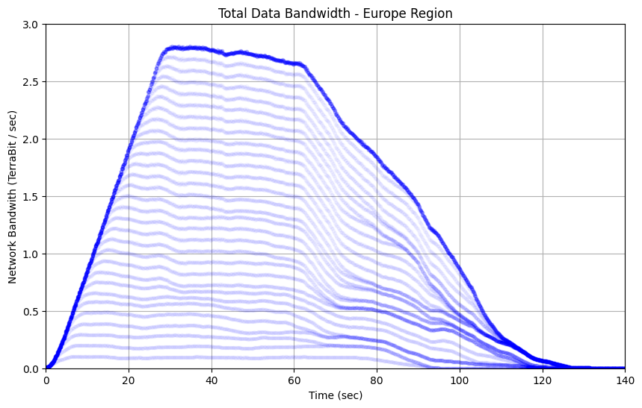

Data Storage and Access - Global Bandwidth
Each region provides triple geo-redundancy for data storage
Load balancing per availability zone to ensure data throughput
Data stays physically located on the continent where it is recorded
Data Access Bandwidth - EU Region
> 2.7 TBit per second
EU
US
ASIA
Total Global Bandwidth:
3 Regions x 3 Availability Zones x 2.7 TBit = >20 TBits

Slide 14




DECTRIS CLOUD Real-Time Data Sharing
Data
Sharing
Cloud Elastic
storage
scalable, versioned, backed up
Lab staff assigns:
Experiment PI
Instrument
data
Lab experiments
Manager:
Instrument staff
Collaborators
LAB sponsored storage
Scientist
data
Science
Projects
Manager: Scientist
Share by adding collaborators
Scientist sponsored storage
No more data transfer – shared access instead
Notes:
and mount the data that you would like to operate on.
the modularization that you can see in this diagram is what enables the flexibility in the cloud - and the safety of working in isolated workspaces.

Slide 15
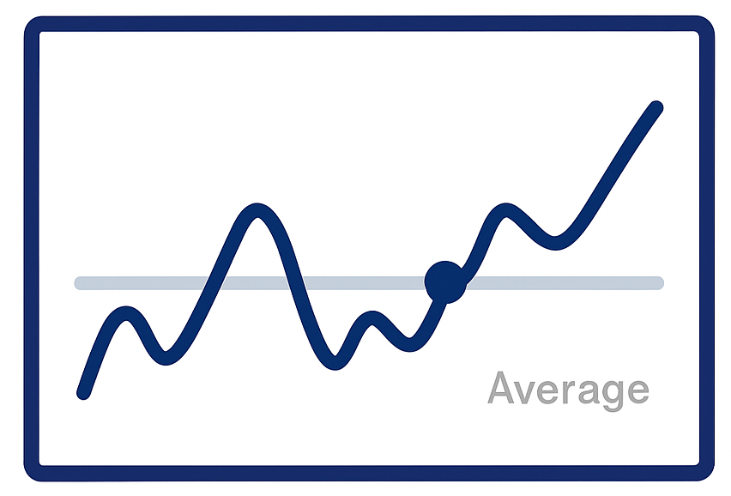

Elastic Storage
Limitless Elastic Storage
*
No hard limit
Data Ingest
Average
Data Cleanup
ASIA
N. AMERICA
EUROPE
Notes:
Flow means elastic storage:
which is the possibility to scale up and down in hot-storage (or active storage)
according to your current demand.
At DECTRIS CLOUD, there is no hard limit in storage usage, and what matters is the average over time:
which means you can upload data above the storage value you purchase (burst mode),
and scale down on demand.

Slide 16









DECTRIS CLOUD Analysis Engine
Environments
Isolated Software containers
versioned
Interactive
Sessions
soon!
Automated
Jobs
Notes:
The DECTRIS CLOUD engine is fundamented in the existence of Environments:
which are isolated software containers, ready to use or custom built, and versioned which serve as basis to 2 types of computation tasks:
interactive sessions: Virtual machines or jupyter notebooks
or automated jobs: which are bash scripts that orchestrate tools

Slide 17

DECTRIS CLOUD Analysis Engine
Compute
Environments
Elastic
Performance
Isolated Software containers
per task
versioned
Interactive
Sessions
soon!
Automated
Jobs
Notes:
for each time you run a compute task, you can select the hardware needed at that moment,

Slide 18

DECTRIS CLOUD Analysis Engine
Compute
Environments
Data
Elastic
Performance
Isolated Software containers
Elastic
Storage
per task
versioned
shareable
Interactive
Sessions
soon!
Automated
Jobs
Notes:
and mount the data that you would like to operate on.
the modularization that you can see in this diagram is what enables the flexibility in the cloud - and the safety of working in isolated workspaces.

Slide 19




Automation API
Create Experiments
Share data automatically
Add description and meta data files
Trigger automated Analysis Jobs
Notes:
The Exploration, Discovery and Impact Licenses for scientists are from today on available
you can purchase your license with no hassle at: app.dectris.cloud/license-configuration

Slide 20
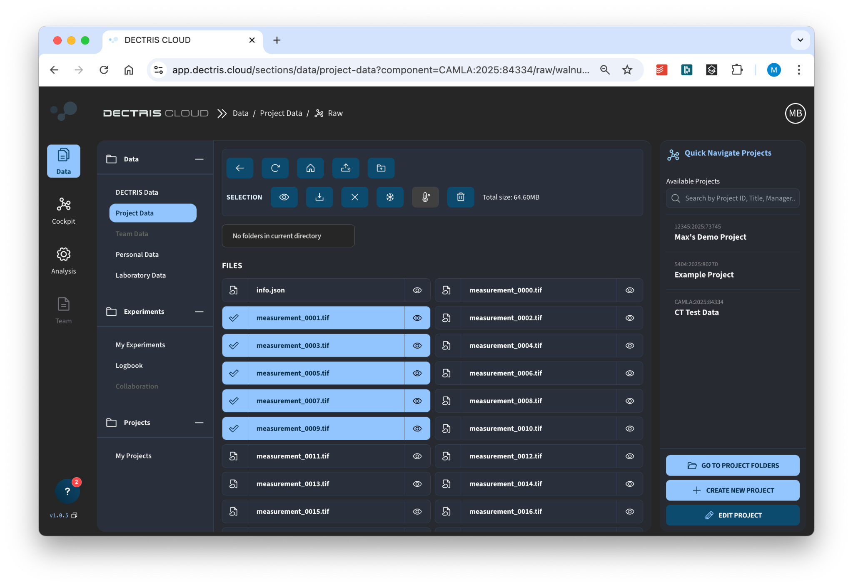
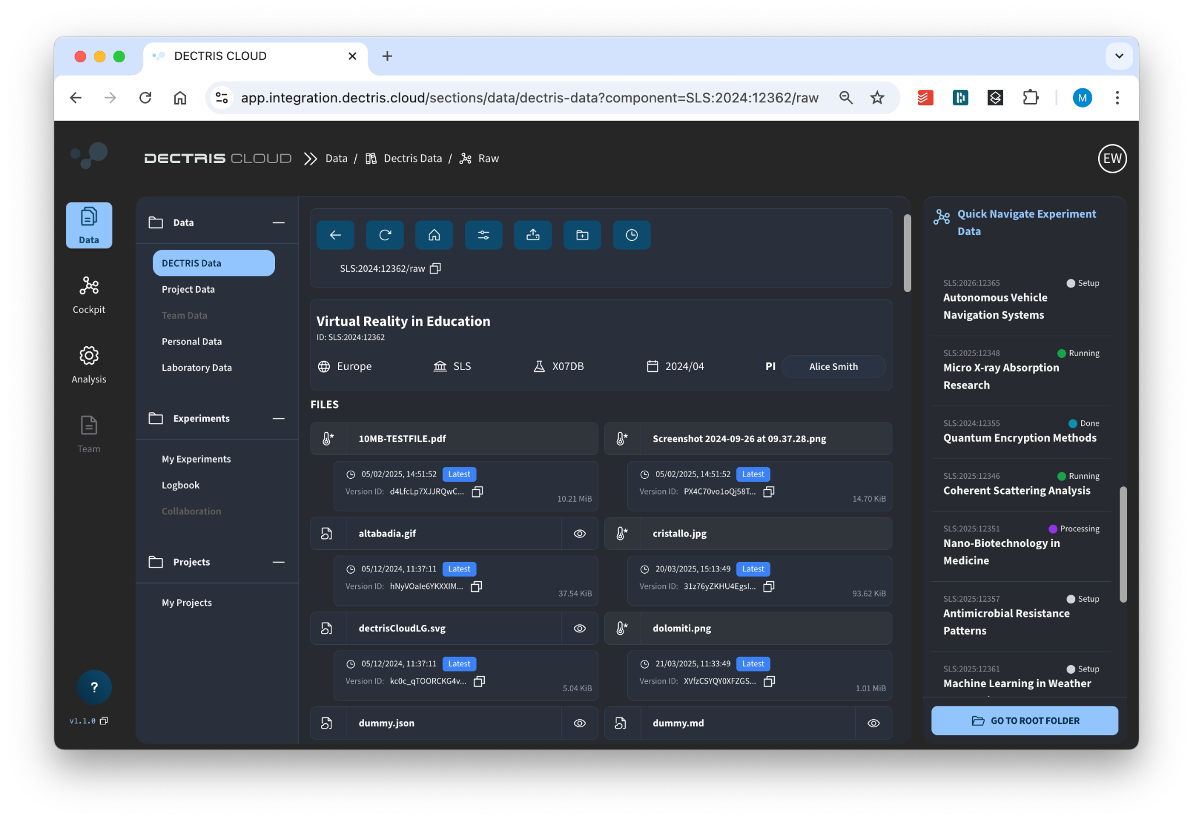
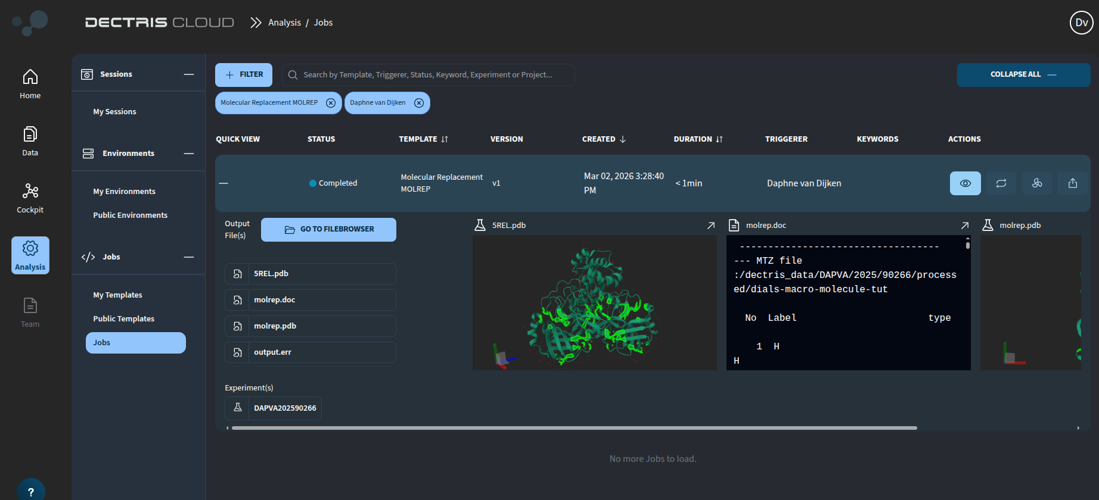

Simple Data & User Management
Data Handling
Archive, Pull from Archive, Grouped download.
Data Versioning
Recover overwritten or deleted data.
Metadata
Search and visualization

Slide 21
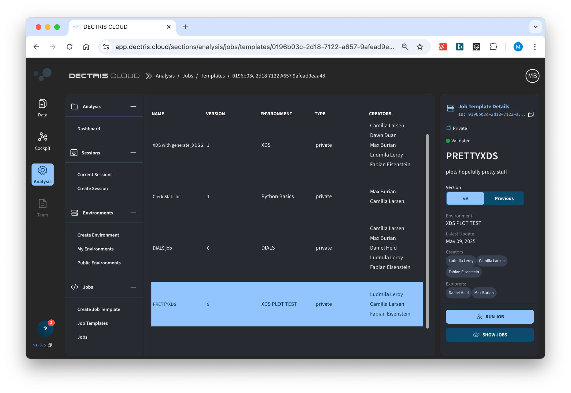
Automatable Data Curation
Job Templates
Custom pipelines to process data.
Publishable
Versioned
Shareable

Slide 22

Automatable Data Curation - Jobs
Input
Data
Output
Data
Input Variables
Job
Template
Running Job
Output Variables
(X)
(X)
Versioned
Shareable
Machine Type
Custom
Output
Figures
Versioned
Software Environment
Shareable
Custom

Slide 23
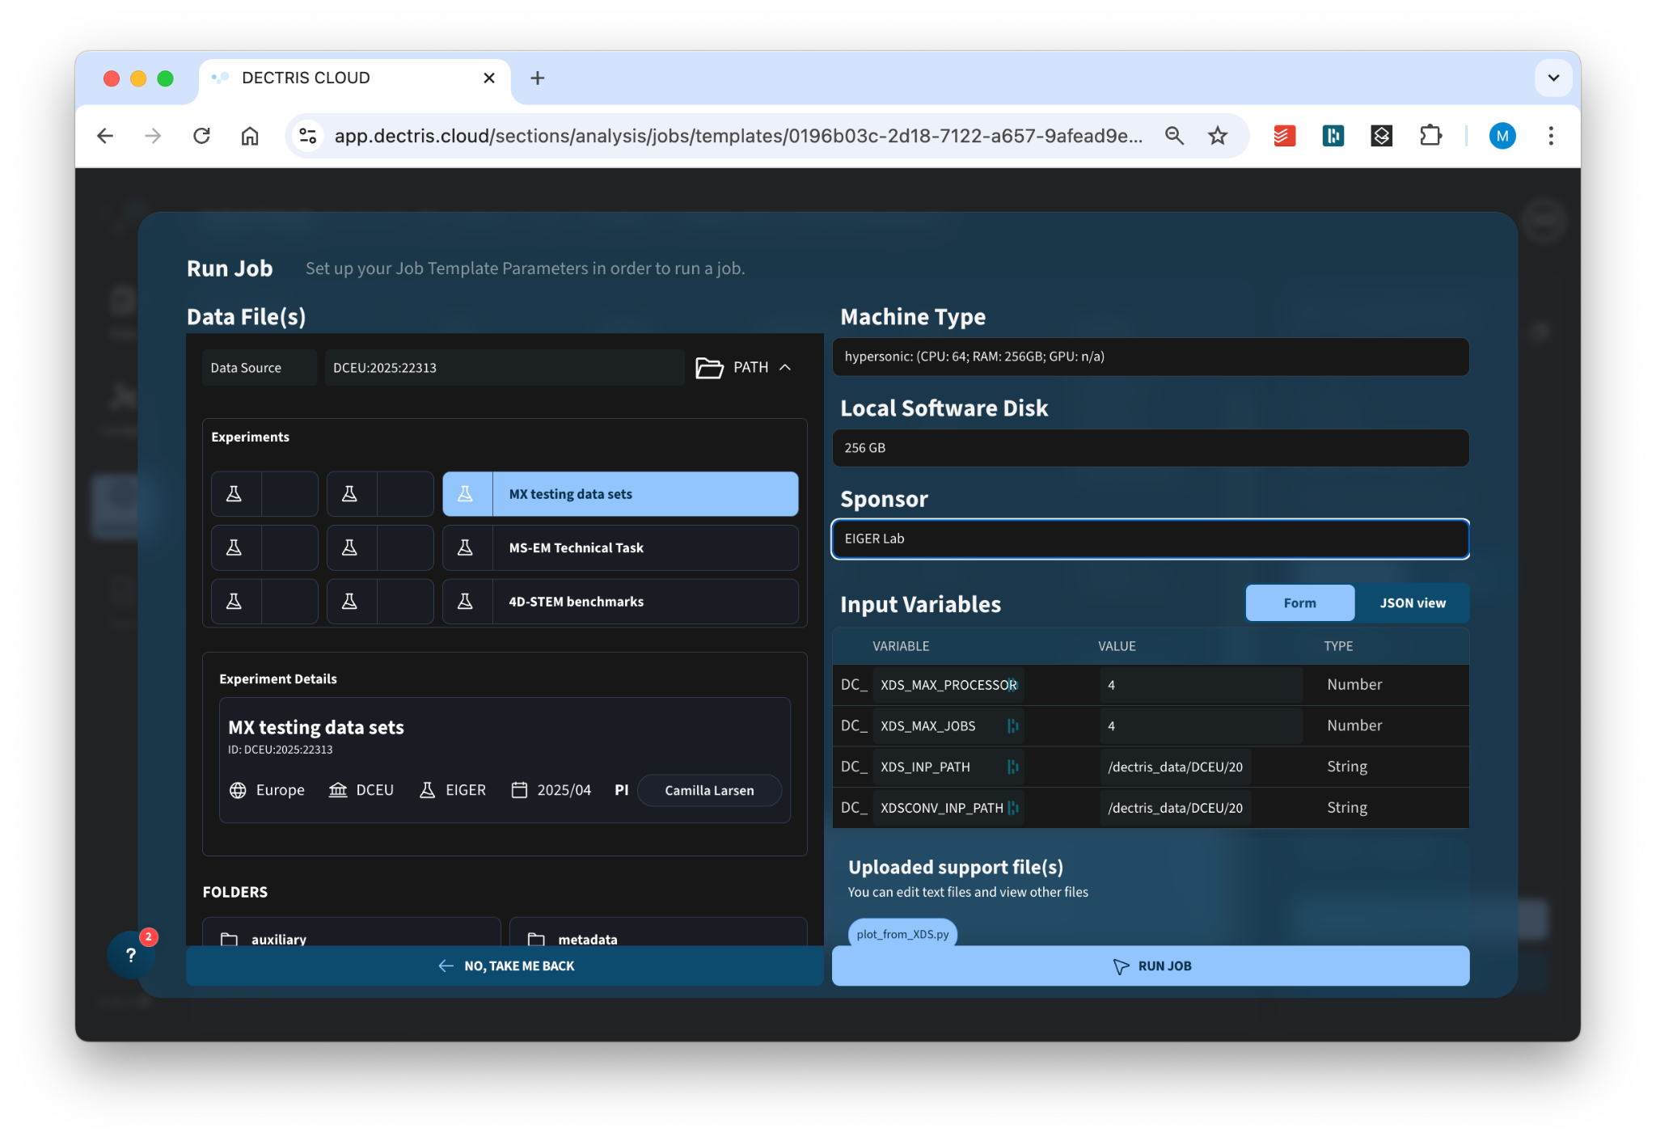
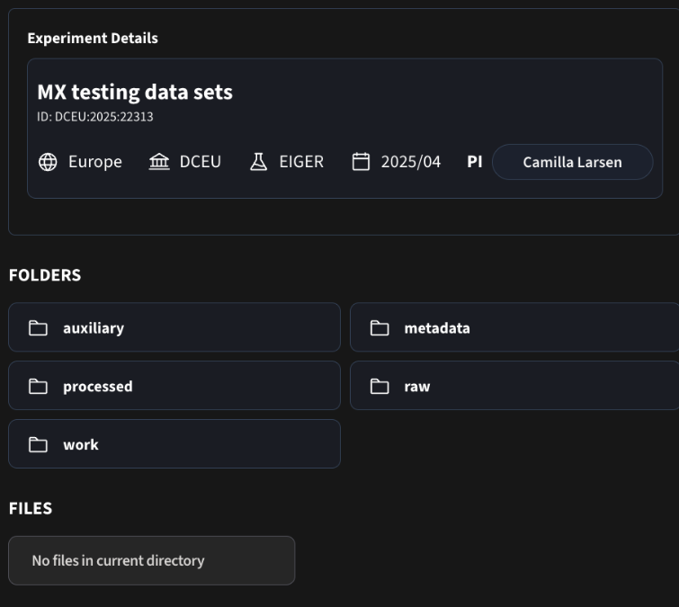
Automatable Data Curation
Job Execution
Wizard for simple running of jobs.
Choosing Machine Performance
Data Selector
Setting Execution Variables
+API Endpoints

Slide 24
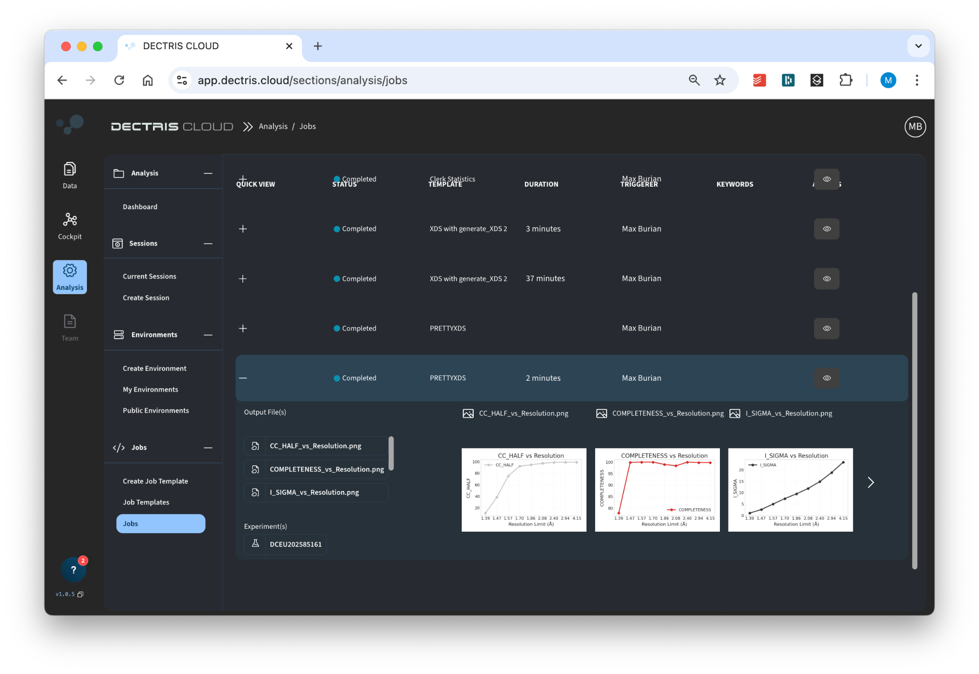
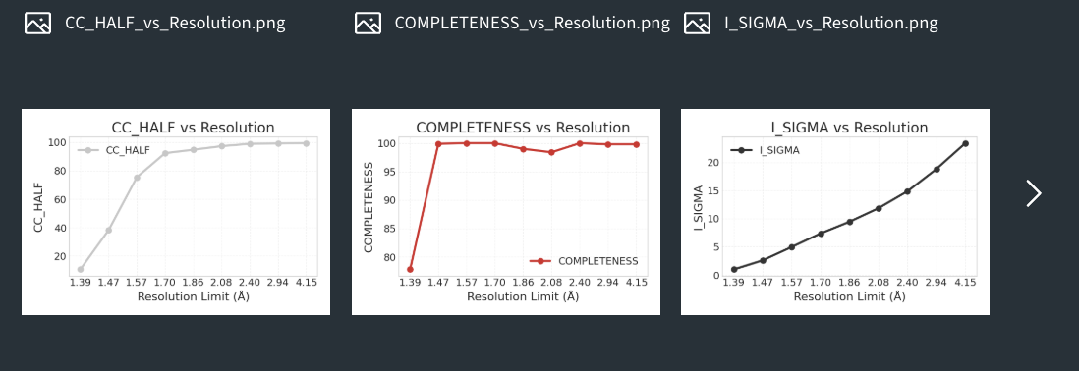
Automatable Data Curation
Job Output Overview
Browse through processing results.
Custom Job Visualization
Adjust/customize visualization as you see fit.

Slide 25
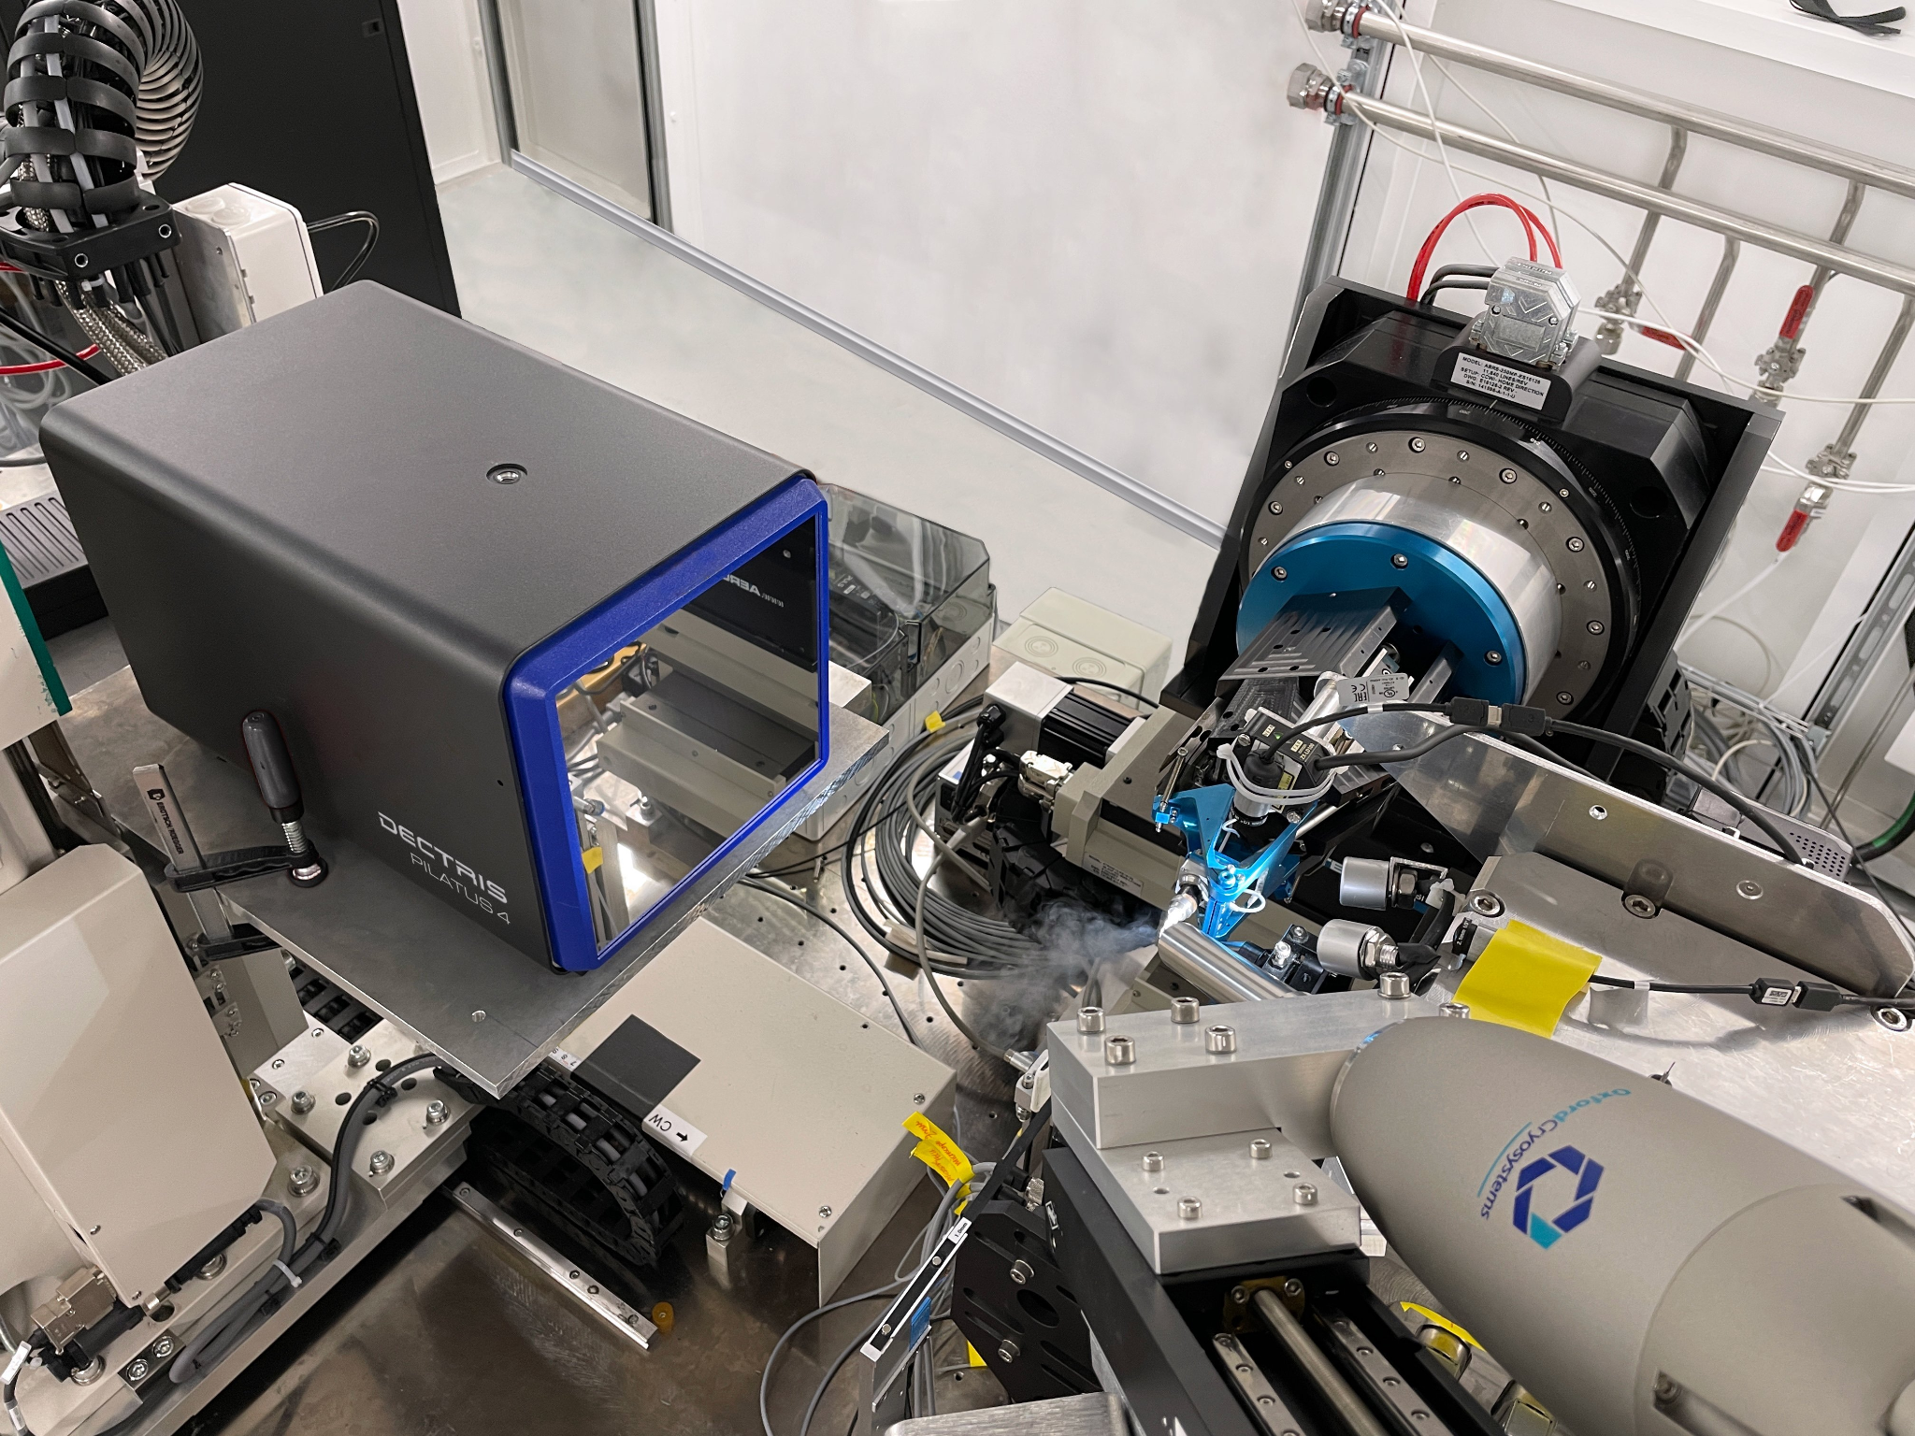
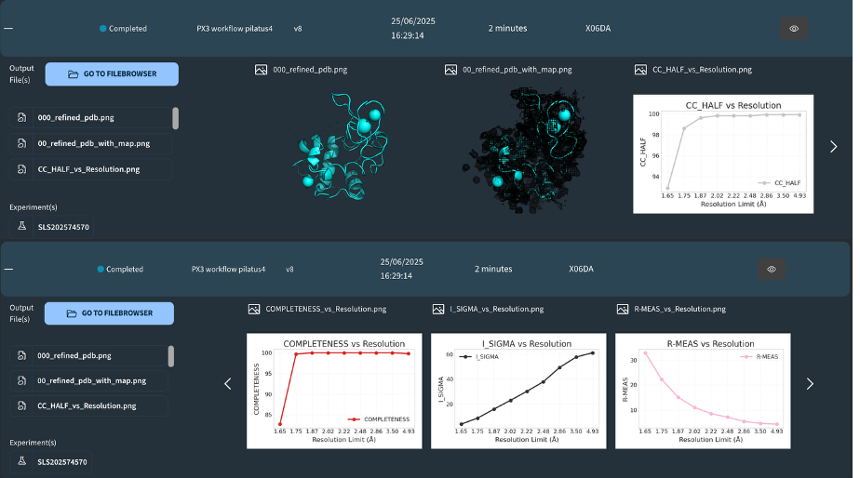


DECTRIS CLOUD at SLS PXIII
Automatic analysis is triggered by the instrument via the API
Results are viewable in real-time on the DECTRIS CLOUD platform:
Users can rerun any processing Job
Data is first stored in local SLS storage
From there copied to the cloud with low latency (< 3s)
Notes:
DECTRIS CLOUD has been integrated into the PXIII beamline
Data from Pilatus4 detector is saved to the local SLS storage
Experiment users can enable data to be uploaded to DECTRIS CLOUD as well.
Data uploaded to the cloud can be shared with users, who can sign up for the platform for free (via email, orcid or google sign-up). Each experiment on the cloud is assigned a PI, who can invite additional collaborators to access the data.
Analysis workflows
Every time the collection of a dataset is finished, the control system of the beamline triggers an analysis job in the cloud via an API call.
In collaboration with the PXIII beamline staff, we have prepared a number of analysis workflows using XDS, CCP4 and autoPROC.
The beamline staff can configure the workflows to run on nodes with different performance types, dependent on their needs
Once the analysis job is finished, the results are viewable on the web app in the job output table (example on slide). The way the output is represented is fully customizable in the job definition. A natively integrated pdb viewer (mol*) also makes it possible to view and rotate the refined structures.
In addition to the automatically triggered jobs, it is also possible for the experiment users to trigger their own analysis workflows. For the duration of the experiment and a short time after, users can use compute resources provided by the lab’s DECTRIS CLOUD license. They can rerun the workflows or define and run their own on the data they have collected.

Slide 26

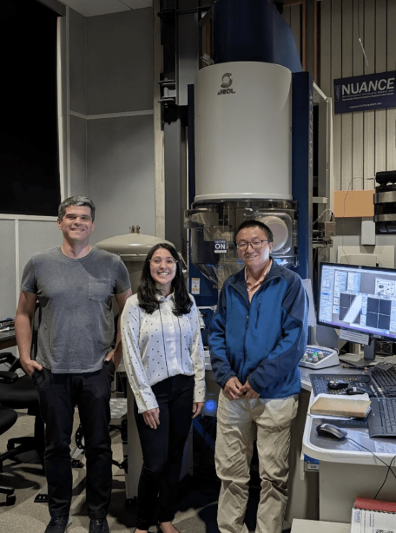
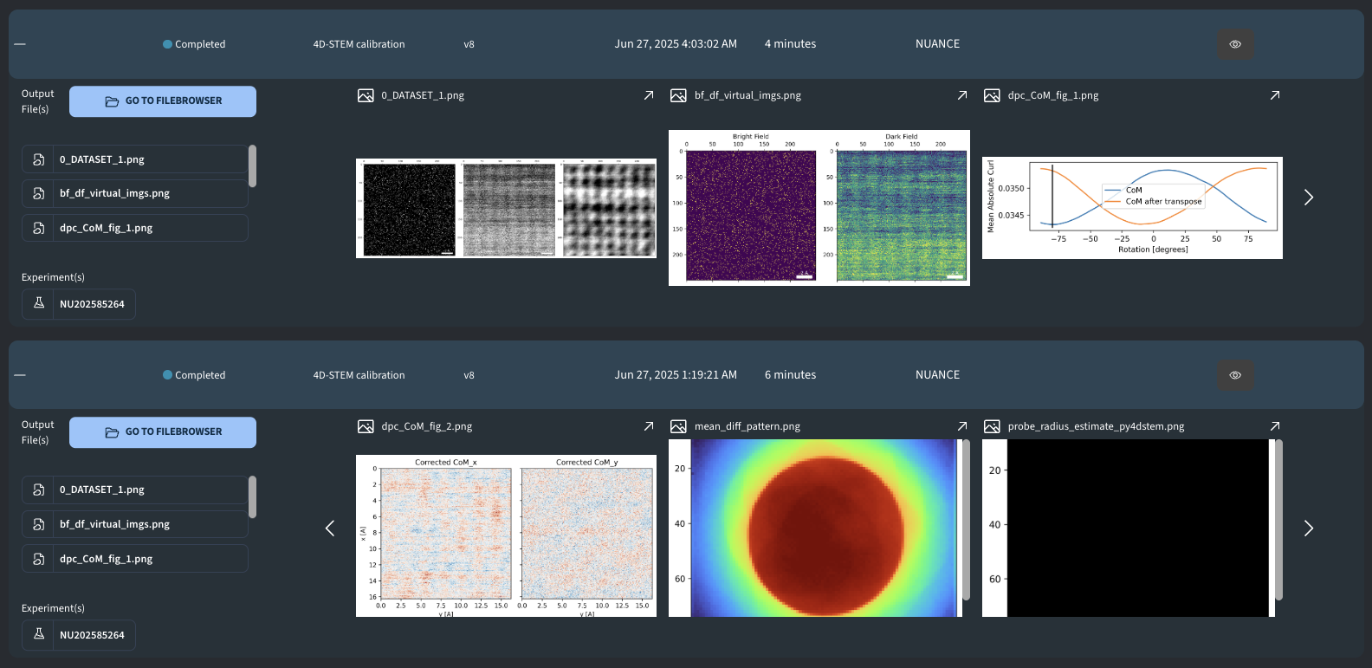



DECTRIS CLOUD at
Data is uploaded via HUB and dedicated router
Real-time 4D-STEM reconstructions viewable within minutes
Notes:
Electron Microscopy (EM)

Slide 27

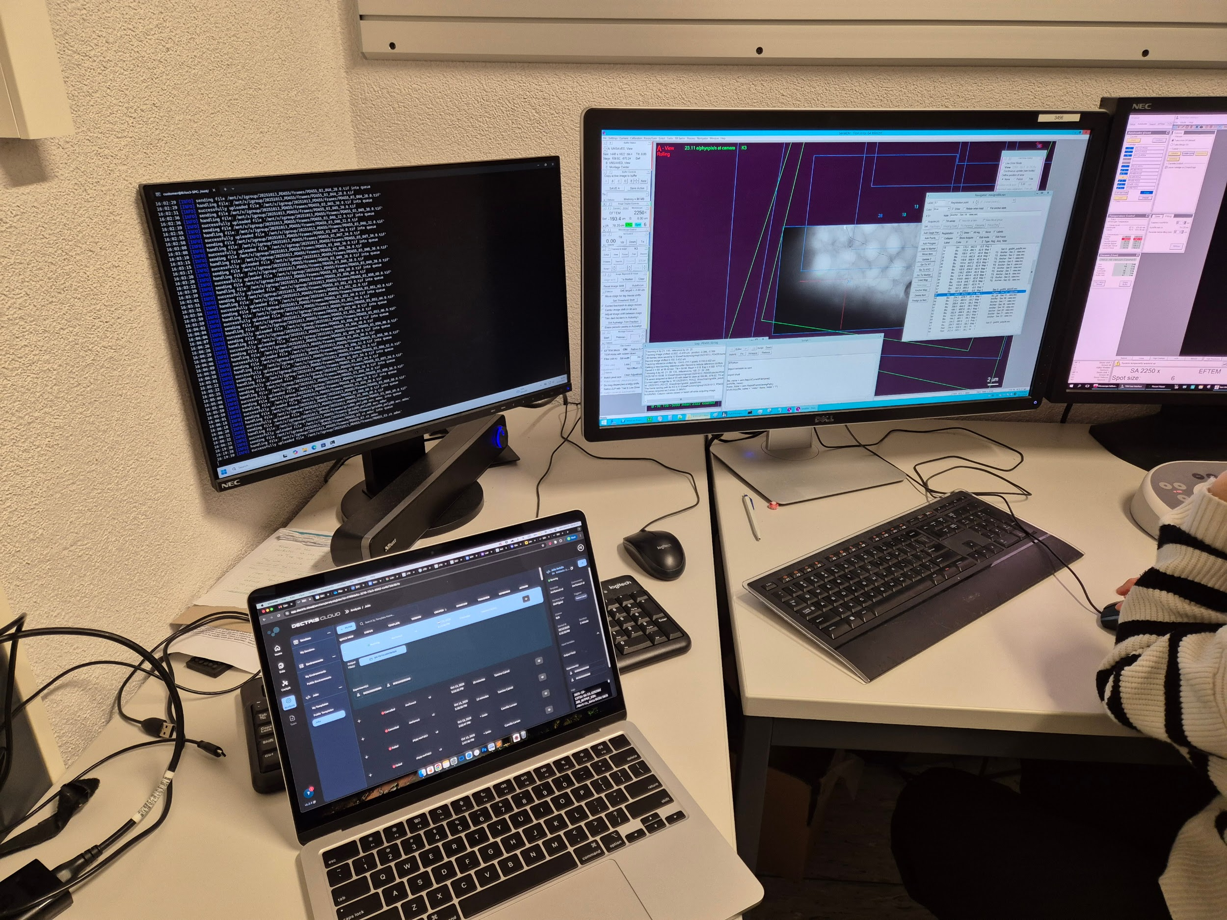
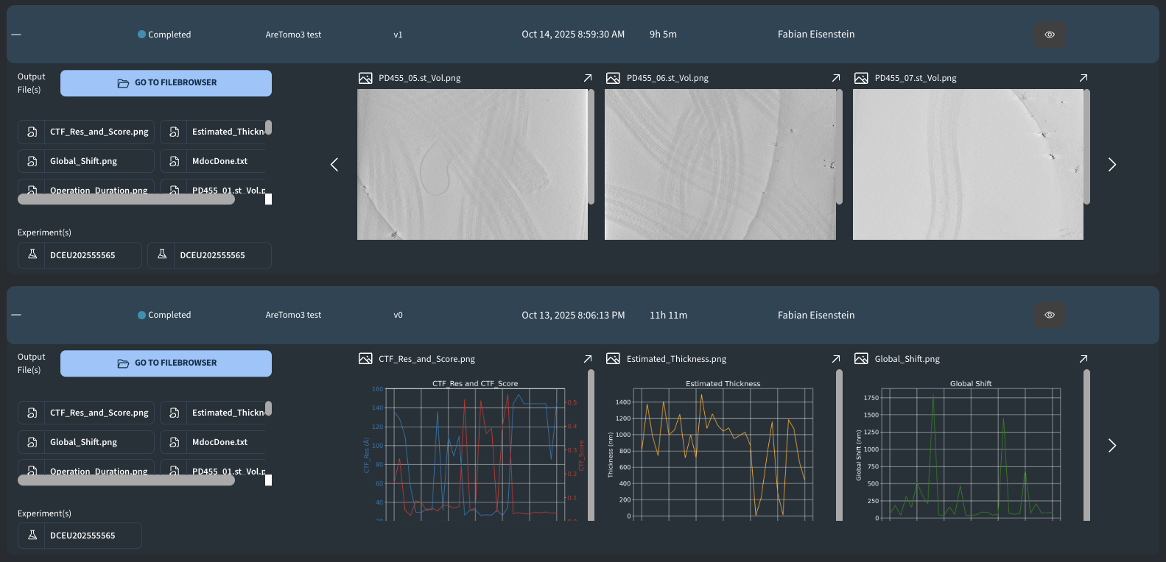
DECTRIS CLOUD at
Data is uploaded via SYNC running on Krios support PC
Real-time Cryo Electron Tomogram reconstructions
viewable within minutes to inform data collection settings

Slide 28


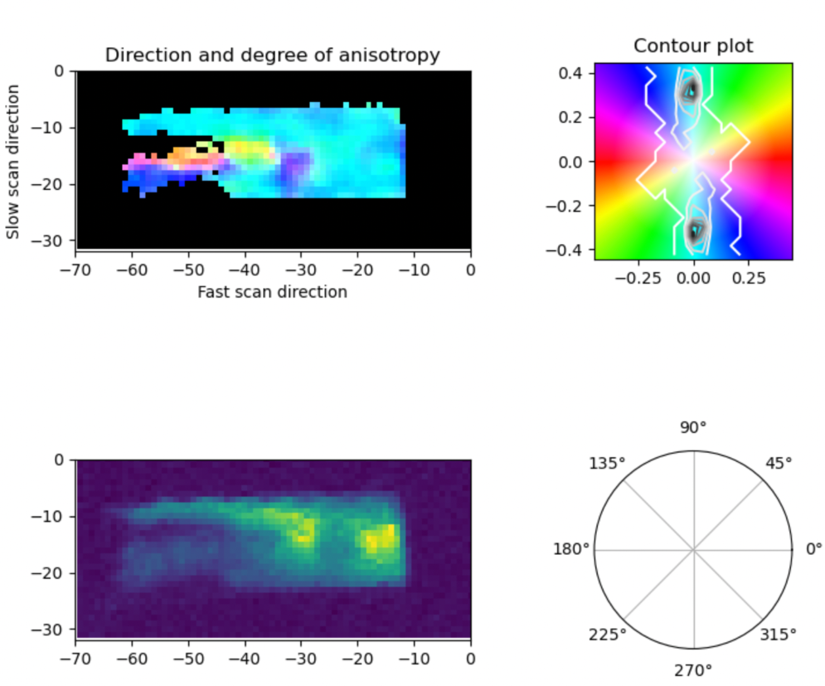
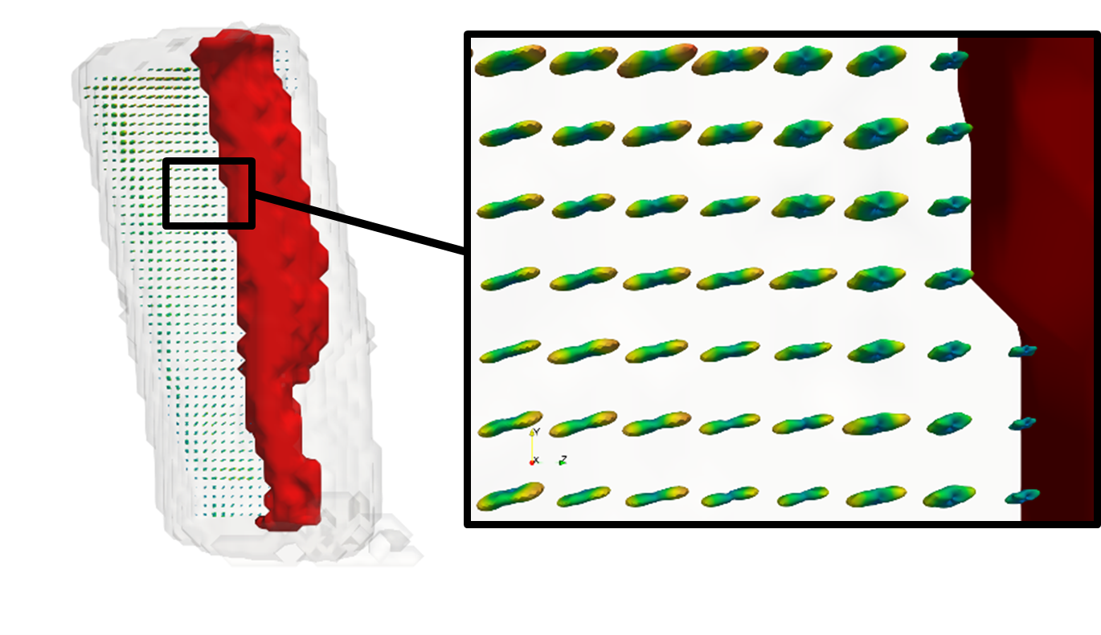


Automation : Texture Tomography at PX-I
- 100 Hz
- 10 GBits data
- > 50 TB in 3 days
for live feedback on computation heavy science
EIGER X 16M
Real-Time Processing
Azimuthal integration
>100 images/s
LIVE FEEDBACK
2D Analysis
Interactive plotting and analysis of reconstructions
Virtual Machine
Image Analysis, 3D Reconstruction,
Segmentation and Visualization
Torne Tänzer, Tatiana Kochetkova, Mathieu Simon, Christian Appel, Filip Leonarski, Ezequiel Panepucci, Meitian Wang, Philippe Zysset, Marianne Liebi

Slide 29


















Collaboration is key
Cryo EM
AutoProc, Buster, …
Ptychography
>500 LifeScience Tools
Protein Crystallography
XDS
Data catalogue
Network USA
CEMK
Web Based SPA
Crystallography
ZMB
BL 8.3.1
MicroMAX,NanoMAX
TexTOM
P14 & Tomography
TTSAXS - MUMOTT
FastDP, DIALS
PXIII MX &
TomCAT CT
A community effort – a big thank you to our collaborators
Notes:
Use Case Example - Run a Peak Indexing pipeline -> XDS
Example: Installing it once (even if difficult) but sharing it with collaborators “plug & play”

Slide 30
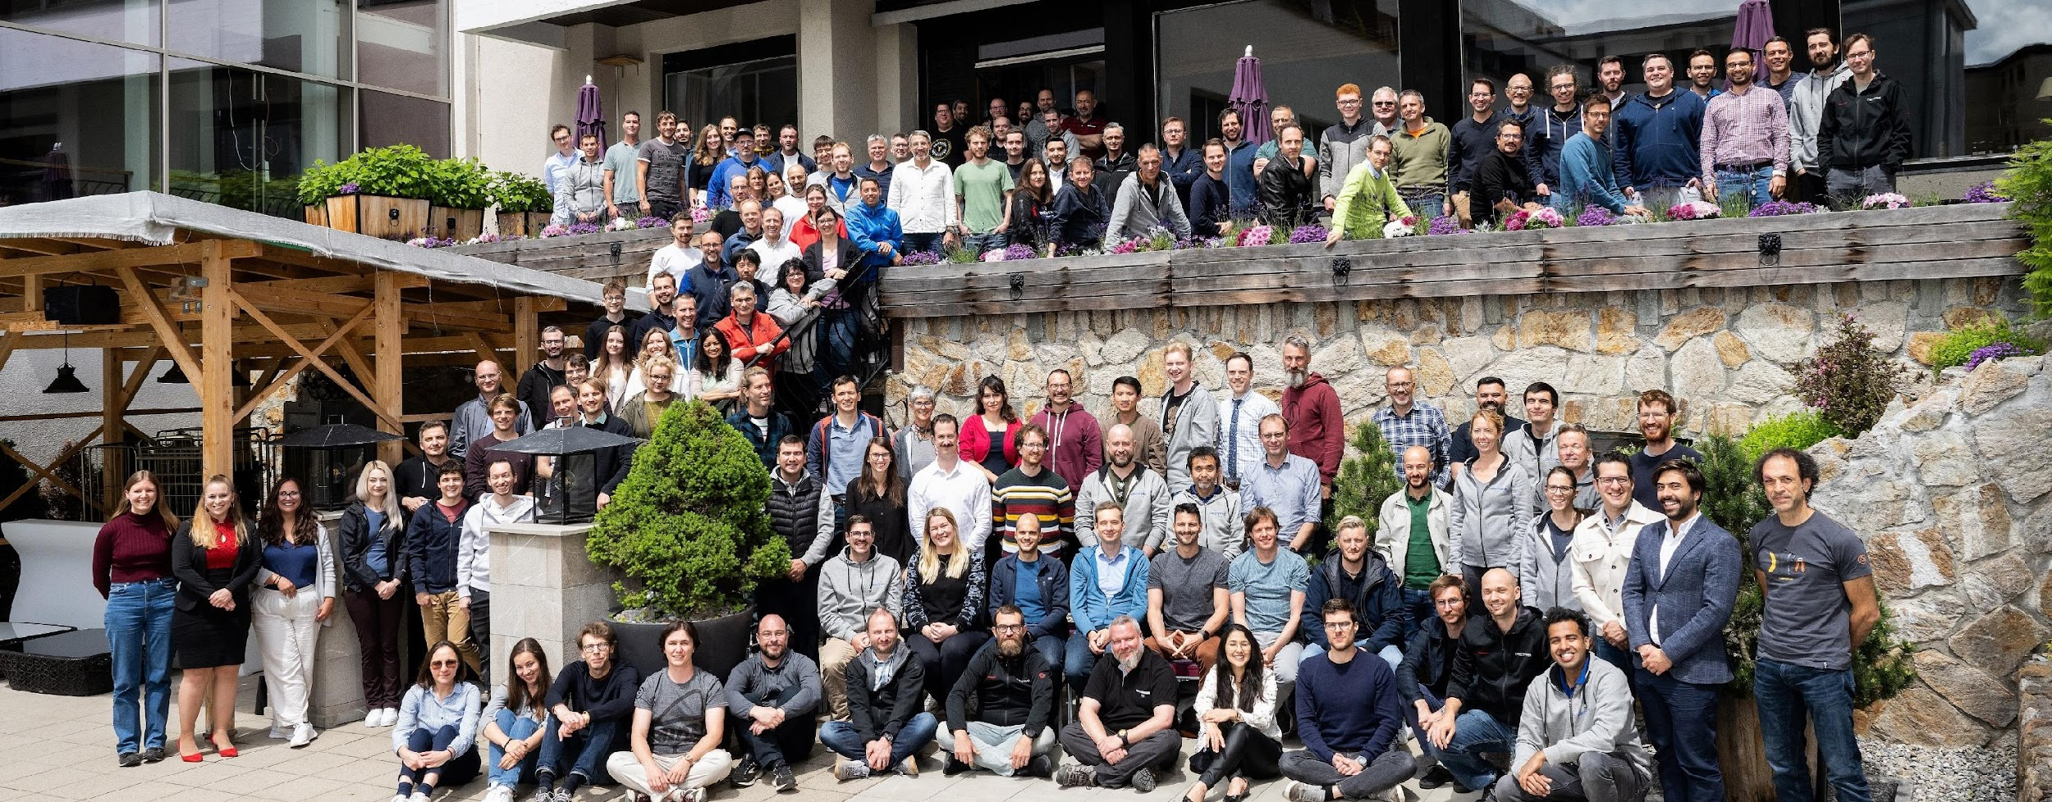
Thank you!
DECTRIS Ltd.
5405 Baden-Dättwil
Switzerland
www.dectris.com

