Slide 1

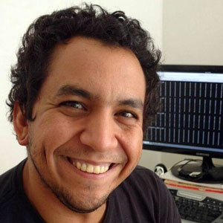

The WeNMR Case Study Research Software as a Service for Demonstrating Impact, Securing Funding and Serving a Global Community International Symposium on Grid and Clouds Academia Sinica, Taipei, Taiwan March 16-20, 2026
Rodrigo
Vargas Honorato
Prof. Alexandre M.J.J. Bonvin
Bijvoet Centre for Biomolecular Research
Faculty of Science, Utrecht University
the Netherlands
a.m.j.j.bonvin@uu.nl
@amjjbonvin.bsky.social

Slide 2
Overview
The Sustainability Challenge
WeNMR A Global Research Platform in Action
Quantifiable Impact
From Metrics to Funding
Building a Scalable and Sustainable Service Portal
Research Software as a Service
Conclusions

Slide 3
Essential Software, Invisible Impact
Develop Software
Publish
Get citations
Hope for funding
Research software is the backbone of modern science.
Yet, the standard metrics for success are flawed:
Downloads: Don't measure actual use.
Citations: Don't capture the full scope of use.
How do we make the invisible work of our software visible and irrefutable?

Slide 4
The RSaaS Model
The Sustainability Challenge
Research Software
Download
Centralized Service
Usage
Captured Usage Data
🔒
🔒
Citations
Quantifiable Impact
Distributed Approach
Centralized Service Approach
Research Software is distributed to the community but the actual usage is a black box , we must use indirect measures.
We provide the users with a centralized way to interact with the Research Software, so we can capture the usage data directly.

Slide 5
Overview
The Sustainability Challenge
WeNMR A Global Research Platform in Action
Quantifiable Impact
From Metrics to Funding
Building a Scalable and Sustainable Service Portal
Research Software as a Service
Conclusions

Slide 6
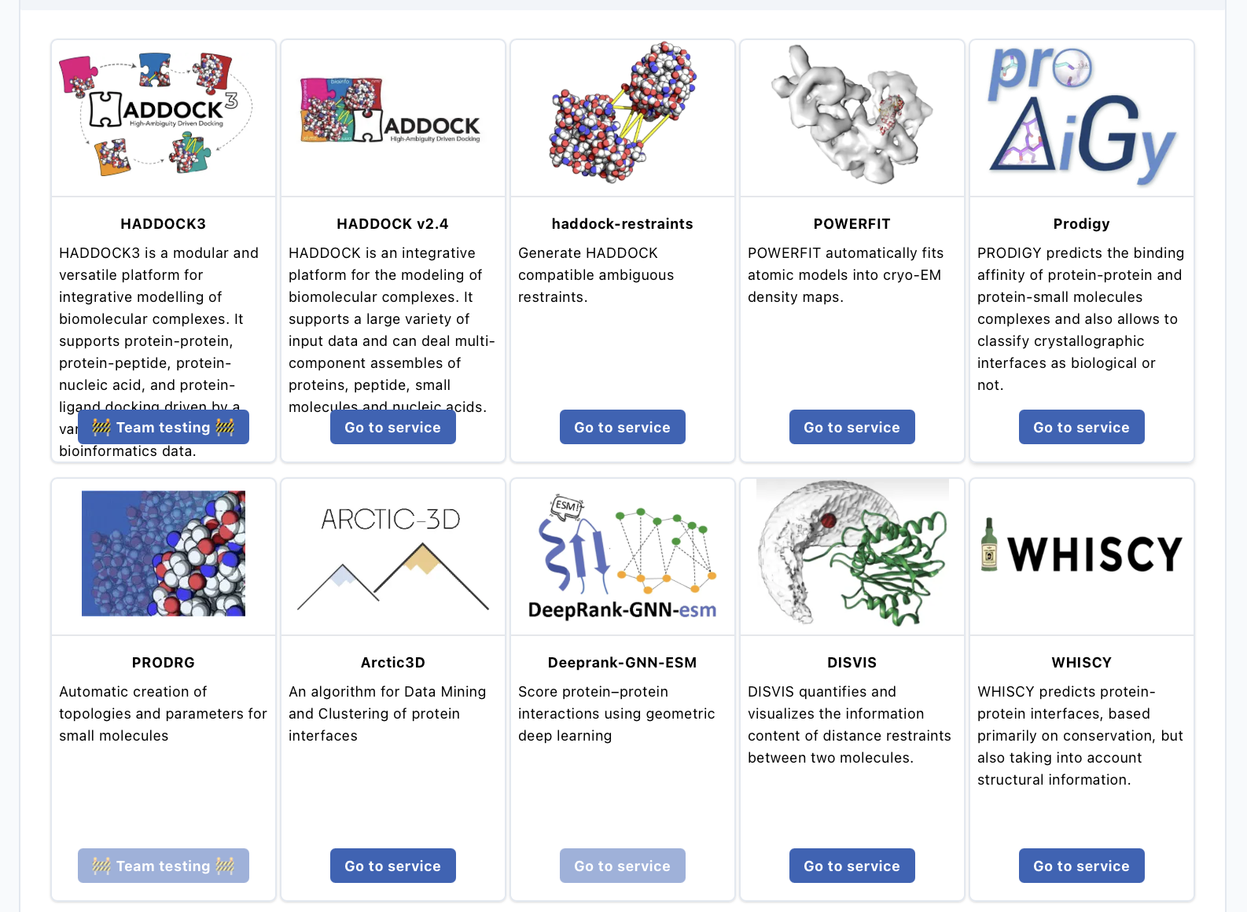
WeNMR
A Virtual Research Environment for Structural Biology
Centralized, web-accessible platform for a suite of structural biology tools.
Provides computational workflows, data management, and expert support.
Eliminates technical barriers for researchers (no installation, no local HPC access needed).
wenmr.science.uu.nl

Slide 7

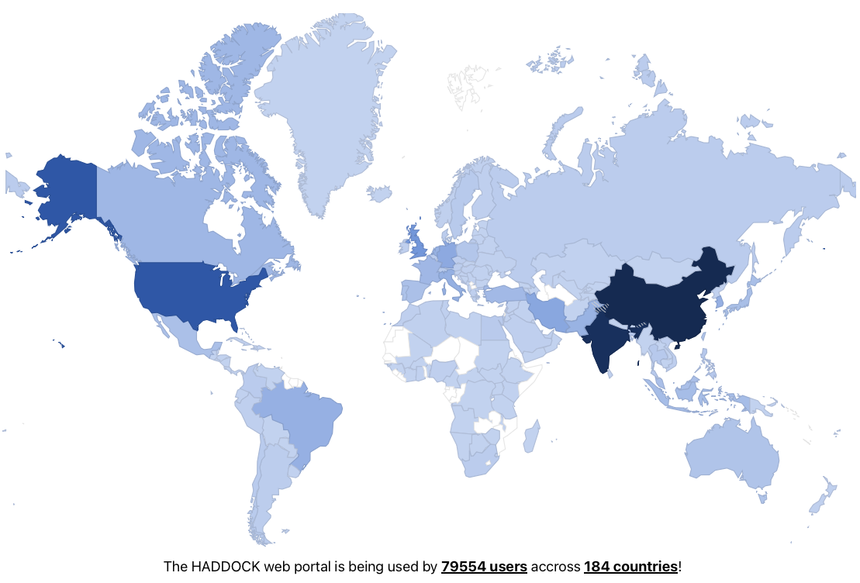
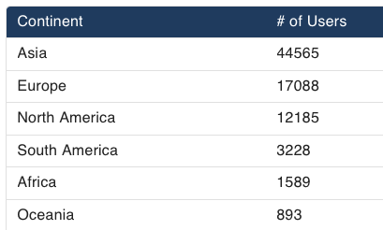
A global community
79.000+ Registered users
184 Countries
13 Services
~6500 CPU years per year

Slide 8
Overview
The Sustainability Challenge
WeNMR A Global Research Platform in Action
Quantifiable Impact
From Metrics to Funding
Building a Scalable and Sustainable Service Portal
Research Software as a Service
Conclusions

Slide 9
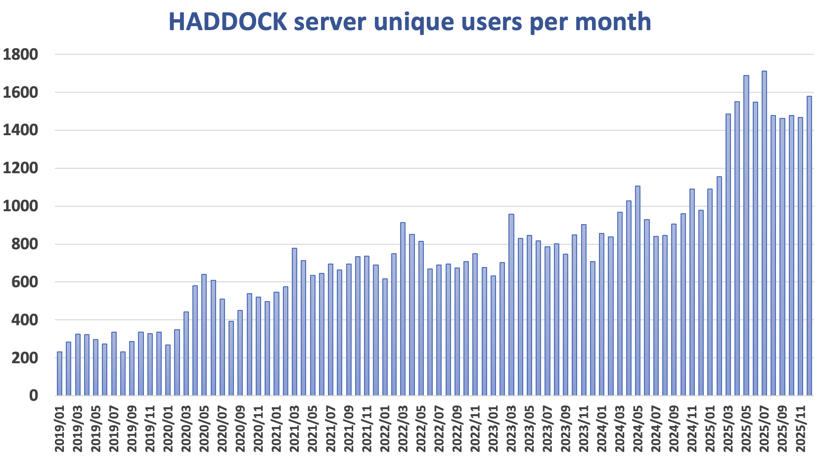
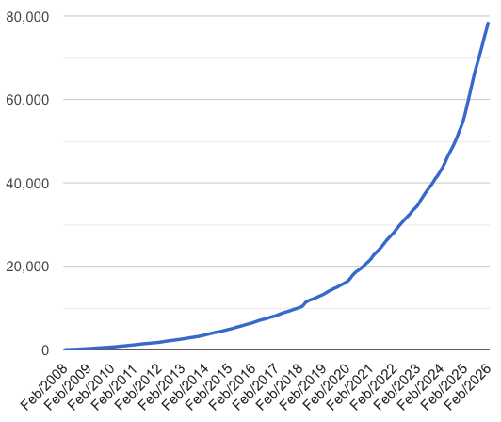


Quantifiable Impact
As a centralized service, every interaction is a data point
Cumulative number of users
https://wenmr.science.uu.nl/stats
Quantifiable Impact

Slide 10
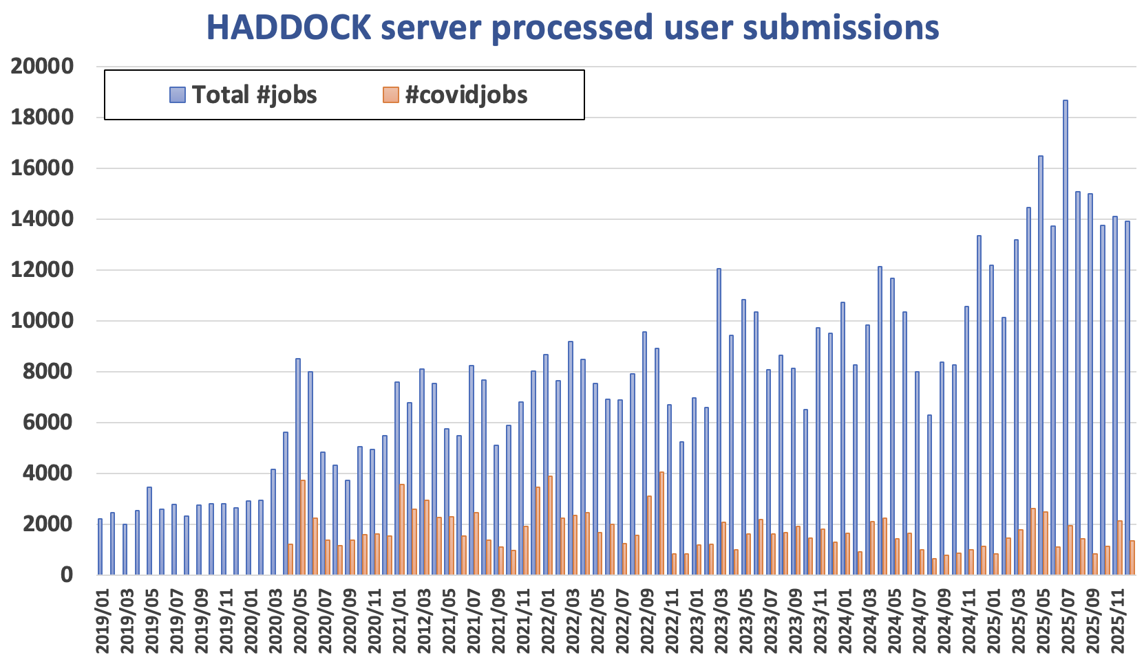
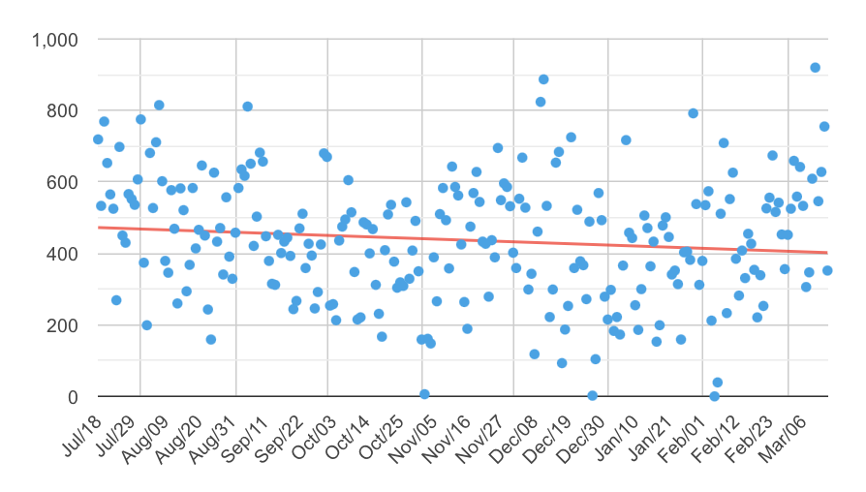
Quantifiable Impact
As a centralized service, every interaction is a data point
HADDOCK server jobs processed per day
https://wenmr.science.uu.nl/stats
Quantifiable Impact

Slide 11
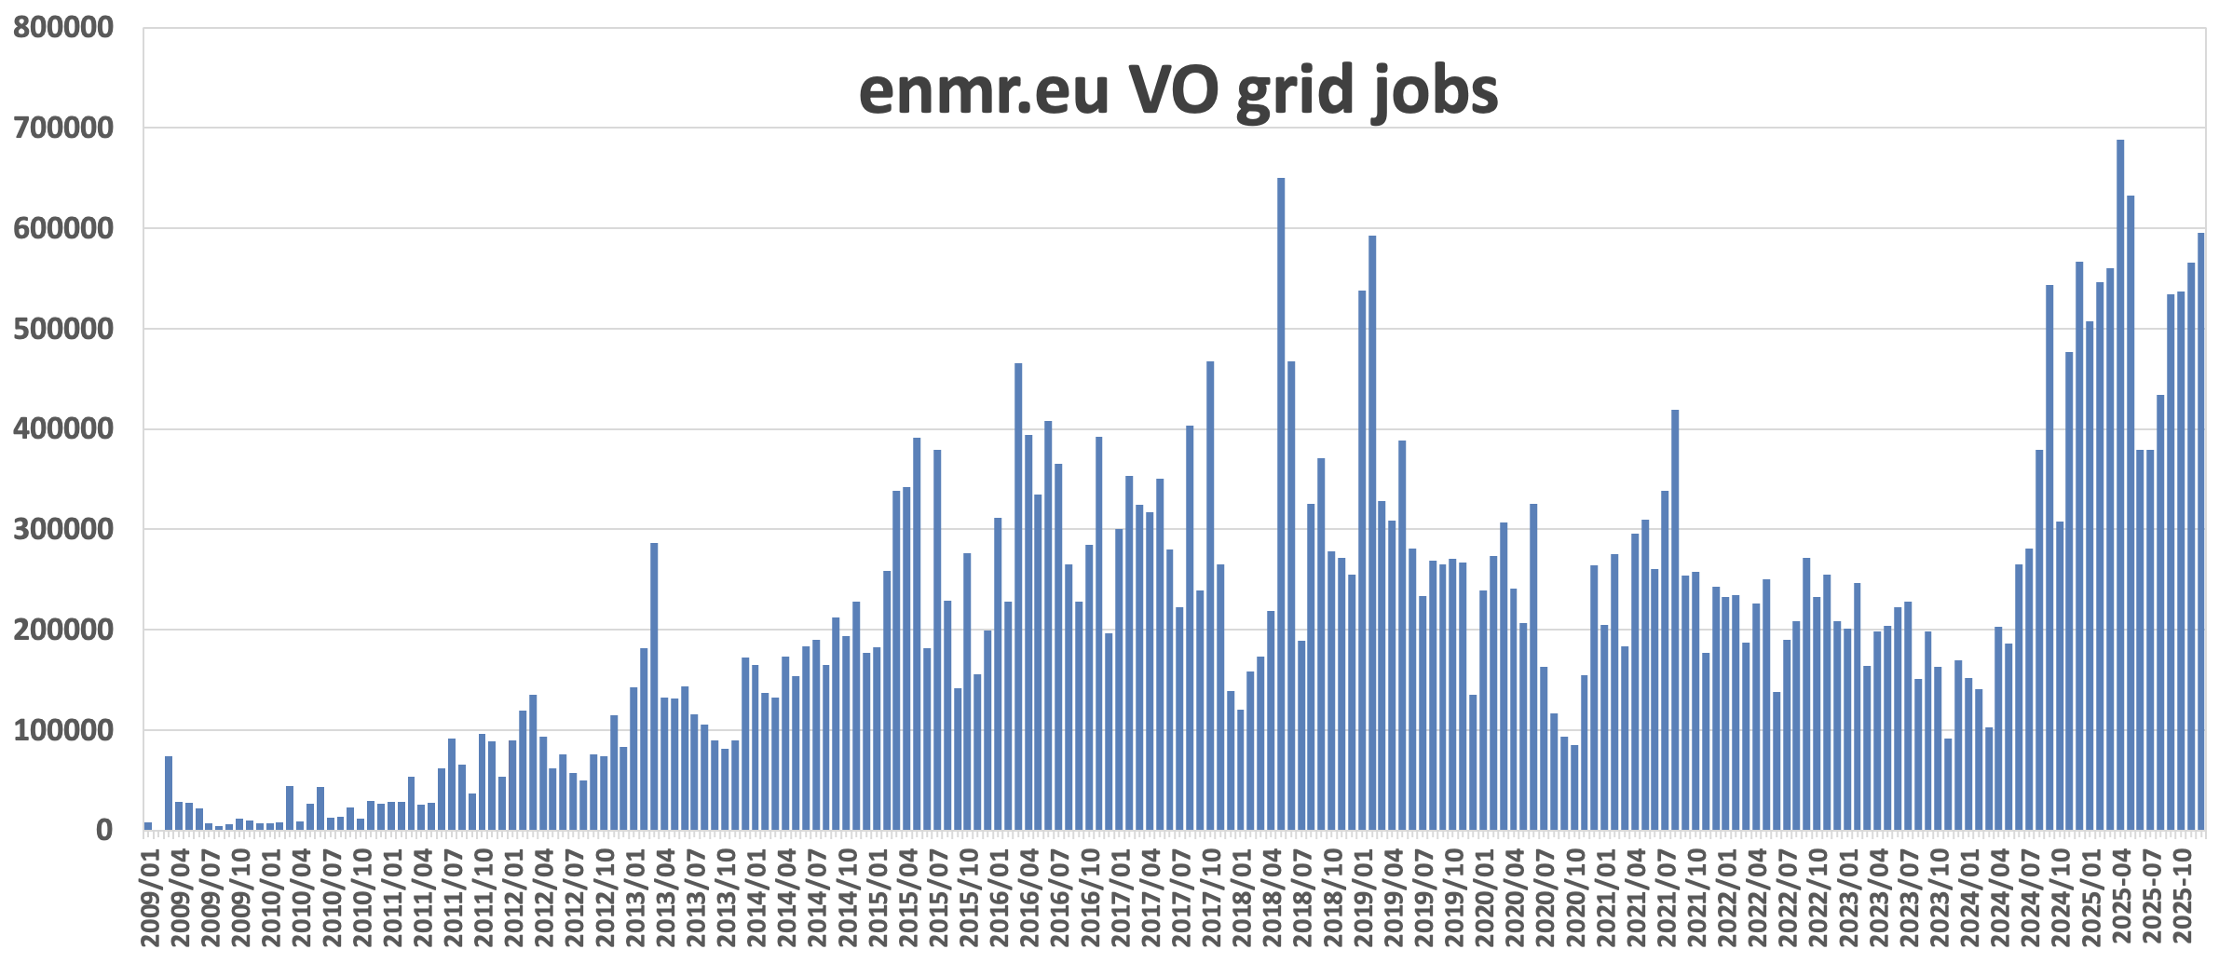
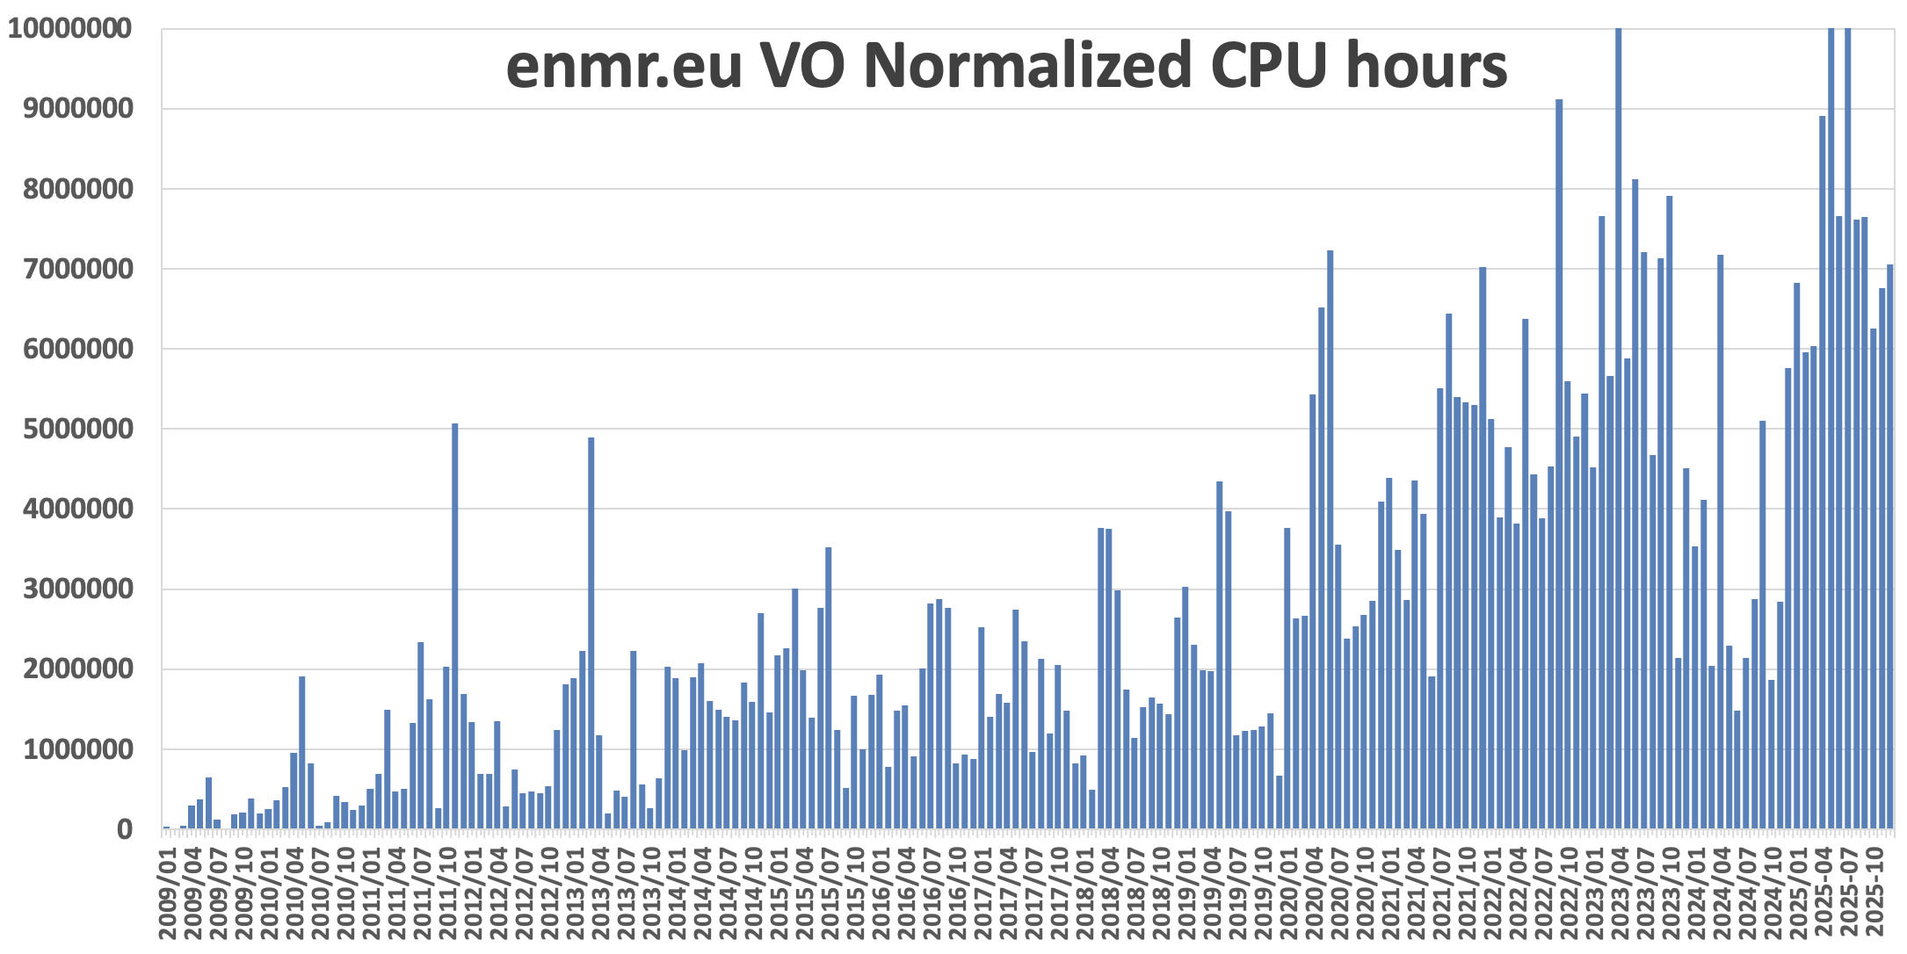

Quantifiable Impact
Data from: https://accounting.egi.eu
Quantifiable Impact

Slide 12
Overview
The Sustainability Challenge
WeNMR A Global Research Platform in Action
Quantifiable Impact
From Metrics to Funding
Building a Scalable and Sustainable Service Portal
Research Software as a Service
Conclusions

Slide 13






Usage data as narrative
"WeNMR is not just software. It is a critical piece of research infrastructure that directly enables 5000+ CPU-years of science annually for a global community of >79,000 researchers."

Slide 14
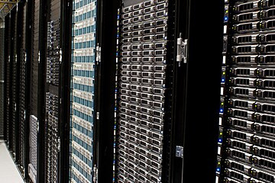

Sustained Investment
Over the past 20 years the WeNMR portal has been a key asset in the acquisition of several grants to sustain its development and operation.
RSaaS model provides accountability and demonstrable impact to funding agencies.
EC H2020 - EOSC Data Commons.
EC H2020 - EOSC-ACE
EC H2020 - EOSC-Hub.
EC H2020 - West-Life
EC H2020 - INDIGO-DataCLoud
EC H2020 - EGI-Engage
NWO-ENW 2020
NWO computing grants (multiple)
EC 7th Framework Programme 2007/2010 (eNMR + WeNMR)
EU EUROHCP-JU - GANANA
NLeSC 2024
NWO-ENW M1 grant 2023
EC EUROHPC CoE – BioExcel 1-3 2017-2026
NLeSC 2021
NWO-ENW PPS 2019
EC H2020-EINFRAEDU-2018-1
SURFsara ML-HPC 2018
NLeSC Accel Sci Discovery 2016
NWO-CW TOP-PUNT 2015
EC H2020-EINFRA-5-2015
Service Operation
Software Development
~9.5M € + ~30M CPU hours

Slide 15
Overview
The Sustainability Challenge
WeNMR A Global Research Platform in Action
Quantifiable Impact
From Metrics to Funding
Building a Scalable and Sustainable Service Portal
Research Software as a Service
Conclusions

Slide 16


Powered by EOSC/EGI
WeNMR Portal
EOSC/EGI
HTC (grid & cloud)
WeNMR is built on top of European e-Infrastructures
Built for scalability
Integrated with EOSC/EGI Grid via DIRAC interware
Users get access seamless (and free) to massive computing resources

Slide 17

WeNMR Portal
Containerized architecture
Job Orchestrator Server
Research Software can be packaged into containers
Reduce complexity and normalize interfaces
Job Orchestrator client
Research Software

Slide 18
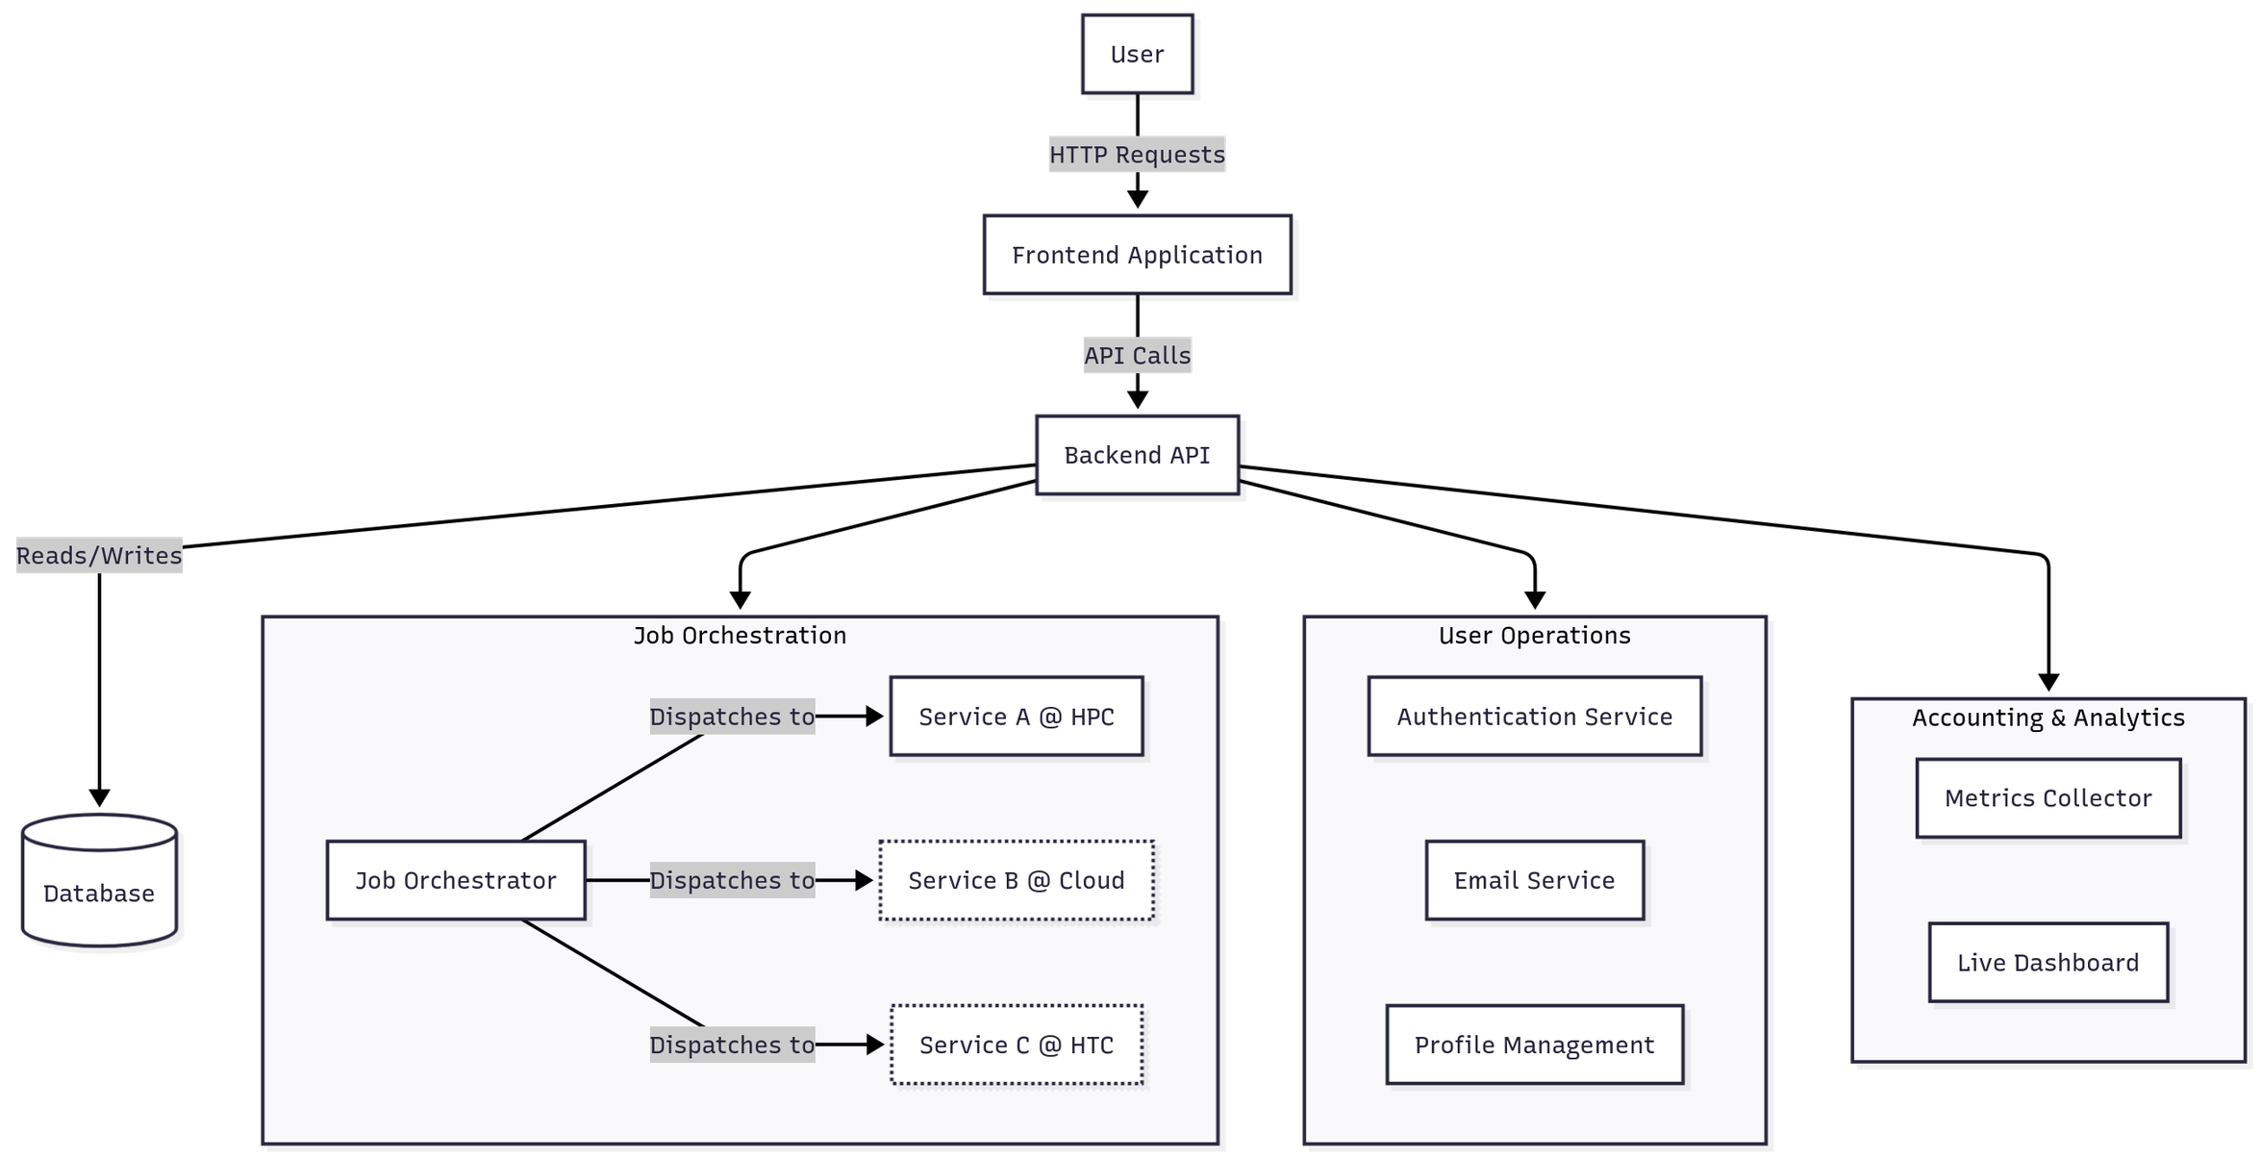
System Design

Slide 19
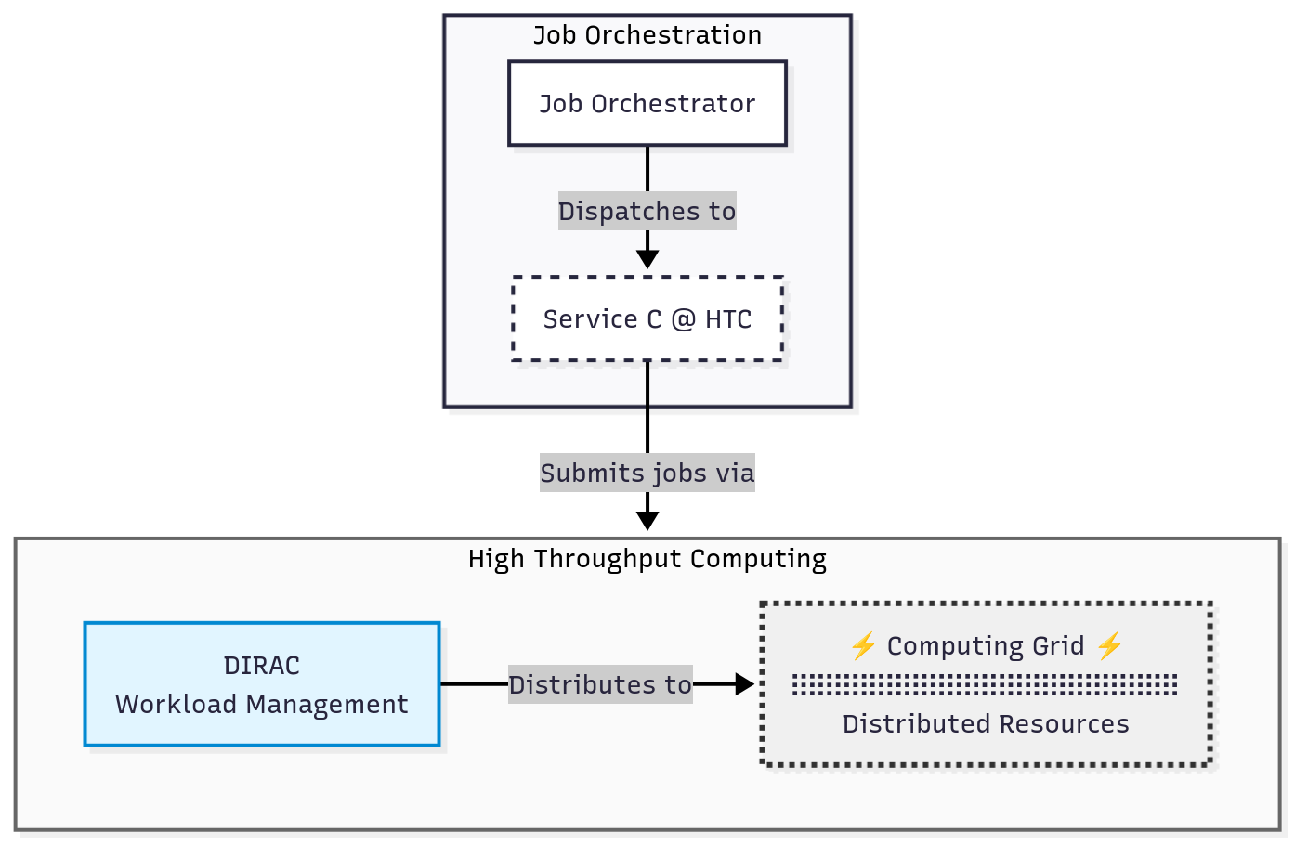

System Design
Building a Scalable and Sustainable Service Portal

Slide 20
Overview
The Sustainability Challenge
WeNMR A Global Research Platform in Action
Quantifiable Impact
From Metrics to Funding
Building a Scalable and Sustainable Service Portal
Research Software as a Service
Conclusions

Slide 21
Main messages
Research Software as a Service
1
3
Move to a Service
Translate Data into Strategy
Move beyond code distribution to a managed, centralized platform. Invest in platforms, not only projects.
Your observable metrics demonstrate relevance.
Clearly state community adoption and scientific throughput.
2
4
Quantify Everything
Build on Scalable foundations
Capture real-time usage data, compute jobs, active users, CPU-years - get direct evidence of your software’s scientific utility.
Use existing e-Infrastructures (EOSC/EGI) and modern DevOps practices. Design for interoperability to ensure long-term viability.

Slide 22









Acknowledgments former and current group members@bonvinlab.org
€€
VICI
TOP-PUNT
ENW
WeNMR
West-Life
EGI-Engage
INDIGO-Datacloud
BioExcel CoE
EOSC-Hub
EGI-Ace
EOSC-Data Commons
GANANA

