Slide 1
The successful removal of IPv4
from WLCG wide area network links

Slide 2
The successful removal of IPv4 from WLCG wide area network links
Bruno Hoeft¹, David Kelsey²
ISGC 2026, Taipeh, 19 March 2026
1 - Karlsruhe Institute of Technology (KIT), Germany
2 - UKRI Science and Technology Facilities Council (STFC UK), United Kingdom

Slide 3
On behalf of all co-authors in the HEPiX IPv6 working group
Active in HEPiX IPv6 Working Group – last 12 months
M Babik (CERN), M Bly (RAL), N Buraglio (ESnet), T Chown (Jisc),
J Chudoba (FZU Prague), P Demar (FNAL), J Flix (PIC), A Forti (GridPP/ATLAS),
C Grigoras (CERN/ALICE), B Hoeft (KIT), H Ito (BNL), D P Kelsey (RAL),
E Martelli (CERN), S McKee (U Michigan), C Misa Moreira (CERN),
F Prelz (INFN), D Rand (Imperial), A Sciabà (CERN/CMS),
M Wadenstein (NDGF), C Walker (Jisc)
many more in the past, and others join from time to time
and thanks also to WLCG operations, WLCG sites, LHC experiments, networking teams, monitoring groups, storage developers…

Slide 4
Outline
The HEPiX IPv6 working group
SCITag – IPv6 header marking
Tier-1/2 Dual-Stack WorkerNodes GGus ticket campaign
Adjust use of dual-stack endpoints towards IPv6
Reduction of LHCOPN to single protocol
LHC experiment position towards IPv6 only
LHCONE IPv6 only
Summary

Slide 5
The HEPiX IPv6 working group

Slide 6
HEPiX-IPv6 Working group
working group : -- created in April 2011
Phase 1 : to consider whether and how IPv6 should be deployed in HEP (especially for WLCG). Readiness and gap analysis of
    HEP applications,
    middleware,
    security issues,
    system management and monitoring tools and
    end to end network monitoring
Phase 2 → dual-stack deployment:
    dual-stack at fileserver (at Tier-1 – realized end of 2020 / at Tier-2 – realized at end of 2023)
    a GGUS-Ticket campaign at end of 2023 → dual-stack WorkerNodes incl. middleware (@Tier-1/2)
Phase 3 : move towards single protocol
→ decommission of IPv4 and migrate to IPv6 only

Slide 7
SCITag – IPv6 header marking

Slide 8
SCITag – IPv6 header marking
Reminder: SciTags is an initiative to identify science domains and their associated network activities anywhere in the network.
Of relevance for this group, packet-marking requires IPv6
recent work:
  SuperComputing 2025 had a successful SciTags packet-marking “Scitags at Scale: 1.1Tbps Packet Marking and WLCG Data Challenge Readiness”
  We have good coverage of storage systems (Xrootd, EOS, Storm) but are still missing dCache. Next Golden release (11.2.1) will support SciTags
  Lots of work on flowd, with Pablo Collado Soto providing newest features in flowd-go and plans to include it in perfSONAR deployments
  All four WLCG experiments support it now
monitoring for SciTags → https://dashboard.stardust.es.net/goto/ffbg1jaie0uf4d?orgId=2
goal of having 80% of our WLCG traffic monitored via SciTags (packet-marking or fireflies) for DC27

Slide 9
Tier-1/2 Dual-Stack WorkerNodes GGus ticket campaign

Slide 10
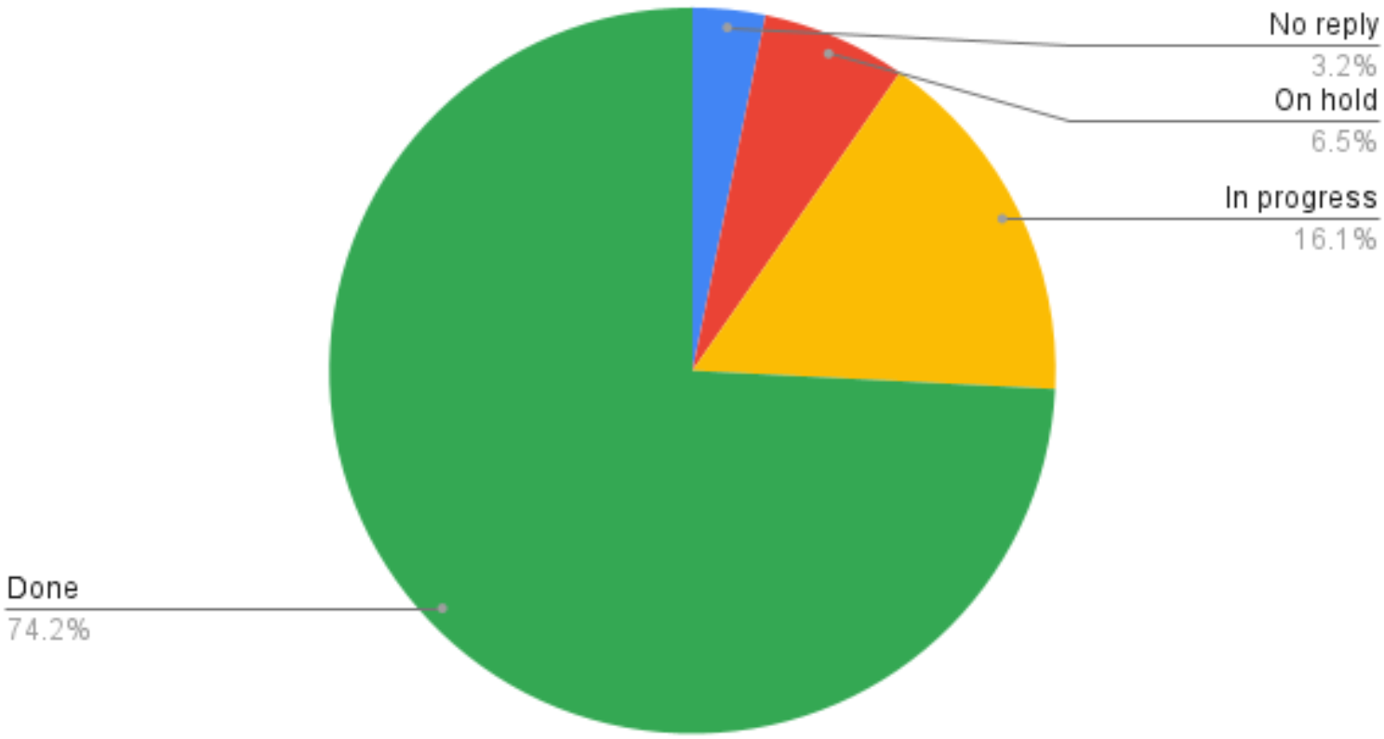
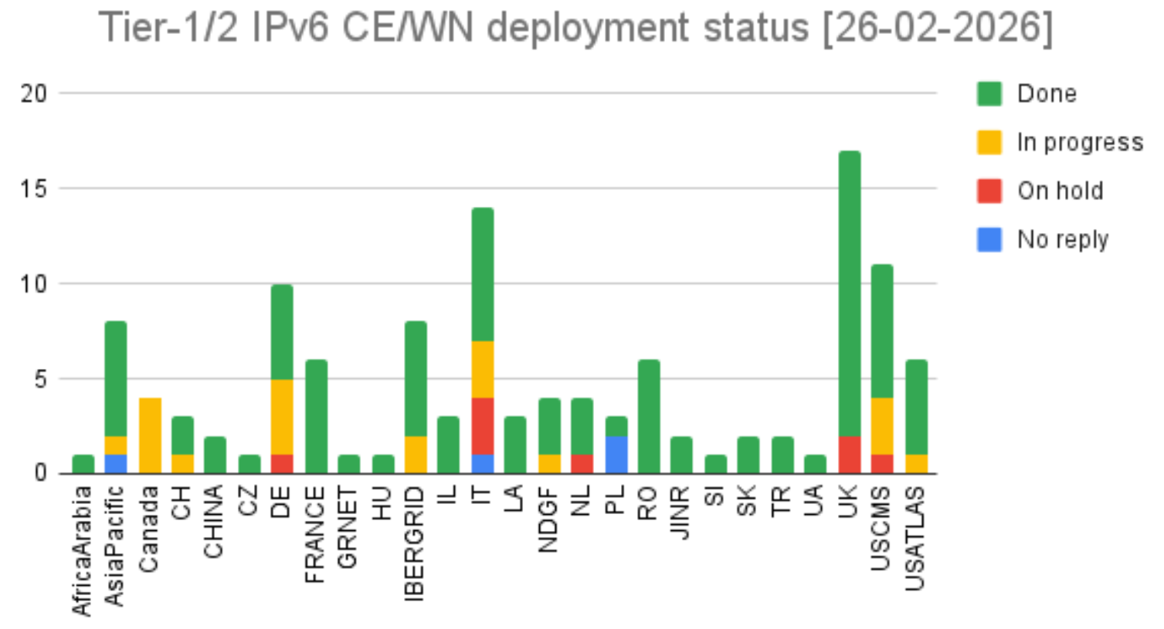
Tier-1/2 WN and CE @ Dual-Stack
Motivations
scarcity of IPv4 addresses
full IPv6 support
by the experiment middleware stacks,
readiness for adoption of packet marking in network traffic
reduction of residual IPv4 traffic
fulfillment of government mandates by some countries
GGus Ticket campaign
Goal
  Storage services successful deployed
  Next step is deploying IPv6 fully enabled infrastructure at entire WLCG
  WLCG management board and LHC experiments approved
    deployment plan for IPv6 requires that Tier-1 and Tier-2 sites
    deploy dual-stack connectivity (IPv4 + IPv6)
    on their computing elements (CE) and worker nodes (WN)
    by 30 June 2024 (long gone)
For more details see https://twiki.cern.ch/twiki/bin/view/LCG/WlcgIpv6#WLCG_Tier_2_IPv6_deployment_stat

Slide 11
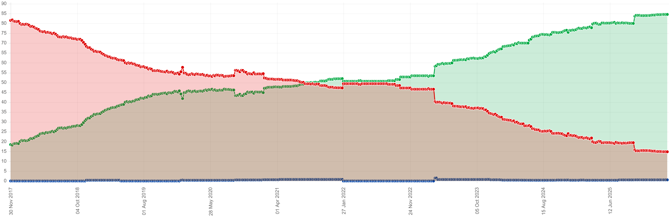
All WLCG services - “VOfeeds” https://orsone.mi.infn.it/~prelz/ipv6_vofeed/
The graphs below record, on a weekly basis (every Thursday at 06:00 CET) the fraction of service endpoints listed in the VO Feeds of the 4 major LHC experiments (Alice, Atlas, CMS, LHC-B) where the DNS returns an IPv4-only (A) resolution (red line), a dual-stack IPv6-IPv4 (A+AAAA) resolution (green line) or an IPv6-only resolution (cyan line). The graph is meant to provide a bird's eye view of the IPv6 transition at WLCG sites.
Comments and complaints → ipv6@hepix.org.
85%
IPv6

Slide 12
Adjust use of dual-stack endpoints towards IPv6

Slide 13
Open Tasks
Software/OS/APP:
Deploy all Grid Services dual-stack
  Missing 15% as shown in “Vofeeds” slide
Set all Linux server to prefer IPv6 over IPv4
  as JINR realized for moving to IPv6
Investigate application configuration
  As shown for CVMFS (Closer to IPv6-only on WLCG, ISGC 2024/slide 14), still not deployed at all sites
  DNS → resolve.conf (first line IPv6 resolver)
  dChache deployment → since (version 7.2.15) IPv6 support
    Incl. JAVA IPv6 support
    With dCache Golden release 11.2.1 will support site tags (even with HTTPS)
Hardware:
Hardware supporting IPv6
  SARA (NLT1) new switching HW is supporting IPv6 (previous → to small memory)
  Except NVIDIA Skyway InfiniBand/Ethernet gateway

Slide 14
Reduction of LHCOPN to protocol IPv6 only

Slide 15
IPv6 only LHCOPN
Assumptions to start with:
(LHCOPN is used for T0-T1s and T1s-T1s transfers)
Aim to remove IPv4 routing from all LHCOPN links
By the first months of LS3 (end of Q4 2026)
IPv6 already ~96% of the total traffic in LHCOPN
IPv4 is not being dropped. It moves to LHCONE or General R&E Internet
Not difficult to bring IPv4 back, if problems should arise

Slide 16
Removal of IPv4 on US Tier1s LHCOPN links
At July WLCG Management Board it was agreed to remove IPv4 from BNL and FNAL LHCOPN links on 2nd of September 2025, during a LHC stop (machine development)
As a consequence, the IPv4 traffic to these two sites would fall-back to LHCONE, with last resort backup over the Internet
  Average amount of IPv6 traffic in LHCOPN already above 90% for several months
  Last clean-up of remaining IPv4 on BNL and FNAL during August:
    JINR: solved by JINR by preferring IPv6 over IPv4 on Linux settings
    Still some IPv4 traffic to NLT1 and IT-INFN-CNAF for well known limitations (switch performance at NLT1 and IPv4-only Infiniband gateway at CNAF)

Slide 17
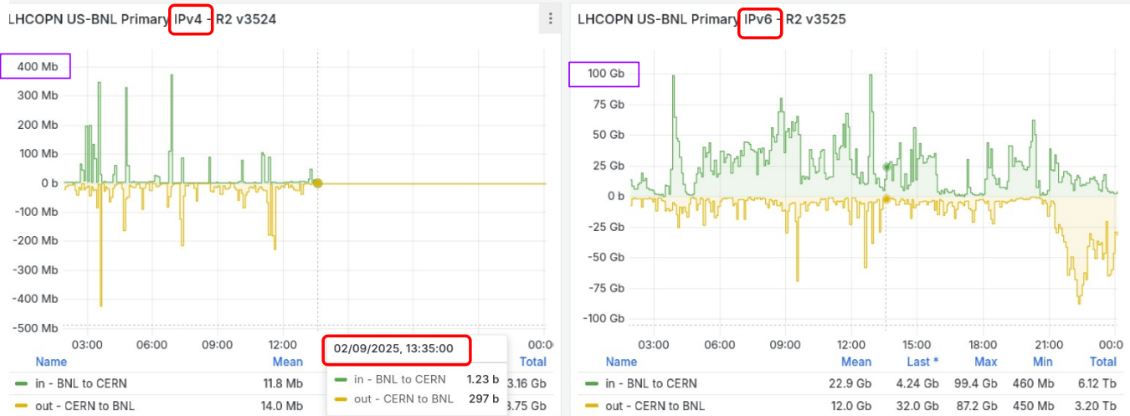
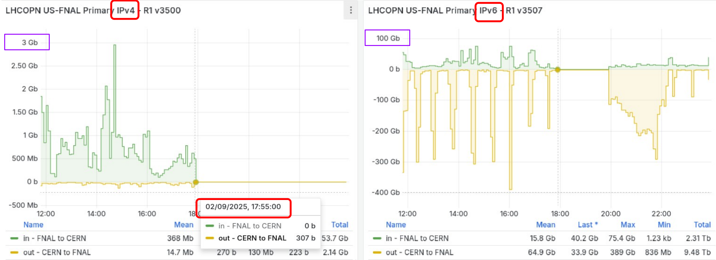
BNL / FNAL dropped IPv4
● BNL stopped all LHCOPN
IPv4 peerings at 11:27 UTC
(7:27 AM EDT or 13:27 CERN
time where plots were copied)
https://monit-grafana-open.cern.ch/d/CIqtof5nk/us-bnl?orgId=16
● FNAL stopped all LHCOPN
IPv4 peerings at 15:53 UTC
● IPv6 was stopped as well by
mistake, but recovered at
~17:50 UTC
https://monit-grafana-open.cern.ch/d/JohzoB5nk/us-fnal?orgId=16

Slide 18


Impact ?
ATLAS
  No noticeable impact.
  Any remaining IPv4 Traffic re-routed onto LHCONE or R&E networks.
  Has a few non-WLCG experiments that were using LHCOPN and now use LHCONE
CMS
  No noticeable impact.
  Any remaining IPv4 Traffic re-routed onto LHCONE or R&E networks.

Slide 19
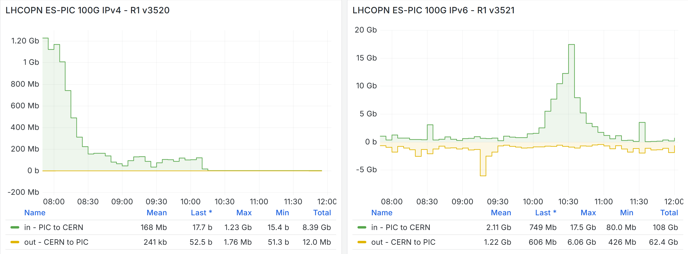
ES-PIC - IPv6 only LHCOPN
The removal of LHCOPN IPv4 was smooth
Experiments did not report any noticeable impact
IPv4 traffic moved to LHCONE (or R&E Internet)

Slide 20
Next LHCOPN IPv6 only candidats
CN-IHEP
  Some tasks still to be solved
    JUNO and JINR communication via LHCONE
    LHCb traffic between IHEP and CNAF
    ALICE traffic between IHEP and KISTI
    AMS traffic between CERN and IAT login node
NGDF
KIT
All other Tier-1s will follow before DC27

Slide 21
LHC experiment position towards IPv6 only

Slide 22
ALICE
Storage nodes: not any time soon, too many WNs on many sites are not dual stacked
  any WN must be able to reach any storage at any time
  the storage itself is close to being fully dual stacked
WNs: could be IPv6-only, as soon as the above is solved
  ok to test with one but in production we will increase the job error rate unless all data is available
LHCOPN: should be ok to drop IPv4
  T1 storages are dual stacked, raw data replication as 3rd party XRootD transfers
  provided IPv4 still works as a fallback (CNAF WNs reading from CERN EOS for example)
LHCONE: should also be ok
  T2s exchange more data between them (job output -> external SEs to the originating site)
  As per the previous slide, IPv4 connectivity is a must
  Site and storage node-level firewalls are prepared for traffic to come from !=LHCONE
    but it won’t be efficient
An area we don’t control is users’ home networks -- They need to be able to access any data file → Thus:
  Storage: needs IPv4 for the foreseeable future
  Network: has to be allow access to the storage on IPv4
  Computing: could go IPv6-only, though a minimal (NAT) IPv4 support might solve a lot of issues

Slide 23
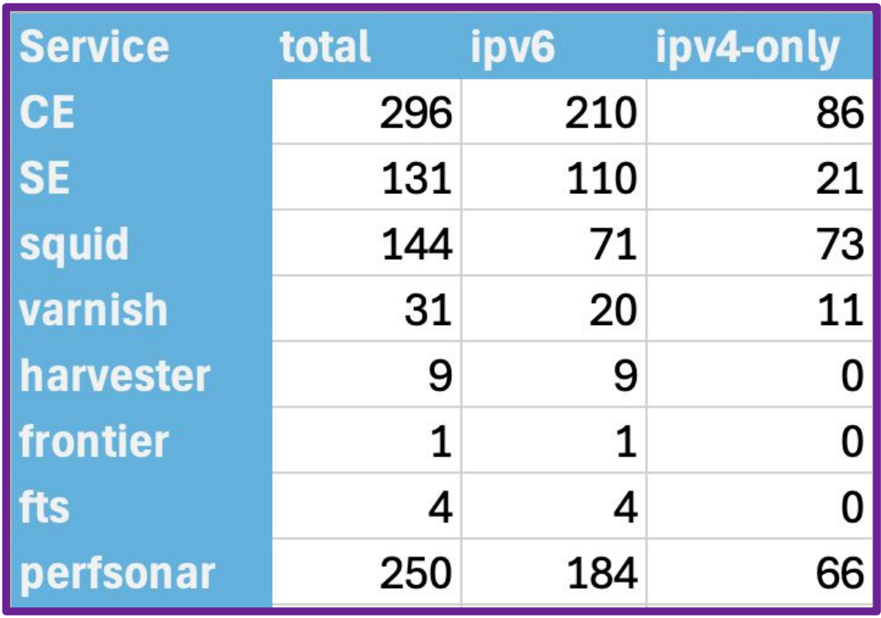
ATLAS
Some sites want to go IPv6-only - not dual stack!
  US sites have a gov requirement → pushing really hard for this
    LHCOPN IPv6 only mini-challange and BNL status still IPv6-only
  Other T1s (pic, NDGF) would also prefer to maintain a single protocol to
  protect/debug!
  Other sites mostly Tier2s but also a couple of T1s have problems
    Poor response from institutions network teams
    Non WLCG use cases
    Hardware to be replaced (planned but not yet there SARA, RAL)
  HPC also are on ipv4 (NVIDIA – skyway)
Initial check
ATLAS hasn’t pushed any site to move proactively
  Position to be reviewed (?) → Certainly central services need to be reviewed
Monitoring is also still not fully equipped

Slide 24
CMS
CMS is one of the strongest supporters of enabling IPv6 on the entire WLCG
  Pushed for an ambitious deadline for the deployment on compute
  Supports switching off IPv6 on LHCOPN (and then LHCONE), of course after having fully understood the nature of any remaining IPv4 traffic
The entire system is fully compatible with IPv6(-only) resources
  Successfully tested IPv6-only at CERN, KIT, Bristol already quite some time ago
IPv6-only storage is already foreseen at some sites (e.g. T1_PL_NCBJ)
  This makes completing the deployment on compute particularly important
Unfortunately, some CMS T1/T2 sites are affected by the infamous Nvidia Skyway incompatibility with IPv6, or use HPC resources with no IPv6 support (and none foreseen ATM)
  CNAF, Aachen, Nebraska, USCMS
Monitoring → improved, but not yet fully validated
  FTS monitoring looks good – even while many “unknowns”
  XRootD monitoring not yet validated
  dCache and XRootD monitoring now use ipver as FTS
CMS pushing for IPv6 deployment
  But concerned about sites that cannot deploy it on WN, as CMS likes to be able to access any data from anywhere

Slide 25
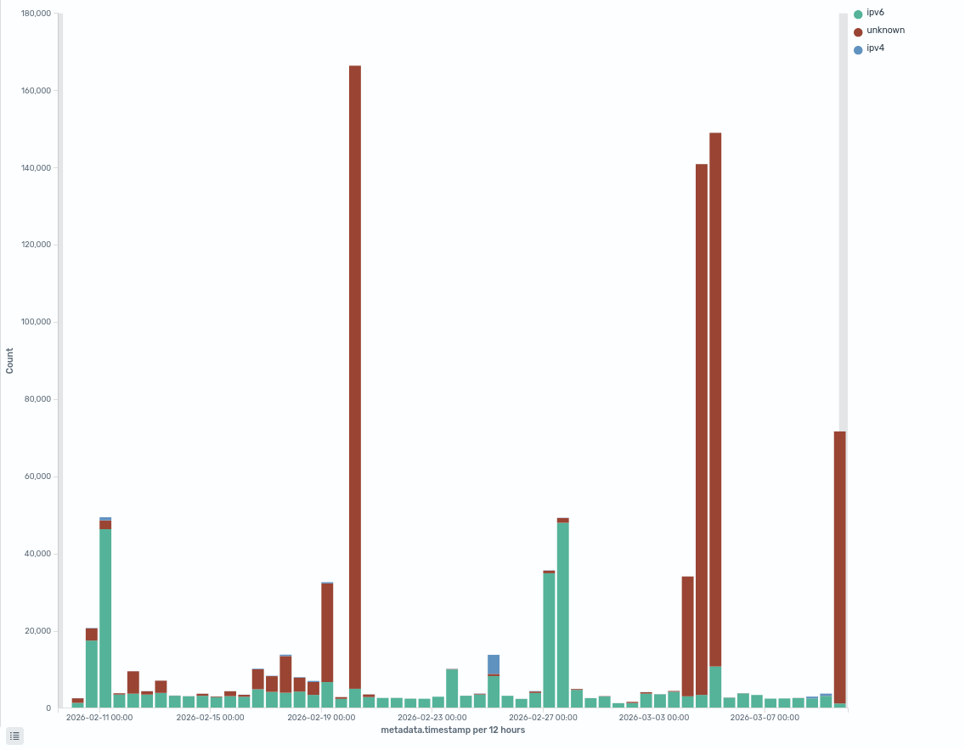
LHCb
Many sites support IPv6
Full IPv6 : 42
Mixed: 6
No_IPv6: 7
Unknown_only: 4
Most site service endpoints in dual-stack
Storage: 99 % (217/218 endpoints)
Compute: 80 % (111/138 endpoints)
Some sites (ie:T1 PIC) prefer to maintain only 1 protocol (IPv6). Recently (23/02) PIC stopped IPv4 peering on LHCOPN.
As in other VO some sites suffer from hardware limitations or HTC without conectivity/IPv6
Central infrastructure services at CERN based on DIRAC which is fully IPv6 compatible.
No particular LHCb monitoring, gfal do not gives us tracking info. Monitoring with FTS still with “unknowns”
In favour of Removing IPV4 from LHCONE and test during next datachallenge (maybe DC27?)

Slide 26
LHCONE IPv6 only

Slide 27
LHCONE IPv6 only
LHCONE IPv4 blackout mini-DC (from Feb. 4th to 6th)
AGLT2, NET2 for ATLAS and UNL, PURDUE for USCMS
  Shutdown IPv4 peering (or IPv4 CIDR adverticements)
  Traffic went via R&E network
  → was successful –> open question “why turning IPv4 back on”
  → gave confidentiality in moving forwards towards IPv6 only
LHCONE IPv6 only bevor DC29
  decent LHCONE IPv4/6 protocol monitoring required
  Looking into remaining IPv4 communication
    identify and migrate to IPv6

Slide 28
Summary
WN + CE dual-stack IPv6 deployment
  Ongoing and activley monitored (by HEPiX-IPv6 Working Group (Andrea Sciaba))
  Encarage to use current Linux settings
  Prefer IPv6 over IPv4
  Configure WLCG SEs and WNs to use IPv6
  WLCG reduction to IPv6 only
  LHCOPN IPv6 only – smoothley in progress
  LHCONE IPv6 only – still discussions ongoing → DC29
  LHC Experiments needs to get included
  They need to get convinced IPv6 only is the path to go
  That they can convince and motivate their community
  New experiments → with IPv6 only,
    no migration „nightmare“

Slide 29
Thanks for your attention
Questions

