Slide 1

Building a National
EOSC Node
The Dutch Cooperative Approach to
Federated Open Science Infrastructure
Maarten Kremers - Open Science
ISGC 2026 - 20th march 2026 – Taipei

Slide 2
We organise collective purchasing under the best conditions
In costs, but also in public values
We share knowledge and coordinate collaboration
in education, research and innovation
We provide IT services
(50+ and very diverse) to make IT accessible, easy and safe
We innovate
To make sure we are ready for the future
SURF is the national ICT cooperative of Dutch education and research institutions.
Members (100+) are all universities, universities of applied sciences, UMCs, and a lot of the research institutions

Slide 3
Services
Trust & Identity
Security
HPC
National Supercomputer
National Research Network
Storage
Procurement
Education services

Slide 4
Research and Data Doesn't Stop at Borders
Cross-border
Fragmented
Sovereignty
Researchers collaborate across borders and disciplines. Data grows exponentially.
"Rich, but fragmented" — overlap, inefficiency, missed connections. (NPOS 2020)
Governments want control. Researchers want openness. How to be both?
How do you build infrastructure that is open and sovereign?

Slide 5
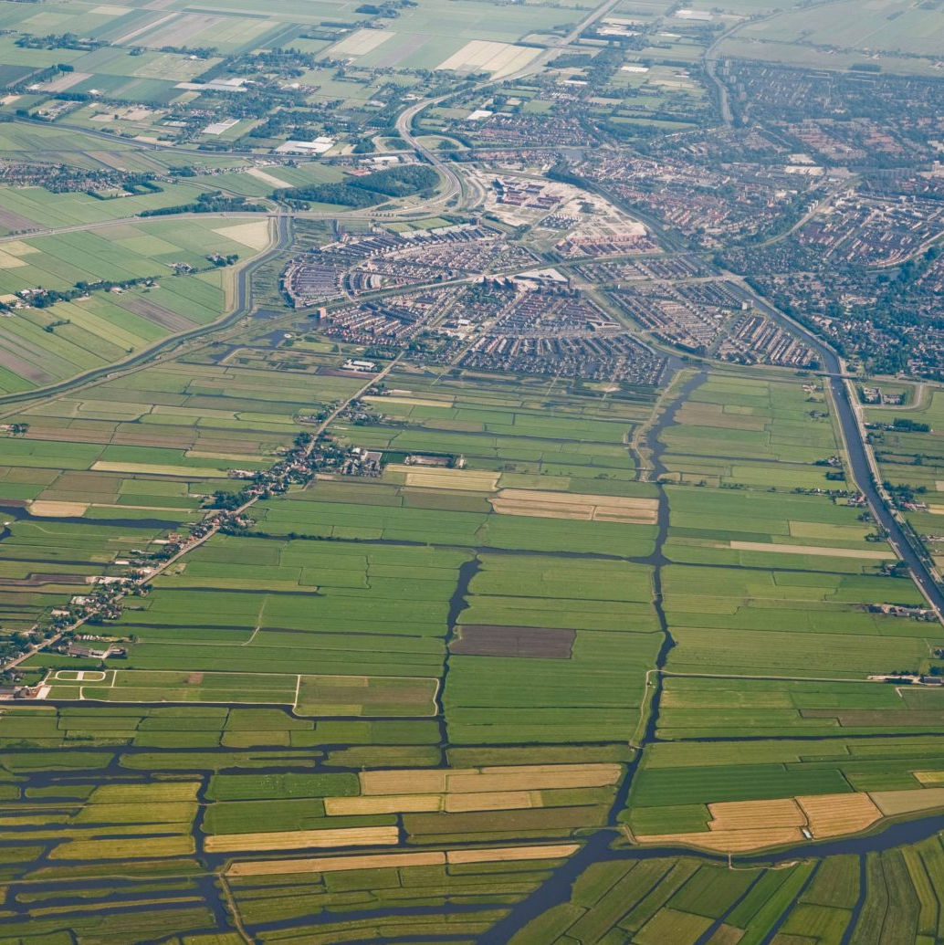
Current data landscape
“The Netherlands has a rich, but fragmented, confusing data landscape. This concerns both data services and the development and dissemination of knowledge about the care of research data. This creates risks of overlap, inefficiency and missing opportunities for connection and innovation.”
Final report Exploration and optimization of national data landscape (NPOS, 2020)

Slide 6
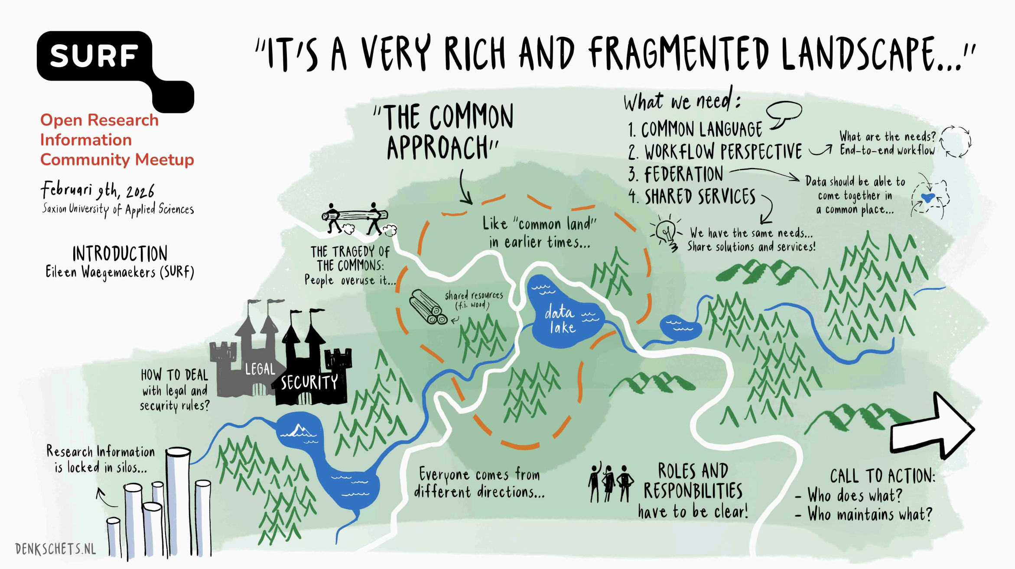

Slide 7
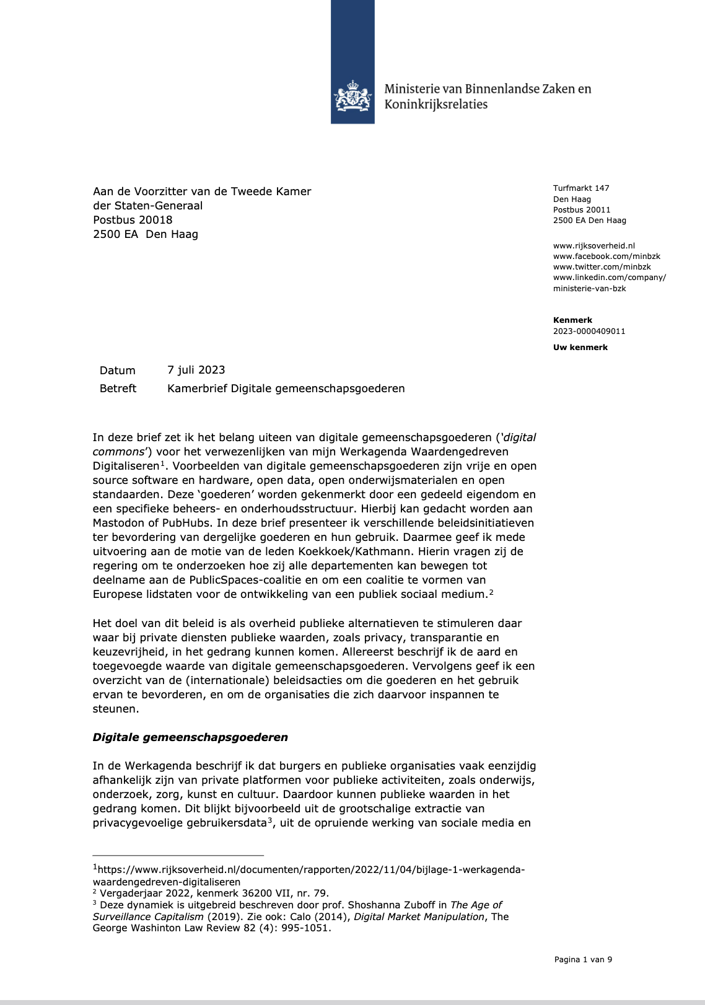

Recommendations
Final report Exploration and optimization of national data landscape (NPOS, 2020)
“Form a national network of all data service providers and repositories (as 'National Open Science Cloud' or 'Commons' or 'Network') with the aim of greater coordination, overview and synergy.”
“Form an international hub for the transparent connection with the experience and expertise that is present and built up in a European and international context (EOSC, CODATA, GO-FAIR, RDA, WDS).”
Letter to Parliament on ‘Digital Commons’ (Van Huffelen, 2023)
“Digital commons” provide a structure in which public values, democratic decision-making and (technological) sovereignty are placed centrally.”

Slide 8
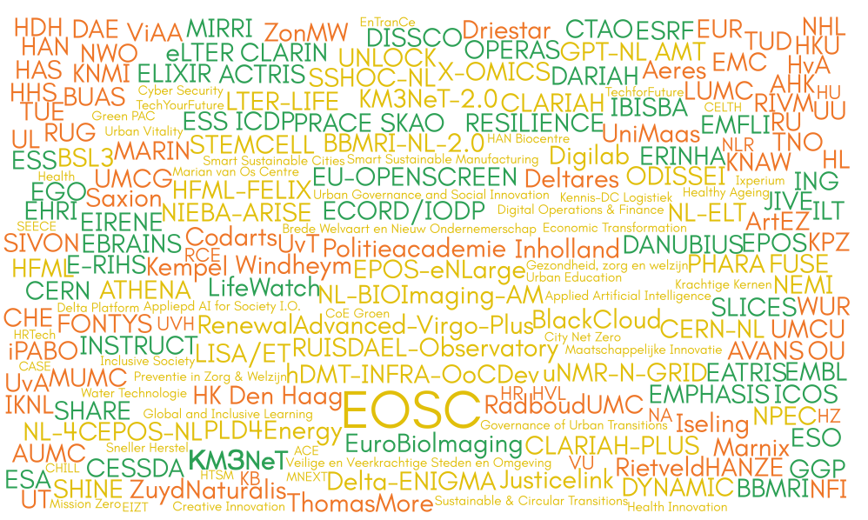
Three areas
Consortium Research Infrastructure
Institutional Research Infrastructure
European Research Infrastructure

Slide 9
How to orchestrate a national infrastructure
Institutional
Consortium
Digital Competence Centers – Tier2
Large Scale Research Infrastructures
EOSC Node
European
Common Language

Slide 10
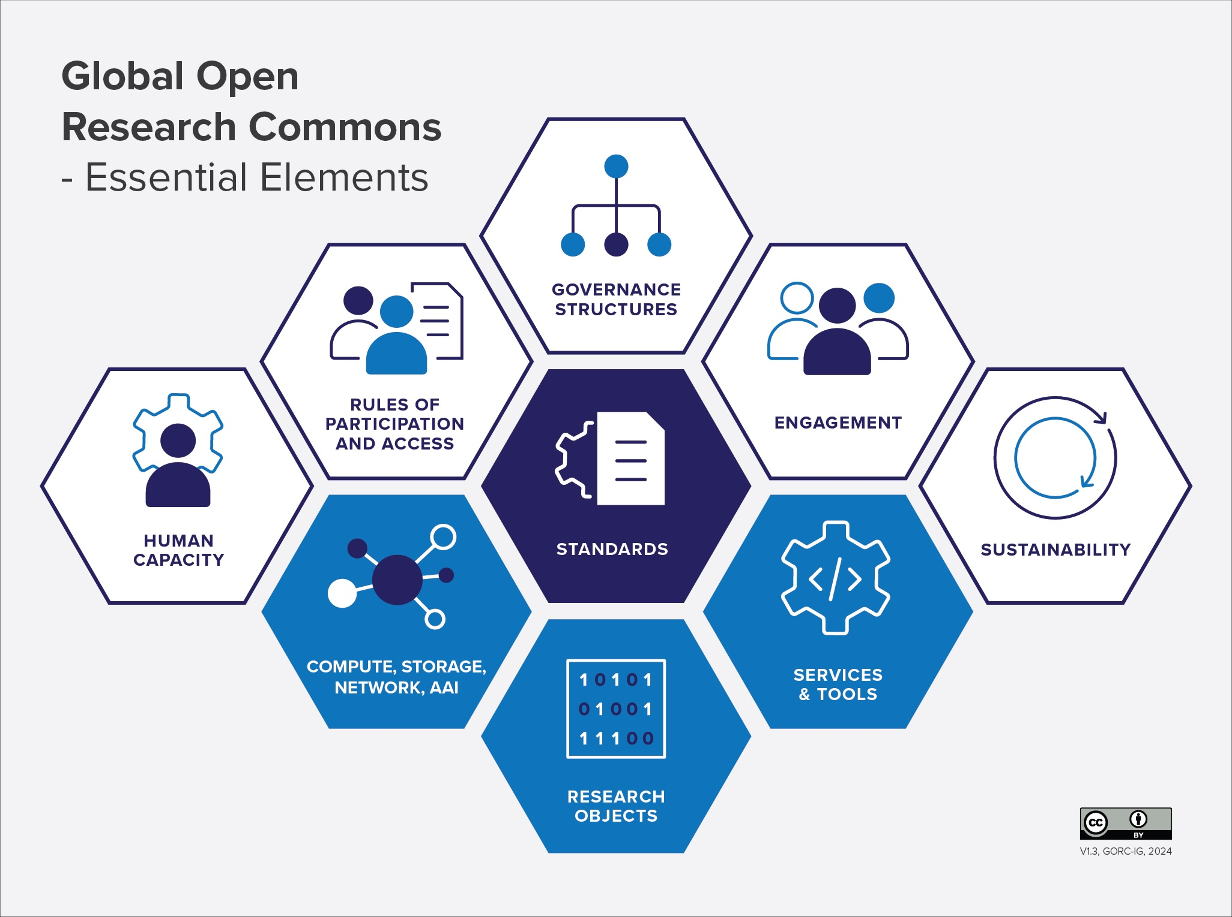
Common Language
To support the development of research commons, and work to make them interoperable.

Slide 11
How to orchestrate a national infrastructure
Institutional
Consortium
Digital Competence Centers – Tier2
Large Scale Research Infrastructures
EOSC Node
European
Common Language
Workflow Perspective

Slide 12
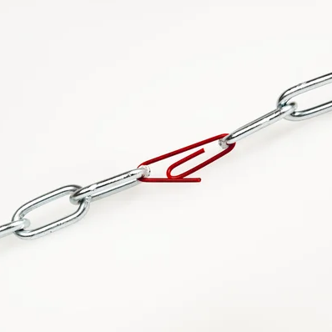
Workflow perspective
Identify researcher needs, to understand the specific needs, generic enough to facilitate.
Cover end-to-end concerns like security, scalability and reproducibility.
Identify cross-service, -institution or -discipline challenges.

Slide 13
How to orchestrate a national infrastructure
Institutional
Consortium
Digital Competence Centers – Tier2
Large Scale Research Infrastructures
EOSC Node
European
Common Language
Workflow Perspective
Federation

Slide 14
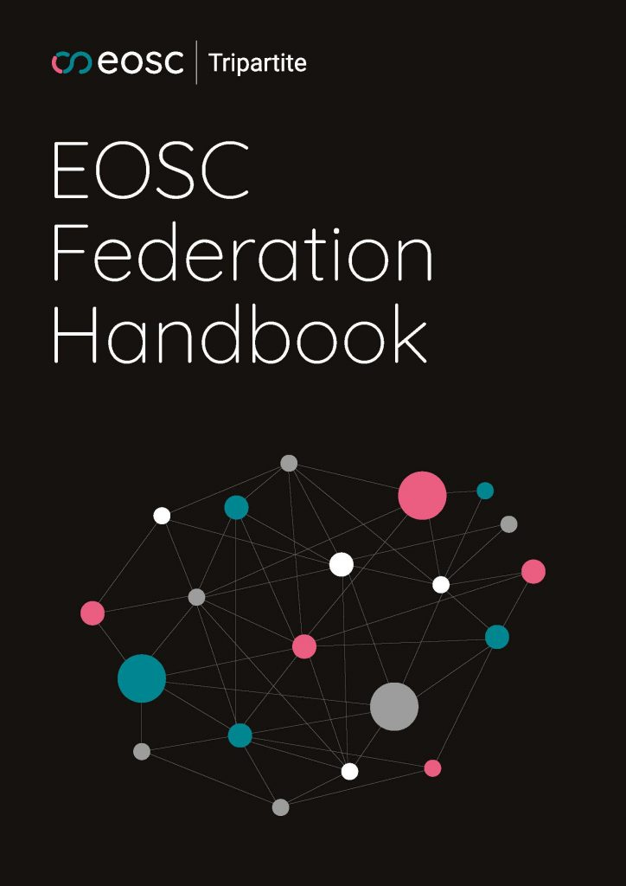
Federation
Provide seamless access to resources that are decentral, e.g.
AAI federation
Catalogue federation
Repository federation
Compute federation
Federation of Nodes
Enables us to preserve autonomy and richness
Requires technology, but also standards and agreements

Slide 15
How to orchestrate a national infrastructure
Institutional
Consortium
Digital Competence Centers – Tier2
Large Scale Research Infrastructures
EOSC Node
European
Common Language
Workflow Perspective
Federation
Shared Services
Notes:
.

Slide 16
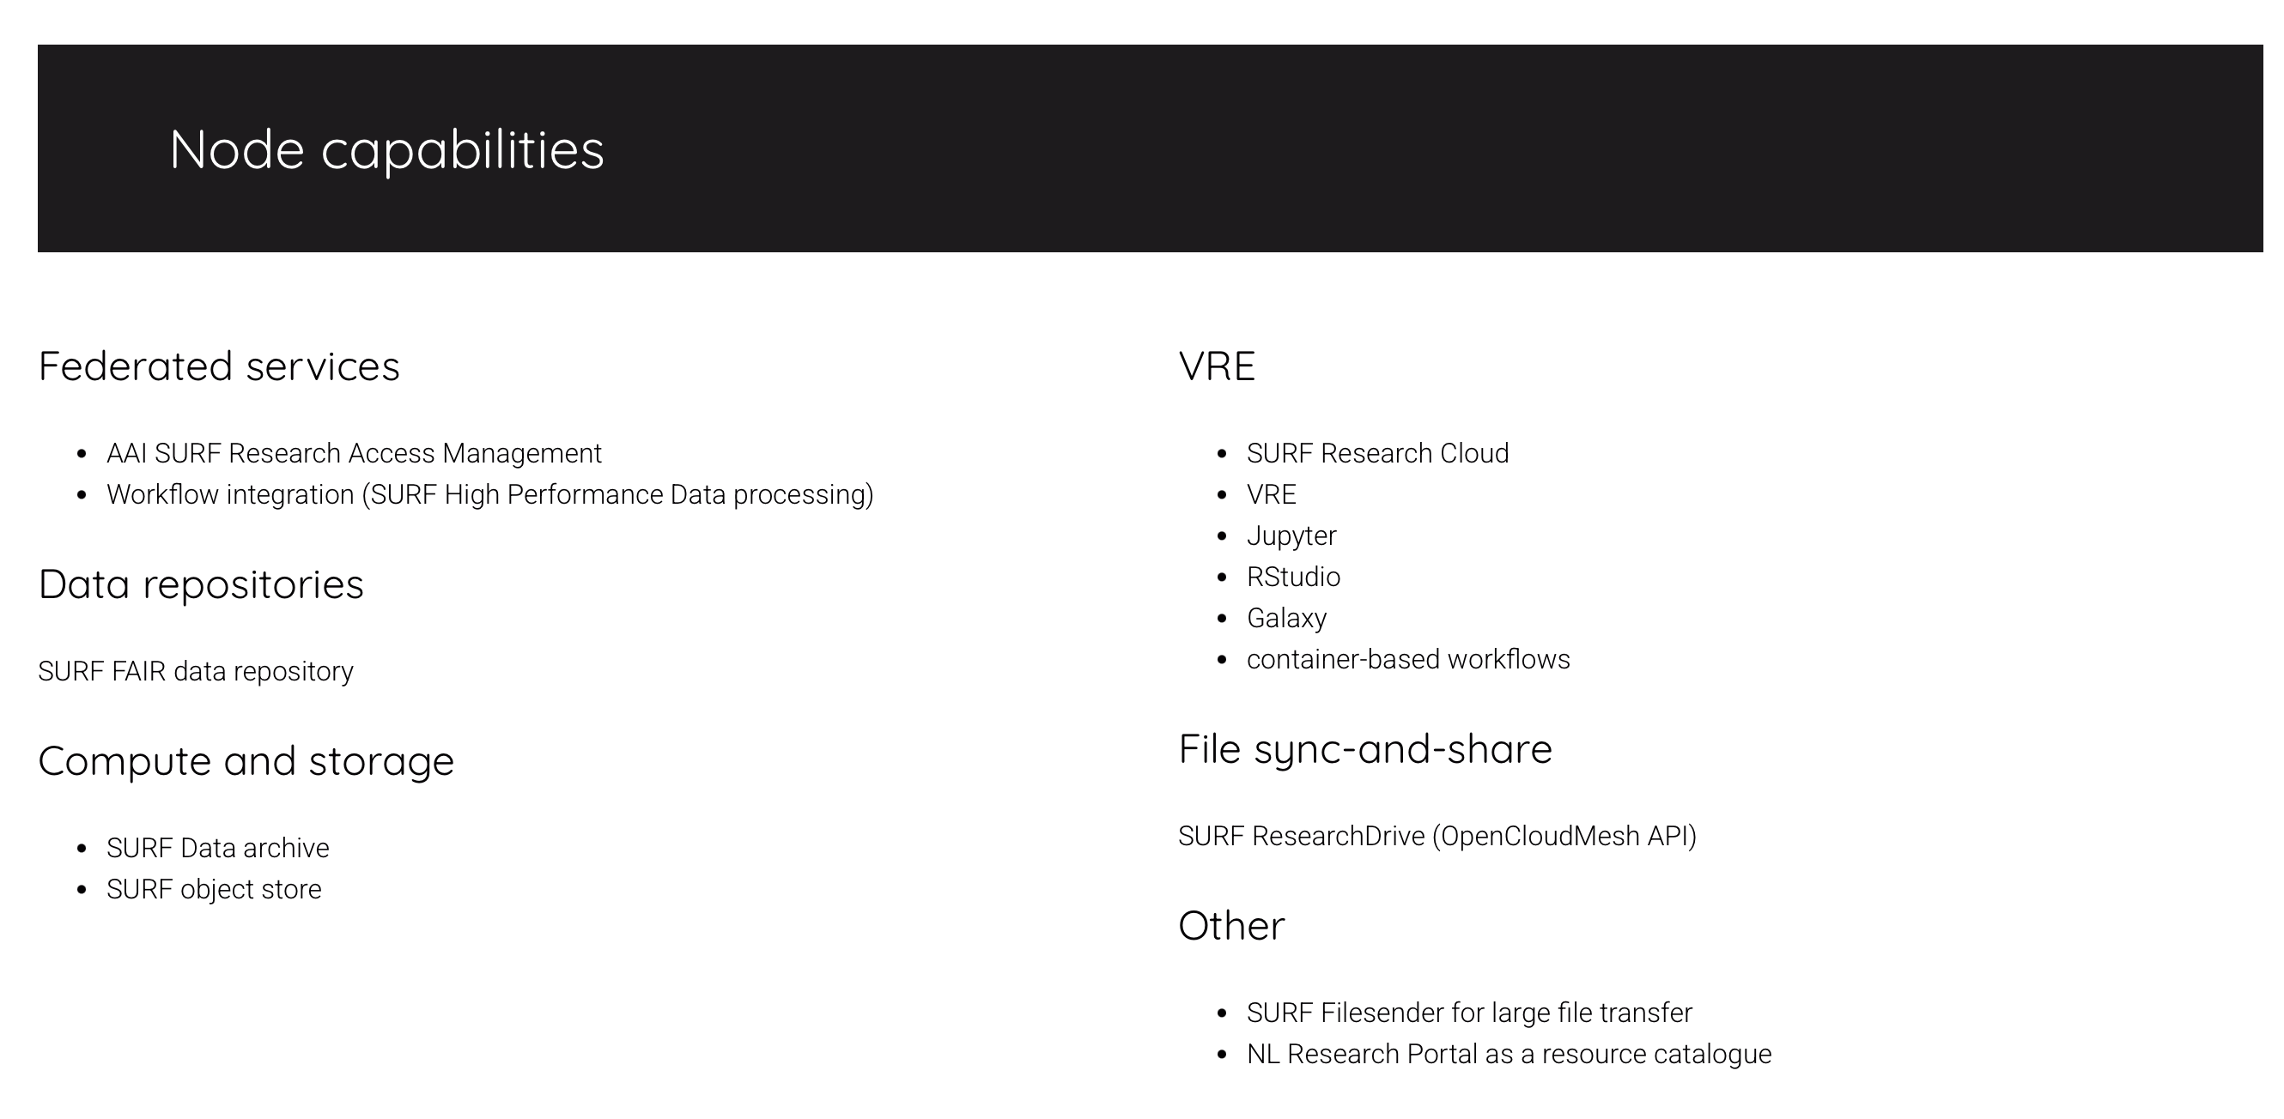

Shared Services
Generic services that can be shared by multiple consortia and institutes
To share costs for building, operating and maintaining services

Slide 17

Chapter yellow
Connecting institutional, consortium, national and European infrastructures:
The EOSC Federation

Slide 18
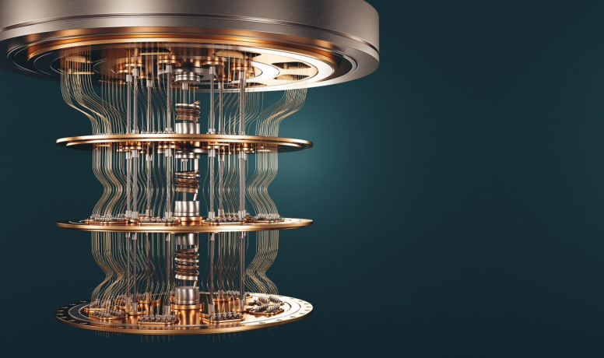
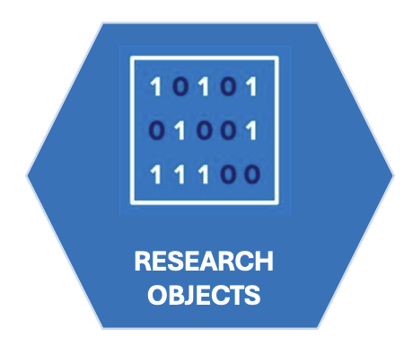

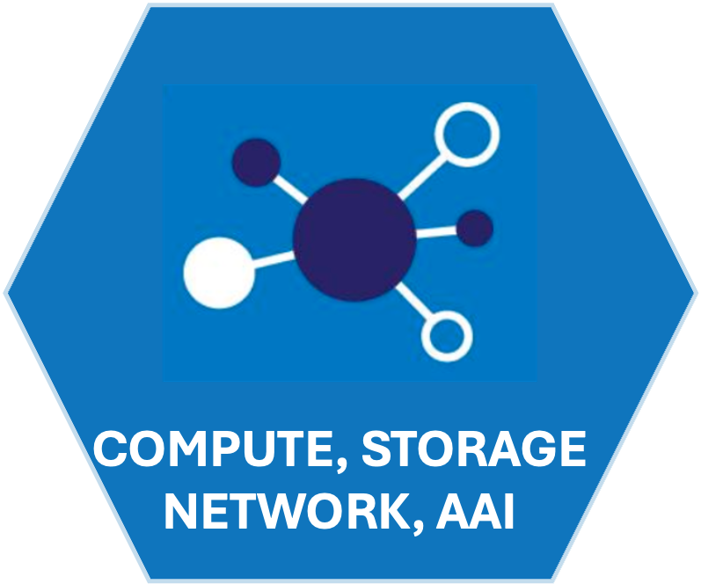

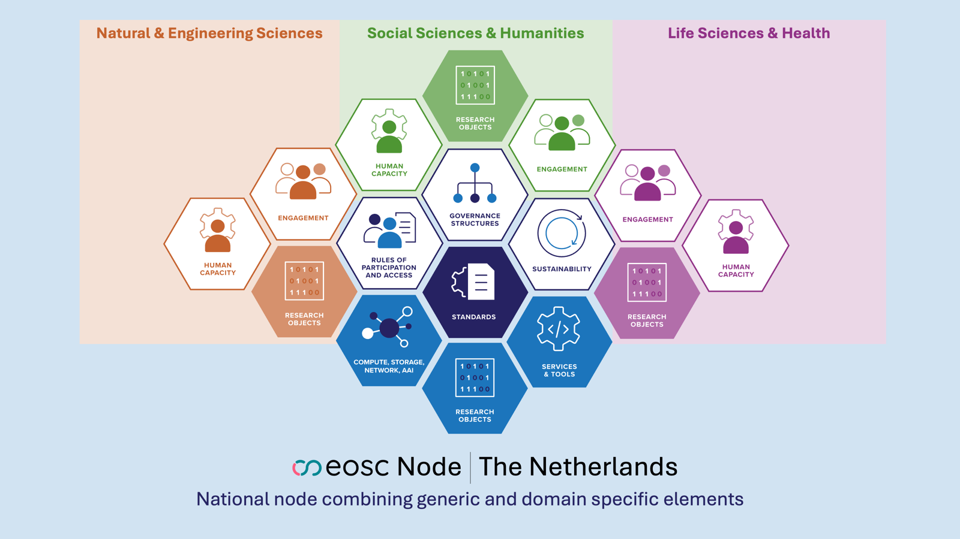
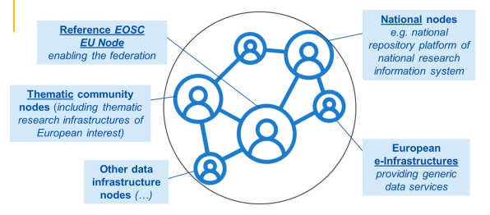

Ambition: Supporting research workflows by connecting data and services through EOSC nodes
European Research Infrastructure Consortium
EOSC NL pilot node
Dutch Quantum
Computer
European Data Spaces
Dutch AI Factory

Slide 19
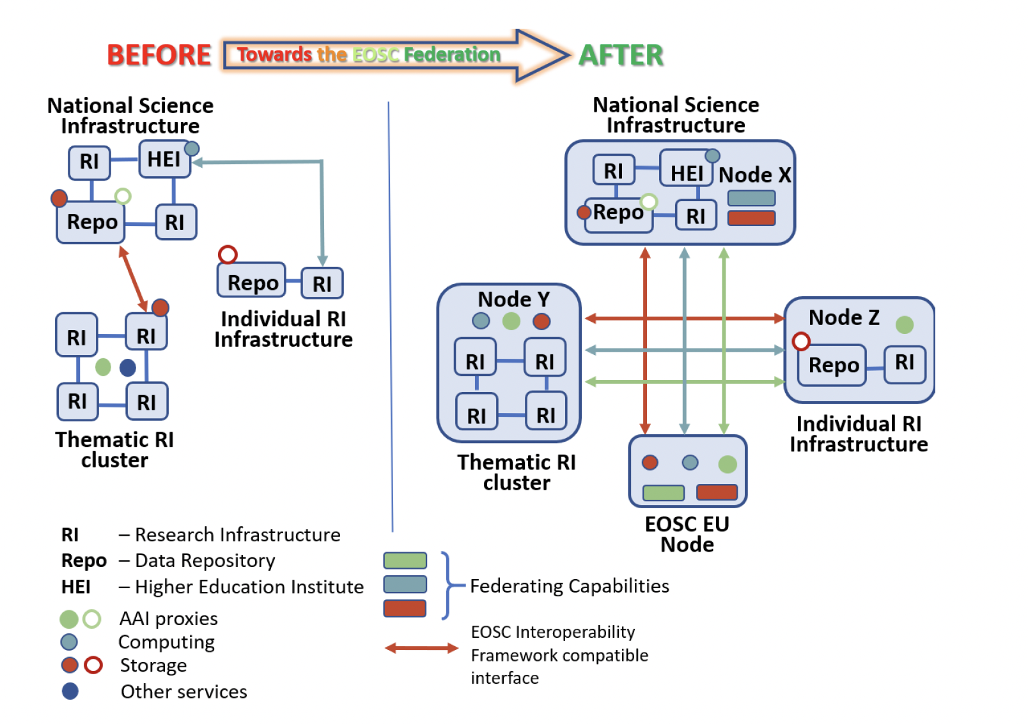
Anatomy of an EOSC Node
EOSC Federation Handbook v2.0 (January 2026)

Slide 20
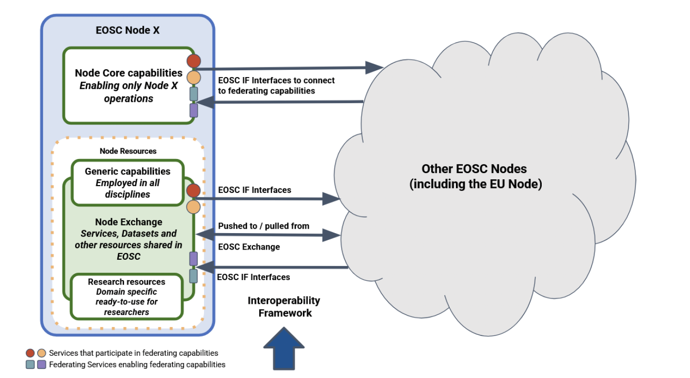
Anatomy of an EOSC Node
EOSC Federation Handbook v2.0 (January 2026)

Slide 21
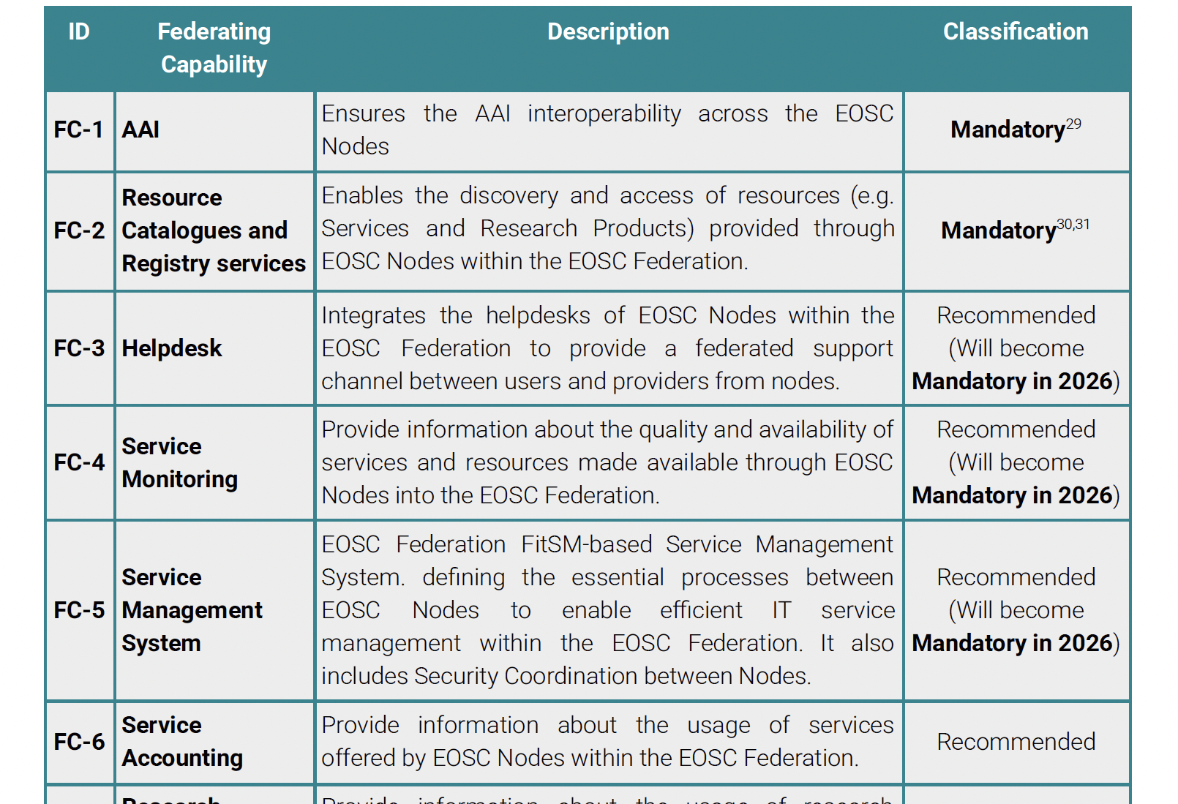
Anatomy of an EOSC Node
Core Capabilities (Federating)
EOSC Federation Handbook v2.0 (January 2026)
Node Resources (Services)

Slide 22
Anatomy of an EOSC Node
Node Resources (Services)
EOSC Federation Handbook v2.0 (January 2026)
Core Capabilities (Federating)
Compute
VRE
Data Storage
Repositories
Tools & Workflow

Slide 23

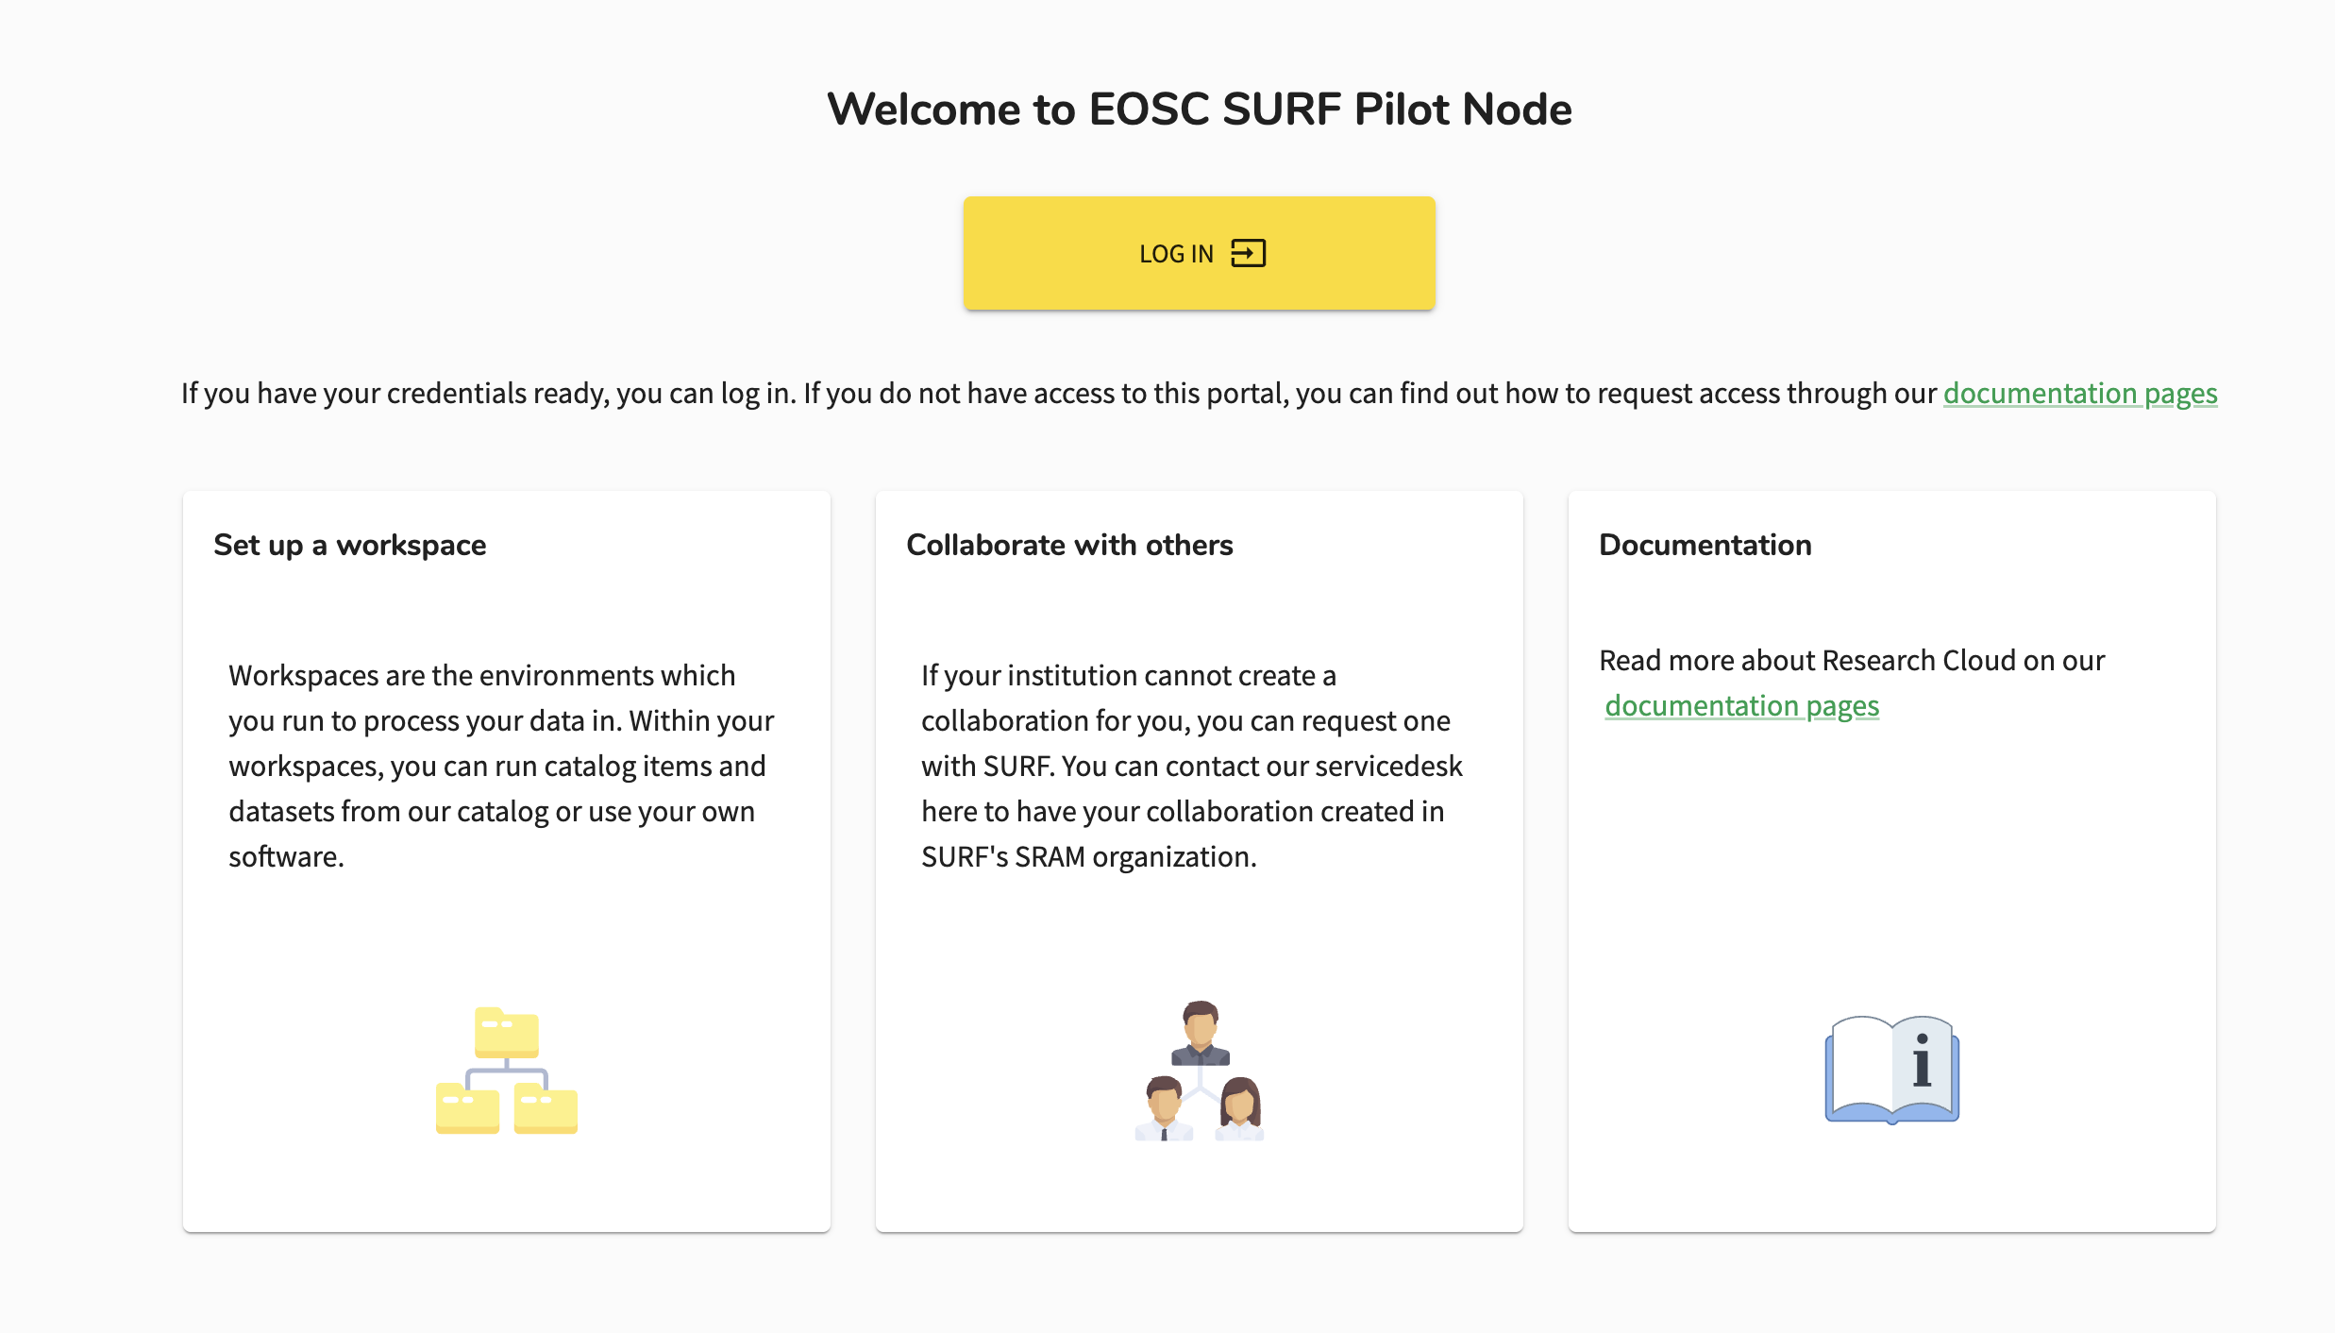
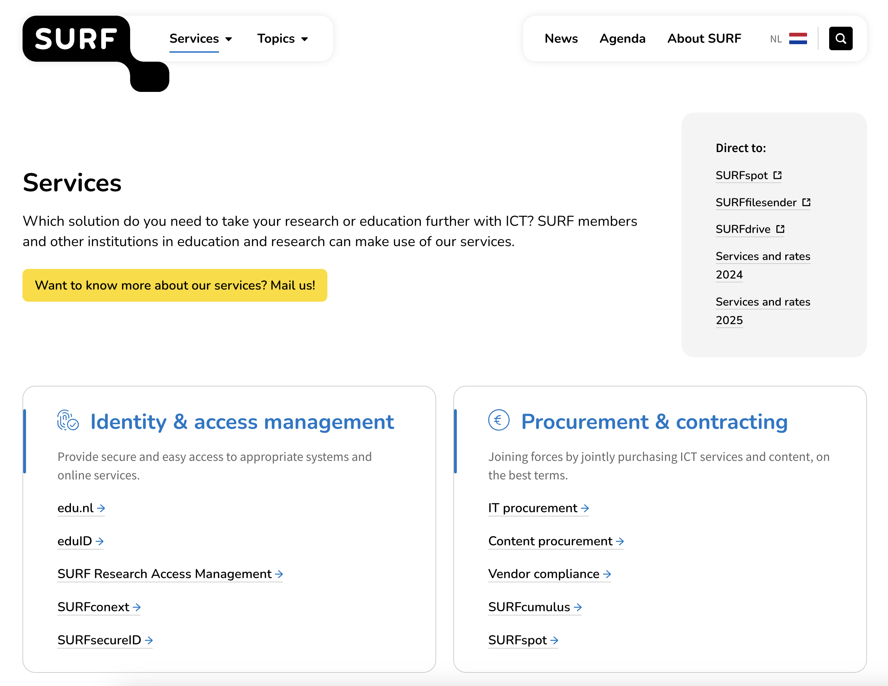
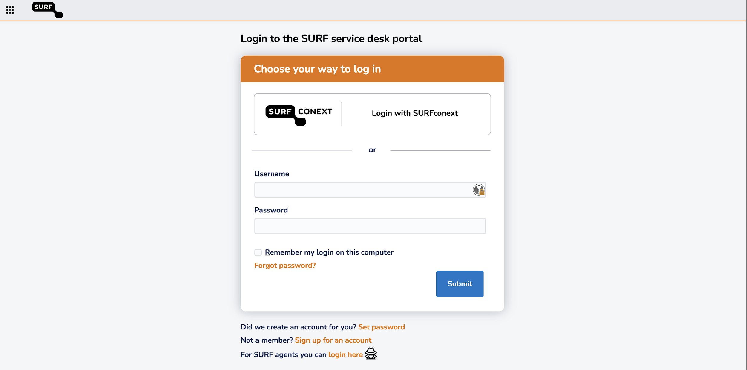
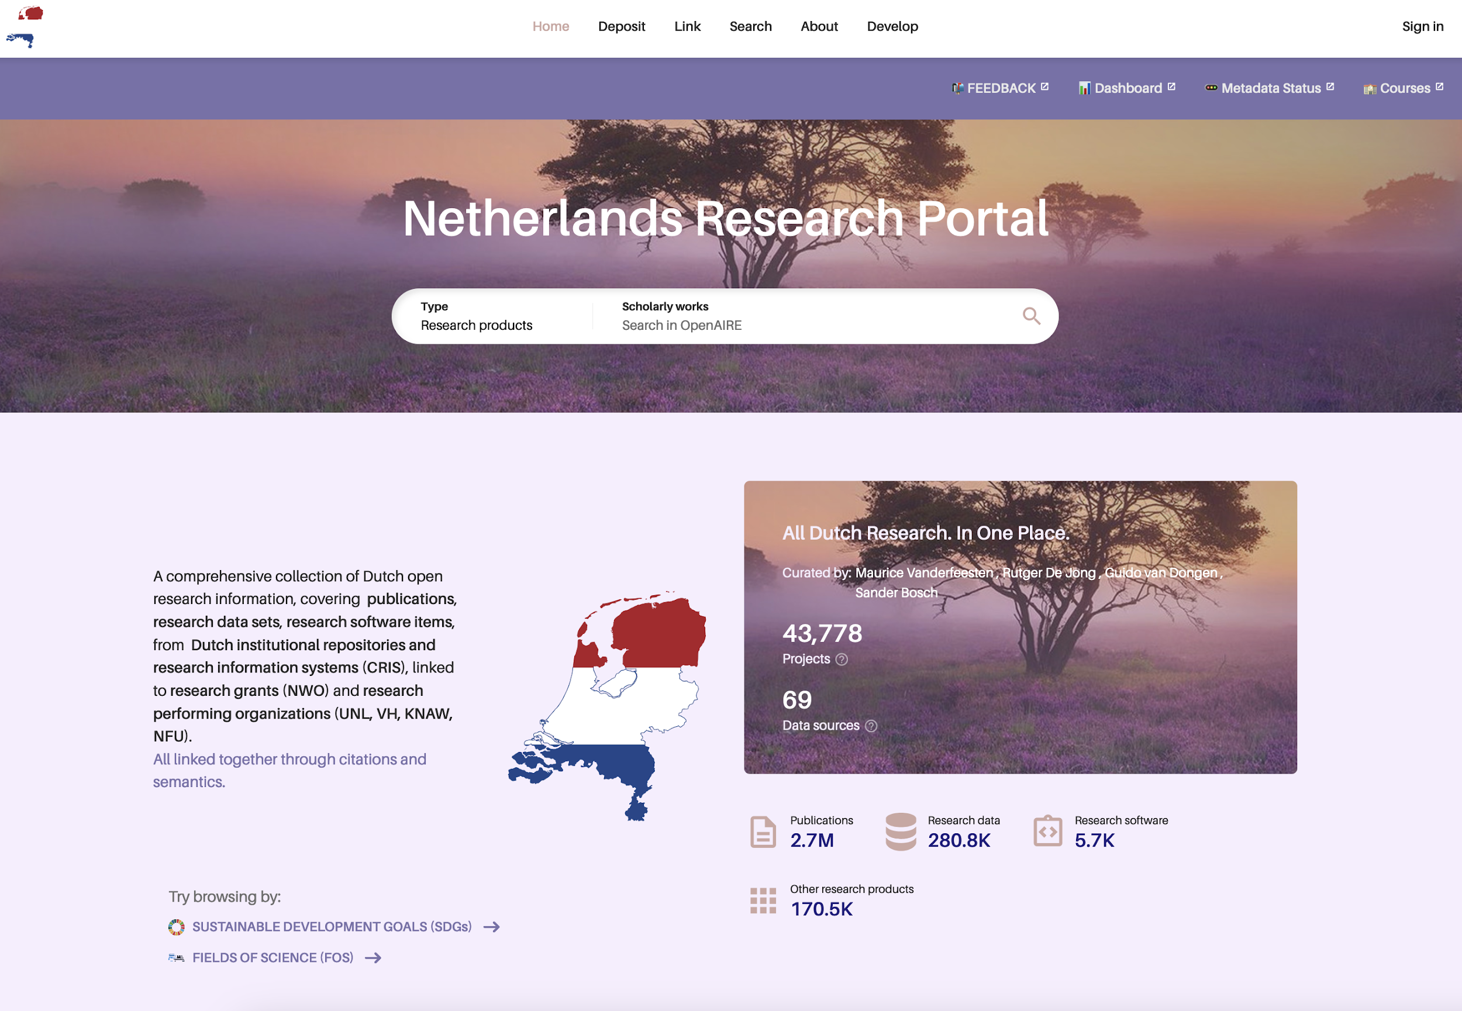
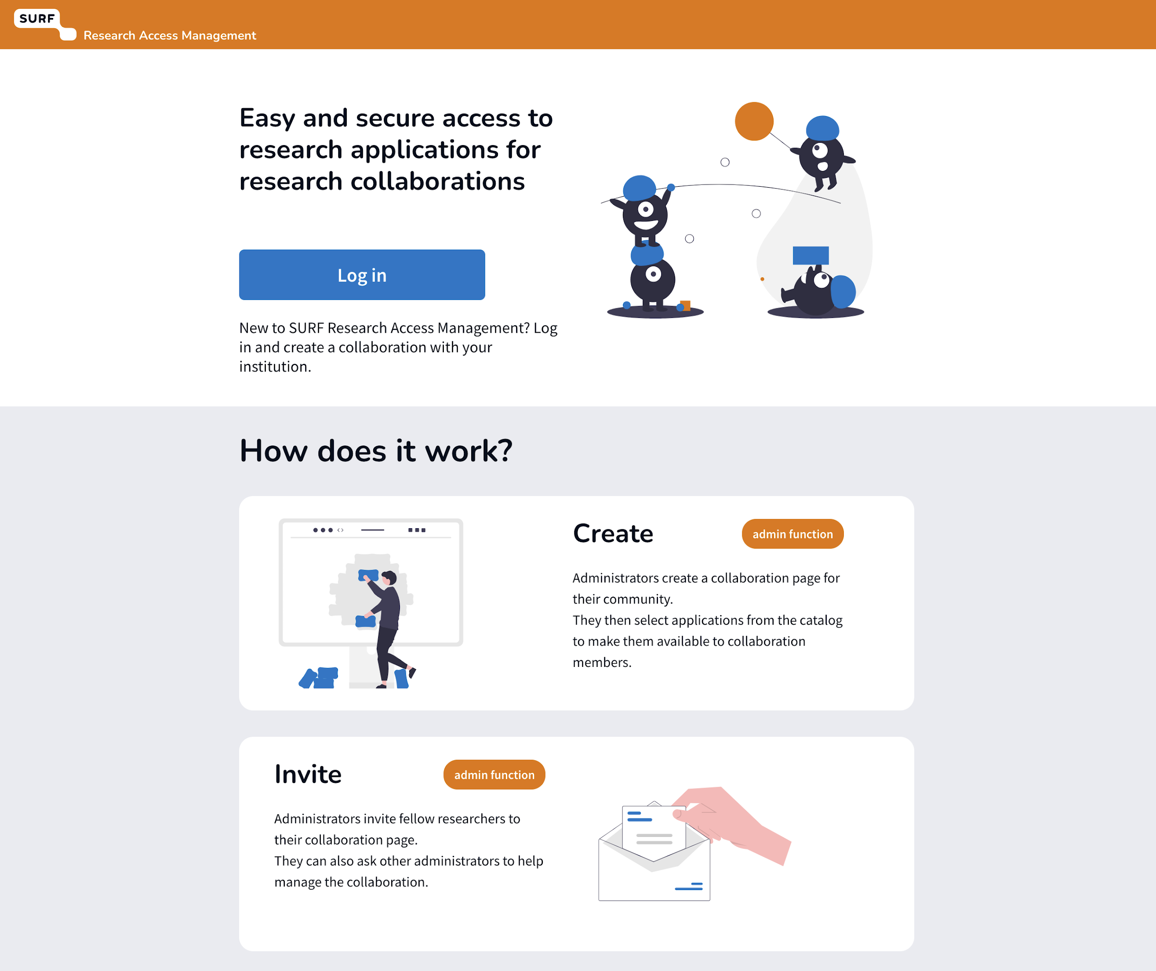
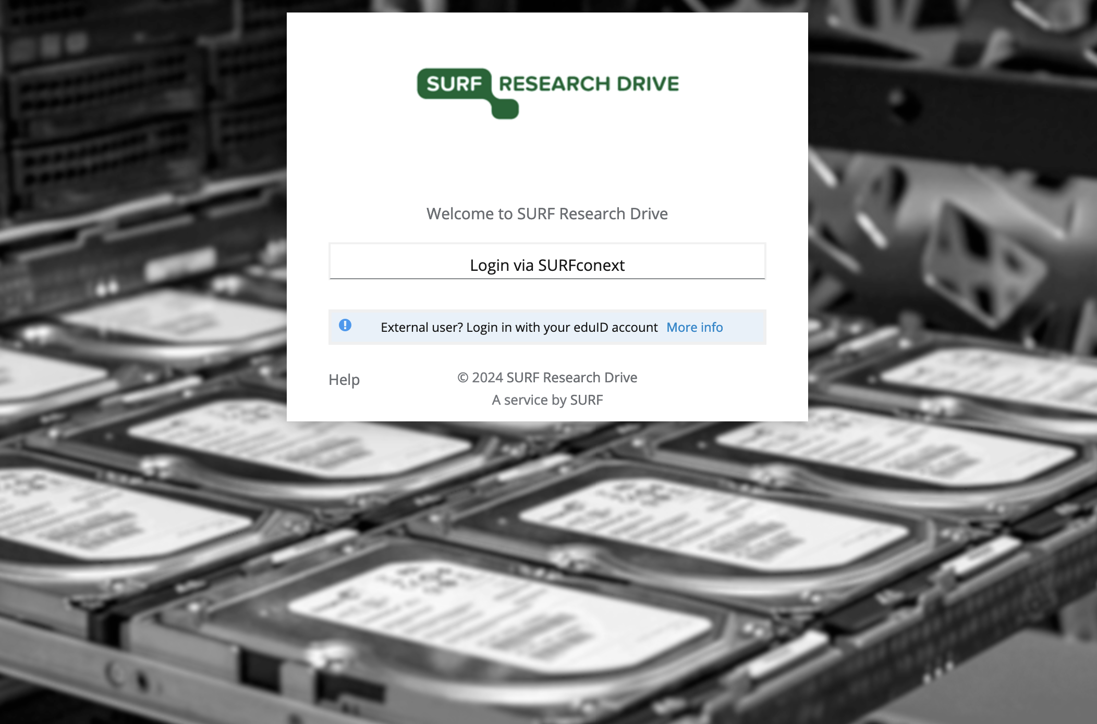
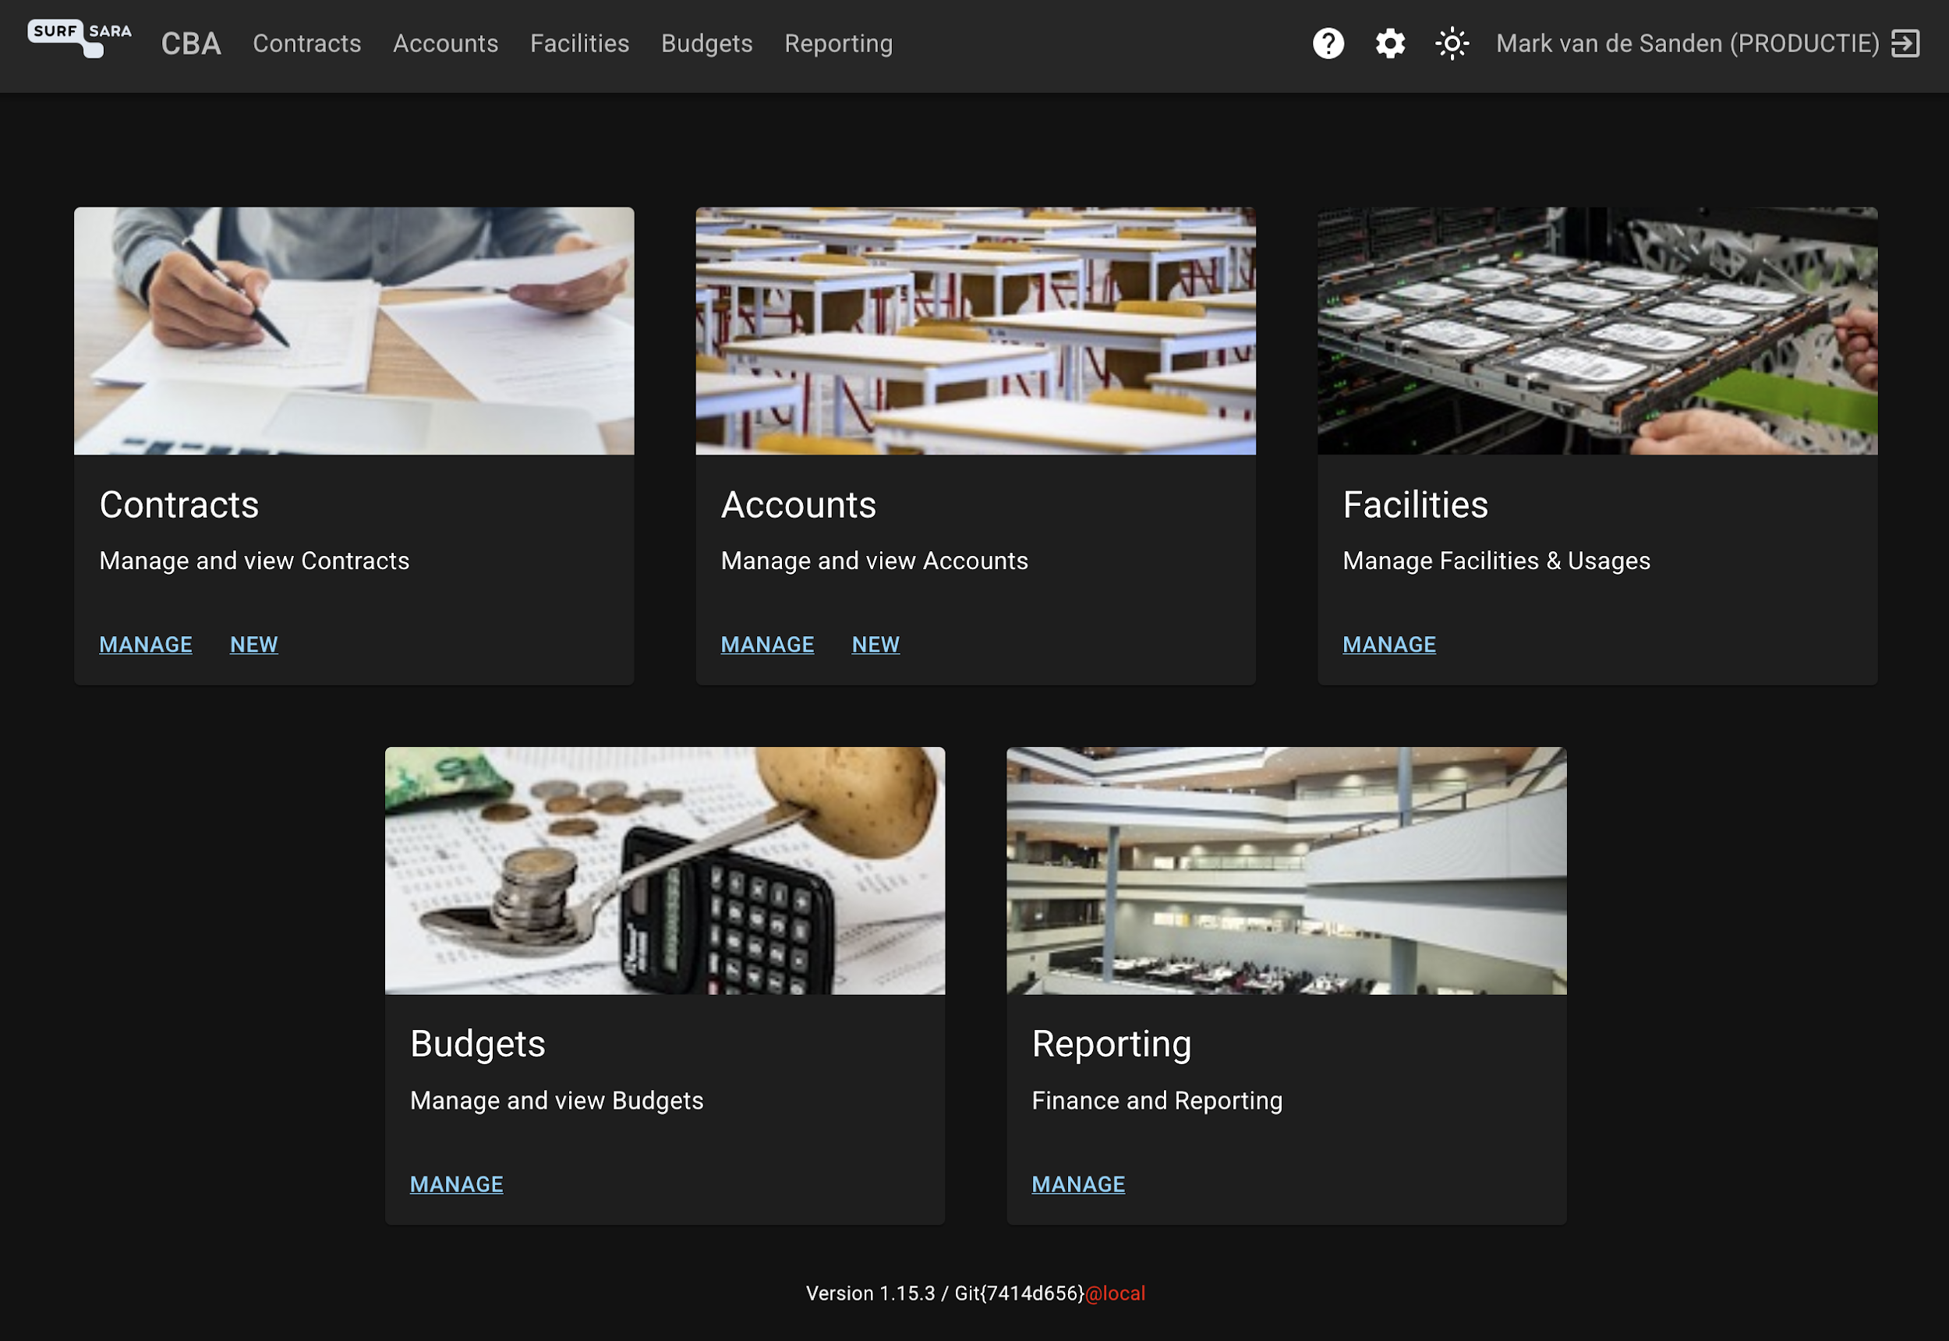

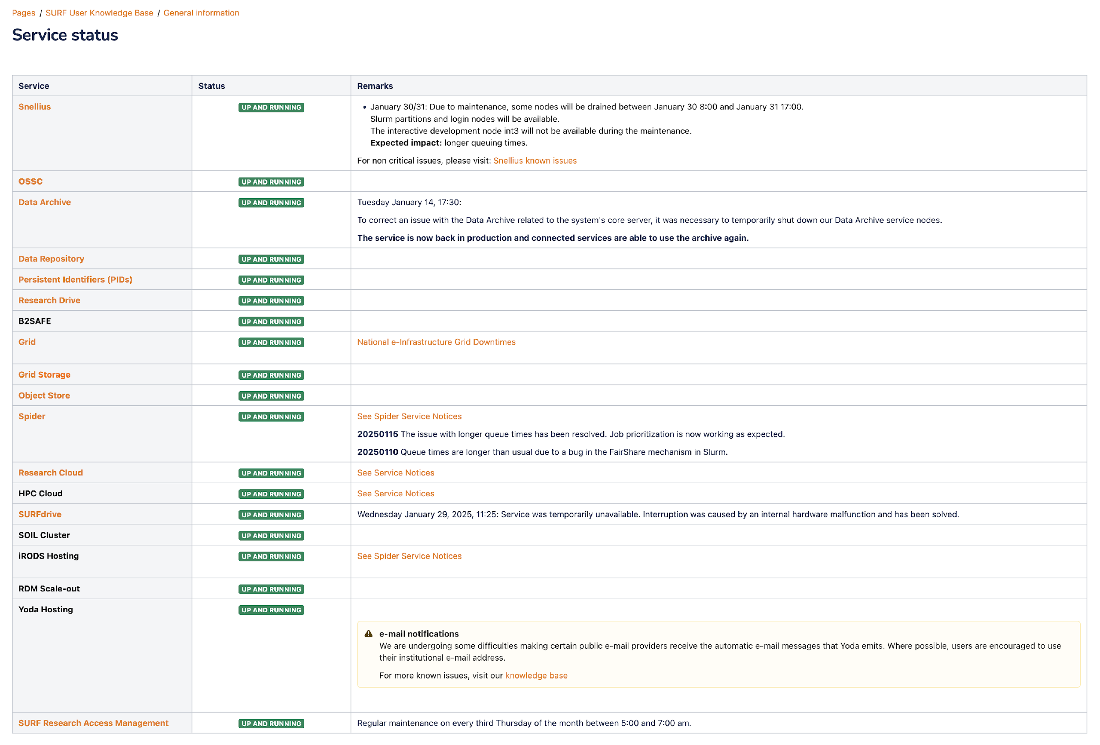
https://www.surf.nl/en/services
(SURF Service Catalogue)
https://servicedesk.surf.nl
(Helpdesk)
https://netherlands.openaire.eu/
(Research Data Discovery)
https://eosc.nl
https://sram.surf.nl/
(Access Management)
https://servicedesk.surf.nl/wiki/display/WIKI/Service+status
(Service Monitoring)

Slide 24
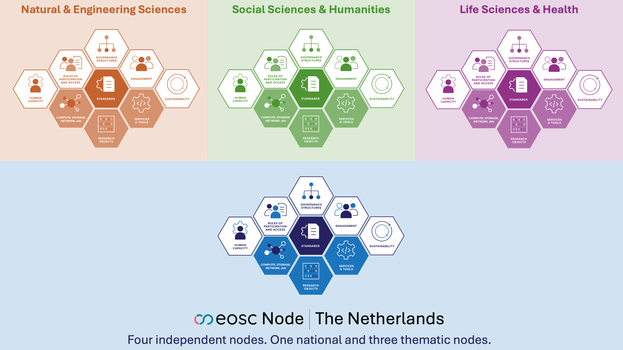
Explore scenarios for defining and setting up one or more EOSC pilot node(s)

Slide 25


Natural & Engineering Sciences
Social Sciences & Humanities
Life Sciences & Health
Node The Netherlands
Node The Netherlands
National node combining generic and domain specific elements

Slide 26
Relevance Beyond Europe
Shared challenges
Everything is Open
Data sovereignty (national, regional)
Federation Handbook
Cross-border research collaboration
CC-BY — Zenodo
GORC Framework
Sustainable funding for shared infrastructure
CC-BY — RDA
Building trust between autonomous organizations
Architecture & policies
Public documentation
Learn from our lessons, share yours. Federation doesn't stop at continental borders.

Slide 27
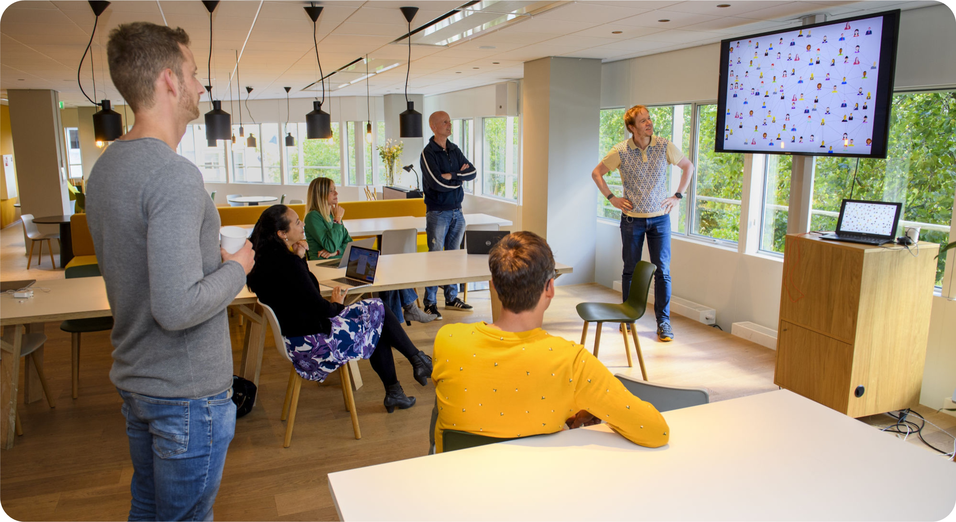
Closing slide
Thank you for your attention
www.surf.nl
maarten.kremers@surf.nl
With many thanks to Laurents Sesink and my other co-workers

